Slide 1
Year in Review: Clinical Investigator Perspectives on the Most Relevant New Datasets and Advances in Oncology
EGFR-Mutant Non-Small Cell Lung Cancer
A CME/MOC-Accredited Live Webinar
Tuesday, April 7, 2026 5:00 PM – 6:00 PM ET
Faculty
Suresh S Ramalingam, MD Helena Yu, MD
Moderator
Neil Love, MD

Slide 2



Faculty
Suresh S Ramalingam, MD
Executive Director, Winship Cancer Institute
Roberto C Goizueta Chair for Cancer Research
Emory University School of Medicine
Atlanta, Georgia
MODERATOR
Neil Love, MD Research To Practice
Miami, Florida
Helena Yu, MD
Medical Oncologist
Attending
Memorial Sloan Kettering Cancer Center
New York, New York

Slide 3
Commercial Support
This activity is supported by educational grants from AstraZeneca Pharmaceuticals LP and Daiichi Sankyo Inc.
Research To Practice CME Planning Committee Members, Staff and Reviewers
Planners, scientific staff and independent reviewers for Research To Practice have no relevant financial relationships to disclose.

Slide 4
Dr Ramalingam — Disclosures
Contracted Research (Research Funding to Institution) | Amgen Inc, AstraZeneca Pharmaceuticals LP, Bristol Myers Squibb, Merck, Pfizer Inc

Slide 5
Dr Yu — Disclosures
Consulting Agreements | Amgen Inc, AstraZeneca Pharmaceuticals LP, Bristol Myers Squibb, Janssen Biotech Inc, SystImmune Inc, Taiho Oncology Inc, Takeda Pharmaceuticals USA Inc
Contracted Research (to Institution) | AstraZeneca Pharmaceuticals LP, Daiichi Sankyo Inc, Janssen Biotech Inc, Kumquat Biosciences, SystImmune Inc, Taiho Oncology Inc

Slide 6
Dr Love — Disclosures
Dr Love is president and CEO of Research To Practice. Research To Practice receives funds in the form of educational grants to develop CME activities from the following companies: Aadi Bioscience, AbbVie Inc, ADC Therapeutics, Agendia Inc, Alexion Pharmaceuticals, Amgen Inc, Array BioPharma Inc, a subsidiary of Pfizer Inc, Arvinas, Astellas, AstraZeneca Pharmaceuticals LP, Aveo Pharmaceuticals, Bayer HealthCare Pharmaceuticals, BeOne, Biotheranostics Inc, A Hologic Company, Black Diamond Therapeutics Inc, Blueprint Medicines, Boehringer Ingelheim Pharmaceuticals Inc, Bristol Myers Squibb, Celcuity, Clovis Oncology, Coherus BioSciences, Corcept Therapeutics Inc, CTI BioPharma, a Sobi Company, Daiichi Sankyo Inc, Eisai Inc, Elevation Oncology Inc, Exact Sciences Corporation, Exelixis Inc, Genentech, a member of the Roche Group, Genmab US Inc, Geron Corporation, Gilead Sciences Inc, GSK, Helsinn Therapeutics (US) Inc, ImmunoGen Inc, Incyte Corporation, Ipsen Biopharmaceuticals Inc, Jazz Pharmaceuticals Inc, Johnson & Johnson, Karyopharm Therapeutics, Kite, A Gilead Company, Kura Oncology, Legend Biotech, Lilly, MEI Pharma Inc, Merck, Mersana Therapeutics Inc, Mirati Therapeutics Inc, Mural Oncology Inc, Natera Inc, Novartis, Novartis Pharmaceuticals Corporation on behalf of Advanced Accelerator Applications, Novocure Inc, Nuvalent, Nuvation Bio Inc, Pfizer Inc, Pharmacyclics LLC, an AbbVie Company, Puma Biotechnology Inc, Regeneron Pharmaceuticals Inc, Revolution Medicines Inc, Rigel Pharmaceuticals Inc, R-Pharm US, Sanofi, Seagen Inc, Servier Pharmaceuticals LLC, SpringWorks Therapeutics Inc, Stemline Therapeutics Inc, Sumitomo Pharma America, Summit Therapeutics, Syndax Pharmaceuticals, Taiho Oncology Inc, Takeda Pharmaceuticals USA Inc, TerSera Therapeutics LLC, and Tesaro, A GSK Company.

Slide 7
This educational activity contains discussion of non-FDA-approved uses of agents and regimens. Please refer to official prescribing information for each product for approved indications.

Slide 8

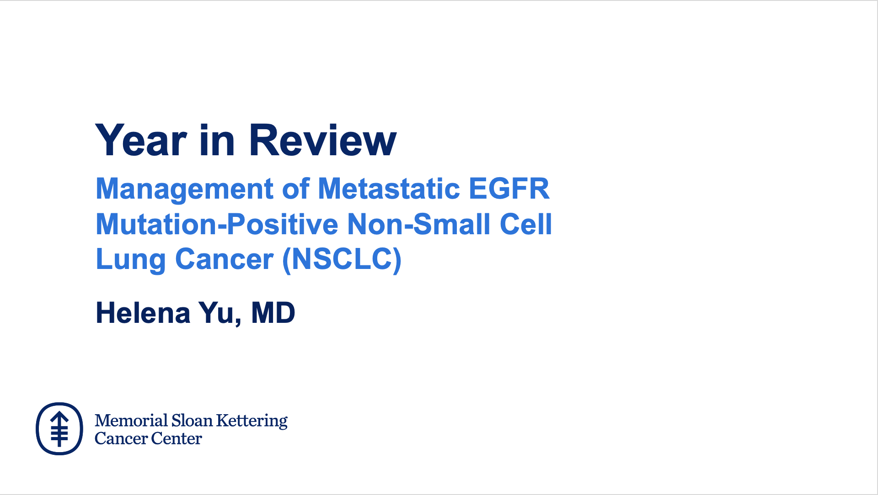

Slide 9
Key Datasets
Helena Yu, MD
Jänne PA et al. Survival with osimertinib plus chemotherapy in EGFR-mutated advanced NSCLC. N Engl J Med 2026;394(1):27-38.
Jänne PA et al. FLAURA2: Exploratory overall survival (OS) analysis in patients (pts) with poorer prognostic factors treated with osimertinib (osi) ± platinum-pemetrexed chemotherapy (CTx) as first-line (1L) treatment (tx) for EGFR-mutated (EGFRm) advanced NSCLC. ESMO 2025;Abstract LBA77.
Elamin YY et al. NorthStar: A phase II randomized study of osimertinib (OSI) with or without local consolidative therapy (LCT) for metastatic EGFR-mutant non-small cell lung cancer (NSCLC). ESMO 2025;Abstract LBA72.
Yang JC et al. Overall survival with amivantamab-lazertinib in EGFR-mutated advanced NSCLC. N Engl J Med 2025;393(17):1681-93.
Scott SC et al. PALOMA-2: Subcutaneous amivantamab administered every 4 weeks plus lazertinib in first-line EGFR-mutated advanced NSCLC. WCLC 2025;Abstract MA08.05.
Alexander M et al. Subcutaneous versus intravenous amivantamab, both in combination with lazertinib, in refractory EGFR-mutated non-small cell lung cancer: Patient satisfaction and resource utilization results from the PALOMA-3 study. Eur J Cancer 2025;227:115624.

Slide 10
Key Datasets
Helena Yu, MD (continued)
Sands J et al. Datopotamab deruxtecan in advanced or metastatic non-small cell lung cancer with actionable genomic alterations: Results from the phase II TROPION-Lung05 study. J Clin Oncol 2025;43(10):1254-65.
Ahn MJ et al. A pooled analysis of datopotamab deruxtecan in patients with EGFR-mutated NSCLC. J Thorac Oncol 2025;20(11):1669-82.
Peled N et al. COMPEL: Osimertinib plus platinum-based chemotherapy in patients with EGFR-mutated advanced NSCLC and progression on first-line osimertinib. ESMO Open 2025;10(10):105807.
Lu S et al. Osimertinib (osi) + datopotamab deruxtecan (Dato-DXd) in patients (pts) with EGFR-mutated (EGFRm) advanced NSCLC (aNSCLC) whose disease progressed on first-line (1L) osi: ORCHARD. ELCC 2025;Abstract 1O.
Lu S et al. Savolitinib plus osimertinib versus chemotherapy for advanced, EGFR mutation-positive, MET-amplified non-small-cell lung cancer in China (SACHI): Interim analysis of a multicentre, open-label, phase 3 randomised controlled trial. Lancet 2026;407(10526):375-87.
de Marinis F et al. Savolitinib plus osimertinib in epidermal growth factor receptor (EGFR)-mutated advanced non-small cell lung cancer with MET overexpression and/or amplification following disease progression on osimertinib: Primary results from the phase II SAVANNAH study. Ann Oncol 2025;36(8):920-33.

Slide 11
Key Datasets
Suresh S Ramalingam, MD
He J et al. Neoadjuvant osimertinib for resectable EGFR-mutated non-small cell lung cancer. J Clin Oncol 2025;43(26):2875-87.
Blakely C et al. Molecular residual disease (MRD) analysis from NeoADAURA: Neoadjuvant osimertinib ± chemotherapy in resectable EGFRm NSCLC. WLCC 2025;Abstract OA02.02.
Herbst RS et al. Molecular residual disease analysis of adjuvant osimertinib in resected EGFR-mutated stage IB-IIIA non-small-cell lung cancer. Nat Med 2025;31(6):1958-68.
Ramalingam SR et al. Osimertinib (osi) after definitive chemoradiotherapy (CRT) in patients (pts) with unresectable (UR) stage III EGFR-mutated (EGFRm) non-small cell lung cancer (NSCLC): Updated overall survival (OS) analysis from the LAURA study. ELCC 2025;Abstract LBA4.
Aperribay EA et al. Molecular residual disease (MRD) analysis from the LAURA study of osimertinib (osi) in unresectable (UR) stage III EGFR-mutated (EGFRm) NSCLC. ESMO 2025;Abstract 1817MO.
Paz-Ares L et al. Patient-reported outcomes and time to symptomatic progression from PAPILLON: Amivantamab plus chemotherapy vs chemotherapy as first-line treatment of EGFR exon 20 insertion-mutated advanced NSCLC. Lung Cancer 2026;213:108788.

Slide 12
Key Datasets
Suresh S Ramalingam, MD (continued)
Yang JC et al. Phase II dose-randomized study of sunvozertinib in platinum-pretreated non-small cell lung cancer with epidermal growth factor receptor Exon 20 insertion mutations (WU-KONG1B). J Clin Oncol 2025;43(29):3198-208.
Piotrowska Z et al. Zipalertinib in patients with epidermal growth factor receptor exon 20 insertion-positive non-small cell lung cancer previously treated with platinum-based chemotherapy with or without amivantamab. J Clin Oncol 2025;43(21):2387-97.
Piotrowska Z et al. Zipalertinib in NSCLC patients (pts) with EGFR exon 20 insertion (Ex20Ins) mutations who received prior amivantamab. WLCC 2025;Abstract MA08.02.
Ohashi K et al. Activity of zipalertinib against active central nervous system (CNS) metastases in patients with non-small cell lung cancer (NSCLC) harboring EGFR exon 20 insertion (ex20ins)/other uncommon mutations. ESMO 2025;Abstract 1847MO.
Fang W et al. Sacituzumab tirumotecan in EGFR-TKI-resistant, EGFR-mutated advanced NSCLC. New Engl J Med 2026;394(1):13-26.
Goldman JW et al. Ivonescimab vs placebo plus chemo, phase 3 in patients with EGFR+ NSCLC progressed with 3rd gen EGFR-TKI treatment: HARMONi. WLCC 2025;Abstract PL02.12.

Slide 13
Year in Review: EGFR-Mutant Non-Small Cell Lung Cancer
INTRODUCTION: Genomics of EGFR (and HER2)
MODULE 1: Metastatic disease
MODULE 2: Localized disease
MODULE 3: EGFR exon 20 insertion mutations
MODULE 4: New agents

Slide 14
Year in Review: EGFR-Mutant Non-Small Cell Lung Cancer
Introduction: Genomics of EGFR (and HER2)
EGFR L858R; Exon 19; Exon 20 insertion; uncommon mutations

Slide 15
Selpercatinib Delivers Substantial Event-Free Survival Benefit as an Adjuvant Therapy in Localized RET Fusion-Positive Lung Cancer Press Release: February 16, 2026
“[The manufacturer] announced positive topline results from the Phase 3 LIBRETTO-432 clinical trial of selpercatinib as adjuvant therapy versus placebo. The study met its primary endpoint, demonstrating a highly statistically significant and clinically meaningful improvement in investigator-assessed event-free survival (EFS) in patients with early-stage (II-IIIA) rearranged during transfection (RET) fusion-positive non-small cell lung cancer (NSCLC).
Overall survival results trended in favor of selpercatinib, but were immature at the time of this analysis with few events observed. The overall safety profile of selpercatinib in LIBRETTO-432 was generally consistent with previously reported trials in the selpercatinib development program.”
https://investor.lilly.com/news-releases/news-release-details/lillys-retevmo-selpercatinib-delivers-substantial-event-free

Slide 16
Year in Review: EGFR-Mutant Non-Small Cell Lung Cancer
MODULE 1: Metastatic disease
FLAURA2, IPASS studies
MARIPOSA study: Amivantamab and lazertinib
PALOMA studies: Subcutaneous amivantamab
DVT, pulmonary emboli; prophylactic anticoagulation
Short-term versus long-term outcomes — tail of the curve?
COMPEL study: Continuation with chemotherapy of first-line osimertinib — CNS disease, ADCs
NorthStar study: Local consolidation — RT, surgery
Datopotamab deruxtecan
Exon 20 insertion, uncommon mutations
Toxicity: Mucositis, keratitis
TROPION-Lung15
MET inhibitors — after disease progression on osimertinib
MET amplified, overexpressed
SACHI study: Savolitinib and osimertinib

Slide 17
Year in Review: EGFR-Mutant Non-Small Cell Lung Cancer
MODULE 1: Metastatic disease
FLAURA2, IPASS studies
MARIPOSA study: Amivantamab and lazertinib
PALOMA studies: Subcutaneous amivantamab
DVT, pulmonary emboli; prophylactic anticoagulation
Short-term versus long-term outcomes — tail of the curve?
COMPEL study: Continuation with chemotherapy of first-line osimertinib — CNS disease, ADCs
NorthStar study: Local consolidation — RT, surgery
Datopotamab deruxtecan
Exon 20 insertion, uncommon mutations
Toxicity: Mucositis, keratitis
TROPION-Lung15
MET inhibitors — after disease progression on osimertinib
MET amplified, overexpressed
SACHI study: Savolitinib and osimertinib

Slide 18

Jänne PA et al. Survival with Osimertinib plus Chemotherapy in EGFR-Mutated Advanced NSCLC. N Engl J Med 2026;394(1):27-38.
FLAURA2 survival
Courtesy of Helena Yu, MD

Slide 19
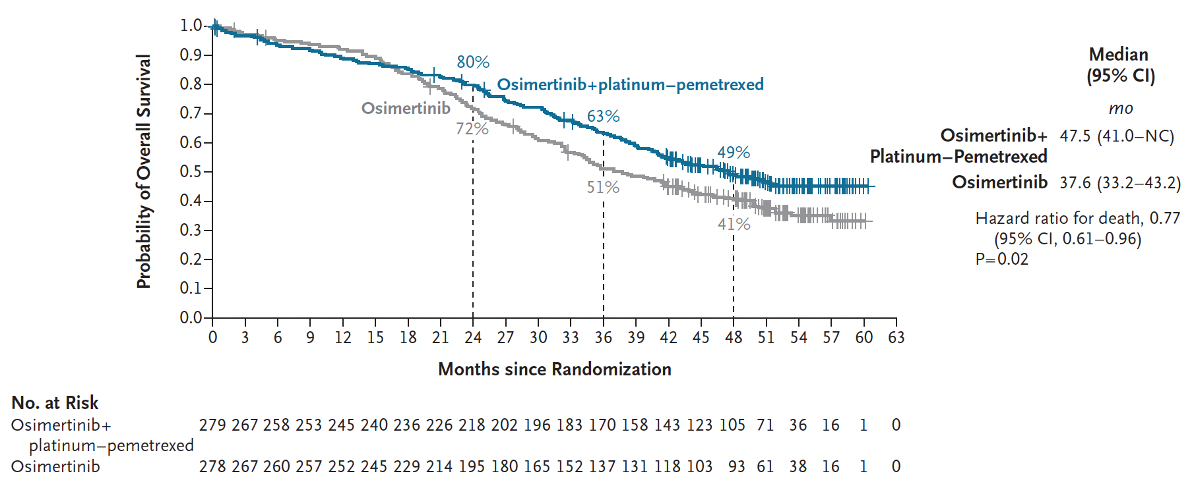
FLAURA2 Overall Survival
Jänne PA et al. N Engl J Med 2026;394(1):27-38.

Slide 20
Year in Review: EGFR-Mutant Non-Small Cell Lung Cancer
MODULE 1: Metastatic disease
FLAURA2, IPASS studies
MARIPOSA study: Amivantamab and lazertinib
PALOMA studies: Subcutaneous amivantamab
DVT, pulmonary emboli; prophylactic anticoagulation
Short-term versus long-term outcomes — tail of the curve?
COMPEL study: Continuation with chemotherapy of first-line osimertinib — CNS disease, ADCs
NorthStar study: Local consolidation — RT, surgery
Datopotamab deruxtecan
Exon 20 insertion, uncommon mutations
Toxicity: Mucositis, keratitis
TROPION-Lung15
MET inhibitors — after disease progression on osimertinib
MET amplified, overexpressed
SACHI study: Savolitinib and osimertinib

Slide 21
Yang JC et al. Overall Survival with Amivantamab-Lazertinib in EGFR-Mutated Advanced NSCLC. N Engl J Med 2025;393(17):1681-93.
MARIPOSA - Overall Survival
Courtesy of Helena Yu, MD

Slide 22
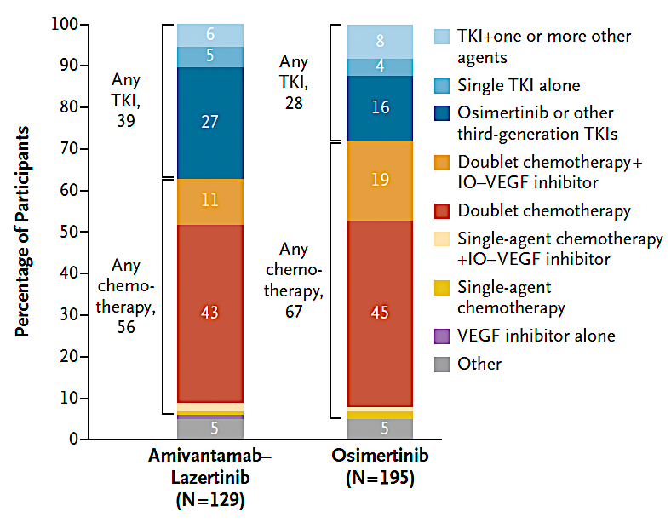
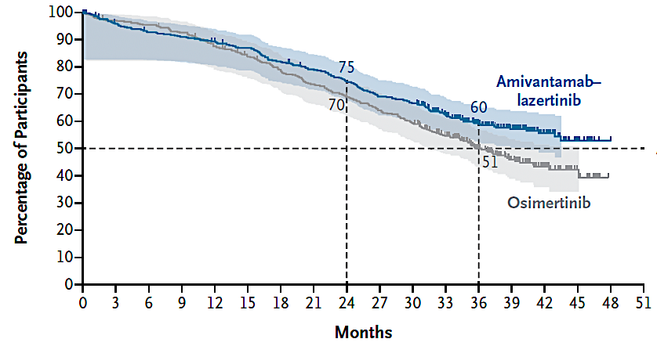
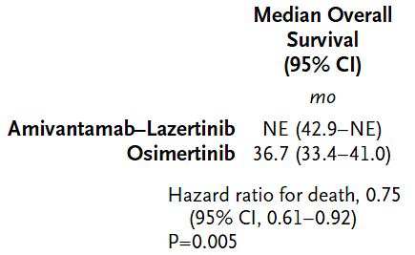
MARIPOSA - Overall Survival
On osimertinib arm, only 3 patients received subsequent amivantamab
Yang JC et al. N Engl J Med 2025;393(17):1681-93.

Slide 23
Year in Review: EGFR-Mutant Non-Small Cell Lung Cancer
MODULE 1: Metastatic disease
FLAURA2, IPASS studies
MARIPOSA study: Amivantamab and lazertinib
PALOMA studies: Subcutaneous amivantamab
DVT, pulmonary emboli; prophylactic anticoagulation
Short-term versus long-term outcomes — tail of the curve?
COMPEL study: Continuation with chemotherapy of first-line osimertinib — CNS disease, ADCs
NorthStar study: Local consolidation — RT, surgery
Datopotamab deruxtecan
Exon 20 insertion, uncommon mutations
Toxicity: Mucositis, keratitis
TROPION-Lung15
MET inhibitors — after disease progression on osimertinib
MET amplified, overexpressed
SACHI study: Savolitinib and osimertinib

Slide 24
Scott SC et al. PALOMA-2: Subcutaneous Amivantamab Administered Every 4 Weeks Plus Lazertinib in First-Line EGFR-Mutated Advanced NSCLC. WCLC 2025;Abstract MA08.05.
Subcutaneous amivantamab
Courtesy of Helena Yu, MD

Slide 25
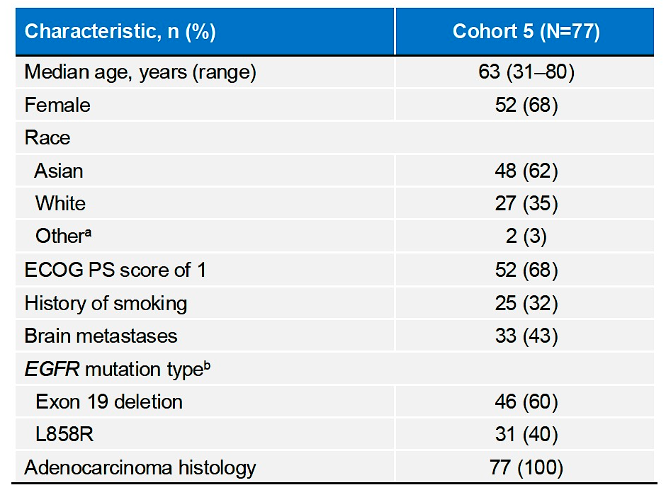
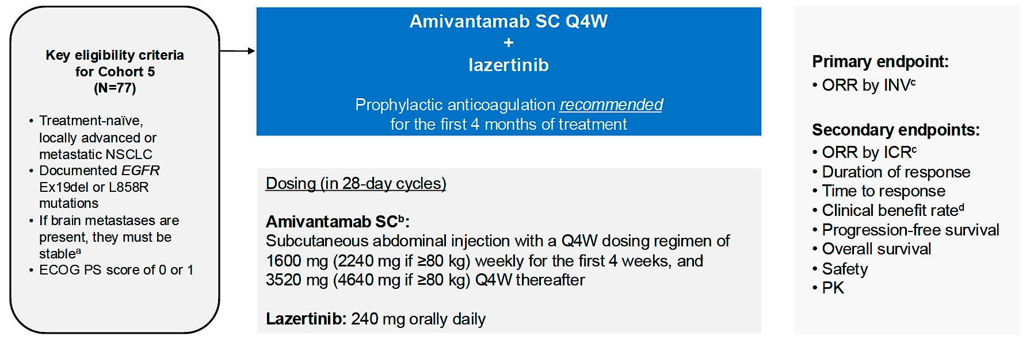
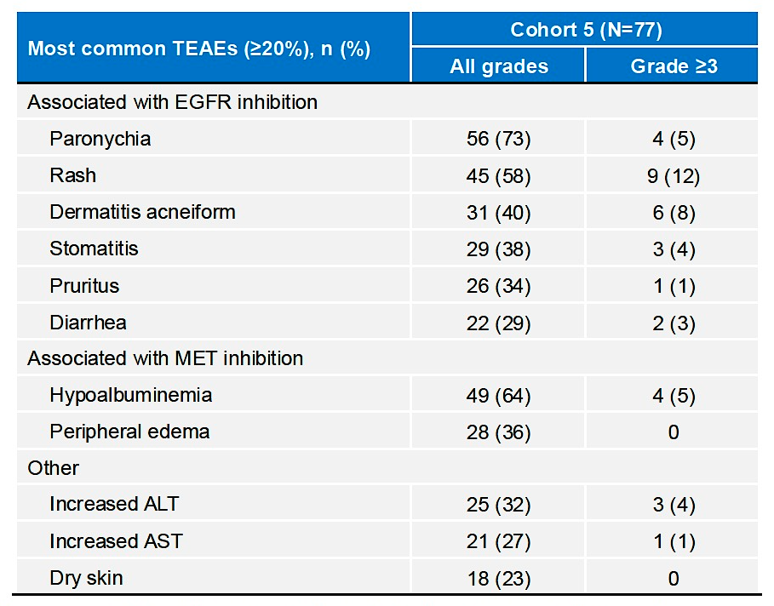
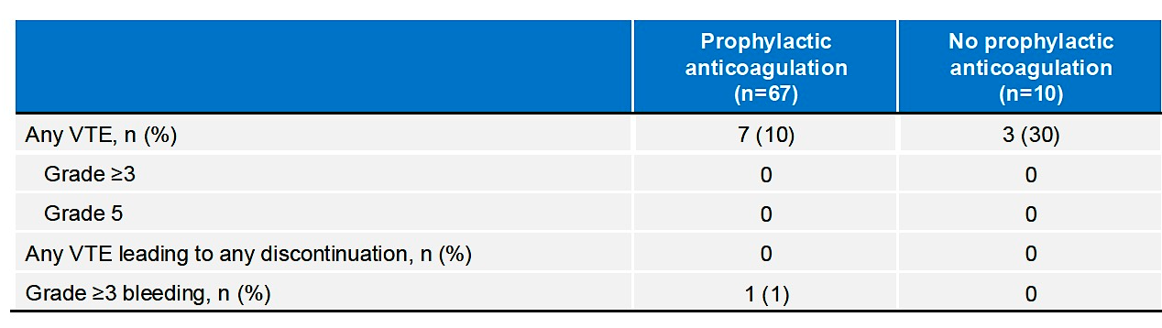
Subcutaneous amivantamab
Scott SC et al. WCLC 2025;Abstract MA08.05.

Slide 26
Year in Review: EGFR-Mutant Non-Small Cell Lung Cancer
MODULE 1: Metastatic disease
FLAURA2, IPASS studies
MARIPOSA study: Amivantamab and lazertinib
PALOMA studies: Subcutaneous amivantamab
DVT, pulmonary emboli; prophylactic anticoagulation
Short-term versus long-term outcomes — tail of the curve?
COMPEL study: Continuation with chemotherapy of first-line osimertinib — CNS disease, ADCs
NorthStar study: Local consolidation — RT, surgery
Datopotamab deruxtecan
Exon 20 insertion, uncommon mutations
Toxicity: Mucositis, keratitis
TROPION-Lung15
MET inhibitors — after disease progression on osimertinib
MET amplified, overexpressed
SACHI study: Savolitinib and osimertinib

Slide 27
Peled N et al. COMPEL: Osimertinib plus platinum-based chemotherapy in patients with EGFR-mutated advanced NSCLC and progression on first-line osimertinib. ESMO Open 2025;10(10):105807.
COMPEL study – osimertinib with chemotherapy
Courtesy of Helena Yu, MD

Slide 28
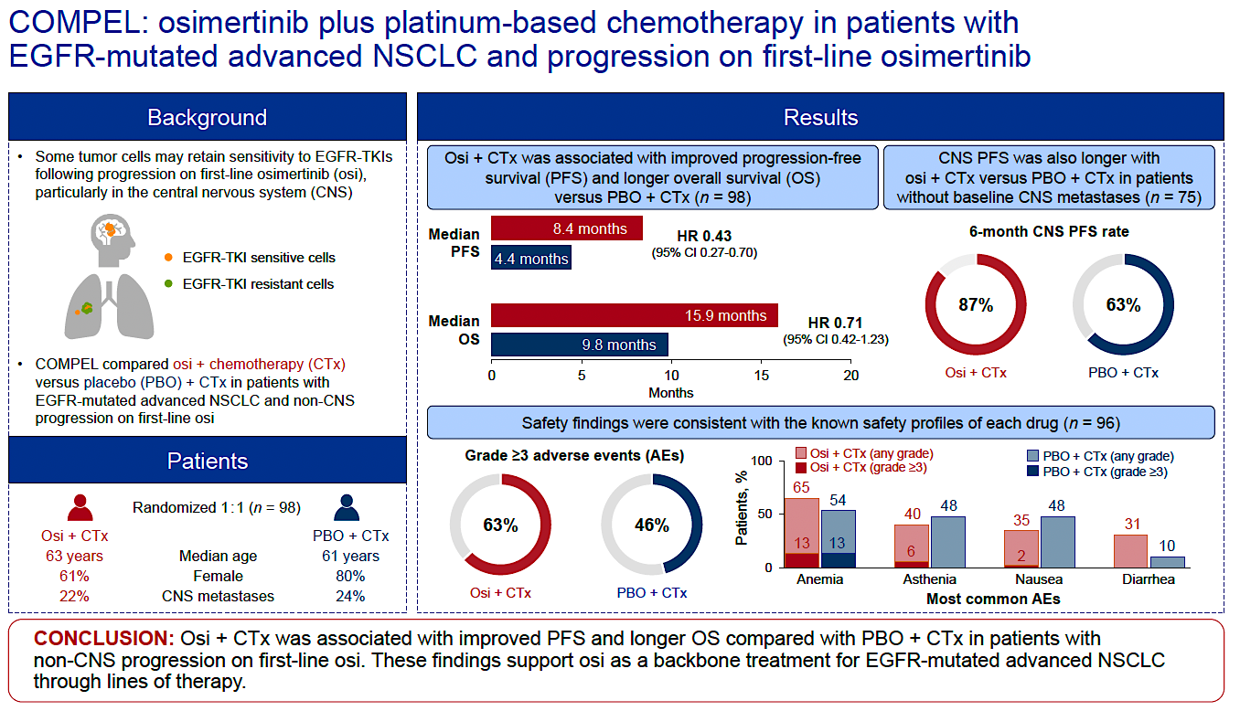
COMPEL study – osimertinib with chemotherapy
Peled N et al. ESMO Open 2025;10(10):105807.

Slide 29
Year in Review: EGFR-Mutant Non-Small Cell Lung Cancer
MODULE 1: Metastatic disease
FLAURA2, IPASS studies
MARIPOSA study: Amivantamab and lazertinib
PALOMA studies: Subcutaneous amivantamab
DVT, pulmonary emboli; prophylactic anticoagulation
Short-term versus long-term outcomes — tail of the curve?
COMPEL study: Continuation with chemotherapy of first-line osimertinib — CNS disease, ADCs
NorthStar study: Local consolidation — RT, surgery
Datopotamab deruxtecan
Exon 20 insertion, uncommon mutations
Toxicity: Mucositis, keratitis
TROPION-Lung15
MET inhibitors — after disease progression on osimertinib
MET amplified, overexpressed
SACHI study: Savolitinib and osimertinib

Slide 30
Elamin YY et al. NorthStar: A phase II randomized study of osimertinib (OSI) with or without local consolidative therapy (LCT) for metastatic EGFR-mutant non-small cell lung cancer (NSCLC). ESMO 2025;Abstract LBA72.
Local consolidation for EGFR+ NSCLC
Courtesy of Helena Yu, MD

Slide 31
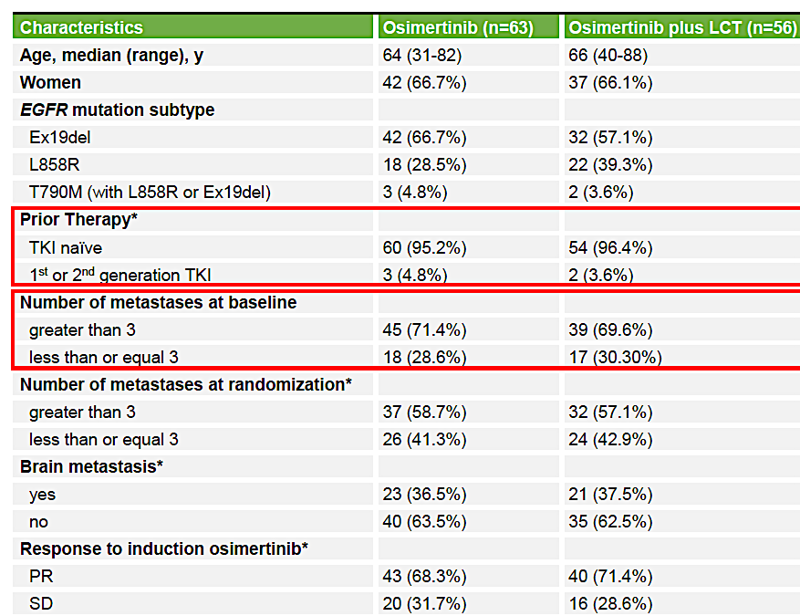
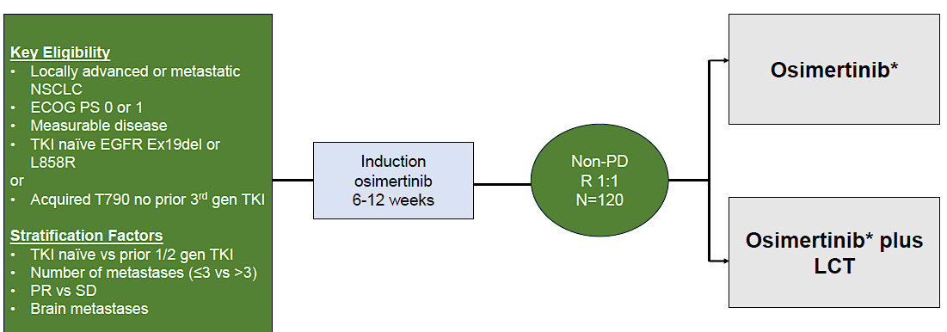
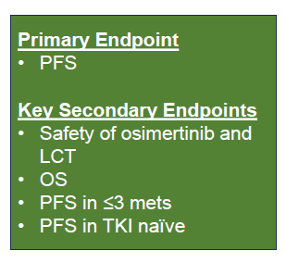
North Star study – Local consolidation for EGFR+ NSCLC
Elamin YY et al. ESMO 2025;Abstract LBA72.

Slide 32
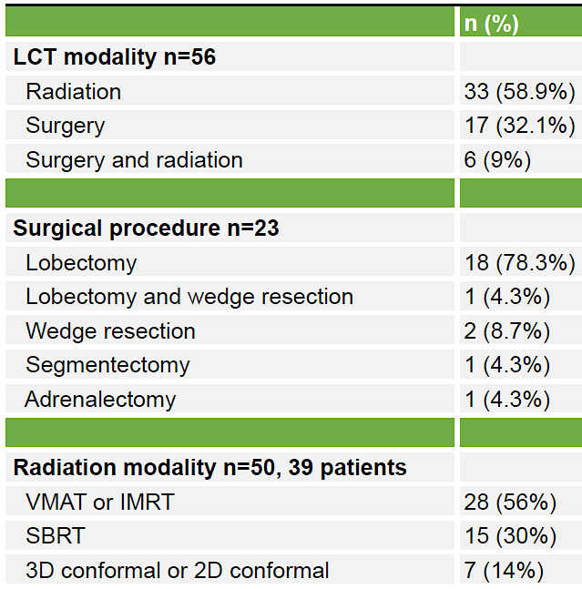

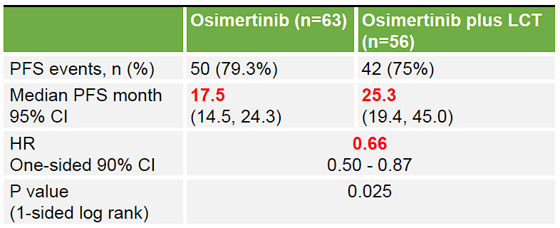
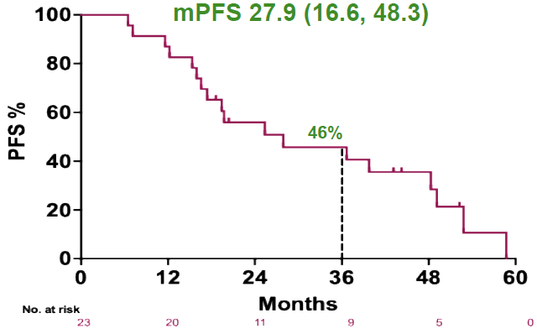
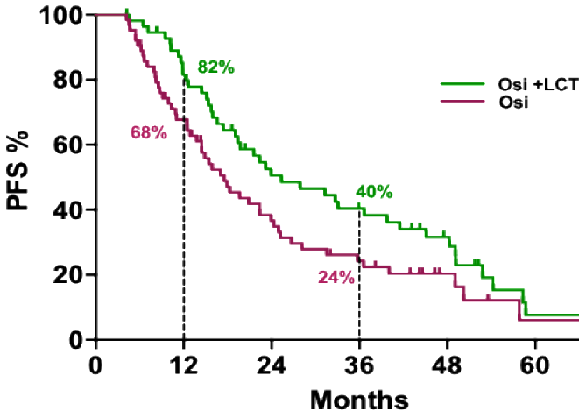

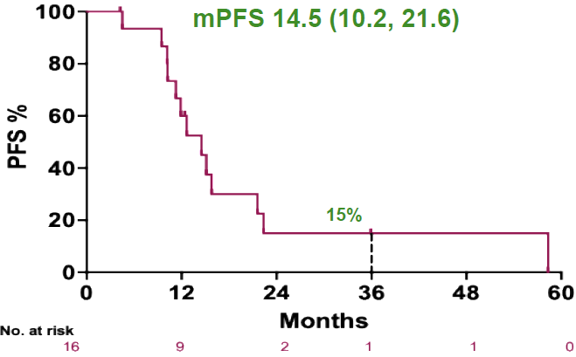
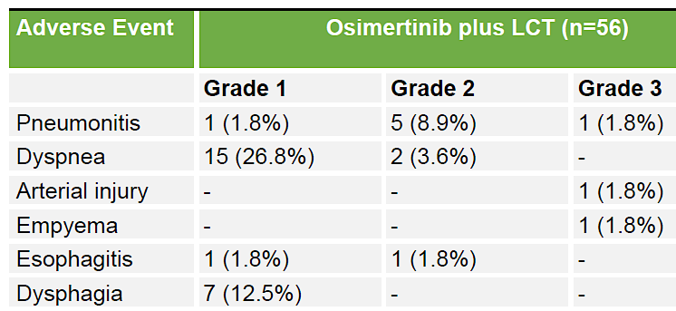
North Star study – Local consolidation for EGFR+ NSCLC
Elamin YY et al. ESMO 2025;Abstract LBA72.

Slide 33
Year in Review: EGFR-Mutant Non-Small Cell Lung Cancer
MODULE 1: Metastatic disease
FLAURA2, IPASS studies
MARIPOSA study: Amivantamab and lazertinib
PALOMA studies: Subcutaneous amivantamab
DVT, pulmonary emboli; prophylactic anticoagulation
Short-term versus long-term outcomes — tail of the curve?
COMPEL study: Continuation with chemotherapy of first-line osimertinib — CNS disease, ADCs
NorthStar study: Local consolidation — RT, surgery
Datopotamab deruxtecan
Exon 20 insertion, uncommon mutations
Toxicity: Mucositis, keratitis
TROPION-Lung15
MET inhibitors — after disease progression on osimertinib
MET amplified, overexpressed
SACHI study: Savolitinib and osimertinib

Slide 34
Sands J et al. Datopotamab Deruxtecan in Advanced or Metastatic Non-Small Cell Lung Cancer With Actionable Genomic Alterations: Results From the Phase II TROPION-Lung05 Study. J Clin Oncol 2025;43(10):1254-65.
Datopotamab deruxtecan - TROPION Lung05
Courtesy of Helena Yu, MD

Slide 35
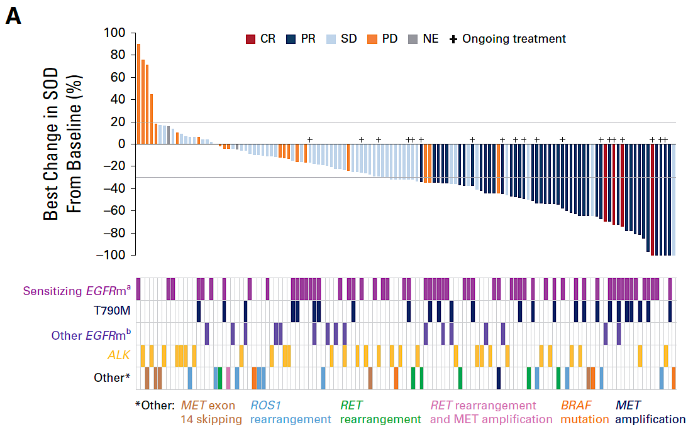
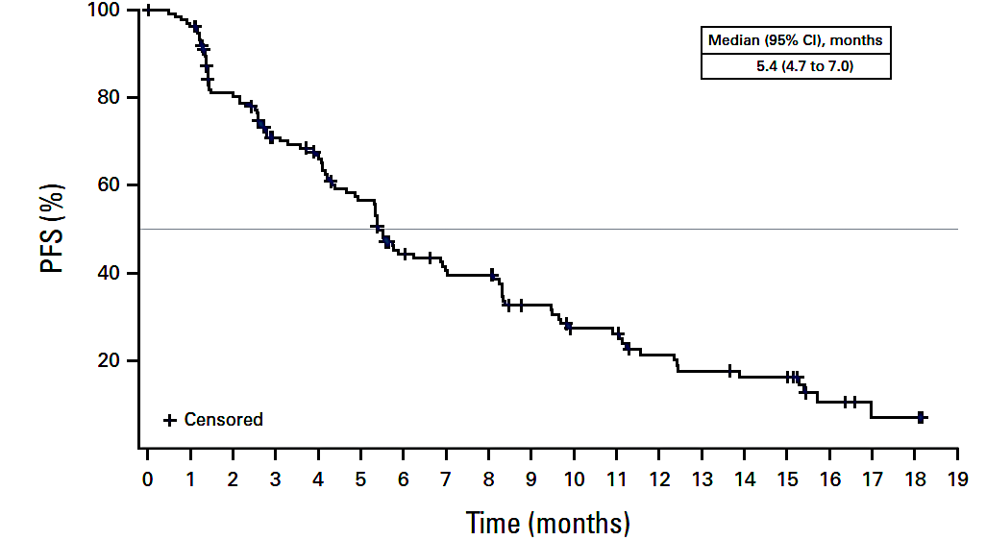
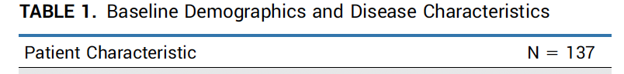
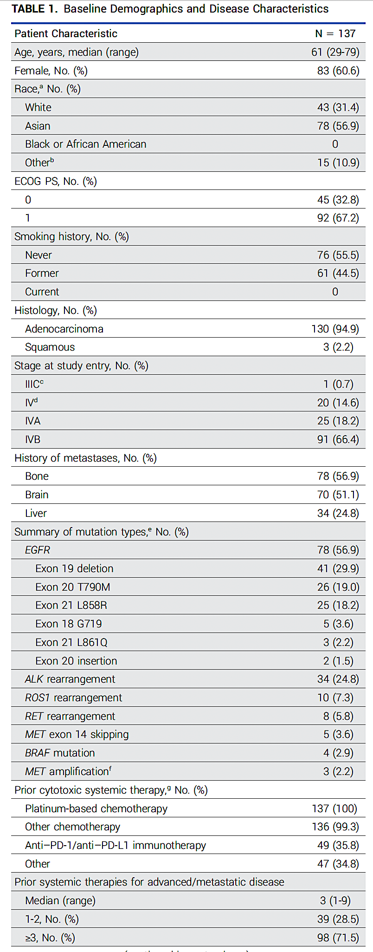
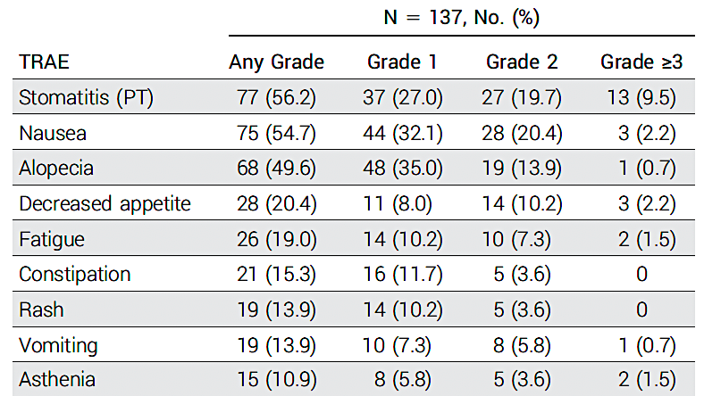
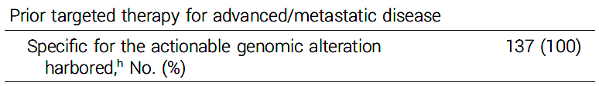
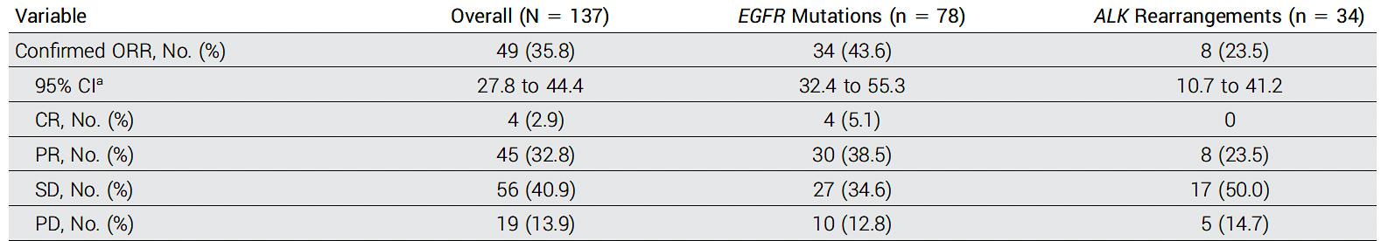
Datopotamab deruxtecan – TROPION-Lung05
Sands J et al. J Clin Oncol 2025;43(10):1254-65.

Slide 36
Ahn MJ et al. A Pooled Analysis of Datopotamab Deruxtecan in Patients With EGFR-Mutated NSCLC. J Thorac Oncol 2025;20(11):1669-82.
Pooled analysis of TL01 and TL05
Courtesy of Helena Yu, MD

Slide 37
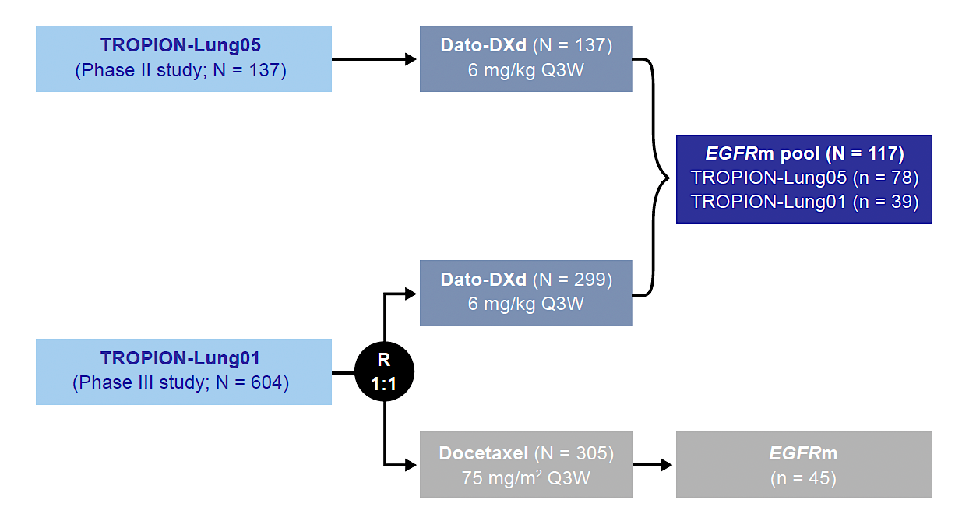
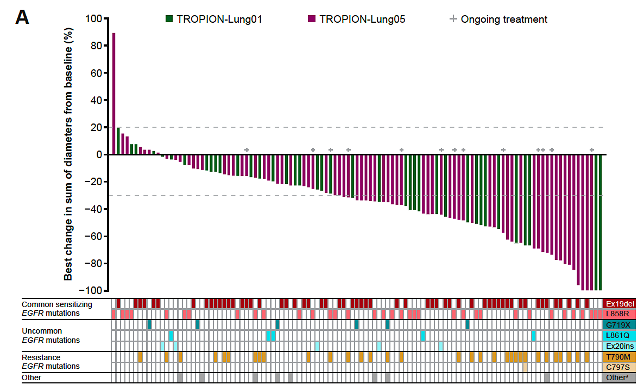
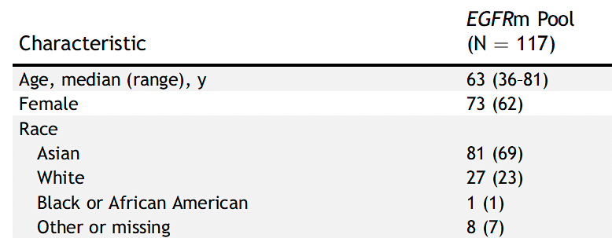
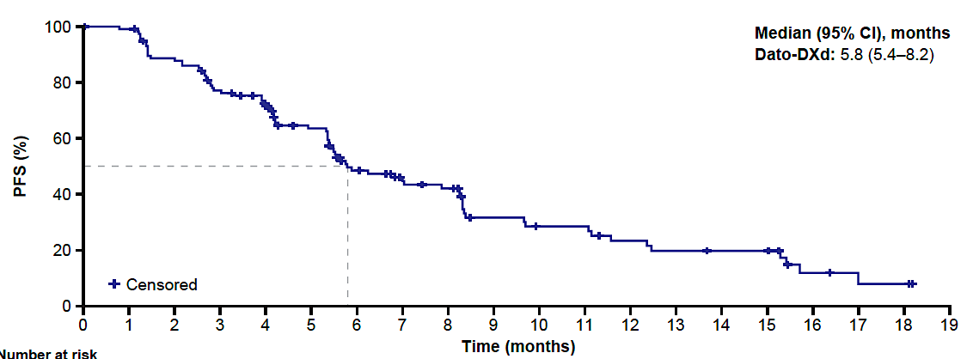
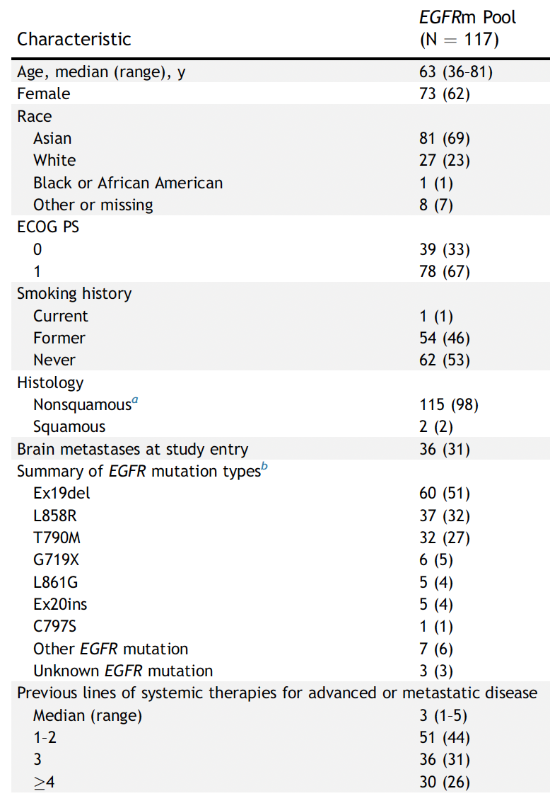
Datopotamab deruxtecan – TROPION-Lung01 and Lung05
Ahn MJ et al. J Thorac Oncol 2025;20(11):1669-82.

Slide 38
Le X et al. Osimertinib (osi) + datopotamab deruxtecan (Dato-DXd) in patients (pts) with EGFR-mutated (EGFRm) advanced NSCLC (aNSCLC) whose disease progressed on first-line (1L) osi: ORCHARD. ELCC 2025;Abstract 1O.
Datopotamab deruxtecan + osimertinib in the ORCHARD study
Courtesy of Helena Yu, MD

Slide 39
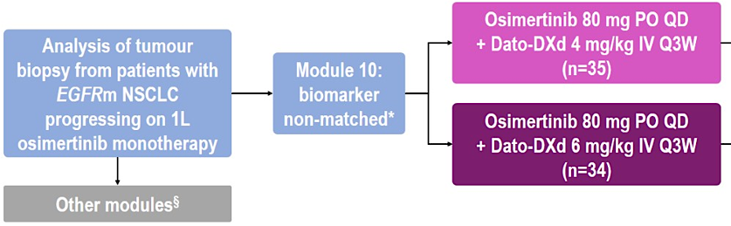
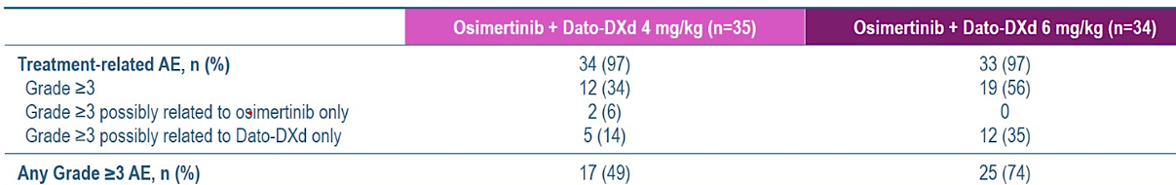
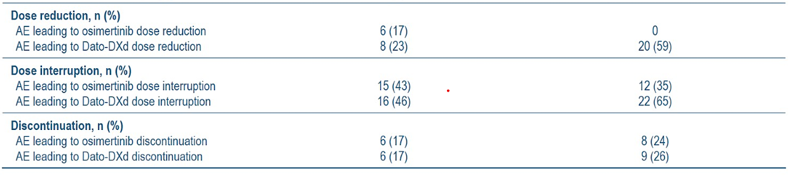
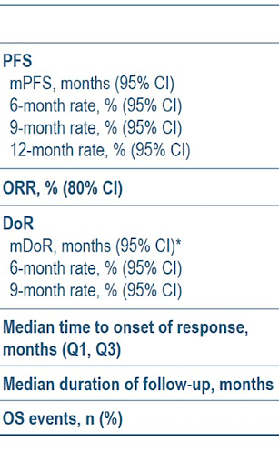
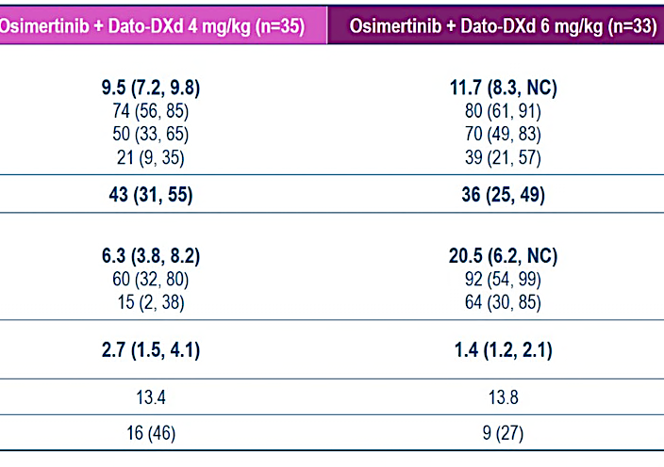
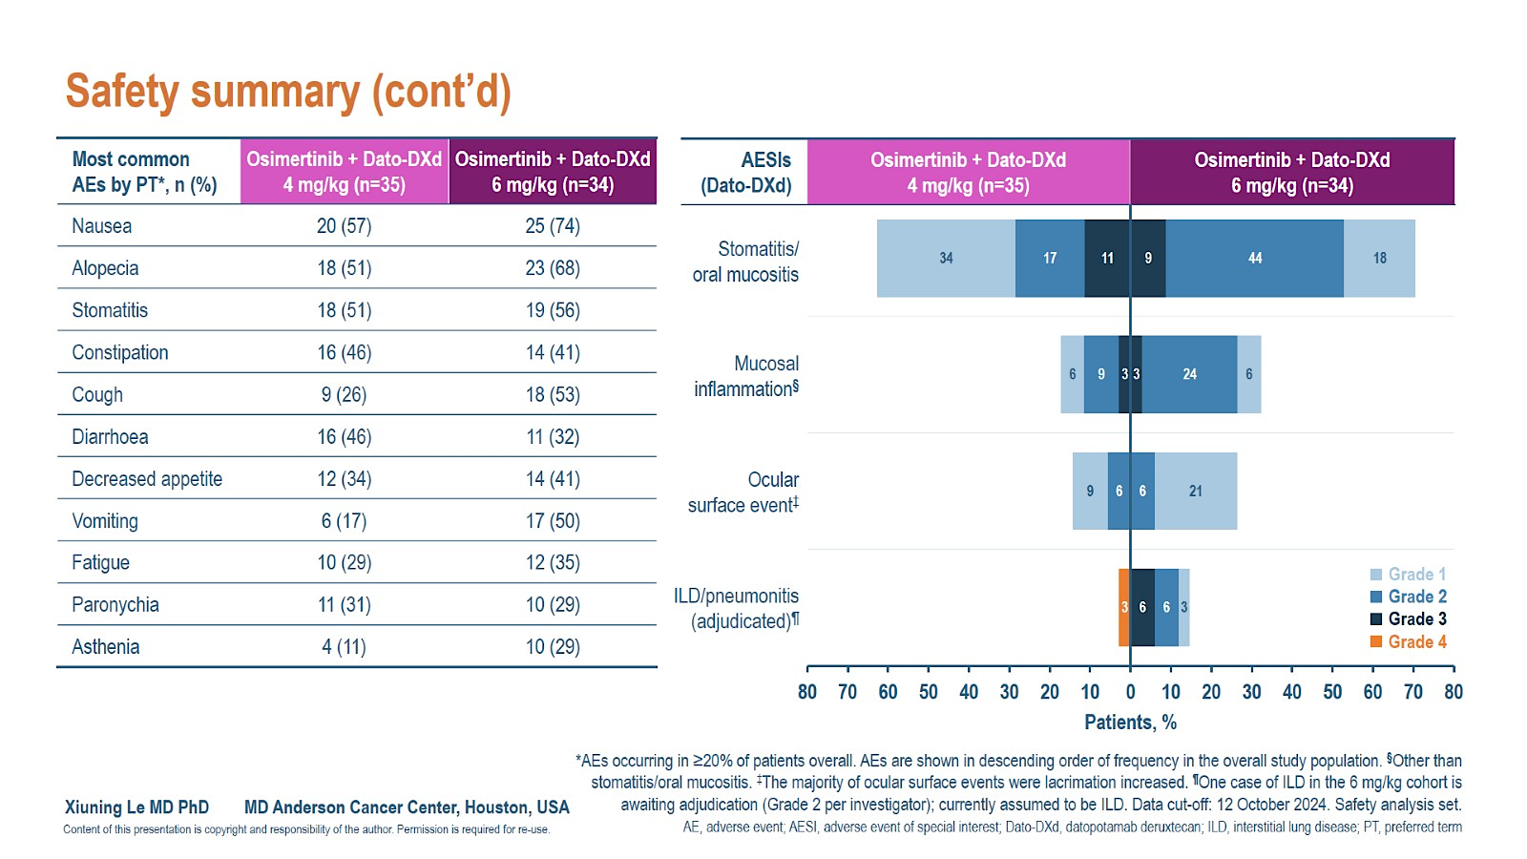
Datopotamab deruxtecan + osimertinib in ORCHARD
Le X et al. ELCC 2025;Abstract 1O.

Slide 40
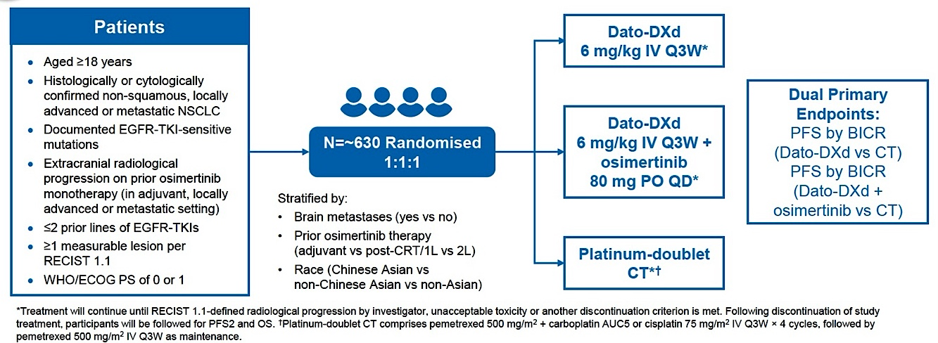
Phase III TROPION-Lung15 Study Design
Enrollment started October 2024 | Enrollment is ongoing
Nadal E et al. ELCC 2025;Abstract 124TiP.

Slide 41
Year in Review: EGFR-Mutant Non-Small Cell Lung Cancer
MODULE 1: Metastatic disease
FLAURA2, IPASS studies
MARIPOSA study: Amivantamab and lazertinib
PALOMA studies: Subcutaneous amivantamab
DVT, pulmonary emboli; prophylactic anticoagulation
Short-term versus long-term outcomes — tail of the curve?
COMPEL study: Continuation with chemotherapy of first-line osimertinib — CNS disease, ADCs
NorthStar study: Local consolidation — RT, surgery
Datopotamab deruxtecan
Exon 20 insertion, uncommon mutations
Toxicity: Mucositis, keratitis
TROPION-Lung15
MET inhibitors — after disease progression on osimertinib
MET amplified, overexpressed
SACHI study: Savolitinib and osimertinib

Slide 42
de Marinis F et al. Savolitinib plus osimertinib in epidermal growth factor receptor (EGFR)-mutated advanced non-small cell lung cancer with MET overexpression and/or amplification following disease progression on osimertinib: Primary results from the phase II SAVANNAH study. Ann Oncol 2025;36(8):920-33.
SAVANNAH study - Savolitinib + osimertinib
Courtesy of Helena Yu, MD

Slide 43
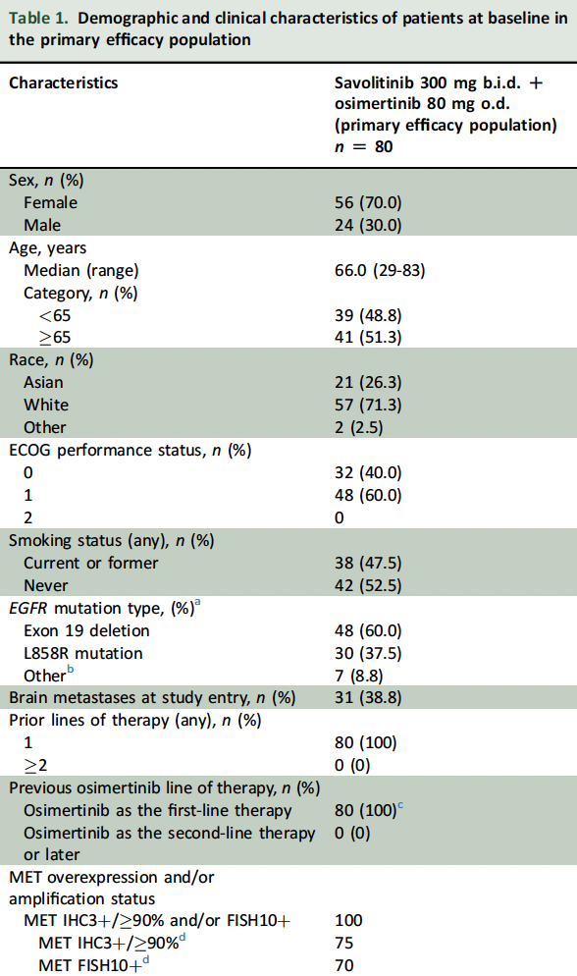
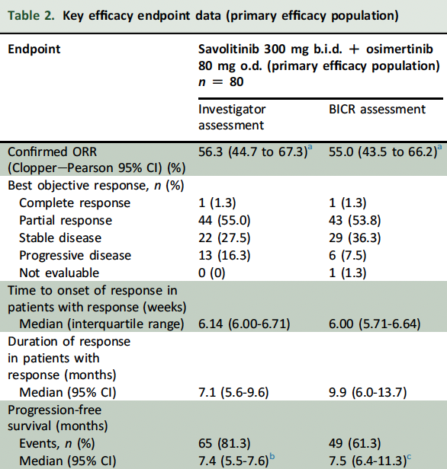
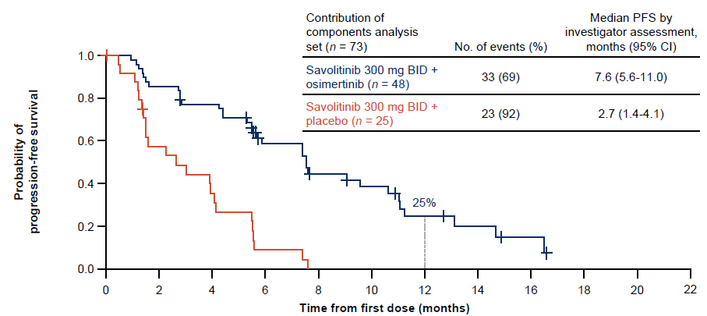
SAVANNAH study- Savolitinib + osimertinib
MET cut-offs initially MET IHC 3+/>50% and/or FISH5+ (>5 MET gene copies, MET/CEP7>2) and increased to MET IHC3+/>90% and FISH10+ after a preliminary analysis.
With lower cutoff, the mPFS was 2.8mo and ORR 9%
de Marinis F et al. Ann Oncol 2025;36(8):920-33.

Slide 44
Lu S et al. Savolitinib plus osimertinib versus chemotherapy for advanced, EGFR mutation-positive, MET-amplified non-small-cell lung cancer in China (SACHI): Interim analysis of a multicentre, open-label, phase 3 randomised controlled trial. Lancet 2026;407(10526):375-87.
SACHI study - Savolitinib + osimertinib
Courtesy of Helena Yu, MD

Slide 45
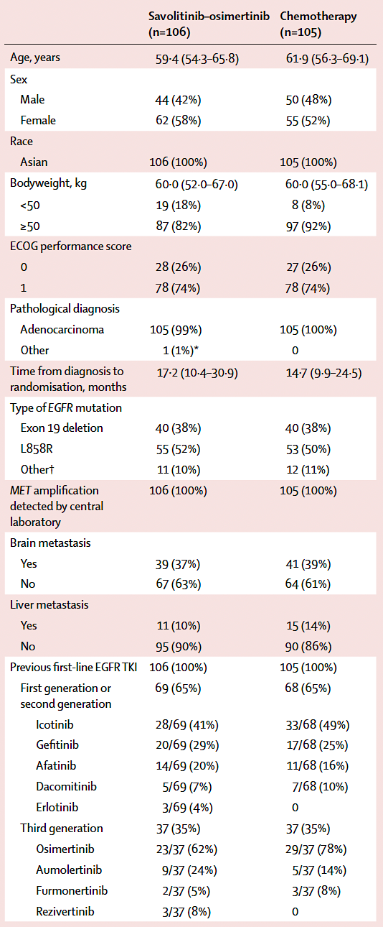
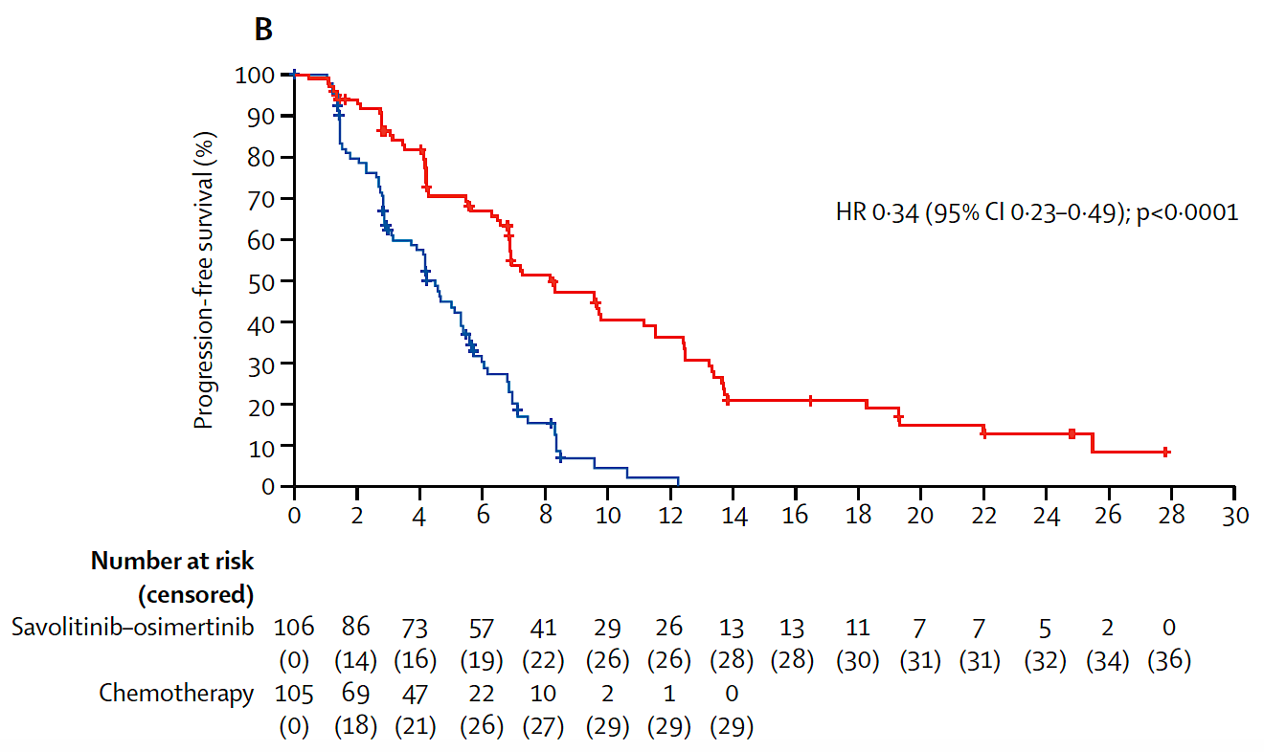
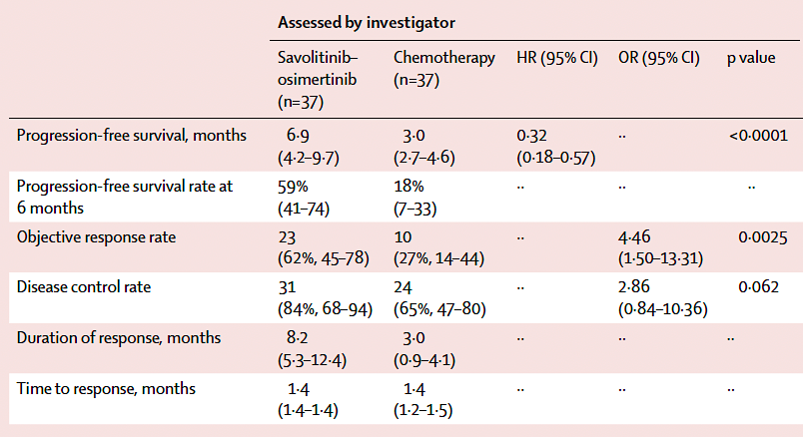
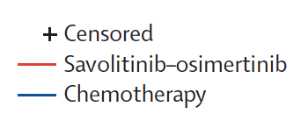
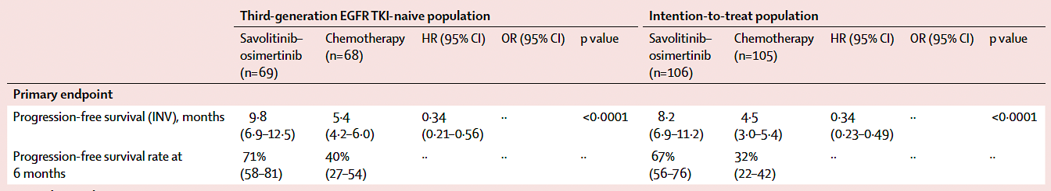
SACHI study- Savolitinib + osimertinib
MET amplification definition: MET copy number >5, MET to CEP7 ratio >2 after 1st/2nd gen EGFR TKI or MET copy number >10 after 3rd gen EGFR TKI
Lu S et al. Lancet 2026;407(10526):375-87.

Slide 46
Year in Review: EGFR-Mutant Non-Small Cell Lung Cancer
MODULE 2: Localized disease
Adjuvant osimertinib (ADAURA trial): ctDNA — 3 years duration?
NeoADAURA trial: Neoadjuvant osimertinib — with chemotherapy
Current role: N2+, Stage IIIA?
Surgically unresectable disease — chemotherapy, radiation therapy
LAURA trial
Indefinite osimertinib: survival results
MRD findings (current role?)
NEOLA trial: osimertinib before and after chemoradiation

Slide 47
Year in Review: EGFR-Mutant Non-Small Cell Lung Cancer
MODULE 2: Localized disease
Adjuvant osimertinib (ADAURA trial): ctDNA — 3 years duration?
NeoADAURA trial: Neoadjuvant osimertinib — with chemotherapy
Current role: N2+, Stage IIIA?
Surgically unresectable disease — chemotherapy, radiation therapy
LAURA trial
Indefinite osimertinib: survival results
MRD findings (current role?)
NEOLA trial: osimertinib before and after chemoradiation

Slide 48
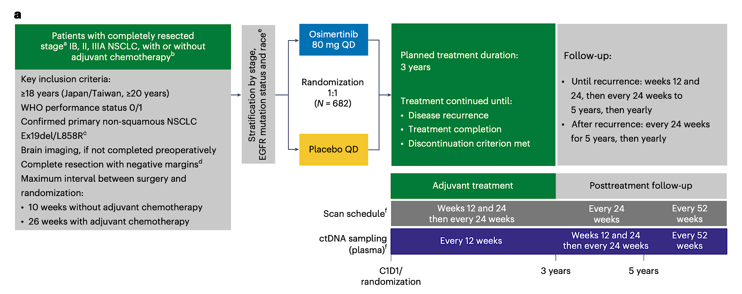
MRD Analysis in ADAURA Trial
Herbst R et al, Nat Med, 2025.

Slide 49
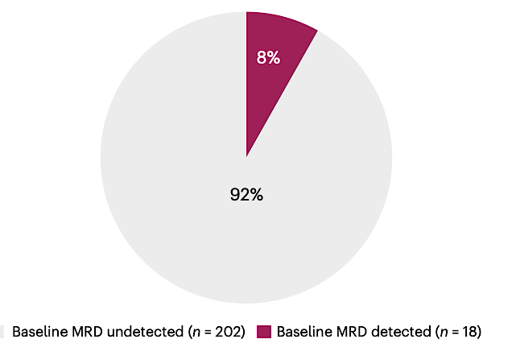
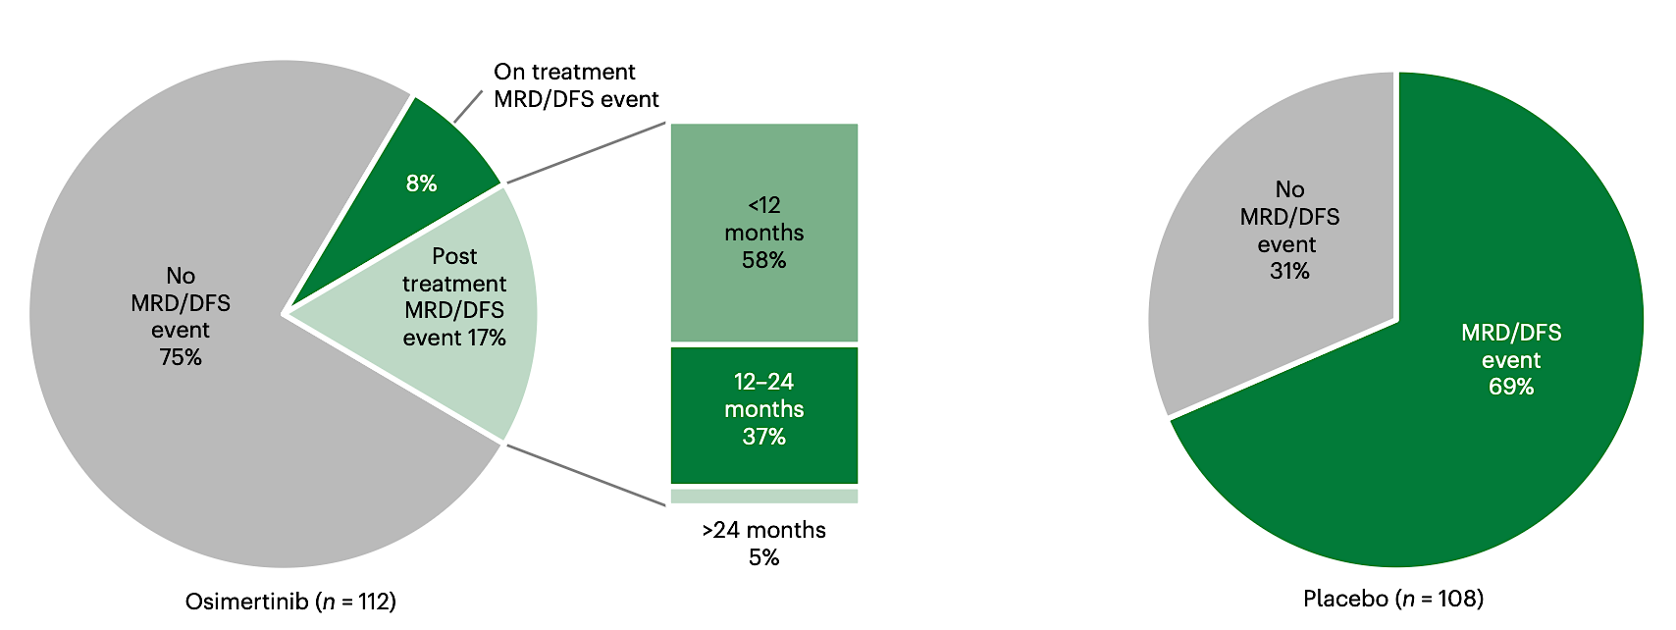
MRD Status at Baseline and with Therapy
Herbst R et al, Nat Med, 2025.

Slide 50
Year in Review: EGFR-Mutant Non-Small Cell Lung Cancer
MODULE 2: Localized disease
Adjuvant osimertinib (ADAURA trial): ctDNA — 3 years duration?
NeoADAURA trial: Neoadjuvant osimertinib — with chemotherapy
Current role: N2+, Stage IIIA?
Surgically unresectable disease — chemotherapy, radiation therapy
LAURA trial
Indefinite osimertinib: survival results
MRD findings (current role?)
NEOLA trial: osimertinib before and after chemoradiation

Slide 51
NeoADAURA
Patients with completely resectable EGFRm stage II–IIIB NSCLC*
Osi 80 mg QD (≥9 weeks)§¶ + carboplatin AUC5 or cisplatin 75 mg/m² + pemetrexed 500 mg/m² (Q3W for 3 cycles)
Surgery
N=358
Key inclusion criteria:
Aged ≥18 years
Histologically / cytologically confirmed non-squamous NSCLC
Ex19del / L858R†
WHO PS 0 / 1
Investigator choice of adjuvant treatment
R 1:1:1
Osi mono 80 mg QD (≥9 weeks)¶#
Post-surgery follow-up visits**
Stratification by:
Stage II / III
Chinese‡ / other Asian
/ non-Asian
Ex19del / L858R
PBO QD (≥9 weeks)§¶ + carboplatin AUC5 or cisplatin 75 mg/m² + pemetrexed 500 mg/m² (Q3W for 3 cycles)
Sponsor-supplied adjuvant osi was available for eligible patients who completed surgery in all arms††
Endpoints:
Primary: major pathological response (MPR; by blinded central pathology review)
Secondary: event-free survival, pathological complete response, nodal downstaging and safety
Chaft J et al, ASCO 2025.

Slide 52
MPR
The MPR rate was statistically significantly higher with both osi-containing regimens
Difference, 24% (95% CI 15, 32);
OR, 19.8 (95.002% CI 4.6, 85.3); p<0.0001
Difference, 23% (95% CI 15, 32); OR, 19.3 (99.9% CI 1.7, 217.4); p<0.0001
MPR rate, %
Osi + CTx (n=121)
Osi mono (n=117)
PBO + CTx (n=120)
Chaft J et al, ASCO 2025.
CI, confidence interval; CTx, chemotherapy; EGFR, epidermal growth factor receptor; Ex19del, Exon 19 deletion; IASLC, International Association for the Study of Lung Cancer; mono, monotherapy; MPR, major pathological response; OR, odds ratio; osi, osimertinib; PBO, placebo

Slide 53
Year in Review: EGFR-Mutant Non-Small Cell Lung Cancer
MODULE 2: Localized disease
Adjuvant osimertinib (ADAURA trial): ctDNA — 3 years duration?
NeoADAURA trial: Neoadjuvant osimertinib — with chemotherapy
Current role: N2+, Stage IIIA?
Surgically unresectable disease — chemotherapy, radiation therapy
LAURA trial
Indefinite osimertinib: survival results
MRD findings (current role?)
NEOLA trial: osimertinib before and after chemoradiation

Slide 54
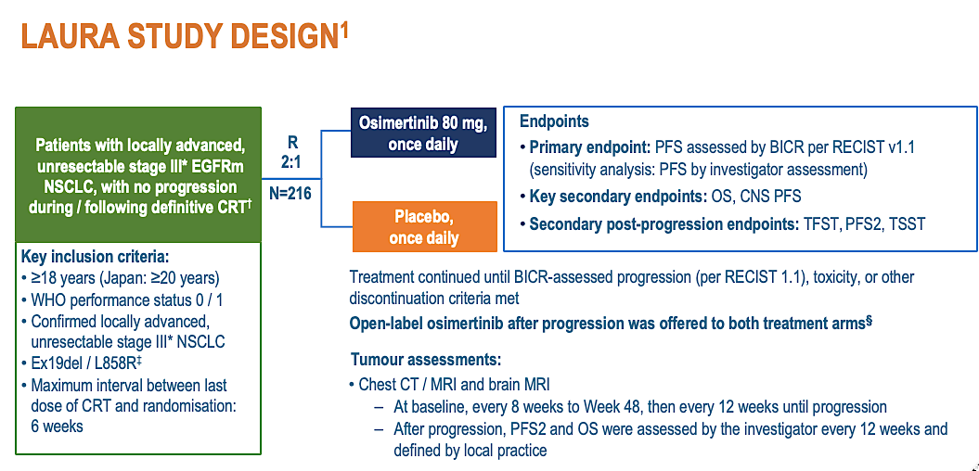
LAURA: updated overall survival results
Ramalingam S et al, ELCC 2025.

Slide 55

Ramalingam S et al, ELCC 2025.

Slide 56

LAURA: Results by MRD Status
Arriola L et al, ESMO 2025.

Slide 57
Year in Review: EGFR-Mutant Non-Small Cell Lung Cancer
MODULE 3: EGFR exon 20 insertion mutations
First-line amivantamab/chemotherapy: PAPILLON trial
Sunvozertinib
WU-KONG1B trial
Press release Phase III trial
Zipalertinib

Slide 58
Year in Review: EGFR-Mutant Non-Small Cell Lung Cancer
MODULE 3: EGFR exon 20 insertion mutations
First-line amivantamab/chemotherapy: PAPILLON trial
Sunvozertinib
WU-KONG1B trial
Press release Phase III trial
Zipalertinib

Slide 59
EGFR Exon 20 Insertion Mutation: PAPILLON Study
Chemotherapy with amivantamab improves PFS
Median PFS improved from 6.7 m to 11.4 m
Approved by FDA for 1st line therapy
Report on patient reported outcomes by Paz-Ares L et al, Lung Cancer, 2025.
Physical functioning and global health status were maintained in both arms
77% of patients remained free of symptomatic progression with chemo-Ami compared at 60% with chemo at 12 months
Zhou C et al, NEJM, 2023; Paz-Ares L et al, Lung Cancer, 2025.

Slide 60
Year in Review: EGFR-Mutant Non-Small Cell Lung Cancer
MODULE 3: EGFR exon 20 insertion mutations
First-line amivantamab/chemotherapy: PAPILLON trial
Sunvozertinib
WU-KONG1B trial
Press release Phase III trial
Zipalertinib

Slide 61
Sunvozertinib for EGFR Exon 20 Mutant NSCLC: WU-KONG1B
Sunvozertinib (DZD9008) is a rationally designed, potent, selective and irreversible EGFR inhibitor targeting EGFR exon 20 insertion mutations (exon20ins).
Locally advanced or metastatic NSCLC Confirmed EGFR exon20ins ECOG PS of 0 or 1 Prior treated with platinum-based chemotherapy
Cohort 1:
200 mg, QD
Continuous dosing until discontinuation criteria were met
Survival follow-up
R 1:1*
Cohort 2:
300 mg, QD
Primary Endpoint: ORR assessed by BICR# Key Secondary Endpoint: DoR by BICR
Yang J et al, ASCO 2025

Slide 62
Sunvozertinib: Summary of Anti-tumor Efficacy
Tumor Response Per BICR |  | 200 mg (N = 85) | 300 mg (N = 89)
Confirmed ORR |  | 46% | 47%
Disease Control Rate |  | 89% | 92%
Median DoR |  | 11.1 m | 13.8 m
Median PFS |  | 8.4 m | 7.7 m
Subgroup Analysis of Confirmed ORR
Prior Amivantamab Treatment | With | 25% | 42%
 | Without | 49% | 48%
Baseline Brain Metastasis | With | 29% | 52%
 | Without | 57% | 46%
The most common TRAEs with grade ≥3 included diarrhea, blood CPK increase
and anemia, generally did not lead to treatment discontinuation or dose reduction.
Yang J et al, ASCO 2024; Yang J et al, JCO 2025

Slide 63
Positive Top-Line Phase III Results from the WU-KONG28 Study of Sunvozertinib as First-Line Treatment for NSCLC with EGFR Exon 20 Insertion Mutations Press Release: March 21, 2026
“[The manufacturer] today announced that its multinational Phase 3 WU-KONG28 study evaluating sunvozertinib monotherapy as first-line treatment in non-small cell lung cancer (NSCLC) with EGFR exon 20 insertion mutations (exon20ins) met its primary endpoint with positive topline results.
WU-KONG28 is a multinational, open-label, randomized confirmatory phase 3 study evaluating sunvozertinib versus platinum-based chemotherapy as first-line treatment in advanced NSCLC patients with EGFR exon20ins. ... The primary endpoint is progression-free survival (PFS) assessed by blinded independent central review (BICR). Topline results demonstrated that sunvozertinib significantly improved PFS compared to platinum-based doublet chemotherapy, with meaningful clinical benefit. Detailed data from the primary analysis will be submitted for presentation at an upcoming international scientific congress.”
https://www.dizalpharma.com/news/detail?id=109&search=&currentPage=1

Slide 64
Year in Review: EGFR-Mutant Non-Small Cell Lung Cancer
MODULE 3: EGFR exon 20 insertion mutations
First-line amivantamab/chemotherapy: PAPILLON trial
Sunvozertinib
WU-KONG1B trial
Press release Phase III trial
Zipalertinib

Slide 65
Zipalertinib: REZILIENT1 Phase 2b study
REZILIENT1 is a phase 1/2, open-label, multicenter trial (NCT04036682)
Primary endpoint:
ORR and DOR as assessed by blinded ICR per RECIST v1.1
Secondary endpoints:
ORR and DOR by investigator
DCR
CBR
PFS by ICR and investigator
OS
Antitumor activity in patients with CNS disease
Safety
Key eligibility criteria
Age ≥18 years
Locally advanced or metastatic NSCLC
Documented EGFR exon 20 insertion
ECOG PS 0 or 1
Stable/asymptomatic CNS metastases allowed
Prior platinum-based chemotherapy without prior ex20ins-targeted therapy
Zipalertinib
100 mg PO BID
Prior platinum-based chemotherapy with prior amivantamab ± other ex20ins-targeted therapy
Safety analysis population: all patients who received ≥1 dose of zipalertinib 100 mg BID (N=244)
Primary efficacy population: all patients who received ≥1 dose of zipalertinib 100 mg BID with ~8 months of minimum follow-up before data cutoff (December 10, 2024) (N=176)
Patients were assigned to a cohort based on previous therapy (ie, platinum-based chemotherapy only or amivantamab)
BID, twice daily; CBR, clinical benefit rate; CNS, central nervous system; DCR, disease control rate; DOR, duration of response; ECOG PS, Eastern Cooperative Oncology Group performance status; EGFR, epidermal growth factor receptor; ex20ins, exon 20 insertions; ICR, independent central review; NSCLC, non-small cell lung cancer; ORR, objective response rate; OS, overall survival; PFS, progression-free survival; PO, orally; RECIST, Response Evaluation Criteria in Solid Tumors.
Yu H et al, ASCO 2025.

Slide 66
Zipalertinib Efficacy
Outcome | Primary efficacy population (N=176) | Platinum-based chemotherapy without ex20ins-targeted therapy (n=125) | Prior amivantamab ± other ex20ins-target therapy (n=51)ª
Confirmed ORR | 35% | 40% | 24%
Median DOR | 8.8 m | 8.8 m | 8.5 m
Any-grade TRAEs reported in ≥10% of patients, No. (%) | Any grade | Grade 3
Paronychia | 94 (38.5) | 0
Rash | 74 (30.3) | 6 (2.5)
Dermatitis acneiform | 60 (24.6) | 1 (0.4)
Dry skin | 60 (24.6) | 0
Diarrhea | 53 (21.7) | 5 (2.0)
Stomatitis | 49 (20.1) | 4 (1.6)
Anemia | 48 (19.7) | 17 (7.0)
Yu H et al, ASCO 2025.

Slide 67
Year in Review: EGFR-Mutant Non-Small Cell Lung Cancer
MODULE 4: New Agents
Ivonescimab: HARMONi Phase III trial — Ivonescimab/chemotherapy
Sacituzumab tirumotecan: OptiTROP-Lung04 study

Slide 68
Year in Review: EGFR-Mutant Non-Small Cell Lung Cancer
MODULE 4: New Agents
Ivonescimab: HARMONi Phase III trial — Ivonescimab/chemotherapy
Sacituzumab tirumotecan: OptiTROP-Lung04 study

Slide 69

HARMONi Phase 3 Trial
Goldman J et al, WCLC 2025.

Slide 70


HARMONi: PFS & OS
Goldman J et al, WCLC 2025.

Slide 71
Year in Review: EGFR-Mutant Non-Small Cell Lung Cancer
MODULE 4: New Agents
Ivonescimab: HARMONi Phase III trial — Ivonescimab/chemotherapy
Sacituzumab tirumotecan: OptiTROP-Lung04 study

Slide 72

Limited to patients of age < 75 yrs
Fang W et al, NEJM, 2025; Zhang et al. ASCO 2025.

Slide 73


Optitrop-Lung04 trial
HR: 0.49; 8.3m vs. 4.3m
HR: 0.6; NE vs 17.4m
Salient AE with Sac-TMT:
Stomatitis; 64% (Gr 1 22%, Gr 2 37% & Gr 3 5%)
Fang W et al, NEJM, 2025.

