Slide 1
Bispecific T-Cell Engagers for Small Cell Lung Cancer
Understanding the Current Paradigm and New Approaches in the Care of Patients with Cancer
A Complimentary NCPD Hybrid Symposium Series Held During the 50th Annual ONS Congress
Friday, April 11, 2025 6:00 AM – 7:30 AM
Faculty
Anne Chiang, MD, PhD
Elizabeth Krueger, NP
Beth Sandy, MSN, CRNP, FAPO
Erin Schenk, MD, PhD
Moderator
Neil Love, MD

Slide 2
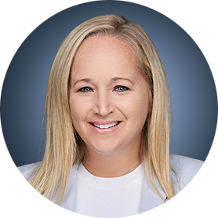
Faculty
Elizabeth Krueger, NP
Nurse Practitioner
Massachusetts General Hospital Center for Thoracic Cancers
Boston, Massachusetts
Anne Chiang, MD, PhD
Associate Professor
Yale University School of Medicine
Associate Yale Cancer Center Director
Smilow Cancer Hospital
New Haven, Connecticut
Beth Sandy, MSN, CRNP, FAPO
Nurse Practitioner
Abramson Cancer Center
University of Pennsylvania
Philadelphia, Pennsylvania
Erin Schenk, MD, PhD
Assistant Professor
Thoracic Oncology
Division of Medical Oncology Department of Medicine
University of Colorado Anschutz Medical Campus
Aurora, Colorado

Slide 3
Dr Chiang — Disclosures
Advisory Committees | Amgen Inc, AstraZeneca Pharmaceuticals LP, Daiichi Sankyo Inc, Fosun Pharma, Genentech, a member of the Roche Group, Janssen Biotech Inc, Zai Lab
Contracted Research | AbbVie Inc, Amgen Inc, AstraZeneca Pharmaceuticals LP, Bristol Myers Squibb, Genentech, a member of the Roche Group, Zai Lab
Data and Safety Monitoring Boards/Committees | AstraZeneca Pharmaceuticals LP
Internal Education Lecture on SCLC | Jazz Pharmaceuticals Inc

Slide 4
Ms Krueger — Disclosures
No relevant conflicts of interest to disclose

Slide 5
Ms Sandy — Disclosures
Advisory Committees | Pfizer Inc
Speakers Bureaus | Amgen Inc, AstraZeneca Pharmaceuticals LP, Janssen Biotech Inc, Jazz Pharmaceuticals Inc, Lilly, Merck, Takeda Pharmaceuticals USA Inc

Slide 6
Dr Schenk — Disclosures
Advisory Committees | AstraZeneca Pharmaceuticals LP, Boehringer Ingelheim Pharmaceuticals Inc, CDR-Life, Harpoon Therapeutics, Janssen Biotech Inc, Johnson & Johnson Pharmaceuticals, Merck, Takeda Pharmaceuticals USA Inc, Thetis Pharmaceuticals LLC
Consulting Agreements | Aadi Bioscience, ALIGN2ACTION Inc, Axon Advisors, BeiGeneius, Expert Connect, GlobalData, Guidepoint Global LLC, HCG, Slingshot Insights, The Scieomics Group, Third Bridge, WC Communications
Data and Safety Monitoring Boards/Committees | Amgen Inc
Speakers Bureaus | Curio Science, Harpoon Therapeutics, Janssen Biotech Inc, Nuvation Bio
Stock Options — Private Companies | Thetis Pharmaceuticals LLC
Nonrelevant Financial Relationships | ASCO Direct, Cancer Therapy Advisor, Horizon CME, IDEOlogy Health, Medscape, OncLive, ROS1ders

Slide 7
Commercial Support
This activity is supported by an educational grant from Amgen Inc.
Research To Practice NCPD Planning Committee Members, Staff and Reviewers
Planners, scientific staff and independent reviewers for Research To Practice have no relevant conflicts of interest to disclose.

Slide 8
This educational activity contains discussion of non-FDA-approved uses of agents and regimens. Please refer to official prescribing information for each product for approved indications.

Slide 9
Agenda
Introduction: Overview of Bispecific Antibodies
Module 1: Biology of Small-Cell Lung Cancer (SCLC) and Review of Its Initial Management
Case Presentation: Ms Krueger – 63-year-old man
Module 2: Current Role of Tarlatamab in Therapy for SCLC
Case Presentation: Ms Sandy – 70-year-old woman
Module 3: Future Directions in the Management of SCLC
Case Presentation: Ms Krueger – 81-year-old man
Module 4: Unique Considerations in SCLC Management
Case Presentation: Ms Sandy – 67-year-old woman

Slide 10
Agenda
Introduction: Overview of Bispecific Antibodies
Module 1: Biology of Small-Cell Lung Cancer (SCLC) and Review of Its Initial Management
Case Presentation: Ms Krueger – 63-year-old man
Module 2: Current Role of Tarlatamab in Therapy for SCLC
Case Presentation: Ms Sandy – 70-year-old woman
Module 3: Future Directions in the Management of SCLC
Case Presentation: Ms Krueger – 81-year-old man
Module 4: Unique Considerations in SCLC Management
Case Presentation: Ms Sandy – 67-year-old woman

Slide 11
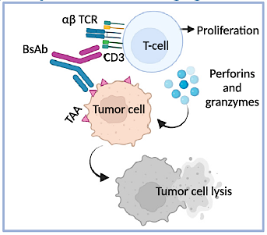
Mechanism of Action of Bispecific Antibodies: T-Cell Engagers
Bispecific antibodies bind the TCR and the selected TAA to facilitate the formation of a synapse between the two cell types; the synapse activates T cells, which can release perforins and granzymes to lyse tumor cells.
Herrera M et al. Trends Cancer 2024;10(10):893-919.

Slide 12
Examples of Bispecific Antibodies with FDA-Approved Indications for Hematologic Cancers
Blinatumomab (CD3 x CD19) for adult and pediatric Philadelphia chromosome-positive acute lymphocytic leukemia
Talquetamab (CD3 x GPRC5D) for multiple myeloma (MM)
Teclistamab (CD3 x BCMA) for MM
Elranatamab (CD3 x BCMA) for MM
Glofitamab (CD3 x CD20) for diffuse large B-cell lymphoma (DLBCL)
Epcoritamab (CD3 x CD20) for follicular lymphoma (FL)
Mosunetuzumab (CD3 x CD20) for DLBCL and FL
https://www.fda.gov/drugs/resources-information-approved-drugs/oncology-cancerhematologic-malignancies-approval-notifications?randparam=228524.

Slide 13
Examples of Bispecific Antibodies with FDA-Approved Indications for Solid Tumors
Amivantamab (EGFR x c-MET) for EGFR exon20ins non-small cell lung cancer
Tarlatamab (CD3 x DDL3) for extensive-stage SCLC
Tebentafusp (CD3 x gp100-HLAA02:01) for uveal melanoma
Zanidatamab (HER2-ECD2 x HER2-ECD4) for HER2-positive biliary tract cancer
https://www.fda.gov/drugs/resources-information-approved-drugs/oncology-cancerhematologic-malignancies-approval-notifications?randparam=228524.

Slide 14
Patient Education: Cytokine Release Syndrome (CRS)
CRS is most common after the first two doses, which is why you will be monitored in the hospital for 22-24 hours after treatment on days 1 and 8
You will receive a “step-up dose”, or a smaller dose on your first day of treatment
If your treatment is delayed by more than two weeks, the “step-up dose” and monitoring may be repeated
Dexamethasone, a steroid, will be given before the first two doses to help lower the risk of CRS
With later doses, monitoring will usually happen in infusion for 2-8 hours after treatment
Notify your team or get medical help right away if you have any signs or symptoms, including:
Fever of 100.4 degrees or higher
Low blood pressure or dizziness
New tiredness or headache
Shortness of breath or trouble breathing
Nausea and vomiting
Confusion, restlessness, or feeling anxious
Problems with walking, or loss of balance or coordination
Unusual bleeding
Weakness or shaking (tremors)
Trouble sleeping
Courtesy of Elizabeth Krueger, NP

Slide 15
Agenda
Introduction: Overview of Bispecific Antibodies
Module 1: Biology of Small-Cell Lung Cancer (SCLC) and Review of Its Initial Management
Case Presentation: Ms Krueger – 63-year-old man
Module 2: Current Role of Tarlatamab in Therapy for SCLC
Case Presentation: Ms Sandy – 70-year-old woman
Module 3: Future Directions in the Management of SCLC
Case Presentation: Ms Krueger – 81-year-old man
Module 4: Unique Considerations in SCLC Management
Case Presentation: Ms Sandy – 67-year-old woman

Slide 16
Small Cell Lung Cancer: Advances in a Changing Landscape
Anne Chiang MD, PhD, FASCO
Associate Professor, Division of Thoracic Medical Oncology
Yale University School of Medicine
Associate Yale Cancer Center Director, Clinical Initiatives

Slide 17
SCLC: Incidence and Risk Factors
~14% of lung cancer
~ 250,000 new cases and 200,000 deaths globally each year
~16,000 new cases of SCLC in the US in 2024
Median age at diagnosis in the US is 69 years
95% SCLC patients have history of tobacco use
2.5-13% SCLC patients are never smokers, and may have a better prognosis
Rarely, NSCLC patients with driver mutations such as EGFR may undergo histologic transformation to SCLC
Wang Q. J Thorac Oncol. 2023;18(1):31.
Rudin CM. Nat Rev Dis Primers. 2021 Jan 14;7(1):3
Kim SY, Park H, Chiang AC, JAMA .2025 March 31, doi:10.1001/jama.2025.0569

Slide 18
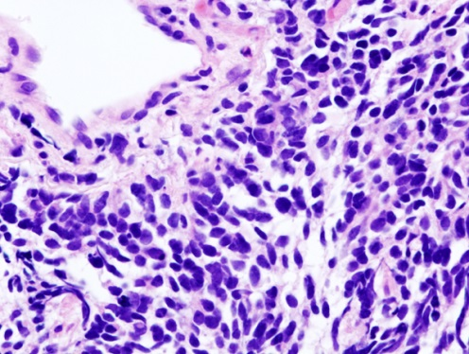
SCLC: Morphology
Characteristics:
Rapid proliferation time
Early development of widespread metastases
Increased sensitivity to both chemotherapy and radiation
Pathology
High-grade neuroendocrine tumor
Small “blue” cells, sparse cytoplasm, nuclear molding
75% with one or more neuroendocrine markers, e.g. chromogranin, synaptophysin, CD56, INSM1
Kim SY, Park H, Chiang AC, JAMA .2025 March 31, doi:10.1001/jama.2025.0569

Slide 19
SCLC: Staging and Prognosis
Staging:
Limited Stage (LS-SCLC): 30%
Includes stage I-III in the TNM staging system
Typically confined to 1 hemothorax and LNs
Can be treated within a radiation field
Extensive Stage (ES-SCLC): 70%
Distant metastatic disease, such as in brain, liver, bones, adrenals
Can include malignant pleural effusion
Prognosis:
Limited Stage: mOS ~4.7 years, 3YOS 56.5%
Extensive Stage: mOS ~13 months, 3YOS 17.6%
LS-SCLC: Stage IIIC (T4N3N0): RUL lung mass, mediastinal LAD
Kim SY, Park H, Chiang AC, JAMA .2025 March 31, doi:10.1001/jama.2025.0569

Slide 20
The Current Era of Immunotherapy (IO)
IMpower-133 and CASPIAN:
Using IO in the frontline setting for ES-SCLC: the current standard of care
ADRIATIC:
Using IO as consolidation in the limited stage setting ASCO 2024, approved by FDA
2018
2019
2020
2024
Checkmate-032 and KEYNOTE-158:
Using IO in 3L setting, subsequently withdrawn due to negative phase III trials but still in NCCN guidelines if no prior IO exposure

Slide 21
ADRIATIC study design
Abstract LBA5

Slide 22
Overall survival (dual primary endpoint)
Abstract LBA5

Slide 23
Conclusions
IS
Abstract LBA5

Slide 24
Extensive Stage SCLC
65-year-old African American female (40 py tobacco history) presented in spring 2020 with worsening SOB on exertion and weight loss over several months.
PET scan shows 7.2 cm RLL mass, satellite nodules, extensive regional nodal involvement in right hilar, mediastinal, and axillary LNs.
Brain MRI is negative
Biopsy of LN reveals small cell carcinoma
She needs systemic treatment!
Treatment options include:
Carboplatin/etoposide/atezolizumab x 4 cycles => maintenance atezolizumab (IMpower133)
Carboplatin/etoposide/durvalumab x 4 cycles => maintenance durvalumab (CASPIAN)
Cisplatin/etoposide/durvalumab x 4 cycles => maintenance durvalumab (CASPIAN)
Carboplatin/etoposide

Slide 25
IMpower133: Atezolizumab/Carboplatin/Etoposide
Stephen V. Liu; Martin Reck; et al, Journal of Clinical Oncology 2021 39619-630. Median Follow up 22.9 months

Slide 26
CASPIAN: Durvalumab/Platinum/Etoposide
1.0
D + EP
EP
Events, n/N (%)
mOS, months (95% CI)
HR (95% CI)
221/268 (82.5)
12.9 (11.3-14.7)
248/269 (92.2)
10.5 (9.3-11.2)
0.8
0.71 (0.60-0.86)
0.0003
Probability of OS
0.6
Nominal P value
52.8%
• Median follow-up in censored patients: 39.4 months (range 0.1–47.5)
Median follow-up in censored patients: 39.4 months (range 0.1-47.5)
0.4
32.0%
39.3%
22.9%
17.6%
0.2
24.8%
5.8%
13.9%
9 12 15 18 21 24 27 30 33 36 39 42 45 48 51
Time from randomization (months)
0
0
3
6
No. at risk
D + EP | 268 | 244 | 214 | 177 | 140 | 109 | 85 | 70 | 60 | 54 | 50 | 46 | 39 | 25 | 13 | 3 | 0 | 0
EP | 269 | 243 | 212 | 156 | 104 | 82 | 64 | 51 | 36 | 24 | 19 | 17 | 13 | 10 | 3 | 0 | 0 | 0
Data cutoff: March 22, 2021. Paz-Ares LG, et al. Ann Oncol. 2021;32(suppl 5):S1283-S1346.

Slide 27
ES-SCLC Clinical Case
Pt has excellent response to 4 cycles of carboplatin, etoposide and atezolizumab and continues maintenance on monthly atezolizumab
Atezo tolerated well except lichenoid rash controlled with steroid topical cream
Pt was on maintenance Atezo for 3 years and is now 2 years off therapy with no evidence of disease!
+
+
+
+
+
+
+
+
+
+
+
+
+
+
+
+
OS, %
+
5-year OS, 12%
+
Atezolizumab + CP/ET
+
+
+
+
+
+
+
+
+
+
+
+
+
+
+
+
+
+
+
+
+
+
+
+
+
+
+
+
+
+
+
+
+
+
+
+
+
Placebo + CP/ET
Time, mo

Slide 28
Approaches to Improve Long-term Outcomes
Seek to understand heterogeneity and determinants of response and resistance
Optimize front line therapy with additional agents
Add novel agents in the maintenance setting
Improve support of our patients throughout their journey

Slide 29
Roundtable Discussion

Slide 30
Agenda
Introduction: Overview of Bispecific Antibodies
Module 1: Biology of Small-Cell Lung Cancer (SCLC) and Review of Its Initial Management
Case Presentation: Ms Krueger – 63-year-old man
Module 2: Current Role of Tarlatamab in Therapy for SCLC
Case Presentation: Ms Sandy – 70-year-old woman
Module 3: Future Directions in the Management of SCLC
Case Presentation: Ms Krueger – 81-year-old man
Module 4: Unique Considerations in SCLC Management
Case Presentation: Ms Sandy – 67-year-old woman

Slide 31
Small-Cell Lung Cancer Case Presentation
Elizabeth Krueger, NP
Nurse Practitioner Massachusetts General Hospital Center
for Thoracic Cancers
Boston, Massachusetts

Slide 32
Case Presentation: 63-year-old man
63yo male, former smoker with ES-SCLC diagnosed 1/2022 when he presented to local ED with difficulty speaking s/p fall (ultimately thought due to seizure activity)
Diagnostics:
Brain MRI with at least 7 brain metastases including 2.8cm R frontal lesion, 1.5cm R frontal lesion and 2cm L cerebellar lesion.
PET CT with 1.5cm RUL nodule and 1.5cm R hilar node.
Bronch/EBUS + small cell lung CA (positive TTF-1, INSMI, synaptophysin, chromogranin and negative for Napsin A, p40. P53 overexpressed, RB loss. Molecular diagnostics negative for fusion transcripts).
Treatment History:
Completed HA-WBRT followed by 1L carboplatin/etoposide/atezolizumab x 4 cycles (3/2022-5/2022) followed by maintenance atezolizumab.
Fatigue, appetite changes, immune mediated skin toxicity (pruritus, lichenoid plaques, requiring standing hydroxyzine TID).
SBRT to enlarging RUL and LUL FDG avid nodules (7/2023) and continued atezolizumab
4/2024 with progression in RUL, R hilum and LUL. Rechallenged with carboplatin/etoposide (and ongoing atezolizumab) x 4 given prior response
November 2024 symptomatic, diffuse progression in lungs, nodes and liver. Transitioned to tarlatamab

Slide 33
Case Presentation: 63-year-old man (continued)
PMH significant for anxiety, depression, osteoarthritis (elbow, hip), GERD
Treatment course complicated by PE requiring apixaban, T11 compression fracture (not pathologic) requiring kyphoplasty, urinary frequency and nocturia (requiring 3 drug regimen), chronic headaches (thought post-concussive in setting of fall 2021, prior CNS disease and treatment; requires bilateral myofascial trigger point injections), fatigue (requiring stimulant), cognitive and memory changes (requiring neuropsychological testing)
Co-managed with medical oncology, radiation oncology, neuro oncology, dermatology, urology, social work, palliative care and psychiatry.
Retired accountant. College graduate. Single/never married, no children. Lives alone currently but has occasionally had roommates. Sold home shortly after diagnosis, financially savvy, self-motivated to optimize community resources. Parents passed of malignancies (possible lymphoma and GI) when older teen/early 20s, raised younger siblings (sister and a brother). Sister splits time between MA and FL. Brother lives locally but “untrustworthy.” Family does not attend appointments but pt has allowed us to call sister at scan review/treatment changes and as his functional status has declined.

Slide 34
Case Presentation: 63-year-old man (continued)
12/4/24 C1D1 tarlatamab 1mg – symptomatically tolerated well with mild nausea and diarrhea x 2. Significant distress r/t shared inpatient room, interior bed without window, roommate on comfort measures due to ongoing capacity challenges.
12/11/24 C1D8 tarlatamab 10mg. VNA RN paged weekend first responder C1D13 reporting generalized weakness, lightheadedness and multiple falls. Anticoagulated, unclear if head strike/LOC. Pt refused ED and refused clinic evaluations until next scheduled visit 12/18/24. Did invest in Life Alert system. VNA RN daily followup. Vital signs stable.
12/18/24 C1D15 held for ongoing weakness, gait instability and pt’s preference to avoid worsening toxicity over holidays. Started home PT. Arranged cane/walker.
1/8/25 PS improved, noting improvement in pre-treatment constitutional and respiratory complaints. Worsening diffuse pains, starts oxycodone as needed. Due to delays in dosing repeat C1D1 1mg ramp up dosing.
1/15/25 Repeat C1D8, given h/o delayed neurotoxicity and concerns would not present to clinic for urgent evaluation is given 10mg IV dexamethasone prior to hospital discharge.
1/22/25 Reports good tolerance without recurrent neuro complaints or worsening constitutional complaints. Treated C1D15 and transitions to ambulatory observation per protocol. Using approx. 40mg oxycodone for diffuse pains, add long acting opioids.

Slide 35
Case Presentation: 63-year-old man (continued)
2/12/25 C2D1 delayed 1 week as pt forgot about previously scheduled visit. Reports mild nausea, bowel changes, weight loss (10 lbs), worsening pain and new bLE neuropathy. Plan to treat and obtain new restaging scans prior to next visit – CT Chest/Abd/Pelv, MRI Brain and add MRI total spine (CTs previously without bony metastases). Discussed symptoms possibly r/t disease or treatment toxicity.
Restaging with nice response in liver, stable disease in chest. MRI Brain without new, progressive disease. MRI total spine aborted d/t pain – rescheduled 4/2/25 per patient preference.
Plan to continue tarlatamab with restaging q2 cycles or as clinically necessary.
Admitted OSH 3/22-3/24/25 c/o confusion, pain, urinary retention s/p multiple falls (tripped over dog’s leash). Polypharmacy likely contributing.
3/26/25 Reports fatigue, taste changes, weight loss. C3D15 tarlatamab.
4/1/25 Calls to report 2 falls at home, 1 with head strike. Also reports new scant hematuria. Recommend urgent visit vs local ED but pt declines both. Plan daily VNA RN visit and daily medical oncology telephone check-ins.
4/2/25 MRI total spine performed – has significant multilevel degenerative joint disease but no evidence of osseous metastases or leptomeningeal disease. His pain is likely due to arthritis and possibly aggravated by tarlatamab.

Slide 36
Patient specific challenges and considerations
Physical
Enjoyed several years of disease stability and good functional status
Local progression amenable to targeted interventions (rarely see in SCLC given aggressiveness of disease)
High healthcare utilizer for comorbid conditions
Neurological complaints due to disease, prior and current therapy, ? Psychiatric component
Psychological/Social
Limited supports (partly a decision)
Cognitive and memory changes requiring frequent reeducation (always in writing) and reinforcement
? Undiagnosed personality disorder – splitting and undermining providers; pleasant and cooperative in person vs angry, suspicious in writing. Maintain primary MD/APP, treating RN and shared visits with multidisciplinary providers whenever possible. Have offered to help coordinate 2nd opinions but repeatedly declines.
“Budgeted” for 1-1.5 yr life expectancy – Increasing financial toxicity. Existential crisis due to good response and inability to plan for future. Increasing financial toxicity.
Operational
Prefers written communication within electronic medical record over telephone which can cause delays in evaluation and management
Lives ~2 hours from hospital, relies on ride service so frequently declines urgent visits
Visiting RN services in place and presents to local ED for symptoms and side effects – care coordination challenging. Finds VNA “intrusive”
Delays in tarlatamab infusions can result in need to repeat step-up dosing, hospital admissions and create capacity challenges in infusion due to length of observations

Slide 37
Patient Education- Side effect management
As needed antiemetics and bowel medications
Encourage fluids (mindful that ES-SCLC may require fluid restriction for SIADH) and small, frequent meals/snacks with emphasis on protein
Nutrition consultation
For taste changes use plastic utensils, chew on cardamom, suck on citrus candies
As needed APAP, NSAIDs or consider complementary supportive care (yoga, reiki, massage, acupuncture) for muscle and joint pains
Fertility/Sexuality counseling
Speak to provider before beginning any new medications, herbs or supplements

Slide 38
Roundtable Discussion

Slide 39
Agenda
Introduction: Overview of Bispecific Antibodies
Module 1: Biology of Small-Cell Lung Cancer (SCLC) and Review of Its Initial Management
Case Presentation: Ms Krueger – 63-year-old man
Module 2: Current Role of Tarlatamab in Therapy for SCLC
Case Presentation: Ms Sandy – 70-year-old woman
Module 3: Future Directions in the Management of SCLC
Case Presentation: Ms Krueger – 81-year-old man
Module 4: Unique Considerations in SCLC Management
Case Presentation: Ms Sandy – 67-year-old woman

Slide 40
Advances in Treatment of Relapsed SCLC: Tarlatamab
Anne Chiang MD, PhD, FASCO
Associate Professor, Division of Thoracic Medical Oncology
Yale University School of Medicine
Associate Yale Cancer Center Director, Clinical Initiatives

Slide 41
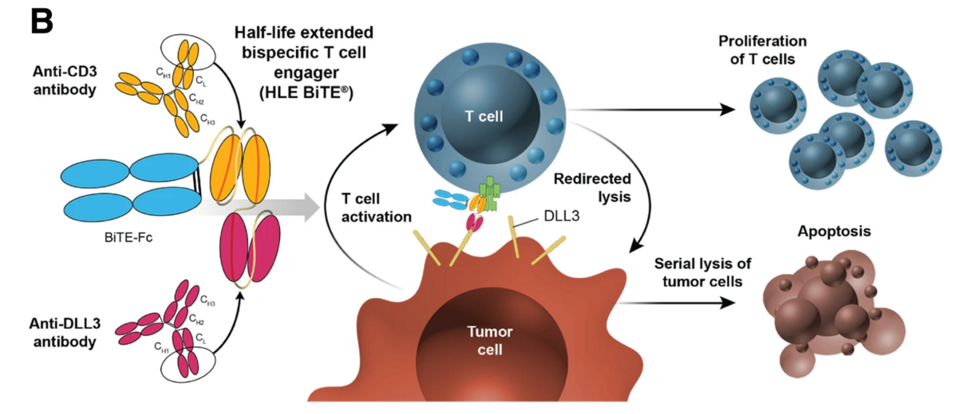
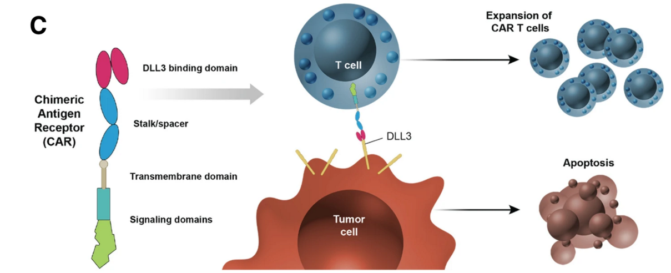
Targeting DLL3 expression to improve the immune response in SCLC
Tarlatamab is a bispecific T cell engager (BiTE) combining the binding specificities for DLL3 and CD3 genetically fused to the IgG Fc region
Designed to induce T cell proliferation and tumor cell lysis
Adoptive cellular therapy using modified T cells to express a CAR targeting DLL3
Owen DH, et al. J Hematol Oncol 2019

Slide 43
Baseline Characteristics
 | Part 1 + 2 Tarlatamab 10 mg (n = 100) | Part 1 Tarlatamab 100 mg (n = 88) | Part 3 Tarlatamab 10 mg (n = 34)
Median age, years (range) | 64 (35–82) | 62 (34–80) | 66 (49–80)
Male, % | 72 | 70 | 71
Asian / Black or African American / White,* % | 41 / 0 / 58 | 41 / 0 / 58 | 6 / 3 / 91
Ever smoker / non-smoker, % | 92 / 8 | 94 / 6 | 97 / 3
ECOG performance status: 0 / 1, % | 26 / 74 | 27 / 73 | 29 / 71
Prior lines of therapy, median (range) | 2 (1–6) | 2 (1–8) | 2 (2–6)
2 prior lines of therapy, % | 65 | 55 | 65
≥ 3 prior lines of therapy, % | 33 | 43 | 35
Prior anti-PD-(L)1 treatment, % | 73 | 70 | 82
< 90 days to progression after first-line platinum therapy,† % | 28 | 20 | 21
Brain / liver metastases, % | 23 / 39 | 36 / 34 | 12 / 35
DLL3 expression (> 0%), n/N evaluable (%) | 80/83 (96) | 71/74 (96) | N/A‡
Data cutoff, June 27, 2023. Median follow-up was 10.6 months for tarlatamab 10 mg and 10.3 months for tarlatamab 100 mg.
*No patients of American Indian, Alaska Native, Native Hawaiian, or other Pacific Islander race were enrolled.
†Platinum sensitivity was calculated as end of first-line platinum therapy to date of first progression.
‡DLL3 sample analysis from Part 3 in progress.
DLL3, delta-like ligand 3; ECOG, Eastern Cooperative Oncology Group; N/A, not available; PD-(L)1, programmed death 1 / ligand 1.
Ahn M-J et al. N Engl J Med 2023;389:2063-2075.

Slide 44
Tarlatamab Anti-Tumor Activity
Outcome | Tarlatamab 10 mg (n = 100) | Tarlatamab 100 mg (n = 88)
Objective response rate, n (%) (97.5% CI) | 40 (40.0) (29.1, 51.7) | 28 (31.8) (21.1, 44.1)
Complete response | 1 (1) | 7 (8)
Partial response | 39 (39) | 21 (24)
Stable disease | 30 (30) | 27 (31)
Progressive disease | 20 (20) | 13 (15)
Not evaluable / no post-baseline scan* | 10 (10) | 20 (23)
Observed duration of response ≥ 6 months, n/N (%) | 23/40 (58) | 17/28 (61)
Disease control rate, n (%) (95% CI) | 70 (70.0) (60.0, 78.8) | 55 (62.5) (51.5, 72.6)
FDA grants accelerated approval to tarlatamab-dlle for extensive stage small cell lung cancer on May 16, 2024
Tarlatamab 10 mg demonstrated anti-tumor activity in heavily pre-treated SCLC with an objective response rate of 40%
Data cutoff, June 27, 2023. Median follow-up was 10.6 months for tarlatamab 10 mg and 10.3 months for tarlatamab 100 mg. The efficacy analysis set consists of patients in Parts 1 and 2 (N = 188). Part 3 did not have adequate follow-up for response analysis. *Not evaluable and no post-baseline scan were considered non-responders for response analysis. SCLC, small cell lung cancer.
Ahn M-J et al. N Engl J Med 2023;389:2063-2075.

Slide 45
Tarlatamab: Adverse Events
Cytokine-release syndrome (CRS) is a systemic inflammatory syndrome with sudden release of cytokines presenting as fever +/- hypotension or hypoxia
Grade 1/2 CRS seen in 56% patients, Grade 3 CRS seen in 3%
Immune effector cell-associated neurotoxicity syndrome (ICANS) characterized by confusion, cognitive deficit, weakness
Grade 1/2 seen in 12% patients, no Grade 3 ICANS seen
Other side effects include dysgeusia, decreased appetite, nausea, neutropenia
CRS mostly managed with acetaminophen, IV hydration, steroids
Other interventions at 10 mg dose:
Tocilizumab used in 5% patients (7/133)
Supplemental Oxygen in 8% pts (11/133)
Vasopressor support in 1% pts (1/133)
ICANS managed with steroids, neuro consult
Most centers admit patients after C1D1, D8 treatment for 22-24 hrs
Need to be within one hour of hospital for subsequent doses
Need reliable patients and caregivers
Ahn M-J et al. N Engl J Med 2023;389:2063-2075.

Slide 46
Cycle 1 Safety Profile
Looking Forward:
6-8h Outpatient vs 48h Inpatient Monitoring
Hospitalizations due to AEs
97
100
100
93
55
50
47
40
33
30
33
28
28
17
20
20
10
The most common TRAEs (≥ 20% either group) within 24 hours post tarlatamab administration on cycle 1 day 1 or cycle 1 day 8 were CRS, nausea, and asthenia.
Chiang et al, ESMO-IO poster 2024
Chiang et al, ESMO Open April 2025, 104538

Slide 47
A Changing Landscape for Relapsed SCLC
Platinum Rechallenge
Lurbinectedin
Topotecan/ Irinotecan
Taxane
Temozolomide
Tarlatamab
Lurbinectedin
?ADCs
Platinum
Rechallenge
Topo/Irino
2L
2L
Other: e.g. tri-specifics, CAR-T,
Radiopharmaceuticals
2023: pre Tarlatamab approval
2024: post Tarlatamab approval

Slide 49
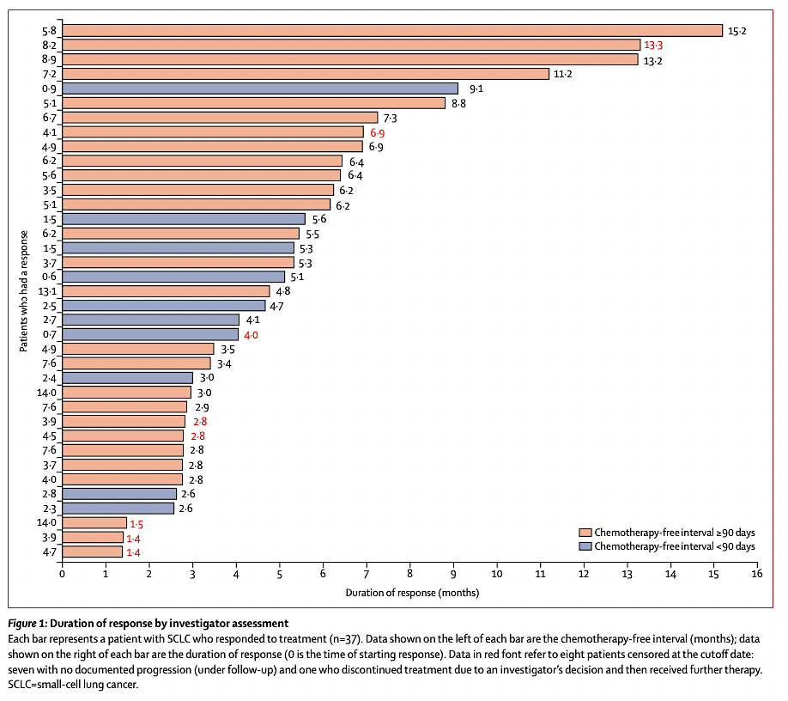
Lurbinectedin
Selective inhibitor of transcription & TME
Phase 2 single-arm basket trial
105 pts with relapsed SCLC (2 or 3L)
3.2 mg/m² dose IV q3weeks
1̊ endpoint: Overall response rate = 35.2%
Platinum-response: 45.0% (S) vs 22.2% (R)
Confirmatory Phase 3 in SCLC (ongoing)
Accelerated FDA approval (June 2020)
Trigo et al, Lancet Oncol 21:645; Subbiah et al, Lung Cancer 150:90, 2020

Slide 50
Balancing Patient Factors for Treatment
Tarlatamab
Lurbinectedin
Shorter platinum-free interval (e.g. chemoresistant disease)
More robust patients with better performance status
Reliable patient and caregiver
Live within 1 hour from hospital
Longer platinum-free interval
Older, more frail patients
Patients who live alone or far away (>1h) from hospital
Need central line

Slide 51
Clinical Cases
68 yo female h/o COPD, GERD, Graves disease, SIADH, PE on anticoagulation, ECOG 1
Diagnosed with LS-SCLC s/p definitive chemoradiation completed in 2/24
Recurrence 6 months later with metastases to brain, liver, bones, treated with gamma knife radiation followed by carbo/etoposide/durvalumab with response, then maintenance durva
Progression of disease and started tarlatamab 2/25
C1D1, D8, doses tolerated well with no CRS, ICANS during hospital observation stay
C1D15 tolerated well in outpatient clinic
79 yo female h/o HTN, DM, COPD on 2L Oxygen for exertion, GERD, PE on anticoagulation, ECOG 1, lives with daughter
Diagnosed with ES-SCLC treated with carbo/etop/atezolizumab with response after 4 cycles, but progression after 5 cycles of maintenance Atezo
Treated with lurbinectedin x 2 cycles with progression
Started tarlatamab in 2/25 with G3 CRS with fever and hypoxemic respiratory failure after C1D1, treated with acetaminophen, Oxygen, steroids
C1D8 tolerated well with G1 CRS (chills, tachypnea), G1 ICANS (ICE score 8/10) treated with steroids with resolution
C1D15 tolerated well in outpatient clinic

Slide 52
SCLC: Key Points
Tarlatamab is an exciting new option to target the SCLC “immune desert”
Side effects such as CRS and ICANS can be managed, primarily with hospital observation stay after C1D1 and D8
Lurbinectedin is a useful tool for relapsed SCLC patients
Stay tuned for other agents including antibody-drug conjugates

Slide 53
Roundtable Discussion

Slide 54
Agenda
Introduction: Overview of Bispecific Antibodies
Module 1: Biology of Small-Cell Lung Cancer (SCLC) and Review of Its Initial Management
Case Presentation: Ms Krueger – 63-year-old man
Module 2: Current Role of Tarlatamab in Therapy for SCLC
Case Presentation: Ms Sandy – 70-year-old woman
Module 3: Future Directions in the Management of SCLC
Case Presentation: Ms Krueger – 81-year-old man
Module 4: Unique Considerations in SCLC Management
Case Presentation: Ms Sandy – 67-year-old woman

Slide 55
Small-Cell Lung Cancer Case Presentation
Beth Sandy, MSN, CRNP, FAPO

Slide 56
Case Presentation: 70-year-old woman
70 y/o female, who is deaf, presented with chest pain and SOB in 1/2023 with 3.5cm R lung mass and 6cm hilar and mediastinal lymph nodes.
Bronchoscopy of nodes + SCLC
3/28/2023-6/2023 treated with etoposide/carboplatin X 4 cycles and XRT to chest overlapped C3 and C4
11/2023 progressive disease in the chest and now 8cm mass in the pelvis
11/2023 etoposide/carboplatin/atezolizumab X 4 cycles, followed by maintenance Atezolizumab

Slide 57
Case Presentation: 70-year-old woman (continued)
8/2024: disease progression and started on lurbinectedin
10/2024: developed brain mets, treated with WBXRT
10/2024: radiation to pelvic metastasis
11/2024: progression of disease on lurbinectedin
1/2025: started on Tarlatamab

Slide 58
Case Presentation: 70-year-old woman (continued)
Comes with her son. She lives alone.
They come from Delaware to Philadelphia. Has not been an issue for patient and family
They are dedicated to their mom, they want the best treatment
Need to have sign language interpreter available at visits
This was not always arranged, made things difficult
She has learned to trust me as her NP, reads my lips well
Refuses to see another NP…. She changes her schedule if I go on vacation.

Slide 59
Case Presentation: 70-year-old woman (continued)
Admitted for monitoring of C1, had developed R arm pain. After infusion, sent her for xray of the R humerus which detected a new metastasis
While admitted for CRS monitoring, in the AM, she got out of bed and fell while walking to the bathroom and fractured her R humerus
Extended hospital stay, required surgery for rod placement. Had also had some mild, grade 1 CRS which delayed the surgery
She was discharged 2 weeks after 1st dose of Tarlatamab

Slide 60
Case Presentation: 70-year-old woman (continued)
Patient concerns:
#1: because discharged and complications, had to resume 1mg dose again in the step up
Last Dose Given | Time since dose | Action
1mg on Day 1 | More than 2 weeks | Must restart step-up
10mg on D8 | More than 3 weeks | Must go back to 1mg
10mg on D15 or more | More than 4 weeks | Must go back to 1mg
Patient concerns:
#2: Because the patient is deaf will I have a hard time assessing for ICANS?
Because the patient has had WBXRT, will I have a hard time assessing for ICANS?
Package Insert Tarlatamab 3/2025.

Slide 61
Roundtable Discussion

Slide 62
Agenda
Introduction: Overview of Bispecific Antibodies
Module 1: Biology of Small-Cell Lung Cancer (SCLC) and Review of Its Initial Management
Case Presentation: Ms Krueger – 63-year-old man
Module 2: Current Role of Tarlatamab in Therapy for SCLC
Case Presentation: Ms Sandy – 70-year-old woman
Module 3: Future Directions in the Management of SCLC
Case Presentation: Ms Krueger – 81-year-old man
Module 4: Unique Considerations in SCLC Management
Case Presentation: Ms Sandy – 67-year-old woman

Slide 63
Future Directions in SCLC Management Erin Schenk, MD, PhD Assistant Professor, Thoracic Oncology Division of Medical Oncology Department of Medicine University of Colorado Anschutz Medical Campus

Slide 64
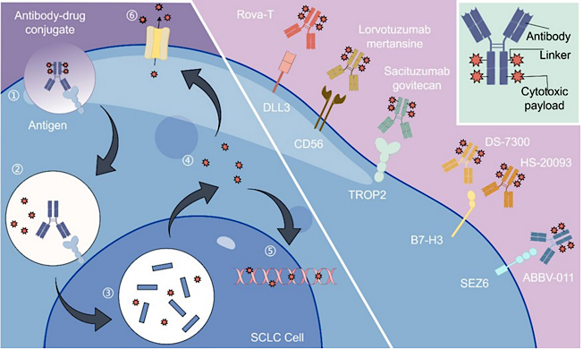
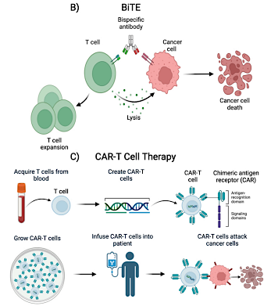
New and Emerging Targets for SCLC
Antibody-Drug Conjugates
Novel Immune-Based Therapies
Meng Y et al. Disc Onc 2024;15:327; Bragasin EI et al. Explor Target Antitumor Ther 2025;6:1002302.

Slide 65
DeLLphi-304
Paz-Ares LG et al. ASCO 2023;Abstract TPS8611.
Courtesy of Melissa Johnson, MD

Slide 66
DeLLphi-305
A Phase 3, open-label, multicenter, randomized study of tarlatamab in combination with durvalumab vs durvalumab alone in subjects with ES-SCLC following platinum, etoposide and durvalumab
Tarlatamab + durvalumab
Participants will receive tarlatamab once every 2 weeks (q2wk) and durvalumab once every 4 weeks (q4wk)
Patients who completed 3-4 cycles of platinum-etoposide chemotherapy with concurrent durvalumab as first-line treatment of ES-SCLC prior to enrollment, without disease progression
R
1:1
Durvalumab
Participants will receive durvalumab q4wk alone
Primary endpoint: OS
Key secondary endpoints: PFS, ORR, DCR, DoR
www.clinicaltrials.gov. NCT06211036. Accessed July 2024.
Courtesy of Melissa Johnson, MD

Slide 67
DeLLphi-306
A Phase 3, randomized, double-blind, placebo-controlled, multicenter study of tarlatamab therapy in subjects with limited-stage small cell lung cancer (LS-SCLC) who have not progressed following concurrent chemoradiation therapy
Hummel H et al. European Lung Cancer Congress 2024;Abstract 214TiP. https://www.britannica.com/animal/African-bush-elephant, Chen Y et al. NEJM 2024;391:1313-27.
Courtesy of Melissa Johnson, MD

Slide 68
DeLLphi-306
A Phase 3, randomized, double-blind, placebo-controlled, multicenter study of tarlatamab therapy in subjects with limited-stage small cell lung cancer (LS-SCLC) who have not progressed following concurrent chemoradiation therapy
Hummel H et al. European Lung Cancer Congress 2024;Abstract 214TiP. https://www.britannica.com/animal/African-bush-elephant, Chen Y et al. NEJM 2024;391:1313-27.
Courtesy of Melissa Johnson, MD

Slide 69
DLL3-CD3 T-Cell Engagers in Development
Rudin CM et al. J Hema and Onc;16, 66 (2023)

Slide 70
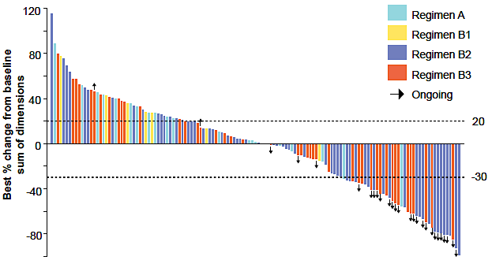
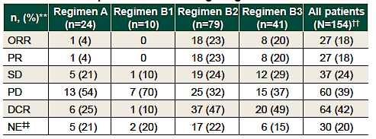
Updated Analysis of Overall Efficacy of Obrixtamig (BI 764532)
Wermke M et al. ESMO 2024;Abstract 670P.

Slide 71
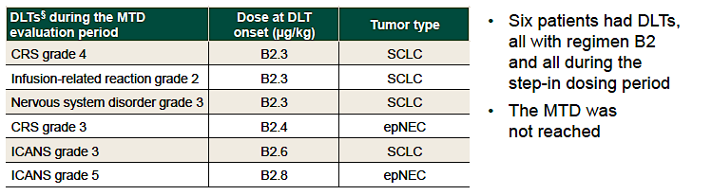
Updated Analysis of Efficacy of Obrixtamig: Dose-Limiting Toxicities and Maximum Tolerated Dose
Ongoing Clinical Development
DAREON-5 – Phase 2 SCLC, NEC 3rd line+
DAREON-8 – Phase 1 ES-SCLC 1st line + chemo IO
DAREON-9 – Phase 1 Refractory SCLC + topotecan
Wermke M et al. ESMO 2024;Abstract 670P.

Slide 72
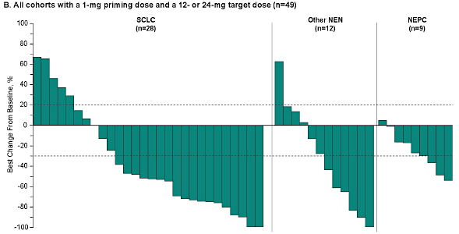
Phase I/II Trial of MK-6070 (HPN328): Response
Beltran H et al. ASCO 2024;Abstract 8090.

Slide 73
Ifinatamab Deruxtecan (I-DXd) B7-H3 Targeting ADC
Courtesy of Charles Rudin, MD, PhD, MSKCC

Slide 74
Ifinatamab Deruxtecan (I-DXd) Activity in SCLC 2L+
Rudin CM et al. WCLC 2024;Abstract OA04.03.

Slide 75
The Future for SCLC Is Already Here

Slide 76
Breakthrough Treatment Barriers to Overcome
For several DLL3 T-cell engager therapies, treatment initiation requires hospitalization due to CRS AEs
Ongoing efforts to reduce duration of hospitalization and implement outpatient monitoring strategies
Dosing frequency
Q1week / Q2week → Q3week
Long-term AEs
Dysguesia can impact QoL

Slide 77
Barriers to Clinical Trial Participation
Efficacy vs Patient Burden
Hospitalization requirement
Dosing frequency
MK-6070 Q2week + I-DXd Q3week
Potential for increased AEs with dual agents
Travel / Lodging / Parking at a tertiary referral center

Slide 78
Roundtable Discussion

Slide 79
Agenda
Introduction: Overview of Bispecific Antibodies
Module 1: Biology of Small-Cell Lung Cancer (SCLC) and Review of Its Initial Management
Case Presentation: Ms Krueger – 63-year-old man
Module 2: Current Role of Tarlatamab in Therapy for SCLC
Case Presentation: Ms Sandy – 70-year-old woman
Module 3: Future Directions in the Management of SCLC
Case Presentation: Ms Krueger – 81-year-old man
Module 4: Unique Considerations in SCLC Management
Case Presentation: Ms Sandy – 67-year-old woman

Slide 80
Small-Cell Lung Cancer Case Presentation
Elizabeth Krueger, NP
Nurse Practitioner Massachusetts General Hospital Center
for Thoracic Cancers
Boston, Massachusetts

Slide 81
Case Presentation: 81-year-old man
81 yo, male former smoker with a history of prostate cancer s/p prostatectomy, type 2 DM, HTN, and hyperlipidemia. He presented to a local hospital in January 2024 after a mechanical fall in the context of a 20 lb unintentional weight loss and cough. LFT elevations noted on admission (AST 84, ALT 35).
Diagnostics:
CT C/A/P – LLL lung mass w/ adjacent satellite subpleural nodules; left lower perihilar masslike opacity; diffuse subpleural disease; numerous bilobar hepatic lesions
IR-guided liver biopsy – small cell carcinoma (IHC positive for synaptophysin, chromogranin and TTF1; Ki67+)
Treatment:
2/2024 C1D1 Carboplatin/Etoposide/Atezolizumab x 4 cycles
5/10/2024 CT C/A/P after 4 cycles demonstrates disease progression in chest and liver
5/25/2024 Starts second-line lurbinectedin
6/29/24: CT C/A/P - worsening hepatic disease, MRI brain with new punctate lesions
7/20/24 C1D1 tarlatamab

Slide 82
Case Presentation: 81-year-old man (continued)
C1D1 tarlatamab 1 mg step up dosing
- Administered in outpatient clinic with plan for direct admission for 22-24H of CRS/ICANS monitoring.
- Labs notable for AST 159, ALT 141 due to extensive hepatic disease
- Complicated by grade 2 CRS treated with dexamethasone and tocilizumab
Fever 104.3 occurred around the 13H mark after drug administration
Symptomatic management with acetaminophen, ibuprofen and meperidine for rigors.
Asymptomatic HoTN SBP 70s, IVF x2L did not require pressure support
0.5-2L new oxygen requirement
Tocilizumab 8mg/kg infused over 1 hour in a single dose (not to exceed 800mg)
Tocilizumab is preferred first rescue medication with CRS
Dexamethasone is preferred rescue medication with ICANS but can also be used with CRS
Symptoms resolved and he was monitored for an additional 12H prior to discharge
Strict return/call criteria reviewed- fever >100.4, low blood pressure, significant fatigue, breathing issues, restlessness, confusion, feeling anxious, dizziness, HA, tremor/seizure, trouble speaking, memory problems.

Slide 83
Recommended management for CRS
Gradeª | Presenting symptoms | Actions
Grade 1 | Symptoms require symptomatic treatment only (e.g., fever ≥ 100.4°F without hypotension or hypoxia). | Withhold TCE until CRS resolves. Administer symptomatic treatment. Administer pretreatment medications prior to next dose of TCE.
Grade 2 | Temperature ≥100.4 °F (38 °C) with either: • Hypotension responsive to fluid and not requiring vasopressors, and/or • Oxygen requirement of low-flow nasal cannula^{d} or blow-by | Withhold TCE until CRS resolves. Administer symptomatic treatment. Consider dexamethasone 8 mg IV (or equivalent) and/or tocilizumab. Monitor patients for 22-24 hour hospitalization following next dose of TCE. Instruct patients to remain within proximity of a healthcare facility for an additional 24 hours after discharge.
Grade 3 (1st occurrence) | Temperature ≥100.4 °F (38 °C) with either: • Hypotension requiring one vasopressor with or without vasopressin, and/or • Oxygen requirement of high-flow nasal cannula^{c}, facemask, non-rebreather mask, or Venturi mask | Withhold TCE until CRS resolves. Administer dexamethasone 8 mg IV (or equivalent) every 8 hours for up to 3 doses. Recommend tocilizumab 8 mg/kg (dose capped at 800 mg). Provide supportive therapy, which may include intensive care. Monitor patients for 22-24 hour hospitalization following next dose of TCE. Instruct patients to remain within proximity of a healthcare facility for an additional 24 hours after discharge. Administer pretreatment dexamethasone prior to next dose of TCE.
Grade 3 (recurrent) | Temperature ≥100.4 °F (38 °C) with either: • Hypotension requiring one vasopressor with or without vasopressin, and/or • Oxygen requirement of high-flow nasal cannula^{c}, facemask, non-rebreather mask, or Venturi mask | Permanently discontinue therapy with TCE. Provide supportive therapy, which may include intensive care, as above.
Grade 4 | Temperature ≥100.4 °F (38 °C) with either: • Hypotension requiring multiple vasopressors (excluding vasopressin), and/or • Oxygen requirement of positive pressure (e.g., continuous positive airway pressure [CPAP], bilevel positive airway pressure [BiPAP], intubation, and mechanical ventilation) | Permanently discontinue therapy with TCE. Provide supportive therapy, which may include intensive care, as per grade 3.

Slide 84
What is Tocilizumab?
Monoclonal antibody that blocks the inflammatory protein IL-6
Treats CRS without affecting anti-tumor activity
8mg/kg for one dose infused over 1 hour, dose not to exceed 800mg

Slide 85
Case Presentation: 81-year-old man (continued)
C1D8 tarlatamab 10mg step up dosing
No changes to treatment plan.
Continued pain at tumor sites during observation period.
Tolerated D8 without incident and was discharged within 22 hours.
C1D15 tarlatamab 10mg transitioned to outpatient observation.
New grade 1 thrombocytopenia, likely due to treatment effect or marrow involvement.
Was able to treat through this and remained stable.
Imaging
SCANS after 2 cycles demonstrate response in the CNS (new punctate lesions are no longer observed) and hepatic disease has responded.
Over the course of 6 months dominant liver lesion in segment 7 went from 54mm->25mm, segment 8 lesion 36mm->19mm.

Slide 86
Case Presentation: 81-year-old man (continued)
Physical
Management of co-morbid conditions- DM2 on multiple agents, weight loss and hypoglycemia
Psychological/Social
Code status: ES-SCLC; was considering DNR/I though given potential for severe CRS/ICANS, he elected to stay FULL CODE
Health care proxy- changed frequently due to strained interpersonal relationships
Primary caretaker for his 17 yo great granddaughter with high functioning ASD. No formal guardianship plan in place after he passes
Arranged for home based palliative care
Operational
How can we improve home monitoring? Blood pressure cuff, sat probe, home thermometer
Delinked visits so he can be home for school drop off/pick up
Discharge with a x1 dose of dexamethasone in hand?

Slide 87
Roundtable Discussion

Slide 88
Agenda
Introduction: Overview of Bispecific Antibodies
Module 1: Biology of Small-Cell Lung Cancer (SCLC) and Review of Its Initial Management
Case Presentation: Ms Krueger – 63-year-old man
Module 2: Current Role of Tarlatamab in Therapy for SCLC
Case Presentation: Ms Sandy – 70-year-old woman
Module 3: Future Directions in the Management of SCLC
Case Presentation: Ms Krueger – 81-year-old man
Module 4: Unique Considerations in SCLC Management
Case Presentation: Ms Sandy – 67-year-old woman

Slide 89
Unique Considerations in SCLC Management Erin Schenk, MD, PhD Assistant Professor, Thoracic Oncology Division of Medical Oncology Department of Medicine University of Colorado Anschutz Medical Campus

Slide 90
Overview of Small Cell Lung Cancer
Cell of origin
Neuroendocrine
Initial presentation
Smoking history/comorbidities
Hilar and mediastinal nodes/symptomatic
Brain metastases, high growth rate
Superior vena cava (SVC) syndrome
Clinical issues
Paraneoplastic syndromes (SIADH, neurologic)
SVC syndrome
Brain metastases

Slide 91
Paraneoplastic Syndromes
Inappropriate production of hormones/bioactive substances or expression of shared antigens that generate an autoimmune response (T or B cell mediated)
Neuroendocrine cells/SCLC has a predisposition to secrete substances and express shared antigens
Soomro Z et al. J Thorac Disease 2020;12(10):6253-63.

Slide 92
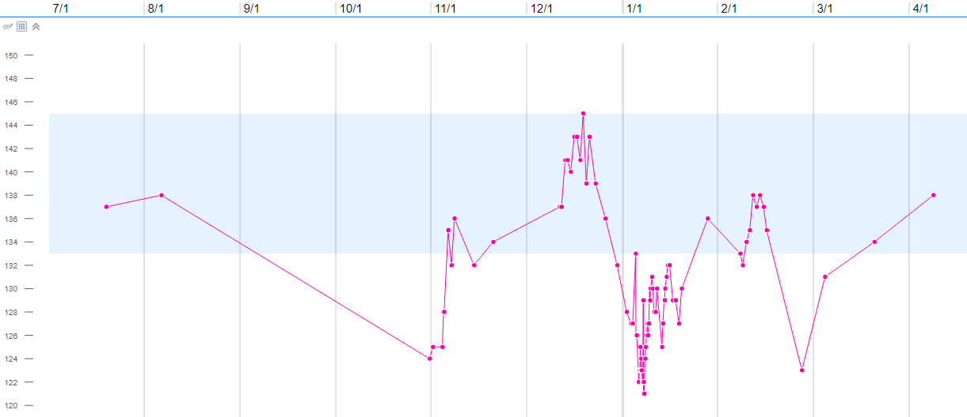
Patient Case – A Rapid Response
65F slow recovery from COVID
Cough and dyspnea
~2-3 months nausea, vomiting
Imaging showed LUL mass with mediastinal adenopathy and pleural metastases
Diagnosis: Extensive-stage (ES) SCLC
Therapy start: no more nausea
Sodium
Therapy Start
Therapy Restart
Diagnosis
Na 124
Urine osm > 600
Treatment
Interruption
Image courtesy of Erin Schenk, MD, PhD, University of Colorado

Slide 93
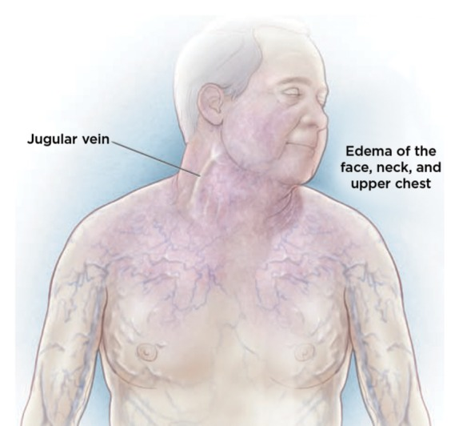
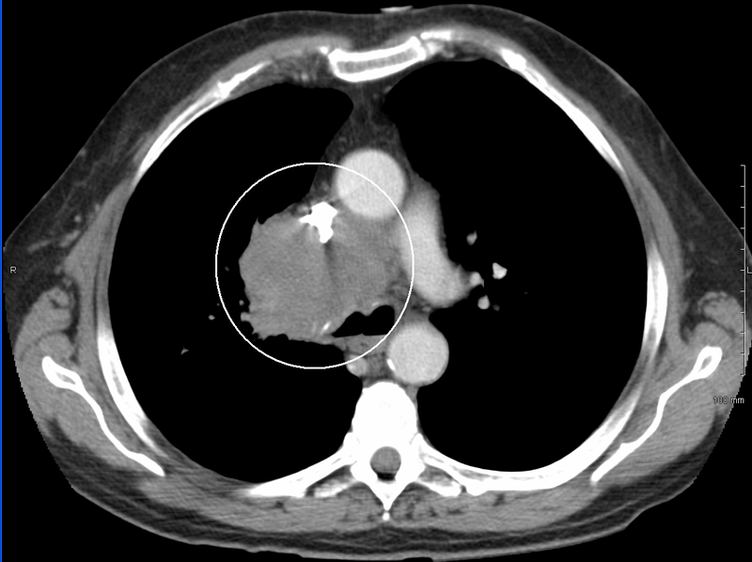
Superior Vena Cava Syndrome
NSCLC (50%), SCLC (22%) and lymphoma (12%) are the most common malignant etiologies
Clinical presentation
Patient may report feeling fullness in the head, facial edema, and dyspnea
Physical exam:
Venous distension in neck or chest wall, facial and UE edema
Management/treatment
Manage underlying disease
Radiation, chemotherapy, corticosteroids, procedures
Chow R et al. Ann Palliat Med 2024;13(3):620-26, J Adv Prac in Onc, 01 September 2018, 9(6):677-9; https://commons.wikimedia.org/wiki/File:SVCCT.PNG

Slide 94
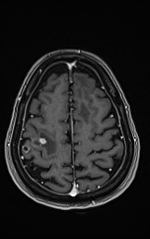
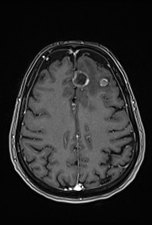
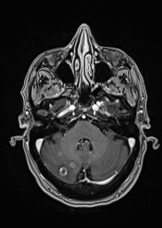
Patient Case – Heartbreak, Delayed
Feb 2023: 60F LUL nodule on CT lung cancer screening
PET LUL + bone metastases – ES SCLC
MRI brain negative
1st line carbo/etop/atezo (April 2023)
Oct 2023: LUL lesion recurrence
Starts DLL3/CD3 T-cell engager trial
Oct 2024: LUL progression. Undergoes resection
Follow-up surveillance – NED
Mar 2025: ED for left sided weakness and confusion
Mar 2025: SRS to 9 lesions
Images courtesy of Erin Schenk, MD, PhD, University of Colorado

Slide 95
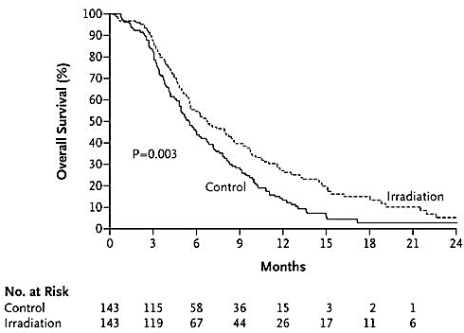
Brain Metastases and SCLC
>10% of patients have BM at initial diagnosis
>50% will develop BM within 2 years
Clinical presentation
Risk factors for BM in SCLC not clear, but BM incidence appears to be higher in younger patients
SCLC more likely associated with multiple BM as opposed to single BM
Parenchymal and leptomeningeal metastases
Management/treatment
Radiation therapy (prophylactic cranial irradiation vs hippocampal avoidance)
Systemic therapy
Potential for neurotoxicity
Lukas RV et al. Oncotarget 2017;8(41):71223-33; Zeng H et al. Front Oncol 2022;12:889161; UpToDate 2025.

Slide 96
Brain Metastases and SCLC
>10% of patients have BM at initial diagnosis
>50% will develop BM within 2 years
Clinical presentation
Risk factors for BM in SCLC not clear, but BM incidence appears to be higher in younger patients
SCLC more likely associated with multiple BM as opposed to single BM
Parenchymal and leptomeningeal metastases
Lukas RV et al. Oncotarget 2017;8(41):71223-33; Zeng H et al. Front Oncol 2022;12:889161; UpToDate 2025.

Slide 97
Brain Metastases and SCLC
>10% of patients have BM at initial diagnosis
>50% will develop BM within 2 years
Clinical presentation
Risk factors for BM in SCLC not clear, but BM incidence appears to be higher in younger patients
SCLC more likely associated with multiple BM as opposed to single BM
Parenchymal and leptomeningeal metastases
Management/treatment
PCI in ES-SCLC
No confirmation of absence of brain metastases
Lukas RV et al. Oncotarget 2017;8(41):71223-33; Zeng H et al. Front Oncol 2022;12:889161; UpToDate 2025. Slotman B et al. NEJM 2007;357:664-72.

Slide 98
Brain Metastases and SCLC
>10% of patients have BM at initial diagnosis
>50% will develop BM within 2 years
Clinical presentation
Risk factors for BM in SCLC not clear, but BM incidence appears to be higher in younger patients
SCLC more likely associated with multiple BM as opposed to single BM
Parenchymal and leptomeningeal metastases
Management/treatment
MAVERICK (SWOG-1827) PCI vs MRI surveillance
No systemic therapy with clear CNS disease control benefit
Radiation approaches
WBRT +/- hippocampal sparing
Practice shifting toward SRS when possible
Lukas RV et al. Oncotarget 2017;8(41):71223-33; Zeng H et al. Front Oncol 2022;12:889161; UpToDate 2025. Slotman B et al. NEJM 2007;357:664-72.

Slide 99
Roundtable Discussion

Slide 100
Agenda
Introduction: Overview of Bispecific Antibodies
Module 1: Biology of Small-Cell Lung Cancer (SCLC) and Review of Its Initial Management
Case Presentation: Ms Krueger – 63-year-old man
Module 2: Current Role of Tarlatamab in Therapy for SCLC
Case Presentation: Ms Sandy – 70-year-old woman
Module 3: Future Directions in the Management of SCLC
Case Presentation: Ms Krueger – 81-year-old man
Module 4: Unique Considerations in SCLC Management
Case Presentation: Ms Sandy – 67-year-old woman

Slide 101
Small-Cell Lung Cancer Case Presentation
Beth Sandy, MSN, CRNP, FAPO

Slide 102
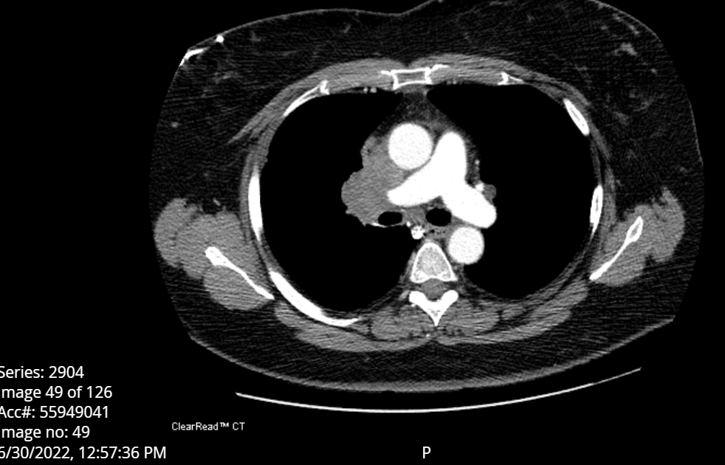
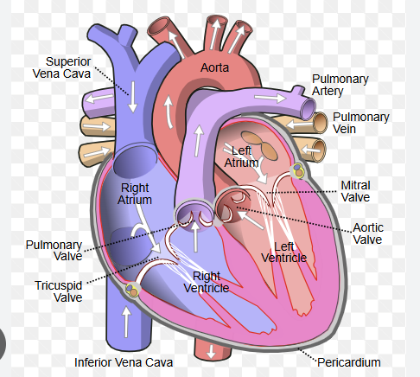
Case Presentation: 67-year-old woman
67 y/o female diagnosed with extensive stage SCLC in 6/2022
Presentation: Facial swelling (and cough that was not out of the ordinary necessarily)
Bronch + SCLC
Found to have SVC syndrome: palliative XRT X 3 fractions
Found to have brain mets at diagnosis as well and had SRS (cyberknife) to 3 lesions

Slide 103
Case presentation: 67-year-old woman (continued)
9/2022: Carboplatin/Etoposide/Atezolizumab followed by Atezolizumab maintenance until 6/2023
6/2023: progressive disease in the R hilum, as well as one new brain met 4mm R occipital lobe
6/2023: started lurbinectedin chemotherapy
10/2023 imaging shows response to lurbinectedin and resolution of brain met (no radiation)
2/2024: progression, 4 more cycles of etoposide/carboplatin/durvalumab
8/2024: progressive brain mets, WBXRT
10/2024: progression in the chest and new liver met
12/2024: Started Tarlatamab

Slide 104
Case presentation: 67-year-old woman (continued)
We reviewed CRS and ICANS
CRS: overview, reassured most commonly occurs in first 2 doses and will be inpatient
ICANS:
I didn’t voice this out loud, however, as a provider I had concerns on ability to evaluate this
Patient had SRS to brain followed by WBXRT
At baseline, her cognition was off….

Slide 105
Case presentation: 67-year-old woman (continued)
12/10/2024: treatment #1 tolerated well, no real s/e
12/17/2024: treatment #2, developed CRS while admitted for overnight monitoring
Fever, complicated by hypotension
Developed lethargy
Though admitted, was worrisome to patient’s daughter who was with her
Was treated with acetaminophen, dexamethasone, IV fluids
Quickly improved in 24-48 hours and was discharged after 48 hours
12/24/2024: treatment #3 tolerated well

Slide 106
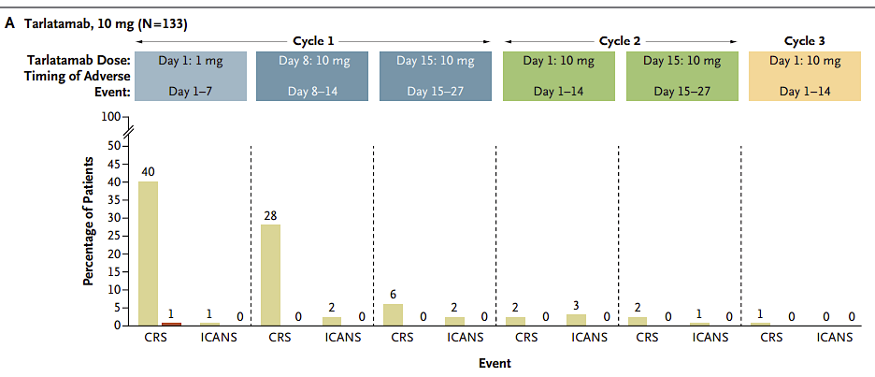
CRS with Tarlatamab
Step up dosing due to CRS
1mg on D1 and 10mg D8 and on
Majority happens in treatment #1 and treatment #2
Occurred in 51% of patients
Majority was grade 1 or 2
Grade 1= Fever only
Grade 2= Fever + a complicating factor:
- hypotension*, hypoxia*, tachycardia, lethargy, nausea/vomiting
*Hypotension responsive to fluids, not requiring vasopressors
*Hypoxia requiring low-flow nasal cannula
Ahn M-J, et al. N Engl J Med 2023;389:2063-75

