Slide 1

Year in Review: Biology Underlying the Utility of Menin Inhibitors in Acute Leukemias: Use of These Agents as Monotherapy
Eunice S. Wang MD
Roswell Park Comprehensive Cancer Center
March 2026

Slide 2
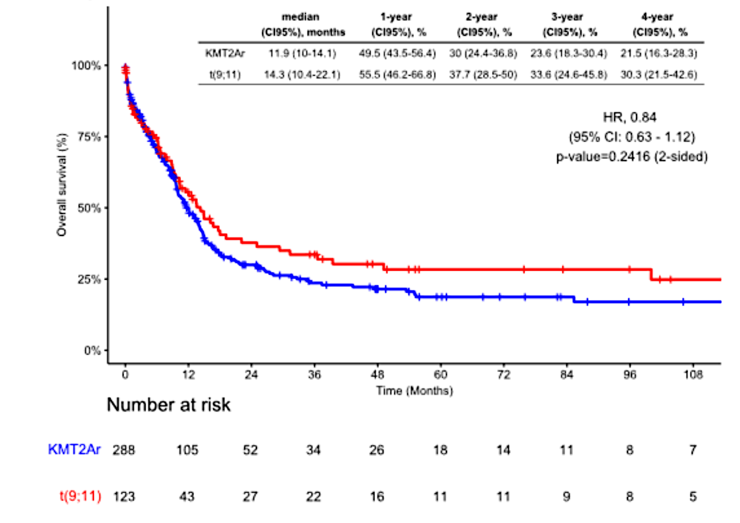
Navarro-Vicente I et al. REAL WORLD OUTCOMES IN A SERIES OF 417 ADULT PATIENTS WITH KMT2A (MLL) GENE REARRANGED ACUTE MYELOID LEUKEMIA. EHA 2025;Abstract S147.
Overall survival
Adult patients reported to the multinational PETHEMA-GPLA-ACHO-GRELAM (Spain, Portugal, Colombia, Chile) epidemiologic registry and diagnosed with KMT2A-rearranged AML from 1996 to 2024.
Median overall survival (OS) was 12.1 months (CI95, 10.4-14.3).
OS following intensive chemotherapy was longer in t(9:11) vs other rearrangements [median OS 17.7 months (CI95, 13.6-100) vs 14.7 (CI95, 12.3-18.1), p=0.12].
t(9;11)
KMT2Ar

Slide 3
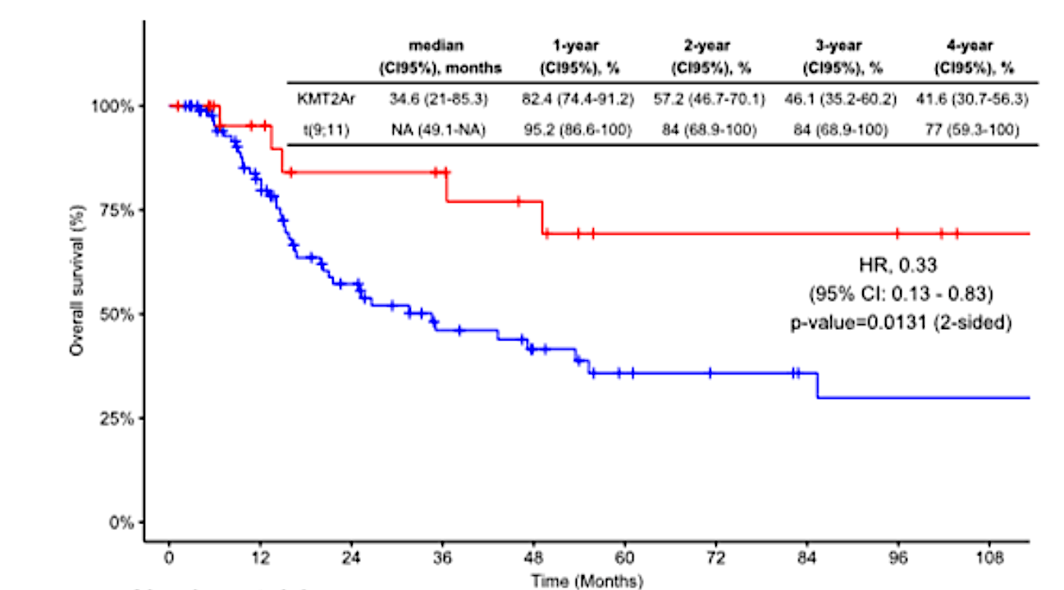
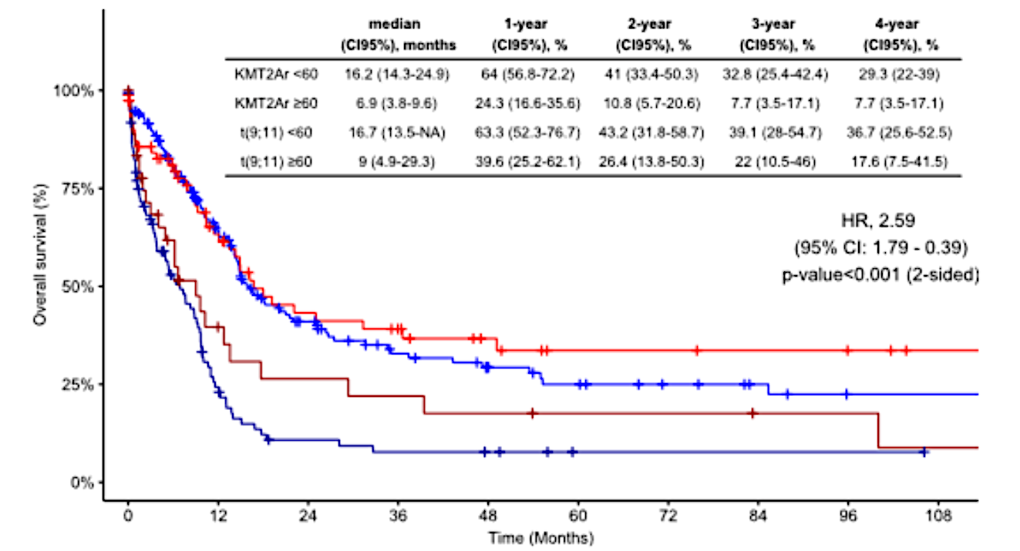
Navarro-Vicente I et al. REAL WORLD OUTCOMES IN A SERIES OF 417 ADULT PATIENTS WITH KMT2A (MLL) GENE REARRANGED ACUTE MYELOID LEUKEMIA. EHA 2025;Abstract S147.
t(9;11)
KMT2Ar
t(9;11) (<60)
KMT2Ar (<60)
t(9;11) (≥60) KMT2Ar (≥60)
Among pts receiving allo-SCT, t(9;11) had a higher OS [median OS NR months (CI95, 49.1-NR) vs 34.6 (CI95, 21-85.3), p=0.01].
In univariate analyses, patients < 60 yo and with t(9;11) had better OS compared with pts >60 years,
regardless of rearrangement, p<0.001.

Slide 4
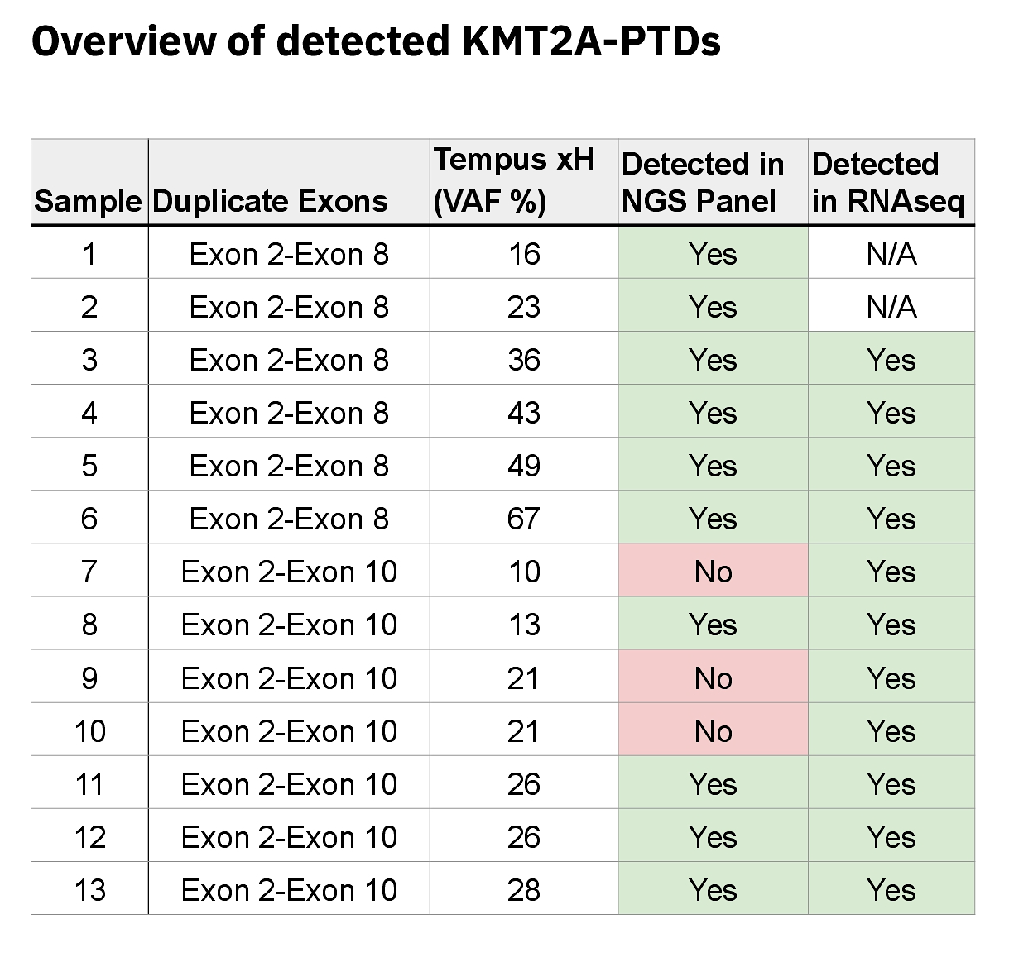
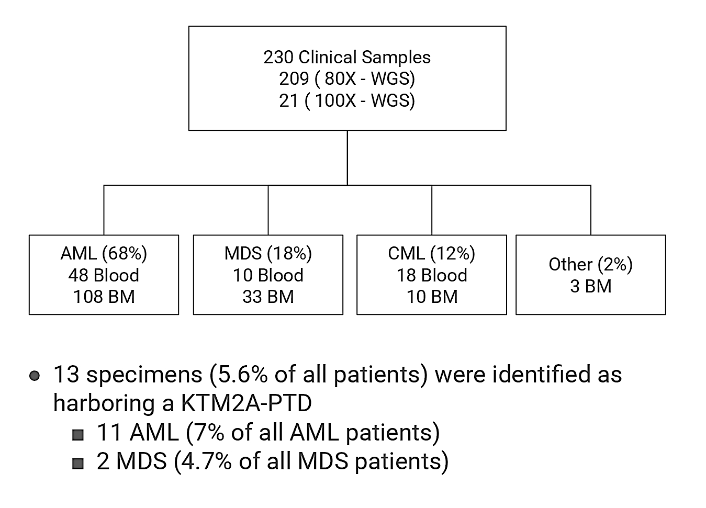
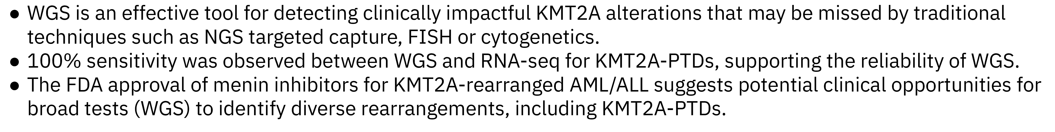
Huether R et al. Detection of KMT2A partial tandem duplication (PTD) in AML by whole genome sequencing (WGS): Addressing limitations of traditional techniques in the era of revumenib approval. ASCO 2025; Abstract 6532.

Slide 5
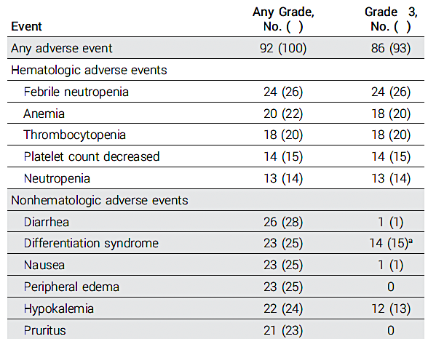
Wang E et al. Ziftomenib in Relapsed or Refractory NPM1-Mutated AML. J Clin Oncol 2025;43(31):3381-90.
Response Rate Adverse events/Safety
Response | Ziftomenib 600 mg QD (N=92)
ORR | 30 (33%)
CR/CRh | 20 (22%)
CR | 13 (14%)
CRh | 7 (8%)
Med Time to ORR | 1.9 (0.8-3.7 mos)
Med DOR | 4.6 (2.8-7.4 mos)
MRD negativity | 14/25 (56%)

Slide 6
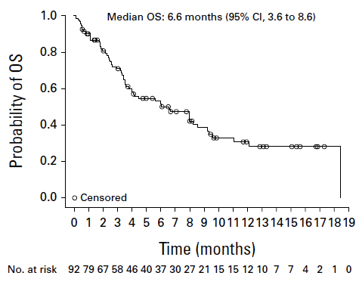
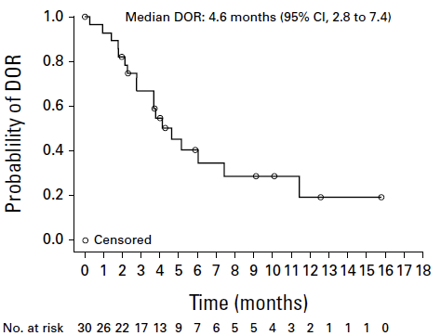
Wang E et al. Ziftomenib in Relapsed or Refractory NPM1-Mutated AML. J Clin Oncol 2025;43(31):3381-90.
Overall survival Duration of Response

Slide 7
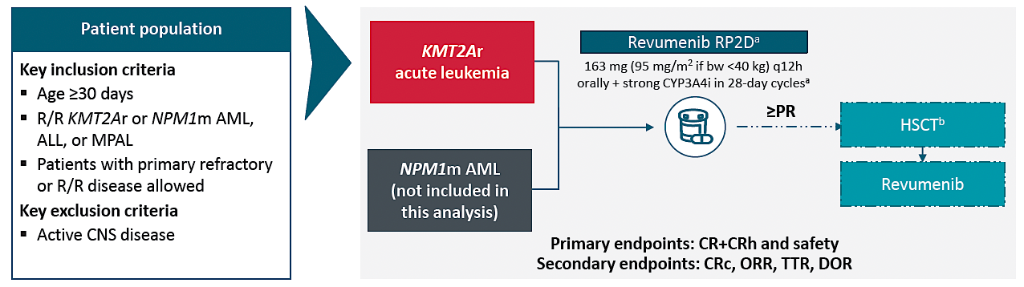
Aldoss I et al. UPDATED RESULTS AND LONGER FOLLOW-UP FROM THE AUGMENT-101 PHASE 2 STUDY OF REVUMENIB IN PATIENTS WITH RELAPSED OR REFRACTORY (R/R) KMT2AR ACUTE LEUKEMIA. EHA 2025; Abstract PS1473.

Slide 8
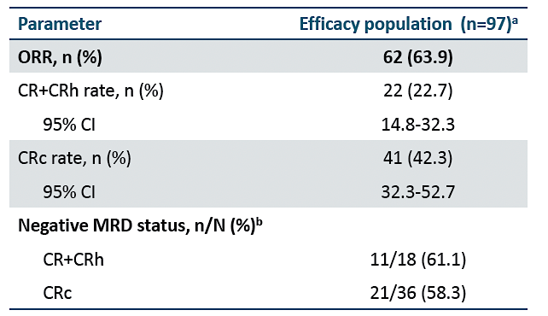
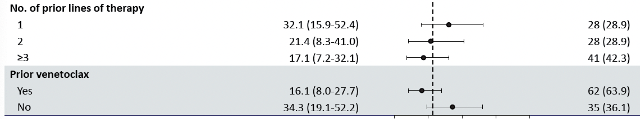
Aldoss I et al. UPDATED RESULTS AND LONGER FOLLOW-UP FROM THE AUGMENT-101 PHASE 2 STUDY OF REVUMENIB IN PATIENTS WITH RELAPSED OR REFRACTORY (R/R) KMT2AR ACUTE LEUKEMIA. EHA 2025; Abstract PS1473.
Median duration of CR/CRh = 6.4 mos 1.9-NR)
Time to first response = 1 month (0.9-3.1 mos)
Time to CR/CRh= 2 months (0.9-4.6 mos)
Out of 62 responders, 21 (34%) proceeded to HSCT
Decreased responses associated with prior lines
of therapy and prior venetoclax

Slide 9
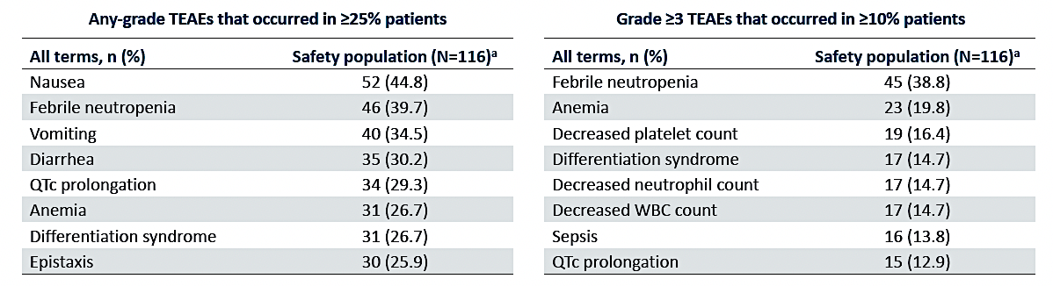
Aldoss I et al. UPDATED RESULTS AND LONGER FOLLOW-UP FROM THE AUGMENT-101 PHASE 2 STUDY OF REVUMENIB IN PATIENTS WITH RELAPSED OR REFRACTORY (R/R) KMT2AR ACUTE LEUKEMIA. EHA 2025; Abstract PS1473.

Slide 10
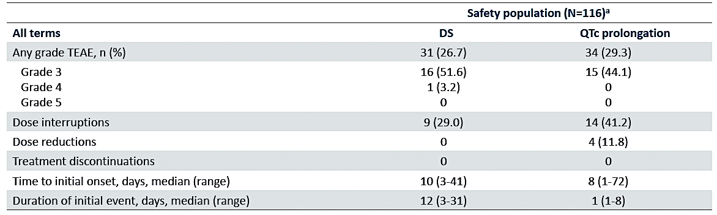
Aldoss I et al. UPDATED RESULTS AND LONGER FOLLOW-UP FROM THE AUGMENT-101 PHASE 2 STUDY OF REVUMENIB IN PATIENTS WITH RELAPSED OR REFRACTORY (R/R) KMT2AR ACUTE LEUKEMIA. EHA 2025; Abstract PS1473.

Slide 11
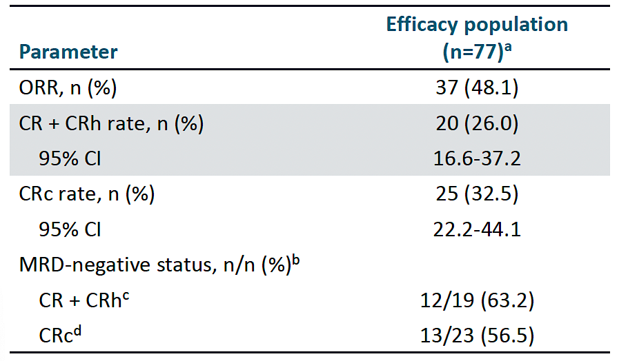
Arellano ML et al. PATIENTS WITH RELAPSED OR REFRACTORY (R/R) NUCLEOPHOSMIN 1-MUTATED (NPM1M) ACUTE MYELOID LEUKEMIA (AML): UPDATED RESULTS FROM THE PHASE 2 AUGMENT-101 STUDY. EHA 2025;Abstract PS1467.
Median time to first CR/CRh = 2.8 (0.9-8.8) months
Median duration of CR/CRh = 4.7 (2.1-8.2) months
Median OS= 4.8 (3.4-8.4) months
Five patients out of 77 proceeded to HSCT

Slide 12
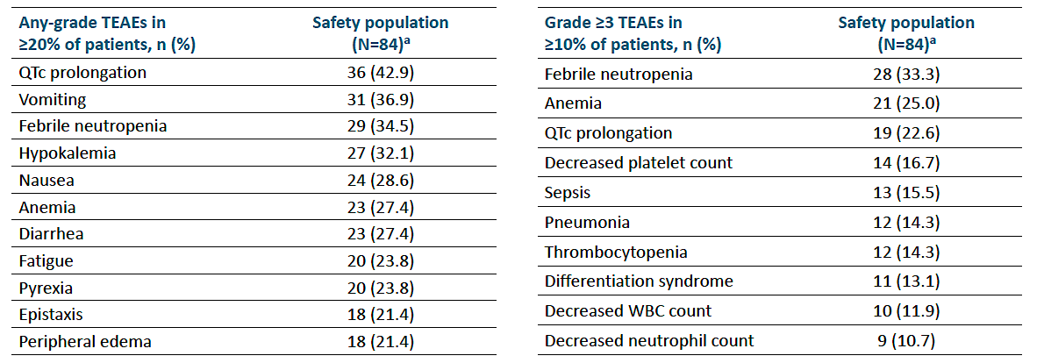
Arellano ML et al. PATIENTS WITH RELAPSED OR REFRACTORY (R/R) NUCLEOPHOSMIN 1-MUTATED (NPM1M) ACUTE MYELOID LEUKEMIA (AML): UPDATED RESULTS FROM THE PHASE 2 AUGMENT-101 STUDY. EHA 2025;Abstract PS1467.

Slide 13
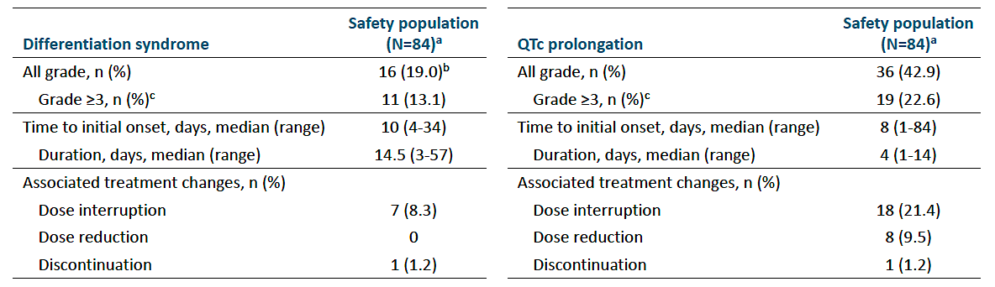
Arellano ML et al. PATIENTS WITH RELAPSED OR REFRACTORY (R/R) NUCLEOPHOSMIN 1-MUTATED (NPM1M) ACUTE MYELOID LEUKEMIA (AML): UPDATED RESULTS FROM THE PHASE 2 AUGMENT-101 STUDY. EHA 2025;Abstract PS1467.

Slide 14
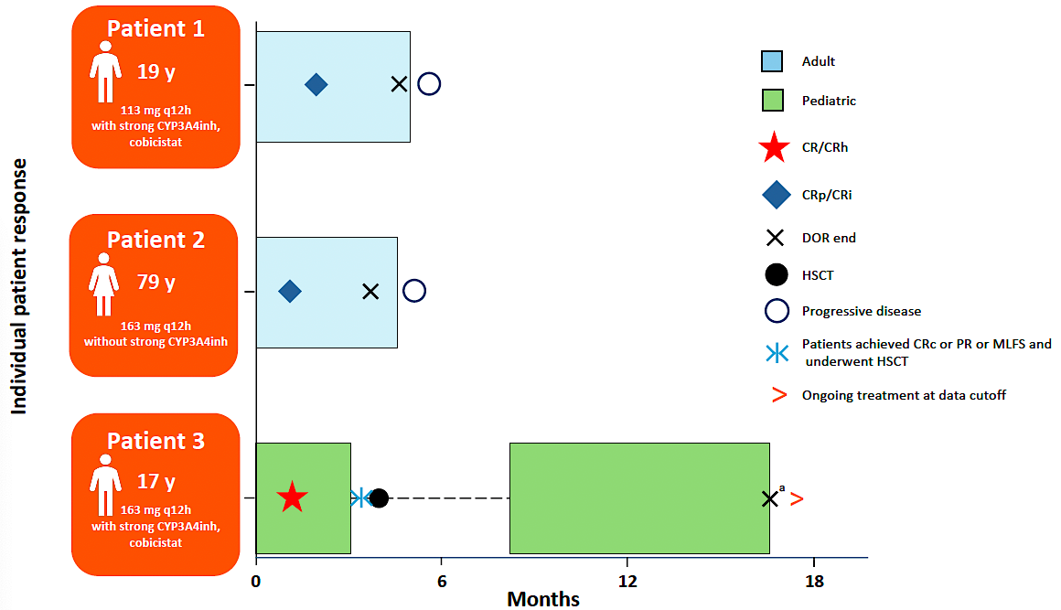
Issa G et al. REVUMENIB ACTIVITY IN PATIENTS WITH ACUTE LEUKEMIA WITH NUP98R: RESULTS FROM THE AUGMENT-101 PHASE 1 STUDY. EHA 2025;Abstract PS1501.
Three out of five patients with R/R NUP98r AML achieved morphological remission on revumenib monotherapy
(113-163 mg BID-TID)
Duration of response
was 2.8, 2.8 and 15.6 months (underwent HSCT)
Adverse events:
Gr 3 decreased LVEF
Gr 2 paresthesia
Gr 1 dysgeusia, alopecia

Slide 15
Daver N et al. Monotherapy update from Phase 1 portion in Phase1/2 trial of the menin-MLL inhibitor enzomenib (DSP-5336) in patients with relapsed or refractory acute leukemia. ASH 2025;Abstract 763.
Each menin inhibitor has a different chemical structure and different physiochemical properties such as polar surface area, lipophilicity, and basicity that may impact safety and efficacy^{1,2}
Enzomenib was specifically and intentionally designed to have low lipophilicity and basicity, which preliminary clinical data from the ongoing phase 1 trial has shown results in rapid clearance and minimal to no accumulation³
1. Hughes J et al. Bioorg Med Chem Lett. 2008 Sep 1;18(17):4872-5.
2. Yukawa T, Naven R. ACS Med Chem Lett. 2020 Jan 29;11(2):203–209.
3. Zeidner et al. ASH 2024;Abstract 213

Slide 16
Enzomenib Monotherapy: Response Rates in R/R AML
KMT2Ar AL (n = 39)
Dose optimization is complete evaluating 200, 300 and 400 mg po bid
Optimal RP2D as monotherapy is 300 mg po bid (n=15)
At RP2D
Overall Response rate (CR/CRh/CRi/MLFS) 73.3%
Composite CR rate (CR/CRh/CRi) 60%
CR + CRh rate 40%
NPM1m AML (n = 25)
Dose optimization is ongoing at 200, 300 and 400 mg po bid and initial activity is similar across dose levels
Response Category* | NPM1m
 | 200 mg BID (n = 10) | 300 mg BID (n = 7) | 400 mg BID (n = 8)
Overall Response rate (CR/CRh/CRi/MLFS) | 60% (6/10) | 57.1% (4/7) | 37.5% (3/8)
Composite CR rate (CR/CRh/CRi) | 50% (5/10) | 42.9% (3/7) | 37.5% (3/8)
CR/CRh rate | 50% (5/10) | 42.9% (3/7) | 37.5% (3/8)
* Pts who achieved CRh and CRi or MLFS were counted as CRh
Of 95 total patients with KMT2Ar or NPM1m, the efficacy analysis population (n = 64) did not include those who received < 200 mg BID enzomenib (n = 16), had prior menin inhibitor treatment (n = 11), and who had bone marrow blasts < 5% (n = 4)
Daver N et al. ASH 2025;Abstract 763
Study ongoing, data cutoff 04 OCT 2025

Slide 17
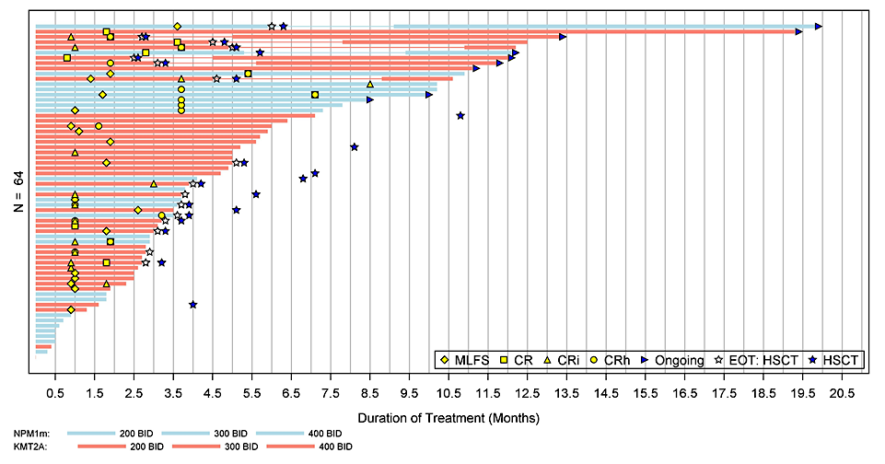
Enzomenib: Responses in R/R AML are Durable
 | KMT2Ar | NPM1m
 | N = 39 | N = 25
Median Time to first response, months | 1.0 | 1.8
Median Time to CR/CRh, months | 1.6 | 3.7
Duration of CR/CRh, months | 12.5 (n=11) | 5.7 (n=11)
Patients with allo-HSCT on study, n (%) | 13 (33%) | 3 (12%)
Transfusion Independence, RBC+PLT, %* | 27% | 38%
KMT2Ar:
NPM1m:
*Proportion of patients with documented transfusion dependence for
RBC or PLT at baseline that had transfusion independence for both RBC and PLT on study prior to HSCT
Study ongoing, data cutoff 04 OCT 2025
Daver N et al. ASH 2025;Abstract 763

Slide 18
Shukla N et al. Detection of MEN1 resistance mutations in cell-free DNA from acute leukemia patients treated with menin inhibitors. ASH 2025;Abstract 938.
High-sensitivity research NGS assay MSK-ACCESS-MEN1 includes probes to all MEN1 exons for cell-free DNA interrogation in hematologic cancers
MSK-ACCESS-MEN1 identified:
an emerging MEN1 M322I mutation in cfDNA from a patient with KMT2A-rearranged AML who had received 14 cycles of revumenib with an MRD-negative BM remission. At the time of cfDNA collection, she remained transfusion independent without evidence of relapse. She subsequently relapsed 3 months later with identification of the MEN1 M322I mutation.
Incorporation of cfDNA monitoring for MEN1 resistance mutations into clinical protocols for menin inhibitor therapy is warranted

