Slide 1
Year in Review:
Menin Inhibitors in Combination
Amir T. Fathi
Director, Leukemia Program, MGB Cancer Institute
Professor of Medicine, Harvard Medical School

Slide 2
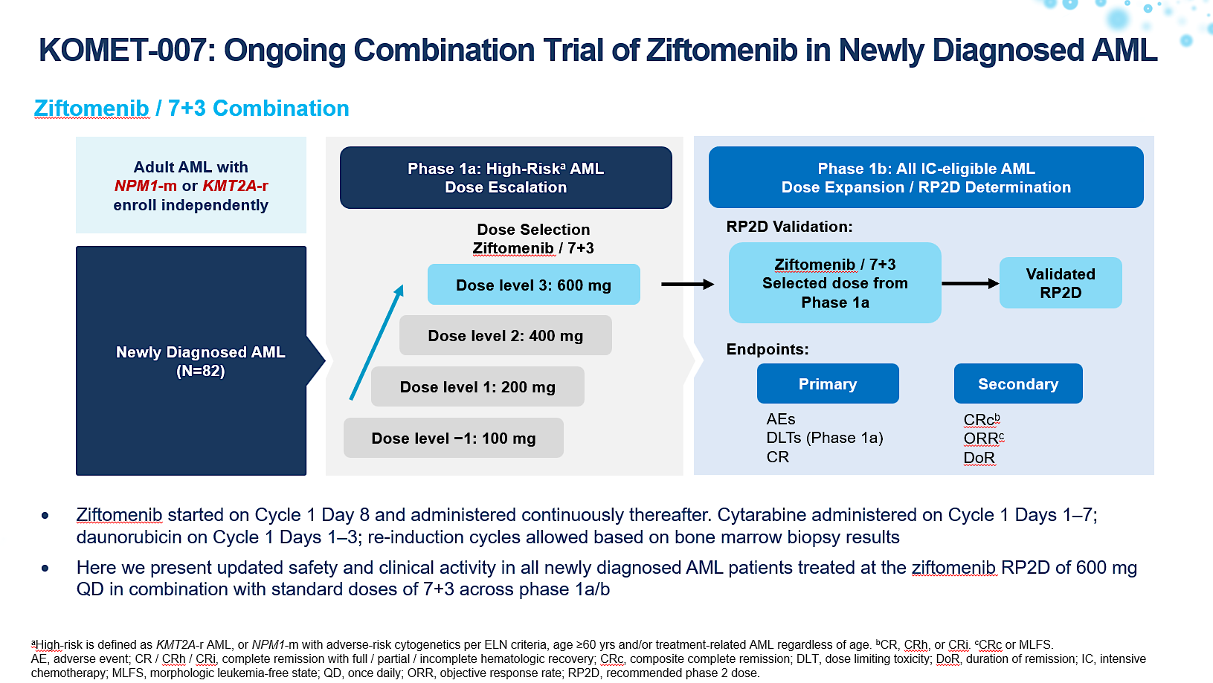
Erba H, et al. EHA, 2025;Abstract S136.

Slide 3
Safety and Tolerability of Ziftomenib in Combination with 7+3 in 1L AML (N=82)
Grade ≥3 TEAEs in ≥10% of All Patients
n (%) | NPM1-m | KMT2A-r | All Patients
 | 600 mg (n=49) | 600 mg (n=33) | 600 mg (N=82)
Grade ≥3 | 42 (86) | 29 (88) | 71 (87)
Febrile neutropenia | 25 (51) | 20 (61) | 45 (55)
Platelet count decreased | 23 (47) | 12 (36) | 35 (43)
Anemia | 16 (33) | 8 (24) | 24 (29)
Neutrophil count decreased | 14 (29) | 6 (18) | 20 (24)
White blood cell count decreased | 10 (20) | 7 (21) | 17 (21)
Sepsis | 8 (16) | 5 (15) | 13 (16)
Lymphocyte count decreased | 5 (10) | 4 (12) | 9 (11)
Grade ≥3 Ziftomenib-related Adverse Events of Interest
  29 Patients (35%) had Grade ≥3 ziftomenib-related adverse events:
    Most common (≥10%) were febrile neutropenia (15%), decreased platelet count (15%), anemia (11%),
    and decreased neutrophil count (11%)
    1 case of differentiation syndrome (KMT2A-r, Gr3), which was successfully managed
    2 cases of investigator-assessed QTc prolongation (both KMT2A-r, Gr3)*
*Both patients were on other medications (posaconazole and/or piperacillin/tazobactam) at time of QT assessment.
Data cutoff: Mar 21, 2025.
QTc, QT corrected; TEAE, treatment-emergent adverse event.
Erba H, et al. EHA, 2025; Abstract S136.

Slide 4
Clinical Activity in All Response-Evaluableª 1L Patients (N=71)
n (%) | NPM1-m | KMT2A-r | All Patients
 | 600 mg (n=44) | 600 mg (n=27) | 600 mg (N=71)
CRc | 41 (93) | 24 (89) | 65 (92)
ORR CR CRh CRi MLFS PR NR NE | 43 (98) 37 (84) 1 (2) 3 (7) 2 (5) 0 1 (2) 0 | 24 (89) 20 (74) 0 4 (15) 0 0 2 (7) 1 (4) | 67 (94) 57 (80) 1 (1) 7 (10) 2 (3) 0 3 (4) 1 (1)
CR MRD-negativity, n/N (%)^{b} CRc MRD-negativity, n/N (%)^{b} | 24/34 (71) 26/38 (68) | 14/16 (88) 15/18 (83) | 38/50 (76) 41/56 (73)
Median time to CR MRD-negativity, weeks (range) Median time to CRc MRD-negativity, weeks (range) | 4.7 (2–17) 4.7 (2–17) | 4.4 (3–12) 4.1 (3–12) | 4.5 (2–17) 4.3 (2–17)
ªPatients who had ≥1 response assessment or who had died.
^{b}Among evaluable responders tested for MRD per local assay (NGS, RT-qPCR, FISH, flow cytometry). Preliminary central testing also shows concordance with local MRD-negative rates.
Data cutoff: Mar 21, 2025.
Per ELN 2022: CR / CRh / CRi, complete remission with full / partial / incomplete hematologic recovery; CRc, composite complete remission; FISH, fluorescence in situ hybridization; MLFS, morphologic leukemia-free state; MRD, measurable residual disease; NE, not evaluable; NGS, next-generation sequencing; NR, no response; ORR, objective response rate; PR, partial remission; RT-qPCR, quantitative reverse transcription polymerase chain reaction.
Erba H, et al. EHA, 2025; Abstract S136.
Notes:
Note: There is the potential for intra-patient improvement for both response and MRD-negativity.

Slide 5
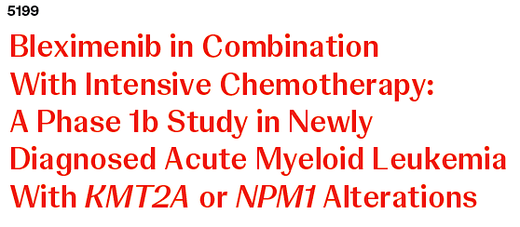
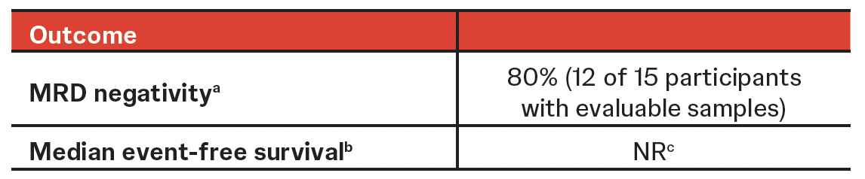
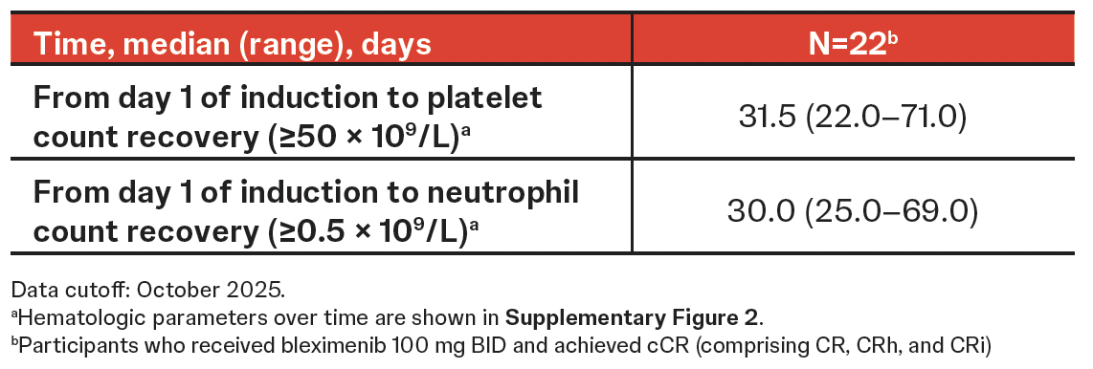
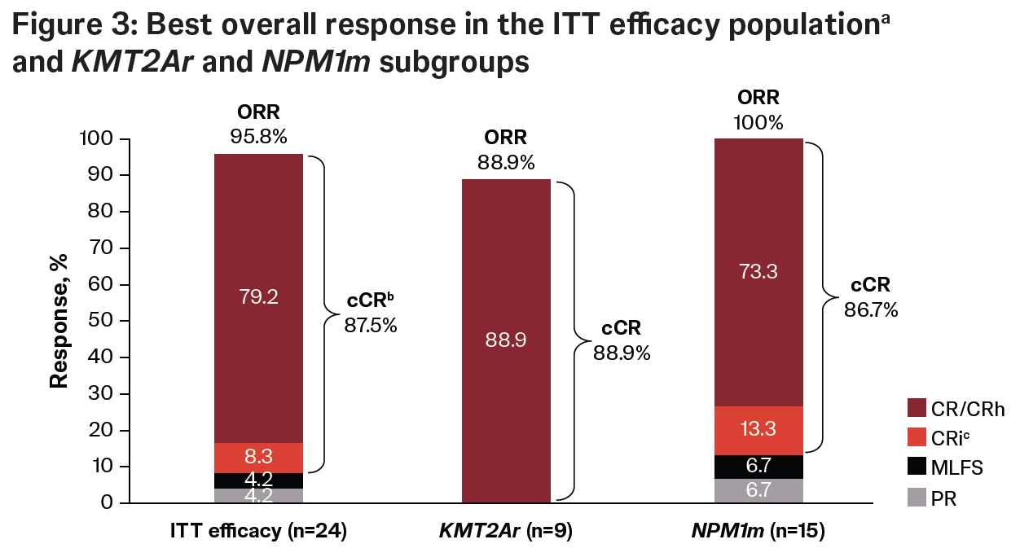
Dohner H, et al. ASH, 2025;Abstract 5199.

Slide 6
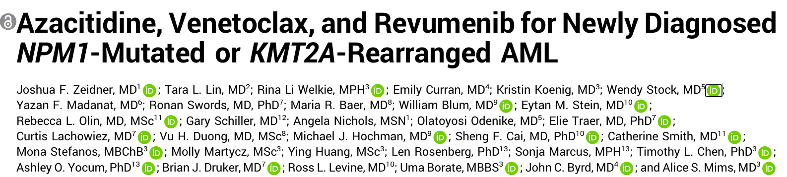
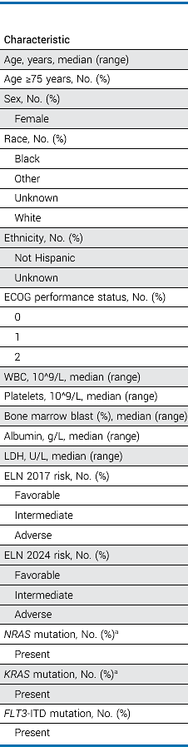
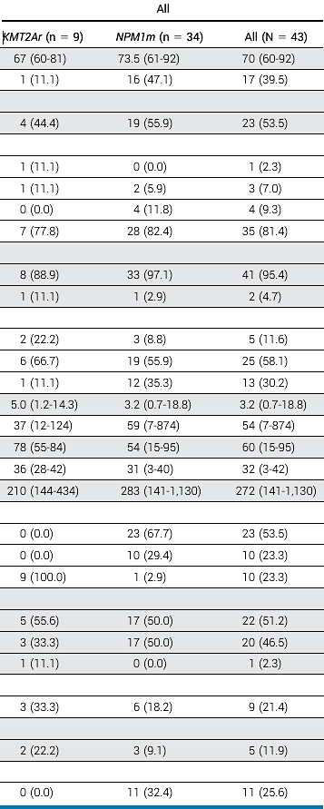
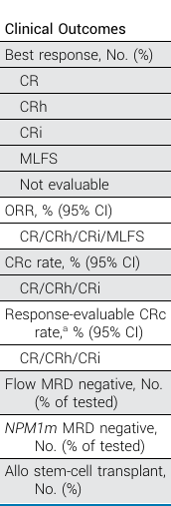
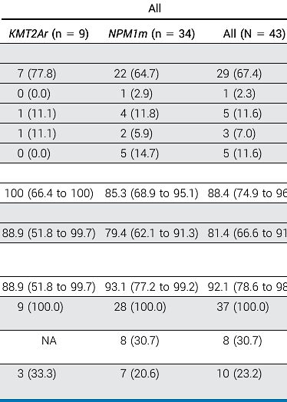
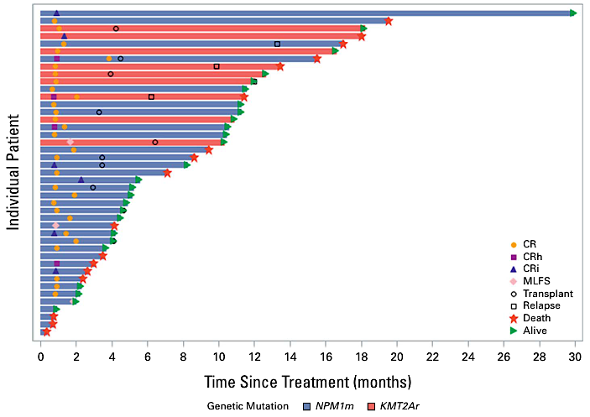
MENi-Triplet (Revumenib)
Zeidner JF, et al. J Clin Oncol, 2025.

Slide 7
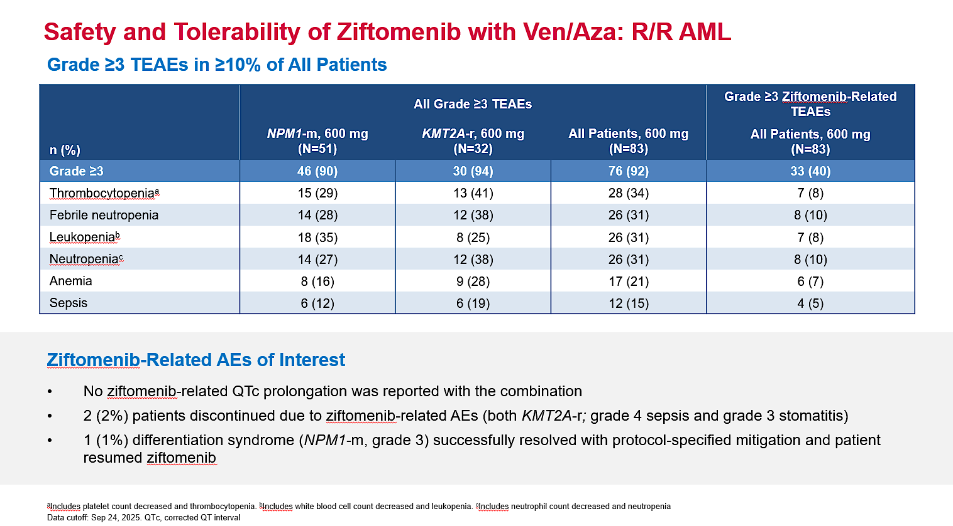
Issa G, et al. ASH, 2025;Abstract 764.

Slide 8
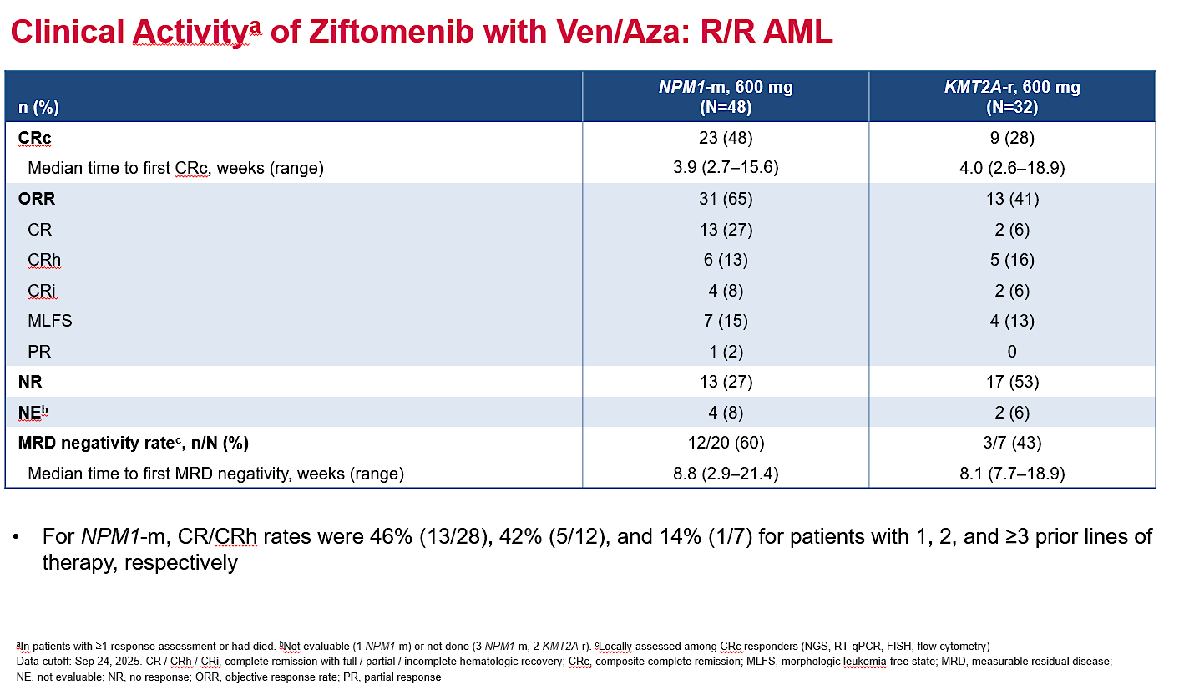
Issa G, et al. ASH, 2025;Abstract 764.

Slide 9
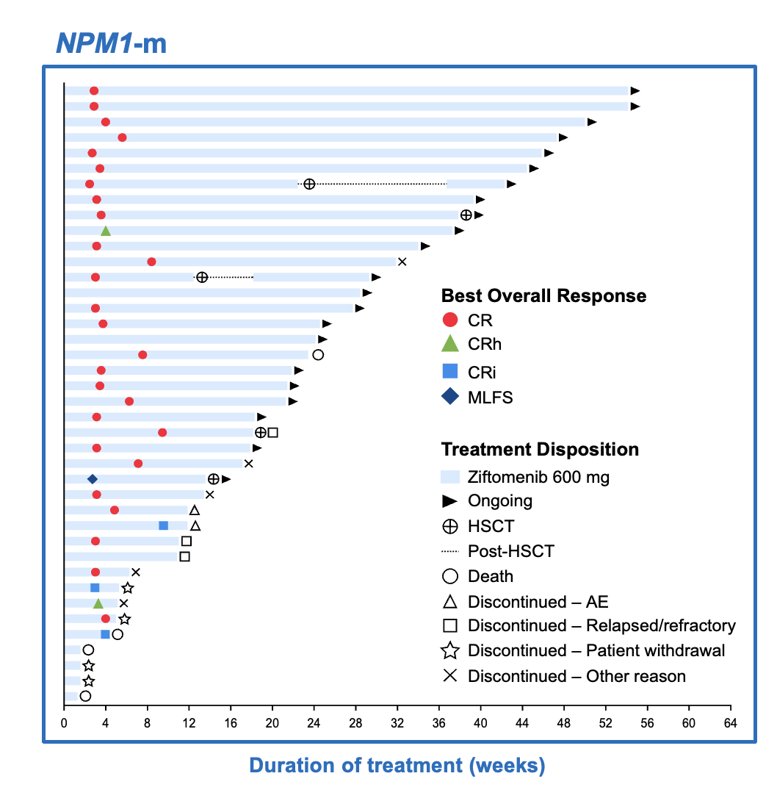
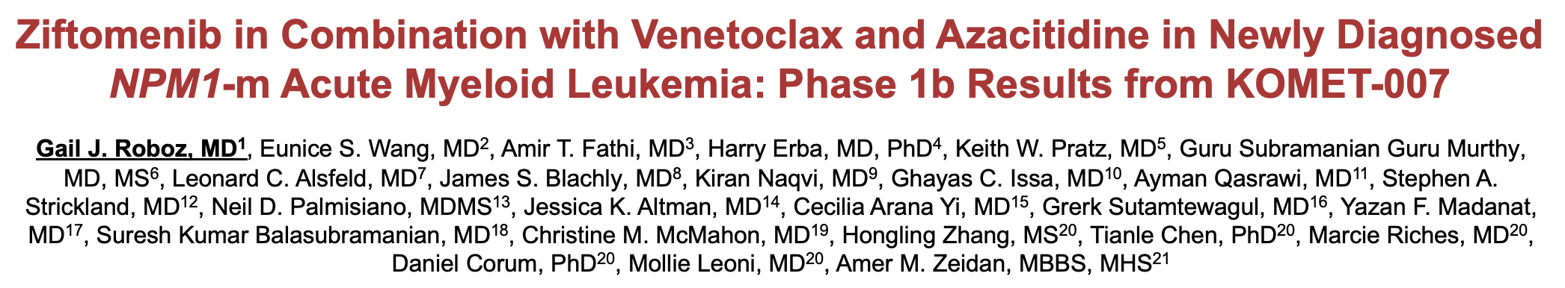
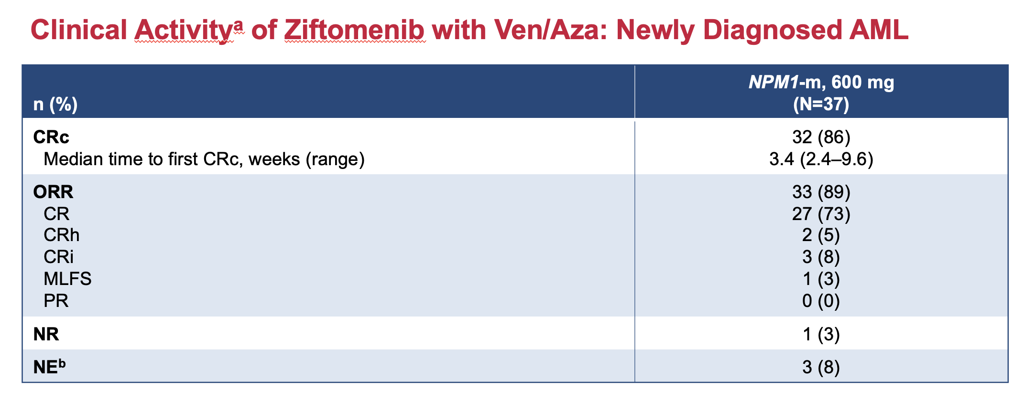
MENi-Triplet (Ziftomenib)
Roboz GJ, et al. ASH, 2025;Abstract 766.

Slide 10
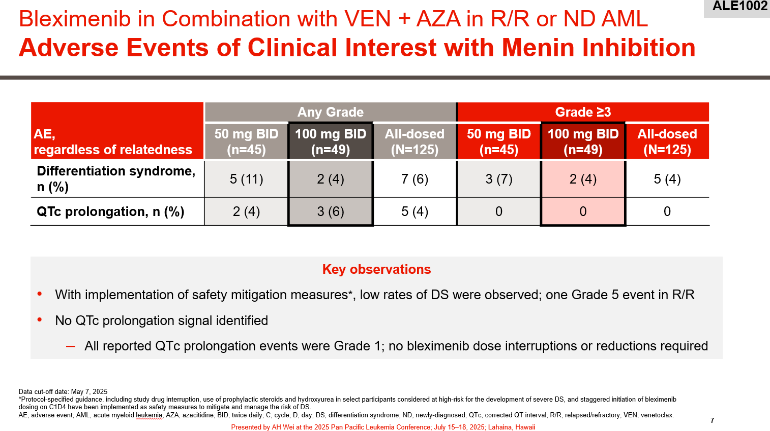
Wei A, et al. EHA, 2025;Abstract S137.

Slide 11
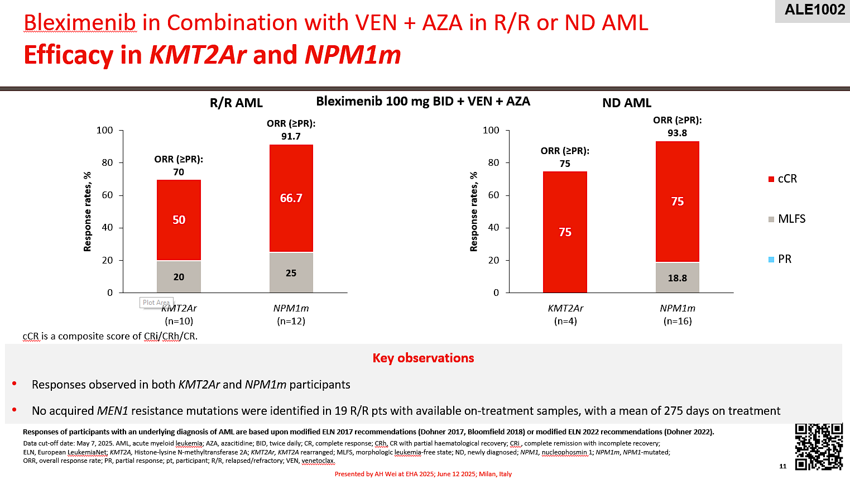
Wei A, et al. EHA, 2025;Abstract S137.

Slide 12
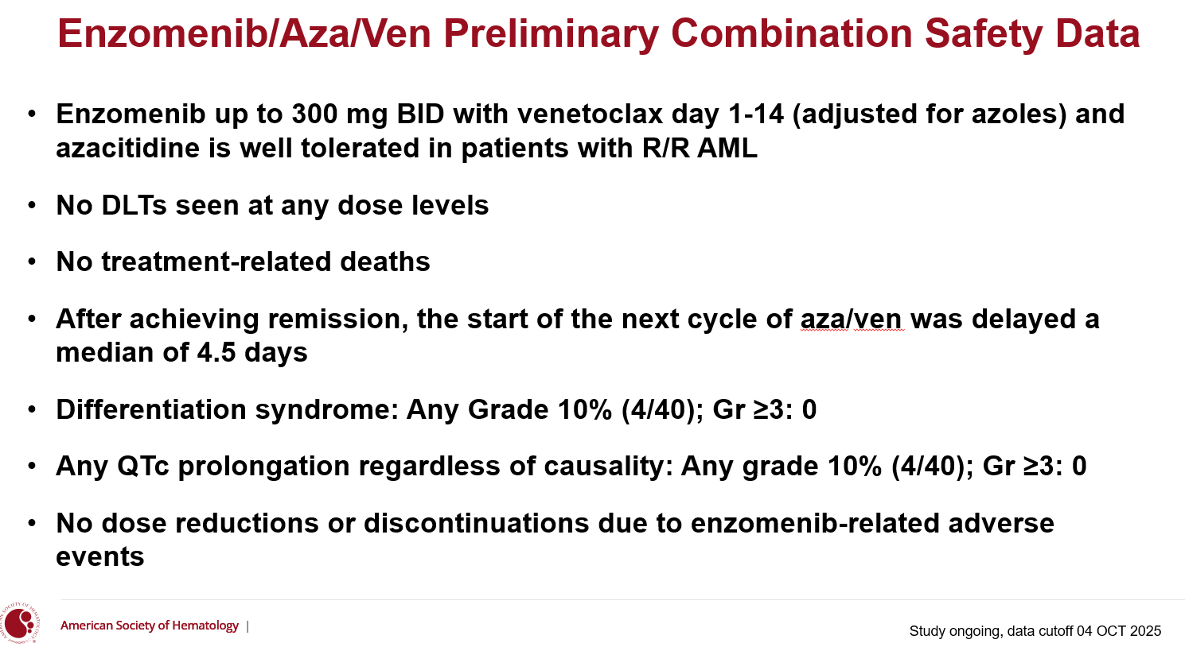
Watts J, et al. ASH, 2025;Abstract 765.

Slide 13
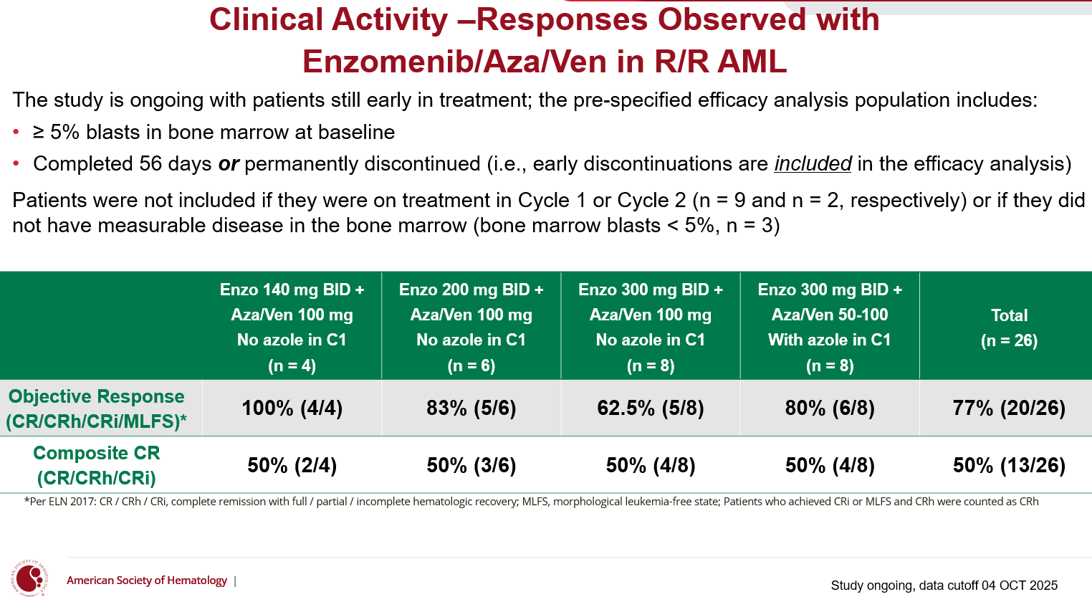
Watts J, et al. ASH, 2025;Abstract 765.

Slide 14
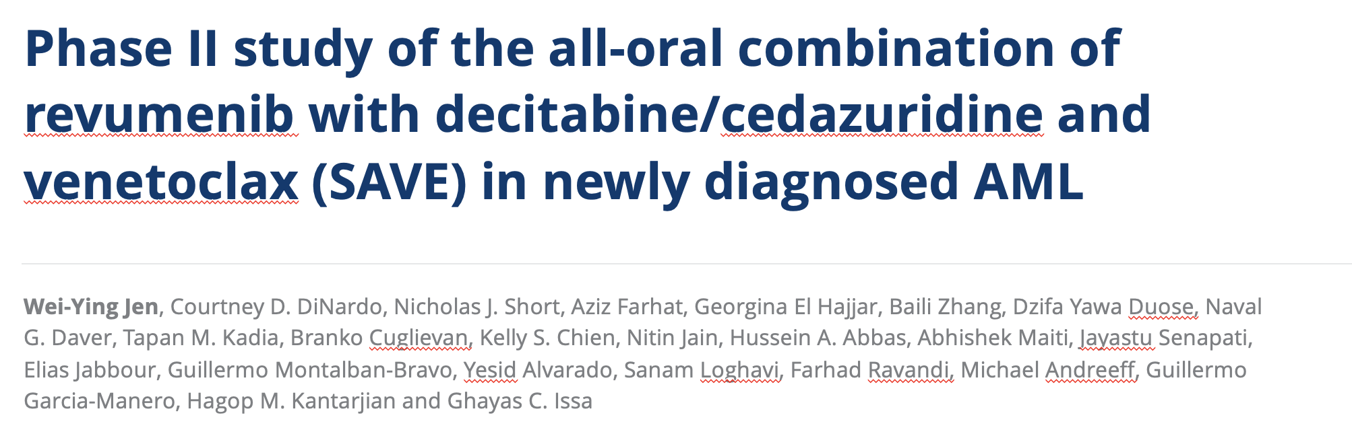
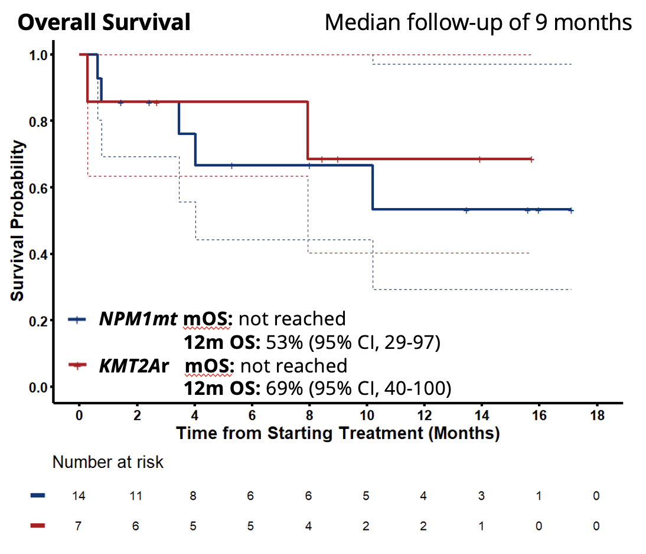
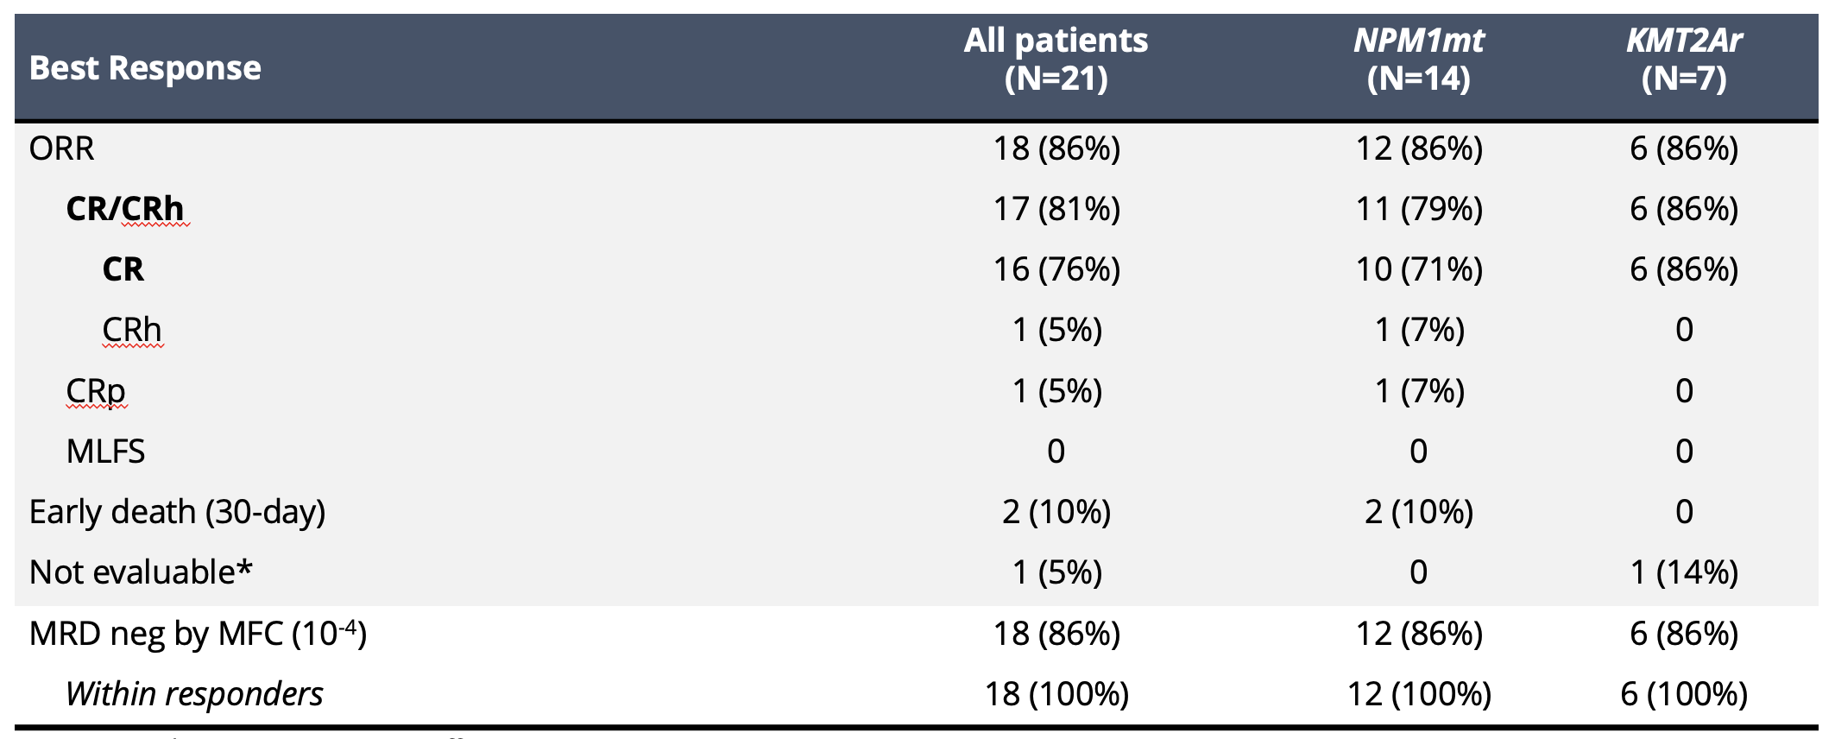
All Oral Triplet Regimens
Jen W, et al. ASH, 2025;Abstract 47.

Slide 15
Conclusions
The emergence of menin inhibitors:
Effective, safe agents with activity in multiply R/R NPM1-m, KMT2A-r AML
Differentiation syndrome as a class effect – requires close vigilance.
Limited durability of response as monotherapy.
The promise of combinations:
Studies reveal promise in combination with HMA-ven and induction chemotherapy
High response rates and promising durability of response, particularly in the frontline setting.
Will likely mitigate risk of DS.
Potential for all-oral regimens
Multiple phase 3 studies under way:
KOMET-017
REVEAL / EVOLVE-2
cAMeLOt

