Slide 1
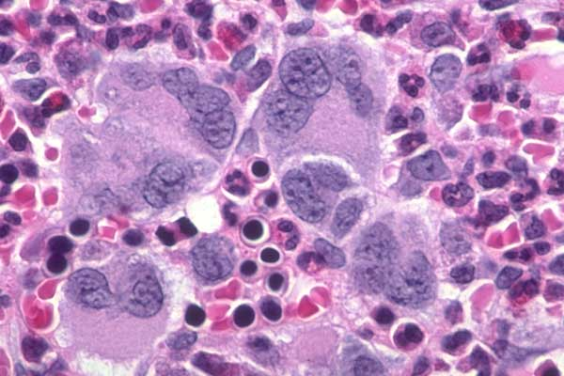

Year in Review Live Webinar | Myelofibrosis Edition
John Mascarenhas, MD
Professor of Medicine
Icahn School of Medicine at Mount Sinai
New York, NY
Notes:
Rather than how to prescribe JAK inh in the setting of cytopenias I chose to interpret this assignment as how to specifically improve cytopenias in MF

Slide 2
Updated Results From the Phase 3 MANIFEST-2 Study of Pelabresib in Combination With Ruxolitinib for Janus Kinase Inhibitor–Naïve Patients With Myelofibrosis
Abstract number: 3178
John Mascarenhas
john.mascarenhas@mssm.edu
John Mascarenhas,¹ Sebastian Grosicki,² Dominik Chraniuk,³ Elisabetta Abruzzese,⁴ Prithviraj Bose,⁵ Aaron Gerds,⁶ Alessandro M. Vannucchi,⁷ Francesca Palandri,⁸
Sung-Eun Lee,⁹ Vikas Gupta,¹⁰ Alessandro Lucchesi,¹¹ Stephen T. Oh,¹² Andrew T. Kuykendall,¹³ Andrea Patriarca,¹⁴ Alberto Álvarez-Larrán,¹⁵ Ruben Mesa,¹⁶
Jean-Jacques Kiladjian,¹⁷ Moshe Talpaz,¹⁸ Morgan Harris,¹⁹ Sarah-Katharina Kays,²⁰ Tabea Kräft,²⁰ Qing Li,²¹ Anna-Maria Jegg,²⁰ Claire Harrison,²² Raajit K. Rampal²³
¹Tisch Cancer Institute, Icahn School of Medicine at Mount Sinai, New York, NY, USA; ²Department of Cancer Prevention, Medical University of Silesia, Katowice, Poland; ³Hematology Ward, Wojewódzki Szpital Zespolony im. L. Rydygiera, Torun, Poland; ⁴Department of Hematology, S. Eugenio Hospital, Tor Vergata University, ASL Roma 2, Rome, Italy; ⁵Leukemia Department, University of Texas MD Anderson Cancer Center, Houston, TX, USA; ⁶Cleveland Clinic Taussig Cancer Institute, Cleveland, OH, USA; ⁷Department of Clinical and Experimental Medicine, University of Florence, Florence, Italy; ⁸IRCCS Azienda Ospedaliero-Universitaria di Bologna, Istituto di Ematologia “Seràgnoli”, Bologna, Italy; ⁹Department of Hematology, Seoul St. Mary's Hospital, College of Medicine, The Catholic University of Korea, Seoul, Republic of Korea; ¹⁰Medical Oncology and Hematology, Princess Margaret Cancer Centre, Toronto, ON, Canada; ¹¹Hematology Unit, IRCCS Istituto Romagnolo per lo Studio e la Cura dei Tumori (IRST) “Dino Amadori”, Meldola (FC), Italy; ¹²Washington University School of Medicine in St. Louis, St. Louis, MO, USA; ¹³Moffitt Cancer Center, Tampa, FL, USA; ¹⁴Hematology Unit, AOU Maggiore della Carità and University of Eastern Piedmont, Novara, Italy; ¹⁵Hematology Department, Hospital Clínic, Institut d'Investigacions Biomèdiques August Pi i Sunyer (IDIBAPS), Barcelona, Spain; ¹⁶Atrium Health Wake Forest Baptist Comprehensive Cancer Center, Wake Forest University School of Medicine, Winston-Salem, NC, USA; ¹⁷Clinical Investigation Center, Hôpital Saint-Louis, Université de Paris, Paris, France; ¹⁸University of Michigan Comprehensive Cancer Center, Ann Arbor, MI, USA; ¹⁹Constellation Pharmaceuticals, a MorphoSys Company, Boston, MA, USA; ²⁰MorphoSys AG, Planegg, Germany; ²¹MorphoSys US Inc, Boston, MA, USA; ²²Department of Haematology, Guy’s and St Thomas’ NHS Foundation Trust, London, UK; ²³Leukemia Service, Memorial Sloan Kettering Cancer Center, New York, NY, USA

Slide 3
Splenic Response at Week 48
SVR35 response rates continued to be greater at Week 48 with pelabresib + ruxolitinib
versus placebo + ruxolitinib (57.0% vs 37.5%, respectively)
Table 1. Splenic Response at Week 48 and Loss of Splenic Response
Figure 1b. Duration of Splenic Response
 | Pelabresib + ruxolitinib (N=214) |  | Placebo + ruxolitinib (N=216)
SVR35 response at Week 48, % | 57.0 |  | 37.5
Difference* (95% CI) | 19.1 (10.1, 28.0)
Mean % change in spleen volume at Week 48† | −54.5 (n=138) |  | −33.5 (n=156)
95% CI | −58.1, −51.0 |  | −36.9, −30.1
SVR35 response at anytime, % (n/N) | 82.2 (176/214) |  | 57.9 (125/216)
Loss of SVR35 response and >25% increase in spleen volume from nadir (main analysis), % (n/N)‡ | 13.1 (23/176) |  | 20.0 (25/125)
Loss of SVR35 response (alternative definition), % (n/N)§ | 21.0 (37/176) |  | 36.8 (46/125)
Pelabresib + ruxolitinib (N=214)
Placebo + ruxolitinib (N=216)
100
Censored
90
80
70
60
50
Probability of Response (%)
40
30
20
10
0
0
12
24
36
48
60
72
84
96
108
120
132
144
Number of at-risk patients
Duration of Splenic Response by Central Read (Weeks)
Pelabresib + ruxolitinib
176
166
152
126
92
70
51
35
24
11
4
1
0
Placebo +
ruxolitinib
125
109
96
76
56
35
27
17
11
8
2
0
0
Higher proportion of patients maintained SVR35 responses in the pelabresib + ruxolitinib arm versus the placebo + ruxolitinib arm

Slide 4
Total Symptom Score at Week 48
Numerically greater improvements for patients treated with pelabresib + ruxolitinib
versus placebo + ruxolitinib, with large symptom reduction in both arms
Figure 2. Total Symptom Score at Week 48
2a. TSS at Week 48 (ITT Population)
2b. TSS Component Scores at Week 48
 | Pelabresib + ruxolitinib (N=214) |  | Placebo + ruxolitinib (N=216)
TSS change* from baseline at Week 48 | −16.24 |  | −14.11
Mean difference† (95% CI) at Week 48 | −2.13 (−4.25, −0.01)
TSS50 response at Week 48, % | 45.3 |  | 39.4
Difference‡ (95% CI) at Week 48 | 5.6 (−3.7, 14.9)
mTSS§ equivalent on 70-point scale at Week 48 | −16.19 |  | −13.86
Mean difference (95% CI) at Week 48 | −2.33 (−4.39, −0.28)
5.5
Pelabresib + ruxolitinib (N=214)
5.3
5
Placebo + ruxolitinib (N=216)
4.3
4.4
4.5
4.4
4
3.6
3.6
3.6
3.3
3.4
3.6
3.2
3.1
3.2
Mean TSS Component Score
3
2.8
2.0
2.2
2.3
2
1.8
1.7
1.8
1.4
1.6
1
0.9
1.2
1.2
1.2
0
Itching
Pain
Under Ribs
Bone Pain
Night
Sweats
Fullness
Abdominal
Discomfort
Fatigue
Baseline
Week 48
Non-MF control group national norms¶ (Morlock R, et al. 2024)¹
TSS individual domain scores were similar between the two arms and similar to the national norms in people without MF¹
In the analysis of mTSS (MFSAF excluding fatigue) equivalent on 70-point scale, LSM change from baseline was −16.19 with pelabresib + ruxolitinib versus −13.86 with placebo + ruxolitinib (mean difference: −2.33; 95% CI −4.39, −0.28)
At Week 48, 36% of patients in the pelabresib + ruxolitinib arm had both SVR35 and TSS50 responses versus 19% in the placebo + ruxolitinib arm

Slide 5
Safety and Efficacy of Bromodomain and Extra-Terminal Inhibitor INCB057643 in Patients With Relapsed or Refractory Myelofibrosis and Other Advanced Myeloid Neoplasms: A Phase 1 Study
Presentation #658
Justin Watts, MD,¹ Anthony M. Hunter, MD,² Alessandro M. Vannucchi, MD,³ Vikas Gupta, MD, FRCP,⁴ Srinivas K. Tantravahi, MD,⁵ Alessandra Iurlo, MD, PhD,⁶ Brandon McMahon, MD,⁷ Francesca Palandri, MD, PhD,⁸ María T. Gómez-Casares, MD,⁹
Junichiro Yuda, MD, PhD,¹⁰ Emma Searle, MD, PhD,^{11,12} Anna B. Halpern, MD,^{13,14} Rosa Ayala Diaz, MD,¹⁵ Akihiro Tomita, MD, PhD,¹⁶ Blanca Xicoy, MD,¹⁷ Prithviraj Bose, MD,¹⁸ Brandi Reeves, MD,¹⁹ Xuejun Chen, PhD,²⁰ Lea Burke, MS,²⁰ Feng Zhou, PhD,²⁰
Fred Zheng, MD,²⁰ Pankit Vachhani, MD²¹
¹Sylvester Comprehensive Cancer Center, University of Miami, Miami, FL, USA; ²Emory University School of Medicine, Atlanta, GA, USA; ³AOU Careggi, University of Florence, Florence, Italy; ⁴Princess Margaret Cancer Centre, Toronto, ON, Canada; ⁵University of Utah Huntsman Cancer Institute, Salt Lake City, UT, USA; ⁶Foundation IRCCS Ca’ Granda Ospedale Maggiore Policlinico, Milan, Italy; ⁷University of Colorado Anschutz Medical Campus, Aurora, CO, USA; ⁸IRCCS Azienda Ospedaliero-Universitaria di Bologna, Istituto di Ematologia “Seràgnoli,” Bologna, Italy; ⁹Hospital Universitario de Gran Canaria Doctor Negrín, Las Palmas de Gran Canaria, Spain; ¹⁰National Cancer Center Hospital East, Chiba, Japan; ¹¹The Christie Hospital NHS Foundation Trust, Manchester, UK; ¹²University of Manchester, Manchester, UK; ¹³University of Washington, Seattle, WA, USA; ¹⁴Fred Hutchinson Cancer Center, Seattle, WA, USA; ¹⁵Hospital Universitario 12 de Octubre, Madrid, Spain; ¹⁶Fujita Health University School of Medicine, Toyoake, Japan; ¹⁷Hospital Germans Trias I Pujol, Institut Català Oncologia, Josep Carreras Leukemia Research Institute, Universitat Autònoma de Barcelona, Badalona, Spain; ¹⁸The University of Texas MD Anderson Cancer Center, Houston, TX, USA; ¹⁹University of North Carolina School of Medicine, Chapel Hill, NC, USA; ²⁰Incyte Corporation, Wilmington, DE, USA; ²¹O’Neal Comprehensive Cancer Center at UAB, Birmingham, AL, USA

Slide 6
Study Design
Watts ASH 2024;Abstract 658
Ongoing, Open-Label, Phase 1, Dose-Escalation and -Expansion Study (NCT04279847)
The initial INCB057643 dose was 4 mg qd with dose escalation up to 12 mg qd
  All doses were administered continuously in 28-day cycles
Dose escalation
r/r MF, MDS, or MDS/MPN
3+3 design
Dose expansion
MF
ET
Part 1: Monotherapy
Patient Population
Adults ≥18 years old
One of the following histologically confirmed diagnoses:
  r/r primary or secondary MF
  ET
  MDS
  MDS/MPN
ECOG PS ≤2
Platelet count ≥50×10⁹/L
Study Endpoints
Primary endpoint
  Safety and tolerability, including identification of DLTs
Secondary endpoints
  ≥35% reduction in spleen volume (SVR35; per MRI/CT) at Week 24
  ≥50% reduction in total symptom score (TSS50; per MPN-SAF TSS) at Week 24
  Anemia response
INCB057643
Monotherapy
Starting dose:
4 mg qd
4 mg qd dose cleared
Dose escalation
INCB057643 + ruxolitinib
MF with suboptimal response to ruxolitinib
3+3 design
Identification of RDE(s)
Dose expansion
INCB057643 + ruxolitinib
Chronic or accelerate-phase MF with suboptimal response to ruxolitinib
MF and naive to JAK inhibitor treatment
Part 2: Combination Therapy
Anemia response
  If transfusion-independent at baseline: ≥1.5 g/dL hemoglobin increase from baseline for ≥12 weeks
  If tranfusion-dependent at baseline: achieving transfusion independence for ≥12 weeks
Notes:
Definitions:
r/r - Patients who have received ≥1 line of prior therapy and experienced disease recurrence or failed to respond to the last treatment, and for whom no additional known therapy is available to offer clinical benefits
Suboptimal response - Patients who have been receiving a stable dose of ruxolitinib 5-25 mg bid for ≥8 weeks before the first study treatment dose but are not experiencing an optimal response to ruxolitinib monotherapy; 1 dose reduction due to toxicities within 8 weeks before Study Day 1 was permitted
Transfusion dependent at baseline - defined as requiring ≥4 units of packed red blood cells in the 56 days before enrollment, with ≥1 transfusion during the 28 days before enrollment; patients not deemed transfusion dependent at baseline were considered transfusion independent.
Patients with MF must have received ≥1 JAK inhibitor, such as ruxolitinib

Slide 7
Efficacy – Monotherapy
Spleen Volume Response in Individual Patients With MF (n=25)
Week 24 SVR35 achieved by 3/7 patients receiving INCB057643 ≥10 mg and 3/20 all evaluable patients
Of 23 evaluable patients, BOR SVR35 achieved by 3 patients; SVR25 achieved by 9 patients
4 mg
6 mg
8 mg
10 mg
12 mg
Spleen Volume Change at Week 24*†
Best Spleen Volume Response During Treatment*‡
Change From Baseline, %
Change From Baseline, %
−35
−35
Visit, wk
24
12
12
12
12
12
12
12
12
12
24
12
12
36
12
12
24
36
48
36
Watts ASH 2024;Abstract 658

Slide 8
Efficacy – Monotherapy
Symptom Response in Individual Patients With MF (n=25)
Week 24 TSS50 achieved by 5/8 evaluable patients receiving INCB057643 ≥10 mg; 7/19 all evaluable patients
BOR TSS50 achieved by 11/20 evaluable patients
4 mg
6 mg
8 mg
10 mg
12 mg
MPN-SAF TSS Change at Week 24*†
Best Symptom Improvement During Treatment*‡
Change From Baseline, %
Change From Baseline, %
Visit, wk
4
12
4
4
8
12
29
12
12
24
16
32
16
24
40
8
44
16
28
44
Watts ASH 2024;Abstract 658

Slide 9
Efficacy – Combination Therapy (“Add-on”)
Spleen Volume Response in Individual Patients With MF With Prior Suboptimal RUX Response (n=23)
Week 24 SVR35 achieved by 4 of 17 evaluable patients
BOR SVR35 achieved by 5 of 20 evaluable patients; BOR SVR25 achieved by 8 patients
4 mg + RUX
6 mg + RUX
8 mg + RUX
Spleen Volume Change at Week 24*†
Best Spleen Volume Response During Treatment*‡
Change From Baseline, %
Change From Baseline, %
−35
−35
Visit, wk
12
12
36
12
12
12
12
12
12
12
12
24
24
12
48
48
24
48
36
Watts ASH 2024;Abstract 658

Slide 10
The Efficacy and Safety of Selinexor in Combination with Ruxolitinib in Ruxolitinib-Treated Myelofibrosis Patients: the Interim Analysis of a Prospective, Open-Label, Multicenter, Parallel-Cohort, Phase 2 Study
Minghui Duan, Lan Ma , Qiuling Wu, Hong Liang, Wei Wang, Shaoling Wu, Lijun Mu, Hai Lin, Hebing Zhou, Hong-Xia Shi, MD, Jinghua Wang, Hongmei Jing

Slide 11
Methods
This is a prospective, open-label, multi-center, parallel-cohort phase 2 study, examining SEL plus RUX regimen in RUX-treated MF pts. The study includes MF pts with suboptimal RUX responses or intolerable to RUX treatment.
MF pts with suboptimal RUX responses or intolerable
SEL40mg or 60mg QW plus RUX
(dosage per investigator judgement, RUX intolerable pts will receive reduced dose of RUX)
Primary endpoint：
spleen response assessed by palpation or CT/MRI scan per IWG-MRT and ELN response criteria
Key secondary endpoints：
anemia response
symptom response
safety
*SEL：Selinexor；RUX：Ruxolitinib
Duan et al. ASH 2024;Abstract 1002

Slide 12

Efficacy Analysis:Spleen reduction and response
The analysis of spleen response included 25pts with spleen length assessment data by either palpation or CT/MRI. Spleen response is defined as length reduction more than 50% per IWG-MRT and ELN response criteria.
Change in Spleen length
88% had a reduction in spleen length
36% achieved spleen response
Duan et al. ASH 2024;Abstract 1002

Slide 13
Efficacy Analysis: symptom response
For symptom response, 30 pts are with available data. 26 (86.67%) pts had symptom alleviation, 9 (40.91%) achieved 50% reduction in TSS or symptom response assessed by physician, of which 1 achieved symptom resolution.
Change in TSS
Duan et al. ASH 2024;Abstract 1002

Slide 14
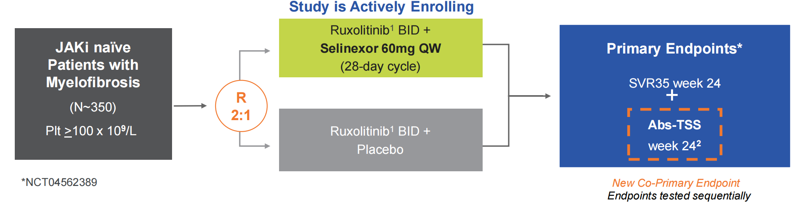
SENTRY (XPORT-MF-034*) Phase 3 Trial of Selinexor in Combination with Ruxolitinib in JAKi-naïve Myelofibrosis
Randomization stratified by:
• Dynamic International Prognostic Scoring System (DIPSS) risk category intermediate -1 vs. intermediate -2 or high-risk
• Spleen volume <1800 cm3 vs. >1800 cm3 by MRI/CT scan
• Baseline platelet counts 100-200 x 10⁹ L vs. >200 x 10⁹/L
Duan et al. ASH 2024;Abstract 1002

Slide 15
Trial Update from IMproveMF, an Ongoing, Open-label, Dose-Escalation and -Expansion
Phase 1/1b Trial to Evaluate the Safety, Pharmacokinetics, and Clinical Activity of the Novel Combination of Imetelstat with Ruxolitinib in Patients with Intermediate-1, Intermediate-2, or High-Risk Myelofibrosis
John O. Mascarenhas, MD,¹ Salman Otoukesh, MD,² Terrence Bradley, MD,³ Bart L. Scott, MD,⁴ Habte A. Yimer, MD,⁵ Souria Dougherty, MBA,⁶ Lixian Peng, PhD,⁶ Fei Huang, PhD,⁶
Ying Wan, MD, PhD,⁶ Faye M. Feller, MD,⁶ Vivian Rodolf, MD,⁶ Judy Ho, BS,⁶ Tymara Berry, MD,⁶ Andrew T. Kuykendall, MD⁷
¹Tisch Cancer Institute, Icahn School of Medicine at Mount Sinai, New York, NY, USA; ²City of Hope Comprehensive Cancer Center, Duarte, CA, USA; ³University of Miami Sylvester Comprehensive Cancer Center, Miami, FL, USA; ⁴Fred Hutchinson Cancer Center, Seattle, WA, USA; ⁵Texas Oncology/US Oncology Research, Tyler, TX, USA; ⁶Geron Corporation, Foster City, CA, USA; ⁷Moffitt Cancer Center, Tampa, FL, USA
Presentation 998 | Presented at the 66th American Society of Hematology (ASH) Annual Meeting and Exposition; December 7-10, 2024; San Diego, CA, USA
Notes:
- [Intro]
- I would like to acknowledge the work of all the authors listed on this slide, and the significant contribution of the senior coauthors, Dr Otoukesh, from City of Hope, and Dr Kuykendall, from Moffit Cancer Center to this study.

Slide 16
Imetelstat Combined With Ruxolitinib Was Well Tolerated
No DLTsª were reported at any imetelstat dose level within the first 28 days of cycle 1
Any-grade TEAEs in ≥15% of patients
Grade 3 TEAEs
Preferred term, n (%) | Total (N=17)
Patients with ≥1 TEAE | 15 (88)
Pain in extremity | 7 (41)
Nausea | 6 (35)
ALT increased | 5 (29)
Anemia | 5 (29)
Thrombocytopenia^{b} | 4 (24)
Fatigue | 4 (24)
AST increased | 3 (18)
Neutropenia^{c} | 3 (18)
Preferred term, n (%) | Total (N=17)
Patients with ≥1 grade 3 TEAE | 8 (47)
Anemia^{d} | 4 (24)
Neutropenia^{c} | 3 (18)
Leukopenia^{e} | 2 (12)
Abdominal pain | 1 (6)
Fatigue | 1 (6)
Pneumonia^{f} | 1 (6)
Epistaxis^{f} | 1 (6)
No grade 4 or 5 events were reported
ALT, alanine aminotransferase; AST, aspartate aminotransferase; DLT, dose-limiting toxicity; SAE, serious adverse event; TEAE, treatment-emergent adverse event.
ªToxicities determined by the investigator to be possibly, probably, or definitely related to imetelstat treatment, and not attributable to the underlying disease, or toxicities with ruxolitinib increasing in grade and/or clinically significant from before imetelstat initiation. ^{b}Combined term includes decreased platelet count. ^{c}Combined term includes decreased neutrophil count. ^{d}One was a SAE considered related to study treatments and resulted in dose reduction to 6.0 mg/kg. ^{e}Combined term includes decreased white blood cell count. ^{f}SAE considered to be related to underlying disease and resolved without dose modification.
Mascarenhas et al. ASH 2024;Abstract 998
Notes:
Data cut-off date: November 4, 2024
All events are reported irrespective of attribution to study drug
There was no dose-dependent relationship for pain in extremity (n=3 for 4.7mg/kg, n=0 for 6.0, n=1 for 7.5, and n=3 for 9.5).
For increased ALT/AST, one event was grade 2 and all others were grade 1. There were no Hy’s Law cases.
There were no grade 3 or 4 thrombocytopenia events

Slide 17
Hematology Values Were Stable Over Time
Hemoglobin (g/L)
120
100
80
7
7
5
6
7
6
7
7
6
5
3
3
Leukocytes (10⁹/L)
25
15
5
7
7
5
6
7
6
7
7
6
5
3
3
Mean value (SE)
Neutrophils (10⁹/L)
15
10
5
7
7
5
6
7
6
7
7
6
5
3
3
Platelets (10⁹/L)
300
200
100
7
7
5
6
7
6
7
7
6
5
3
3
Baseline
C1D8
C1D15
C1D22
C2D1
C2D8
C2D15
C2D22
C3D1
C4D1
C5D1
C6D1
Visit
Imetelstat 9.4 mg/kg
C, cycle; D, day; SE, standard error.
Mascarenhas et al. ASH 2024;Abstract 998
Notes:
Plot of mean (SE) hematology panel over time for 9.4 mg/kg cohort

Slide 18
Imetelstat Versus Best Available Therapy in Patients with Intermediate-2 or High-Risk Myelofibrosis Relapsed or Refractory to Janus Kinase Inhibitor in IMpactMF, a Randomized, Open-label, Phase 3 Trial
John O. Mascarenhas, MD,¹ Claire Harrison, MD,² Prithviraj Bose, MD,³ Jean-Jacques Kiladjian, MD, PhD,⁴ Alessandro Lucchesi, MD, PhD,⁵ Alessandro M. Vannucchi, MD,⁶ Tymara Berry, MD,⁷ Jennifer Riggs, MPH,⁷ Lixian Peng, PhD,⁷ Fei Huang, PhD,⁷ Ying Wan, MD, PhD,⁷
Vivian Rodolf, MD,⁷ Judy Ho, BS,⁷ Shyamala Navada, MD,⁷ Rami S. Komrokji, MD⁸
¹Tisch Cancer Institute, Icahn School of Medicine at Mount Sinai, New York, NY, USA; ²Guy’s and St Thomas’ National Health Service Foundation Trust, London, UK; ³The University of Texas MD Anderson Cancer Center, Houston, TX, USA; ⁴Hôpital Saint-Louis, Assistance Publique-Hôpitaux de Paris, Université Paris Cité, Paris, France; ⁵Hematology Unit, IRCCS Istituto Romagnolo per lo Studio dei Tumori (IRST) “Dino Amadori,” Meldola, Italy; ⁶University of Florence, Florence, Italy; ⁷Geron Corporation, Foster City, CA, USA; ⁸H. Lee Moffitt Cancer Center, Tampa, FL, USA
Poster 1808.1 | Presented at the 66th American Society of Hematology (ASH) Annual Meeting and Exposition; December 7-10, 2024; San Diego, CA, USA

Slide 19
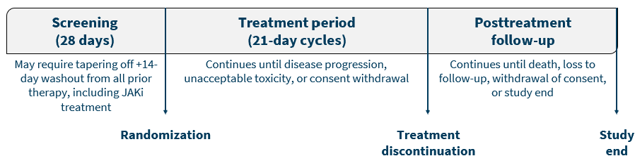
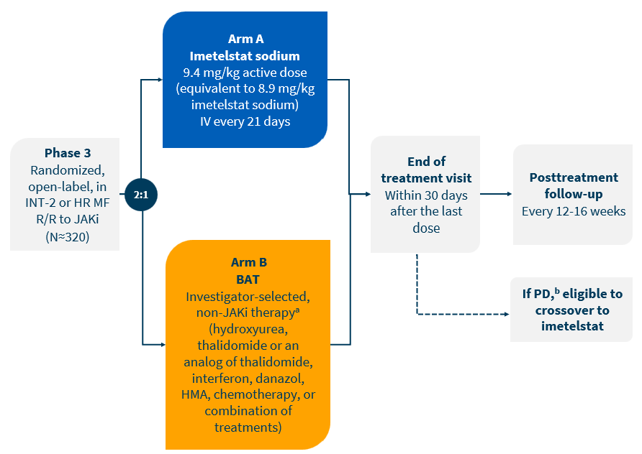
IMpactMF Phase 3 Study Design
An interim analysis is planned when ~35% of the planned enrolled patients have died (early 2026)
The final analysis is planned when >50% of the planned enrolled patients have died (early 2027)
(n≈214)
  BAT, best available therapy; HMA, hypomethylating agent; HR, high risk; INT, intermediate; IV, intravenous; JAKi, Janus kinase inhibitor; MF, myelofibrosis; PD, progressive disease; R/R, relapsed or refractory.
  ªHematopoietic stem cell transplantation or splenectomy are not to be permitted as BAT. ^{b}Must demonstrate ≥25% increase in spleen volume from baseline during the study or a palpable increase in splenomegaly after 6 months of BAT.
Mascarenhas ASH 2024;Abstract 1808.1

Slide 20
Patient Population
Eligible patients will be stratified based on (a) INT-2 or HR, and (b) platelet count at study entry
Key Eligibility Criteria
Adults with diagnosis of primary MF per the revised WHO criteria; or post-essential thrombocythemia MF or post-polycythemia vera MF per the IWG-MRT
DIPSS INT-2 or HR MF
ECOG PS ≤2
R/R to JAKi treatment
Absolute neutrophil count ≥1.5×10⁹/L
Platelets ≥75×10⁹/L
Measurable splenomegaly demonstrated by a palpable spleen measuring ≥5 cm below the left costal margin or a spleen volume ≥450 cm³ by MRI or CT
Peripheral blood blast count <10%
Bone marrow blast count <10%
Active symptoms of MF on the MFSAF v4.0
CT, computed tomography; DIPSS, Dynamic International Prognostic Scoring System; ECOG PS, Eastern Cooperative Oncology Group performance status; HR, high risk; INT, intermediate; IWG-MRT, International Working Group-Myeloproliferative Neoplasms Research and Treatment; JAKi, Janus kinase inhibitor; MF, myelofibrosis; MFSAF, Myelofibrosis Symptom Assessment Form; MRI, magnetic resonance imaging; R/R, relapsed or refractory; WHO, World Health Organization.
Mascarenhas ASH 2024;Abstract 1808.1

Slide 21
Study End Points
PRIMARY END POINT
Overall survival
EXPLORATORY END POINTS
Association between baseline cytogenetic and mutational status and clinical responses; change in mutant allele burden (molecular response)
Correlation between baseline TA, TL, or hTERT and OS, symptom response, or spleen response
SECONDARY END POINTS
Symptom response rate at week 24 (≥50% reduction in TSS measured by MFSAF v4.0)
PFS
Spleen response rate at week 24 (≥35% spleen volume reduction by MRI or CT)
Complete remission, partial remission, clinical improvement, spleen response, symptom response, and anemia response per modified 2013 IWG-MRT criteria
Time to and duration of responses
Reduction in the degree of bone marrow fibrosis
Safety
PK and immunogenicity of imetelstat
PROs as measured by the EORTC QLQ-C30 and EuroQol-EQ-5D (EQ-5D-5L) questionnaires
BAT, best available therapy; CT, computed tomography; EORTC QLQ-C30, European Organisation for Research and Treatment of Cancer Quality of Life Questionnaire-Core 30 items; hTERT, human telomerase reverse transcriptase; IWG-MRT, International Working Group-Myeloproliferative Neoplasms Research and Treatment; MFSAF, Myelofibrosis Symptom Assessment Form; MRI, magnetic resonance imaging; OS, overall survival; PFS, progression-free survival; PK, pharmacokinetics; PRO, patient-reported outcome; TA, telomerase activity; TL, telomere length; TSS, Total Symptom Score.
Mascarenhas ASH 2024;Abstract 1808.1

Slide 22
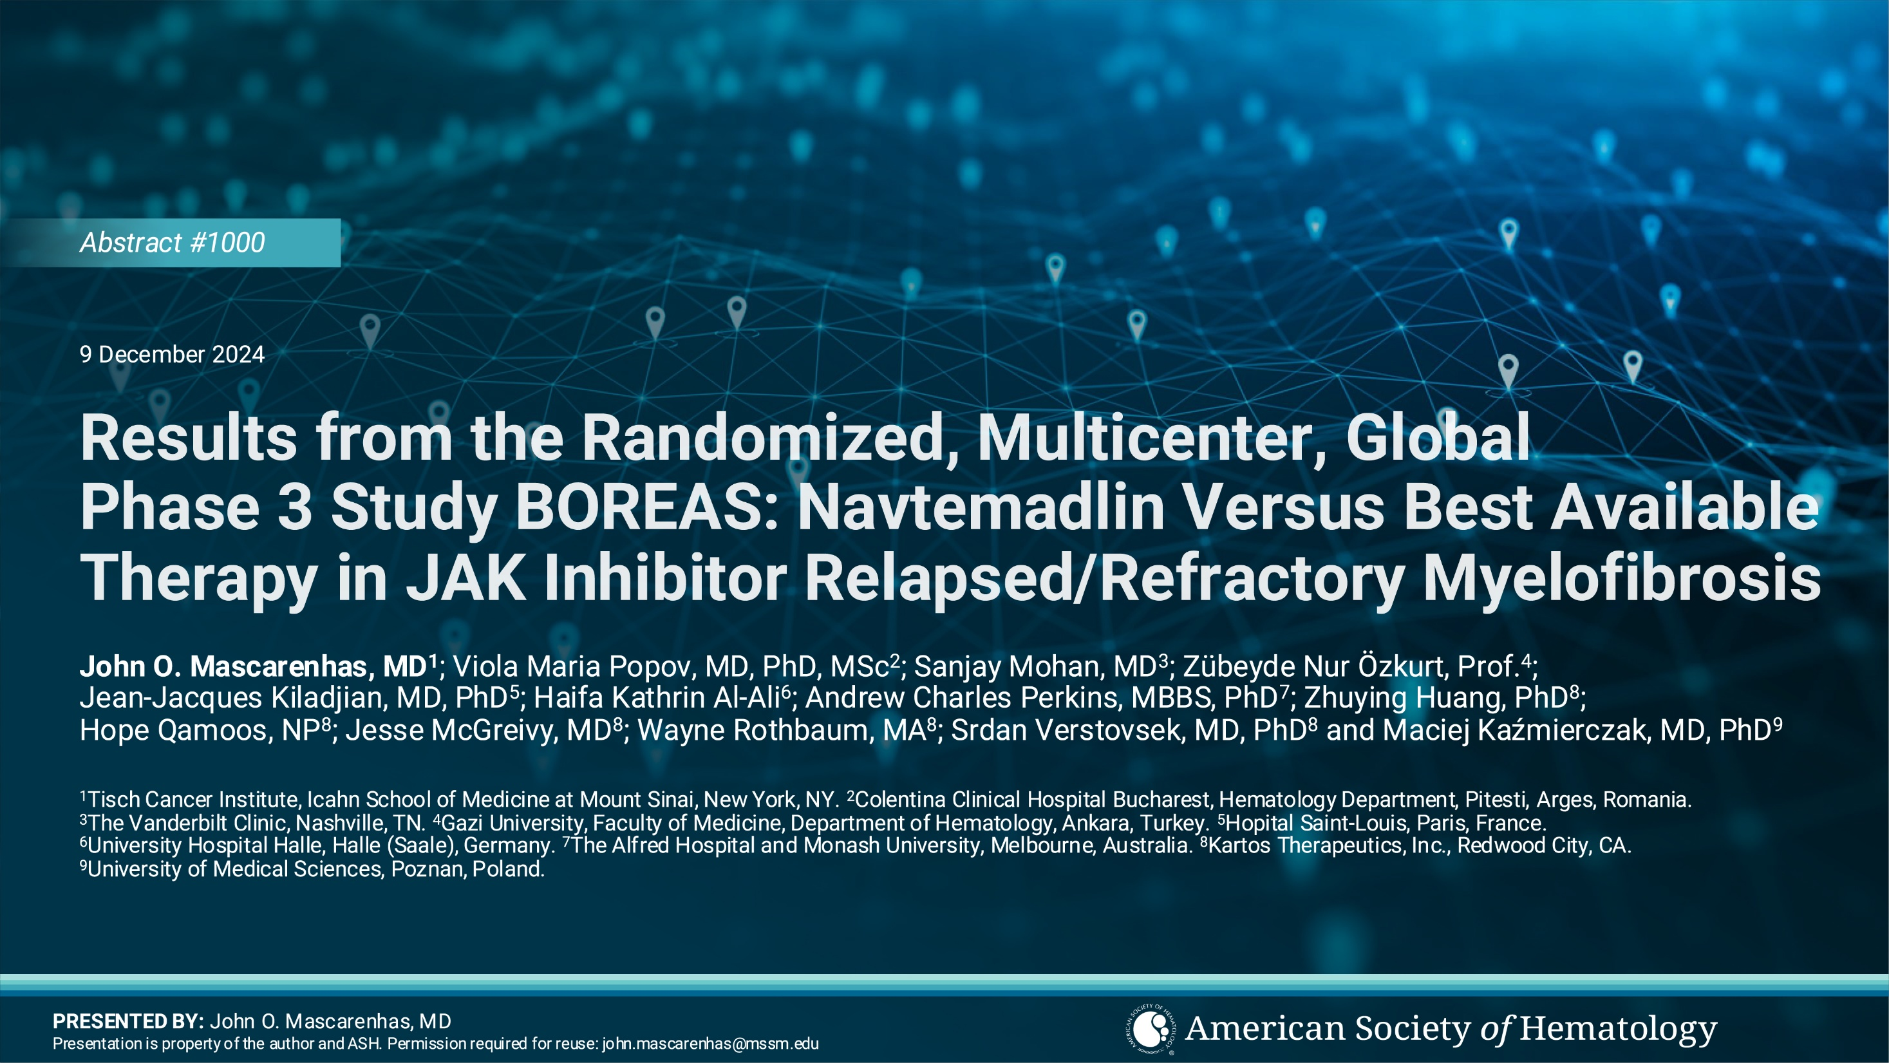

Slide 23
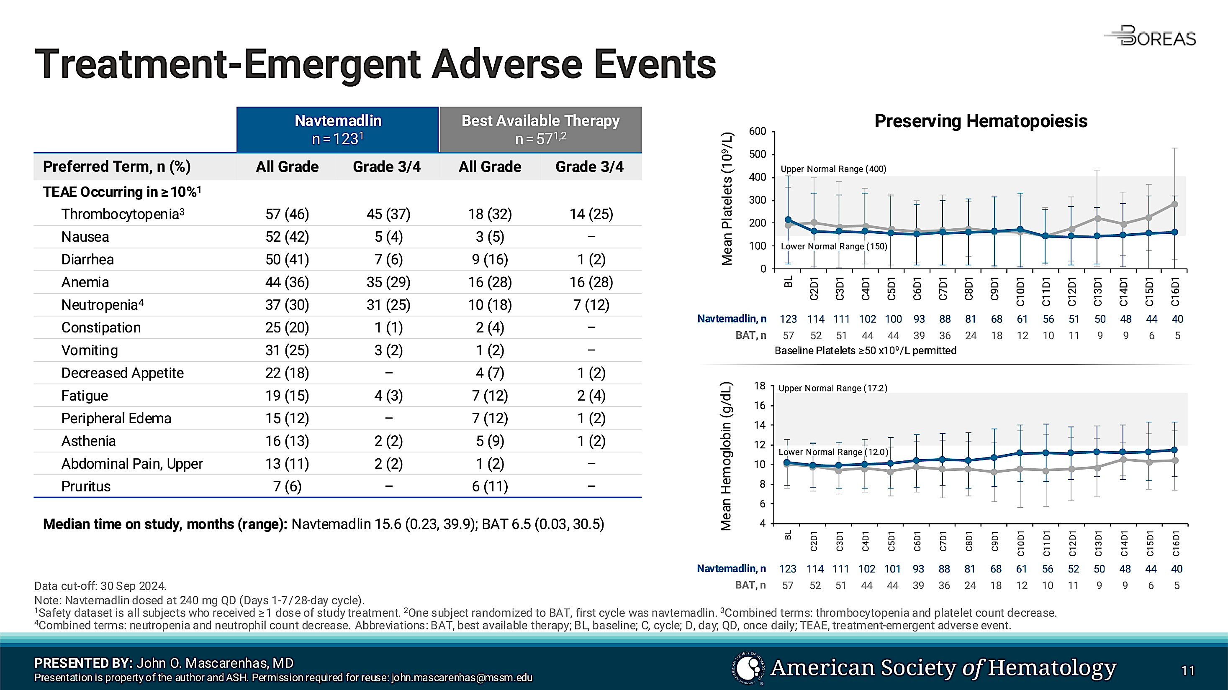
Mascarenhas et al. ASH 2024;Abstract 1000

Slide 24
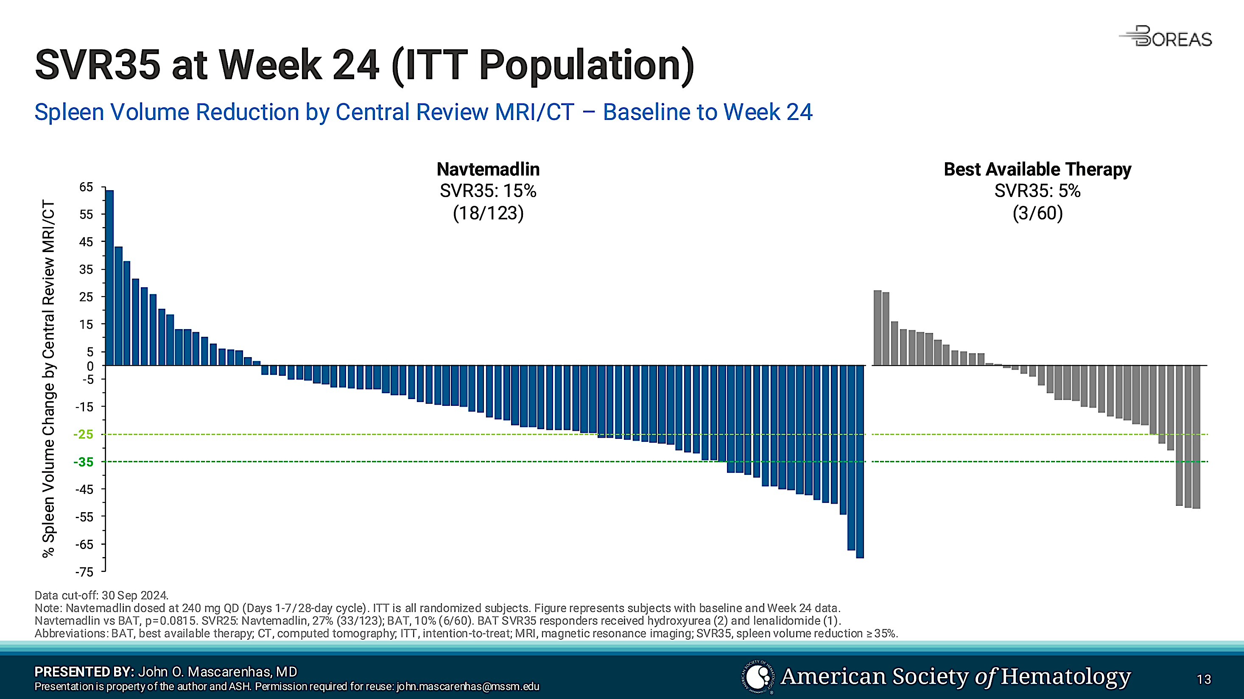
Mascarenhas et al. ASH 2024;Abstract 1000

Slide 25
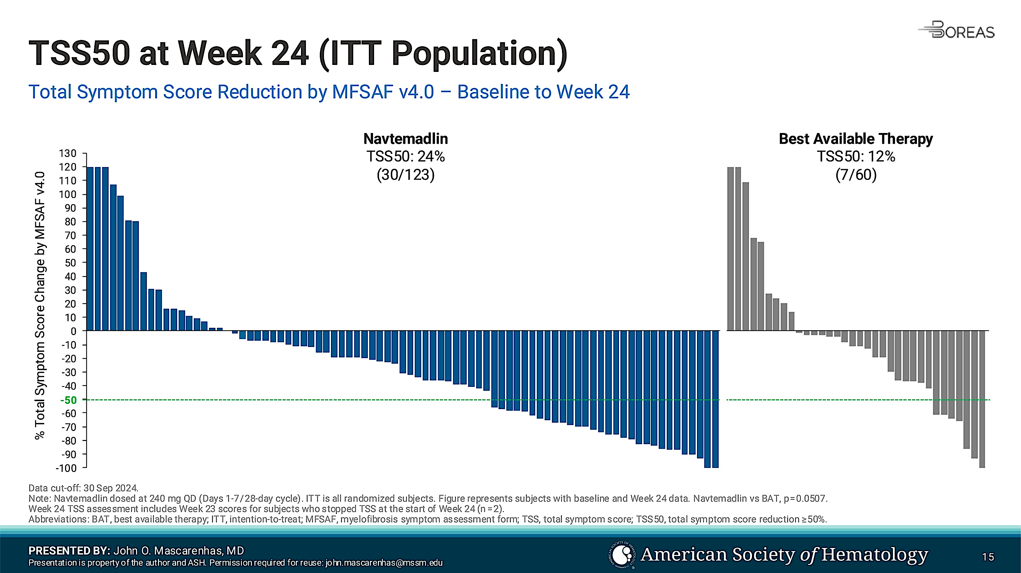
Mascarenhas et al. ASH 2024;Abstract 1000

Slide 26
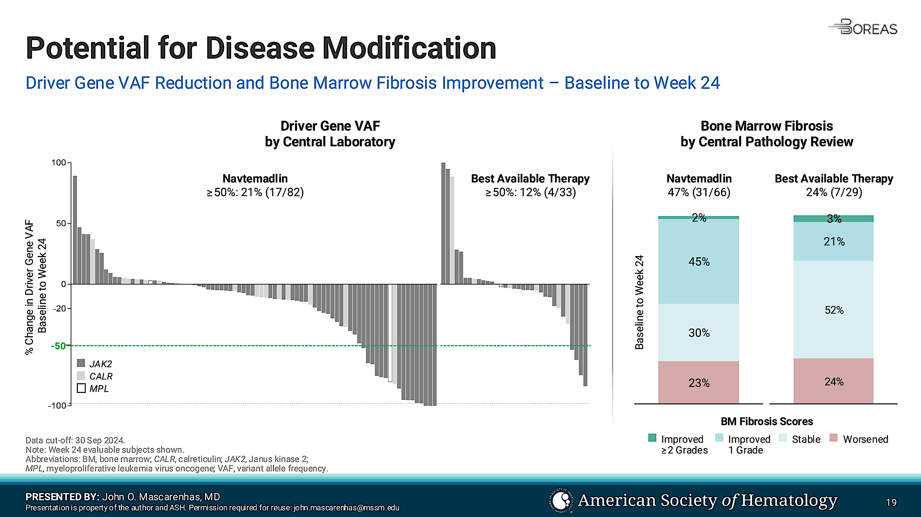
Mascarenhas et al. ASH 2024;Abstract 1000

Slide 27
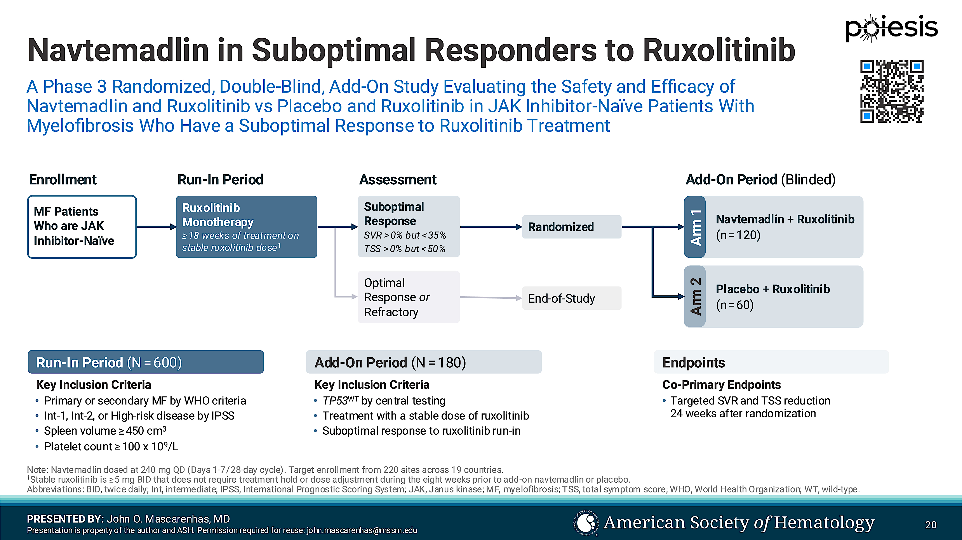
Mascarenhas et al. ASH 2024;Abstract 1000

Slide 28
Nuvisertib (TP-3654), an Investigational Selective PIM1 Kinase Inhibitor, Showed Durable Clinical Response and Sustained Hematological Improvement in Patients With Relapsed/Refractory Myelofibrosis
Firas El Chaer, MD¹, Lindsay Rein, MD², Junichiro Yuda, MD, PhD³, Kazuya Shimoda, MD, PhD⁴, Akiyoshi Takami, MD, PhD⁵, Michiko Ichii, MD, PhD⁶, James McCloskey, MD⁷, Joseph Scandura, MD, PhD⁸, Allessandra Iurlo, MD, PhD⁹, Prithviraj Bose, MD¹⁰, Tamanna Haque, MD¹¹, Alessandro Lucchesi, MD, PhD¹², Shuichi Shirane, MD, PhD¹³, Giulia Benevolo, MD¹⁴, Idoroenyi Amanam, MD¹⁵, Jean-Jacques Kiladjian, MD, PhD¹⁶, Pankit Vachhani, MD¹⁷, Srinivas Tantravahi, MBBS, MRCP¹⁸, Yasushi Onishi, MD, PhD¹⁹, Ciro Rinaldi, MD, PhD²⁰, Marcello Rotta, MD²¹, Nikki Granacher, MD²², Anand A. Patel, MD²³, Michael Loschi, MD, PhD²⁴, Samah Alimam, MD, PhD²⁵, Terrence Bradley, MD²⁶, Stanley Cheung, MD, PhD²⁷, Vincent Ribrag, MD²⁸, Sujan Kabir, MD²⁹, Karen Ansaldo, PharmD²⁹, Masataka Seki, MS²⁹, Vincent Loksa, PharmD²⁹, Zhonggai Li, PhD²⁹, Jason M Foulks, PhD²⁹, Jatin Shah, MD²⁹, Raajit Rampal, MD, PhD¹¹
¹University of Virginia Health System, VA; ²Duke University Medical Center, NC; ³National Cancer Center Hospital East, Japan; ⁴University of Miyazaki, Japan; ⁵Aichi Medical University School of Medicine, Japan; ⁶Osaka University Graduate School of Medicine, Japan; ⁷John Theurer Cancer Center at Hackensack Meridian Health, NJ; ⁸Weill Cornell Medicine, NY; ⁹Hematology, Foundation IRCCS Ca' Granda Ospedale Maggiore Policlinico, Italy; ¹⁰MD Anderson Cancer Center, University of Texas, TX; ¹¹Memorial Sloan Kettering Cancer Center, NY; ¹²IRCCS Istituto Romagnolo per lo Studio dei Tumori (IRST) “Dino Amadori”, Italy; ¹³Juntendo University School of Medicine, Japan;¹⁴ Azienda Ospedaliero-Universitaria, Italy; ¹⁵City of Hope, CA; ¹⁶Hopital Saint-Louis, France; ¹⁷University of Alabama at Birmingham, AL; ¹⁸Huntsman Cancer Institute, UT; ¹⁹Tohoku University Hospital, Japan; ²⁰United Lincolnshire Teaching Hospital and University of Lincoln, UK; ²¹Colorado Blood Cancer Institute, CO; ²²ZNA Middelheim, Belgium; ²³University of Chicago, IL; ²⁴CHU de Nice Hôpital l'Archet 1, France; ²⁵University College London Hospitals, UK; ²⁶University of Miami Health System, FL; ²⁷ICON Cancer Care, Australia; ²⁸Institut Gustave Roussy, France; ²⁹Sumitomo Pharma America, Inc., MA

Slide 29
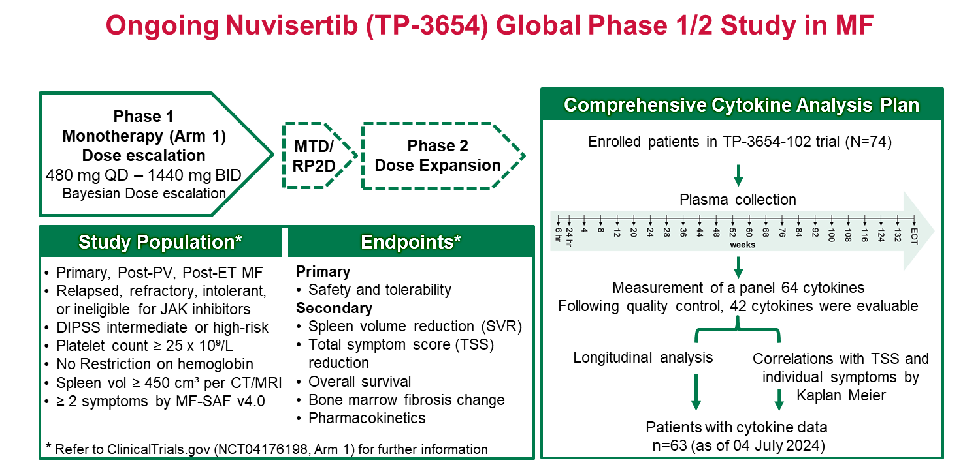
El Chaer ASH 2024;Abstract 655

Slide 30
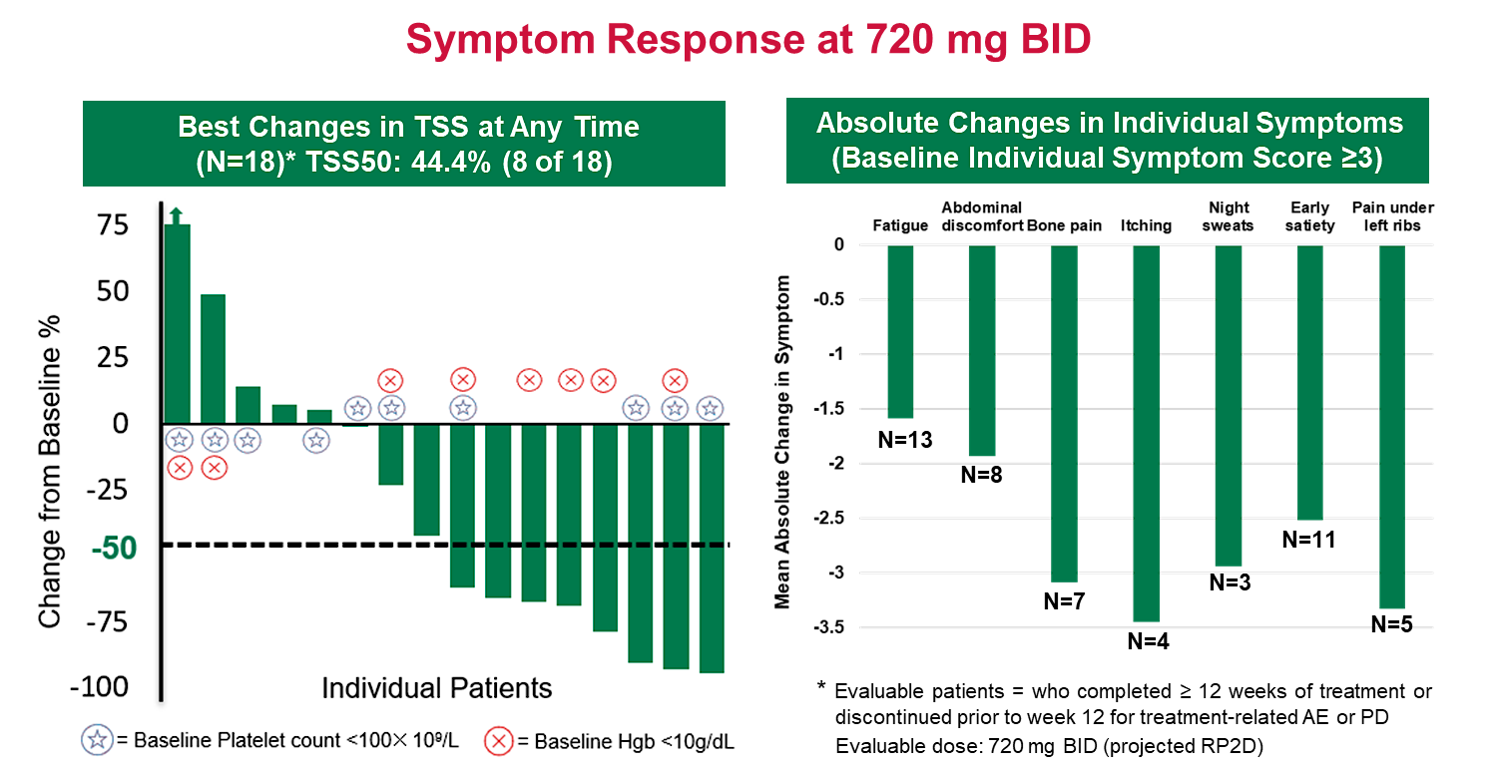
El Chaer ASH 2024;Abstract 655

Slide 31
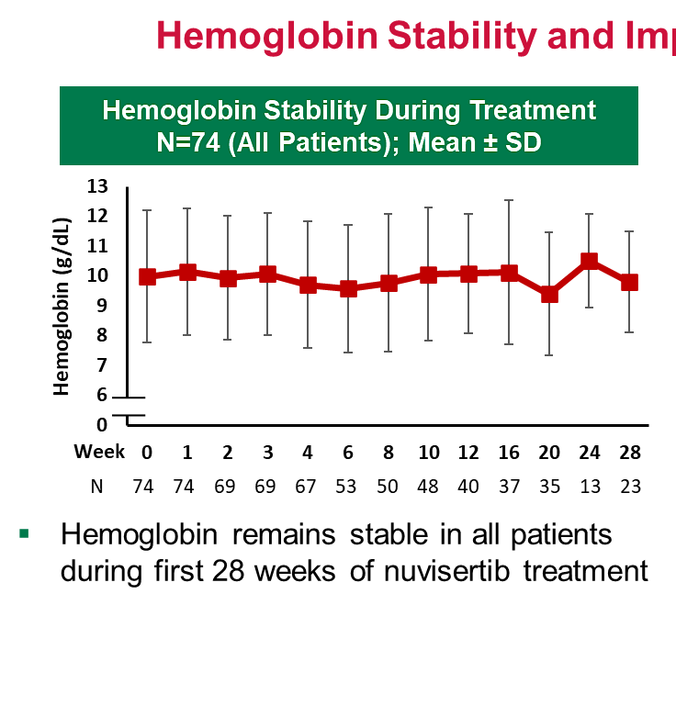
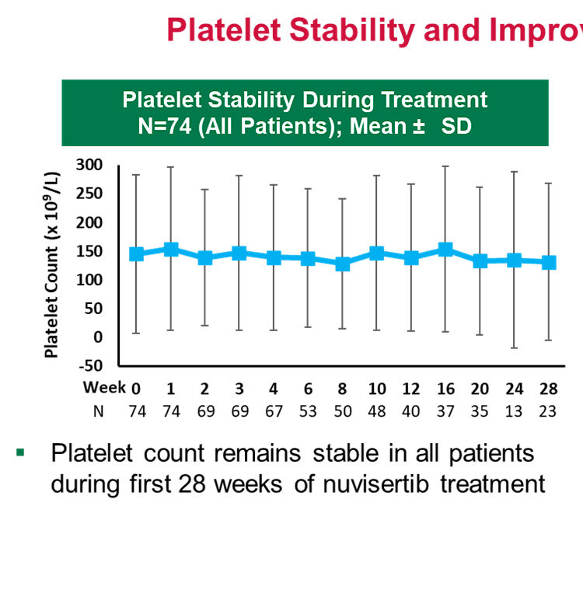
Preservation of hematopoiesis with nuvisertib
El Chaer ASH 2024;Abstract 655

Slide 32
Hematological Improvement and Other Clinical Benefits of Elritercept as Monotherapy and in Combination with Ruxolitinib in Participants with Myelofibrosis from the Ongoing Phase 2 RESTORE Trial
Claire Harrison, MD, FRCP, FRCPath
Professor of Myeloproliferative Neoplasms and Deputy Chief Medical Officer (Research, Data, and Analytics) of the Guy’s and St. Thomas’ NHS Foundation Trust, UK

Slide 33
Phase 2 RESTORE Study (NCT05037760): Design and Status​
Part 1: Dose Escalation
0.75 mg/kg to 4.5 mg/kg
Part 2: Dose Expansion
RP2D*
Monotherapy:
JAK inhibitor relapsed, refractory, intolerant or ineligible
Monotherapy:
JAK inhibitor relapsed, refractory, intolerant or ineligible
Primary MF, Post-ET or Post-PV MF with Anemia
Combination with Ruxolitinib:
Prior ruxolitinib treatment ≥ 8 weeks with stable dose ≥ 4 weeks
Combination with Ruxolitinib:
Prior ruxolitinib treatment ≥ 8 weeks with stable dose ≥ 4 weeks
Key Eligibility Criteria Transfusion dependent (TD6): received ≥ 6 RBC units/12 weeks with ≥ 1 transfusion within 28 days prior to treatment Non-transfusion dependent (Non-TD6): baseline hemoglobin < 10 g/dL, with or without transfusions, but not meeting TD6 Baseline platelet count ≥ 25 x 10⁹/L | Objectives and Endpoints Primary: To evaluate safety and tolerability of elritercept as monotherapy or in combination with ruxolitinib in participants with MF and anemia Secondary/Exploratory: To evaluate effects of elritercept on anemia, spleen volume, symptom score, exploratory biomarkers | Study Status Part 1 Dose Escalation enrollment complete RP2D identified as 3.75 mg/kg Q4W with option to up-titrate to 5 mg/kg Q4W Part 2 Dose Expansion open and enrolling (32 participants enrolled, N=8 monotherapy, N=24 combination) 73 participants (N=29 monotherapy, N=44 combination) enrolled in Parts 1 and 2 as of data cutoff date
RP2D = recommended Part 2 dose.
Harrison et al. ASH 2024;Abstract 997
MF = myelofibrosis; ET = essential thrombocytosis; PV = polycythemia vera; JAK = Janus kinase; Q4W = every 4 weeks, transfusion dependent.
Data as of 30 Aug2024

Slide 34
Elritercept was Generally Well Tolerated
Most frequently reported TEAEs across both arms were thrombocytopenia and diarrhoea
  Grade ≥ 3 thrombocytopenia in 12 (16.4%):
    Monotherapy: 8 (27.6%)
    Combination: 4 (9.1%)
  14 of the 15 participants with a TEAE of thrombocytopenia had baseline platelets < 150 x 10⁹/L
In Part 1 Dose Escalation, 1 participant (monotherapy, 1.5 mg/kg dose) experienced a dose limiting toxicity (DLT) of Hgb increase ≥ 2 g/dL, which met protocol criteria for dose reduction and was not associated with AEs
There were 2 TESAEs (anemia and fall) considered related to elritercept, and 2 TESAEs (anemia and external ear neoplasm) considered related to ruxolitinib by the treating Investigator
6 participants had unrelated TEAEs leading to death (pneumonia, pneumonia aspiration, multiple organ dysfunction, transformation to AML, cerebrovascular accident, septic shock)
Category | Monotherapy (N=29) | Combination (N=44) | Total (N=73)
TEAEs, n (%) | 29 (100) | 40 (90.9) | 69 (94.5)
Most Frequent TEAEs (≥ 15% of participants), n (%) Thrombocytopenia Diarrhoea | 10 (34.5) 5 (17.2) | 5 (11.4) 9 (20.5) | 15 (20.5) 14 (19.2)
TESAEs, n (%) | 12 (41.4) | 14 (31.8) | 26 (35.6)
Treatment-Related TEAEs, n (%) Elritercept Related Ruxolitinib Related | 11 (37.9) N/A | 15 (34.1) 13 (29.5) | 26 (35.6) 13 (17.8)
Treatment-Related TESAEs, n (%) Elritercept Related Ruxolitinib Related | 1 (3.4) N/A | 1 (2.3) 2 (4.5) | 2 (2.7) 2 (2.7)
TEAEs Leading to Discontinuation, n (%) Elritercept Discontinuation Ruxolitinib Discontinuation | 6 (20.7) N/A | 3 (6.8) 3 (6.8) | 9 (12.3) 3 (4.1)
TEAEs Leading to Death, n (%) | 4 (13.8) | 2 (4.5) | 6 (8.2)
AE = adverse event; N/A = not applicable; TEAE = treatment-emergent adverse event; TESAE = treatment-emergent serious adverse event
Harrison et al. ASH 2024;Abstract 997
Data as of 30 Aug2024
Notes:
Sources:
Exposure Table 14.1.10.1.1 (t_14_1_10_1_ex_sum_ker050_pharm)
Disposition Table 14.1.3 (t_14_1_3_ds_ph)
t-14-03-01-05lt-teae-pt
Medical History by Preferred Term Table 14.1.6.2 (t_14_01_06_02_mhpt)

Slide 35
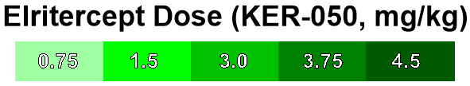
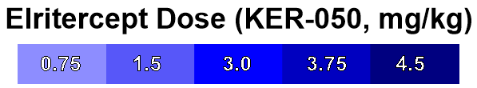
Hemoglobin Responses Observed with Elritercept Treatment:
Increases Observed in Both Monotherapy and Combination Arms
Overall, in both arms, increases in Hgb were observed in most evaluable** non-TD6 participants over a 12-week period within the first 24 weeks
  15/29 (51.7%) had increase ≥ 1.0 g/dL
  6/29 (20.7%) had increase ≥ 1.5 g/dL
  3/29 (10.3%) had increase ≥ 2 g/dL
For evaluable** non-TD6 participants in the combination arm treated with a starting dose of elritercept of 3 mg/kg or higher:
  10/18 (55.6%) had increase ≥ 1.0 g/dL
Increases in Hgb were observed in both arms supporting potential to address both ruxolitinib-associated anemia and anemia due to underlying MF
BL Hgb = baseline hemoglobin; Max Hgb = maximum mean postbaseline hemoglobin over 12 weeks within the first 24 weeks; Non-TD6 = non-transfusion dependent (< 6 RBC U/12 weeks, or no transfusions within the 28 days prior to C1D1, and BL Hgb <10g/dL)*Denotes Non-TD6 participants who received ≥ 3 RBC U/12 weeks at baseline. **Evaluable = Non-TD6 with ≥ 12 consecutive weeks of post-baseline Hgb within the first 24 weeks of treatment. Non-TD6 participants who did not have 12 consecutive weeks of post-baseline Hgb values due to insufficient time on treatment or due to censoring for transfusions (n=18; 9 monotherapy, 9 combination) were excluded from the analysis.
Harrison et al. ASH 2024;Abstract 997
Data as of 30Aug2024
Notes:
Source: l_ntd_hgbchg_waterfall_wk24
f-14-02-01-01-01-03-bs-eff-waterfall-hemo-fbase-ntd6.rtf

Slide 36
Observed Decreases in Transfusion Burden:
Transfusion Independence Observed in Both Arms
Overall, in both arms, reductions in transfusion burden were observed in evaluable** TD3 participants over the first 24 weeks of treatment
  16/41 (39%) had reduction ≥ 50%
  10/41 (24%) achieved transfusion independence (TI)
For evaluable** TD3 participants in the combination arm treated with a starting dose of elritercept of 3 mg/kg or higher:
  10/16 (62.5%) had reduction ≥ 50%
  6/16 (37.5%) achieved TI
Reductions in transfusion burden observed in both arms further support potential to address ruxolitinib-associated anemia as well as anemia due to underlying MF
BL RBC U = baseline RBC U/12 weeks; Min RBC U = minimum postbaseline RBC U/12 weeks; TD = transfusion dependent, TD3 = received ≥ 3 RBC U/12 weeks at baseline; TI = transfusion independence. *Denotes TD3 participants who also qualified as transfusion dependent based on IWG 2013 criteria (TD6); **Evaluable = TD3 with at least 12 consecutive weeks of postbaseline RBC transfusion data in the first 24 weeks. Participants without 12 consecutive weeks of transfusion data (n = 10; 6 monotherapy, 4 combination) were excluded from the analysis.
Harrison et al. ASH 2024;Abstract 997
Data as of 30Aug2024
Notes:
Source: MF_waterfall_TD_Combo_12wk_RBC3_p1p2_wk24_pharmaron_20240715.pdf, MF_waterfall_TD_Mono_12wk_RBC3_p1p2_wk24_pharmaron_20240715.pdf
https://kerostx.sharepoint.com/sites/Programs/Shared%20Documents/Forms/AllItems.aspx?id=%2Fsites%2FPrograms%2FShared%20Documents%2FKER%2D050%2F050%2DClinical%2F050%2DClinical%20Studies%2FKER050%2DMF%2D301%2FExploratory%20Data%20Analysis%2Fbiostat%2F20240715%5Fdata%5Ftransfer%2Funvalidated%2Ffigures&viewid=2b4abae2%2D944f%2D4e15%2Dbe31%2D6cb5a75e4b9e

Slide 37

A Phase Ib, Open-label Study of Add-On Therapy with CK0804 in Participants with Myelofibrosis and Suboptimal Response to Ruxolitinib
Abstract # 999
Lucia Masarova, MD, Meixian Huang, Swati Goel, MD, Sharon Bledsoe, Naveen Pemmaraju, MD, Tapan M. Kadia, MD, Prithviraj Bose, MD, Jo Ishizawa, MD, Phd, Guillermo Montalban-bravo, MD, Mi-ae Lyu, Tara Sadeghi, Simrit Parmar, MBBS, Christopher R. Flowers, MD, MS and Hagop M. Kantarjian, MD

Slide 38
Tregs with ruxolitinib in MF
Phase 1b Study of CK0804: CXCR4 Enriched, Non-HLA matched, Cryopreserved, Multi-Dose, Treg Therapy in MF Patients with Suboptimal Response to Ruxolitinib
Eligible patients
Age > 18 years with PMF/ PPV-MF or PET-MF by IWG MRT criteria.
On ruxolitinib for at least 3 months and stable dose for 8 weeks and presence of:
disease-related symptoms, as determined by a MPN SAF TSS score of ≥10 points
OR
splenomegaly of ≥5 cm below the costal margin by physical examination or by ultrasound or MRI.
OR
new grade ≥2 anemia or thrombocytopenia or neutropenia
Primary Objective: Safety of the add-on CK0804 to ruxolitinib
Secondary Objective: Efficacy of the add-on CK0804 to ruxolitinib
Exploratory Objective: PB and BM immune reconstitution; longitudinal serum biomarker and plasma inflammatory cytokines analysis
Safety Run-In
Expansion Cohort 1
Every 28 days x 6 infusions of 100 million Tregs per dose;
N=9
Every 7 days x 4 infusions; then
Every 28 days x 5 infusions
N=6
Masarova et al. ASH 2024;Abstract 999

Slide 39
Tregs with ruxolitinib in MF
Spleen Volume Change (Best); n=6
MPN SAF TSS: Early Satiety; n=6
782 cm³
2680 cm³
1699 cm³
2562 cm³
1264 cm³
1799 cm³
Maximum SVR = EOC6 in all pt
  The Early Satiety subset score
 | Mean | 95% CI Lower | 95% CI Upper
Baseline | 4.0 | 2.0 | 5.5
C4D1 | 1.8 | 0 | 4.0
EOC6 | 2.1 | 0.5 | 5.0
Masarova et al. ASH 2024;Abstract 999

Slide 40
Reduction of TGF-𝛃 Levels Correlates with Clinical Response [n=5]
Tregs with ruxolitinib in MF
Patients # 1-5
C1D8 | C2D1 | C3D1 | C4D1 | C5D1 | C6D1 | EOT
TGF𝛃 Baseline Levels [9] | Median (range) | Ref.
TGF𝛃1 (ng/ml) | 11629 (5935-25630) | <2
TGF𝛃2 (ng/ml) | 574 (336-1035) | <0.2
TGF𝛃3 (ng/ml) | 382 (9.3-2503) | <0.1
8364
863
9.2
TGF-β1
TGF-β2
TGF-β3
TSS50 & Improved TD
14538
602
TGF-β1
TGF-β2
TSS30 & Improved TD
16192
720
22
TGF-β1
TGF-β2
TGF-β3
TSS50 & SVR35
TGF- β Levels Prior to CK0804
16496
991
40
TGF-β1
TGF-β2
TGF-β3
Increase > 50%
TSS50 & SVR25
Increase 25- 50%
Increase 0 - 25%
12654
1067
2413
TGF-β1
TGF-β2
TGF-β3
Decrease 0 - 25%
TSS50 & SVR10
Decrease 25- 50%
Decrease > 50%
Masarova et al. ASH 2024;Abstract 999

Slide 41
ASH 2024 MF Highlights
Durable responses seen at 48 weeks with combination of ruxolitinib and pelabresib in JAKi naïve MF (MANIFEST-2)
INCB057643 is a potent BETi already demonstrating early mono and combo activity in MF
Additional data from China on Selinexor activity as add-on salvage therapy complements ongoing upfront combination therapy Phase 3 (SENTRY) trial
Addition of imetelstat to ruxolitinib is well tolerated and early signs of clinical activity (IMproveMF) while awaiting the phase 3 (IMpactMF) for single agent imetelstat after ruxolitinib failure with OS as endpoint!
Navtemadlin monotherapy demonstrates significant clinical responses and disease modification after JAKi failure in MF (BOREAS) and now in phase 3 for JAK inhibitor suboptimal responses (POIESIS)
Single agent nuvisertib lacks myelosuppression and reduces symptoms in MF, may be a great combination partner
Elritercept is an activin ligand trap with early data showing improvements in anemia, thrombocytopenia and symptoms, more to come
CK008 is an intriguing T regulatory cell approach for MF, awaiting mature results

Slide 42
Appendix

Slide 43
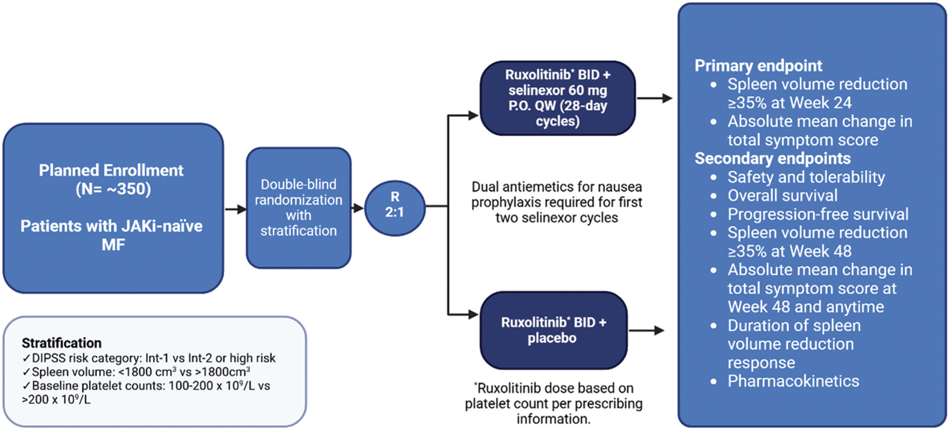
SENTRY Phase 3 Study Design
Mascarenhas J et al. Future Oncol 2025;21(7):807-13.

