Slide 1
Non-Hodgkin Lymphoma
Understanding the Current Paradigm and
New Approaches in the Care of Patients with Cancer
A Complimentary NCPD Hybrid Symposium Series Held During the 50th Annual ONS Congress
Saturday, April 12, 2025
6:00 PM – 7:30 PM
Faculty
Christopher Flowers, MD, MS
Manali Kamdar, MD, MBBS
Robin Klebig, MSN, APRN, CNP, AOCNP
Caitlin Murphy, DNP, FNP-BC, AOCNP
Moderator
Neil Love, MD

Slide 2
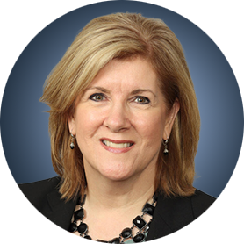
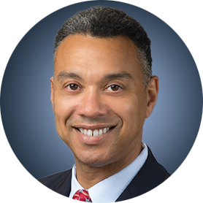
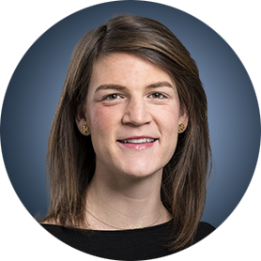

Faculty
Robin Klebig, MSN, APRN, CNP, AOCNP
Hematology Outpatient APP Supervisor
Assistant Professor of Medicine
Nurse Practitioner, Lymphoma Group
Division of Hematology
Mayo Clinic
Rochester, Minnesota
Christopher Flowers, MD, MS
Division Head, Division of Cancer Medicine
Chair, Professor, Department of Lymphoma/Myeloma
John Brooks Williams and Elizabeth Williams Distinguished University Chair in Cancer Medicine
The University of Texas
MD Anderson Cancer Center
Houston, Texas
Caitlin Murphy, DNP, FNP-BC, AOCNP
Clinical Nurse Practitioner
Director of Advanced Practice Nursing
Dana-Farber Cancer Institute
Boston, Massachusetts
Manali Kamdar, MD, MBBS
Associate Professor
Clinical Director of Lymphoma Services
Morton and Sandra Saffer Endowed Chair in Hematology Research
Division of Hematology, Hematologic Malignancies
University of Colorado Cancer Center
Aurora, Colorado

Slide 3
Dr Flowers — Disclosures
Consulting Agreements | AbbVie Inc, Bayer HealthCare Pharmaceuticals, BeiGene Ltd, Celgene Corporation, Denovo Biopharma, Genentech, a member of the Roche Group, Genmab US Inc, Gilead Sciences Inc, Karyopharm Therapeutics
Contracted Research | 4D Pharma PLC, AbbVie Inc, Acerta Pharma — A member of the AstraZeneca Group, Alaunos Therapeutics, Allogene Therapeutics, Amgen Inc, Bayer HealthCare Pharmaceuticals, Celgene Corporation, Cellectis, EMD Serono Inc, Genentech, a member of the Roche Group, Gilead Sciences Inc, Guardant Health, Iovance Biotherapeutics, Janssen Biotech Inc, Kite, A Gilead Company, MorphoSys, Nektar Therapeutics, Novartis, Pfizer Inc, Pharmacyclics LLC, an AbbVie Company, Sanofi, Takeda Pharmaceuticals USA Inc, TG Therapeutics Inc, Xencor
Nonrelevant Financial Relationships | Burroughs Wellcome Fund, Cancer Prevention and Research Institute of Texas (CPRIT Scholar in Cancer Research), Eastern Cooperative Oncology Group, Foresight Diagnostics, National Cancer Institute, N-Power Medicine Inc, V Foundation

Slide 4
Dr Kamdar — Disclosures
Consulting Agreements | AbbVie Inc, AstraZeneca Pharmaceuticals LP, BeiGene Ltd, Bristol Myers Squibb, Celgene Corporation, Genentech, a member of the Roche Group
Contracted Research | Novartis
Data and Safety Monitoring Boards/Committees | Celgene Corporation, Genentech, a member of the Roche Group

Slide 5
Ms Klebig — Disclosures
No relevant conflicts of interest to disclose.

Slide 6
Ms Murphy — Disclosures
Advisory Committees | Genmab US Inc, Seagen Inc

Slide 7
Commercial Support
This activity is supported by educational grants from ADC Therapeutics and AstraZeneca Pharmaceuticals LP.
Research To Practice NCPD Planning Committee Members,
Staff and Reviewers
Planners, scientific staff and independent reviewers for Research To Practice have no relevant conflicts of interest to disclose.

Slide 8
This educational activity contains discussion of
non-FDA-approved uses of agents and regimens. Please refer to official prescribing information for each product for approved indications.

Slide 9
Agenda
Introduction: Overview of Bispecific Antibodies and Chimeric Antigen Receptor T-Cell Therapy for Non-Hodgkin Lymphoma
Module 1: Current and Future Use of Bruton Tyrosine Kinase Inhibitors for Mantle Cell Lymphoma
Module 2: First-Line Therapy for Diffuse Large B-Cell Lymphoma (DLBCL)
Module 3: Role of Loncastuximab Tesirine for Patients with Relapsed/Refractory (R/R) DLBCL
Module 4: Role of Tafasitamab for Patients with R/R DLBCL and Follicular Lymphoma

Slide 10
Agenda
Introduction: Overview of Bispecific Antibodies and Chimeric Antigen Receptor T-Cell Therapy for Non-Hodgkin Lymphoma
Module 1: Current and Future Use of Bruton Tyrosine Kinase Inhibitors for Mantle Cell Lymphoma
Module 2: First-Line Therapy for Diffuse Large B-Cell Lymphoma (DLBCL)
Module 3: Role of Loncastuximab Tesirine for Patients with Relapsed/Refractory (R/R) DLBCL
Module 4: Role of Tafasitamab for Patients with R/R DLBCL and Follicular Lymphoma

Slide 11
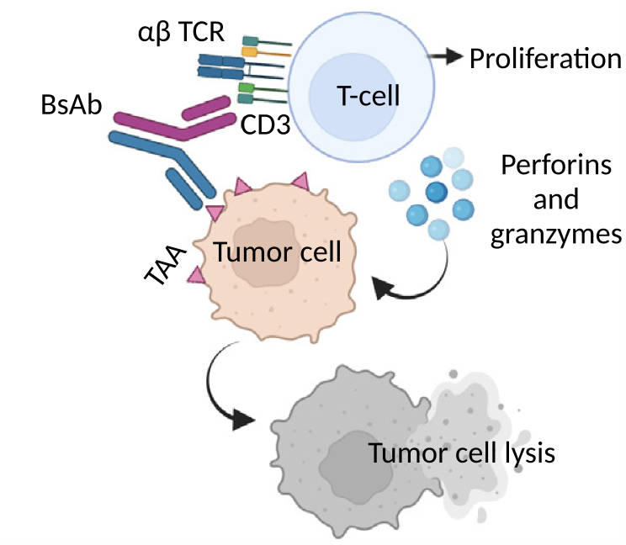
Mechanism of Bispecific Antibodies
Herrera M et al. Trends Cancer 2024;10(10):893-919.

Slide 12
Approved and Investigational Bispecific Antibodies in R/R NHL
Drug Name | Route of Administration | FDA Approval Status
Mosunetuzumab | Intravenous | Approved (FL)
Glofitamab | Intravenous | Approved (DLBCL)
Epcoritamab | Subcutaneous | Approved (DLBCL, FL)
Odronextamab | Intravenous | Investigational (DLBCL, FL)
Respective package inserts. Accessed April 2025.

Slide 13
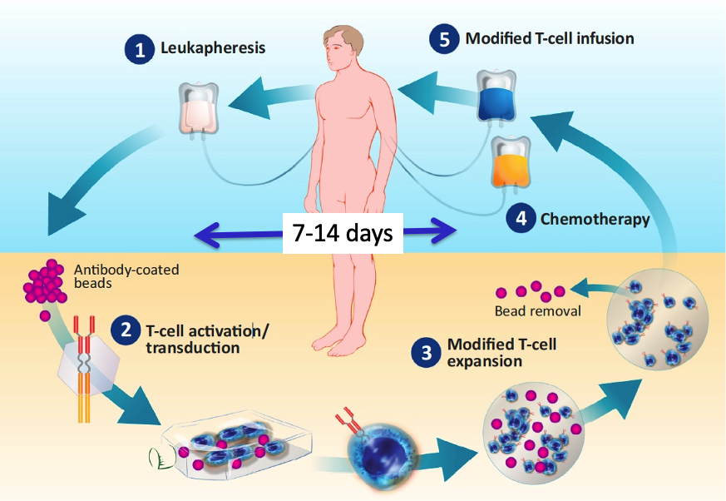
Overview of CAR T-Cell Therapy
Modification, Courtesy of David Porter, MD

Slide 14
Approved CAR-T Cell Therapies in R/R NHL
Drug Name | Disease State
Tisagenlecleucel | DLBCL, FL
Axicabtagene ciloleucel | DLBCL, FL
Lisocabtagene maraleucel | DLBCL, FL, MCL
Brexucabtagene autoleucel | MCL
Respective package inserts. Accessed April 2025.

Slide 15
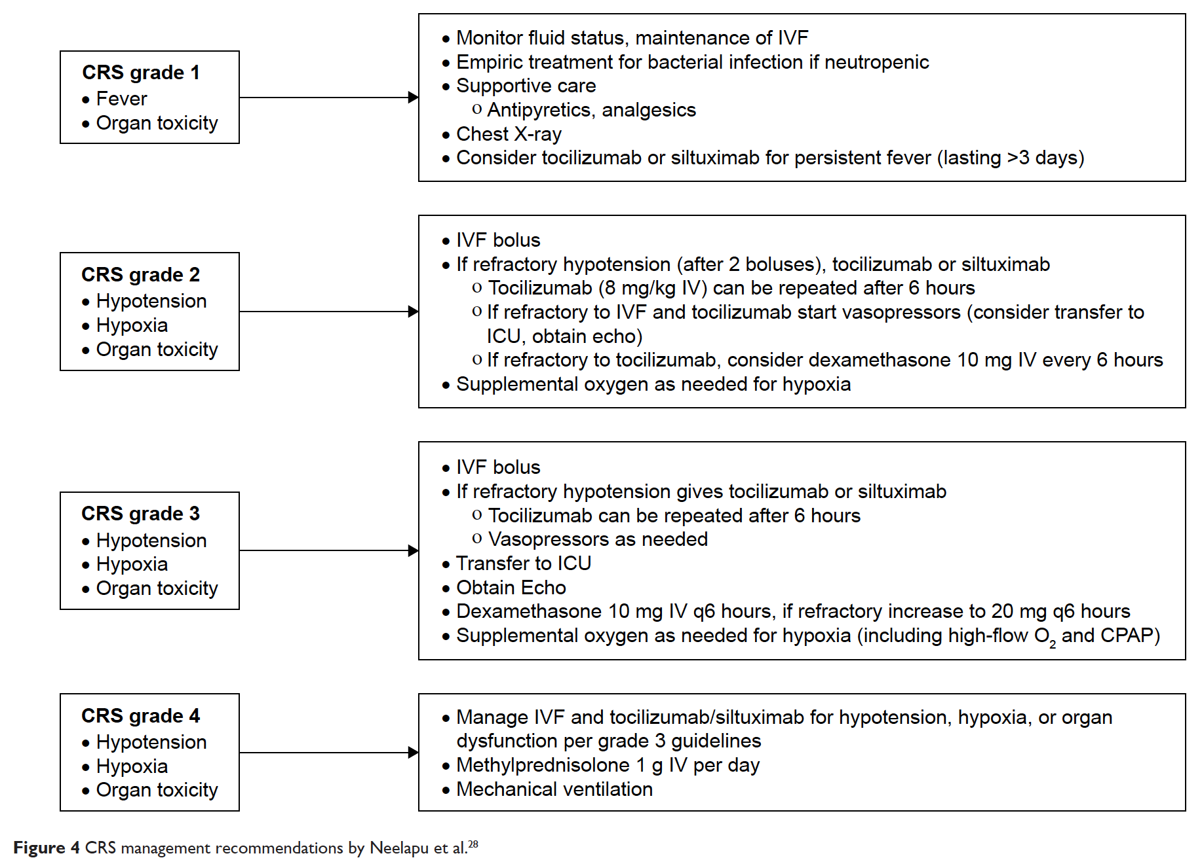
Clinical Management of CRS
Riegler LL et al. Ther Clin Risk Manag 2019;15:323-335.

Slide 16
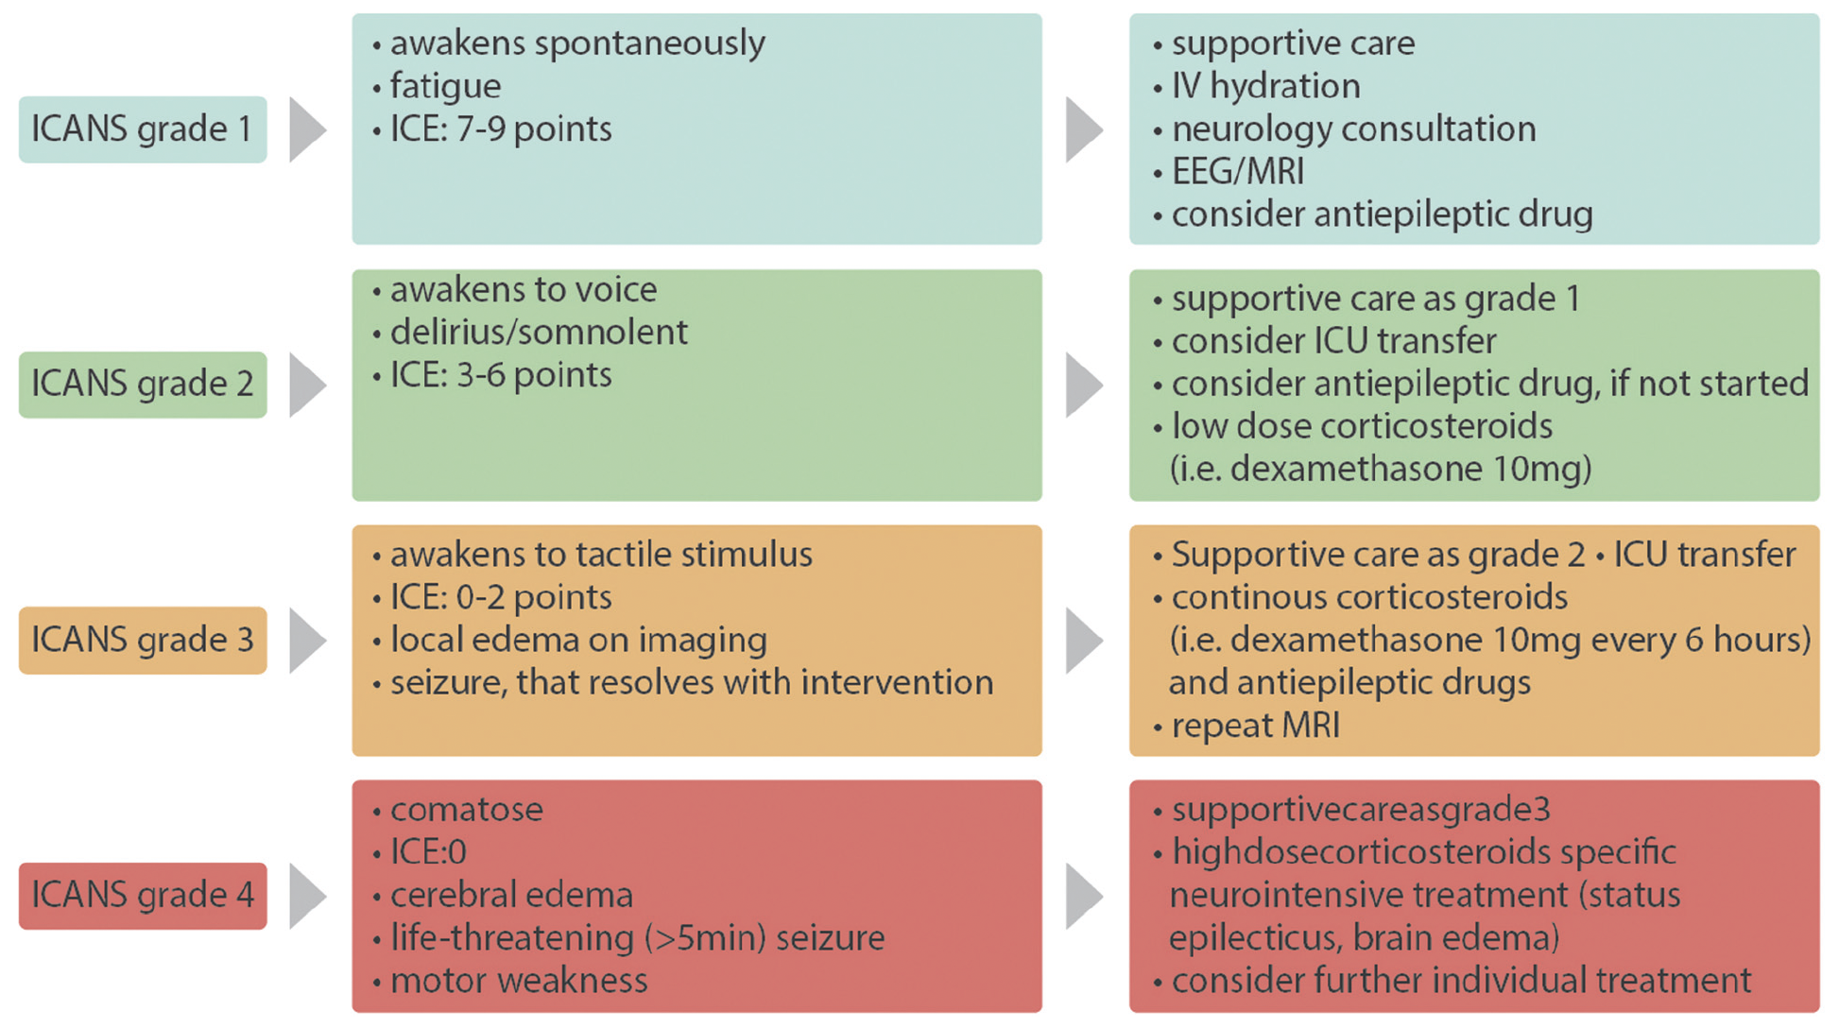
Clinical Management of ICANS
Garcia Borrega J et al. Hemasphere 2019;3(2):e191.

Slide 17
Agenda
Introduction: Overview of Bispecific Antibodies and Chimeric Antigen Receptor T-Cell Therapy for Non-Hodgkin Lymphoma
Module 1: Current and Future Use of Bruton Tyrosine Kinase Inhibitors for Mantle Cell Lymphoma
Module 2: First-Line Therapy for Diffuse Large B-Cell Lymphoma (DLBCL)
Module 3: Role of Loncastuximab Tesirine for Patients with Relapsed/Refractory (R/R) DLBCL
Module 4: Role of Tafasitamab for Patients with R/R DLBCL and Follicular Lymphoma

Slide 18
Clinical Scenario
An older patient with newly diagnosed MCL is about to start first-line treatment with acalabrutinib/bendamustine/rituximab

Slide 19

Understanding the Current Paradigm and New Approaches in the Care of Patients with Non-Hodgkin Lymphoma
Manali Kamdar, MD, MBBS
Associate Professor of Medicine, Clinical director of lymphoma services,
Morton and Sandra Saffer Endowed Chair in Hematology Research, Division of Hematology,
University of Colorado
ONS congress, RTP Symposium, 4/12/2025

Slide 20
Current and Future Use of BTK Inhibitors in Mantle Cell Lymphoma

Slide 21
Clinical Case
77-year-old male with ECOG 1 with PMH sig for Afib controlled on metoprolol and apixaban, noted gradual onset fatigue and dyspnea over 6 months. Work up including a CT scan revealed adenopathy above and below the diaphragm. Excisional biopsy of the inguinal node was consistent with Mantle cell lymphoma, blastoid variant, ki67 70%. Labs revealed mild anemia and thrombocytopenia, LDH elevated. Bone marrow biopsy positive for involvement with MCL. FISH and NGS did not show any TP53 aberration.
Next steps in the management of High-risk MCL in an older patient?

Slide 22
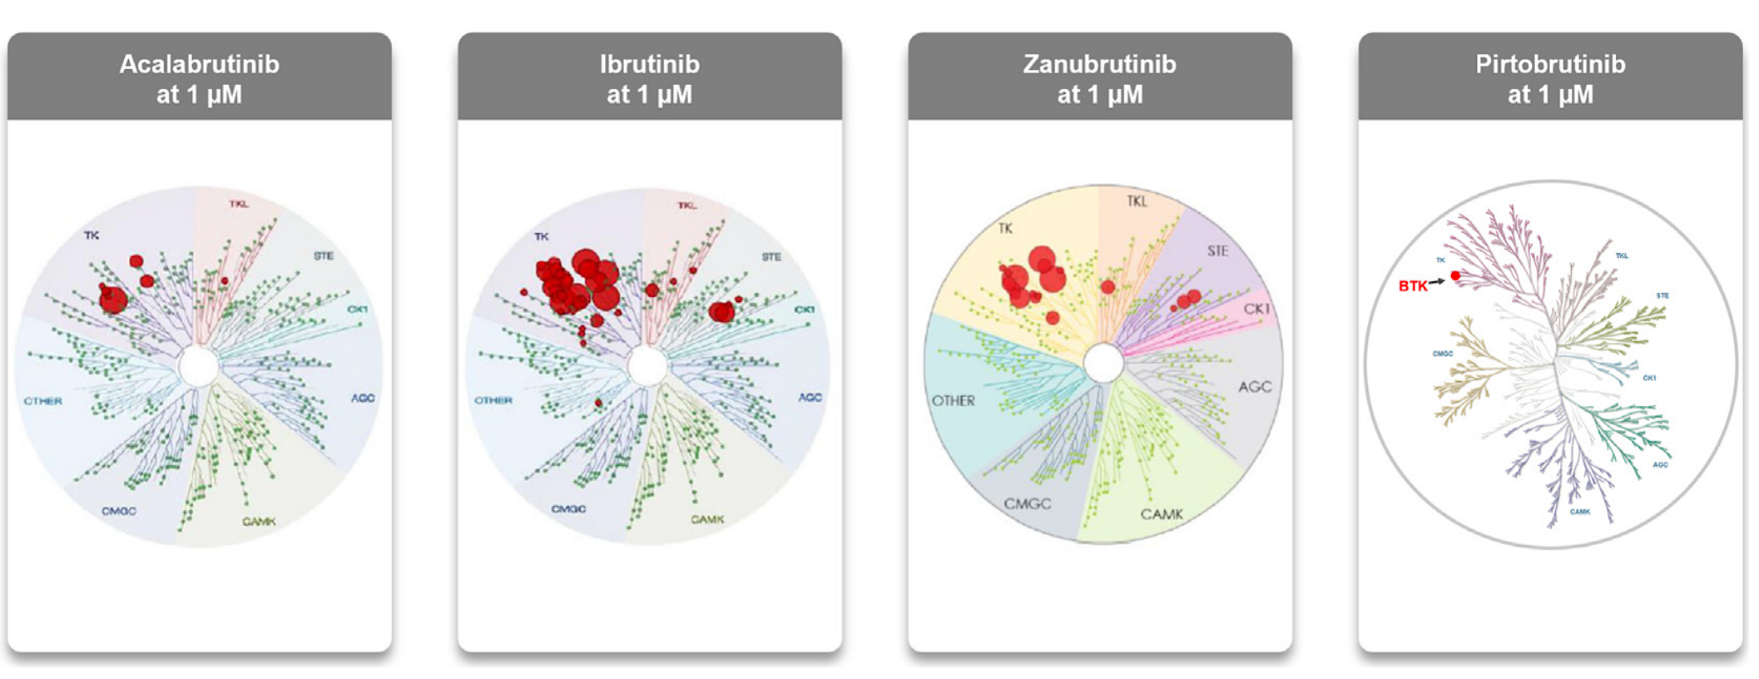
BTK inhibitors in Mantle Cell Lymphoma
Covalent BTKi
Non-Covalent BTKi
2nd Gen
1st Gen
2nd Gen
Approved 2017
Approved 2013
Approved 2019
Approved in 2023
Indication
Withdrawn 2023

Slide 23
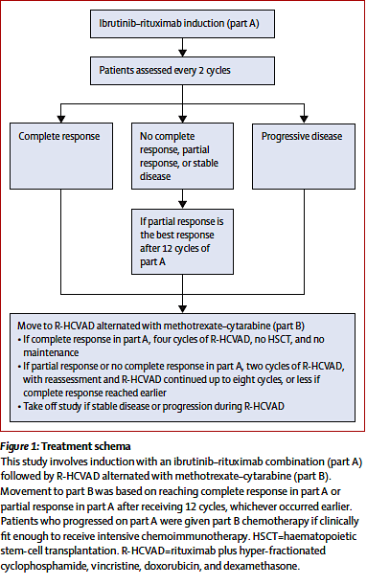
Treatment Paradigm in young and fit untreated MCL
1993: HD chemo + ASCT
1990s: CHOP, FC, CEOP
1998: HyperCVAD
2005: R-CHOP, R-HyperCVAD
2008: Nordic Regimen
2016: MCL Younger
2017: LYMA (R maintenance)
2020: BR/HiDAC
Issues with Cytotoxic Rx
Tolerability
Toxicity (Short and Long term)
Efficacy in high-risk MCL (TP53 +)
WINDOW STUDY
N = 131
ORR : 89%
CR: 77%
5-yr PFS 67%
5-yr OS 95%
Incorporating BTKi upfront Feasible
Chemo-based
TP53-mut CR lower
Wang et al. Lancet Oncol. 2022

Slide 24
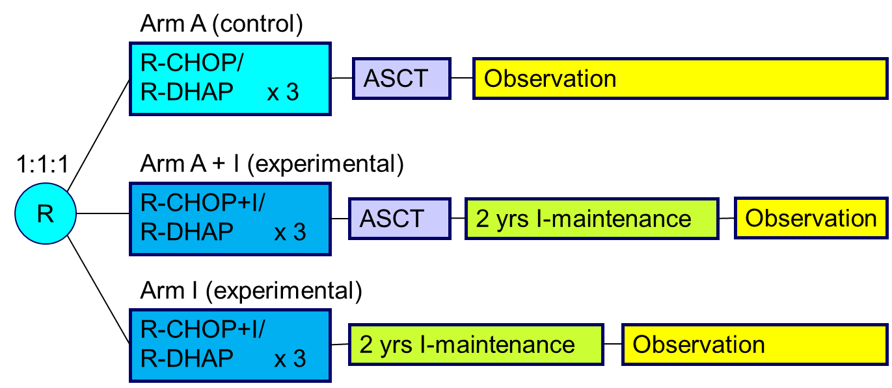
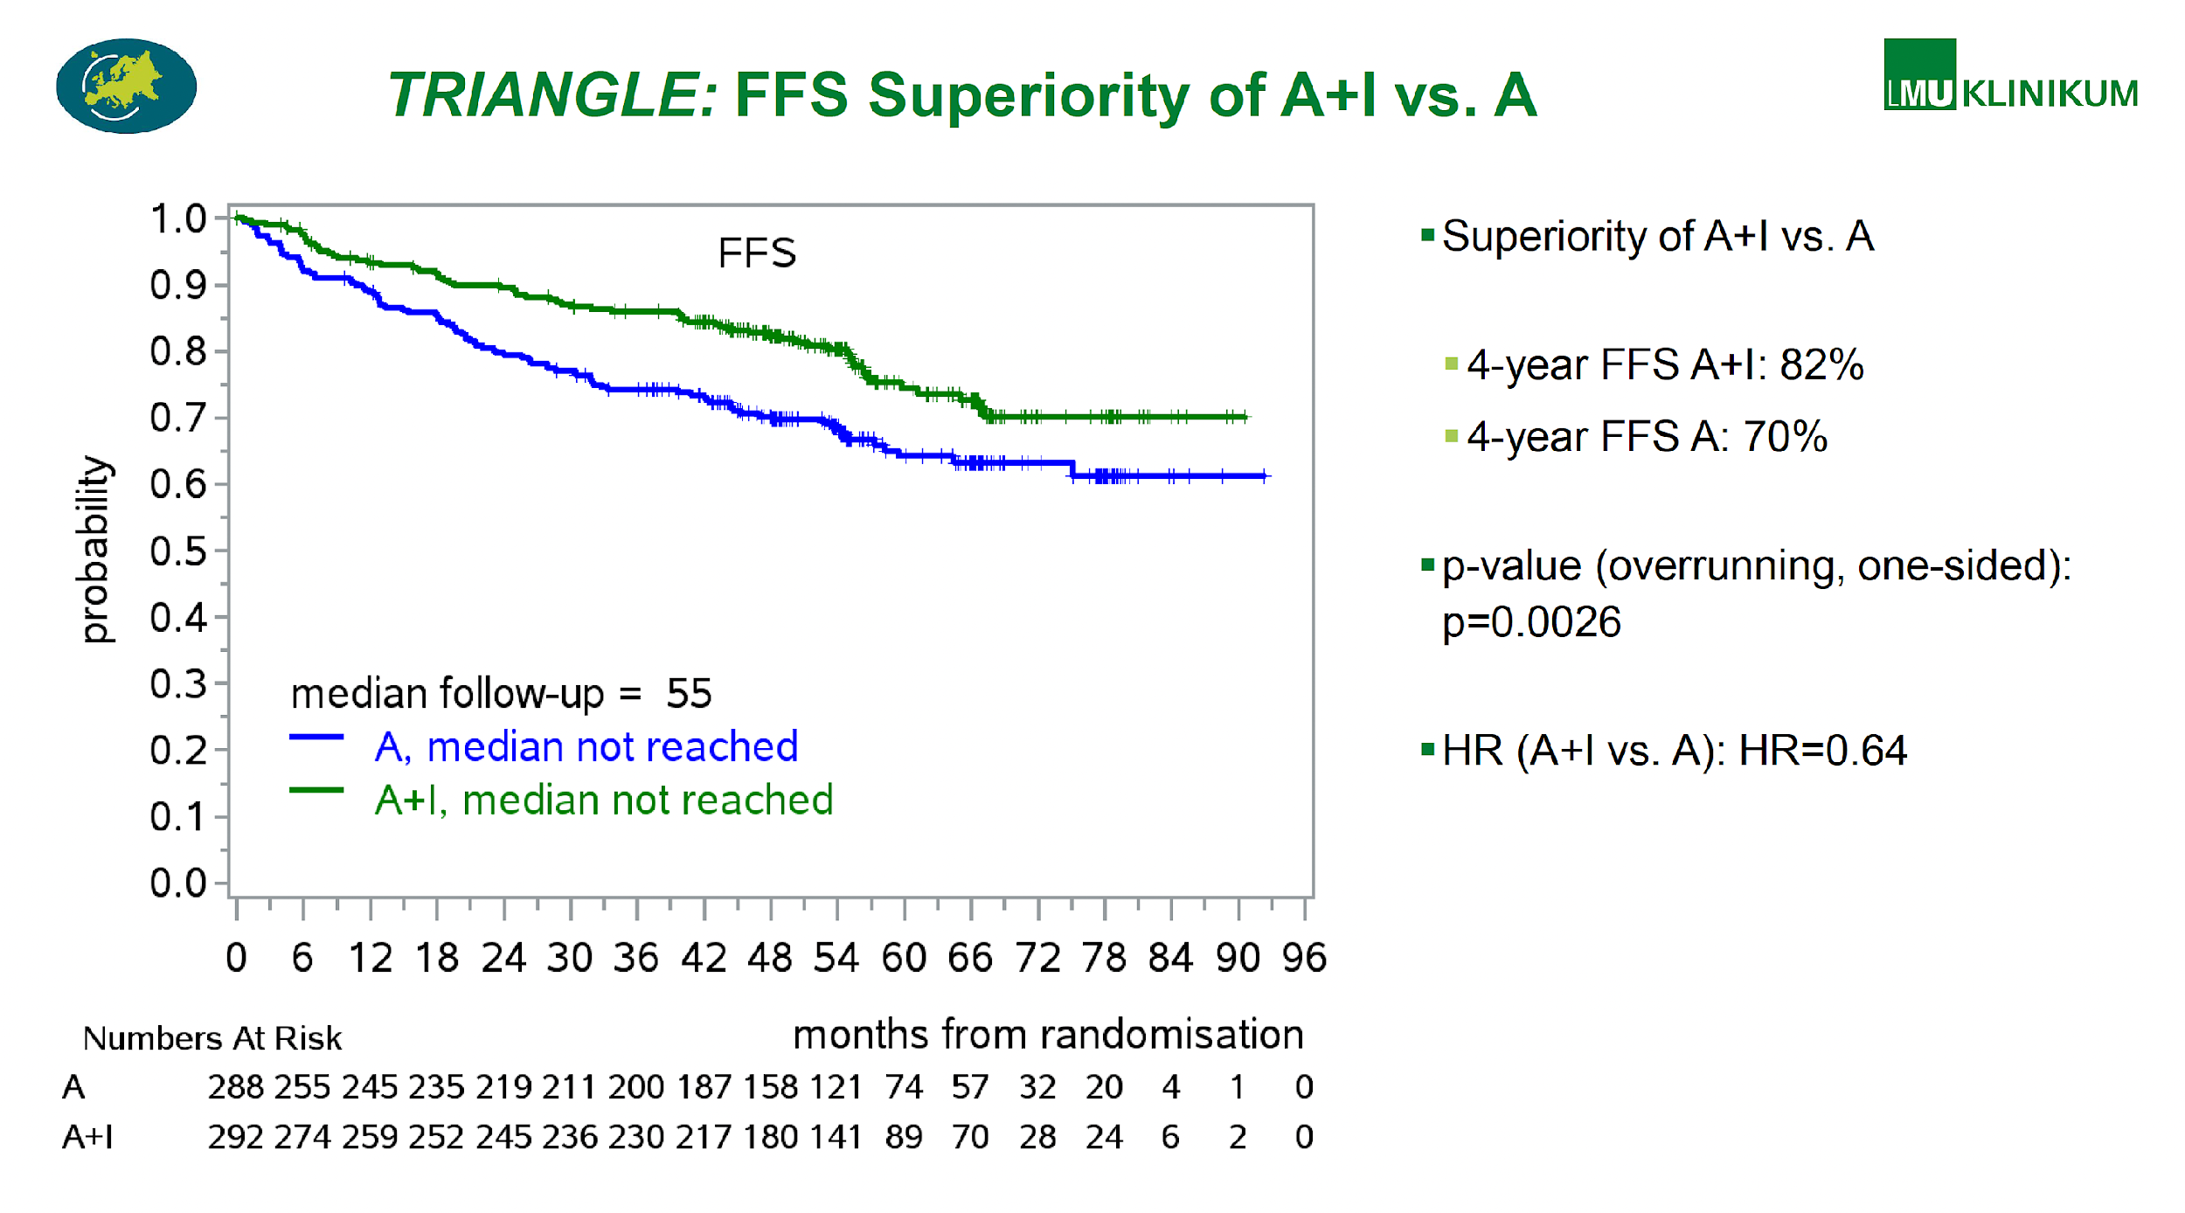
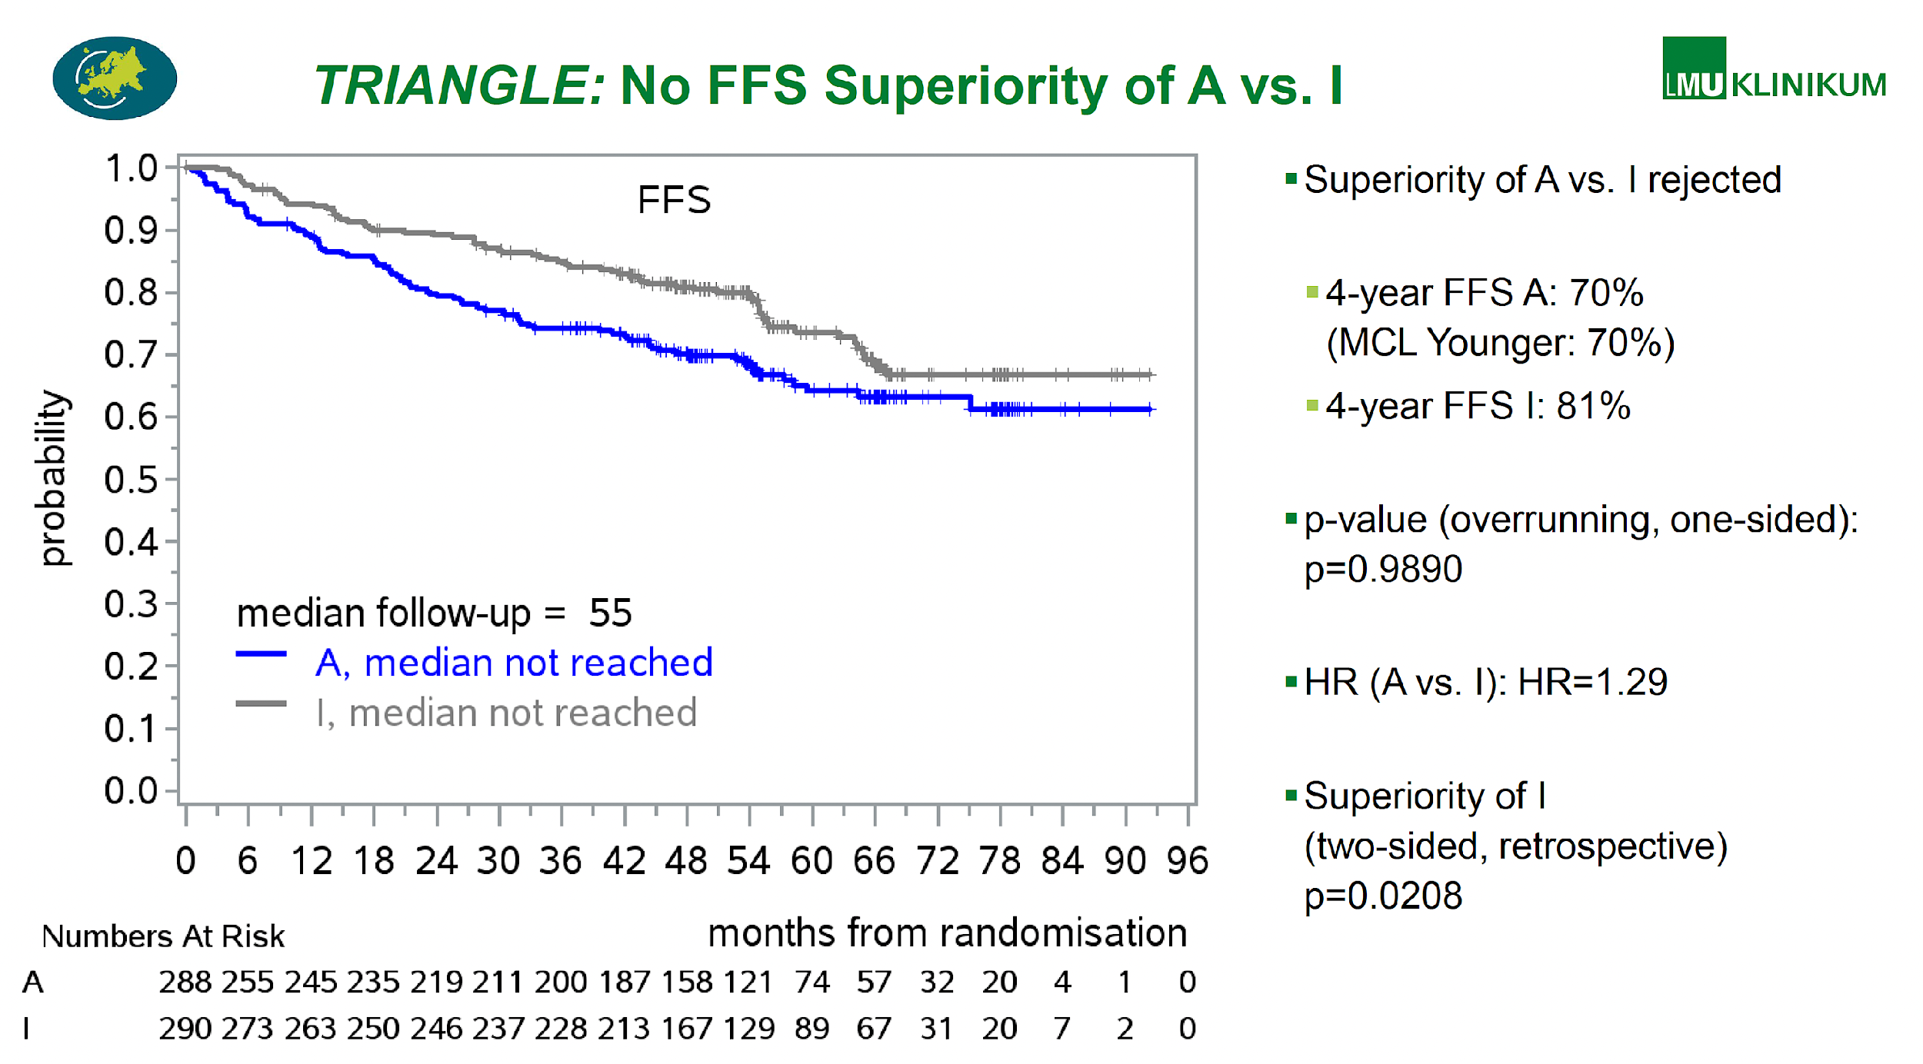
TRIANGLE PHASE III Study: Can Ibrutinib + SOC substitute ASCT in young/fit MCL?
Primary endpoint: FFS
Secondary endpoints: Response rates, PFS, RD, OS, safety
Previously untreated stage II-IV MCL
Age <66 years
Suitable for HA and ASCT
ECOG PS 0-2
Rituximab maintenance (without or with Ibrutinib) was started in
168 (58 %)/165 (57 %)/158 (54 %) of A/A+I/I randomized patients
Median FU 55 months
Dreyling M et al. Lancet 2024;403(10441):2293-306.
Dreyling M, et al. ASH 2024;Abstract 240.

Slide 25
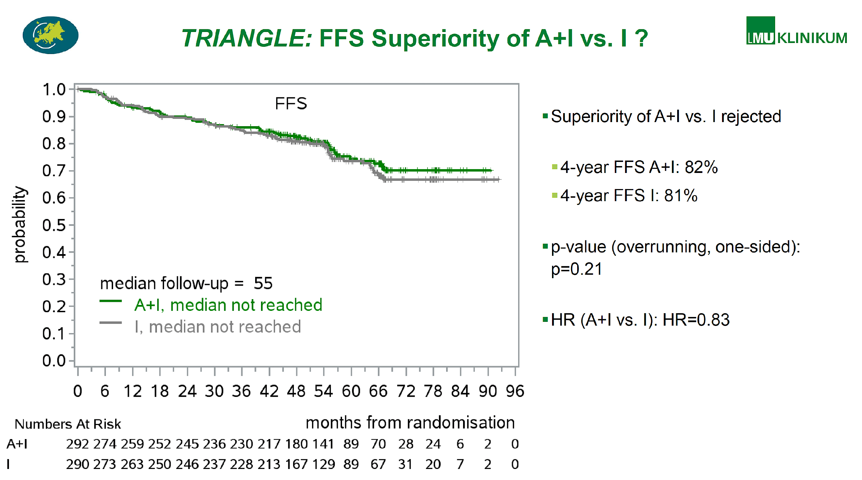
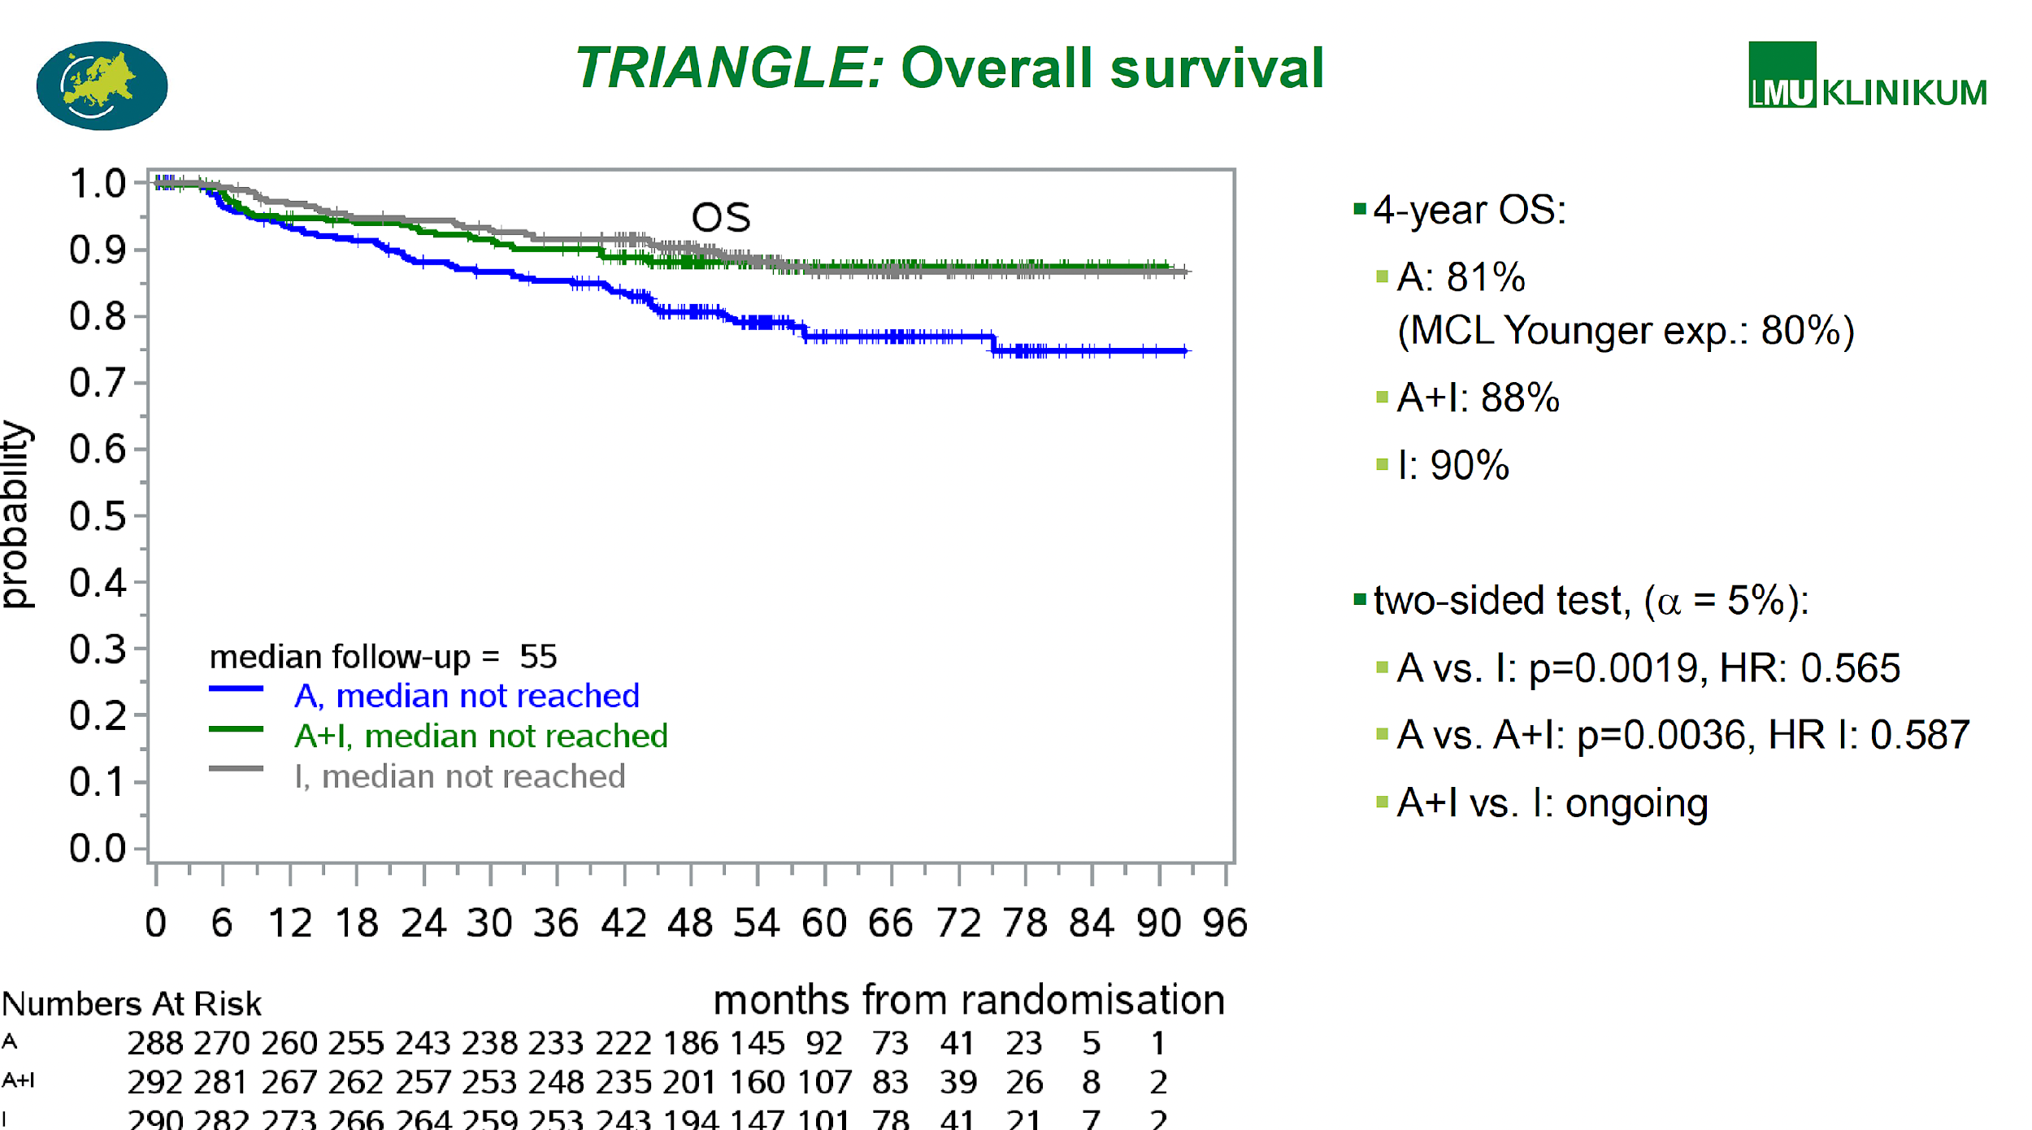
TRIANGLE PHASE III Study: Can Ibrutinib + SOC substitute ASCT in young/fit MCL?
Primary endpoint: FFS
Secondary endpoints: Response rates, PFS, RD, OS, safety
KEY TAKEAWAYS
BTKi + Chemo can Substitute ASCT in 1L MCL
No sufficient benefit of ASCT + I vs. I even in high-risk patients (TP53, high Ki67, Blastoid)
TRIANGLE regimen -- new SOC in younger MCL patients
Implications :
Substitution of Ibrutinib with Sec Gen BTKi
Can we do better in High-Risk disease – Chemo in TP53 ?
Treatment at relapse ? Rechallenging with BTKi ? Something else?
Dreyling M, et al. ASH 2024;Abstract 240.

Slide 26
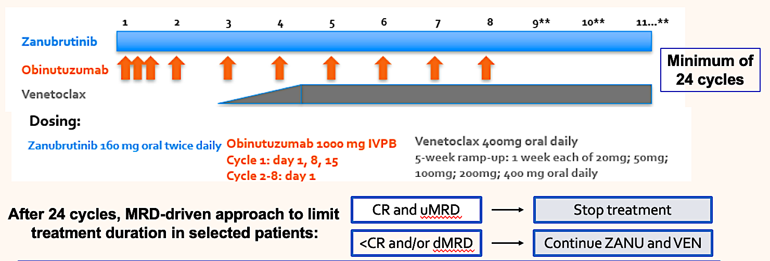
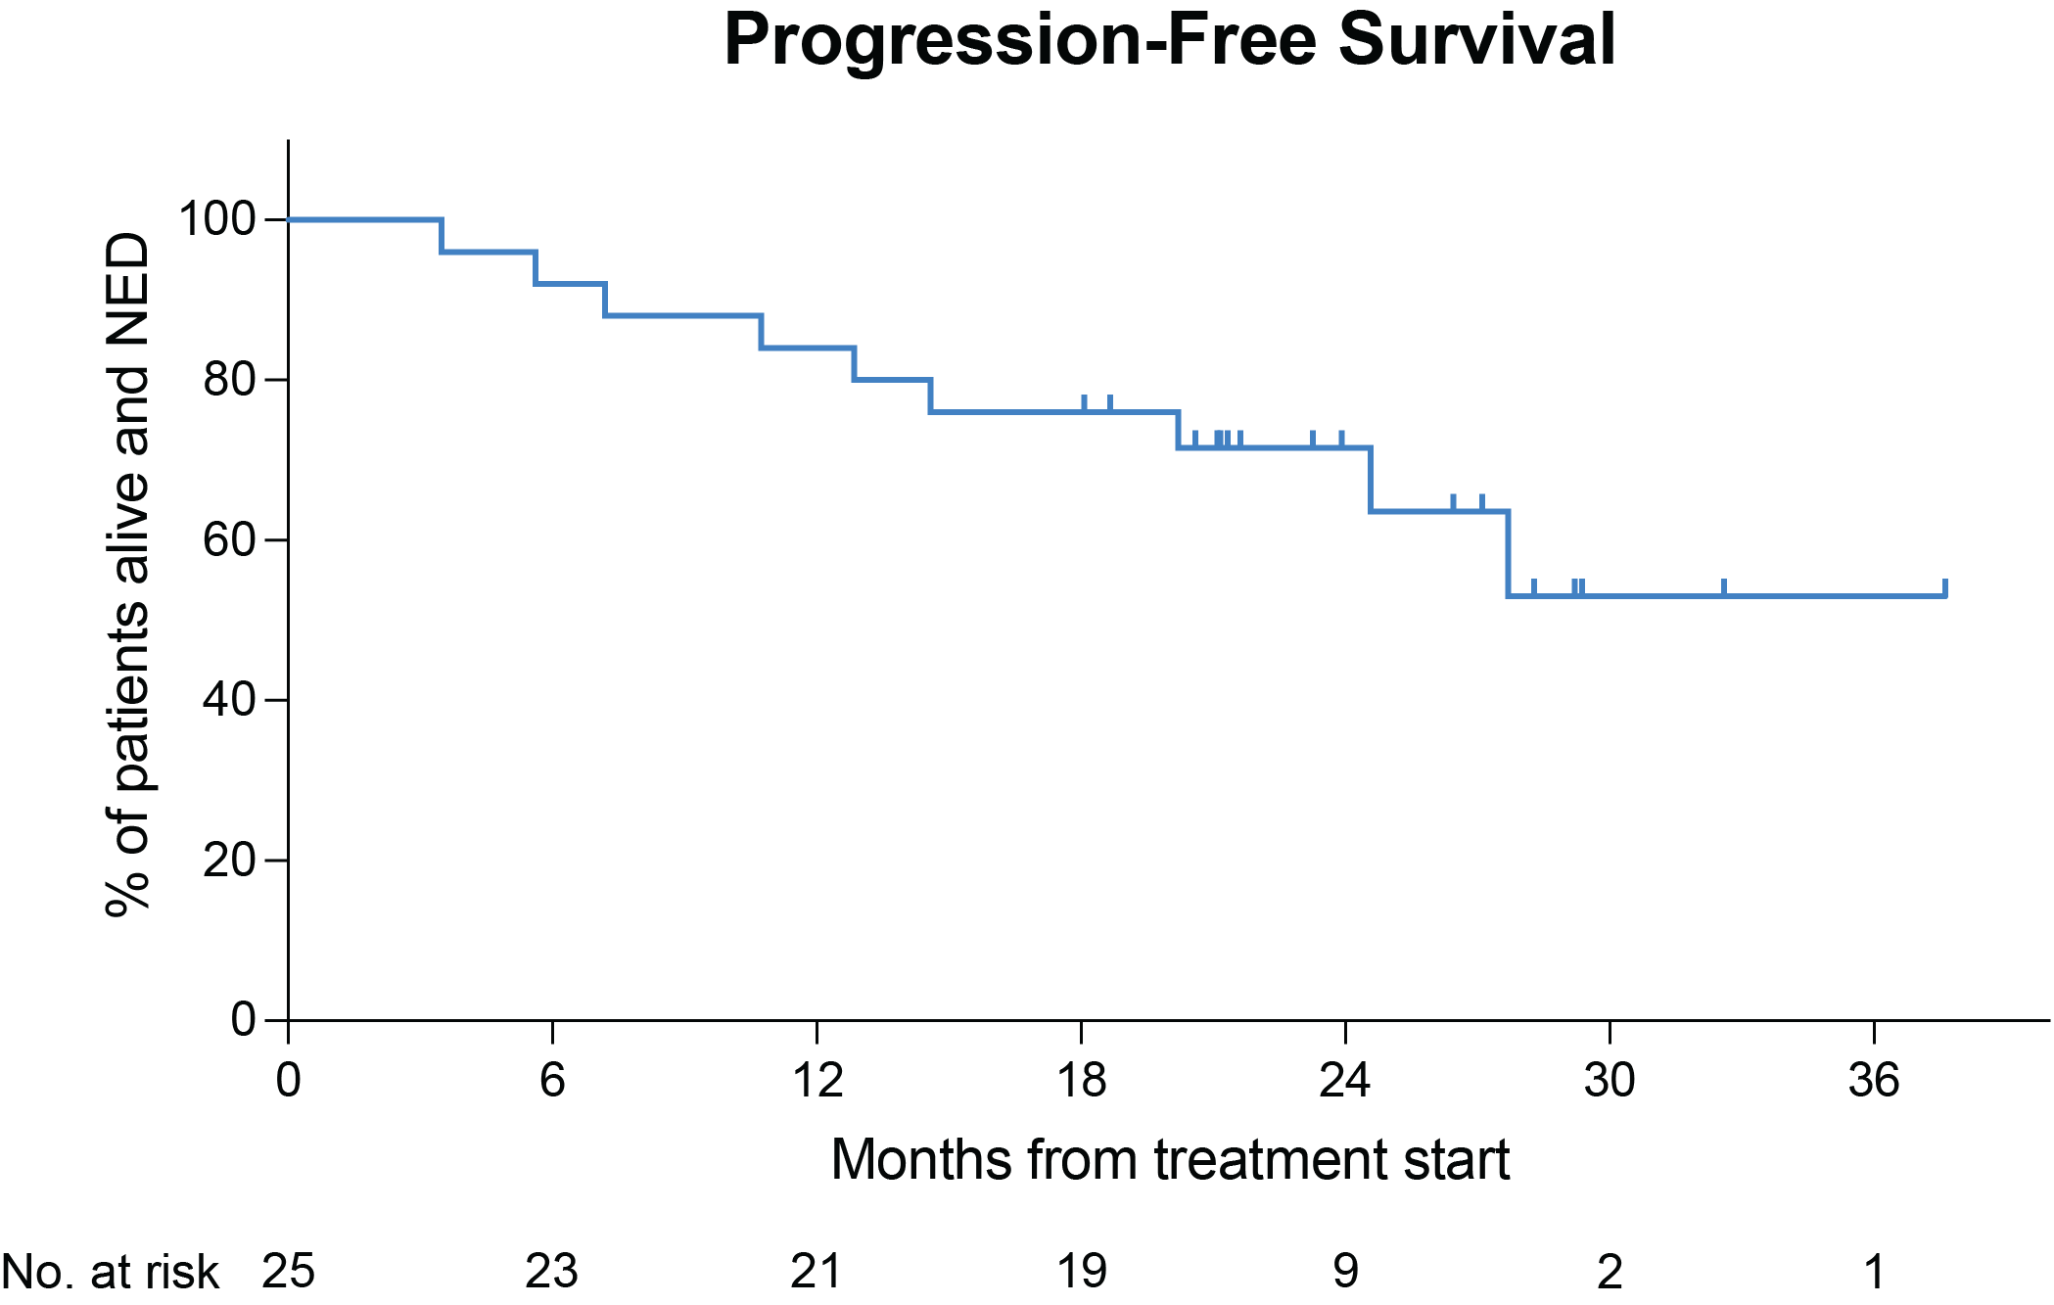
A multicenter, phase 2 trial with zanubrutinib, obinutuzumab, and venetoclax (BOVen) in patients with treatment-naïve, TP53-mutant MCL
N= 25; mAge 65 (29-82)
Primary Endpoint: PFS at 2y
Median FU 23.3 months
SAFETY
well-tolerated and safe
Most common AEs were diarrhea, COVID19 infection, neutropenia
Grade 3 neutropenia (16%) resolved with GCSF
Diarrhea was predominantly grade 1
RESULTS:
ORR 96%, CR 88%
5 PD, 4 deaths (In response, 2 covid)
11 completed therapy
10 with MRD data – 8/10 uMRD –stopped
2/10- dMRD- continuing Ven plus Zanu
2yr PFS 72%
mPFS NR
Practice
Implications
NCCN – TP53mut
? TRIANGLE
Rx at Relapse?
Kumar et al ASH 2023; Abstract 738

Slide 27
Treatment Paradigm in young and fit untreated MCL
1993: HD chemo + ASCT
1990s: CHOP, FC, CEOP
1998: HyperCVAD
2005: R-CHOP, R-HyperCVAD
2008: Nordic Regimen
2016: MCL Younger
2017: LYMA (R maintenance)
2020: BR/HiDAC
ASCT ERA
2022: WINDOW-1
2023: TRIANGLE
2024: BOVEN
CHEMO + BTKi ERA

Slide 28
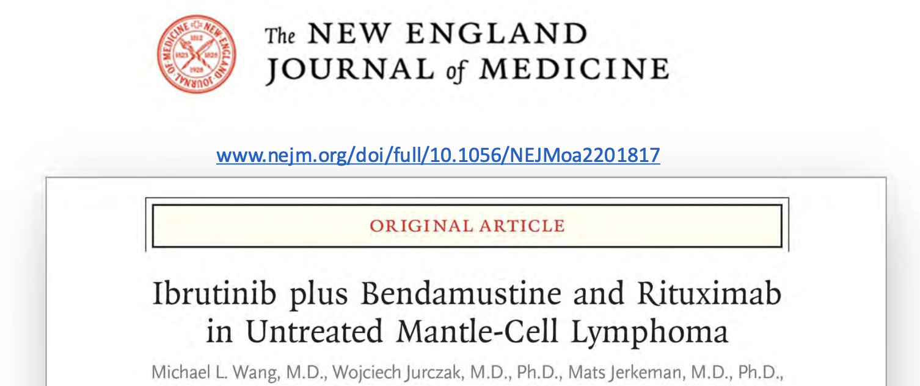
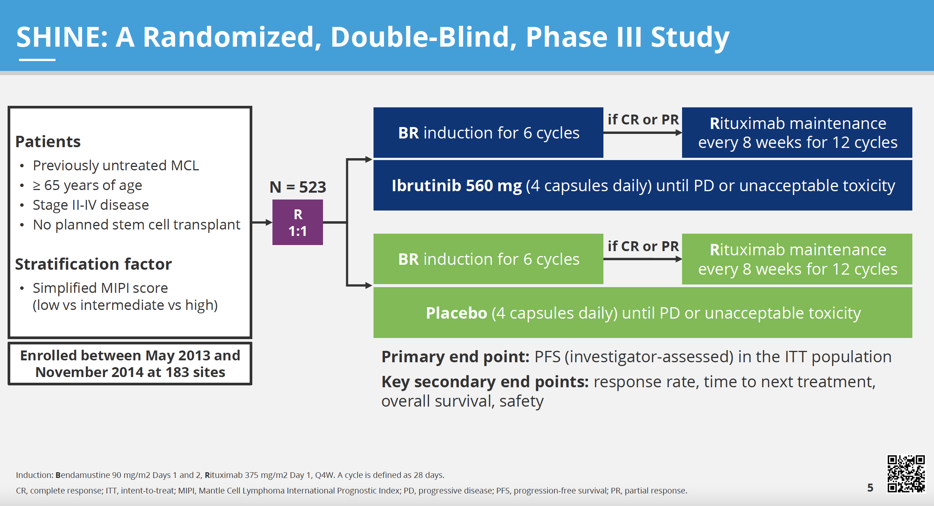
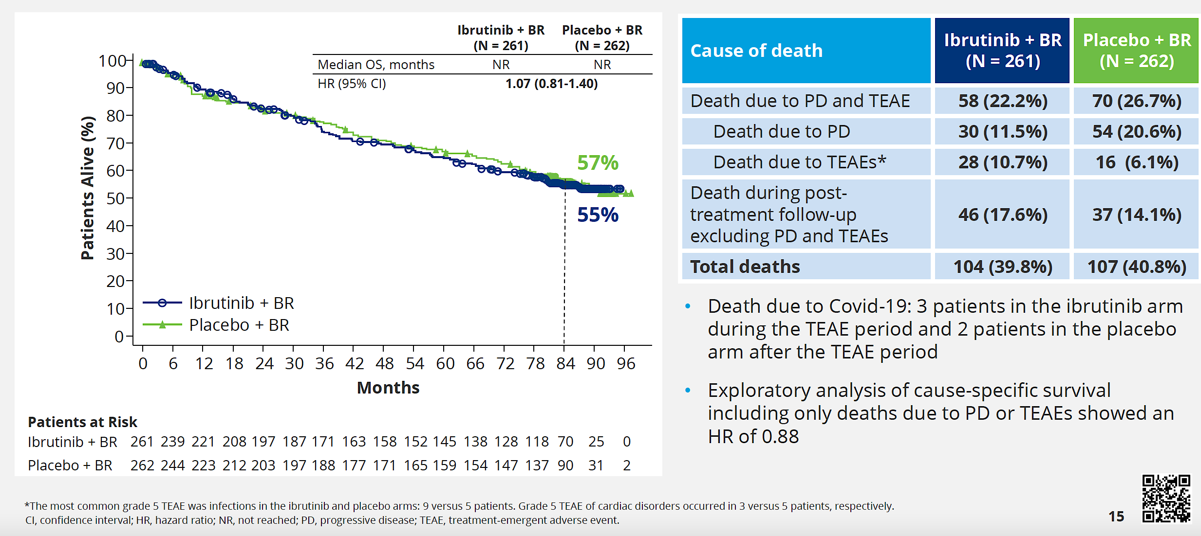
Treatment Paradigm in elderly and unfit untreated MCL
1990: CHOP, FC, CEOP
2012: R-CHOP with Ritux Maintenance
2013: BR
2017: RBAC
2018: VR-CAP
+ BTKi Trials

Slide 29
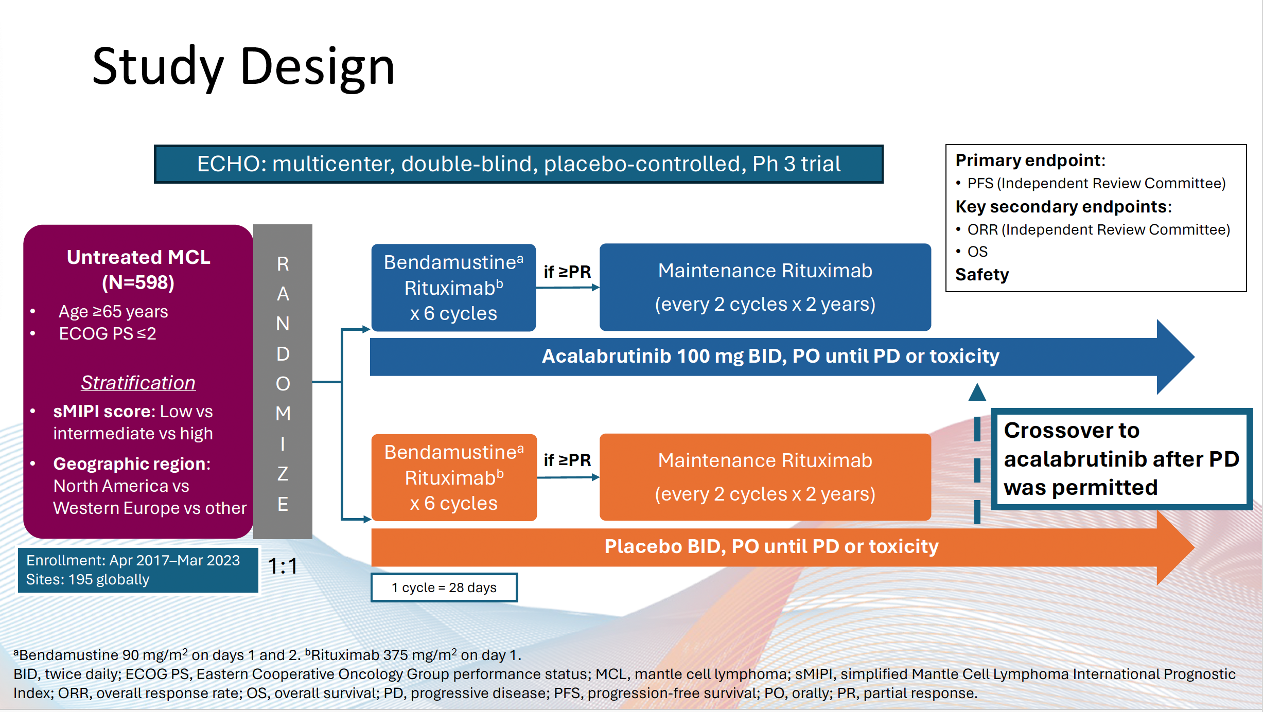
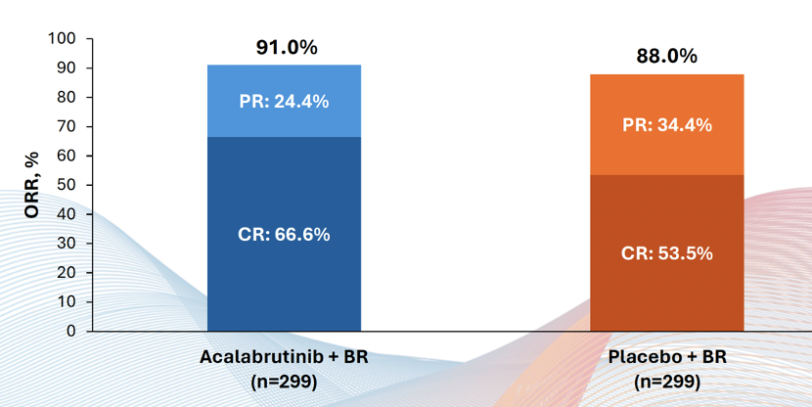
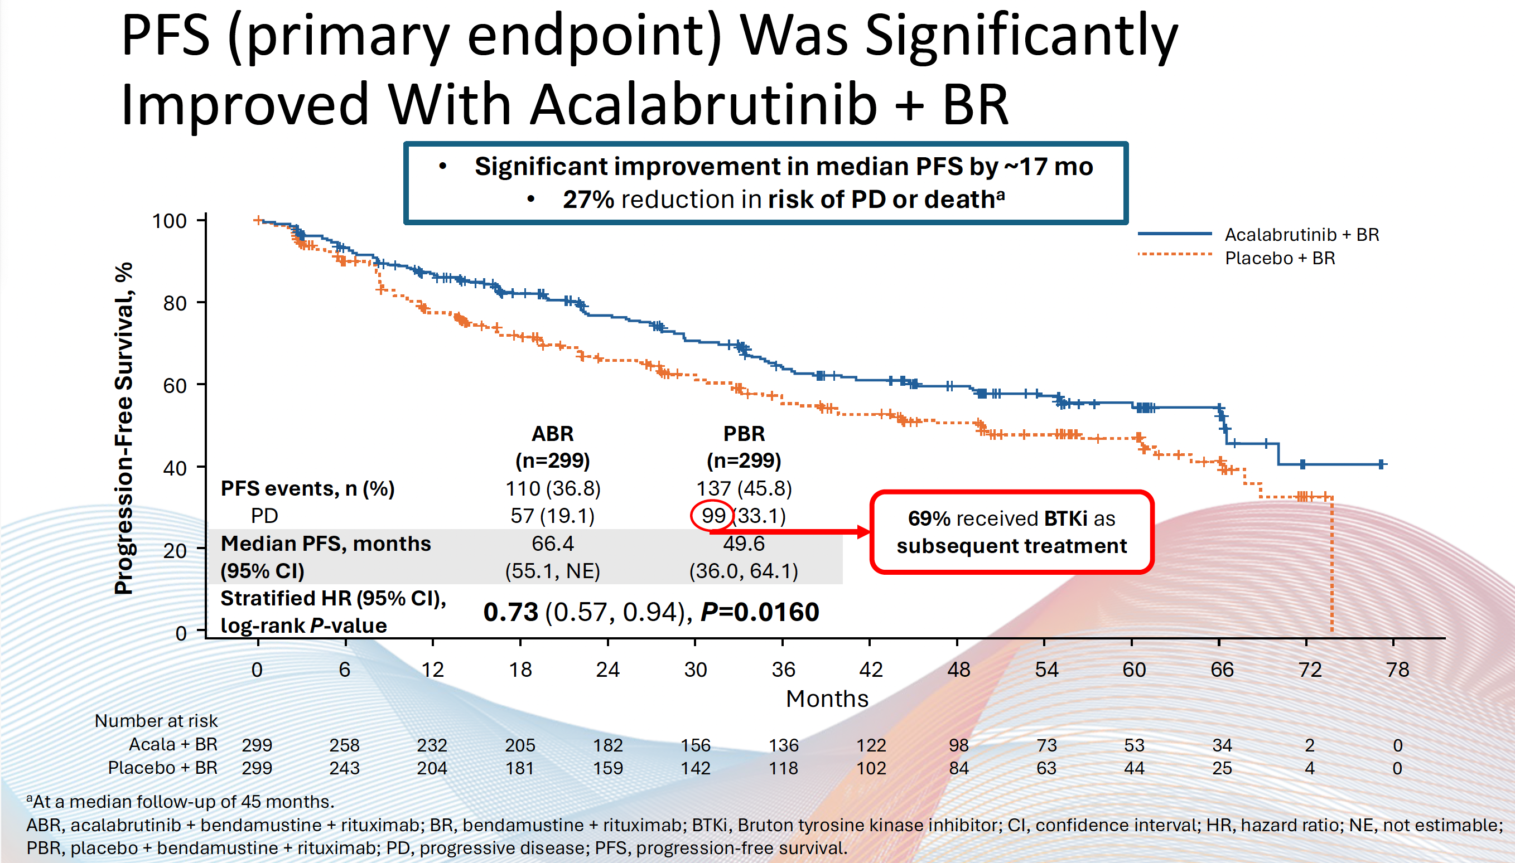
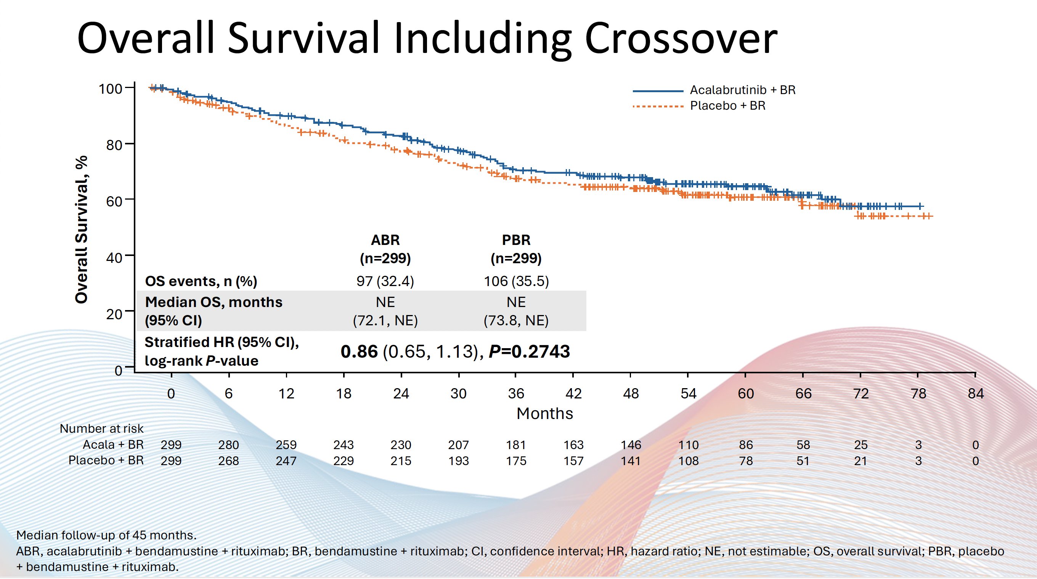
Acalabrutinib plus bendamustine and rituximab in untreated MCL: Results from the phase 3, double-blind, placebo-controlled ECHO trial
Wang et al. EHA 2024;Abstract LBA 3439

Slide 30
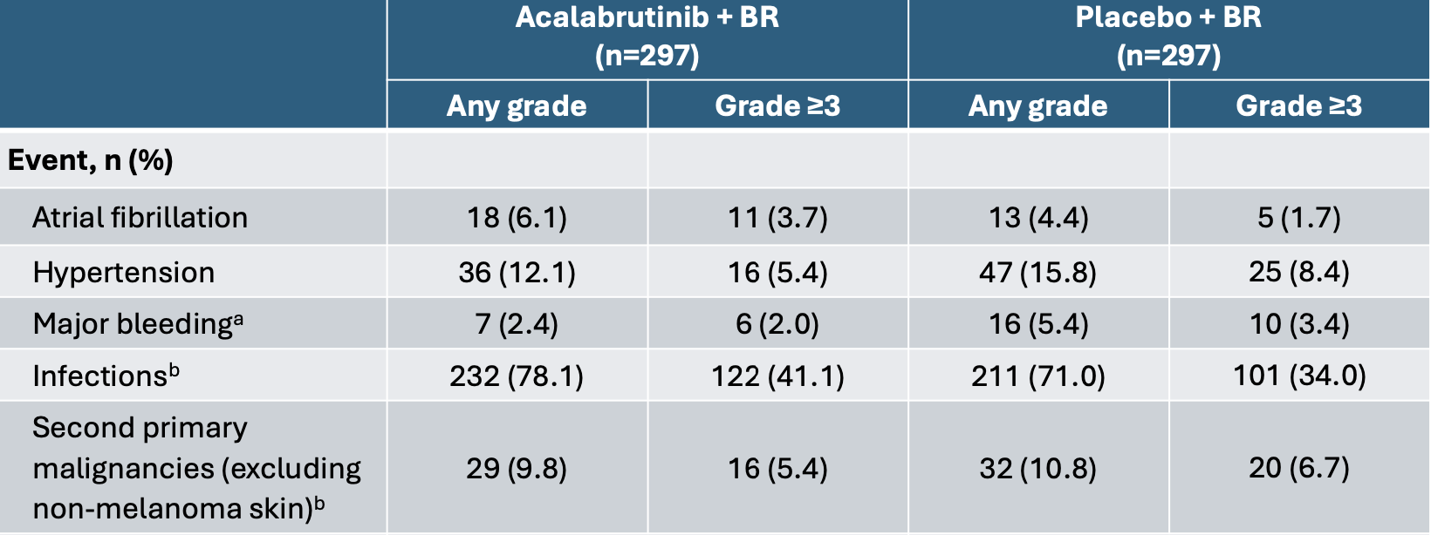
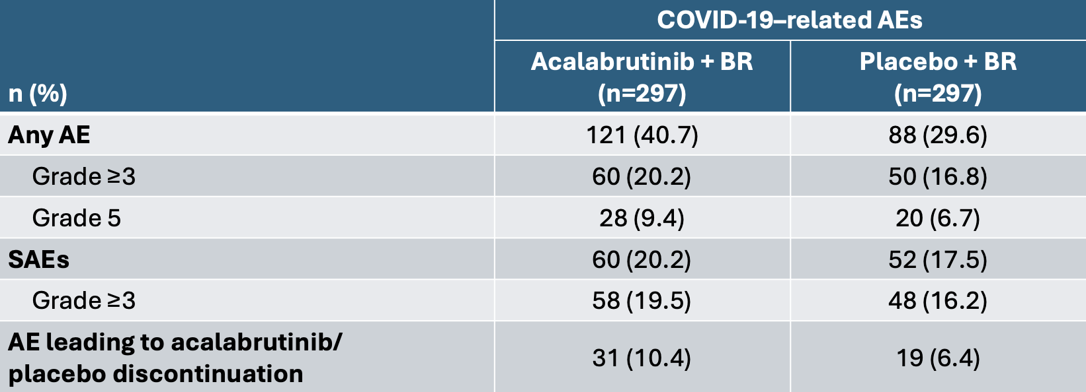
Toxicity

Slide 31
Treatment Paradigm in elderly and unfit untreated MCL
1990: CHOP, FC, CEOP
2012: R-CHOP with Ritux Maintenance
2013: BR
2017: RBAC
2018: VR-CAP
CHEMO ERA
2022: SHINE
2024: BOVEN
2024: ECHO
CHEMO + BTKi ERA

Slide 32
Clinical Case
77-year-old male with ECOG 1 with PMH sig for Afib controlled on metoprolol and apixaban, noted gradual onset fatigue and dyspnea over 6 months. Exam revealed axillary and cervical adenopathy. Work up including a CT scan revealed adenopathy above and below the diaphragm. Excisional biopsy of the inguinal node was consistent with Mantle cell lymphoma, blastoid variant, ki67 70%. Labs revealed mild anemia and thrombocytopenia, LDH elevated. Bone marrow biopsy positive for involvement with MCL. FISH and NGS did not show any TP53 aberration.
In Jan 2025 – BR plus Acalabrutinib
C1– headaches, diarrhea – Continued Acalabrutinib – supportive care
C2– Complicated by nose bleeds --- temporary interruption of Acalabrutinib and apixaban
C3 – going well thus far + symptoms have resolved + on exam no evidence of adenopathy
Next steps – If in a CR at EOT – Acalabrutinib until progression?
MRD driven approach? Durability?

Slide 33
Management of MCL in 2025
Practice Impact
Essential to check TP53 aberration status at diagnosis
ASCT no longer required for young/fit patients
Upfront treatment with 2nd generation BTKi’s (BOVEN or TRIANGLE) new SOC in young/fit patients
Upfront treatment with 2nd generation BTKi’s MAY be incorporated in old/unfit patients
Lingering questions
Treatment at relapse ? – BTKi retreatment? CAR-T ?
High-risk (esp TP53 mutation +) MCL needs novel DURABLE approaches
CUREs still elusive – need long-term follow up, clinical trials.

Slide 34
Roundtable Discussion

Slide 35
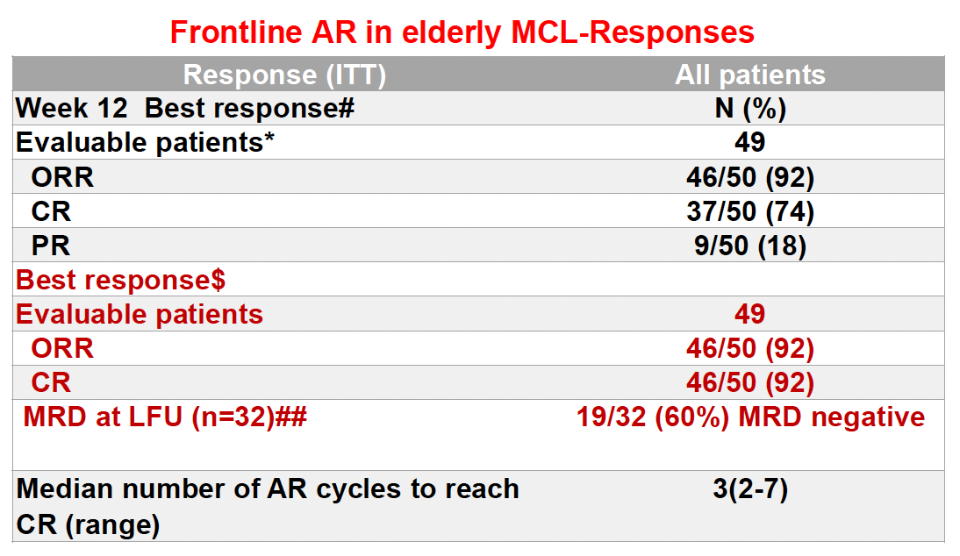
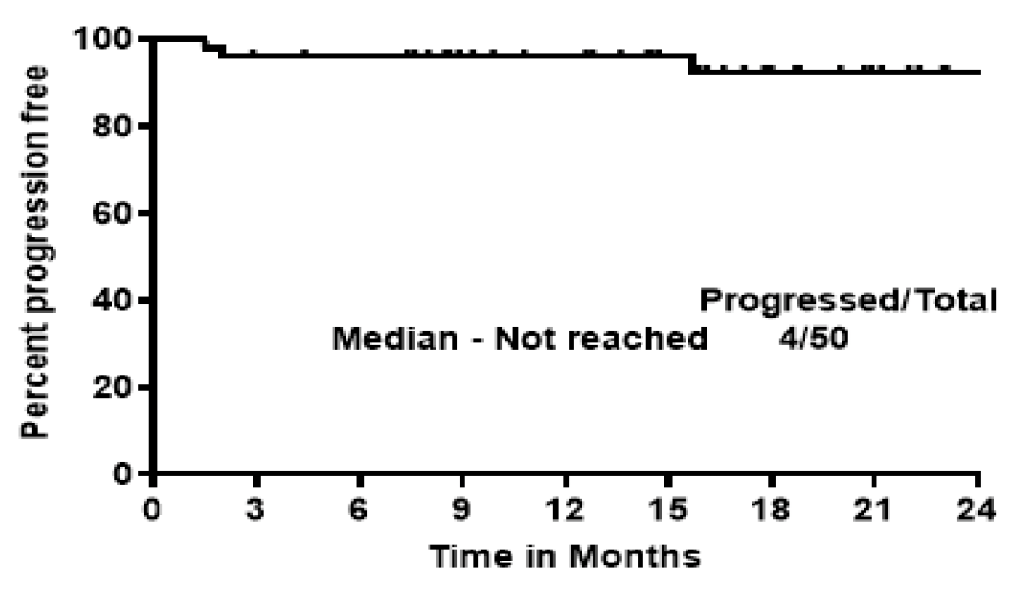
Phase II Study of Acalabrutinib with Rituximab as First-Line Therapy for Older Patients with MCL
PFS
With median follow-up of 28 months, median PFS and OS were not reached.
2-year PFS: 94%
2-year OS: 96%
Jain P et al. ASH 2024;Abstract 3038.

Slide 36
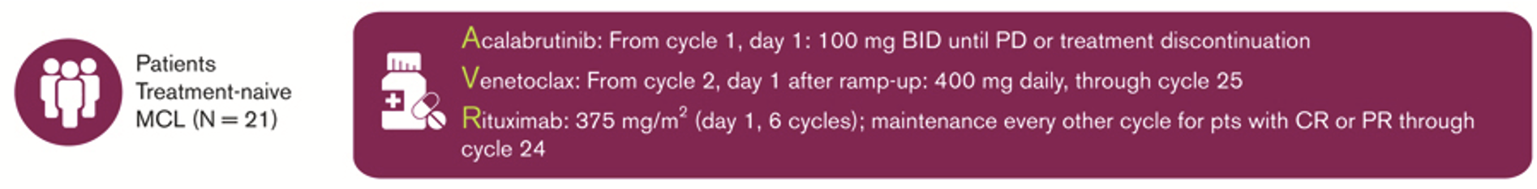
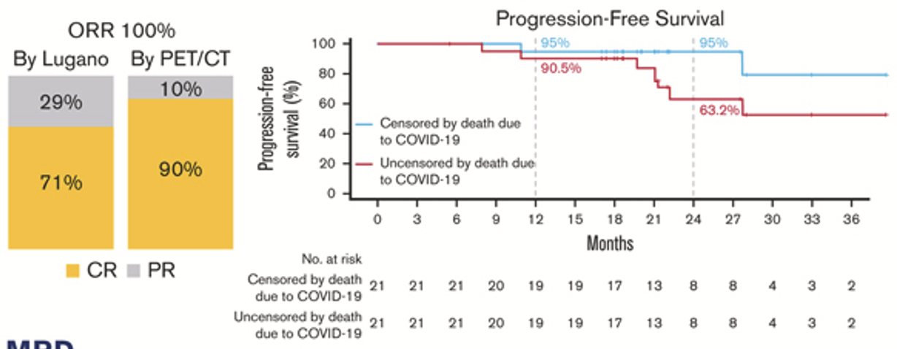
A Phase I Study of Acalabrutinib + Venetoclax + Rituximab in MCL
With median follow-up of 27.8 months, median PFS and OS were not reached.
1-year PFS: 90.5% (95% CI, 67.0-97.5)
2-year PFS: 63.2% (95% CI, 34.7-82.0)
1-year OS: 95.2% (95% CI, 70.7-99.3)
2-year OS: 75.2% (95% CI, 50.3-88.9)
Wang M et al. Blood Adv 2024;8(17):4539-4548.

Slide 37
ONS 2025 NHL
Robin Klebig, APRN, CNP, AOCNP
April 12, 2025

Slide 38
Scenario 4: An older patient with newly diagnosed mantle cell lymphoma (MCL) is about to start first-line treatment with acalabrutinib/BR
What side effects can occur with ibrutinib, acalabrutinib, zanubrutinib and pirtobrutinib? What do you tell your patients about to start one of these agents about potential toxicities? How does this vary according to the specific agent?
Bleeding/bruising (all – but more common with ibrutinib)
  Avoid NSAIDS due to increased risk of bleeding
Atrial fibrillation (more common with ibrutinib)
Hypertension (more common with ibrutinib)
Ventricular arrhythmias, heart failure
Arthralgia (more common with ibrutinib)
Headache (acalabrutinib)
Diarrhea
Low blood counts (neutropenia, anemia, thrombocytopenia)
Infection
Fatigue
Rash
Nail changes (ibrutinib)

Slide 39
Nursing Considerations for Patients Receiving a BTK Inhibitor — Ms Klebig
How do you monitor for and manage common toxicities associated with BTK inhibitors?
Bleeding/bruising – assess pt for bleeding/bruising; educate on risk; avoid NSAIDs; hold BTK inhibitor prior to and after surgical/invasive procedures (3-7 days depending on procedure)
A fib/HTN – Monitor blood pressure and symptoms of A fib (lightheadedness, palpitations, irregular or fast heart rate)
Arthralgias – remain active, acetaminophen, warmth, topical analgesics, avoid NSAIDs
Headache – acetaminophen & caffeine, hydration; reassure typically resolves after first month
Diarrhea – dietary modification, loperamide; reassure typically resolves after a few months
Cytopenias – monitor and educate pts on neutropenic precautions, monitoring for infection, bleeding risk, etc
Fatigue – encourage activity to maintain conditioning, balance with rest periods, prioritize activities
Nail changes – may try cuticle oil to nail bed, Biotin (2.5 mg daily)

Slide 40
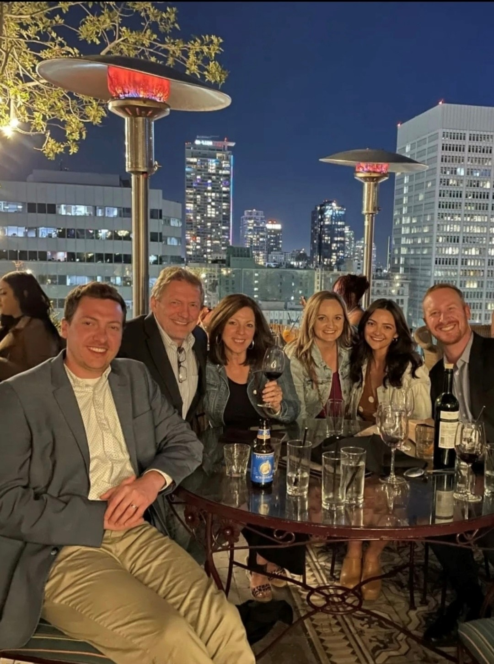
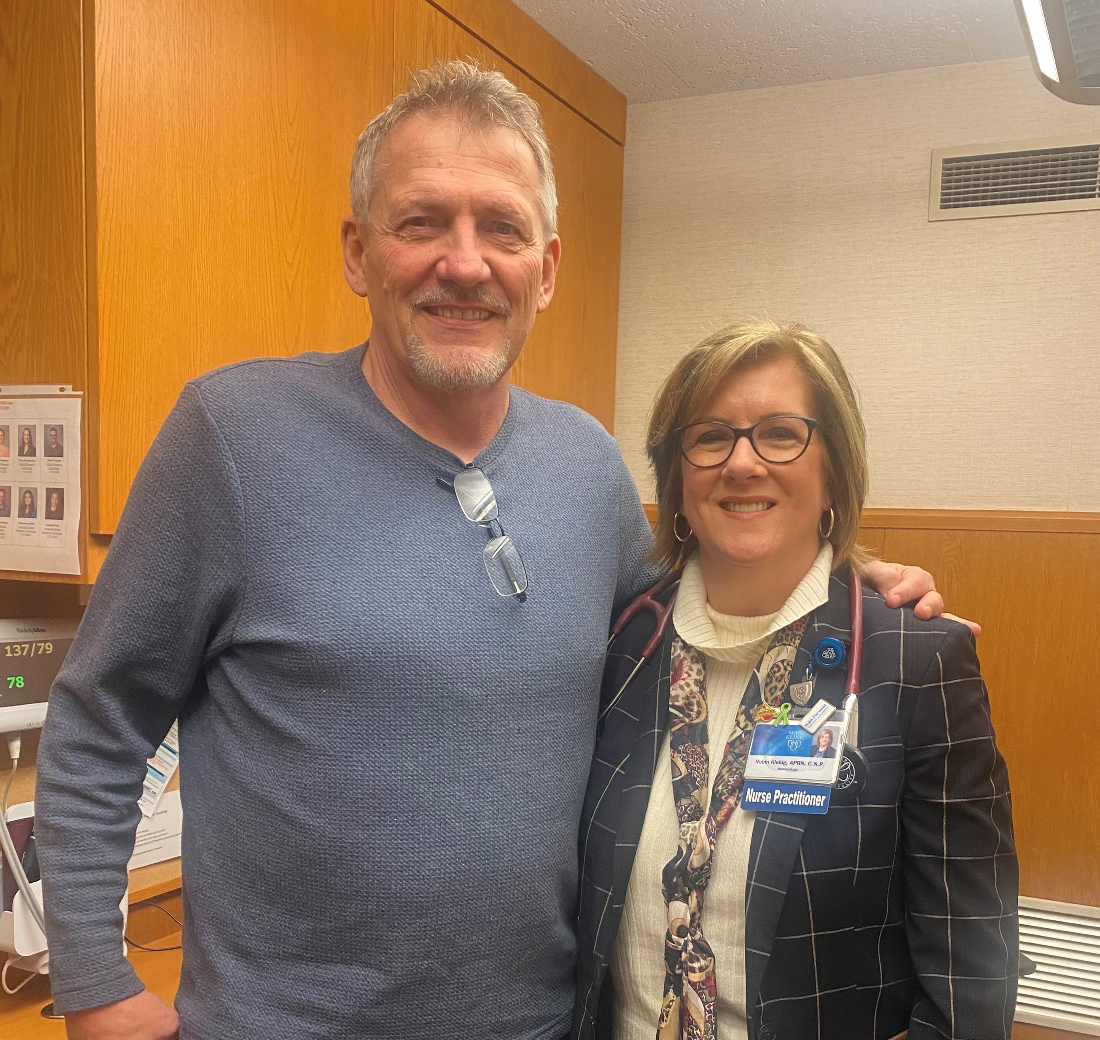
An older patient w/ newly diagnosed mantle cell lymphoma starting first-line treatment with acalabrutinib/BR
63 yo male
PMH:
  Gout
SH: Married, 2 children, ammunition specialist, enjoys fishing and golfing
Lives 1-1/2 hrs from Mayo Clinic

Slide 41
Presentation – 2020
Palpated right inguinal node
  had been present x 2 years before reporting
Bx: Mantle cell lymphoma
Bone marrow: 5% involvement
Elected to observe as asymptomatic, indolent, COVID

Slide 42
Progression 9/2021
Presented to ED w/ LUQ pain radiating to Left shoulder
CT showed splenomegaly with splenic infarct
Bone marrow: 60% involvement by MCL
Initiated rituximab, bendamustine, acalabrutinib per EA4181

Slide 43
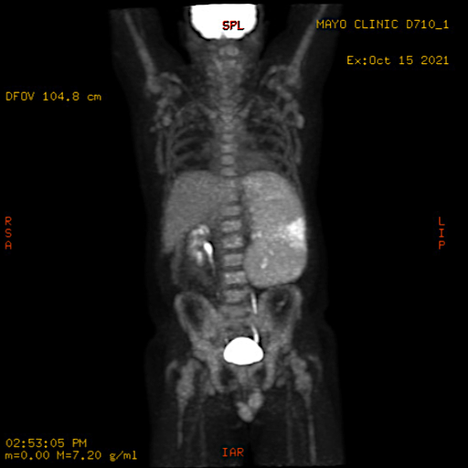
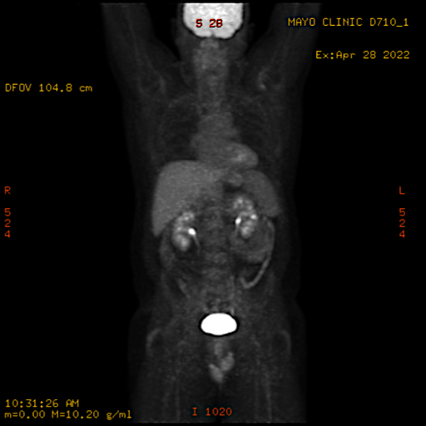
Response
Baseline
After 6 cycles – Deauville 1

Slide 44
Response
Bone marrow – negative
MRD negative

Slide 45
Discussion & Plan
Options
  Observation
  Auto SCT
  Maintenance rituximab
  Consideration of clinical trial EA4151
    If MRD (-) would randomize to rituximab maintenance or SCT f/b maintenance
They were building their dream house on a lake – wanted to enjoy the summer – timing wasn’t right to consider SCT
Elected maintenance rituximab

Slide 46
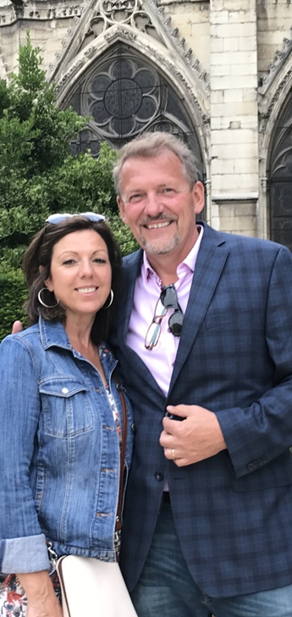
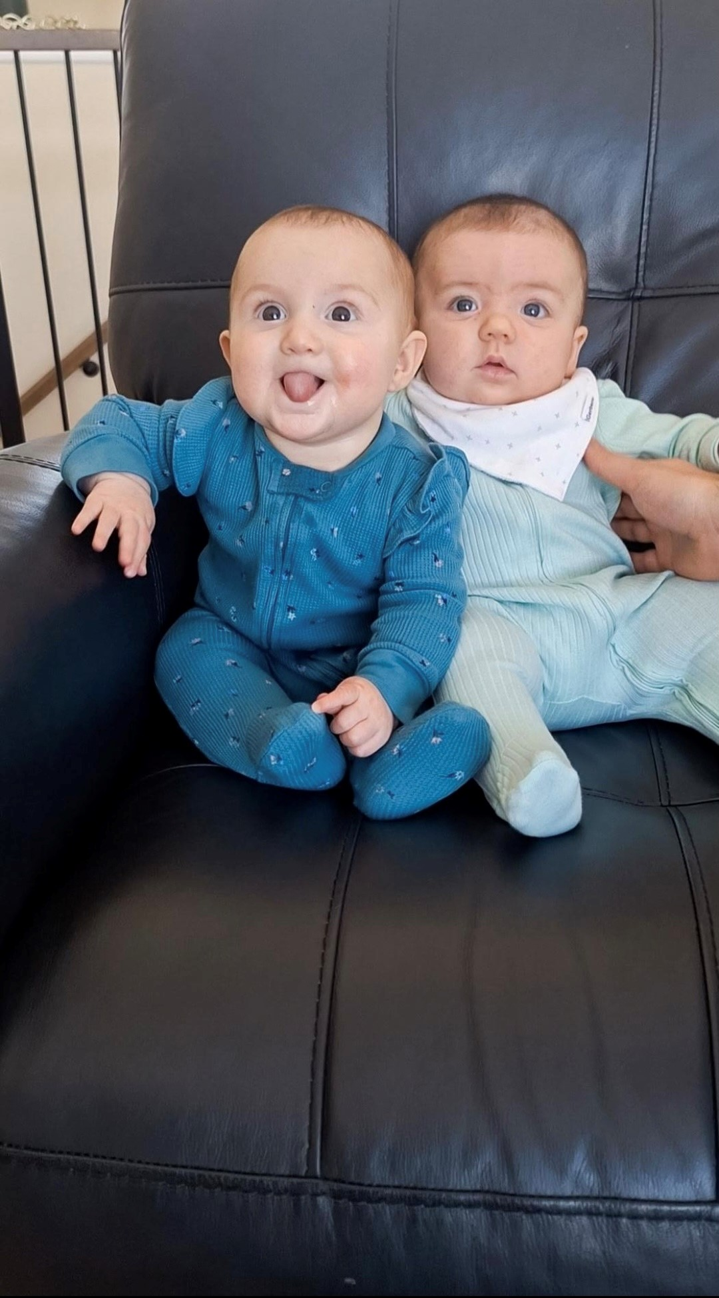
He will complete rituximab maintenance in May 2025
Then they are off to Italy for a vacation with their family (including the grandbabies!) for their 40th wedding anniversary

Slide 47
Roundtable Discussion

Slide 48
Agenda
Introduction: Overview of Bispecific Antibodies and Chimeric Antigen Receptor T-Cell Therapy for Non-Hodgkin Lymphoma
Module 1: Current and Future Use of Bruton Tyrosine Kinase Inhibitors for Mantle Cell Lymphoma
Module 2: First-Line Therapy for Diffuse Large B-Cell Lymphoma (DLBCL)
Module 3: Role of Loncastuximab Tesirine for Patients with Relapsed/Refractory (R/R) DLBCL
Module 4: Role of Tafasitamab for Patients with R/R DLBCL and Follicular Lymphoma

Slide 49
Clinical Scenario
A patient with newly diagnosed DLBCL is about to start first-line treatment with polatuzumab vedotin/R-CHP

Slide 50
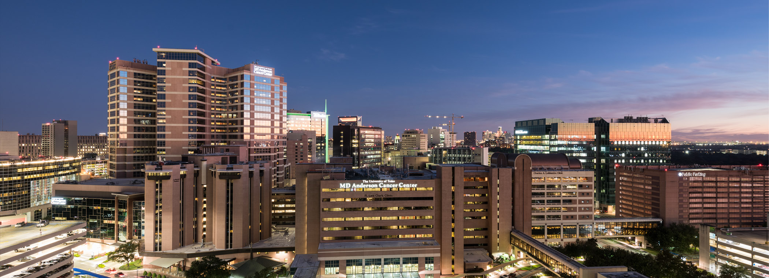
Advances in the First-line Treatment of Diffuse Large B-Cell Lymphoma
Christopher Flowers, MD, MS, FASCO
Division Head Division of Cancer Medicine
Chair, Professor Department of Lymphoma/Myeloma

Slide 51
Case: 63 yo woman with DLBCL
Initially admitted with epidural DLBCL with compression fracture
IR Biopsy showed ABC subtype
PET/CT Stage IV disease with BM involvement by PET
LDH > ULN
LP negative

Slide 52

Annual Incidence of Lymphoid Cancers in the United States
Overall Survival
U.S. cancer statistics for lymphoid malignancies by World Health Organization subtypes
Teras LR, DeSantis CE, Morton LM, Cerhan JR, Jemal A, Flowers CR
CA Cancer J Clin. 2016

Slide 53
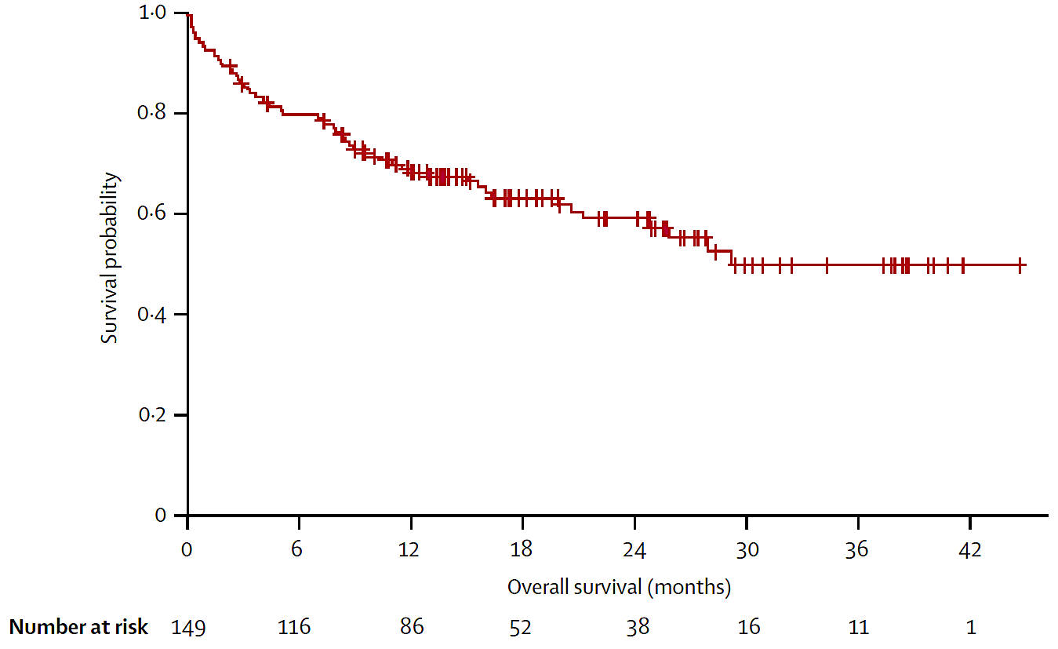
There is unmet need for older patients
PFS from R- mini-CHOP is not adequate: 2-yr 47%
Only 72% received the full intended 6 cycles
12 deaths, 8% grade 5 toxicity
Unmet need to improve outcome
  ?
Peyrade F et al. Lancet Oncol. 2011; 12(5):460-8

Slide 54
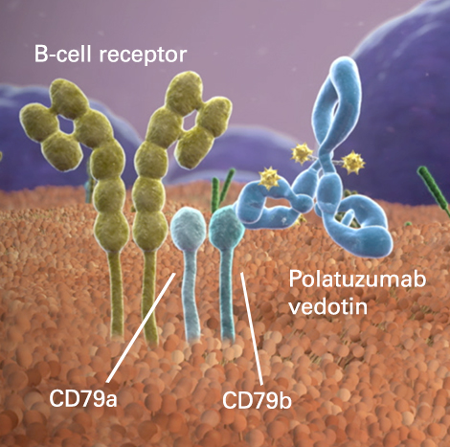
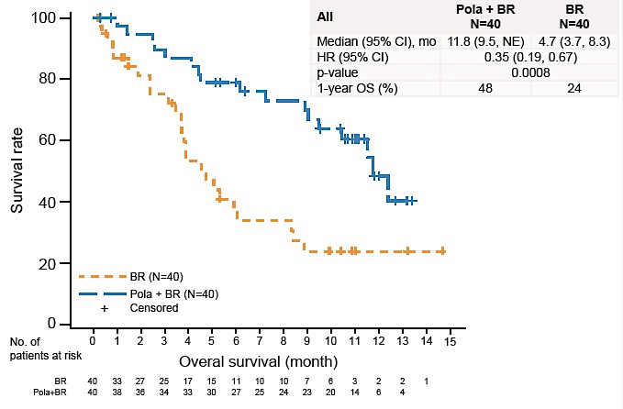
Polatuzumab Vedotin in Relapsed or Refractory Diffuse Large B-Cell Lymphoma J Clin Oncol. 2020
Laurie H Sehn, Alex F Herrera, Christopher R Flowers, Manali Kamdar, Andrew McMillan, Mark Hertzberg, Sarit Assouline, Tae Min Kim, Won Seog Kim, Muhit Ozcan, Jamie Hirata, Elicia Penuel, Elicia Penuel, Ji Cheng, Joseph N. Paulson, Grace Ku, Matthew Matasar

Slide 55
POLARIX: 1L DLBCL Phase 3
Pola-R-CHP
Primary endpoint
Progression-free survival (Investigator-assessed)
Polatuzumab vedotin (1.8mg/kg)* +
R-CHP + vincristine placebo
Patients
Previously untreated DLBCL
Age 18–80 years
IPI 2–5
ECOG PS 0–2
Secondary endpoints
Event-free survival
Complete response rate at end of treatment (PET/CT, IRC-assessed)
Disease-free survival
Overall survival
Rituximab
375mg/m²
R
1:1
Cycles 1–6
(1 cycle=21 days)
R-CHOP
Cycles 7 & 8
Stratification factors
IPI score (2 vs 3–5)
Bulky disease (<7.5 vs ≥7.5cm)
Geographic region
(Western Europe, US, Canada,
& Australia vs Asia vs rest
of world)
Safety endpoints
Incidence, nature, and severity of adverse events
R-CHOP† +
polatuzumab vedotin placebo
Tilly et al. NEJM 2021

Slide 56
Primary endpoint: Progression-free survival
Pola-R-CHP significantly improved PFS vs R-CHOP
100
Pola-R-CHP (N=440)
R-CHOP (N=439)
HR 0.73 (P=0.02)
95% CI: 0.57, 0.95
80
Censored
60
Pola-R-CHP demonstrated a 27% reduction in the relative risk of disease progression, relapse,
or death vs R-CHOP
24-month PFS:
76.7% with Pola-R-CHP vs 70.2% with R-CHOP (∆=6.5%)
5-year PFS:
63.1% with Pola-R-CHP vs 59.1% with R-CHOP
PFS (%)
40
20
0
0
6
12
18
24
30
36
42
Time (months)
No. of patients at risk
Pola-R-CHP | 440 | 404 | 353 | 327 | 246 | 78 | NE | NE
R-CHOP | 439 | 389 | 330 | 296 | 220 | 78 | 3 | NE
Tilly et al. NEJM 2021
Salles ASH 2024

Slide 57
Safety summary
Safety profiles were similar with Pola-R-CHP and R-CHOP
n (%) | Pola-R-CHP (N=435) | R-CHOP (N=438)
Any-grade adverse events | 426 (97.9) | 431 (98.4)
Grade 3–4 | 251 (57.7) | 252 (57.5)
Grade 5 | 13 (3.0) | 10 (2.3)
Serious adverse events | 148 (34.0) | 134 (30.6)
Adverse events leading to:
Discontinuation of any study drug | 27 (6.2) | 29 (6.6)
Polatuzumab vedotin / vincristine | 19 (4.4) | 22 (5.0)
Dose reduction of any study drug | 40 (9.2) | 57 (13.0)
Common adverse events
Pola-R-CHP
R-CHOP
Peripheral neuropathy*
Grade
Nausea
1
Diarrhea
2
Neutropenia
3
Anemia
4
Constipation
Fatigue
Alopecia
Decreased appetite
Pyrexia
Vomiting
Febrile neutropenia
Cough
Headache
Decreased weight
Asthenia
Dysgeusia
Frequency (%)
ITT population. Data cut-off: June 28, 2021; median 28.2 months’ follow-up.
CI, confidence interval; HR, hazard ratio; NE, not evaluable; PFS, progression-free survival.
Tilly et al. NEJM 2021

Slide 58
Evolving Molecular Classification with Technology
Upcoming
Genetic Subtypes
Multi-Omics Integration
(Genes, Transcripts, Proteins, LME, Function)
Genetic Evolution Studies
(bulk and single cell)
Al
NGS, Liquid biopsies
Data integration
HGBL
Targeted Studies,
i.e. FISH
PMBCL
GEP Subtypes, i.e.ABC/GCB mBL
Technology wave
GEP
T- vs B-NHL
Morphologic Subtypes,
i.e. TCHRBCL, PCNSL
Hodgkin vs
Non-Hodgkin
IHC
Microscopy
Past Present Future

Slide 59
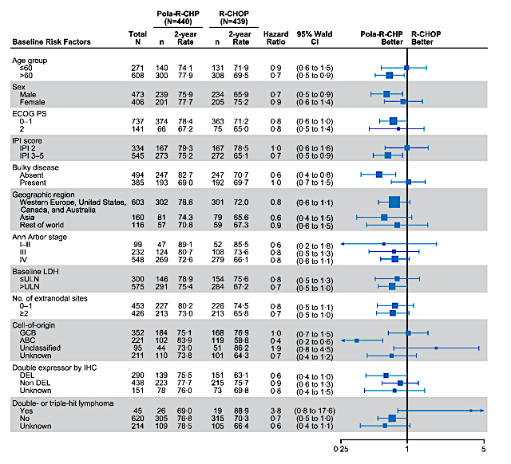
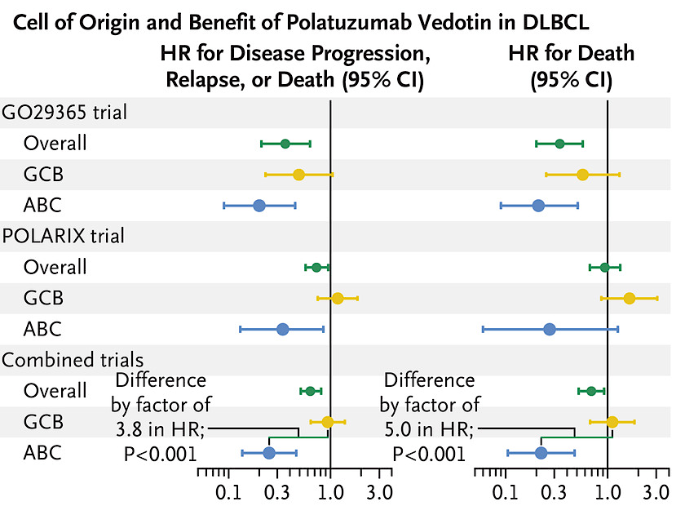
Polatuzumab Vedotin Efficacy in DLBCL Subtypes by COO
Palmer et al. NEJM 2023
Tilly et al. NEJM 2022

Slide 60
Take Home Points & Future Directions
Pola-R-CHP provides a novel 1L therapy with ↑ PFS
Molecularly targeted therapy for DLBCL
    - Needs new testing approaches
    Need to consider all factors that influence outcomes

Slide 61
Roundtable Discussion

Slide 62
Nursing Considerations for Patients Receiving Polatuzumab Vedotin
Caitlin Murphy DNP, FNP-BC, AOCNP

Slide 63
1st Line Treatment:
Diffuse Large B Cell Lymphoma
R-CHOP
  Rituximab (CD-20 mab)
  Cyclophosphamide (Alkylating Agent)
  Doxorubicin (Anthracycline)
  Vincristine (Vinca alkaloid)
  Prednisone (Steroid)
R-Pola-CHP
  Rituximab (CD-20 mab)
  Cyclophosphamide (Alkylating Agent)
  Doxorubicin (Anthracycline)
  Polatuzumab vedotin (CD-79 monoclonal ab)
  Prednisone (Steroid)

Slide 64
Adverse Effects/Common Toxicities
Monitor for HSR reaction
Peripheral Neuropathy—may occur with first cycle and it is cumulative!
  Monitor this over time with each cycle
    ADLs (texting/typing on phone, signature, buttons on clothing, jewelry)
Febrile Neutropenia
Infection—URIs
  Vaccinate prior to initiation of treatment if feasible
Hematological AEs
  Most notable: lymphopenia followed by anemia, neutropenia & thrombocytopenia
GI--low rates of diarrhea but more notable than in R-CHOP arm
Fatigue
  Exercise!

Slide 65
Supportive Care
Premedicate patients with an antihistamine and antipyretic at least 30 to 60 minutes prior to infusion to help mitigate infusion-related reactions
Prophylaxis with granulocyte colony-stimulating factor (G-CSF)
Pneumocystis jiroveci pneumonia and herpesvirus prophylaxis throughout treatment
Tumor lysis prophylaxis
DDI interactions
  CYP3A Inhibitors---monitor for signs of toxicity
  CYP3A Inducers---may decrease unconjugated MMAE AUC
Polatuzumab vedotin package insert.

Slide 66
Dosing Schedule
21-day cycle x 6 cycles
Polatuzumab vedotin
  Cycle 1: Infused over 90 minutes with 90-minute post infusion monitoring
  If tolerated, increase rate to 30 minutes with 30-minute post infusion monitoring
Polatuzumab vedotin package insert.

Slide 67
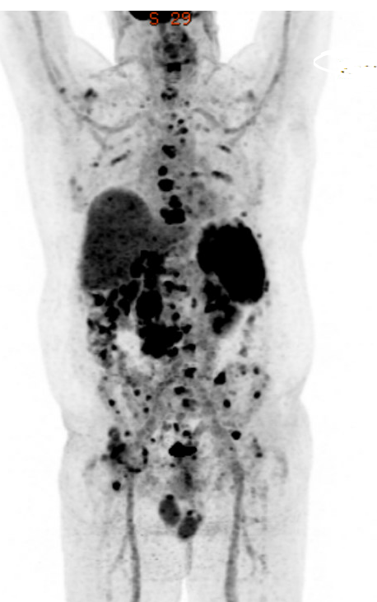
Meet the patient
64 y/o male presents to local PCP with persistent right hip pain concerning for labral tear, arthritis
Core needle biopsy of RP node which demonstrates diffuse large B-cell lymphoma (non GCB subtype)
LDH elevated at 313
Renal function preserved with creatinine 0.91 on baseline labs

Slide 68
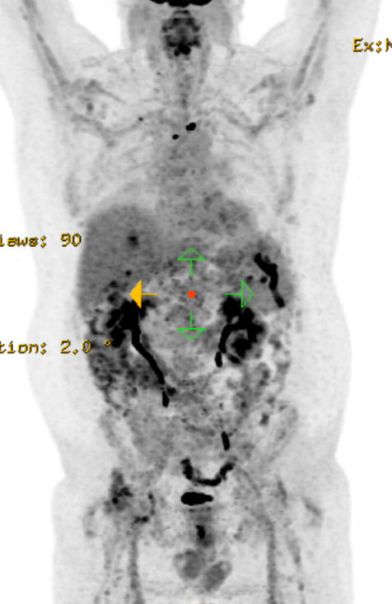
Interim PET
Patient reports
  Fatigue
  Mild nausea controlled with
  anti-emetic regimen
    Aprepitant
    Palonosetron
    Olanzapine
  Grade 1-2 neuropathy in fingertips

Slide 69
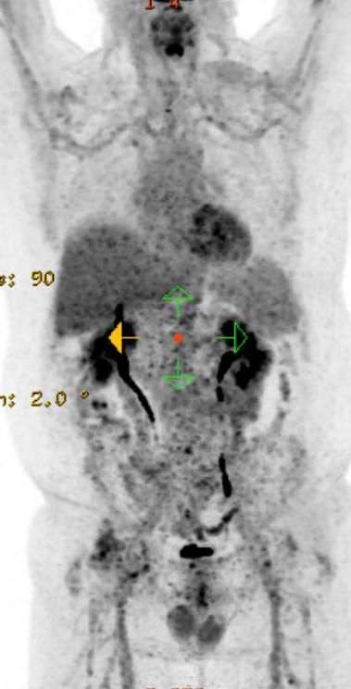
EOT PET
Treatment related symptoms:
Improvement in fatigue
Gradual improvement in neuropathy (numbness, tingling)

Slide 70
Roundtable Discussion

Slide 71
Agenda
Introduction: Overview of Bispecific Antibodies and Chimeric Antigen Receptor T-Cell Therapy for Non-Hodgkin Lymphoma
Module 1: Current and Future Use of Bruton Tyrosine Kinase Inhibitors for Mantle Cell Lymphoma
Module 2: First-Line Therapy for Diffuse Large B-Cell Lymphoma (DLBCL)
Module 3: Role of Loncastuximab Tesirine for Patients with Relapsed/Refractory (R/R) DLBCL
Module 4: Role of Tafasitamab for Patients with R/R DLBCL and Follicular Lymphoma

Slide 72
Clinical Scenario
A patient with R/R DLBCL is about to start treatment with loncastuximab tesirine

Slide 73
Understanding the Current Paradigm and New Approaches in the Care of Patients with Non-Hodgkin Lymphoma
Manali Kamdar, MD, MBBS
Associate Professor of Medicine, Clinical director of lymphoma services,
Morton and Sandra Saffer Endowed Chair in Hematology Research, Division of Hematology,
University of Colorado
ONS congress, RTP Symposium, 4/12/2025

Slide 74
Role of Loncastuximab Tesirine for Patients with R/R DLBCL

Slide 75
Clinical Case
65 yo male with ECOG 1 with PMH sig for CAD (stent in 2009) on aspirin, HTN, DM on insulin, Neuropathy grade 2 on gabapentin. Diagnosed in 2023 with Stage III DLBCL, GC subtype, FISH normal treated from 4/2023-8/2023 achieved a CR. Unfortunately, relapsed in 6/2024 with biopsy proven Stage III DLBCL. Underwent Apheresis, bridging therapy with R-Gem-Ox and then received CAR-T cell therapy with Lisocel in 8/2024. Course complicated by Grade 2 CRS from which he fully recovered. D90 PET CT in 11/2024 showed a CR.
PET CT at the 6-month mark post-CAR in 2/2025 showed disease progression.
Biopsy confirms Localized DLBCL- CD19 +ve, CD20 -ve.
ECOG 1, Counts normal.
Next steps --- ?

Slide 76
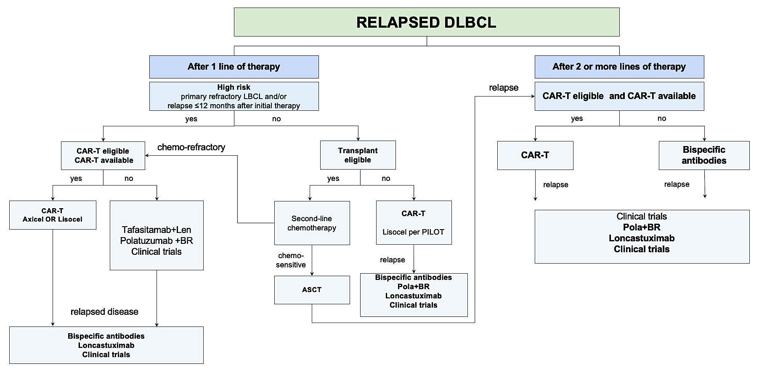
Treatment Algorithm for R/R DLBCL in 2025
Timing of Relapse Matters!
New unmet need in 2025
CAR-T and BispAb Refractory/Ineligible
Kamdar et al ASH Education book 2023

Slide 77
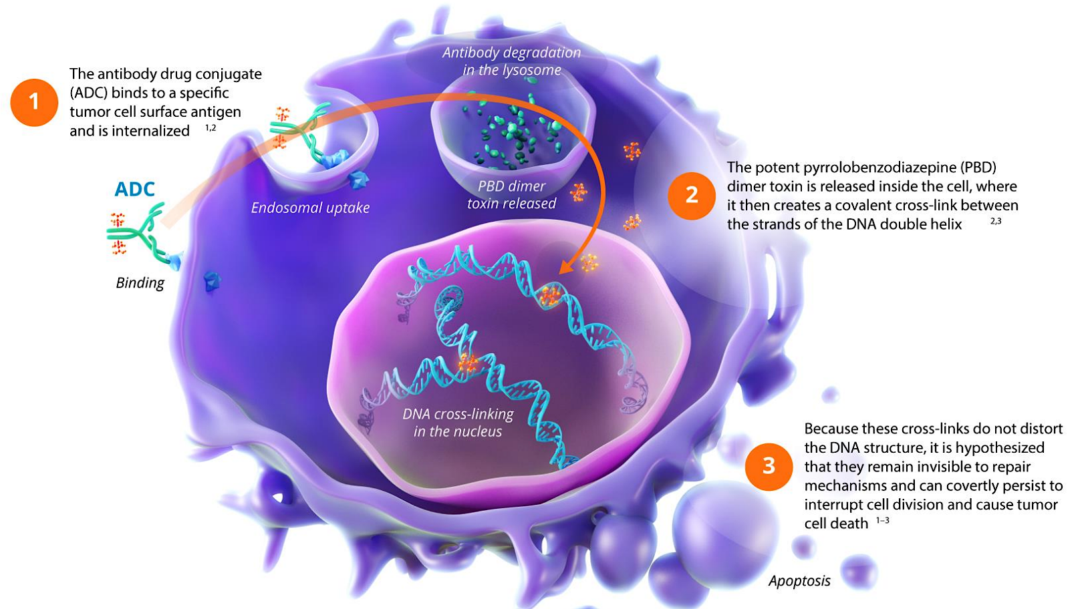
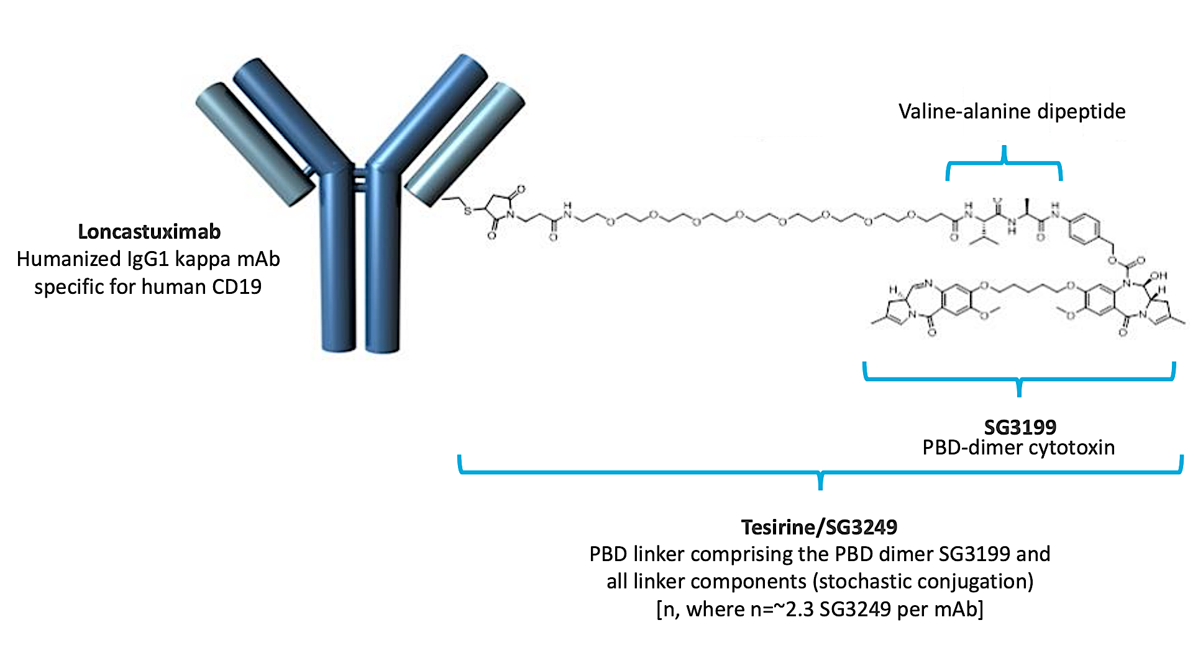
Mechanism of Action of Loncastuximab Tesirine
Antibody drug conjugate
ADCT-402
Target- CD19, Cytotoxin- PBD

Slide 78
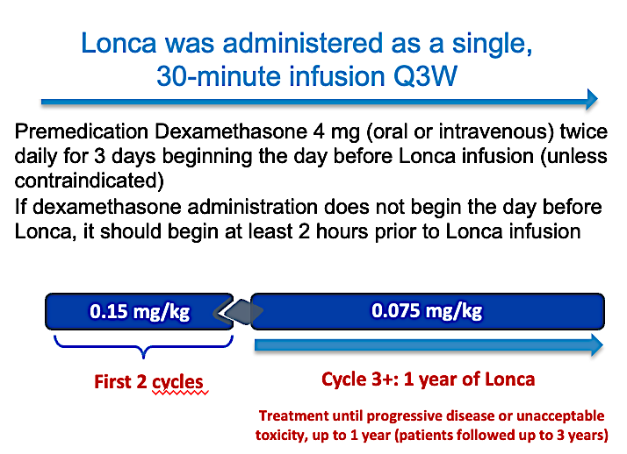
LOTIS-2: The Pivotal Phase 2 Open-Label Study
Primary Endpoint: Overall response rate (ORR) by IRC
N=145,
R/R DLBCL (including Transformed lymphoma) after ≥2 prior LOT,
Median age 66 (23-94), mLOT 3 (2-7),
Primary Refractory – 20%; Refractory to last rx 60%,
Prior CD19-CAR- 10% (n=14- all had CD19 expression)
Caimi et al., Hematologica 2024

Slide 79
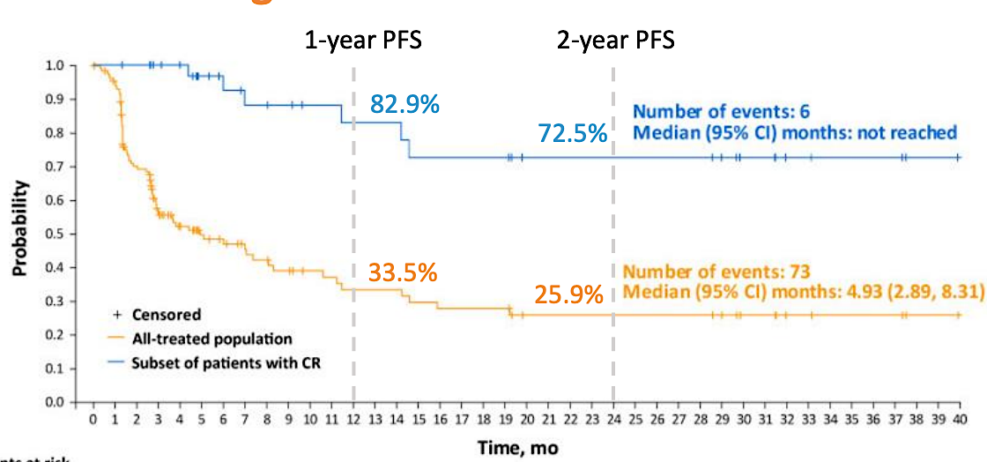
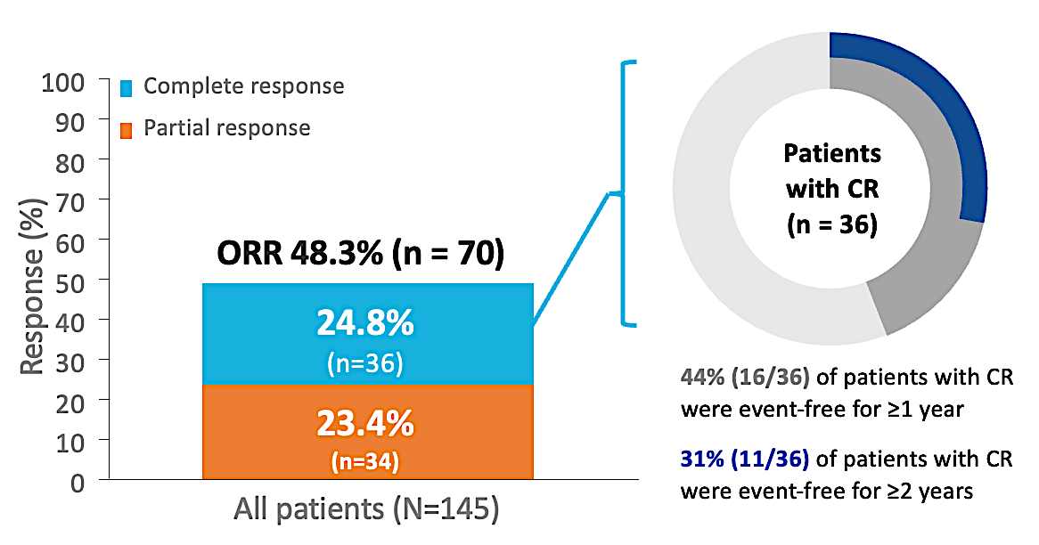


LOTIS-2: Final Efficacy Results (N=145)
Median FU 7.8 months (0.3 - 42m)
mPFS: 5 months
mOS: 10 months
Median Lonca cycles: 3.0 (1-26)
Median Lonca cycles for CR: 8.0 (1-26);
Median Time to Response: 41 days (35-247)
mDOR : 13.4 months, CR: NR

Slide 80
Safety
 | All-treated Population (N = 145) |  |  | All-treated Population (N = 145)
 | All grades, n (%) | Grade ≥3, n (%) |  | All grades, n (%) | Grade ≥3, n (%)
Any TEAE | 143 (98.6) | 107 (73.8) | Increased ALT | 22 (15.2) | 4 (2.8)
Increased GGT | 61 (42.1) | 25 (17.2) | Decreased appetite | 22 (15.2) | -
Neutropenia | 58 (40.0) | 38 (26.2) | Leukopenia | 21 (14.5) | 13 (9.0)
Thrombocytopenia | 48 (33.1) | 26 (17.9) | Hypomagnesemia | 20 (13.8) | 1 (0.7)
Fatigue | 40 (27.6) | 2 (1.4) | Pruritus | 19 (13.1) | -
Anemia | 38 (26.2) | 15 (10.3) | Rash | 19 (13.1) | 1 (0.7)
Nausea | 34 (23.4) | - | Vomiting | 19 (13.1) | -
Cough | 33 (22.8) | 1 (0.7) | Abdominal pain | 17 (11.7) | 4 (2.8)
Increased blood ALP | 29 (20.0) | 1 (0.7) | Constipation | 17 (11.7) | -
Peripheral edema | 29 (20.0) | 2 (1.4) | Dyspnea | 17 (11.7) | 2 (1.4)
Pyrexia | 28 (19.3) | 2 (1.4) | Insomnia | 16 (11.0) | -
Diarrhea | 25 (17.2) | 3 (2.1) | Pleural effusion | 16 (11.0) | 3 (2.1)
Increased AST | 23 (15.9) | 1 (0.7) | Erythema | 15 (10.3) | 1 (0.7)
Hypokalemia | 23 (15.9) | 6 (4.1) | Headache | 15 (10.3) | 1 (0.7)
Hypophosphatemia | 23 (15.9) | 8 (5.5) | Photosensitivity reaction | 15 (10.3) | 3 (2.1)
Management Pearls
Sun Protectants
Euvolemia- Diuretics
Dexamethasone
Rx Discontinuation – 19%
Dose Interruption – 50%
Dose Reduction – 8%

Slide 81


Sequencing with CD19- CAR-T cell therapies
CD19 CAR → Lonca-T
Lonca-T → CD19-CAR-T
Subgroup Analysis LOTIS-2
N=14, CR=3, PR=3
1) Retrospective analysis- LOTIS-2
N=14, 10/14 CD19+, 4 UK
CR= 6/14 (43%), PR= 1/14
2) Multicenter Retrospective Study¹
2) CIBMTR Registry Study²
Best Response to CAR-T Therapy, % | Lonca Therapy Type
 | Last LOT n = 5 | BT n = 11 | N =16
Complete remission | 60 | 36 | 44
Partial remission | 0 | 27 | 19
No response/stable disease | 20 | 18 | 19
Progressive disease | 20 | 18 | 19
Duration of Response | Lonca in 3L (n = 95) | Lonca in 4L (n = 23)
Median DOR (95% CI) | NR (8, NR) | 7.6 (6.0, 8.9)
12-month DOR, % | 68 | 22
1.Epperla, et al. Tandem 2024/Blood Cancer J 2024
2.Hamadani, et al. Tandem 2024/eJHaem 2024

Slide 82
Clinical Case
65 yo male with ECOG 1 with PMH sig for CAD (stent in 2009) on aspirin, HTN, DM on insulin, Neuropathy grade 2 on gabapentin. Diagnosed in 2023 with Stage III DLBCL, GC subtype, FISH normal treated from 4/2023-8/2023 achieved a CR. Unfortunately, relapsed in 6/2024 with biopsy proven Stage III DLBCL. Underwent Apheresis, bridging therapy with R-Gem-Ox and then received CAR-T cell therapy with Lisocel in 8/2024. Course complicated by Grade 2 CRS from which he fully recovered. D90 PET CT in 11/2024 showed a CR.
PET CT at the 6-month mark post-CAR in 2/2025 showed disease progression.
Biopsy confirms Localized DLBCL- CD19 +ve, CD20 -ve.
ECOG 1, Counts normal.
Next steps --- Initiated Single Agent Lonca-T in February 2025
March 2025 – Isolated adenopathy clinically smaller
Next questions – Is in CR --- Allo SCT ?? Or continue Lonca-T ??

Slide 83
Roundtable Discussion

Slide 84
ONS 2025 NHL
Robin Klebig, APRN, CNP, AOCNP
April 12, 2025

Slide 85
Scenario 2: A patient with R/R DLBCL is about to start treatment with loncastuximab tesirine
What do you tell your patients about to start treatment with loncastuximab tesirine about how it works and why they are receiving it?
Your lymphoma has not responded to prior traditional chemotherapy – this drug is indicated for relapsed/refractory DLBCL after 2 or more lines of systemic therapy
Clinical studies have shown 48% overall response rate and 24% CR in patients with relapsed/refractory DLBCL
Antibody-drug conjugate (monoclonal antibody and chemotherapy drug)
  Monoclonal antibody targets CD19 on surface of the lymphoma cells
  Once bound to the cell, the drug is internalized by the cell and chemotherapy component is released inside the cancer cell, causing DNA damage that leads to the cancer cell death
The drug is given intravenously over 30 minutes every 3 weeks
  0.15 mg/kg for first 2 cycles
  smaller dose (0.075 mg/kg) for subsequent cycles
Treatment will continue until disease progression or unacceptable toxicity

Slide 86
Scenario 2: A patient with R/R DLBCL is about to start treatment with loncastuximab tesirine
What side effects can occur with loncastuximab tesirine? What do you tell your patients about to start loncastuximab tesirine about potential toxicities?
Common side effects include
  Nausea
  Fatigue
  Cytopenias (anemia, neutropenia, thrombocytopenia)
  Liver enzyme abnormalities (GGT)
  Edema
  Effusions
  Shortness of breath
  Severe cutaneous reactions/photosensitivity
You will be premedicated with dexamethasone to reduce risk of side effects (fluid retention)
  Dexamethasone 4 mg twice daily x 3 days – beginning day before loncastuximab infusion
    If dexamethasone does not begin day before loncastuximab, should begin at least 2 hours prior to infusion
Avoid sun exposure, wear protective clothing, use sunscreen

Slide 87
Nursing Considerations for Patients Receiving Loncastuximab Tesirine — Ms Klebig
How do you monitor for and manage common toxicities associated with loncastuximab tesirine?
  Premedicate with antiemetic
  Monitor labs (CBC)
    Hold if ANC <1.0, consider G-CSF
      education on neutropenic precautions and infection monitoring
    Hold if plts <50,000
      education on s/s bleeding/bruising
  Monitor LFTs (GGT)
    Hold if grade 3 (>5.0-20.0 ULN)
  Potential for pleural/pericardial effusions
    Monitor for swelling, weight gain, respiratory symptoms
    May require dose delay or modification if Grade 2 or higher edema/effusion
    Diuretics may be required
  Dexamethasone education/administration
  Extravasation may cause irritation, swelling, pain, and/or tissue damage
  Monitor phosphorus
    May require replacement

Slide 88



A patient who received loncastuximab for R/R DLBCL
74 yo male
PMH:
  Chronic ischemic heart disease, CAD s/p LAD stent, ICD, unstable angina
  DVT/PE w/ Factor V Leiden on clopidogrel, warfarin, ASA s/p IVC filter
  DM2
  COPD
  Parkinson’s disease
  Splenic marginal zone NHL s/p 6 doses of rituximab 15 mos prior
SH: Widowed, 2 children, retired factory worker, enjoys fishing and gambling
Lives 1-1/2 hrs from Mayo Clinic

Slide 89

DLBCL presentation
Presented to local ED with abdominal pain, SOB
PE: Splenomegaly
Labs:
  Hgb 9.0, plts 49K, ANC 1.23
CT: splenic infarct, external iliac lymphadenopathy
Transferred to Mayo Clinic
Rough hospital course, splenectomy planned but respiratory failure >> ICU

Slide 90


Thankfully, another “hot spot” to biopsy
Lymph node, Right axillary, core bx: Diffuse large B-cell lymphoma
COMMENT: CD5 expression on the tumor suggests transformation from previously diagnosed CD5-positive low-grade B-cell lymphoma
Non-GCB, double-expressor of MYC and BCL2
FISH negative for MYC, BCL2 and BCL6 rearrangements

Slide 91
Treatment course
Rituximab and methylprednisolone
  While awaiting biopsy results
R-CEOP x 6 cycles
  Anthracyclines avoided due to significant cardiac history
  Rituximab, cyclophosphamide, etoposide, vincristine, prednisone

Slide 92


Response
Baseline
After 6 cycles R-CEOP – Deauville 2

Slide 93
Response
Baseline
After 6 cycles R-CEOP
Bone marrow: 60% involved by mixed small B cell and large B cell lymphoma
Bone marrow: Minimal involvement by B-cell lymphoma (less than 5%), similar to previously described with large B cell lymphoma involvement

Slide 94
Refractory DLBCL
Options discussed
  Polatuzumab/BR
  Tafasitamab/lenalidomide
  Loncastuximab
  Selinexor
  Not a candidate for clinical trial due to cardiac disease
Selected loncastuximab due to schedule (1 day every 3 weeks)

Slide 95
Loncastuximab course
Tolerated well
Bone marrow repeated after 6 cycles – negative
Elected to hold/discontinue treatment since CR and had multiple other comorbidities
  GI bleed due to AVMs, ulcers, anticoagulation
  COPD
  Cardiac issues
Expired 6 months later due to COPD exacerbation, heart failure

Slide 96
Roundtable Discussion

Slide 97
Agenda
Introduction: Overview of Bispecific Antibodies and Chimeric Antigen Receptor T-Cell Therapy for Non-Hodgkin Lymphoma
Module 1: Current and Future Use of Bruton Tyrosine Kinase Inhibitors for Mantle Cell Lymphoma
Module 2: First-Line Therapy for Diffuse Large B-Cell Lymphoma (DLBCL)
Module 3: Role of Loncastuximab Tesirine for Patients with Relapsed/Refractory (R/R) DLBCL
Module 4: Role of Tafasitamab for Patients with R/R DLBCL and Follicular Lymphoma

Slide 98
Clinical Scenario
A patient with R/R DLBCL is about to start treatment with tafasitamab/lenalidomide

Slide 99
Relapsed/Refractory
Diffuse Large B-Cell Lymphoma
Christopher Flowers, MD, MS, FASCO
Division Head Division of Cancer Medicine
Chair, Professor Department of Lymphoma/Myeloma

Slide 100
Case: 72 yo man with DLBCL
Initially diagnosed with DLBCL at age 66 with extensive retroperitoneal disease treated on protocol with R-CHOP + X. Tolerated therapy well with the exception of being admitted twice for neutropenic fever. Improved on empiric antibiotics, Cultures negative.
Experienced relapse at 28 months and received autologous SCT with PD on EOT scan and then received CAR T cell therapy
Now returns 3 years later with a new inguinal LN biopsy proven to be relapsed DLBCL with ABC subtype and here for initiation of next line of therapy

Slide 101
Who are “old” patients?
Definition
  65: American Society of Clinical Oncology
  70: International Society of Geriatric Oncology
Importance of assessment of functional status
  Chronological age is less important
  Geriatric assessment
    Not standardized
      Provides challenge in interpreting trial or research results
SEER-Medicare study
  57% of patients age >85 only received palliative care or no treatment
Diamond A et al. ASH. 2022

Slide 102

Not Everyone Will Benefit from CAR-T
Predictive factors associated with poor outcome following CAR T-cell therapy:
≥ 2 extranodal sites
TMTV > 80 mL
Elevated LDH
Vercellino L et al. Blood Adv. 2020;4(22):5607-5615.

Slide 103
Selected Therapies Approved in R/R DLBCL
 | Pola-BR | Selinexor | Tafasitamab/Lenalidomide | Loncastuximab Tesirine
MOA | Anti-CD79b ADC | XPO-1 inhibitor | Anti-CD19 mAb/Immunomodulator | Anti-CD19 ADC
ORR | 45% | 28% | 58% | 48%
CR rate | 40% | 10% | 40% | 24%
PFS | 9.2 m | 2.6 m | 11.6 m | 4.9 m
DOR | 12.6 m | 9.3 m | 43.9 m | 10.3 m
OS | 12.4 m | NR | 33.5 m | 9.9 m
Novel salvage regimens may improve outcomes with ASCT
Sehn LH et al. Blood Adv. 2022;6(2):533-543.
Kalakonda N et al. Lancet Haematol. 2020;7(7):e511-e522.
Duell J et al. Haematologica. 2021;106(9):2417-2426.
Caimi PF et al. Lancet Oncol. 2021;22(6):790-800.

Slide 104

Tafasitamab Mechanism of Action
Tafasitamab
Lenalidomide enhances NK cell function with enhanced ADCC
in vitro
Tafasitamab
Salles G et al. Lancet Oncol 2020;21(7):978-88.

Slide 105



Tafasitamab + Lenalidomide: Outcomes
Median PFS Overall: 11.6 months
Median OS Overall: 33.5 months
Salles G et al. Lancet Oncol. 2020;21(7):978-988.
Duell J et al. Haematologica 2024;109:553-66.
Notes:
The primary results of L-MIND included

Slide 106

Tafasitamab + Lenalidomide: Safety
37 patients (43%) required lenalidomide dose reduction
62/80 patients (78%) were able to stay at dose ≥ 20mg/d
Incidence and severity of TEAEs are lower during the tafasitamab monotherapy phase
Ten patients (12%) discontinued tafasitamab + LEN because of AEs
ªAE collection period included 30 days after end of treatment
AEs, adverse events; LEN, lenalidomide; TEAEs, treatment-emergent AEs .
Salles G et al. Lancet Oncol. 2020;21(7):978-988.

Slide 107
inMIND study: phase 3, tafa-R2 vs R2
4-week treatment cycles
Screening ≤28 days
Randomization 1:1
Tafasitamab Arm (Experimental Arm)
Tafasitamab 12 mg/kg iv, 12 cycles (cycles 1-3: qw; cycles 4-12: q2w)
Len 20 mg/day (days 1-21) po for 12 cycles
R 375 mg/m² iv for 5 cycles (cycle 1: qw; cycles 2-5: q4w)
End of treatment
5-year follow-up
Key Inclusion Criteria
Age ≥18 years
FL grades 1-3A (or MZL)*
≥1 prior line of therapy, including an anti-CD20 mAb
ECOG PS 0-2
No prior treatment with Len
in combination with R
Placebo Arm (Control Arm)
Placebo iv for 12 cycles (cycles 1-3: qw; cycles 4-12: q2w)
Len 20 mg/day (days 1-21) po for 12 cycles
R 375 mg/m² iv for 5 cycles (cycle 1: qw; cycles 2-5: q4w)
Stratification Factors (Patients With FL)
POD24
Refractoriness to prior anti-CD20 mAb therapy
Number of prior lines of therapy (1 or ≥2)
Study Endpoints in FL Population (Investigator Assessed Unless Specified)
Primary study endpoint: PFS
Key secondary: PET-CR rate in the FDG-avid population, OS
Select other secondary: PFS by IRC, ORR, DOR, safety, QoL, MRD
Exploratory: TTNT, B-cell recovery, Ig levels, CD19 expression
Notes:
median follow-up time of 10 years

Slide 108

inMIND study: phase 3, tafa-R2 vs R2
Primary endpoint: PFS
Sehn et al. ASH 2024

Slide 109
Roundtable Discussion

Slide 110
Nursing Considerations for Patients Receiving Tafasitamab
Caitlin Murphy DNP, FNP-BC, AOCNP

Slide 111
Tafasitamab plus lenalidomide
Adult patients with relapsed or refractory diffuse large B-cell lymphoma
DLBCL arising from low grade lymphoma, and who are not eligible for autologous stem cell transplant
Tafasitamab package insert.

Slide 112
Schedule of Administration
Dosage of is 12 mg/kg as an intravenous infusion
Cycle 1: Days 1, 4, 8, 15 and 22 of the 28-day cycle
Cycles 2 and 3: Days 1, 8, 15 and 22 of each 28-day cycle
Cycle 4 and beyond: Days 1 and 15 of each 28-day cycle
Administer tafa in combination with lenalidomide for a maximum of 12 cycles
Lenalidomide 25 mg/day days 1-21 of 28 day cycle
May continue tafa monotherapy until disease progression or unacceptable toxicity
Tafasitamab package insert.

Slide 113
Adverse Effects/Common Toxicities
Monitor for to minimize infusion-related reactions
  Administer premedication 30 minutes to 2 hours prior to starting infusion
  Acetaminophen
  histamine H₁ receptor antagonists
  histamine H₂ receptor antagonists
  and/or glucocorticosteroids
Hematological AEs
  Most notable: neutropenia, anemia, thrombocytopenia and then febrile neutropenia
Infection—
  Respiratory tract infections
  UTIs
  Bronchitis
GI—diarrhea (36%)
Peripheral Neuropathy
Fatigue
  Exercise!
Tafasitamab package insert.

Slide 114
Supportive Care
80% of infusion-related reactions occurred during cycle 1 or 2
Monitor CBC prior to administration of each treatment cycle and throughout treatment.
Monitor patients with neutropenia for signs of infection
Consider granulocyte colony-stimulating factor (G-CSF) support

Slide 115
Lenalidomide Supportive Care
REMS program
May cause birth defects or embryo-fetal death
  Counseling around safe sex practices for male and female sex patients
Significantly increased risk of deep vein thrombosis (DVT) and pulmonary embolism (PE)
  Anti-thrombotic prophylaxis is recommended
Cytopenias—Neutropenia and Thrombocytopenia
  HSV prophylaxis

Slide 116
Patient Case
72 y/o woman with notable history of IBS, HTN, HLD, and arthritis who presented with weight loss and bloating
Underwent CT which demonstrated retroperitoneal mass about 5 x 5 cm with highest SUV 12 and pulmonary nodules
IR guided biopsy and pathology consistent with DLBCL
Received 6 cycles of R-CHOP
EOT PET with persistent lung nodules

Slide 117
Patient Case
Ongoing surveillance with intermittent imaging when patient noted waxing/waning cervical nodes, stable pulmonary nodes
In 2024, cervical nodes increasing on exam; small axillary and RP nodes; biopsy consistent with DLBCL
Treatment considerations:
  Location of care
  Caregiver support
  Goals of care and intensity of treatment

Slide 118
Patient Case
Community based clinic setting close to home
No change in location of care—team consistent across all lines of therapy
Limited caregiver support and able to have multiple caregivers for various appointments and family, friends could support patient in ways suited to their abilities

Slide 119
Patient Case
HSR with cycle 1 day 1 as fever, chills, flushing
  Managed with rescue medications; able to tolerate subsequent infusions
Lenalidomide
  Dose reductions over first 3 cycles and maintained 10 mg dosing
Interim restaging PET with PR
Continued with 12 cycles and is in ongoing surveillance with stable pulmonary nodes

