Slide 1
Chronic Myeloid Leukemia
Understanding the Current Paradigm and
New Approaches in the Care of Patients with Cancer
A Complimentary NCPD Hybrid Symposium Series Held During the 50th Annual ONS Congress
Thursday, April 10, 2025
6:00 AM – 7:30 AM
Faculty
Ilene Galinsky, RN, BSN, MSN, ANP-C
Michael J Mauro, MD
Neil P Shah, MD, PhD
Sara M Tinsley-Vance, PhD, APRN, AOCN
Moderator
Neil Love, MD

Slide 2
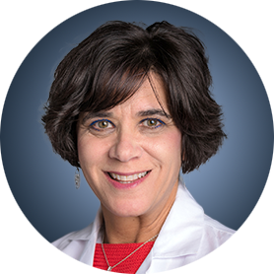



Faculty
Ilene Galinsky, RN, BSN, MSN, ANP-C
Senior Adult Research Program Nurse Practitioner Adult Leukemia Division
Dana-Farber Cancer Institute
Boston, Massachusetts
Michael J Mauro, MD
Director, Chronic Myeloid Leukemia Program
Attending Physician, Leukemia Service
Memorial Sloan Kettering Cancer Center
New York, New York
Sara M Tinsley-Vance, PhD, APRN, AOCN
Nurse Practitioner and Researcher
Moffitt Cancer Center
Tampa, Florida
Neil P Shah, MD, PhD
Edward S Ageno Distinguished Professor in Hematology/Oncology
Director, UCSF Molecular Medicine Residency Program
Chair, National Comprehensive Cancer Network CML Guidelines Panel
University of California, San Francisco
San Francisco, California

Slide 3
Ms Galinsky — Disclosures
Advisory Committees | Autolus Therapeutics, Blueprint Medicines, Bristol Myers Squibb, GSK, Novartis
Consulting Agreements | Novartis

Slide 4
Dr Mauro — Disclosures
Advisory Committees and Consulting Agreements | Bristol Myers Squibb, Enliven Therapeutics, Novartis, Takeda Pharmaceuticals USA Inc, Terns Pharmaceuticals
Contracted Research | Enliven Therapeutics, Novartis, Sun Pharma Advanced Research Company (SPARC), Sun Pharmaceutical Industries Ltd, Terns Pharmaceuticals

Slide 5
Dr Shah — Disclosures
Contracted Research | Kumquat Biosciences
Honoraria | Novartis (Delphi panel)

Slide 6
Dr Tinsley-Vance — Disclosures
No relevant conflicts of interest to disclose

Slide 7
Commercial Support
This activity is supported by an educational grant from Novartis.
Research To Practice NCPD Planning Committee Members,
Staff and Reviewers
Planners, scientific staff and independent reviewers for Research To Practice have no relevant conflicts of interest to disclose.

Slide 8
This educational activity contains discussion of
non-FDA-approved uses of agents and regimens. Please refer to official prescribing information for each product for approved indications.

Slide 9
Agenda
Introduction: Chronic Myeloid Leukemia (CML) as a Model for Targeted Treatment
Module 1: Biology of CML; Role of First- and Second-Generation Tyrosine Kinase Inhibitors (TKIs) as Initial Treatment for Chronic-Phase (CP)-CML
Module 2: Role of Asciminib for Newly Diagnosed CP-CML
Module 3: Feasibility of TKI Discontinuation for Patients with Sustained Response to Treatment
Module 4: Management of CP-CML After Failure of Initial Therapy

Slide 10
Agenda
Introduction: Chronic Myeloid Leukemia (CML) as a Model for Targeted Treatment
Module 1: Biology of CML; Role of First- and Second-Generation Tyrosine Kinase Inhibitors (TKIs) as Initial Treatment for Chronic-Phase (CP)-CML
Module 2: Role of Asciminib for Newly Diagnosed CP-CML
Module 3: Feasibility of TKI Discontinuation for Patients with Sustained Response to Treatment
Module 4: Management of CP-CML After Failure of Initial Therapy

Slide 11
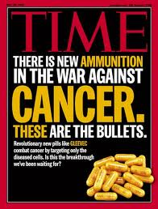


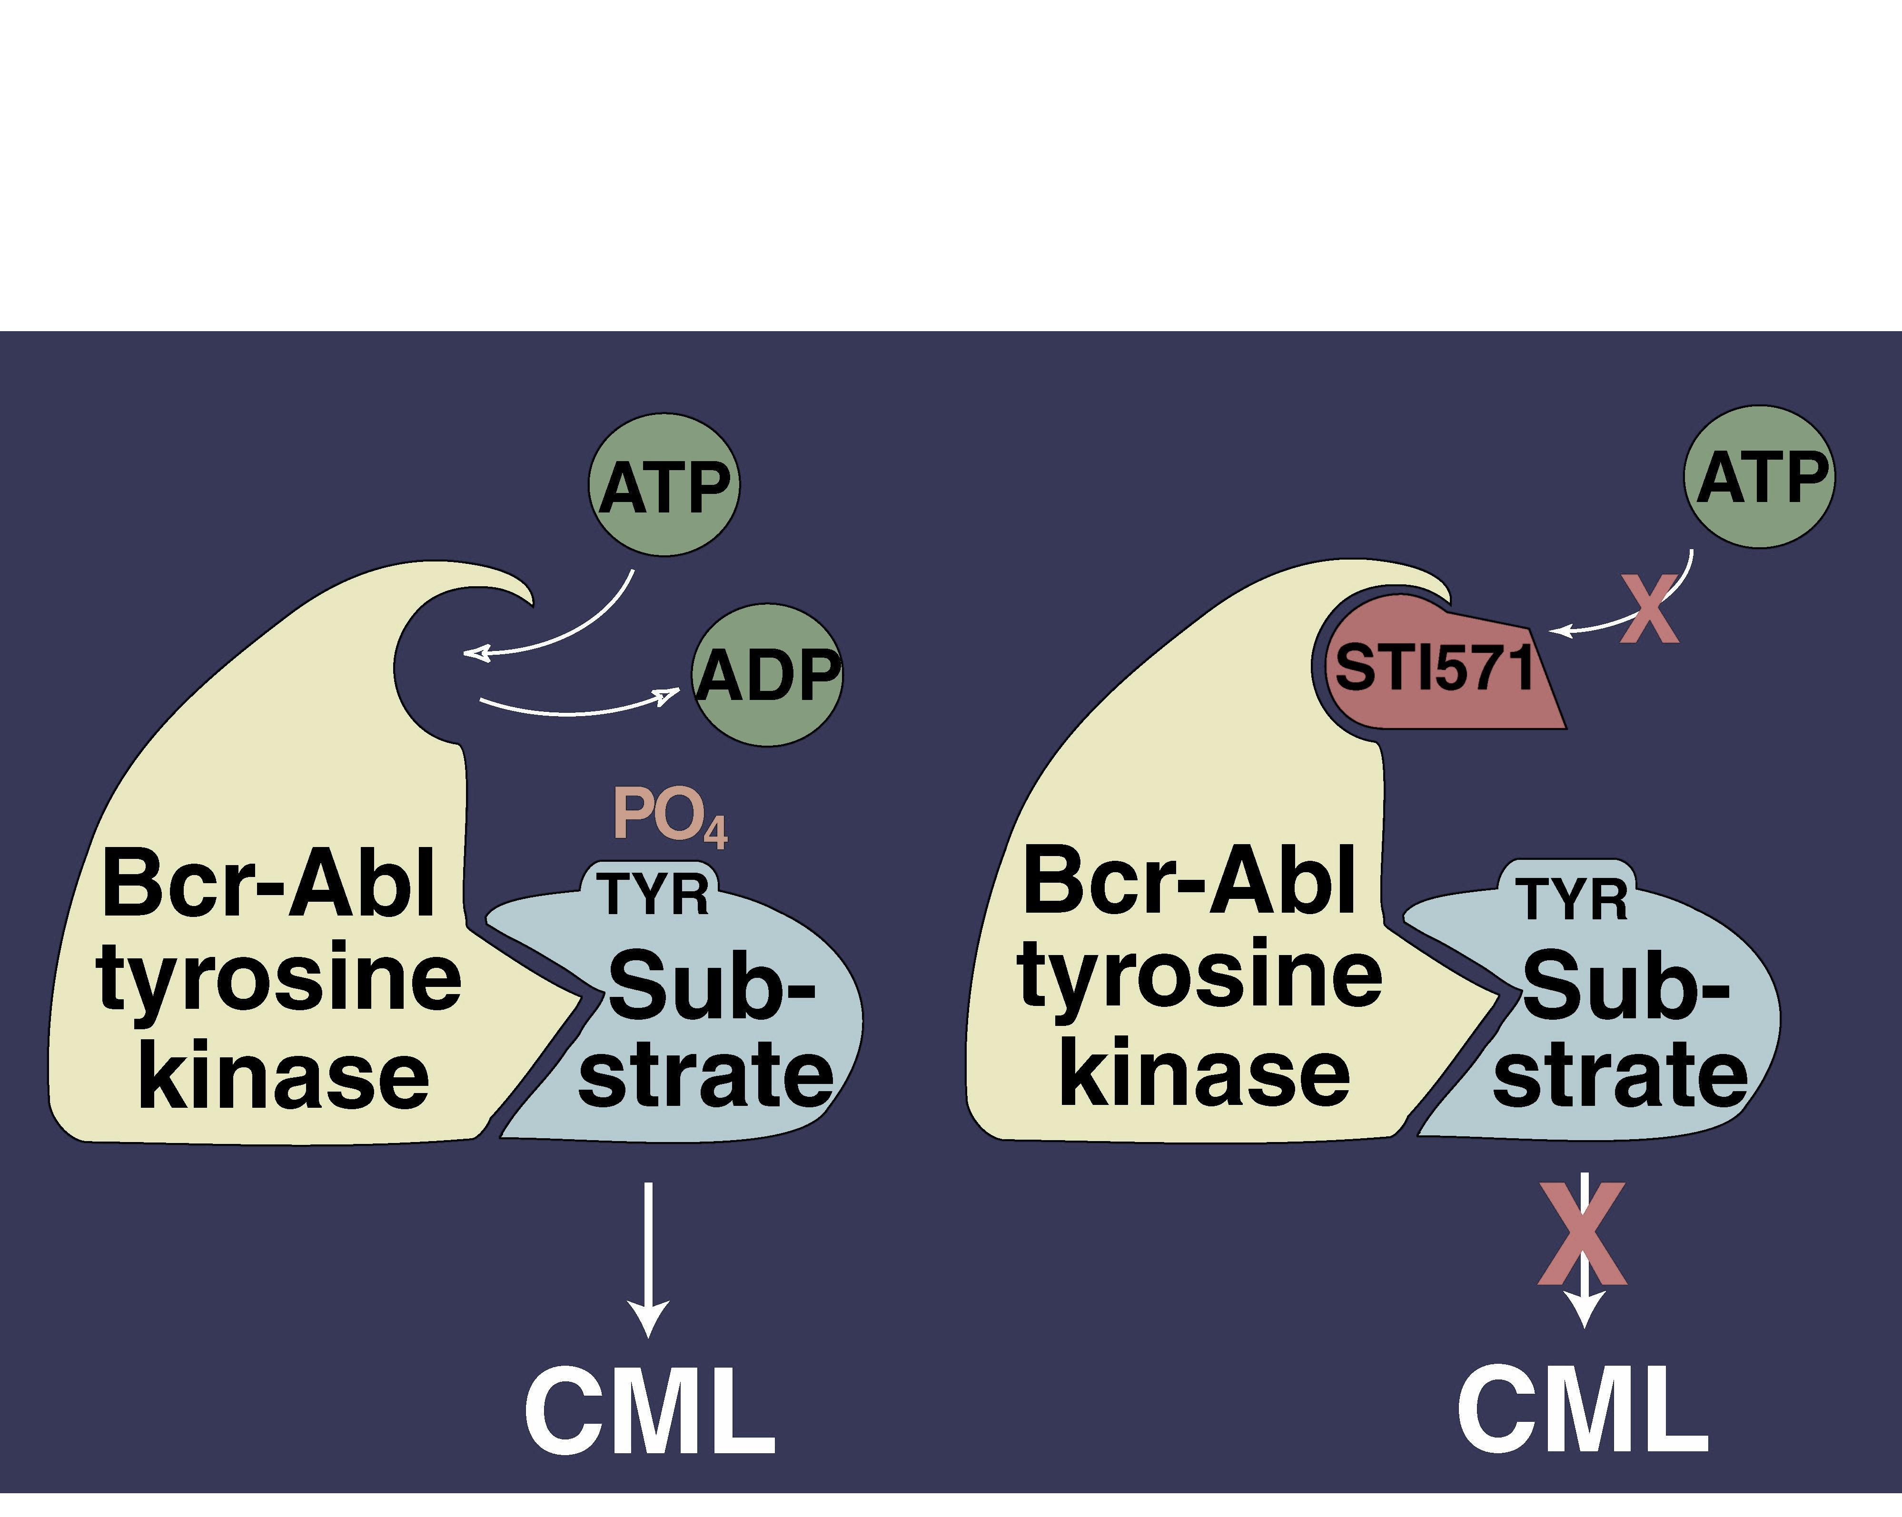
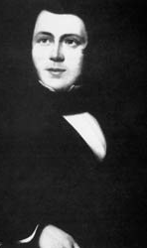

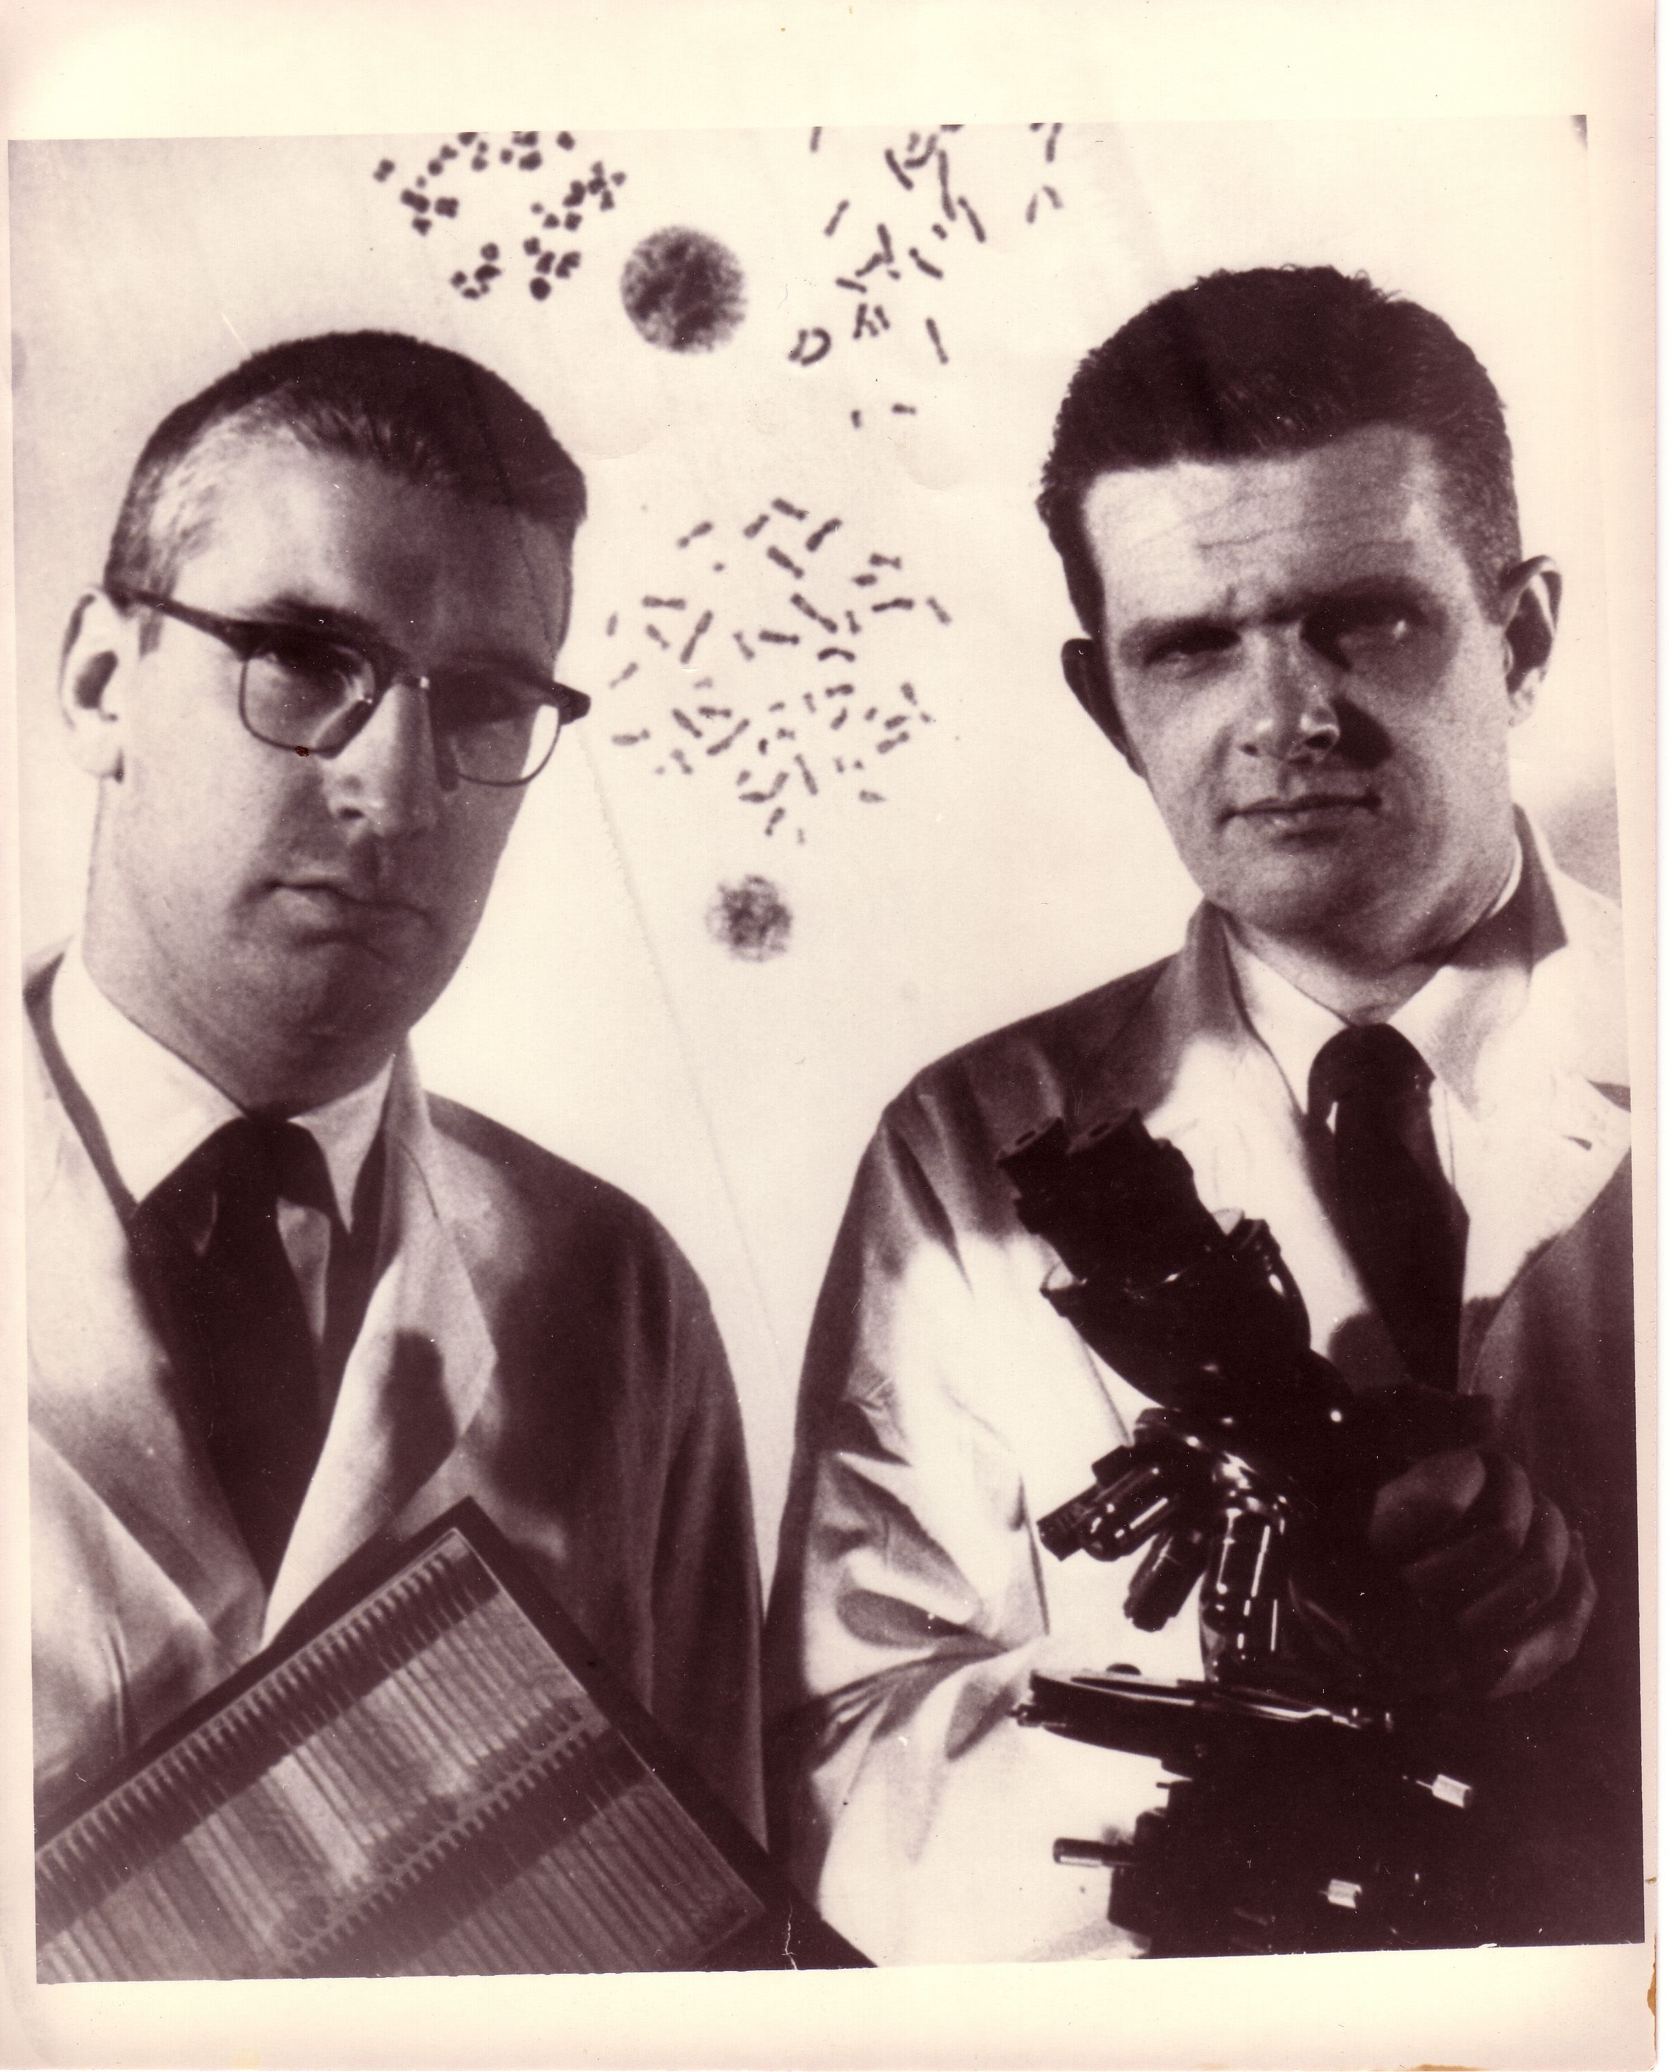
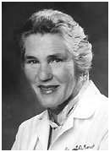
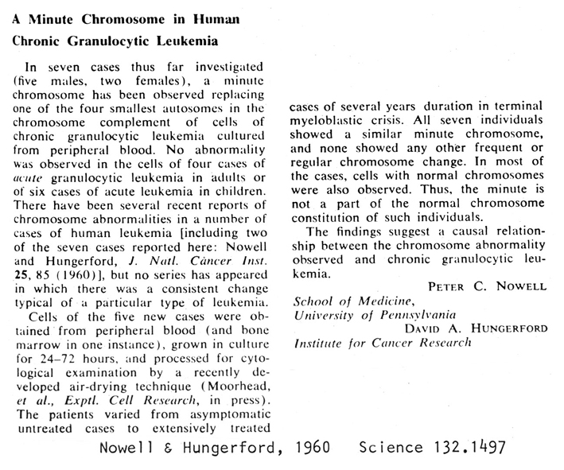
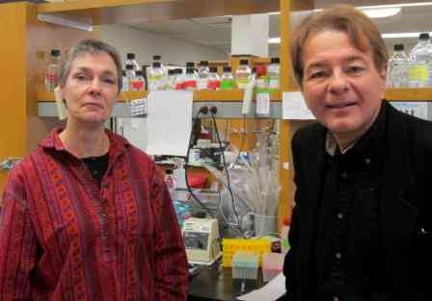
The history of CML is long, the kinase inhibitor era short…
2000: Started my work in CML with Brian Druker (OHSU, Portland, Oregon)
WBC x 10³
1845
1865
1879
1903
1953
1965
1968
1983
2001
2006
2012
2016
2021
Days
First description of CML
Fowler’s solution -1% arsenic trioxide
Staining methods for blood
Radiotherapy
Busulfan
1998: After seminal preclinical work first clinical trials commence with STI571 (imatinib); 1999, target inhibition validated, resistance identified (T315I)
Hydroxyurea
BMT
Interferon
1845:
John Hughes Bennett reported a “Case of Hypertrophy of the Spleen and Liver in which Death Took Place from Suppuration of the Blood” in the Edinburgh Medical Journal; Virchow in Germany wrote up a similar observation
Imatinib
Dasatinib
Nilotinib
1960:
Nowell & Hungerford describe the Philadelphia Chromosome
1973:
Janet Rowley
describes the
9:22 translocation
Bosutinib
Ponatinib
1983: Nora Heisterkamp and John Groffen, with others, describe the BCR-ABL fusion gene product
Generic Imatinib
Asciminib

Slide 12
Agenda
Introduction: Chronic Myeloid Leukemia (CML) as a Model for Targeted Treatment
Module 1: Biology of CML; Role of First- and Second-Generation Tyrosine Kinase Inhibitors (TKIs) as Initial Treatment for Chronic-Phase (CP)-CML
Module 2: Role of Asciminib for Newly Diagnosed CP-CML
Module 3: Feasibility of TKI Discontinuation for Patients with Sustained Response to Treatment
Module 4: Management of CP-CML After Failure of Initial Therapy

Slide 13
Clinical Scenario
A patient with newly diagnosed CP-CML who is about to start treatment with a first- or second-generation tyrosine kinase inhibitor

Slide 14
Biology of CML: Role of First- and Second-Generation TKIs as Initial Treatment for CP-CML
Neil P. Shah, MD, PhD
Professor
Division of Hematology/Oncology
University of California, San Francisco
San Francisco, California

Slide 15
Assigning Disease Phase
Modified MDACC Criteria are Preferred (not WHO)
Chronic Phase Accelerated Phase Blast Phase
<15% blasts in PB or BM 15-29% blasts in PB/BM ≥30% blasts
<30% blasts + promyelocytes ≥30% blasts + promyelocytes
in PB or BM (with <30% blasts)
≥100K platelets <100K platelets (unrelated to tx)
<20% basophils ≥20% basophils
No extramedullary disease
(except liver/spleen) Clonal evolution (additional karyotypic
abnormalities not present at diagnosis)

Slide 17
Natural Course of CML:
Historical Survival by Disease Phase
Circa 1980
1.0
CML Phase Total Dead
0.9
Chronic 2449 1043
Accelerated 479 276
Blastic 285 219
0.8
0.7
0.6
0.5
5 mo
28 mo
71 mo
Cumulative proportion surviving
0.4
0.3
0.2
0.1
0
0
1
2
3
4
5
6
7
8
Years from referral

Slide 18
Common and Selective
TKI-associated Toxicities
Imatinib
Edema/fluid retention,
myalgia, hypophosphatemia ↑,
GI effects (diarrhea, nausea)
Ponatinib
Pancreatic enzyme ↑, hypertension, skin toxicity, thrombotic events
Bosutinib
Diarrhea, nausea/emesis,
rash
Common Effects Myelosuppression
Fatigue
Musculoskeletal Discomfort
Transaminase ↑
Nilotinib
Pancreatic enzyme ↑,
indirect hyperbilirubinemia, hyperglycemia
QT prolongation, cardiovascular events
Asciminib
Pancreatic enzyme elevation, hypertension, thrombotic events
Dasatinib
Pleural effusions,
bleeding risk, pulmonary arterial hypertension

Slide 19
Individualizing Targeted Therapy in Patients with
CML and Specific History or Comorbidities
Bosutinib PI. Dasatinib PI. Imatinib PI. Asciminib PI. Hochhaus. Ann Oncol. 2017;28:iv41.

Slide 22
My Initial Frontline TKI Dosing Strategy in CP-CML Patients
Imatinib - 400 mg daily with a meal and a large glass of water
Dasatinib – 100 mg daily (with or without food) if younger than 60 or on PPI/H2 blocker. Otherwise, 50 mg daily
Nilotinib – 300 mg twice daily fasting
Bosutinib – 200 mg daily initially with dose escalation after 2-3 weeks to 300 mg and 400 mg as tolerated and as necessary to achieve treatment milestone responses
Asciminib – 80 mg daily fasting, 40 mg daily if frail

Slide 23
Notable Characteristics of First Line TKIs for CML
TKI | Efficacy | Daily Tolerability | Lack of Serious AND Irreversible Toxicity | Lack of vulnerability to resistance-conferring kinase domain mutations | Lowest Financial Burden to Society (of generic if available) | Ease of administration (based on frequency of dosing, fasting requirement)
imatinib | ++ | ++ | ++++ | + | ++++ | +++
dasatinib | +++ | +++ | +++ | +++ | +++ | ++++
nilotinib | +++ | +++ | ++ | +++ | + | +
bosutinib | +++ | +++ | +++ | +++ | + | +++
asciminib | +++ | ++++ | +++ | ++ | + | ++

Slide 24
Case
A 46 year-old woman who works as a nurse was incidentally noted to have a WBC of 53.2K in January 2025. Prior CBC performed in 2023 was unremarkable. She was referred to a hematologist and diagnosed with chronic phase CML. Her PMH includes hypertension, bilateral hip osteoarthritis and anxiety. She was started on bosutinib at a dose of 500 mg by her hematologist.
She developed problematic diarrhea after starting bosutinib for which she received IV hydration. Her LFTs were elevated at that time (AST 133, ALT 272) and her bosutinib was held. She presented to UCSF for a second opinion in mid-February 2025. She was prescribed dasatinib 100 mg, which she began in early March when her LFTs had normalized. In early April, 2025, her CBC/diff and LFTs were normal. She is tolerating treatment well to date.

Slide 25
Roundtable Discussion

Slide 26
Newly Diagnosed Patient with Chronic Phase CML
What I tell my patients about to start treatment
with 1st or 2nd generation TKIs.
Sara M Tinsley-Vance, PhD, APRN, AOCN

Slide 27
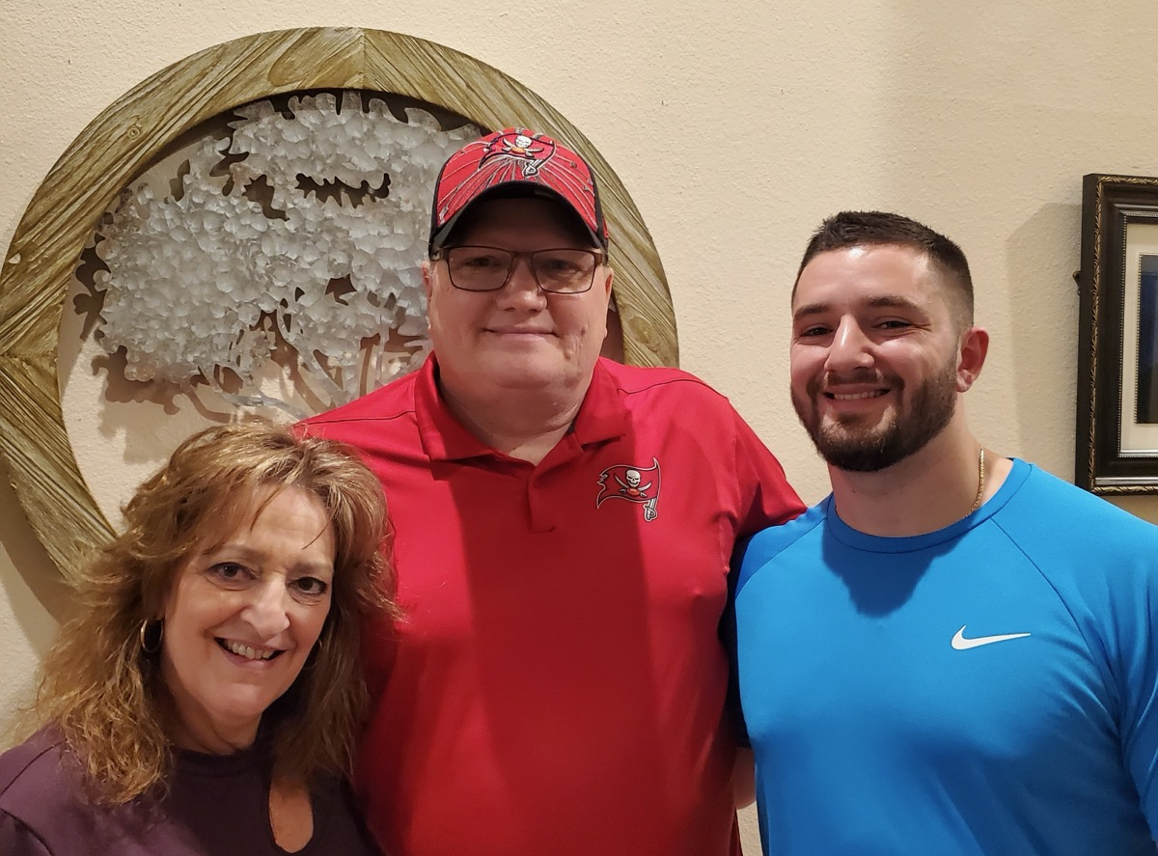
A 20-year journey together with CML

Slide 28

Flashback to the Journey’s Start
Diagnosed with CML-chronic phase in 1995
Pre-imatinib era
Started treatment with interferon
  Tolerated very poorly and was discontinued
Evaluated for allogeneic transplant
No donor identified
Underwent autologous stem cell transplant in 1998
Relapsed late 1999- the timing was perfect for the start of STI-571 (imatinib) clinic trials

Slide 29
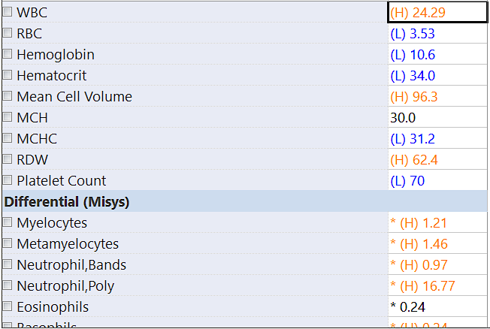
Relapse post Autologous Stem Cell Transplant
Enrolled in clinical trial STI-571
Dose of STI-571 (imatinib) was 400mg PO bid
Intermittently missed doses related to nausea and vomiting
Experienced hematologic and cytogenetic response
In 2004 WBC began to increase, Hb and platelets decrease
Spleen enlarged to 14cm
Kinase domain mutation analysis with mutation of H396P, sensitive to AMN as per in vitro studies.

Slide 30

2nd Clinical Trial
Started clinical trial AMN 107 (nilotinib)
400mg PO BID
Wife became pregnant 9 months into the study
Concern for potential birth defects
Dose reduced to 400mg daily for chest pain, hospitalization

Slide 31
Key Educational Points on Trial
Regular EKGs
Pharmacokinetics testing- frequent blood draws and study visits
Fasting 2 hours before dose and 1-hour post-dose
On trial, visits monthly
Detailed medication list
Symptoms and grading of toxicities
Bone marrow biopsies every 3 months

Slide 32

At 18 months of AMN 107
FISH for BCR/ABL was negative for BCR/ABL gene rearrangement
PCR for BCR/ABL was below the reproducible, quantifiable limits of the assay
Complete hematologic, cytogenetic, and molecular response on AMN 107

Slide 33
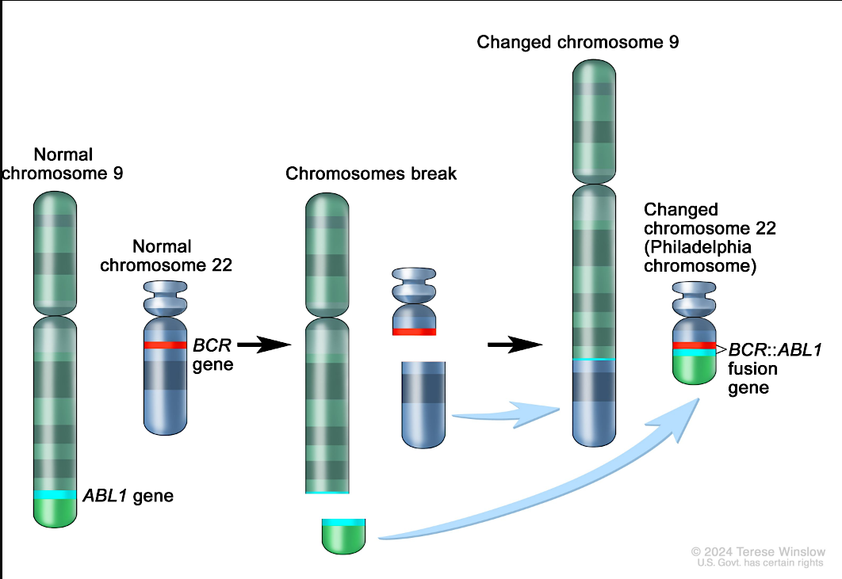
Characterized by the Philadelphia Chromosome

Slide 34
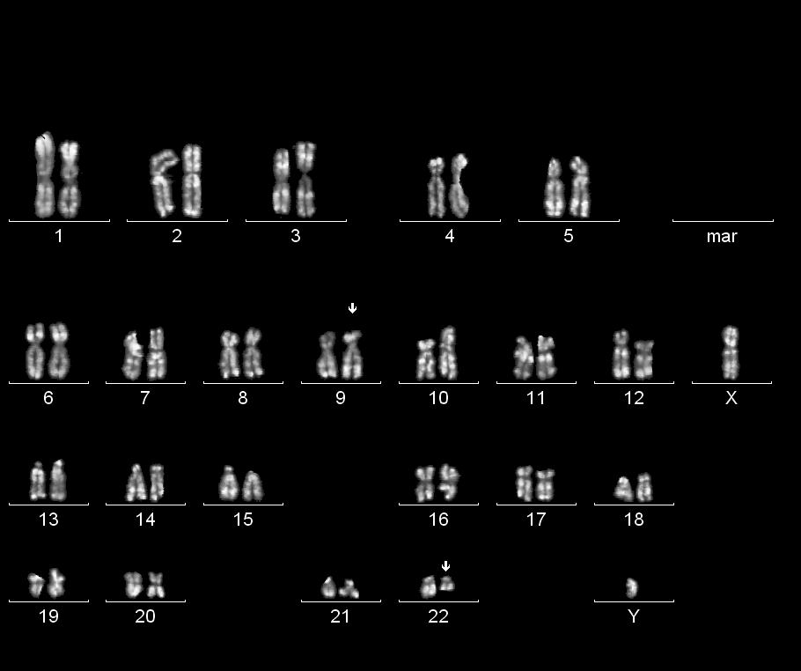
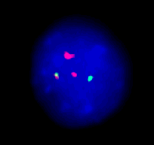
Tests Used to Identify the BCR/ABL gene
Karyotyping by G-banding technique from
Bone marrow aspirate
Fluorescent in situ hybridization (FISH) for CML from bone marrow aspirate or peripheral blood

Slide 35
Tests Used to Identify the BCR/ABL gene
PCR (Polymerase Chain Reaction) for BCR-ABL is a molecular test used to detect and quantify the BCR-ABL fusion gene
BCR-ABL1 Gene Rearrangement, Quantitative PCR (qPCR) test measures
  Two P210 transcripts (e13a2 and e14a2)
  P190 transcript (e1a2)
  Rarely P230
Results are standardized to the international scale (IS)
  Allows direct comparison across different laboratories regardless of method variations
Highly sensitive
Can detect 1 tumor cell in 100,000 cells
Measures the proportion of cells with the BCR/ABL gene

Slide 36

Monitoring Response by qPCR for BCR/ABL
CBC with diff measures above the surface
qPCR measures depth of response-below the surface

Slide 37
Tyrosine Kinase Inhibitors- How they work
Oral medications that block the signals of the BCR/ABL gene that allow the cancer to grow
“Unplugging the cancer from its energy source”
If TKIs are not taken correctly or combined with medications that interfere with blocking the signal, then the CML or BCR/ABL gene can grow
qPCR is used to measure the proportion of cells with the BCR/ABL gene

Slide 38
How to know if the medication is working
Complete Hematologic Response-1st level of response
  Normal blood counts without immature cells such as myelocytes, promyelocytes, or blasts
  Reduction of the spleen to normal size
  Resolution of symptoms
Cytogenetic Response-2nd level of response
  No translocation or Philadelphia chromosome by FISH or karyotyping- complete cytogenetic response
  Between 0 and 35% cells Ph+ - Major cytogenetic response
  Between 36 and 65% cells Ph+ - Minor cytogenetic response

Slide 39
How to know if the medication is working
Molecular Response-3rd level of response
  Measured with qPCR for BCR/ABL
  Most patients (60-80%) achieve a complete cytogenetic response, and the depth of response can be monitored by qPCR
  Major molecular response is
    At least a 3-log reduction in BCR/ABL transcripts of qPCR for BCR/ABL of 0.1%
  Deep molecular response (bottom of the iceberg)
    4-log reduction in BCR/ABL transcripts of qPCR for BCR/ABL of 0.01%
    MR4.5 is 4.5 log reduction in BCR/ABL transcripts or < 0.0032%

Slide 40
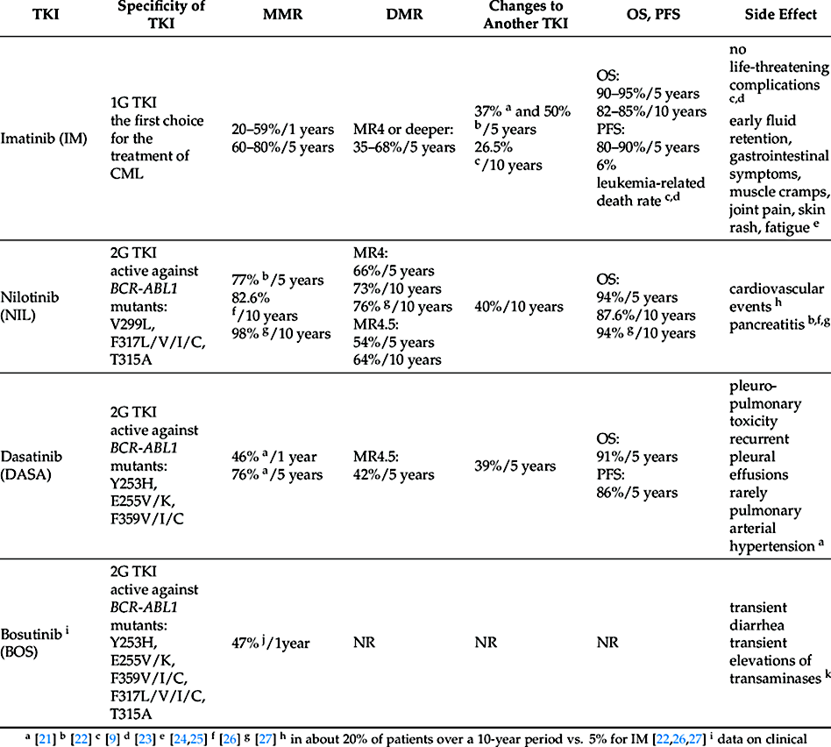
Kwaśnik P, Giannopoulos K. Treatment-Free Remission-A New Aim in the Treatment of Chronic Myeloid Leukemia. J Pers Med. 2021 Jul 22;11(8):697. doi: 10.3390/jpm11080697. PMID: 34442340; PMCID: PMC8399881.

Slide 41
Side Effect Management
Cytopenias
  Managed with close follow-up
    CBC with diff weekly during the first month of treatment, monthly in months 2 and 3, and every 3 months once stabilized
    Schedule adjusted based on level of cytopenias
  Dose interruption according to prescribing guidelines
  Dose reduction if recurrent after prolonged dose interruption
  Growth factors (off-label use, although occurs in practice)
  May need to change therapy
Fatigue
  Set expectations
  Plan activities during periods of least fatigue
  Rule out other contributing causes, such as poor sleep habits
Fluid Retention
  Decrease dietary salt intake
Jabbour, E., Deininger, M. & Hochhaus, A. Management of adverse events associated with tyrosine kinase inhibitors in the treatment of chronic myeloid leukemia. Leukemia 25, 201–210 (2011). https://doi.org/10.1038/leu.2010.215

Slide 42
Side Effect Management
Fluid retention
  Imatinib associated with periorbital edema, lower extremity edema
  Manage with diuretics as needed
  Dasatinib associated with pleural (28%) and pericardial effusions (1-2%)
    Dose interruptions and dose reductions PRN
    Thoracentesis for moderate to large pleural effusions with symptoms
    Steroids
    Diuretics
Cardiotoxicity with nilotinib
  Black box warning for potential QT prolongation and sudden death
  Perform ECG
    Baseline
    7 days after treatment initiation
    Following dose adjustments
  Correct hypokalemia and hypomagnesemia
  Educate patients to not eat 2 hours before and 1 hour after taking nilotinib
Cortes JE, Jimenez CA, Mauro MJ, Geyer A, Pinilla-Ibarz J, Smith BD. Pleural Effusion in Dasatinib-Treated Patients With Chronic Myeloid Leukemia in Chronic Phase: Identification and Management. Clinical Lymphoma Myeloma and Leukemia. 2017/02/01/ 2017;17(2):78-82. doi:https://doi.org/10.1016/j.clml.2016.09.012
Jabbour, E., Deininger, M. & Hochhaus, A. Management of adverse events associated with tyrosine kinase inhibitors in the treatment of chronic myeloid leukemia. Leukemia 25, 201–210 (2011). https://doi.org/10.1038/leu.2010.215

Slide 43
Side Effect Management
Metabolic
  Grade 3-4 elevations in aspartate aminotransferase (AST), alanine aminotransferases, and bilirubin (7% or less) with nilotinib and imatinib, <1% for dasatinib, bosutinib (up to 18%)
  Manage by performing monthly CMP panels
  Grade toxicity level and interrupt and reduce dose as needed
  Discuss potential contributors to hepatic toxicity (i.e. acetaminophen, alcohol) and limit their use
  Nilotinib associated with increased lipase and pancreatitis (1-2%)
  Nilotinib associated with hyperglycemia (12%)
  Grade toxicity level and interrupt or reduce dose
  Hospitalization may be necessary for pancreatitis
  Avoid using nilotinib in individuals prone to increased lipase, pancreatitis, or hyperglycemia
Cortes, J.E., Apperley, J.F., DeAngelo, D.J. et al. Management of adverse events associated with bosutinib treatment of chronic-phase chronic myeloid leukemia: expert panel review. J Hematol Oncol 11, 143 (2018). https://doi.org/10.1186/s13045-018-0685-2
Jabbour, E., Deininger, M. & Hochhaus, A. Management of adverse events associated with tyrosine kinase inhibitors in the treatment of chronic myeloid leukemia. Leukemia 25, 201–210 (2011). https://doi.org/10.1038/leu.2010.215

Slide 44
Side Effect Management
Metabolic
  Hypophosphatemia
    Imatinib -50% incidence
    Dasatinib or nilotinib -10%
    Bosutinib-20%
  Replace phosphorous and monitor periodically throughout treatment
Musculoskeletal
  Common with imatinib ~ 50% musculoskeletal pain and muscle cramps in the IRIS trial
  Grade 3–4 musculoskeletal pain in 5% and myalgia 24%
  Symptomatic relief with hydration, magnesium and calcium supplements
Cortes, J.E., Apperley, J.F., DeAngelo, D.J. et al. Management of adverse events associated with bosutinib treatment of chronic-phase chronic myeloid leukemia: expert panel review. J Hematol Oncol 11, 143 (2018). https://doi.org/10.1186/s13045-018-0685-2
Jabbour, E., Deininger, M. & Hochhaus, A. Management of adverse events associated with tyrosine kinase inhibitors in the treatment of chronic myeloid leukemia. Leukemia 25, 201–210 (2011). https://doi.org/10.1038/leu.2010.215

Slide 45
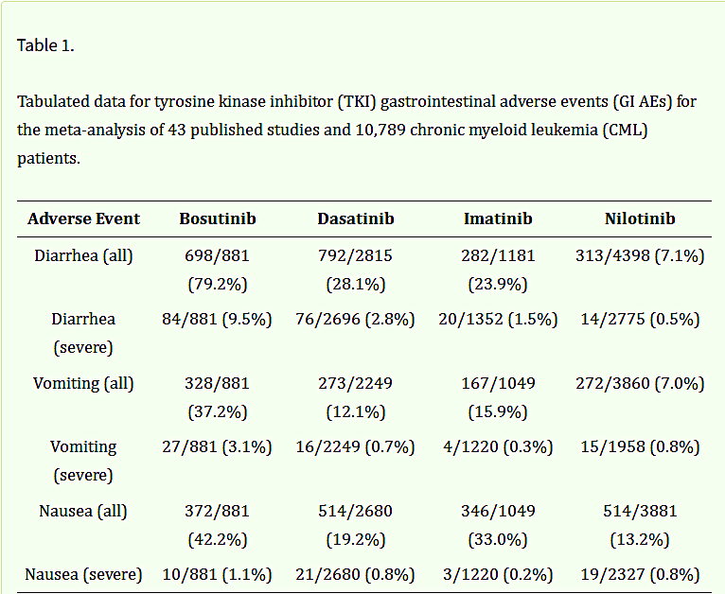
Mohanavelu P, Mutnick M, Mehra N, White B, Kudrimoti S, Hernandez Kluesner K, Chen X, Nguyen T, Horlander E, Thenot H, Kota V, Mitchell CS. Meta-Analysis of Gastrointestinal Adverse Events from Tyrosine Kinase Inhibitors for Chronic Myeloid Leukemia. Cancers (Basel). 2021 Apr 1;13(7):1643. doi: 10.3390/cancers13071643. PMID: 33915952; PMCID: PMC8037766.

Slide 46
GI Side Effect Management
Bosutinib and imatinib should be taken with food and a full glass of water to decrease GI side effects
Dasatinib may be taken with or without food
Nilotinib should be taken on an empty stomach, at least 2 hours before or 1 hour after eating any food
Provide dietary counseling for preventing diarrhea
  Avoid spicy or fatty food, caffeine, alcohol, dairy products, and raw fruit and vegetables (except for bananas and apples)
  Eat low-fiber starchy food and food that is high in sodium and potassium
  Eat small meals, snack frequently, avoid very hot or cold food and drink
  Re-introduce a balanced diet (high-fiber food, fruit, and vegetables) once diarrhea has resolved

Slide 47
GI Side Effect Management
Discontinue medications and supplements that exacerbate diarrhea
Antidiarrheals as needed
Emphasize the importance of adequate hydration
Encourage them to continue and remind them that with time, this improves for most patients

Slide 48
Roundtable Discussion

Slide 49
Practical Nursing Considerations with the Use of TKIs for CML
Ilene Galinsky, RN, BSN, MSN, ANP-C
Dana-Farber Cancer Institute
Boston, Massachusetts

Slide 50
Nursing considerations:
The dosing of the TKI’s vary based on phase- for purposes of this discussion the dosing is for those with chronic phase CML.
Imatinib: 400 mg every day- can take with food and water any time of day- watery eyes, orbital edema-avoid grapefruit juice-myelosuppression- dose adjustment per guidelines
Dasatinib:100 mg once per day- pleural effusions- muscle ache-rash-GI symptoms-can be taken with or without food-dose modifications as outlined
Nilotinib: BLACK BOX WARNING- cardiovascular complications; QT syndrome; myelosuppression-avoid antacids; joint pain
400 mg BID (at least 12 hours apart)-Take on an empty stomach

Slide 51
Nursing Consideration
Bosutinib: starting dose is 400mg once per day 300mg for moderate renal dysfunction. Take once per day with food.
Diarrhea; nausea; abdominal pain; headache- most patients are dose reduced

Slide 52
General
Work with all our patients, to notify us before they take any new medication or over the counter medications-teaching fact sheets-pharmacy support for oral medication
St. Johns wort, antacids, PPI, Grapefruit Juice
If you don’t take it, you are not going to have a response- showing them and discussing their PCR results; encouraging them to discuss symptoms so we can work together to come up with a solution so they do take their medication
Discuss openly goals, stopping studies if milestones are met-they understand why they are on this medication

Slide 53
76-year-old female
Dx with chronic phase CML- started imatinib at soc dose of 400mg per day
Developed nausea and vomiting, diarrhea, elevated liver enzymes- treated with supportive care, including a drug holiday- liver enzymes resolved- dose decreased to 300mg per day- now developing severe headaches- several scans and neurology consult- unable to identify a cause- thought to be possibly related to imatinib- decreased dose to 200mg per day- still headaches “migraine like” continued- unable to remain on imatinib…

Slide 54
What next?
Patient with a history of cardiovascular disease; hyperlipidemia; hypertension--- what do we choose?
Options:
Dasatinib- concerned with fluid issues- pleural effusions
Nilotinib- cardiovascular issues- history of cardiovascular issues
Bosutinib- GI side effects (especially diarrhea)- history of GI issues
Asciminib: enrolled patient on clinical trial-started 80mg daily

Slide 55
Results?
She has now been on trial for two years
Remains on starting dose
Achieving PCR milestones- last PCR 0.0035%= 4.45 log reduction
Nausea, vomiting, diarrhea, fatigue, arthralgias- improved
Headaches improved now they come and go now receiving botulinum toxin injections PS = 0

Slide 56
Roundtable Discussion

Slide 57
Agenda
Introduction: Chronic Myeloid Leukemia (CML) as a Model for Targeted Treatment
Module 1: Biology of CML; Role of First- and Second-Generation Tyrosine Kinase Inhibitors (TKIs) as Initial Treatment for Chronic-Phase (CP)-CML
Module 2: Role of Asciminib for Newly Diagnosed CP-CML
Module 3: Feasibility of TKI Discontinuation for Patients with Sustained Response to Treatment
Module 4: Management of CP-CML After Failure of Initial Therapy

Slide 58
Clinical Scenario
A patient with newly diagnosed CP-CML who is about to start treatment with asciminib

Slide 59











Role of Asciminib in Newly Diagnosed Chronic Phase CML
Michael J. Mauro, MD
Director, Chronic Myeloid Leukemia Program
Memorial Sloan Kettering Cancer Center
New York, NY
TEAM922

Slide 60
The history of CML is long, the kinase inhibitor era short…
2000: Started my work in CML with Brian Druker (OHSU, Portland, Oregon)
WBC x 10³
1845
1865
1879
1903
1953
1965
1968
1983
2001
2006
2012
2016
2021
Days
First description of CML
Fowler’s solution -1% arsenic trioxide
Staining methods for blood
Radiotherapy
Busulfan
1998: After seminal preclinical work first clinical trials commence with STI571 (imatinib); 1999, target inhibition validated, resistance identified (T315I)
Hydroxyurea
BMT
Interferon
1845:
John Hughes Bennett reported a “Case of Hypertrophy of the Spleen and Liver in which Death Took Place from Suppuration of the Blood” in the Edinburgh Medical Journal; Virchow in Germany wrote up a similar observation
Imatinib
Dasatinib
Nilotinib
1960:
Nowell & Hungerford describe the Philadelphia Chromosome
1973:
Janet Rowley
describes the
9:22 translocation
Bosutinib
Ponatinib
1983: Nora Heisterkamp and John Groffen, with others, describe the BCR-ABL fusion gene product
Generic Imatinib
Asciminib

Slide 61
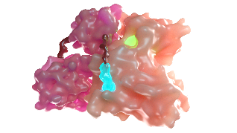
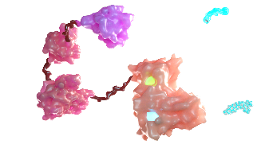
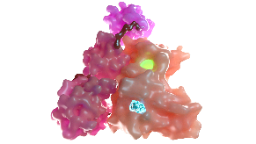
Asciminib is the 1st and only approved BCR::ABL1 inhibitor that works by STAMP (Specifically Targeting the ABL Myristoyl Pocket)
Normal conditions
In CML
In CML with asciminib
Inactive ABL1
with N-terminus binding
Constitutively active BCR::ABL1
with loss of N-terminus
Inactive BCR::ABL1
with asciminib binding
ATP-binding site
Approved ATP-competitive TKIs target the ATP-binding site
BCR
Displaced
N-terminus
BCR
BCR
BCR
SH3
ATP-binding site
Myristoylated
N-terminus
SH3
SH3
Asciminib
Kinase domain
ABL1
ABL1
Kinase domain
Kinase
domain
SH2
SH2
SH2
Asciminib targets the myristoyl pocket
Myristoyl pocket
Myristoyl pocket
Adapted from Manley PW, et al. Leuk Res. 2020;98:106458. Copyright © 2020 Elsevier Ltd.
1. Colicelli J. Sci Signal. 2010;3:re6. 2. Hughes TP, et al. N Engl J Med. 2019;381:2315-2326. 3. Hantschel O. Genes Cancer. 2012;3:436-446. 4. Manley PW, et al. Leuk Res. 2020;98:106458. 5. Mauro MJ, et al. Oral presentation at: 63rd ASH Annual Meeting & Exposition; December 11–14, 2021; San Diego, CA, and virtual. Presentation 310.

Slide 62
Study design
Phase 3 ASC4FIRST study results in patients with newly diagnosed CML receiving asciminib or investigator-selected TKIs
Hochhaus A, et al. N Engl J Med. 2024;391(10):885-898.
Cortes JE, et al. Oral presentation at: 66th ASH Annual Meeting & Exposition; December 7-10, 2024; San Diego, CA. Oral presentation 475.
ASC 80 mg QD (n=201)
End of study: LPFT +
5 years^{b}
Key inclusion criteria
Newly diagnosed Ph+ CML‑CP with no prior TKIsª
≥18 years of age
Prerandomization TKI selection
The TKI a patient will take if randomized to IS-TKI arm
Selected by physician in consultation with patient
Stratification by:
Prerandomization TKI selection (IMA or 2G TKI)
ELTS risk category (low/intermediate/ high)
Imatinib stratum: ASC^{IMA} (n=101)
2G TKI stratum: ASC^{2G} (n=100)
R 1:1
N=405
All IS-TKIs at label doses (n=204)
Imatinib stratum: IS-TKI^{IMA} (n=102)
2G TKI stratum: IS-TKI^{2G} (n=102)
From Hochhaus A, et al. N Engl J Med. 2024;391(10):885-898. Copyright © 2024 Massachusetts Medical Society. Adapted with permission from Massachusetts Medical Society.
Primary endpoints | MMR at week 48 with ASC vs all IS-TKIs MMR at week 48 with ASC^{IMA} vs IS-TKI^{IMA} (imatinib stratum)
Key secondary endpoints | MMR at week 96 with ASC vs all IS-TKIs MMR at week 96 with ASC^{IMA} vs IS-TKI^{IMA} (imatinib stratum)
Data cutoff: Nov 28, 2023
Data cutoff: Oct 22, 2024
2G, 2nd generation; ASC, asciminib; CML-CP, chronic myeloid leukemia in chronic phase; ELTS, EUTOS long-term survival score; EUTOS, European Treatment and Outcome Study; IMA, imatinib; IS, investigator selected; LPFT, last person 1st treatment; MMR, major molecular response; Ph, Philadelphia chromosome; QD, once daily; R, randomized; TKI, tyrosine kinase inhibitor.
ª Either imatinib, bosutinib, dasatinib, or nilotinib is allowed for ≤2 weeks prior to randomization. Treatment with other TKIs prior to randomization was not permitted. ^{b} Patients will remain on study for 5 years after the last patient 1st dose, unless they have discontinued early due to treatment failure, disease progression, intolerance, or investigator or patient decision.
Hochhaus A, et al. N Engl J Med. 2024;391(10):885-898.

Slide 63
ASC4FIRST: MMR rates at time points (@2y)
ASC vs IS-TKIs
ASC^{IMA} vs IS-TKI^{IMA}
ASC^{2G} vs IS-TKI^{2G}
Primary endpoint 1
Key secondary endpoint 1
Primary endpoint 2
Key secondary endpoint 2
Secondary endpointsª
18.9%ª
(95% CI, 9.6%-28.2%; P<.001)^{c}
22.4%ª
(95% CI, 13.6%-31.3%; P<.001)^{c}
29.6%^{b}
(95% CI, 16.9%-42.2%; P<.001)^{c}
29.7%^{b}
(95% CI, 17.6%-41.8%; P<.001)^{c}
8.2%^{b}
(95% CI, −5.1% to 21.5%)
15.1%^{b}
(95% CI, 2.3%-28.0%)
Patients, %
Week
48
96
48
96
48
96
ASC (n=201)
IS-TKI (n=204)
ASC^{IMA} (n=101)
IS-TKI^{IMA} (n=102)
ASC^{2G} (n=100)
IS-TKI^{2G} (n=102)
Reused with permission from the American Society of Hematology. © 2024 The Authors. All rights reserved. Officially licensed by ASH for distribution.
MMR rate at week 96 continued to be superior with ASC vs all IS-TKIs, meeting the 1st key secondary endpoint
MMR rate at week 96 continued to be superior with ASC^{IMA} vs IS-TKI^{IMA}, meeting the 2nd key secondary endpoint
Treatment difference for the MMR rate at week 96 between ASC^{2G} and IS-TKI^{2G} increased
MMR rates at week 96 were consistently higher with ASC overall and across strata
2G, 2nd generation; ASC, asciminib; ELTS, EUTOS long-term survival score; EUTOS, European Treatment and Outcome Study; IMA, imatinib; IRT, interactive response technology; IS, International Scale; IS-TKI, investigator-selected tyrosine kinase inhibitor; MMR, major molecular response (BCR::ABL1^{IS} ≤0.1%); TKI, tyrosine kinase inhibitor.
Error bars represent 95% CIs. The common treatment difference and its 95% CI were estimated using the Mantel-Haenszel method after stratifying for ª prerandomization-selected TKI and baseline ELTS risk groups (both IRT data) or ^{b} baseline ELTS risk groups (IRT data). ^{c} Adjusted 1-sided P value was calculated based on the graphical gatekeeping procedure. The null hypothesis is rejected if the adjusted P value is ≤.025.
Cortes JE, et al. Oral presentation at: 66th ASH Annual Meeting & Exposition; December 7-10, 2024; San Diego, CA. Oral presentation 475.

Slide 64
ASC4FIRST: Overview of Adverse Events (@2y)
AEs leading to
discontinuation
AEs leading to dose
adjustment/interruption
Grade ≥3 AEs
Patients, %ª
ASC
(n=200)
IMA
(n=99)
2G TKIs
(n=102)
ASC
(n=200)
IMA
(n=99)
2G TKIs
(n=102)
ASC
(n=200)
IMA
(n=99)
2G TKIs
(n=102)
Reused with permission from the American Society of Hematology. © 2024 The Authors. All rights reserved. Officially licensed by ASH for distribution.
The median average daily dose was 80 mg/day with ASC, 400 mg/day with IMA, 600 mg/day with NIL, 100 mg/day with DAS, and 316 mg/day with BOS
The hazard ratio for time to treatment discontinuation due to AEs with ASC vs 2G TKIs was 0.46 (95% CI, 0.215-0.997)
  Risk of discontinuation due to AEs^{b} was 54% lower with asciminib than 2G TKIs
2G, 2nd generation; AE, adverse event; ASC, asciminib; BOS, bosutinib; DAS, dasatinib; IMA, imatinib; NIL, nilotinib; TKI, tyrosine kinase inhibitor.
ª Safety analyses were done in patients who received ≥1 dose of study drug. Patients were analyzed according to the study treatment received. A patient with multiple severity grades for an AE is only counted under the maximum grade. ^{b} Discontinuation for other reasons was a competing event.
Cortes JE, et al. Oral presentation at: 66th ASH Annual Meeting & Exposition; December 7-10, 2024; San Diego, CA. Oral presentation 475.

Slide 65
ASC4FIRST: Most relevant AEsª with ASC^{IMA} vs IS-TKI^{IMA} (@2y)
ASC^{IMA} (n=100)
IS-TKI^{IMA} (n=99)
^{b}
^{c}
Hematologic
^{d}
^{e}
^{f}
Most relevant AEs were lower with ASC^{IMA} than IS-TKI^{IMA} by the week 96 cutoff
GI
Constitutional
^{g}
Laboratory
All grade
All grade
Reused with permission from the American Society of Hematology. © 2024 The Authors. All rights reserved. Officially licensed by ASH for distribution.
Grade ≥3
Grade ≥3
AE, adverse event; ALT, alanine aminotransferase; ASC, asciminib; AST, aspartate aminotransferase; GI, gastrointestinal; IMA, imatinib; IS-TKI, investigator-selected tyrosine kinase inhibitor.
ª A patient with multiple severity grades for an AE is only counted under the maximum grade. COVID-19 is not listed. ^{b} Includes platelet count decreased and thrombocytopenia.
^{c} Includes neutrophil count decreased and neutropenia. ^{d} Includes decreased white blood cell count and leukopenia. ^{e} Includes decreased lymphocyte count and lymphopenia.
^{f} Includes anemia and red blood cell count decreased and hematocrit decreased. ^{g} Includes periorbital edema and face edema.
Cortes JE, et al. Oral presentation at: 66th ASH Annual Meeting & Exposition; December 7-10, 2024; San Diego, CA. Oral presentation 475.

Slide 66
ASC4FIRST: Most relevant AEsª with ASC^{2G} vs IS-TKI^{2G} (@2y)
ASC^{2G} (n=100)
IS-TKI^{2G} (n=102)
^{b}
^{c}
Hematologic
^{d}
^{e}
^{f}
Most relevant AEs were lower with ASC^{2G} than IS-TKI^{2G} by the week 96 cutoff
GI
Constitutional
^{g}
Laboratory
All grade
All grade
Reused with permission from the American Society of Hematology. © 2024 The Authors. All rights reserved. Officially licensed by ASH for distribution.
Grade ≥3
Grade ≥3
2G, 2nd generation; AE, adverse event; ALT, alanine aminotransferase; ASC, asciminib; AST, aspartate aminotransferase; GI, gastrointestinal; IS-TKI, investigator-selected tyrosine kinase inhibitor.
ª A patient with multiple severity grades for an AE is only counted under the maximum grade. COVID-19 is not listed. ^{b} Includes platelet count decreased and thrombocytopenia.
^{c} Includes neutrophil count decreased and neutropenia. ^{d} Includes decreased white blood cell count and leukopenia. ^{e} Includes decreased lymphocyte count and lymphopenia.
^{f} Includes anemia and red blood cell count decreased and hematocrit decreased. ^{g} Includes periorbital edema and face edema.
Cortes JE, et al. Oral presentation at: 66th ASH Annual Meeting & Exposition; December 7-10, 2024; San Diego, CA. Oral presentation 475.

Slide 67
ASC4FIRST: Arterial Occlusive Events (@2y)
Patients, n (%) | All ASC (n=200)ª |  | IMA (n=99)ª |  | 2G TKIs (n=102)ª
 | All grade | Grade ≥3 | All grade | Grade ≥3 | All grade | Grade ≥3
Patients with ≥1 AOE | 4 (2.0) | 1 (0.5) | 0 | 0 | 3 (2.9) | 1 (1.0)
Angina pectoris | 1 (0.5) | 0 | 0 | 0 | 0 | 0
Peripheral arterial occlusive disease | 1 (0.5)^{b} | 0 | 0 | 0 | 0 | 0
Arteriosclerosis coronary artery | 2 (1.0)^{b} | 0 | 0 | 0 | 0 | 0
Cerebrovascular accident | 1 (0.5) | 1 (0.5) | 0 | 0 | 0 | 0
Cerebral infarction | 0 | 0 | 0 | 0 | 1 (1.0) | 0
Myocardial infarction | 0 | 0 | 0 | 0 | 1 (1.0)^{c} | 1 (1.0)^{c}
Myocardial ischemia | 0 | 0 | 0 | 0 | 1 (1.0)^{c} | 0
Vertebral artery arteriosclerosis | 0 | 0 | 0 | 0 | 1 (1.0) | 0
Reused with permission from the American Society of Hematology. © 2024 The Authors. All rights reserved. Officially licensed by ASH for distribution.
Since the week 48 cutoff, 2 additional patients had AOEs with ASC (angina pectoris and peripheral arterial occlusive disease [in the patient who had arteriosclerosis coronary artery in the week 48 analysis] and arteriosclerosis coronary artery), and 1 additional patient had an AOE with bosutinib (cerebral infarction)
AOEs occurred in 2 patients with ASC^{IMA} stratum and 2 with ASC^{2G}
2G, 2nd generation; AOE, arterial occlusive event; ASC, asciminib; IMA, imatinib; TKI, tyrosine kinase inhibitor.
ª Safety analyses were done in patients who received ≥1 dose of study drug. Patients were analyzed according to the study treatment received. ^{b} 1 patient who had arteriosclerosis coronary artery at the week 48 analysis presented with new peripheral arterial occlusive disease. ^{c} Myocardial infarction and myocardial ischemia occurred in the same patient with 2G TKIs.
Cortes JE, et al. Oral presentation at: 66th ASH Annual Meeting & Exposition; December 7-10, 2024; San Diego, CA. Oral presentation 475.

Slide 68

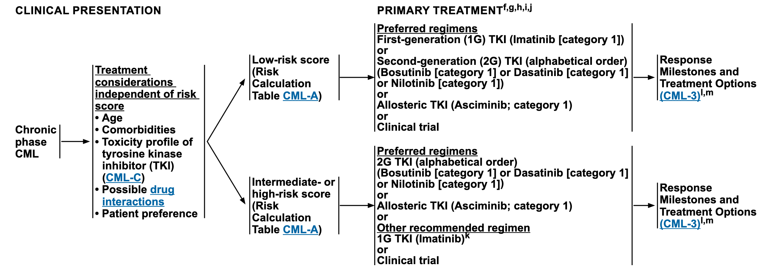
US Front Line TKI Recommendations
Step 1: precise diagnosis, baseline measurements
Step 2: informed and careful discussion and choice of therapy
NCCN CML Guidelines, Version 3.2025, Accessed with permission, www.nccn.org

Slide 69
Case: New Diagnosis CML
39yo interior designer splitting time between New York and London noted on routine health check to have fatigue, change in menses pattern, abd cramps/pain preceding cycle
no significant 'b' sx such as night sweats, weight loss; no bruising, bleeding, other changes; bloodwork one year prior WNL
initial bloodwork 5/2023 with mild leukocytosis (12-13k), plts 600k; reactive lymphs noted in diff, no immature forms but unclear if manual differential (London)
f/u bloodwork in NYC 6/2023: wbc 19 hgb 13.7 hct 42.8 plt 705 differential 4% myelocytes 2% eos 9% basophils 1% blasts

Slide 70
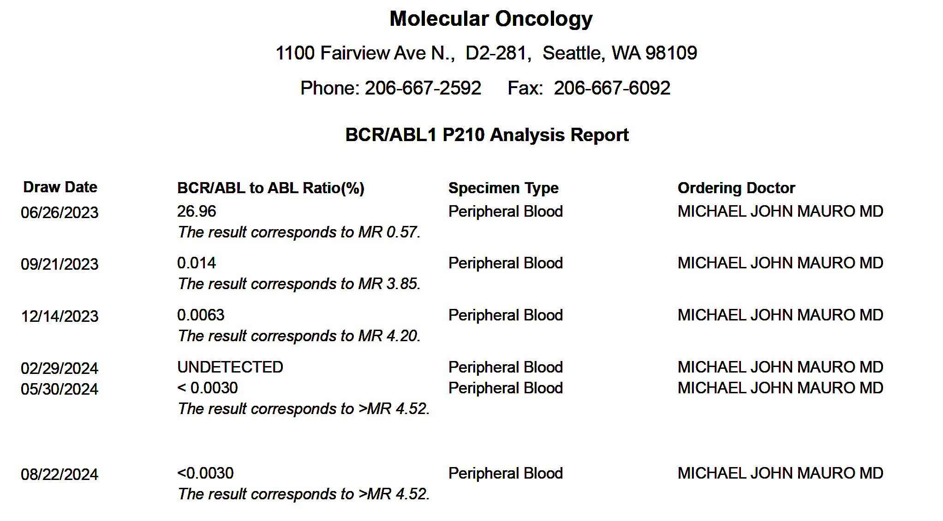


Case: New Diagnosis CML
Despite travel requirement, enrolled in Khoury Cure CML Consortium front line study (phase II frontline Asciminib)
NO adverse effects
3mo response near MR4
6mo response deep MR
Ongoing deep MR; TFR planned

Slide 71
Principles in the Treatment of Chronic Myeloid Leukemia
First line
Subsequent line
Early and comprehensive diagnosis
  Clinical/pathological stage, features
    WHO shift on biphasic versus triphasic disease
  Appraisal of BCR-ABL, and likely non-BCR ABL, mechanisms
  Comorbidities
Goals of therapy
  Is it treatment free remission, or remission with preserved QOL?
Capacity and limitations: provider, patient
  Monitoring, adherence, follow-up, collaboration
  Access to diagnostics including comprehensive resistance testing; Access to TKIs (approved versus reimbursed)
  Breadth of options: allografting, alternative TKIs
Running the marathon that CML is
  Paradigm of chronic disease on chronic therapy warrants specific approaches
    Continual reassessment of adverse events, comorbidities- with special attention to emerging events
  Treatment is several years minimum and lifelong for many
Disease specifics: phase, prior exposure / adverse events, mutation status, other resistance mechanisms
If not initially assessed, formal cardiovascular risk assessment informative to guide AE avoidance, management in later line therapy
  Attribution of CV AEs challenging if no baseline data
Optimization as early as possible to minimize risk and maximize stability and QOL
Beyond
‘Survivorship’
Treatment free remission + chronic maintenance cohorts
TKI specific long term adverse events
Cardiac, Pulmonary, Neurocognitive, Renal, Gastrointestinal / Pancreatic, Musculoskeletal, Dermatologic
Nonheme second cancers, CH/other hematologic disorders

Slide 72
The (Tougher) Reality: The Spectrum of Adverse Events with BCR::ABL TKIs
Issue | Imatinib | Nilotinib | Dasatinib | Bosutinib | Ponatinib | Asciminib
Dosing | QD/BID, with food | BID, without food (2h) | QD, w/ or w/o food | QD, with food | QD, w/ or w/o food | QD or BID, w/o food; dosing varies (T315I or not)
Long term safety | Most extensive | Extensive; Emerging toxicity | Extensive; Emerging toxicity | Extensive, No emerging toxicity | More limited but increasing; Emerging toxicity | Emerging; long phase I data (8y)
Heme toxicity | Intermediate | Least | Most severe; ASA-like effect; Lymphocytosis | ~dasatinib in 2nd, 3rd line; ~nilotinib in 1st line | Thrombocytopenia ASA-like effect | Thrombocytopenia Neutropenia
Non-Heme toxicity | Edema, GI effects (diarrhea, nausea), Muscle cramps, ⬇Phos | ⬆Lipase, ⬆Bili, ⬆Chol, ⬆Glu, Fatigue, Musculo-skeletal symptoms Black box: QT prolongation | Headache (early/transient) Pleural / pericardial effusions | Diarrhea; Transaminitis | ⬆Lipase, Pancreatitis, Rash, Hypertension Black box: vascular occlusion, heart failure, and hepatotoxicity | ⬆Lipase, Pancreatitis, Hypertension, Hypersensitivity reaction
Special concern issues | Early question re: CHF ?late renal effects | Vascular events (ICVE, IHD, PAD) | ?PAH (pulmonary arterial hypertension) | ? Mild renal effects | Vascular events (ICVE, IHD, PAD, VTE) | Early (Ph 1) and randomized data on CV/vascular events reassuring; more data coming

Slide 73
Putting it all together in 2025?
Front-line IMA
Front-line 2GTKI
Front-line ASC
Lowest cost in many systems
Global access best
  Remains primary tx for many
OS despite ‘suboptimal / warning’ status remains good
  Competing comorbidity risk?
  Risk dying from CML low
Broader resistance possible
Higher AE rate-> discontinuation?
Slower/lower deep MR
More time on therapy needed / lifelong for more?
Lower cost emerging
Lower dose proposed
Many choices
Faster / deeper remissions
No improvement in TFR success -> cure
AEs with greater morbidity
Select resistance (T315I , others)
Comparative superiority in efficacy in frontline
Comparative improvement in tolerability
Safety data extremely reassuring
Higher cost, not accessible / fully accessible yet in many HC systems
Select resistance (myristoyl site dominant, select ATP site mutations)
Specificity->vulnerability regarding non-BCR-ABL mutations (ASXL1); amenable to ATP competitive TKIs
Asciminib should offer increased eligibility for TFR; will it offer increase in success?

Slide 74
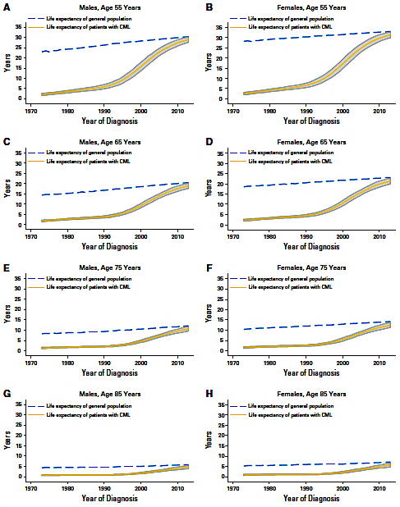
CML is an increasingly prevalent and survivable cancer
lifespan
prevalence
Number of Cases
10x greater
steady state number
of CML patients in US
by 2050
Year
Huang et al, Cancer 118:3123-3127, 2012.
Bower H et al, J Clin Oncol 34:2851-57, 2016.

Slide 75
Roundtable Discussion

Slide 76
Asciminib in newly diagnosed patient with CP-CML
Ilene Galinsky, RN, BSN, MSN, ANP-C
Dana-Farber Cancer Institute
Boston, Massachusetts

Slide 77
Pre starting Asciminib-I have mostly used it as second line or intolerance to other- aware of the new data however- like to have in our back pocket
Discuss with the patient why we are switching therapies- patient did not tolerate their dasatinib due to recurrent pleural effusions.
Always check for mutational analysis
More potent and more specific
Less side effects than other TKI’s-better tolerated
Mild muscle ache
Mild GI symptoms
Mild increase in BP

Slide 78
Side effect management
I encourage patients to note their symptoms and to communicate them to me.
Most side effects are easily managed- by adjusting time of drug administration, supportive medications
Suggest taking in am when you get up (can’t take for at least two hours after eating)

Slide 79
Patient
24-year-old female, failed imatinib and dasatinib both to intolerance- enrolled on first Asciminib phase one trial- enrolled on the highest cohort dosing, hx of depression
First drug she was on that she had manageable side effects. She had no GI symptoms, nor rash, or fluid retention, she did develop thrombocytopenia early on (due to her disease- that required romiplostim) - responded both by CBC and PCR
Tried to become pregnant so it was stopped and she was switched to interferon- major worsening of depression and unable to conceive- returned to Asciminib- 2018

Slide 80
Patient continued
2025- continues on 160 mg BID of Asciminib; PCR 0.014%, mother of an adopted baby boy!
In her words- “this drug has saved my life and kept me from needing a transplant”

Slide 81
Roundtable Discussion

Slide 82
Practical Nursing Considerations with the Use of Asciminib for CML
Sara M Tinsley-Vance, PhD, APRN, AOCN

Slide 83
New Treatment on the Block - Asciminib
On October 29, 2024, the Food and Drug Administration granted accelerated approval to asciminib for adult patients with newly diagnosed Philadelphia chromosome-positive chronic myeloid leukemia (Ph+ CML) in chronic phase (CP).
On October 29, 2021, the Food and Drug Administration granted accelerated approval to asciminib for adult patients with Ph+ CML in CP with the T315I mutation.

Slide 84

CML Chronic Phase with T315I Mutation

Slide 85
Rocky Journey with the Same Cancer
56-year-old with CML diagnosed in 2000
Started on imatinib
  In remission- no details beyond “remission”
    ? Normal blood counts
    ? Cytogenetic remission
    ? Molecular remission
  Local oncologist discontinued medication
  “Relapse” in 2013
  Started on nilotinib
    Lost insurance coverage
    Lost to follow up until 2022

Slide 86

Life Threatening Complications
Hospitalized, requiring multiple blood transfusions with pRBC and platelets
Diagnosed with deep venous thrombosis
Started on bosutinib and remained on treatment for 1 year
Bone marrow biopsy completed showing CML

Slide 87
Kinase Domain Mutation Analysis
Diagnosed with T315I mutation
Treatment options limited to:
  Ponatinib
  Asciminib
Started on ponatinib
Tolerated ponatinib poorly with hospitalization and increased need for transfusions with blood and platelets
Started Asciminib- suboptimal dose due to recurrent cytopenias
Awaiting vital organ testing to proceed with allogeneic stem cell transplant if passes vital organ testing

Slide 88
Challenges with CML
Chronic leukemia with a major breakthrough in treatment and survival
Not treated as potentially deadly if not treated appropriately
Patients feel well -sometimes until it is too late
Guidelines and expert recommendations not followed
Disparities exist when patients don’t have access to TKIs and experts in the treatment and management of CML

Slide 89
Asciminib in Newly Diagnosed Chronic Phase CML
80 mg PO daily OR 40 mg PO BID
Take without food
Avoid eating for at least 2 hours before and 1 hour after taking a dose
Once-daily dosing: Administer orally at about the same time each day
Swallow tablets whole; do NOT break, crush, or chew
Missed dose
  Once-daily dosing regimen: If a dose is missed by >12 hr, skip the dose and take the next dose as scheduled
  Twice-daily dosing regimen: If a dose is missed by >6 hr, skip the dose and take the next dose as scheduled
Asciminib. Prescribing information.

Slide 90
Asciminib dosing for chronic phase CML with T315I mutation
200 mg orally twice daily
Take without food
Avoid food for at least 2 hours before and 1 hour after taking
Swallow tablets whole
Do not break, crush, or chew the tablets
Asciminib. Prescribing information.

Slide 91
Dosing Considerations with Asciminib
Fasting condition is challenging for many patients
Difficult to manage daily meals and schedules
Impacts adherence and long-term compliance
  Potentially impacting response
35.8% of patients taking their medication once daily were highly adherent
24.9% of patients taking their medication twice daily were highly adherent
Consider once-daily dosing for non-T315I patients with CML
Combes, F.P., Sy, S.K.B., Li, Y.F. et al. Dose Justification for Asciminib in Patients with Philadelphia Chromosome-Positive Chronic Myeloid Leukemia with and without the T315I Mutation. Clin Pharmacokinet 63, 1301–1312 (2024). https://doi.org/10.1007/s40262-024-01411-1.
Geissler J, Sharf G, Bombaci F, Daban M, De Jong J, Gavin T, et al. Factors influencing adherence in CML and ways to improvement: results of a patient-driven survey of 2546 patients in 63 countries. J Cancer Res Clin Oncol. 2017;143(7):1167–76.

Slide 92
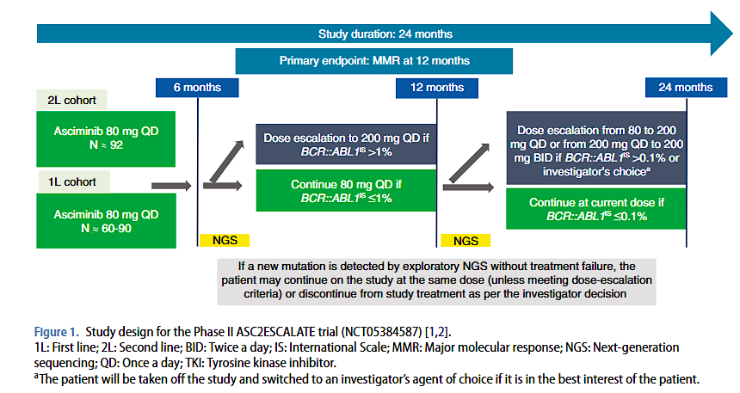
Other Dosing Considerations
Atallah, E. L., Mauro, M. J., Sasaki, K., Levy, M. Y., Koller, P., Yang, D., … Cortes, J. E. (2024). Dose-escalation of second-line and first-line asciminib in chronic myeloid leukemia in chronic phase: the ASC2ESCALATE Phase II trial. Future Oncology, 20(38), 3065–3075. https://doi.org/10.1080/14796694.2024.2402680

Slide 93
Drug Interactions with Asciminib
716 drugs known to interact with Asciminib
  67 major
  602 moderate
  47 minor
Educate the patient to inform your team of any new medications or over-the-counter medications including supplements
Review of medications is critical for every patient visit to ensure patient safety
Encourage patient/family to keep a current list of medications
If possible, have access to other outside medications prescribed
  Cerner (Oracle Health) capability
https://www.drugs.com/drug-interactions/asciminib.html

Slide 94
Common Major Interactions
Itraconazole Oral Solution and other azoles
Clarithromycin
Cannabis
Grapefruit and grapefruit juice
Warfarin
Statins
Midazolam
Repaglinide
Rosiglitazone
Asciminib. Prescribing information.

Slide 95
Encouraging Clinical Trial Participation
Develop rapport with the patient and their family and friends
Explain the study in understandable terms
Allow time for questions
Discuss the advantages and risks associated with the trial and include
  Time commitment
  Visits
  Procedures
  Billing concerns
Provide a written explanation of the study for review
Do not pressure the patient into participation
Arrange follow-up if needed to discuss further

Slide 96
Barriers to Clinical Trial Participation
Distance from treatment center
Fear of increased expenses not covered by insurance
Bias from previous research in race and ethnicities
The best approach is exploring each person’s values, goals, and preferences.
Tailor the visit and discussion to the individual patient

Slide 97
Roundtable Discussion

Slide 98
Agenda
Introduction: Chronic Myeloid Leukemia (CML) as a Model for Targeted Treatment
Module 1: Biology of CML; Role of First- and Second-Generation Tyrosine Kinase Inhibitors (TKIs) as Initial Treatment for Chronic-Phase (CP)-CML
Module 2: Role of Asciminib for Newly Diagnosed CP-CML
Module 3: Feasibility of TKI Discontinuation for Patients with Sustained Response to Treatment
Module 4: Management of CP-CML After Failure of Initial Therapy

Slide 99
Clinical Scenario
A patient with CP-CML who has been receiving a first-line TKI for 3 years and would like to discontinue therapy

Slide 100
Feasibility of TKI Discontinuation in Patients with Sustained Response to Treatment
Neil P. Shah, MD, PhD
Professor
Division of Hematology/Oncology
University of California, San Francisco
San Francisco, California

Slide 101
Following CML Patients on TKI Therapy
CBC/diff every 1-2 weeks for 6-8 weeks following TKI initiation to assess for significant cytopenias
Office visit after 4 weeks of treatment to assess tolerability
Office visit, CBC/diff, CMP, BCR::ABL1 quantitative PCR after three months of treatment and every three months thereafter

Slide 102
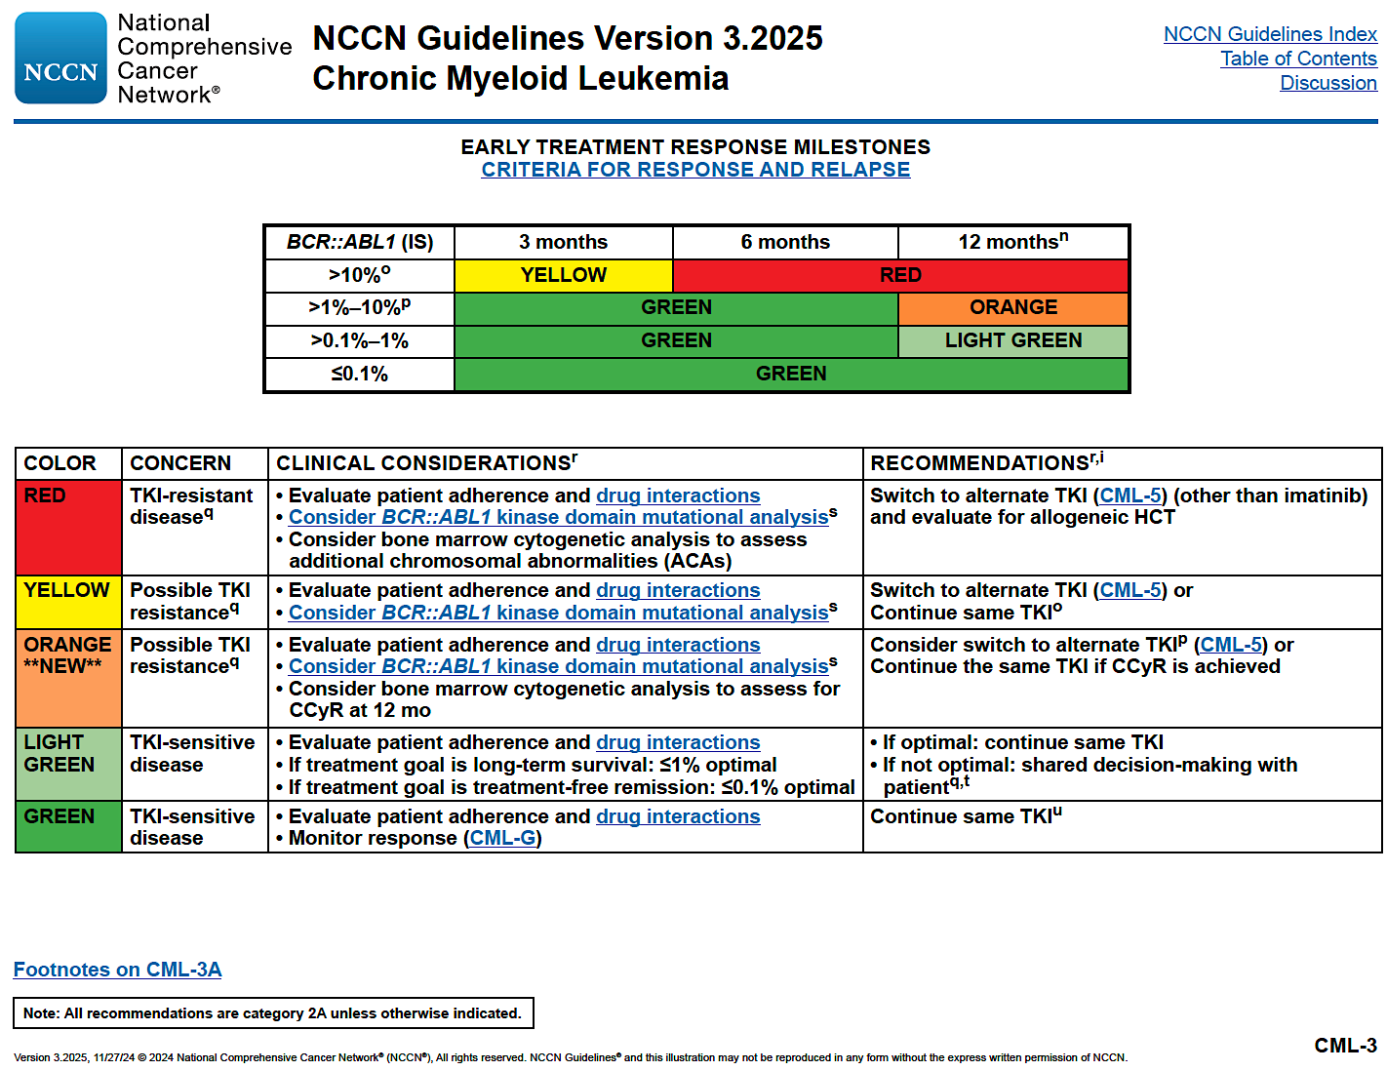
Reproduced with permission from the NCCN Clinical Practice Guidelines in Oncology (NCCN Guidelines®) for Chronic Myeloid Leukemia V.3.2025. © 2024 National Comprehensive Cancer Network, Inc. All rights reserved. The NCCN Guidelines® and illustrations herein may not be reproduced in any form for any purpose without the express written permission of NCCN. To view the most recent and complete version of the NCCN Guidelines, go online to NCCN.org. The NCCN Guidelines are a work in progress that may be refined as often as new significant data becomes available. NCCN makes no warranties of any kind whatsoever regarding their content, use or application and disclaims any responsibility for their application or use in any way.

Slide 103
Stop Imatinib (STIM) study design
N=100
Q- RT-PCR from peripheral blood every month in the first year and every 2 months thereafter
Start Imatinib
STOP
CMR
Sustained CMR
for ≥ 2 years
Molecular recurrence: positivity of BCR–ABL1 transcript in Q-RT-PCR confirmed by a second analysis point indicating the increase of one log in relation to the first analysis point, at two successive assessments, or loss of MMR at one point.
Five BCR–ABL1 analyses by
Q- RT-PCR during these 2 years
Sixth datapoint checked in centralized laboratory
Mahon FX et al. The Lancet Oncology, 2010;11(11): 1029-1035.

Slide 104
Long-term Follow-up From Stop Imatinib (STIM) Trial in CP-CML: Survival Without Recurrence
100
Similar data have been obtained from numerous studies with other TKIs, using higher disease thresholds for stopping (e.g. MR4) and restarting (loss of MR3) treatment
80
60
Survival without Molecular Recurrence (%)
40
20
0
0
6
12
18
24
30
36
42
48
54
60
66
72
78
84
90
96
Patients
at Risk, n
Time From Discontinuation of Imatinib (Mo)
Etienne. JCO. 2017;35:298.
100
44
41
40
38
38
38
38
38
38
36
32
25
21
17
5
0

Slide 105
Data from Numerous TKI Discontinuation Trials: ~50 Percent Likelihood of Success
Study | Treatment prior to discontinuation | No. of patients | Depth and duration of molecular response (MR) required for discontinuation | Trigger to resume TKI therapy | Median duration of follow‑up | Treatment‑free remission (TFR) rate
STIM1^{167,168} | Imatinib ± interferon | 100 | MR5.0 for at least 2 years | Loss of MR5.0 | 77 months | 43% at 6 months; 38% at 60 months
STIM2¹⁶⁹ | Imatinib | 124 | MR5.0 for at least 2 years | Loss of MR5.0 | 12 months | 61% at 12 months
TWISTER¹⁷⁰ | Imatinib ± interferon | 40 | MR4.5 for at least 2 years | Loss of MR5.0 | 42 months | 47% at 24 months
HOVON¹⁷¹ | Imatinib + cytarabine | 15 | MR4.5 for at least 2 years | Loss of MR4.5 | 36 months | 33% at 24 months
A‑STIM¹⁷² | Imatinib ± interferon | 80 | MR5.0 for at least 2 years | Loss of MMR | 31 months | 64% at 24 months; 61% at 36 months
ISAV¹⁷³ | Imatinib | 112 | CMR for at least 18 months | Loss of MMR | 22 months | 52%
KIDS¹⁷⁵ | Imatinib ± interferon | 90 | MR4.5 for at least 2 years | Loss of MMR | 27 months | 62% at 12 months; 58.5% at 24 months
Stop 2G‑TKI¹⁷⁹ | Dasatinib/Nilotinib (first‑line or second‑line) | 60 | MR4.5 for at least 2 years | Loss of MMR | 47 months | 63% at 12 months; 53.6% at 48 months
DADI¹⁷⁴ | Dasatinib (second‑line) | 63 | MR4.0 for at least 1 year | Loss of MR4.0 | 20 months | 49% at 6 months
ENESTFreedom¹⁷⁸ | Nilotinib (first‑line) | 190 | MR4.5 for at least 1 year | Loss of MMR | 48 weeks | 52%
ENESTop¹⁷⁷ | Nilotinib (second‑line) | 126 | MR4.5 for at least 1 year | Loss of MR4.0 or Loss of MMR | 48 weeks | 58%
EuroSKI¹⁷⁶ | Imatinib/Dasatinib/Nilotinib (first‑line or second‑line) | 755 | MR4.0 for at least 1 year | Loss of MMR | 27 months | 50% at 12 months
DASFREE | Dasatinib (first‑line or second‑line) | 84 | MR4.5 for at least 1 year | Loss of MMR | 18 months | 48% at 18 months
LAST | Imatinib/Dasatinib/Nilotinib/Bosutinib | 173 | MR4.0 for at least 2 years | Loss of MMR | 12 months | 66% at 12 months

Slide 106
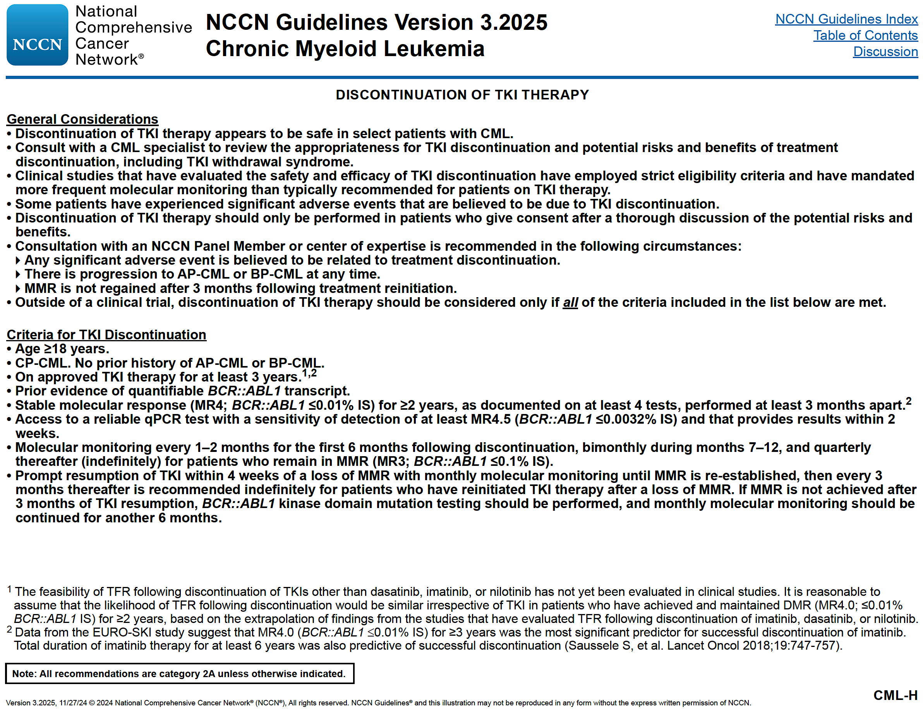
Reproduced with permission from the NCCN Clinical Practice Guidelines in Oncology (NCCN Guidelines®) for Chronic Myeloid Leukemia V.3.2025. © 2024 National Comprehensive Cancer Network, Inc. All rights reserved. The NCCN Guidelines® and illustrations herein may not be reproduced in any form for any purpose without the express written permission of NCCN. To view the most recent and complete version of the NCCN Guidelines, go online to NCCN.org. The NCCN Guidelines are a work in progress that may be refined as often as new significant data becomes available. NCCN makes no warranties of any kind whatsoever regarding their content, use or application and disclaims any responsibility for their application or use in any way.

Slide 107
Reproduced with permission from the NCCN Clinical Practice Guidelines in Oncology (NCCN Guidelines®) for Chronic Myeloid Leukemia V.3.2025. © 2024 National Comprehensive Cancer Network, Inc. All rights reserved. The NCCN Guidelines® and illustrations herein may not be reproduced in any form for any purpose without the express written permission of NCCN. To view the most recent and complete version of the NCCN Guidelines, go online to NCCN.org. The NCCN Guidelines are a work in progress that may be refined as often as new significant data becomes available. NCCN makes no warranties of any kind whatsoever regarding their content, use or application and disclaims any responsibility for their application or use in any way.

Slide 108
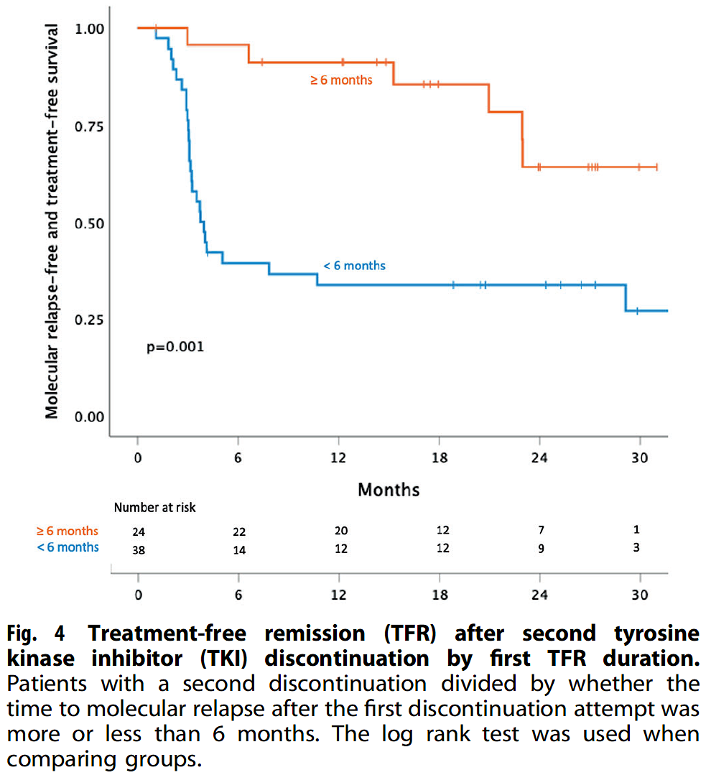
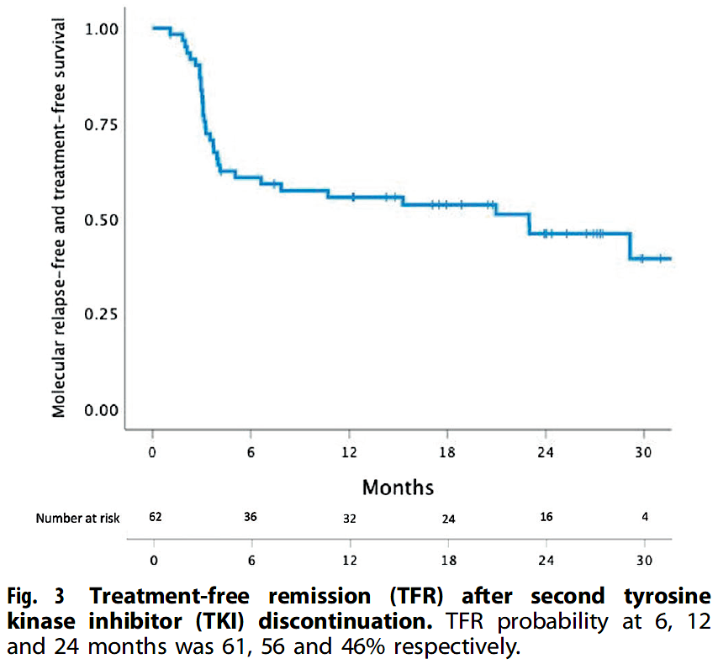
Can TFR Be Successful the Second Time Around?
Flygt et al, Leukemia 2024

Slide 109
Common Reasons for Attempting
Treatment-free Remission (TFR)
Bothersome side effects
Financial toxicity (individual, societal)
Concern about known and currently unknown late toxicities
Preference to avoid medications if possible

Slide 110
Known Risks of Attempting TFR
TKI withdrawal syndrome (~25%)
  New musculoskeletal pain
Follow-up to date is less than 10 years
More frequent testing, which can provoke anxiety
Risk of progressive disease (anecdotal, appears <1%)
  Has been observed during TFR period as well as months or years after resuming TKI
Attempting TFR should be driven by the patient after a thorough discussion of the risks/benefits

Slide 111
At least 65-70% of CML Patients Will Require Lifelong Treatment:
Maximizing QoL Assumes Great Importance in Responding Patients
Maximizing QoL Assumes Greater Importance with Need for Prolonged Treatment.
Reduced TKI Doses can be Better Tolerated in Some Instances
Successful TFR on 1st attempt
No sustained DMR
Successful TFR on 2nd attempt
Unsuccessful TFR attempt(s)

Slide 112
Case 1
A 41 year-old woman who works as a PICC line nurse was incidentally noted to have thrombocytosis of 509K in February 2012 that had persisted for over six months. Prior CBC performed in 2023 was unremarkable. She was referred to a hematologist who ordered a BCR::ABL1 quantitative PCR that was grossly positive and bone marrow biopsy/aspiration confirmed a diagnosis of chronic phase CML. Her PMH includes hypertension. She initiated dasatinib 100 mg which was associated with generalized skin hypopigmentation but otherwise well-tolerated and transferred her care to UCSF. After 3 months, her BCR::ABL1 transcript was undetectable and remained undetectable on subsequent tests. As her BP had declined, she discontinued her anti-hypertensive.
In December 2014, she elected to enroll in a TKI discontinuation study that required a minimum of 2 years of TKI therapy and one year of persistent MR4.5. She Stopped dasatinib, and her skin tone returned to normal. Her BP rose above the normal range requiring resumption of antihypertensive medication. She remains in a deep molecular remission off TKI as of April 2025.

Slide 113
Case 2
A 34 year-old woman who works as a Labor & Delivery nurse was noted to have mild leukocytosis in April 2011 while pregnant and in the first trimester. Leukocytosis persisted following an uneventful delivery in November 2011. PMH includes hypercholesterolemia and pyelonephritis s/p ureteral stent placement. She was referred to a hematologist in February 2012. At that time her WBC was 19.2K and a BCR::ABL1 test was grossly positive. Bone marrow biopsy and aspiration confirmed chronic phase CML. She initiated dasatinib 100 mg daily, on which she had substantial musculoskeletal discomfort and she transferred care to UCSF. Her dose was reduced to 50 mg in September 2012 but her pain persisted and her dasatinib dose was further reduced to 20 mg daily in December 2012.
She first achieved MMR in August 2012 and persistent MR4.5 in November 2012. She enrolled in a TKI discontinuation study in December 2015 but lost MMR in August 2016 and resumed dasatinib 20 mg, on which she recaptured MR4.5. She elected to attempt TFR again in August 2021 and has continued to have no detectable CML off treatment as of March 2025.

Slide 114
Roundtable Discussion

Slide 115
Agenda
Introduction: Chronic Myeloid Leukemia (CML) as a Model for Targeted Treatment
Module 1: Biology of CML; Role of First- and Second-Generation Tyrosine Kinase Inhibitors (TKIs) as Initial Treatment for Chronic-Phase (CP)-CML
Module 2: Role of Asciminib for Newly Diagnosed CP-CML
Module 3: Feasibility of TKI Discontinuation for Patients with Sustained Response to Treatment
Module 4: Management of CP-CML After Failure of Initial Therapy

Slide 116
Clinical Scenario
A patient with CP-CML who has been receiving imatinib for several years but is now experiencing progression with T315I-mutant disease and is about to start treatment with asciminib

Slide 117
Management of CP-CML after Failure of Initial Therapy
Michael J. Mauro, MD
Director, Chronic Myeloid Leukemia Program
Memorial Sloan Kettering Cancer Center
New York, NY
TEAM922

Slide 118
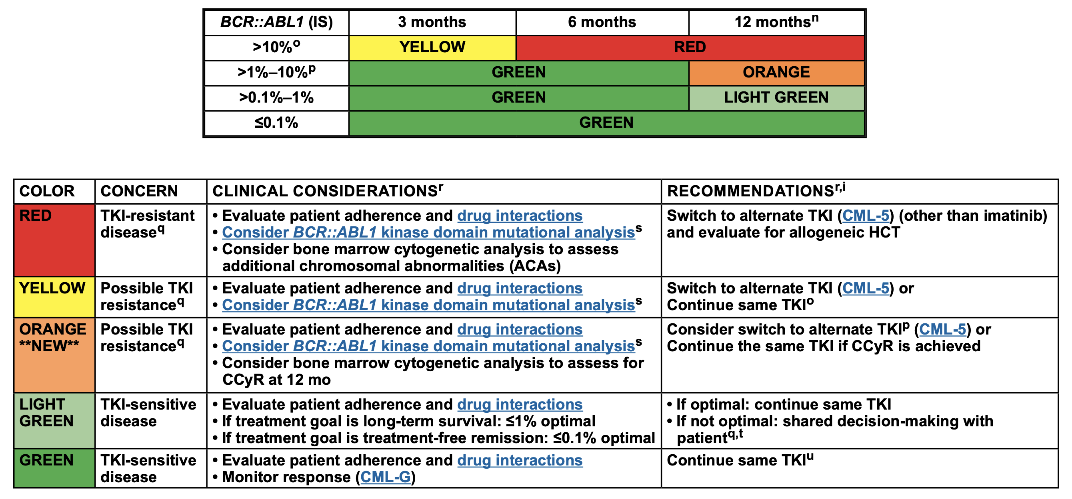
How Can Therapy Fail the CP-CML Patient?
Primary hematologic resistance: exceedingly rare
Minimal transcript reduction: slow/no “EMR,” persistent BCR::ABL >1%-10% (no CCyR)
  Ominous: may predict for inferior response to salvage
CCyR but failure to achieve MMR: “kinetic failure” (18-24-mo window); protection from progression but EFS lower, subsequent resistance risk
MMR but remains between 0.1% and 0.01%: “safe harbor,” ? imperfect
  TFR based on current guidelines not feasible
Deep molecular remission (<0.01%) but PCR “positive”: not failure
10%
1%
0.1%
0.01%
0.0032%
‘traffic light’ guide
MCyR
CCyR
MMR
MR⁴
MR^{4.5}
Increasing depth
of response
12-month CCyR
is correlated
with better OS
12-month MMR is correlated with
better PFS and OS
MR⁴ or MR^{4.5} or DMR is correlated with a lower risk of progression and death and is a criterion for attempting TFR
NCCN Guidelines®. Chronic Myeloid Leukemia — V.3.2025.

Slide 119
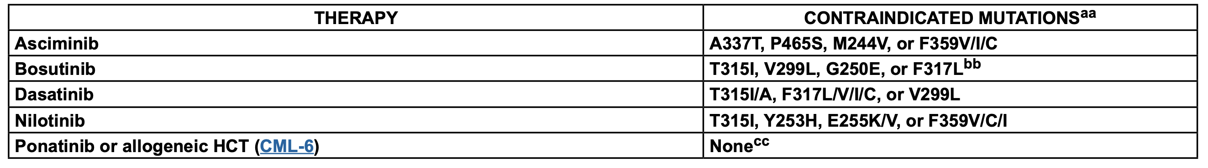
NCCN Treatment Milestones; Mutation Guidance
NCCN Guidelines®. Chronic Myeloid Leukemia — V.3.2025.

Slide 120
TKI intolerance remains a primary reason for treatment discontinuation
Years of follow-up
1
2
3
4
5
6
7
8
9
10
IRIS^{1,3} Imatinib 400 mg QD
4%
6.9%
Discontinuations due to AEs in CML trials of 1st treatment over time
ENESTnd^{2,4} Nilotinib 300 mg BID
12.1%
18.8%
DASISION⁵ Dasatinib 100 mg QD
19%ª
BFORE⁶ Bosutinib 400 mg QD
BELA⁷ Bosutinib 500 mg QD
25%
24%
PACE⁸ Ponatinib 45 mg QD
21% (2nd)
Discontinuations due to AEs in CML trials of 2nd treatment and beyond over time
CA180-034⁹ Dasatinib 100/140 mg QD and 50/70 mg BID
24% to 31%^{c} (2nd)
BYOND¹⁰ Bosutinib 500 mg QD
Study 200¹¹ Bosutinib 500 mg QD
21.7%^{b}/26.2%^{b} (2nd/3rd+)
30%/26%
(3rd+ 8 y/2nd 9 y)
A2101¹² Nilotinib 400 mg BID
19% (2nd)
1. Hochhaus A, et al. N Engl J Med. 2017;376: 917-927. 2. Kantarjian HM, et al. Leukemia. 2021;35:440-453. 3. Druker BJ, et al. N Engl J Med. 2006;355:2408-2417. 4. Hochhaus A, et al. Leukemia. 2016;30:1044-1054. 5. Cortes JE, et al. J Clin Oncol. 2016;34:2333-2340. 6. Brümmendorf TH, et al. Blood. 202m 0;136(suppl 1). Abstract 46. 7. Brümmendorf TH, et al. Br J Haematol. 2015;168:69-81. 8. Cortes JE, et al. Blood. 2018;132:393-404. 9. Shah NP, et al. Am J Hematol. 2016;91:861-874. 10. Hochhaus A, et al. Leukemia. 2020;34:2125-2137. 11. Cortes JE, et al. Presented at: EHA25 Virtual; June 11-21, 2020. Abstract EP766. 12. Kantarjian HM, et al. Blood. 2011;117(4):1141-1145.

Slide 121
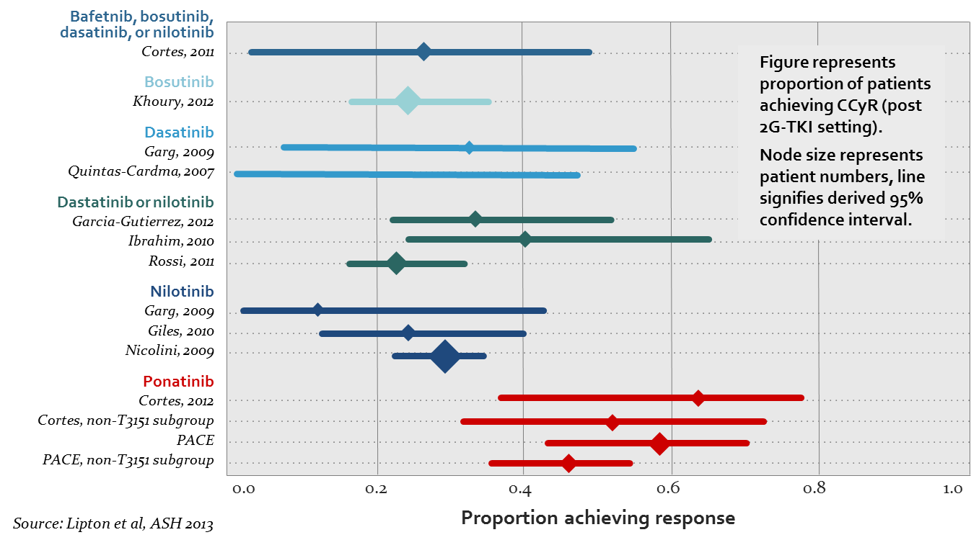
Choosing Salvage
TKI | Dasatinib^{1,2} |  | Nilotinib |  | Bosutinib
Follow-up | 2 years^{1,2} (minimum follow-up) | 6 years³ (data lock at 6y) | 2 years⁴ (minimum follow-up) | 4 years⁵ (minimum follow-up) | 2 years⁶ (minimum follow-up)
Number of pts | 167* | 167* | 226 | 321* | 200
Discontinued, n (%) | NR | 114 (69) | 197/321 (61) | 224 (70) | 108 (54)
MCyR | 63%* | NR | 56% | 59* | 58%
CCyR | 50%* | NR | 41% | 45* | 46%
PFS, % | 80* | 49* | 64* | 57* | 81*
Point 1: 2G TKI post imatinib:
Response is similar
Bafetinib, bosutinib,
dasatinib, or nilotinib
Point 2: ’Recycling 2G TKIs’-
Switch to 3rd gen (here Ponatinib) improved CCyR
Quintas-Cardama, 2007
Dasatinib, or nilotinib
*Includes imatinib-intolerant patients. NR, not reported.
1. Dasatinib. Official prescribing information
2. Shah NP, et al. J Clin Oncol. 2010;28:15s (abstract 6512)
3. Shah NP, et al. Blood. 2014;123:2317-24
4. Kantarjian HM et al. Blood. 2011;117:1141-1145
5. Giles FJ, et al. Leukemia. 2013;27:107-12
6. Gambacorti-Passerini C, et al. Am J Hematol. 2014
Lipton J, et al. ASH 2013. Abstract 4010.
Cortes, non-T315I subgroup
PACE, non-T315I subgroup

Slide 122
Ponatinib data: PACE, OPTIC
Overall Efficacy Outcomes in OPTIC and PACE
PACE CP-CML
OPTIC 45 mg → 15 mg
MMR rate ≤0.1% BCR::ABL1^{IS} | PACE (all patients) | OPTIC (all patients)
12mo | 28 | 20
24mo | 34 | 34
60mo | 37 | n/a
Patients, %
131/270 pts
48/93
pts
141/270 pts
52/93 pts
146/270
pts
N/A
≤1% BCR::ABL1^{IS}
by 12 mo
≤1% BCR::ABL1^{IS}
by 24 mo
≤1% BCR::ABL1^{IS}
by 60 mo
OPTIC: ≤1% BCR::ABL1^{IS} Response
Rate by Mutation Status
45mg remains appropriate start dose,
esp for T315I; same for other cases?
27/50
15/25
9/16
24/58
5/20
6/15
22/53
2/19
9/19
No mut
T315I mut
Mut other than T315I
No mut
T315I mut
Mut other than T315I
No mut
T315I mut
Mut other than T315I
Mutation status:
4515 mg
3015 mg
15 mg

Slide 123
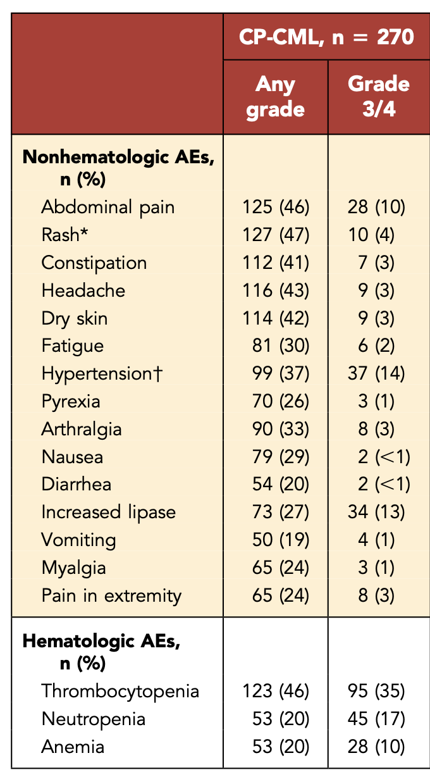
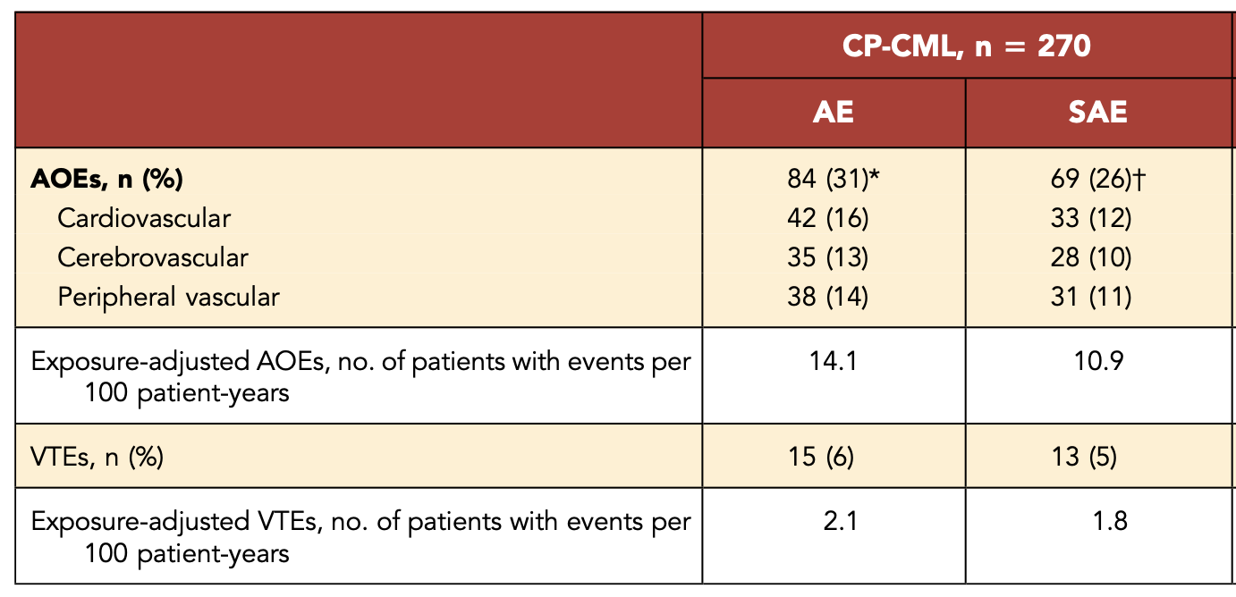
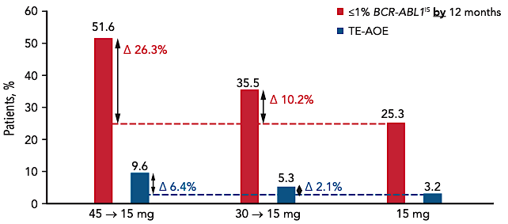
Ponatinib: PACE, OPTIC
PACE
PACE study AOEs
OPTIC:
Dose reduction reduced AEs
Unmet need:
novel, T315I active BCR::ABL inhibitors
with greater safety margin…
Kantarjian HM et al, Am J Hematology, in press; Deininger MN et al, ASH 2021; Cortes J, et al. Blood (2021) 138 (21): 2042–50.

Slide 124
Phase III ASCEMBL, End of Study (EOS):
a phase III trial of asciminib vs bosutinib in patients with CML-CP previously treated with ≥2 TKIs¹⁻⁵
Réa D, et al. Oral presentation at: 2022 ASCO Annual Meeting: June 3-7, 2022; Chicago, IL & online. Abstract 7004.
Réa D, et al. Oral presentation at: EHA2022 Hybrid Congress; June 9-12, 2022; Vienna, Austria, & online. Abstract S155.
Hochhaus A, et al. Leukemia. 2023;37(3):617-626.
Data cutoff for EOS treatment analysis: March 22, 2023
Median duration of follow-up: 3.7 years (16.8 months of additional follow-up since the week 96 analysis)
EOS treatment: ≤96 weeks after the last patient received their first dose or ≤48 weeks after the last patient switched to asciminib, whichever was longer, unless patients had discontinued treatment earlier
Treatment duration: ≥96 weeks
Key inclusion criteria
Adults with CML-CP, previously treated with ≥2 TKIs
Failureª with or intolerance of most recent TKI
Patients with intolerance of most recent TKI must have BCR::ABL1^{IS} >0.1% at screening
No T315I or V299L mutations
ASCEMBL
(NCT03106779)
Randomized 2:1
(stratified by MCyR vs no MCyR at baseline)
N=233
Asciminib
40 mg twice daily
n=157
Survival follow-up
Bosutinib
500 mg once daily
n=76
Part of current EOS treatment analysis
Switch allowed for those meeting lack of efficacy criteria on bosutinib^{b}
Asciminib
40 mg twice daily
(n=25)
Reprinted from Hochhaus A, et al. Leukemia. 2023;37(3):617-626. Creative Commons Attribution 4.0 International License (https://creativecommons.org/licenses/by/4.0/).
Survival
follow-up
CML-CP, chronic myeloid leukemia in chronic phase; ELN, European LeukemiaNet; EOS, end of study; IS, International Scale; MCyR, major cytogenetic response; MMR, major molecular response (BCR::ABL1^{IS} ≤0.1%); TKI, tyrosine kinase inhibitor.
ª This trial was recently completed, and secondary analyses presented here are based on data collected after all randomized patients had completed their EOS treatment visit or discontinued earlier. ^{b} Must meet lack of efficacy criteria based on 2013 ELN recommendations for patients treated with 1 prior TKI.
^{c} Patients who discontinue bosutinib treatment due to intolerance or any reason other than lack of efficacy are not allowed to switch to asciminib.
1. Réa D, et al. Blood. 2021;138(21):2031-2041. 2. Réa D, et al. Oral presentation at: 2022 ASCO Annual Meeting; June 3-7, 2022; Chicago, IL, and virtual. Abstract 7004. 3. Réa D, et al. Oral presentation at: EHA 2022; June 9-17, 2022; Vienna, Austria. Abstract S155. 4. Hochhaus A, et al. Leukemia. 2023;37:617-626. 5. Mauro MJ, et al. Presented at 65th ASH Annual Meeting & Exposition; December 9-12, 2023; San Diego, California & virtual. Abstract 4536.

Slide 125
ASCEMBL (EOS):
Cumulative incidence of MMR by weeks 24, 96, and 156^{1-4,a,b}
Asciminib (n=157)
Bosutinib (n=76)
MMR was achieved rapidly and remained consistently higher with asciminib than with bosutinib by week 156; the difference in cumulative incidence of MMR between the treatment arms became evident by week 12¹⁻⁴
Durability of MMR
The probability (95% CI) of maintaining MMR for ≥120 weeks was 97.0% (88.6%-99.2%) with asciminib and 92.9% (59.1%-99.0%) with bosutinib, and response rates were highly durable⁴
Probability of MMR, %
By week 24
By week 96
By week 156
CI, confidence interval; EOS, end of study; MMR, major molecular response (BCR::ABL1^{IS} ≤0.1%).
ª Non-responders were censored at their last molecular assessment date. ^{b} Discontinuation from treatment for any reason without prior achievement of MMR is considered a competing event.
1. Rea D, et al. Oral presentation at: 2022 ASCO Annual Meeting; June 3-7, 2022; Chicago, IL, and virtual. Abstract 7004. 2. Rea D, et al. Oral presentation at: EHA 2022; June 9-17, 2022; Vienna, Austria. Abstract S155. 3. Hochhaus A, et al. Leukemia. 2023;37:617-626.4. Mauro MJ, et al. Presented at 65th ASH Annual Meeting & Exposition; December 9-12, 2023; San Diego, California & virtual. Abstract 4536.

Slide 126
ASCEMBL (EOS):
MR⁴ and MR^{4.5} rates at weeks 24, 96, and 156¹⁻⁴
Week 24
Week 96
Week 156
Asciminib (n=157)
Bosutinib (n=76)
Patients, %
MR⁴
MR^{4.5}
MR⁴
MR^{4.5}
MR⁴
MR^{4.5}
At week 156, deep molecular response rates continued to be higher with asciminib than bosutinib⁴
Rea D, et al. Presented at European Hematology Association 2022 Congress. Abstract S155. Reprinted with permission by the author.
IS, International Scale; MR⁴, BCR::ABL1^{IS} ≤0.01%; MR^{4.5}, BCR::ABL1^{IS} ≤0.0032%.
1. Rea D, et al. Oral presentation at: ASCO 2022; June 3-7, 2022. Chicago, IL and virtual. Abstract 7004. 2. Rea D, et al. Oral presentation at: EHA 2022; June 9-17, 2022. Vienna, Austria and virtual. Abstract S155. 3. Hochhaus A, et al. Leukemia. 2023;37:617-626. 4. Mauro MJ, et al. Presented at 65th ASH Annual Meeting & Exposition; December 9-12, 2023; San Diego, California & virtual. Abstract 4536.

Slide 127
ASCEMBL (EOS):
Most frequent AEs by the end of study treatment cutoff
(in ≥20% of patients in any treatment arm)
Asciminib (n=156)
Bosutinib (n=76)
All grade
Grade ≥3
All grade
Grade ≥3
Patients, %
Thrombocytopeniaª
Neutropenia^{b}
Diarrhea
Nausea
Rash
Vomiting
Increased AST
Increased ALT
Mauro MJ, et al. Presented at the 65th American Society of Hematology Annual Meeting & Exposition 2023. Abstract 4536. Reprinted with permission by the author.
The safety and tolerability of asciminib continued to be favorable and better than that of bosutinib with longer follow-up and duration of exposure¹⁻³
The most frequently reported grade ≥3 AEs with asciminib were the same by EOS as by week 96 and included thrombocytopenia and neutropenia¹⁻³
ALT, alanine aminotransferase; AST, aspartate aminotransferase.
ª Includes thrombocytopenia and platelet count decreased. ^{b} Includes neutropenia and neutrophil count decreased.
1. Mauro MJ, et al. Presented at 65th ASH Annual Meeting & Exposition; December 9-12, 2023; San Diego, California & virtual. Abstract 4535. 2. Rea D, et al. Blood. 2021;138:2031-3041. 3. Hochhaus A, et al. Leukemia. 2023;37:617-626.

Slide 128
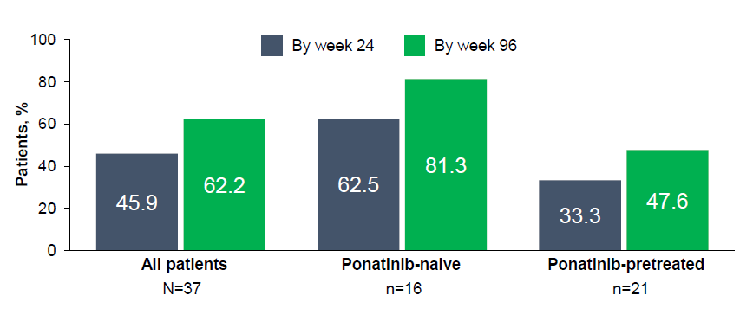
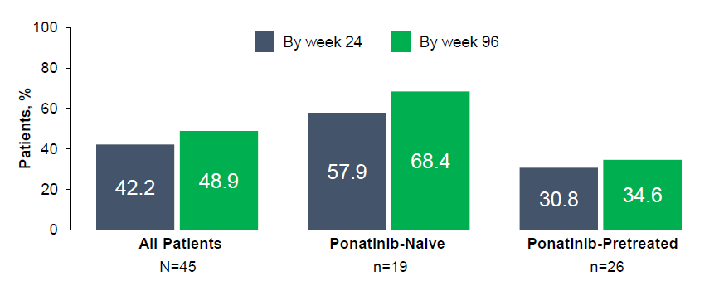
Asciminib X2101 T315I Cohort: Cumulative BCR::ABL1^{IS} ≤1%, ≤0.1%
≤1%
(CCyR)
BCR::ABL1^{IS} ≤1% was achieved by a high proportion (62.2%) of patients without this response at baseline (n=37), including almost 50% of ponatinib-pretreated patients
≤0.1%
(MMR)
45 of 48 patients were evaluable for MMR / DMR; 3 were excluded for BCR::ABL1 atypical/unknown transcripts
Almost half of patients (22/45 [48.9%]) achieved MMR by week 96;responses were durable regardless of prior ponatinib treatment
19/22 patients maintained MMR or improved to a deeper level of response up to the cutoff date
The KM–estimated probability of maintaining MMR for ≥96 weeks was:
84% (95% CI, 68.1%-100.0%) in all patients
91%(95% CI, 73.9%-100.0%) in ponatinib-naive patients
78% (95% CI, 50.6%-100.0%) in ponatinib-pretreated patients

Slide 129
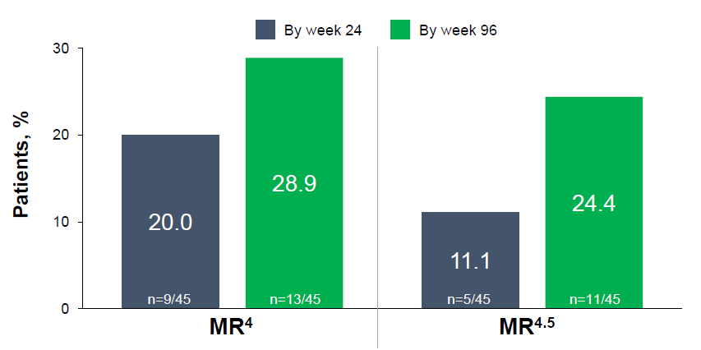
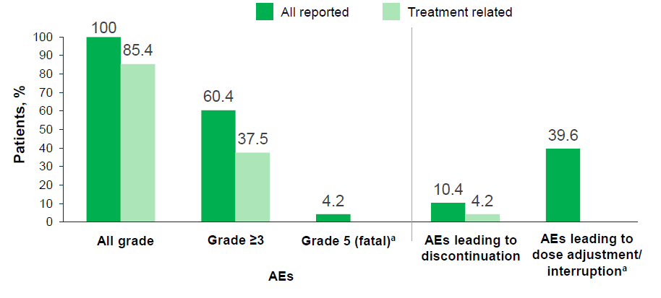
Asciminib X2101 T315I Cohort: Deep Molecular Response, Overall AEs
>50% of patients who achieved MMR improved to a deeper molecular response level (MR⁴ or MR^{4.5}), with most achieving deeper responses by week 60
Even after >2 years of median exposure, asciminib maintained a favorable safety/tolerability profile
  After ≈9 months of added exposure, there was <5% difference in incidences of AEs compared to the previous cutoff
AEs leading to discontinuation included COVID-19 pneumonia (grade 5 with fatal outcome) in 2 patients and pancytopenia (grade 4), thrombocytosis (grade 2), and lipase increased (grade 3) in 1 patient each

Slide 130
Case: Resistant/Intolerant CML
43yo pediatric RN diagnosed with CML in chronic phase, 2014 (Sokal high, 1.28, and Hasford intermediate, 945.9, at diagnosis)
Initial therapy with Dasatinib 100 mg with good early molecular (EMR) then major molecular response (MMR)
Loss of MMR 2-2.5y into therapy; found to have T315I mutation
Seen at MSKCC, saw cardio-oncology for evaluation prior to therapy change; familial hypercholesterolemia only noted)
Fit, bodybuilder, no history of hypertension or other CV disease

Slide 131
Case: Resistant/Intolerant CML
Moved to 30 mg ponatinib; improvement and stable for a prolonged period of time with ongoing molecular response (>MMR; best response 10/17 0.0264% IS)
Unprovoked increase in LFTs prompting hepatology evaluation, drug hold, steroid therapy for drug induced liver injury
Rechallenged with lower dose ponatinib (15 mg) with continued low dose steroid; persistent LFT rise and CML proliferation (loss of CCyR)
Stopped ponatinib on 2/16/19; significant relapse with PCR 2/19 20.4% IS

Slide 132
Case: Resistant/Intolerant CML
Enrolled on phase I study with ABL001 200mg BID, initiated therapy 2/22/2019
PCR trajectory:
Deep MR with fluctuation until Jan 2022; since then, all values <0.01%
No adverse events; worked in nursing field through pandemic
Transitioned to commercial drug supply at end of study
Deep MR (<0.01%) since Jan 2020
start | 1mo | 2mo | 3mo | 4mo | 5mo | 6mo | 7mo
20.4% | 0.96% | 0.14% | 0.073% | 0.041% | 0.023% | 0.010% | 0.006%

Slide 133
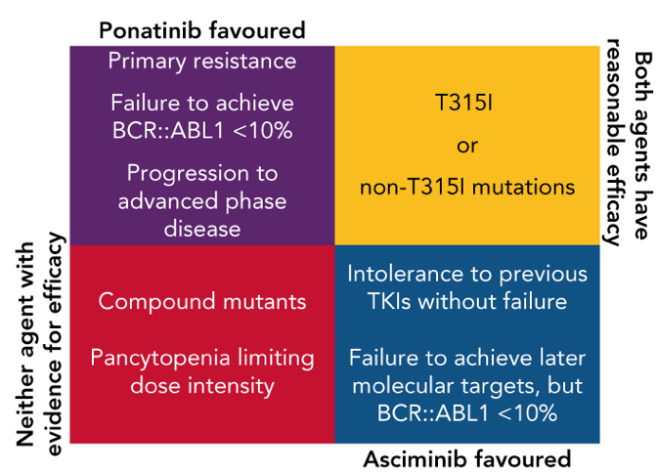
What have we learned from PON and ASC trials?
How are these agents positioned?
PONATINIB
ASCIMINIB
PACE:
  Efficacy in MDR CML
  Efficacy in T315I
  AOEs significant, dose dependent, stable over time, lag time (persistent)
OPTIC:
  45mg start optimal, esp T315I (sl less difference nonT315I)
  Adjudicated AOEs sl less
EPIC
  Frontline incremental response increase over 2GTKI possible
  Risk too great
Phase I (x2101)
  Confident single agent efficacy
  Toxicity similar across dose range (up to 200mg BID)
  Mutational based resistance less, myristoyl mutations possible
ASCEMBL
  Optimal third line agent: superior tolerance and efficacy versus BOS
  AOEs minimal and small difference vs BOS; further study to confirm
ASC4FIRST / ASCEND
  Frontline efficacy may be highest yet
  Tolerability superior
  Resistance predictable
  Next question: TFR fraction / success
Yeung DT, Shanmuganathan N, Timothy P. Hughes TP; Blood 2022; 139 (24): 3474–3479

