Slide 1
Year in Review: Clinical Investigator Perspectives on the
Most Relevant New Datasets and Advances in Oncology
Kathleen N Moore, MD, MS
Ovarian Cancer
A CME/MOC-Accredited Live Webinar
Thursday, February 19, 2026
5:00 PM – 6:00 PM ET
Faculty
Nicoletta Colombo, MD
Kathleen N Moore, MD, MS
Moderator
Neil Love, MD

Slide 2



Faculty
Nicoletta Colombo, MD
Director, Gynecologic Oncology Program
European Institute of Oncology IRCCS
Milan, Italy
MODERATOR
Neil Love, MD
Research To Practice
Miami, Florida
Kathleen N Moore, MD, MS
Deputy Director and Director, Phase 1 Clinical Trials
Fred and Pamela Buffett Cancer Center at the University of Nebraska
Omaha, Nebraska

Slide 3
Commercial Support
This activity is supported by educational grants from AstraZeneca Pharmaceuticals LP, Corcept Therapeutics Inc, and Merck.
Research To Practice CME Planning Committee Members,
Staff and Reviewers
Planners, scientific staff and independent reviewers for Research To Practice have no relevant conflicts of interest to disclose.

Slide 4
Prof Colombo — Disclosures
Advisory Committees | AbbVie Inc, AstraZeneca Pharmaceuticals LP, BeOne, BioNTech SE, Corcept Therapeutics Inc, Eisai Inc, Gilead Sciences Inc, GSK, ImmunoGen Inc, Lilly, MSD, Novocure Inc, Regeneron Pharmaceuticals Inc, Seagen Inc
Data and Safety Monitoring Boards/Committees | Incyte Corporation
Speakers Bureaus | AstraZeneca Pharmaceuticals LP, Eisai Inc, GSK, MSD

Slide 5
Dr Moore — Disclosures
Advisory Committees | AstraZeneca Pharmaceuticals LP, Corcept Therapeutics Inc, GSK, Mersana Therapeutics Inc
Consulting Agreements | Aadi Bioscience, AbbVie Inc, AstraZeneca Pharmaceuticals LP, BioNTech SE, Caris Life Sciences, Corcept Therapeutics Inc, Daiichi Sankyo Inc, Duality Biologics, GSK, ImmunoGen Inc, Janssen Biotech Inc, Merck, Regeneron Pharmaceuticals Inc, Schrödinger, Takeda Pharmaceuticals USA Inc, Verastem Inc, Whitehawk Therapeutics, Zentalis Pharmaceuticals, Zymeworks Inc
Contracted Research | Accent Therapeutics, Advaxis Inc, Allarity Therapeutics, AstraZeneca Pharmaceuticals LP, Daiichi Sankyo Inc, GSK, Immunocore, Iovance Biotherapeutics, Regeneron Pharmaceuticals Inc, Schrödinger, Verastem Inc
Data and Safety Monitoring Boards/Committees | Bicycle Therapeutics
Nonrelevant Financial Relationships | ASCO, GOG Partners, NRG Oncology

Slide 6
Dr Secord — Disclosures
Advisory Committees | AbbVie Inc, AstraZeneca Pharmaceuticals LP, Daiichi Sankyo Inc, Foundation Medicine, Genmab US Inc, Gilead Sciences Inc, GSK, HistoSonics, Medtronic Inc, Merck
Clinical Trial Steering Committees | Genmab US Inc, OncoQuest Inc
Consulting Agreements | GSK, Merck
Contracted Research | AbbVie Inc, Aravive Inc, AstraZeneca Pharmaceuticals LP, Canaria Bio Inc, Daiichi Sankyo Inc, Ellipses Pharma, Genentech, a member of the Roche Group, Genmab US Inc, GSK, ImmunoGen Inc, Karyopharm Therapeutics, Merck, Mersana Therapeutics Inc, Myriad Genetic Laboratories Inc, OncoQuest Inc, TORL BioTherapeutics, Zentalis Pharmaceuticals
Stock Options/Stock — Public Companies | Stock in Amgen Inc and Johnson & Johnson, divested in June 2024

Slide 7
Dr Love — Disclosures
Dr Love is president and CEO of Research To Practice. Research To Practice receives funds in the form of educational grants to develop CME activities from the following companies: Aadi Bioscience, AbbVie Inc, ADC Therapeutics, Agendia Inc, Alexion Pharmaceuticals, Amgen Inc, Array BioPharma Inc, a subsidiary of Pfizer Inc, Arvinas, Astellas, AstraZeneca Pharmaceuticals LP, Aveo Pharmaceuticals, Bayer HealthCare Pharmaceuticals, BeOne, Biotheranostics, A Hologic Company, Black Diamond Therapeutics Inc, Blueprint Medicines, Boehringer Ingelheim Pharmaceuticals Inc, Bristol Myers Squibb, Celcuity, Clovis Oncology, Coherus BioSciences, Corcept Therapeutics Inc, CTI BioPharma, a Sobi Company, Daiichi Sankyo Inc, Eisai Inc, Elevation Oncology Inc, Exact Sciences Corporation, Exelixis Inc, Genentech, a member of the Roche Group, Genmab US Inc, Geron Corporation, Gilead Sciences Inc, GSK, Helsinn Therapeutics (US) Inc, ImmunoGen Inc, Incyte Corporation, Ipsen Biopharmaceuticals Inc, Jazz Pharmaceuticals Inc, Johnson & Johnson, Karyopharm Therapeutics, Kite, A Gilead Company, Kura Oncology, Legend Biotech, Lilly, MEI Pharma Inc, Merck, Mersana Therapeutics Inc, Mirati Therapeutics Inc, Mural Oncology Inc, Natera Inc, Novartis, Novartis Pharmaceuticals Corporation on behalf of Advanced Accelerator Applications, Novocure Inc, Nuvalent, Nuvation Bio Inc, Pfizer Inc, Pharmacyclics LLC, an AbbVie Company, Puma Biotechnology Inc, Regeneron Pharmaceuticals Inc, Revolution Medicines Inc, Rigel Pharmaceuticals Inc, R-Pharm US, Sanofi, Seagen Inc, Servier Pharmaceuticals LLC, SpringWorks Therapeutics Inc, Stemline Therapeutics Inc, Sumitomo Pharma America, Syndax Pharmaceuticals, Taiho Oncology Inc, Takeda Pharmaceuticals USA Inc, TerSera Therapeutics LLC, and Tesaro, A GSK Company.

Slide 8
This educational activity contains discussion of
non-FDA-approved uses of agents and regimens. Please refer to official prescribing information for each product for approved indications.

Slide 9



Slide 10
Key Datasets
Nicoletta Colombo, MD
Olawaiye AB et al. Relacorilant and nab-paclitaxel in patients with platinum-resistant ovarian cancer (ROSELLA): An open-label, randomised, controlled, phase 3 trial. Lancet 2025;405(10496):2205-16.
Lorusso D et al. ROSELLA (GOG3073, ENGOTov72, APGOT-OV10): Relacorilant + nab-paclitaxel in the subgroup of patients with platinum-resistant ovarian cancer (PROC) previously exposed to a PARP inhibitor. ESMO 2025;Abstract LBA45.
Colombo N et al. Pembrolizumab vs placebo plus weekly paclitaxel ± bevacizumab in platinum-resistant recurrent ovarian cancer: Results from the randomized double-blind phase III ENGOT-ov65/KEYNOTE-B96 study. ESMO 2025;Abstract LBA3.
Ray-Coquard IL et al. Raludotatug deruxtecan (R-DXd) in patients (pts) with platinum-resistant ovarian cancer (PROC): Primary analysis of the phase II dose-optimization part of REJOICE-Ovarian01. ESMO 2025;Abstract LBA42.
Moore KN et al. Raludotatug deruxtecan (R-DXd) monotherapy in patients (pts) with heavily pretreated platinum-sensitive ovarian cancer (PSOC): Subgroup analysis of a phase I study. ESMO Gynaecological Cancers 2025;Abstract 77MO.

Slide 11
Key Datasets
Nicoletta Colombo, MD (continued)
Lee EK et al. Rinatabart sesutecan for patients with advanced ovarian cancer: Results from dose expansion cohort B1 of phase I/II study. SGO 2025;Abstract 809034.
Secord A et al. A phase 3, open-label, randomized study of rinatabart sesutecan (Rina-S) vs investigator’s choice (IC) of chemotherapy in patients with platinum-resistant ovarian cancer (PROC). ASCO 2025;Abstract TPS5627.
Oaknin A et al. First-in-human study of AZD5335, a folate receptor α (FRα)-targeted antibody-drug conjugate, in patients with platinum-resistant recurrent ovarian cancer. ESMO 2025;Abstract 1065MO.

Slide 12
Key Datasets
Angeles Alvarez Secord, MD, MHSc
Harter P et al. Efficacy of subsequent therapies in patients with advanced ovarian cancer who relapse after first-line olaparib maintenance: Results of the PAOLA-1/ENGOT-ov25 trial. Ann Oncol 2025 February;36(2):185-96.
Vergote I et al. Chemotherapy with or without pembrolizumab followed by maintenance with olaparib RR placebo for first-line treatment of advanced BRCA non-mutated epithelial ovarian cancer: Results from the randomized phase 3 ENGOT-OV43/GOG-3036/KEYLYNK-001 study. ESGO 2025;Abstract 128.
Hardy-Bessard AC et al. Dostarlimab and niraparib in primary advanced ovarian cancer. Ann Oncol 2025 December;36(12):1503-13.
Clamp AR et al. ICON8B: GCIG phase III randomised trial comparing first-line weekly dose-dense chemotherapy + bevacizumab to three-weekly chemotherapy + bevacizumab in high-risk stage III-IV epithelial ovarian cancer (EOC): Final overall survival (OS) analysis. ESMO 2025;Abstract 1064O.
González-Martín A et al. An open-label, randomized, multicenter, phase III study of trastuzumab deruxtecan (T-DXd) with bevacizumab (BEV) vs BEV monotherapy as first-line (1L) maintenance therapy in HER2-expressing ovarian cancer: DESTINY-Ovarian01 (DO 01). ESMO Gynaecological Cancers 2025;Abstract 127TiP.

Slide 13
Key Datasets
Angeles Alvarez Secord, MD, MHSc (continued)
Pujade-Lauraine E et al. Bevacizumab combined with chemotherapy for platinum-resistant recurrent ovarian cancer: The AURELIA open-label randomized phase III trial. J Clin Oncol 2014;32(13):1302-8.
Poveda AM et al. Bevacizumab combined with weekly paclitaxel, pegylated liposomal doxorubicin, or topotecan in platinum-resistant recurrent ovarian cancer: Analysis by chemotherapy cohort of the randomized phase III AURELIA trial. J Clin Oncol 2015;33(32):3836-8.
Van Gorp T et al. Final overall survival analysis among patients with folate receptor alpha-positive, platinum-resistant ovarian cancer treated with mirvetuximab soravtansine versus investigator’s choice chemotherapy in phase II MIRASOL (GOG-3045/ENGOT-ov55) study. SGO 2025;Abstract 939696.
Secord AA et al. The efficacy and safety of mirvetuximab soravtansine in FRα-positive, third-line and later, recurrent platinum-sensitive ovarian cancer: the single-arm phase II PICCOLO trial. Ann Oncol 2025;36(3):321-30.
Secord AA et al. Final analysis of the single-arm phase 2 PICCOLO trial of mirvetuximab soravtansine (MIRV) in folate receptor alpha (FRα)-positive, third-line and later, recurrent platinum-sensitive ovarian cancer (PSOC). ESMO Gynaecological Cancers 2025;Abstract 76MO.

Slide 14
Key Datasets
Angeles Alvarez Secord, MD, MHSc (continued)
Matulonis UA et al. Safety and efficacy of mirvetuximab soravtansine, a folate receptor alpha (FRα)-targeting antibody-drug conjugate (ADC), in combination with pembrolizumab in patients with platinum-resistant ovarian cancer. Gynecol Oncol 2025;200:96-104.
Makker V et al. Trastuzumab deruxtecan (T-DXd) for pretreated patients (pts) with HER2-expressing solid tumors: DESTINY-PanTumor02 (DP-02) part 1 final analysis. ESMO 2025;Abstract 957P.
Banerjee SN et al. Efficacy and safety of avutometinib defactinib in recurrent low-grade serous ovarian cancer: Primary analysis of ENGOT-OV60/GOG-3052/RAMP 201. J Clin Oncol 2025;43(25):2782-92.

Slide 15
Year in Review:
Ovarian Cancer
MODULE 1: Promising Novel Agents and Strategies Under Investigation in Ovarian Cancer
  Antibody-drug conjugates
  KEYNOTE-B96 Phase III trial: Pembrolizumab and paclitaxel +/- bevacizumab
  ROSELLA Phase III trial: Relacorilant with nab paclitaxel
MODULE 2: Current Management of Newly Diagnosed and Relapsed/Refractory Ovarian Cancer
  First-line treatment approaches
  Chemotherapy/bevacizumab for platinum-resistant ovarian cancer
  Mirvetuximab soravtansine
  Trastuzumab deruxtecan

Slide 16
Year in Review:
Ovarian Cancer
MODULE 1: Promising Novel Agents and Strategies Under Investigation in Ovarian Cancer
  Antibody-drug conjugates
  KEYNOTE-B96 Phase III trial: Pembrolizumab and paclitaxel +/- bevacizumab
  ROSELLA Phase III trial: Relacorilant with nab paclitaxel
MODULE 2: Current Management of Newly Diagnosed and Relapsed/Refractory Ovarian Cancer
  First-line treatment approaches
  Chemotherapy/bevacizumab for platinum-resistant ovarian cancer
  Mirvetuximab soravtansine
  Trastuzumab deruxtecan

Slide 17
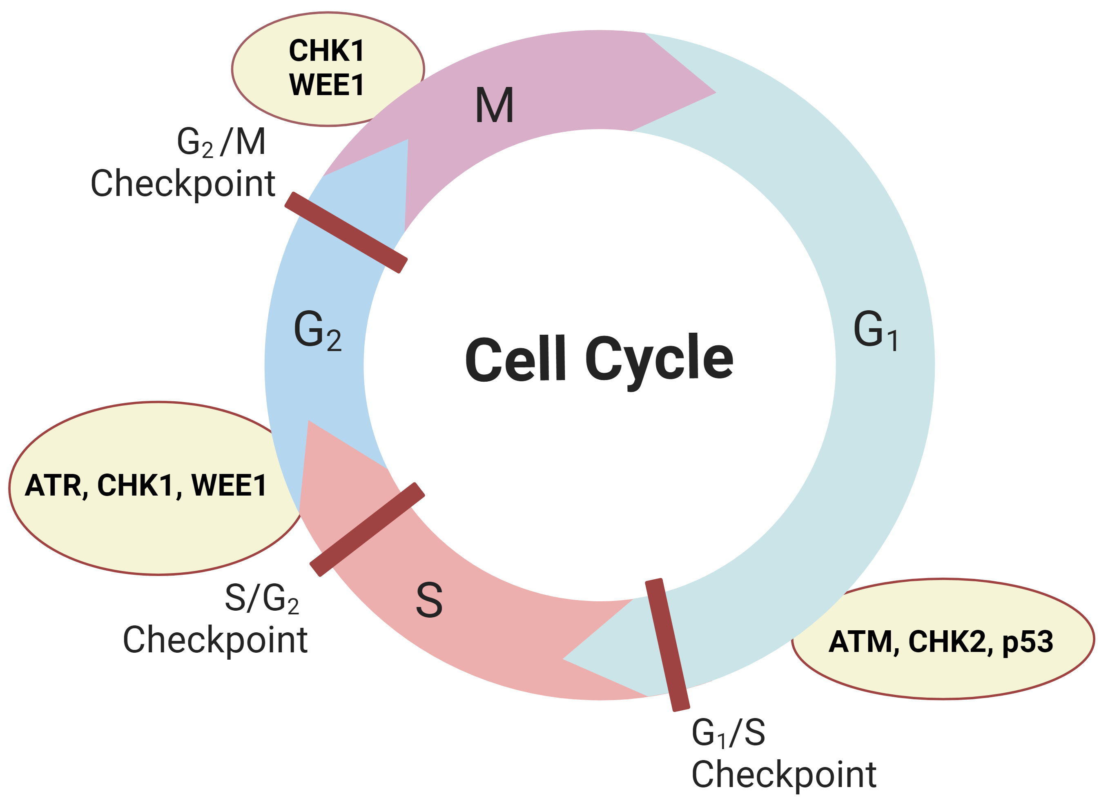
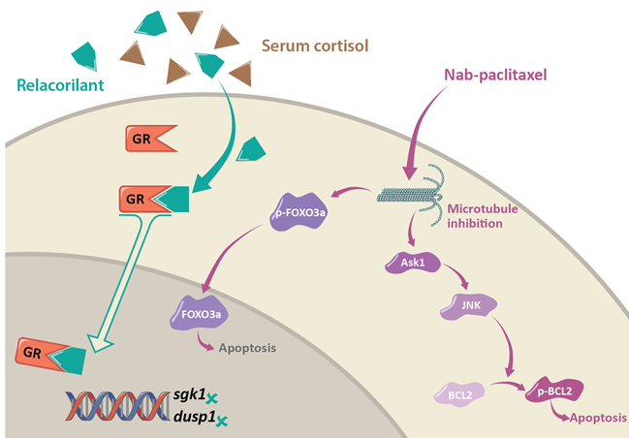
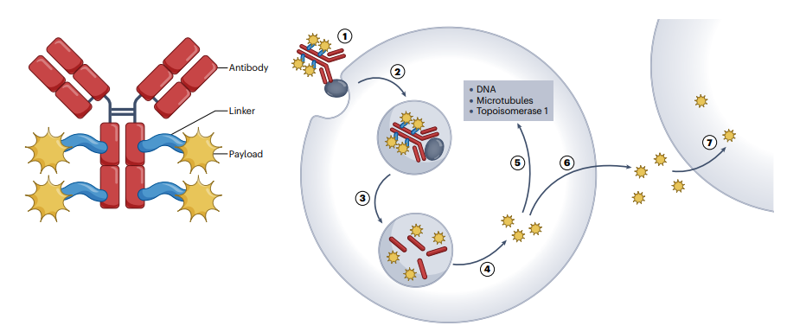
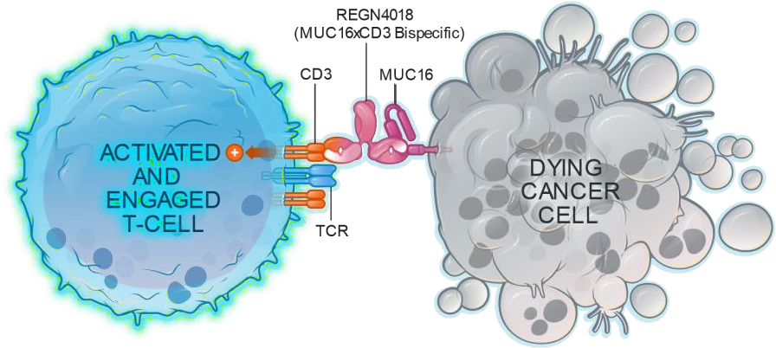
Platinum Ineligible Ovarian Cancer
ANTIBODY DRUG CONJUGATED (ADCS)
CELL CYCLE REGULATION AND DNA REPAIR
IMMUNOTHERAPY
GLUCOCORTICOID RECEPTOR
Mirvetuximab-soravtansine ¹
Trastuzumab-deruxtecan ²
Raludotatug- Deruxtecan ³
Rinatabart Sesutecan (Rina-S)⁴
AZD5335 ⁵
Ly4170156 ⁶
NAPISTAR 1-01 ⁷
ADAVOSERTIB ⁸
azenosertib⁹
CDK2i ¹⁰
Paclitaxel/pembro ¹¹
UBAMATAMAB ¹²
RELACORILANT ¹³
¹ [NCT04296890 – Soraya] [NCT04209855 – Mirasol]; ² [NCT04482309]; ³ [NCT04707248]; ⁴ [NCT06619236]; ⁵ [NCT05797168] ; ⁶ [NCT06400472]; ⁷ [NCT06303505];
⁸ [NCT03579316]; ⁹ [NCT02595892]; ¹⁰ [INCB123667]; ¹¹ [NCT05116189]; ¹² [NCT03564340] ¹³ [NCT05257408 – Rosella]; [NCT03776812 – phase II];
Courtesy of Nicoletta Colombo, MD

Slide 18


Antibody Drug Conjugates in ovarian cancer
Future?
CLDN6
TF
NaPi2b
Mesothelin
HER2
MUC16
TROP2
B7-H4
CLDN6
CDH6
FRα
With permission of Ainhoa Madariaga
Courtesy of Nicoletta Colombo, MD

Slide 19
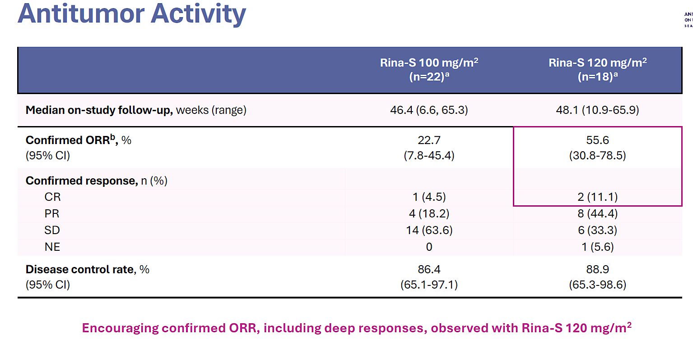

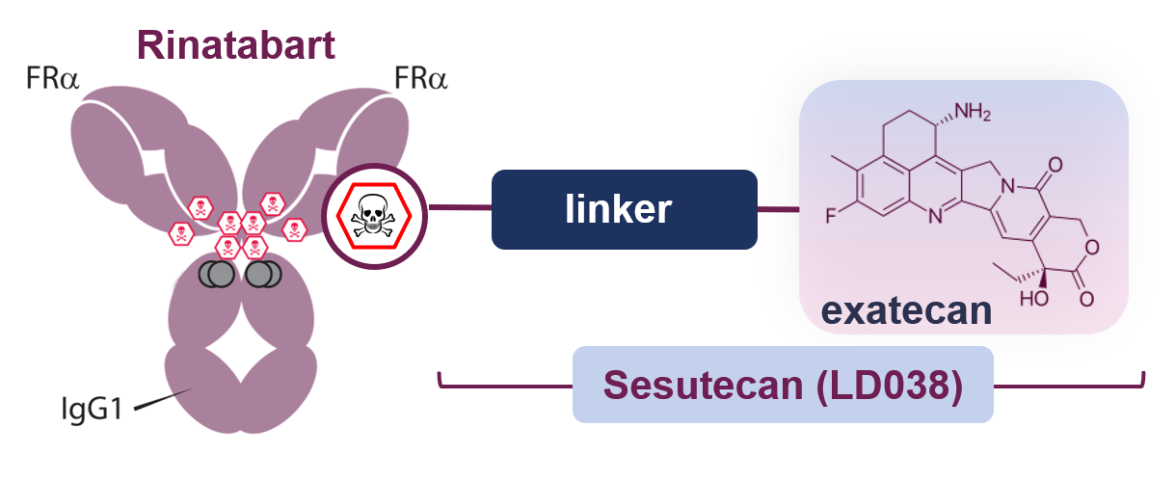
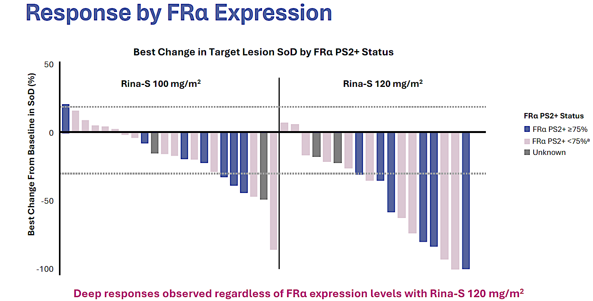
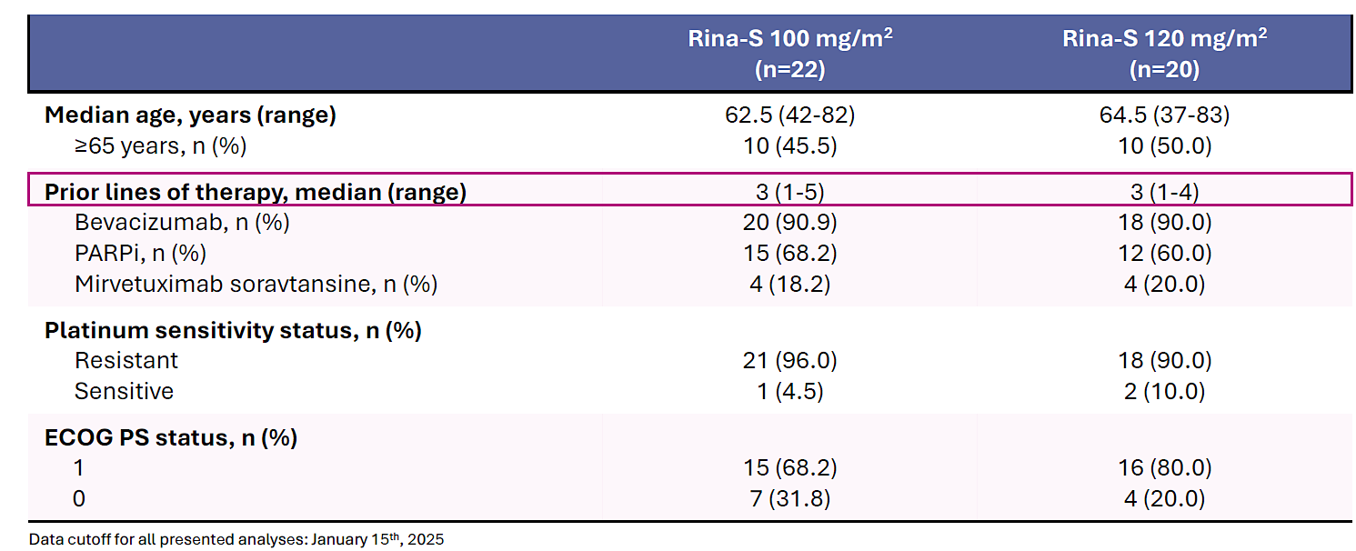
Targeting FRα: RAINFOL-01
Phase 1/2 Study (NCT05579366)
Courtesy of Nicoletta Colombo, MD
Rinatabart sesutecan (Rina-S)
Novel FRα-directed ADC
Highly hydrophilic linker, sesutecan
Topoisomerase 1 inhibitor payload
Phase I/II: Part B – Dose expansion
R (1:1): Rina-S 100 or Rina-S 120 mg/m2, q 3w

Slide 20
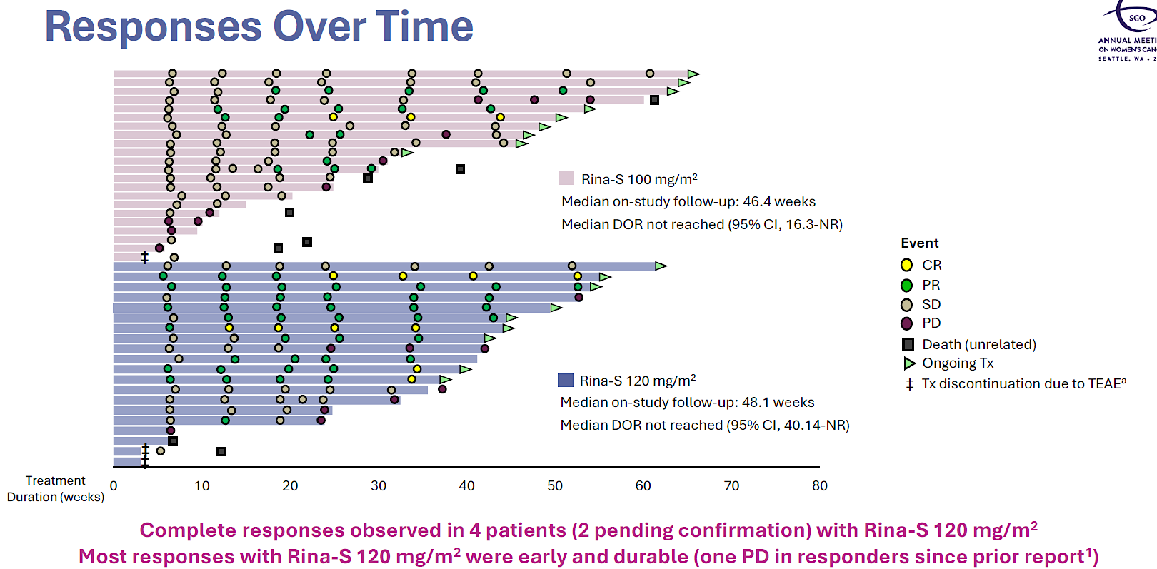
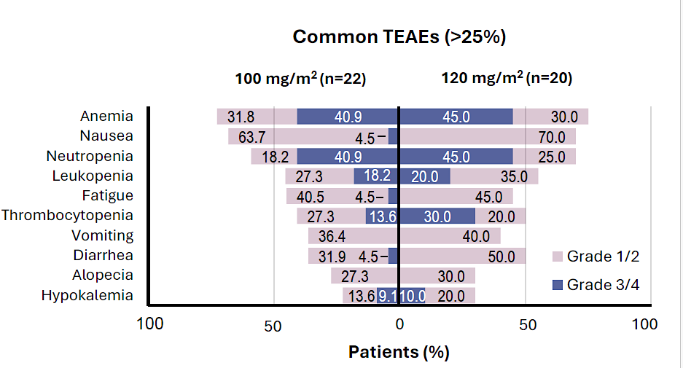
Targeting FRα: RAINFOL-01
Phase 1/2 Study (NCT05579366)
Rina-S was well tolerated with TEAEs of primarily cytopenias and low-grade GI events
No signals of ocular toxicity, neuropathy, or ILD were observed
Courtesy of Nicoletta Colombo, MD

Slide 21
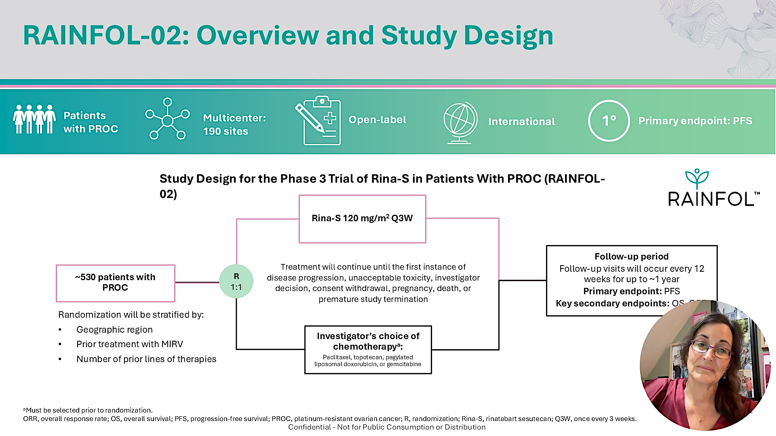
Follow-up period
Follow-up visits will occur every 12 weeks for up to ~1 year
Primary endpoint: PFS
Key Secondary endpoints: OS, ORR
Angeles Alvarez Secord presented at ASCO 2025;Abstract TPS5627
Courtesy of Nicoletta Colombo, MD

Slide 22
AZD5335: An FRα-targeting TOP1i ADC
Schematic of AZD5335
FRα is a cell surface protein that binds and internalises folate, a cofactor required for DNA synthesis, cell growth, and proliferation.^{1–3}
FRα is highly expressed in multiple epithelial tumours and a clinically validated ADC target in HGSOC.^{2–4}
AZD5335 is a specific, targeted ADC with a potent TOP1i payload (AZ14170132) that binds to FRα with high affinity.⁵
  The cleavable peptide linker (mp-PEG8-Val-Ala) is
  bystander-capable and serum-stable.
  AZD5335 has an average DAR of 8.
  Conjugated
  TOP1i payload
  TOP1i
Cleavable peptide linker
Figure adapted from Gymnopoulos M, et al. Presented at AACR 2023 (LB025).
1. Kelemen LE. Int J Cancer 2006;119:243–50;
2. Ledermann JA, et al. Ann Oncol 2015;26:2034–43;
3. Scaranti M, et al. Nat Rev Clin Oncol 2020;17:349–59;
4. Moore KN, et al. N Engl J Med 2023;389:2162–74;
5. Gymnopoulos M, et al. Poster presented at AACR 2023 (Abstract LB025).
ADC, antibody-drug conjugate; DAR, drug-to-antibody ratio; FRα, folate receptor α;
OC, ovarian cancer; TOP1i, topoisomerase 1 inhibitor
Oaknin, ESMO 2025
Courtesy of Nicoletta Colombo, MD

Slide 23
Torvutatug Samrotecan (Torvu-S): FRα-binding Ab, cleavable peptide linker, topo1i payload, DAR 8
AZD5335 demonstrates efficacy across 1.6–2.4 mg/kg dose range
100
Phase I Part A - Escalation
Part B – Dose expansion (≤3 lines, FRα ≥25%)
Median lines 3 (1-9)
 | Parts A + B1
 | 1.6 mg/kg (n=50) | 2.0 mg/kg (n=57) | 2.4 mg/kg (n=61)
ORR*, n (%) [95% CI] | 28 (56.0) [41.3, 70.0] | 32 (56.1) [42.4, 69.3] | 30 (49.2) [36.1, 62.3]
80
60
40
20
0
Best change from baseline (%) in TL tumor size
–20
AZD5335 dose
1.6 mg/kg
–40
2.0 mg/kg
2.4 mg/kg
–60
PD at best percent
change visit
–80
–100
Oaknin, ESMO 2025
Among patients who received 1.6, 2.0, or 2.4 mg/kg AZD5335 in Parts A + B1, the overall ORR* was
53.6% (95% CI: 45.7, 61.3).
The most common TEAEs across the 1.6–2.4 mg/kg dose range were nausea, fatigue, and neutropenia.
AZD5335 vs. Mirvetuximab Soravtansine in FRα-high and AZD5335 vs. Chemotherapy in
FRα-low Platinum-resistant Ovarian Cancer (TREVI-OC-01) ClinicalTrials.gov ID NCT07218809
Courtesy of Nicoletta Colombo, MD

Slide 24
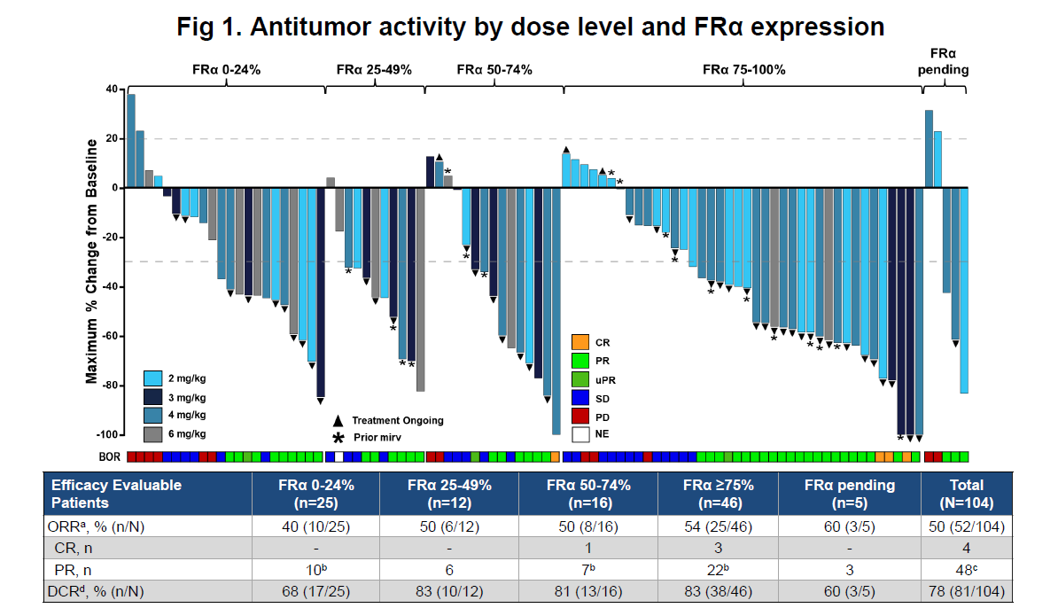
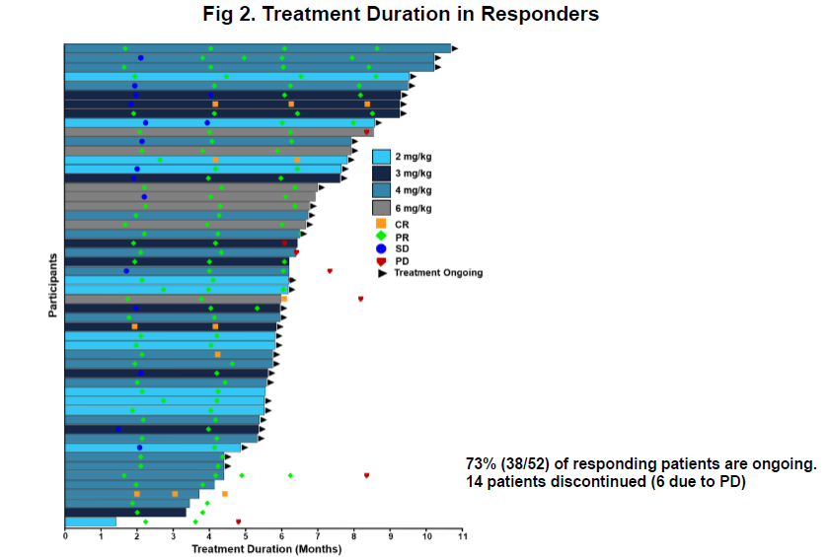
Sofetabart mipitecan (Sofe-M): FRα-binding Ab, cleavable PSAR linker, exatecan topo1i payload, DAR 8
Initial results from a first-in-human phase 1 study of LY4170156 in advanced ovarian cancer and other solid tumors.
Most common adverse events: Nausea, fatigue, myelotoxicity
Phase III FRAmework-01 NCT07213804
Ray-Coquard, ESMO 2025
Courtesy of Nicoletta Colombo, MD

Slide 25
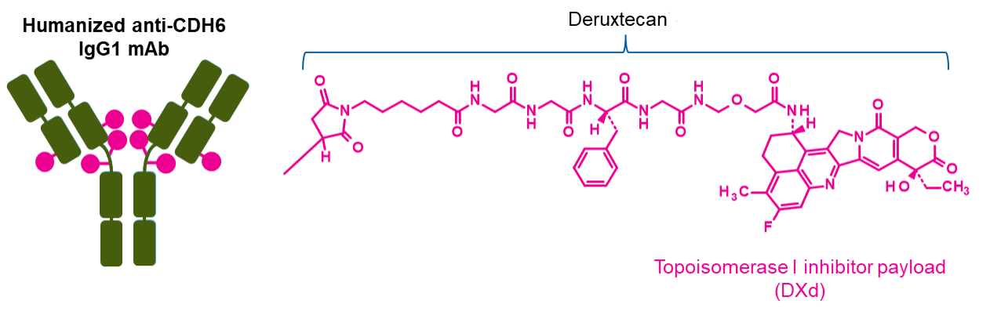
Targeting Cadherin 6 (CDH6)
Courtesy of Nicoletta Colombo, MD
R-DXd was designed with 7 key attributes:
Platinum-resistant OC is associated with poor outcomes;^{1,2} standard of care is single-agent non-platinum chemotherapy, which provides only a modest benefit; ORR is 10–15% and median OS is 10–12 months¹
Expression of CDH6 is observed in ~65 to 85% of epithelial OC tumors^{3–5}
Raludotatug deruxtecan (R-DXd) is a CDH6-directed ADC comprising a humanized CDH6 IgG1 mAb, covalently linked to a TOPO I inhibitor payload via a tetrapeptide-based cleavable linker^{6,7}
In the ongoing Phase 1 trial (NCT04707248), R-DXd demonstrated a manageable safety profile and promising antitumor activity in 45 patients with heavily pretreated OC (89% had platinum-resistant OC)^{8,a}
R-DXd was administered at 4.8, 5.6, or 6.4 mg/kg IV Q3W. Across doses, 48.6% of patients achieved a confirmed objective response⁸
Humanized anti-CDH6 IgG1 mAb^{b}
Deruxtecan^{6,7}
Cleavable tetrapeptide-based linker
TOPO I inhibitor payload (DXd)
1 | Payload mechanism of action: TOPO I inhibitor^{7,c}
2 | High potency of payload^{6,7,c}
3 | High drug-to-antibody ratio of ≈8^{6,c}
4 | Payload with short systemic half-life^{7,c,d}
5 | Plasma-stable linker-payload^{6,7,c}
6 | Tumor-selective cleavable linker^{6,7,c}
7 | Bystander antitumor effect^{6,c}

Slide 26
REJOICE-Ovarian01 study design
Targeting Cadherin 6 (CDH6)
Courtesy of Nicoletta Colombo, MD
A Phase 2/3 multicenter, randomized study of R-DXd in patients with platinum-resistant,
high-grade serous or endometroid ovarian, primary peritoneal, or fallopian tube cancer^{1,2}
Key eligibility criteria
High-grade serous or high-grade endometrioid ovarian, primary peritoneal, or fallopian tube cancerª
1−3 prior LOT, including bevacizumab^{b}
Platinum-resistant disease^{c} (primary platinum-refractory disease is exclusionary)
Prior mirvetuximab soravtansine^{d} (for tumors with high FRα expression)
ECOG PS 0−1
No prior CDH6-targeting agents or ADCs with a linked exatecan derivative
No selection by tumor CDH6 expression
Phase 2 (N≈260)
Dose-optimization analysis (N=108)^{f}
40 days
LTSFU Q3M
Phase 3 (N≈450)
40 days
LTSFU Q3M
Follow-up
Follow-up
R-DXd IV Q3W
R-DXd IV Q3W
4.8 mg/kg
R-DXd at RP3D
R
1:1:1
R
1:1
5.6 mg/kg
Treatment of physician’s choice
6.4 mg/kg
Until PD,^{g} death, lost to FU, other reason
Until PD,^{g} death, lost to FU, other reason
Stratification factors
Number of prior LOT (1 vs 2–3)
CDH6 expression (≥75% vs <75%)^{e}
TPC (paclitaxel vs other; Phase 3 only)
Primary endpoint
ORR per BICR^{g}
Key secondary endpoints
ORR per inv^{g}
DOR per BICR and inv^{g}
Primary endpoints
ORR per BICR^{g}
PFS per BICR^{g}
Key secondary endpoints
OS
QOL
Ray-Coquard, ESMO 2025

Slide 27
Clinically meaningful tumor responses were seen irrespective of doseª
Courtesy of Nicoletta Colombo, MD
R-DXd 4.8 mg/kg, n=36
R-DXd 5.6 mg/kg, n=36
R-DXd 6.4 mg/kg, n=35
ORR: 44.4% (95% CI, 27.9–61.9)
DCR: 75.0% (95% CI, 57.8–87.9)^{b}
ORR: 50.0% (95% CI, 32.9–67.1)
DCR: 80.6% (95% CI, 64.0–91.8)^{b}
ORR: 57.1% (95% CI, 39.4–73.7)
DCR: 77.1% (95% CI, 59.9–89.6)^{b}
Best change in sum of diameters from baseline (%)
Ray-Coquard, ESMO 2025

Slide 28
Most common TEAEs (≥10% of overall population)ª
The 5.6-mg/kg dose provided the optimal benefit–risk profile
Courtesy of Nicoletta Colombo, MD
R-DXd 4.8 mg/kg (n=36)^{b}
R-DXd 5.6 mg/kg (n=36)^{b}
R-DXd 6.4 mg/kg (n=35)^{b}
CTCAE gr 1–2
CTCAE gr ≥3
Total (%) / gr ≥3 (%)
CTCAE gr 1–2
CTCAE gr ≥3
Total (%) / gr ≥3 (%)
CTCAE gr 1–2
CTCAE gr ≥3
Total (%) / gr ≥3 (%)
Nausea
Anemia
Asthenia
Neutropenia^{c}
Vomiting
Constipation
Decreased appetite
AST increased
Diarrhea
Thrombocytopenia^{d}
Leukopenia^{e}
ALT increased
Pyrexia
GGT increased
Fatigue
Cough
Abdominal pain
66.7 / 2.8
69.4 / 5.6
71.4 / 0
52.8 / 19.4
58.3 / 13.9
60.0 / 17.1
36.1 / 0
50.0 / 11.1
54.3 / 5.7
33.3 / 11.1
44.4 / 16.7
51.4 / 28.6
25.0 / 0
33.3 / 0
28.6 / 0
25.0 / 0
27.8 / 0
34.3 / 0
13.9 / 0
25.0 / 5.6
25.7 / 0
19.4 / 0
16.7 / 0
22.9 / 0
11.1 / 0
16.7/0
28.6 / 2.9
8.3 / 2.8
19.4 / 5.6
25.7 / 8.6
16.7 / 5.6
13.9 / 2.8
14.3 / 8.6
19.4 / 0
8.3 / 0
11.4 / 2.9
13.9 / 0
13.9 / 0
8.6 / 0
5.6 / 0
16.7 / 2.8
11.4 / 5.7
8.3 / 2.8
16.7 / 2.8
5.7 / 2.9
5.6 / 0
11.1 / 0
14.3 / 0
5.6 / 0
13.9 / 2.8
11.4 / 2.9
Patients (%)
Patients (%)
Patients (%)
Nausea, anemia, asthenia and neutropenia were the most common TEAEs across all doses
Ray-Coquard, ESMO 2025

Slide 29
REJOICE-Ovarian01: Efficacy of R-DXd in PROC
Phase 2/3 REJOICE-Ovarian01/ENGOT-ov77; GOG-3096
Key Eligibility Criteria
High-grade serous or endometrioid ovarian, primary peritoneal, or fallopian tube cancer
1-3 prior LOT (including bevacizumab)
Platinum-resistant disease
Prior MIRV if high FRαª
ECOG PS 0-1
No prior CDH6-targeting agents or ADCs with linked TOPO I inhibitor
Patients with primary platinum-refractory disease are not eligible
Phase 2
40 d
Long-term survival follow-up every 3 mo
Phase 3
40 d
Long-term survival follow-up every 3 mo
Follow-up
Follow-up
R-DXd IV Q3W
R-DXd IV Q3W
4.8 mg/kg
R-DXd at RP3D
R
1:1:1
5.6 mg/kg
R
1:1
TPC (gemcitabine, PLD, topotecan, paclitaxel)
6.4 mg/kg
Until PD,^{b} death, lost to FU, other reason
Until PD,^{b} death, lost to FU, other reason
R
1:1
Primary endpoints: ORR per BICR,^{b} PFS
per BICR^{b}
Key secondary endpoints: OS, QOL
Stratification
Number of prior LOT (1 vs 2/3)
CDH6 expression (high vs low)
TPC (paclitaxel vs others; phase 3 only)
Primary endpoint: ORR per BICR^{b}
Key secondary endpoints: ORR per investigator,^{b} DOR
ª Unless ineligible, not approved, or available locally. ^{b} Per RECIST v1.1.
1. https://clinicaltrials.gov/study/NCT06161025.
Courtesy of Nicoletta Colombo, MD

Slide 30
Raludotatug Deruxtecan Granted FDA Breakthrough Therapy Designation for CDH6-Expressing Platinum-Resistant Ovarian, Primary Peritoneal or Fallopian Tube Cancers Previously Treated with Bevacizumab
Press Release: September 15, 2025
“Raludotatug deruxtecan (R-DXd) has been granted Breakthrough Therapy Designation (BTD) by the U.S. Food and Drug Administration (FDA) for the treatment of adult patients with platinum-resistant epithelial ovarian, primary peritoneal or fallopian tube cancers expressing CDH6 who have received prior treatment with bevacizumab.
The FDA granted this BTD based on data from a phase 1 trial and the ongoing REJOICE-Ovarian01 phase 2/3 trial. A subgroup analysis of the phase 1 trial was presented at the 2023 European Society for Medical Oncology meeting (#ESMO23). Subsequent subgroup analyses of the phase 1 trial were presented at the 2024 Society for Gynecologic Oncology Annual Meeting on Women’s Cancer and the 2025 European Society for Medical Oncology Gynaecological Cancers Congress.”
https://daiichisankyo.us/press-releases/-/article/raludotatug-deruxtecan-granted-breakthrough-therapy-designation-by-us-fda-for-patients-with-cdh6-expressing-platinum-resistant-ovarian-primary-peritoneal-or-fallopian-tube-cancers-previously-treated-with-bevacizumab

Slide 31
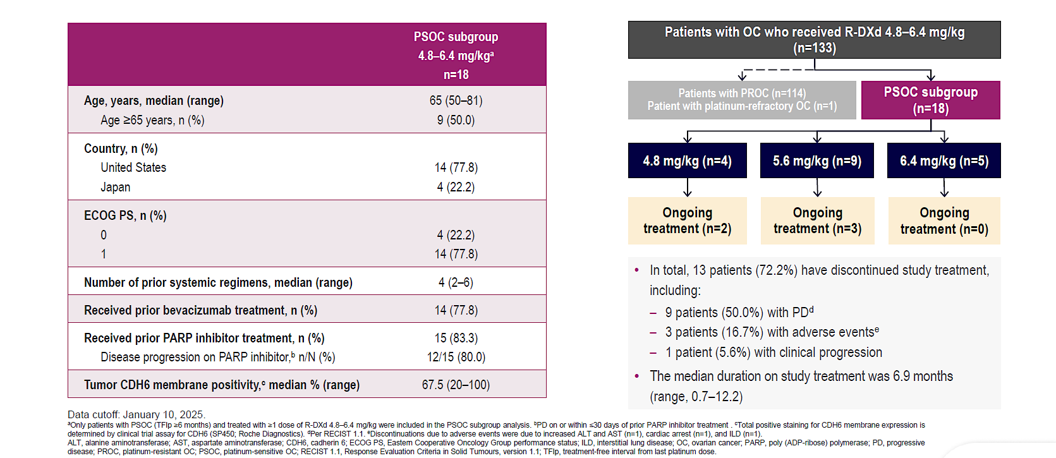
REJOICE-Ovarian01: Efficacy of R-DXd in PSOC
Kathleen Moore, ESMO GYN 2025
Courtesy of Nicoletta Colombo, MD

Slide 32
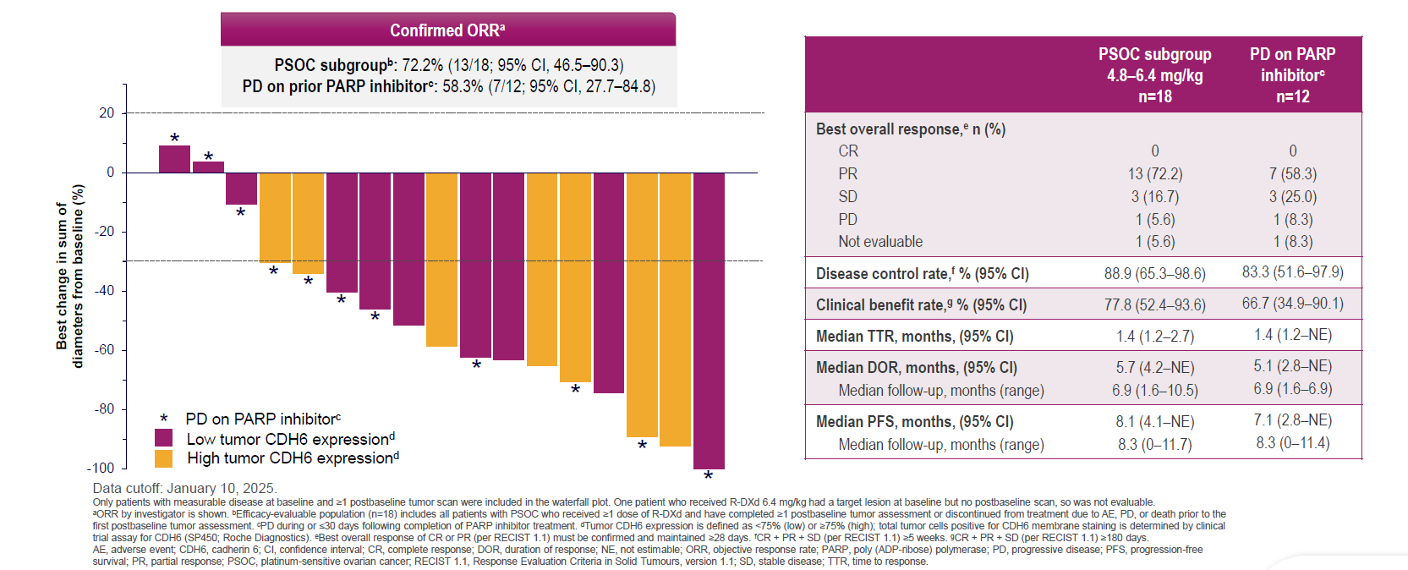
REJOICE-Ovarian01: Efficacy of R-DXd in PSOC
Kathleen Moore, ESMO GYN 2025
Courtesy of Nicoletta Colombo, MD

Slide 33
NAPISTAR 1-01: Study Design
A multicenter, FIH dose escalation and optimization Phase I/IIa Study (NCT06303505),
investigating the NaPi2b ADC TUB-040 in PROC*
Phase I
Dose Escalation
Phase IIa
Dose Optimization
5.3 mg/kg
4.4. mg/kg
3.3 mg/kg
Dose 1
2.5 mg/kg
2.1 mg/kg
Dose 2
1.67 mg/kg
1.0 mg/kg
0.5 mg/kg
Study design: ATD followed by BOIN
  Key Eligibility Criteria
  Histologically confirmed, platinum resistant, high-grade serous epithelial ovarian, fallopian tube or primary peritoneal cancer
  A maximum of 5 platinum-based and 2 non-platinum prior lines of therapy
  ECOG 0-1
  No prior treatment with an ADC containing a TOPO-I inhibitor payload
  No biomarker selection based on NaPi2b expression
  Objectives and Endpoints
  Safety and tolerability
  Determination of MTD
  ORR per RECIST 1.1, DCR, DoR, PFS and OS
  PK parameters of TUB-040
  Immunogenicity
  Quality of life
* NAPISTAR 01-1 also includes an NSCLC arm, which is currently being explored independently from the PROC arm. Cut off: 01 September 2025. ADAs, anti-drug antibodies; ADC=antibody-drug conjugate; ATD, accelerated titration dosing; BOIN, Bayesian optimal interval; DCR, disease control rate; DoR, duration of response; FIH, first-in-human; MTD, maximum tolerated dose; NaPi2b, sodium-dependent phosphate transporter protein 2B; NSCLC, non-small cell lung cancer; ORR, overall response rate; OS, overall survival; PBC, platinum-based chemotherapy; PFS, progression-free survival; PK, pharmacokinetics; PROC, platinum-resistant ovarian cancer.
Antonio Gonzalez-Martin, ESMO 2025
Courtesy of Nicoletta Colombo, MD

Slide 34
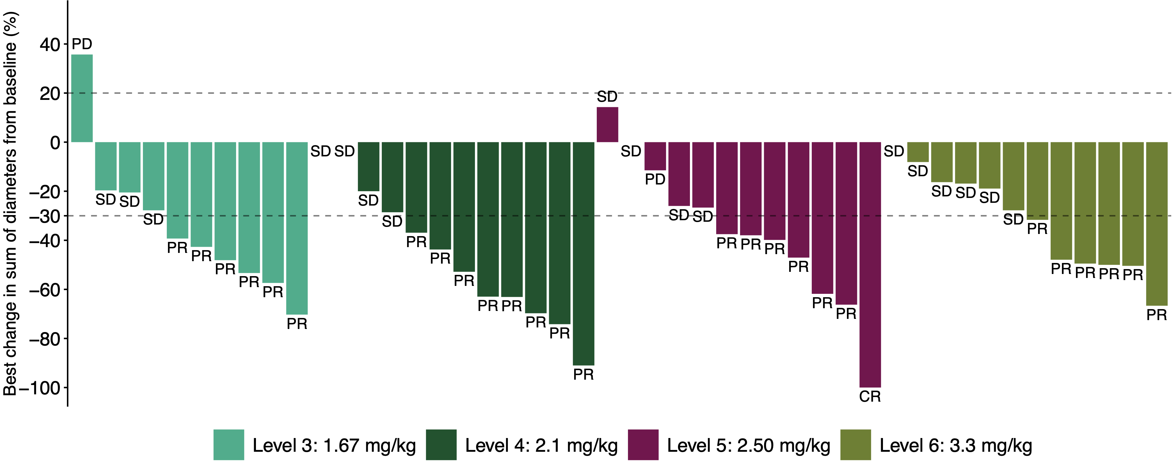
Efficacy across a wide therapeutic range with complete responses
Antonio Gonzalez-Martin, ESMO 2025
59% ORR (50% cORR) within 1.67 – 3.3 mg/kg cohorts
#
#
#
#
Across 1.67 – 3.3 mg/kg:
Onset of activity at low doses
Complete response observed
CA125 response rate⁴ 81%
93% (25/27) of responding patients are ongoing
80% (37/46) of patients remain on treatment, indicating durable benefit
# Prior mirvetuximab soravtansine
Efficacy |  |  |  |  | Dose Levels 1.67-3.3 mg/kg (n=46)
 | 1.67 mg/kg (n=10) | 2.1 mg/kg (n=12) | 2.5 mg/kg (n=12) | 3.3 mg/kg (n=12)
ORR² n (%) | 6 (60) | 8 (67) | 7 (58) | 6 (50)³ | 27 (59)
Confirmed ORR, n (%) | 4 (40) | 7 (58) | 7 (58) | 5 (42) | 23 (50)
DCR n (%) | 9 (90) | 12 (100) | 11 (92) | 12 (100) | 44 (96)
Confirmed DCR, n (%) | 9 (90) | 12 (100) | 11 (92) | 12 (100) | 44 (96)
Confirmed CR, n (%) | 0 | 0 | 1 (8) | 0 | 1 (2)
All evaluable patients 0.5 – 5.3 mg/kg (n=66)¹
36 (55)
26 (39)
64 (97)
60 (91)
1 (2)
1. N=66 evaluable patients who had at least 1 RECIST response assessment across doses from 0.5 – 5.3 mg/kg. There were no responses observed at doses below 1.67 mg/kg. 2. Responses of PR/CR per RECIST at a minimum of 1 post-baseline assessment. 3. Efficacy data in patients treated at 3.3 mg/kg continue to mature. 4. CA125 responses determined per GCIG; 34 responders in 42 CA125 evaluable subjects. CR, complete response; DCR, disease control rate; PR, partial response; SD, stable disease. Data Cut off: 01 September 2025.
Data Cut off: 01 September 2025
Courtesy of Nicoletta Colombo, MD

Slide 35
Platinum Ineligible Ovarian Cancer
ANTIBODY DRUG CONJUGATED (ADCS)
CELL CYCLE REGULATION AND DNA REPAIR
Mirvetuximab-soravtansine ¹
Trastuzumab-deruxtecan ²
Raludotatug- Deruxtecan ³
Rinatabart Sesutecan (Rina-S)⁴
AZD5335 ⁵
Ly4170156 ⁶
NAPISTAR 1-01 ⁷
ADAVOSERTIB ⁸
azenosertib⁹
CDK2i ¹⁰
¹ [NCT04296890 – Soraya] [NCT04209855 – Mirasol]; ² [NCT04482309]; ³ [NCT04707248]; ⁴ [NCT06619236]; ⁵ [NCT05797168] ; ⁶ [NCT06400472]; ⁷ [NCT06303505];
⁸ [NCT03579316]; ⁹ [NCT02595892]; ¹⁰ [INCB123667]; ¹¹ [NCT05116189]; ¹² [NCT03564340] ¹³ [NCT05257408 – Rosella]; [NCT03776812 – phase II];
Courtesy of Nicoletta Colombo, MD

Slide 36
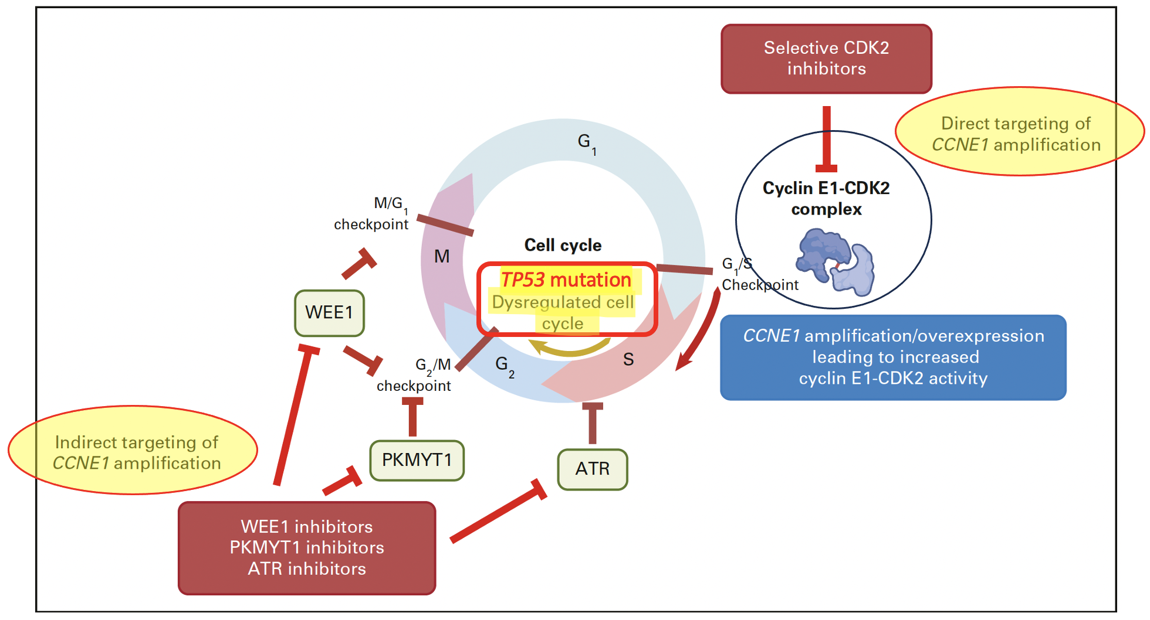
Exploiting Replication stress in
CCNE1 amplified tumours
p53 deficient & CCNE1 amplified cells rely on other cell-cycle checkpoints
Au-Yeung G etal., JCO 2023
Frederik Marmé
Courtesy of Nicoletta Colombo, MD

Slide 37
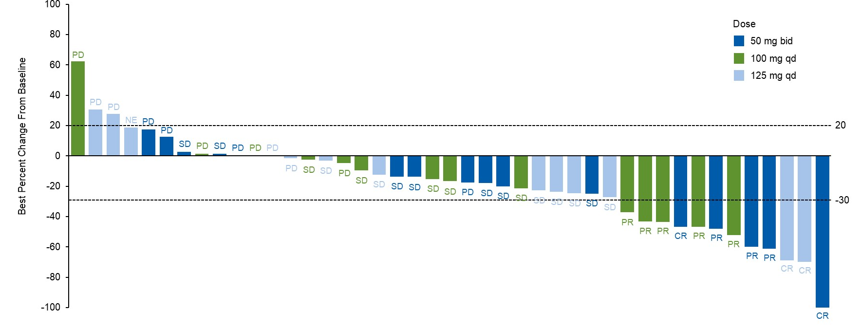
Direct targeting of CCNE1
CDK2-inhibitors in Platinum Resistant/Refractory Ovarian cancer
INCB123667: Phase 1B, CCNE1 amplified or overexpressed EOC (n=45)
ORR: 33.3%
DOR: 3.6 mo.
mPFS: 5.3 mo.
Responses were observed in pts with CCNE1 amplification (7/29) & without (5/16)
Treatment ongoing in some patients beyond 300 days (n=3)
Good tolerability
Damian S et al., ASCO 2025 abstract #5514
Damian S et al., Journal of Clinical Oncology 2025 Vol. 43 Issue 16_suppl Pages 5514-5514
Courtesy of Nicoletta Colombo, MD

Slide 38
Platinum Ineligible Ovarian Cancer
ANTIBODY DRUG CONJUGATED (ADCS)
CELL CYCLE REGULATION AND DNA REPAIR
IMMUNOTHERAPY
Mirvetuximab-soravtansine ¹
Trastuzumab-deruxtecan ²
Raludotatug- Deruxtecan ³
Rinatabart Sesutecan (Rina-S)⁴
AZD5335 ⁵
Ly4170156 ⁶
NAPISTAR 1-01⁷
ADAVOSERTIB ⁸
azenosertib⁹
CDK2i ¹⁰
Paclitaxel/pembro ¹¹
UBAMATAMAB ¹²
¹ [NCT04296890 – Soraya] [NCT04209855 – Mirasol]; ² [NCT04482309]; ³ [NCT04707248]; ⁴ [NCT06619236]; ⁵ [NCT05797168] ; ⁶ [NCT06400472]; ⁷ [NCT06303505];
⁸ [NCT03579316]; ⁹ [NCT02595892]; ¹⁰ [INCB123667]; ¹¹ [NCT05116189]; ¹² [NCT03564340] ¹³ [NCT05257408 – Rosella]; [NCT03776812 – phase II];
Courtesy of Nicoletta Colombo, MD

Slide 39

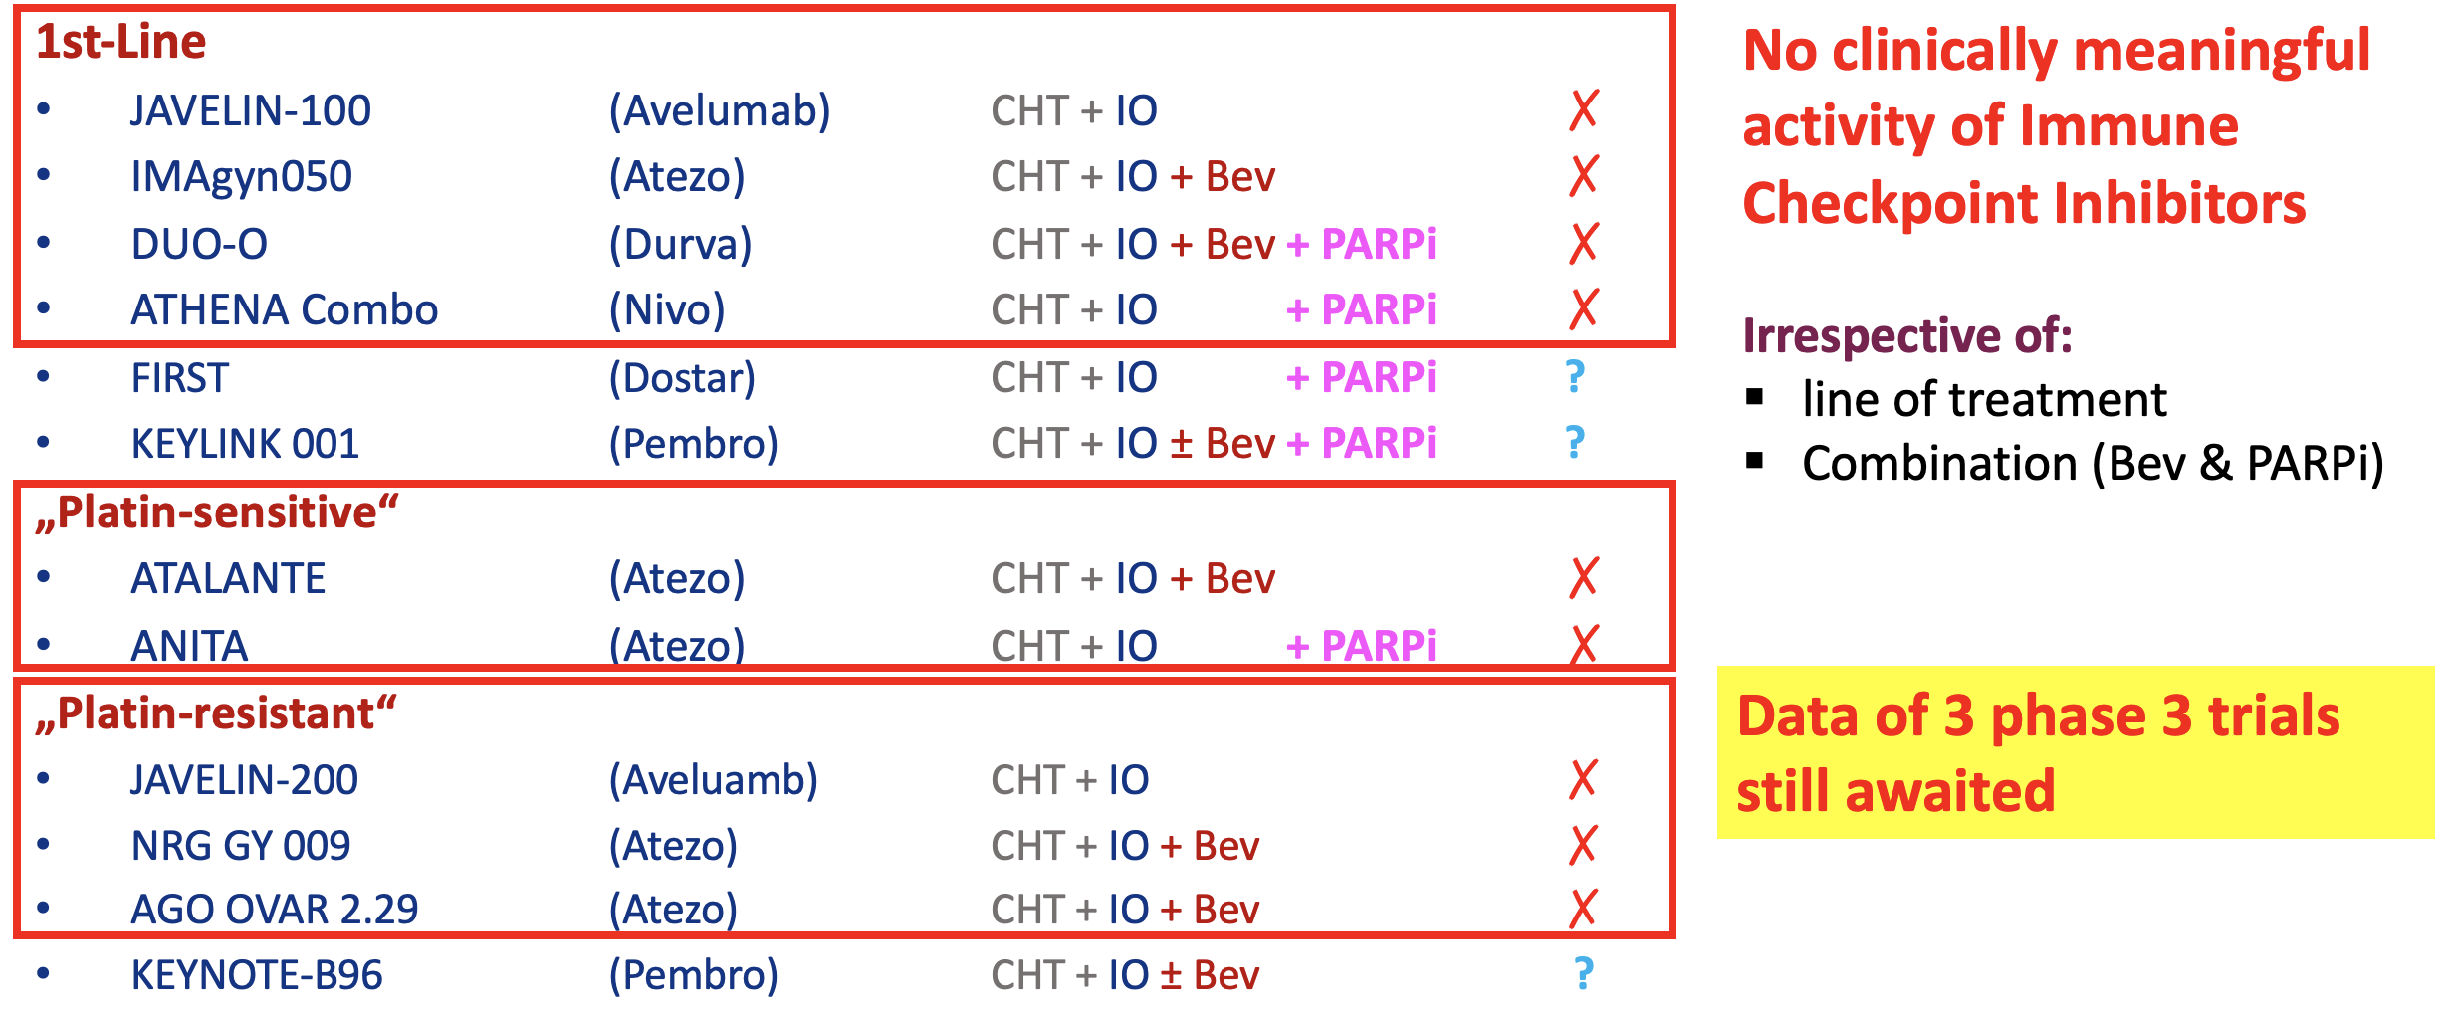
Immune Checkpoint Inhibitors In Ovarian Cancer: Phase 3 Evidence
Frederik Marmé
Courtesy of Nicoletta Colombo, MD

Slide 40
ENGOT-ov65/KEYNOTE-B96 Study Design (NCT05116189)
Key Eligibility Criteria
Histologically confirmed epithelial ovarian, fallopian tube, or primary peritoneal carcinoma
1 or 2 prior lines of therapy; at least 1 platinum-based chemotherapy
  Prior anti-PD-1 or anti-PD-L1, PARPi and bevacizumab permitted
Radiographic progression within 6 months after the last dose of platinum-based chemotherapy
ECOG PS 0 or 1
Pembrolizumab 400 mg
(Q6W, 18 cycles) +
Paclitaxelª 80 mg/m² Days 1, 8, 15
of each Q3W cycle
(± bevacizumab 10 mg/kg Q2W)
R 1:1
N = 643
Placebo
(Q6W, 18 cycles) +
Paclitaxelª 80 mg/m² Days 1, 8, 15
of each Q3W cycle
(± bevacizumab 10 mg/kg Q2W)
Stratification Factors
Planned bevacizumab use (yes vs no)
Region (US vs EU vs ROW)
PD-L1 CPS (<1 vs 1 to <10 vs ≥10)^{b}
Primary Endpoint: PFS per RECIST v1.1 by investigator
Key Secondary: OS
ªDocetaxel (75 mg/m² Q3W) may be considered in participants with severe hypersensitivity reaction to paclitaxel or an adverse event requiring discontinuation of paclitaxel after consultation with the Sponsor. ^{b}The combined positive score (CPS) was assessed at a central laboratory using PD-L1 IHC 22C3 pharmDx and defined as the number of PD-L1 CPS ≥1 cells (tumor cells, lymphocytes, macrophages) divided by the total number of tumor cells × 100.
Courtesy of Nicoletta Colombo, MD

Slide 41
Progression-Free Survival in the CPS ≥1 Population at IA1
100
12-mo rate (95% CI)
35.2% (28.8-41.7)
22.6% (17.0-28.7)
90
80
70
HR 0.72 (95% CI, 0.58-0.89) P = 0.0014ª
60
 | Pts w/ Event | Median, mo (95% CI)
Pembro Arm | 69.2% | 8.3 (7.0-9.4)
Placebo Arm | 77.6% | 7.2 (6.2-8.1)
Information fraction: 87.9%
50
Progression-Free Survival, %
40
30
20
10
Median follow-up:
15.6 months
0
0
5
10
15
20
25
30
No. at risk
Time, months
234
170
87
21
5
1
0
232
150
64
16
3
1
0
Colombo N, ESMO 2025
Courtesy of Nicoletta Colombo, MD

Slide 42
Progression-Free Survival in the ITT Population at IA1
100
12-mo rate (95% CI)
33.1% (27.7-38.5)
21.3% (16.6-26.4)
90
80
70
HR 0.70 (95% CI, 0.58-0.84) P < 0.0001ª
60
 | Pts w/ Event | Median, mo (95% CI)
Pembro Arm | 71.7% | 8.3 (7.2-8.6)
Placebo Arm | 78.8% | 6.4 (6.2-8.1)
Information fraction: 89.5%
50
Progression-Free Survival, %
40
30
20
10
Median follow-up:
15.6 months
0
0
5
10
15
20
25
30
No. at risk
Time, months
322
233
119
34
6
1
0
321
200
84
19
3
1
0
Colombo N, ESMO 2025
Courtesy of Nicoletta Colombo, MD

Slide 43
Key Secondary Endpoint: Overall Survival in the CPS ≥1 Population at IA2
100
12-mo
69.1%
59.3%
18-mo
51.5%
38.9%
90
80
HR 0.76 (95% CI, 0.61-0.94) P = 0.0053ª
70
60
Overall Survival, %
 | Pts w/ Event | Median, mo (95% CI)
Pembro Arm | 67.1% | 18.2 (15.3-21.0)
Placebo Arm | 75.4% | 14.0 (12.5-16.1)
Information fraction: 90.0%
50
40
30
20
10
Median follow-up:
26.6 months
0
0
6
12
18
24
30
36
42
No. at risk
Time, months
234
207
161
120
49
13
3
0
232
200
137
89
41
10
1
0
Colombo N, ESMO 2025
Courtesy of Nicoletta Colombo, MD

Slide 44
FDA Approves Pembrolizumab with Paclitaxel for Platinum-Resistant Epithelial Ovarian, Fallopian Tube or Primary Peritoneal Carcinoma
Press Release: February 10, 2026
“The Food and Drug Administration approved pembrolizumab as well as pembrolizumab and berahyaluronidase alfa-pmph in combination with paclitaxel, with or without bevacizumab, for adult patients with platinum-resistant epithelial ovarian, fallopian tube, or primary peritoneal carcinoma whose tumors express PD-L1 (CPS≥1) as determined by an FDA-authorized test, and who have received one or two prior systemic treatment regimens.
FDA also approved the PD-L1 IHC 22C3 pharmDx as a companion diagnostic device to identify patients with epithelial ovarian, fallopian tube, or primary peritoneal carcinoma whose tumors express PD-L1 (CPS≥1) for treatment with pembrolizumab.
Efficacy was evaluated in KEYNOTE-B96 (NCT05116189), a multicenter, randomized, double-blind, placebo-controlled trial that enrolled 643 patients with platinum-resistant, epithelial ovarian, fallopian tube, or primary peritoneal carcinoma who received one or two prior lines of systemic therapy for ovarian carcinoma.”
https://www.fda.gov/drugs/resources-information-approved-drugs/fda-approves-pembrolizumab-paclitaxel-platinum-resistant-epithelial-ovarian-fallopian-tube-or

Slide 45
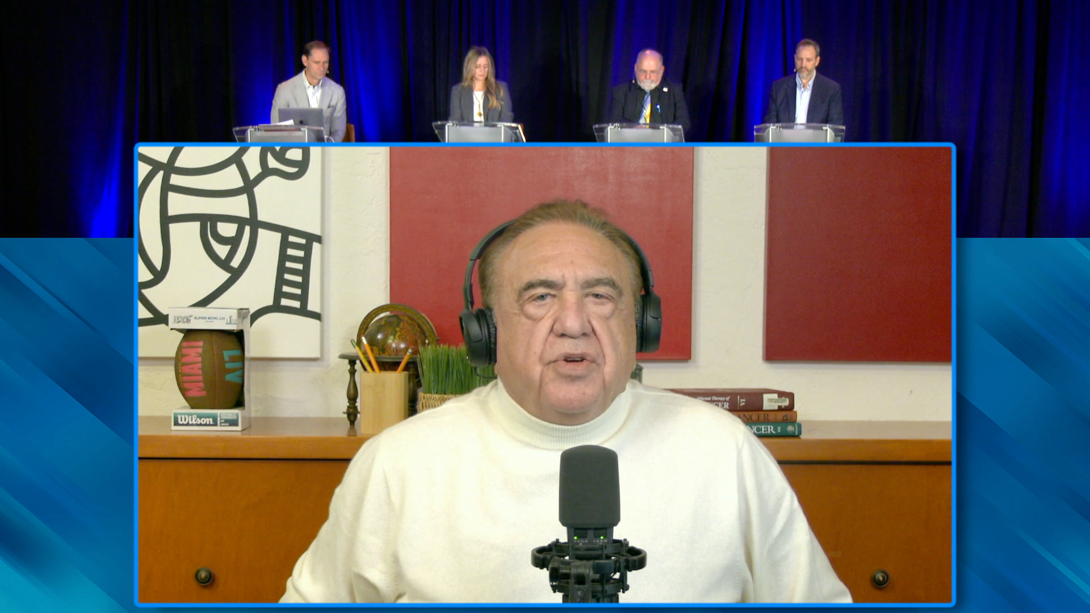
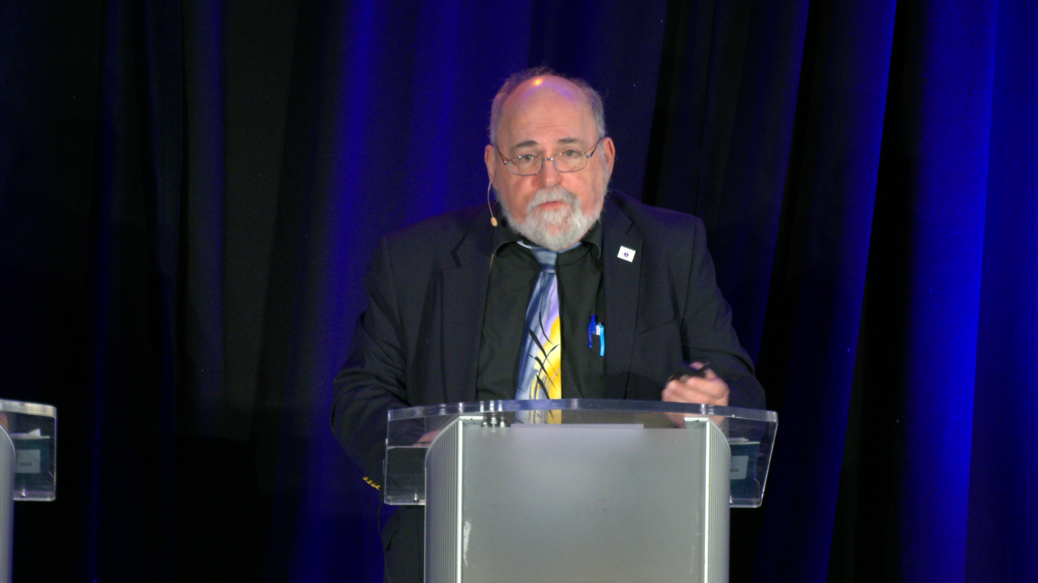

Slide 46
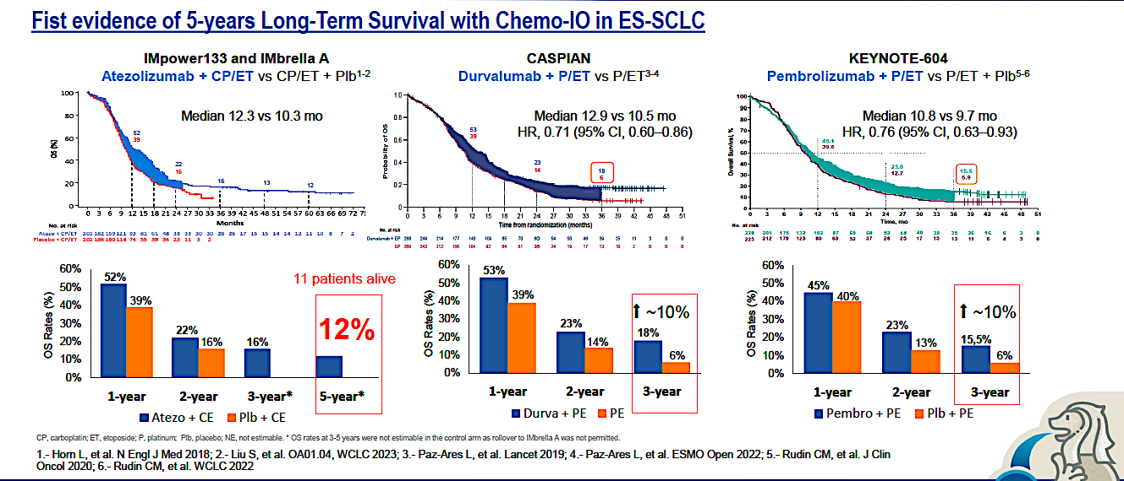
Pivotal Trials of ICIs in ES SCLC – Long term outcome
Courtesy of Corey J Langer, MD

Slide 47
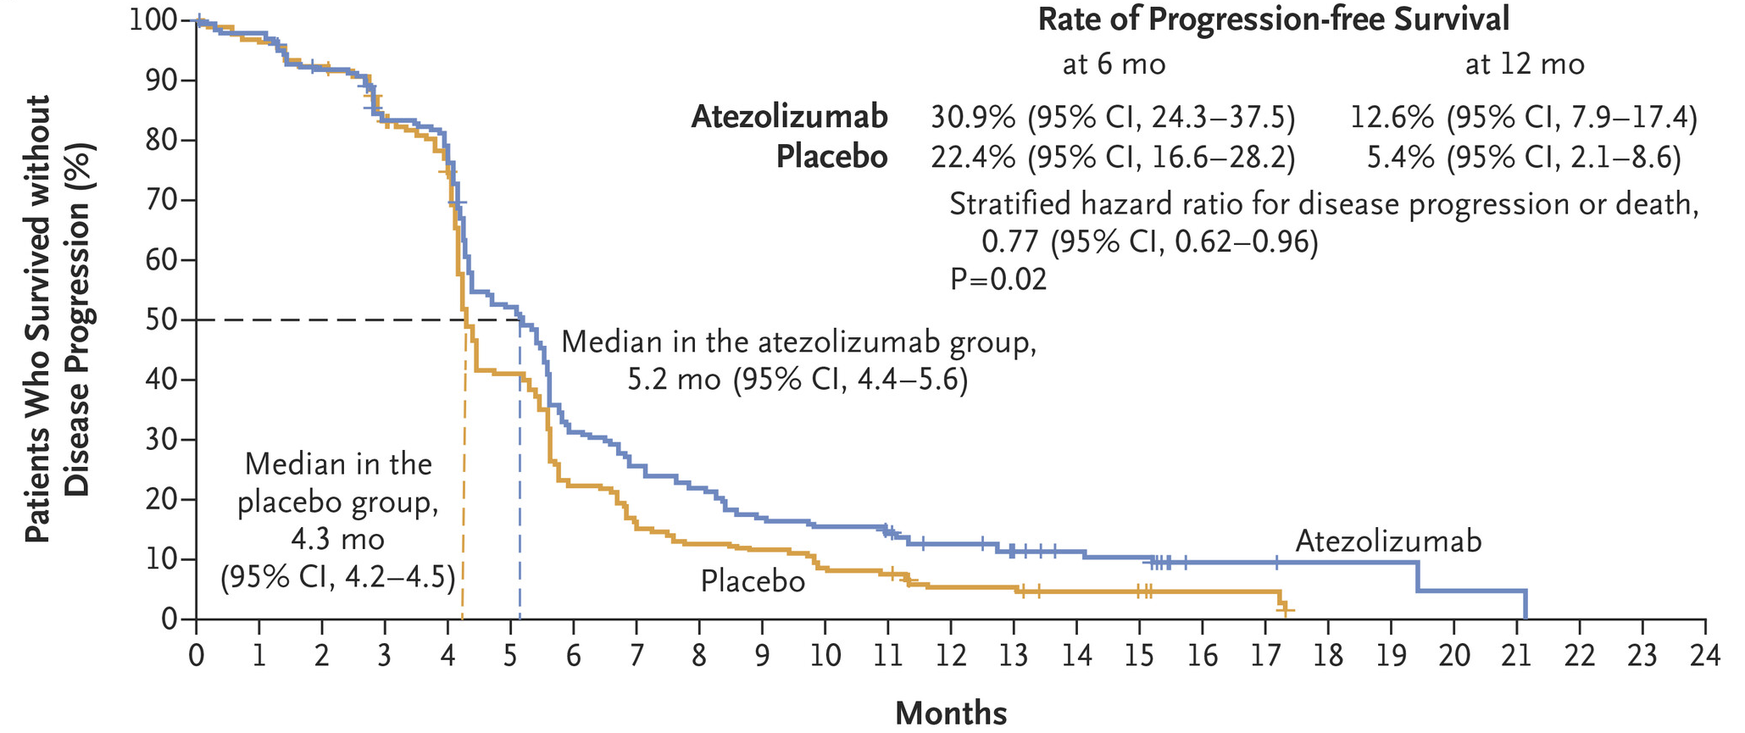
Phase III IMpower133 Trial: Primary Progression-Free Survival with Atezolizumab/Carboplatin/Etoposide (ITT Population)
ITT = intention to treat
Horn L et al. N Engl J Med 2018 December 6;379(23):2220-9.

Slide 48
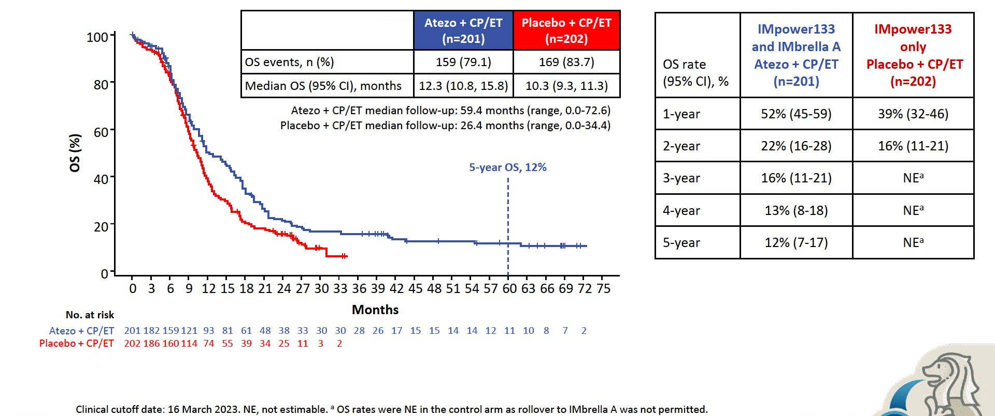
Merged Analysis of IMpower133 and IMbrella A: Long-Term OS
NE = not evaluable
Liu SV et al. WCLC 2023;Abstract OA01.04; Reck M et al. Lung Cancer 2024;196:107924.

Slide 49
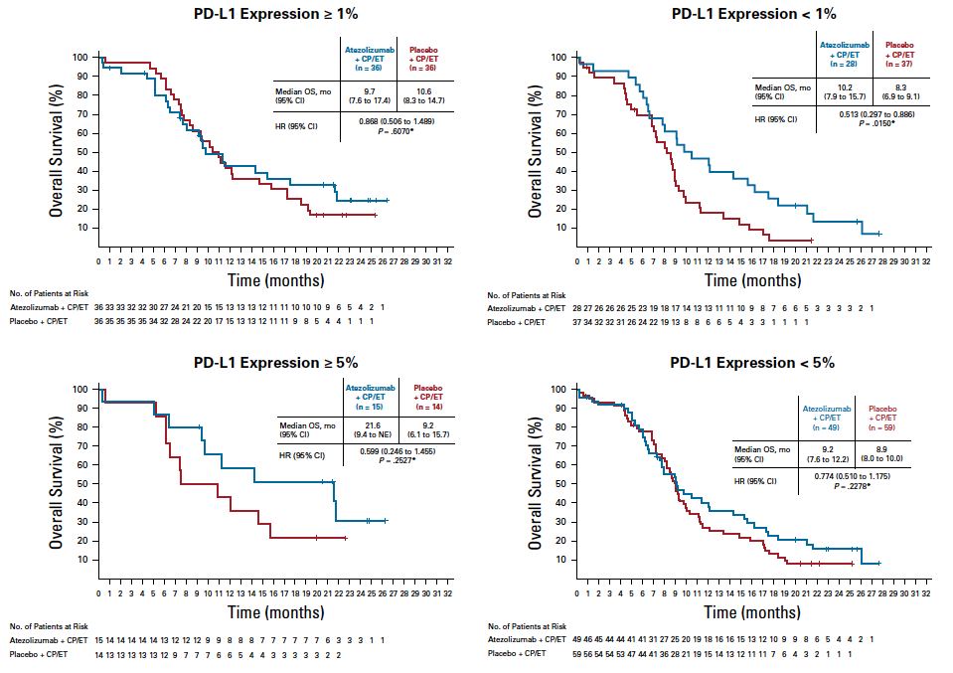
Phase III IMpower133: OS by PD-L1 Expression with Atezolizumab/Carboplatin/Etoposide
Liu SV et al. J Clin Oncol 2021;39:619-30.

Slide 50
T-cell Engagers
Ubamatamab (REGN4018) in Advanced Ovarian Cancer
Ubamatamab is a human bispecific antibody, developed using VelocImmune technology
Ubamatamab is designed to bridge MUC16 on cancer cells with CD3-expressing T cells to facilitate T-cell activation and cytotoxicity⁴
In immune-deficient mice, ubamatamab combined with human immune cells led to dose-dependent antitumor activity against intraperitoneal MUC16- expressing ovarian tumour cells and malignant ascites^{5,6}
Ubamatamab
(MUC16xCD3 bispeciﬁc)
1. National Cancer Institute. Available at: https://seer.cancer.gov/statfacts/html/ovary.html. Accessed January 20, 2022; 2. Siddiqui MK et al. Gynecol Oncol. 2017;146:44–51; 3. Pujade-Lauraine et al. J Clin Oncol. 2014; 13:1302-8; 4. Crawford A et al. Sci Transl Med. 2019;11:1–13; 5. Crawford A et al. Abstract presented at AACR 2018, Chicago, USA; 6. Crawford A et al. Oral presentation at PEGS Boston Summit 2020, Virtual.
Courtesy of Nicoletta Colombo, MD

Slide 51


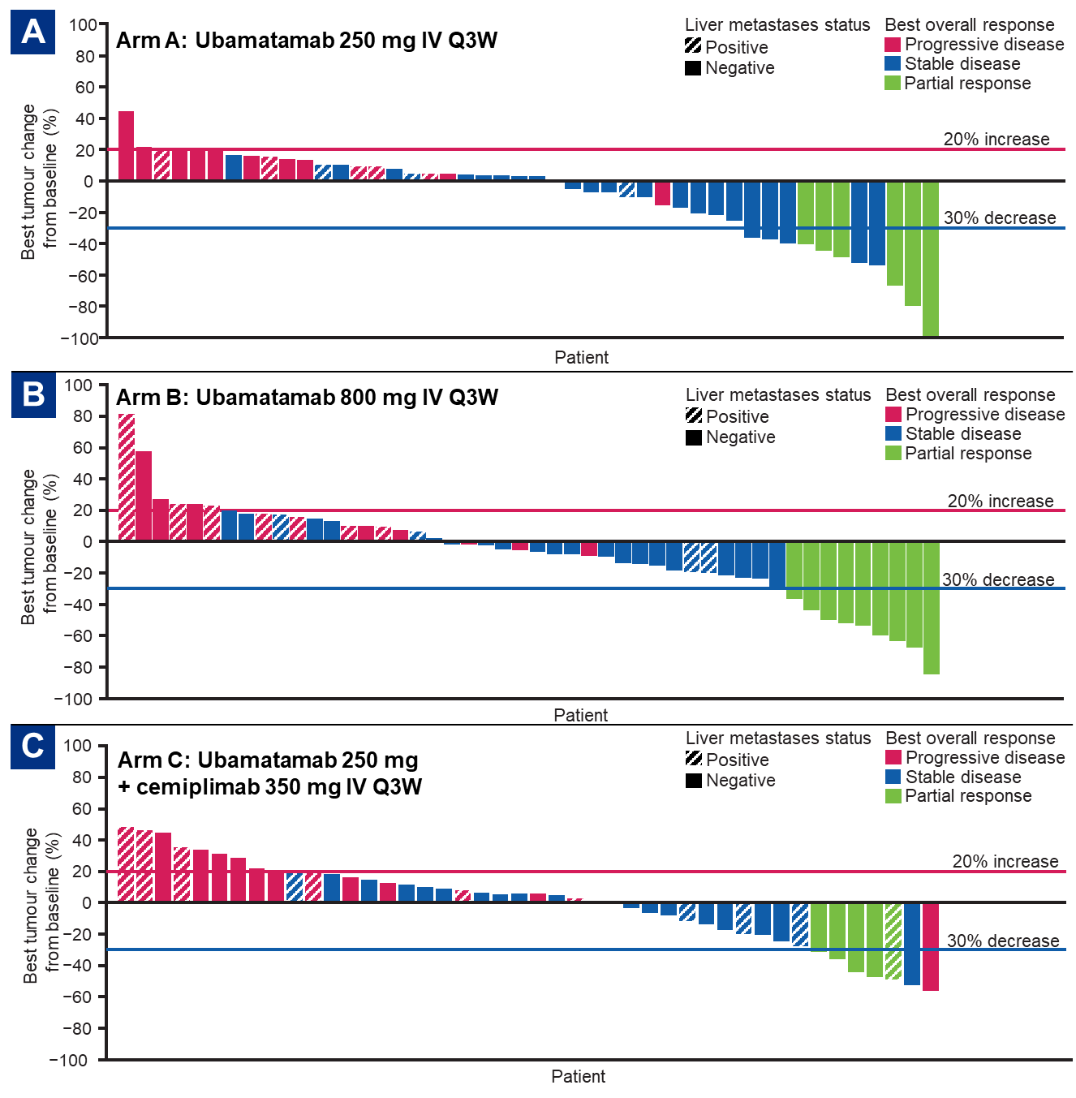
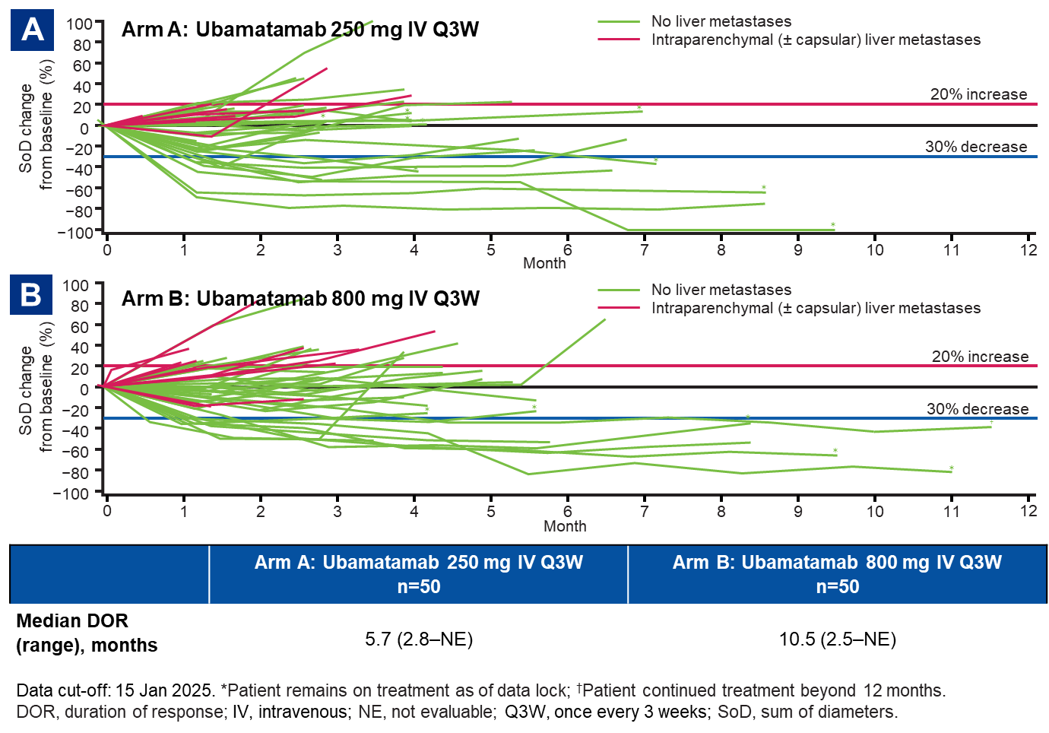
Randomised Phase 2 study of ubamatamab ± cemiplimab in patients (pts) with platinum-resistant ovarian cancer (OC)
Jung-Yun Lee, ESMO 2025
Courtesy of Nicoletta Colombo, MD

Slide 52
Platinum Ineligible Ovarian Cancer
ANTIBODY DRUG CONJUGATED (ADCS)
CELL CYCLE REGULATION AND DNA REPAIR
IMMUNOTHERAPY
GLUCOCORTICOID RECEPTOR
Mirvetuximab-soravtansine ¹
Trastuzumab-deruxtecan ²
Raludotatug- Deruxtecan ³
Rinatabart Sesutecan (Rina-S)⁴
AZD5335 ⁵
Ly4170156 ⁶
NAPISTAR 1-01⁷
ADAVOSERTIB ⁸
azenosertib⁹
CDK2i ¹⁰
Paclitaxel/pembro ¹¹
UBAMATAMAB ¹²
RELACORILANT ¹³
¹ [NCT04296890 – Soraya] [NCT04209855 – Mirasol]; ² [NCT04482309]; ³ [NCT04707248]; ⁴ [NCT06619236]; ⁵ [NCT05797168] ; ⁶ [NCT06400472]; ⁷ [NCT06303505];
⁸ [NCT03579316]; ⁹ [NCT02595892]; ¹⁰ [INCB123667]; ¹¹ [NCT05116189]; ¹² [NCT03564340] ¹³ [NCT05257408 – Rosella]; [NCT03776812 – phase II];
Courtesy of Nicoletta Colombo, MD

Slide 53



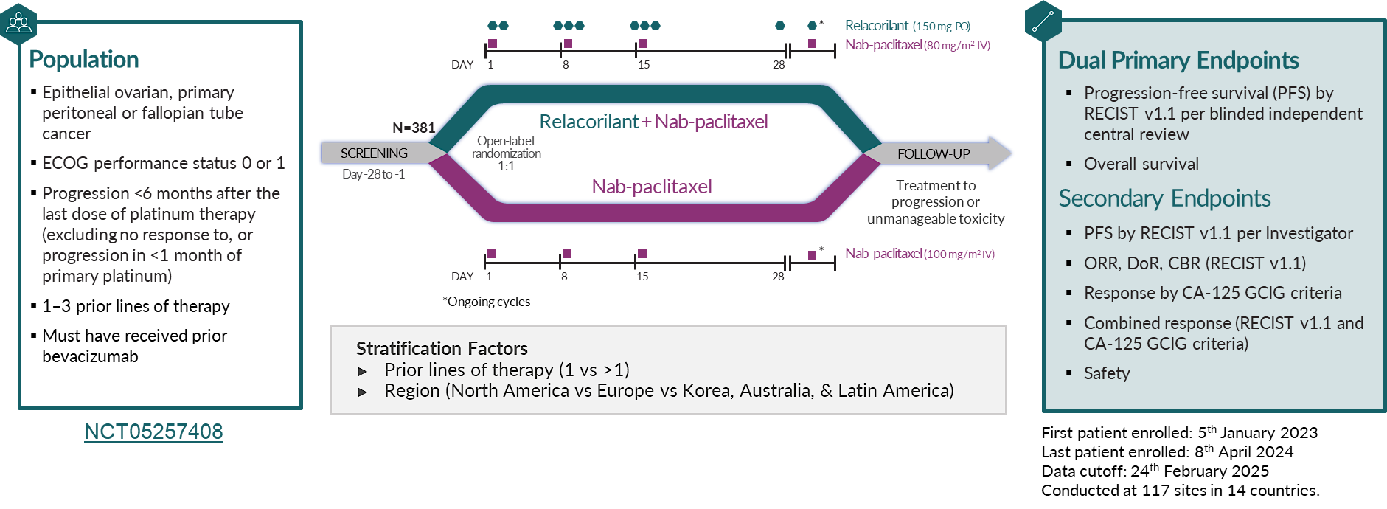






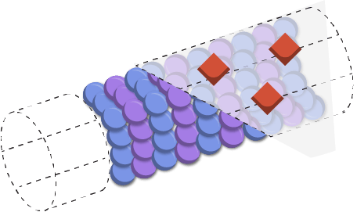



ROSELLA
Relacorilant is a novel, selective GR antagonist (SGRA) that restores the sensitivity of cancers to cytotoxic chemotherapy^{3,5,6}
Relacorilant MOA
Relacorilant Mechanism of Action
Relacorilant
Cortisol
Multiprotein Complex
Glucocorticoid Receptor
Co-regulators
SGK1
DUSP1
GR Response Element
Tumor
Cell
BAX
BAK
Taxane-induced Microtubule Disruption
Apoptotic Cell Death
Pro-apoptotic BCL2 Proteins
Pro-apoptotic Synergy with Taxanes
1. Martorana, et al. Int J Gynecol Cancer. 2025;35(1):100009. 2. Veneris, et al. Gynecol Oncol. 2017;146(1):153-60. 3. Greenstein, et al. Oncotarget. 2021;12(13):1243-55. 4. Melhelm, et al. Clin Cancer Res. 2009;15(9):3196-3204. 5. Stringer-Reasor, et al. Gynecol Oncol. 2015;138(3):656-62. 6. Munster, et al. Clin Cancer Res. 2022;28(15):3214-24. 7. Colombo, et al. J Clin Oncol. 2023;41(30):4779-89.
Courtesy of Nicoletta Colombo, MD

Slide 54
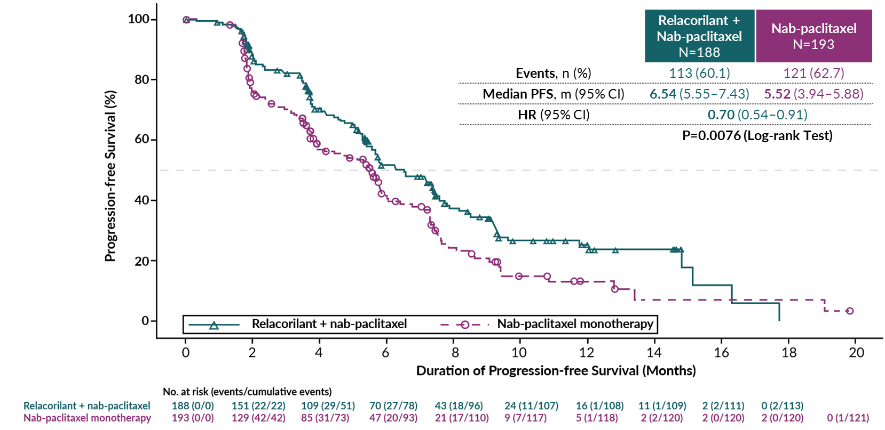
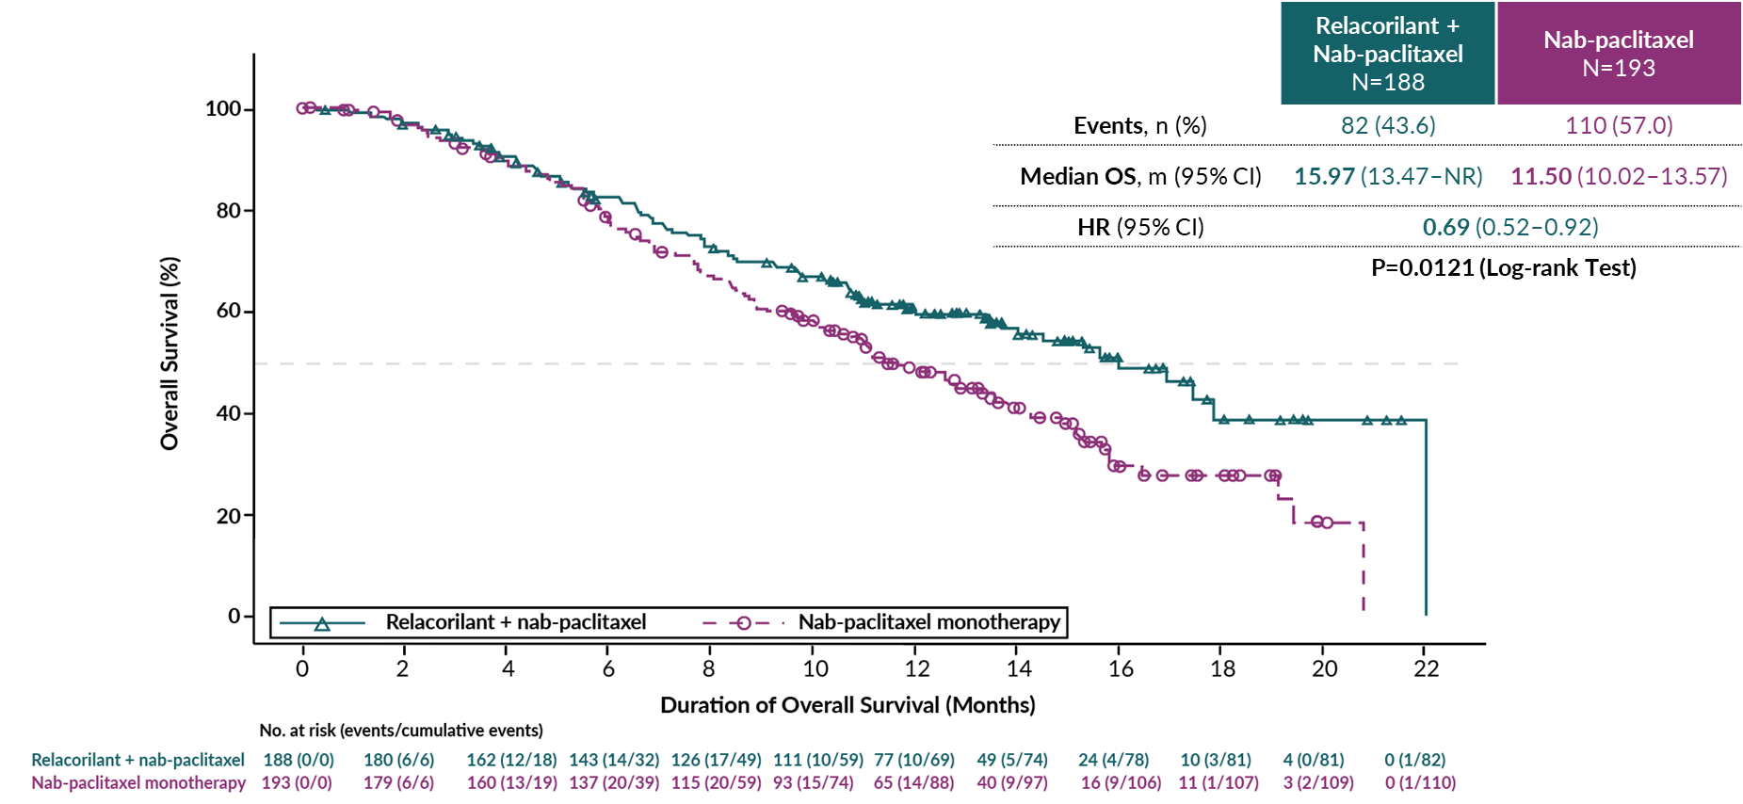
ROSELLA | Relacorilant Significantly Improved Progression-Free Survival Assessed by Blinded Review
ROSELLA | Relacorilant Improved Overall Survival at this Interim Analysis ( not yet significant)
statistical significance threshold at the interim analysis: P≤0.0001
Alexander Olawaiye, ASCO 2025, Lancet 2025
Courtesy of Nicoletta Colombo, MD

Slide 55
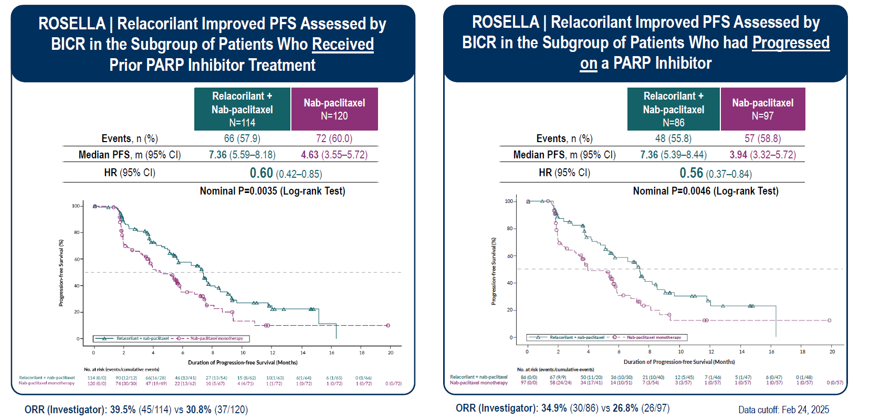
Lorusso, ESMO 2025
Courtesy of Nicoletta Colombo, MD

Slide 56
Overall Survival Primary Endpoint Met in Phase III ROSELLA Trial of Relacorilant for Patients with Platinum-Resistant Ovarian Cancer
Press Release: January 22, 2026
“…[The company] today announced that ROSELLA, the company’s pivotal Phase 3 trial of relacorilant plus nab-paclitaxel to treat patients with platinum-resistant ovarian cancer, met its overall survival (OS) primary endpoint.
Data demonstrate a 35 percent reduction in the risk of death
Both dual primary endpoints (progression-free and overall survival) were met, without the need for biomarker selection and without increased safety burden
Relacorilant’s New Drug Application (NDA) is under review by the U.S. Food and Drug Administration as a treatment for patients with platinum-resistant ovarian cancer with a Prescription Drug User Fee Act (PDUFA) target action date of July 11, 2026.
Complete results from ROSELLA will be presented at an upcoming medical conference.”
https://ir.corcept.com/news-releases/news-release-details/overall-survival-primary-endpoint-met-corcepts-pivotal-phase-3

Slide 57
Year in Review:
Ovarian Cancer
MODULE 1: Promising Novel Agents and Strategies Under Investigation in Ovarian Cancer
  Antibody-drug conjugates
  KEYNOTE-B96 Phase III trial: Pembrolizumab and paclitaxel +/- bevacizumab
  ROSELLA Phase III trial: Relacorilant with nab paclitaxel
MODULE 2: Current Management of Newly Diagnosed and Relapsed/Refractory Ovarian Cancer
  First-line treatment approaches
  Chemotherapy/bevacizumab for platinum-resistant ovarian cancer
  Mirvetuximab soravtansine
  Trastuzumab deruxtecan

Slide 58


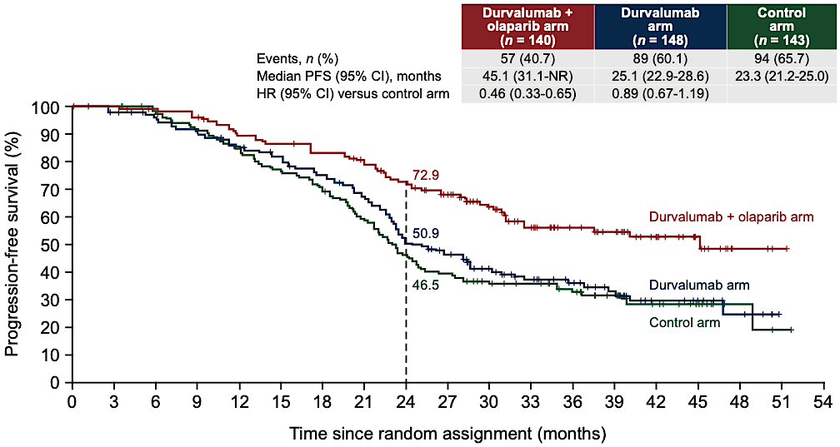
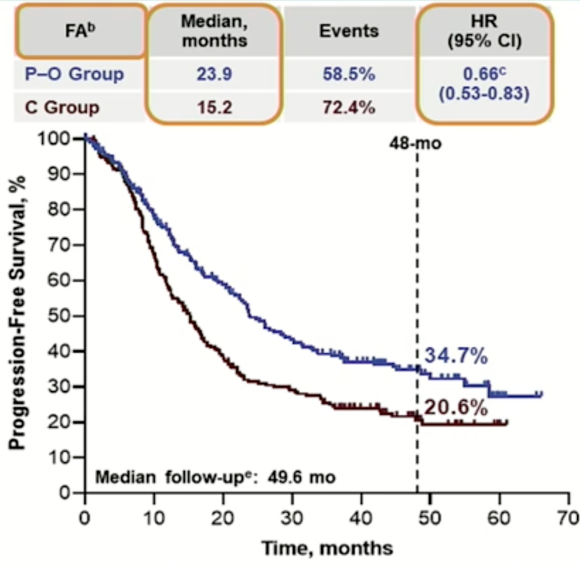
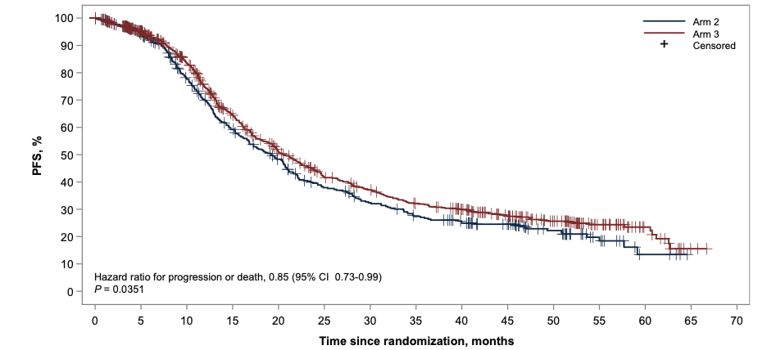
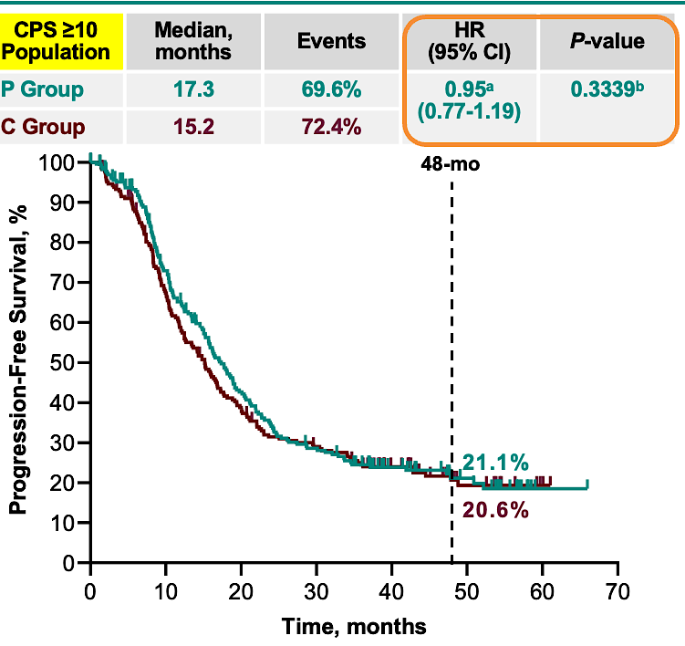

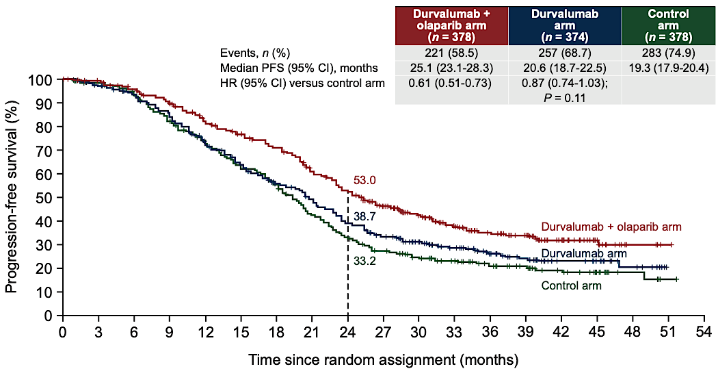
Progression-Free Survival: PARPi and Immunotherapy
DUO-O
KEYLYNK 001
FIRST
PCB + Niraparib
Dostarlimab + Niraparib
Harter P Ann Oncol 2025; Vergote I ESGO 2025; Hardy-Bessard AC Ann Oncol 2025
Courtesy of Angeles Alvarez Secord, MD, MHSc

Slide 59

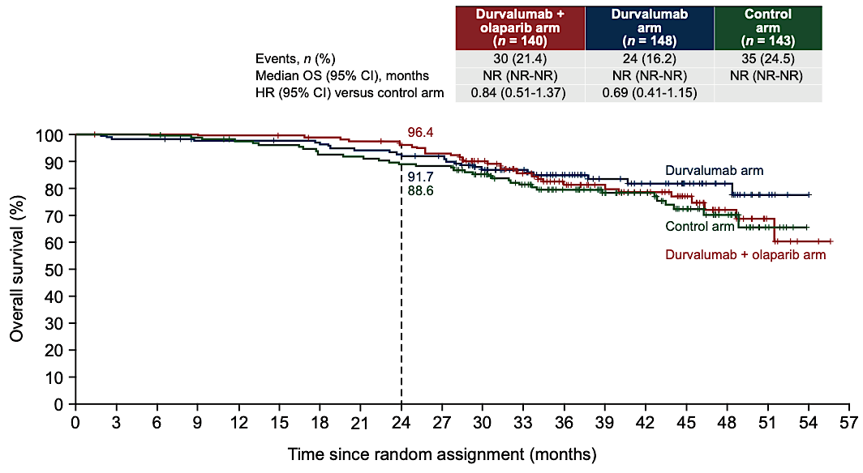
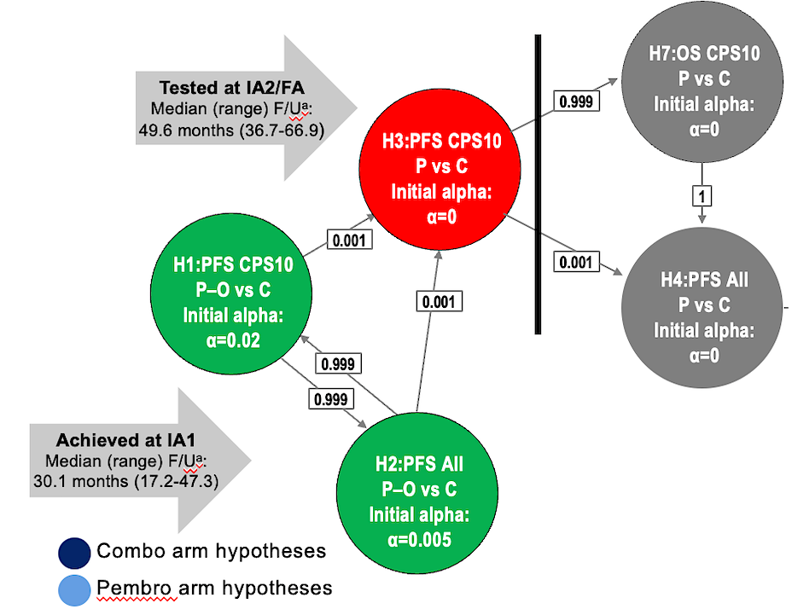
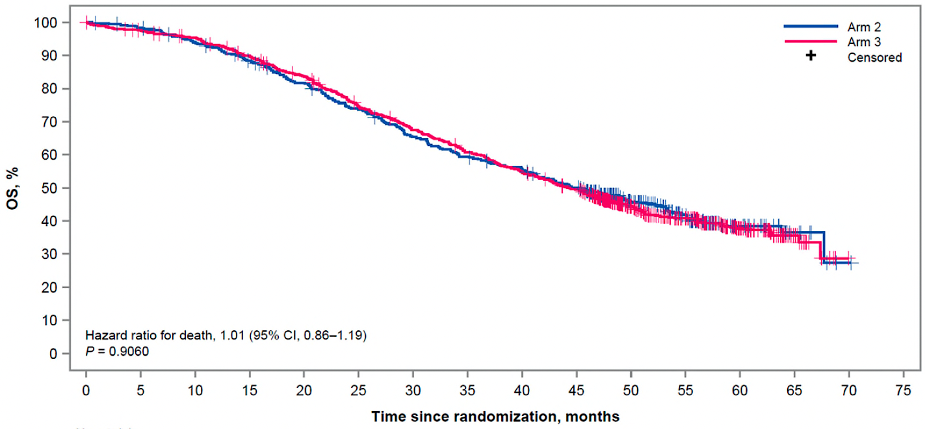

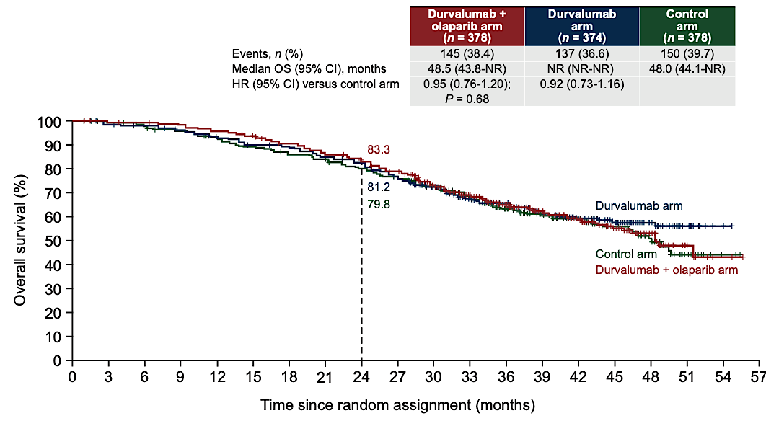
Overall Survival: PARPi and Immunotherapy
DUO-O
KEYLYNK 001
FIRST
PCB + Niraparib
Dostarlimab + Niraparib
Harter P Ann Oncol 2025; Vergote I ESGO 2025; Hardy-Bessard AC Ann Oncol 2025
Courtesy of Angeles Alvarez Secord, MD, MHSc

Slide 60
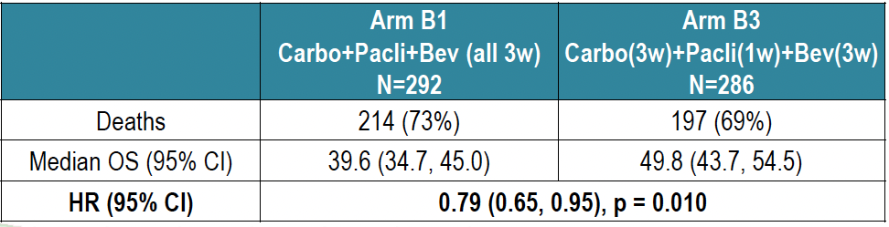
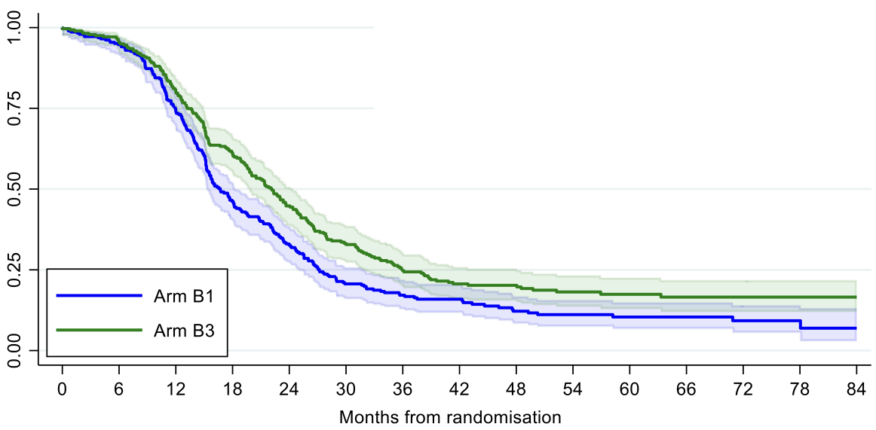
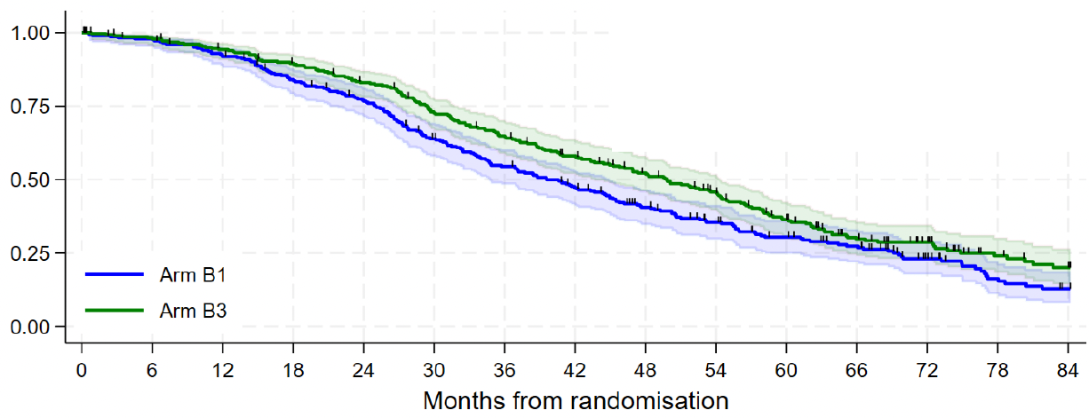
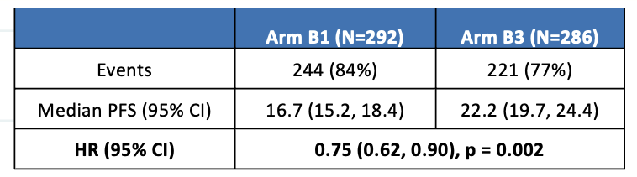
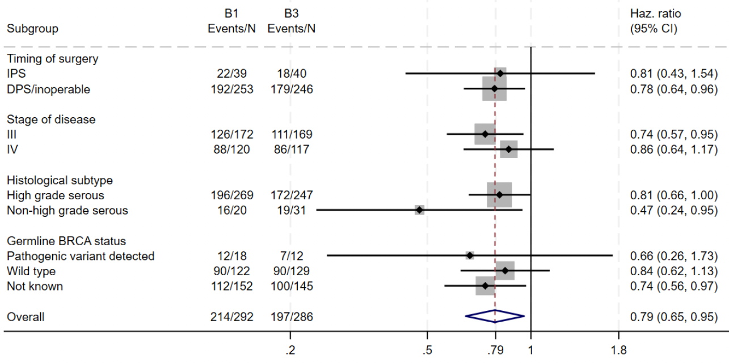
ICON8B: Revisiting Weekly Paclitaxel in Epithelial Ovarian Cancer
Survival outcomes
Progression-free Survival
Overall Survival
+10.2 months
Median FU 72 months
Overall Survival
Subgroup Analysis
Clamp A ESMO 2025
Courtesy of Angeles Alvarez Secord, MD, MHSc

Slide 61
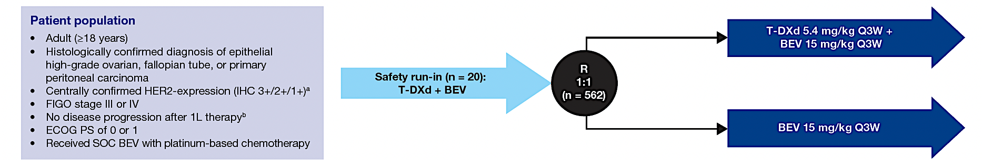
DESTINY-Ovarian01 (DO-01) Phase 3 Study of trastuzumab deruxtecan (T-DXd) with bevacizumab vs bevacizumab monotherapy 1L maintenance in HER2-expressing ovarian cancer
Primary Endpoint: PFS by BICR in HER2 IHC 3+/2+ population
Key Secondary: OS HER2 3+/2+ population
Secondary:
PFS by BICR HER2 3+/2+/1+
OS HER2 3+/2+/1+
PFS and PFS2 HER2 3+/2+ and 3+/2+/1+
ORR and DOR by BICR HER2 3+/2+ and 3+/2+/1+
TFST/TSST HER2 3+/2+ and 3+/2+/1+
Safety & PROs
Exploratory:
CBR by BICR HER2 3+/2+ and 3+/2+/1+
PFS by CA125 HER2 3+/2+ and 3+/2+/1+
HRQoL
Primary Objective: Safety
Minimum 30% with HER2 IHC 3+
Maximum 15% with HER2 IHC 1+
Stratification Factors:
HER2 expression (3+ vs 2+ vs 1+)
Surgical outcome (No residual vs residual vs no surgery)
Histology (HGSC vs nonserous)
T-DXd for a maximum of 34 cycles and BEV for up to 16 cycles (maximum 22 cycles including concurrent with 1L chemotherapy or until PD, unacceptable toxicity, withdrawal consent or study termination.
González-Martín A ESMO GYN 2025
Courtesy of Angeles Alvarez Secord, MD, MHSc

Slide 62
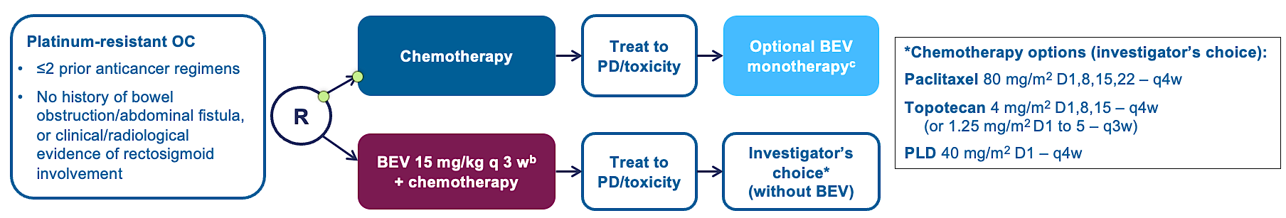
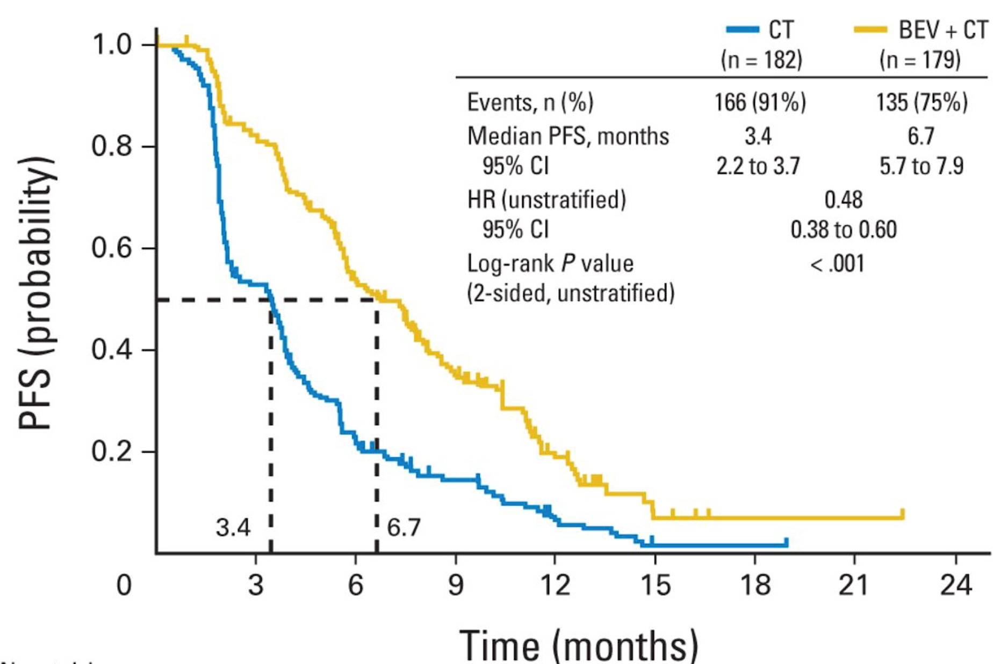


AURELIA Open-Label Phase III Trial
Pujade-Lauraine E JCO 2014
Courtesy of Angeles Alvarez Secord, MD, MHSc

Slide 63




AURELIA Open-Label Phase III Trial
Paracentesis
53.3% vs 30.2%
13.7% vs 7.8%
17% vs 0%
Pujade-Lauraine E JCO 2014; Poveda AM JCO 2015
Courtesy of Angeles Alvarez Secord, MD, MHSc

Slide 64

MIRASOL (GOG 3045/ENGOT-ov55) Phase 3 study MIRV vs Investigator’s Choice Chemotherapy in FRα-Positive, Platinum-Resistant Ovarian Cancer (PROC) : Final Overall Survival Analysis
Patient Population
•Primary Endpoint: PFS by INV (BICR sensitivity analysis)
•Key Secondary:
ORR by INV
OS
PRO (EORTC QLQ-OV28 abdominal/GI subscale)
•Secondary: Safety and tolerability, DOR, CA-125 response, and PFS2
Key Eligibility
•Platinum-resistant disease (PFI ≤6 mo)
•FRα+ by IHC (≥75% tumor cells with ≥2+ membrane staining)
•High-grade serous
•1-3 prior lines of therapy
•Prior BEV and PARPi allowed
•1⁰ platinum-refractory disease excluded (primary PFI <3 mo)
MIRV
(6 mg/kg adjusted ideal body weight Q3W)
IC Chemotherapy
Paclitaxel, PLD, or topotecan
Treatment until progression or unacceptable toxicity
Stratification Factors”
IC chemotherapy: paclitaxel, PLD, or topotecan
Prior lines of therapy: 1 vs 2 vs 3
*Final OS analysis after 300 deaths, if statistical significance at the IA is not reached per the prespecified efficacy stopping boundary
VanGorp T SGO Meeting 2025
Courtesy of Angeles Alvarez Secord, MD, MHSc

Slide 65




MIRASOL Phase III Trial: Platinum Resistant Ovarian Cancer
No new safety signals
Most common > G3 in MIRV versus ICC, respectively, were blurred vision (8% vs 0%), keratopathy (10% vs 0%), abdominal pain (3% vs 1%), fatigue (2%
vs 5%) and diarrhea (1% vs 1%). Ocular AEs completely or partially resolved in 93% of patients.
VanGorp T SGO Meeting 2025
Courtesy of Angeles Alvarez Secord, MD, MHSc

Slide 66
PICCOLO Phase II Trial: 3L+ Platinum Sensitive Ovarian Cancer
Novel therapies in PSOC are urgently needed:
In a Medidata® pooled clinical trials analysis of patients with 3L+ PSOC, of whom 96.9% had PD on PARPi
ORR was 16.9%
median PFS was 6.11 months
median OS was 19.35 months
Patient Population (N=79)
Key eligibility
Platinum-sensitive disease (defined as radiographic progression >6 mo from last dose of most recent platinum therapy)
FRα positivity by IHC (≥75% tumor cells with ≥2+ membrane staining)
At least 2 prior platinum-containing regimens
Prior PARPi required if BRCA+
Appropriate for single-agent therapy
Treatment until PD, unacceptable toxicity, withdrawal of consent, or death, whichever comes first
MIRV
(6 mg/kg adjusted ideal body weight Q3W)
Prior BEV not required
•Primary Endpoint: ORR by INV
•Key Secondary: DOR by INV
•Secondary: PFS, OS, Safety
Alvarez Secord A Ann Oncol 2025; Coleman RL ASCO 2025
Courtesy of Angeles Alvarez Secord, MD, MHSc

Slide 67







PICCOLO Phase II Trial: 3L+ Platinum Sensitive Ovarian Cancer
Confirmed inv-assessed ORR:
51.9% (95% CI 40.4%- 63.3%)
6 CRs (7.6%)
35 PRs (44.3%)
SD 36.7%
mDOR = 8.25 months (95% CI 5.55-10.78 months)
mPFS was 6.93 months (95% CI 5.85-9.59 months)
Alvarez Secord A Ann Oncol 2025
Courtesy of Angeles Alvarez Secord, MD, MHSc

Slide 68

PICCOLO Phase II Trial: 3L+ Platinum Sensitive Ovarian Cancer: Final Analysis
Efficacy summary in overall population and by prior PARPi treatment
Outcome | Overall population (N=79) | PARPi naïve (n=12) | Prior PARPi treatment (n=64) | PD with PARPi (n=59)
ORR, n (%)ª | 41 (51.9) | 9 (75.0) | 30 (46.9) | 27 (45.8)
(95% CI) | (40.4–63.3) | (42.8–94.5) | (34.3–59.8) | (32.7–59.2)
Median DOR, mo^{a,b} | 8.25 | 8.77 | 8.25 | 7.33
(95% CI) | (5.55–10.78) | (3.52–15.18) | (5.45–10.78) | (5.03–10.78)
Median PFS, moª | 6.93 | 10.02 | 6.87 | 6.18
(95% CI) | (5.85–9.59) | (6.87–15.31) | (5.55–8.90) | (5.55–8.41)
Median OS, mo | 27.17 | 27.89 | 27.17 | 27.04
(95% CI) | (23.79–NR) | (15.31–NR) | (23.79–NR) | (22.14–NR)
Median OS
27.17 Months (95% CI, 23.79-NR)
77% received subsequent therapy:
47% platinum, 32% gemcitabine, 30% anthracyclines; 28% other chemotherapy; 25% bev; 23% taxanes
Alvarez Secord A Ann Oncol 2025; Alvarez Secord A ESMO-Gyn 2025;
Courtesy of Angeles Alvarez Secord, MD, MHSc

Slide 69
FORWARD II: Mirvetuximab and Pembrolizumab in Platinum Resistant Ovarian Cancer
Patient Population (N=56)
•Primary Endpoint: ORR
•Secondary: DOR, PFS, Safety
Key eligibility
Recurrent EOC/FT/PP Cancer
Platinum-resistant disease (defined as radiographic progression within 6 mo from last dose of most recent platinum therapy)
Tumor FRα expression thresholds were ≥25 % (dose escalation cohort) and ≥50 % (dose expansion cohort) of cells with ≥2+ membrane staining intensity.
Treatment until PD, unacceptable toxicity, withdrawal of consent, or death, whichever comes first. If MIRV was discontinued, participants could continue on pembrolizumab monotherapy for up to 2 years.
MIRV
(6 mg/kg adjusted ideal body weight) + Pembrolizumab 200 mg Q3W
Participants grouped by FRα expression
low, n = 14
medium, n = 14
high, n = 26
20% had 3 priors, 43 % had ≥4 priors
43 % had prior Bev
41 % had prior PARPi
Matulonis U Gynecol Oncol 2025
Courtesy of Angeles Alvarez Secord, MD, MHSc

Slide 70



FORWARD II: Mirvetuximab and Pembrolizumab in PROC
N= 55 evaluable ORR was 31 % (95% CI, 19–45)
Median DOR = 8.0 months (95% CI, 4.2-NR)
Median PFS = 4.2 months (95% CI, 2.8–5.6)
**Treatment-emergent pneumonitis 25 %, G ≥3 in 2 (4 %) participants.
Matulonis U Gynecol Oncol 2025
Courtesy of Angeles Alvarez Secord, MD, MHSc

Slide 71




DESTINY-PanTumor02: Phase 2 study of Trastuzumab deruxtecan (T-DXd), HER2-targeted ADC, in advanced HER2 expressing tumors. Part 1 Final Analysis
DESTINY-PanTumor02: Phase 2 study of Trastuzumab deruxtecan (T-DXd), HER2-targeted ADC, in advanced HER2 expressing tumors. Part 1 Final Analysis
NCT04482309
Inv-assessed ORRs by central HER2 IHC Status
**
Median PFS*
Months
Median OS*
Months
(95% CI) [n]; ** Based on ASCO/CAP guidelines for HER2 scoring for gastric cancer; ‡ HER2 for enrollment based on local assessment.
Makker V. ESMO 2025
Courtesy of Angeles Alvarez Secord, MD, MHSc

Slide 72

DESTINY-PanTumor02: Phase 2 study of Trastuzumab deruxtecan (T-DXd), HER2-targeted ADC, in advanced HER2 expressing tumors. Part 1 Final Analysis
Safety Summary
Drug-related Grade ≥3 AEs occurred in 111 (41.6%) patients
The most common were neutropenia (11.2%), anemia (10.9%), decreased ANC (8.6%), and fatigue (6.0%)
Adjudicated drug-related ILD/pneumonitis 11.6% (n=31)
- Most G1 (n=8, 3.0%) or G2 (n=19, 7.1%)
Three (1.1%) G5 events reported
Makker V. ESMO 2025
Courtesy of Angeles Alvarez Secord, MD, MHSc

Slide 73
Emerging ADC Therapies: Clinical Characteristics and Efficacy Summary
 | T-DXd HER2 | R-DXd CDH6 | Rina-S FRa | AZD5335 FRa | HS-20089 B7-HR | TUB-040 NaPi2b
Population | EOC | HGSC/HGEC | EOC | EOC | EOC | HGSC
Prior Regimen (1L/2L/3L) | Median 3 (1-12) | 9%/39%/51% | Median 3 (1-5) | Median 3 (1-9) | Median 3 (1-9) | Median 4 (1-7)
PFI < 3 mo | -- | 44% | -- | -- | 46% | --
Prior PARPi | -- | 70% | 64% | 63% | 73% | --
Prior Bev | -- | 83% | 90% | 69% | 73% | 84%
Prior Mirv | -- | 3% | 19% | 4%* | -- | 13%
ORR (%) | 64% 3+/37% 2+ | 44-57% | 23-56% | 54% | 48% | 55%
Median DoR (mo) | 11.3 | -- | NR | -- | 6.8 | --
Median PFS (mo) | 12.5 3+/5.9 all | -- | -- | -- | 6.4 | --
Median OS (mo) | 13.2 | -- | -- | -- | 14.6 | --
Meric-Bernstam F JCO 2023; Ray-Coquard I ESMO 2025; Lee EK SGO 2025; Oaknin A ESMO 2025; Yuan G ESMO 2025; Gonzalez Martin A ESMO 2025
Courtesy of Angeles Alvarez Secord, MD, MHSc

Slide 74


Efficacy and safety of avutometinib +/- defactinib in recurrent LGSOC: ENGOT-OV60/GOG-3052/RAMP 201
Banerjee SN J Clin Oncol 2025
Courtesy of Angeles Alvarez Secord, MD, MHSc

Slide 75





Efficacy and safety of avutometinib +/- defactinib in recurrent LGSOC: ENGOT-OV60/GOG-3052/RAMP 201
ORR by BICR
Total N=109 | KRAS mt N=57 | KRAS wt N=52
31% | 44% | 17%
Banerjee SN J Clin Oncol 2025
Courtesy of Angeles Alvarez Secord, MD, MHSc

Slide 76

Efficacy and safety of avutometinib +/- defactinib in recurrent LGSOC: ENGOT-OV60/GOG-3052/RAMP 201
May 8, 2025
For patients with KRAS-mutated recurrent low-grade serous ovarian cancer who have received prior systemic therapy.
https://www.fda.gov/drugs/resources-information-approved-drugs/fda-grants-accelerated-approval-combination-avutometinib-and-defactinib-kras-mutated-recurrent-low
Courtesy of Angeles Alvarez Secord, MD, MHSc

