Slide 1

Year in Review: Promising Novel Agents and Strategies Under Investigation in OC
Nicoletta Colombo, MD
European Institute of Oncology, Milan

Slide 2
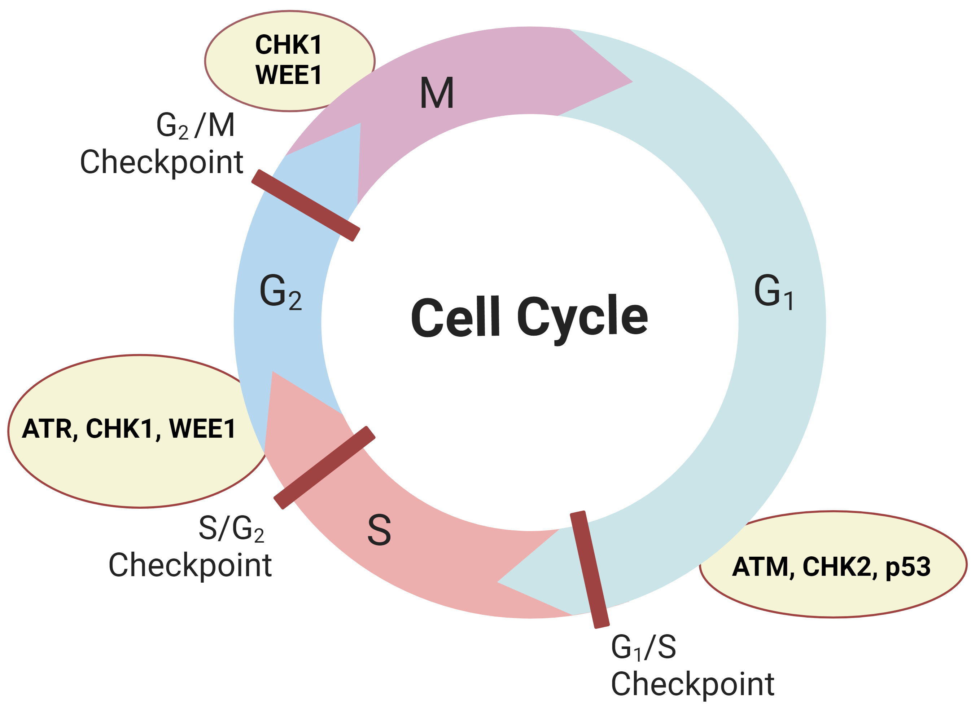
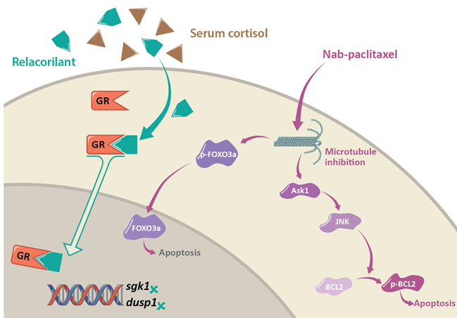
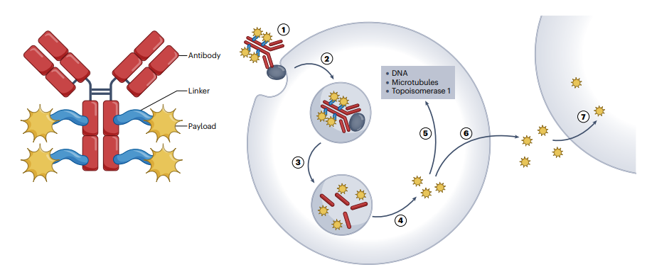
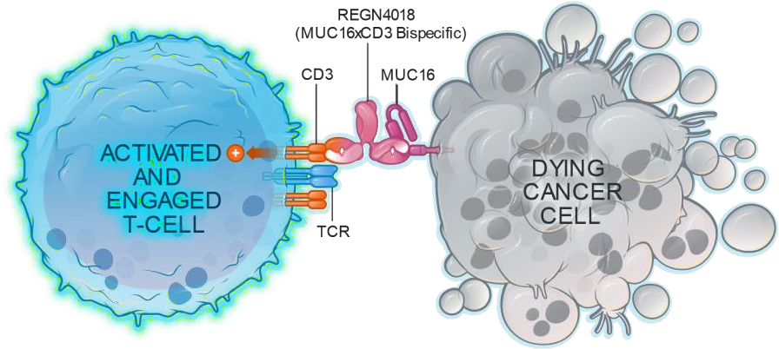
Platinum Ineligible Ovarian Cancer
ANTIBODY DRUG CONJUGATED (ADCS)
CELL CYCLE REGULATION AND DNA REPAIR
IMMUNOTHERAPY
GLUCOCORTICOID RECEPTOR
Mirvetuximab-soravtansine ¹
Trastuzumab-deruxtecan ²
Raludotatug- Deruxtecan ³
Rinatabart Sesutecan (Rina-S)⁴
AZD5335 ⁵
Ly4170156 ⁶
NAPISTAR 1-01 ⁷
ADAVOSERTIB ⁸
azenosertib⁹
CDK2i ¹⁰
Paclitaxel/pembro ¹¹
UBAMATAMAB ¹²
RELACORILANT ¹³
¹ [NCT04296890 – Soraya] [NCT04209855 – Mirasol]; ² [NCT04482309]; ³ [NCT04707248]; ⁴ [NCT06619236]; ⁵ [NCT05797168] ; ⁶ [NCT06400472]; ⁷ [NCT06303505];
⁸ [NCT03579316]; ⁹ [NCT02595892]; ¹⁰ [INCB123667]; ¹¹ [NCT05116189]; ¹² [NCT03564340] ¹³ [NCT05257408 – Rosella]; [NCT03776812 – phase II];

Slide 3
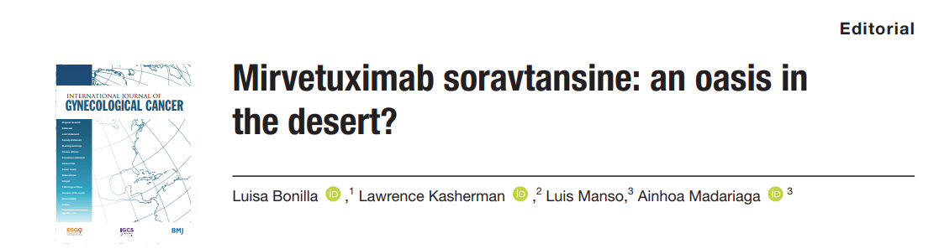

Antibody Drug Conjugates in ovarian cancer
Future?
CLDN6
TF
NaPi2b
Mesothelin
HER2
MUC16
TROP2
B7-H4
CLDN6
CDH6
FRα
With permission of Ainhoa Madariaga

Slide 4
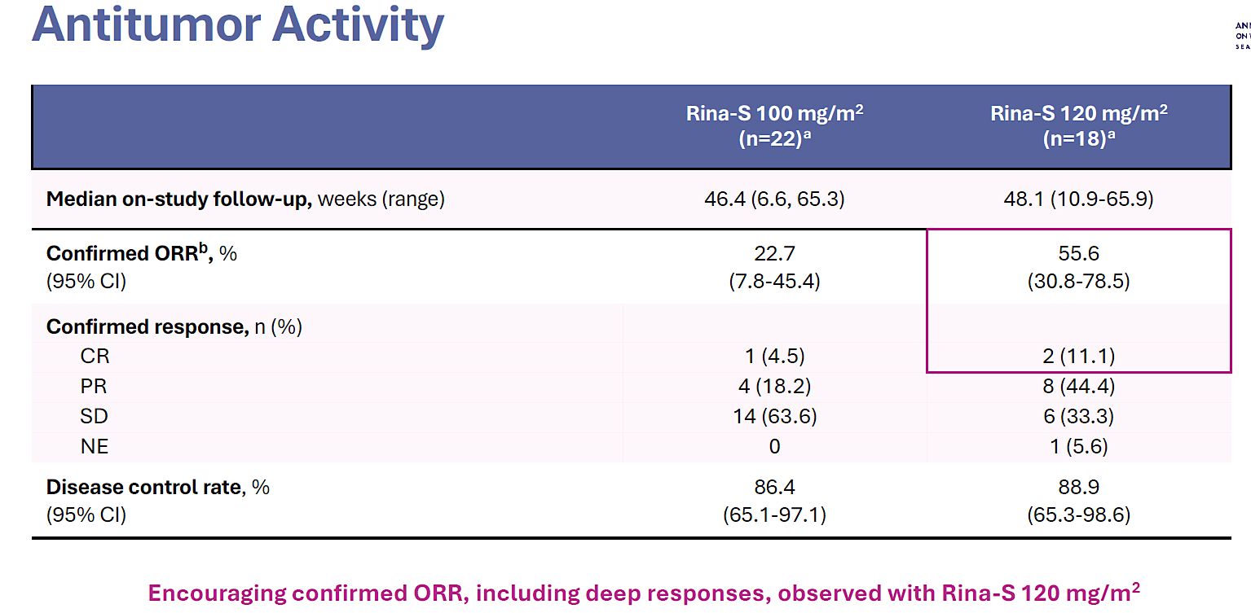

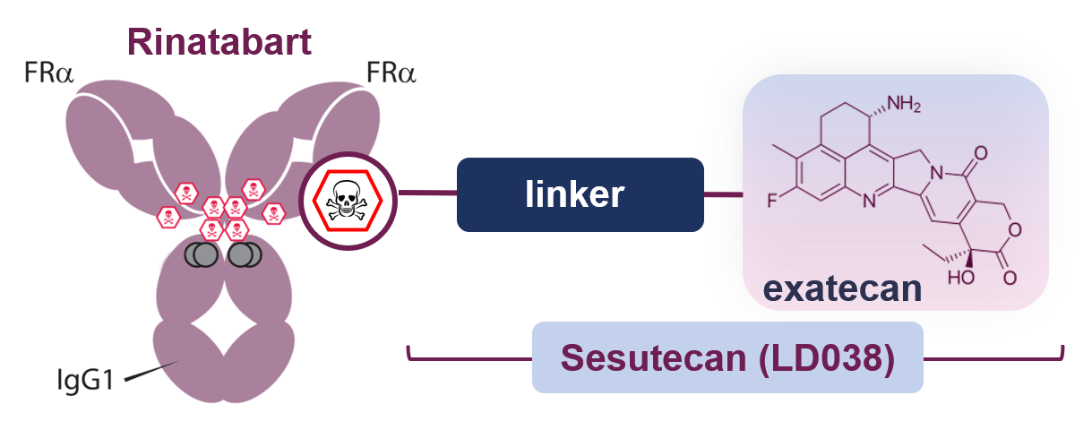
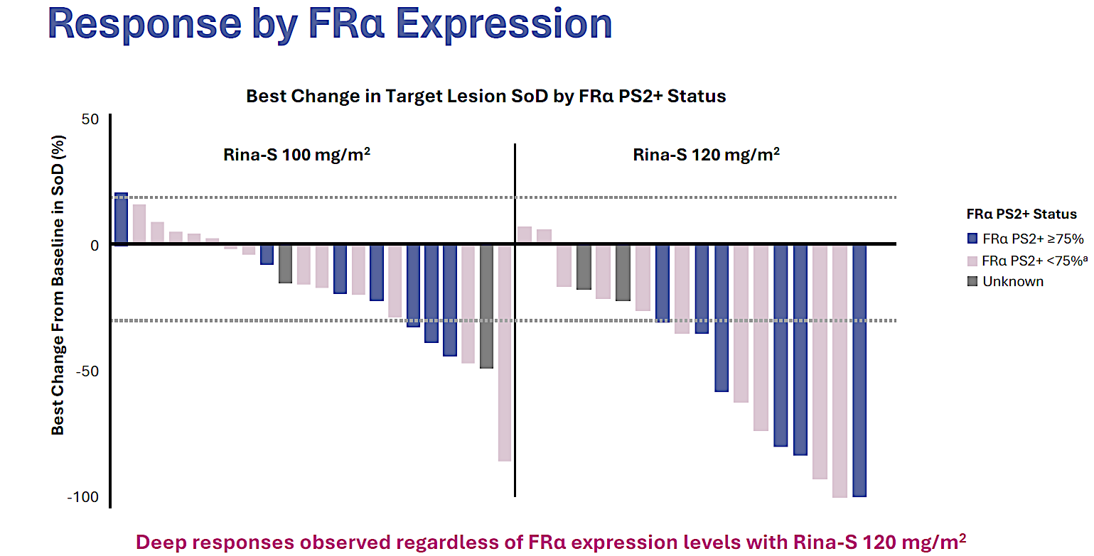
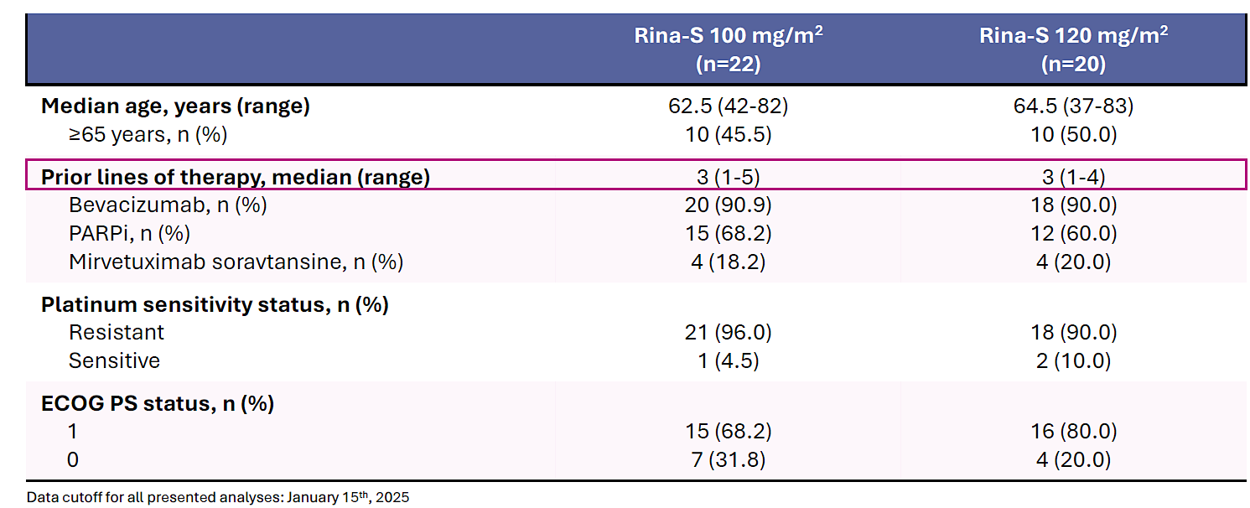
Targeting FRα: RAINFOL-01
Phase 1/2 Study (NCT05579366)
Rinatabart sesutecan (Rina-S)
Novel FRα-directed ADC
Highly hydrophilic linker, sesutecan
Topoisomerase 1 inhibitor payload
Phase I/II: Part B – Dose expansion
R (1:1): Rina-S 100 or Rina-S 120 mg/m2, q 3w

Slide 5
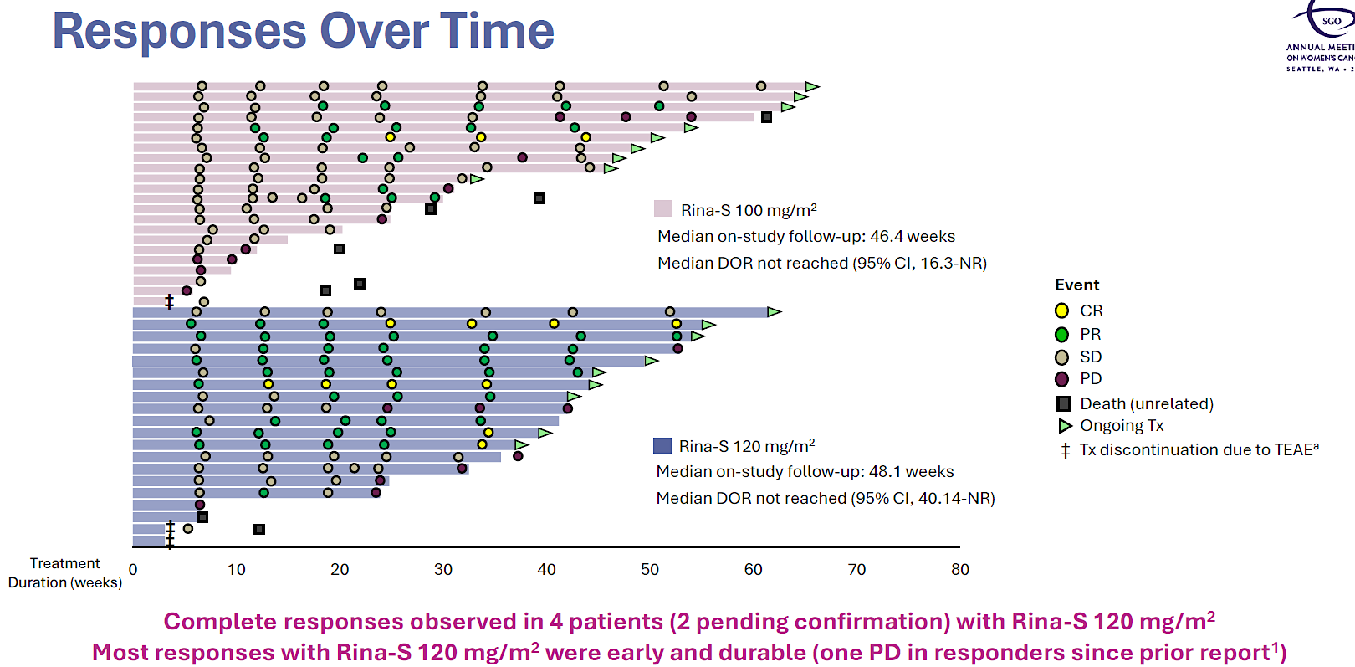
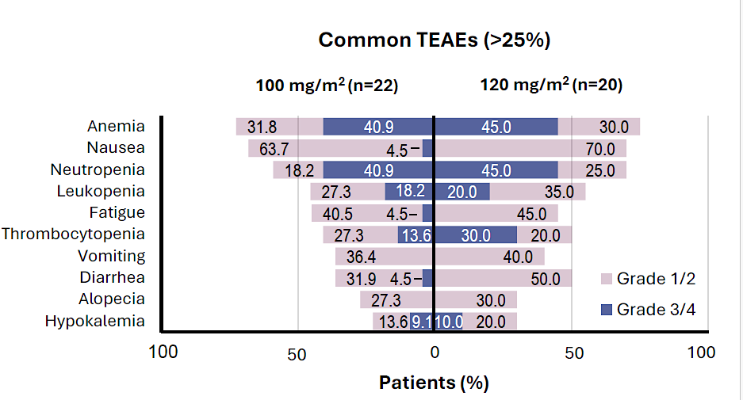
Targeting FRα: RAINFOL-01
Phase 1/2 Study (NCT05579366)
Rina-S was well tolerated with TEAEs of primarily cytopenias and low-grade GI events
No signals of ocular toxicity, neuropathy, or ILD were observed

Slide 6
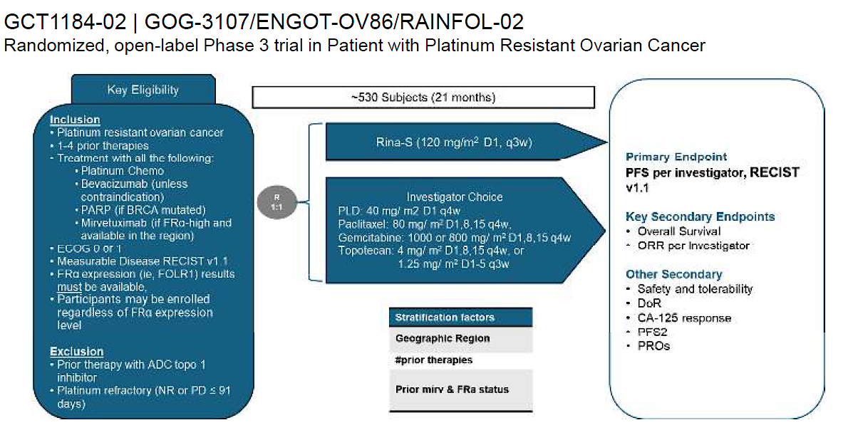
Randomized, open-label Phase 3 trial in Patients with Platinum Resistant Ovarian Cancer
https://clinicaltrials.gov/study/NCT06619236
Angeles Alvarez Secord presented at ASCO 2025

Slide 7
AZD5335: An FRα-targeting TOP1i ADC
Schematic of AZD5335
FRα is a cell surface protein that binds and internalises folate, a cofactor required for DNA synthesis, cell growth, and proliferation.^{1–3}
FRα is highly expressed in multiple epithelial tumours and a clinically validated ADC target in HGSOC.^{2–4}
AZD5335 is a specific, targeted ADC with a potent TOP1i payload (AZ14170132) that binds to FRα with high affinity.⁵
  The cleavable peptide linker (mp-PEG8-Val-Ala) is
  bystander-capable and serum-stable.
  AZD5335 has an average DAR of 8.
  Conjugated
  TOP1i payload
  TOP1i
Cleavable peptide linker
Figure adapted from Gymnopoulos M, et al. Presented at AACR 2023 (LB025).
1. Kelemen LE. Int J Cancer 2006;119:243–50;
2. Ledermann JA, et al. Ann Oncol 2015;26:2034–43;
3. Scaranti M, et al. Nat Rev Clin Oncol 2020;17:349–59;
4. Moore KN, et al. N Engl J Med 2023;389:2162–74;
5. Gymnopoulos M, et al. Poster presented at AACR 2023 (Abstract LB025).
ADC, antibody-drug conjugate; DAR, drug-to-antibody ratio; FRα, folate receptor α;
OC, ovarian cancer; TOP1i, topoisomerase 1 inhibitor
Oaknin, ESMO 2025

Slide 8
Torvutatug Samrotecan (Torvu-S): FRα-binding Ab, cleavable peptide linker, topo1i payload, DAR 8
AZD5335 demonstrates efficacy across 1.6–2.4 mg/kg dose range
100
Phase I Part A - Escalation
Part B – Dose expansion (≤3 lines, FRα ≥25%)
Median lines 3 (1-9)
 | Parts A + B1
 | 1.6 mg/kg (n=50) | 2.0 mg/kg (n=57) | 2.4 mg/kg (n=61)
ORR*, n (%) [95% CI] | 28 (56.0) [41.3, 70.0] | 32 (56.1) [42.4, 69.3] | 30 (49.2) [36.1, 62.3]
80
60
40
20
0
Best change from baseline (%) in TL tumor size
–20
AZD5335 dose
1.6 mg/kg
–40
2.0 mg/kg
2.4 mg/kg
–60
PD at best percent
change visit
–80
–100
Among patients who received 1.6, 2.0, or 2.4 mg/kg AZD5335 in Parts A + B1, the overall ORR* was
53.6% (95% CI: 45.7, 61.3).
The most common TEAEs across the 1.6–2.4 mg/kg dose range were nausea, fatigue, and neutropenia.
AZD5335 vs. Mirvetuximab Soravtansine in FRα-high and AZD5335 vs. Chemotherapy in
FRα-low Platinum-resistant Ovarian Cancer (TREVI-OC-01) ClinicalTrials.gov ID NCT07218809
Oaknin, ESMO 2025

Slide 9
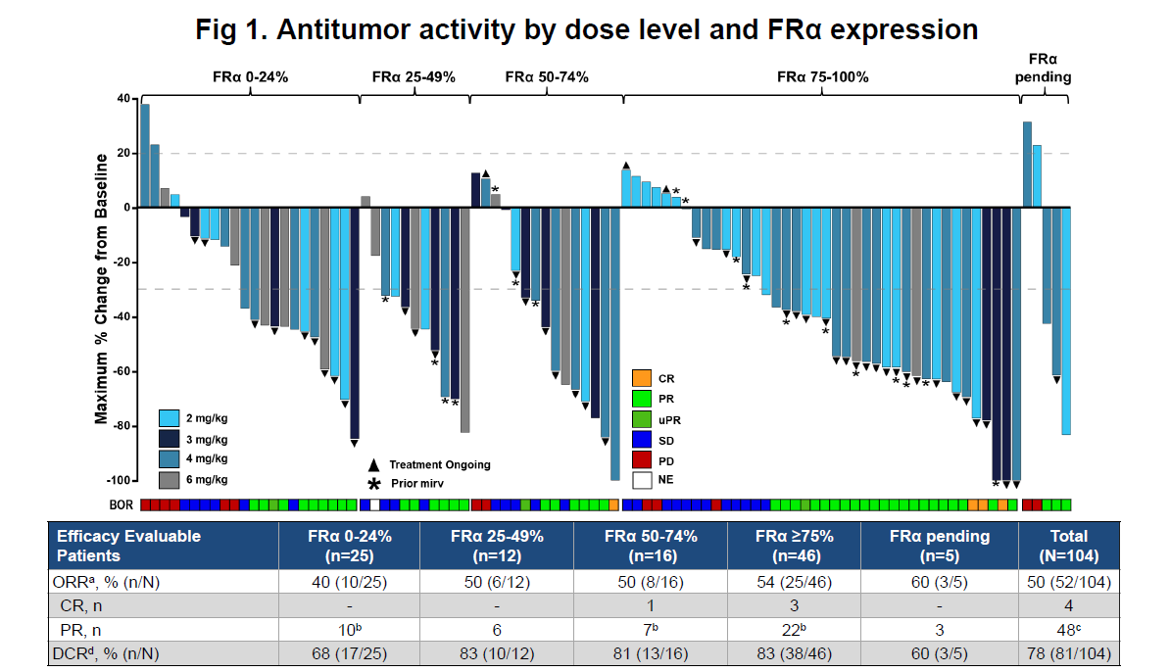
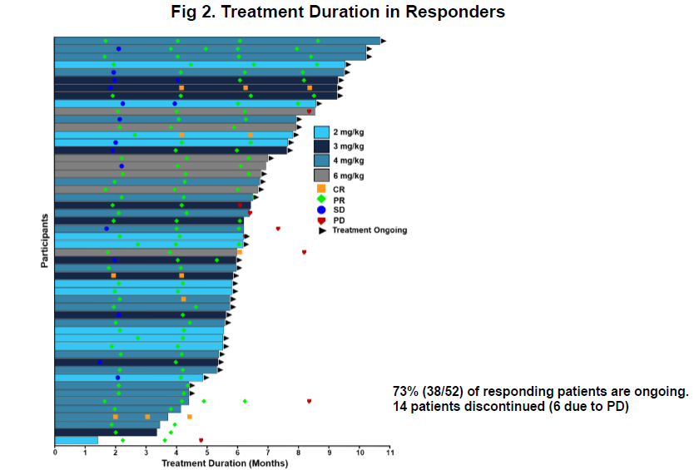
Sofetabart mipitecan (Sofe-M): FRα-binding Ab, cleavable PSAR linker, exatecan topo1i payload, DAR 8
Initial results from a first-in-human phase 1 study of LY4170156 in advanced ovarian cancer and other solid tumors.
Most common adverse events: Nausea, fatigue, myelotoxicity
Ray-Coquard, ESMO 2025
Phase III FRAmework-01 NCT07213804

Slide 10
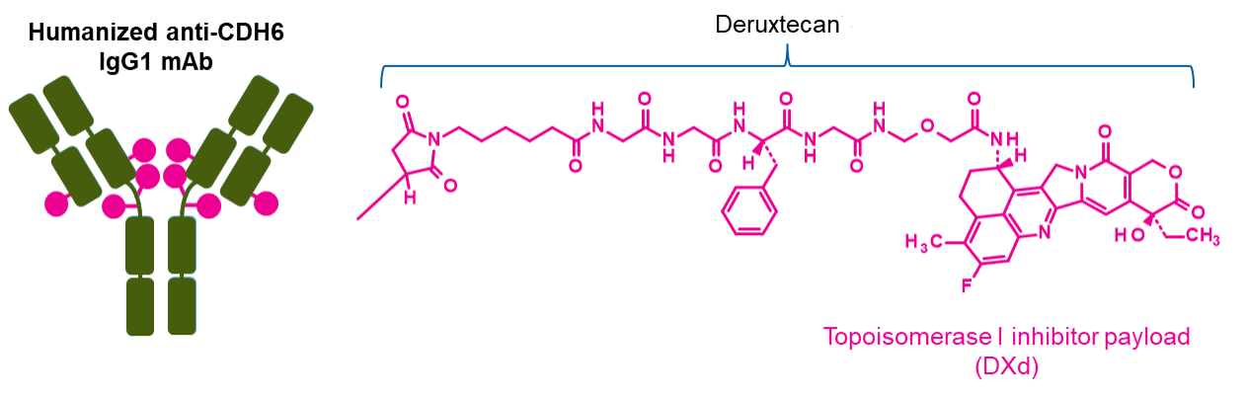
Targeting Cadherin 6 (CDH6)
R-DXd was designed with 7 key attributes:
Platinum-resistant OC is associated with poor outcomes;^{1,2} standard of care is single-agent non-platinum chemotherapy, which provides only a modest benefit; ORR is 10–15% and median OS is 10–12 months¹
Expression of CDH6 is observed in ~65 to 85% of epithelial OC tumors^{3–5}
Raludotatug deruxtecan (R-DXd) is a CDH6-directed ADC comprising a humanized CDH6 IgG1 mAb, covalently linked to a TOPO I inhibitor payload via a tetrapeptide-based cleavable linker^{6,7}
In the ongoing Phase 1 trial (NCT04707248), R-DXd demonstrated a manageable safety profile and promising antitumor activity in 45 patients with heavily pretreated OC (89% had platinum-resistant OC)^{8,a}
R-DXd was administered at 4.8, 5.6, or 6.4 mg/kg IV Q3W. Across doses, 48.6% of patients achieved a confirmed objective response⁸
Humanized anti-CDH6 IgG1 mAb^{b}
Deruxtecan^{6,7}
Cleavable tetrapeptide-based linker
TOPO I inhibitor payload (DXd)
1 | Payload mechanism of action: TOPO I inhibitor^{7,c}
2 | High potency of payload^{6,7,c}
3 | High drug-to-antibody ratio of ≈8^{6,c}
4 | Payload with short systemic half-life^{7,c,d}
5 | Plasma-stable linker-payload^{6,7,c}
6 | Tumor-selective cleavable linker^{6,7,c}
7 | Bystander antitumor effect^{6,c}

Slide 11
REJOICE-Ovarian01 study design
Targeting Cadherin 6 (CDH6)
A Phase 2/3 multicenter, randomized study of R-DXd in patients with platinum-resistant,
high-grade serous or endometroid ovarian, primary peritoneal, or fallopian tube cancer^{1,2}
Key eligibility criteria
High-grade serous or high-grade endometrioid ovarian, primary peritoneal, or fallopian tube cancerª
1−3 prior LOT, including bevacizumab^{b}
Platinum-resistant disease^{c} (primary platinum-refractory disease is exclusionary)
Prior mirvetuximab soravtansine^{d} (for tumors with high FRα expression)
ECOG PS 0−1
No prior CDH6-targeting agents or ADCs with a linked exatecan derivative
No selection by tumor CDH6 expression
Phase 2 (N≈260)
Dose-optimization analysis (N=108)^{f}
40 days
LTSFU Q3M
Phase 3 (N≈450)
40 days
LTSFU Q3M
Follow-up
Follow-up
R-DXd IV Q3W
R-DXd IV Q3W
4.8 mg/kg
R-DXd at RP3D
R
1:1:1
R
1:1
5.6 mg/kg
Treatment of physician’s choice
6.4 mg/kg
Until PD,^{g} death, lost to FU, other reason
Until PD,^{g} death, lost to FU, other reason
Stratification factors
Number of prior LOT (1 vs 2–3)
CDH6 expression (≥75% vs <75%)^{e}
TPC (paclitaxel vs other; Phase 3 only)
Primary endpoint
ORR per BICR^{g}
Key secondary endpoints
ORR per inv^{g}
DOR per BICR and inv^{g}
Primary endpoints
ORR per BICR^{g}
PFS per BICR^{g}
Key secondary endpoints
OS
QOL
Ray-Coquard, ESMO 2025

Slide 12
Clinically meaningful tumor responses were seen irrespective of doseª
R-DXd 4.8 mg/kg, n=36
R-DXd 5.6 mg/kg, n=36
R-DXd 6.4 mg/kg, n=35
ORR: 44.4% (95% CI, 27.9–61.9)
DCR: 75.0% (95% CI, 57.8–87.9)^{b}
ORR: 50.0% (95% CI, 32.9–67.1)
DCR: 80.6% (95% CI, 64.0–91.8)^{b}
ORR: 57.1% (95% CI, 39.4–73.7)
DCR: 77.1% (95% CI, 59.9–89.6)^{b}
Best change in sum of diameters from baseline (%)
Ray-Coquard, ESMO 2025

Slide 13
Most common TEAEs (≥10% of overall population)ª
The 5.6-mg/kg dose provided the optimal benefit–risk profile
R-DXd 4.8 mg/kg (n=36)^{b}
R-DXd 5.6 mg/kg (n=36)^{b}
R-DXd 6.4 mg/kg (n=35)^{b}
CTCAE gr 1–2
CTCAE gr ≥3
Total (%) / gr ≥3 (%)
CTCAE gr 1–2
CTCAE gr ≥3
Total (%) / gr ≥3 (%)
CTCAE gr 1–2
CTCAE gr ≥3
Total (%) / gr ≥3 (%)
Nausea
Anemia
Asthenia
Neutropenia^{c}
Vomiting
Constipation
Decreased appetite
AST increased
Diarrhea
Thrombocytopenia^{d}
Leukopenia^{e}
ALT increased
Pyrexia
GGT increased
Fatigue
Cough
Abdominal pain
66.7 / 2.8
69.4 / 5.6
71.4 / 0
52.8 / 19.4
58.3 / 13.9
60.0 / 17.1
36.1 / 0
50.0 / 11.1
54.3 / 5.7
33.3 / 11.1
44.4 / 16.7
51.4 / 28.6
25.0 / 0
33.3 / 0
28.6 / 0
25.0 / 0
27.8 / 0
34.3 / 0
13.9 / 0
25.0 / 5.6
25.7 / 0
19.4 / 0
16.7 / 0
22.9 / 0
11.1 / 0
16.7/0
28.6 / 2.9
8.3 / 2.8
19.4 / 5.6
25.7 / 8.6
16.7 / 5.6
13.9 / 2.8
14.3 / 8.6
19.4 / 0
8.3 / 0
11.4 / 2.9
13.9 / 0
13.9 / 0
8.6 / 0
5.6 / 0
16.7 / 2.8
11.4 / 5.7
8.3 / 2.8
16.7 / 2.8
5.7 / 2.9
5.6 / 0
11.1 / 0
14.3 / 0
5.6 / 0
13.9 / 2.8
11.4 / 2.9
Patients (%)
Patients (%)
Patients (%)
Nausea, anemia, asthenia and neutropenia were the most common TEAEs across all doses
Ray-Coquard, ESMO 2025

Slide 14
REJOICE-Ovarian01: Efficacy of R-DXd in PROC
Phase 2/3 REJOICE-Ovarian01/ENGOT-ov77; GOG-3096
Key Eligibility Criteria
High-grade serous or endometrioid ovarian, primary peritoneal, or fallopian tube cancer
1-3 prior LOT (including bevacizumab)
Platinum-resistant disease
Prior MIRV if high FRαª
ECOG PS 0-1
No prior CDH6-targeting agents or ADCs with linked TOPO I inhibitor
Patients with primary platinum-refractory disease are not eligible
Phase 2
40 d
Long-term survival follow-up every 3 mo
Phase 3
40 d
Long-term survival follow-up every 3 mo
Follow-up
Follow-up
R-DXd IV Q3W
R-DXd IV Q3W
4.8 mg/kg
R-DXd at RP3D
R
1:1:1
5.6 mg/kg
R
1:1
TPC (gemcitabine, PLD, topotecan, paclitaxel)
6.4 mg/kg
Until PD,^{b} death, lost to FU, other reason
Until PD,^{b} death, lost to FU, other reason
R
1:1
Primary endpoints: ORR per BICR,^{b} PFS
per BICR^{b}
Key secondary endpoints: OS, QOL
Stratification
Number of prior LOT (1 vs 2/3)
CDH6 expression (high vs low)
TPC (paclitaxel vs others; phase 3 only)
Primary endpoint: ORR per BICR^{b}
Key secondary endpoints: ORR per investigator,^{b} DOR
ª Unless ineligible, not approved, or available locally. ^{b} Per RECIST v1.1.
1. https://clinicaltrials.gov/study/NCT06161025.

Slide 15
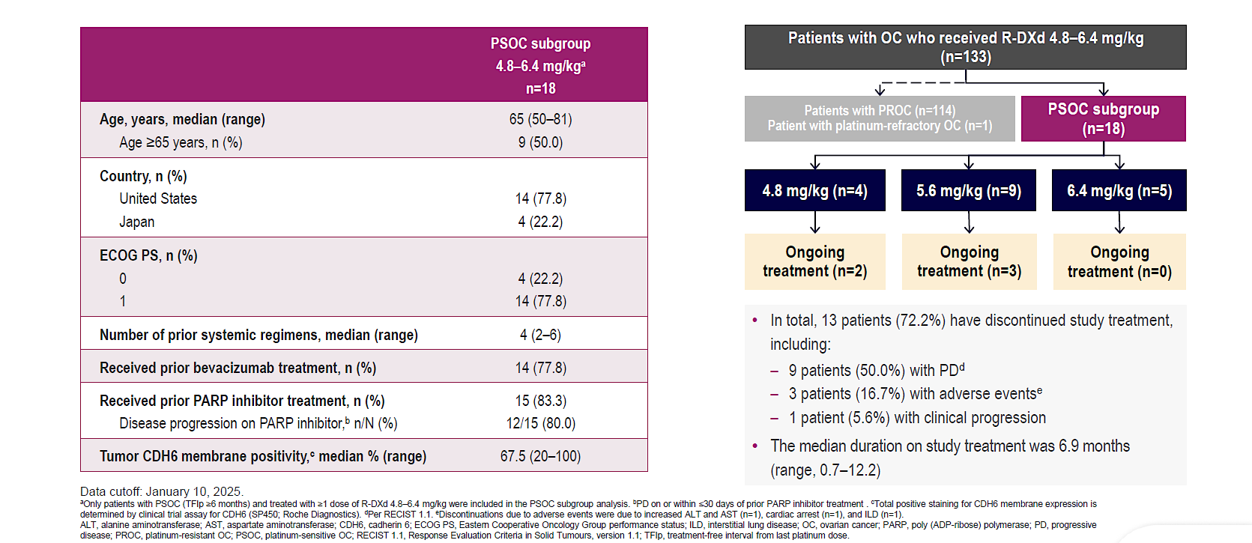
REJOICE-Ovarian01: Efficacy of R-DXd in PSOC
Kathleen Moore, ESMO GYN 2025

Slide 16
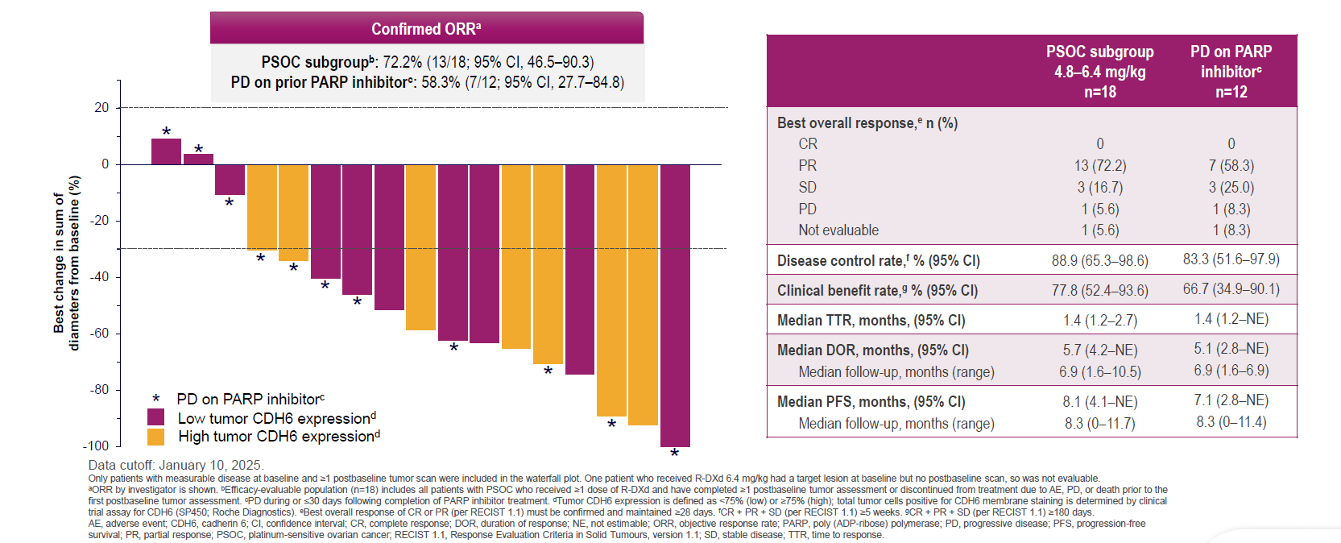
REJOICE-Ovarian01: Efficacy of R-DXd in PSOC
Kathleen Moore, ESMO GYN 2025

Slide 17
NAPISTAR 1-01: Study Design
Antonio Gonzalez-Martin, ESMO 2025
A multicenter, FIH dose escalation and optimization Phase I/IIa Study (NCT06303505),
investigating the NaPi2b ADC TUB-040 in PROC*
Phase I
Dose Escalation
Phase IIa
Dose Optimization
5.3 mg/kg
4.4. mg/kg
3.3 mg/kg
Dose 1
2.5 mg/kg
2.1 mg/kg
Dose 2
1.67 mg/kg
1.0 mg/kg
0.5 mg/kg
Study design: ATD followed by BOIN
  Key Eligibility Criteria
  Histologically confirmed, platinum resistant, high-grade serous epithelial ovarian, fallopian tube or primary peritoneal cancer
  A maximum of 5 platinum-based and 2 non-platinum prior lines of therapy
  ECOG 0-1
  No prior treatment with an ADC containing a TOPO-I inhibitor payload
  No biomarker selection based on NaPi2b expression
  Objectives and Endpoints
  Safety and tolerability
  Determination of MTD
  ORR per RECIST 1.1, DCR, DoR, PFS and OS
  PK parameters of TUB-040
  Immunogenicity
  Quality of life
* NAPISTAR 01-1 also includes an NSCLC arm, which is currently being explored independently from the PROC arm. Cut off: 01 September 2025. ADAs, anti-drug antibodies; ADC=antibody-drug conjugate; ATD, accelerated titration dosing; BOIN, Bayesian optimal interval; DCR, disease control rate; DoR, duration of response; FIH, first-in-human; MTD, maximum tolerated dose; NaPi2b, sodium-dependent phosphate transporter protein 2B; NSCLC, non-small cell lung cancer; ORR, overall response rate; OS, overall survival; PBC, platinum-based chemotherapy; PFS, progression-free survival; PK, pharmacokinetics; PROC, platinum-resistant ovarian cancer.

Slide 18
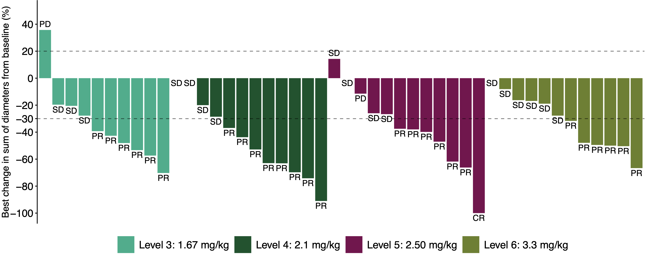
Efficacy across a wide therapeutic range with complete responses
Antonio Gonzalez-Martin, ESMO 2025
59% ORR (50% cORR) within 1.67 – 3.3 mg/kg cohorts
#
#
#
#
Across 1.67 – 3.3 mg/kg:
Onset of activity at low doses
Complete response observed
CA125 response rate⁴ 81%
93% (25/27) of responding patients are ongoing
80% (37/46) of patients remain on treatment, indicating durable benefit
# Prior mirvetuximab soravtansine
Efficacy |  |  |  |  | Dose Levels 1.67-3.3 mg/kg (n=46)
 | 1.67 mg/kg (n=10) | 2.1 mg/kg (n=12) | 2.5 mg/kg (n=12) | 3.3 mg/kg (n=12)
ORR² n (%) | 6 (60) | 8 (67) | 7 (58) | 6 (50)³ | 27 (59)
Confirmed ORR, n (%) | 4 (40) | 7 (58) | 7 (58) | 5 (42) | 23 (50)
DCR n (%) | 9 (90) | 12 (100) | 11 (92) | 12 (100) | 44 (96)
Confirmed DCR, n (%) | 9 (90) | 12 (100) | 11 (92) | 12 (100) | 44 (96)
Confirmed CR, n (%) | 0 | 0 | 1 (8) | 0 | 1 (2)
All evaluable patients 0.5 – 5.3 mg/kg (n=66)¹
36 (55)
26 (39)
64 (97)
60 (91)
1 (2)
1. N=66 evaluable patients who had at least 1 RECIST response assessment across doses from 0.5 – 5.3 mg/kg. There were no responses observed at doses below 1.67 mg/kg. 2. Responses of PR/CR per RECIST at a minimum of 1 post-baseline assessment. 3. Efficacy data in patients treated at 3.3 mg/kg continue to mature. 4. CA125 responses determined per GCIG; 34 responders in 42 CA125 evaluable subjects. CR, complete response; DCR, disease control rate; PR, partial response; SD, stable disease. Data Cut off: 01 September 2025.
Data Cut off: 01 September 2025

Slide 19
ADCs in ovarian cancer
Target
Payload
Setting
Partner
Bystander effect needed
Bystander effect controlled (new linker-payload platforms)
Potency and DAR
Best target
Level of expression
Predictive biomarker
Platinum-resistant
Platinum-sensitive
Maintenance
Single agent
Combo with chemo
Combo with targeted therapies
New combinations:
- EARLIER lines: Plat sensitive, 1st line
- Maintenance (ongoing)

Slide 20
Platinum Ineligible Ovarian Cancer
ANTIBODY DRUG CONJUGATED (ADCS)
CELL CYCLE REGULATION AND DNA REPAIR
Mirvetuximab-soravtansine ¹
Trastuzumab-deruxtecan ²
Raludotatug- Deruxtecan ³
Rinatabart Sesutecan (Rina-S)⁴
AZD5335 ⁵
Ly4170156 ⁶
NAPISTAR 1-01 ⁷
ADAVOSERTIB ⁸
azenosertib⁹
CDK2i ¹⁰
¹ [NCT04296890 – Soraya] [NCT04209855 – Mirasol]; ² [NCT04482309]; ³ [NCT04707248]; ⁴ [NCT06619236]; ⁵ [NCT05797168] ; ⁶ [NCT06400472]; ⁷ [NCT06303505];
⁸ [NCT03579316]; ⁹ [NCT02595892]; ¹⁰ [INCB123667]; ¹¹ [NCT05116189]; ¹² [NCT03564340] ¹³ [NCT05257408 – Rosella]; [NCT03776812 – phase II];

Slide 21
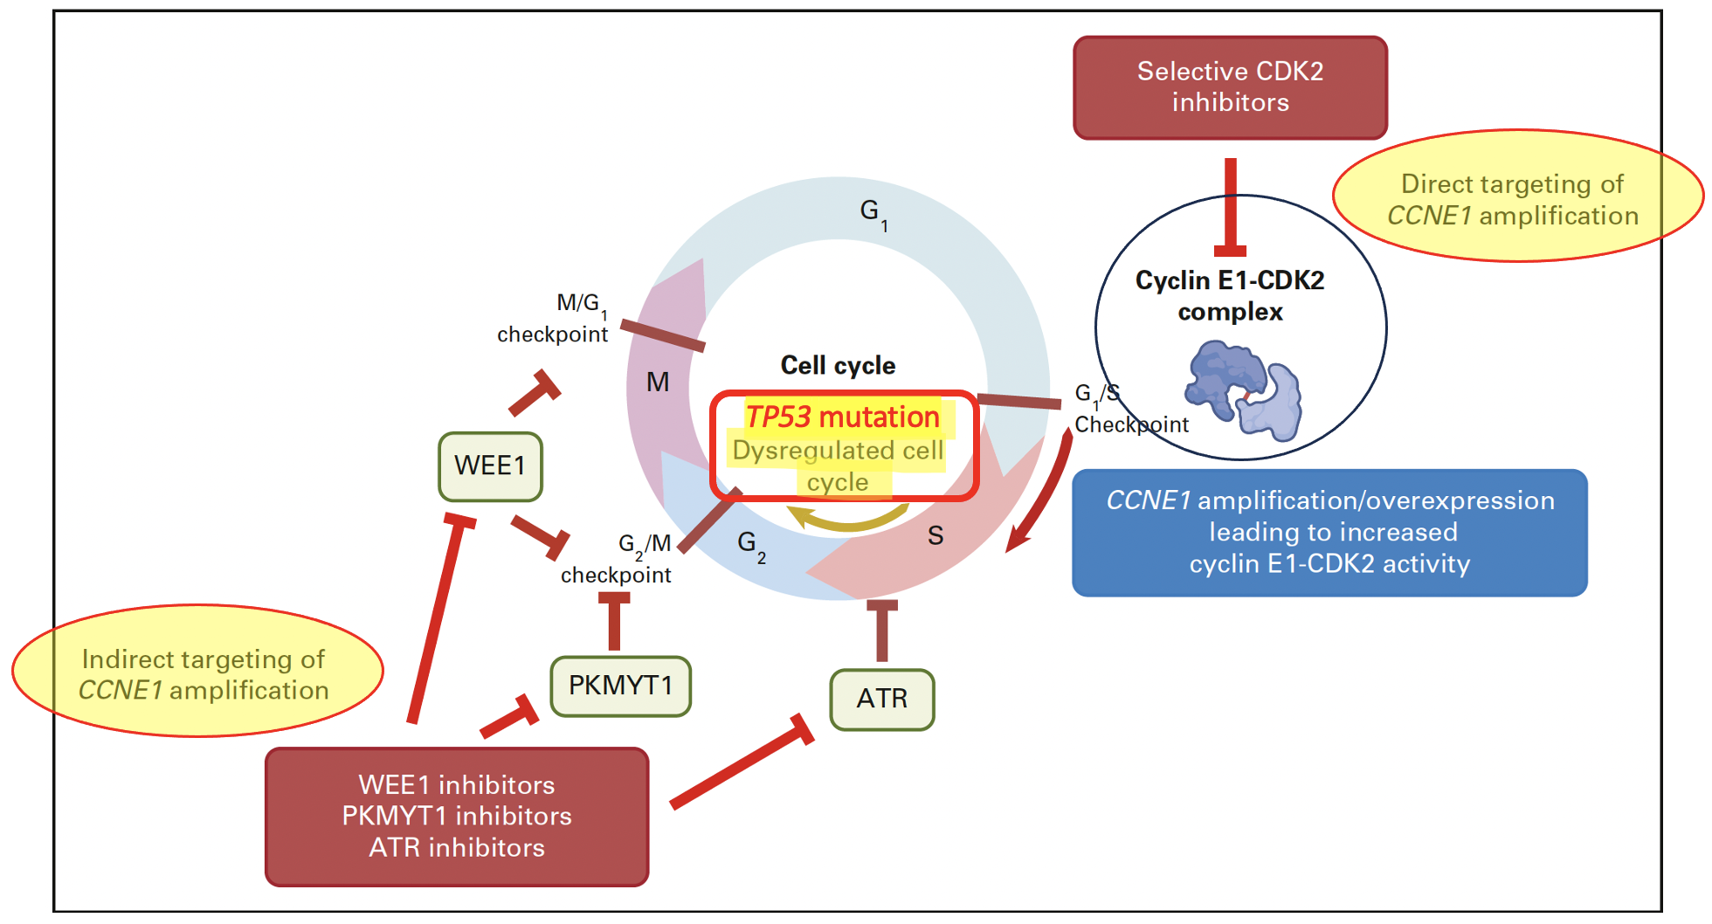
Exploiting Replication stress in
CCNE1 amplified tumours
p53 deficient & CCNE1 amplified cells rely on other cell-cycle checkpoints
Au-Yeung G etal., JCO 2023
Frederik Marmé

Slide 22
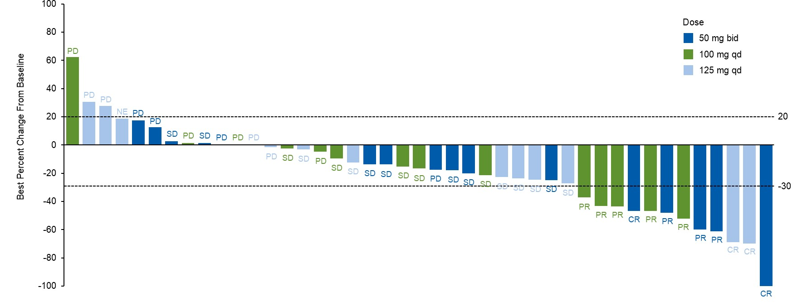
Direct targeting of CCNE1
CDK2-inhibitors in Platinum Resistant/Refractory Ovarian cancer
INCB123667: Phase 1B, CCNE1 amplified or overexpressed EOC (n=45)
ORR: 33.3%
DOR: 3.6 mo.
mPFS: 5.3 mo.
Responses were observed in pts with CCNE1 amplification (7/29) & without (5/16)
Treatment ongoing in some patients beyond 300 days (n=3)
Good tolerability
Damian S et al., ASCO 2025 abstract #5514
Damian S et al., Journal of Clinical Oncology 2025 Vol. 43 Issue 16_suppl Pages 5514-5514

Slide 23
Platinum Ineligible Ovarian Cancer
ANTIBODY DRUG CONJUGATED (ADCS)
CELL CYCLE REGULATION AND DNA REPAIR
IMMUNOTHERAPY
Mirvetuximab-soravtansine ¹
Trastuzumab-deruxtecan ²
Raludotatug- Deruxtecan ³
Rinatabart Sesutecan (Rina-S)⁴
AZD5335 ⁵
Ly4170156 ⁶
NAPISTAR 1-01⁷
ADAVOSERTIB ⁸
azenosertib⁹
CDK2i ¹⁰
Paclitaxel/pembro ¹¹
UBAMATAMAB ¹²
¹ [NCT04296890 – Soraya] [NCT04209855 – Mirasol]; ² [NCT04482309]; ³ [NCT04707248]; ⁴ [NCT06619236]; ⁵ [NCT05797168] ; ⁶ [NCT06400472]; ⁷ [NCT06303505];
⁸ [NCT03579316]; ⁹ [NCT02595892]; ¹⁰ [INCB123667]; ¹¹ [NCT05116189]; ¹² [NCT03564340] ¹³ [NCT05257408 – Rosella]; [NCT03776812 – phase II];

Slide 24

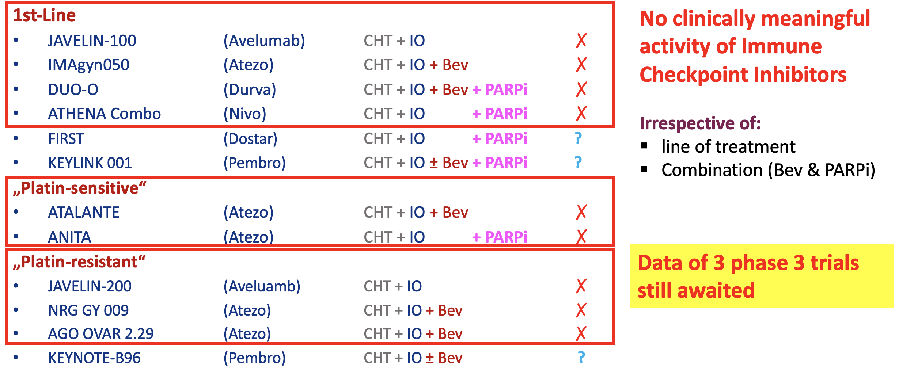
Immune Checkpoint Inhibitors In Ovarian Cancer: Phase 3 Evidence
Frederik Marmé

Slide 25
ENGOT-ov65/KEYNOTE-B96 Study Design (NCT05116189)
Key Eligibility Criteria
Histologically confirmed epithelial ovarian, fallopian tube, or primary peritoneal carcinoma
1 or 2 prior lines of therapy; at least 1 platinum-based chemotherapy
  Prior anti-PD-1 or anti-PD-L1, PARPi and bevacizumab permitted
Radiographic progression within 6 months after the last dose of platinum-based chemotherapy
ECOG PS 0 or 1
Pembrolizumab 400 mg
(Q6W, 18 cycles) +
Paclitaxelª 80 mg/m² Days 1, 8, 15
of each Q3W cycle
(± bevacizumab 10 mg/kg Q2W)
R 1:1
N = 643
Placebo
(Q6W, 18 cycles) +
Paclitaxelª 80 mg/m² Days 1, 8, 15
of each Q3W cycle
(± bevacizumab 10 mg/kg Q2W)
Stratification Factors
Planned bevacizumab use (yes vs no)
Region (US vs EU vs ROW)
PD-L1 CPS (<1 vs 1 to <10 vs ≥10)^{b}
Primary Endpoint: PFS per RECIST v1.1 by investigator
Key Secondary: OS
ªDocetaxel (75 mg/m² Q3W) may be considered in participants with severe hypersensitivity reaction to paclitaxel or an adverse event requiring discontinuation of paclitaxel after consultation with the Sponsor. ^{b}The combined positive score (CPS) was assessed at a central laboratory using PD-L1 IHC 22C3 pharmDx and defined as the number of PD-L1 CPS ≥1 cells (tumor cells, lymphocytes, macrophages) divided by the total number of tumor cells × 100.

Slide 26
Progression-Free Survival in the CPS ≥1 Population at IA1
100
12-mo rate (95% CI)
35.2% (28.8-41.7)
22.6% (17.0-28.7)
90
80
70
HR 0.72 (95% CI, 0.58-0.89) P = 0.0014ª
60
 | Pts w/ Event | Median, mo (95% CI)
Pembro Arm | 69.2% | 8.3 (7.0-9.4)
Placebo Arm | 77.6% | 7.2 (6.2-8.1)
Information fraction: 87.9%
50
Progression-Free Survival, %
40
30
20
10
Median follow-up:
15.6 months
0
0
5
10
15
20
25
30
No. at risk
Time, months
234
170
87
21
5
1
0
232
150
64
16
3
1
0
Colombo N, ESMO 2025

Slide 27
Progression-Free Survival in the ITT Population at IA1
100
12-mo rate (95% CI)
33.1% (27.7-38.5)
21.3% (16.6-26.4)
90
80
70
HR 0.70 (95% CI, 0.58-0.84) P < 0.0001ª
60
 | Pts w/ Event | Median, mo (95% CI)
Pembro Arm | 71.7% | 8.3 (7.2-8.6)
Placebo Arm | 78.8% | 6.4 (6.2-8.1)
Information fraction: 89.5%
50
Progression-Free Survival, %
40
30
20
10
Median follow-up:
15.6 months
0
0
5
10
15
20
25
30
No. at risk
Time, months
322
233
119
34
6
1
0
321
200
84
19
3
1
0
Colombo N, ESMO 2025

Slide 28
Key Secondary Endpoint: Overall Survival in the CPS ≥1 Population at IA2
100
12-mo
69.1%
59.3%
18-mo
51.5%
38.9%
90
80
HR 0.76 (95% CI, 0.61-0.94) P = 0.0053ª
70
60
Overall Survival, %
 | Pts w/ Event | Median, mo (95% CI)
Pembro Arm | 67.1% | 18.2 (15.3-21.0)
Placebo Arm | 75.4% | 14.0 (12.5-16.1)
Information fraction: 90.0%
50
40
30
20
10
Median follow-up:
26.6 months
0
0
6
12
18
24
30
36
42
No. at risk
Time, months
234
207
161
120
49
13
3
0
232
200
137
89
41
10
1
0
Colombo N, ESMO 2025

Slide 29
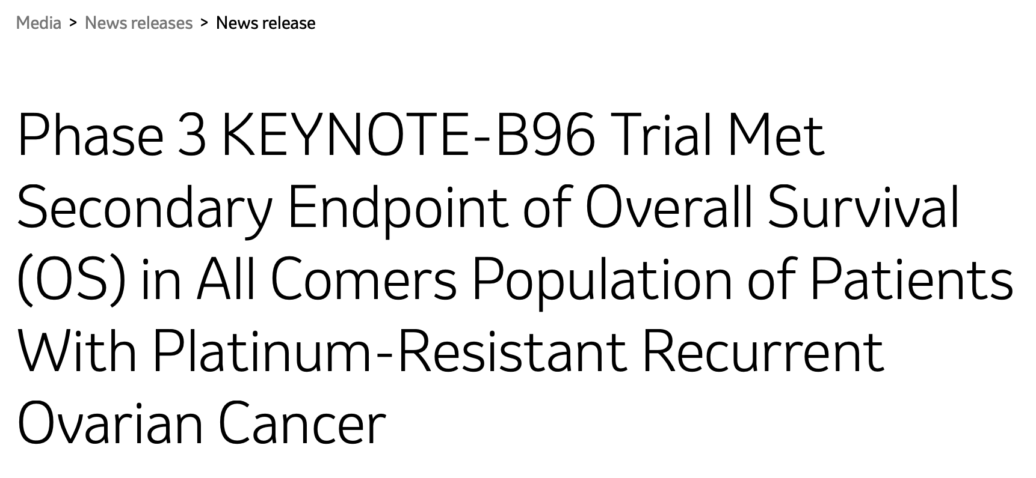
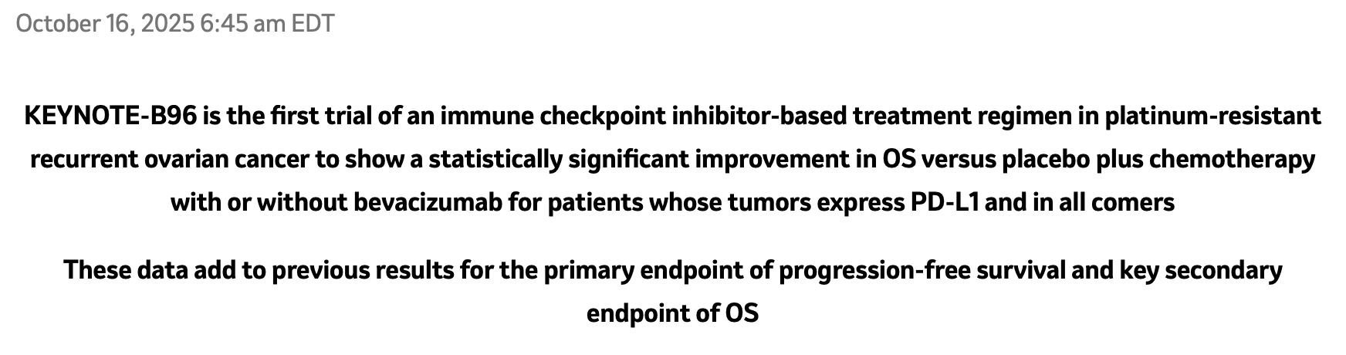

Slide 30
T-cell Engagers
Ubamatamab (REGN4018) in Advanced Ovarian Cancer
Ubamatamab is a human bispecific antibody, developed using VelocImmune technology
Ubamatamab is designed to bridge MUC16 on cancer cells with CD3-expressing T cells to facilitate T-cell activation and cytotoxicity⁴
In immune-deficient mice, ubamatamab combined with human immune cells led to dose-dependent antitumor activity against intraperitoneal MUC16- expressing ovarian tumour cells and malignant ascites^{5,6}
Ubamatamab
(MUC16xCD3 bispeciﬁc)
1. National Cancer Institute. Available at: https://seer.cancer.gov/statfacts/html/ovary.html. Accessed January 20, 2022; 2. Siddiqui MK et al. Gynecol Oncol. 2017;146:44–51; 3. Pujade-Lauraine et al. J Clin Oncol. 2014; 13:1302-8; 4. Crawford A et al. Sci Transl Med. 2019;11:1–13; 5. Crawford A et al. Abstract presented at AACR 2018, Chicago, USA; 6. Crawford A et al. Oral presentation at PEGS Boston Summit 2020, Virtual.

Slide 31


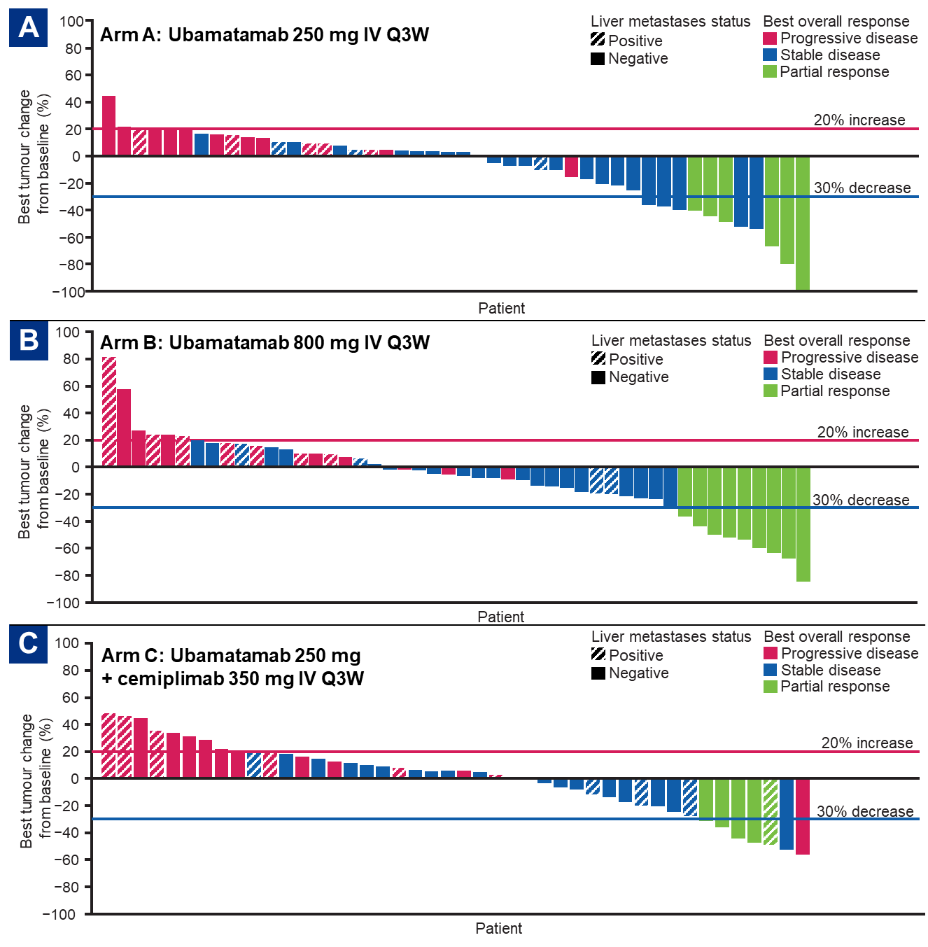
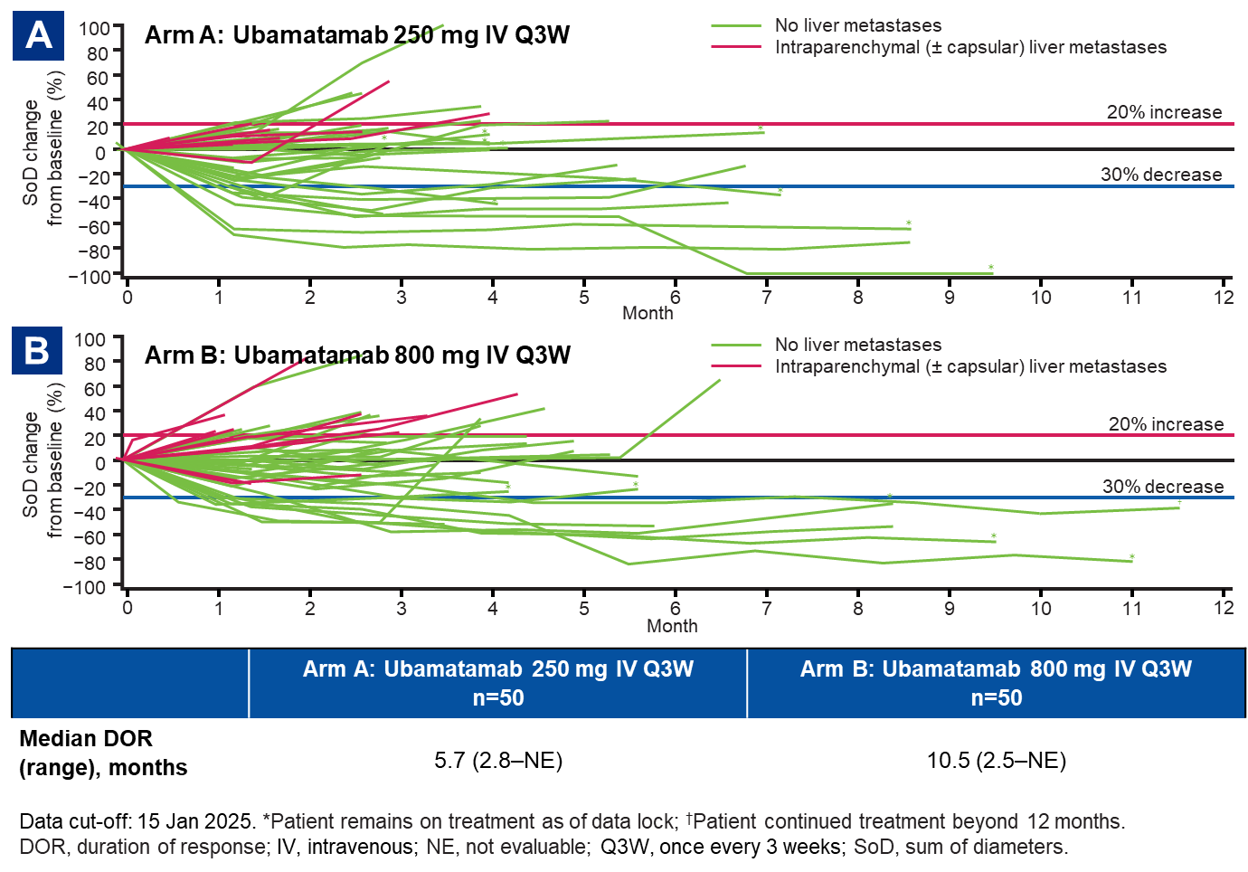
Randomised Phase 2 study of ubamatamab ± cemiplimab in patients (pts) with platinum-resistant ovarian cancer (OC)
Jung-Yun Lee, ESMO 2025

Slide 32
Platinum Ineligible Ovarian Cancer
ANTIBODY DRUG CONJUGATED (ADCS)
CELL CYCLE REGULATION AND DNA REPAIR
IMMUNOTHERAPY
GLUCOCORTICOID RECEPTOR
Mirvetuximab-soravtansine ¹
Trastuzumab-deruxtecan ²
Raludotatug- Deruxtecan ³
Rinatabart Sesutecan (Rina-S)⁴
AZD5335 ⁵
Ly4170156 ⁶
NAPISTAR 1-01⁷
ADAVOSERTIB ⁸
azenosertib⁹
CDK2i ¹⁰
Paclitaxel/pembro ¹¹
UBAMATAMAB ¹²
RELACORILANT ¹³
¹ [NCT04296890 – Soraya] [NCT04209855 – Mirasol]; ² [NCT04482309]; ³ [NCT04707248]; ⁴ [NCT06619236]; ⁵ [NCT05797168] ; ⁶ [NCT06400472]; ⁷ [NCT06303505];
⁸ [NCT03579316]; ⁹ [NCT02595892]; ¹⁰ [INCB123667]; ¹¹ [NCT05116189]; ¹² [NCT03564340] ¹³ [NCT05257408 – Rosella]; [NCT03776812 – phase II];

Slide 33



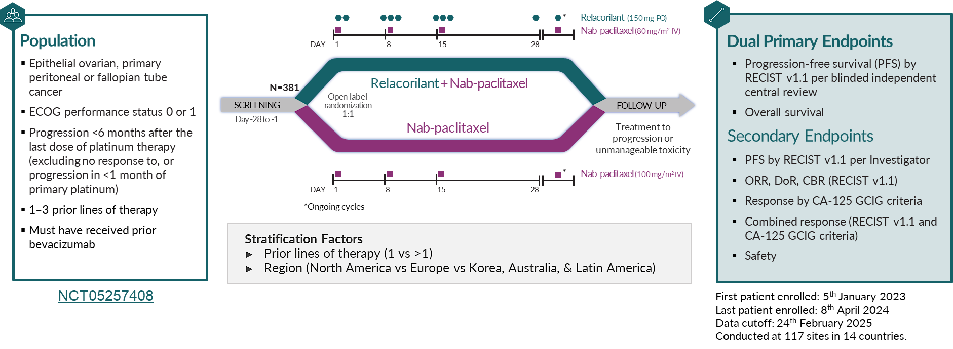






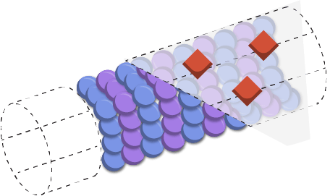



ROSELLA
Relacorilant is a novel, selective GR antagonist (SGRA) that restores the sensitivity of cancers to cytotoxic chemotherapy^{3,5,6}
Relacorilant MOA
Relacorilant Mechanism of Action
Relacorilant
Cortisol
Multiprotein Complex
Glucocorticoid Receptor
Co-regulators
SGK1
DUSP1
GR Response Element
Tumor
Cell
BAX
BAK
Taxane-induced Microtubule Disruption
Apoptotic Cell Death
Pro-apoptotic BCL2 Proteins
Pro-apoptotic Synergy with Taxanes
1. Martorana, et al. Int J Gynecol Cancer. 2025;35(1):100009. 2. Veneris, et al. Gynecol Oncol. 2017;146(1):153-60. 3. Greenstein, et al. Oncotarget. 2021;12(13):1243-55. 4. Melhelm, et al. Clin Cancer Res. 2009;15(9):3196-3204. 5. Stringer-Reasor, et al. Gynecol Oncol. 2015;138(3):656-62. 6. Munster, et al. Clin Cancer Res. 2022;28(15):3214-24. 7. Colombo, et al. J Clin Oncol. 2023;41(30):4779-89.

Slide 34
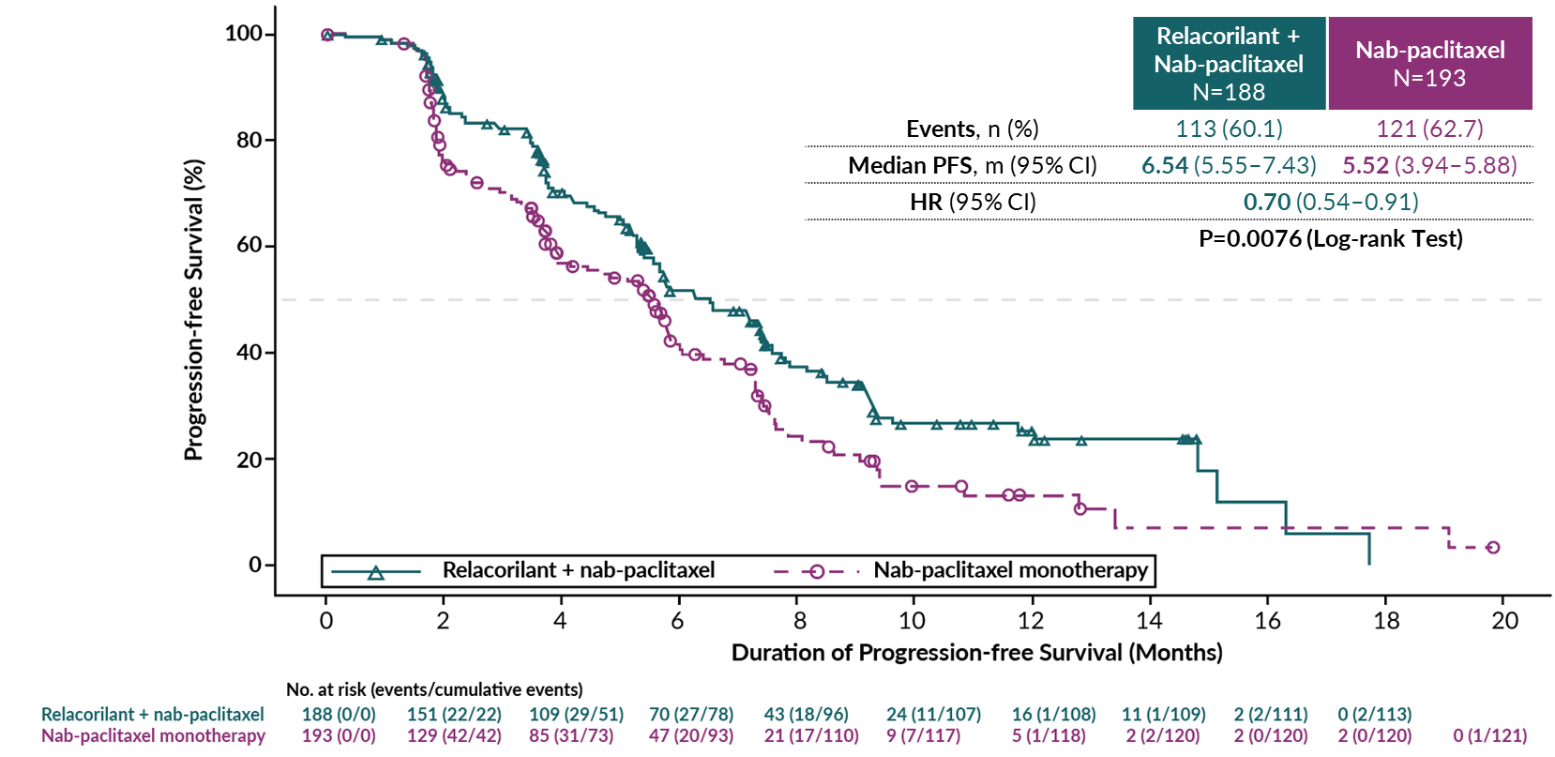
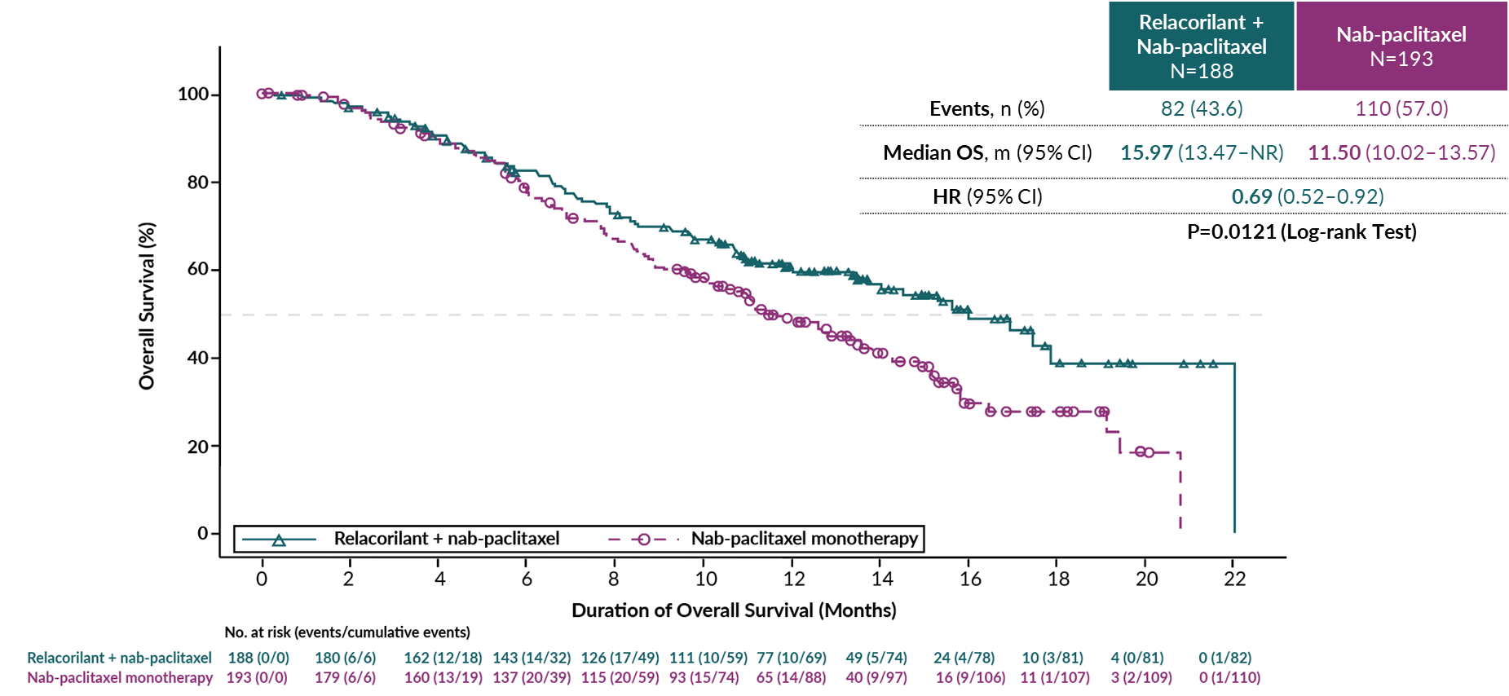
ROSELLA | Relacorilant Significantly Improved Progression-Free Survival Assessed by Blinded Review
ROSELLA | Relacorilant Improved Overall Survival at this Interim Analysis ( not yet significant)
statistical significance threshold at the interim analysis: P≤0.0001
Alexander Olawaiye, ASCO 2025, Lancet 2025

Slide 35
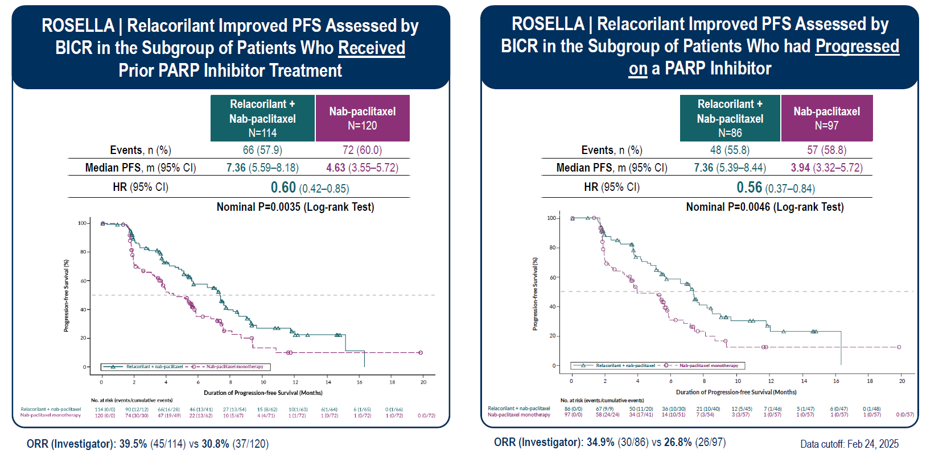
Lorusso, ESMO 2025

Slide 36
Conclusions
ADCs are the new standard in platinum-resistant ovarian cancer.
Approval of MIRV (high FR𝛂, EMA & FDA) and T-DXd (Her2 3+, FDA).
Other promising ADCs:
R-DXd (CDH6 target), phase III ongoing
New FR𝛂 targeting ADCs. Phase III ongoing, including low/no FR𝛂 expression, post-MIRV sequence
New targets Napi2B, claudin6, B7H3, B7H4, other.
Multiple phase III ongoing and planned (PlatR, PlatS, maintenance)
  Restriction in prior PlatR lines.
  Limited by shared targets and payloads (Topo1i)→ Sequencing data needed.
Beyond ADCs, two new drugs that may change clinical practice: Relacorilant and Pembrolizumab
Approvals awaited.
Unclear treatment sequencing.

Slide 37
Appendix

Slide 38
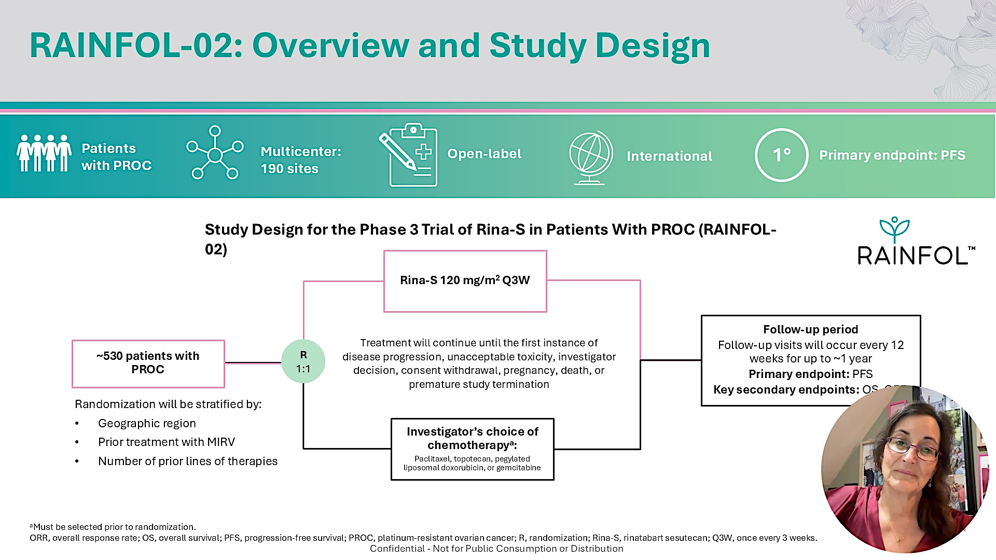
Follow-up period
Follow-up visits will occur every 12 weeks for up to ~1 year
Primary endpoint: PFS
Key Secondary endpoints: OS, ORR
Angeles Alvarez Secord presented at ASCO 2025;Abstract TPS5627

