Slide 1

Year in Review: Optimizing the Role of Hormonal Therapy in the Care of Patients with Prostate Cancer
Andrew J Armstrong MD ScM FACP
March 2026
Professor of Medicine, Surgery, Pharmacology and Cancer Biology
Director of Research
Duke Cancer Institute’s Center for Prostate and Urologic Cancers

Slide 2
PCWG4: new indications model and terminology
Non-Metastatic
APMN or APMS
Metastatic
APMN or APMS
Clinically Localized
APMR
Specified by Prior Therapy
Non-Metastatic
APMR
Metastatic
APMR
Androgen Pathway Modulation Sensitive (APMS) or Naïve (APMN)
Androgen Pathway Modulation Resistant (APMR)
Within each state, specify where relevant: 1) genotype (germline, somatic), 2) imaging modality used to define metastasis (PET, CT/MRI/bone scan), 3) disease characteristics and biomarkers critical for risk stratification, and 4) prior therapies.
APMN/S is the preferred term for hormone/castration naïve/sensitive disease (HSPC, CSPC) while APMR is the preferred term for castration/hormone resistant prostate cancer (CRPC/HRPC).
Armstrong AJ, Morris MJ…Scher HI PCWG4; J Clin Oncol 2026

Slide 3
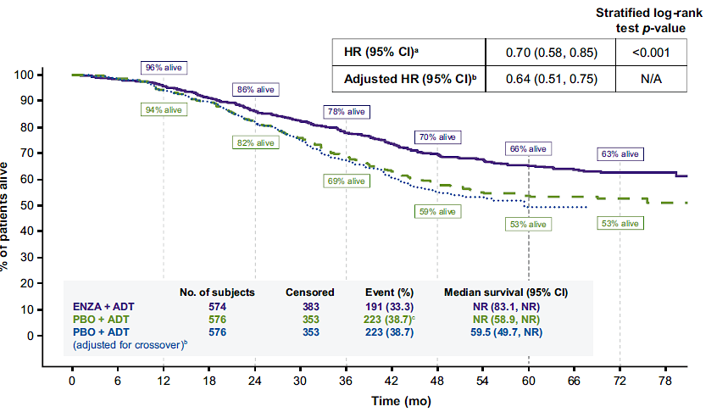
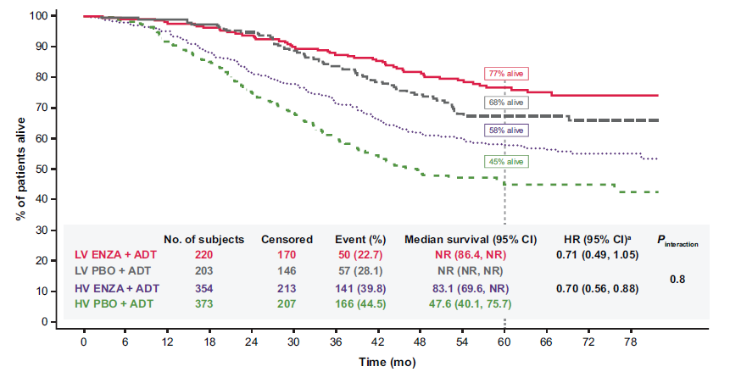
Early of use of ARPIs Improve Survival
Armstrong et al Eur Urol 2026

Slide 4
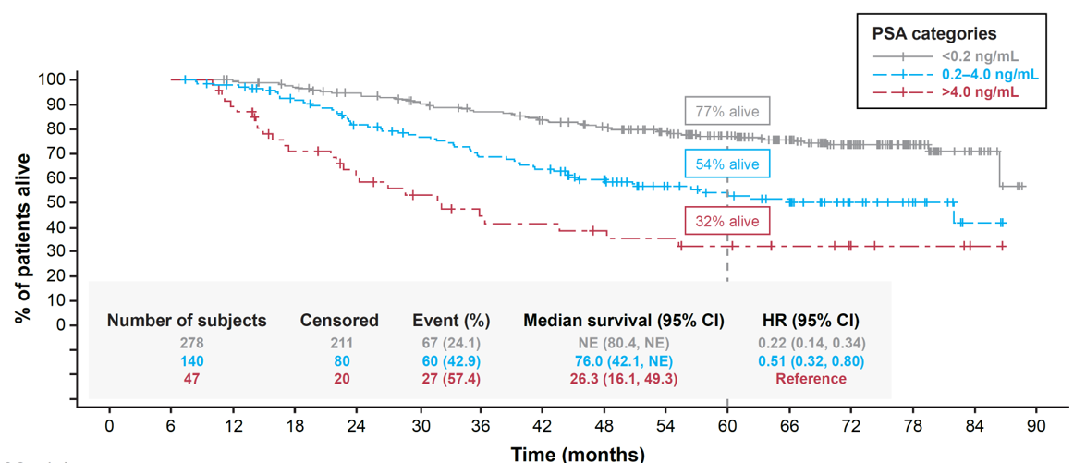
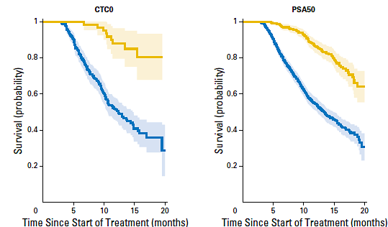
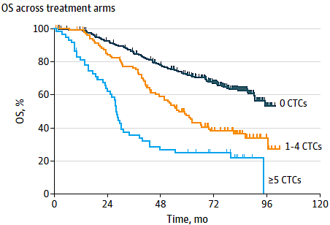
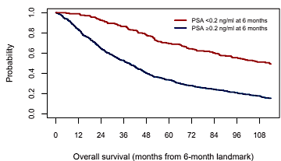
PSA and CTC Declines Are Strongly Prognostic
Heller et al JCO 2017: mCRPC (APMR)
Armstrong et al EU 2026: mHSPC (APMS): ARCHES
Goldkorn et al JAMA NO 2024: mHSPC (APMS)
Tripathy et al
Annals Oncol 2025: mHSPC docetaxel (APMS): CHAARTED

Slide 5
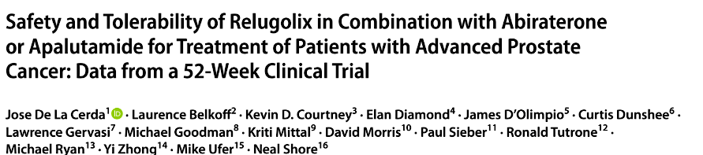
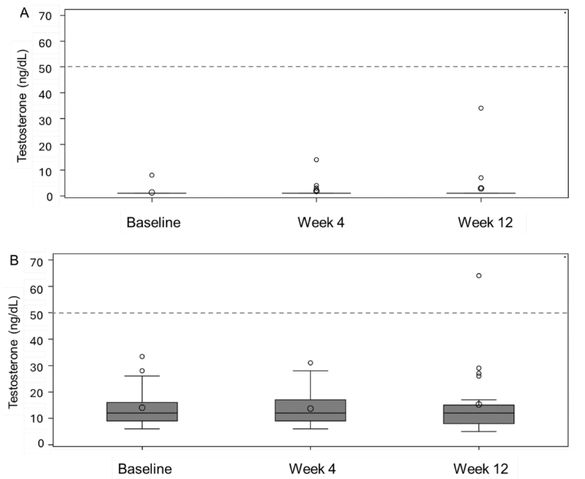
Key take-home point: if you give relugolix with apalutamide, the dose should be 240 mg/d (2x standard dose) due to CYP3A4/2C9/P-gp induction
No adjustments needed for abi (or enza/ darolutamide, not studied here)
Testosterone suppression and PSA decline efficacy was demonstrated
HTN seen with abi (25%) and rash seen with apa (21%)
Abi + relugolix
95% achieved <20 ng/dL
Apa + relugolix
83% achieved <20 ng/dL
De La Cerda J et al. Targeted Oncology 2025

Slide 6
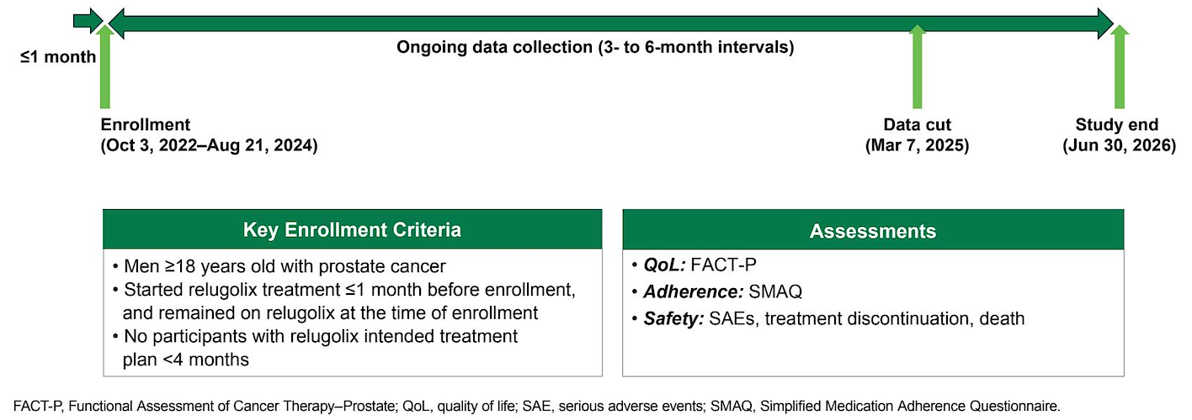
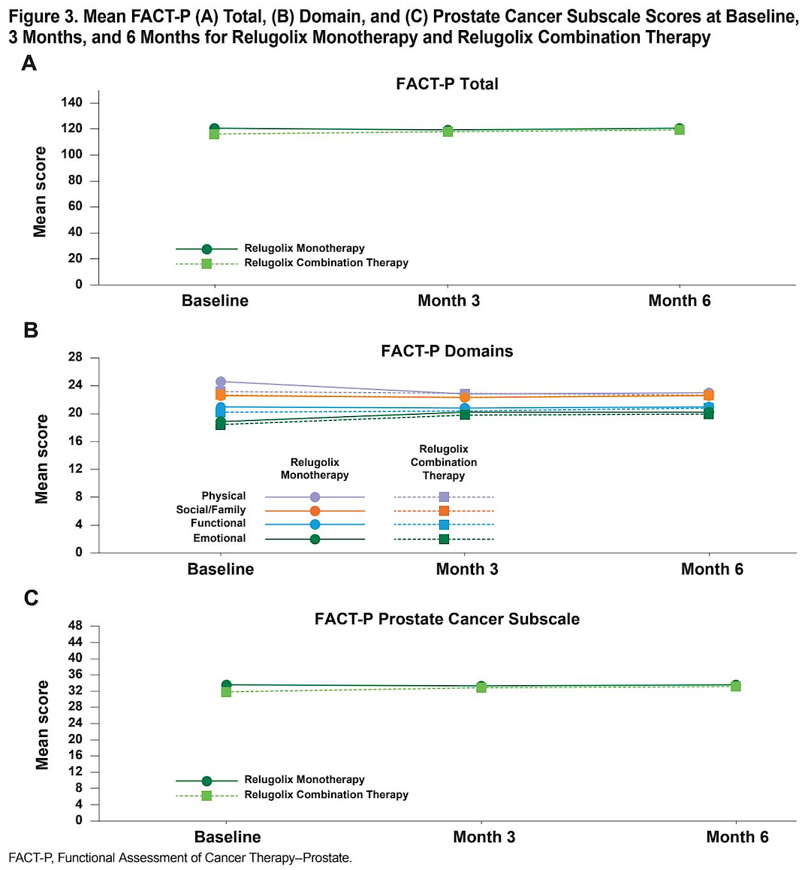
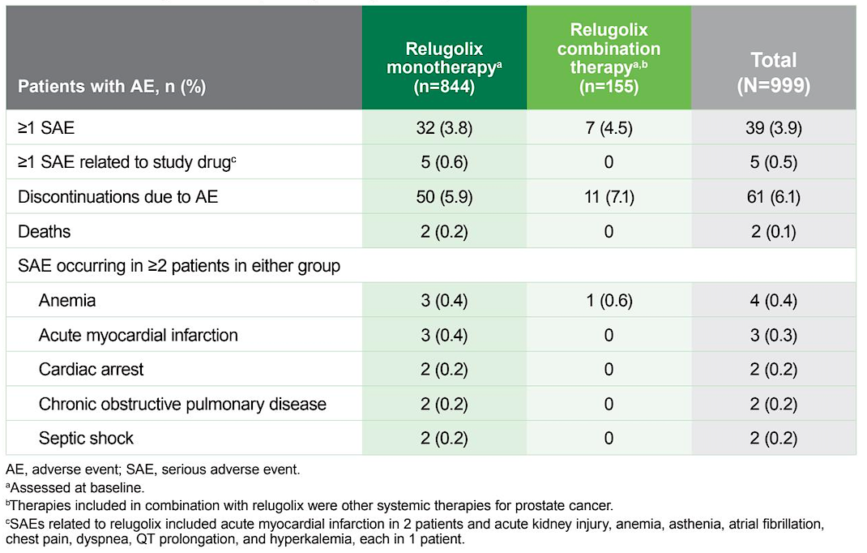
McKay R et al. Quality of life, adherence, and adverse events among patients with advanced prostate cancer treated with relugolix: 6-month results of the OPTYX multicenter registry. Genitourinary Cancer Symposium 2026;Abstract 122.
Take Home:
Real-world use of relugolix alone or with other systemic therapies was well tolerated with only 6-7% discontinuing due to side effects and 17% reporting a missed dose over 6 mo
CV AEs were very rare during this 6 mo follow up period
Remains unclear if GnRH agonist vs antagonist provides differential CV safety

Slide 7
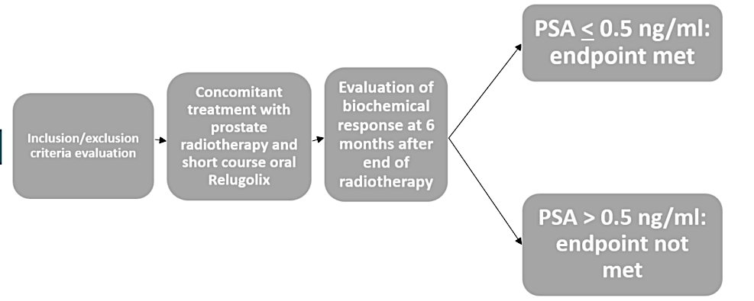
Francolini G et al. Ultra-hypofractionated radiotherapy and concomitant oral relugolix for treatment of intermediate risk prostate cancer (ULTRA-HERO). Genitourinary Cancer Symposium 2026;Abstract TPS411.
UIR prostate cancer
Primary endpoint: rate of complete PSA response (nadir<0.5) at 6 mo after completing prostate SBRT (36.25 Gy/5 fractions). N=73, 6 mo ADT

Slide 8
EMBARK study design
Patient population:
Screening PSA ≥1 ng/mL after RP and at least 2 ng/mL above the nadir for primary EBRT
PSADT ≤9 mo
No metastases on bone scan or CT/MRI per central read
Testosterone ≥150 ng/dL
Prior hormonal therapy ≥9 mo prior to R (neoadjuvant/adjuvant for ≤36 mo OR ≤6 mo for rising PSA)
Stratification factors:
Screening PSA (≤10 ng/mL vs. >10 ng/mL)
PSADT (≤3 mo vs. >3 to ≤9 mo)
Prior hormonal therapy (yes vs. no)
Enzalutamide (160 mg oral qd) + leuprolide acetate (22.5 mg IM/q12w)
n = 355
Blinded
Week 37
Primary endpoint^{b}:
MFS by BICR, enzalutamide + leuprolide acetate vs. leuprolide acetate alone
Suspend treatment at week 37 Monitor PSA (reinitiate if PSA rises)ª
Yes
Key secondary endpoints^{b,c}:
MFS by BICR, enzalutamide monotherapy vs. leuprolide acetate alone
Time to PSA progression
Time to first use of new antineoplastic therapy
OS^{c}
Other secondary endpoints:
Safety^{d}
R
1:1:1
Placebo + leuprolide acetate (22.5 mg IM/q12w)
n = 358
Blinded
PSA <0.2 ng/mL at week 36
N = 1068
No
Remain on treatment
Enzalutamide monotherapy (160 mg oral qd)
n = 355
Unblinded
ªStudy treatment was suspended once at week 37 if PSA was <0.2 ng/mL and restarted when PSA was ≥5.0 ng/mL (without prior RP) and ≥2 ng/mL (prior RP). ^{b}Intent-to-treat population. ^{c}Primary endpoint and key secondary endpoints for enzalutamide combination and enzalutamide monotherapy are alpha-protected. P-value to determine significance for OS of combination and monotherapy treatment comparisons was dependent on outcomes of primary endpoint and key secondary endpoints. ^{d}Safety population. BICR, blinded independent central review; CT, computed tomography; d, day; EBRT, external beam radiotherapy; IM, intramuscular; MFS, metastasis-free survival; mo, month; MRI, magnetic resonance imaging; OS, overall survival; PSA, prostate-specific antigen; PSADT, PSA doubling time; q, every; R, randomization; RP, radical prostatectomy; w, weeks.
Notes:
MDV3100 protocol 2021/p34A/p35AFG/p36AB
MDV3100 protocol 2021/p31ACD/p85B
MDV3100 protocol 2021/p31B
MDV3100 protocol 2021/p31E
MDV3100 protocol 2021/p79D
MDV3100 protocol 2021/p30BC

Slide 9
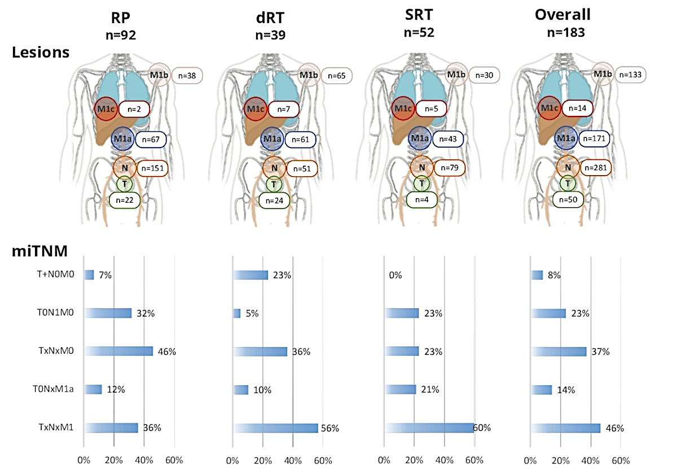
PSMA Imaging in EMBARK-like patients
In total, 182 patients met EMBARK enrolment criteria
Median PSA 2.8 ng/ml
Median PSADT 3.6 months
All had PSMA imaging
Overall, 84% were PSMA positive
46% had distant metastases
Holzgreve et al. JAMA Network Open. 2025
Armstrong WR et al. ASCO 2023;Abstract 5091

Slide 10
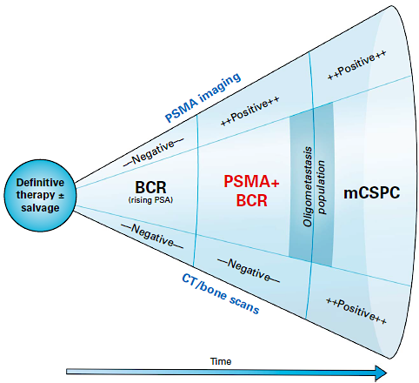
Who are EMBARK Patients?
EMBARK
Epstein et al J Clin Oncol. 2025 Dec;43(34):3672-3683.

Slide 11
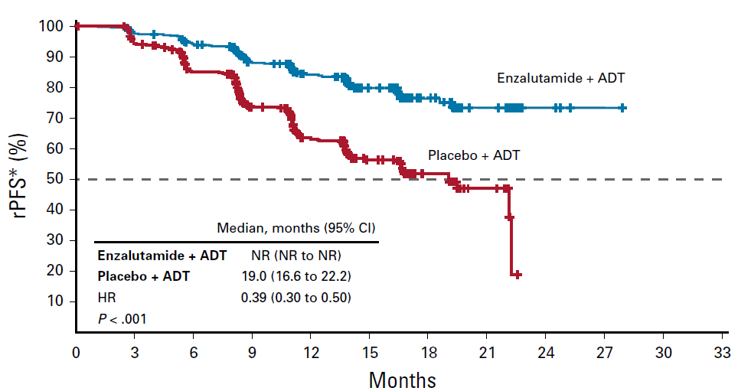
Outcomes of High-risk BCR vs. Conventional Imaging Positive mHSPC: Progression
3-year rate
92.9%
83.5%
5-year rate
87.3%
71.4%
100
80
Enzalutamide combination
Leuprolide acetate
60
Metastasis-free survival (%)
40
HR (95% CI):
0.42 (0.31–0.61); P<0.0001ª
20
0
0
6
12
18
24
30
36
42
48
54
60
66
72
78
84
90
96
Metastasis-free survival (mo)
Freedland et al. NEJM. 2023
Armstrong et al. JCO. 2019

Slide 12
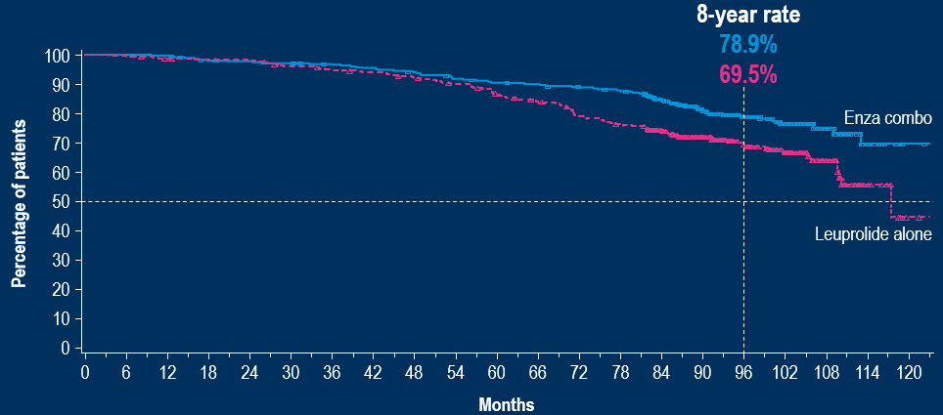
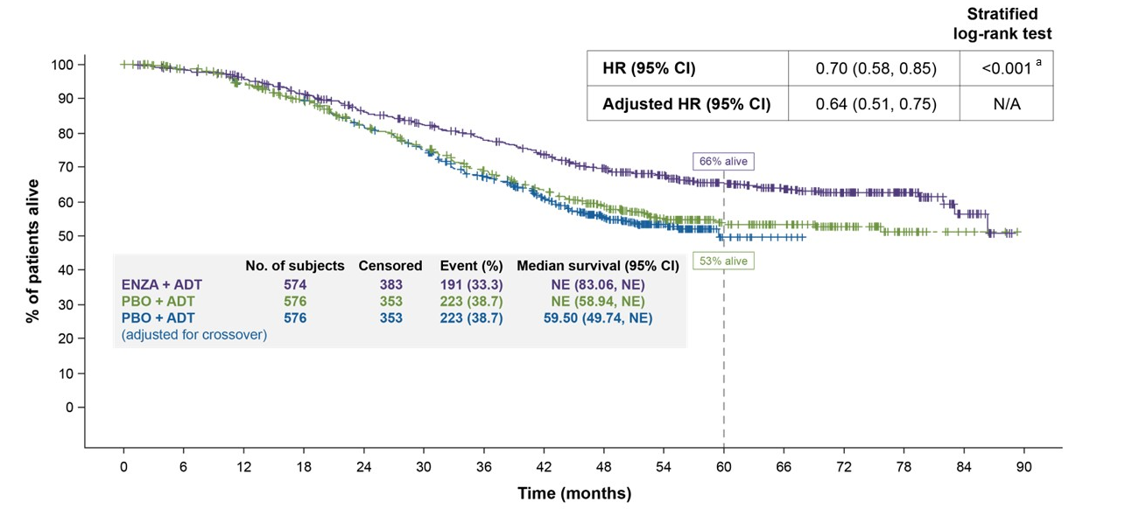
Outcomes of High-risk BCR vs. Conventional Imaging Positive mHSPC: Overall Survival
HR (95% CI):
0.597 (0.444–0.804) p=0.0005
(Pre-specified efficacy boundary, P<0.0499)
Shore et al. NEJM. 2025
Armstrong et al. EU 2026
8 year survival with ADT/ARPI: 79%
Medians not reached
Improved by 9-10% vs ADT alone
5 year survival with ADT/ARPI: 66%
Improved by 3 years in high volume disease
Improved by 13% vs ADT alone

Slide 13
Overall survival: Enza mono
8-year rate
73.1%
69.5%
100
 | Enza mono (n=355) | Leuprolide alone (n=358)
Events | 93 | 111
8-year OS (95% CI), % | 73.1 (67.6, 77.9) | 69.5 (64.0, 74.3)
90
80
70
Enza mono
60
50
Percentage of patients
Leuprolide alone
40
HR (95% CI): 0.830
(0.630, 1.095); P=0.1867
30
20
10
0
0
6
12
18
24
30
36
42
48
54
60
66
72
78
84
90
96
102
108
114
120
Months
Enza mono
355
355
352
350
349
343
338
326
316
306
300
291
276
271
237
170
114
77
39
8
0
Patients at risk
Leuprolide alone
Patients at risk
358
357
352
350
348
338
333
329
322
312
298
288
270
259
228
171
117
81
39
10
1
The risk of death was 17.0% lower for enza mono compared with leuprolide alone, which did not reach statistical significance
Intent-to-treat population. The median follow-up was 93.8 months in the enza mono group and 94.0 months in the leuprolide-alone group. OS was defined as the time between randomization and death due to any cause. HRs were calculated using a Cox regression model with treatment as the only covariate, with stratification according to PSA level at screening, PSADT, and previous hormonal therapy, as reported in the interactive Web-response system. The two-sided P-values were determined on the basis of a log-rank test, stratified according to PSA level at screening, PSADT, and previous hormonal therapy, as reported in the interactive Web-response system. The data cutoff date was May 27, 2025. The squares and triangles indicate censored data. CI, confidence interval; enza mono; enzalutamide monotherapy; HR, hazard ratio; OS, overall survival; PSA, prostate-specific antigen; PSADT, PSA doubling time.
Notes:
EMBARK OS TLFs/p30
8 year OS: Table_14.2.2.316_OsratesJUL2025/2A
EMBARK OS TLFs/p30
Median follow up time: EMBARK OS TLFs/28A
EMBARK OS TLFs/p30

Slide 14
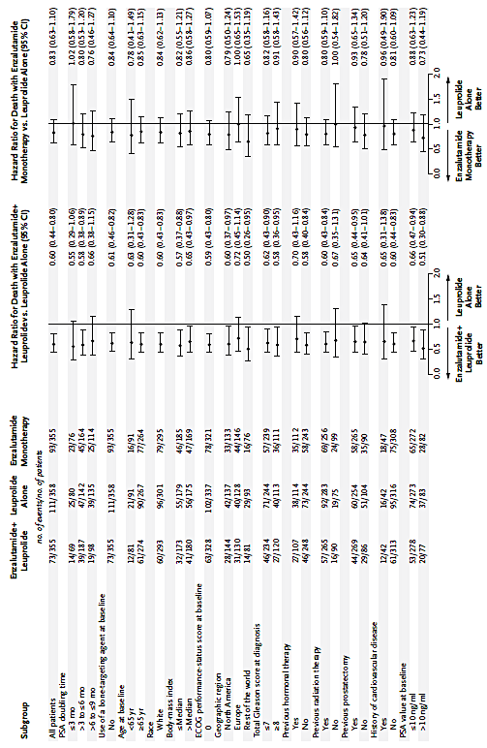
Who benefits from treatment intensification?
Shore et al. New Engl J Med 2025

Slide 15
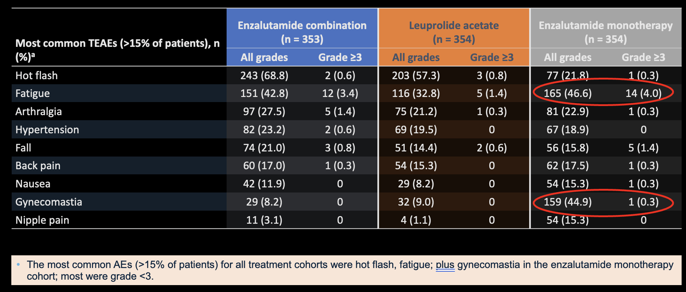
Most common TEAEs
Freedland et al. NEJM Oct 2023

Slide 16
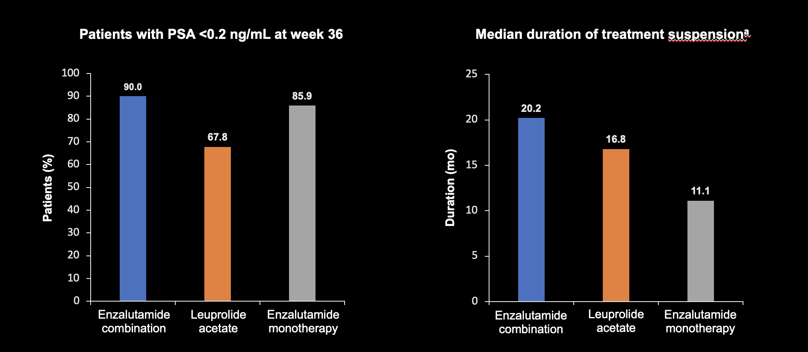
Secondary endpoint Undetectable PSA and Duration of suspension
Freedland et al. NEJM Oct 2023

Slide 17
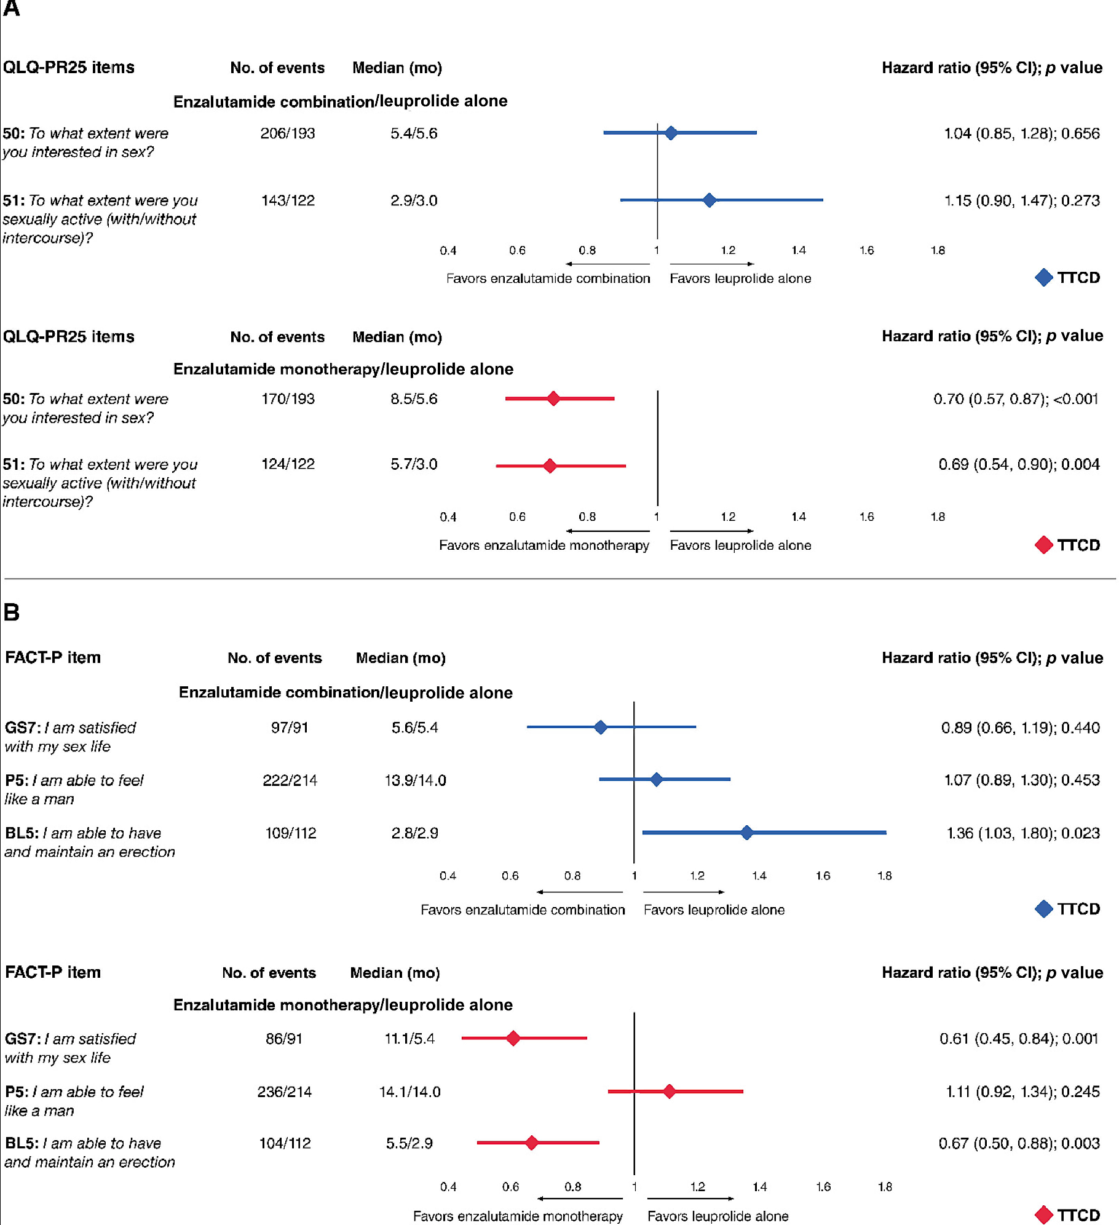
Sexual Quality of Life
Freedland et al. Eur Urol 2025

Slide 18
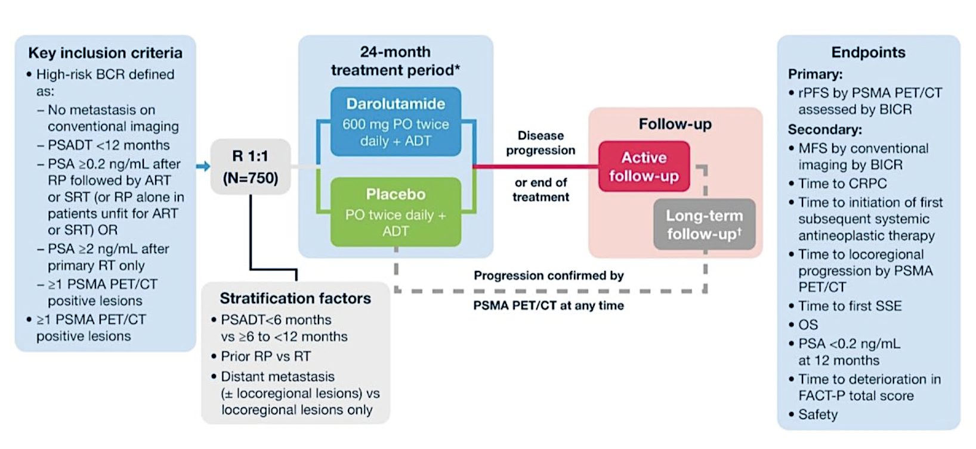
ARASTEP
Morgans AK et al. ESMO 2023;Abstract 1841TiP

Slide 19
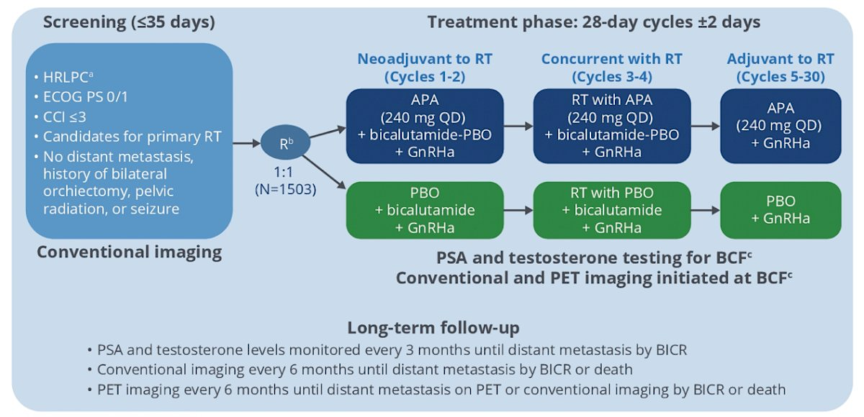
ATLAS
Sandler et al. ASCO 2022;Abstract 5084.

Slide 20
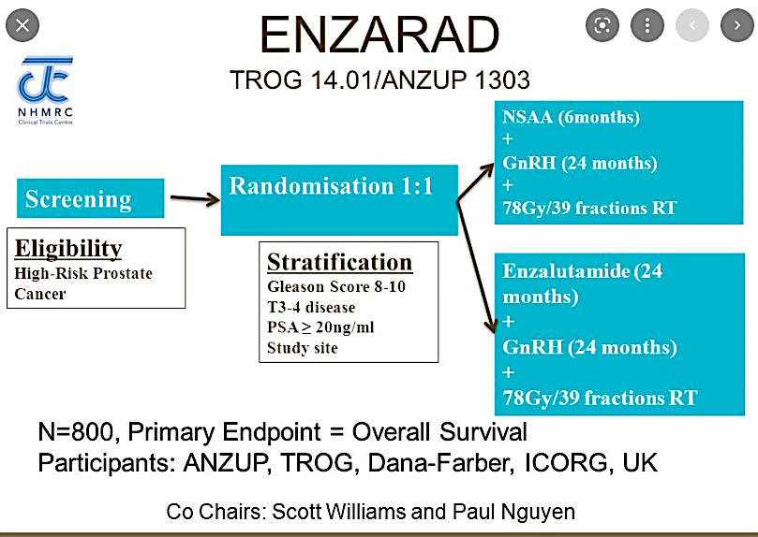
Williams et al. ASCO GU 2018;Abstract TPS156.

Slide 21
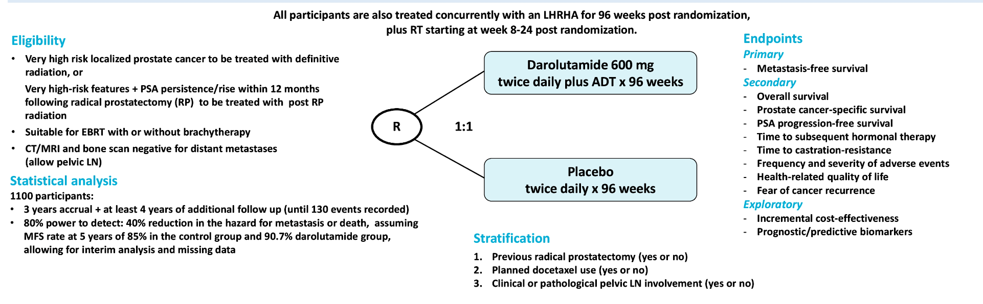
DASL HiCaP
Niazi et al. ASCO GU 2023;Abstract TPS396.

Slide 22
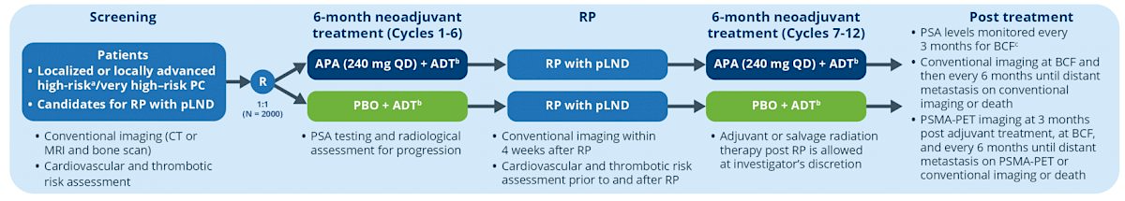
PROTEUS: ADT Intensification in Surgery
The primary endpoints are pCR rate and MFS on conventional imaging
MFS based on PSMA PET or conventional imaging will be assessed as a separate endpoint.
Kibel et al. ASCO GU 2022;Abstract TPS285.

Slide 23
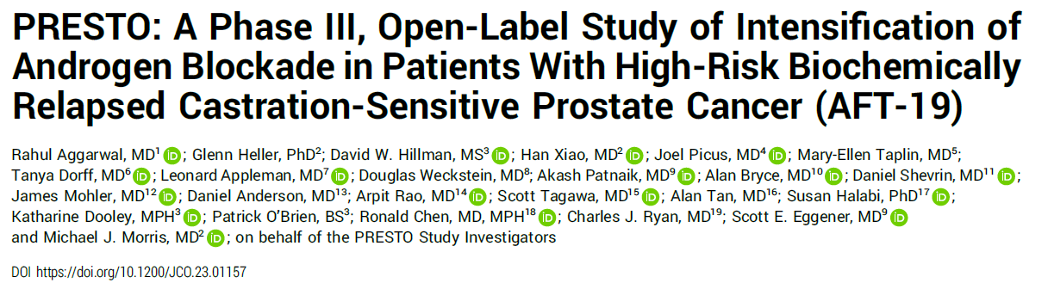
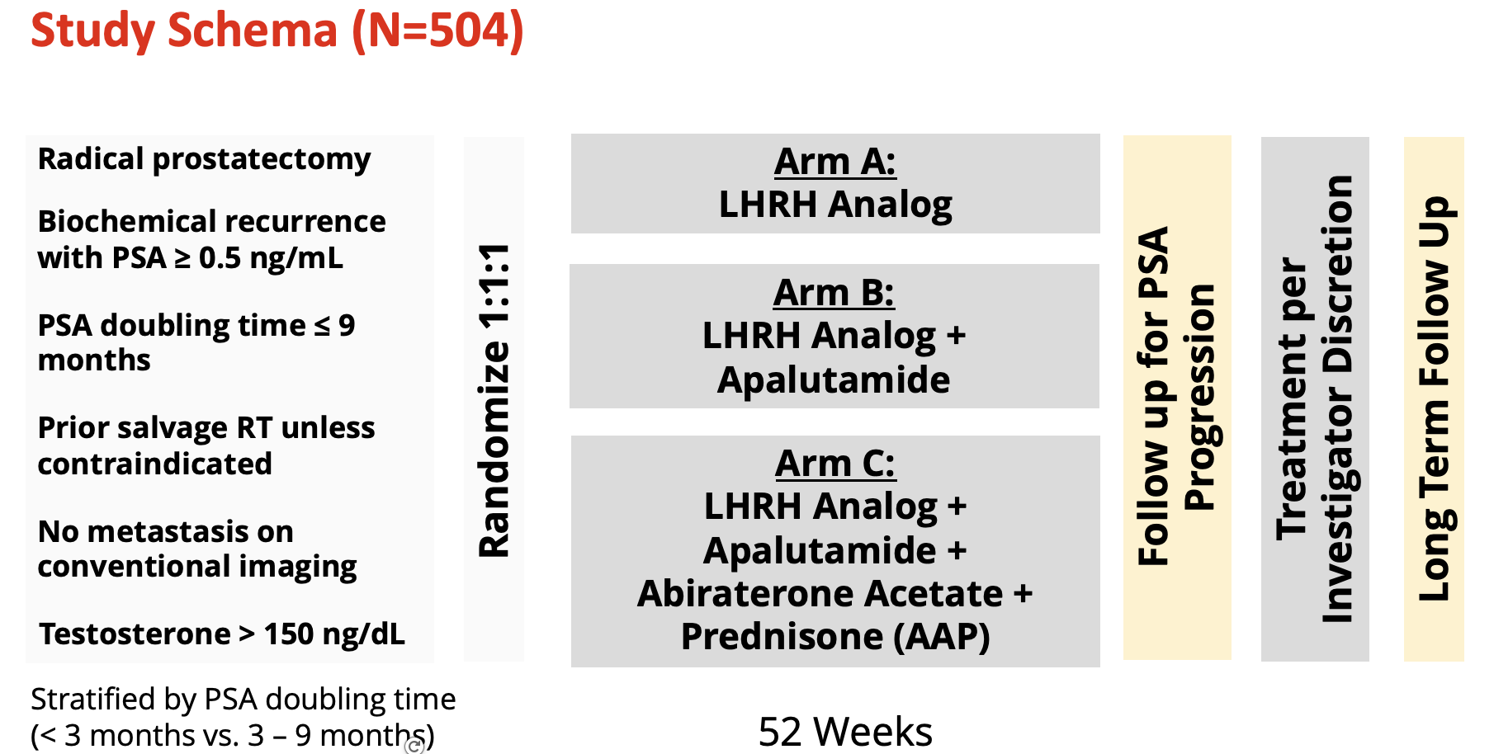

Slide 24
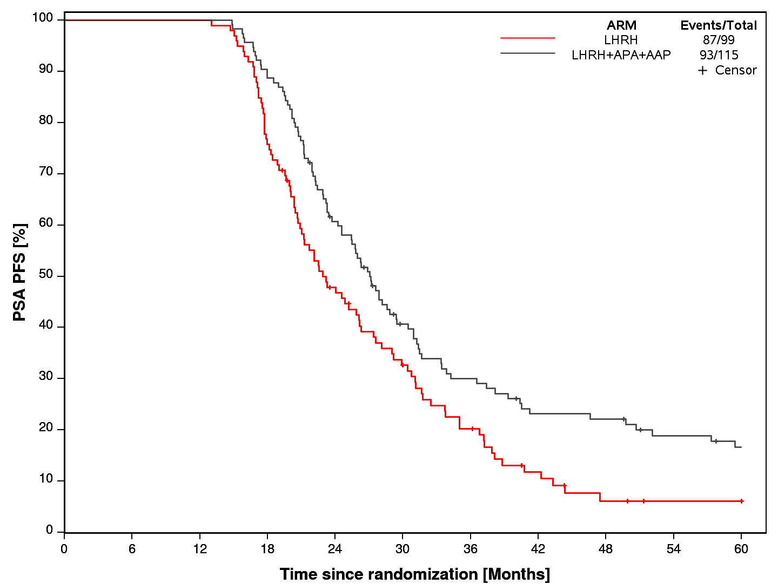
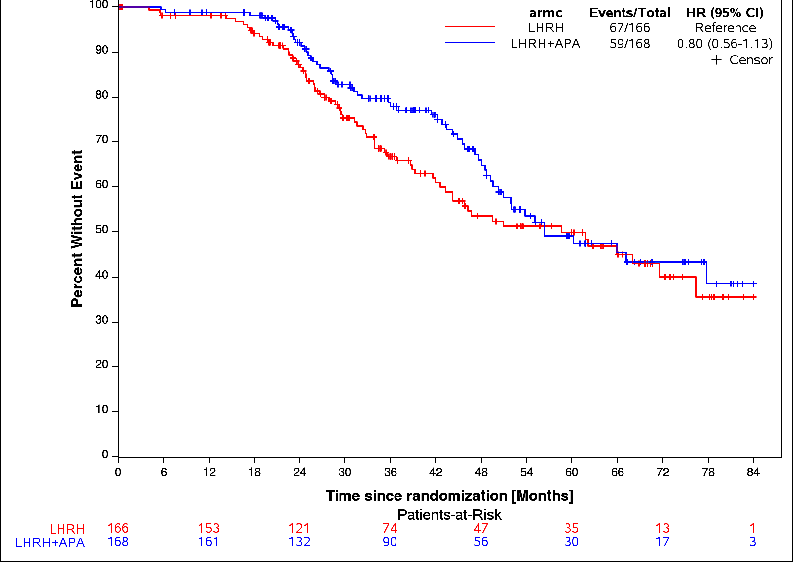
PRESTO (AFT-19): MFS
Take home: apalutamide did not improve MFS in the nmHSPC setting
Final analysis: HR 0.80 (95%CI 0.56-1.13), RMST improved by only 2.9 months
Median
PSA-PFS
HR 0.72 95% CI 0.55-0.93 p=0.0283
ADT: 6.1 months
ADT + apa: 6.4 months
AAP, abiraterone acetate + prednisone; ADT, androgen deprivation therapy; APA, Apalutamide; LHRH, luteinizing hormone-releasing hormone; PSA, prostate-specific antigen; PSA-PFS, PSA progression free-survival.
Aggarwal R, et al. JCO 42:1114-23, 2024.
Aggarwal ESMO 2025;Abstract LBA88

Slide 25
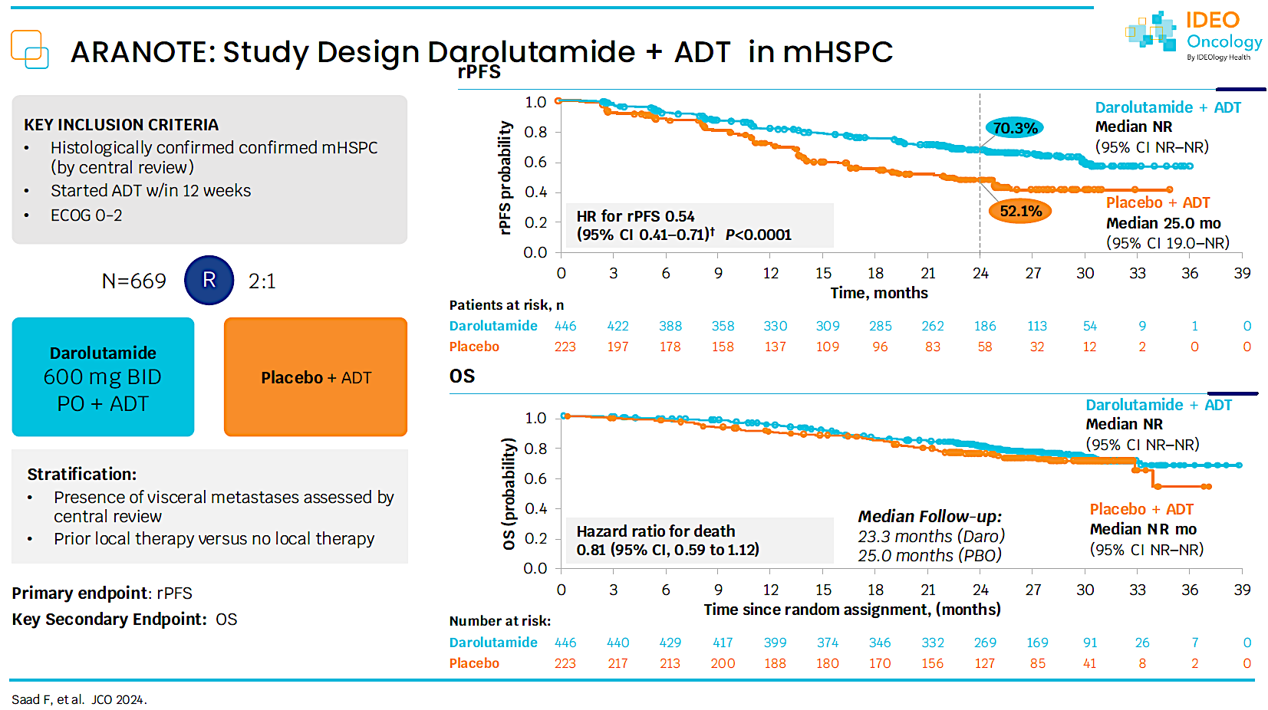
ARANOTE Primary Endpoint: rPFS*
Darolutamide significantly reduced the risk of radiological progression or death by 46%
mHSPC
1.0
0.9
70.3%
0.8
Darolutamide + ADT
Median NR (95% CI NR–NR)
0.7
0.6
rPFS probability
0.5
0.4
52.1%
Placebo + ADT
Median 25.0 mo (95% CI 19.0–NR)
0.3
0.2
HR for rPFS 0.54
(95% CI 0.41–0.71)†
P<0.0001
0.1
0.0
0
3
6
9
12
15
18
21
24
27
30
33
36
39
Patients at risk, n
Time, months
Darolutamide
446
422
388
358
330
309
285
262
186
113
54
9
1
0
Placebo
223
197
178
158
137
109
96
83
58
32
12
2
0
0
Median follow-up: darolutamide group 25.3 months; placebo group 25.0 months
*Primary analysis occurred after 222 events (darolutamide 128; placebo 94).
†HR and 95% CI were calculated using the Cox model stratified on visceral metastases (Y/N) and prior therapy (Y/N).

Slide 26
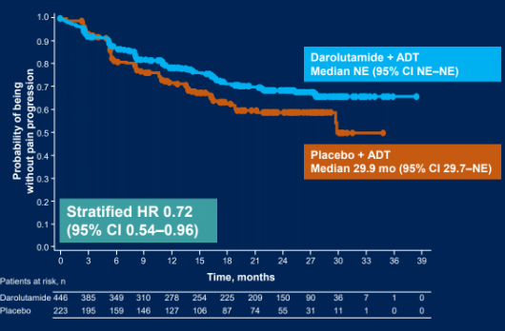
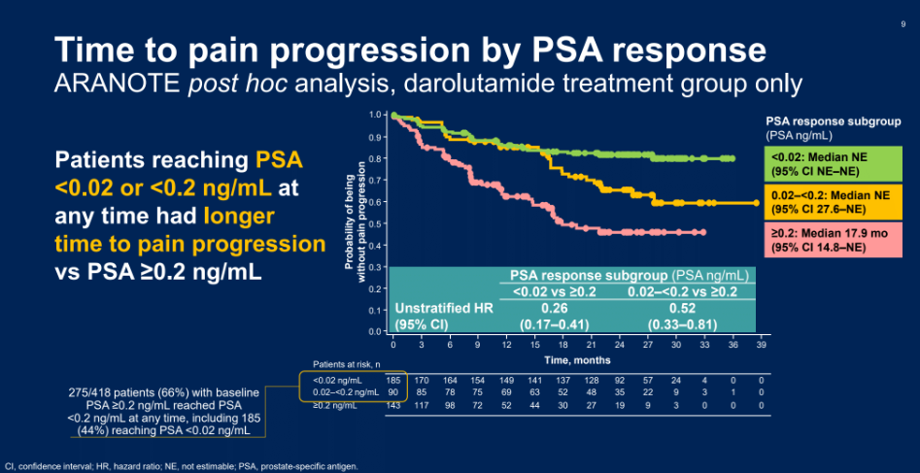
What about Quality of Life?
Morgans ASCO abstract 5004

Slide 27
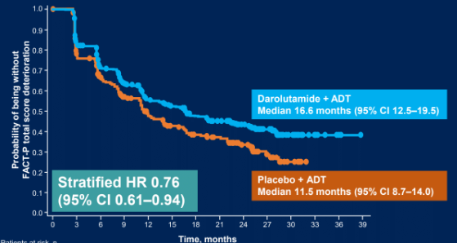
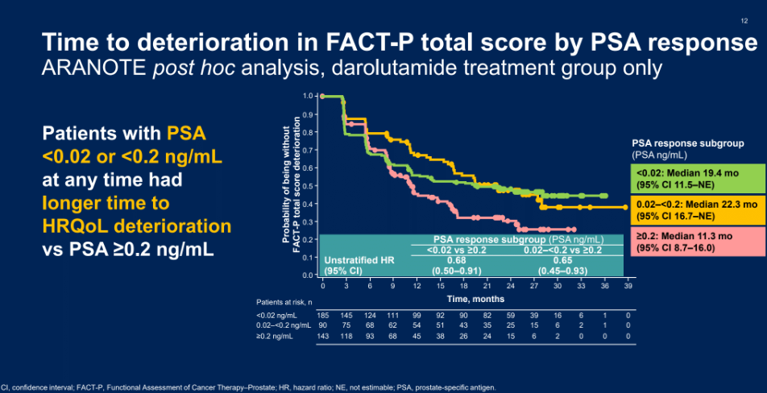
What about Quality of Life?
Morgans ASCO abstract 5004

Slide 28
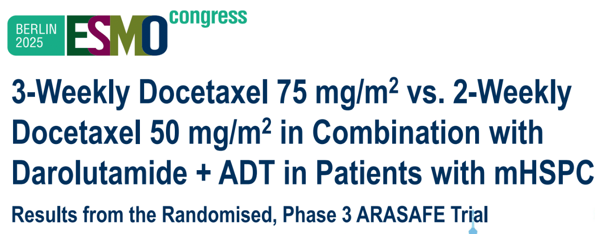
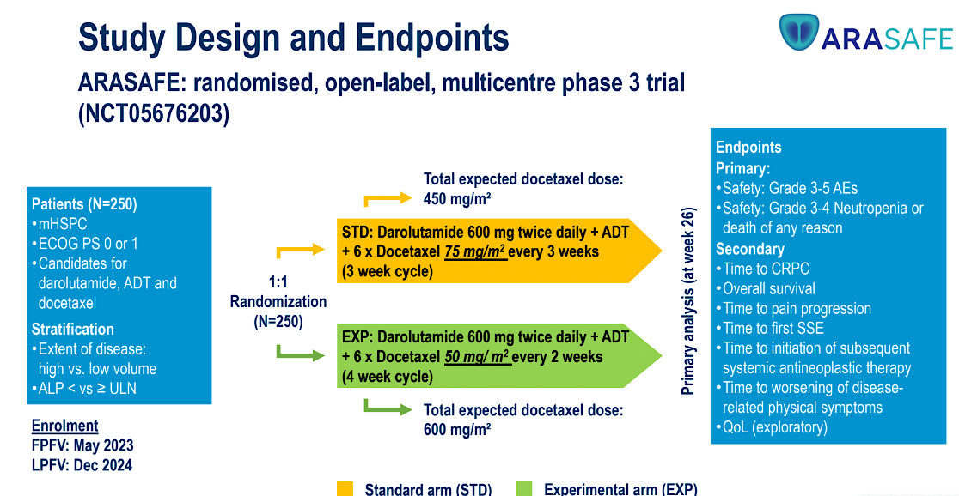
Can we improve docetaxel tolerability?
Primary endpoint: G3-5 AE rates and grade 3-4 neutropenia/death
Grimm et al ESMO 2025 LBA92

Slide 29
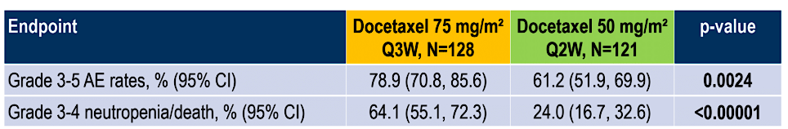
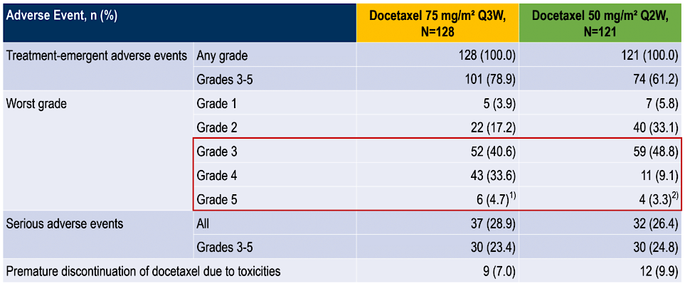
Q3 vs Q2 week docetaxel in mHSPC patients
Take home: q2 week Rx is safer and similarly effective
G3-5 Neutropenia: 56 vs 20%
Febrile neutropenia:
5.5% vs 1.7%
PSA <0.2 at week 26: 48.8 vs 41.3%

Slide 30
CAPItello-281 Study Design
A global, multicentre, randomized, double-blind, Phase 3 study
Capivasertib
Patients with PTEN deficient de novo mHSPC
400 mg BID 4 days on, 3 days off
Primary endpoint
Investigator assessed rPFS
Secondary endpoints
Overall survival
Time to first subsequent therapy
Symptomatic skeletal-event free survival
Time to pain progression
Time to castration resistance
Time to PSA progression
Exploratory post-hoc PTEN deficiency subgroups
PTEN deficiency: (diagnostic cut-off of ≥90% of viable malignant cells with no specific cytoplasmic staining by IHC)*
i.e. <10% of cells expressing PTEN by IHC
Abiraterone/pred + ADT
1000 mg/5 mg QD + ADT
1,012 patients
(R 1:1)
Placebo
400 mg BID
4 days on, 3 days off
Abiraterone/pred + ADT
Of ~6,200 patients submitting tumour tissue 97% had a valid IHC result and 25% were PTEN deficient
1000 mg/5 mg QD + ADT
Current analysis
Stratification factors:†
M1 volume (CHAARTED criteria) and visceral mets
Geography
Study timeline
Enrolment period
13 July 2020–5 Feb 2024
Primary rPFS DCO
7 Oct 2024
Median rPFS follow-up:‡ ~18 mo
Final OS DCO
Planned for 522 deaths (52.2% maturity)
NCT04493853. Full eligibility criteria available in the online article. *Determined using investigational antibody for PTEN (SP218) (Roche Diagnostics). †High-vol. disease with visceral mets, high-vol disease without visceral mets, low-vol. disease; North America; Western Europe and Australia; Latin America and Eastern Europe; Asia. ‡In censored patients. ADT, androgen deprivation therapy; BID, twice daily; IHC, immunohistochemistry; mHSPC, metastatic hormone-sensitive prostate cancer; pred, prednisone/prednisolone; QD, once daily; rPFS, radiographic progression-free survival
Karim Fizazi MD, PhD
Abstract 2383O

Slide 31
CAPItello-281 Primary endpoint: investigator-assessed rPFS
1.0
 | Capi + abi (N=507) | Pbo + abi (N=505)
Events, n (%) | 183 (36.1) | 215 (42.6)
Median rPFS, months (95% CI) | 33.2 (25.8, 44.2) | 25.7 (22.0, 29.9)
HR (95% CI) | 0.81 (0.66, 0.98)
P-value | 0.034
0.8
0.6
Probability of rPFS
0.4
25.7 months
7.5 months
33.2 months
0.2
Capivasertib + Abiraterone (N=507)
Placebo + Abiraterone (N=505)
0.0
0
3
6
9
12
15
18
21
24
27
30
33
36
39
42
45
Time from randomisation (months)
Number of patients at risk
Capi + abi | 507 | 460 | 435 | 353 | 282 | 233 | 217 | 165 | 123 | 93 | 69 | 62 | 41 | 21 | 6 | 0
Pbo + abi | 505 | 479 | 440 | 359 | 276 | 215 | 198 | 154 | 113 | 83 | 59 | 51 | 37 | 23 | 8 | 0
A stratified log-rank test was used to calculate two-sided P values. HRs and 95% CIs were calculated using a stratified Cox proportional-hazards model. Median follow-up: 18.4 months (capi + abi), 18.5 months (pbo + abi) abi, abiraterone; capi, capivasertib; CI, confidence interval; HR, hazard ratio; pbo, placebo; rPFS, radiographic progression-free survival
Karim Fizazi MD, PhD
Abstract 2383O

Slide 32
CAPItello-281: Interim OS
OS analysis was conducted at 26% maturity, further follow-up is planned
 | Capi + abi (N=507) | Pbo + abi (N=505)
Events, n (%) | 129 (25.4) | 138 (27.3)
Median OS, months (95% CI) | NC (42.5, NC) | NC (NC, NC)
HR (95% CI) | 0.90 (0.71, 1.15)
P-value | 0.401
1.0
0.8
0.6
Probability of OS
0.4
0.2
Capivasertib + Abiraterone (N=507)
Placebo + Abiraterone (N=505)
0.0
0
3
6
9
12
15
18
21
24
27
30
33
36
39
42
45
48
Number of patients at risk
Time from randomisation (months)
Capi + abi | 507 | 487 | 476 | 447 | 400 | 335 | 286 | 242 | 199 | 164 | 128 | 96 | 60 | 42 | 22 | 7 | 0
Pbo + abi | 505 | 494 | 479 | 449 | 388 | 330 | 273 | 227 | 188 | 153 | 113 | 88 | 56 | 33 | 19 | 7 | 0
A stratified log-rank test was used to calculate two-sided P values. HRs and 95% CIs were calculated using a stratified Cox proportional-hazards model. CI, confidence interval; HR, hazard ratio; NC, not calculable; OS, overall survival; pbo, placebo
Karim Fizazi MD, PhD
Abstract 2383O

Slide 33
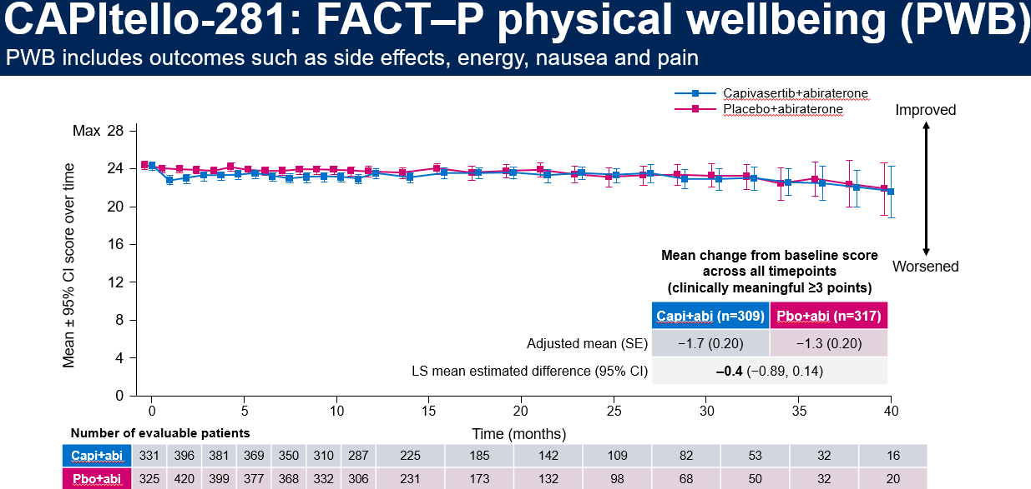
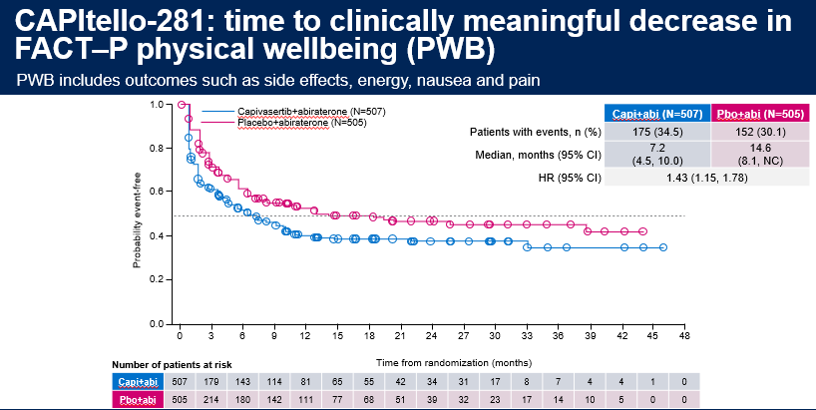
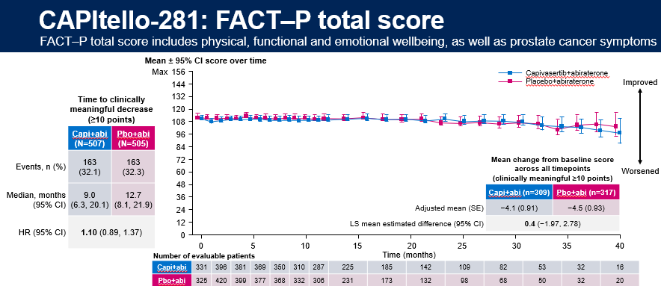
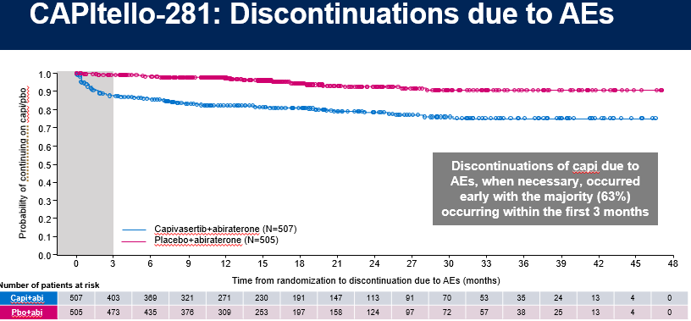
George DJ et al. Patient reported outcomes (PRO) and tolerability of capivasertib (capi) plus abiraterone (abi) versus placebo (pbo) plus abi in patients (pts) with PTEN-deficient metastatic hormone-sensitive prostate cancer (mHSPC): CAPItello-281. Genitourinary Cancer Symposium 2026;Abstract 14.

Slide 34
CAPItello-281: investigator-reported AEs (≥10% of patients)
Capi+abi (N=503)
Pbo+abi (N=503)
Total (%)/Grade ≥3 (%)
Grade 1
Grade 2
≥Grade 3
≥Grade 3
Grade 2
Grade 1
Total (%)/Grade ≥3 (%)
Diarrhea
51.9 / 6.2
8.0 / 0.4
Hyperglycemia*
38.0 / 10.3
12.9 / 0.6
Rash†
35.4 / 12.3
7.0 / 0.2
Anemia
23.9 / 5.2
12.7 / 1.0
Hypokalemia
22.1 / 8.7
12.7 / 4.8
Hypertension
19.9 / 5.8
23.9 / 7.8
Fatigue
15.9 / 0.4
12.5 / 0.8
ALT increased
14.1 / 4.4
13.3 / 3.4
Urinary tract infection
13.7 / 4.2
10.1 / 1.2
AST increased
12.9 / 2.6
11.7 / 2.0
Nausea
12.1 / 0.6
4.4 / 0.0
COVID-19
11.7 / 0.8
8.7 / 0.6
Asthenia
11.3 / 0.8
5.0 / 0.4
Pyrexia
10.9 / 1.2
2.8 / 0.0
Hot flush
10.5 / 0.2
13.5 / 0.0
Pruritus
10.5 / 0.2
2.6 / 0.0
Back pain
9.9 / 0.6
10.9 / 0.0
Constipation
8.3 / 0.2
11.9 / 0.0
Arthralgia
7.6 / 0.4
10.1 / 0.4
Diabetic ketoacidosis was reported in six patients (1.2%) in the capi+abi arm and zero patients in the pbo+abi arm *Grouped term (includes the preferred terms of blood glucose increased, hyperglycemia); †Grouped term (includes the preferred terms of erythema, rash, rash erythematous, rash macular, rash maculo-papular, rash papular, rash pruritic). abi, abiraterone; AE, adverse event; ALT, alanine aminotransferase; AST, aspartate aminotransferase; capi, capivasertib; pbo, placebo; PTEN, phosphatase and tensin homolog
Professor Daniel J. George
Abstract 14

Slide 35
CAPItello-281: common AEs associated with AKT inhibition
Rash*
Diarrhea
Hyperglycemia†
 | Capi+abi (N=503) | Pbo+abi (N=503)
Any grade AE, n (%) | 178 (35.4) | 35 (7.0)
Grade ≥3 AE,‡ n (%) | 62 (12.3) | 1 (0.2)
Median (IQR) time to onset, days | 13 (11–43) | 78 (37–195)
AE leading to, n (%)
Interruption of capi/pbo | 85 (16.9) | 3 (0.6)
Reduction of capi/pbo | 43 (8.5) | 2 (0.4)
Discontinuation of capi/pbo | 24 (4.8) | 0
Supportive treatment given, n (%) | 146 (29.0) | 20 (4.0)
Outcome at time of DCO, n (%) Recovered/recovering Not recovered | 164 (32.6) 24 (4.8) | 28 (5.6) 8 (1.6)
Capi+abi (N=503) | Pbo+abi (N=503)
261 (51.9) | 40 (8.0)
31 (6.2) | 2 (0.4)
12 (3–43) | 142 (28–339)
63 (12.5) | 1 (0.2)
22 (4.4) | 0
5 (1.0) | 0
167 (33.2) | 19 (3.8)
238 (47.3) 45 (8.9) | 36 (7.2) 4 (0.8)
Capi+abi (N=503) | Pbo+abi (N=503)
191 (38.0) | 65 (12.9)
52 (10.3) | 3 (0.6)
54 (15–114) | 114 (71–326)
55 (10.9) | 4 (0.8)
33 (6.6) | 1 (0.2)
5 (1.0) | 0
127 (25.2) | 23 (4.6)
140 (27.8) 65 (12.9) | 43 (8.5) 25 (5.0)
*Grouped term including the preferred terms of erythema, rash, rash erythematous, rash macular, rash maculopapular, rash papular, rash pruritic. †Grouped term including the preferred terms of blood glucose increased, hyperglycemia. ‡A diarrhea AE of Grade 4 was reported for one patient (0.2%) in the capi+abi arm only, hyperglycemia AEs of Grade 4 and Grade 5 were reported for one patient (0.2%) each in the capi+abi arm only, no Grade 4–5 AEs of rash were reported. No primary prophylaxis interventions were used during the CAPItello-281 trial for prospective AE management. Additional data on supportive treatment received are available via QR code. abi, abiraterone; AE, adverse event; capi, capivasertib; DCO, data cutoff; IQR, interquartile range; pbo, placebo
Professor Daniel J. George
Abstract 14

Slide 36
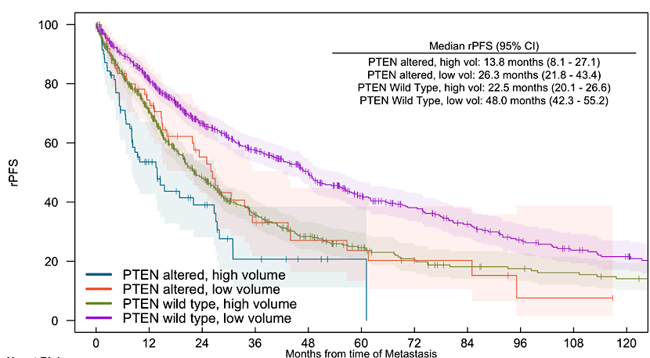
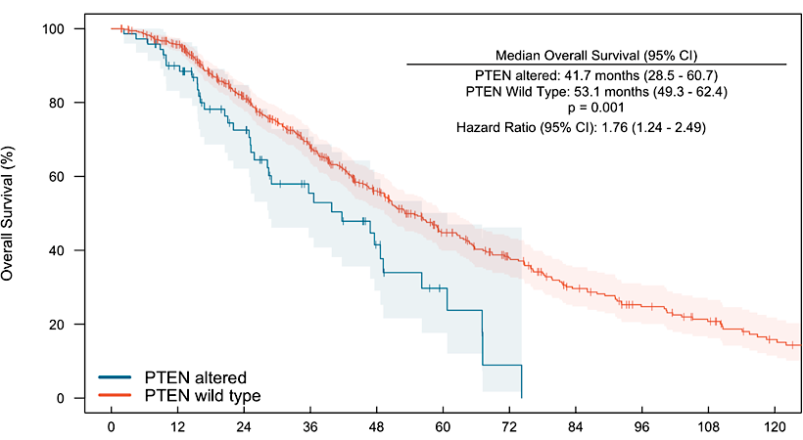
My Takeaways: Capitello-281
PTEN loss is associated with worse rPFS and OS with ADT/ARPI therapy in men with mHSPC. See our data from the PROMISE registry (Thapa and Kilmari, manuscript submitted)
Similar poor outcomes seen in Capitello-281 (25.7 mo vs LATTITUDE (33.0 mo), with frequent PSA-radiographic discordant progression
Capi/abi improves rPFS but does not yet improve OS, and is associated with more toxicities, short term worsening of QOL, and treatment discontinuations
Unclear if this will represent a new standard of care without improved survival

Slide 37
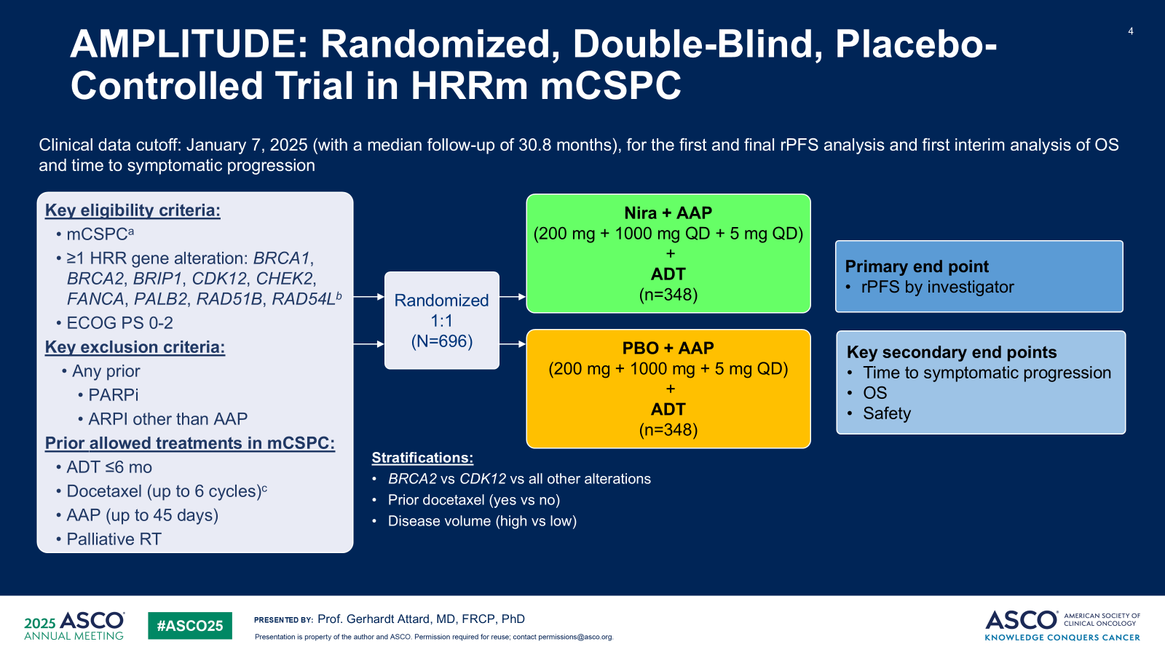
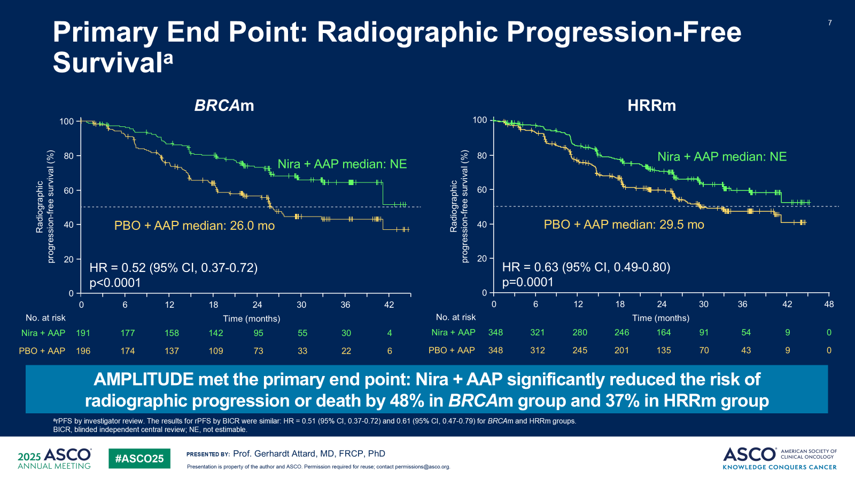
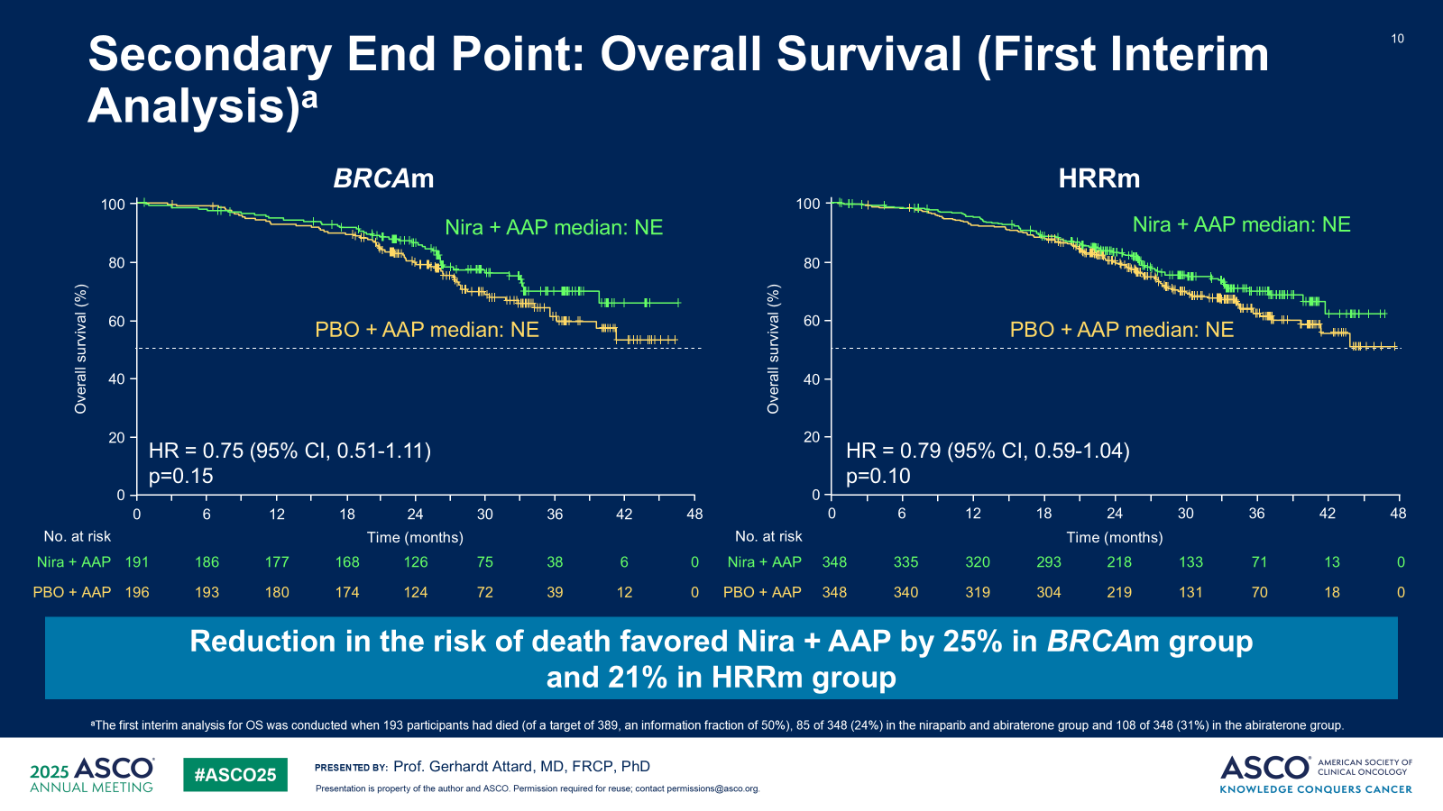
AMPLITUDE
rPFS
86% synchronous
77% high-volume
55% BRCAm
16% prior docetaxel
No radiation to primary
(Benefit in non-BRCA HRR: “unclear”)
OS (1st interim)
Attard G et al. ASCO 2025;Abstract LBA5006

Slide 38
TALAPRO-3 (Talazoparib): Phase 3 Trial Design (mHSPC)
Key Eligibility
Men aged ≥ 18 years with confirmed mHSPC (adenocarcinoma)
Metastatic disease documented by greater than or equal to (>=) 1 bone or soft tissue lesion(s)
Positive for deleterious germline or somatic homologous recombination repair (HRR) gene mutations
Radiation/surgery with curative intent or prior treatment with chemotherapy or PARPi is not allowed
Patients with brain metastases or a history of MDS or AML were excluded
R A N D O M I Z E D
n=550
Talazoparib 0.5 mg/day
(0.35 mg/day [PO]
if moderate renal
impairment)
+
open-label enzalutamide
160 mg/day (PO)
Efficacy end points
Primary:
rPFS
Secondary:
OS
ORR
PSA response
Health-related quality of life
Placebo
+
open-label enzalutamide
160 mg/day (PO)
www.clinicaltrials.gov: (NCT04821622)
1 Agarwal et al., 2022, ABSTRACT TPS 221 ASCO-GU

Slide 39
EvoPAR-Prostate01: Phase 3 Trial Design (mHSPC)
A Phase III, 2-cohort, 2-arm, randomized, double-blind, placebo-controlled study evaluating the efficacy and safety of saruparib plus physician’s choice of NHA (abiraterone, darolutamide, or enzalutamide) versus placebo plus physician’s choice of NHA in participants with mCSPC
Eligibility criteria
≈550 patients
Saruparib 60 mg plus physician’s choice NHA
Select endpoints
HRRm
HRRm cohort
rPFS
OS
Non-HRRm cohort
rPFS
OS
Aged ≥18 years
Histologically confirmed mCSPC (de novo or recurrent low- or high-volume disease)
ECOG PS 0–1
Prospectively defined HRRm status*
Must be receiving ADT throughout the study or have undergone bilateral orchiectomy, and must be suitable for treatment with NHAs
No prior treatment with PARP inhibitors, CT, or NHAs in the metastatic setting†
No suspected or prior history of myelodysplastic syndrome/acute myeloid leukemia
R 1:1
Placebo plus physician’s choice NHA
No crossover between cohorts
Saruparib 60 mg plus physician’s choice NHA
Statistical analyses
Non-HRRm
rPFS and OS will be tested for each cohort separately using a stratified log-rank test
R 1:1
Placebo plus physician’s choice NHA
≈1250 patients
Treatment will continue until disease progression, unacceptable toxicity, or participant-initiated withdrawal
www.clinicaltrials.gov: (NCT06120491)
Agarwal N. et al, AUA 2024

Slide 40
mHSPC Algorithm 2026
Metastatic Hormone-Sensitive Prostate Cancer (mHSPC)
High-volume mHSPC
(based on conventional imaging)
Low-volume mHSPC
(based on conventional imaging)
Synchronous/de novo metastases
Metachronous/relapsed metastases
Synchronous/de novo metastases
Metachronous/ relapsed metastases
Triplet therapy:
Docetaxel + abiraterone + ADT
Niraparib + abi + ADT (BRCA2m)
Docetaxel + darolutamide + ADT
(preferred)
or
Docetaxel + ADT → ADT/enzalutamide
Docetaxel + ADT → ADT/apalutamide
Triplet therapy: Docetaxel + ARSI + ADT vs.
Doublet therapy:
ADT + ARSI or docetaxel
Triplet therapy: Docetaxel + ARSI + ADT or
Abi+ niraparib + ADT (BRCA2m)
vs.
Doublet therapy:
ADT + ARSI or docetaxel
+
Radiation to the primary (+/- pelvis)
Doublet therapy: ARSI + ADT

Slide 41
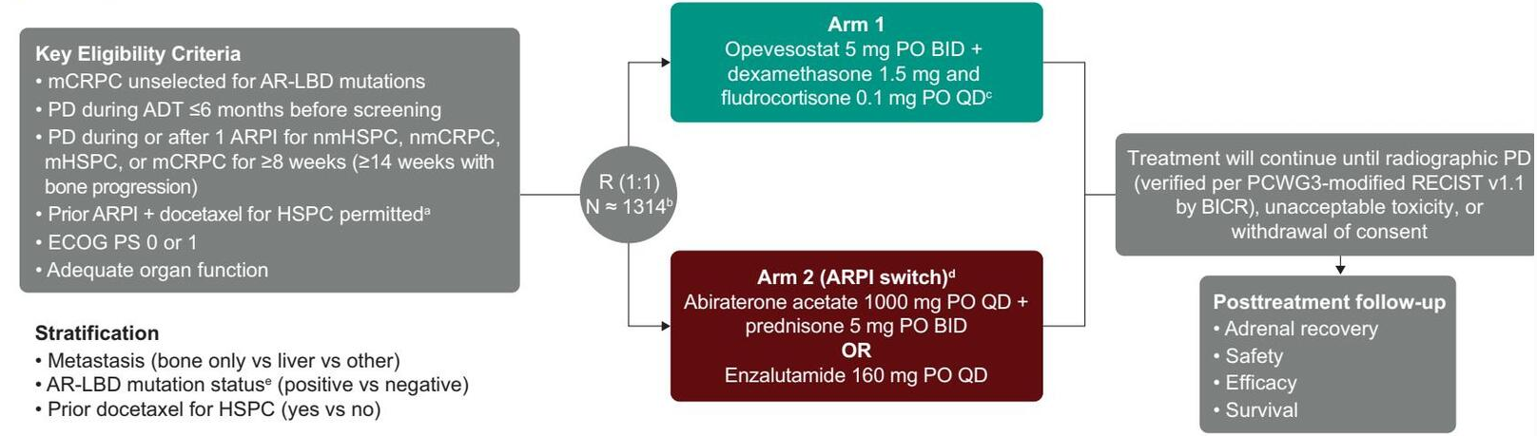
Emerging Therapy: Opevesostat (CYP11A1 Upstream Androgen Synthesis Inhibitor)
OMAHA-004
Primary endpoints: rPFS
N=400 AR LBD+
N=900 AR LBD-
Separately
OMAHA-003: Similar but requires 1-2 prior taxanes for mCRPC (n=1310). Primary: OS (separate analysis by AR LBD status)
Fizazi K et al. ASCO GU 2026
Yu E et al. ASCO GU 2026
AbstractsTPS298-9

Slide 42
Appendix

Slide 43
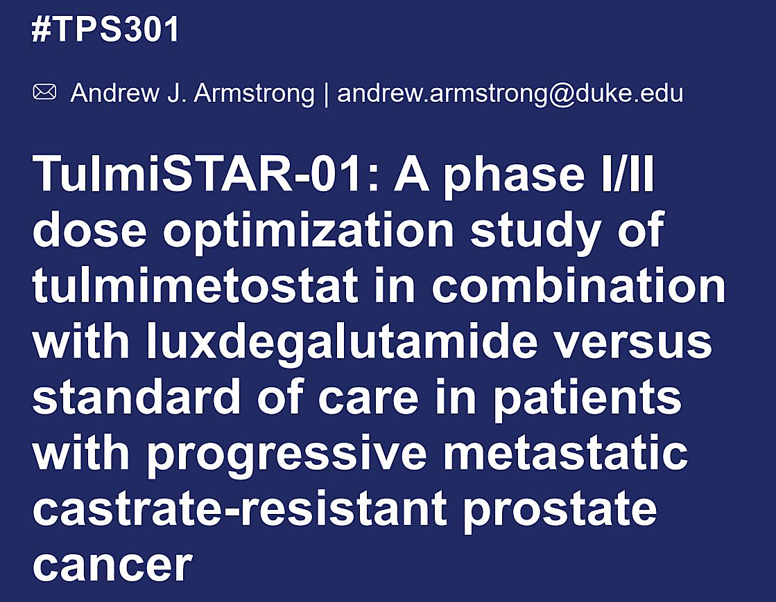
Armstrong A et al. ASCO GU 2026
Notes:
TulmiSTAR-01:

Slide 44

TulmiSTAR01: Study Design
Armstrong A et al. ASCO GU 2026

Slide 45

TulmiSTAR01: Key Points
Armstrong A et al. ASCO GU 2026

