Slide 1
Gastroesophageal Cancers
Understanding the Current Paradigm and
New Approaches in the Care of Patients with Cancer
A Complimentary NCPD Hybrid Symposium Series Held During the 50th Annual ONS Congress
Saturday, April 12, 2025
12:15 PM – 1:45 PM
Faculty
Sunnie Kim, MD
Brooke Parker, MSN, FNP
Michal F Segal, BSN, RN, OCN
Manish A Shah, MD
Moderator
Neil Love, MD

Slide 2




Faculty
Brooke Parker, MSN, FNP
Gastrointestinal Oncology Nurse Practitioner
UCHealth Cancer Care
Aurora, Colorado
Sunnie Kim, MD
GI Medical Oncologist
Associate Professor
University of Colorado Cancer Center
Aurora, Colorado
Michal F Segal, BSN, RN, OCN
Clinical Trials Nurse II
Memorial Sloan Kettering Cancer Center
New York, New York
Manish A Shah, MD
Professor of Medicine
Bartlett Family Professor of Gastrointestinal Oncology
Chief, Solid Tumor Oncology
Weill Cornell Medicine/NewYork-Presbyterian Hospital
New York, New York

Slide 3
Dr Kim — Disclosures
Consulting Agreements | Amgen Inc, AstraZeneca Pharmaceuticals LP, BeiGene Ltd, Bristol Myers Squibb, Gilead Sciences Inc, I-Mab Biopharma, Merck
Contracted Research | Merck
Data and Safety Monitoring Boards/ Committees | Jazz Pharmaceuticals Inc

Slide 4
Ms Parker — Disclosures
No relevant conflicts of interest to disclose

Slide 5
Ms Segal — Disclosures
Consulting Agreements | Astellas

Slide 6
Dr Shah — Disclosures
No relevant conflicts of interest to disclose

Slide 7
Commercial Support
This activity is supported by educational grants from Astellas and BeiGene Ltd.
Research To Practice NCPD Planning Committee Members,
Staff and Reviewers
Planners, scientific staff and independent reviewers for Research To Practice have no relevant conflicts of interest to disclose.

Slide 8
This educational activity contains discussion of
non-FDA-approved uses of agents and regimens. Please refer to official prescribing information for each product for approved indications.

Slide 9
Agenda
Introduction: Clinical Presentation of Gastroesophageal Cancer
Module 1: Management of Localized or Locally Advanced Gastroesophageal Cancers; Current and Future Role of Immune Checkpoint Inhibitors
Module 2: Incorporation of Immunotherapeutic Strategies for HER2-Negative Metastatic Gastroesophageal Tumors
Module 3: Role of Therapy Targeting CLDN18.2 in Advanced Gastric/Gastroesophageal Junction Adenocarcinoma
Module 4: Considerations in the Care of Patients with HER2-Positive Gastroesophageal Cancers

Slide 10
Agenda
Introduction: Clinical Presentation of Gastroesophageal Cancer
Module 1: Management of Localized or Locally Advanced Gastroesophageal Cancers; Current and Future Role of Immune Checkpoint Inhibitors
Module 2: Incorporation of Immunotherapeutic Strategies for HER2-Negative Metastatic Gastroesophageal Tumors
Module 3: Role of Therapy Targeting CLDN18.2 in Advanced Gastric/Gastroesophageal Junction Adenocarcinoma
Module 4: Considerations in the Care of Patients with HER2-Positive Gastroesophageal Cancers

Slide 11
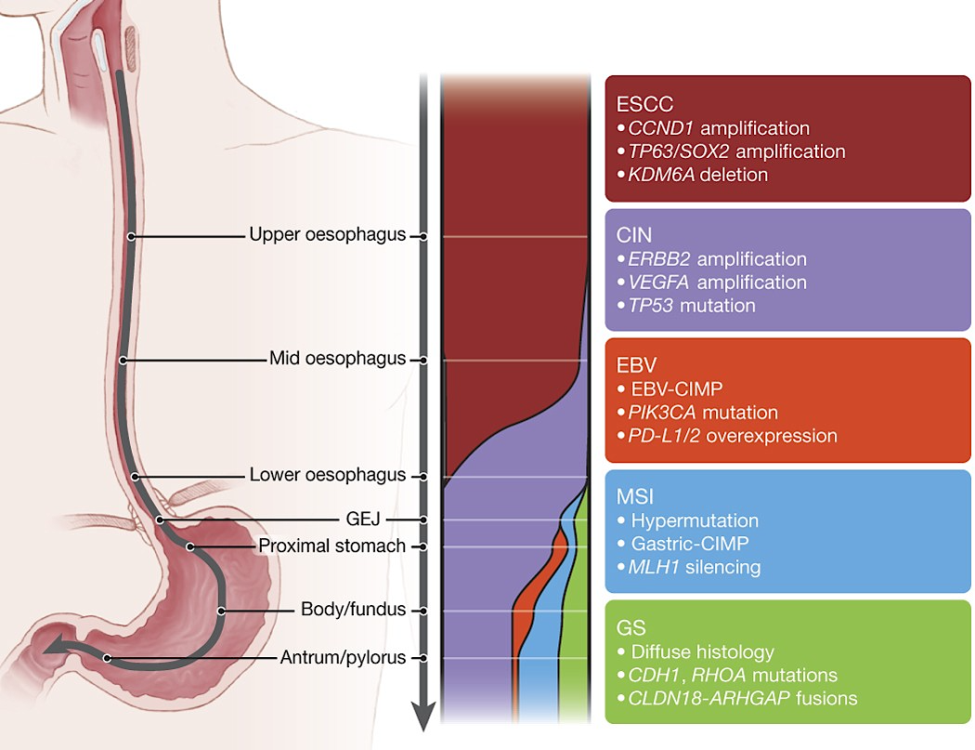
Esophago-gastric cancer subclasses
The Cancer Genome Atlas Research Network. Nature. 2017;541:169-175

Slide 12
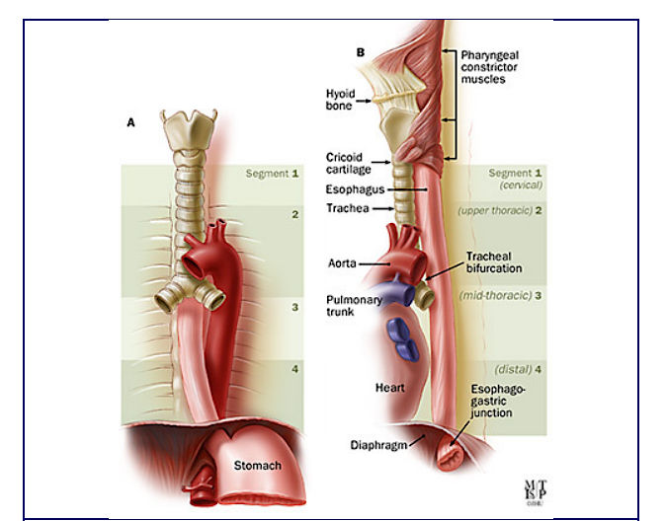
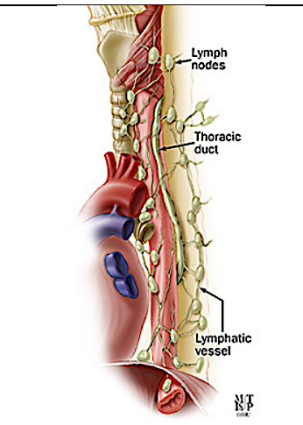
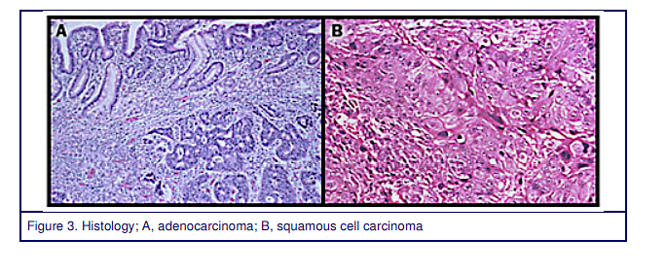
Adenocarcinoma v. Squamous Cell Cancer?
Esophageal Cancer can present as Squamous Cell Carcinoma (SCC) or Adenocarcinoma
Esophageal Cancer can present as Squamous Cell Carcinoma (SCC) or Adenocarcinoma

Slide 13
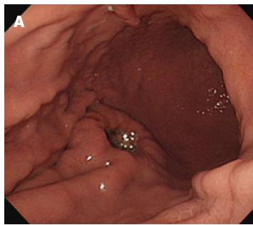
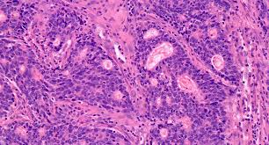
Case Presentation: Dr Shah
67-year-old male presents with anemia and pain after eating. He continues to work as a lawyer but is finding he needs to rest in the afternoons.
Work up reveals pallor on exam, Hb 7.4, LFT WNL
EGD reveals a mass in the gastric cardia
Pathology is consistent with adenocarcinoma, intestinal type, moderately differentiated

Slide 14
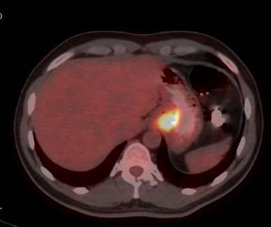
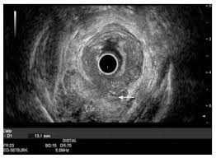
Case Presentation: Dr Shah
CT/PET is without evidence of metastatic disease
EUS reveals tumor invading into submucosa, 2 lymph nodes, FNA of the node is positive for adeno ca - cT3N1M0
Laparascopic evaluation is without evidence of disease, cytology washings are negative
Molecular testing reveals the following profile:
  PD-L1 tumor area positivity (TAP) >10%, HER2-negative, microsatellite stable (MSS)

Slide 15
Case Presentation: Dr Shah
67-year-old male presents with anemia and pain after eating. He continues to work as a lawyer but is finding he needs to rest in the afternoons.
Work up reveals pallor on exam, Hb 7.4, LFT WNL
EGD reveals a mass in the gastric cardia, adenocarcinoma, moderately differentiated
Pt received perioperative FLOT chemotherapy
Resection – rare cancer cells, consistent with major pathologic response. TRG 1. ypT3N0. (0/18 lymph nodes).

Slide 16
Agenda
Introduction: Clinical Presentation of Gastroesophageal Cancer
Module 1: Management of Localized or Locally Advanced Gastroesophageal Cancers; Current and Future Role of Immune Checkpoint Inhibitors
Module 2: Incorporation of Immunotherapeutic Strategies for HER2-Negative Metastatic Gastroesophageal Tumors
Module 3: Role of Therapy Targeting CLDN18.2 in Advanced Gastric/Gastroesophageal Junction Adenocarcinoma
Module 4: Considerations in the Care of Patients with HER2-Positive Gastroesophageal Cancers

Slide 17
Clinical Scenario
A patient with newly diagnosed esophageal cancer that is amenable to surgical resection

Slide 18

Locally Advanced Esophageal Cancer
Manish A. Shah, MD, FASCO
Weill Cornell Medicine/NewYork-Presbyterian
mas9313@med.cornell.edu

Slide 19
Epidemiology
Esophageal cancer is the 7th leading cause of cancer deaths
1% of all malignancy and 6% of all GI malignancy
Most common in China, Iran, South Africa, India and former Soviet Union
Incidence rises with age, reaching a peak in the 6th to 7th decade of life
Male:female 3.5:1
In the US African-American males:white males 5:1

Slide 20
CROSS Trial: Major Results
93% received all courses chemotherapy
  95% went to operating room
  ~23% had >grade 3 toxicity from pre-op therapy
R0 resection rate: 92% versus 67% p<0.001
  ~26% had pathologic complete remissions
Post-operative morbidity and mortality almost identical

Slide 21
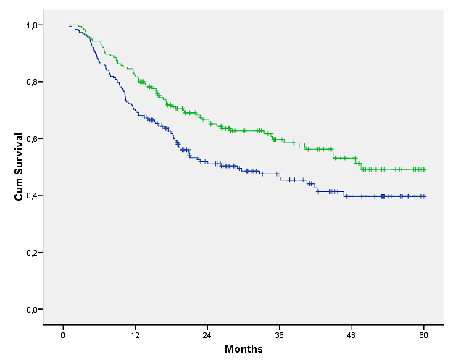
CROSS Trial: Overall Survival
1-year survival 82 versus 70%
2-year survival 67 versus 52%
Median survival 49 versus 26 months

Slide 22
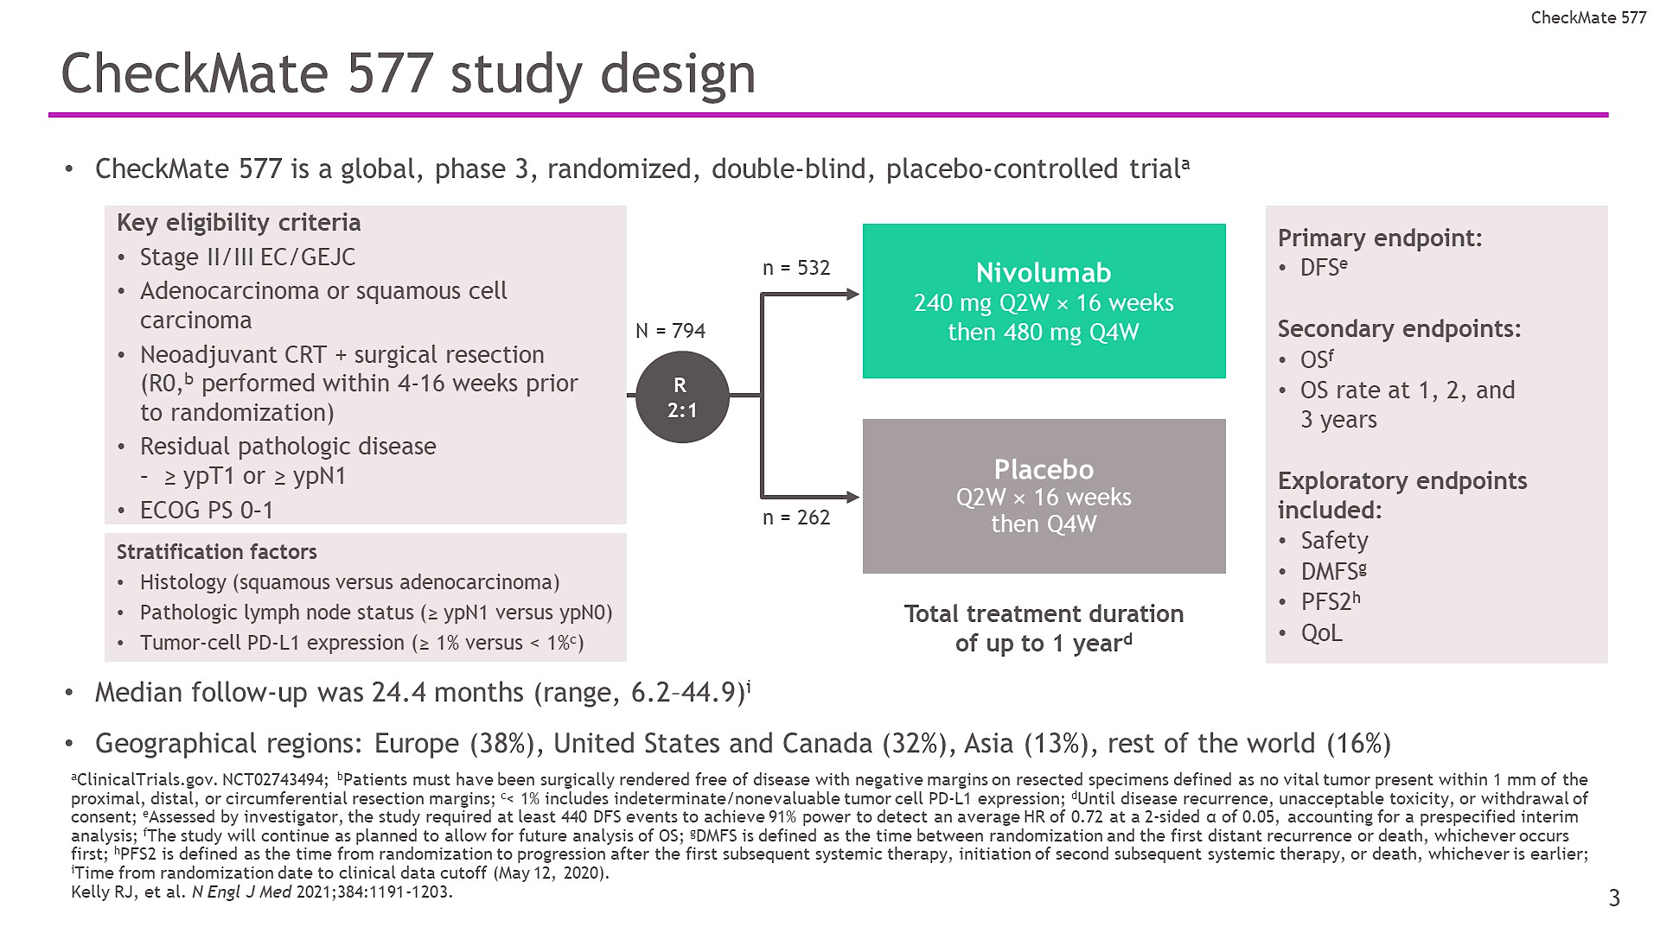
Kelly et al., N Engl J Med 2021;384:1191-1203

Slide 23
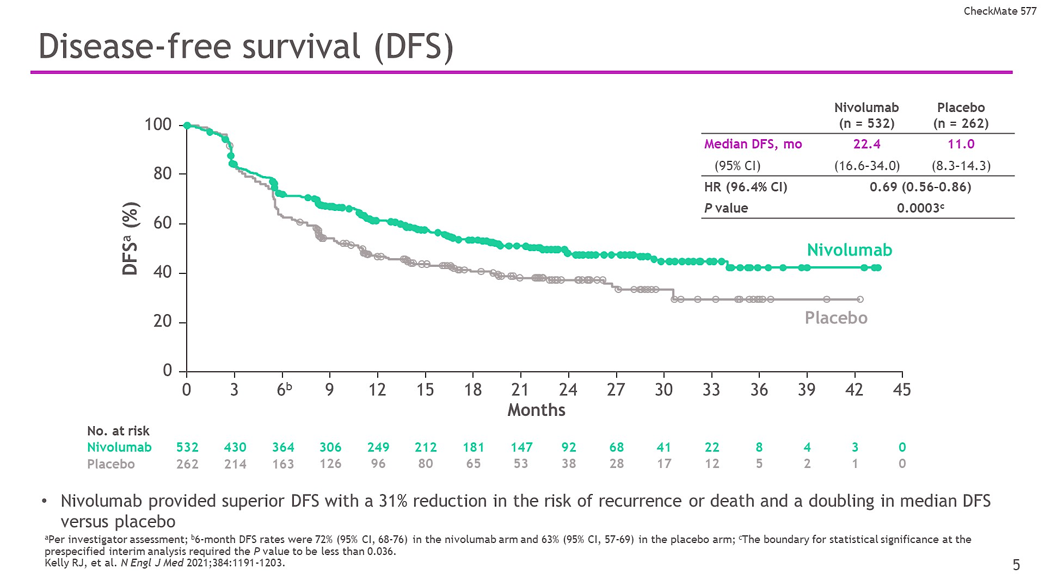
Kelly et al., N Engl J Med 2021;384:1191-1203

Slide 24
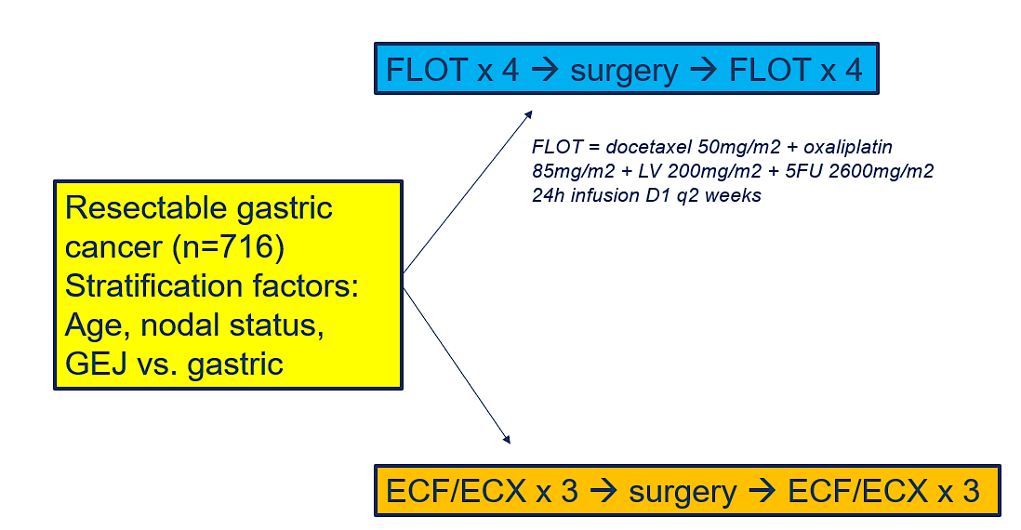
FLOT4-AIO: Perioperative FLOT vs ECF/ECX

Slide 25
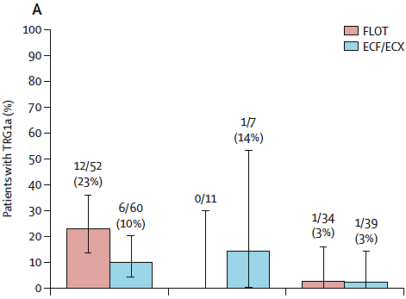
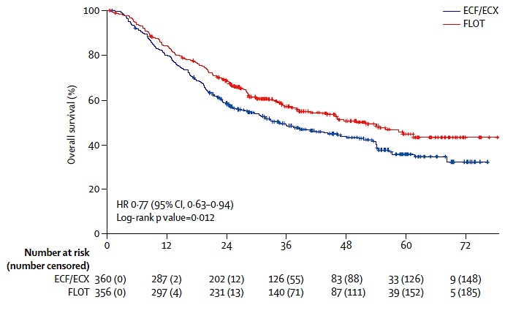
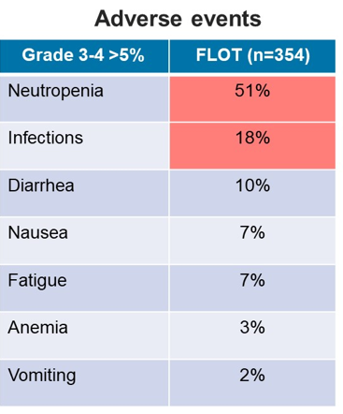
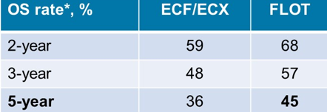
FLOT4-AIO: Perioperative FLOT improves OS vs ECF/ECX
Overall pCR (TRG1a):
FLOT: 16%
ECF/ECX: 6%
Median OS: 50 mo vs 35 mo
Median DFS: 30 mo vs 18 mo
Al-Batran SE et al. Lancet. 2019;393(10184):1948-1957;
Al-Batran SE et al. Lancet Oncol. 2016;17(12):1697-1708;
Tables extrapolated from Dr. Burguete-Torres’ presentation, ASCO GI 2024

Slide 26
Durvalumab-based regimen demonstrated statistically significant and clinically meaningful improvement in event-free survival in resectable early-stage gastric and gastroesophageal junction cancers
Press Release: March 7, 2025
Positive high-level results from the MATTERHORN Phase III trial showed perioperative treatment with durvalumab in combination with standard-of-care FLOT (fluorouracil, leucovorin, oxaliplatin, and docetaxel) chemotherapy demonstrated a statistically significant and clinically meaningful improvement in the primary endpoint of event-free survival (EFS).
Patients were treated with neoadjuvant durvalumab in combination with chemotherapy before surgery, followed by adjuvant durvalumab in combination with chemotherapy, then durvalumab monotherapy. The trial evaluated this regimen versus perioperative chemotherapy alone for patients with resectable, early-stage and locally advanced (Stages II, III, IVA) gastric and gastroesophageal junction (GEJ) cancers.
For the secondary endpoint of overall survival (OS), a strong trend was observed in favour of the durvalumab-based regimen at this interim analysis. The trial will continue to follow OS, which will be formally assessed at the final analysis.
https://www.astrazeneca.com/media-centre/press-releases/2025/imfinzi-improved-efs-in-early-stage-gastric-cancer.html

Slide 27
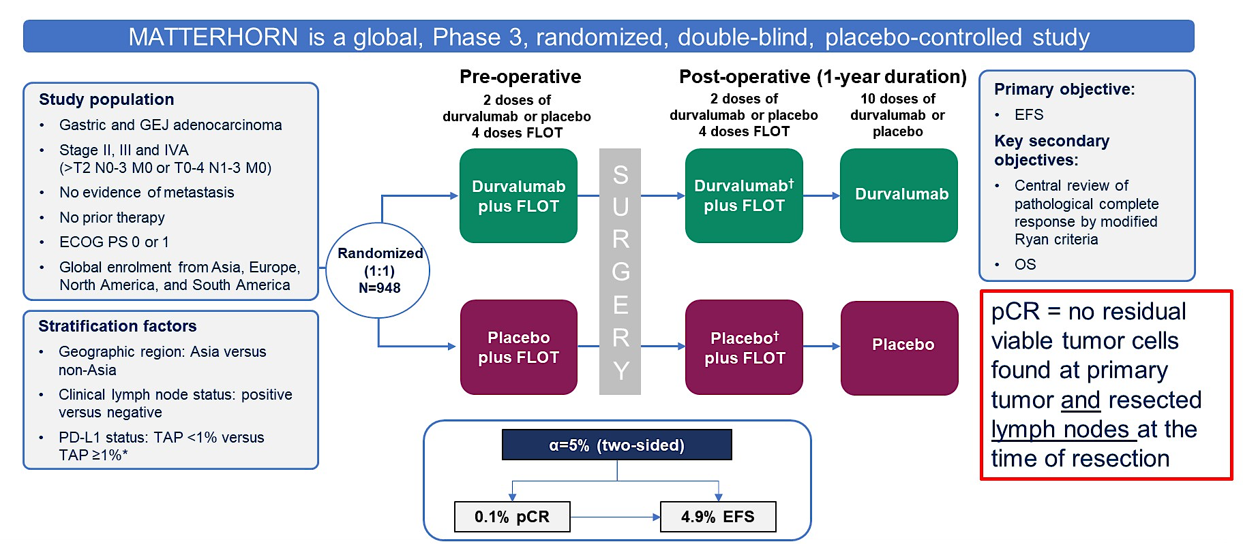
Methods
Janjigian YY, et al., Annal Oncol 2023, 34:S1315-S1316

Slide 28
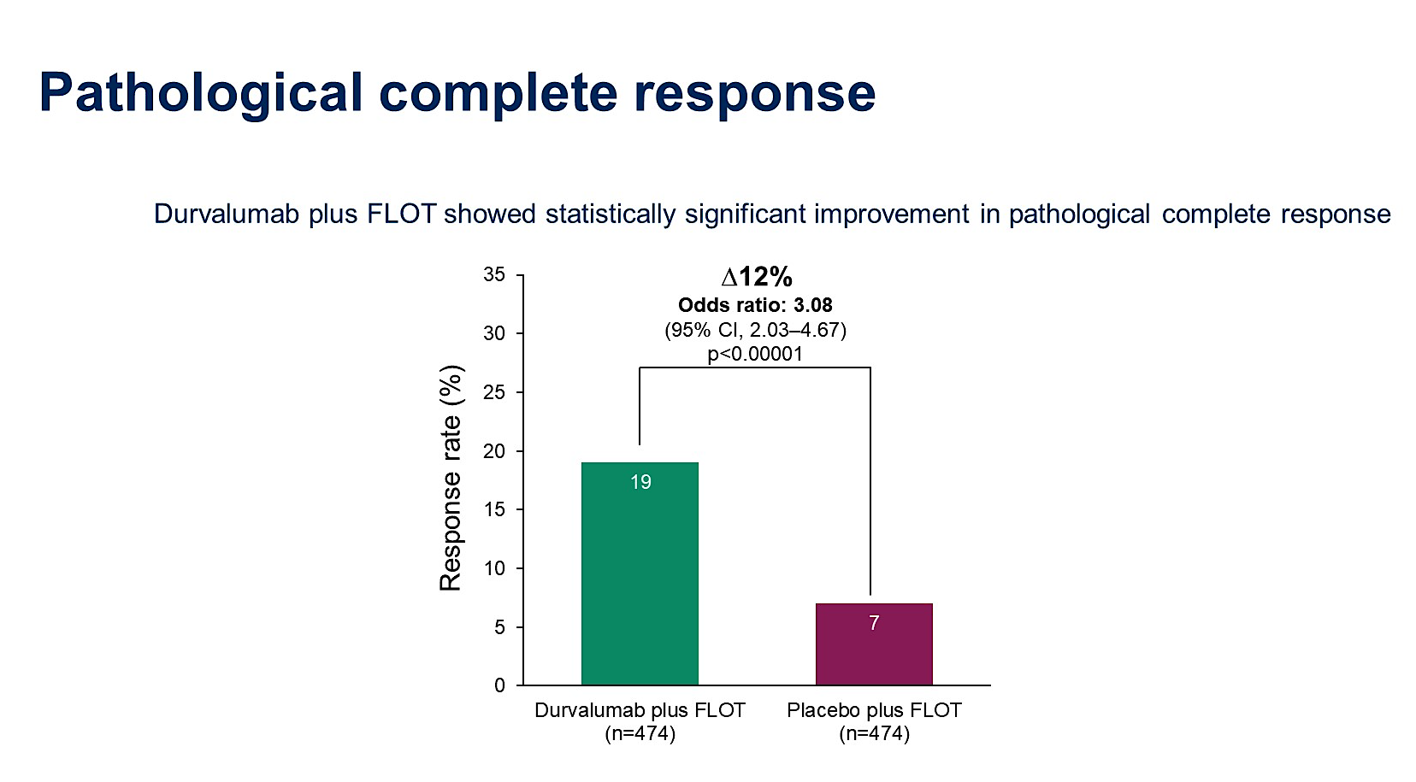
Pathological complete response
Janjigian YY, et al., Annal Oncol 2023, 34:S1315-S1316

Slide 29
Primary endpoint (EFS) met!
Janjigian YY, et al., Annal Oncol 2023, 34:S1315-S1316

Slide 30
Summary
FLOT remains standard of care in perioperative MSS esophagogastric cancer
  ESOPEC
  Checkmate 577
MSI H/dMMR disease IO
The addition of IO to perioperative chemotherapy has improved pCR but not impacted OS
  Matterhorn is positive for EFS
The role of radiation limited to R1 disease

Slide 31
Roundtable Discussion

Slide 32
Management of Localized/Locally Advanced Gastroesophageal Cancers
Nursing Considerations
Michal F Segal, BSN, RN, OCN

Slide 33
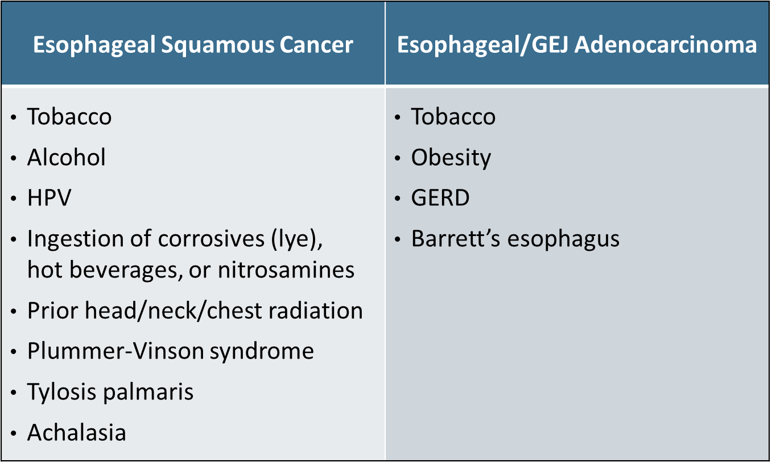
Known Risk Factors
Esoph/GEJ/Gastric
Age Sex Race
Source: Enzinger PC, Mayer RJ. Esophageal cancer. N Engl J Med. 2003;349(23):2241-2252.

Slide 34
Known Risk Factors
Gastric Adenocarcinoma
Fried foods, salted meats, low fiber, nitrates, pickled vegetables H. pylori Tobacco Atrophic gastritis Intestinal metaplasia High Body Mass Index Coal mining, lumber, rubber Low vitamin C Previous gastric ca surgery
Genetic Risk Factors
Lynch syndrome Menetrier disease FAP (Familial adenomatous polyposis) Hereditary diffuse gastric Ca: (CDH1) E-cadherin mutations
Salted foods: (Int J Cancer. 2004;108(4):606-12)
Vit C use: Cancer Epidemiol Biomarkers Prev. 2002;11(1):35-41. :
Occupation: Scand J Work Environ Health. 1991 Aug;17(4):240-7.
Smoking: Smoking: Int J Cancer. 2003 Nov 20;107(4):629-34.
J Gastroenterol Hepatol. 2003 Nov;18(11):1257-1263
Pernicious anemia Gut. 2003 Jul;52(7):938-41.

Slide 35


Common Presenting Symptoms
Dysphagia/Odynophagia
Weight loss
Abdominal pain
Supraclavicular adenopathy
Other
          Cough
          Hoarseness

Slide 36
Typical Side Effects: Chemotherapy, Immunotherapy and/or Radiation
Chemotherapy and Immunotherapy | Radiation
Fatigue, weakness Nausea, vomiting, loss of appetite Weight loss Constipation, diarrhea Mouth sores Hand-foot syndrome Photosensitivity Hair loss (paclitaxel) Effects from supportive medications IO: “Itis’s” (colitis, gastritis, etc.) | Fatigue Nausea Skin changes Dysphagia/odynophagia

Slide 37
Side Effect Prevention and Management
All Modalities
Pre-medication Take home PRN – Proactive with Rx and OTC Weight management – stress caloric intake, protein Small, frequent meals, liberalize food choices and textures IV hydration as needed Rest/time off from work Manage activities/physical expectations Reporting symptoms Mouth care prevention Skin care prevention Hygiene/avoid sick people Movement/light exercise Support system

Slide 38
Post Op Management
Monitoring Tools
Food tracking Scale for weight Blood test Albumin Metabolic panel
Manage expectations
PEG/PEJ tube (short-term)
Hydration – with calories (limit during meals)
Supplements (Shakes, meal-replacement)
Slow, small, frequent meals
Soft, avoid spicy, avoid fatty, avoid carbonated
Mindset adjustment, food schedule
Pain management
Dumping syndrome – sugary, fatty
Reflux management

Slide 39
Supportive Care
Integrative Medicine
Acupuncture Acupressure Yoga Tai chi Massage therapy Dance and movement therapy Meditation and other mind-body relaxation therapies Music therapy Exercise
Nutritionist
Registered Dietician
  Meal Plans
  Recipe ideas
  Tips/tricks
Support Groups
Resources for Life After Cancer (RLAC) Program (MSK)

Slide 40
Case Study
60-year-old male with a history of GERD presents with 2 months of progressive dysphagia accompanied with 10-pound weight loss. Endoscopy last week revealed partially obstructing mass at the gastroesophageal junction extending into the cardia. Pathology confirmed poorly differentiated adenocarcinoma.
What are next steps?

Slide 41
Case Study
Preparation and Education
Complete work up (imaging, EUS)
Mediport, EKG, basis labs
Discuss adjuvant and neoadjuvant therapy
Investigate available support system
Introduce nutrition and social work
What to expect, manage anxiety
Help guide disability leave, or accommodations
Cancer center navigation

Slide 42
Roundtable Discussion

Slide 43
Agenda
Introduction: Clinical Presentation of Gastroesophageal Cancer
Module 1: Management of Localized or Locally Advanced Gastroesophageal Cancers; Current and Future Role of Immune Checkpoint Inhibitors
Module 2: Incorporation of Immunotherapeutic Strategies for HER2-Negative Metastatic Gastroesophageal Tumors
Module 3: Role of Therapy Targeting CLDN18.2 in Advanced Gastric/Gastroesophageal Junction Adenocarcinoma
Module 4: Considerations in the Care of Patients with HER2-Positive Gastroesophageal Cancers

Slide 44
Clinical Scenario
A patient with newly diagnosed metastatic gastric cancer who is about to begin first-line treatment with chemotherapy in combination with an anti-PD-1/PD-L1 antibody

Slide 45
Incorporation of Immunotherapeutic Strategies for Patients with HER2-Negative Metastatic Gastroesophageal Tumors
Sunnie Kim, MD

Slide 46
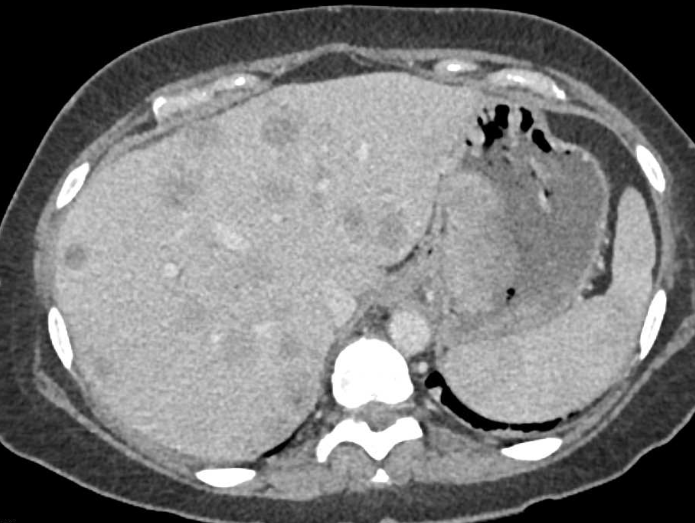
Patient Case
67-year-old woman presents with abdominal pain, anemia and weight loss
EGD shows fungating mass in gastric body
Pathology reveals moderately differentiated adenocarcinoma with signet ring features
CT CAP shows liver lesions, lung nodules, and peritoneal thickening consistent with metastatic disease
Next steps?

Slide 47
Growing List of Biomarker Testing in GE Cancers
PD-L1
MMR/MSI
HER2
Claudin 18.2
Rarer alterations (NTRK, EBV, EGFR, BRAF V600E, RET)

Slide 48
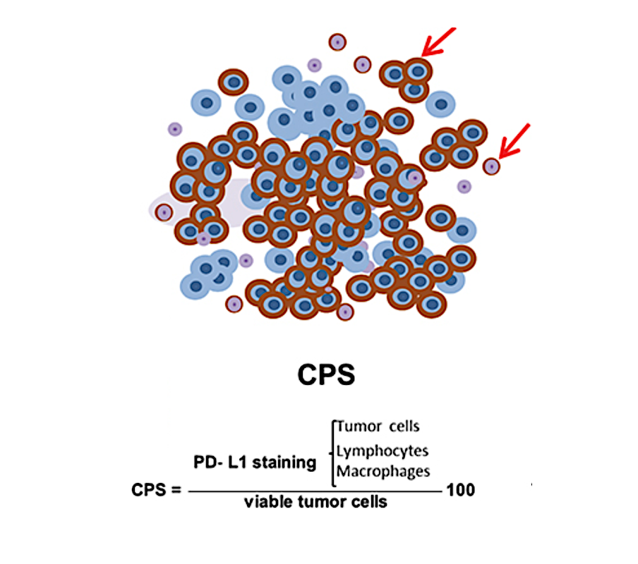
PD-L1 Combined Positive Score (CPS)
Epistola R, Cancer Management Research 2023

Slide 49
Patient Case
67-year-old woman with Stage 4 gastric cancer
Biomarker testing as follows:
  pMMR
  PD-L1 CPS: 10
  HER2 negative
  Claudin 18.2 negative
Started FOLFOX+nivolumab

Slide 50
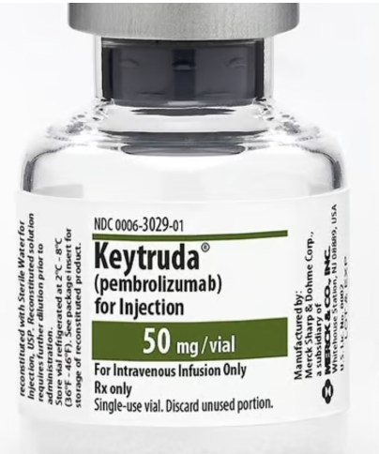
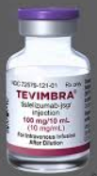
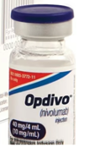
Phase 3 trials of 1L chemo+PD-1 inhibitor versus chemo in advanced gastric/GEJ cancer
Pembrolizumab
Tislelizumab
Nivolumab
KEYNOTE-859
OS: 12.9 months v 11.5 months
RATIONALE-305
OS: 15.0 months v 12.9 months
CheckMate 649
OS: 13.7 months v 11.6 months
Ra, SY G ASCO 2024
Qiu, MZ BMJ 2024
Janjigian YY GI ASCO 2025

Slide 51
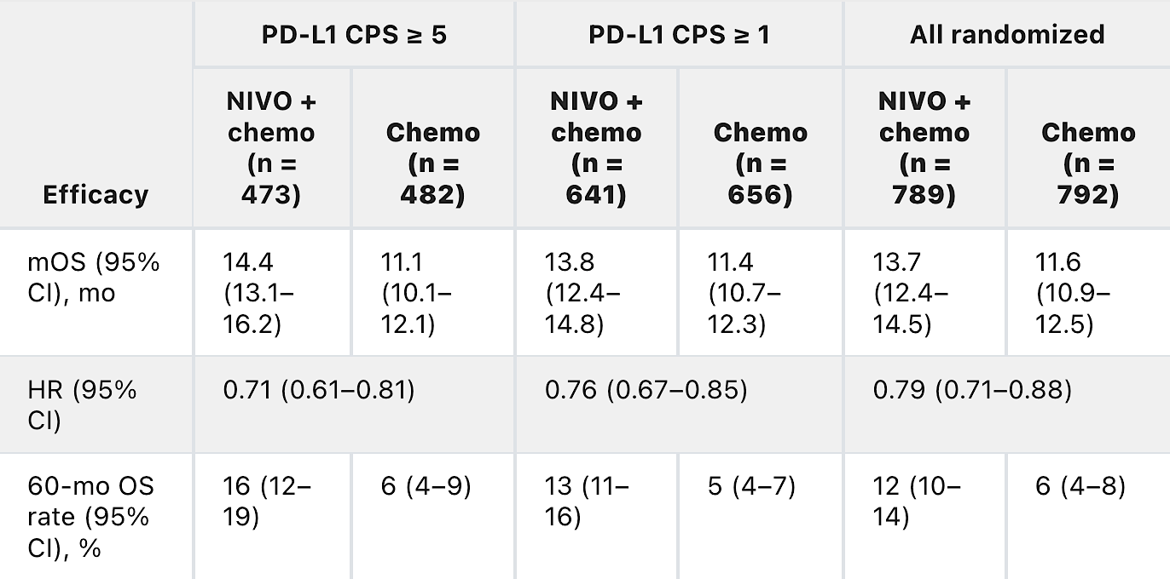
How does a PD-L1 score affect clinical outcomes?
CheckMate 649
Janjigian YY, GI ASCO 2025

Slide 52
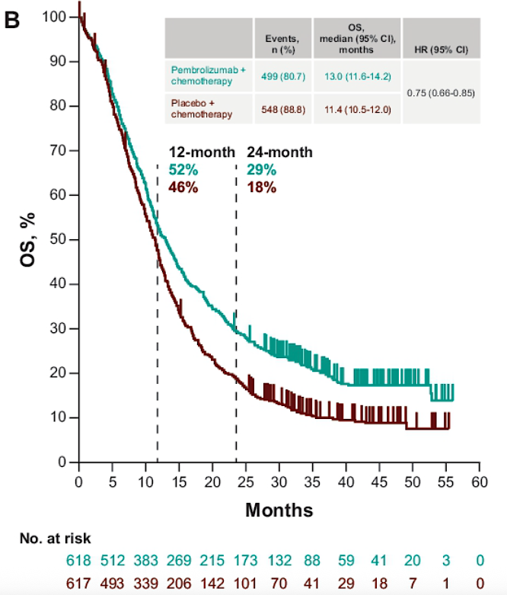
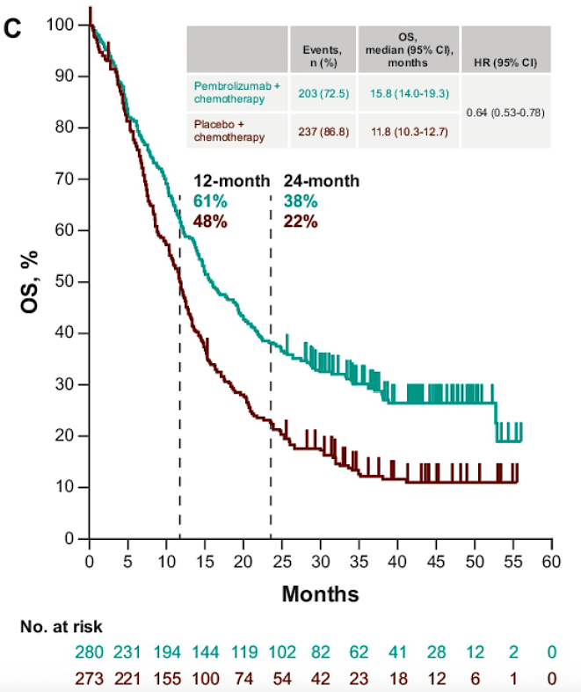
KEYNOTE-859: Overall Survival Benefit with
PD-1 inhibitor improves with higher PD-L1 CPS
PD-L1 CPS ≥ 1
PD-L1 CPS ≥ 10
Rha SY, et al. ASCO 2024;
MH Ryu et al. ESMO Asia Congress 2024

Slide 53
Patient Case
67-year-old woman with Stage 4 gastric cancer, PD-L1 CPS: 10
Started FOLFOX+nivolumab
At next restaging scan, liver lesions decreased in size with decreased gastric wall thickening
Disease control for 2 years before disease progression

Slide 54
Management of dMMR/MSI-H Gastric/GEJ Cancers

Slide 55
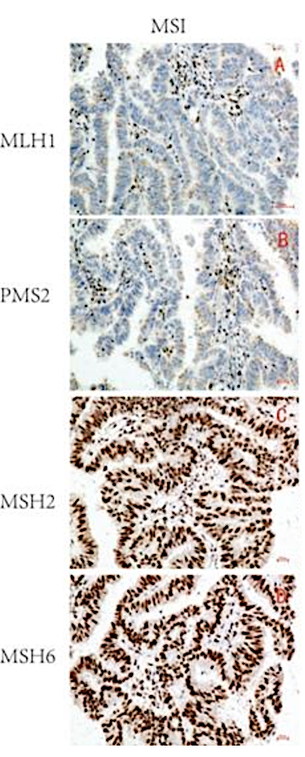
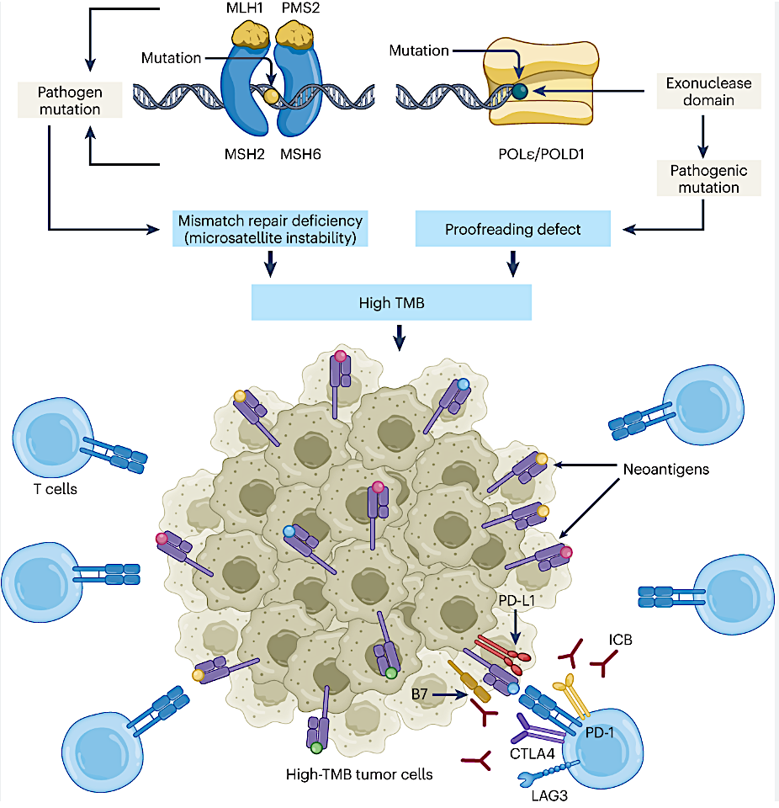
Role of MMR Deficiency and MSI in Gastric Cancer
Alouani, E Nature Cancer 2022, Wang, Y J Cancer 2021

Slide 56
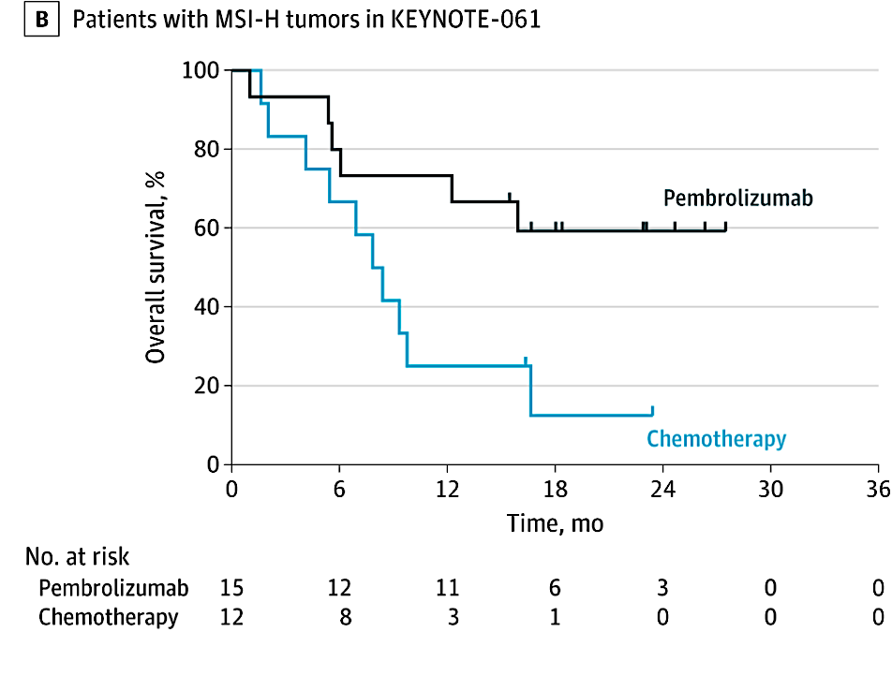
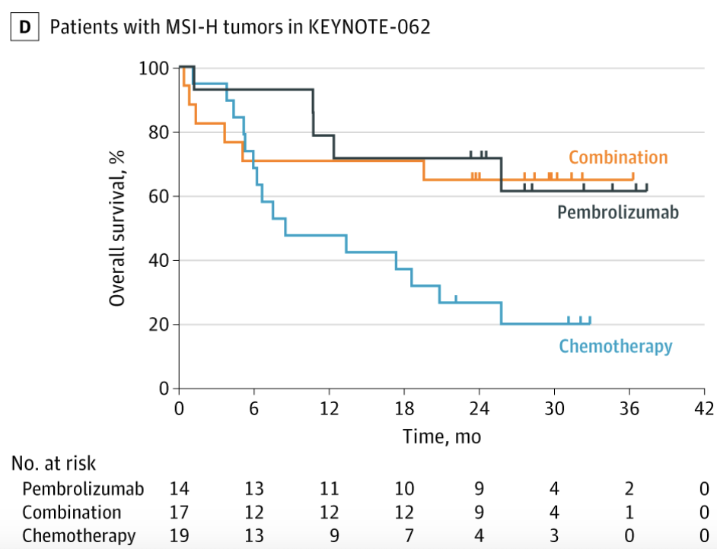
Survival benefit with PD-1 inhibitor based therapy for for MSI-H gastric cancer
Chao J, JAMA Oncology 2021

Slide 57
Significant survival benefit with PD-1 inhibitor for MSI-H gastric cancer
CheckMate 649
  MSI-H
  MSS
 | Nivo + chemo (n = 23) | Chemo (n = 21)
Median OS, mo | 38.7 | 12.3
(95% CI) | (8.4-44.8) | (4.1-16.5)
Unstratified HR (95% CI) | 0.38 (0.17-0.84)
ORR* % | 55 | 39
(95% CI) | (32-77) | (17-64)
 | Nivo + chemo (n = 696) | Chemo (n = 682)
Median OS, mo | 13.8 | 11.5
(95% CI) | (12.4-14.5) | (10.8-12.5)
Unstratified HR (95% CI) | 0.78 (0.70-0.88)
ORR* % | 59 | 46
(95% CI) | (55-63) | (42-51)
100
100
90
90
80
80
70
70
60
Nivo + chemo
60
Overall survival (%)
Overall survival (%)
50
50
40
40
30
30
20
20
Nivo + chemo
10
10
0
Chemo
0
Chemo
0
3
6
9
12
15
18
21
24
27
30
33
36
39
42
45
0
3
6
9
12
15
18
21
24
27
30
33
36
39
42
45
48
51
No. at risk
Months
Months
Nivo + chemo
23
21
16
15
15
15
13
13
12
11
9
7
6
3
2
0
696
646
554
452
375
308
251
214
184
137
103
75
50
29
22
9
2
0
Chemo
21
19
14
12
11
7
6
6
5
3
3
0
0
0
0
0
682
601
506
405
312
235
188
146
126
94
67
44
28
20
12
6
0
0
Shitara K et al. Nature. 2022

Slide 58
Recommendations for PD-1 inhibitor-based therapy for gastric cancer
For pMMR gastric/GEJ cancer, can add PD-1 inhibitor to doublet chemo for PD-L1 CPS+ tumors
  Increasing survival benefit with higher PD-L1 CPS
For dMMR/MSI-H gastric cancer, a PD-1 inhibitor-based treatment (monotherapy or with chemo) has significant clinical benefit

Slide 59
Roundtable Discussion

Slide 60
Nursing Considerations for Patients Receiving an Anti-PD-1/PD-L1 Antibody
Brooke Parker MSN, FNP
Gastrointestinal Oncology
University of Colorado Cancer Center

Slide 61
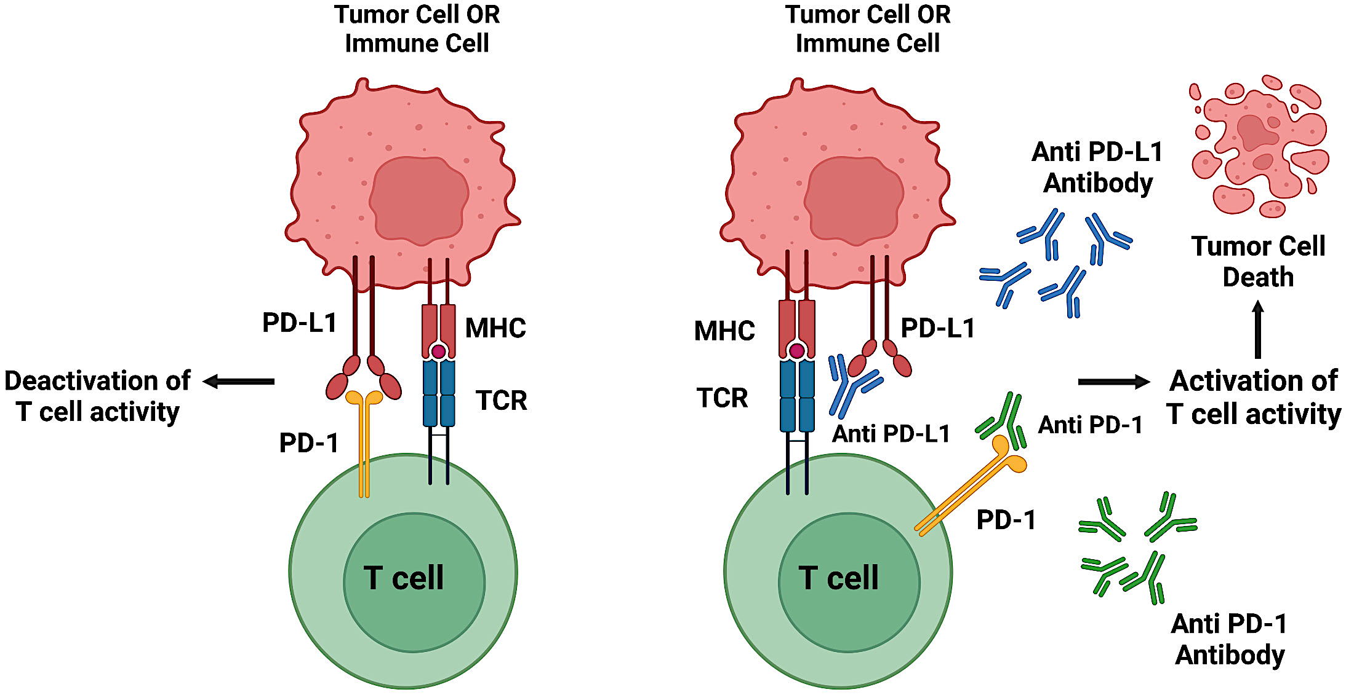
Setting the Stage
The Players
T Cells – Immune cells that help detect and destroy abnormal cells
PD- 1 – Proteins on T cells that downregulate the immune response
PDL-1 – Protein on cancer cells and will bind with our T cells PD-1 to “turn off” our immune system. This is called the PD-1 Pathway
Immunotherapy – Anti PDL-1/PD-1 antibodies bind proteins to keep your immune system (T cells) working!
Why is it being given?
Per NCCN guidelines, patients with GEJ cancer who have either PDL-1 CPS > 1 or are MSI-H/dMMR should receive immunotherapy
Image Parvel, 2023
NCCN GEJ Guidelines, 2025
Jeddo, 2024

Slide 62
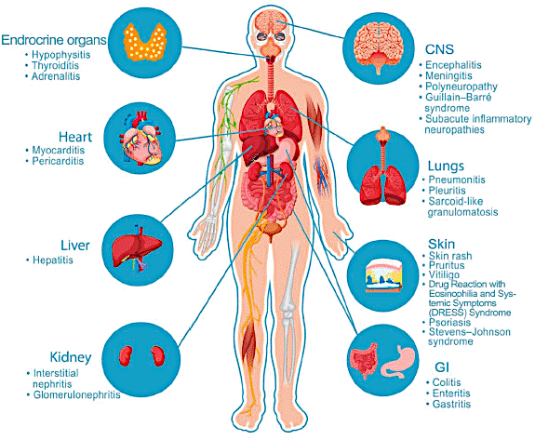
Adverse Events of Anti PD-1/PDL-1 Antibodies
Onset - typically 3-6 months
Prevalence – Any AEs 66%, severe/life threatening ~6%
Fatigue (16-25%)
Cutaneous (20%)
Pneumonitis (<10%)
Hormone related (1-6%)
Hepatitis (5% or less)
Muscles and Joints (5% or less)
Colitis (1-3%)
Heart, Kidney, CNS (<1%)
Infusion Reaction (<1%)
Image Abdihamid, 2021
Naidoo, 2015
NCCN Management of Immunotherapy-Related Toxicities 2024

Slide 63
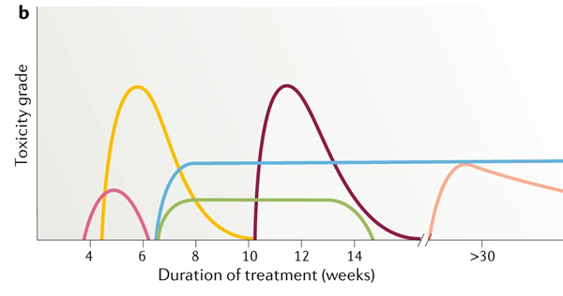


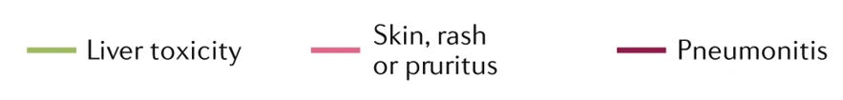
Starting Treatment
Does the patient have a hx of autoimmune disease?
Communication from the patient is key!
Provide wallet card
Educate on the importance of keeping a symptom diary
When to call
  Severe fatigue
  Rash
  Cough
  Shortness of breath
  Chest pain
  New/worsening diarrhea
  Headache
  Muscle weakness
  Vision changes
  Muscle & joint pain
Early recognition and early management
Image Martins, 2019

Slide 64
While on Treatment
Monitor
Treatment of ICI AEs
Physical exams
  Skin checks
Blood work
  CBC, CMP every treatment
  TSH and FT4 every 4-6 weeks
  Consider serum cortisol every 4-6 weeks
O2 sats
Periodic Imaging
Internal history
Treatment depends on severity of AEs
Grade 3-4
  Discontinue treatment
  First line - steroids
    Prednisone 1-2 mg/kg/day for 4-8 weeks
    Prolonged steroid taper
  Second line – immunomodulators
Endocrinopathies
  Hormone replacements
NCCN Management of Immunotherapy-Related Toxicities 2024

Slide 65
Clinical Experience
54 yo male with stage IV gastric cancer. PMH of obesity and poorly controlled T2DM (no current insulin use)
Began FOLFOX + Nivolumab on 11/3/24
On 1/15/25 he complained of having 8 episodes of diarrhea per day with negative GI PCR
Started on 100mg prednisone with PJP prophylaxis and a PPI
1 week later he returned to clinic with improvement in diarrhea but a blood glucose of 349mg/dL
Started on insulin by PCP and successfully completed taper
NCCN Prevention and treatment of cancer-related infections. Guidelines, 2024

Slide 66
Roundtable Discussion

Slide 67
Agenda
Introduction: Clinical Presentation of Gastroesophageal Cancer
Module 1: Management of Localized or Locally Advanced Gastroesophageal Cancers; Current and Future Role of Immune Checkpoint Inhibitors
Module 2: Incorporation of Immunotherapeutic Strategies for HER2-Negative Metastatic Gastroesophageal Tumors
Module 3: Role of Therapy Targeting CLDN18.2 in Advanced Gastric/Gastroesophageal Junction Adenocarcinoma
Module 4: Considerations in the Care of Patients with HER2-Positive Gastroesophageal Cancers

Slide 68
Clinical Scenario
A patient with newly diagnosed CLDN18.2-positive metastatic gastric cancer who is about to begin first-line treatment with chemotherapy in combination with zolbetuximab

Slide 69
Management of Metastatic Gastric/GEJ Adenocarcinoma:
First Line Therapy
Manish A. Shah, MD, FASCO
Weill Cornell Medicine/NewYork-Presbyterian
mas9313@med.cornell.edu
ISGIO
Hollywood, FL
October 2024

Slide 70
Case Study
Patient:
  85-year-old male
PMH:
  HFrecEF, HTN, HLD, IPMNs, ESRD secondary to bilateral native nephrectomies for urogenital cancer s/p DDKT 2021
HPI:
  1 year history of worsening fatigue, abdominal pain, weight loss

Slide 71
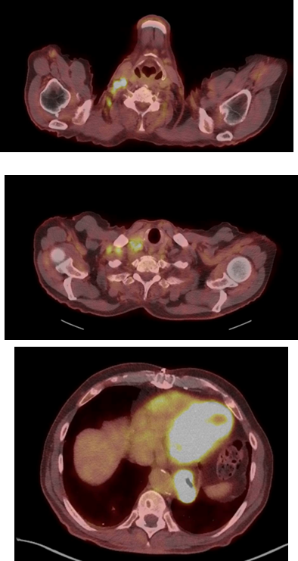
Case Study
Staging
EGD: large, ulcerated, partially circumferential (involving one-half of the lumen circumference) mass with oozing bleeding was found in the distal esophagus.
Biopsy: invasive poorly differentiated adenocarcinoma with signet ring cell features, MMR proficient, HER2 IHC equivocal, arising in a background of intestinal metaplasia and high-grade dysplasia
PD-L1 CPS 20%
CLDN18.2 IHC is 80%
PET scan: right neck and supraclavicular adenopathy, SUV avid distal esophageal malignancy.

Slide 72
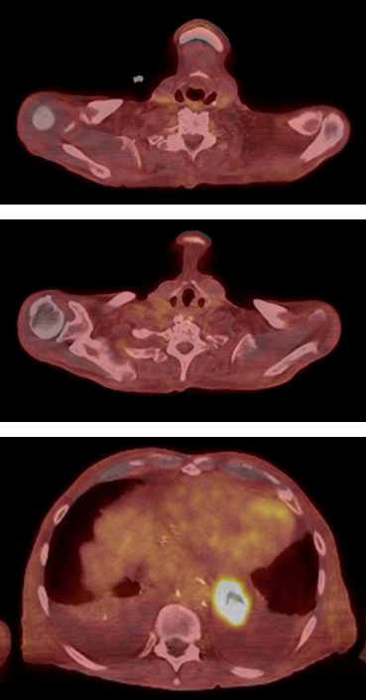
Case Study
Esophageal cancer treatment
  Option 1: Chemotherapy with immunotherapy
  Option 2: Chemotherapy with Claudin18.2 inhibition
  Option 3: Chemotherapy
  - Things to consider – patient has a transplanted kidney. There is ~30%-40% rate of graft failure.

Slide 73
Key Biomarkers in Gastroesophageal Cancer
Key markers in advanced disease
HER2 positive: 15%-20% of patients; improved survival with chemo + HER2-targeting trastuzumab
MSI high: 3%-5% of patients, high response rates to immunotherapies ± chemo
PD-L1 positive: 30%-50% of patients; identifies those more likely to benefit from immunotherapy; likely gradation within PD-L1+ (CPS)
CLDN18.2 high: 30%-35% of patients; response predictor for CLDN18.2-targeting agent
Investigational biomarkers
FGFR2 amp: 5%-10% of patients; multiple trials of inhibitors
FGFR2 high: May be up to 30% of HER2 negative
EGFR amp: 5%-7%; may predict response to EGFR agents
Tumor agnostic
Mismatch repair deficiency (or MSI-H)
Tumor mutation burden
NTRK fusion
Kuwata T. Pathol Int. 2024;74(6):301-316.

Slide 74
Claudin18.2: Leveraging Biology
Normal Gastric Epithelia
Gastric Cancer
Luminal
Luminal
Malignant
Transformation
Claudin18.2 is a major structural component of intercellular tight junctions
Not routinely expressed in any normal tissue outside gastric mucosa (cancer-restricted antigen)
Broadly expressed in several tumor types including gastric, GEJ, biliary, and pancreatic
Baek JH et al. Anticancer Res. 2019;39(12):6973-6979.

Slide 75
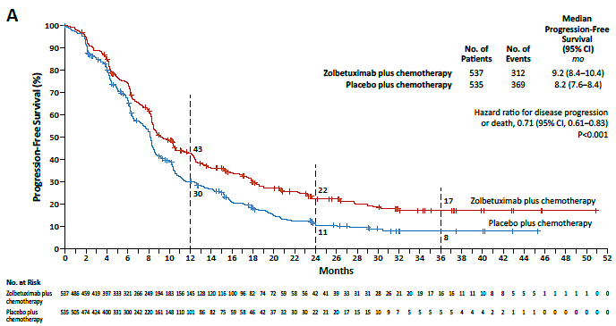
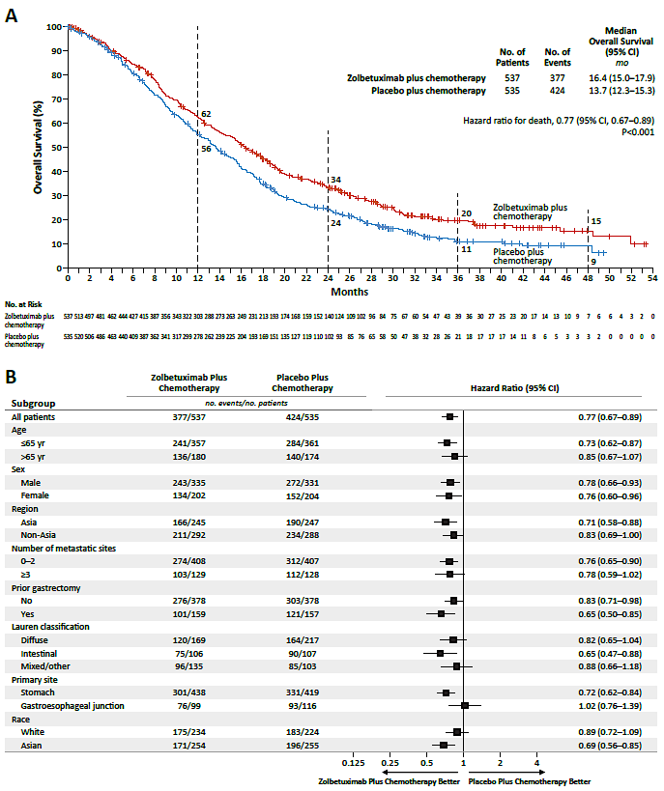
SPOTLIGHT and GLOW – Combined Final Analysis
Progression Free Survival
Overall Survival
Total Population – 1072 (n=537 Zolbe + chemo)
PFS HR 0.71 (0.61-0.83), p < 0.001
OS HR 0.77 (0.67-0.89), p < 0.01
Measurable disease (n=820),
Complete Response - 5.2%. v. 3.1%
Partial Response - 52.2%. v. 52.2%
Overall Response Rate - 57.4%. Vs. 55.3%
Key Toxicity
≥Grade 3 toxicity higher than control
Nausea - 12.6%. vs. 4.7%
Vomiting 14.3%. vs. 4.9%
Decreased appetite - 6.4% vs. 2.5%
Shitara K, Shah MA et al. N Engl J Med. 391(12):1159-1162.

Slide 76
SPOTLIGHT and GLOW – Combined Final Analysis
Key Points
Broad activity
? GEJ resistance?
? White people?
Validated Target
Shitara K, Shah MA et al. N Engl J Med. 391(12):1159-1162.

Slide 77
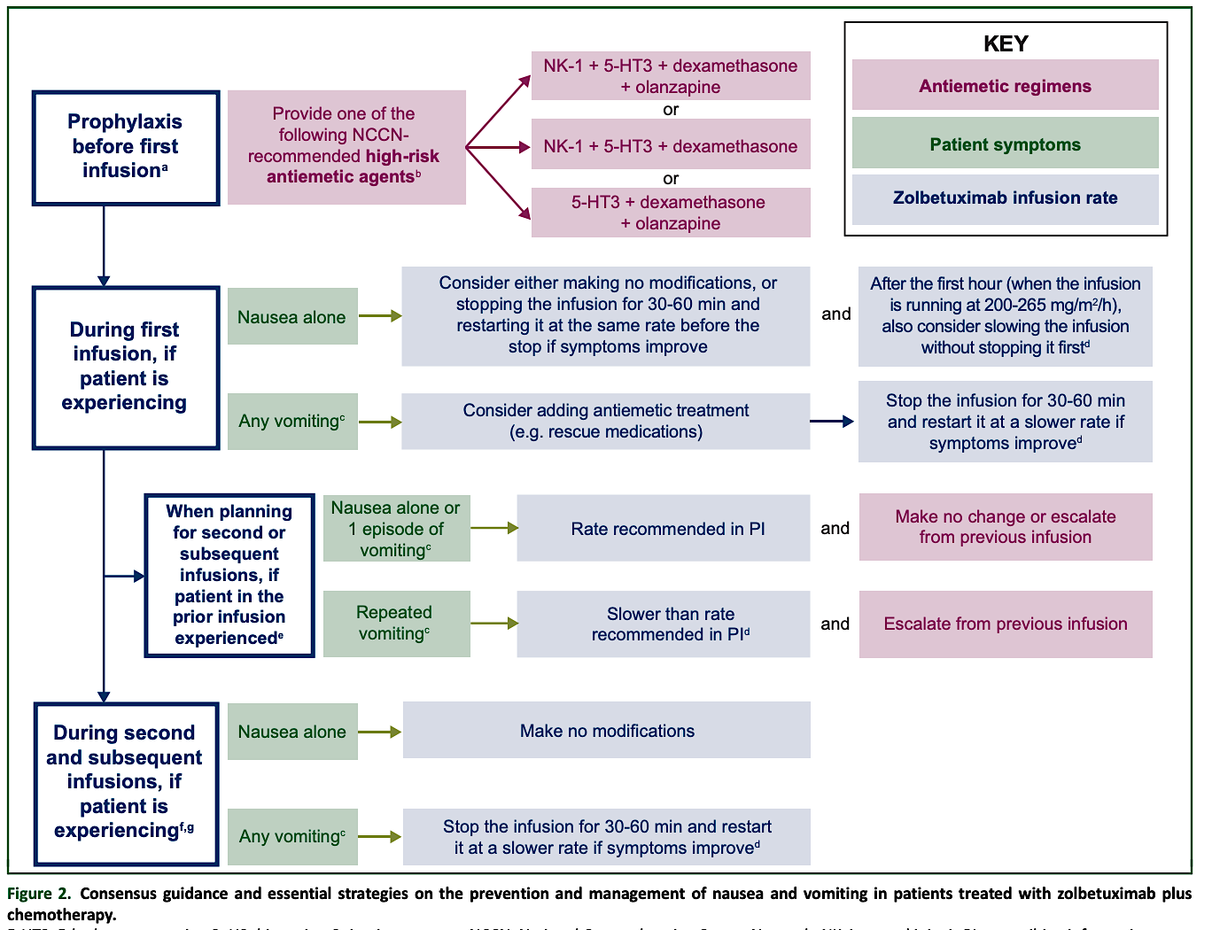
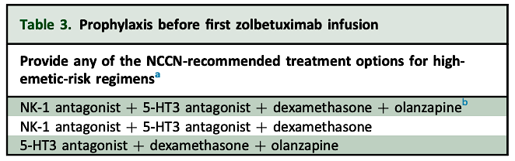
Klempner SJ et al. ESMO Gastrointestinal Oncology 2025

Slide 78
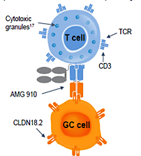
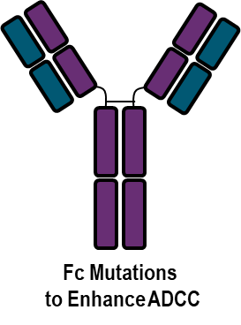
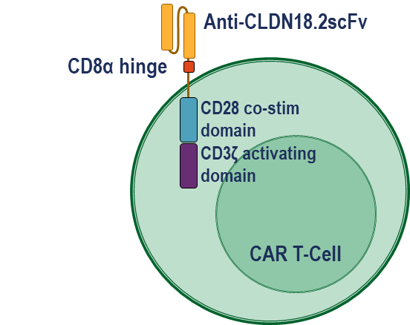
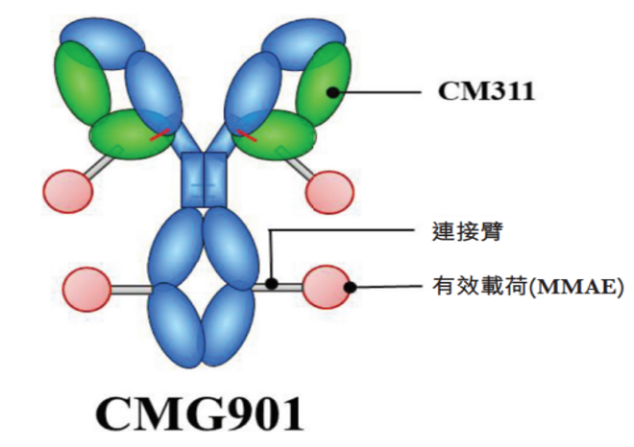
CLDN 18.2 Targeted Therapies
Monoclonal antibody
- Humanized mAb
- Engineered mAb
CAR-T
Bispecific
ADCs
CMG901, EO-3021
TORL-2800
TPX4589
RC118
LM302
SOT102
SKB315
JS107
IBI343
Zolbetuximab
TST-001
ABI011, MIL93, ZL1211 etc.
CT-041
LCAR-C18S
LY011
AMG910/ASP2138 (CD3)
TJ-CD4B (4-1BB)
PT886 (CD47)
Q-1802 (PD-L1)
IBI 389

Slide 79
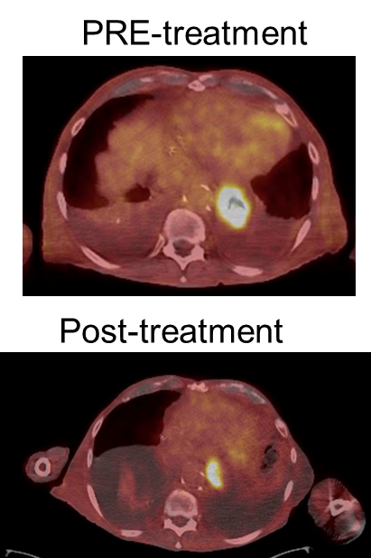
Case Study
After counseling, patient did undergo FOLFOX plus zolbetuximab.
The first infusion was fraught with nausea and vomiting necessitating the infusion to be held
PET: Decreased SUV avidity within the distal esophageal, approximately 6 cm, SUV 13.7, previously 9.6 cm SUV 21.1 possibly reflecting residual tumor ± inflammatory process

Slide 80
Conclusions
Critical to obtain Biomarkers to optimally treat advanced Gastric/GEJ adenocarcinoma
  PD-L1
  HER2
  MMR
  CLDN18.2
  FGFR2
Immunotherapy + chemotherapy for PD-L1 positive gastric/GEJ adeno
CLDN18.2 positive tumors – zolbetuximab
HER2 – chemotherapy + pembrolizumab + trastuzumab

Slide 81
Roundtable Discussion

Slide 82
Tolerability/Toxicity Profile of Zolbetuximab
Michal F Segal, BSN, RN, OCN

Slide 83
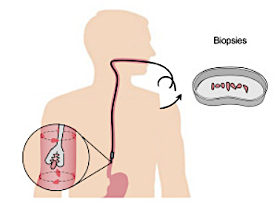
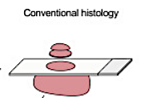
Gastroesophageal Ca and Claudin 18.2
Newly diagnosed metastatic disease
Treatment is palliative
Response measured with CT or MRI
Chemotherapy backbone
Add-ons: monoclonal antibodies and immunotherapy
Biomarkers – PDL1, HER2, MMR, Claudin18.2
Staining and biomarkers
Treatment planning

Slide 84
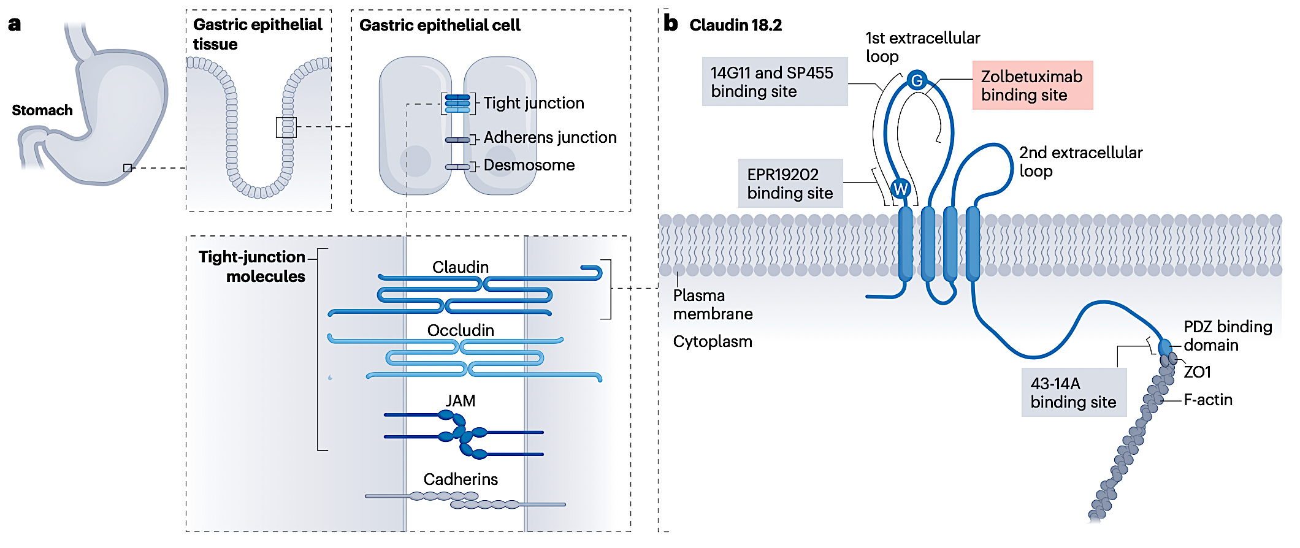
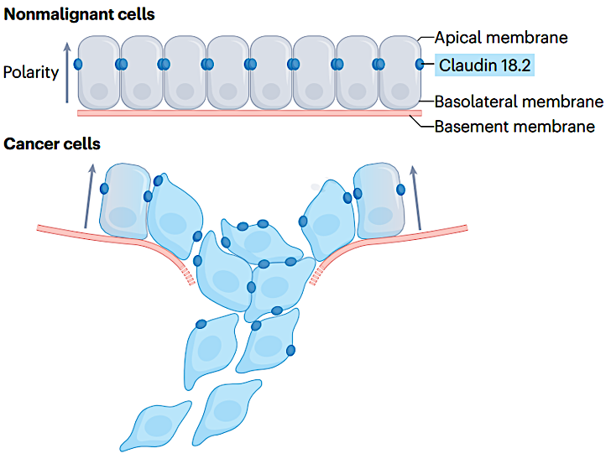
Claudin 18.2 Carcinogenesis
CLDN18.2 is a tight junction molecule on healthy tissue
Abnormal expression leads to disruption of tight junction integrity, loss of cohesion and cellular polarity, impaired differentiation, and increased invasion
CLDN18.2 becomes expressed on surface of gastric tumor
Hewitt et al. BMC Cancer 2006; Jun et al. Int J Surg 2014; Sanada et al. J Pathol 2006; Suzuki et al. Cell Mol Gastroenterol 2019; Nakayama et al, Nat Rev Clin Oncol 2024

Slide 85

Zolbetuximab Mechanism of Action
Zolbetuximab
Zolbetuximab is a CLDN18.2-directed cytolytic antibody that selectively binds to cells that express CLDN18.2, where cytotoxic immune responses are activated.
Zolbetuximab depletes CLDN18.2+ cells via ADCC.
ADCC: Effector cells, such as natural killer cells, recognize antibody-targeted tumor cells and release cytotoxic molecules for lysis
Zolbetuximab also depletes CLDN18.2+ cells via CDC.
CDC: In addition, complement proteins gather to assemble a membrane attack complex (MAC) which forms pores that lyse targeted tumor cells

Slide 86
Side Effects and Patient Education
Most common side effects: nausea and vomiting
Important safety: hypersensitivity reactions, including infusion-related reactions
Potential overlapping toxicities in combination with mFOLFOX6
    GI: nausea, vomiting, abdominal pain
    Hematological: anemia and neutropenia
GI adverse reactions often occur within 30–45 minutes of initiating infusion
Reducing initial infusion rate is associated with lower severity of GI toxicity events or hypersensitivity
          overall better subject tolerability
        Patients with prior gastrectomy – less symptoms
GI, gastrointestinal; mFOLFOX6, modified 5-fluorouracil, leucovorin and oxaliplatin.

Slide 87


Side Effects Management - ASCO
Day 1: recommend having an anti‑emetic ordered ahead of infusion if needed (PRN)
5-HT3, 5-hydroxytryptamine 3 receptor antagonist; ASCO, American Society of Clinical Oncology; IV, intravenous; N/A, not applicable; NK-1, Neurokinin 1; PO, by mouth; PRN, when required.
Hesketh PJ, et al. J Clin Oncol 2020;38(24):2782–2797.

Slide 88
Monitoring and Support
        Stress importance of delayed emesis regimen (dexamethasone and olanzapine days 2-4)
        Stress to take PRNs
        Stress to call office if not managing at home
        Eat, hydrate, maintain weight
        IV hydration
        Dose reductions
        Check in calls
        Antacids as needed and daily mucosal protectant (PPI)
        Sleep elevated, on pillows or a wedge
        Try eating dry foods
        Hard candy, such as mints, ginger, or tart candies
        Avoid hot or strong-smelling foods when nauseous

Slide 89


Diet Review
Liberalize diet
Small, frequent meals; eat slowly; chew food well
Avoid eating foods that are fried, greasy, creamy, rich or spicy; avoid alcohol
Eat calorie-dense foods
High-protein foods
High-protein supplemental drinks and powders
In case of dysphagia, stick to soft, puréed, blended food
  Avoid chewy or tough foods
  Treat food like medicine

Slide 90
Self-Care Measures
Oral hygiene
Infection precautions – Manage constipation
or diarrhea
Take pain medication for pain
Moisturize skin and wear sun protection (SPF 30)
  Safety precautions – wear comfortable, protective footwear; wear thick, supportive socks; wear slippers at home; use night lights/clear path to bathroom
Rest when needed – keep naps to a minimum; plan events and activities for time points when energy will be highest
Use relaxation methods to manage stress
Listening to music
Deep breathing exercises
Yoga, Meditation
Applying a damp washcloth with or without peppermint oil to the back of your neck
Progressive muscle relaxation (PMR)
Exercising at home
Using acupressure and other complementary therapies
Support groups
Advocacy groups

Slide 91
Roundtable Discussion

Slide 92
Agenda
Introduction: Clinical Presentation of Gastroesophageal Cancer
Module 1: Management of Localized or Locally Advanced Gastroesophageal Cancers; Current and Future Role of Immune Checkpoint Inhibitors
Module 2: Incorporation of Immunotherapeutic Strategies for HER2-Negative Metastatic Gastroesophageal Tumors
Module 3: Role of Therapy Targeting CLDN18.2 in Advanced Gastric/Gastroesophageal Junction Adenocarcinoma
Module 4: Considerations in the Care of Patients with HER2-Positive Gastroesophageal Cancers

Slide 93
Clinical Scenario
A patient with HER2-positive metastatic gastric cancer who has experienced disease progression on first-line pembrolizumab/ chemotherapy/trastuzumab and is about to begin treatment with trastuzumab deruxtecan

Slide 94
Considerations in the Care of Patients with HER2-Positive Gastroesophageal Cancers
Sunnie Kim, MD

Slide 95
Patient Case
59-year-old man presents with dysphagia, weight loss, heartburn
EGD reveals fungating mass in GEJ
Pathology shows poorly differentiated adenocarcinoma
CT CAP shows multiple liver lesions concerning for metastases
Biomarker testing shows intact MMR proteins, PD-L1 CPS: 1, HER2 IHC 2+, Claudin 18.2 negative
Next steps?

Slide 96
Biomarker Testing in Advanced GE Cancer
Mismatch Repair Proteins/Microsatellite Instability
HER2
Claudin 18.2
PD-L1 CPS
Rarer biomarkers: NTRK, BRAF V600E, RET, EBV, EGFR

Slide 97

HER2 Testing Algorithm
Adapted from American College of Pathologists, 2016

Slide 98

Grillo F, World J Gastroenterol 2016

Slide 99

HER2 overexpression differs based on location and histology
By Location
By Histology
30% of intestinal type gastric cancers
15% of mixed type tumors
5% of diffuse type
Signet ring type is typically HER2 negative.
30%
15%
Van Cutsem, Gastric Cancer 2015

Slide 100
Patient Case continued
59-year-old man with Stage IV GEJ adenoca to liver
Biomarker testing shows intact MMR proteins, PD-L1 CPS: 1, HER2 IHC 2+, Claudin 18.2 negative
HER2 FISH positive
Started on FOLFOX, trastuzumab, pembrolizumab

Slide 101

KEYNOTE-811 Study Design
Janjigian, ESMO 2024

Slide 102

Chemo+Trastuzumab+Pembro shows OS benefit
Current FDA approval is to use quadruplet in PD-L1 CPS>/=1
Janjigian, NEJM 2024

Slide 103

No clinical benefit with PD-L1 CPS<1
Janjigian, ESMO 2024

Slide 104


Slide 105
DESTINY-Gastric01: 2L treatment option for HER2+ gastric/GEJ adenoca
Multicenter, open-label, randomized phase II study
T-DXd 6.4 mg/kg, 3-week cycles
(n = 126)
Adult patients with HER2+*
locally advanced or metastatic gastric or GEJ cancer that progressed on
≥ 2 prior regimens†
(N = 188)
R
2:1
Until PD, unacceptable AEs, or pt withdrawal
Physician’s choice:
Irinotecan 150 mg/m² every 2 weeks or
Paclitaxel 80 mg/m² Days 1, 8, 15 every 4 weeks
(n = 62)
Primary endpoint: ORR by ICR (RECIST v1.1)
Secondary endpoints: OS (key), DoR, PFS, DCR, confirmed ORR, safety
Stratified by region (Japan vs Korea), ECOG PS (0 vs 1), HER2 status (IHC 3+ vs IHC 2+/ISH+)
*HER2+ based on IHC 3+ or IHC 2+/ISH+ according to ASCO/CAP guidelines.
†Prior regimens included fluoropyrimidine, a platinum agent, and trastuzumab or approved biosimilar.
Shitara. ASCO 2020. Abstr 4513. Shitara. N Engl J Med 2020; 382:2419-2430

Slide 106

OS Improvement Noted in T-DXd Group
Yamaguchi, GI ASCO 2022

Slide 107


What is the optimal 2L treatment for HER2+ GC?
Advanced HER2+ gastric/GEJ cancer
After disease progression with trastuzumab regimen
T-DXd
6.4mg/kg
Press Release (March 3, 2025):
Overall survival benefit of T-DXd over ram/paclitaxel
DESTINY-
GASTRIC04
Ramucirumab
Paclitaxel

Slide 108



Med
Oncs
Treating HER2+ GC
Ram/
PACLITAXEL
T-DXd

Slide 109
Patient Case continued
59-year-old man with Stage IV GEJ adenoca to liver
Biomarker testing shows intact MMR proteins, PD-L1 CPS: 1, HER2 IHC 2+, Claudin 18.2 negative
HER2 FISH positive
Started on FOLFOX, trastuzumab, pembrolizumab
Disease progression after 9 months
Retested tumor HER2→2+/FISH positive
Started T-DXd, disease response for 6 months

Slide 110
Roundtable Discussion

Slide 111
Nursing Considerations for Trastuzumab Deruxtecan
Brooke Parker MSN, FNP
Gastrointestinal Oncology
University of Colorado Cancer Center

Slide 112

Why Trastuzumab Deruxtecan
How does it work?
How does it work?
Mechanism of Action of T-DXd
HER2 gene can malfunction and cause an excess of HER2 receptors, which leads to uncontrolled cell growth.
  Occurs in 10-30% of gastric/gastroesophageal cancers
Trastuzumab is a type of antibody that targets these HER2 receptors.
  This blocks the receptor to help prevent cell growth
Deruxtecan is a topoisomerase I inhibitor (like irinotecan) and is combined with trastuzumab.
  The trastuzumab is a homing beacon and the deruxtecan acts like a chemo-bomb directly to the tumor cell.
T-DXd
T-DXd is made up of
The antibody part of
T-DXd targets and attaches
to the HER2+ cancer cell
T-DXd enters the
The chemotherapy part
of T-DXd helps destroy
the cancer cell as well as other
cells nearby
m I giving it?
Why we give it
Second line therapy for gastric/esophageal cancers for patients with HER2 overexpression
Media Delveinsight, 2023
Iqbal, 2014
NCCN Guidelines (Gastric and Gastroesophageal), 2025
Notes:
o Her2 gene makes her2 proteins/recptors that regulate normal cell growth. When it malfunctions it becomes overactive which causes an excess of her2 receptors which causes uncontrolled cell growth
o Trastuzumab targets is a type of antibody that targets these her2 receptors. Blocks these cells to prevent cell growth
▪ Lso helps immune system recognize and attack cancer cells
o NCCN guidelines for second line with patients with HER2 overexpression
o Deruxtecan is which is combined with trasstuzumab. The trazutuma acts a homing beacon and then the serucetan acts like a bo,b of chemo directly to the tumor cell.

Slide 113
Common Adverse events seen
(DESTINY-GASTRIC01 study)
 | Any Grade | Grade ≥3
Nausea | 63% | 5%
Neutrophil count decreased | 63% | 38%
Decreased appetite | 60% | 17%
Anemia | 58% | 38%
Platelet count decreased | 39% | 10%
Diarrhea | 32% | 2%
Vomiting | 26% | --
Alopecia | 22% | --
Fatigue | 22% | 7%
Interstitial Lung Disease | 10% | 2%
When to call
Coughing, chest tightness, wheezing
Trouble breathing or shortness of breath
Feeling tired
Swelling of your ankles or legs
Irregular heartbeat
Sudden weight gain
Dizziness or feeling light-headed
Loss of consciousness
Fever
*No decreased left ejection fraction seen with this study. However, thought to be anywhere between 3-8%
Shitara, 2020

Slide 114
Management of Adverse effects
Common AEs – Fatigue, nausea, vomiting, diarrhea, neutropenia etc.
  Manage as you would with any typical chemotherapy
    Anti-emetics
    Anti-diarrheals
    GCSF
    Hold treatment and consider dose reduction
Left ventricular dysfunction
Need baseline TTE prior to initiating treatment. Repeat every 3 months while on treatment
Holds, discontinuations and dose reductions are based off of severity of LVEF decrease
Dose Reductions in GE
Dose level -1 = 5.4 mg/kg
Dose level -2 = 4.4 mg/kg
T-DXd package insert.

Slide 115
Management of Interstitial
Lung Disease
Asymptomatic gr 1 ILD
Consider corticosteroid treatment (eg, ≥0.5 mg/kg per day prednisolone or equivalent)
Interrupt T-DXd until resolved to Grade 0, then:
  If resolved in ≤28 days from date of onset, maintain dose
  If resolved in >28 days from date of onset, reduce dose 1 level
Gr ≥ 2 symptomatic ILD
Promptly initiate systemic corticosteroid treatment (eg, ≥1 mg/kg per day prednisolone or equivalent)
Continue for ≥14 days followed by gradual taper for ≥4 weeks
Permanently discontinue T-DXd in patients who are diagnosed with any symptomatic ILD/pneumonitis
Chiu et al., 2023

Slide 116

Clinical experience
64 yo old male with stage IV esophageal cancer
Treated with T-DXd from 10/18/24-1/08/25. Discontinued treatment due to clinical progression and switched to paclitaxel + ramucirumab
1/30/25 complained of increased SOB. CTA chest for PE showed no evidence of PE, but diffuse bilateral ground glass opacities and septal thickening
Started on 80mg of prednisone
Attempted taper, but unable to complete due to worsening symptoms. Admitted to hospice following disease progression
Image Cuete, n.d.

