Slide 1
Hormone Receptor-Positive Breast Cancer
Understanding the Current Paradigm and
New Approaches in the Care of Patients with Cancer
A Complimentary NCPD Hybrid Symposium Series Held During the 50th Annual ONS Congress
Wednesday, April 9, 2025
6:00 PM – 8:00 PM
Faculty
Virginia F Borges, MD, MMSc
Jamie Carroll, APRN, MSN, CNP
Ronald Stein, JD, MSN, NP‑C, AOCNP
Seth Wander, MD, PhD
Moderator
Neil Love, MD

Slide 2




Faculty
Jamie Carroll, APRN, MSN, CNP
Assistant Professor, Oncology
Mayo Clinic
Rochester, Minnesota
Virginia F Borges, MD, MMSc
Professor of Medicine with Tenure
Robert F and Patricia Young-Connor Endowed
Chair in Young Women’s Breast Cancer Research
Deputy Head, Division of Medical Oncology
Director, Breast Cancer Research Program
and Young Women’s Breast Cancer
Translational Program
University of Colorado Cancer Center
Aurora, Colorado
Ronald Stein, JD, MSN, NP-C, AOCNP
Clinical Instructor of Medicine
USC Norris Comprehensive Cancer Center
Los Angeles, California
Seth Wander, MD, PhD
Assistant Professor of Medicine
Harvard Medical School
Attending Physician
Massachusetts General Hospital
Boston, Massachusetts

Slide 3
Dr Borges — Disclosures
Advisory Committees | AstraZeneca Pharmaceuticals LP, Gilead Sciences Inc, Olema Oncology, Pfizer Inc, Seagen Inc
Consulting Agreements | Gilead Sciences Inc, Olema Oncology
Contracted Research | Agendia Inc, AstraZeneca Pharmaceuticals LP, Genentech, a member of the Roche Group, Gilead Sciences Inc, Olema Oncology, Pfizer Inc, Seagen Inc
Data and Safety Monitoring Boards/Committees | Pfizer Inc, Seagen Inc (HER2CLIMB-02 trial)
Nonrelevant Financial Relationships | Pearl Scientific LLC

Slide 4
Ms Carroll — Disclosures
Advisory Committees | AstraZeneca Pharmaceuticals LP, Lilly, Merck, Novartis
Nonrelevant Financial Relationships | Clinical Care Options, Horizon CME, MJH Life Sciences, OncLive, Scientific Global

Slide 5
Mr Stein — Disclosures
Advisory Committees | Biotheranostics Inc
Consulting Agreements | AstraZeneca Pharmaceuticals LP

Slide 6
Dr Wander — Disclosures
Advisory Committees | Biovica International AB, Genentech, a member of the Roche Group, Hologic Inc, Pfizer Inc, Puma Biotechnology Inc, Regor Therapeutics Group
Consulting Agreements | AstraZeneca Pharmaceuticals LP, Foundation Medicine, Lilly, Novartis
Contracted Research | Genentech, a member of the Roche Group, Lilly, Nuvation Bio, Pfizer Inc, Regor Therapeutics Group, Sermonix Pharmaceuticals
Data and Safety Monitoring Boards/Committees | Regor Therapeutics Group
Speakers Bureaus | Guardant Health, Lilly
Nonrelevant Financial Relationships | 2nd.MD

Slide 7
Commercial Support
This activity is supported by educational grants from AstraZeneca Pharmaceuticals LP, Genentech, a member of the Roche Group, Novartis, and Stemline Therapeutics Inc.
Research To Practice NCPD Planning Committee Members,
Staff and Reviewers
Planners, scientific staff and independent reviewers for Research To Practice have no relevant conflicts of interest to disclose.

Slide 8
This educational activity contains discussion of
non-FDA-approved uses of agents and regimens. Please refer to official prescribing information for each product for approved indications.

Slide 9
Agenda
Module 1: Role of CDK4/6 Inhibitors in Localized and Metastatic Hormone Receptor (HR)-Positive Breast Cancer
Module 2: PI3K Inhibition as First-Line Treatment for HR-Positive, HER2-Negative Metastatic Breast Cancer (mBC)
Module 3: Clinical Utility of AKT and PI3K Inhibitors in Progressive HR-Positive mBC
Module 4: Current and Future Role of Oral Selective Estrogen Receptor Degraders in HR-Positive mBC

Slide 10
Agenda
Module 1: Role of CDK4/6 Inhibitors in Localized and Metastatic Hormone Receptor (HR)-Positive Breast Cancer
Module 2: PI3K Inhibition as First-Line Treatment for HR-Positive, HER2-Negative Metastatic Breast Cancer (mBC)
Module 3: Clinical Utility of AKT and PI3K Inhibitors in Progressive HR-Positive mBC
Module 4: Current and Future Role of Oral Selective Estrogen Receptor Degraders in HR-Positive mBC

Slide 11
Clinical Scenarios
A patient with higher-risk ER-positive, HER2-negative breast cancer receives local treatment and is about to start adjuvant therapy that includes a CDK4/6 inhibitor
A patient with ER-positive, HER2-negative mBC is about to start first-line treatment with a CDK4/6 inhibitor and endocrine therapy

Slide 12

CDK4/6 Inhibitors for Hormone Receptor (HR)-Positive Breast Cancer
Virginia F. Borges, MD, MMSc
University of Colorado Cancer Center

Slide 13
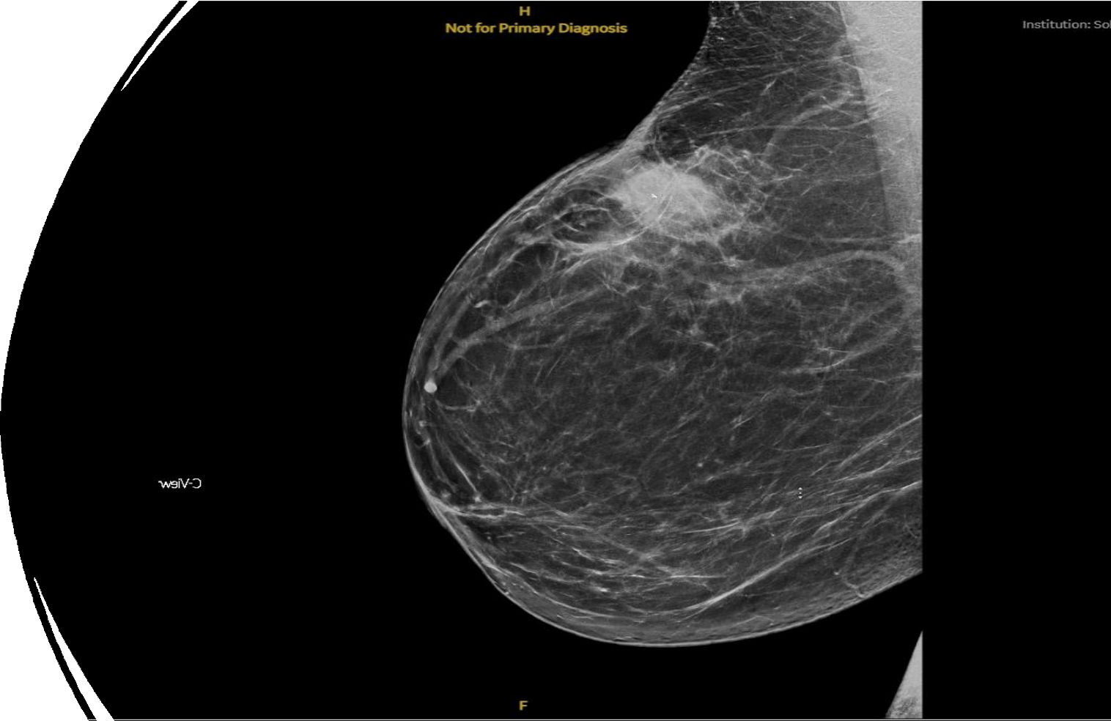

A typical day in MDC…
39-year-old, premenopausal, lawyer
Imaging:
6.5-cm left breast mass
Left axillary lymphadenopathy
Pathology:
IDC, G2, ER+, PR+, HER2neg
Ki-67 45%, LN is positive
PMH: Healthy, G2P2, childbearing complete, husband s/p vasectomy
ER+, estrogen receptor positive; G2P2, gravida 2 para2; gr, grade; HER2-, human epidermal receptor 2 negative; IDC, intraductal carcinoma; LN, lymph node; PR+, progesterone receptor positive.

Slide 14
Treatment Sequence
Her genetic testing shows an ATM pathologic alteration
She received neoadjuvant chemotherapy on a clinical trial for 24 weeks.
She opted for bilateral mastectomies with delayed reconstruction.
She completes her post-mastectomy radiation due to the + LN.
She is now here to start her adjuvant endocrine therapy:
  Ovarian function suppression + aromatase inhibitor (SOFT trial)
  Bone supportive medication – zoledronic acid (ABCSG-12 and S0307)
  Should she get anything more?

Slide 15
Adjuvant EBC Trials With CDK4/6 Inhibitors
 | PALLAS^{1,2} | monarchE^{3,4} | PENELOPE-B^{5,6} | NATALEE⁷
CDK4/6 inhibitor | Palbociclib | Abemaciclib | Palbociclib | Ribociclib
Sample size | 5760 | 4580 | 1250 | 5101
Design | Phase 3 randomized open label | Phase 3 randomized open label | Phase 3 randomized placebo-controlled | Phase 3 randomized open label
Patient population | Stage II-III (Stage IIA capped 1000 pts) | High-risk N+ plus 1 other risk factor (size, grade, Ki67) | Very high-risk with residual disease after neoadjuvant chemo (CPS-EG score ≥ 3 or 2 and N+) | Stage II-III
Duration of CDK4/6 therapy | 2 years (26 cycles) | 2 years (26 cycles) | 1 year (13 cycles) | 3 years (39 cycles)
Primary endpoint | iDFS | iDFS | iDFS | iDFS
Median duration of follow-up | 43 months | 42 months | 43 months | 28 months
This information is not presented to compare the efficacy or safety profile of the discussed products. No implication of superiority or inferiority is intended or should be inferred. Cross-trial comparisons
are unreliable as they are likely to be confounded due to differences in study design and patient population.
AFT=Alliance Foundation Trials, LLC; AGO=German Gynecological Oncology Working Group; BIG=Breast International Group; GBG=German Breast Group; iDFS=invasive disease-free survival;
NSABP=National Surgical Adjuvant Breast and Bowel Project; TRIO=Translation Research in Oncology.
1. PALLAS. Updated June 15, 2023. Accessed October 19, 2023. https://clinicaltrials.gov/ct2/show/NCT02513394 2. Mayer EL et al. 2020 ESMO Congress. LBA12.
3. monarchE. Updated July 14, 2023. Accessed October 19, 2023. https://clinicaltrials.gov/ct2/show/NCT03155997 4. Rastogi P et al. 2020 SABCS. GS1-01. 5. PENELOPE-B.
Updated April 12, 2022. Accessed October 19, 2023. https://clinicaltrials.gov/ct2/show/NCT01864746 6. Loibl S et al. 2020 SABCS. 7. NATALEE. Updated October 3, 2023.
Accessed October 19, 2023. https://clinicaltrials.gov/ct2/show/NCT03701334

Slide 16
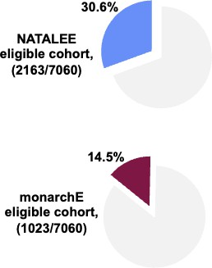
Different Eligibility, Different Populations
AJCC Stage | TN | NATALEE | monarchE
Stage 1A | T1N0 | X | X
Stage IB | T0N1mi | X | X
 | T1N1mi | X | X
Stage IIA | T0N1 | ✓ | X
 | T1N1 | ✓ | G3 or Ki67 >20%
 | T2N0 | G3, or G2 with Ki67 >20% or high genomic risk | X
Stage IIB | T2N1 | ✓ | G3 or Ki67 >20%
 | T3N0 | ✓ | X
Stage IIIA | T0N2 | ✓ | ✓
 | T1N2 | ✓ | ✓
 | T2N2 | ✓ | ✓
 | T3N1 | ✓ | ✓
 | T3N2 | ✓ | ✓
Stage IIIB | T4N0 | ✓ | X
 | T4N1 | ✓ | ✓
 | T4N2 | ✓ | ✓
Stage IIIC | AnyTN3 | ✓ | ✓
US EHR Analysis of HR+ eBC
Tarantino et al, ESMO 2024

Slide 17
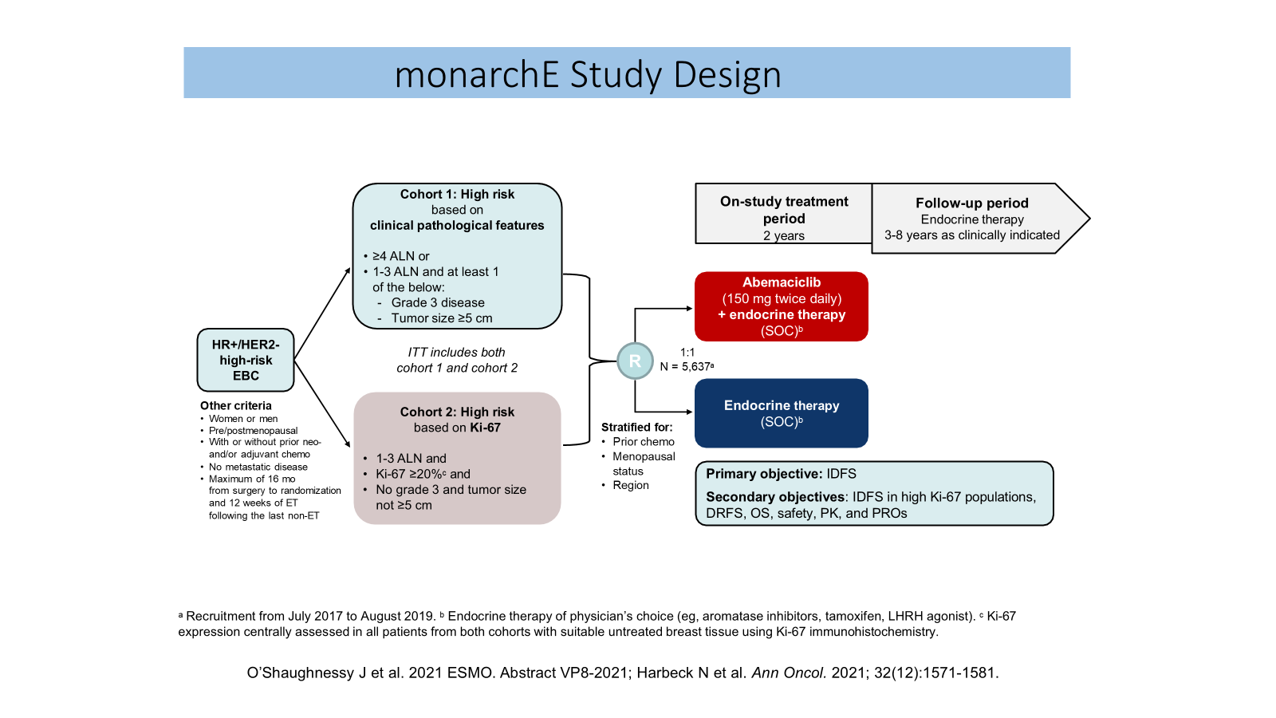
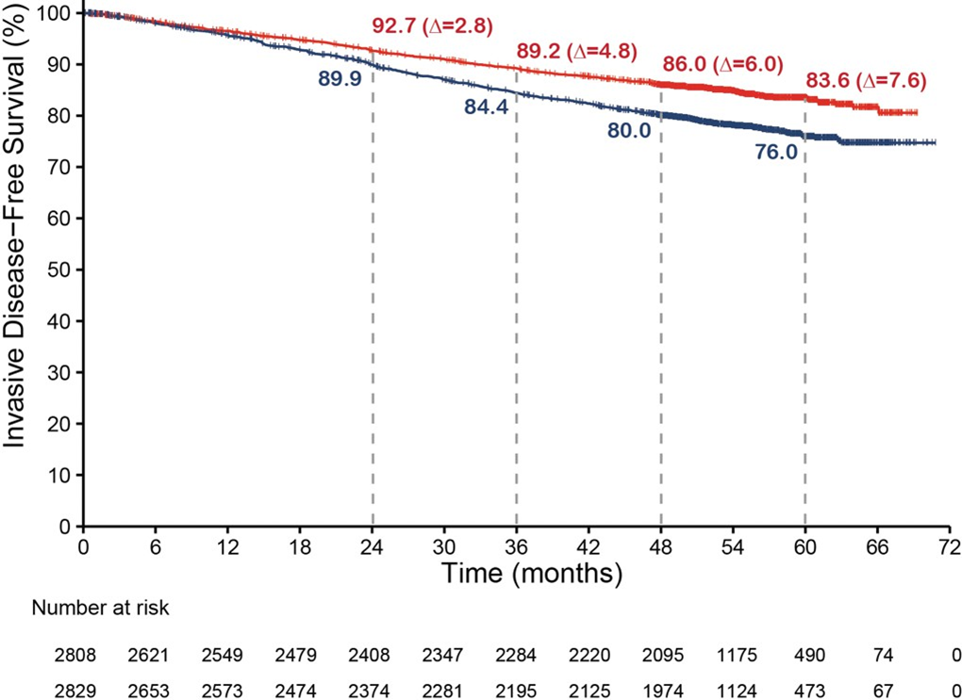
monarchE Study Design and iDFS Results
32% reduction in the risk of developing an IDFS event.
The KM curves continue to separate and the absolute difference in IDFS rates between arms was 7.6% at 5 years
Nadia Harbeck, MD
ESMO, Madrid, Spain. 20 October 2023
Rastogi P et al. JCO 2024

Slide 18

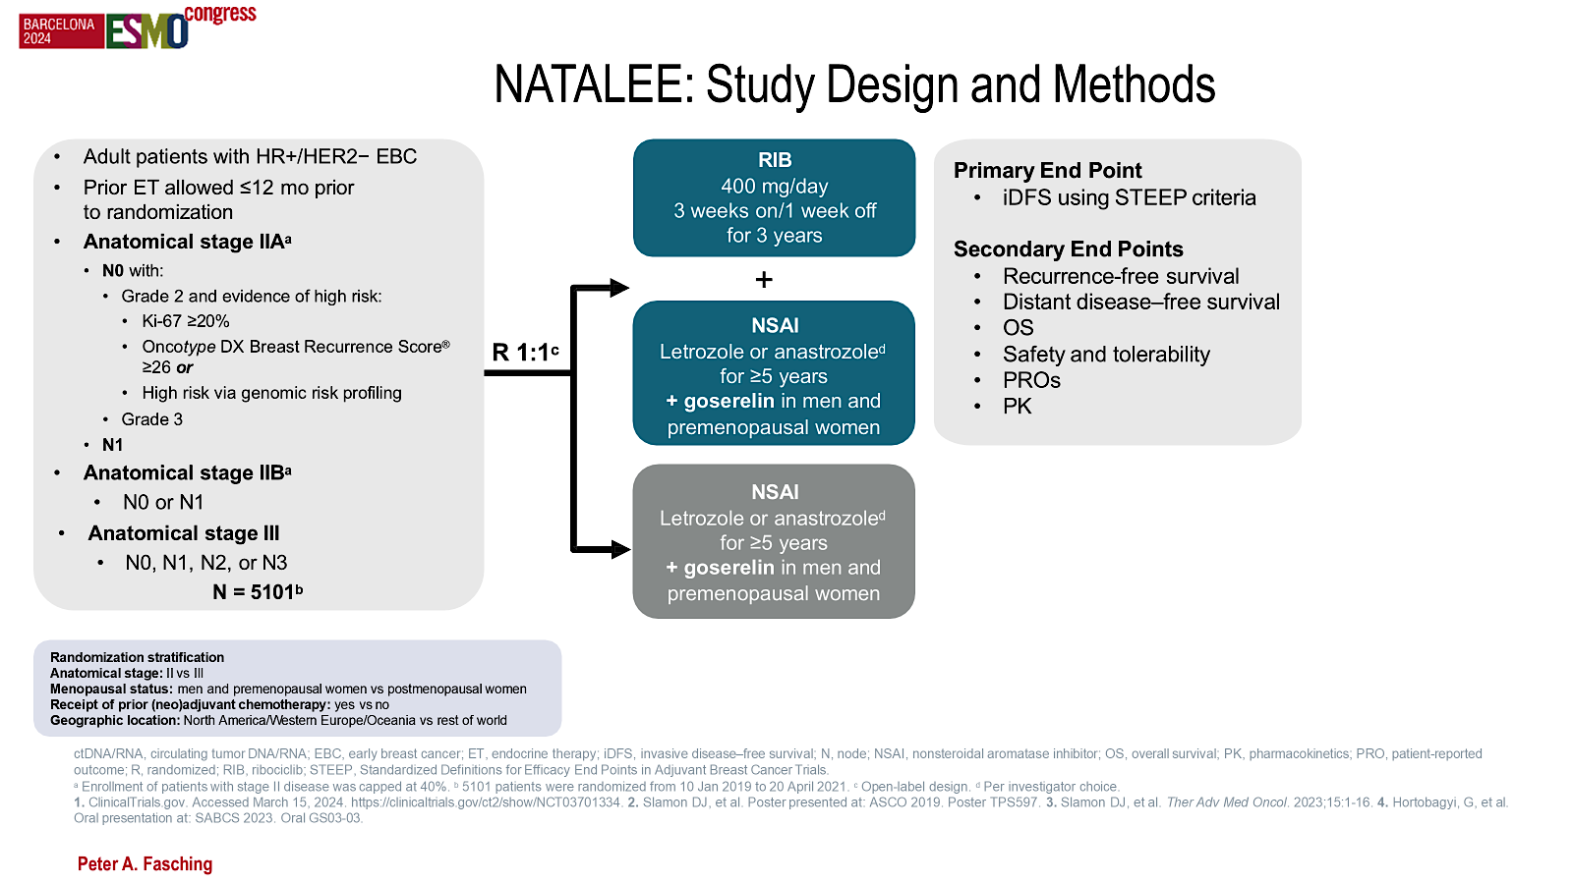
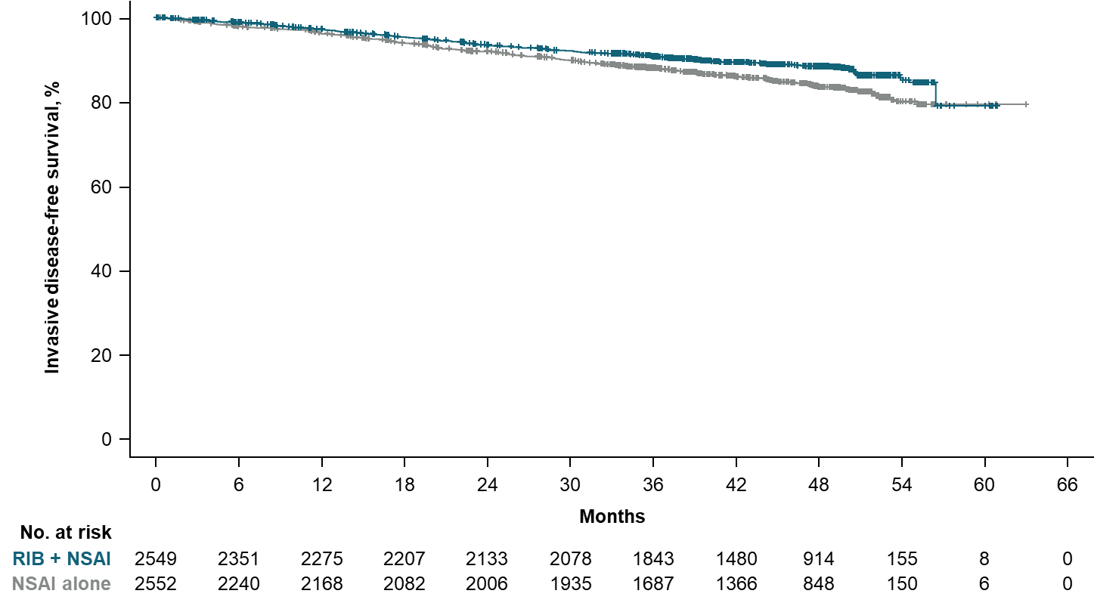
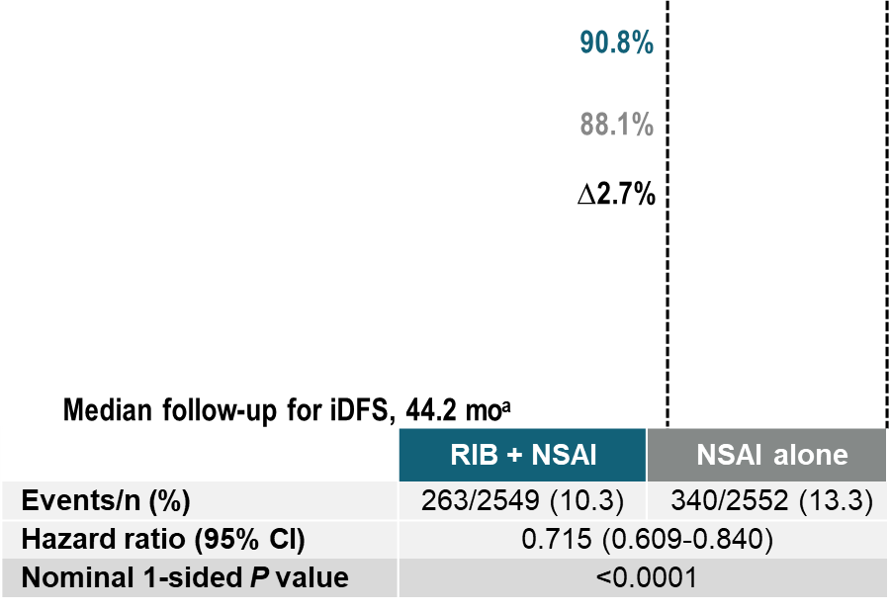
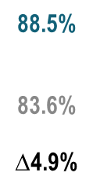
NATALEE: Study Design, Methods & 3-yr iDFS
Peter A. Fasching iDFS, invasive disease–free survival; ITT, intent to treat; NSAI, nonsteroidal aromatase inhibitor; RIB, ribociclib.
ª An additional 10.9 months of follow-up compared with the protocol-specified final iDFS analysis.
At 1 yr post end of treatment, the reduction in iDFS is persisting

Slide 19
Summary: CDK4/6 inhibitors in ER+EBC
Abemaciclib and ribociclib have shown reduction in recurrence risk in higher risk breast cancer
They differ in side effect profiles and durations of treatment
It is not known which is better
These drugs carry more toxicity than perhaps suggested by the clinical trials data
To date, there is no OS benefit
Not clear that neoadjuvant CDK4/6i therapy improves long-term tumor response or outcomes

Slide 20
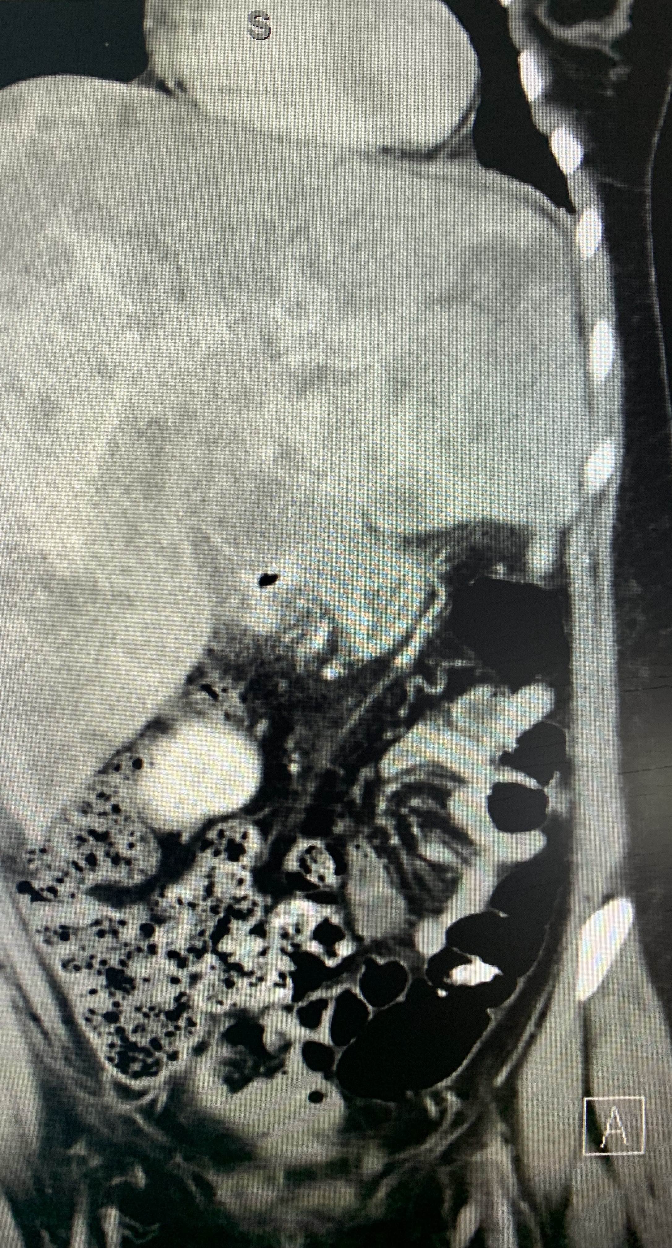
Case –De Novo Stage IV YWBC
36-year-old math teacher, mother of 2 boys, presents with several month history of feeling unwell, back pain, recent fevers
Imaging: widespread metastatic HR+HER2neg breast cancer
6cm breast mass and LR LAD
Liver metastasis present
LFTS 2x ULN, bili normal
Bone metastasis
Blood counts normal
Premenopausal
PMH: Hypothyroidism
G2P2, youngest child is 4
Meds: Synthroid, OCPs, melatonin, occ. CBD
Gene testing completed and no cancer-predisposing mutations found
Treatment Considerations
Stop OCPs and initiate non-hormonal highly effective contraception.
Initiate ovarian function suppression –which one?
Initiate bone supportive medication – zoledronic acid or denosumab
What first line therapy to choose?
  Endocrine therapy alone?
  Endocrine therapy with targeted therapy?
  Chemotherapy?

Slide 21
First Line therapy decision making
CDK 4/6 inhibitor | Study | ET partner | Menopausal Status | Disease Status | PFS Exp v control (HR)
palbociclib | Paloma-1 | letrozole | Pre/post | AI sens | 20.2 v 10.2 (0.48)
 | Paloma-2 |  |  |  | 27.6 v 14.5 (0.56)
 | Paloma-3 | fulvestrant |  | AI resis | 9.5 v 4.6 (0.46)
ribociclib | Monaleesa-2 | letrozole | Post | AI sens | 25.3 v 16 (0.56)
 | Monaleesa-3 | fulvestrant |  | AI mixed | 20.5 v 12.8 (0.59)
 | Monaleesa-7 | Tam/NSAI | Pre | AI sens | 23.8 v 13.3 (0.55)
abemaciclib | Monarch-1 | None (phase II) | Pre/post | AI resis | 6.0 (single arm)
 | Monarch-2 | fulvestrant | Pre/post | AI resis | 16.4 v 9.3 (0.55)
 | Monarch-3 | NSAI |  | AI sens | 28.1 v 14.7 (0.54)

Slide 22
Sequencing of CDK4/6 Inhibitor Studies
SONIA trial: Patients with MBC were randomized to AI alone vs AI + CDK4/6 inhibitor; patients who were on AI as a first line received CDK4/6 inhibitor as a second line. No difference in PFS. (Gabe S. Sonke et. al, JCO 41, LBA1000-LBA1000, 2023).
RIGHT CHOICE trial: first line ribociclib with endocrine therapy vs chemotherapy for patients with HR+ breast cancer with aggressive MBC. First-line ribociclib plus endocrine therapy showed better PFS, similar response rates, and better tolerability (Yen-Shan Lu et al., JCO 42, 2812-2821, 2024).
postMONARCH trial: Abemaciclib Plus Fulvestrant in Advanced Breast Cancer After Progression on CDK4/6 Inhibition: Results From the Phase III postMONARCH Trial

Slide 23
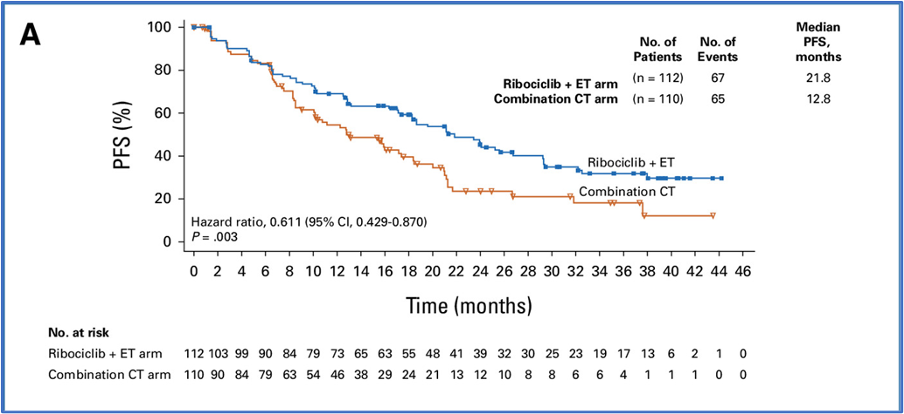
RIGHT Choice: Ribociclib Plus Endocrine Therapy Versus Combination Chemotherapy in Premenopausal Women With Clinically Aggressive Hormone Receptor–Positive/Human Epidermal Growth Factor Receptor 2–Negative Advanced Breast Cancer
Characteristics | Ribociclib + ET (n = 112) | Combination CT (n = 110)
Age, years, median (range) | 44.0 (26-58) | 43.0 (26-55)
Disease-free interval,ª No. (%)
De novo disease | 70 (62.5) | 73 (66.4)
Relapsed from early breast cancer | 42 (37.5) | 37 (33.6)
≤12 months | 6 (5.4) | 2 (1.8)
>12 and ≤24 months | 8 (7.1) | 7 (6.4)
>24 months | 28 (25.0) | 28 (25.5)
Disease history, No. (%)
Rapid progression | 23 (20.5) | 18 (16.4)
Symptomatic nonvisceral disease | 15 (13.4) | 16 (14.5)
Symptomatic visceral metastases | 74 (66.1) | 76 (69.1)
Visceral crisis status, No. (%)
Yes | 57 (50.9) | 49 (44.5)
Metastatic sites,^{d} No. (%)
Bone | 60 (53.6) | 68 (61.8)
Bone only | 5 (4.5) | 4 (3.6)
CNS | 1 (0.9) | 3 (2.7)
Liver | 54 (48.2) | 53 (48.2)
Liver or lung | 87 (77.7) | 82 (74.5)
Lung | 62 (55.4) | 55 (50.0)
Lymph node | 74 (66.1) | 75 (68.2)
Other | 46 (41.1) | 38 (34.5)
Skin | 9 (8.0) | 2 (1.8)
Soft tissue | 3 (2.7) | 5 (4.5)
Metastatic sites, No. (%)
1 | 19 (17.0) | 11 (10.0)
2 | 29 (25.9) | 39 (35.5)
≥3 | 64 (57.1) | 60 (54.5)
No OS difference seen
Lu, J Clin Oncol, JCO 2024 https://doi.org/10.1200/JCO.24.0014

Slide 24
Sequencing of CDK4/6 inhibitors
Metastatic HR+ BC
Endocrine
sensitive
Endocrine
resistant
Single agent endocrine
(select patients)
CDK4/6 plus
AI
CDK4/6
fulvestrant
First line therapy
PIK3CA mutated?
Even if organ crisis is present or impending
No
yes
If at any time organ crisis is present or impending
Front line therapy for HR+ metastatic breast cancer:
Do not give chemotherapy: regimen of CKD4/6 inhibitors + endocrine therapy are superior even in visceral crisis!
AI sensitive: AI alone (SONIA trial) or AI + CDK4/6 inhibitor
Endocrine resistance (recurrence on adjuvant therapy or ≤12 months after): SERD + CDK 4/6
(PIK3CA + can consider inavolisib + fulvestrant +palbociclib)
mTOR
endocrine tx
?
Alpelisib
fulvestrant
Single agent
chemotherapy
Combination
chemotherapy

Slide 25
Roundtable Discussion

Slide 26
Nursing Considerations for Patients Receiving a CDK4/6 Inhibitor
Ronald Stein, JD, MSN, NP-C, AOCNP
Clinical Instructor of Medicine
USC Norris Comprehensive Cancer Center
Los Angeles, California

Slide 27
Why recommend a CDK4/6 inhibitor (metastatic setting)?
For ER+ HER2- metastatic patients, generally first line treatment
Significant progression-free survival benefit when compared to endocrine therapy alone
Real case #1: 58 y.o. F originally diagnosed in 2007 ER+ HER2-, s/p B mastectomy, adjuvant chemo, 5 yrs tamoxifen. In 2021, diagnosed with significant T4 and T12 metastases. S/P T12 corpectomy, T11-L1 laminectomy, T9-L1 posterior spinal fusion. Started letrozole + palbociclib 4/2021. PET scans q 4 months have continued to show stable disease over the past 4 years. Pt tolerating at full dose. Married with adult children, husband recently retired, extensive global traveling
Potentially better QOL with oral drugs, not infusion-dependent
Hits cancer cells in 2 ways (when combined with endocrine therapy)
These drugs have been studied for nearly 10 years

Slide 28
Why recommend a CDK4/6 inhibitor (adjuvant setting)?
In certain groups of ER+ breast cancer patients (e.g. those who are at moderate to high risk of recurrence based on nodal status, tumor size, Ki-67 index scores), the addition of certain CDK4/6 inhibitors can add a statistically significant benefit in terms of invasive disease-free survival
Real case #2: 50 year-old postmenopausal F with ER+ HER2- L breast CA s/p mastectomy with surgical pathology pT3N2aM0. After completion of adjuvant chemotherapy, she began anastrozole + abemaciclib (dose ultimately reduced due to neutropenia, diarrhea and fatigue). Currently at 50 mg BID. She will complete 2 years of abemaciclib in December 2025. Interestingly, she was diagnosed with high-grade endometrial CA (ER positive) in December 2024. Staging exams were negative for distant disease. She underwent surgery and is now on surveillance. GYN/ONC felt that the paclitaxel and anastrozole given for breast CA may have “temporized” the uterine CA and theoretically, her uterine CA was at a higher stage. Prior genetic testing revealed two VUS not clinically actionable.

Slide 29
How CDK4/6 inhibitors work: What patients need to know
Breast cancer cells need to grow and proliferate in order to do damage and cause harm
Cancer cells use proteins called cyclin-dependent kinases (“CDKs”) to multiply, grow and thrive. Two of these CDKs are CDK4 and CDK6
The CDK4/6 inhibitors block the activity of CDK4 and CDK6
This, in turn, disrupts breast cancer cells from growing and causing harm

Slide 30
Common side effects of CDK4/6 inhibitors
Pancytopenia (WBC, RBC, platelets)
Abnormal LFTs (especially ribociclib)
Elevated creatinine (especially abemaciclib)
Fatigue
N/V/D
Decreased appetite
Hair thinning or alopecia
Skin rash
Infections
Cough
Fetal toxicity

Slide 31
Less common but potentially dangerous side effects of CDK4/6 inhibitors
Hepatic toxicity (especially ribociclib)
Diarrhea leading to dehydration and electrolyte imbalance (especially abemaciclib)
QT prolongation (especially ribociclib)
Neutropenic fever and sepsis (all)
Interstitial lung disease (all)
Venous thrombus (all)
Real case #3: 52 yo Asian female (BRCA 2+) with R breast cancer metastatic to bones diagnosed 5/2020 ER+PR+HER2-. Palbociclib/letrozole/leuprolide from 6/2020 to 2/2023, olaparib 3/2/23 to 1/25/24, exemestane/everolimus 2/2024, then switched to fulvestrant/abemaciclib 6/2024 due to progression. After 1 week on abemaciclib, pt presented to clinic with extreme shortness of breath. Sent to ED for CT angio. Negative for PE. Admitted and underwent thorough pulmonary work-up. Ultimately diagnosed with hypersensitivity pneumonitis and started on prednisone. Remained in hospital 6 days.

Slide 32
Potential toxicities What to tell patients prior to starting a CDK4/6 inhibitor
They will be monitored very closely with clinic visits, labs and EKGs (ribociclib) at regularly scheduled intervals
Notify provider/ED if any shortness of breath, excessive fatigue, persistent dry cough, chest pain, palpitations, persistent diarrhea or bothersome GI symptoms, extremity swelling
Notify provider/ED for fever > 100.4 °F
Don’t panic if toxicities develop; can hold and then do dose adjustments if necessary
Communication is everything! Please call with any questions and/or concerns (24/7 contact information provided)

Slide 33
Monitoring of adverse effects
Closely follow package inserts!
Tend to go beyond package insert recommendations, with more frequent labs and clinic visits during the first 2 months of therapy
ASCO recommendation for Hep B screening
EKGs as recommended per manufacturer (ribociclib)
Always check to see if new medications have been prescribed by other providers (CYP3A4 inhibitors or inducers)
Monitoring and management essentially same regardless of adjuvant versus metastatic. However, after initial (more intensive) monitoring period (e.g. after 6 months of starting treatment), tend to see metastatic patients more frequently in clinic, as they often have more comorbidities (e.g. more frequent lab monitoring in a patient with known liver metastasis)

Slide 34
Management of more common adverse effects
Diarrhea: loperamide, diphenoxylate/atropine
Dehydration: IVF, electrolyte replacement
N/V: anti-emetics (potentially lots of trial and error at times)
Topical steroids for rashes
“Magic” mouthwash for stomatitis, mucositis
NOTE: Depending on severity/grade of adverse effects, follow guidelines for holding med and then dose-adjusting
NOTE: For more severe adverse effects (e.g. QT prolongation, suspected interstitial lung disease, liver failure, febrile neutropenia: Stop drug, notify attending immediately; likely will need hospitalization

Slide 35
Dosing schedules and duration for CDK4/6 inhibitors
Ribociclib
> Taken with aromatase inhibitor (adjuvant). No tamoxifen (QT prolongation)
> Taken with aromatase inhibitor/fulvestrant (metastatic)
> Once daily (with or without food) for 21 days, then 7 days off
> Starting dose 400 mg (adjuvant) and 600 mg (metastatic)
Palbociclib
> Taken with aromatase inhibitor/fulvestrant (metastatic)
> Once daily (with or without food) for 21 days, then 7 days off
> Starting dose 125 mg

Slide 36
Dosing schedules and duration for CDK4/6 inhibitors, continued
Abemaciclib
> Taken with endocrine therapy (tamoxifen, AI) or fulvestrant (depending on whether metastatic or adjuvant)
> Can be used single-agent in metastatic setting under certain circumstances
> Twice a day (with or without food), every day, no breaks
> Starting dose 150 mg (generally), 200 mg (monotherapy)
DURATION
> Metastatic setting: Generally ongoing with observation for disease progression, poor toleration or drug toxicity
> Adjuvant: Abemaciclib 2 years
Ribociclib 3 years

Slide 37
Roundtable Discussion

Slide 38
Agenda
Module 1: Role of CDK4/6 Inhibitors in Localized and Metastatic Hormone Receptor (HR)-Positive Breast Cancer
Module 2: PI3K Inhibition as First-Line Treatment for HR-Positive, HER2-Negative Metastatic Breast Cancer (mBC)
Module 3: Clinical Utility of AKT and PI3K Inhibitors in Progressive HR-Positive mBC
Module 4: Current and Future Role of Oral Selective Estrogen Receptor Degraders in HR-Positive mBC

Slide 39
Clinical Scenario
A patient with ER-positive, HER2-negative breast cancer develops metastatic disease while receiving or soon after receiving adjuvant endocrine therapy, is found to have a PIK3CA mutation and is about to start treatment with inavolisib/palbociclib/fulvestrant

Slide 40
PI3K Inhibitors as First-Line Treatment for HR+/HER2- Metastatic Breast Cancer
April 9th, 2025
Research To Practice Breast Cancer Symposium
ONS Annual Congress
Denver, CO
Seth A. Wander, MD, PhD
Assistant Professor of Medicine
Harvard Medical School
Massachusetts General Hospital
swander@mgh.harvard.edu

Slide 41
Targeting PI3K in HR+/HER2- Metastatic Breast Cancer
Key elements related to PI3K/AKT signaling
Testing for PIK3CA mutations
SOLAR-1: alpelisib and early insights in PI3K blockade
INAVO120: inavolisib triplet therapy for high-risk HR+/HER2- MBC
Summary and future directions

Slide 42
Oncogenic PI3K Signaling and Structure
Vasan N and Cantley LC Nat Rev Clin Onc 2022

Slide 43
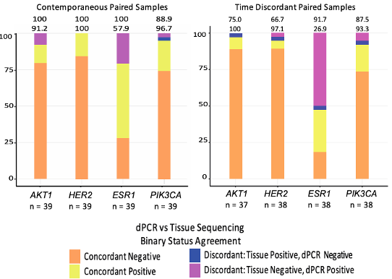
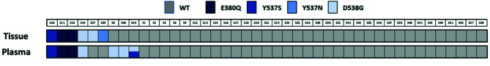
Biopsy Approach and Sequencing Methodology
Tissue Biopsy
Invasive, biopsy
Provides ER/PR/HER2/PDL1, etc
Limited insights into heterogeneity
May utilize archival specimens
Liquid Biopsy
Non-invasive blood test
Unable to assess receptor status
Reflects tumor heterogeneity
Updated sequencing in real-time
Generally high concordance rates, 80-90%+, between simultaneous solid and liquid biopsies for key genes (PIK3CA, PTEN, AKT – slightly less for ESR1)
Turner N et al Lancet Onc 2020; Urso L et al Front Onc 2021; Vasan N et al ASCO 2024

Slide 44
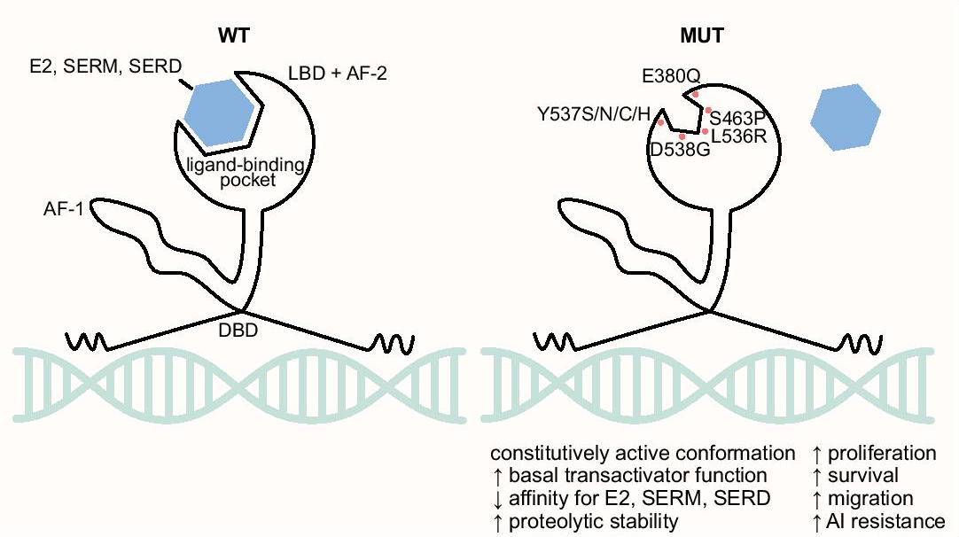
Truncal vs Acquired Alterations
PIK3CA mutations are early events, present at baseline = Truncal
ESR1 mutations are rare in primary/untreated HR+ breast cancer (<5%)
Increased after prolonged exposure to aromatase inhibitors = Acquired
ESR1m: 25-40% frequency in 2nd-3rd line metastatic setting
ESR1 D538G
PIK3CA H1047R
PIK3CA H1047R
Reviewed in Brett JO et al Breast Cancer Res 2021

Slide 45
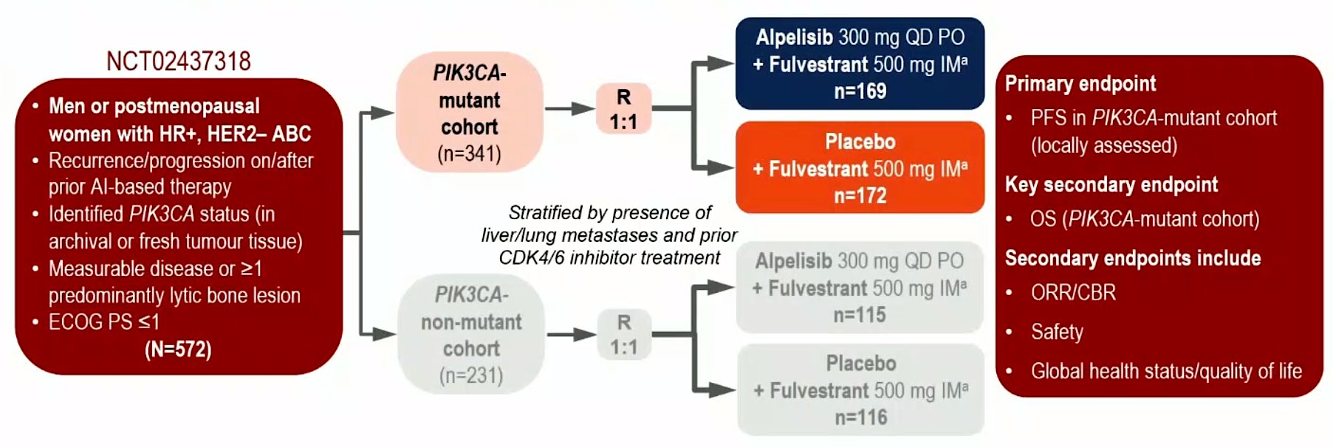
SOLAR-1: 1st Generation PI3K inhibition in HR+ MBC
Andre F et al NEJM 2019; Andre F et al Ann Onc 2020

Slide 46
SOLAR-1: 1st Generation PI3K inhibition in HR+ MBC
Median PFS 5.6m > 7.4m
HR 0.85 (95% CI 0.58-1.25
Median PFS 5.7m > 11.0m
HR 0.65 (95% CI 0.50-0.85), p<0.001
Andre F et al NEJM 2019; Andre F et al Ann Onc 2021

Slide 47
SOLAR-1: 1st Generation PI3K inhibition in HR+ MBC
Inclusion A1c <6.4%
Key toxicities:
Hyperglycemia
GI (nausea, diarrhea)
Mucositis
Rash
Andre F et al NEJM 2019; Andre F et al Ann Onc 2021

Slide 48
INAVO120: Inavolisib for Endocrine Refractory, PIK3CAm HR+ MBC
Jhaveri KL et al SABCS 2023 and Turner NC et al NEJM 2024

Slide 49
INAVO120: Inavolisib for Endocrine Refractory, PIK3CAm HR+ MBC
Median PFS 7.3m > 15.0m
HR 0.43 (95% CI 0.32-0.59), p<0.001
Median OS 31.1m > NR
HR 0.64 (95% CI 0.43-0.97), p<0.001
Jhaveri KL et al SABCS 2023 and Turner NC et al NEJM 2024

Slide 50
INAVO120: Inavolisib for Endocrine Refractory, PIK3CAm HR+ MBC
Inclusion A1c <6%
Key toxicities:
Hyperglycemia
GI (nausea, diarrhea)
Mucositis
Rash
Jhaveri KL et al SABCS 2023 and Turner NC et al NEJM 2024

Slide 51
Key Toxicities Across Available PI3K Pathway Inhibitors
 | SOLAR-1 |  | INAVO120 |  | Capitello291 (AKTi)
 | All Grade | Grade 3+ | All Grade | Grade 3+ | All Grade | Grade 3+
Hyperglycemia | 63.7% | 36.6% | 58.6% | 5.6% | 16.3% | 2.3%
Diarrhea | 57.7% | 6.7% | 48.1% | 3.7% | 72.4% | 9.3%
Mucositis | 24.6% | 2.5% | 51.2% | 5.6% | 14.6% | 2.0%
Rash | 35.6% | 9.9% | 25.3% | 0.0% | 38.0% | 12.1%
Inclusion A1c <6.4%
Inclusion A1c <6%
Inclusion A1c <8%

Slide 52
Summary and Future Directions
The PI3K pathway is frequently activated in HR+ breast cancer (~40%)
Early (truncal) events, detected in tissue or liquid biopsy
Alpelisib with fulvestrant can be used in PIK3CAm, 2nd line
Inavolisib + palbociclib + fulvestrant can be used in PI3KCAm, 1st line, endocrine resistant
Key toxicities include hyperglycemia, GI issues, mucositis, rash
New, mutant-specific, PI3K inhibitors are under development (less toxicity!)
Combinations with next-generation, oral antiestrogens are being explored

Slide 53
Roundtable Discussion

Slide 54
Nursing Considerations for Patients Receiving Inavolisib/Palbociclib/Fulvestrant
Research To Practice
Jamie Carroll
April 9, 2025

Slide 55
65 yo presents with screen detected abnormality. Diagnostic w/u ensued.
Biopsy reveals invasive ductal carcinoma, Grade II, ER/PR 91-100%, HER2 1+
Enrolled in neoadjuvant ET study x 6 months
Proceeded to bilateral mastectomy. Final pathology reveals 2.0 cm tumor, Grade II, tumor cellularity 30% (ypT1cN0)

Slide 56
Sept 2020-July 2022 Anastrozole, dc due to arthralgias
July 2022-May 2024 Letrozole, dc due to arthralgias/myalgias
May 2024-March 2025 Exemestane
March 2025-Presented with new flank pain. CT scan revealed multiple osseous lesions, most prominent L1/L2.
Seen back in clinic with Tempus testing and biopsy of bone.
Bone biopsy: Positive for malignancy, consistent with breast primary. ER/PR 91-100%, HER2 2+, FISH negative.

Slide 57
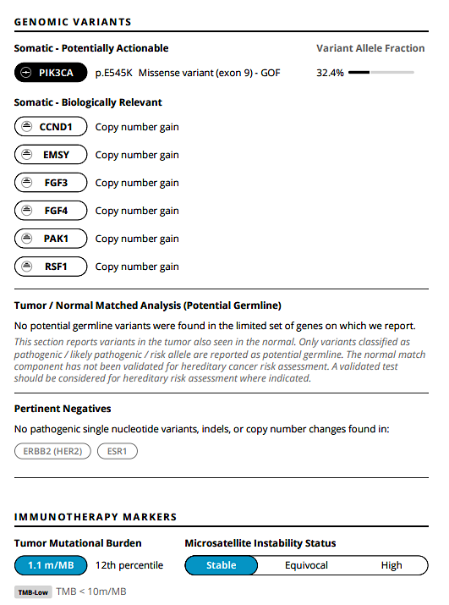

Slide 58
Patient started Inavolisib, Fulvestrant and Palbociclib
Inavolisib-9 mg taken daily Days 1-28
Palbociclib-125 mg taken daily Days 1-21
Fulvestrant-500 mg Days 1, 15 of C1 then every 28 days
Notes:
Understanding how to take pills is important.

Slide 59
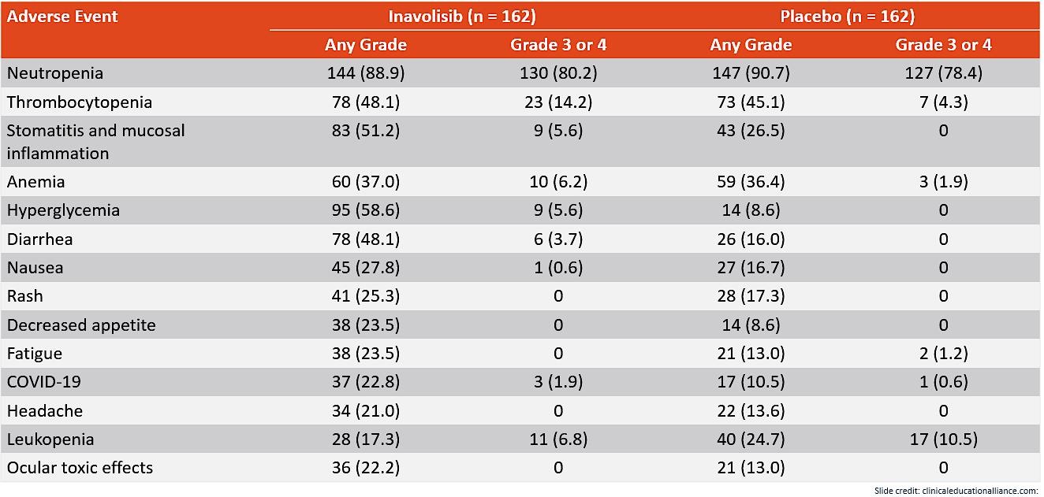

Inavo120: Safety

Slide 60
Case study side effects
Neutropenia: Held until recovered, dose reduced Palbociclib 100mg
Stomatitis: Dexamethasone mouth rinse 0.5 mg/ml QID
Hyperglycemia: Glucose monitor and Metformin 500 mg BID
Diarrhea: Loperamide 2mg, up to 16 mg per day
Nausea: Ondansetron 8 mg, Prochlorperazine 25 mg and Olanzapine 5 mg at bedtime

Slide 61
Roundtable Discussion

Slide 62
Agenda
Module 1: Role of CDK4/6 Inhibitors in Localized and Metastatic Hormone Receptor (HR)-Positive Breast Cancer
Module 2: PI3K Inhibition as First-Line Treatment for HR-Positive, HER2-Negative Metastatic Breast Cancer (mBC)
Module 3: Clinical Utility of AKT and PI3K Inhibitors in Progressive HR-Positive mBC
Module 4: Current and Future Role of Oral Selective Estrogen Receptor Degraders in HR-Positive mBC

Slide 63
Clinical Scenario
A patient with ER-positive, HER2-positive mBC experiences disease progression on a first-line CDK4/6 inhibitor and endocrine therapy, is found to have a PTEN/PI3K/AKT pathway alteration and is about to start treatment with capivasertib/fulvestrant

Slide 64
PI3K/AKT/PTEN Inhibitors for Hormone Receptor (HR)-Positive Breast Cancer
Virginia F. Borges, MD, MMSc
University of Colorado Cancer Center

Slide 65
Timeline of initial novel drug approvals for HR+ HER 2- metastatic breast cancer
CDK4/6 palbociclib
ribociclib
abemaciclib
PIK3CA-PTEN-AKT –capivasertib
PIK3CA-alpelisib
SERM -tamoxifen
SERD -fulvestrant
mTOR -everolimus
SERD -elacestrant
PIK3CA-inavolisib
anastrozole
letrozole
exemestane
1977
1995-1999
2002
2012
2015-2018
2019
2023----> 2024
Borges, JCO, Dec 2021- updated

Slide 66
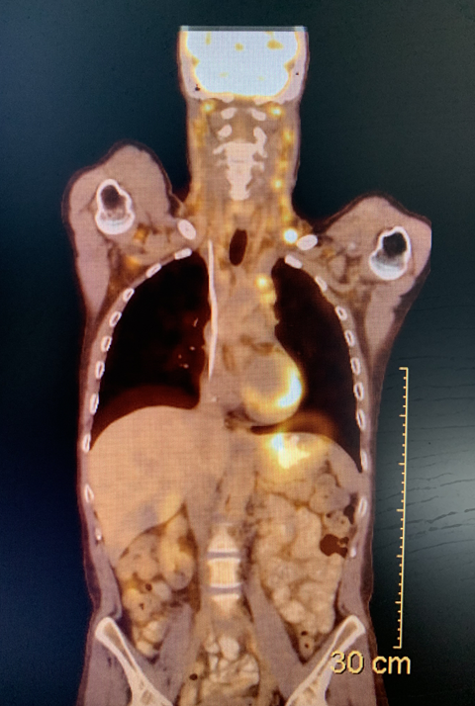
Case –Progressive HR+ HER2- MBC
2015: 35 yo presented with stage IIIC LABC, HR+ HER2neg
  AC-T dose dense chemo-> 2cm and 1/17 LN involved at mastectomy
  PMCWXRT -> OFS and AI for endocrine therapy x 5 years
2021: Notices enlarged cervical nodes
metastatic HR+HER 2+ breast cancer
  Extensive neck and mediastinal LAD, bone involvement
  NSG testing shows BRCA WT, PIK3CA Mut, erb-B2 WT, ESR1 WT
  Asymptomatic -> OFS, AI, ribociclib, zoledronic acid
  OFS converted to BSO in 2022
  2024: Follow-up PET with progression in bones and LN
  What are the options now?
  ctDNA genomic assay sent…

Slide 67
Sequencing of Treatment
Metastatic HR+ BC
Endocrine
sensitive
Endocrine
resistant
Single agent endocrine
(select patients)
CDK4/6 plus
AI
CDK4/6
fulvestrant
First line therapy
PIK3CA mutated?
Even if organ crisis is present or impending
No
yes
If at any time organ crisis is present or impending
mTOR
endocrine tx
?
Alpelisib
fulvestrant
What about after a CDK4/6 inhibitor?
Single agent
chemotherapy
Combination
chemotherapy

Slide 68
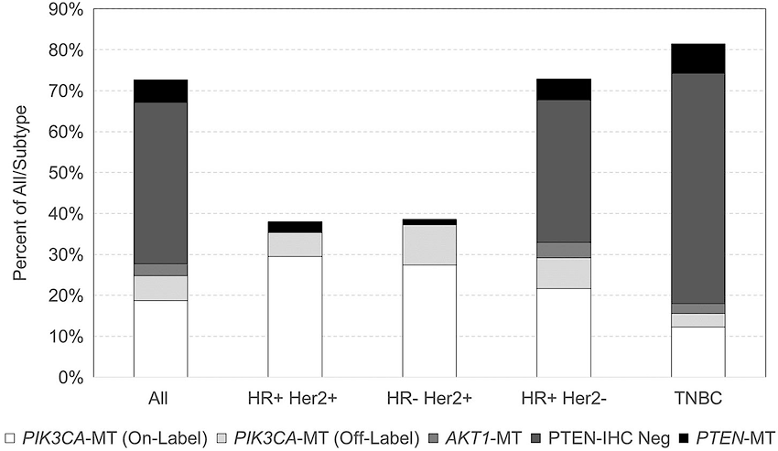
Frequency of PI3K/AKT/mTOR Mutations in Breast Cancer
PTEN Inactivating Mutations
AKT Mutations
6%
7%
87%
PIK3CA Mutations
https://www.researchgate.net/journal/Frontiers-in-Oncology
Cerma K, et al. Biomedicines. 2023;11(109):1-17.

Slide 69
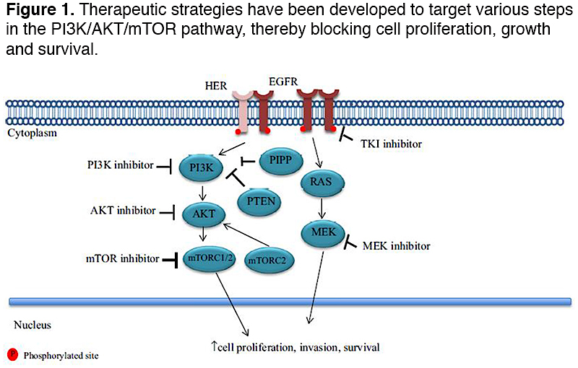
Oncology Nurse Advisor, Dec 2020

Slide 70

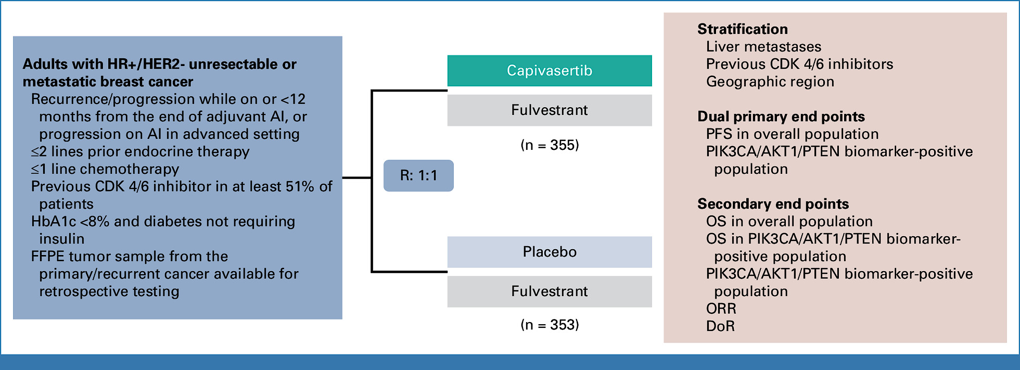
Phase III CAPitello Clinical Trial: Study Design

Slide 71
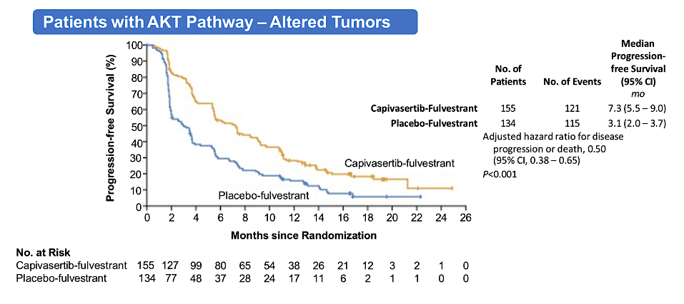
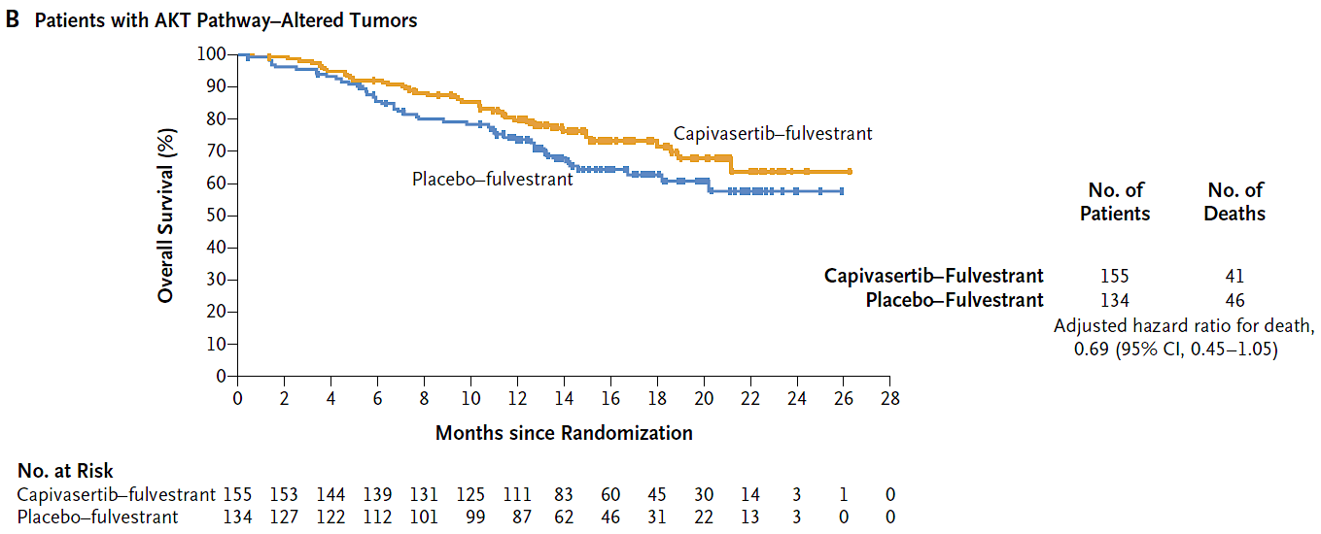
Phase III CAPitello-291 Clinical Trial: Initial Results
PFS improved from 3.1 to 7.3 months
Turner RC, et al. N Engl J Med. 2023;388(22):2058-2070.

Slide 72
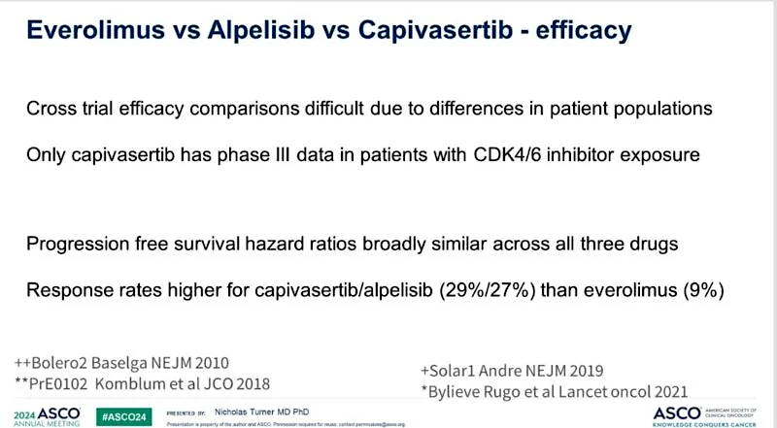
Kornblum

Slide 73
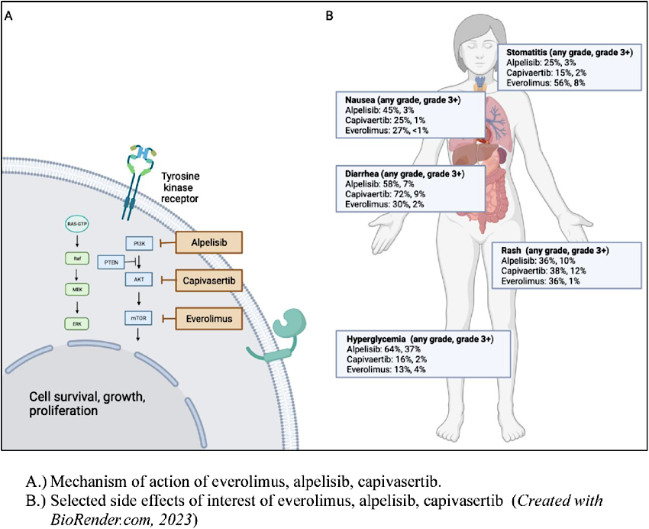

Capivasertib:
Capivasertib:
Capivasertib:
Capivasertib:
Capivasertib:
Schlam & Chavez-McGregor, Feb 2024

Slide 74
Sequencing of CDK4/6 inhibitor data in context
Metastatic HR+ BC
Endocrine
sensitive
Endocrine
resistant
Even if organ crisis is present or impending
Single agent endocrine
CDK4/6 plus
AI
CDK4/6
fulvestrant
PIK3CA/AKT/PTEN mutated?
PIK3CA/AKT/PTEN mutated?
CDK4/6 plus
AI
No
yes
If at any time organ crisis is present or impending
Second line therapy
No
yes
abemaciclib plus fulvestrant
Alpelisib (PI3K)/capivasertib
fulvestrant
everolimus +
endocrine tx
Second line therapy for HR+ metastatic breast cancer:
SERD + CDK 4/6 and sequencing of CDK4/6 to second line abemaciclib appropriate
PI3K/AKT/PTEN + consider alpelisib (PI3K only) or capivasertib + fulvestrant
Combination
chemotherapy

Slide 75
Case –Progressive HR+ HER2- MBC
2015: 35 yo presented with stage IIIC LABC, HR+ HER2neg
  AC-T dose dense chemo-> 2cm and 1/17 LN involved at mastectomy
  PMCWXRT -> OFS and AI for endocrine therapy x 5 years
2021: Notices enlarged cervical nodes
metastatic HR+HER 2+ breast cancer
  Extensive neck and mediastinal LAD, bone involvement
  NSG testing shows BRCA WT, PIK3CA Mut, erb-B2 WT, ESR1 WT
  Asymptomatic -> OFS, AI, ribociclib, zolendronic acid
  OFS converted to BSO in 2022
  2024: PET with progression in bones and LN
  fulvestrant and capivasertib started
  Ongoing duration of benefit in April 2025

Slide 76
Roundtable Discussion

Slide 77
Nursing Considerations for Patients Receiving Capivasertib
Ronald Stein, JD, MSN, NP-C, AOCNP
Clinical Instructor of Medicine
USC Norris Comprehensive Cancer Center
Los Angeles, California

Slide 78
Why recommend treatment with capivasertib for metastatic breast cancer?
For ER+ HER2- metastatic patients with one or more genetic alterations in PIK3CA/AKT1/PTEN, and progression on at least 1 endocrine-based therapy in the metastatic setting
Significant progression-free survival benefit when compared to fulvestrant therapy alone
Real case #1: 67 y.o. Asian F originally diagnosed 2018, s/p lumpectomy (pT1cN2a), received adjuv chemo, radiation, AI. In 2021, she presented with spinal cord compression/bone, liver, lung and brain mets. S/P kyphoplasty and radiation. In past 4 years: Started abemaciclib with fulvestrant - poor tolerance. Then sacituzumab govitecan. 10/2022 started trastuzumab deruxtecan given HER2 low disease. Everolimus and letrozole 4/2024 with progression of disease and was on weekly paclitaxel 7/2024 until 1/2025. Outside molecular genomics showed pathogenic variants PIK3CA and PTEN. Started on capivasertib with fulvestrant 1/25/25.
Potentially improved QOL with oral drugs, not infusion-dependent
Hits cancer cells in 2 ways (when combined with endocrine therapy)

Slide 79
How capivasertib works: What patients need to know
It is a targeted therapy known as an AKT inhibitor
Breast cancer cells need to grow and proliferate in order to do damage and cause harm
Your breast cancer cells use a protein called AKT to multiply, grow and thrive
Capivasertib blocks AKT
This, in turn, disrupts breast cancer cells from growing and causing harm
Thorough review of anticipated and potential adverse effects. Communication is everything – please call!

Slide 80
How capivasertib is administered
Orally, 400 mg (two 200 mg tablets) twice daily (with or without food)
Take for 4 days in a row, then 3 days off
If dose missed by greater than 4 hours, skip that dose and take the next dose
If the dose is vomited, then skip and take the next dose at the scheduled time

Slide 81
Common side effects of capivasertib
Hyperglycemia
Skin rash and hand/foot syndrome
Diarrhea
Stomatitis/mucositis
Leukopenia
Anemia
N/V
Fetal toxicity
Hypocalcemia and hypokalemia
Fatigue
Increased creatinine
Increased ALT

Slide 82
Monitoring of adverse events
Closely follow package inserts!
Tend to go beyond package insert recommendations, with more frequent labs and clinic visits during the first 2 months of therapy
ASCO recommendation for Hep B screening
Always check to see if new medications have been prescribed by other providers (CYP3A4 inhibitors or inducers)
Hyperglycemia: Excessive thirst, excessive urination, confusion. Hemoglobin A1C prior to initiating therapy
Cutaneous/skin problems
Diarrhea: Watch for dehydration and electrolyte abnormalities
DON’T FORGET DOSE ADJUSTMENTS!

Slide 83
Management of more common adverse effects – skin changes
Real case, continued: Pt began capivasertib/fulvestrant in Jan 2025 and did OK for the first week. However, when she resumed after 3 days off, within 24 hours she developed moderate to severe pruritic rash, generalized to her entire body but especially prevalent on her upper extremities, anterior/posterior torso and in labial/vaginal area. Determined to be Grade 2-3. She did not notify her providers when she developed the rash and presented to clinic 2 days later as scheduled. She began taking diphenhydramine 25 mg q 8 hours but obtained very little relief. No anaphylaxis symptoms. VS within acceptable ranges. Immediate treatment in clinic included STOPPING capivasertib and giving diphenhydramine 50 mg IV x 1, famotidine 20 mg IV x 1. Also provided triamcinolone topical cream rx – BID to affected areas. Contacted pharma MSL who recommended starting cetirizine 10 mg PO q 12 hours until symptoms improved. Pt notified. Seen 2 days later with condition about 90% resolved. Continued on cetirizine 10 mg DAILY, restarted capivasertib at full dose 1 week later. No further dermatologic problems.
Topical steroids, antihistamines, hypoallergenic moisturizer, avoid hot bath/shower, oatmeal bath, consider Dermatology consult

Slide 84
Management of more common adverse effects, continued - diarrhea
Real case, continued: Pt continued on fulvestrant/capivasertib for the next 2 weeks. When she came in for follow-up, she endorsed extreme fatigue and weakness. Pt stoic and reticent, but husband indicated that she started having loose stools several days beforehand, on average 4-5 per day, mostly after eating. She did not call any of her providers about this. Had been taking loperamide 1 tablet in AM and 1 tablet q HS without relief. Lost 5 pounds in 2 weeks. BMI 18. BP 88/59 (baseline 110/70), HR 99 bpm (baseline 70 bpm). CMP normal except for mild transaminitis. Tumor markers CEA and CA 15-3 both decreased since starting treatment and pt very pleased. Actions taken during clinic included NS IVF bolus, counseling concerning proper dosing of loperamide and importance of notifying providers about adverse effects. Also advised to try several small meals/snacks per day (in lieu of larger meals), maintain adequate fluid intake. Since that time, pt now takes loperamide more often (but only as needed) and loose stools average only once daily.
Loperamide (consider diphenoxylate/atropine if refractory), IV hydration, electrolyte replacement, more frequent follow-up with labs

Slide 85
Management of more common adverse effects, continued - hyperglycemia
Real case, continued: Pt’s hemoglobin A1c prior to treatment was 5.3 (normal). She has had labs checked about 7 times since beginning treatment in early-January 2025, and her highest glucose level on CMP was 127.
Do not take this lightly. There have been case reports of diabetic ketoacidosis in patients taking capivasertib
More frequent glucose monitoring in patients with known diabetes and in patients with hyperglycemia risk factors (e.g. obesity)
Diet modifications and exercise
Leuprolide has potential in certain patients to contribute to hyperglycemia
Strongly consider Endocrinology consult

Slide 86
Roundtable Discussion

Slide 87
Agenda
Module 1: Role of CDK4/6 Inhibitors in Localized and Metastatic Hormone Receptor (HR)-Positive Breast Cancer
Module 2: PI3K Inhibition as First-Line Treatment for HR-Positive, HER2-Negative Metastatic Breast Cancer (mBC)
Module 3: Clinical Utility of AKT and PI3K Inhibitors in Progressive HR-Positive mBC
Module 4: Current and Future Role of Oral Selective Estrogen Receptor Degraders in HR-Positive mBC

Slide 88
Clinical Scenario
A patient with ER-positive, HER2-positive mBC experiences disease progression on a first-line CDK4/6 inhibitor and endocrine therapy, is found to have an ESR1 mutation and is about to start treatment with elacestrant

Slide 89
Current and Future Role of Oral Selective Estrogen Receptor Degraders (SERDs) in HR+ Metastatic Breast Cancer
April 9th, 2025
Research To Practice Breast Cancer Symposium
ONS Annual Congress
Denver, CO
Seth A. Wander, MD, PhD
Assistant Professor of Medicine
Harvard Medical School
Massachusetts General Hospital
swander@mgh.harvard.edu

Slide 90
Novel SERDs for ESR1m HR+ Metastatic Breast Cancer
ESR1 mutations: frequency, function, and approach to testing
EMERALD: elacestrant monotherapy for HR+/HER2- ESR1m MBC
EMBER3: emerging data for imlunestrant +/- abemaciclib
Summary, key ongoing studies, and future directions

Slide 91
ESR1 Mutations Arise Under Selective Pressure
  Mutations are enriched in the ligand-binding domain
  Active ER (without estrogen)
  ESR1 alterations arise in metastatic samples, but are very rare in untreated/early stage cancers (acquired)
Jeselsohn R, et al. Nat Rev Clin Oncol. 2015
Notes:
Fig 1 and 2
Jeselsohn R, Buchwalter G, De Angelis C, Brown M, Schiff R. ESR1 mutations—a mechanism for acquired endocrine resistance in breast cancer. Nat Rev Clin Oncol. 2015 Oct;12(10):573-83. doi: 10.1038/nrclinonc.2015.117. Epub 2015 Jun 30. PMID: 26122181; PMCID: PMC4911210.

Slide 92
Truncal vs Acquired Alterations
PIK3CA mutations are early events, present at baseline = Truncal
ESR1 mutations are rare in primary/untreated HR+ breast cancer (<5%)
Increased after prolonged exposure to aromatase inhibitors = Acquired
ESR1m: 25-40% frequency in 2nd-3rd line metastatic setting
ESR1 D538G
PIK3CA H1047R
PIK3CA H1047R
Reviewed in Brett JO et al Breast Cancer Res 2021

Slide 93
Mechanisms of Emerging Next-Generation Antiestrogens
Patel R, et al. NPJ Breast Cancer 2023

Slide 94
EMERALD: Elacestrant, Phase III
Postmenopausal women
and men with ER+/HER2- advanced or metastatic BC
≤1 lines prior chemo for mBC
1 to 2 lines of ET, and documented PD on CDK4 and 6 inhibitor
Measurable disease (RECIST v1.1) or bone-only disease eligible
Stratification factors
ESR1 mutation status (by ctDNA)
Prior fulvestrant
Any visceral disease
Elacestrant 400 mg PO QD
N = 466
Until PD, unacceptable toxicity,
or death
R
Endocrine therapy*
Primary endpoint: PFS by BICR in all patients and in patients with mutant ESR1
  Overall population (power ≥ 90% for HR of 0.667​) or ESR1-mutated subset (power ≥ 80% for HR 0.610​) at an overall α level of 5%
Secondary endpoints: OS, PFS by BIRC in patients with WT ESR1, PFS by investigator review, ORR, DoR, CBR, safety, PK, and QOL
Bardia A, et al. J Clin Oncol. 2020;38(suppl): Abstract TPS1104.

Slide 95
EMERALD: Elacestrant Efficacy
Patient Characteristics: Elacestrant vs. Control
Prior Chemotherapy: 20% vs 24%
ESR1m: 48% vs 47%
Two prior lines of ET: 46% vs 41%
Median PFS Improvements:
ITT: 1.94 > 2.79m; HR (95%CI) 0.68 (0.52-0.90), p=0.0049
ESR1m: 1.87 > 3.78m; HR (95%CI) 0.50 (0.34-0.74), p=0.0005
Bidard FC et al JCO 2022

Slide 96
EMERALD: Elacestrant Efficacy in ESR1m
Kaklamani et al SABCS 2022 and Bardia et al CCR 2024

Slide 97
EMERALD: Toxicity Experience
Bidard FC et al JCO 2022

Slide 98
EMBER3: Imlunestrant, Phase III
Jhaveri K et al SABCS 2024 and NEJM 2024

Slide 99
EMBER3: Imlunestrant Efficacy
Patients: Contrast with EMERALD
  No prior chemotherapy
  No prior fulvestrant
  40% without prior CDK4/6i exposure
Jhaveri K et al SABCS 2024 and NEJM 2024

Slide 100
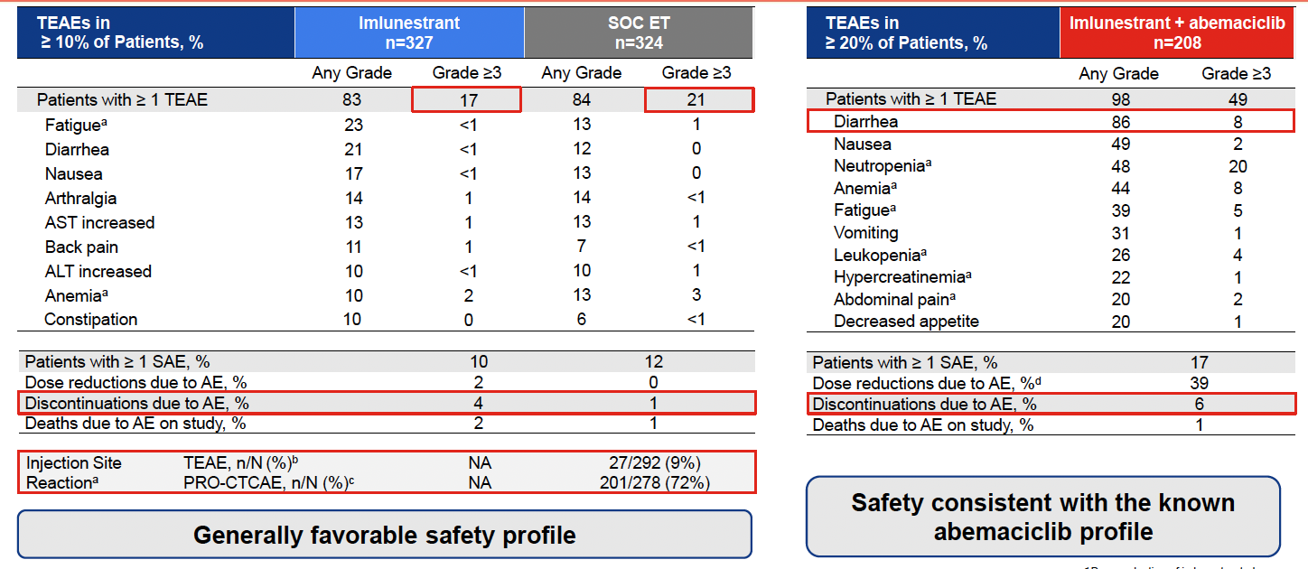
EMBER3: Imlunestrant Safety
Jhaveri K et al SABCS 2024 and NEJM 2024

Slide 101
Summary and Future Directions
ESR1 mutations are rare in primary/untreated tumors
Acquired after antiestrogen treatment, and best identified via liquid biopsy (ctDNA)
Oral SERDs are well tolerated, with some activity as single agents in patients with ESR1m
Many trials are ongoing with oral SERDs and other novel antiestrogens
These agents are being developed in combinations with many targeted therapies
Active efforts to better understand molecular/genomic changes that predict response/resistance to these new agents

Slide 102
Key Ongoing/Completed Metastatic Antiestrogen Trials
Agent | Elacestrant | Camizestrant | Imlunestrant +/- Abema | Vepdegestrant | Lasofoxifene + Abema | Amcenestrant | Giredestrant
Mechanism | SERD | SERD | SERD | PROTAC | SERM | SERD | SERD
Study | EMERALD¹ | SERENA-2^{2,3} | EMBER-3⁴ | VERITAC-2⁵ | ELAINE-3⁶ | AMEERA-3^{7,8} | acelERA^{9,10}
Control | Fulvestrant/AI | Fulvestrant | Fulvestrant/AI | Fulvestrant | Fulvestrant + Abema | Fulvestrant/AI/Tam | Fulvestrant/AI
Phase (N) | Phase III (477) | Phase II (240) | Phase III (860) | Phase III (560) | Phase III (400) | Phase II (290) | Phase II (303)
Prior CDK4/6i | Required | Permitted | Permitted | Required | Required | Permitted | Permitted
Prior Fulvestrant | Allowed | Excluded | Excluded | Excluded | Excluded | Allowed | Allowed
Results | Positive | Positive | Positive | Ongoing | Ongoing | Negative | Negative
1. Bidard et al JCO. 2022. 2. NCT04214288. 3. Oliveira et al SABCS 2022. 4. NCT04975308. 5. NCT05654623 6. NCT05696626 7. NCT04059484 8. Tolaney et al JCO. 2023 9. NCT04576455. 10. Jimenez et al. ESMO 2022.

Slide 103
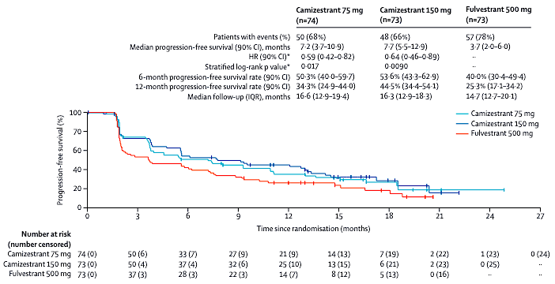
SERENA-2 Trial: Progression-Free Survival with Camizestrant versus Fulvestrant for Postmenopausal Women with ER-Positive, HER2-Negative Advanced Breast Cancer
Progression-free survival benefit with camizestrant was also observed in prespecified clinically important subgroups, such as patients with disease progression on previous CDK4/6 inhibitors, patients with liver and/or lung metastases and patients with detectable ESR1 mutations at baseline.
Oliveira M et al. Lancet Oncol 2024;25:1424-39.

Slide 104
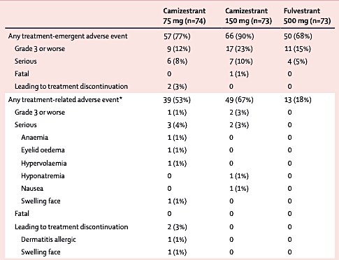
SERENA-2: Overview of Adverse Events
Oliveira M et al. Lancet Oncol 2024;25:1424-39.

Slide 105
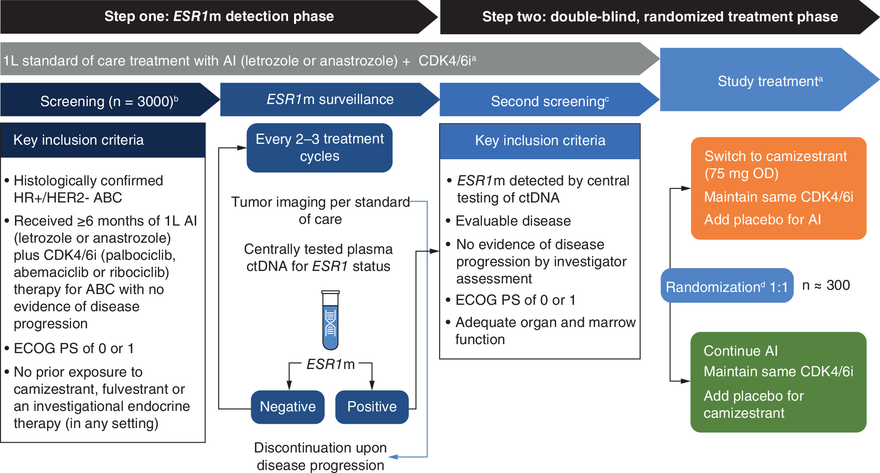
SERENA-6: Phase III, Camizestrant via ctDNA ESR1 Dynamics
Turner NC et al Future Onc 2023; NCT04964934

Slide 106
Camizestrant demonstrated statistically significant improvement in PFS in 1st-line advanced HR-positive breast cancer with an emergent ESR1 tumor mutation in SERENA-6 Phase III trial
Press Release: February 26, 2025
Positive high-level results from a planned interim analysis of the SERENA-6 Phase III trial showed that camizestrant in combination with a cyclin-dependent kinase (CDK) 4/6 inhibitor (palbociclib, ribociclib or abemaciclib) demonstrated a highly statistically significant and clinically meaningful improvement in the primary endpoint of progression-free survival (PFS).
The trial evaluated switching to the camizestrant combination versus continuing standard-of-care treatment with an aromatase inhibitor (AI) (anastrozole or letrozole) in combination with a CDK4/6 inhibitor in the 1st-line treatment of patients with hormone receptor (HR)-positive, HER2-negative advanced breast cancer whose tumours have an emergent ESR1 mutation.
The key secondary endpoints of time to second disease progression (PFS2) and overall survival (OS) were immature at the time of this interim analysis. However, the camizestrant combination demonstrated a trend toward improvement in PFS2. The trial will continue as planned to further assess key secondary endpoints.
https://www.astrazeneca.com/media-centre/press-releases/2025/camizestrant-improved-pfs-in-1l-hr-breast-cancer.html

Slide 107
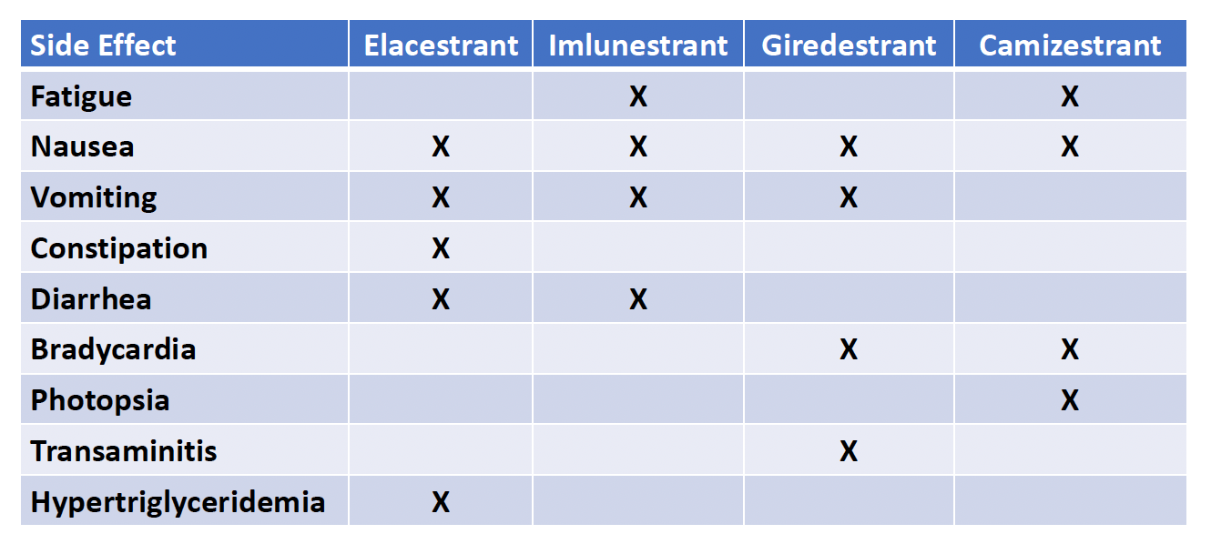
SERDs: Side Effects More Commonly Encountered
Than with Fulvestrant in RCTs
Burstein et al. SABCS 2024;Abstract GS1-01 Discussant.

Slide 108
Roundtable Discussion

Slide 109
Nursing Considerations for
Patients Receiving Oral SERDs
Research To Practice
Jamie Carroll
April 9, 2025

Slide 110
37 yo presented w/ self detected right breast mass.
Biopsy reveals invasive ductal carcinoma, grade II, ER/PR 91-100%, HER2 2+ FISH Negative.
(cT1cN1) s/p WLE, Radiation, Oncotype RS 23, declined adjuvant therapy. (pT1cN1a)

Slide 111
2017-2 years later patient presents with bony pain. PET reveals osseous metastatic disease.
Biopsy right iliac bone ER/PR 91-100%, HER2 1+
Began Goserelin, Palbociclib and Letrozole. Stable disease for 5 years.

Slide 112
Mid 2023-Progression of bony disease. Radiate painful areas in spine.
Guardant360 completed.

Slide 113
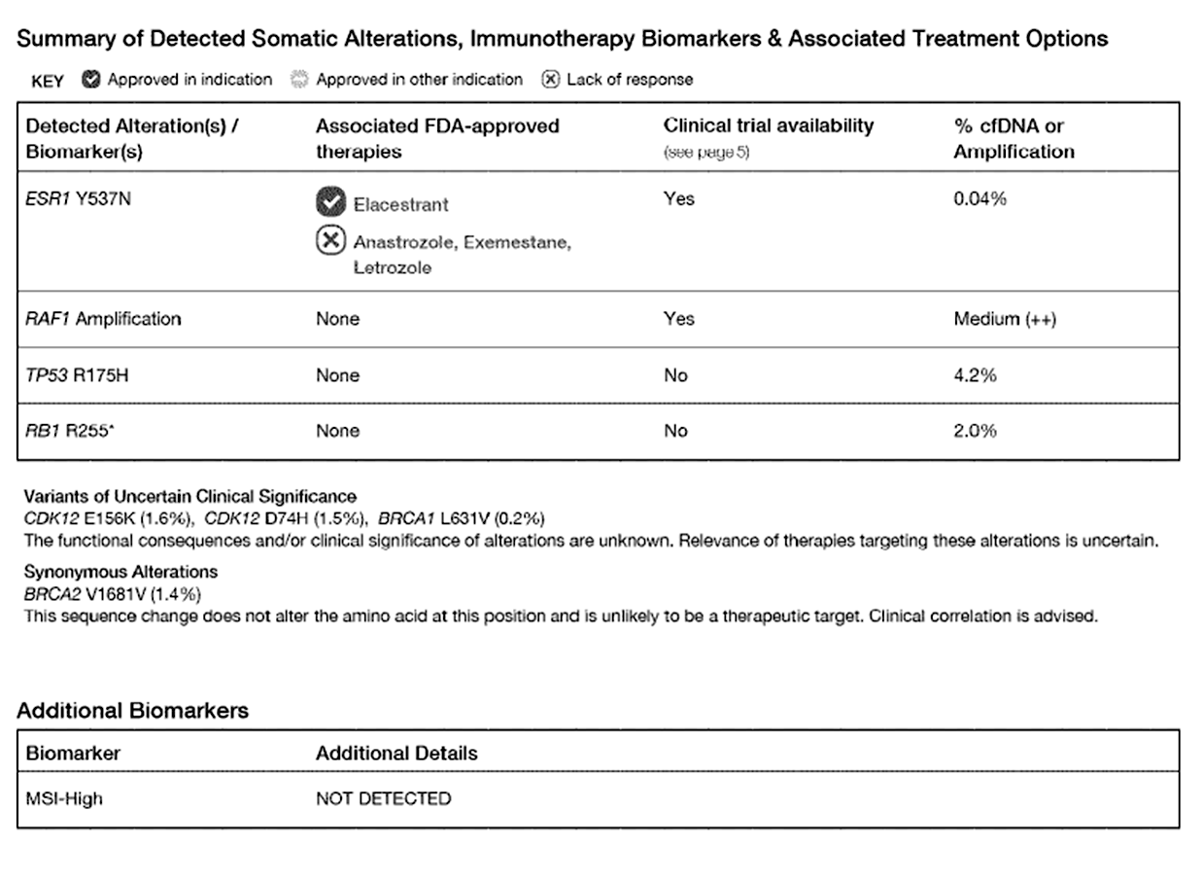
Notes:
Why Elacestrant as next line of therapy?
Specific patient details-desire for travel, never had kids, oral therapy allows that ability

Slide 114
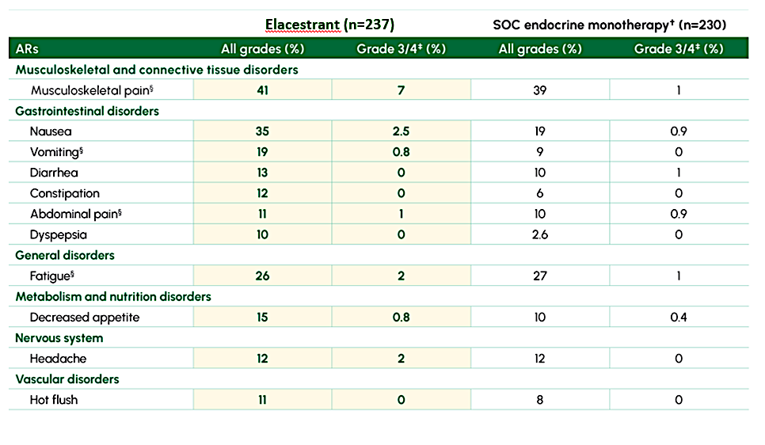
EMERALD: Safety

Slide 115
Warnings from the Package Insert for Elacestrant
Dyslipidemia: Elacestrant may cause hypercholesterolemia and hypertriglyceridemia. Monitor lipid profile prior to starting treatment and periodically thereafter.
Embryo-Fetal Toxicity: Elacestrant can cause fetal harm. Advise of the potential risk to a fetus and to use effective contraception.
Elacestrant package insert. 11/2023.

Slide 116
Dose Modification for Elacestrant
Dose Reduction | Dosage | Number and Strength of Tablets
First-dose reduction | 258 mg once daily | Three 86 mg tablets
Second-dose reduction | 172 mg once daily | Two 86 mg tablets
If further dose reduction below 172 mg once daily is required, permanently discontinue.
Severity | Dose Modification for Management of Adverse Events
Grade 1 | Continue at current dose of elacestrant
Grade 2 | Consider interruption of elacestrant until recovery to Grade ≤ 1 or baseline. Then resume elacestrant at the same dose level.
Grade 3 | Interrupt elacestrant until recovery to Grade ≤ 1 or baseline. Then resume elacestrant at the next lower dose level. If the Grade 3 toxicity recurs, interrupt elacestrant until recovery to Grade ≤ 1 or baseline. Then resume elacestrant reduced by another dose level.
Grade 4 | Interrupt elacestrant until recovery to Grade ≤ 1 or baseline. Then resume elacestrant reduced by one dose level. If a Grade 4 or intolerable adverse reaction recurs, permanently discontinue elacestrant.
Elacestrant package insert. 11/2023.

Slide 117
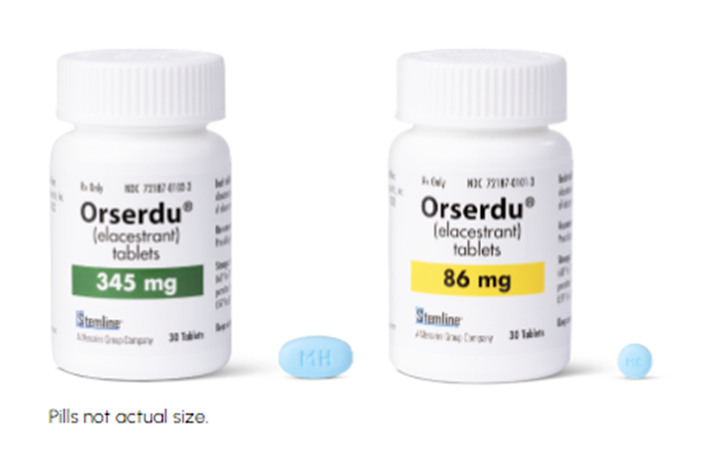


Don’t throw it in your pill box!

Slide 118
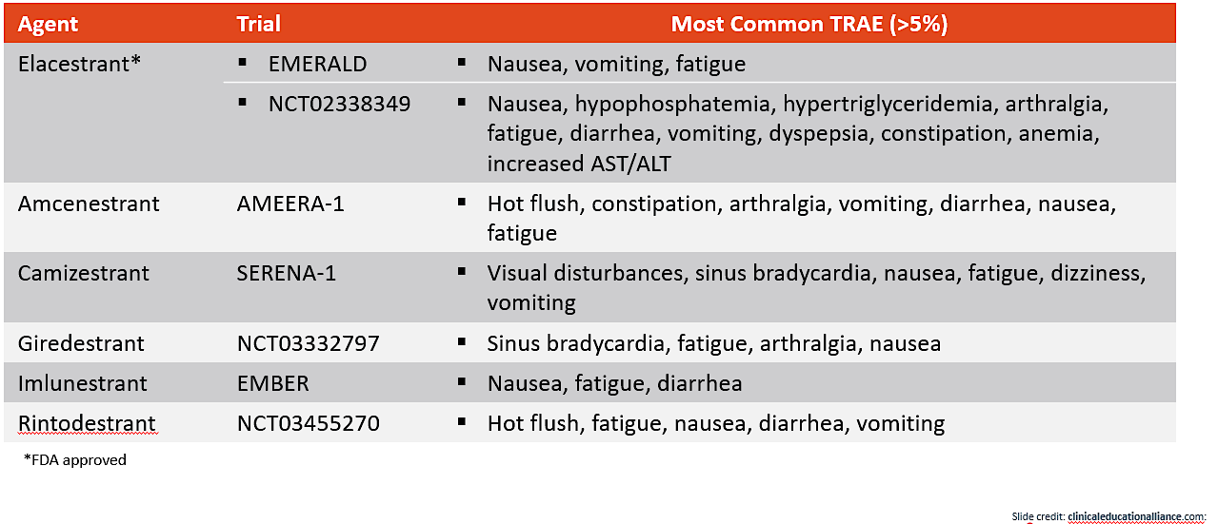
Approved and Emerging oral SERDs

Slide 119
Adherence Considerations
Educate!
Ensure access to oral medications
Two way communication
Frequent check ins w/team
Social support
Involve entire care team

