Slide 1
Hepatobiliary Cancers Saturday, April 27, 2024 6:00 AM – 7:30 AM
What I Tell My Patients: Integrating New Research Information into Current Clinical Care
A Complimentary NCPD Hybrid Symposium Series Held During the 49th Annual ONS Congress
Faculty
Blanca Ledezma, MSN, NP, AOCNP
Stacey Stein, MD
Amanda K Wagner, APRN-CNP, AOCNP
Mark Yarchoan, MD
Moderator
Neil Love, MD

Slide 2
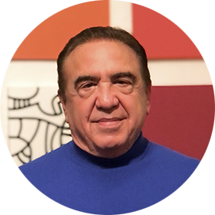
Faculty
Blanca Ledezma, MSN, NP, AOCNP
UCLA Santa Monica Hematology/Oncology
Santa Monica, California
Mark Yarchoan, MD
Associate Professor of Medical Oncology
Johns Hopkins Sidney Kimmel
Comprehensive Cancer Center
Baltimore, Maryland
Stacey Stein, MD
Associate Professor of Medicine
Assistant Medical Director of the Clinical
Trials Office
Yale Cancer Center
Yale School of Medicine
New Haven, Connecticut
Moderator Neil Love, MD Research To Practice Miami, Florida
Amanda K Wagner, APRN-CNP, AOCNP
GI Malignancies
The James Cancer Hospital
The Ohio State University
Columbus, Ohio

Slide 3
Ms Ledezma — Disclosures
Speakers Bureaus | AstraZeneca Pharmaceuticals LP, Lilly

Slide 4
Dr Stein — Disclosures
Advisory Committees | AbbVie Inc, Eisai Inc, Genentech, a member of the Roche Group
Consulting Agreements | AstraZeneca Pharmaceuticals LP, Merck
Data and Safety Monitoring Boards/ Committees | Aethlon Medical Inc, Genentech, a member of the Roche Group

Slide 5
Ms Wagner — Disclosures
No relevant conflicts of interest to disclose

Slide 6
Dr Yarchoan — Disclosures
Consulting Agreements | AstraZeneca Pharmaceuticals LP, Eisai Inc, Exelixis Inc, Genentech, a member of the Roche Group
Co-Founder with Equity | Adventris Pharmaceuticals
Research Funding (to Johns Hopkins) | Bristol Myers Squibb, Exelixis Inc, Genentech, a member of the Roche Group, Incyte Corporation

Slide 7
Commercial Support
This activity is supported by educational grants from AstraZeneca Pharmaceuticals LP, Incyte Corporation, and Taiho Oncology Inc.
Research To Practice NCPD Planning Committee Members, Staff and Reviewers
Planners, scientific staff and independent reviewers for Research To Practice have no relevant conflicts of interest to disclose.

Slide 8
This educational activity contains discussion of non-FDA-approved uses of agents and regimens. Please refer to official prescribing information for each product for approved indications.

Slide 9
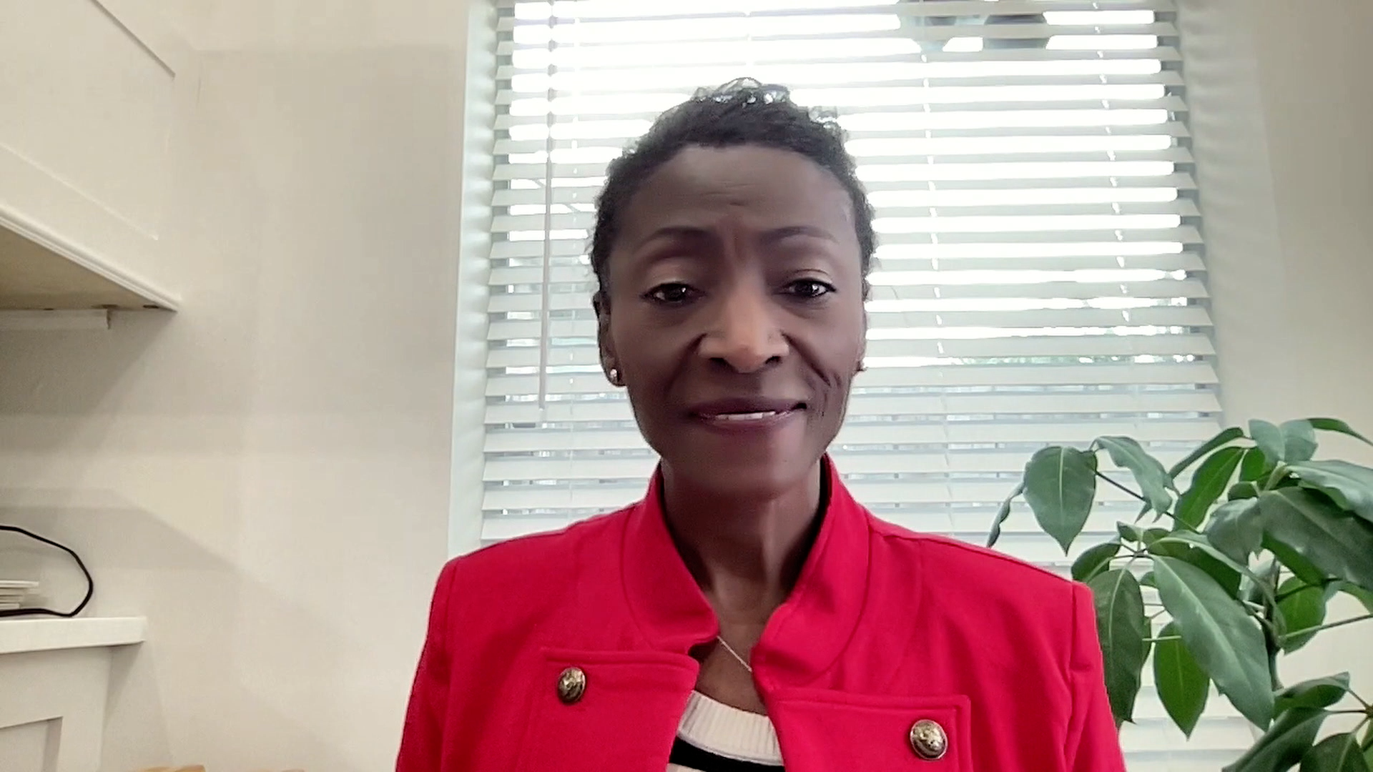
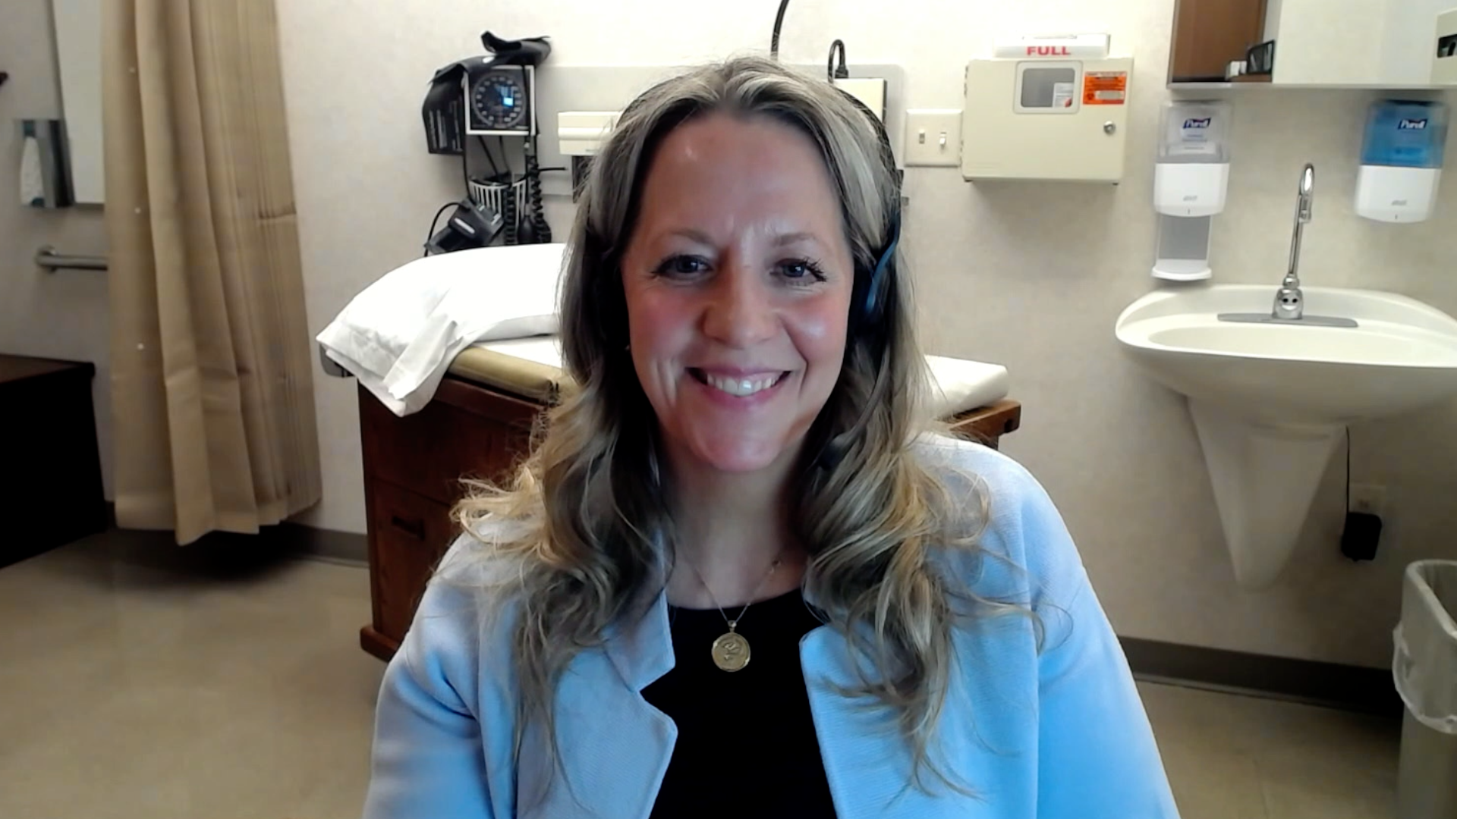
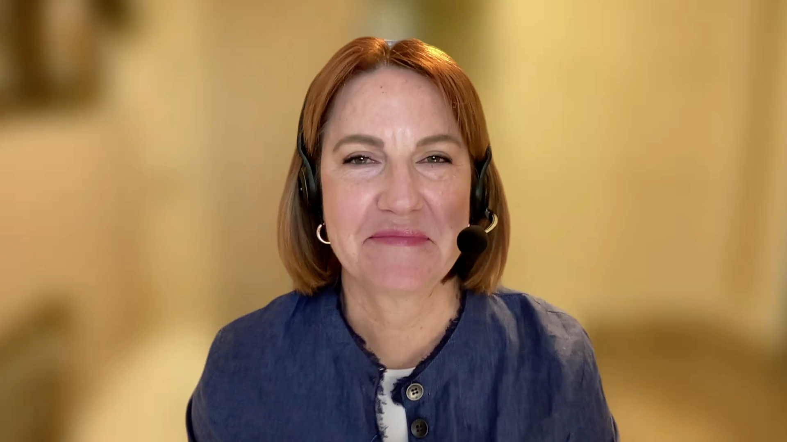
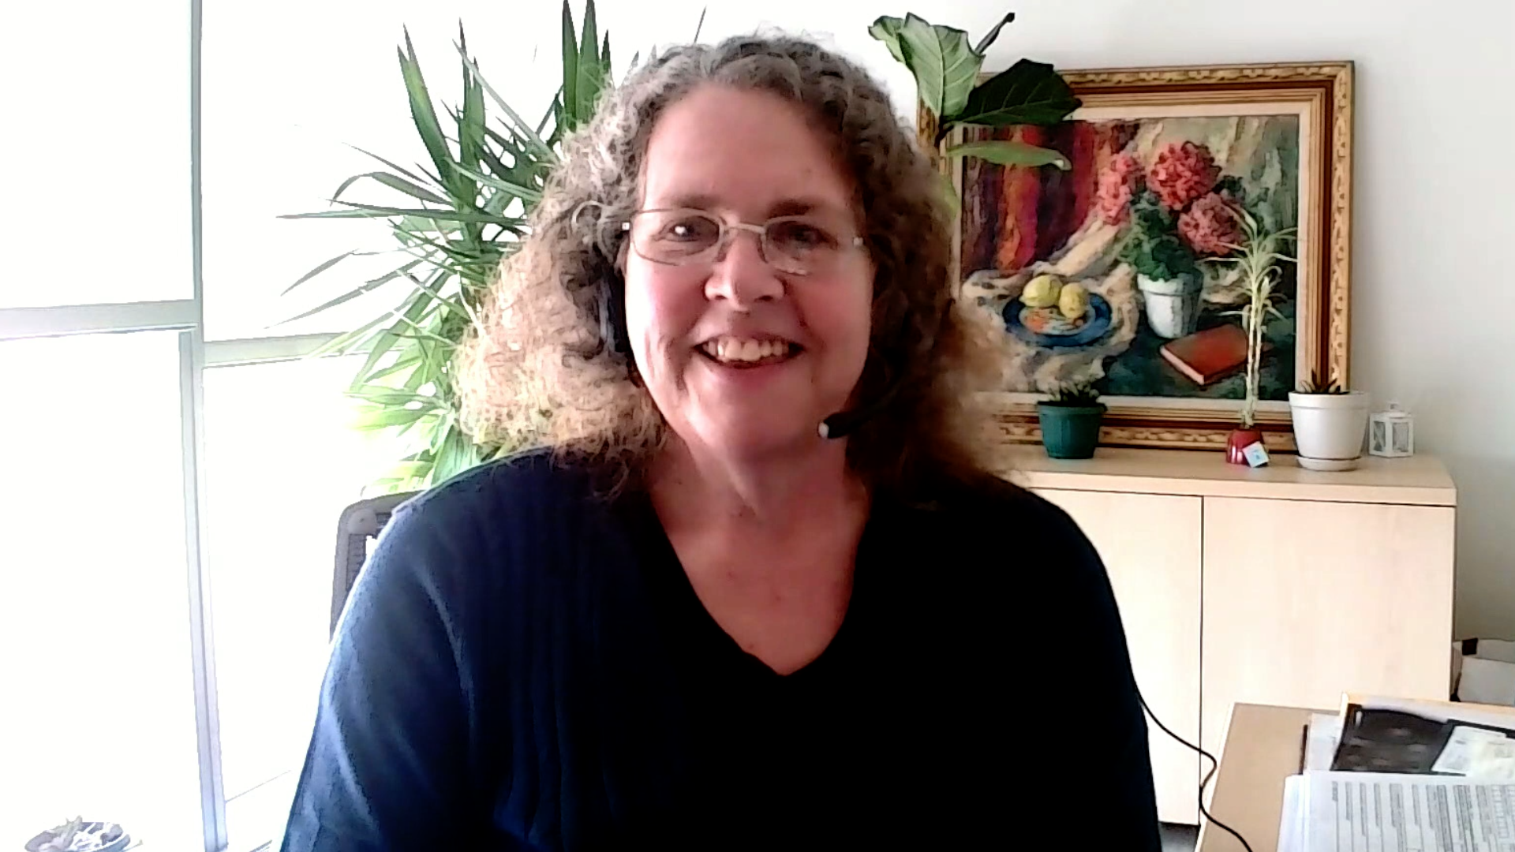
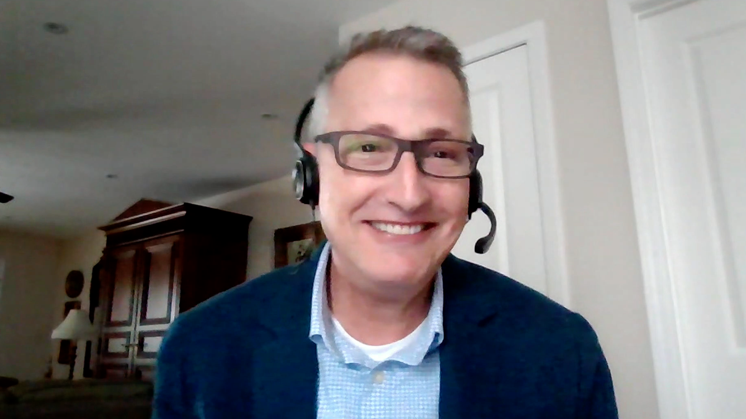
Consulting Nurse Faculty
Jacqueline Broadway-Duren, PhD, DNP, APRN, FNP-BC
The University of Texas MD Anderson Cancer Center
Houston, Texas
Jessica Mitchell, APRN, CNP, MPH
Mayo Clinic College of Medicine and Science
Rochester, Minnesota
Kathleen D Burns, RN, MSN, AGACNP-BC, OCN
City of Hope Comprehensive Cancer Center
Duarte, California
Tiffany A Richards, PhD, ANP-BC, AOCNP
The University of Texas MD Anderson Cancer Center
Houston, Texas
Sonia Glennie, ARNP, MSN, OCN
Swedish Cancer Institute Center for Blood Disorders
Seattle, Washington
Kimberly A Spickes, MNSc, RN, APRN, OCN, ACNP-BC
University of Arkansas for Medical Sciences
Little Rock, Arkansas
Amy Goodrich, CRNP
The Sidney Kimmel Comprehensive Cancer Center
Baltimore, Maryland
Ronald Stein, JD, MSN, NP-C, AOCNP
USC Norris Comprehensive Cancer Center
Los Angeles, California
https://www.ResearchToPractice.com/ONS2024Clips

Slide 10
Agenda
Introduction
Part 1: Hepatocellular Carcinoma
Part 2: Biliary Tract Cancers

Slide 11
Agenda
Introduction
Part 1: Hepatocellular Carcinoma
Part 2: Biliary Tract Cancers

Slide 12
Consulting Nursing Faculty Comments
Psychosocial impact, self-advocacy and spirituality
Kimberly A Spickes, MNSc, RN, APRN, OCN, ACNP-BC

Slide 13
Agenda
Introduction
Part 1: Hepatocellular Carcinoma (HCC)
Adjuvant Therapy for Early-Stage HCC
Role of Immunotherapy in Intermediate-Stage HCC
First-Line Therapy for Advanced HCC
Part 2: Biliary Tract Cancers

Slide 14
Agenda
Introduction
Part 1: Hepatocellular Carcinoma (HCC)
Adjuvant Therapy for Early-Stage HCC
Role of Immunotherapy in Intermediate-Stage HCC
First-Line Therapy for Advanced HCC
Part 2: Biliary Tract Cancers

Slide 15
The Current and Future Use of Adjuvant Systemic Therapy for Early-Stage Hepatocellular Carcinoma (HCC)
Dr Stein
New Haven, Connecticut
Dr Yarchoan
Baltimore, Maryland
Long-term outcomes with traditional treatment approaches for early-stage HCC; clinical features that impart a high risk of disease recurrence
Historical data with adjuvant therapeutic approaches, such as sorafenib, for patients with HCC
Design, eligibility criteria and key endpoints of the Phase III IMbrave050 study of atezolizumab in combination with bevacizumab for patients with high-risk HCC after curative resection or ablation
Improved recurrence-free survival with adjuvant atezolizumab/bevacizumab compared to active surveillance in the IMbrave050 trial; clinical and research implications
Other ongoing Phase III studies evaluating adjuvant immune checkpoint inhibitor therapy for HCC

Slide 16
Amanda K Wagner, APRN-CNP, AOCNP
What I tell my patients with earlier-stage HCC about the goals of adjuvant therapy and what to expect from it

Slide 17
IMbrave050 Primary Endpoint: Recurrence-Free Survival by Independent Assessment
Qin S et al. Lancet 2023; 402: 1835–47

Slide 18
Agenda
Introduction
Part 1: Hepatocellular Carcinoma (HCC)
Adjuvant Therapy for Early-Stage HCC
Role of Immunotherapy in Intermediate-Stage HCC
First-Line Therapy for Advanced HCC
Part 2: Biliary Tract Cancers

Slide 19
The Potential Role of Immunotherapeutic Strategies for Intermediate-Stage HCC
Dr Stein
New Haven, Connecticut
Dr Yarchoan
Baltimore, Maryland
Historical outcomes associated with locoregional treatments, such as transarterial chemoembolization (TACE), for patients with intermediate-stage HCC
Design, eligibility criteria and key efficacy and safety endpoints of the Phase III EMERALD-1 trial comparing durvalumab in combination with TACE with or without bevacizumab to TACE alone for patients with locoregional HCC not amenable to curative therapy
Recently presented findings indicating a progression-free survival advantage with durvalumab, TACE and bevacizumab compared to TACE alone in the EMERALD-1 trial
Potential clinical role of durvalumab with TACE and bevacizumab in therapy for intermediate-stage HCC

Slide 20
Blanca Ledezma, MSN, NP, AOCNP
What I tell my patients with intermediate-stage HCC who are about to undergo TACE and those being considered for or enrolling on a trial evaluating TACE in combination with immunotherapy with or without bevacizumab

Slide 21
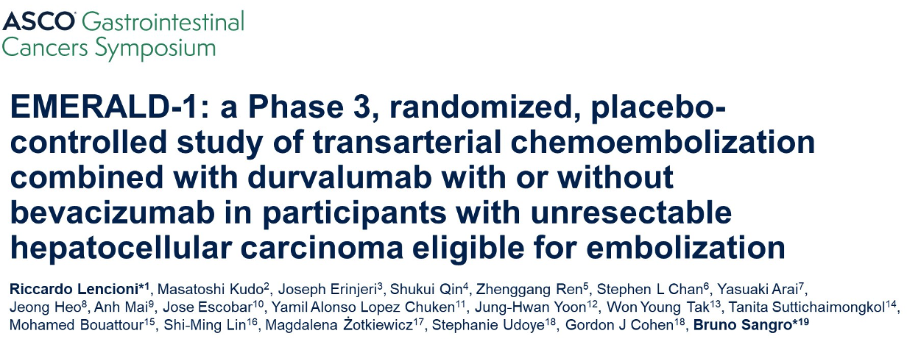
Abstract LBA432

Slide 22
EMERALD-1: Phase III Study Design
TACE = transarterial chemoembolization
Lencioni R et al. Gastrointestinal Cancers Symposium 2024;Abstract LBA432.

Slide 23
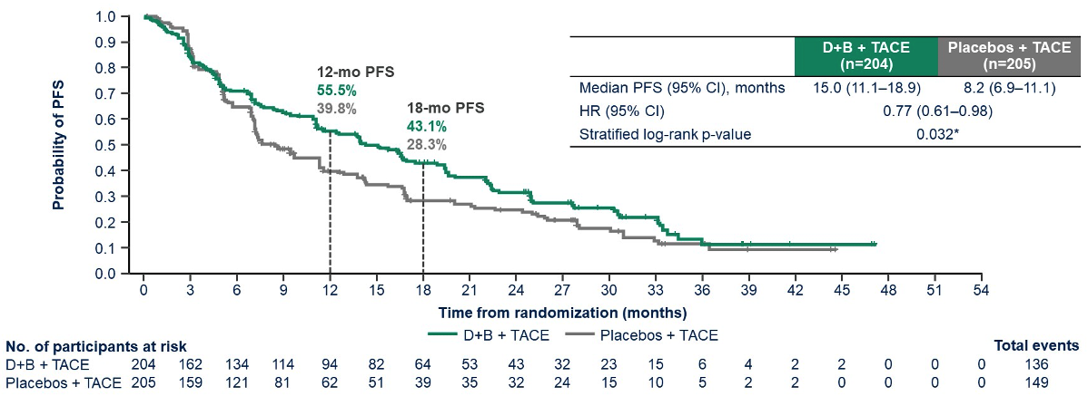
EMERALD-1: Primary Endpoint Progression-Free Survival (PFS) with Durvalumab/Bevacizumab (D+B) and TACE Compared to Placebos and TACE
Lencioni R et al. Gastrointestinal Cancers Symposium 2024;Abstract LBA432.

Slide 24
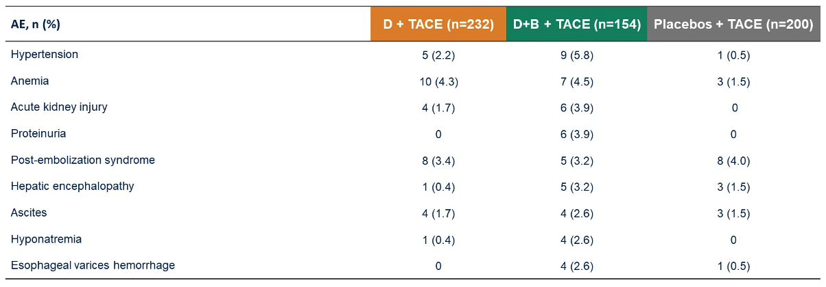
EMERALD-1: Most Common Grade 3 or 4 Treatment-Emergent Adverse Events (AE)
Lencioni R et al. Gastrointestinal Cancers Symposium 2024;Abstract LBA432.

Slide 25
EMERALD-1: Author Conclusions
Lencioni R et al. Gastrointestinal Cancers Symposium 2024;Abstract LBA432.

Slide 26
Agenda
Introduction
Part 1: Hepatocellular Carcinoma (HCC)
Adjuvant Therapy for Early-Stage HCC
Role of Immunotherapy in Intermediate-Stage HCC
First-Line Therapy for Advanced HCC
Part 2: Biliary Tract Cancers

Slide 27
First-Line Therapy for Advanced HCC
Dr Stein
New Haven, Connecticut
Dr Yarchoan
Baltimore, Maryland
Biological rationale for combining anti-PD-1/PD-L1 and anti-VEGF antibodies for advanced HCC
Long-term data with atezolizumab/bevacizumab as first-line therapy for unresectable HCC
Selection of patients for up-front treatment with atezolizumab/bevacizumab
Role of atezolizumab/bevacizumab in therapy for patients who would not have qualified for participation in the pivotal trial, such as those with Child-Pugh B disease
Rationale for the combination of anti-PD-1/PD-L1 antibodies with anti-CTLA-4 antibodies for advanced HCC

Slide 28
First-Line Therapy for Advanced HCC
Dr Stein
New Haven, Connecticut
Dr Yarchoan
Baltimore, Maryland
Long-term efficacy and safety outcomes, including updated overall survival results, reported with durvalumab/tremelimumab for previously untreated advanced HCC
Advantages and disadvantages of dual immune checkpoint inhibitor therapy compared to other evidence-based front-line options for unresectable HCC
Selection of patients for up-front durvalumab/tremelimumab

Slide 29
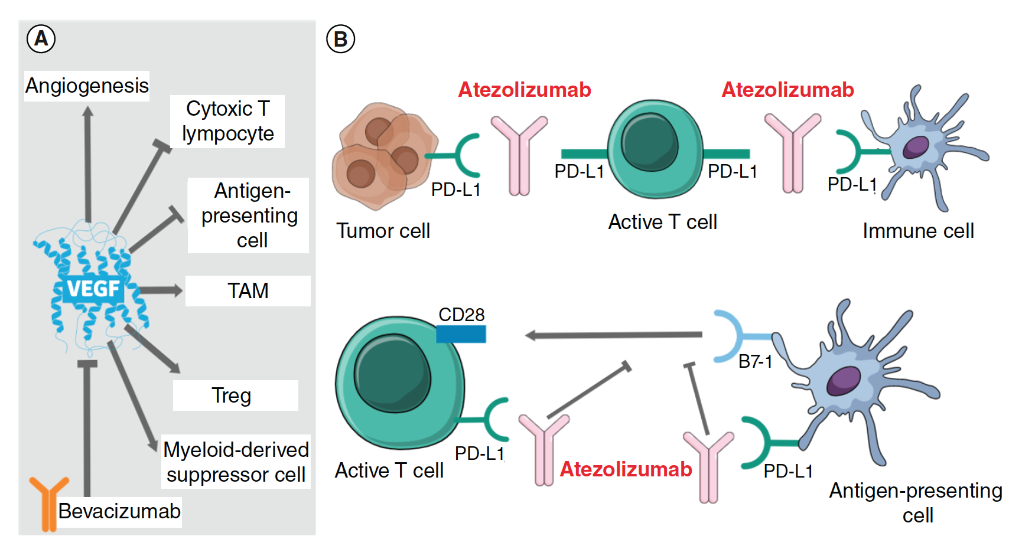
Mechanism of Action of Atezolizumab and Bevacizumab
Liu X et al. Future Oncol 2021;17(17):2243-56.

Slide 30
Atezolizumab/Bevacizumab Regimen
Mechanism of action
PD-L1 inhibitor
Anti-VEGF monoclonal antibody
Indication in HCC
For patients with unresectable or metastatic hepatocellular carcinoma (HCC) who have not received prior systemic therapy
Recommended dose in HCC
Atezolizumab: 840 mg IV q2wk, 1,200 mg IV q3wk or 1,680 mg IV q4wk
Bevacizumab: 15 mg/kg IV q3wk
Key issues
Screening for esophageal varices
Atezolizumab package insert, 4/2024.

Slide 31
Toxicities and Other Practical Considerations with Immune Checkpoint Inhibitor-Based Regimens for HCC
Dr Stein
New Haven, Connecticut
Dr Yarchoan
Baltimore, Maryland
Spectrum, incidence and severity of immune-related adverse events (AEs) and other toxicities observed with anti-PD-1/PD-L1 antibodies for HCC
Effects on tolerability of administering anti-PD-1/PD-L1 antibodies in combination with other systemic therapies, such as anti-angiogenic agents or anti-CTLA-4 antibodies, for HCC
Algorithms for monitoring and managing immune-related and other AEs with immune checkpoint inhibitors for patients with HCC
Recommended dosing schedules for up-front atezolizumab/bevacizumab and durvalumab/tremelimumab
Role, if any, for rechallenging with immune checkpoint inhibitor therapy after relapse on first-line atezolizumab/bevacizumab or durvalumab/tremelimumab

Slide 32
Amanda K Wagner, APRN-CNP, AOCNP
What I tell my patients with advanced HCC who are about to start first-line therapy with durvalumab/tremelimumab

Slide 33
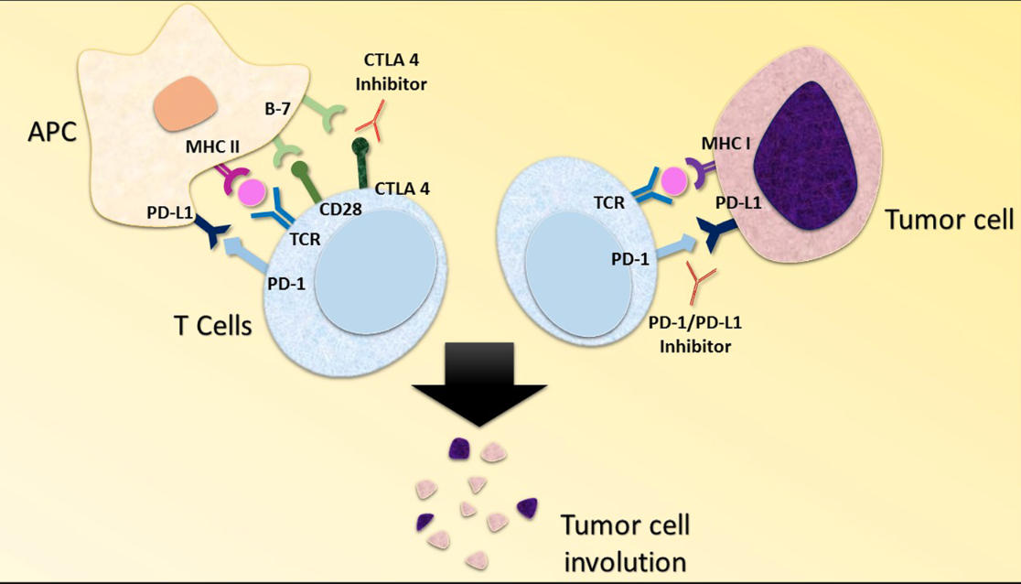
Mechanism of Action of Combined PD-1/PD-L1 and CTLA-4 Inhibitors
Chae YK et al. J Immuno Ther 2018;6(1):39.

Slide 34
Durvalumab/Tremelimumab Regimen
Mechanism of action
PD-L1 inhibitor
CTLA-4 inhibitor
Indication in HCC
For adult patients with unresectable hepatocellular carcinoma (HCC)
Recommended dose in HCC
Tremelimumab: Single priming dose of 300 mg (if weight 30 kg and more); single priming dose of 4 mg/kg (if weight less than 30 kg)
Durvalumab: 1,500 mg Cycle 1/Day 1, followed by 1,500 mg as a single agent every 4 weeks (if weight 30 kg and more); 20 mg/kg Cycle 1/Day 1, followed by 20mg/kg as a single agent every 4 weeks (if weight less than 30 kg)
Durvalumab package insert, 6/2023; Tremelimumab package insert, 6/2023

Slide 35
Ann Oncol 2024 February 19;[Online ahead of print].

Slide 36
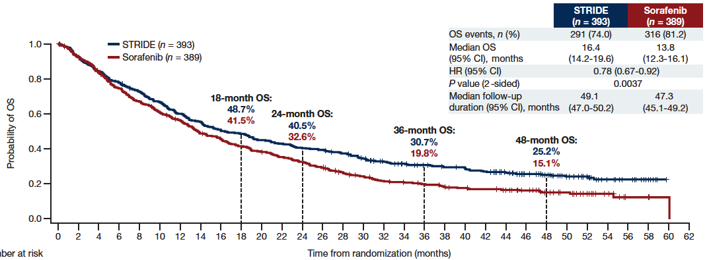
HIMALAYA 4-Year Updated Analysis: Overall Survival (OS) with STRIDE versus Sorafenib
STRIDE = 300 mg of tremelimumab (1 dose) and 1,500 mg of durvalumab every 4 weeks
Sangro B et al. Ann Oncol 2024 February 19;[Online ahead of print].

Slide 37
CheckMate 9DW Trial Evaluating Nivolumab with Ipilimumab Meets Primary Endpoint of Overall Survival for the First-Line Treatment of Advanced Hepatocellular Carcinoma Press Release – March 20, 2024
“The Phase 3 CheckMate-9DW trial evaluating nivolumab plus ipilimumab as a first-line treatment for patients with advanced hepatocellular carcinoma (HCC) who have not received prior systemic therapy met its primary endpoint of improved overall survival (OS) compared to investigator’s choice of sorafenib or lenvatinib at a pre-specified interim analysis.
The dual immunotherapy combination of nivolumab plus ipilimumab demonstrated a statistically significant and clinically meaningful improvement in OS compared to investigator’s choice of sorafenib or lenvatinib. The safety profile for the combination of nivolumab plus ipilimumab remained consistent with previously reported data and was manageable with established protocols, with no new safety signals identified.”
https://news.bms.com/news/corporate-financial/2024/Bristol-Myers-Squibb-Announces-CheckMate--9DW-Trial-Evaluating-Opdivo-nivolumab-Plus-Yervoy-ipilimumab-Meets-Primary-Endpoint-of-Overall-Survival-for-the-First-Line-Treatment-of-Advanced-Hepatocellular-Carcinoma/default.aspx

Slide 38
Agenda
Introduction
Part 1: Hepatocellular Carcinoma
Part 2: Biliary Tract Cancers (BTCs)
Immunotherapy in the Management of Advanced BTCs
Biomarker Testing Recommendations and the Use of FGFR Inhibitors for Advanced Cholangiocarcinoma
Potential Role of HER2-Targeted Therapy for BTCs

Slide 39
Agenda
Introduction
Part 1: Hepatocellular Carcinoma
Part 2: Biliary Tract Cancers (BTCs)
Immunotherapy in the Management of Advanced BTCs
Biomarker Testing Recommendations and the Use of FGFR Inhibitors for Advanced Cholangiocarcinoma
Potential Role of HER2-Targeted Therapy for BTCs

Slide 40
The Role of Anti-PD-1/PD-L1 Antibodies in the Management of Advanced BTCs
Dr Stein
New Haven, Connecticut
Dr Yarchoan
Baltimore, Maryland
Long-term outcomes achieved with historical approaches to up-front treatment for advanced BTCs
Pivotal findings with the addition of durvalumab to first-line chemotherapy for advanced BTCs
Published results with pembrolizumab combined with cisplatin/gemcitabine as first-line treatment for advanced BTCs
Optimal integration into practice of up-front chemoimmunotherapeutic strategies for patients with advanced BTCs

Slide 41
Durvalumab
Mechanism of action
PD-L1 inhibitor
Indication in BTC
In combination with gemcitabine and cisplatin for locally advanced or metastatic biliary tract cancer (BTC)
Recommended dose in BTC
Weight ≥30 kg: 1,500 mg every 3 weeks in combination with chemotherapy, and then 1,500 mg every 4 weeks as a single agent
Weight <30 kg: 20 mg/kg every 3 weeks in combination with chemotherapy, and then 20 mg/kg every 4 weeks as a single agent
Durvalumab package insert, 6/2023.

Slide 42
Pembrolizumab
Mechanism of action
PD-1 inhibitor
Indication in BTC
In combination with gemcitabine and cisplatin, for the treatment of patients with locally advanced unresectable or metastatic biliary tract cancer (BTC)
Recommended dose in BTC
200 mg every 3 weeks or 400 mg every 6 weeks
Pembrolizumab package insert, 3/2024.

Slide 43
Blanca Ledezma, MSN, NP, AOCNP
What I tell my patients with newly diagnosed metastatic biliary tract cancer who are about to receive chemoimmunotherapy

Slide 44
Consulting Nursing Faculty Comments
Patient adherence to therapy, dose reductions, and oral medication conversion
Sonia Glennie, ARNP, MSN, OCN

Slide 45
Agenda
Introduction
Part 1: Hepatocellular Carcinoma
Part 2: Biliary Tract Cancers (BTCs)
Immunotherapy in the Management of Advanced BTCs
Biomarker Testing Recommendations and the Use of FGFR Inhibitors for Advanced Cholangiocarcinoma
Potential Role of HER2-Targeted Therapy for BTCs

Slide 46
The Importance of Biomarker Testing in the Care of Patients with Advanced BTCs
Dr Stein
New Haven, Connecticut
Dr Yarchoan
Baltimore, Maryland
Spectrum and clinical relevance of genomic aberrations in patients with advanced BTCs
Prevalence of targetable molecular alterations in various BTCs: Intrahepatic cholangiocarcinoma versus extrahepatic cholangiocarcinoma versus gallbladder cancer
Available platforms for and optimal timing of genomic evaluation
Variable capacity of genetic testing methods to accurately identify different abnormalities

Slide 47
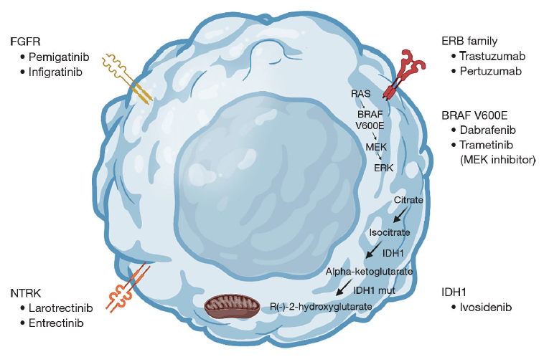
Key Targets in Biliary Tract Cancers
LaPelusa M et al. Chin Clin Oncol 2023 April;12(2):14.

Slide 48
Therapeutic Targets and Approach to Molecular Profiling for Biliary Tract Cancers
Target | Frequency | Targeted agents | Molecular test
IDH1 | 13% of intrahepatic cholangiocarcinomas | Ivosidenib | Tumor next-generation DNA sequencing or targeted sequencing for hotspot mutations in coding region of IDH1
FGFR pathway | 20% of intrahepatic cholangiocarcinomas | Erdafitinib; futibatinib; infigratinib; pemigatinib | Tumor next-generation DNA sequencing including FGFR2 intronic region, targeted RNAseq or FISH testing for FGFR2 translocation
BRAF | 5% of intrahepatic cholangiocarcinomas | Dabrafenib with trametinib; vemurafenib | Tumor next-generation DNA sequencing or targeted sequencing for hotspot mutations in coding region of BRAF
MSI-high or MMR deficiency | 2% of biliary tract cancers | Pembrolizumab | Multiple testing modalities available: PCR, immunohistochemistry or tumor next-generation DNA sequencing
ERBB2 (HER2) | 15%-20% gallbladder cancer; extrahepatic cholangiocarcinomas | Trastuzumab deruxtecan | Multiple testing modalities available including immunohistochemistry and FISH for expression and amplification, tumor next-generation DNA sequencing for mutations
FISH = fluorescence in situ hybridization
Valle JW et al. Lancet 2021;397(10272):428-44.

Slide 49
The Role of FGFR Inhibitors in the Management of Advanced Cholangiocarcinoma
Dr Stein
New Haven, Connecticut
Dr Yarchoan
Baltimore, Maryland
Mechanistic similarities and differences between the approved FGFR inhibitors pemigatinib and futibatinib for advanced cholangiocarcinoma
Principal findings with pemigatinib and with futibatinib for previously treated, unresectable locally advanced or metastatic cholangiocarcinoma with an FGFR2 fusion or other rearrangement
Evidence-based selection and sequencing of pemigatinib and futibatinib for FGFR-altered cholangiocarcinoma
Ongoing Phase III trials evaluating FGFR inhibition for patients with treatment-naïve cholangiocarcinoma

Slide 50
Tolerability and Other Considerations with FGFR Inhibitors for Cholangiocarcinoma
Dr Stein
New Haven, Connecticut
Dr Yarchoan
Baltimore, Maryland
Comparative tolerability profiles of the approved FGFR inhibitors for cholangiocarcinoma; implications for therapeutic selection
Pathophysiology of the ocular toxicities observed with pemigatinib and futibatinib; monitoring and management protocols
Incidence and management of other common AEs reported with pemigatinib and futibatinib, such as hyperphosphatemia, nail changes, stomatitis, hand-foot syndrome and dry skin
Role, if any, of rechallenging with an FGFR inhibitor for patients who have experienced disease progression on FGFR inhibitor therapy

Slide 51
Amanda K Wagner, APRN-CNP, AOCNP
What I tell my patients with metastatic biliary tract cancer and an FGFR alteration about the mechanism of action of and side effects and tolerability issues with the FGFR inhibitors pemigatinib and futibatinib

Slide 52
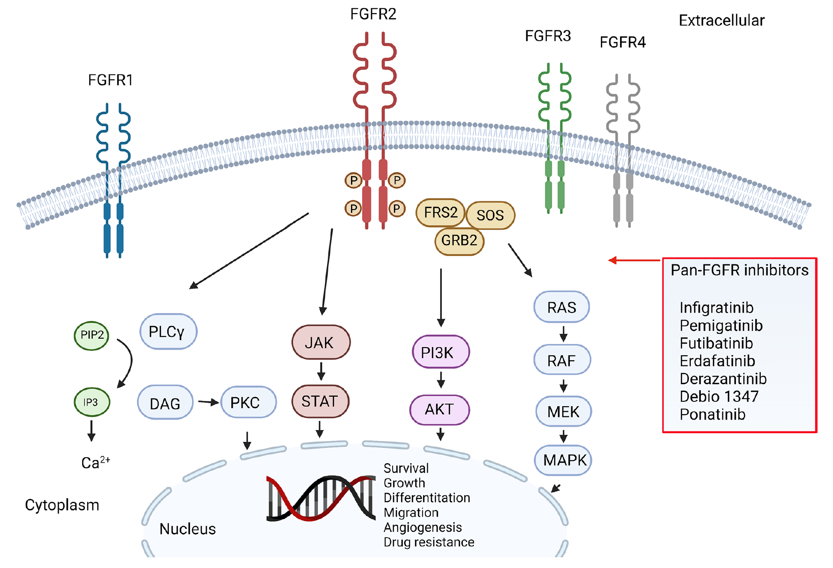
FGFR Inhibitors Mechanism of Action
Differentiation
Zugman M et al. Front Oncol 2022;12:860453.

Slide 53
Futibatinib
Mechanism of action
FGFR inhibitor
Indication
For patients with previously treated, unresectable locally advanced or metastatic intrahepatic cholangiocarcinoma harboring FGFR2 gene fusions or other rearrangements
Recommended dose
20 mg orally (five 4-mg tablets) once daily with or without food until disease progression or unacceptable toxicity
Futibatinib package insert, 4/2024.
Notes:
20 mg orally (five 4 mg tablets) once daily until disease progression or unacceptable toxicity occurs

Slide 54
FOENIX-CCA2: A Phase II Study of Futibatinib for Intrahepatic Cholangiocarcinoma with FGFR2 Fusions/Rearrangements
Median PFS: 9.0 mos
Median OS: 21.7 mos
Goyal L et al. N Engl J Med 2023;388;228-39.

Slide 55
Pemigatinib
Mechanism of action
FGFR inhibitor
Indication
For patients with previously treated, unresectable locally advanced or metastatic cholangiocarcinoma harboring FGFR2 fusions or other rearrangements
Recommended dose
13.5 mg orally once daily, with or without food, for 14 consecutive days followed by 7 days off therapy in 21-day cycles until disease progression or unacceptable toxicity
Pemigatinib package insert, 6/2023.
Notes:
PO20 mg orally (five 4 mg tablets) once daily until disease progression or unacceptable toxicity occurs

Slide 56
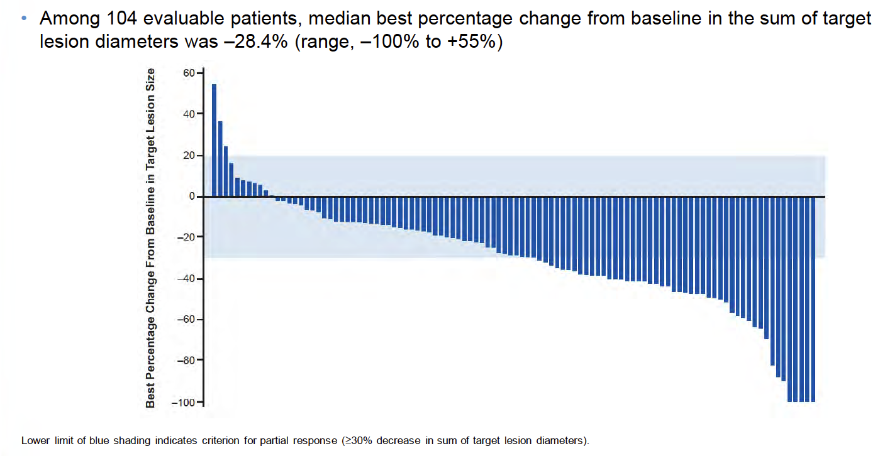
FIGHT-202 Final Results: Best Percent Change from Baseline in Target Lesion Size in Cohort A
Vogel A et al. ESMO World Congress on Gastrointestinal Cancer 2022;Abstract O-2.

Slide 57
Efficacy of FDA-Approved FGFR Inhibitors for FGFR2 Fusion-Positive Cholangiocarcinoma
 | Pemigatinib (N = 107) | Futibatinib (N = 67)
ORR | 37.0% | 42.0%
Disease control rate | 82.0% | 83.0%
Median progression-free survival | 7.0 mo | 9.0 mo
Median overall survival | 17.5 mo | 21.7 mo
Toxicities | Hyperphosphatemia, Alopecia, Diarrhea | Hyperphosphatemia, Diarrhea, Dry mouth
Vogel A et al. ESMO GI 2022;Abstract O-2; Goyal L et al. N Engl J Med 2023;388:228-39

Slide 58
Agenda
Introduction
Part 1: Hepatocellular Carcinoma
Part 2: Biliary Tract Cancers (BTCs)
Immunotherapy in the Management of Advanced BTCs
Biomarker Testing Recommendations and the Use of FGFR Inhibitors for Advanced Cholangiocarcinoma
Potential Role of HER2-Targeted Therapy for BTCs

Slide 59
The Potential Role of HER2-Targeted Therapy for BTCs
Dr Stein
New Haven, Connecticut
Dr Yarchoan
Baltimore, Maryland
Incidence of HER2 overexpression in patients with BTCs
Mechanism of action of the novel HER2-targeted bispecific antibody zanidatamab
Recent pivotal trial findings with zanidatamab for previously treated advanced or metastatic HER2-positive BTCs
Key efficacy and safety findings with trastuzumab deruxtecan for patients with previously treated HER2-positive BTCs
Current off-protocol and potential future role of HER2-targeted therapy for advanced BTCs

Slide 60
Blanca Ledezma, MSN, NP, AOCNP
What I tell my patients with advanced BTC about the importance of HER2 testing and potential therapy with trastuzumab deruxtecan

Slide 61
FDA Grants Accelerated Approval to Trastuzumab Deruxtecan for Unresectable or Metastatic HER2-Positive Solid Tumors Press Release – April 5, 2024
“On April 5, 2024, the Food and Drug Administration granted accelerated approval to fam-trastuzumab deruxtecan-nxki for adult patients with unresectable or metastatic HER2-positive (IHC3+) solid tumors who have received prior systemic treatment and have no satisfactory alternative treatment options. Efficacy was evaluated in 192 adult patients with previously treated unresectable or metastatic HER2-positive (IHC 3+) solid tumors who were enrolled in one of three multicenter trials: DESTINY-PanTumor02 (NCT04482309), DESTINY-Lung01 (NCT03505710), and DESTINY-CRC02 (NCT04744831). All three trials excluded patients with a history of interstitial lung disease (ILD)/pneumonitis requiring treatment with steroids or ILD/pneumonitis at screening and clinically significant cardiac disease. Patients were also excluded for active brain metastases or ECOG performance status >1. Treatment was administered until disease progression, death, withdrawal of consent, or unacceptable toxicity.
The recommended fam-trastuzumab deruxtecan-nxki dosage for this indication is 5.4 mg/kg given as an intravenous infusion once every 3 weeks (21-day cycle) until disease progression or unacceptable toxicity. This tumor agnostic indication is approved under accelerated approval based on objective response rate and duration of response. Continued approval for this indication may be contingent upon verification and description of clinical benefit in a confirmatory trial(s).”
https://www.fda.gov/drugs/resources-information-approved-drugs/fda-grants-accelerated-approval-fam-trastuzumab-deruxtecan-nxki-unresectable-or-metastatic-her2

Slide 62
Trastuzumab Deruxtecan
Mechanism of action
Antibody-drug conjugate directed against HER2
Indication
Unresectable or metastatic HER2-positive (IHC 3+) solid tumors who have received prior systemic treatment and have no satisfactory alternative treatment options
Key clinical trial
Phase II DESTINY-PanTumor02 trial evaluating trastuzumab deruxtecan in patients with HER2-expressing solid tumors
Meric-Bernstam F et al. J Clin Oncol 2024;42(1):47-58.

