Slide 1
Oncology Today — Special Edition: Key Presentations on Lung Cancer from Recent Major Oncology Conferences
Stephen V Liu, MD
Associate Professor of Medicine
Georgetown University Hospital
Washington, DC

Slide 2
Neoadjuvant and Perioperative Immunotherapy Approaches

Slide 3
FDA Approves Neoadjuvant/Adjuvant Nivolumab for Resectable Non-Small Cell Lung Cancer Press Release: October 3, 2024
“On October 3, 2024, the Food and Drug Administration approved nivolumab with platinum-doublet chemotherapy as neoadjuvant treatment, followed by single-agent nivolumab after surgery as adjuvant treatment, for adults with resectable (tumors ≥ 4 cm and/or node positive) non-small cell lung cancer (NSCLC) and no known epidermal growth factor receptor (EGFR) mutations or anaplastic lymphoma kinase (ALK) rearrangements.
Efficacy was evaluated in CHECKMATE-77T (NCT04025879), a randomized, double-blind, placebo-controlled multicenter trial in 461 patients with previously untreated and resectable NSCLC (Stage IIA to select stage IIIB [AJCC, 8th edition]). Patients were randomized (1:1) to either nivolumab or placebo, with platinum-based chemotherapy, every 3 weeks for up to 4 cycles (neoadjuvant treatment) followed by either continued single-agent nivolumab or placebo every 4 weeks for up to 13 cycles (adjuvant treatment).
The recommended nivolumab dosage is 360 mg every 3 weeks (neoadjuvant treatment) and 480 mg every 4 weeks (adjuvant treatment). Nivolumab should be administered prior to chemotherapy when administered on the same day. ”
https://www.fda.gov/drugs/resources-information-approved-drugs/fda-approves-neoadjuvantadjuvant-nivolumab-resectable-non-small-cell-lung-cancer

Slide 4
WCLC 2024;Abstract PL02.08

Slide 5
CheckMate 77T versus CheckMate 816: Study Designs
Forde PM et al. WCLC 2024;Abstract PL02.08.

Slide 6
CheckMate 77T versus CheckMate 816: Primary Endpoint
EFS = event-free survival; BICR = blinded independent central review
Forde PM et al. WCLC 2024;Abstract PL02.08.

Slide 7
CheckMate 77T versus CheckMate 816: Safety
AEs = adverse events; TRAEs = treatment-related AEs; SAEs = serious AEs
Forde PM et al. WCLC 2024;Abstract PL02.08.

Slide 8
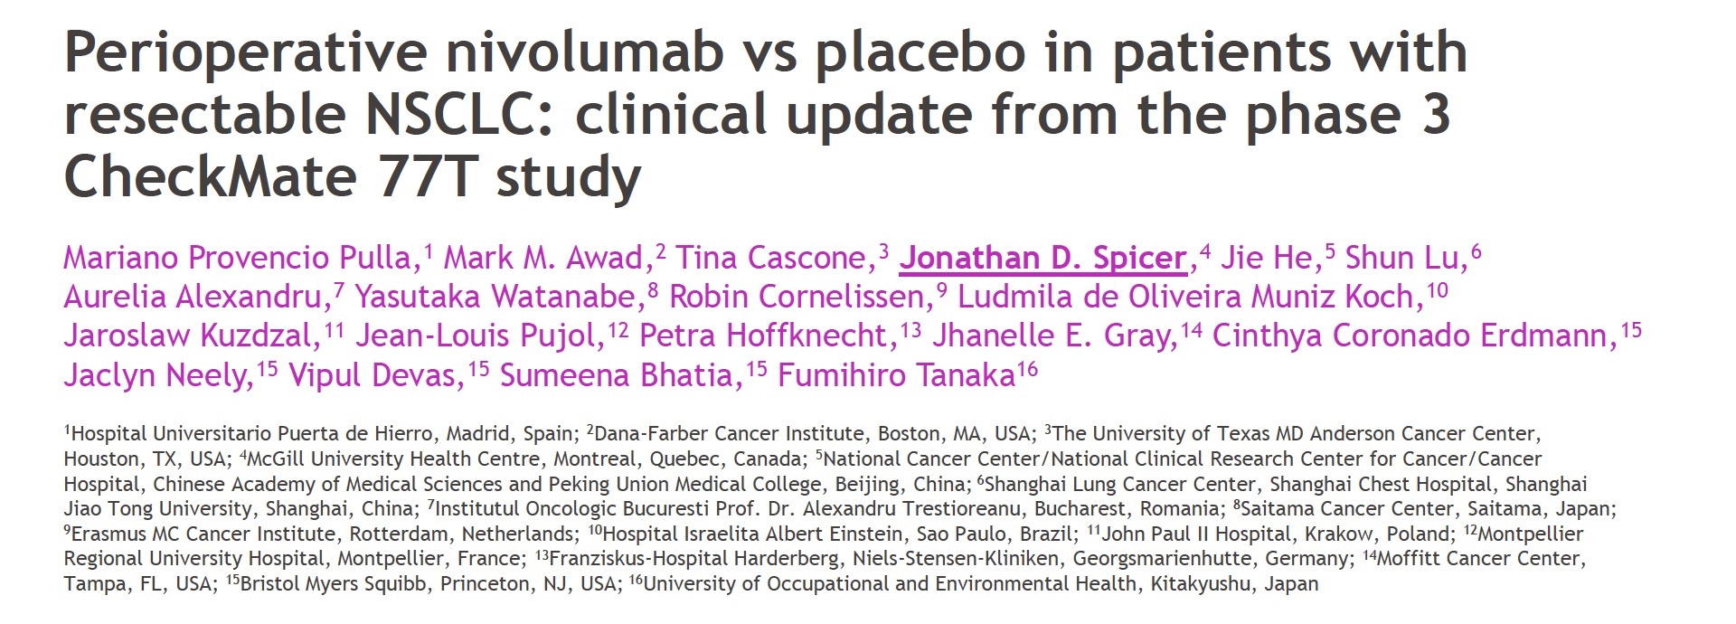
ASCO 2024; Abstract LBA8010
ESMO 2024; Abstract LBA50

Slide 9
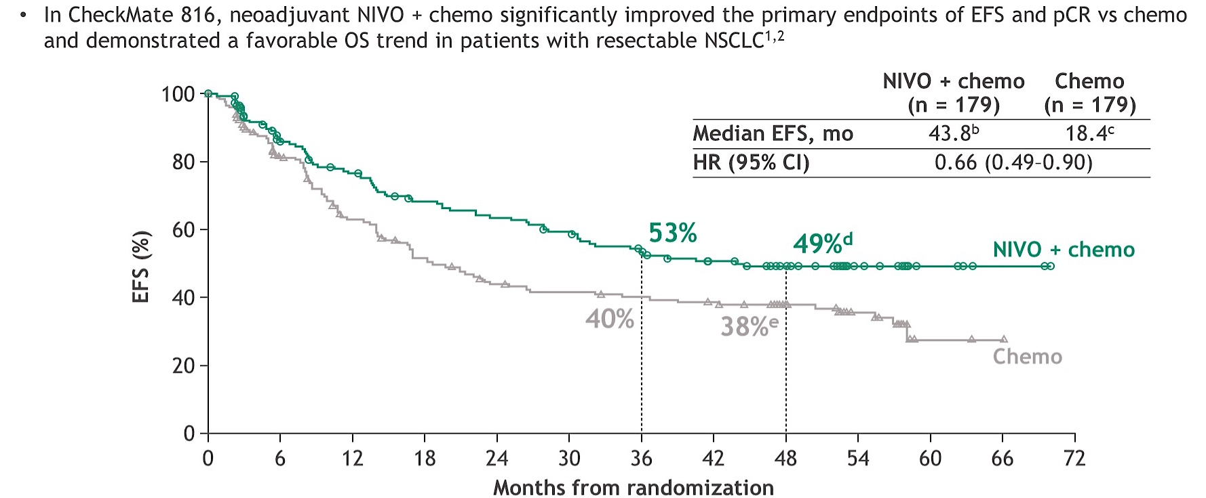
Phase III CheckMate 816 Study: 4-Year EFS Update with Neoadjuvant Nivolumab
pCR = pathologic complete response; OS = overall survival
Spicer JD et al. ASCO 2024;Abstract LBA8010.

Slide 10
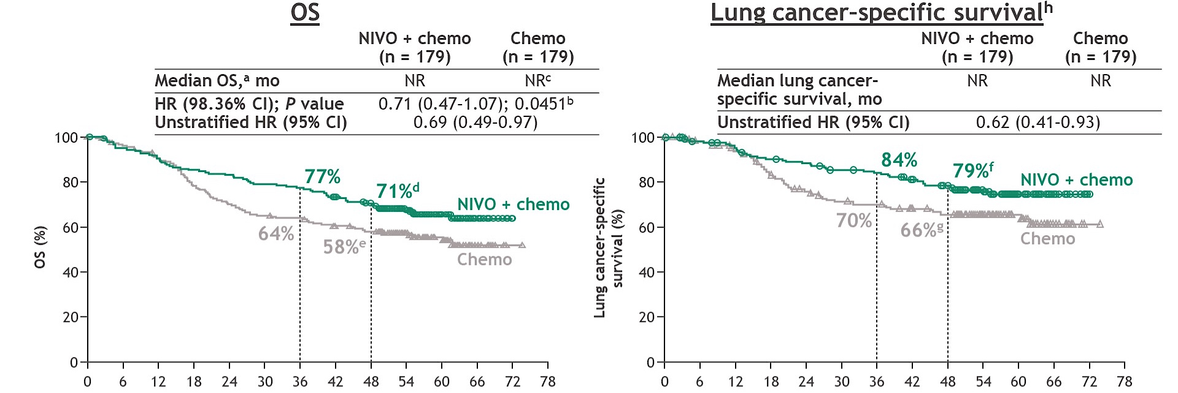
Phase III CheckMate 816 Study: 4-Year OS Update with Neoadjuvant Nivolumab
Spicer JD et al. ASCO 2024;Abstract LBA8010.

Slide 11
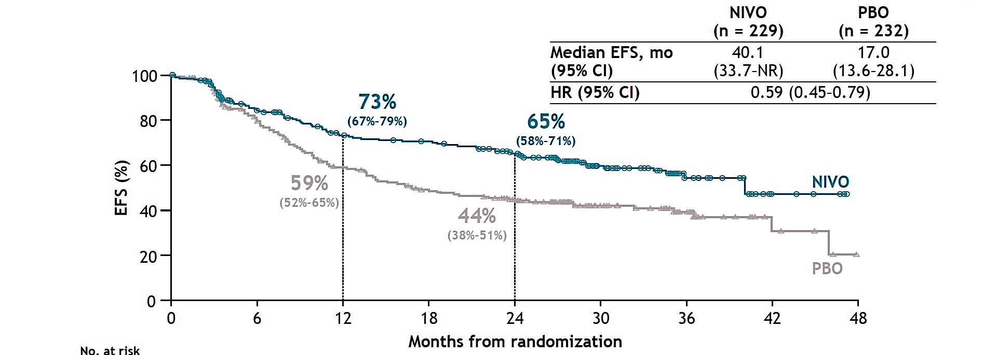
Phase III CheckMate 77T Study: Primary Endpoint (EFS per BICR) with Perioperative Nivolumab
Spicer JD et al. ESMO 2024;Abstract LBA50.

Slide 12
WCLC 2024; Abstract PL02.07

Slide 13
Phase II NeoCOAST-2 Study Design
mPR = major pathological response
Cascone T et al. WCLC 2024;Abstract PL02.07.

Slide 14
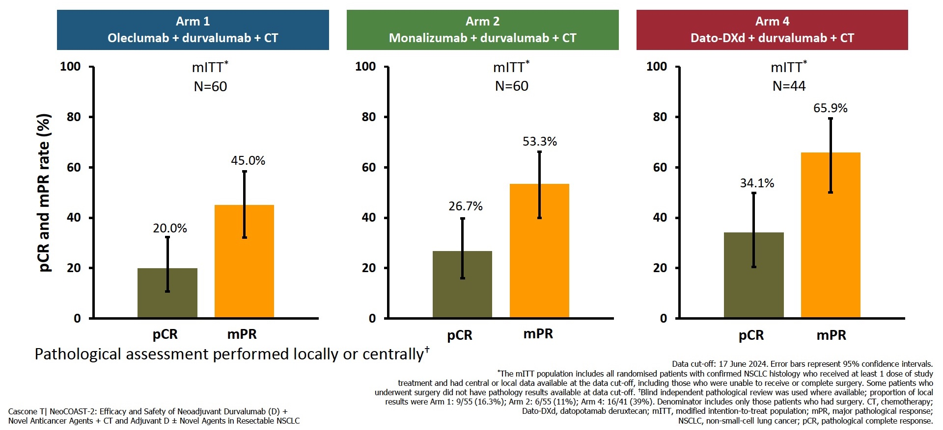
Phase II NeoCOAST-2 Study: Efficacy (pCR and mPR)
Cascone T et al. WCLC 2024;Abstract PL02.07.

Slide 15
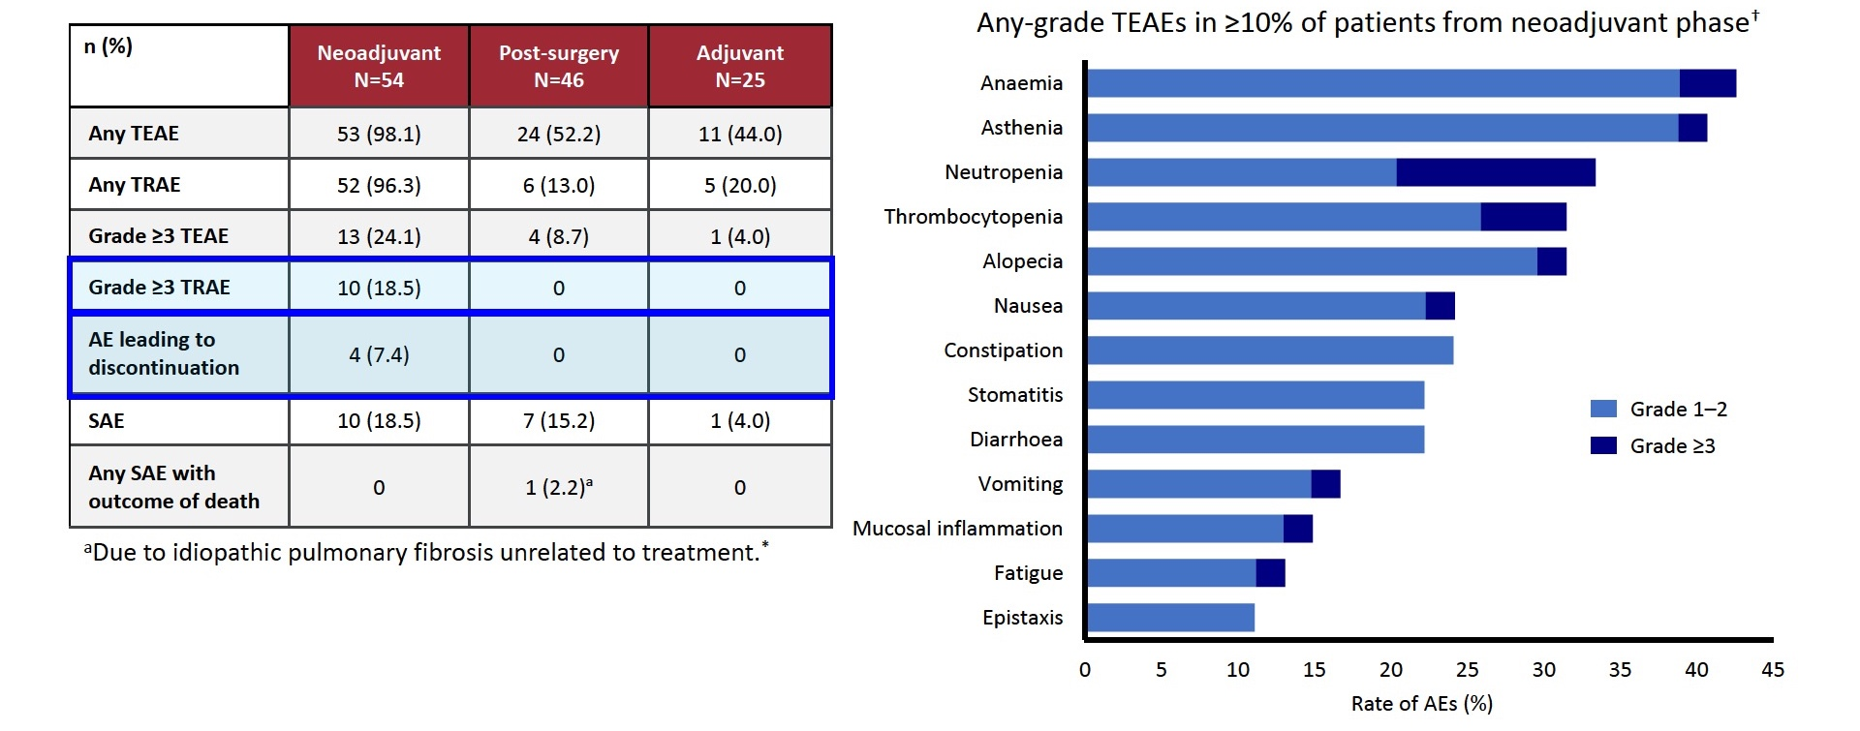
Phase II NeoCOAST-2 Study: Safety of Dato-DXd with Durvalumab and CT
Cascone T et al. WCLC 2024;Abstract PL02.07.

Slide 16
FDA Approves Neoadjuvant/Adjuvant Durvalumab for Resectable Non-Small Cell Lung Cancer Press Release: August 15, 2024
“On August 15, 2024, the Food and Drug Administration approved durvalumab with platinum-containing chemotherapy as neoadjuvant treatment, followed by single-agent durvalumab as adjuvant treatment after surgery for adults with resectable (tumors ≥ 4 cm and/or node positive) non-small cell lung cancer (NSCLC) and no known epidermal growth factor receptor (EGFR) mutations or anaplastic lymphoma kinase (ALK) rearrangements. Efficacy was evaluated in AEGEAN (NCT03800134), a randomized, double-blind, placebo-controlled multicenter trial in 802 patients with previously untreated and resectable squamous or non-squamous NSCLC (Stage IIA to select Stage IIIB [AJCC, 8th edition]). Patients were randomized (1:1) to either durvalumab or placebo, with platinum-based chemotherapy, every 3 weeks for up to 4 cycles (neoadjuvant treatment) followed by either continued single-agent durvalumab or placebo, every 4 weeks for up to 12 cycles (adjuvant treatment).
Median EFS was not reached (95% CI: 31.9, not estimable [NE]) in the durvalumab arm and 25.9 months (95% CI: 18.9, NE) in the placebo arm (hazard ratio 0.68 [95% CI: 0.53, 0.88]; p-value=0.0039). The pCR rate was 17% (95% CI: 13, 21) and 4.3% (95% CI: 2.5, 7) in the durvalumab and placebo arms, respectively. At the time of the prespecified interim analyses, overall survival (OS) was not formally tested for statistical significance; however, a descriptive analysis revealed no clear detriment.”
https://www.fda.gov/drugs/resources-information-approved-drugs/fda-approves-neoadjuvantadjuvant-durvalumab-resectable-non-small-cell-lung-cancer

Slide 17
Immunotherapy as First-Line Treatment

Slide 18
WCLC 2024; Abstract OA11.06

Slide 19
Phase III EMPOWER-Lung 1 Study Design
Kilickap S et al. WCLC 2024;Abstract OA11.06.

Slide 20
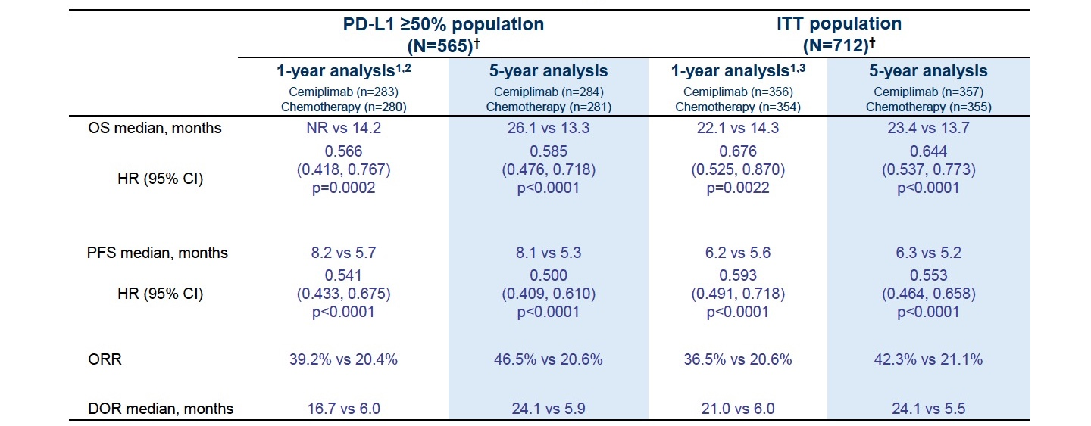
Phase III EMPOWER-Lung 1 Study: Continued Benefits at 5 Years
Cemiplimab benefits in OS and objective response rate increase with PD-L1 expression
Kilickap S et al. WCLC 2024;Abstract OA11.06.

Slide 21
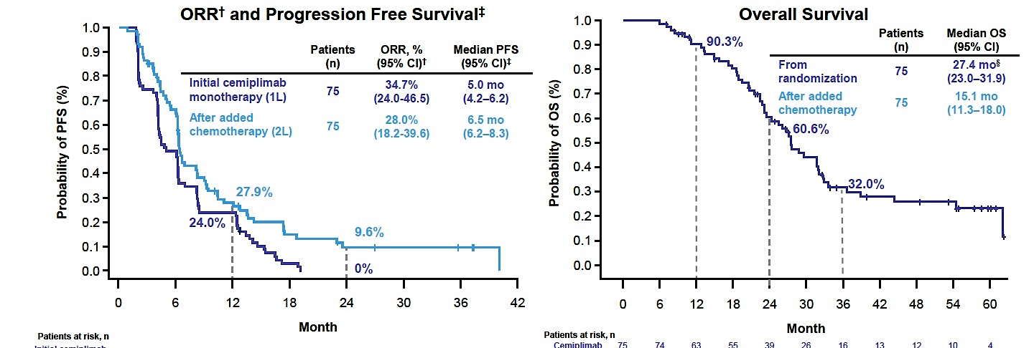
Cemiplimab with Addition of Chemotherapy Beyond Disease Progression
Kilickap S et al. WCLC 2024;Abstract OA11.06.

Slide 22
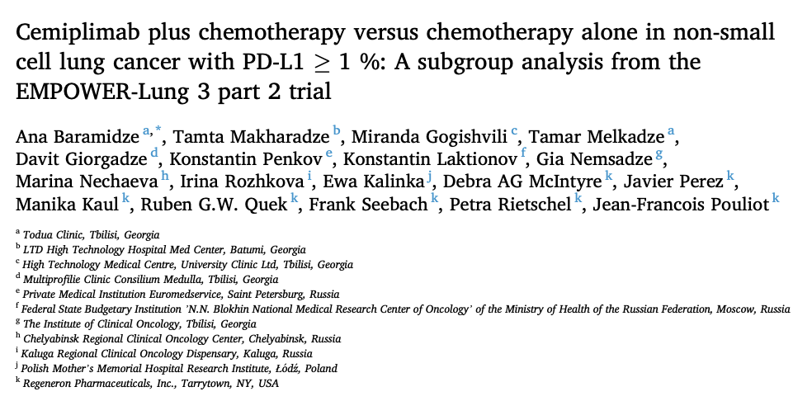
EMPOWER-Lung 3 recruited patients with advanced NSCLC without EGFR, ALK or ROS1 aberrations.
Lung Cancer July 2024;193:107821.
Kalinka E et al. ELCC 2023;Abstract 114M0.

Slide 23
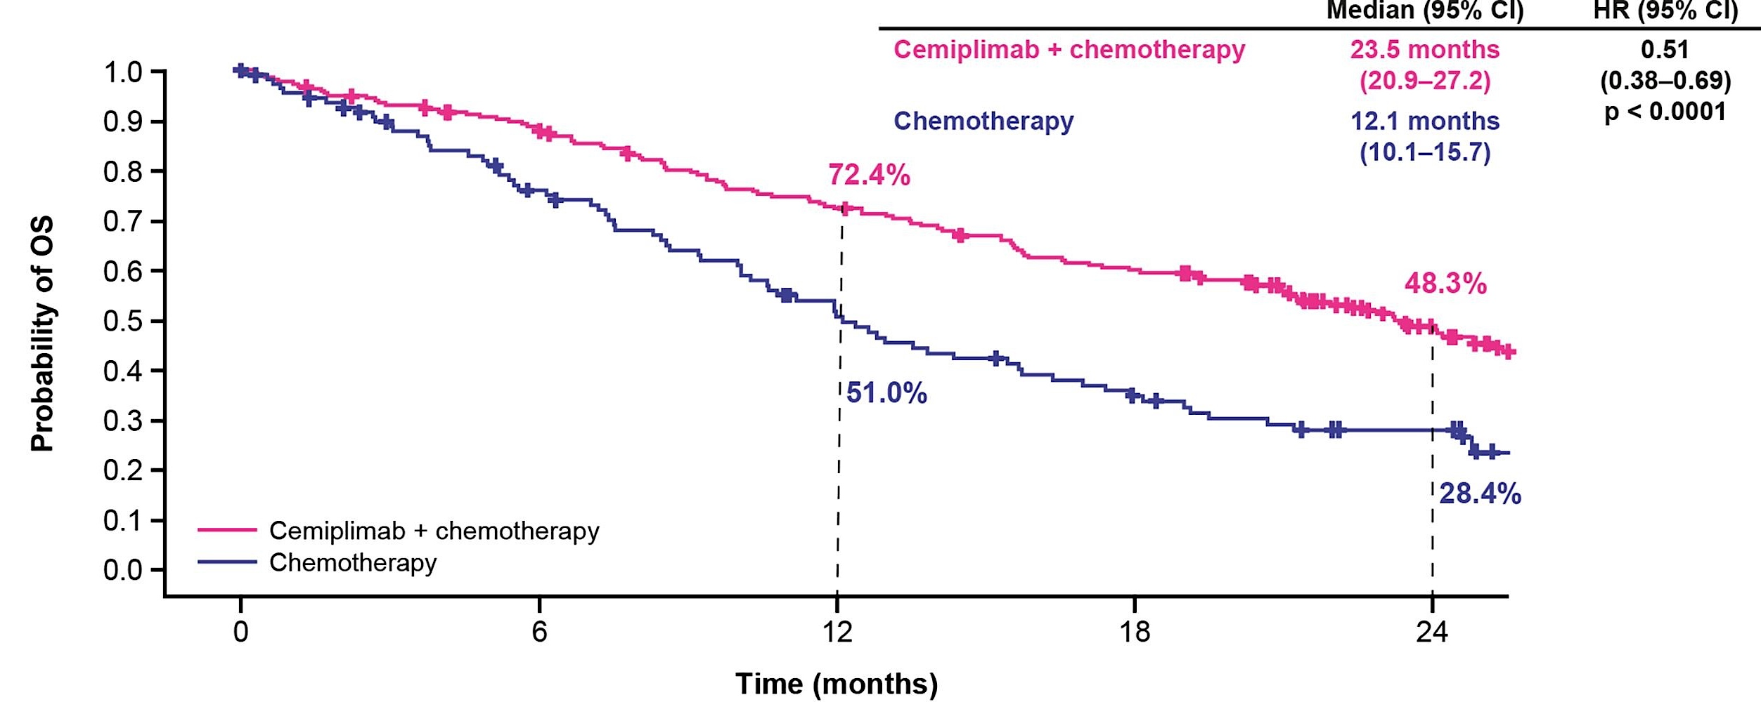
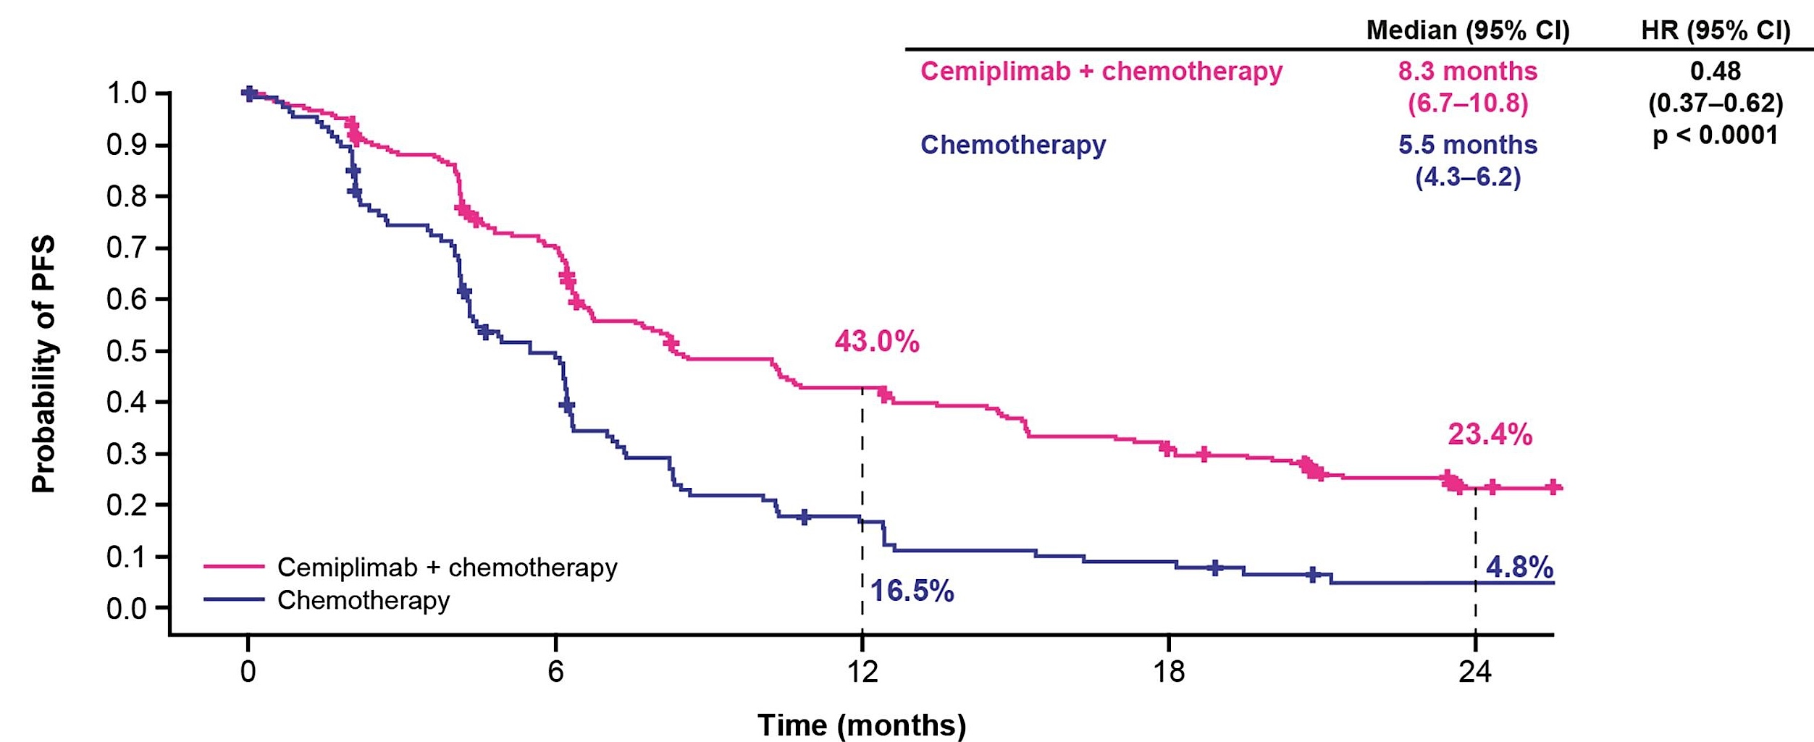
Phase III EMPOWER-Lung 3 Part 2: Survival
Improved efficacy of the combination over chemotherapy alone was observed in both squamous and nonsquamous histology
Baramidze A et al. Lung Cancer July 2024;193:107821.

Slide 24
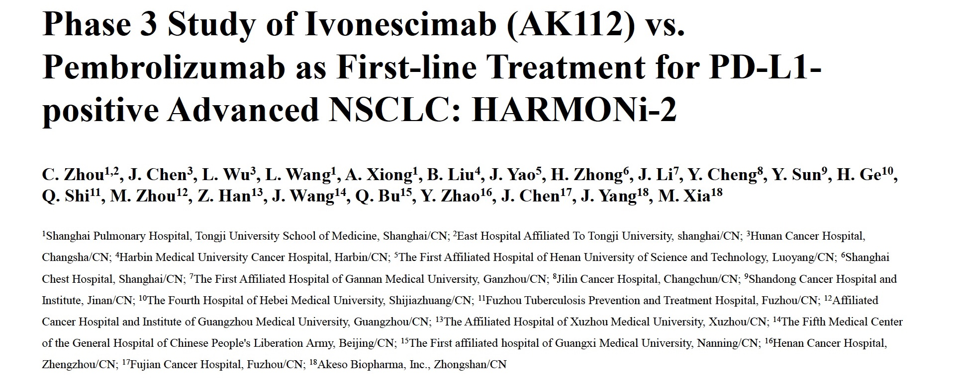
WCLC 2024; Abstract PL02.04

Slide 25
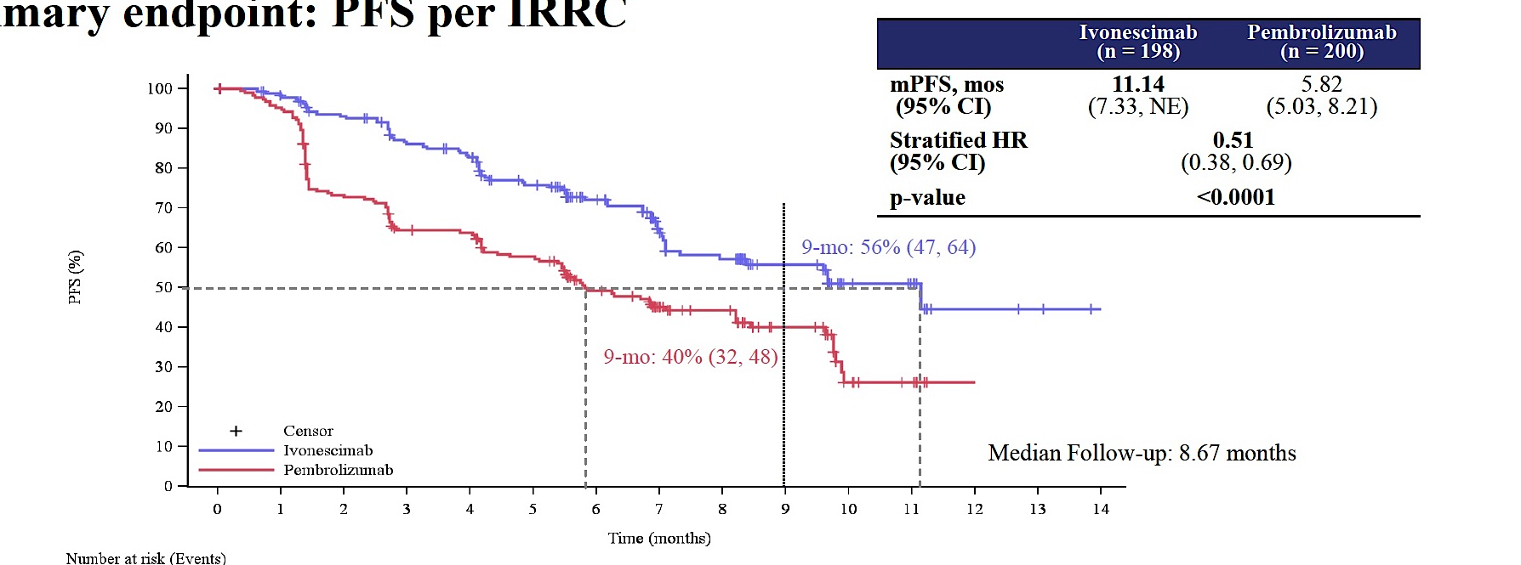
Phase II HARMONi-2 Trial: Primary Endpoint (PFS per Independent Radiologic Review Committee)
Ivonescimab showed meaningful improvement in PFS vs pembrolizumab for patients with both low and high PD-L1, and with squamous or nonsquamous advanced NSCLC.
Zhou C et al. WCLC 2024;Abstract PL02.04.

Slide 26
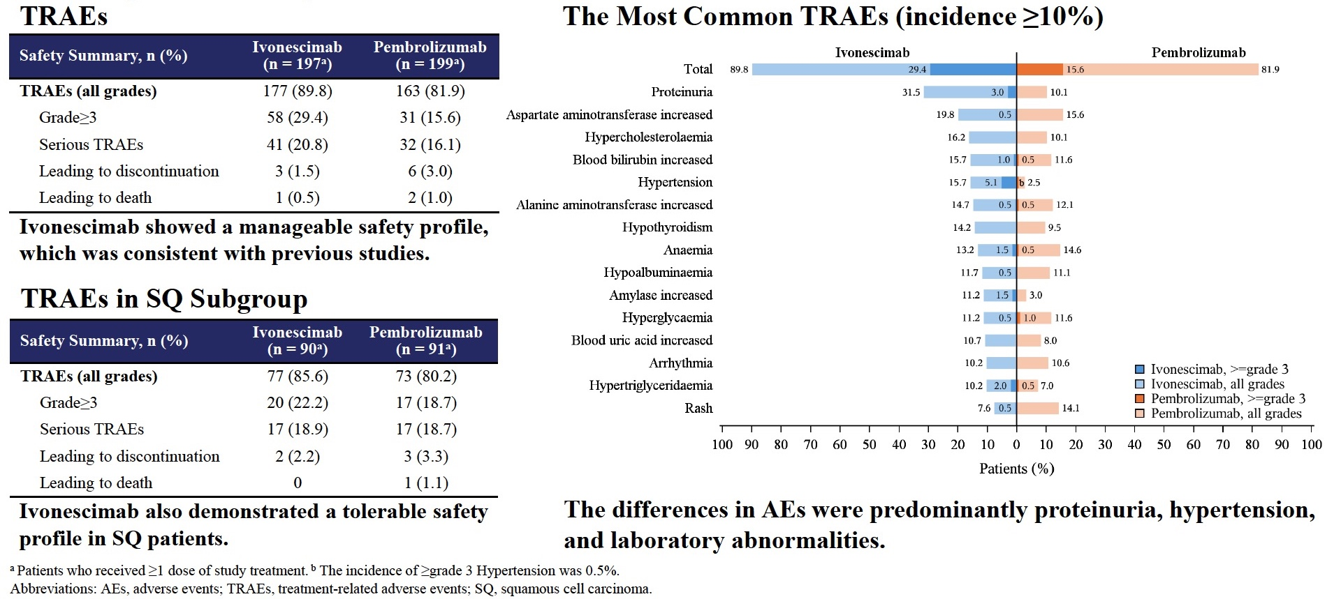
Phase II HARMONi-2 Trial: Safety
Zhou C et al. WCLC 2024;Abstract PL02.04.

Slide 27
Antibody-Drug Conjugates

Slide 28
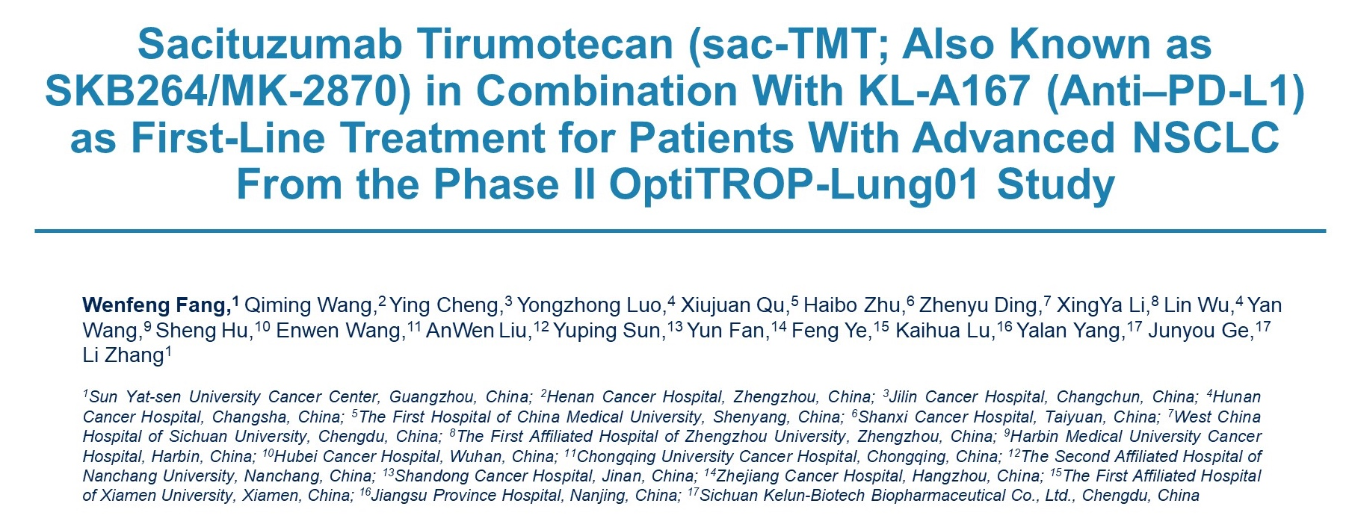
ASCO 2024; Abstract 8502

Slide 29
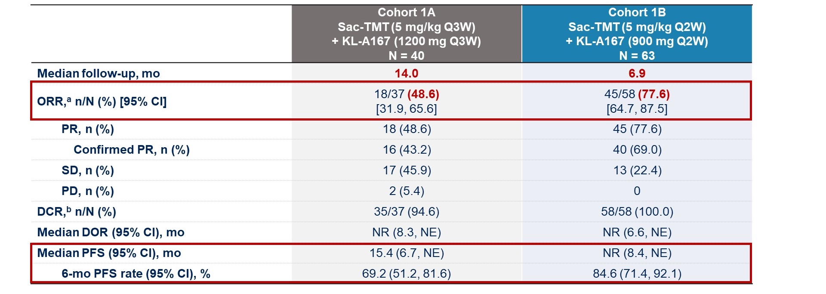
Phase II OptiTROP-Lung01 Study
PR = partial response; SD = stable disease; PD = progressive disease; DCR = disease control rate; DOR = duration of response; NR = not reached; NE = not evaluable
Fang W et al. ASCO 2024;Abstract 8502.

Slide 30
Phase II OptiTROP-Lung01 Study: Subgroup Efficacy in Cohort 1B (Q2wk)
ORR = objective response rate
Fang W et al. ASCO 2024;Abstract 8502.

Slide 31
Phase II OptiTROP-Lung01 Study: Safety
ILD = interstitial lung disease; irAE = immune-related adverse event
Fang W et al. ASCO 2024;Abstract 8502.

Slide 32
Phase III TroFuse-007 Study Design
Primary endpoint:
Overall survival
Secondary endpoints:
Efficacy outcomes (PFS, ORR, DOR)
Patient-reported outcomes
Frost N et al. WCLC 2024;Abstract P4.11D.02.

Slide 33
WCLC 2024; Abstract OA08.03

Slide 34
Phase III TROPION-Lung01 Study: OS (by Histology)
Sands J et al. WCLC 2024;Abstract OA08.03.

Slide 35
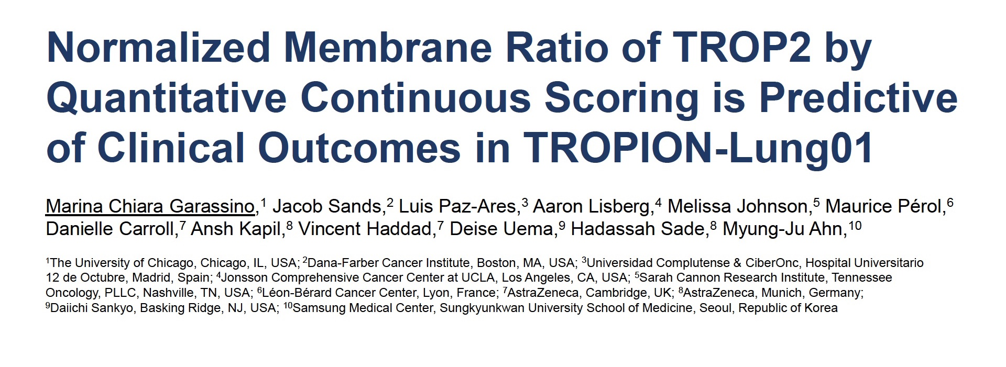
WCLC 2024; Abstract PL02.11

Slide 36
Measuring TROP2 Normalized Membrane Ratio (NMR) using Quantitative Continuous Scoring (QCS)
Garassino MC et al. WCLC 2024;Abstract PL02.11.

Slide 37
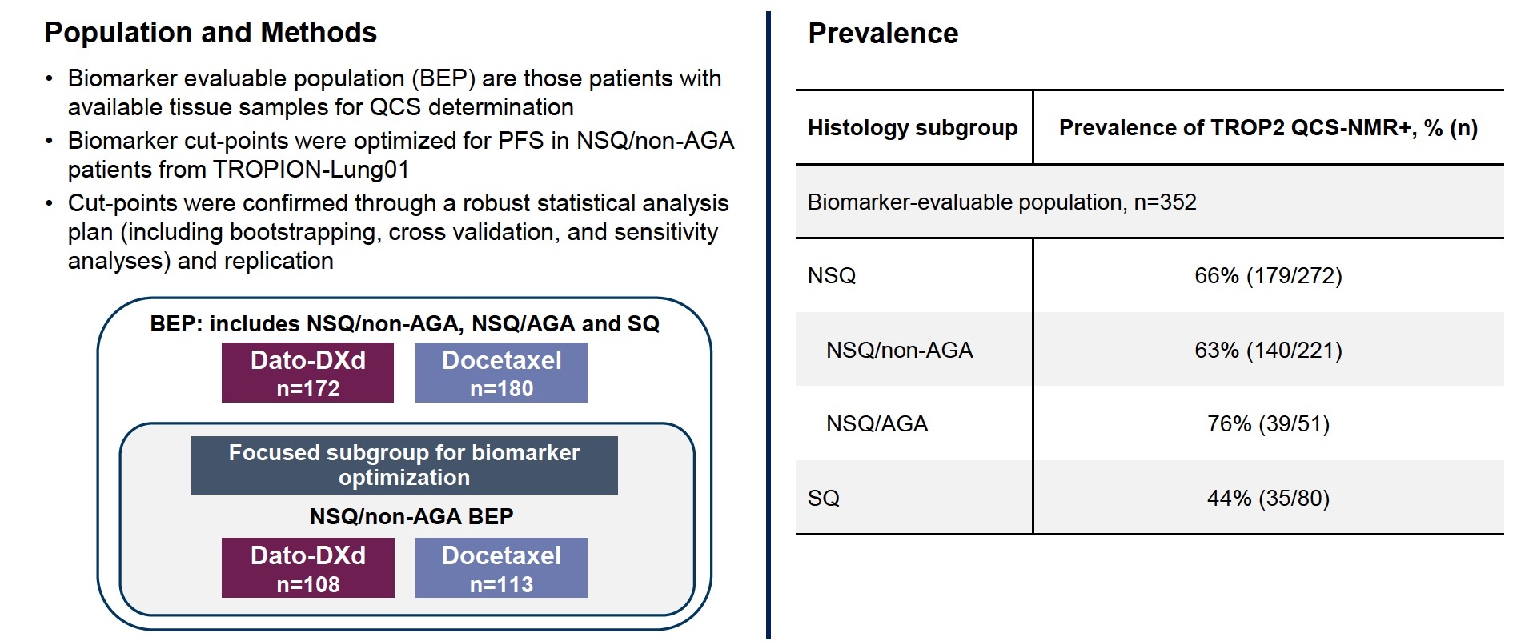
Methods for Quantifying TROP2 QCS-NMR in TROPION-Lung01
NSQ = nonsquamous; AGA = actionable genomic alteration
Garassino MC et al. WCLC 2024;Abstract PL02.11.

Slide 38
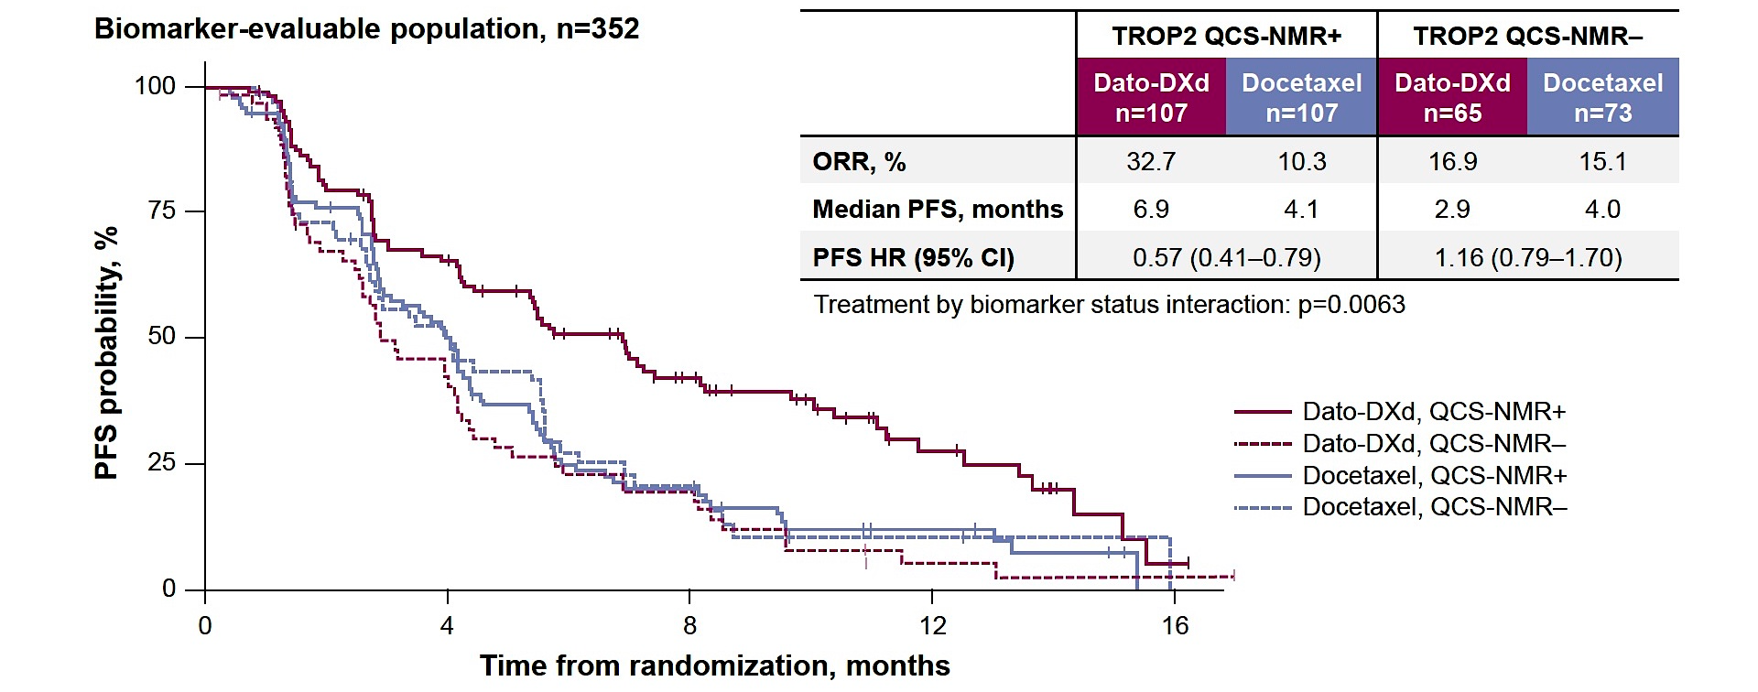
TROP2 QCS-NMR Predicts Longer PFS with Dato-DXd (Biomarker-Evaluable Population)
Garassino MC et al. WCLC 2024;Abstract PL02.11.

Slide 39
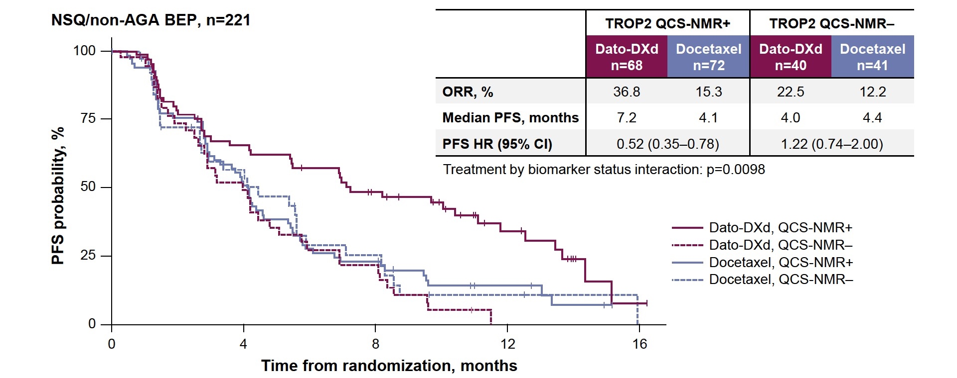
TROP2 QCS-NMR Predicts Longer PFS with Dato-DXd (Nonsquamous, No Actionable Genomic Alterations)
BEP = biomarker-evaluable population
Garassino MC et al. WCLC 2024;Abstract PL02.11.

Slide 40
Targeted Therapies

Slide 41
FDA Approves Osimertinib for Locally Advanced, Unresectable (Stage III) NSCLC After Chemoradiation Therapy Press Release: September 25, 2024
“On September 25, 2024, the Food and Drug Administration approved osimertinib for adult patients with locally advanced, unresectable (stage III) non-small cell lung cancer (NSCLC) whose disease has not progressed during or following concurrent or sequential platinum-based chemoradiation therapy and whose tumors have EGFR exon 19 deletions or exon 21 L858R mutations, as detected by an FDA-approved test.
Efficacy was evaluated in LAURA (NCT03521154), a double blind, randomized, placebo-controlled trial in 216 adult patients with locally advanced, unresectable stage III NSCLC with EGFR exon 19 deletions or exon 21 L858R mutations who had not progressed during or following definitive platinum-based chemoradiation within 42 days prior to study randomization. Patients were randomized (2:1) to receive either osimertinib 80 mg orally once daily or placebo until disease progression or unacceptable toxicity.
Osimertinib demonstrated a statistically significant improvement in PFS compared to placebo with a hazard ratio of 0.16 (95% CI: 0.10, 0.24; p-value <0.001). The median PFS was 39.1 months (95% CI: 31.5, not estimable [NE]) in the osimertinib arm and 5.6 months (95% CI: 3.7, 7.4) in the placebo arm. While OS results were immature at the current analysis, with 36% of pre-specified deaths for the final analysis reported, no trend towards a detriment was observed.”
https://www.fda.gov/drugs/resources-information-approved-drugs/fda-approves-osimertinib-locally-advanced-unresectable-stage-iii-non-small-cell-lung-cancer

Slide 42
ASCO 2024;Abstract 8522

Slide 43
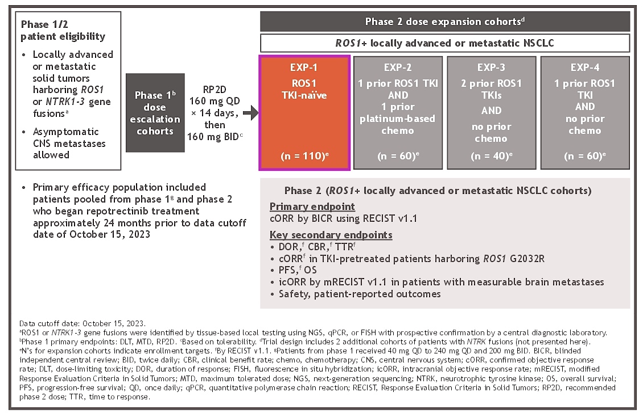
Phase I/II TRIDENT-1 Study Design
Drilon AE et al. ASCO 2024;Abstract 8522.

Slide 44
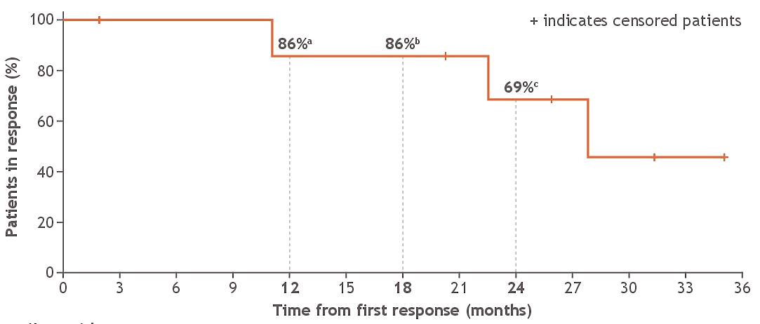
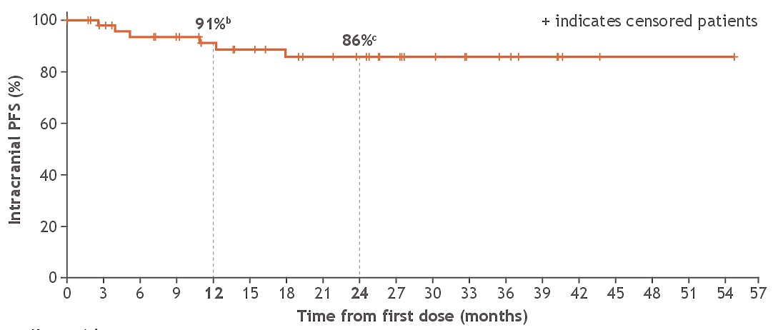
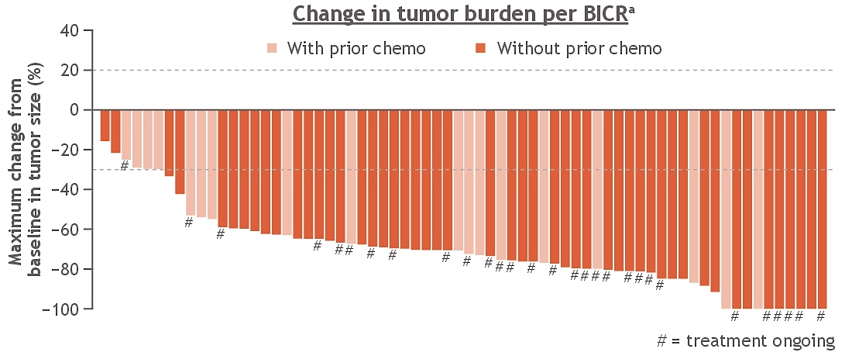
Phase I/II TRIDENT-1 Study: Change in Tumor Size, Intracranial Efficacy
Intracranial DOR (per BICR) in pts with brain mets
Intracranial PFS (per BICR) in pts without brain mets
Drilon AE et al. ASCO 2024;Abstract 8522.

Slide 45
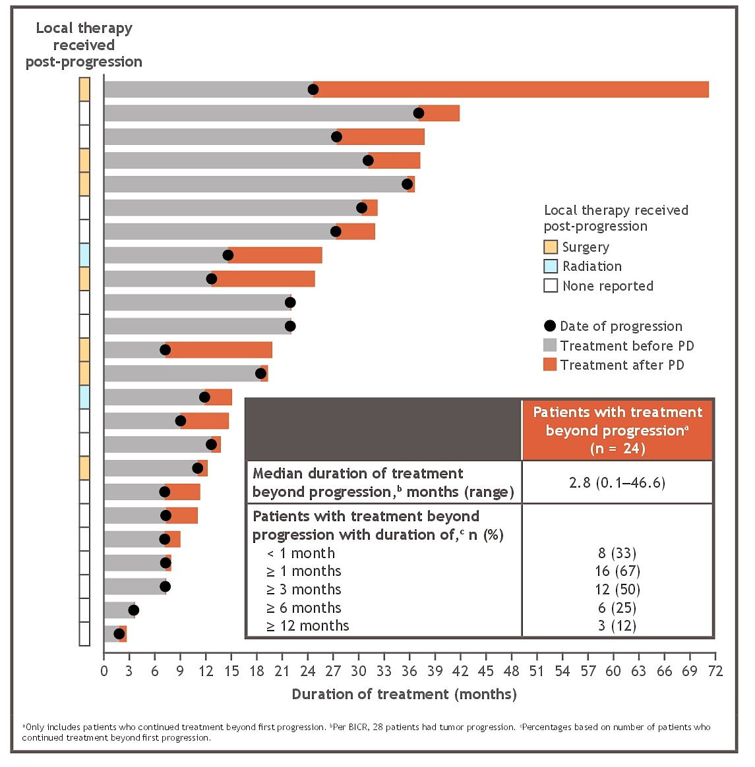
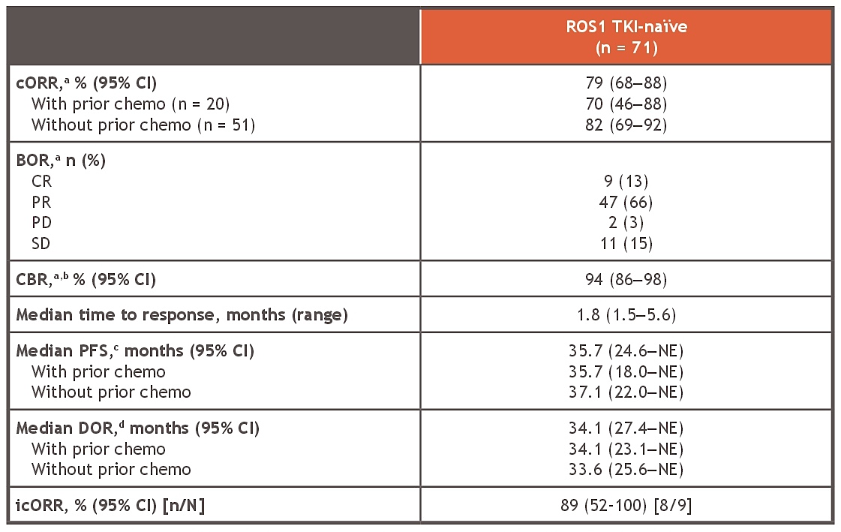
Phase I/II TRIDENT-1 Study: cORR and Treatment Beyond Disease Progression
cORR = confirmed objective response rate; BOR = best overall response; CR = complete response; CBR = clinical benefit rate
Drilon AE et al. ASCO 2024;Abstract 8522.

Slide 46
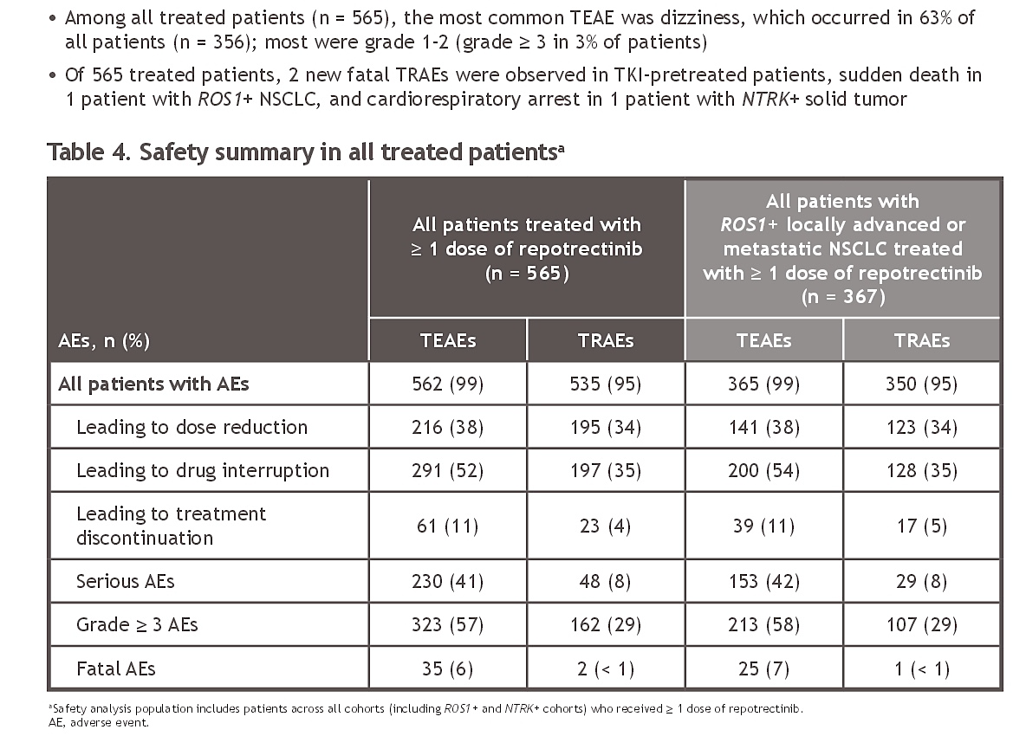
Phase I/II TRIDENT-1 Study: Safety and Conclusions
TKI = tyrosine kinase inhibitor
Drilon AE et al. ASCO 2024;Abstract 8522.

Slide 47
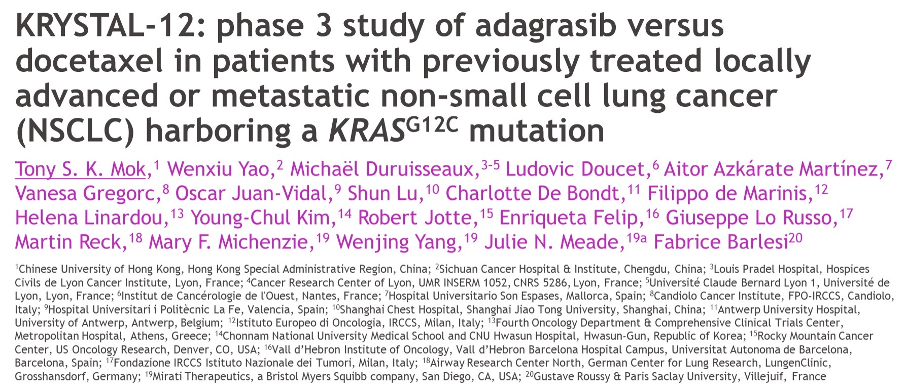
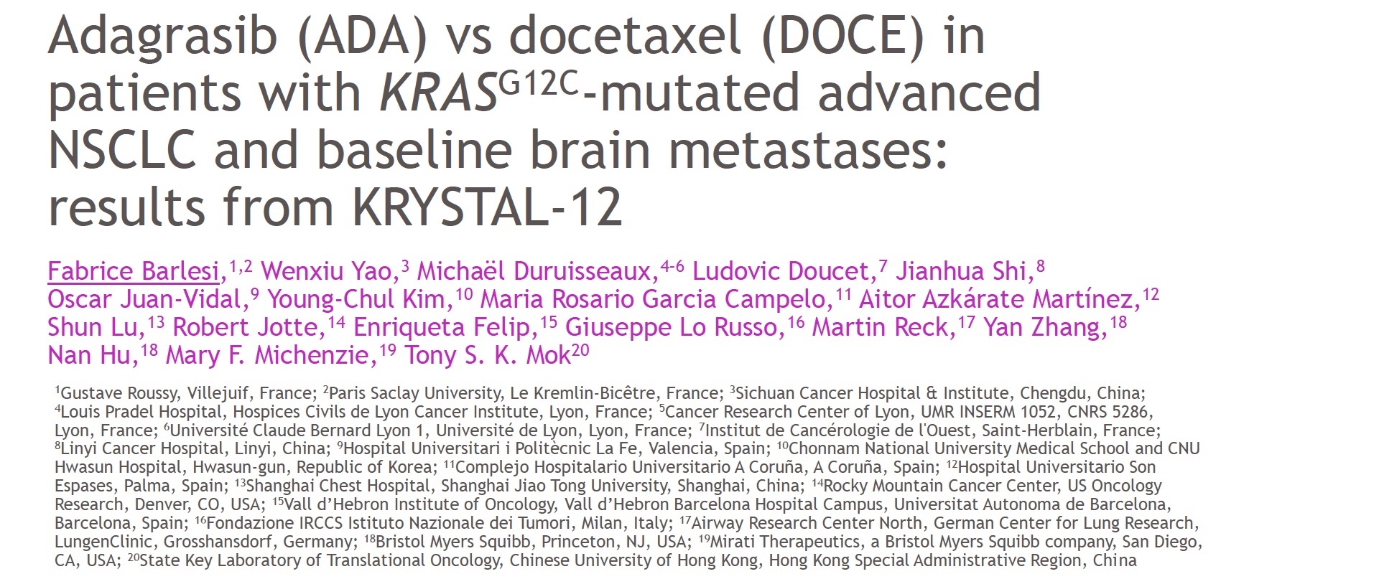
ASCO 2024; Abstract LBA8509
ESMO 2024; Abstract LBA57

Slide 48
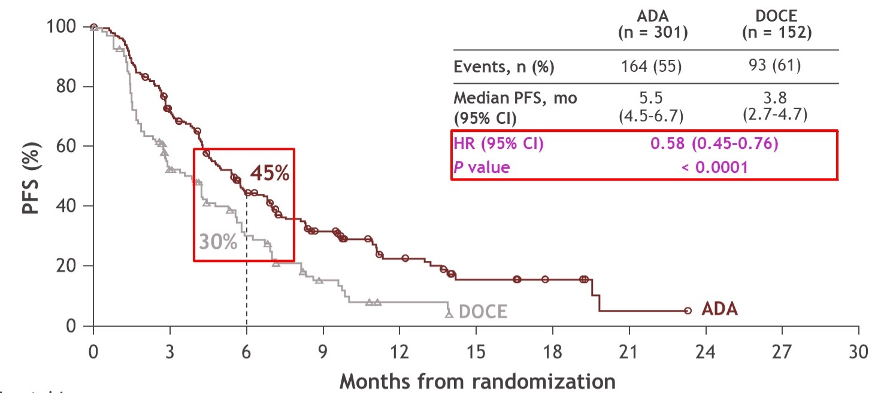
Phase III KRYSTAL-12 Trial: PFS per BICR
Mok TSK et al. ASCO 2024;Abstract LBA8509 .

Slide 49
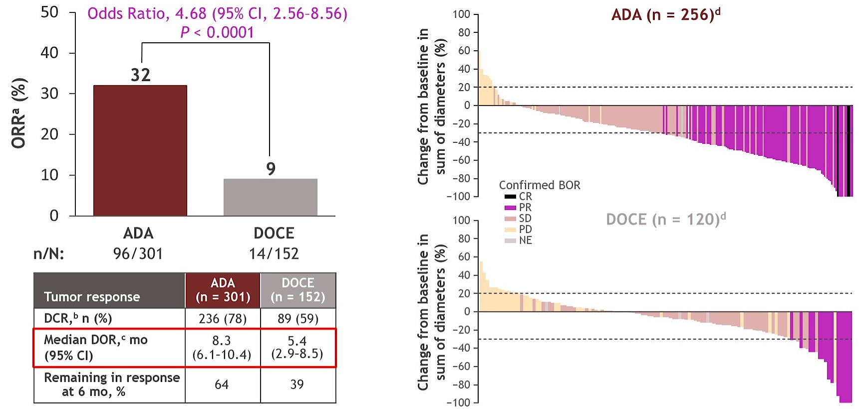
Phase III KRYSTAL-12 Trial: Overall Efficacy
Mok TSK et al. ASCO 2024;Abstract LBA8509

Slide 50
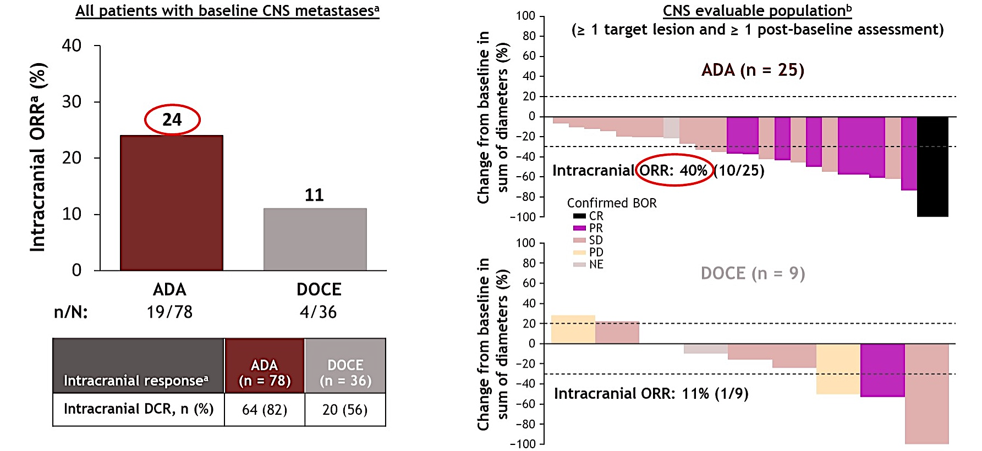
Phase III KRYSTAL-12: Intracranial Efficacy
Mok TSK et al. ASCO 2024;Abstract LBA8509.

Slide 51
Phase III KRYSTAL-12 Trial: Exploratory Study Design
Barlesi F et al. ESMO 2024;Abstract LBA57.

Slide 52
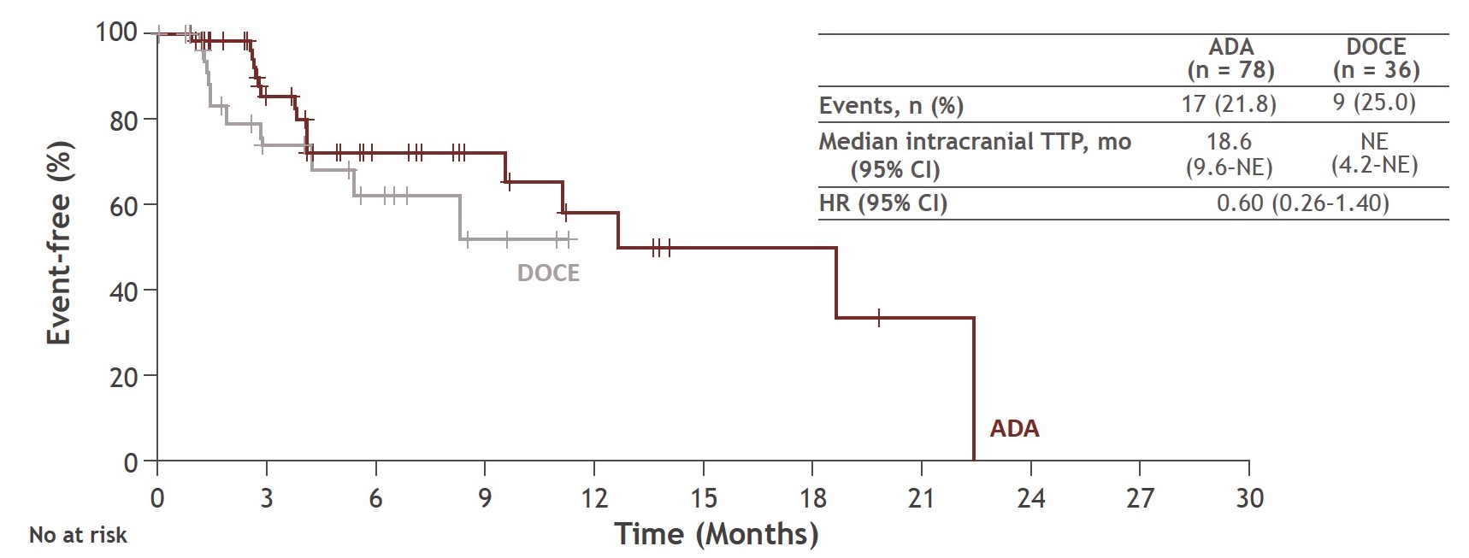
Phase III KRYSTAL-12 Trial: Intracranial TTP in Patients with Brain Metastases
TTP = time to disease progression
Barlesi F et al. ESMO 2024;Abstract LBA57.

Slide 53
Phase III KRYSTAL-12 Trial: Systemic Efficacy by Brain Metastases
Barlesi F et al. ESMO 2024;Abstract LBA57.

Slide 54
FDA Approves Lazertinib with Amivantamab-vmjw for NSCLC Press Release: August 19, 2024
“On August 19, 2024, the Food and Drug Administration approved lazertinib in combination with amivantamab-vmjw for the first-line treatment of locally advanced or metastatic non-small cell lung cancer (NSCLC) with epidermal growth factor receptor (EGFR) exon 19 deletions or exon 21 L858R substitution mutations, as detected by an FDA-approved test.
Efficacy was evaluated in MARIPOSA (NCT04487080), a randomized, active-controlled, multicenter trial of 1074 patients with exon 19 deletion or exon 21 L858R substitution mutation-positive locally advanced or metastatic NSCLC and no prior systemic therapy for advanced disease. Patients were randomized (2:2:1) to receive lazertinib in combination with amivantamab, osimertinib monotherapy, or lazertinib monotherapy (an unapproved regimen for NSCLC) until disease progression or unacceptable toxicity.
Lazertinib with amivantamab demonstrated a statistically significant improvement in PFS compared to osimertinib with a hazard ratio of 0.70 (95% confidence interval [CI]: 0.58, 0.85; p-value=0.0002). The median PFS was 23.7 months (95% CI: 19.1, 27.7) in the lazertinib with amivantamab arm and 16.6 months (95% CI: 14.8, 18.5) in the osimertinib arm.”
https://www.fda.gov/drugs/resources-information-approved-drugs/fda-approves-lazertinib-amivantamab-vmjw-non-small-lung-cancer

Slide 55
FDA Approves Amivantamab-vmjw with Carboplatin and Pemetrexed for NSCLC with EGFR Exon 19 Deletions or L858R Mutations Press Release: September 19, 2024
“On September 19, 2024, the Food and Drug Administration approved amivantamab-vmjw with carboplatin and pemetrexed for adult patients with locally advanced or metastatic non-small cell lung cancer (NSCLC) with epidermal growth factor receptor (EGFR) exon 19 deletions or exon 21 L858R substitution mutations whose disease has progressed on or after treatment with an EGFR tyrosine kinase inhibitor.
Efficacy was evaluated in MARIPOSA-2 (NCT04988295), a randomized, open-label, multicenter trial in 657 patients with locally advanced or metastatic NSCLC with EGFR exon 19 deletions or exon 21 L858R substitution mutations and disease progression on or after receiving osimertinib. Patients were randomized (1:2:2) to receive amivantamab-vmjw with carboplatin and pemetrexed (amivantamab + CP), carboplatin and pemetrexed (CP), or amivantamab-vmjw as part of another combination regimen.
Median PFS was 6.3 months (95% CI: 5.6, 8.4) in the amivantamab + CP arm and 4.2 months (95% CI: 4.0, 4.4) in the CP arm (hazard ratio 0.48 [95% CI: 0.36, 0.64], p-value<0.0001). The confirmed ORR was 53% (95% CI: 44, 62) in the amivantamab + CP arm and 29% (95% CI: 23, 35) in the CP arm (p-value<0.0001).”
https://www.fda.gov/drugs/resources-information-approved-drugs/fda-approves-amivantamab-vmjw-carboplatin-and-pemetrexed-non-small-cell-lung-cancer-egfr-exon-19

Slide 56
Small Cell Lung Cancer

Slide 57
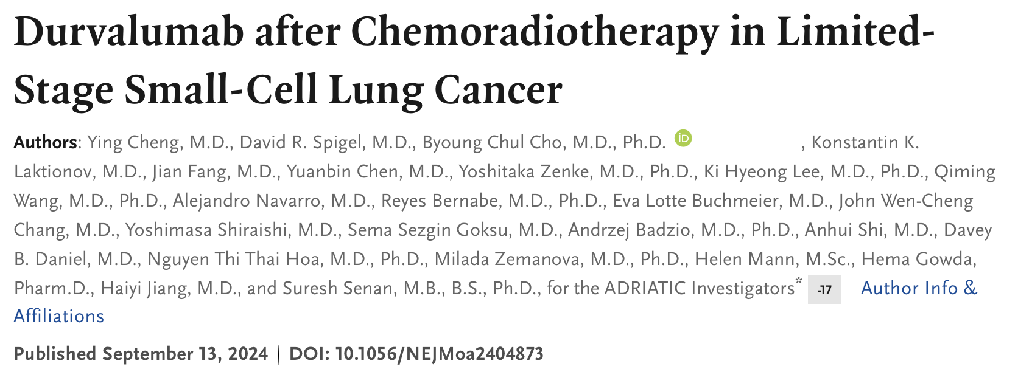
N Engl J Med 2024 September 15;[Online ahead of print].

Slide 58
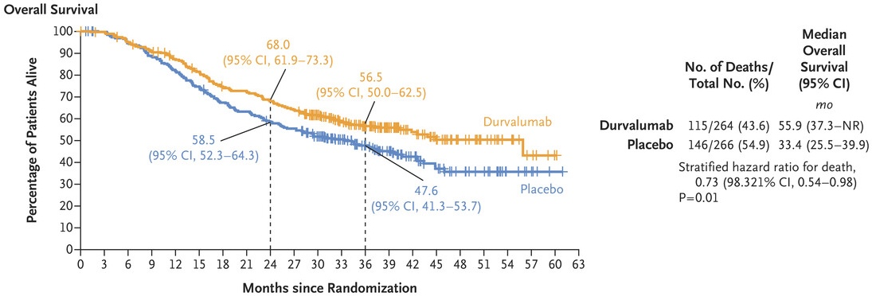
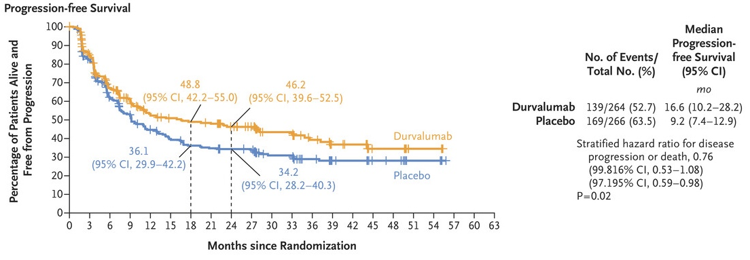
Phase III ADRIATIC Study: Survival Outcomes
Overall survival
Progression-free survival
Cheng Y et al. N Engl J Med 2024;September 15;[Online ahead of print].

Slide 59
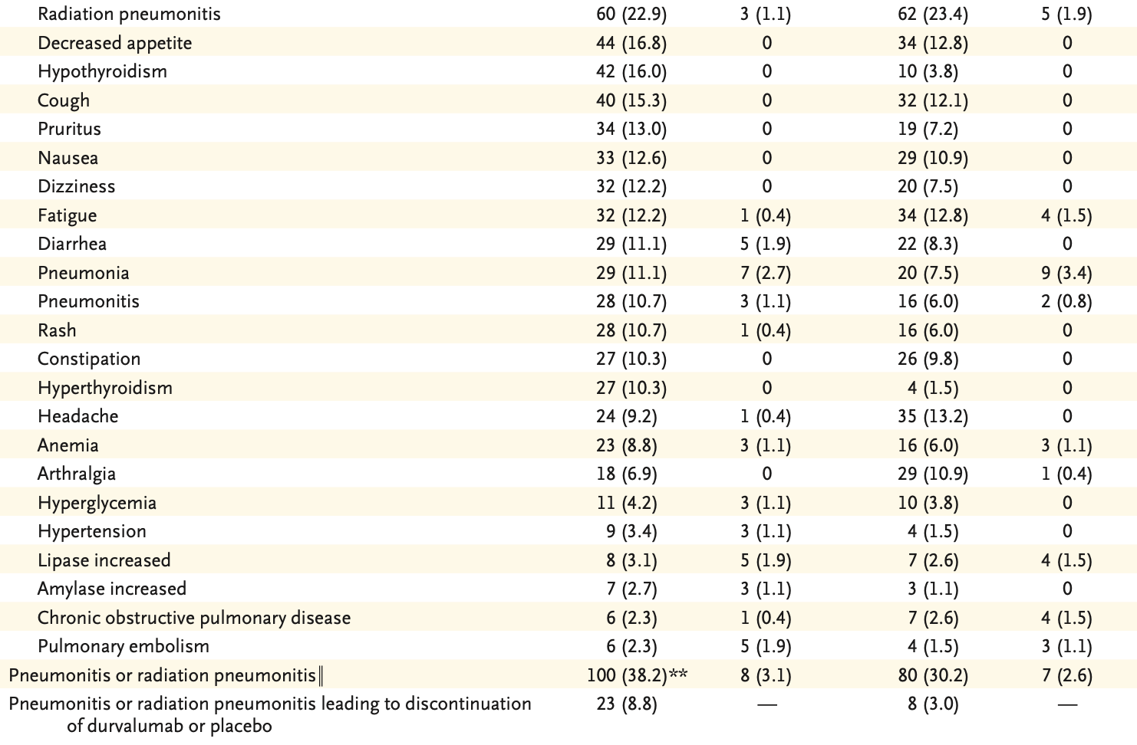
Phase III ADRIATIC Study: Safety
† One patient who had been randomly assigned to the durvalumab group received tremelimumab in addition to durvalumab and thus is not included here. The patient will be included in the durvalumab–tremelimumab group of the safety population.
‡ The numbers and percentages of patients with an adverse event of a maximum Grade of 3 or 4 are shown.
‖ Pneumonitis or radiation pneumonitis included events with the preferred terms of immune-mediated lung disease, interstitial lung disease, pneumonitis, radiation fibrosis–lung and radiation pneumonitis.
** One patient in the durvalumab group had pneumonitis or radiation pneumonitis with an outcome of death.
Cheng Y et al. N Engl J Med 2024; September 15;[Online ahead of print].

Slide 60
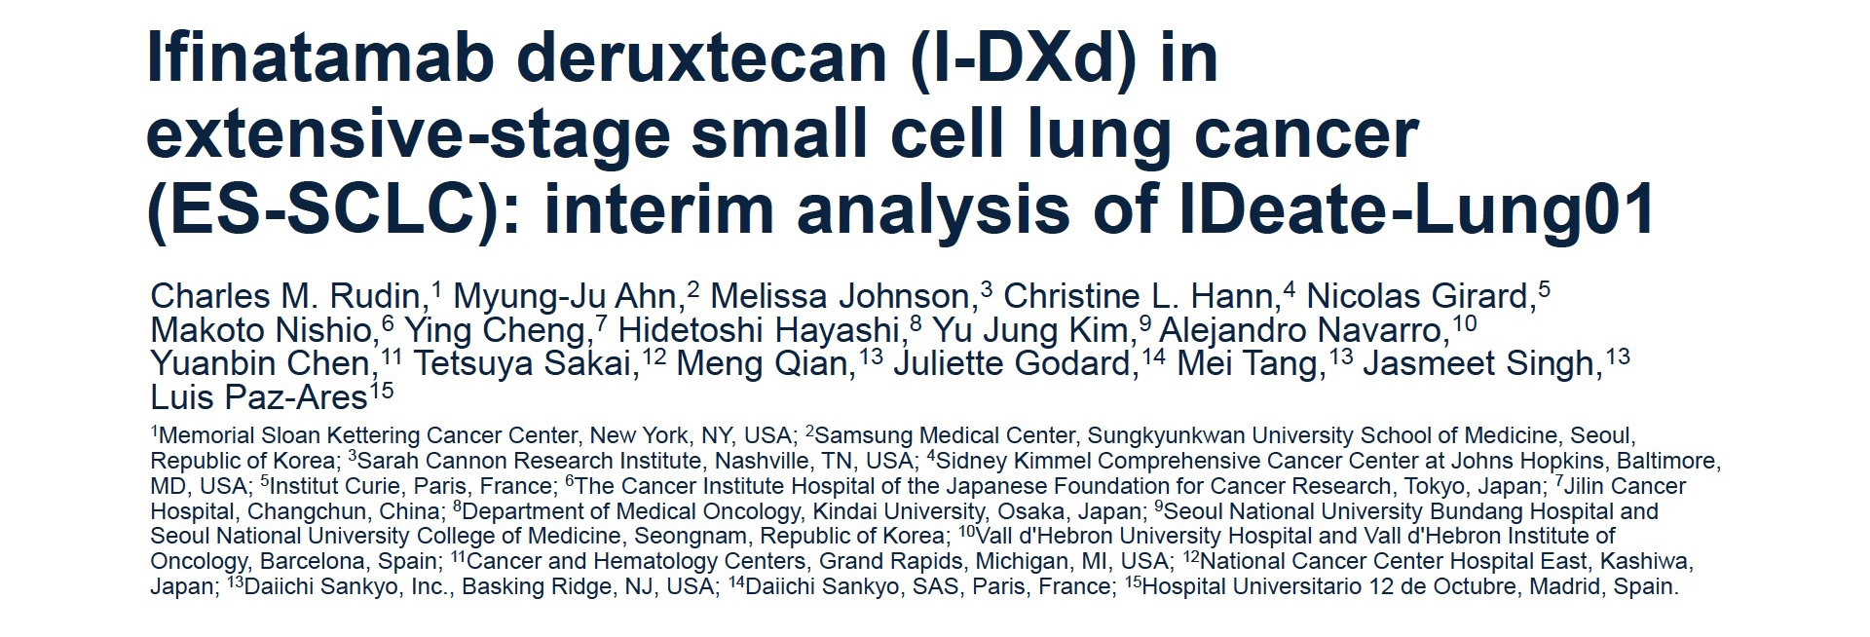
WCLC 2024; Abstract OA.04.03
Intracranial Response in Patients with Baseline Brain Metastases and Extensive-Stage Small Cell Lung Cancer Treated with Ifinatamab Deruxtecan (I-DXd) in the Ideate-Lung01 Study
Johnson M et al.
ESMO 2024;Abstract 1787P.

Slide 61
Phase II IDeate-Lung01 Study Design
Rudin CM et al. WCLC 2024;Abstract OA.04.03.

Slide 62
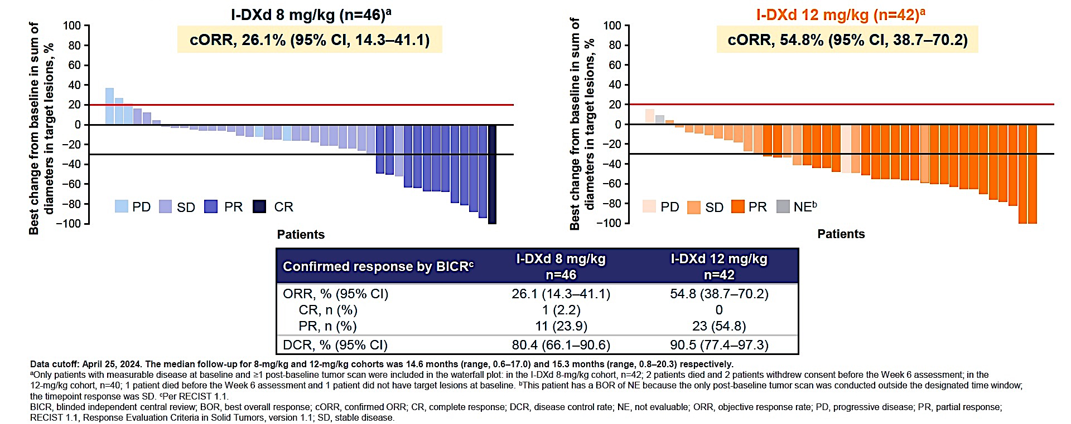
Phase II IDeate-Lung01 Study: ORR by Dosage
Rudin CM et al. WCLC 2024;Abstract OA.04.03.

Slide 63
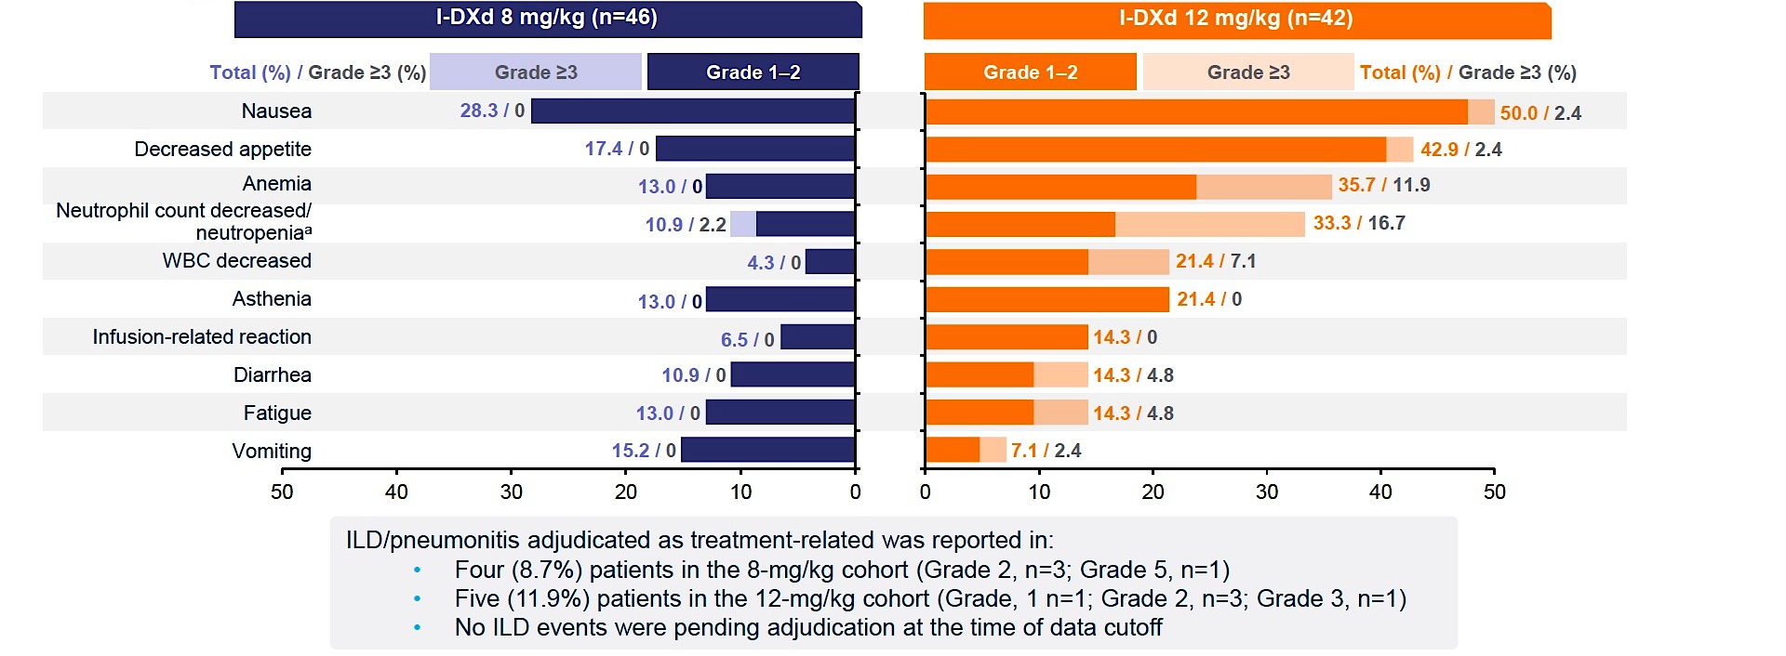
Phase II IDeate-Lung01 Study: Safety
Rudin CM et al. WCLC 2024;Abstract OA.04.03.

Slide 64
Phase II IDeate-Lung01 Study: Intracranial Response Analysis
Johnson M et al. ESMO 2024;Abstract 1787P.

Slide 65
Tumor Treating Fields

Slide 66
FDA Approves Tumor Treating Fields for the Treatment of Metastatic NSCLC Press Release: October 15, 2024
The FDA has approved tumor treating fields (TTFields) for concurrent use with PD-1/PD-L1 inhibitors or docetaxel in the treatment of metastatic NSCLC in adult patients who have experienced disease progression on or after a platinum-based regimen.
Approval was based on results of the Phase III LUNAR trial that compared TTFields concurrent with PD-1/PD-L1 inhibitors or docetaxel (experimental arm) to PD-1/PD-L1 inhibitors or docetaxel alone (control arm) for patients with metastatic NSCLC progressing during or after platinum-based therapy.
The primary endpoint of the study was achieved demonstrating a statistically significant and clinically meaningful 3.3-month (p = 0.04) extension in median overall survival (OS) for patients who received TTFields concurrently with a PD-1/PD-L1 inhibitor or docetaxel (n = 145). The group treated with TTFields concurrently with a PD-1/PD-L1 inhibitor or docetaxel had a median OS of 13.2 months (95% CI, 10.3 to 15.5 months) compared to a median OS of 9.9 months (95% CI, 8.2 to 12.2 months) in the group who received a PD-1/PD-L1 inhibitor or docetaxel (n = 146).
https://www.novocure.com/fda-approves-novocures-optune-lua-for-the-treatment-of-metastatic-non-small-cell-lung-cancer/

Slide 67
Phase III LUNAR-2 (EF-44) Study Design
Eaton MS-S et al. ASCO 2024;Abstract TPS8665.

