Slide 1
Thierry André
Service d’Oncologie Médicale
Et unité INSERM UMRS 938
‘Microsatellite Instability and Cancer’
Sorbonne université
Hôpital Saint Antoine

Slide 2
Neoadjuvant Pembrolizumab in Localized Microsatellite Instability High/Deficient Mismatch Repair Solid Tumors (1)
35 pts: 19 colon, 8 rectum and 8 others various types tumors at MD Anderson
17 pts (49%) with surgery (median of 3 pembrolizumab inj before surgery)
  15 patients evaluable for pathological response after 3 cycles: 10 are in cPR
  2 patients evaluable for pathological response after 1 or 2 cycles: one in cPR
  Six of 17 surgically resected patients did not demonstrate a pCR
  11 patients on 17 with cPR (65%)
18 pts (51%)
  - 10 received one year of pembrolizumab without PD
  - 5 received less than 1 year: 3 are in CR radiographic or endoscopic response
  and 2 were with SD
Ludford K et al. J Clin Oncol 2023;41(12):2181-90.

Slide 3
Neoadjuvant Pembrolizumab in Localized Microsatellite Instability High/Deficient Mismatch Repair Solid Tumors (2)
During the study course and subsequent follow-up, progression events were seen in 6 patients.
- 2 patients with pancreatic cancer with PD at 6 and 4 months, respectively
- 2 colorectal patients with PD at 6 weeks
- 2 other CRC patients
with PD at 6 and 9 months following initial response of PR and SD, respectively
Proof of concept for locally un-resectable GI/CRC:
Growing body of evidence role of anti-PD1 antibody therapy in GI cancers dMMR/MSI-H, where deep and major pathologic responses are observed in a substantial majority of patients with localized disease.
But many questions:
How many cycles before surgery?
Watch and Wait approach possible for who? And in this case duration of treatment with pembrolizumab?
Predictive factor of efficacy?
Ludford K et al. J Clin Oncol 2023;41(12):2181-90.

Slide 4
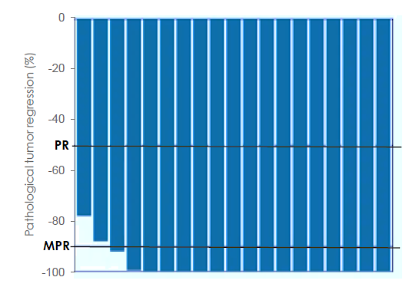
Neoadjuvant nivolumab plus relatlimab (anti-LAG3) in locally advanced MMR-deficient colon cancers: The NICHE-3 study (1)
Nivolumab d1-d15 & relatlimab
(anti-LAG3) d1, Surgery 6 weeks after (n=19)
Characteristics | n=19
Age, median (range) | 56 (36-85)
Sex female | 10 (53%)
ECOG PS 0 1 | 14 (74%) 5 (26%)
Radiologic Stage T (cT) T2 T3 T4 | 1 (5%) 11 (58%) 7 (37%)
Radiologic Stage N (cN) N- N+ | 5 (26%) 14 (74%)
Localisation Right Colon Left Colon | 16 (84%) 3 (16%)
Lynch syndrome | 5 (26%)
Verschoor YL et al. ESMO 2023;Abstract LBA31

Slide 5
Neoadjuvant nivolumab plus relatlimab (anti-LAG3) in locally advanced MMR-deficient colon cancers: The NICHE-3 study (2)
Pathologic Response Residual Viable Tumor | Niche 1-2 n=107 MSI/dMMR | Niche 3 n=19 MSI/dMMR | Toripalimab n=34 MSI/dMMR | Niche 1 n=22 MSS/pMMR
Yes (≤ 50%) | 106 (99%) | 19 (100%) | 19 (100%) | 5 (22.7%)
Complete (0%) | 72 (67%) | 15 (79%) | 26 (76%) | 2 (9%)
Major but not complete (≤ 10%) | 36 (38%) | 2 (10%) | 6 (16%) | 2 (9%)
Partial (10%-50%) | 4 (4%) | 2 (11%) | 0 | 1 (4.5%)
No or minor (> 50%) or NE | 1 (1%) | 0 | 2 (8%) | 17 (77%)
Verschoor YL et al., ESMO 2023;Abstract LBA31;
Chalabi, Nature Med 2020; Chalabi M et al., ESMO 2022 abstr. LBA7; Hu, Lancet Gastro & Hep 2021

Slide 6
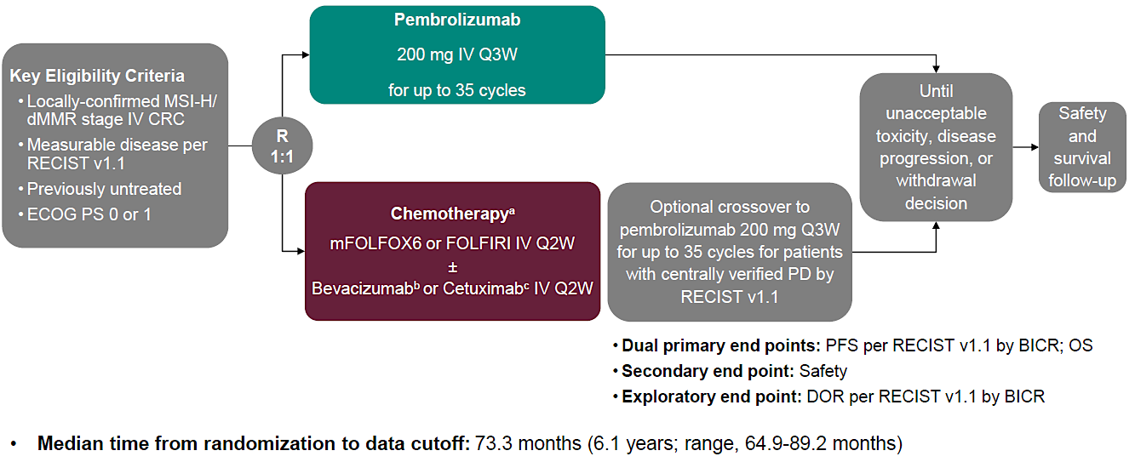
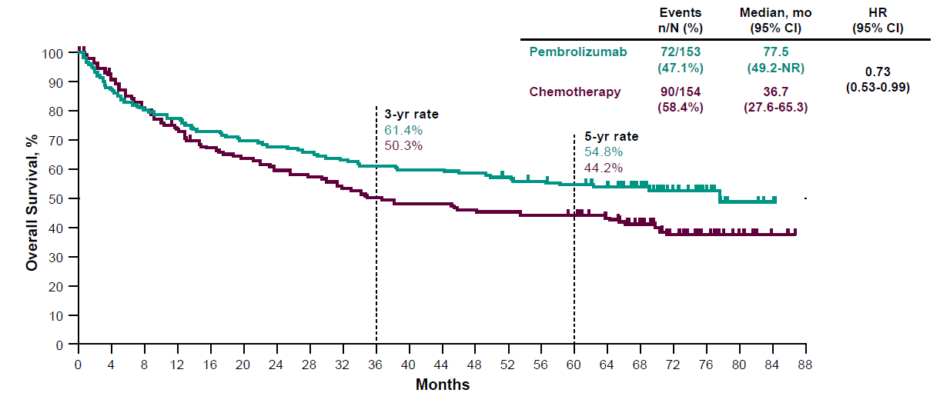
Pembrolizumab Versus Chemotherapy in MSI-H/dMMR mCRC :
5-Year Follow-Up of the Randomized Phase 3 KEYNOTE-177 Study (1)
Overall survival
Shiu KK et al. ESMO 2023;Abstract LBA32.

Slide 7
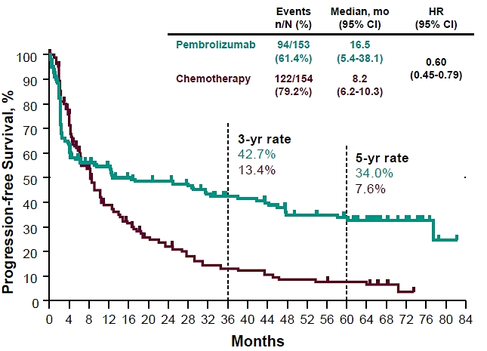
Pembrolizumab Versus Chemotherapy in MSI-H/dMMR mCRC :
5-Year Follow-Up of the Randomized Phase 3 KEYNOTE-177 Study (2)
PFS
Adverse Events
n (%) | Pembrolizumab N = 153 | Chemotherapy N = 143
Any AE | 149 (97.4) | 142 (99.3)
Treatment-related AE | 122 (79.7) | 141 (98.6)
Grade 3-5 | 33 (21.6) | 96 (67.1)
Led to treatment discontinuation | 15 (9.8) | 10 (7.0)
Led to death | 0 | 1 (0.7)
Immune-mediated AEs and Infusion Reactions
All | 51 (33.3) | 23 (16.1)
Grade 3-5 | 16 (10.5) | 3 (2.1)
Shiu KK et al. ESMO 2023;Abstract LBA32.

Slide 8
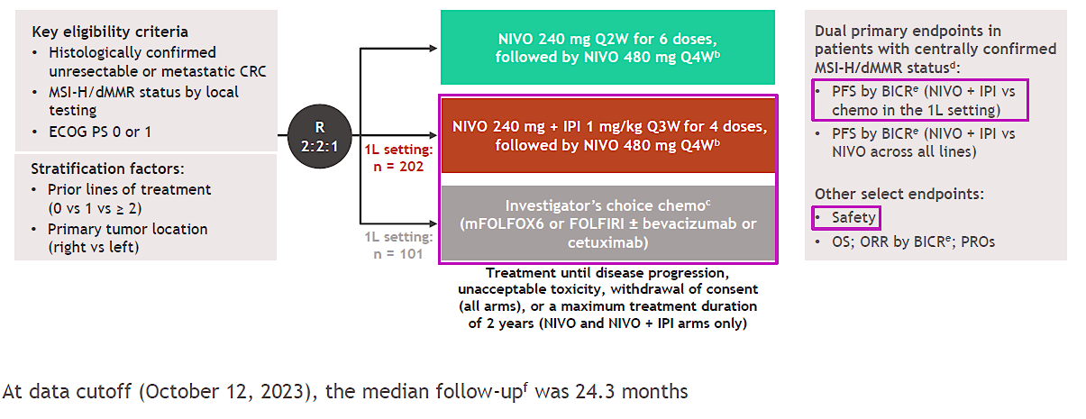
Nivolumab plus ipilimumab vs chemotherapy as first-line treatment for MSI-H/dMMR mCRC: First results of the CheckMate 8HW study (1)
Characteristic (1L all randomized patients) | Category | NIVO + IPI (n = 202) | Chemo (n = 101)
Age | Median (range), years | 62 (21–86) | 65 (26–87)
 | < 65 years | 58 | 46
Sex | Male | 47 | 45
Region | US/Canada/Europe | 66 | 70
 | Asia | 9 | 11
 | Rest of world | 25 | 19
ECOG PS | 0 | 55 | 51
Disease stage at initial diagnosis | Stage IV | 42 | 49
Tumor sidedness | Right | 68 | 67
Sites of metastases^{a,b} | Liver | 38 | 42
 | Lung | 22 | 25
 | Peritoneum | 42 | 43
Centrally confirmed MSI-H/dMMR status | Yes | 85 | 83
 | No | 15 | 17
Tumor cell PD-L1^{c,d} | < 1% | 72 | 79
 | ≥ 1% | 21 | 12
BRAF, KRAS, NRAS mutation status^{d,e} | BRAF/KRAS/NRAS all wild-type | 23 | 23
 | BRAF mutant | 26 | 24
 | KRAS or NRAS mutant | 21 | 21
 | Unknown | 27 | 31
Clinical history of Lynch syndrome^{d,f} | Yes | 11 | 17
 | No | 67 | 49
 | Reported as unknown | 22 | 30
Andre T et al. Gastrointestinal Cancers Symposium 2024;Abstract LBA768.

Slide 9
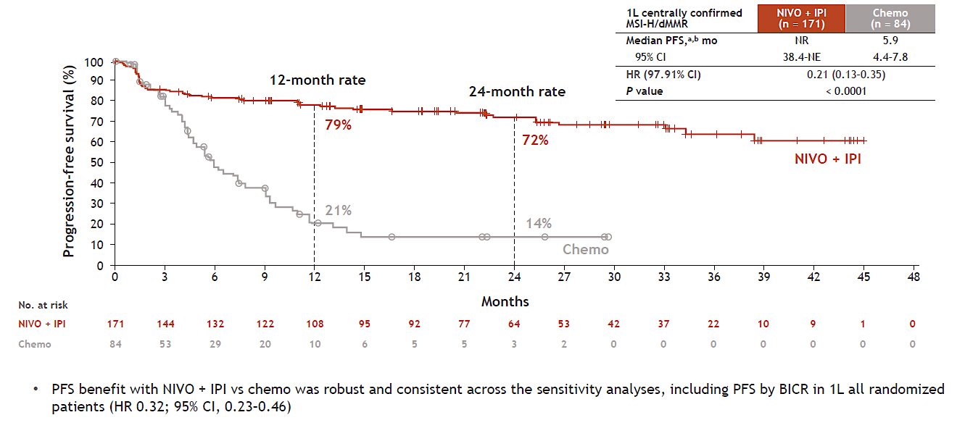
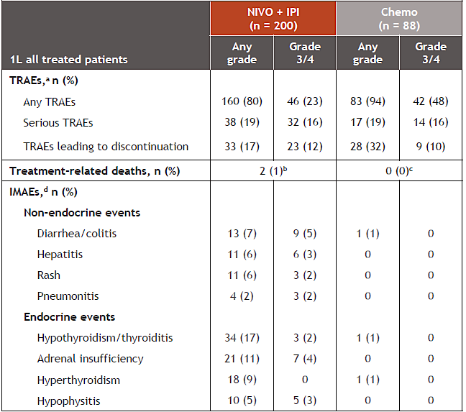
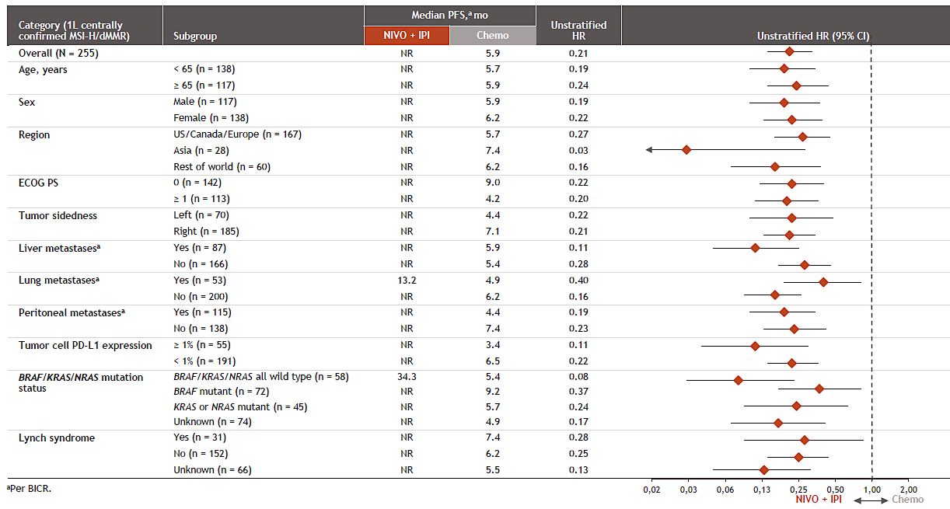
Nivolumab plus ipilimumab vs chemotherapy as first-line treatment for MSI-H/dMMR mCRC: First results of the CheckMate 8HW study (2)
PFS
Andre T et al. Gastrointestinal Cancers Symposium 2024;Abst LBA768.

Slide 10
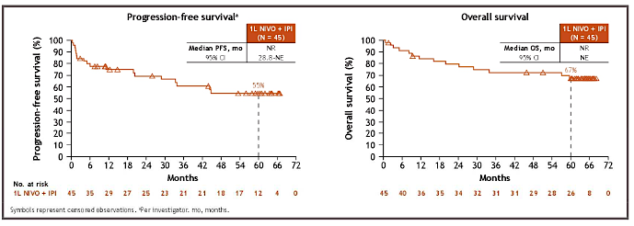
First-line (1L) nivolumab (NIVO) + ipilimumab (IPI) in patients (pts) with microsatellite instability-high/mismatch repair deficient
(MSI-H/dMMR) metastatic colorectal cancer (mCRC):
64-month (mo) follow-up from CheckMate 142
NIVO 3 mg/kg Q2W + IPI 1 mg/kg Q6W until disease progression or unacceptable toxicity.
Lenz HJ et al. Gastrointestinal Cancers Symposium 2024;Abstract 97.

Slide 11
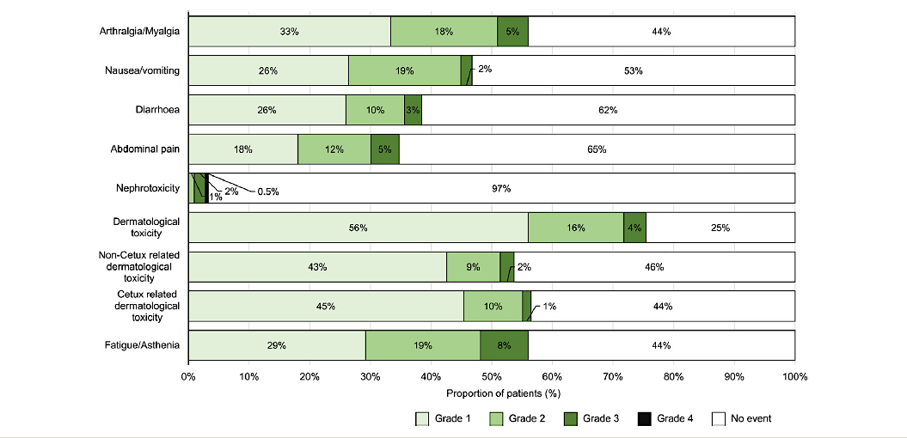
Adverse events with encorafenib plus cetuximab in patients with
BRAFV600E-mutant mCRC: An analysis of the BEACON CRC study
This analysis indicated that, except for rare cases of nephrotoxicity, encorafenib+cetuximab is well tolerated in most patients, with most AEIs being mild-to-moderate in severity, occurring early and resolving rapidly.
Taieb J et al. Clin Colorectal Cancer 2023;22(1):59-66.

Slide 12
ANCHOR CRC: Single-arm, phase II of encorafenib+binimetinib
and cetuximab in previously untreated BRAFV600E-mutant mCRC
BRAFV600E-mutated mCRC : oral encorafenib 300 mg once daily + oral binimetinib 45 mg twice daily
in 28-day cycles, plus IV cetuximab 400 mg/m2 on day 1 of cycle 1, then 250 mg/m2 weekly for the first 7
cycles, and 500 mg/m2 once on d1 and 15 from cycle 8 onward.
The primary end point : confirmed objective response rate (cORR).
Among 95 patients, cORR was 47.4% (95% CI, 37.0 to 57.9) ; the primary end point was met.
Median PFS 5.8 months and the median OS 18.3 months (median follow-up of 20.1 months).
Encorafenib + binimetinib + cetuximab was associated with disease control in the majority of patients
and a manageable safety profile in patients with BRAFV600E-mutant mCRC, suggesting that it may be an option for patients not eligible to receive standard first-line therapy.
Van Cutsem E et al. J Clin Oncol 2023;41(14):2628-37.

Slide 13
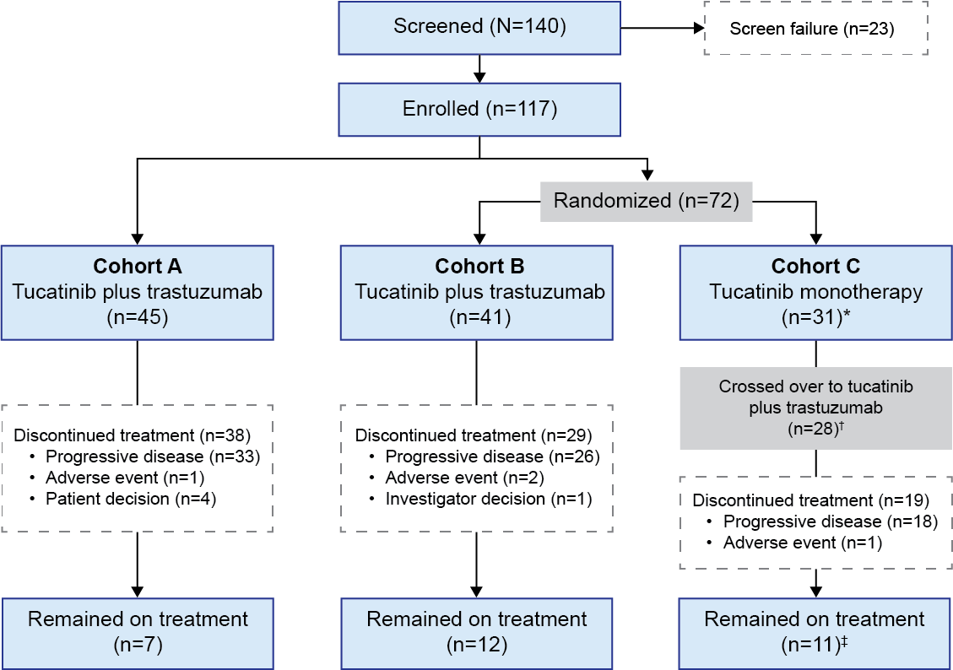
Tucatinib plus trastuzumab for chemotherapy-refractory, HER2-positive, RAS wild-type unresectable or mCRC (MOUNTAINEER): A multicentre, open-label, phase 2 study (1)
HER2 status: local determination
Eligible patients: if IHC+++ or IHC++ and FISH+,
or amplification by next-generation sequencing (NGS)
Inclusion criteria: mCRC HER2 over expressed, RAS wild-type, patients previously treated with fluoropyrimidines, oxaliplatin, irinotecan, a VEGF monoclonal antibody, and anti-PD-1 if MSI-H
117 patients included
Previous lines of systemic therapy median :3
Strickler JH et al. Lancet Oncol 2023;24(5):496-508.

Slide 14
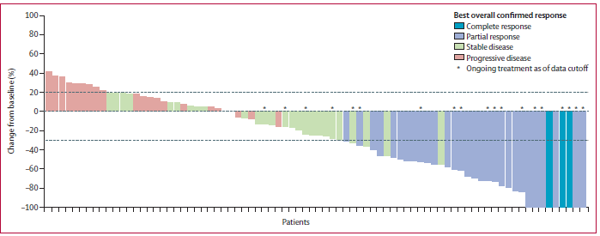
Tucatinib plus trastuzumab for chemotherapy-refractory, HER2-positive, RAS wild-type unresectable or mCRC (MOUNTAINEER): A multicentre, open-label, phase 2 study (2)
Response | Tucatinib + Trastuzumab (N = 84)
Confirmed objective response rate* — % (95% CI) | 38·1 (27·7–49·3)
Complete response ​— no. (%)† | 3 (3·6)
Partial response ​— no. (%)† | 29 (34·5)
Stable disease ​— no. (%)†,‡ | 28 (33·3)
Progressive disease ​— no. (%)† | 22 (26·2)
Not available ​— no. (%)§ | 2 (2·4)
Disease control rate — n (%) | 60 (71·4)
Duration of response, months ​— median (IQR) | 12·4 (8·3–25·5)
In combination arm median PFS per BICR was 8.2 months (IQR 2.1–18.4), and median OS was 24.1 months (IQR 10·5–not achieved).
The objective response per BICR by week 12 with monotherapy (n = 31) : 3% (95% CI 0.1–17.2).
The most common treatment-emergent adverse events with tucatinib+trastuzumab were diarrhoea (64% all; 3.5% grade 3-4), fatigue (44%; 2.3% grade 3-4), and nausea (35%; 0 % grade3-4). There were no deaths due to adverse events.
Strickler JH et al. Lancet Oncol 2023;24(5):496-508.

Slide 15
HER2 testing in the MOUNTAINEER trial: Analysis of treatment response
based on central HER2 assessment using IHC/ISH and NGS
Treatment response to Tucatinib + Trastuzumab was predicted by a HER2+ result from any of the three testing platforms (IHC, NGS tissue-based assay or NGS blood ctDNA)
High level of percent agreement of HER2 status observed across multiple central HER2 testing modalities (all cohorts included; pairwise comparisons)
Patients in which HER2 amplification was not detected by ctDNA NGS may have HER2 amplification by a tissue-based assay and may benefit from treatment with a HER2-directed therapy
• Confirmed ORR in IHC2+/ISH+ was numerically lower than IHC3+
Strickler JH et al. ASCO 2023;Abstract 3528.

Slide 16
MOUNTAINEER-03 Study design (study ongoing)
Tucatinib 300 mg PO BID + Trastuzumab 6 mg/kg IV (8 mg/kg loading dose C1D1) q 3 weeks + mFOLFOX6
N=200
PRIMARY ENDPOINT:
PFS per RECIST v1.1
as assessed per BICR
KEY SECONDARY ENDPOINTS:
OS
cORR, per BICR
Patient Population
N = 400
1L mCRC, HER2+
IHC/ISH gastric criteria
R
1:1
N=400
mFOLFOX6
+/- Bevacizumab 5 mg/kg IV q 2 weeks or Cetuximab 250 mg/m2 (400 mg/m2 loading dose C1D1) IV weekly
N=200
*Stratification:
primary tumor sidedness & liver metastases
BICR, blinded independent central review; ISH, in situ hybridization; HER2+, HER2 gene amplification; IHC, immunohistochemistry; mCRC, metastatic colorectal cancer; ORR, objective response rate; OS, overall survival; PFS, progression-free survival; BID, bis in die; C1D1, cycle 1 day 1; RECIST v1.1, Response Evaluation Criteria in Solid Tumors version 1.1.

Slide 17
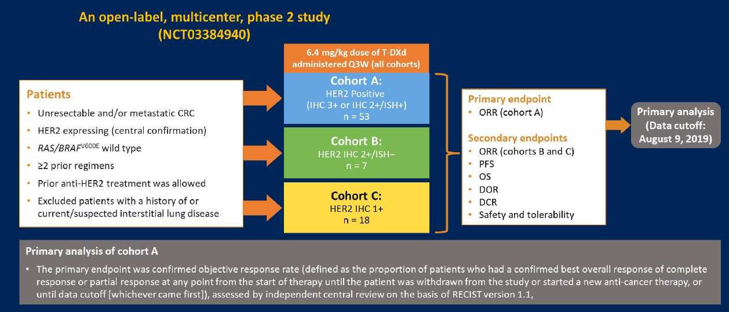
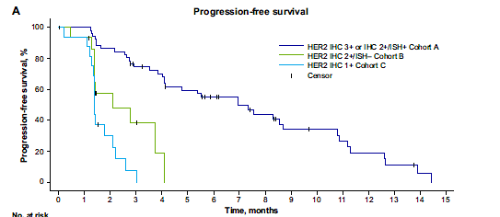
Final results of DESTINY-CRC01 investigating trastuzumab deruxtecan in patients with HER2-expressing mCRC
86 patients were enrolled (53 in cohort A, 15 in cohort B, and 18 in cohort C)
ORR of 45.3% in cohort A
No responses occurred in cohorts B or C
In cohort A median PFS: 6.9 months and median 0S:
15.5 months
Most common grade ≥3: decreased neutrophil count and anemia
Interstitial lung disease/pneumonitis: 8 patients (9.3%)
These findings support the continued exploration of
T-DXd in HER2-positive mCRC
Yoshino T et al. Nat Commun 2023;14(1):3332.

Slide 18
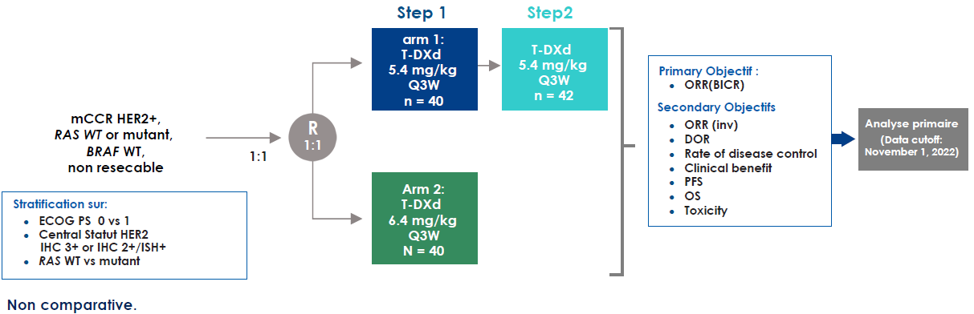
Trastuzumab deruxtecan (T-DXd) in patients with HER2+ mCR: Primary
results from the randomized, phase 2 DESTINY-CRC02 study (1)
non resectable
Stratification:
PFS by BICR
 | T-DXd 5.4 mg/kg Q3W |  |  | T-DXd 6.4 mg/kg Q3W
 | Stage 1 n = 40 | Stage 2 n = 42 | Total N = 82 | Stage 1 N = 40
cORR, n (%) CR PR SD PD NE | 18 (45.0) 0 18 (45.0) 20 (50.0) 2 (5.0) 0 | 13 (31.0) 0 13 (31.0) 20 (47.6) 6 (14.3) 3 (7.1) | 31 (37.8) 0 31 (37.8) 40 (48.8) 8 (9.8) 3 (3.7) | 11 (25) 0 11 (27.5) 23 (57.5) 4 (10.0) 2 (5.0)
PFS
Raghav KPS et al. ASCO 2023;Abstract 3501.

Slide 19
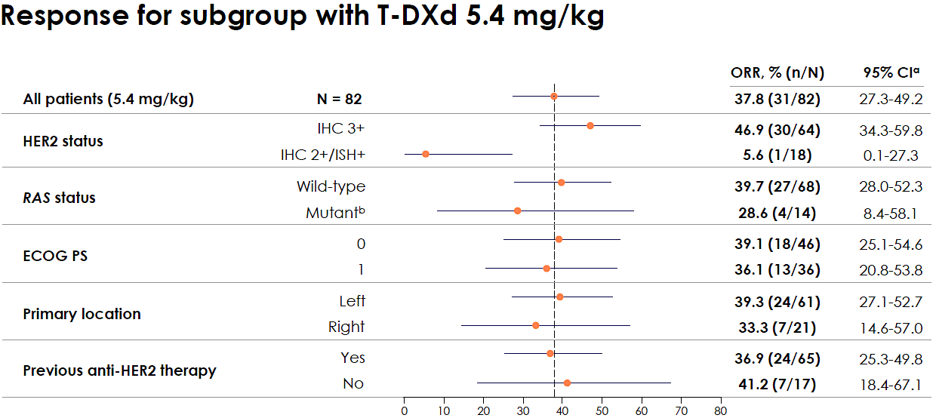
Trastuzumab deruxtecan (T-DXd) in patients with HER2+ mCR: Primary
results from the randomized, phase 2 DESTINY-CRC02 study (2)
Adjudicated as drug-related ILD/pneumonitis, n (%) | T-DXd 5.4 mg/kg Q3W |  |  | T-DXd 6.4 mg/kg Q3W
 | Stage 1 n = 41ª | Stage 2 n = 42 | Total N = 83 | Stage 1 N = 39
Any grade | 4 (9.8) | 3 (7.1) | 7 (8.4) | 5 (12.8)
Grade 1 | 1 (2.4) | 0 | 1 (1.2) | 2 (5.1)
Grade 2 | 3 (7.3) | 3 (7.1) | 6 (7.2) | 2 (5.1)
Grade 3 | 0 | 0 | 0 | 0
Grade 4 | 0 | 0 | 0 | 0
Grade 5 | 0 | 0 | 0 | 1 (2.6)
ORR %
Conclusion DESTINY-CRC02
Good anti-tumor efficacy of T-DXd
Better response rate in IHC3+ patients
Good efficacy of low dose with less pulmonary toxicity
Maintained efficacy if already treated with antiHER2 and mutated RAS
5.4 mg/kg/d every 21 days: new standard dose
Raghav KPS et al. ASCO 2023;Abstract 3501.

Slide 20
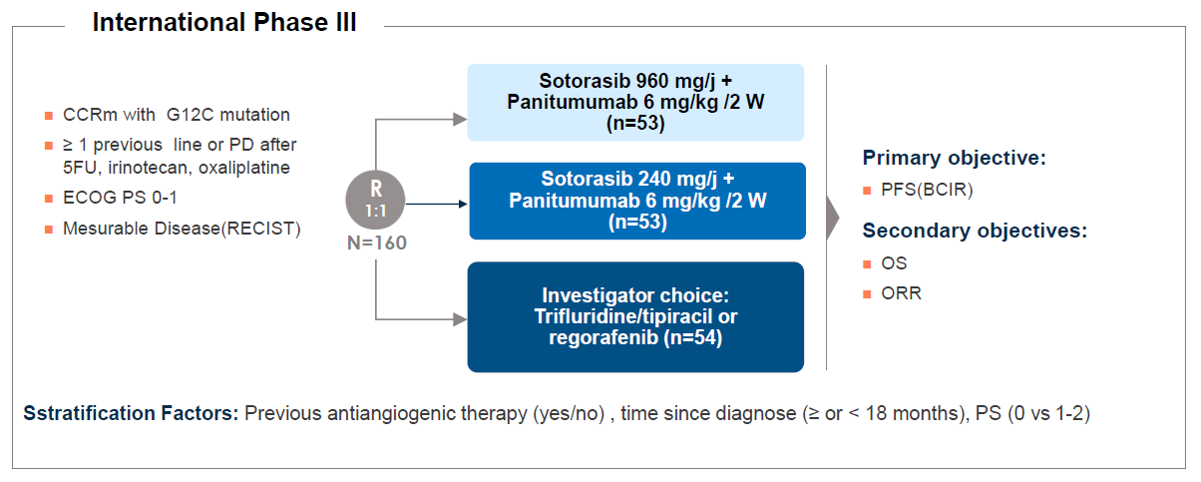
Sotorasib plus panitumumab in refractory colorectal cancer with mutated
KRAS G12C (1)
KRAS G12C mutations: 3% of CCRm
Sotorasib: Inhibitor of KRAS G12C
oxaliplatin
Stratification Factors: Previous antiangiogenic therapy (yes/no), time since diagnosis (≥ or < 18 months), PS (0 vs 1-2)
ORR | Sotorasib 960mg + Panitumumab (n=53) | Sotorasib 240mg + Panitumumab (n=53) | Investigator’s choice (n=54)
ORR, % (95% CI)*† | 26 (15.3-40.3) | 6 (1.2-15.7) | 0 (0-6.6)
CR, n (%) | 1 (2) | 0 | 0
PR, n(%) | 13 (25) | 3 (6) | 0
SD, n (%) | 24 (45) | 33 (62) | 25 (46)
PD, n(%) | 12 (23) | 13 (25) | 17 (31)
Non evaluable/ non doden(%) | 3 (6) | 2 (4) | 11 (20)
Tumoral control % (95% CI)* | 72 (57.7-83.2) | 68 (53.7-80.1) | 46 (32.6-60.4)
Fakih MG et al. N Engl J Med 2023;389(23):2125-39.

Slide 21
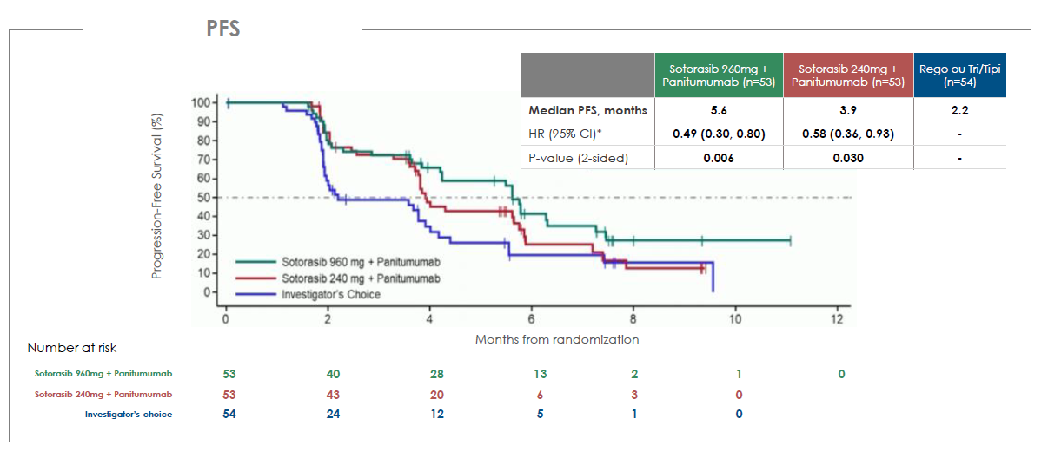
Sotorasib plus panitumumab in refractory colorectal cancer with mutated
KRAS G12C (2)
or
TRAE of grade 3 or higher: 35.8%, 30.2%, and 43.1% of patients, respectively.
Skin-related toxic effects and hypomagnesemia = most common AE observed with sotorasib–pani.
Fakih MG et al. N Engl J Med 2023;389(23):2125-39.

Slide 22
Adagrasib ± cetuximab in mCRC with mutated KRAS G12C
Phase 1–2, open-label, nonrandomized clinical trial
Heavily pretreated patients with mCRC cancer with mutant KRAS G12C
Treatment:
- Adagrasib monotherapy (600 mg orally twice daily)
- Adagrasib (at the same dose) in combination with cetuximab*
The primary end points were objective response (complete or partial response) and safety
ORR | Adagrasib monotherapy (n=43) | Adagrasib + cetuximab (n=28)
ORR, % (95% CI) by BICR | 23% (12-39) | 46% (28-66)
CR, n (%) | 0% | 0%
PR, n(%) | 19% | 46%
SD, n (%) | 67% | 54%
PD, n(%) | 14% | 0%
Non evaluable/ non doden(%) | 0% | 0%
Median duration of response (months) | 4.3 | 7.6
Median PFS (months) (95% CI) | 5.6 (4.1-8.3) | 6.9 (5.5-8.1)
Median OS (months) (95% CI) | 19.8 (12.5-23) | 13.4 (9.5-20.1)
The percentage of grade 3 or 4 treatment-related adverse events was 34% in the monotherapy group and 16% in the combination-therapy group
No grade 5 adverse events were observed
*IV cetuximab once a week (initial dose of 400 mg/m², followed by a dose of 250 mg mg/m²)
or every 2 weeks (with a dose of 500 mg per square meter).
Yaeger R et al. N Engl J Med 2023;388(1):44-54.

Slide 23


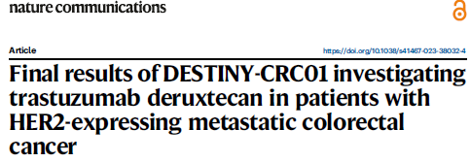
Conclusion (1) Molecular target in metastatic CRC 2023
Significant progress
Kopetz S, NEJM 2019
André T et al; NEJM 2020
Shiu KK et al, ESMO 2023
BRAF mt
~9%
NRAS mt
~7%
MSI 4%
Watanabe J et al, Jama 2023
Nivolumab plus ipilimumab vs chemotherapy as first-line treatment
for MSI-H/dMMR mCRC
Andre T et al. ASCO GI 2024;AbsLBA768
RAS WT
~44%
KRAS mt
~45%
4–6% HER2
3-4%
G12c
Strickler JH et al, Lancet Oncol 2023
<1% NTRK
Trastuzumab deruxtecan in patients with HER2+ mCR
Raghav KPS et al. ASCO 2023;Abstract 3501
Yaeger R et al, NEJM 2023
4
Fakih M et al, NEJM 2023
Yoshino T et al. Nat Commun 2023
Hong DS et al. Lancet Oncol 2020

Slide 24
Conclusion 2: MSI-H/dMMR Colorectal cancer
5% of mCRC are MSI-H/dMMR with amazing results with immune checkpoint inhibitor(s)
- Pembrolizumab or Nivolumab + Ipilimumab are 2 options in first line ¹⁻³
10-15% of non mCRC are MSI-H/dMMR (2% of non metastatic rectal cancer)
- Proof of concept with immune checkpoint inhibitor for locally advanced ⁴
- Better strategy for resectable CRC MSI-H/dMMR needs to be defined ⁵⁻⁸
1. Shiu KK et al. ESMO 2023;Abstract LBA32
2. Lenz HJ et al. Gastrointestinal Cancers Symposium 2024;Abstract 97
3. Andre T et al. Gastrointestinal Cancers Symposium 2024;Abstract LBA768
4. Ludford K et al. J Clin Oncol 2023;41(12):2181-90
5. Verschoor YL et al. ESMO 2023;Abstract LBA31
6. Chalabi, Nature Med 2020; 7. Chalabi M et al., ESMO 2022 abstr. LBA7; 8. Hu, Lancet Gastro & Hep 2021

