Slide 1
Hormonal Therapy for Hormone Receptor-Positive Breast Cancer
What I Tell My Patients: Integrating New Research Information into Current Clinical Care
A Complimentary NCPD Hybrid Symposium Series Held During the 49th Annual ONS Congress
Wednesday, April 24, 2024 6:00 PM – 8:00 PM
Faculty
Harold J Burstein, MD, PhD
Kelly Fischer, MSN, FNP-BC
Komal Jhaveri, MD, FACP
Melissa Rikal, FNP-BC, AOCNP
Moderator
Neil Love, MD

Slide 2
Faculty
Harold J Burstein, MD, PhD
Institute Physician Dana-Farber Cancer Institute
Professor of Medicine Harvard Medical School
Boston, Massachusetts
Melissa Rikal, FNP-BC, AOCNP
Nurse Practitioner
Sarah Cannon Research Institute
Nashville, Tennessee
Kelly Fischer, MSN, FNP-BC
Family Nurse Practitioner
Dana-Farber Cancer Institute
Boston, Massachusetts
Moderator Neil Love, MD Research To Practice Miami, Florida
Komal Jhaveri, MD, FACP
Patricia and James Cayne Chair for Junior Faculty
Associate Attending Physician
Breast Medicine Service and Early Drug Development Service
Section Head
Endocrine Therapy Research Program
Clinical Director
Early Drug Development Service
Department of Medicine
Memorial Sloan Kettering Cancer Center
Associate Professor of Medicine
Weill Cornell College of Medicine
New York, New York

Slide 3
Dr Burstein — Disclosures
No relevant conflicts of interest to disclose

Slide 4
Ms Fischer — Disclosures
No relevant conflicts of interest to disclose

Slide 5
Dr Jhaveri — Disclosures
Advisory Committees and Consulting Agreements | AbbVie Inc, AstraZeneca Pharmaceuticals LP, Blueprint Medicines, Bristol Myers Squibb, Daiichi Sankyo Inc, Eisai Inc, Genentech, a member of the Roche Group, Gilead Sciences Inc, Jounce Therapeutics, Loxo Oncology Inc, a wholly owned subsidiary of Eli Lilly & Company, Menarini Group, Novartis, Olema Oncology, Pfizer Inc, Scorpion Therapeutics, Seagen Inc, Stemline Therapeutics Inc, Sun Pharma Advanced Research Company, Taiho Oncology Inc
Contracted Research | AstraZeneca Pharmaceuticals LP, Debiopharm, Genentech, a member of the Roche Group, Gilead Sciences Inc, Loxo Oncology Inc, a wholly owned subsidiary of Eli Lilly & Company, Merck, Novartis, Pfizer Inc, Puma Biotechnology Inc, Scorpion Therapeutics, Zymeworks Inc

Slide 6
Ms Rikal — Disclosures
Advisory Committee | Stemline Therapeutics Inc
Consulting Agreements and Speakers Bureaus | AstraZeneca Pharmaceuticals LP, Daiichi Sankyo Inc

Slide 7
Commercial Support
This activity is supported by educational grants from AstraZeneca Pharmaceuticals LP, Lilly, and Stemline Therapeutics Inc.
Research To Practice NCPD Planning Committee Members, Staff and Reviewers
Planners, scientific staff and independent reviewers for Research To Practice have no relevant conflicts of interest to disclose.

Slide 8
This educational activity contains discussion of non-FDA-approved uses of agents and regimens. Please refer to official prescribing information for each product for approved indications.

Slide 9
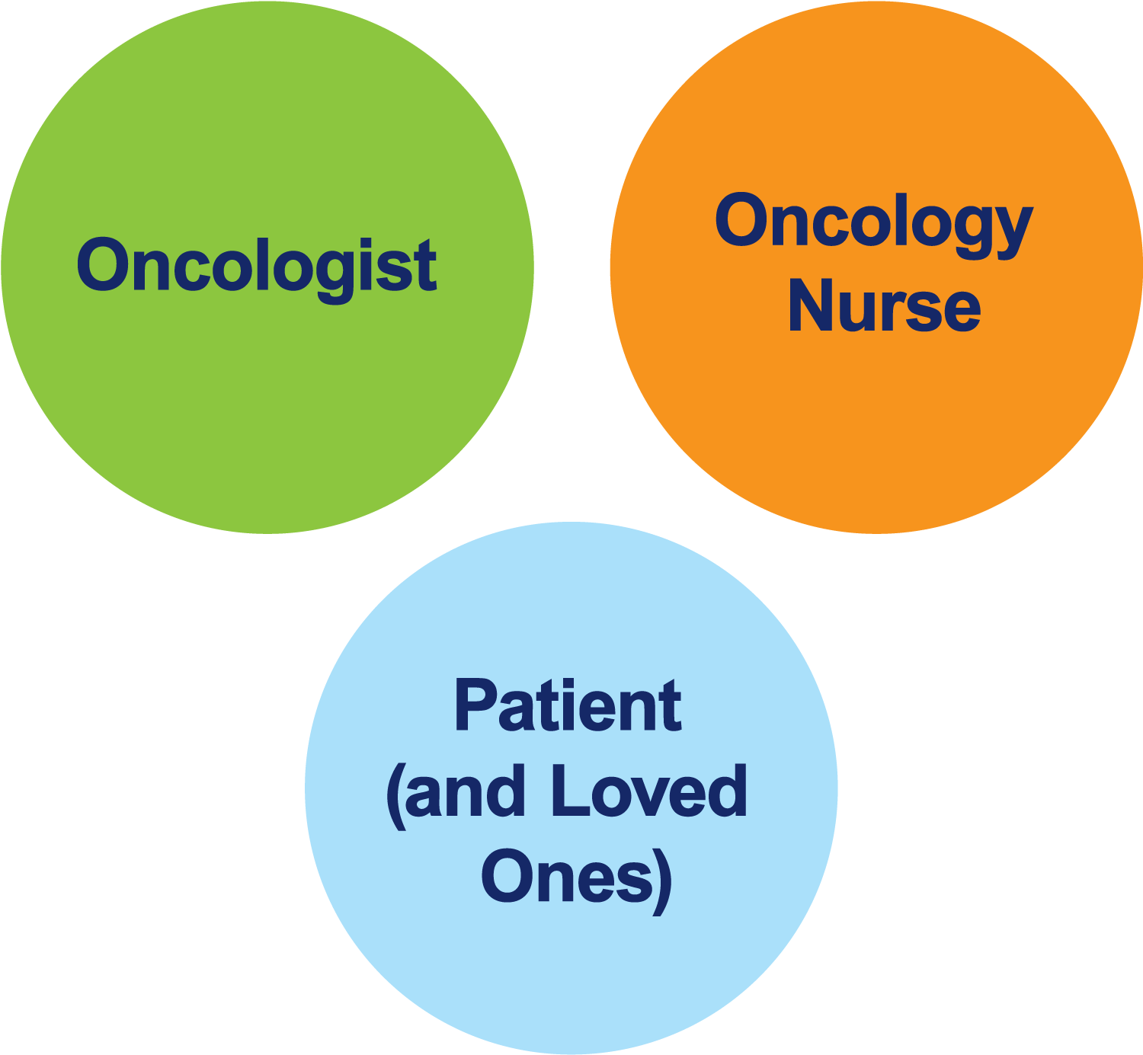
The Core Oncology Triad Developing an Individualized Oncology Strategy

Slide 10
How was it different to take care of this patient versus another patient in the same oncologic setting?
What unique biopsychosocial factors (eg, attitude, comorbidities, social support) were considered in the overall management of this case?

Slide 11
Consulting Nurse Faculty
Jacqueline Broadway-Duren, PhD, DNP, APRN, FNP-BC
The University of Texas MD Anderson Cancer Center
Houston, Texas
Jessica Mitchell, APRN, CNP, MPH
Mayo Clinic College of Medicine and Science
Rochester, Minnesota
Kathleen D Burns, RN, MSN, AGACNP-BC, OCN
City of Hope Comprehensive Cancer Center
Duarte, California
Tiffany A Richards, PhD, ANP-BC, AOCNP
The University of Texas MD Anderson Cancer Center
Houston, Texas
Sonia Glennie, ARNP, MSN, OCN
Swedish Cancer Institute Center for Blood Disorders
Seattle, Washington
Kimberly A Spickes, MNSc, RN, APRN, OCN, ACNP-BC
University of Arkansas for Medical Sciences
Little Rock, Arkansas
Amy Goodrich, CRNP
The Sidney Kimmel Comprehensive Cancer Center
Baltimore, Maryland
Ronald Stein, JD, MSN, NP-C, AOCNP
USC Norris Comprehensive Cancer Center
Los Angeles, California
https://www.ResearchToPractice.com/ONS2024Clips

Slide 12
Oncology clinical trial terminology
Waterfall plot
Kaplan-Meier curve
Overall survival
Progression-free survival
Disease-free survival
Objective response rate
Hazard ratio
Phase I/II/III
Minimal residual disease
Circulating tumor DNA
Notes:
12
12
12
12
12

Slide 13
Agenda
Introduction
Module 1: The Utility of Genomic Assays in Treatment Decision-Making for HR-Positive, HER2-Negative Localized Breast Cancer
Module 2: The Role of CDK4/6 Inhibitors in Therapy for HR-Positive Breast Cancer
Module 3: Oral Selective Estrogen Receptor Degraders (SERDs) in the Management of HR-Positive Metastatic Breast Cancer (mBC)
Module 4: Alpelisib and Capivasertib in Treatment for HR-Positive mBC

Slide 14
Agenda
Introduction
Module 1: The Utility of Genomic Assays in Treatment Decision-Making for HR-Positive, HER2-Negative Localized Breast Cancer
Module 2: The Role of CDK4/6 Inhibitors in Therapy for HR-Positive Breast Cancer
Module 3: Oral Selective Estrogen Receptor Degraders (SERDs) in the Management of HR-Positive Metastatic Breast Cancer (mBC)
Module 4: Alpelisib and Capivasertib in Treatment for HR-Positive mBC

Slide 15
Consulting Nursing Faculty Comments
New diagnoses and introducing patients to cancer treatment
Sonia Glennie, ARNP, MSN, OCN

Slide 16
Agenda
Introduction
Module 1: The Utility of Genomic Assays in Treatment Decision-Making for HR-Positive, HER2-Negative Localized Breast Cancer
Module 2: The Role of CDK4/6 Inhibitors in Therapy for HR-Positive Breast Cancer
Module 3: Oral Selective Estrogen Receptor Degraders (SERDs) in the Management of HR-Positive Metastatic Breast Cancer (mBC)
Module 4: Alpelisib and Capivasertib in Treatment for HR-Positive mBC

Slide 17
The Utility of Genomic Assays in Treatment Decision-Making for HR-Positive, HER2-Negative Localized Breast Cancer
Dr Burstein
Boston, Massachusetts
Dr Jhaveri
New York, New York
Clinicopathologic factors affecting the decision to consult a genomic assay for patients with HR-positive, HER2-negative localized breast cancer
Key studies informing the use of the 21-gene Recurrence Score® to guide neoadjuvant and adjuvant treatment decision-making
Practical interpretation of 21-gene Recurrence Score results
Current clinical utility, if any, of other genomic assays in treating HR-positive localized breast cancer

Slide 18
Genomic Assays
Available assays
Oncotype DX®
MammaPrint®
Prosigna®
PAM50
Breast Cancer Index®
Key issues
Benefit of adding chemotherapy to endocrine therapy for premenopausal and postmenopausal patients

Slide 19
Mechanisms of Action of Hormonal Therapy; Adjuvant Hormonal Therapy for Premenopausal Patients with HR-Positive Breast Cancer
Dr Burstein
Boston, Massachusetts
Dr Jhaveri
New York, New York
Individualized selection of an adjuvant hormonal therapy approach for premenopausal patients with breast cancer
Identification of appropriate candidates for ovarian function suppression (OFS)/ablation
Utility of OFS as a means to preserve fertility in premenopausal patients
Frequency and severity of common side effects with various hormonal therapy approaches

Slide 20
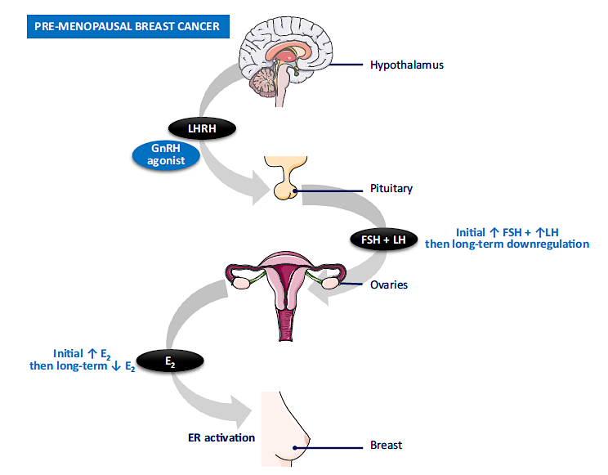
GnRH Agonist Mode of Action in Premenopausal Breast Cancer
McCann KE et al. NPJ Breast Cancer 2024;10(1):8.

Slide 21
Kelly Fischer, MSN, FNP-BC
What I tell my patients about to begin various classic hormonal therapies (eg, tamoxifen, aromatase inhibitors, ovarian function suppression)

Slide 22
Melissa Rikal, FNP-BC, AOCNP
What I tell my patients about the possibility of taking a break from adjuvant hormonal therapy to become pregnant

Slide 23
Agenda
Introduction
Module 1: The Utility of Genomic Assays in Treatment Decision-Making for HR-Positive, HER2-Negative Localized Breast Cancer
Module 2: The Role of CDK4/6 Inhibitors in Therapy for HR-Positive Breast Cancer
Module 3: Oral Selective Estrogen Receptor Degraders (SERDs) in the Management of HR-Positive Metastatic Breast Cancer (mBC)
Module 4: Alpelisib and Capivasertib in Treatment for HR-Positive mBC

Slide 24
CDK4/6 Inhibitors as Adjuvant Therapy
Dr Burstein
Boston, Massachusetts
Dr Jhaveri
New York, New York
Long-term findings with the addition of abemaciclib to adjuvant hormonal therapy for patients with HR-positive, HER2-negative breast cancer at high risk for recurrence
Published data with the addition of ribociclib to adjuvant endocrine therapy for localized HR-positive breast cancer
Identification of candidates for adjuvant CDK4/6 inhibitors
Ongoing studies evaluating CDK4/6 inhibitors as a component of neoadjuvant or adjuvant therapy

Slide 25
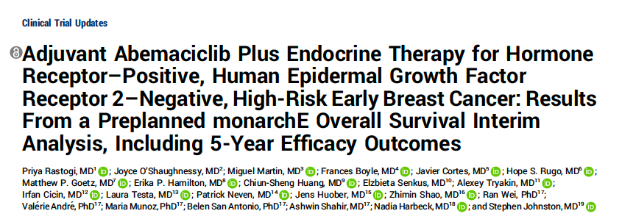
J Clin Oncol 2024;42(9):987-93.

Slide 26
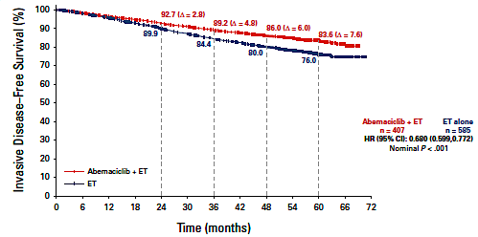
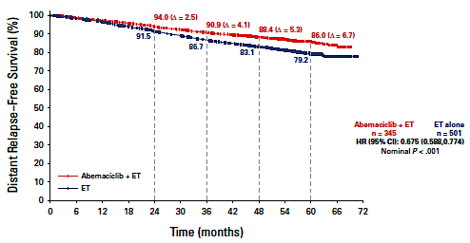
monarchE Trial: Invasive Disease-Free Survival and Distant Relapse-Free Survival
IDFS
DRFS
ET = endocrine therapy
Rastogi P et al. J Clin Oncol 2024;42(9):987-93.

Slide 27
monarchE: Adverse Events in ≥10% of Patients
Abemaciclib + ET (N = 2791) |  |  | ET alone (N = 2800)
n (%) | Any Grade | Grade ≥3 | Any grade | Grade ≥3
Diarrhea | 2331 (83.5) | 219 (7.8) | 242 (8.6) | 6 (0.2)
Infections | 1429 (51.2) | 155 (5.6) | 1102 (39.4) | 83 (3.0)
Neutropenia | 1278 (45.8) | 546 (19.6) | 157 (5.6) | 23 (0.8)
Fatigue | 1133 (40.6) | 80 (2.9) | 499 (17.8) | 4 (0.1)
Nausea | 824 (29.5) | 14 (0.5) | 252 (9.0) | 2 (0.1)
Anemia | 681 (24.4) | 57 (2.0) | 104 (3.7) | 10 (0.4)
Headache | 546 (19.6) | 8 (0.3) | 421 (15.0) | 5 (0.2)
Vomiting | 491 (17.6) | 15 (0.5) | 130 (4.6) | 3 (0.1)
Stomatitis | 385 (13.8) | 4 (0.1) | 151 (5.4) | 0 (0.0)
Thrombocytopenia | 373 (13.4) | 36 (1.3) | 52 (1.9) | 4 (0.1)
Decreased appetite | 329 (11.8) | 16 (0.6) | 68 (2.4) | 2 (0.1)
Alopecia | 313 (11.2) | N/A | 75 (2.7) | 0 (0.0)
ALT | 343 (12.3) | 77 (2.8) | 157 (5.6) | 19 (0.7)
AST | 330 (11.8) | 52 (1.9) | 137 (4.9) | 15 (0.5)
Rash | 312 (11.2) | 11 (0.4) | 127 (4.5) | 0 (0.0)
ILD | 89 (3.2) | 11 (0.4) | 37 (1.3) | 1 (0.0)
Rugo HS et al. Ann Oncol. 2022; 33: 616-627

Slide 28
CDK4/6 Inhibitors
Agent | Current indications and usage for ER-positive, HER2-negative breast cancer
Palbociclib | With an aromatase inhibitor (AI) as initial endocrine-based therapy for advanced or metastatic disease With fulvestrant for advanced or metastatic disease after disease progression on endocrine therapy
Ribociclib | With an AI as initial endocrine-based therapy for pre/peri/postmenopausal women or men with advanced or metastatic disease With fulvestrant as initial endocrine-based therapy or after disease progression on endocrine therapy for postmenopausal women or men with advanced or metastatic disease
Abemaciclib | With endocrine therapy as adjuvant treatment for node-positive localized breast cancer at high risk of recurrence As monotherapy for advanced or metastatic disease with disease progression after endocrine therapy and prior chemotherapy in the metastatic setting With fulvestrant after disease progression on endocrine therapy for adult patients with advanced or metastatic disease With an AI as initial endocrine-based therapy for postmenopausal women and men with advanced or metastatic disease

Slide 29
Consulting Nursing Faculty Comments
The patient with disease relapse after adjuvant treatment
Ronald Stein, JD, MSN, NP-C, AOCNP

Slide 30
CDK4/6 Inhibitors for Metastatic Breast Cancer (mBC)
Dr Burstein
Boston, Massachusetts
Dr Jhaveri
New York, New York
Long-term follow-up data, including overall survival findings, with abemaciclib, palbociclib and ribociclib for patients with HR-positive mBC
Factors affecting the selection of a CDK4/6 inhibitor and an endocrine partner for premenopausal and postmenopausal patients
Role of CDK4/6 inhibitors in treatment for unique patient populations, such as those with aggressive visceral disease or central nervous system metastases
Available data on the utility of continuing CDK4/6 inhibitors beyond progression or rechallenge in later lines of therapy; current clinical role of this strategy

Slide 31
Side Effects of CDK4/6 Inhibitors
Dr Burstein
Boston, Massachusetts
Dr Jhaveri
New York, New York
Spectrum and frequency of clinically relevant hematologic and nonhematologic toxicities, including cytopenias, gastrointestinal (GI) events, interstitial lung disease/pneumonitis and venous thromboembolic events, with CDK4/6 inhibitors
Optimal monitoring for and management of CDK4/6 inhibitor-associated toxicities
Role of switching between CDK4/6 inhibitors for patients experiencing tolerability issues
Comparative tolerability of CDK4/6 inhibitors in the adjuvant versus metastatic settings; appropriate threshold for dose reduction/delay or treatment discontinuation for patients undergoing potentially curative therapy

Slide 32
Kelly Fischer, MSN, FNP-BC
What I tell my patients about to begin treatment with a CDK4/6 inhibitor

Slide 33
Agenda
Introduction
Module 1: The Utility of Genomic Assays in Treatment Decision-Making for HR-Positive, HER2-Negative Localized Breast Cancer
Module 2: The Role of CDK4/6 Inhibitors in Therapy for HR-Positive Breast Cancer
Module 3: Oral Selective Estrogen Receptor Degraders (SERDs) in the Management of HR-Positive Metastatic Breast Cancer (mBC)
Module 4: Alpelisib and Capivasertib in Treatment for HR-Positive mBC

Slide 34
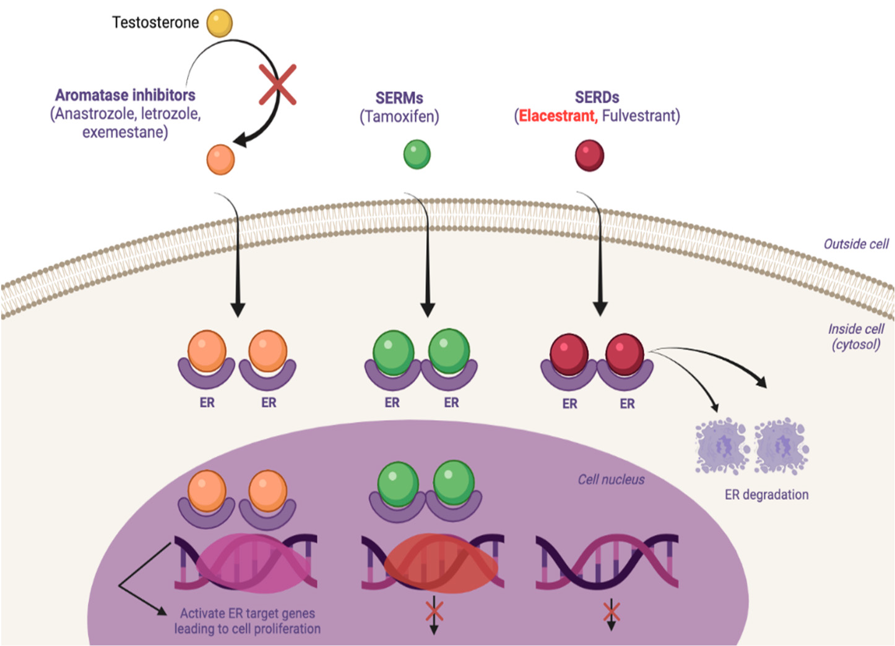
Mechanism of Action of Different Endocrine Therapies
(Eg, fulvestrant, elacestrant, camizestrant)
Hernando C et al. Int J Mol Sci 2021;22:7812.

Slide 35
Oral Selective Estrogen Receptor Degraders (SERDs) in the Management of HR-Positive mBC
Dr Burstein
Boston, Massachusetts
Dr Jhaveri
New York, New York
Prevalence of ESR1 mutations in HR-positive mBC; optimal timing and approach to testing
Major findings with elacestrant versus endocrine monotherapy for pretreated HR-positive, HER2-negative mBC; outcomes among patients with and without ESR1 mutations
FDA approval of elacestrant for postmenopausal patients with HR-positive, HER2-negative mBC with an ESR1 mutation; optimal incorporation into current management algorithms
Available findings with and ongoing evaluation of other oral SERDs, such as camizestrant and imlunestrant, alone and in combination with other systemic therapies for advanced HR-positive, HER2-negative breast cancer

Slide 36
Elacestrant
Mechanism of action
Oral SERD (selective estrogen receptor degrader)
Indication
For postmenopausal women or adult men with ER-positive, HER2-negative, advanced or metastatic breast cancer with an ESR1 mutation and disease progression after at least 1 line of endocrine therapy
Recommended dose
One 345-mg tablet po qd, with food
Elacestrant package insert, 11/2023.

Slide 37
Camizestrant
Mechanism of action
Oral SERD
Indication
Investigational
Key clinical trial
Phase II SERENA-2 trial evaluating camizestrant in postmenopausal women with locally advanced or metastatic ER-positive, HER2-negative breast cancer previously treated with endocrine therapy
Oliveira M et al. SABCS 2022;Abstract GS3-02.
Notes:
Phase II

Slide 38
Imlunestrant
Mechanism of action
Oral SERD
Indication
Investigational
Key clinical trial
Phase Ia/Ib EMBER trial evaluating imlunestrant monotherapy for patients with ER-positive, HER2-negative advanced breast cancer
Phase III EMBER-3 trial evaluating imlunestrant, investigator’s choice of endocrine therapy, and imlunestrant with abemaciclib for patients with ER-positive, HER2-negative advanced breast cancer
Jhaveri KL et al. JCO 40, 1021-1021(2022). Jhaveri K et al. SABCS 2021;Abstract OT2-11-01.

Slide 39
Tolerability/Toxicity Profile of Oral SERDs
Dr Burstein
Boston, Massachusetts
Dr Jhaveri
New York, New York
Spectrum and incidence of common adverse events observed with oral SERDs; comparative side-effect profiles of approved and investigational agents in this class
Pathophysiology of the hyperlipidemia observed with elacestrant; optimal monitoring of lipid profiles and other laboratory values in patients receiving oral SERDs
Recommended prophylaxis for and management of GI toxicities associated with elacestrant
Strategies to encourage adherence among patients with HR-positive, HER2-negative mBC receiving oral SERDs

Slide 40
Melissa Rikal, FNP-BC, AOCNP
What I tell my patients about to begin treatment with elacestrant

Slide 41
Agenda
Introduction
Module 1: The Utility of Genomic Assays in Treatment Decision-Making for HR-Positive, HER2-Negative Localized Breast Cancer
Module 2: The Role of CDK4/6 Inhibitors in Therapy for HR-Positive Breast Cancer
Module 3: Oral Selective Estrogen Receptor Degraders (SERDs) in the Management of HR-Positive Metastatic Breast Cancer (mBC)
Module 4: Alpelisib and Capivasertib in Treatment for HR-Positive mBC

Slide 42
Role of Alpelisib in Treatment for HR-Positive mBC
Dr Burstein
Boston, Massachusetts
Dr Jhaveri
New York, New York
Prevalence of PIK3CA mutations in HR-positive mBC; published research findings with alpelisib-based therapy in this population
Optimal incorporation of alpelisib-based therapy into current management algorithms
Incidence and severity of common toxicities associated with alpelisib, such as hyperglycemia, GI-related adverse events (AEs) and cutaneous AEs
Appropriate strategies to monitor for, prevent and manage alpelisib-related toxicities

Slide 43
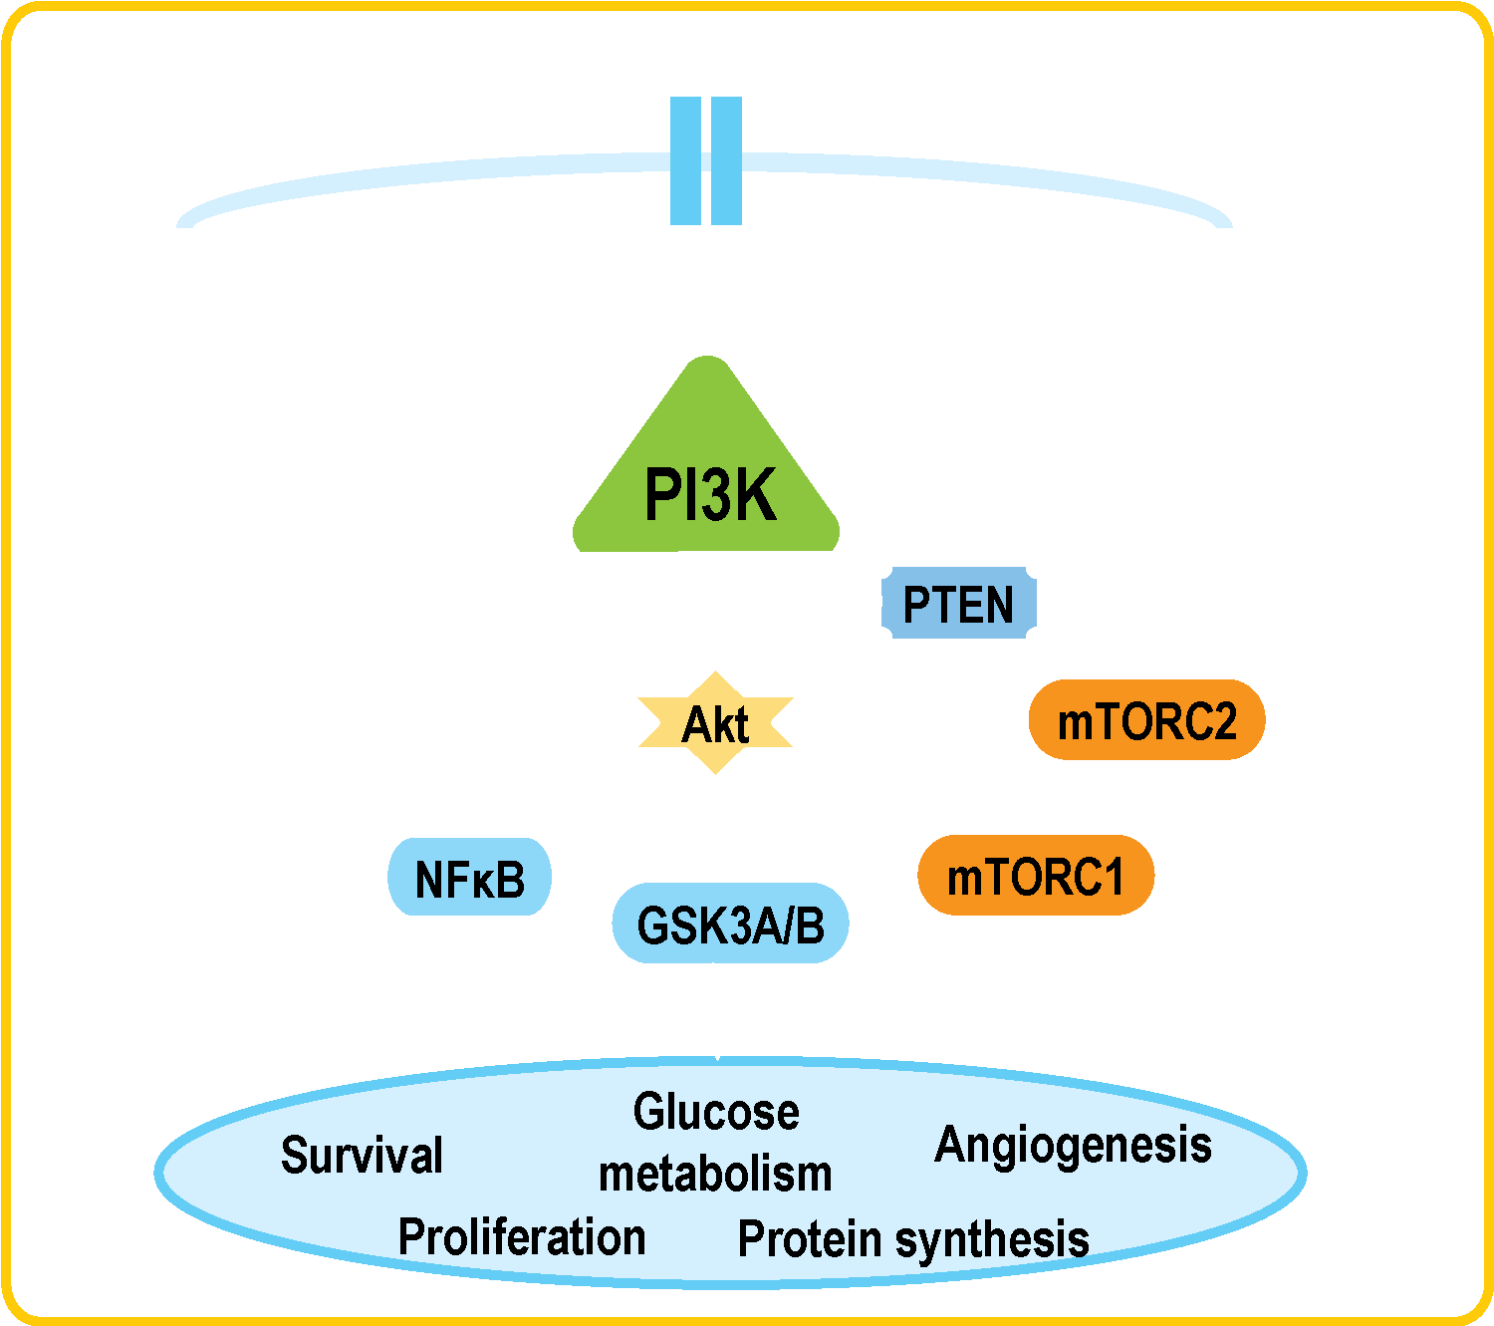
PI3 Kinase Inhibitors: Mechanism of Action
PI3K is involved in the activation of AKT.
Hyperactivation of the PI3K pathway is implicated in malignant transformation, cancer progression and endocrine therapy resistance.
PIK3CA encodes the alpha isoform of the PI3K catalytic subunit.
Around 40% of patients with HR-positive, HER2-negative breast cancer present with an activating PIK3CA tumor mutation.
Alpelisib is a specific inhibitor of the PI3K alpha isoform.
André F et al. ESMO 2018;Abstract LBA3_PR.

Slide 44
Alpelisib
Mechanism of action
PI3K inhibitor
Indication
In combination with fulvestrant for adults with HR-positive, HER2-negative, PIK3CA-mutated advanced or metastatic breast cancer as detected by an FDA-approved test after disease progression on or after an endocrine-based regimen
Recommended dose
300 mg (two 150-mg tablets) taken orally once daily with food
Alpelisib package insert, 1/2024.

Slide 45
Kelly Fischer, MSN, FNP-BC
What I tell my patients about to begin treatment with alpelisib

Slide 46
Inavolisib Combination Reduces the Risk of Disease Progression by 57% in People With Advanced Hormone Receptor-Positive, HER2-Negative Breast Cancer With a PIK3CA Mutation Press Release – December 8, 2023
“[The manufacturer] presented today positive results from the Phase III INAVO120 study evaluating inavolisib in combination with palbociclib and fulvestrant as a first-line treatment for people with PIK3CA-mutated, hormone receptor (HR)-positive, HER2-negative, endocrine-resistant, locally advanced or metastatic breast cancer.
The inavolisib combination reduced the risk of disease worsening or death (progression-free survival; PFS) by 57% compared to palbociclib and fulvestrant alone. The benefit was consistent across subgroups. Overall survival (OS) data were immature at this time, but a clear positive trend has been observed. Follow-up for OS will continue to the next analysis. Data available for other secondary endpoints at this analysis showed clinically meaningful increases in objective response rate, duration of response and clinical benefit rate.
The inavolisib combination was well tolerated and adverse events were consistent with the known safety profiles of the individual study treatments, with no new safety signals observed.
Inavolisib, an investigational oral therapy, is currently being investigated in three Phase III clinical studies in people with PIK3CA-mutated locally advanced or metastatic breast cancer (INAVO120, INAVO121, INAVO122). Data from the INAVO120 study will be submitted to health authorities with the view of bringing this potential treatment option to patients as soon as possible.”
https://finance.yahoo.com/news/genentech-inavolisib-combination-reduces-risk-164500740.html

Slide 47
Capivasertib and Its Use in the Management of HR-Positive mBC
Dr Burstein
Boston, Massachusetts
Dr Jhaveri
New York, New York
Biological rationale for inhibiting AKT in HR-positive mBC; mechanism of action of capivasertib
Key efficacy and safety data with capivasertib/fulvestrant for recurrent HR-positive, HER2-negative mBC
FDA approval of capivasertib/fulvestrant for patients with HR-positive, HER2-negative locally advanced or metastatic breast cancer with 1 or more PIK3CA/AKT1/PTEN alterations who experience disease progression on at least 1 endocrine-based regimen in the metastatic setting or recurrence on or within 12 months of completing adjuvant therapy
Optimal approach to PIK3CA/AKT1/PTEN testing and integration of capivasertib/fulvestrant into current treatment algorithms

Slide 48
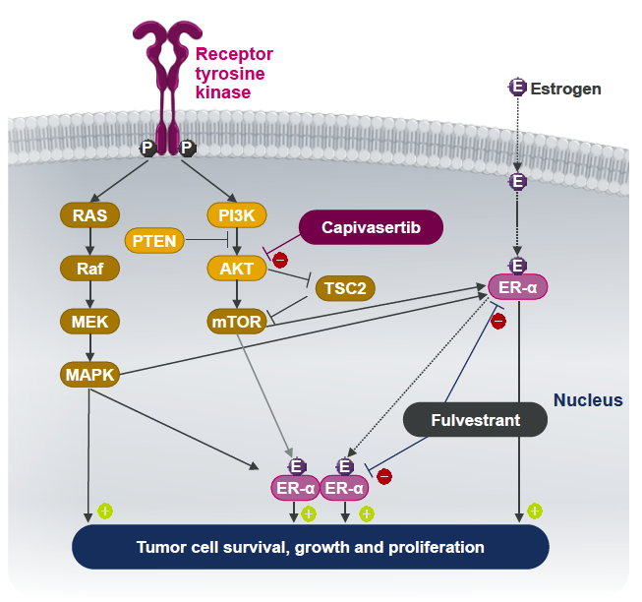
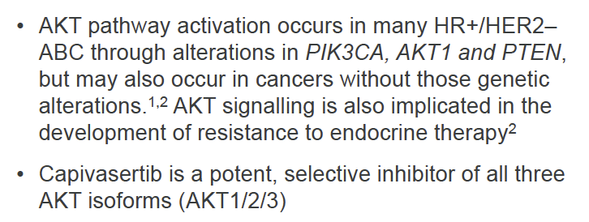
Capivasertib Mechanism of Action
Turner NC et al. SABCS 2022;Abstract GS3-04.

Slide 49
Capivasertib
Mechanism of action
AKT inhibitor
Indication
In combination with fulvestrant for patients with HR-positive, HER2-negative locally advanced or metastatic breast cancer with 1 or more PIK3CA/AKT1/PTEN alterations, as detected by an FDA-approved test, after disease progression on at least 1 endocrine-based regimen in the metastatic setting or recurrence on or within 12 months of completing adjuvant therapy
Recommended dose
400 mg PO BID, with or without food, for 4 days followed by 3 days off
Capivasertib package insert, 11/2023.

Slide 50
FDA Approves Capivasertib with Fulvestrant for Breast Cancer Press Release – November 16, 2023
“… the Food and Drug Administration approved capivasertib with fulvestrant for adult patients with hormone receptor (HR)-positive, human epidermal growth factor receptor 2 (HER2)-negative locally advanced or metastatic breast cancer with one or more PIK3CA/AKT1/PTEN-alterations, as detected by an FDA-approved test, following progression on at least one endocrine-based regimen in the metastatic setting or recurrence on or within 12 months of completing adjuvant therapy.
FDA also approved the FoundationOne®CDx assay as a companion diagnostic device to identify patients with breast cancer for treatment with capivasertib with fulvestrant.
Efficacy was evaluated in CAPItello-291 (NCT04305496), a randomized, double-blind, placebo-controlled, multicenter trial in 708 patients with locally advanced or metastatic HR-positive, HER2-negative breast cancer, of which 289 patients had tumors with PIK3CA/AKT1/PTEN-alterations. All patients were required to have progression on aromatase inhibitor-based treatment. Patients could have received up to two prior lines of endocrine therapy and up to 1 line of chemotherapy for locally advanced or metastatic disease.”
https://www.fda.gov/drugs/resources-information-approved-drugs/fda-approves-capivasertib-fulvestrant-breast-cancer

Slide 51
Side Effects and Other Practical Considerations with Capivasertib
Dr Burstein
Boston, Massachusetts
Dr Jhaveri
New York, New York
Spectrum, frequency and severity of toxicities associated with capivasertib
Incidence of hyperglycemia in patients receiving capivasertib; indications for blood glucose monitoring and role, if any, in treatment for those with preexisting diabetes
Recommending monitoring and treatment strategies for patients experiencing diarrhea while receiving capivasertib
Pathophysiology, spectrum and optimal treatment of cutaneous adverse reactions with capivasertib
Dose, schedule and recommended approach to dose reductions with capivasertib

Slide 52
Melissa Rikal, FNP-BC, AOCNP
What I tell my patients about to begin treatment with capivasertib

Slide 53
Optimal Implementation of Antibody-Drug Conjugates Thursday, April 25, 2024 12:15 PM – 1:45 PM
What I Tell My Patients: Integrating New Research Information into Current Clinical Care
A Complimentary NCPD Hybrid Symposium Series Held During the 49th Annual ONS Congress
Faculty
Jamie Carroll, APRN, MSN, CNP
Kelly EH Goodwin, MSN, RN, ANP-BC
Erika Hamilton, MD
Hope S Rugo, MD
Moderator
Neil Love, MD

Slide 54
Consulting Nursing Faculty Comments
Preventing professional burnout
Jessica Mitchell, APRN, CNP, MPH

