Slide 1
Therapeutic Approaches for Patients with Other Actionable Genomic Alterations
Gregory J Riely, MD, PhD
Attending
Memorial Sloan Kettering Cancer Center
New York, New York

Slide 2
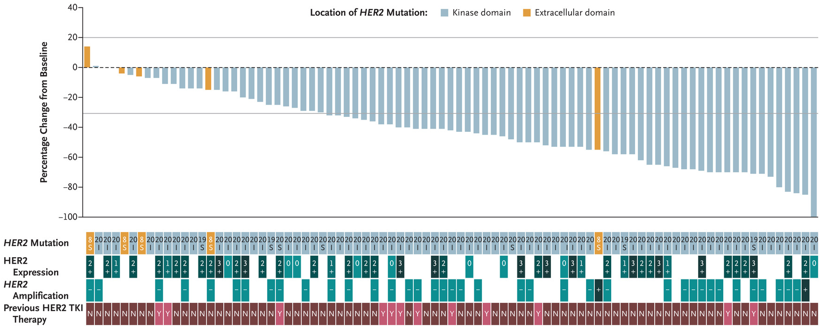
Trastuzumab deruxtecan in patients with HER2 (ERBB2) mutant NSCLC
confirmed response rate
55% (95% CI 44-65)
Li BT et al. Trastuzumab deruxtecan in HER2-mutant non-small-cell lung cancer. N Engl J Med 2022;386(3):241-51.

Slide 3
Trastuzumab deruxtecan in patients with HER2 (ERBB2) mutant NSCLC
Li BT et al. Trastuzumab deruxtecan in HER2-mutant non-small-cell lung cancer. N Engl J Med 2022;386(3):241-51.

Slide 4
Trastuzumab deruxtecan in patients with HER2 (ERBB2) mutant NSCLC
Identifying HER2 mutations in patients with NSCLC leads to a targeted therapy option
In the setting of patients with previously-treated HER2 mutant NSCLC, trastuzumab deruxtecan has reasonable efficacy as evaluated by response rate and progression-free survival
Li BT et al. Trastuzumab deruxtecan in HER2-mutant non-small-cell lung cancer. N Engl J Med 2022;386(3):241-51.

Slide 5
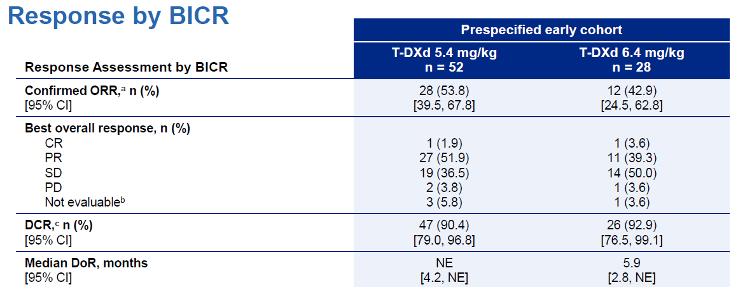
What’s the right dose of trastuzumab deruxtecan?
Goto K et al. Trastuzumab deruxtecan in patients with HER2-mutant metastatic non-small cell lung cancer: Interim results from the Phase II DESTINY-Lung02 trial. ESMO 2022;Abstract LBA55.

Slide 6
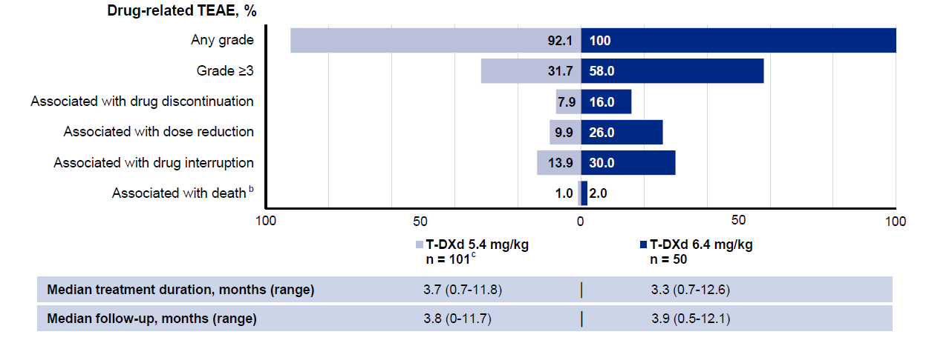
What’s the right dose of trastuzumab deruxtecan?
Goto K et al. Trastuzumab deruxtecan in patients with HER2-mutant metastatic non-small cell lung cancer: Interim results from the Phase II DESTINY-Lung02 trial. ESMO 2022;Abstract LBA55.

Slide 7
What’s the right dose of trastuzumab deruxtecan?
Both 5.4 mg/kg and 6.4 mg/kg have efficacy in patients with previously-treated HER2 mutant NSCLC
There was no clear increase in efficacy with the higher dose.
There was a lower incidence of ILD and other adverse events with the 5.4 mg/kg dose
“The totality of the evidence and a compelling positive benefit-risk balance supported the FDA’s approval of T-DXd 5.4 mg/kg as the first HER2-targeted treatment for patients with previously treated HER2m NSCLC and support the establishment of T-DXd as a new SoC in this population”
Goto K et al. Trastuzumab deruxtecan in patients with HER2-mutant metastatic non-small cell lung cancer: Interim results from the Phase II DESTINY-Lung02 trial. ESMO 2022;Abstract LBA55.

Slide 8
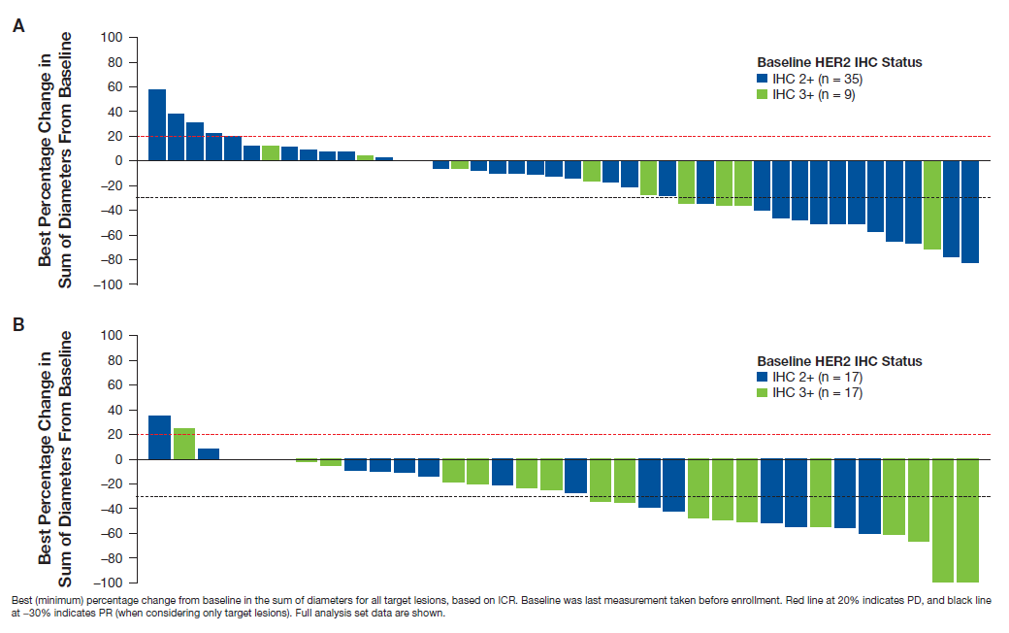
How effective is trastuzumab deruxtecan in patients with HER2 overexpression?
Response Rate
27%
mDOR
5.8 months
6.4 mg/kg
Response Rate
34%
mDOR
6.2 months
5.4 mg/kg
Smit EF et al. Trastuzumab deruxtecan in patients with HER2-overexpressing metastatic non-small cell lung cancer: Results from the DESTINY-Lung01 trial. ESMO 2022;Abstract 975P.

Slide 9
How effective is trastuzumab deruxtecan in patients with HER2 overexpression?
Trastuzumab deruxtecan has efficacy in patients with HER2 over-expression (HER2 2+ or HER2 3+)
Smit EF et al. Trastuzumab deruxtecan in patients with HER2-overexpressing metastatic non-small cell lung cancer: Results from the DESTINY-Lung01 trial. ESMO 2022;Abstract 975P.

Slide 10
Comparing targeted therapy to chemotherapy in patients with KRAS G12C mutant NSCLC
Improved PFS
No difference in OS
Johnson ML et al. Sotorasib versus docetaxel for previously treated non-small cell lung cancer with KRASG12C mutation: CodeBreaK 200 Phase III study. ESMO 2022;Abstract LBA10.

Slide 11
Comparing targeted therapy to chemotherapy in patients with KRAS G12C mutant NSCLC
Johnson ML et al. Sotorasib versus docetaxel for previously treated non-small cell lung cancer with KRAS G12C mutation: CodeBreaK 200 Phase III study. ESMO 2022;Abstract LBA10.

Slide 12
Comparing targeted therapy to chemotherapy in patients with KRAS G12C mutant NSCLC
Sotorasib is superior to docetaxel based on response rate and primary endpoint of progression free survival
Absence of an improvement in overall survival from use of sotorasib compared with docetaxel suggests benefits may be fleeting
Toxicity of sotorasib is superior to docetaxel
Johnson ML et al. Sotorasib versus docetaxel for previously treated non-small cell lung cancer with KRASG12C mutation: CodeBreaK 200 Phase III study. ESMO 2022;Abstract LBA10.

Slide 13
Adagrasib for the treatment of KRAS G12C mutant NSCLC
Jänne PA et al. Adagrasib in non-small-cell lung cancer harboring a KRASG12C mutation. N Engl J Med 2022;387(2):120-31.

Slide 14
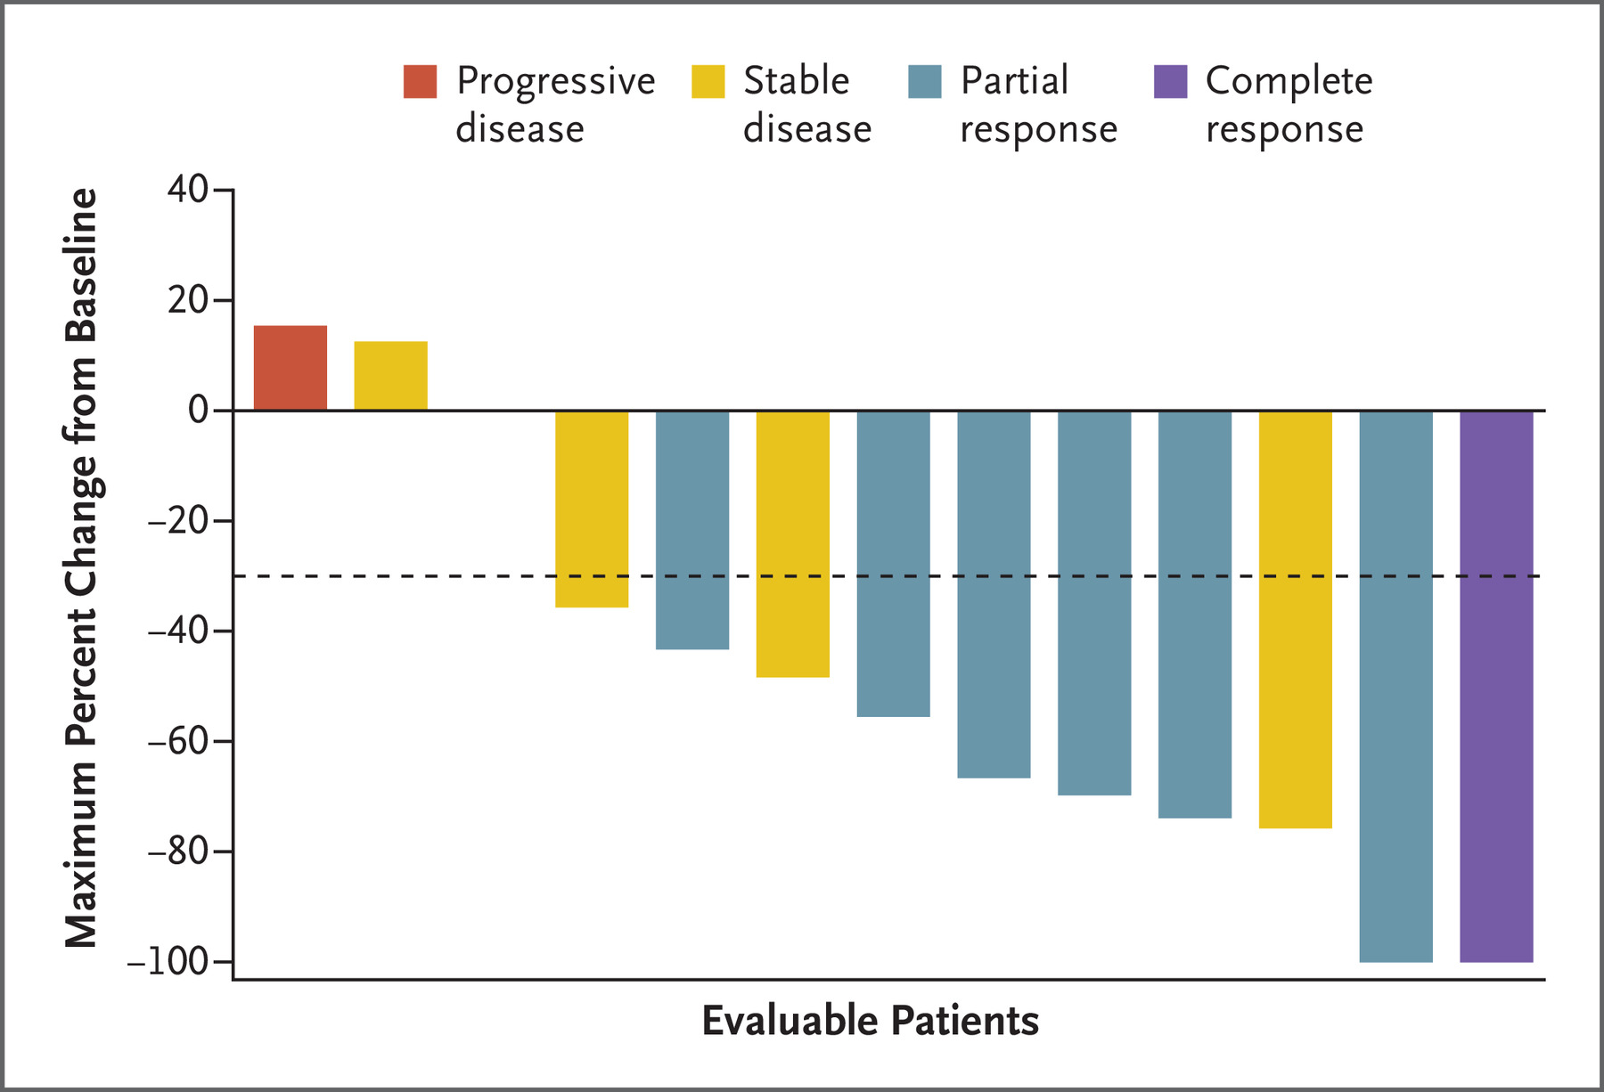
Adagrasib for the treatment of KRAS G12C mutant NSCLC CNS Efficacy
Jänne PA et al. Adagrasib in non-small-cell lung cancer harboring a KRASG12C mutation. N Engl J Med 2022;387(2):120-31.

Slide 15
Adagrasib for the treatment of KRAS G12C mutant NSCLC
Adagrasib is a newly approved drug targeting treatment of NSCLC in patients with KRAS G12C mutations
From single-arm study, similar efficacy to that reported for sotorasib
Provocative data to suggest CNS efficacy for adagrasib in patients with KRAS G12C mutant NSCLC
Jänne PA et al. Adagrasib in non-small-cell lung cancer harboring a KRASG12C mutation. N Engl J Med 2022;387(2):120-31.

Slide 16
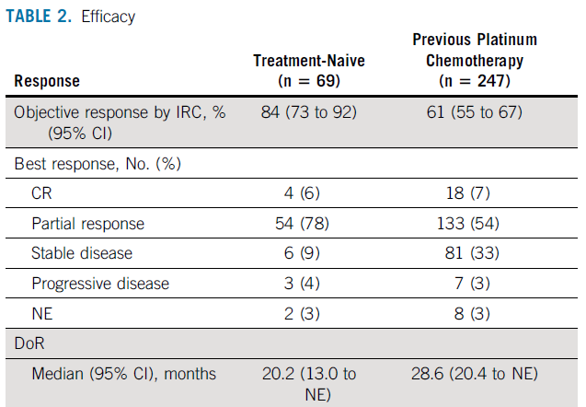
Selpercatinib in RET fusion-positive NSCLC
Modified from Drilon A et al. Selpercatinib in patients with RET fusion-positive non-small-cell lung cancer: Updated safety and efficacy from the registrational LIBRETTO-001 Phase I/II trial. J Clin Oncol 2022;[Online ahead of print].

Slide 17
Selpercatinib in RET fusion-positive NSCLC
Further data to support efficacy of selpercatinib in RET fusion positive NSCLC
Higher response rate in the first-line setting, but other measures of efficacy (PFS, DoR, and OS) are similar
Drilon A et al. Selpercatinib in patients with RET fusion-positive non-small-cell lung cancer: Updated safety and efficacy from the registrational LIBRETTO-001 Phase I/II trial. J Clin Oncol 2022;[Online ahead of print].

Slide 18
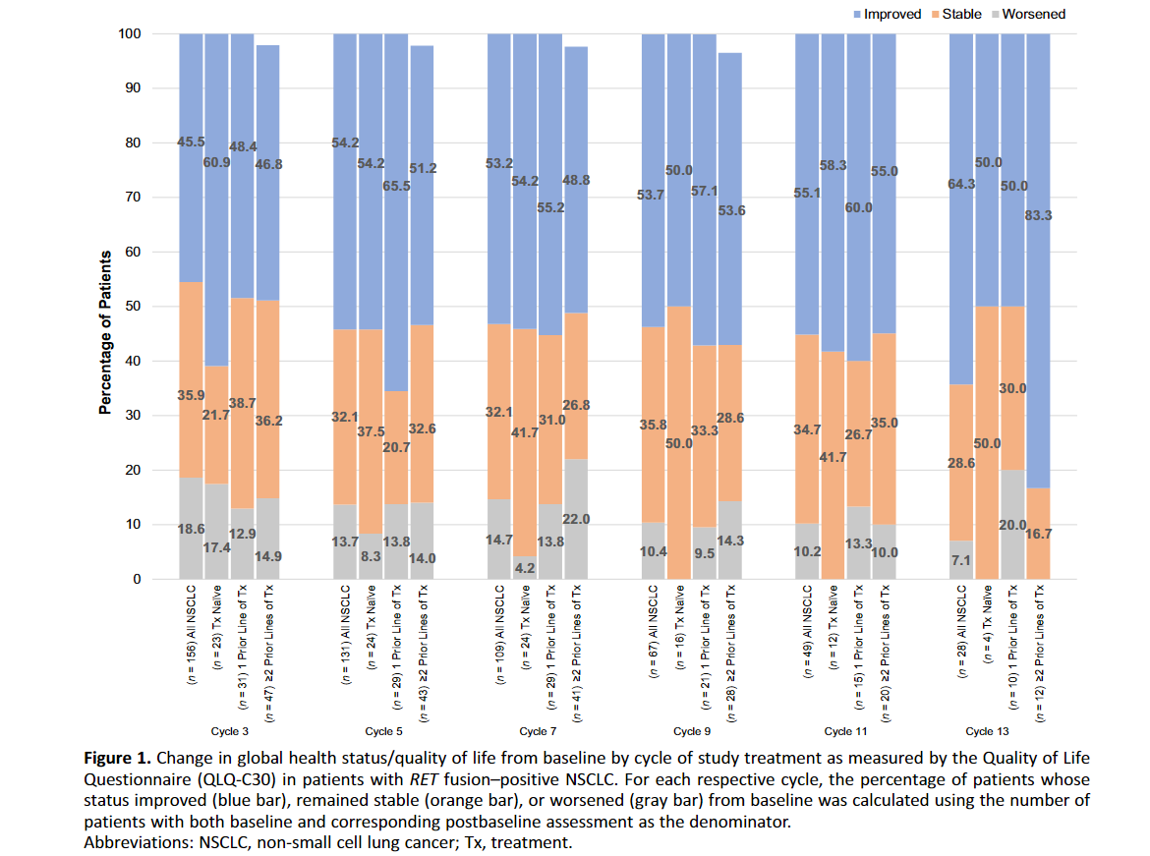
Quality of Life for Selpercatinib in RET fusion- positive NSCLC
Minchom A et al. Patient-reported outcomes with selpercatinib among patients with RET fusion-positive non-small cell lung cancer in the Phase I/II LIBRETTO-001 trial. Oncologist 2022;27(1):22-9.

Slide 19
Quality of Life for Selpercatinib in RET fusion- positive NSCLC
In addition to objective evidence of disease regression, selpercatinib treatment clearly improves quality of life across a range of categories.
Selpercatinib continues to improve quality of life over many cycles of therapy
Minchom A et al. Patient-reported outcomes with selpercatinib among patients with RET fusion-positive non-small cell lung cancer in the Phase I/II LIBRETTO-001 trial. Oncologist 2022;27(1):22-9.

Slide 20
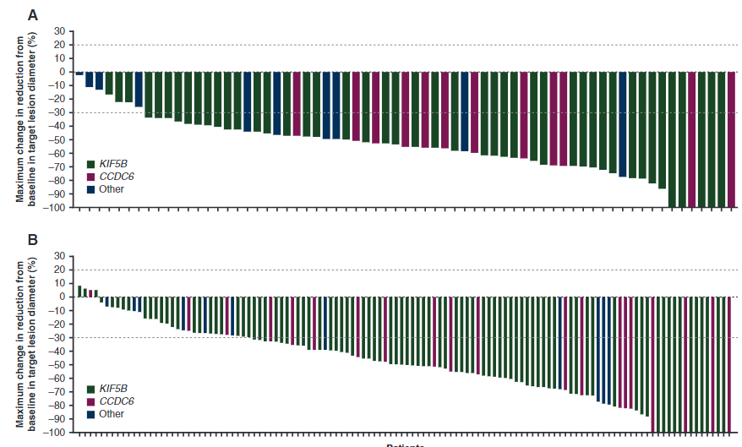
Pralsetinib for treatment of patients with RET fusion-positive NSCLC
First-line
RR- 72%
Prior platinum
RR- 59%
Griesinger F et al. Safety and efficacy of pralsetinib in RET fusion-positive non-small-cell lung cancer including as first-line therapy: Update from the ARROW trial. Ann Oncol 2022;33(11):1168-1178

Slide 21
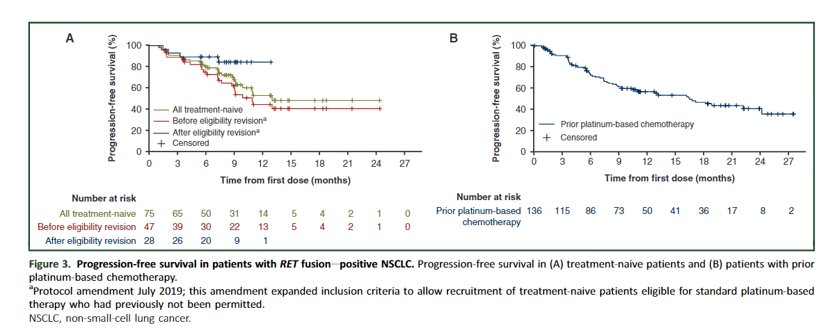
Pralsetinib for treatment of patients with RET fusion-positive NSCLC
Griesinger F et al. Safety and efficacy of pralsetinib in RET fusion-positive non-small-cell lung cancer including as first-line therapy: Update from the ARROW trial. Ann Oncol 2022;33(11):1168-1178

Slide 22
Pralsetinib for treatment of patients with RET fusion-positive NSCLC
Continued evidence of efficacy for pralsetinib in patients with RET fusion-positive NSCLC
Higher response rate observed in first-line therapy suggests upfront testing for patients with NSCLC is critical to identify best therapy up front.
Griesinger F et al. Safety and efficacy of pralsetinib in RET fusion-positive non-small-cell lung cancer including as first-line therapy: Update from the ARROW trial. Ann Oncol 2022;33(11):1168-1178

Slide 23
Tepotinib for MET exon 14 NSCLC
Thomas M et al. Tepotinib in patients with MET exon 14 skipping NSCLC: Primary analysis of the confirmatory VISION cohort C. WCLC 2022;Abstract OA03.05.

Slide 24
Tepotinib for MET exon 14 NSCLC
Thomas M et al. Tepotinib in patients with MET exon 14 skipping NSCLC: Primary analysis of the confirmatory VISION cohort C. WCLC 2022;Abstract OA03.05.

Slide 25
Tepotinib for MET exon 14 NSCLC
Additional efficacy data for tepotinib in patients with MET exon 14 positive NSCLC
Once again see that efficacy data support superiority of first-line use of tepotinib compared with later line therapy in patients with MET exon 14 positive NSCLC
Thomas M et al. Tepotinib in patients with MET exon 14 skipping NSCLC: Primary analysis of the confirmatory VISION cohort C. WCLC 2022;Abstract OA03.05.

Slide 26
Amivantamab in patients with MET exon 14 NSCLC
Krebs M et al. Amivantamab in patients with NSCLC with MET exon 14 skipping mutation: Updated results from the CHRYSALIS study. ASCO 2022;Abstract 9008.

Slide 27
Amivantamab in patients with MET exon 14 NSCLC
In addition to capmatinib and tepotinib, the FDA-approved options for patients with MET exon 14 NSCLC, amivantamab has some efficacy and we look forward to additional data exploring its place in this group of patients.
Very modest efficacy after prior MET-directed therapy.
Krebs M et al. Amivantamab in patients with NSCLC with MET exon 14 skipping mutation: Updated results from the CHRYSALIS study. ASCO 2022;Abstract 9008.

Slide 28
Seribantumab, an anti-HER3 antibody, has efficacy in patients with NRG1 fusions
Carrizosa D et al. CRESTONE: Initial efficacy and safety of seribantumab in solid tumors harboring NRG1 fusions. ASCO 2022;Abstract 3006.

Slide 29
Seribantumab, an anti-HER3 antibody, has efficacy in patients with NRG1 fusions
NRG1 fusions are a rare molecular entity that occur in a range of tumor types. These gene fusions lead to overactivation of the HER3 pathway.
Seribantumab, an anti-HER3 antibody, has clear efficacy in patients with NRG1 fusions with different tumor types (including lung and pancreas) and different fusion partners.
Carrizosa D et al. CRESTONE: Initial efficacy and safety of seribantumab in solid
tumors harboring NRG1 fusions. ASCO 2022;Abstract 3006.

Slide 30
Adagrasib + Pembrolizumab in KRAS G12C mut NSCLC
Jänne et al, Preliminary safety and efficacy of adagrasib with pembrolizumab in patients with advanced non-small cell lung cancer (NSCLC) harboring a KRAS^{G12C} mutation, ESMO IO 12/7/22

Slide 31
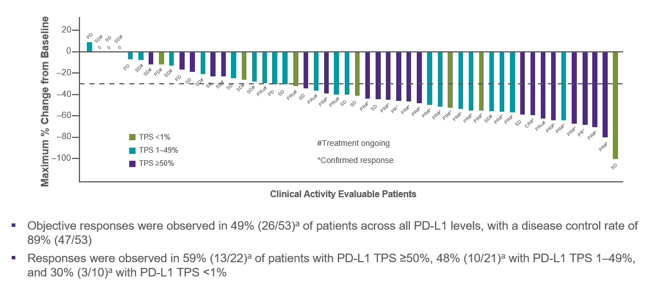
Adagrasib + Pembrolizumab in KRAS G12C mut NSCLC
Jänne et al, Preliminary safety and efficacy of adagrasib with pembrolizumab in patients with advanced non-small cell lung cancer (NSCLC) harboring a KRAS^{G12C} mutation, ESMO IO 12/7/22

Slide 32
Adagrasib + Pembrolizumab in KRAS G12C mut NSCLC
Adagrasib can be safely combined with pembrolizumab in KRAS G12C mutant NSCLC.
This is contrasted with the excess toxicities observed when sotorasib is given with pembrolizumab.
There is no clear efficacy advantage to giving this combination, but further study is ongoing.
Jänne et al, Preliminary safety and efficacy of adagrasib with pembrolizumab in patients with advanced non-small cell lung cancer (NSCLC) harboring a KRAS^{G12C} mutation, ESMO IO 12/7/22

