Slide 1
Year in Review: Webinar Non-Targeted Lung Cancer
Heather Wakelee, MD, FASCO
Professor of Medicine, Oncology
Chief, Division of Medical Oncology
Interim Medical Director, Stanford Cancer Center
Stanford University School of Medicine
Deputy Director, Stanford Cancer Institute
President, International Association for the Study of Lung Cancer (IASLC)

Slide 2
Included Studies
de Castro G Jr et al. Five-year outcomes with pembrolizumab versus chemotherapy as first-line therapy in patients with non-small-cell lung cancer and programmed death ligand-1 tumor proportion score ≥ 1% in the KEYNOTE-042 study. J Clin Oncol 2022;[Online ahead of print].
Özgüroğlu M et al. Three years survival outcome and continued cemiplimab (CEMI) beyond progression with the addition of chemotherapy (chemo) for patients (pts) with advanced non-small cell lung cancer (NSCLC): The EMPOWER-Lung 1 trial. ESMO 2022;Abstract LBA54.
Burotto Pichun M et al. IMscin001 (Part 2: Randomized Phase III): Pharmacokinetics (PK), efficacy and safety of atezolizumab (atezo) subcutaneous (SC) vs intravenous (IV) in previously treated locally advanced or metastatic non-small cell lung cancer (NSCLC). ESMO Immuno-Oncology Congress 2022;Abstract 61MO.
Garassino MC et al. Pembrolizumab plus pemetrexed and platinum in nonsquamous non-small-cell lung cancer: 5-year outcomes from the Phase 3 KEYNOTE-189 study. J Clin Oncol 2023;[Online ahead of print].
Novello S et al. Pembrolizumab plus chemotherapy in squamous non-small-cell lung cancer: 5-year update of the Phase III KEYNOTE-407 study. J Clin Oncol 2023;[Online ahead of print].
Gogishvili M et al. Cemiplimab plus chemotherapy versus chemotherapy alone in non-small cell lung cancer: A randomized, controlled, double-blind phase 3 trial. Nat Med 2022;28(11):2374-80.
Brahmer JR et al. Five-year survival outcomes with nivolumab plus ipilimumab versus chemotherapy as first-line treatment for metastatic non-small-cell lung cancer in CheckMate 227. J Clin Oncol 2023;41(6):1200-12.
Paz-Ares LG et al. First-line (1L) nivolumab (NIVO) + ipilimumab (IPI) + 2 cycles of chemotherapy (chemo) versus chemo alone (4 cycles) in patients (pts) with metastatic non–small cell lung cancer (NSCLC): 3-year update from CheckMate 9LA. ASCO 2022;Abstract LBA9026.
Johnson ML et al. Durvalumab with or without tremelimumab in combination with chemotherapy as first-line therapy for metastatic non-small-cell lung cancer: The Phase III POSEIDON study. J Clin Oncol 2023;41(6):1213-27.
Johnson ML et al. Durvalumab (D) ± tremelimumab (T) + chemotherapy (CT) in 1L metastatic (m) NSCLC: Overall survival (OS) update from POSEIDON after median follow-up (mFU) of approximately 4 years (y). ESMO 2022;Abstract LBA59.
Levy B et al. TROPION-Lung02: Initial results for datopotamab deruxtecan plus pembrolizumab and platinum chemotherapy in advanced NSCLC. WCLC 2022;Abstract MA13.07.
Ricordel C et al. Safety and efficacy of tusamitamab ravtansine (SAR408701) in long-term treated patients with nonsquamous non–small cell lung cancer (NSQ NSCLC) expressing carcinoembryonic antigen-related cell adhesion molecule 5 (CEACAM5). ASCO 2022;Abstract 9039.
Besse B et al. HUDSON: An open-label, multi-drug, biomarker-directed, Phase II platform study in patients with NSCLC, who progressed on anti-PD(L)1 therapy. WCLC 2022;Abstract OA15.05.
Novocure announces pivotal LUNAR Study in non-small cell lung cancer met primary overall survival endpoint [press release]. Available at https://www.novocure.com/novocure-announces-pivotal-lunar-study-in-non-small-cell-lung-cancer-met-primary-overall-survival-endpoint/.
Kotecha R et al. KEYNOTE B36: A pilot study of first-line tumor treating fields (150 kHz) plus pembrolizumab for advanced or metastatic NSCLC. WCLC 2022;Abstract EP08.01-076.
Lee SM et al. IPSOS (Phase 3): First-line atezolizumab vs single-agent chemotherapy in patients with NSCLC (non-platinum eligible). ESMO 2022;Abstract LBA11.

Slide 3
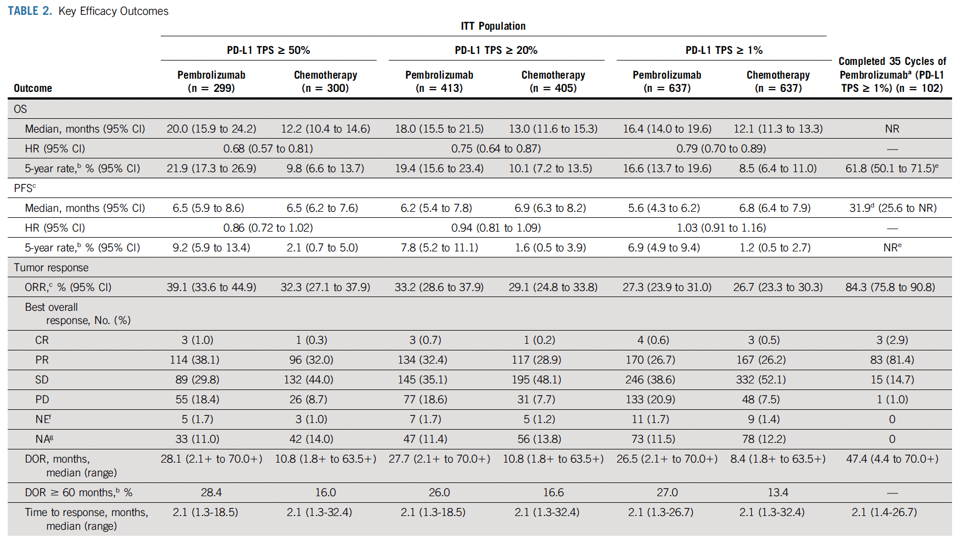
de Castro G Jr et al. Five-year outcomes with pembrolizumab versus chemotherapy as first-line therapy in patients with non-small-cell lung cancer and programmed death ligand-1 tumor proportion score ≥ 1% in the KEYNOTE-042 study. J Clin Oncol 2022
Long term benefit (~20% survival at 5 years),
Most benefit seen in pts with tumors with high PD-L1

Slide 4
Özgüroğlu M et al. Three years survival outcome and continued cemiplimab (CEMI) beyond progression with the addition of chemotherapy (chemo) for patients (pts) with advanced non-small cell lung cancer (NSCLC): The EMPOWER-Lung 1 trial. ESMO 2022;Abstract LBA54. EMPOWER-Lung 1: Continued cemiplimab beyond progression
Treatment Period 1
Treatment Period 2
Key eligibility
Treatment-naïve advanced NSCLC
PD-L1 ≥50%
No EGFR, ALK or ROS1 mutations
ECOG PS 0 or 1
Treated, clinically stable CNS metastases and controlled hepatitis B or C or HIV were allowed
Arm A
Cemiplimab monotherapy IV 350 mg Q3W Treat until PD or 108 weeks
PD
Optional continuation of cemiplimab until progression + 4 cycles of chemotherapy
Primary endpoints:
OS
PFS
Secondary endpoints:
ORR (key)
DOR
HRQoL
Safety
R 1:1
Follow-up
Arm B
4–6 cycles of investigator’s choice chemotherapy
PD
Optional crossover to cemiplimab monotherapy
*Stratification factors
Histology (squamous vs non-squamous)
Region (Europe, Asia or ROW)

Slide 5
Özgüroğlu M et al. Three years survival outcome and continued cemiplimab (CEMI) beyond progression with the addition of chemotherapy (chemo) for patients (pts) with advanced non-small cell lung cancer (NSCLC): The EMPOWER-Lung 1 trial. ESMO 2022;Abstract LBA54.
1.0
3-year OS
ITT: 3-year OS
 | Cemiplimab (n=357) | Chemotherapy (n=355)
Median OS, months (95% CI) | 23.4 (19.4, 27.4) | 13.7 (11.2, 16.2)
HR (95% CI) | 0.63 (0.52, 0.77); P=0.0001
0.9
0.8
0.7
0.6
Probability of survival
0.5
0.4
0.3
0.2
0.1
0.0
0
2
4
6
8
10
12
14
16
18
20
22
24
26
28
30
32
34
36
38
40
42
44
46
48
50
52
54
56
Patients-at-Risk
Month
Cemiplimab
357
321
286
269
254
229
215
202
190
179
169
159
147
130
110
103
88
63
52
36
29
23
21
13
10
6
1
1
0
Chemotherapy
355
318
278
242
211
182
160
143
126
117
106
95
88
78
69
60
51
39
35
29
22
17
11
6
4
2
1
0
0
1.0
3-year PFS
0.9
ITT: 3-year PFS
 | Cemiplimab (n=357) | Chemotherapy (n=355)
Median PFS, months (95% CI) | 6.3 (4.6, 8.3) | 5.3 (4.3, 6.0)
HR (95% CI) | 0.56 (95% CI, 0.47-0.67); P=0.0001
0.8
0.7
0.6
Probability of PFS
0.5
0.4
0.3
0.2
0.1
0.0
0
2
4
6
8
10
12
14
16
18
20
22
24
26
28
30
32
34
36
38
40
42
44
46
48
50
52
54
56
Patients-at-Risk
Month
Cemiplimab
357
295
229
183
158
134
128
110
98
93
88
82
77
69
60
52
43
29
20
12
9
6
5
2
1
0
0
0
0
Chemotherapy
355
296
222
147
67
41
21
17
13
12
8
8
7
7
6
5
2
2
2
1
1
1
1
0
0
0
0
0
0

Slide 6
Özgüroğlu M et al. Three years survival outcome and continued cemiplimab (CEMI) beyond progression with the addition of chemotherapy (chemo) for patients (pts) with advanced non-small cell lung cancer (NSCLC): The EMPOWER-Lung 1 trial. ESMO 2022;Abstract LBA54.
Tumor response
 | Cemiplimab beyond progression n=64
 | Period 1 | Period 2
Objective Response Rate (ORR: CP+PR), n (%) 95% CI for ORR (range %) | 19 (29.7) (18.9, 42.4) | 20 (31.3) (20.2, 44.1)
Best overall tumor response, n (%) CR PR SD Non-CR/Non-PD PD NE | 0 19 (29.7) 28 (43.8) 0 13 (20.3) 4 (6.3) | 3 (4.7) 17 (26.6) 35 (54.7) 0 9 (14.1) 0
PFS
 | Cemiplimab beyond progression n=64
 | Period 1 | Period 2
Median (95% CI, months) | 6.2 (4.2, 8.2) | 6.6 (6.1, 9.3)
Estimated event-free probability, % (95% CI) 6 months 12 months 18 months 24 months | 50.7 (37.0, 62.9) 24.1 (13.3, 36.6) 0 (NE, NE) 0 (NE, NE) | 66.2 (53.0, 76.5) 31.2 (19.5, 43.7) 15.7 (7.2, 27.2) 8.4 (2.0, 20.7)
OS
 | Cemiplimab beyond progression n=64
 | Period 1+2 randomization to death | Period 2 Day 1 of continued treatment to death
Median, months (95% CI) | 27.4 (23.0, 31.8)ª | 15.1 (11.3, 18.7)
Estimated event-free probability, % (95% CI) 6 months 12 months 18 months 24 months | 100 (NE, NE) 91.8 (81.4, 96.5) 60.5 (46.6, 71.8) 32.3 (20.1, 45.1) | 91.9 (81.6, 96.5) 56.8 (43.0, 68.5) 26.2 (14.3, 39.8) NE (NE, NE)
This study confirms ongoing benefit and the benefit of addition of chemotherapy, but does not demonstrate that continued cemiplimab is beneficial
ªIncludes the 15.1 months of survival beyond progression

Slide 7
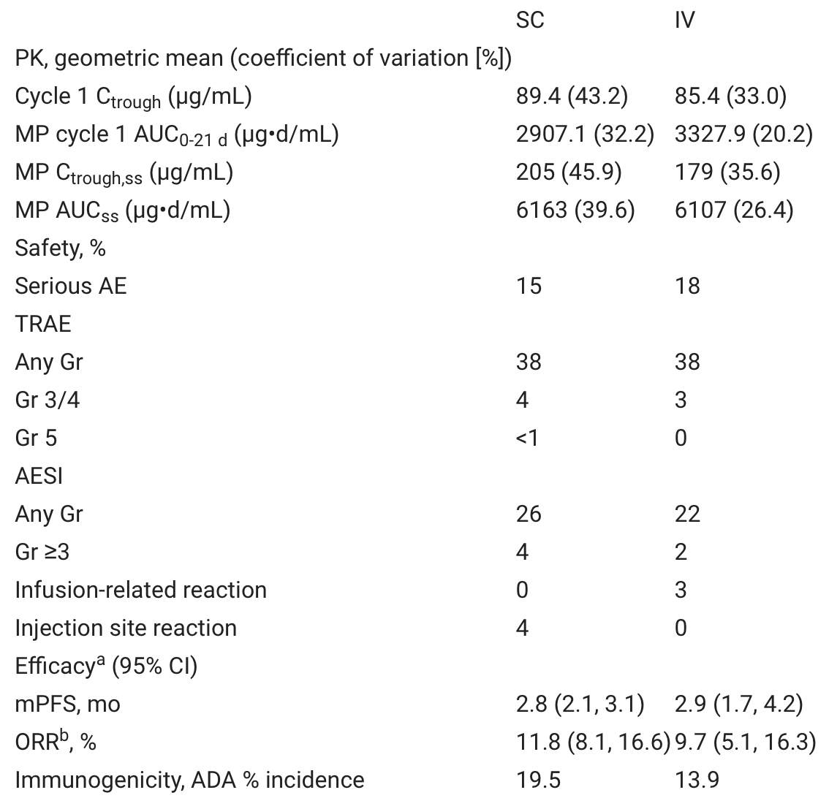
Burotto Pichun M et al. IMscin001 (Part 2: Randomized Phase III): Pharmacokinetics (PK), efficacy and safety of atezolizumab (atezo) subcutaneous (SC) vs intravenous (IV) in previously treated locally advanced or metastatic non-small cell lung cancer (NSCLC). ESMO Immuno-Oncology Congress 2022;Abstract 61MO
Novel fixed-dose atezo SC co-formulated with recombinant human hyaluronidase
Open-label, randomized, multicentre IMscin001 study (NCT03735121) to investigate non-inferiority of drug exposure at Cycle 1 after atezo SC vs IV administration in NSCLC.
Randomised 2:1 to receive 2L atezo SC (1875 mg) or IV (1200 mg) every 3 weeks.
247 vs 124 patients in the atezo SC and IV arms, respectively. Efficacy, immunogenicity and safety were similar between arms ªOS and DoR showed similar trends
Atezo SC demonstrated non-inferior exposure vs IV for both co-primary PK endpoints. Efficacy and safety were similar between arms and consistent with the known atezo IV profile; atezo immunogenicity was comparable between arms and within the historical range for atezo IV across indications. These results support atezo SC as an alternative to IV.
SC option has promise of reduced cost, home administration, broader distribution

Slide 8
Garassino MC et al. Pembrolizumab plus pemetrexed and platinum in nonsquamous non-small-cell lung cancer: 5-year outcomes from the Phase 3 KEYNOTE-189 study. J Clin Oncol 2023
62.1
80
60
40
48.3
n=132
50.0
100
20
33.1
n=278
25.7
n=128
Tumor response
19.9
20.7
n=127
14.3
ORR (%)
n=70
n=281
n=58
n=63
0
DOR^{b} Median (range),^{b} months | ITT |  | PD-L1 TPS ≥50% |  | PD-L1 TPS 1% - 49% |  | PD-L1 TPS <1%
 | Pembro + chemo | Placebo + chemo | Pembro + chemo | Placebo + chemo | Pembro + chemo | Placebo + chemo | Pembro + chemo | Placebo + chemo
DOR^{b} Median (range),^{b} mo | 12.7 (1.1+ to 68.3+) | 7.1 (2.4 to 31.5) | 15.3 (1.2+ to 68.3+) | 7.1 (3.4 to 31.5) | 13.6 (2.1+ to 67.6+) | 7.6 (2.4 to 31.0+) | 10.8 (1.1 to 59.4+) | 7.8 (4.1 to 28.3+)
OS (ITT population)
PFS (ITT population)
100
 | Pembro + chemo | Placebo + chemo
Events, n (%) | 329 (80.2) | 183 (88.8)
Median , months (95% CI) | 22.0 (19.5, 24.5) | 10.6 (8.7, 13.6)
HR (95% CI) | 0.60 (0.50, 0.72)
 | Pembro + chemo | Placebo + chemo
Events, n (%) | 369 (90.0) | 201 (97.6)
Median , months (95% CI) | 9.0 (8.1, 10.4) | 4.9 (4.7, 5.5)
HR (95% CI) | 0.50 (0.42, 0.60)
69.8% 48.0%
100
80
80
OS (%)
45.7% 27.3%
5-y OS 19.4% 11.3%
39.8% 17.7%
60
60
40
31.3% 17.4%
23.6% 13.8%
PFS (%)
23.1% 4.3%
13.1% 1.9%
5-y PFS 7.5% 0.6%
40
10.2% 1.3%
20
20
0
0
12
24
36
48
60
72
0
0
12
24
36
48
60
72
No. at risk
Time, months
No. at risk
Time, months
Pembro + chemo
410
283
184
126
95
77
0
Pembro + chemo
410
158
91
49
37
21
0
Placebo + chemo
206
96
55
34
27
22
0
Placebo + chemo
208
35
8
3
2
1
0
 | PD-L1 TPS ≥50% | Arm C | PD-L1 TPS 1% - 49% | HR & CI (Arm B : Arm C | PD-L1 TPS <1%
 | Pembro + chemo (n=132) | Placebo + chemo (n=70) | Pembro + chemo (n=128) | Placebo + chemo (n=58) | Pembro + chemo (n=127) | Placebo + chemo (n=63)
OS HR (95% CI) | 0.68 (0.49, 0.96) | 11/24 17/20 | 0.65 (0.46, 0.90) |  | 0.55 (0.39, 0.76)
5-y OS rate^{b}, % | 29.6 | 21.4 | 19.8 | 7.7 | 9.6 | 5.3
 | PD-L1 TPS ≥50% | Arm C | PD-L1 TPS 1% - 49% | HR & CI (Arm B : Arm C | PD-L1 TPS <1%
 | Pembro + chemo (n=132) | Placebo + chemo (n=70) | Pembro + chemo (n=128) | Placebo + chemo (n=58) | Pembro + chemo (n=127) | Placebo + chemo (n=63)
PFS HR (95% CI) | 0.35 (0.25, 0.49) | 11/24 17/20 | 0.57 (0.41, 0.80) |  | 0.67 (0.49, 0.92)
5-y PFS rate^{b}, % | 12.8 | 0 | 6.5 | 1.9 | 2.4 | 0

Slide 9
Garassino MC et al. Pembrolizumab plus pemetrexed and platinum in nonsquamous non-small-cell lung cancer: 5-year outcomes from the Phase 3 KEYNOTE-189 study. J Clin Oncol 2023
t
 | N=57
ORR (95% CI),ª % | 86.0 (74.2, 93.7)
Best overall response, n (%) CR PR | 8 (14.0) 41 (71.9)
Median DOR (range),^{b} months | 57.7 (4.2–68.3)
3-year OS rate after completing 35 cycles^{c} | 71.9%
Alive without PD or subsequent therapy, n (%) | 23 (40.4)
t
t
t
First course follow-up
First course treatment
Second-course pembrolizumab
Began subsequent therapy
CR
PR
SD
PD
Death
0
6
12
18
24
30
36
42
48
54
60
66
72
Time, months
This update confirms long-term benefit of the KN189 regimen including OS, despite crossover
Benefit is seen regardless of PD-L1 level, but best survival in those with high PD-L1
Reporting long term benefit of the long term responders is biased

Slide 10
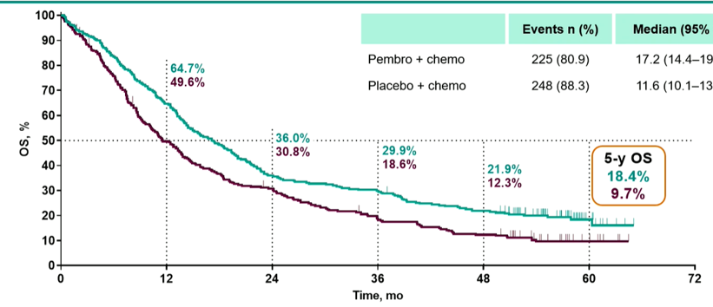
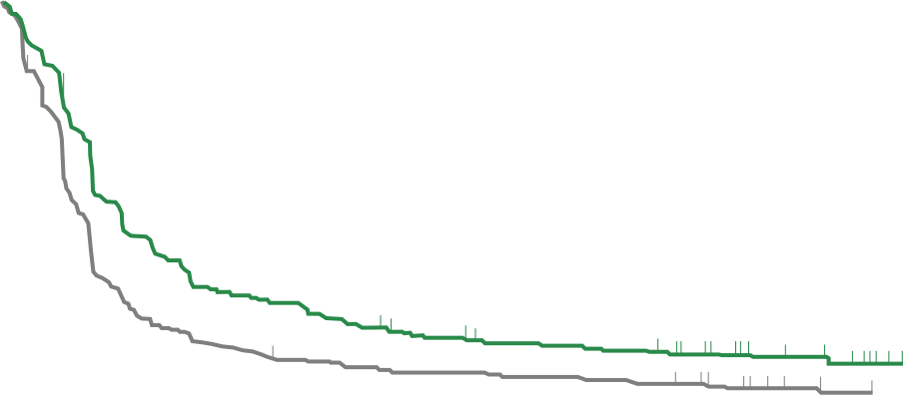
Novello S et al. Pembrolizumab plus chemotherapy in squamous non-small-cell lung cancer: 5-year update of the Phase III KEYNOTE-407 study. J Clin Oncol 2023
100
Tumor response
62.2
64.4
54.4
67.4
ORR (%)
n=278
n=73
43.3
n=95
41.4
80
60
40
20
38.8
30.1
n=103
n=281
n=73
n=104
n=99
0
DOR^{b} Median (range),^{b} months | ITT |  | PD-L1 TPS ≥50% |  | PD-L1 TPS 1% - 49% |  | PD-L1 TPS <1%
 | Pembro + chemo | Placebo + chemo | Pembro + chemo | Placebo + chemo | Pembro + chemo | Placebo + chemo | Pembro + chemo | Placebo + chemo
DOR^{b} Median (range),^{b} mo | 9.0 (1.3–61.5) | 4.9 (1.3–58.6) | 10.4 (2.7–59.4) | 4.6 (1.3–58.6) | 11.1 (1.3– 61.5) | 4.8 (2.0–58.6) | 6.9 (1.4– 58.9) | 5.7 (1.4–55.8)
OS (ITT population)
PFS (ITT population)
 | Pembro + chemo | Placebo + chemo
Events, n (%) | 225 (80.9) | 248 (88.3)
Median , months (95% CI) | 17.2 (14.4, 19.7) | 11.6 (10.1, 13.7)
HR (95% CI) | 0.71 (0.59, 0.85)
 | Pembro + chemo | Placebo + chemo
Events, n (%) | 241 (86.7) | 265 (94.3)
Median , months (95% CI) | 8.0 (6.3, 8.5) | 5.1 (4.3, 6.0)
HR (95% CI) | 0.62 (0.52, 0.74)
100
80
36.3% 19.2%
PFS (%)
60
20.7% 10.1%
5-y PFS 10.8% 3.5%
40
16.1% 7.5%
13.3% 5.6%
20
0
0
12
24
36
48
60
72
No. at risk
No. at risk
Time, months
Pembro + chemo
278
100
56
40
30
7
0
Pembro + chemo
278
100
56
40
30
7
0
Placebo + chemo
281
53
27
20
14
1
0
Placebo + chemo
281
53
27
20
14
1
0
 | PD-L1 TPS ≥50% | Arm C | PD-L1 TPS 1% - 49% | HR & CI (Arm B : Arm C | PD-L1 TPS <1%
 | Pembro + chemo (n = 73) | Placebo + chemo (n = 73) | Pembro + chemo (n = 103) | Placebo + chemo (n = 104) | Pembro + chemo (n = 95) | Placebo + chemo (n = 99)
OS HR (95% CI) | 0.48 (0.33-0.69 | 11/24 17/20 | 0.60 (0.45-0.81) |  | 0.70 (0.52-0.95)
5-y OS rate^{b}, % | 15.0 | NR | 11.8 | NR | 7.1 | 6.7
 | PD-L1 TPS ≥50% | Arm C | PD-L1 TPS 1% - 49% | HR & CI (Arm B : Arm C | PD-L1 TPS <1%
 | Pembro + chemo (n = 73) | Placebo + chemo (n = 73) | Pembro + chemo (n = 103) | Placebo + chemo (n = 104) | Pembro + chemo (n = 95) | Placebo + chemo (n = 99)
PFS HR (95% CI) | 0.48 (0.33-0.69 | 11/24 17/20 | 0.60 (0.45-0.81) |  | 0.70 (0.52-0.95)
5-y PFS rate^{b}, % | 15.0 | NR | 11.8 | NR | 7.1 | 6.7

Slide 11
Novello S et al. Pembrolizumab plus chemotherapy in squamous non-small-cell lung cancer: 5-year update of the Phase III KEYNOTE-407 study. J Clin Oncol 2023
 | n = 55
ORR (95% CI),ª % | 90.9 (80.0, 97.0)
Best overall response, n (%) CR PR | 9 (16.4) 41 (74.5)
Median DOR (range),^{b} months | NR (7.1–61.5)
3-year OS rate after completing 35 cycles^{c} | 69.5%
Alive without PD or subsequent therapy, n (%) | 24 (43.6)
First course follow-up
First course treatment
Second-course pembrolizumab
Began subsequent therapy
CR
PR
SD
PD
Death
0
6
12
18
24
30
36
42
48
54
60
66
72
Time, months
This update confirms long-term benefit of the KN407 regimen including OS, despite crossover
Reporting long term benefit of the long term responders is biased

Slide 12
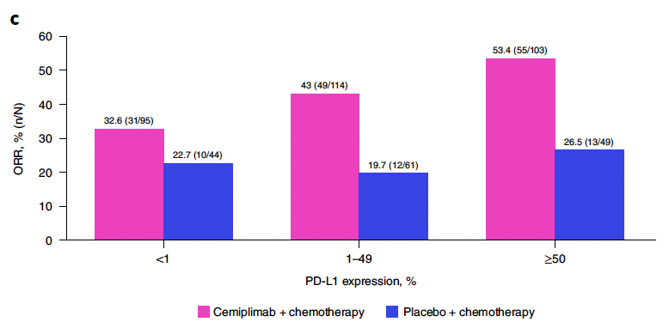
Gogishvili M et al. Cemiplimab plus chemotherapy versus chemotherapy alone in non-small cell lung cancer: A randomized, controlled, double-blind phase 3 trial. Nat Med 2022;28(11):2374-80.
Another positive chemo + IO study, PD-L1 dependent outcomes

Slide 13
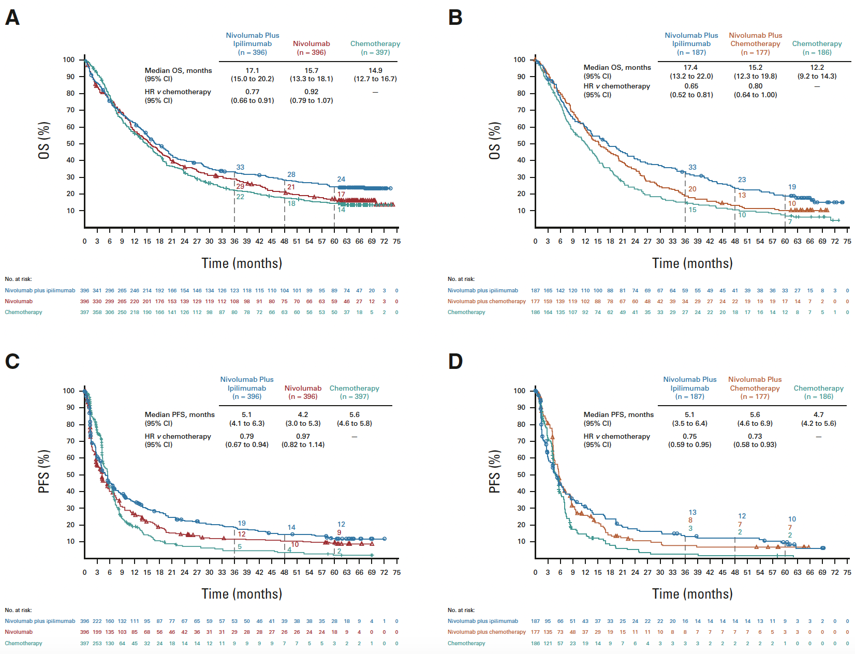
Brahmer JR et al. Five-year survival outcomes with nivolumab plus ipilimumab versus chemotherapy as first-line treatment for metastatic non-small-cell lung cancer in CheckMate 227. J Clin Oncol 2023;41(6):1200-12
PD-L1 >1% 5 yr OS 24% vs 14%
PD-L1 <1% 5 yr OS 19% vs 7%
OS, PFS, and ORR/DOR in randomly assigned patients by tumor PD-L1 expression level. OS in patients with (A) tumor PD-L1 expression > 1% or
(B) tumor PD-L1 expression,<1%; PFS in randomly assigned patients with (C) tumor PD-L1 expression >1%or (D) tumor PD-L1 expression <1%
2/3 of long-term survivors were off therapy
Long term benefit (~20% survival at 5 years),
Benefit seen in pts regardless of tumor PD-L1 levels

Slide 14
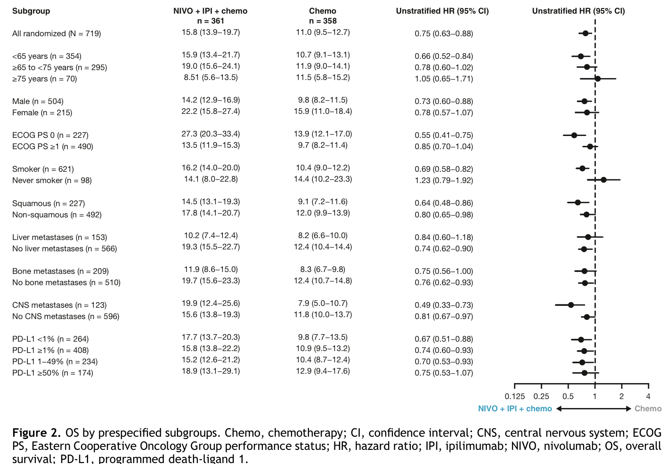
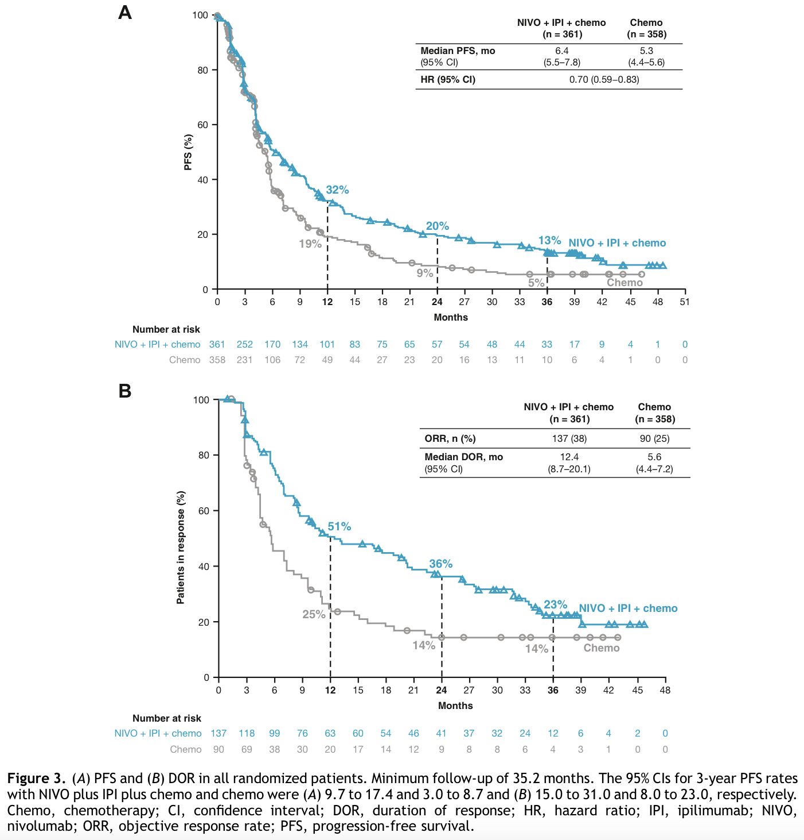
Paz-Ares LG et al. First-line (1L) nivolumab (NIVO) + ipilimumab (IPI) + 2 cycles of chemotherapy (chemo) versus chemo alone (4 cycles) in patients (pts) with metastatic non–small cell lung cancer (NSCLC): 3-year update - CheckMate 9LA ASCO 2022;Abstract LBA9026; JTO 18(2), 2023
OS: 15.8 versus 11.0 mo [0.74; 0.62–0.87]; 3-y OS: 27% versus 19%
Long term benefit seen with 3yr OS 27%
Benefit seen in pts regardless of tumor PD-L1 levels

Slide 15
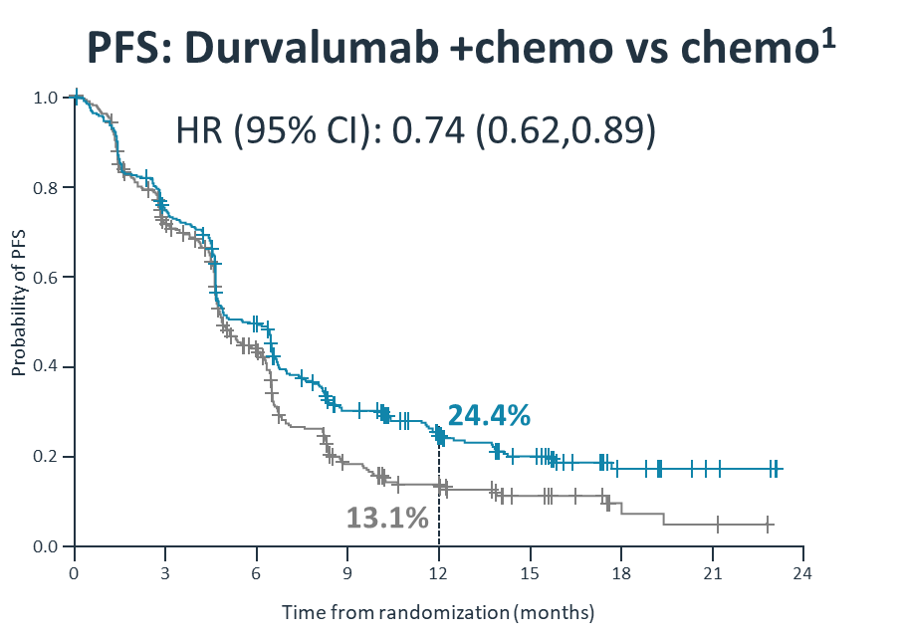
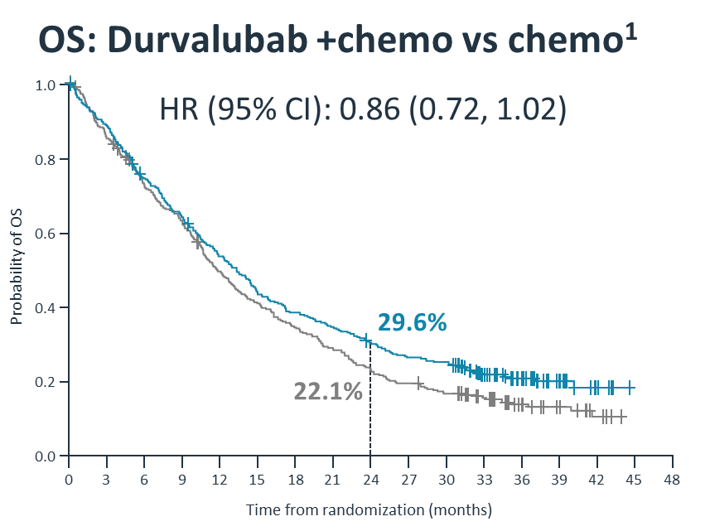
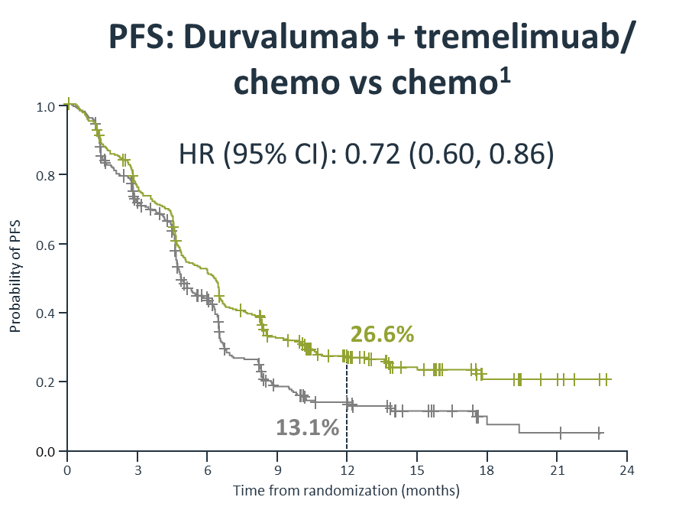
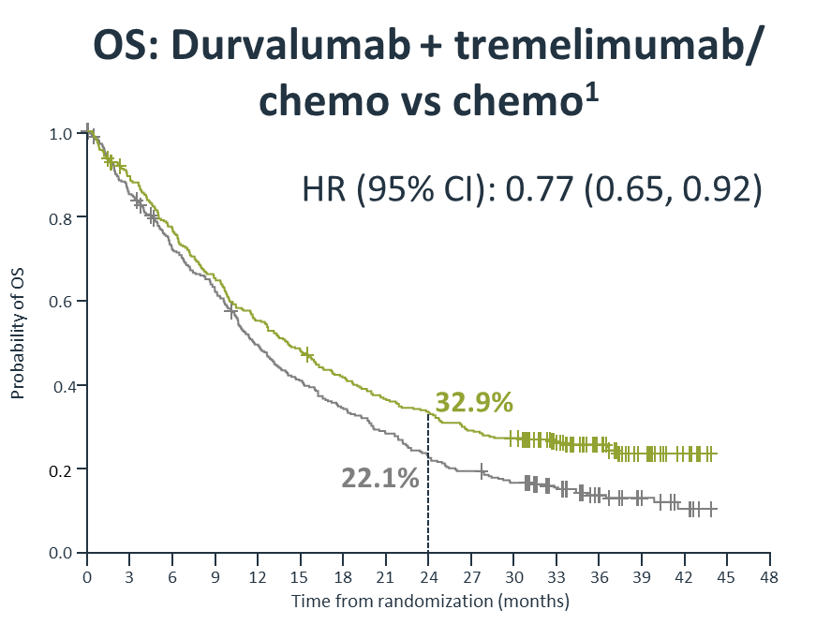
Johnson ML et al. Durvalumab with or without tremelimumab in combination with chemotherapy as first-line therapy for metastatic non-small-cell lung cancer: The Phase III POSEIDON study. J Clin Oncol 2023;41(6):1213-27; ESMO 2022 4 yr survival update LBA59
Durvalumab 1500 mg + CT Q3W (4 cycles) followed by maintenance
N=1013
Key eligibility
Stage IV NSCLC
No EGFR or ALK alterations
Treatment naïve for metastatic disease
ECOG PS 0−1
OS: Durvalumab + chemo vs chemo¹
Durvalumab 1500 mg + tremelimumab 75 mg +CT* Q3W (4 cycles) followed by maintenance
R
1:1:1
Platinum-based CT Q3W (up to 6 cycles) followed by maintenance
PFS: Durvalumab + tremelimumab/ chemo vs chemo¹
Stratification factors
PD-L1 expression
Disease stage
Histology
Primary endpoints:
PFS (BICR)
OS
Key secondary endpoints:
ORR, DoR, BOR
HRQoL Safety
D+C vs C
HR
T+D+C vs C

Slide 16
Johnson ML et al. Durvalumab with or without tremelimumab in combination with chemotherapy as first-line therapy for metastatic non-small-cell lung cancer: The Phase III POSEIDON study. J Clin Oncol 2023;41(6):1213-27; ESMO 2022 4 yr survival update LBA59
T+D+CT vs CT
D+CT vs CT
1.0
 | T + D + CT | CT
Events, n/N | 264/338 (78.1) | 301/337 (89.3)
mOS, months (95% CI) | 14.0 (11.7, 16.1) | 11.7 (10.5, 13.1)
HR* (95% CI) | 0.75 (0.63, 0.88) | –
1.0
 | D+CT | CT
Events, n/N | 276/338 (81.7) | 301/337 (89.3)
mOS, months (95% CI) | 13.3 (11.4, 14.7) | 11.7 (10.5, 13.1)
HR* (95% CI) | 0.84 (0.71, 0.99) | –
0.8
0.8
0.6
54.8%
0.6
53.2%
Probability of OS
Probability of OS
49.1%
49.1%
0.4
32.9%
0.4
25.0%
29.6%
20.7%
20.7%
16.3%
0.2
22.0%
0.2
22.0%
13.6%
8.3%
13.6%
8.3%
0.0
0
6
12
18
24
30
36
42
48
54
60
0.0
0
6
12
18
24
30
36
42
48
54
60
Time from randomization (months)
Time from randomization (months)
No. at risk
T+D+CT |  | 338 |  | 256 |  | 183 |  | 137 |  | 109 |  | 89 |  | 83 |  | 70 |  | 32 |  | 6 |  | 0
CT |  | 337 |  | 236 |  | 160 |  | 111 |  | 71 |  | 51 |  | 42 |  | 31 |  | 14 |  | 5 |  | 0
No. at risk
D+CT |  | 338 |  | 247 |  | 176 |  | 126 |  | 97 |  | 81 |  | 67 |  | 57 |  | 26 |  | 5 |  | 0
CT |  | 337 |  | 236 |  | 160 |  | 111 |  | 71 |  | 51 |  | 42 |  | 31 |  | 14 |  | 5 |  | 0
Long term benefit (~20% survival at 4 years) with T+D+CT,
Benefit regardless of PD-L1 with T+D, but PD-L1 dependent for D alone

Slide 17
Levy B et al. TROPION-Lung02: Initial results for datopotamab deruxtecan plus pembrolizumab and platinum chemotherapy in advanced NSCLC. WCLC 2022;Abstract MA13.07
Dato-DXd ADC: humanized TROP2 IgG1 mAb covalently linked to topoisomerase I inhibitor payload; via stable tetrapeptide-based cleavable linker
Study approach: safety of Dato-DXd + pembro “doublets” was established prior to evaluation of platinum-containing “triplets”
Safety of Dato-DXd 4-mg/kg combinations was established prior to evaluation of 6-mg/kg combinations
 | Dato-DXd IV Q3W |  |  | + | Pembro IV Q3W | + | Platinum CT IV Q3W
Cohort 1 (n=20): | 4 mg/kg |  |  | + | 200 mg
Cohort 2 (n=20): |  | 6 mg/kg |  | + | 200 mg
Cohort 3 (n=17): |  | 4 mg/kg |  | + | 200 mg | + | carboplatin AUC 5
Cohort 4 (n=20): |  |  | 6 mg/kg | + | 200 mg | + | carboplatin AUC 5
Cohort 5 (n=7): |  | 4 mg/kg |  | + | 200 mg | + | cisplatin 75 mg/m²
Cohort 6 (n=4): |  |  | 6 mg/kg | + | 200 mg | + | cisplatin 75 mg/m²
Patient baseline characteristics
Characteristic |  | Doublet (n=40) | Triplet (n=48)
Age, median (range), years |  | 68 (44–77) | 64 (33–84)
Male, n (%) |  | 28 (70) | 33 (69)
Histology, n (%) | Non-squamous | 28 (70) | 41 (85)
 | Squamous | 11 (28) | 7 (15)
History of brain metastases, n (%) |  | 8 (20) | 10 (21)
PD-L1 expression, n (%) | <1% | 13 (33) | 21 (44)
 | 1–49% | 13 (33) | 14 (29)
 | ≥50% | 12 (30) | 11 (23)
Prior lines of therapy, median^{c} |  | 1 | 0
Previous systemic treatment, n (%) | Immunotherapy | 12 (30) | 18 (38%)
 | Platinum CT | 24 (60) | 17 (35)
Dato-DXd combination line of therapy, n (%) | 1L | 13 (33)^{d} | 30 (63)^{d}
 | 2L+ | 27 (68)^{d} | 18 (38)^{d}
“Doublet”
“Triplet”
Primary endpoint:
Safety & tolerability
Secondary endpoints:
Efficacy, pharmacokinetics, anti-drug antibodies

Slide 18
Levy B et al. TROPION-Lung02: Initial results for datopotamab deruxtecan plus pembrolizumab and platinum chemotherapy in advanced NSCLC. WCLC 2022;Abstract MA13.07
Safety
Events, n (%) | Doublet (n=40) | Triplet (n=48)
TEAEs | 37 (93) | 47 (98)
Study treatment-relatedª | 33 (83) | 46 (96)
Grade ≥3 TEAEs | 16 (40) | 29 (60)
Study treatment-relatedª | 14 (35) | 26 (54)
Serious TEAEs | 9 (23) | 13 (27)
Study treatment-related | 4 (10) | 7 (15)
TEAEs associated with
Death^{b} | 2 (5) | 1 (2)
Discontinuation due to any drug | 9 (22) | 9 (19)
Discontinuation due to Dato-DXd | 6 (15) | 5 (10)
ILD adjudicated as drug related
Grade 1/2 | 2 (5) | 0
Grade 3 | 1 (3) | 1 (2)
Antitumor activity
In the overall population:
ORRs (confirmed + pending):
Double (n=38): 37%
Triplet (n=37): 41%
Both groups had 84% DCR
Best overall response with 1L therapy for advanced NSCLC^{a,b}
Response, n (%) | Doublet (n=13) | Triplet (n=20)
ORR (confirmed + pending) | 8 (62) | 10 (50)
CR | 0 | 0
PR (confirmed) | 8 (62) | 7 (35)
PR (pending) | 0 | 3 (15)
SD | 5 (39) | 8 (40)
DCR | 13 (100) | 18 (90)
The Phase 3 TROPION-Lung08 trial (NCT05215340) is evaluating Dato-DXd + pembro vs pembro alone as 1L therapy in advanced/metastatic NSCLC with PD-L1 TPS >50%
As 2L+ therapy, respective ORRs (confirmed + pending) were 24% and 29%

Slide 19
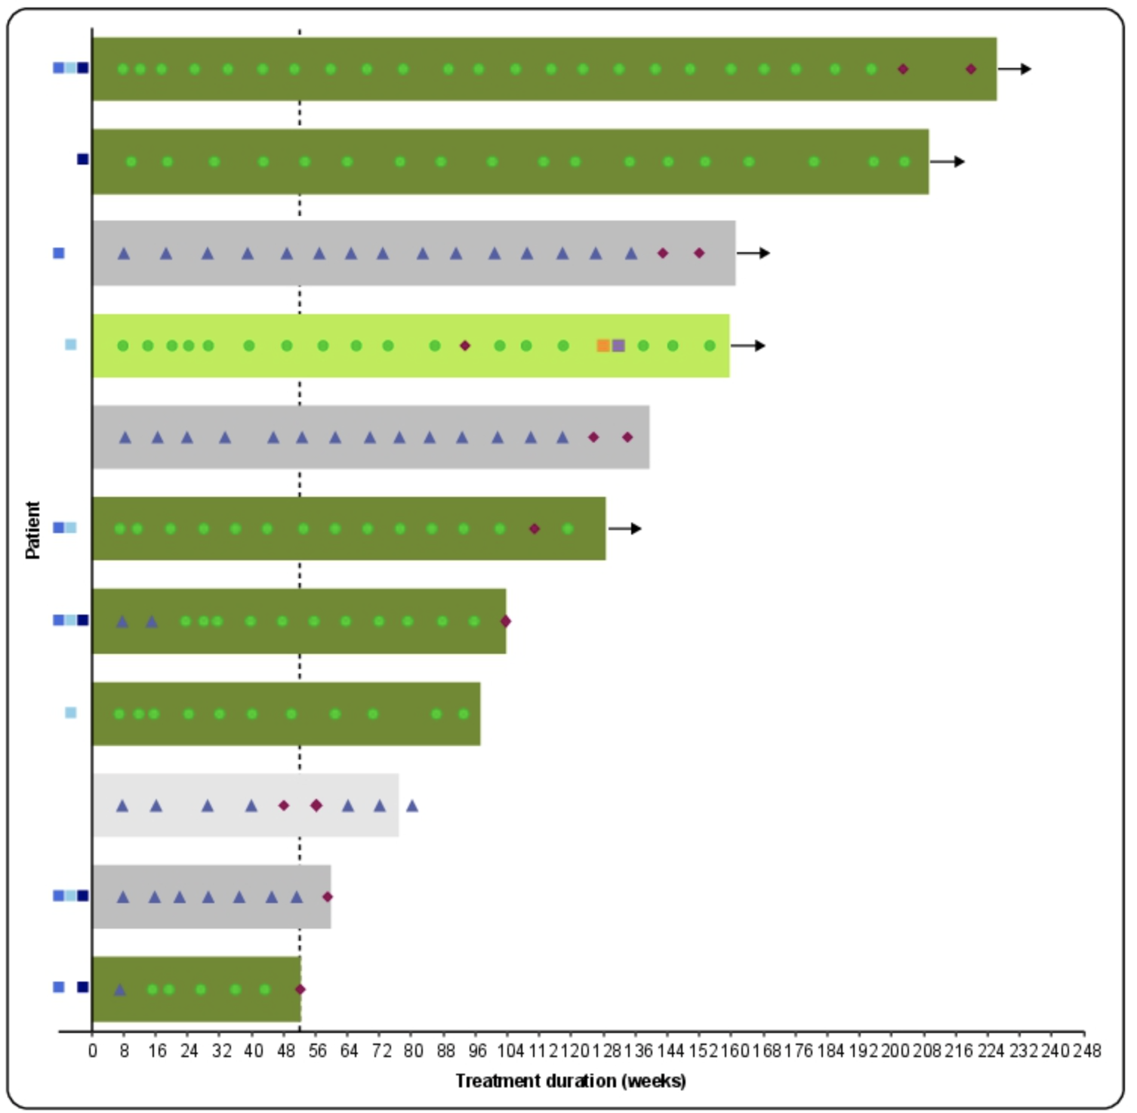
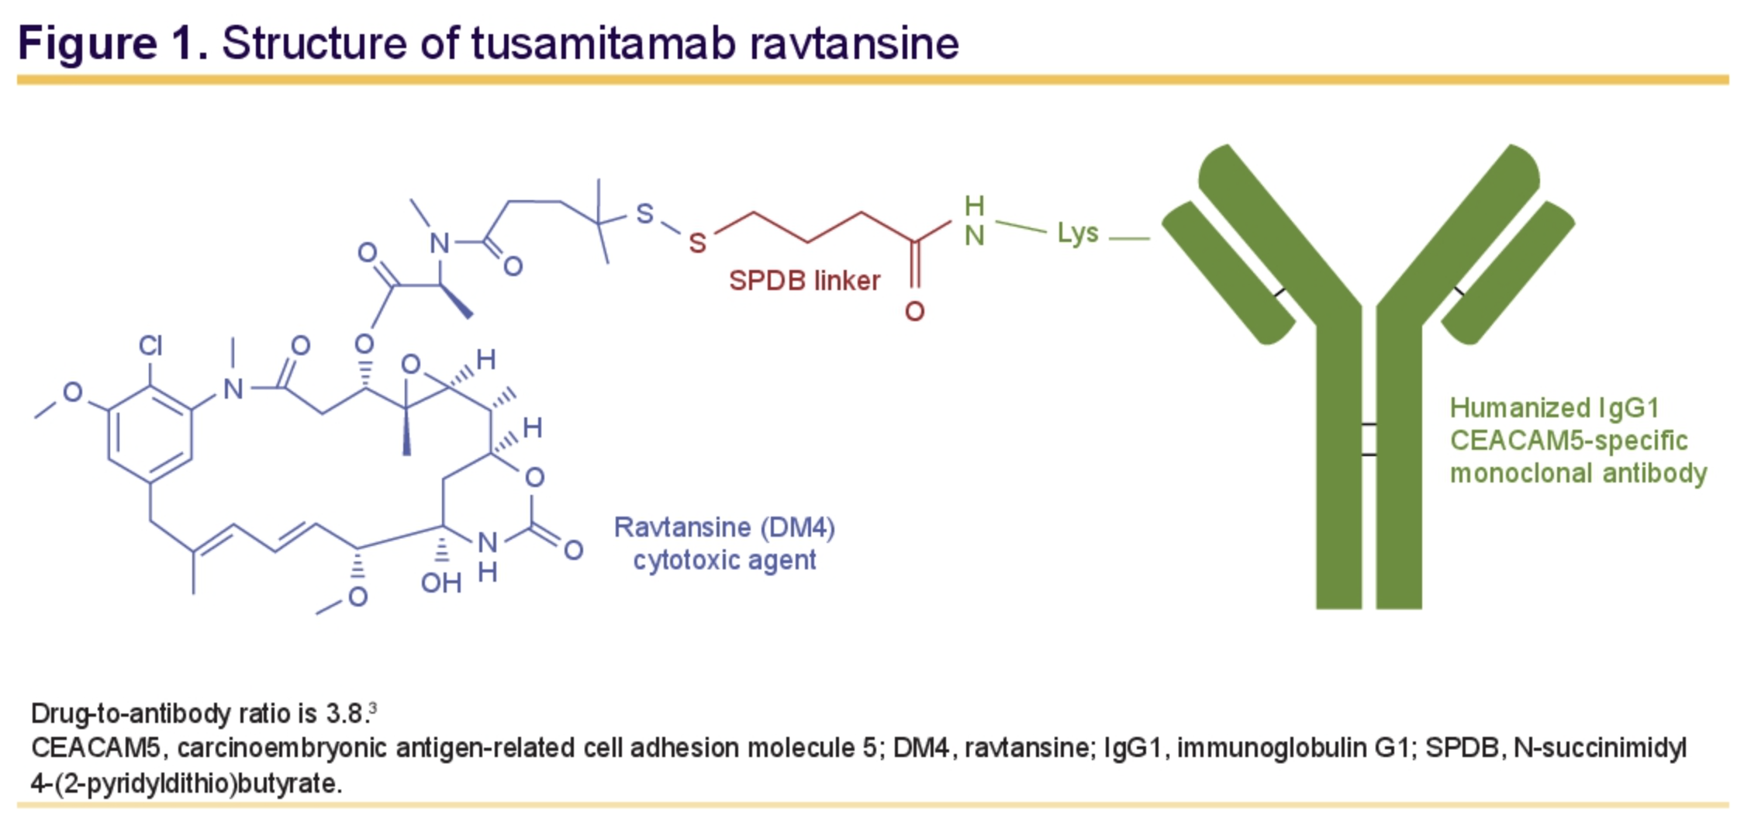
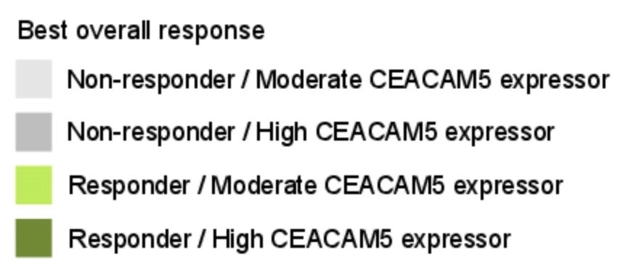
Ricordel C et al. Safety and efficacy of tusamitamab ravtansine (SAR408701) in long-term treated patients with nonsquamous non–small cell lung cancer (NSQ NSCLC) expressing carcinoembryonic antigen-related cell adhesion molecule 5 (CEACAM5). ASCO 2022;Abstract 9039
11/92 patients had long responses

Slide 20
HUDSON is an ongoing, modular phase II trial evaluating several treatment options for patients with biomarker matched or nonmatched locally advanced/metastatic NSCLC after receipt of a platinum doublet and failure of anti–PD-1/PD-L1 immunotherapy Current analysis reports results from cohorts of durvalumab in combination with either ceralasertib (ATR inhibitor), danvatirsen (STAT3 inhibitor), olaparib (PARP inhibitor), or oleclumab (anti-CD73 mAb)
Besse B et al. HUDSON: An open-label, multi-drug, biomarker-directed, Phase II platform study in patients with NSCLC, who progressed on anti-PD(L)1 therapy. WCLC 2022;Abstract OA15.05
Multidrug, nonrandomized umbrella phase II study (data cutoff April 14, 2021)
Primary endpoint: ORR
Secondary endpoints: DCR, PFS, OS, safety
Group A: Biomarker Matched (n = 86)
HRRm: durvalumab + olaparib (n = 21)
LKB1: durvalumab + olaparib (n = 21)
ATM: durvalumab + ceralasertib* (n = 21)
ATM: ceralasertib*
CD73h: durvalumab + oleclumab (n = 23)
HER2e/m: durvalumab + trastuzumab deruxtecan†
Group B: Biomarker Nonmatched (n = 169)
Primary Resistance (PD‡ ≤24 Wk)
Durvalumab + olaparib (n = 22)
Durvalumab + danvatirsen (n = 23)
Durvalumab + ceralasertib (n = 20)
Durvalumab + oleclumab (n = 9)
Acquired Resistance (PD‡ >24 Wk)
Durvalumab + olaparib (n = 23)
Durvalumab + danvatirsen (n = 22)
Durvalumab + ceralasertib (n = 25)
Durvalumab + oleclumab (n = 25)
Durvalumab + cediranib†
Locally advanced or metastatic NSCLC; previous platinum-doublet chemotherapy and PD-1/PD-L1 targeted therapy; no EGFR, ALK, ROS1, BRAF, MET, or RET targetable mutations
(N = 225)
Notes:
ATM, ataxia telangiectasia mutated; CD73h, high expression of cluster of differentiation 73; DCR, disease control rate; HRRm, homologous recombination mutated; LKB1, LKB1/STK11 aberration; HER2e, human epidermal growth factor receptor 2 expression; HER2m, human epidermal growth factor receptor mutated; NSCLC, non-small-cell lung cancer; ORR, overall response rate; OS, overall survival; PD, progressive disease; PFS, progression-free survival.

Slide 21
Besse B et al. HUDSON: An open-label, multi-drug, biomarker-directed, Phase II platform study in patients with NSCLC, who progressed on anti-PD(L)1 therapy. WCLC 2022;Abstract OA15.05 — PFS/OS by Treatment
Efficacy Parameter | Durvalumab + Ceralasertib (n = 66) | Durvalumab + Olaparib (n = 87) | Durvalumab + Danvatirsen (n = 45) | Durvalumab + Oleclumab (n = 57)
ORR (primary endpoint), % | 16.7 | 4.6 | 0 | 1.8
Median PFS, mo (80% CI) | 6.0 (4.6-7.5) | 2.7 (1.6-3.0) |  | 2.9 (1.7-3.1) | 1.8 (1.6-2.7)
6-mo PFS, % (80% CI) | 46.3 (37.9-54.2) |  | 18.7 (13.5-24.5) | 18.8 (11.5-27.6) | 16.6 (10.8-23.6)
OS Parameter | Durvalumab + Ceralasertib (n = 66) | Other Regimens* (n = 189) | Durvalumab + Olaparib (n = 87) | Durvalumab + Danvatirsen (n = 45) | Durvalumab + Oleclumab (n = 57)
Median OS, mo (80% CI) | 15.9 (14.1-20.3) | 9.4 (7.5-10.6) | 9.4 (6.9-10.8) | 7.9 (6.0-10.6) | 11.0 (7.6-13.5)
12-mo OS, % (80% CI) | 61.6 (53.4-68.8) | 39.7 (35.1-44.3) | 40.8 (34.0-47.5) | 28.8 (20.2-38.0) | 46.2 (37.5-54.5)
In this umbrella phase II study, durvalumab + ceralasertib showed promising activity
HUDSON remains ongoing,
*Pooled internal control of durvalumab + olaparib, durvalumab + danvatirsen, and durvalumab + oleclumab.
Notes:
OS, overall survival.

Slide 22
Pivotal LUNAR Study in non-small cell lung cancer meets primary overall survival endpoint [press release]. Kotecha R et al. KEYNOTE B36: A pilot study of first-line tumor treating fields (150 kHz) plus pembrolizumab for advanced or metastatic NSCLC. WCLC 2022;Abstract EP08.01-076
January 5, 2023: The LUNAR study met its primary endpoint
Tumor Treating Fields (TTFields) are a locoregional, anti-mitotic treatment modality approved for glioblastoma and unresectable malignant pleural mesothelioma. Preclinical data have shown that TTFields induce immunogenic cell death and enhance the efficacy of PD-1 inhibitors
The LUNAR study is a pivotal, open-label, randomized study evaluating the safety and efficacy of TTFields when used together with immune checkpoint inhibitors or docetaxel (experimental arm) versus immune checkpoint inhibitors or docetaxel alone (control arm) for patients with stage 4 NSCLC who progressed during or after platinum-based therapy
The LUNAR study showed a statistically significant and clinically meaningful improvement in OS w/TTFields + ICI vs ICI alone and a positive trend in OS when patients were treated with TTFields and docetaxel versus docetaxel alone.. TTFields therapy was well tolerated by patients enrolled in the experimental arm of the study.
KEYNOTE B36 (NCT04892472) is a multicenter, single arm, phase 2 open-label study designed to evaluate the safety and efficacy of TTFields (150 kHz) plus pembrolizumab for first-line treatment of advanced NSCLC
Promising novel therapy
Await full data
Unclear if patients will be accepting

Slide 23
Lee SM et al. IPSOS (Phase 3): First-line atezolizumab vs single-agent chemotherapy in patients with NSCLC (non-platinum eligible). ESMO 2022. Abstract LBA11
Eligibility criteria
Treatment-naïve stage IIIB/IV (AJCC 7th edition) NSCLC
Squamous or non-squamous histology
Platinum ineligible because of:
ECOG PS 2 or 3
ECOG PS 0 or 1 permitted if ≥70 years of age with substantial comorbidities/contraindications to platinum chemotherapy
EFGR+ (L858R or exon 19 deletion) or ALK+ excluded
Patients with treated asymptomatic brain metastases permitted
Atezolizumab 1200 mg IV Q3W
PD or loss of clinical benefit
Survival follow-up
Primary endpoint:
OS
Key secondary endpoints:
OS (6, 12, 18, 24 months)
PFS
Objective response rate
DoR rate
OS, PFS (PD-L1 +ve)
R 2:1
N=453
Vinorelbine oral/IV dosing per local PI
PD
Investigator choice
Gemcitabine IV dosing per local PI
 | ATEZO (n=302) | Chemo (n=151)
Age, median (range), years <70 years, n (%) 70–79 years, n (%) ≥80 y, n (%) | 75.0 (33, 94) 80 (26.5) 125 (41.4) 97 (32.1) | 75.0 (37, 89) 43 (28.5) 65 (43.0) 43 (28.5)
ECOG PS, n (%) 0/1 2 3 | 56 (18.5) 228 (75.5) 18 (6.0) | 19 (12.6) 116 (76.8) 16 (10.6)
Sex, male, n (%) | 220 (72.8) | 108 (71.5)
Race, n (%)ª White Asian | 203 (67.2) 75 (24.8) | 95 (62.9) 38 (25.2)
Histology, n (%)^{b} Non-squamous Squamous | 173 (57.3) 129 (42.7) | 87 (57.6) 64 (42.4)
 | ATEZO (n=302) | Chemo (n=151)
Brain metastases, n (%)^{b} Yes No Missing | 27 (8.9) 273 (90.4) 2 (0.7) | 13 (8.6) 137 (90.7) 1 (0.7)
Smoking status, n (%) Previous Current Never | 209 (69.2) 58 (19.2) 5 (11.6) | 103 (68.2) 28 (18.5) 20 (13.2)
PD-L1 expression n (%)^{c} TC <1% TC ≥1% TC 1–49 TC ≥50% Unknown | 151 (50.0) 127 (42.1) 77 (25.5) 50 (16.6) 24 (7.9) | 61 (40.4) 78 (51.7) 53 (35.1) 25 (16.6) 12 (7.9)
*Stratification factors
Histology (squamous or non-squamous)
PD-L1ª (TC3 or IC3 vs TC0/1/2 or ICO/1/2^{b} vs unknown)
Brain metastases (yes/no)

Slide 24
Lee SM et al. IPSOS (Phase 3): First-line atezolizumab vs single-agent chemotherapy in patients with NSCLC (non-platinum eligible). ESMO 2022. Abstract LBA11
Duration of response
8.9 (95% CI: 2.4, 15.5)
PR CR
Treatment response
Atezolizumab
Chemotherapy
 | Atezolizumab (n=302) | Chemotherapy (n=151)
ORR, n (%) (95% CI) | 51 (16.9) (12.8, 21.6) | 12 (7.9) (4.2, 13.5)
CR, n (%) | 4 (1.3) | 0 (0)
PR, n (%) | 47 (15.6) | 12 (7.9)
Stable disease, n (%) | 122 (40.4) | 73 (48.3)
Disease control rate, n (%) | 173 (57.3) | 85 (56.3)
Progressive disease, n (%) | 67 (22.2) | 36 (23.8)
Non-evaluable, n (%) | 14 (4.6) | 12 (7.9)
Missing, n (%) | 48 (15.9) | 18 (11.9)
16.9%
Response (%)
7.9%
Median DOR, months (95% CI) | 14.0 (8.1, 20.3) | 7.8 (4.8, 9.7)
PFS

Slide 25
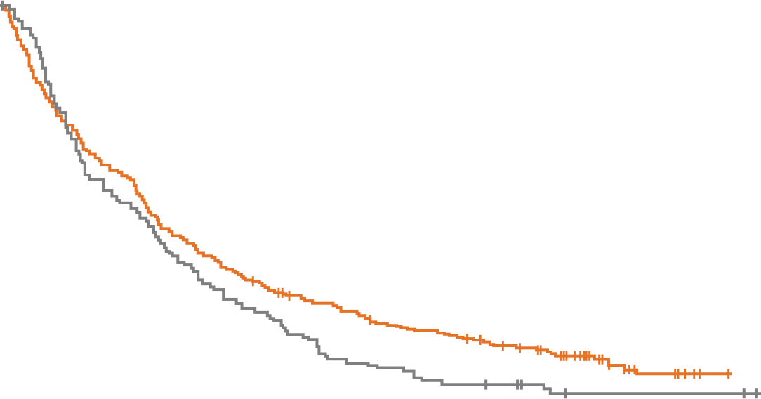
Lee SM et al. IPSOS (Phase 3): First-line atezolizumab vs single-agent chemotherapy in patients with NSCLC (non-platinum eligible). ESMO 2022. Abstract LBA11
Subgroup analysisª
OS (primary endpoint)
Subgroup |  | HR (95% CI)
All patients |  | 0.78 (0.63, 0.97)
Age
<70 y |  | 0.75 (0.49, 1.14)
70–79 y |  | 0.68 (0.49, 0.94)
≥80 y |  | 0.97 (0.66, 1.44)
Sex
Male |  | 0.76 (0.59, 0.98)
Female |  | 0.86 (0.58, 1.27)
Race
White |  | 0.86 (0.67, 1.11)
Asian |  | 0.74 (0.46, 1.20)
ECOG PS
0/1 |  | 0.64 (0.36, 1.13)
2 |  | 0.86 (0.67, 1.10)
3 |  | 0.74 (0.35, 1.57)
Tobacco use history
Previous |  | 0.83 (0.64, 1.08)
Current |  | 0.65 (0.40, 1.07)
Never |  | 0.70 (0.37, 1.35)
Histology
Non-squamous |  | 0.77 (0.58, 1.03)
Squamous |  | 0.80 (0.58, 1.12)
Subgroup |  | HR (95% CI)
All patients |  | 0.78 (0.63, 0.97)
Stage
IIIB |  | 0.69 (0.39, 1.24)
IV |  | 0.81 (0.64, 1.02)
Brain metastases
Yes |  | 0.85 (0.40, 1.80)
No |  | 0.78 (0.62, 0.98)
Liver metastases
Yes |  | 0.94 (0.55, 1.59)
No |  | 0.77 (0.61, 0.98)
Number of metastatic sites
<3 |  | 0.74 (0.53, 1.03)
≥3 |  | 0.78 (0.56, 1.07)
PD-L1 expression level
TC <1% |  | 0.81 (0.58. 1.11)
TC ≥1% |  | 0.84 (0.62, 1.15)
TC 1–49% |  | 0.84 (0.57, 1.22)
TC ≥50% |  | 0.87 (0.50, 1.52)
Unknown |  | 0.49 (0.21, 1.14)
100
 | Atezo (n=302) | Chemo (n=151)
Events, n (%) | 249 (82.5) | 130 (86.1)
mOS (95% CI), mo | 10.3 (9.4, 11.9) | 9.2 (5.9, 11.2)
HR (95% CI)ª | 0.78 (0.63, 0.97)
P-value | 0.028
80
60
Median follow-up: 41.0 months
Minimum follow-up: 32.0 months
Overall survival (%)
43.7%
40
38.6%
24.3%
20
0
12.4%
0
6
12
18
24
30
36
42
48
54
No. at risk
Months
Atezo
302
180
122
86
64
50
37
17
5
0
Chemo
151
80
52
31
16
9
7
2
2
0
Subsequent anti-cancer therapies
 | ATEZO (n=302) | Chemo (n=151)
Number of patients with any subsequent anti-cancer therapy, n (%) | 61 (20.2) | 45 (29.8)
Chemotherapy, n (%) | 48 (15.9) | 16 (10.6)
Cancer immunotherapy, n (%) | 4 (1.3) | 28 (18.5)
TKI, n (%) | 10 (3.3) | 5 (3.3)
Other, n (%) | 3 (1.0) | 1 (0.7)
HR
Atezolizumab better
HR
Chemotherapy better
Atezolizumab better
Chemotherapy better
Atezolizumab was superior to single agent chemo
Low ORR, but durable responses leading to OS benefit
Expected toxicity
Biomarkers of response/ toxicity for better selection of patients still needed
Positive Phase 3 trial

