Slide 1
Research To Practice
ASH 2022 CLL Updates
John N. Allan Associate Professor of Clinical Medicine
03.30.2023

Slide 2
Overview
Frontline Management of CLL
Acalabrutinib updates
Combination Approaches
Triplets, Doublets, Genetic Risk Factors
Relapsed Management of CLL
ALPINE LBA
Pirtobrutinib Extended Follow-up
Novel therapeutics
BCL2 inhibitors, Bispecifics

Slide 3
Frontline CLL

Slide 4
Acalabrutinib Updates
Byrd et al. Final Results of the Phase 1/2 Study of Acalabrutinib Monotherapy in Treatment-Naive Chronic Lymphocytic Leukemia with >6 Years of Follow-up. ASH 2022;Abstract 4431.
Davids et al. Contribution of Obinutuzumab to Acalabrutinib Therapy in Patients with Treatment-Naive Chronic Lymphocytic Leukemia: Analysis of Survival Outcomes By Genomic Features. ASH 2022;Abstract 1815.
Jacobs R et al. Real-World Comparison of Time to Next Treatment for Patients with CLL Initiated on First-Line Treatment with Ibrutinib Versus Acalabrutinib. ASH 2022;Abstract 797.

Slide 5
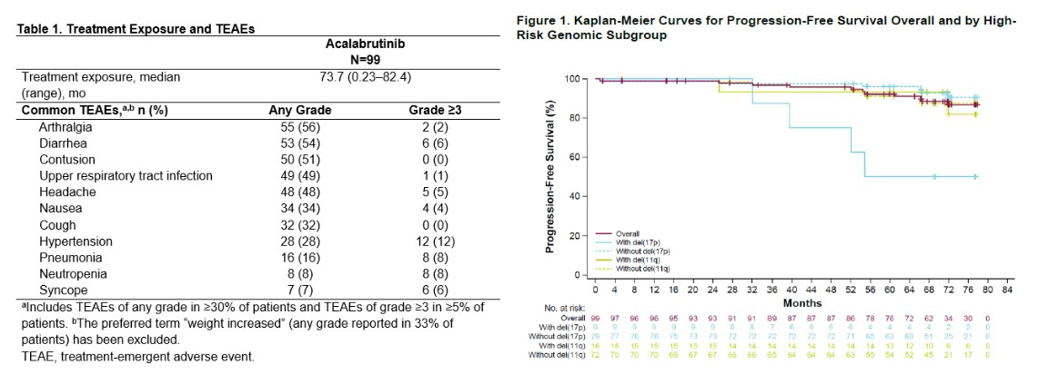
Byrd J et al. Final Results of the Phase 1/2 Study of Acalabrutinib Monotherapy in Treatment-Naive Chronic Lymphocytic Leukemia with >6 Years of Follow-up. ASH 2022;Abstract 4431.
7 year PFS 87%

Slide 6
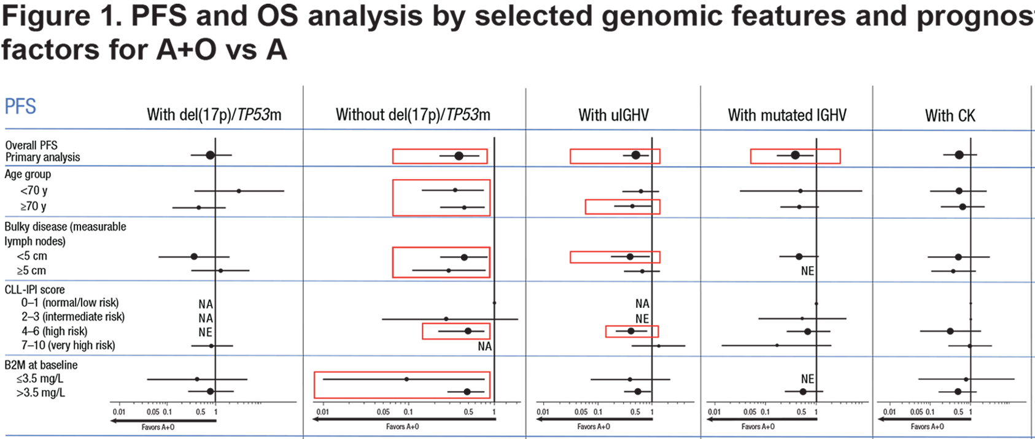
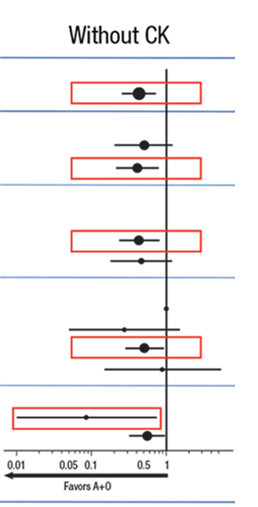
Davids M et al. Contribution of Obinutuzumab to Acalabrutinib Therapy in Patients with Treatment-Naive Chronic Lymphocytic Leukemia: Analysis of Survival Outcomes By Genomic Features. ASH 2022;Abstract 1815.

Slide 7
Jacobs R et al. Real-World Comparison of Time to Next Treatment for Patients with CLL Initiated on First-Line Treatment with Ibrutinib Versus Acalabrutinib. ASH 2022;Abstract 797.

Slide 8
Combination Studies
Niemann C et al. Residual Disease Kinetics Among Patients with High-Risk Factors Treated with First-Line Fixed-Duration Ibrutinib Plus Venetoclax (Ibr+Ven) Versus Chlorambucil Plus Obinutuzumab (Clb+O): The Glow Study. ASH 2022;Abstract 93.
Allan J et al. Treatment Outcomes after Undetectable MRD with First-Line Ibrutinib (Ibr) Plus Venetoclax (Ven): Fixed Duration Treatment (Placebo) Versus Continued Ibr with up to 5 Years Median Follow-up in the CAPTIVATE Study. ASH 2022;Abstract 92.
Munir T et al. Combination of Ibrutinib Plus Venetoclax with MRD-Driven Duration of Treatment Results in a Higher Rate of MRD Negativity in IGHV Unmutated Than Mutated CLL: Updated Interim Analysis of FLAIR Study. ASH 2022;Abstract 94.
Ryan C et al. Updated Results from a Multicenter, Phase 2 Study of Acalabrutinib, Venetoclax, Obinutuzumab (AVO) in a Population of Previously Untreated Patients with CLL Enriched for High-Risk Disease. ASH 2022;Abstract 344.
Tausch E et al. Genetic Markers and Front Line FCR/BR Vs. Rve, Gve and Give Treatment – Outcome Results from the CLL13/GAIA Trial. ASH 2022;Abstract 345.

Slide 9
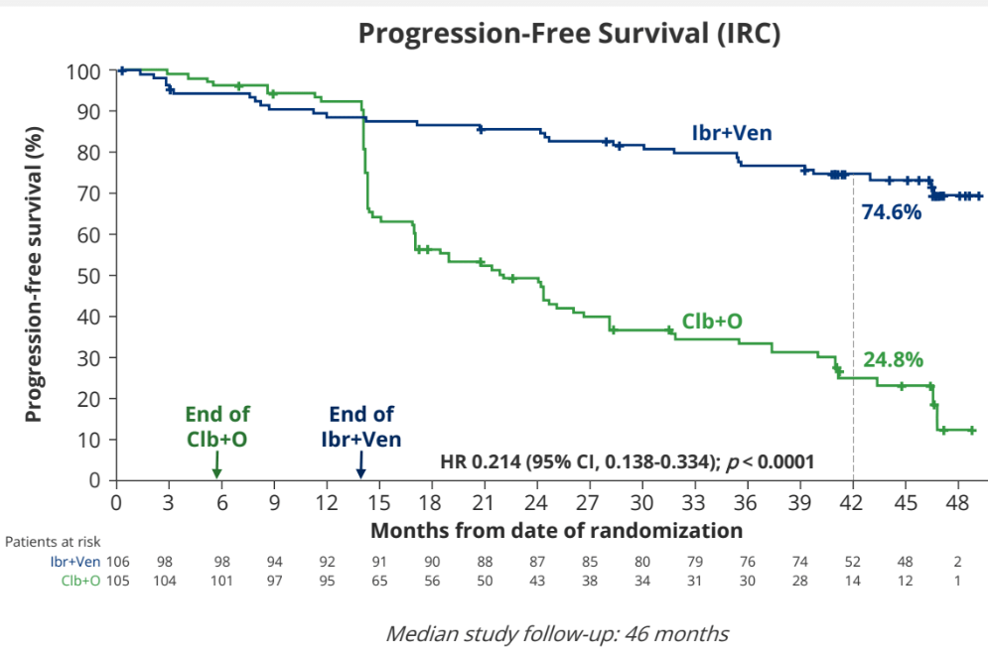
Neimann C et al. Residual Disease Kinetics Among Patients with High-Risk Factors Treated with First-Line Fixed-Duration Ibrutinib Plus Venetoclax (Ibr+Ven) Versus Chlorambucil Plus Obinutuzumab (Clb+O): The Glow Study. ASH 2022;Abstract 93.

Slide 10
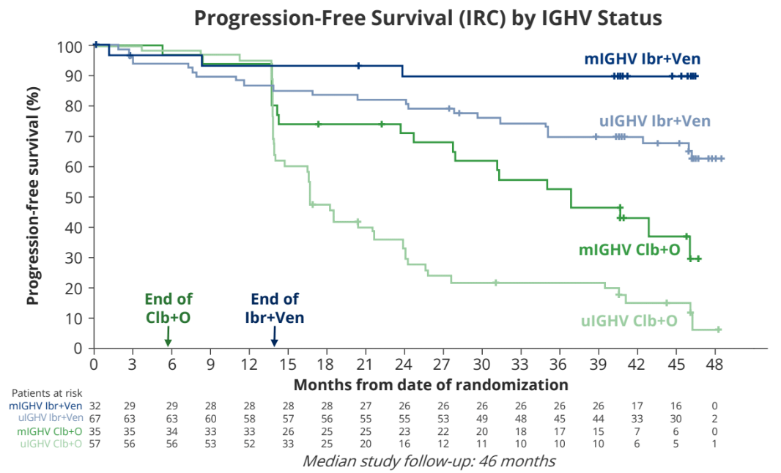
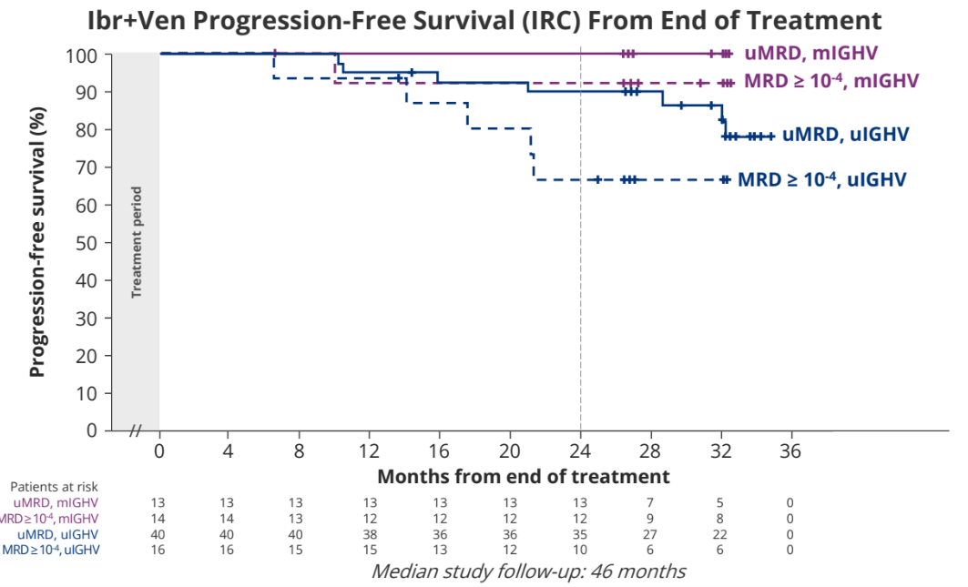
Neimann C et al. Residual Disease Kinetics Among Patients with High-Risk Factors Treated with First-Line Fixed-Duration Ibrutinib Plus Venetoclax (Ibr+Ven) Versus Chlorambucil Plus Obinutuzumab (Clb+O): The Glow Study. ASH 2022;Abstract 93.

Slide 11
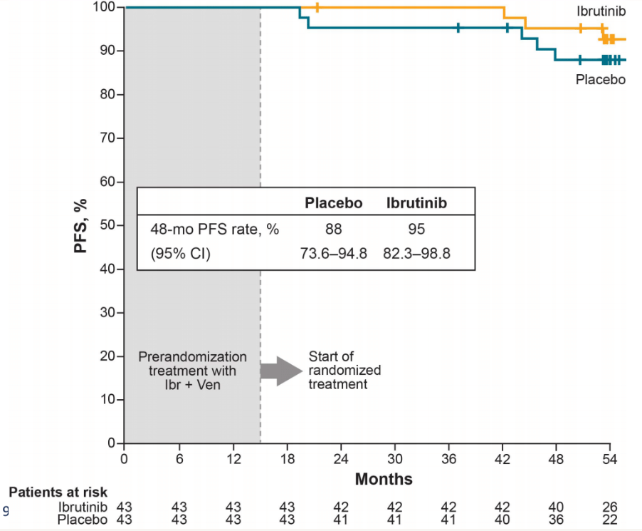
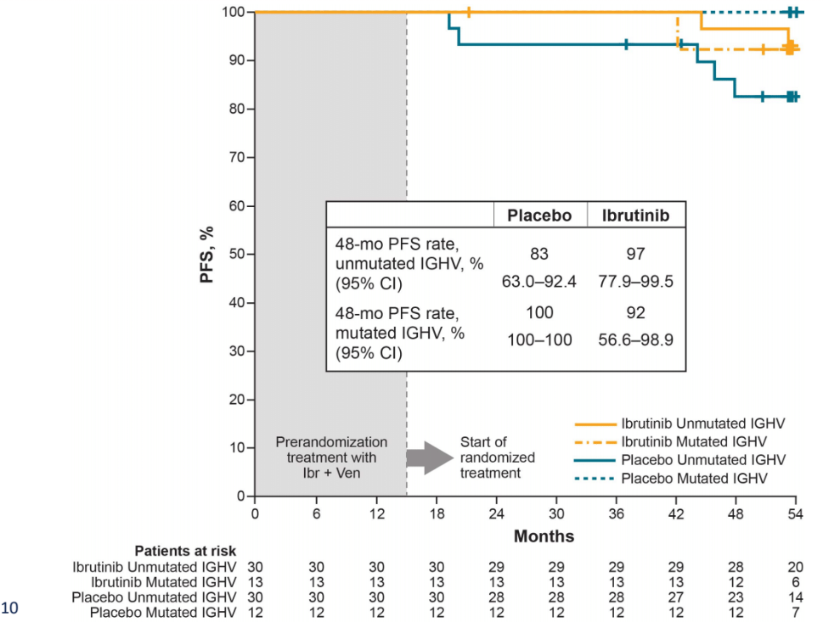
Allan J et al. Treatment Outcomes after Undetectable MRD with First-Line Ibrutinib (Ibr) Plus Venetoclax (Ven): Fixed Duration Treatment (Placebo) Versus Continued Ibr with up to 5 Years Median Follow-up in the CAPTIVATE Study. ASH 2022;Abstract 92.
PFS

Slide 12
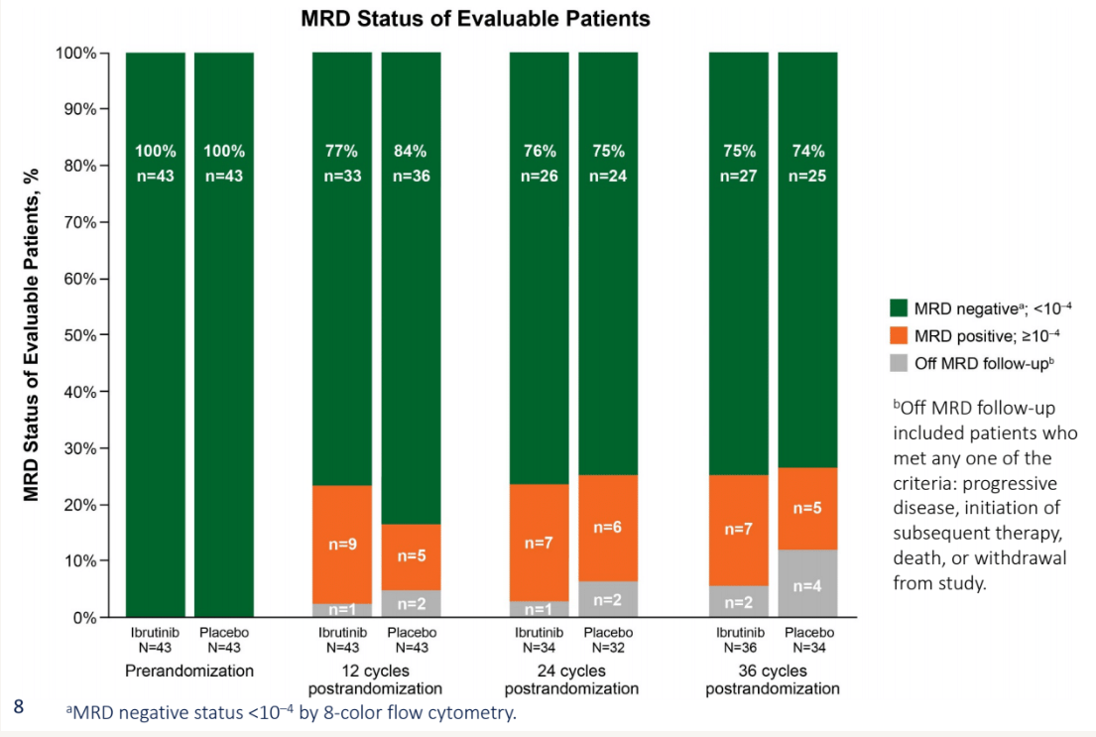
Allan J et al. Treatment Outcomes after Undetectable MRD with First-Line Ibrutinib (Ibr) Plus Venetoclax (Ven): Fixed Duration Treatment (Placebo) Versus Continued Ibr with up to 5 Years Median Follow-up in the CAPTIVATE Study. ASH 2022;Abstract 92.

Slide 13
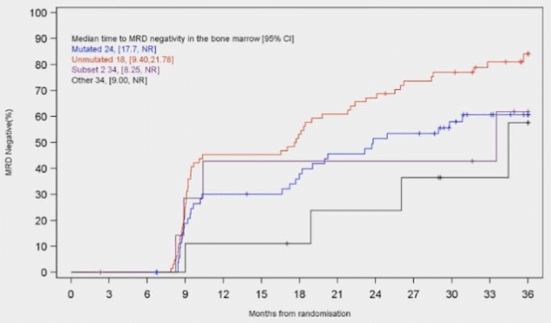
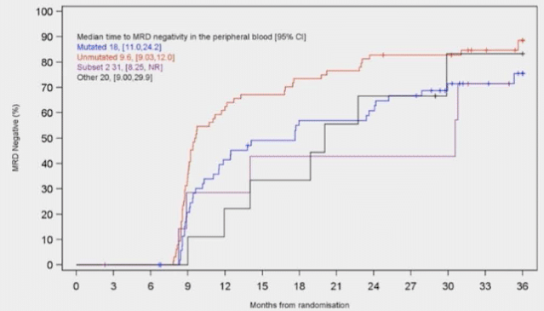
Munir T et al. Combination of Ibrutinib Plus Venetoclax with MRD-Driven Duration of Treatment Results in a Higher Rate of MRD Negativity in IGHV Unmutated Than Mutated CLL: Updated Interim Analysis of FLAIR Study. ASH 2022;Abstract 94.
TTuMRD

Slide 14
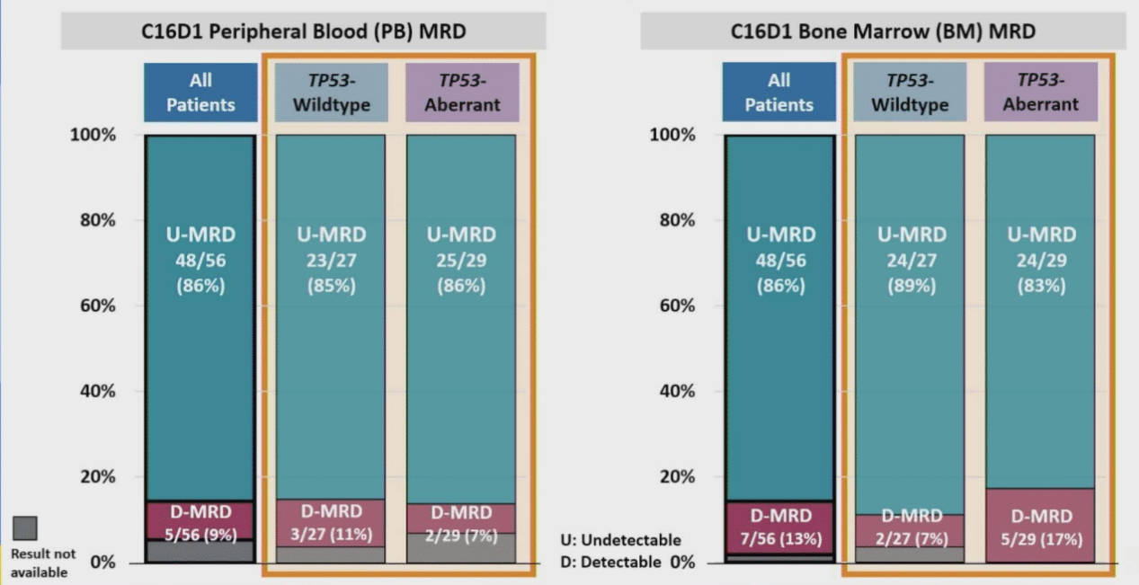
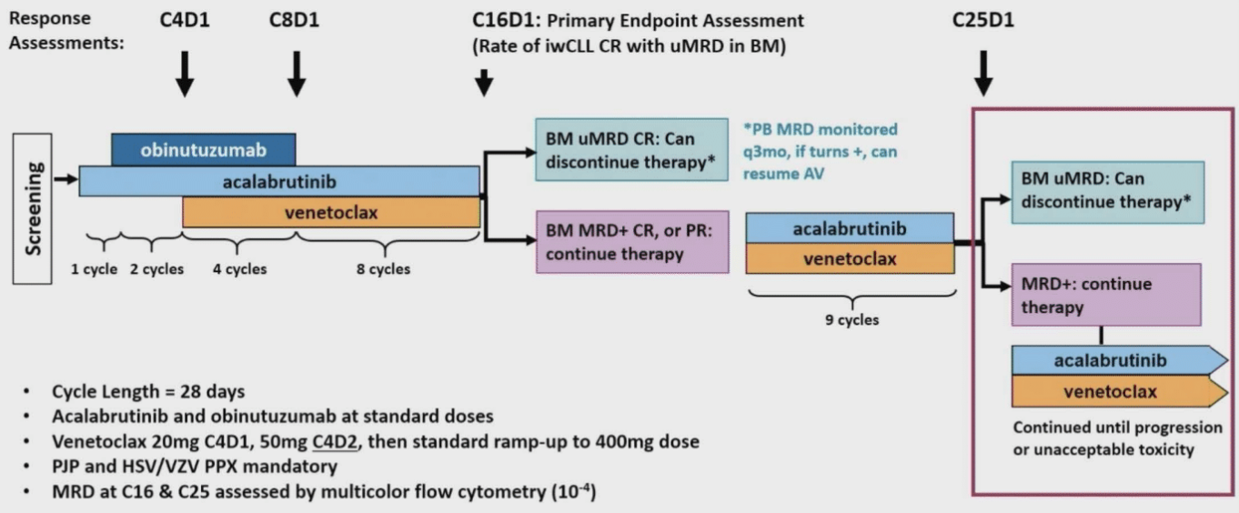
Ryan C et al. Updated Results from a Multicenter, Phase 2 Study of Acalabrutinib, Venetoclax, Obinutuzumab (AVO) in a Population of Previously Untreated Patients with CLL Enriched for High-Risk Disease. ASH 2022;Abstract 344.

Slide 15
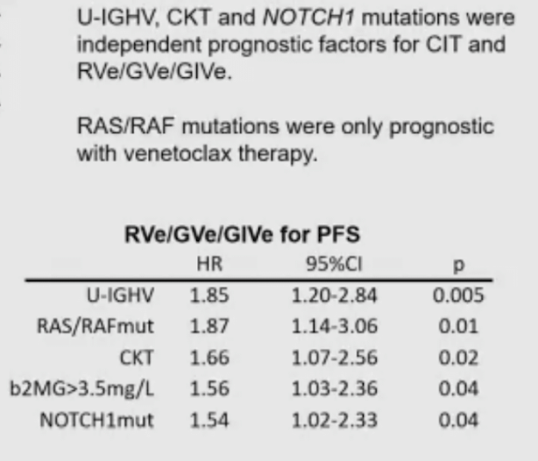
Tausch E et al. Genetic Markers and Front Line FCR/BR Vs. Rve, Gve and Give Treatment – Outcome Results from the CLL13/GAIA Trial. ASH 2022;Abstract 345.

Slide 16
Relapsed CLL
ASH Updates 2022

Slide 17
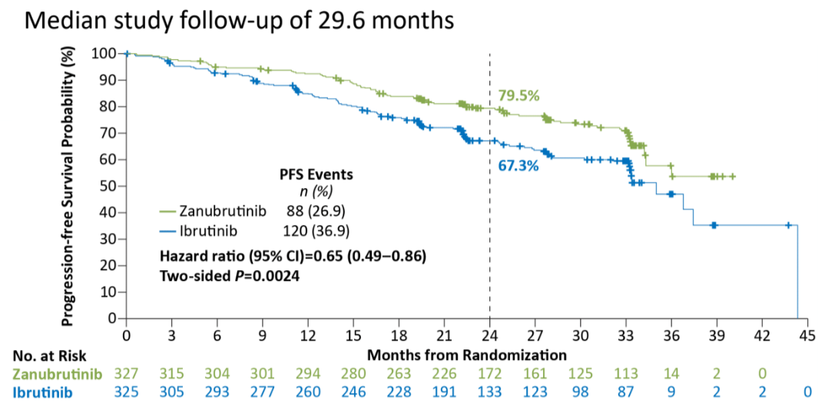
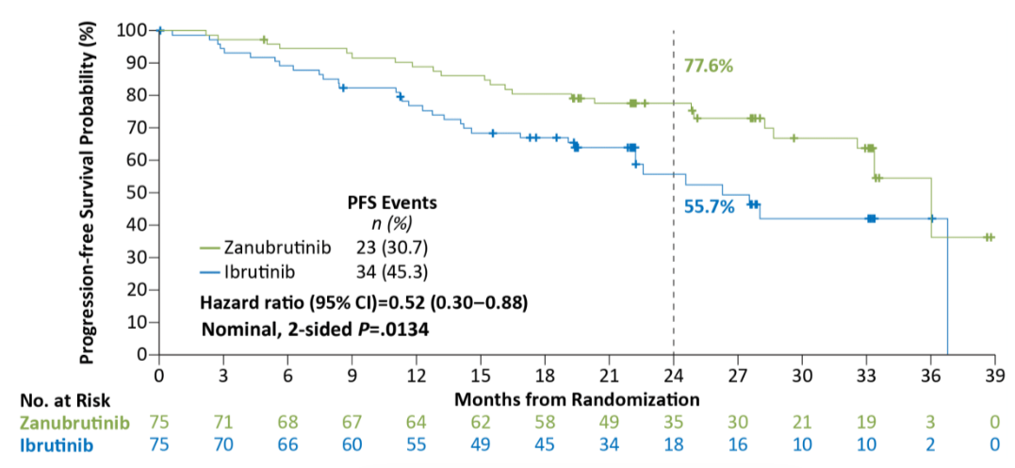
Brown J et al. Zanubrutinib Demonstrates Superior Progression-Free Survival (PFS) Compared with Ibrutinib for Treatment of Relapsed/Refractory Chronic Lymphocytic Leukemia and Small Lymphocytic Lymphoma (R/R CLL/SLL): Results from Final Analysis of ALPINE Randomized Phase 3 Study. ASH 2022;Abstract LBA-6.
PFS All Patients
PFS Del17p

Slide 18
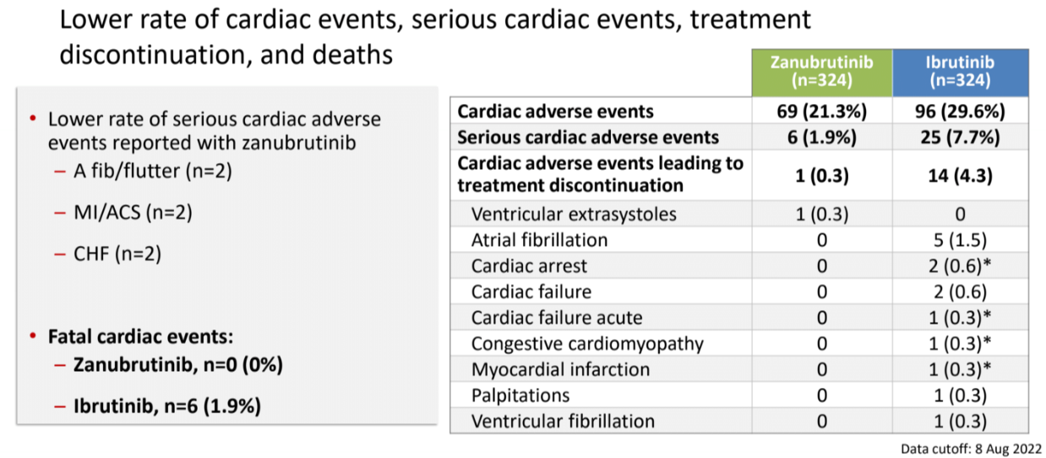
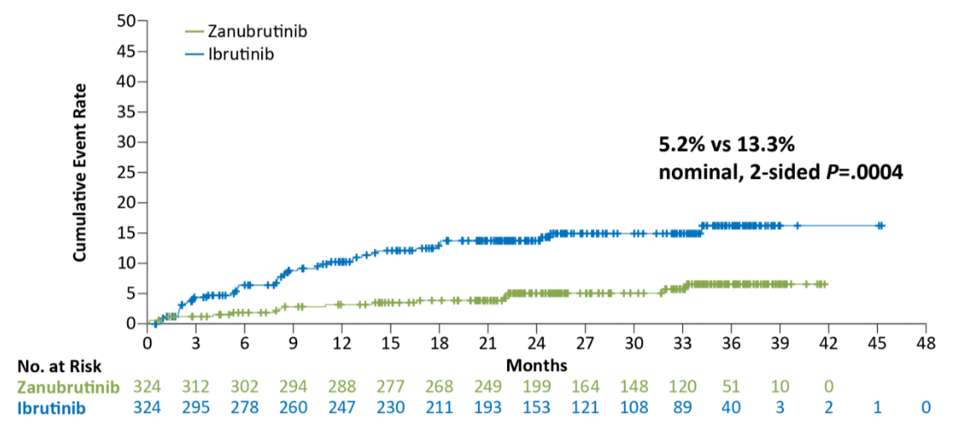
Brown J et al. Zanubrutinib Demonstrates Superior Progression-Free Survival (PFS) Compared with Ibrutinib for Treatment of Relapsed/Refractory Chronic Lymphocytic Leukemia and Small Lymphocytic Lymphoma (R/R CLL/SLL): Results from Final Analysis of ALPINE Randomized Phase 3 Study. ASH 2022;Abstract LBA-6.

Slide 19
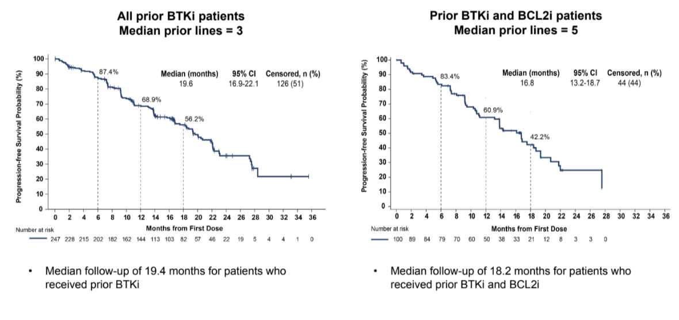
Mato AR et al. Efficacy of Pirtobrutinib in Covalent BTK-Inhibitor Pre-Treated Relapsed / Refractory CLL/SLL: Additional Patients and Extended Follow-up from the Phase 1/2 BRUIN Study. ASH 2022;Abstract 961.

Slide 20
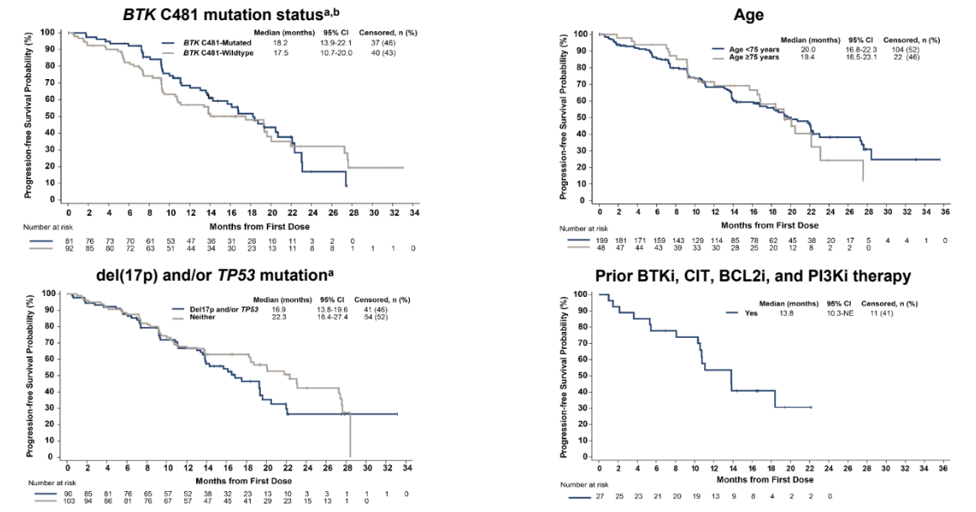
Mato AR et al. Efficacy of Pirtobrutinib in Covalent BTK-Inhibitor Pre-Treated Relapsed / Refractory CLL/SLL: Additional Patients and Extended Follow-up from the Phase 1/2 BRUIN Study. ASH 2022;Abstract 961

Slide 21
Davids M et al. Lisaftoclax (APG-2575) Safety and Activity As Monotherapy or Combined with Acalabrutinib or Rituximab in Patients (pts) with Treatment-Naïve, Relapsed or Refractory Chronic Lymphocytic Leukemia/Small Lymphocytic Lymphoma (R/R CLL/SLL): Initial Data from a Phase 2 Global Study. ASH 2022;Abstract 964.

Slide 22
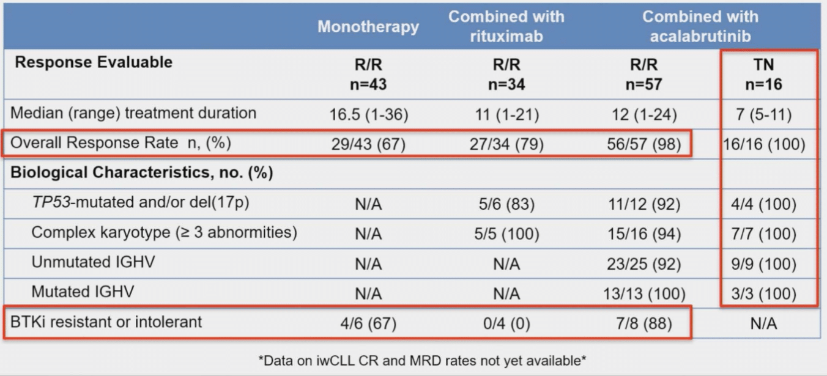
Davids M et al. Lisaftoclax (APG-2575) Safety and Activity As Monotherapy or Combined with Acalabrutinib or Rituximab in Patients (pts) with Treatment-Naïve, Relapsed or Refractory Chronic Lymphocytic Leukemia/Small Lymphocytic Lymphoma (R/R CLL/SLL): Initial Data from a Phase 2 Global Study. ASH 2022;Abstract 964.

Slide 23
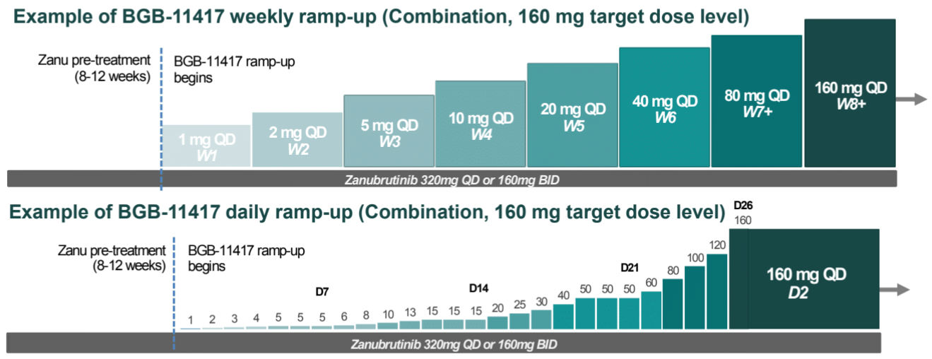
Cheah C et al. A Phase 1 Study with the Novel B-Cell Lymphoma 2 (Bcl-2) Inhibitor Bgb-11417 As Monotherapy or in Combination with Zanubrutinib (ZANU) in Patients (Pts) with CLL/SLL: Preliminary Data. ASH 2022;Abstract 962.

Slide 24
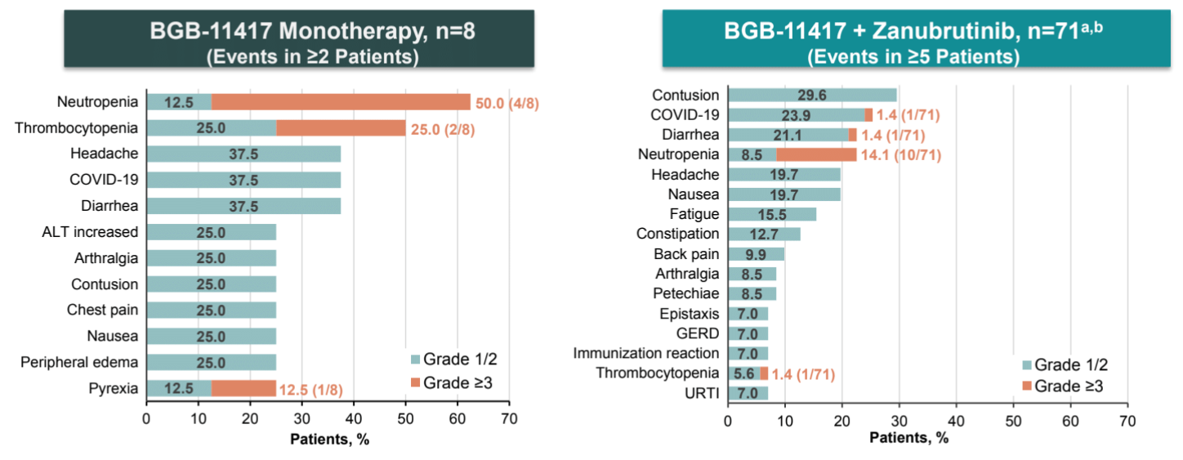
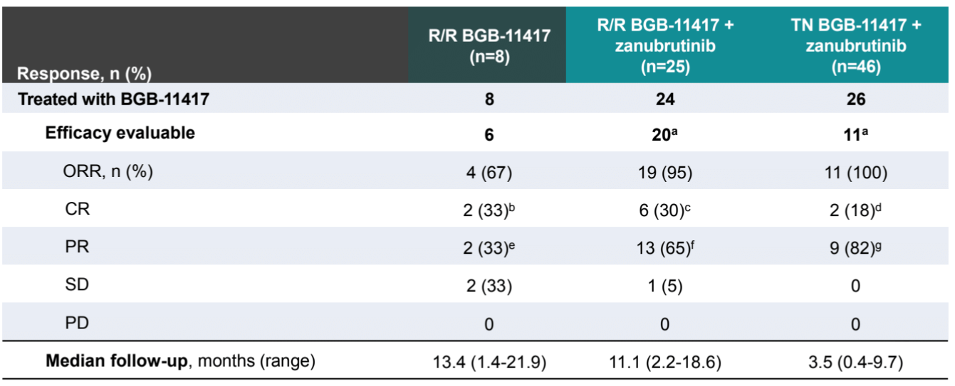
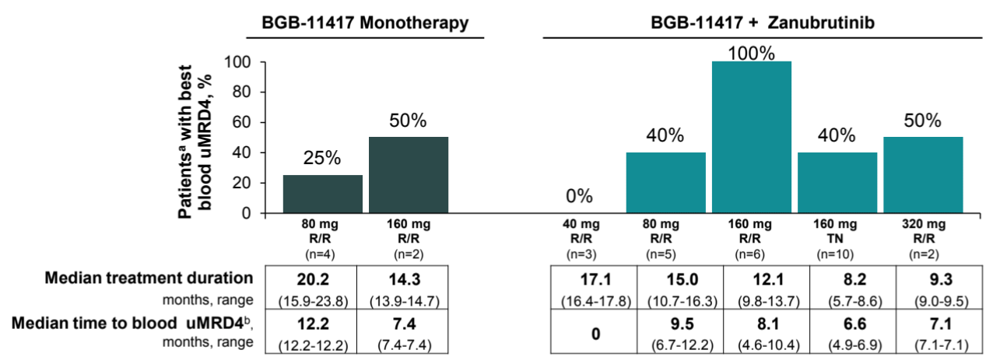
Cheah C et al. A Phase 1 Study with the Novel B-Cell Lymphoma 2 (Bcl-2) Inhibitor Bgb-11417 As Monotherapy or in Combination with Zanubrutinib (ZANU) in Patients (Pts) with CLL/SLL: Preliminary Data. ASH 2022;Abstract 962.

Slide 25
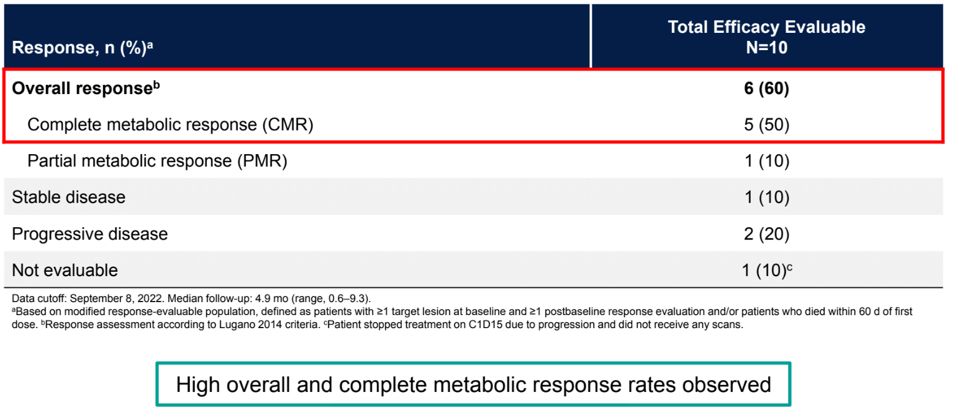
Kater A et al. Subcutaneous Epcoritamab in Patients with Richter’s Syndrome: Early Results from Phase 1b/2 Trial (EPCORE CLL-1). ASH 2022;Abstract 348.

Slide 26
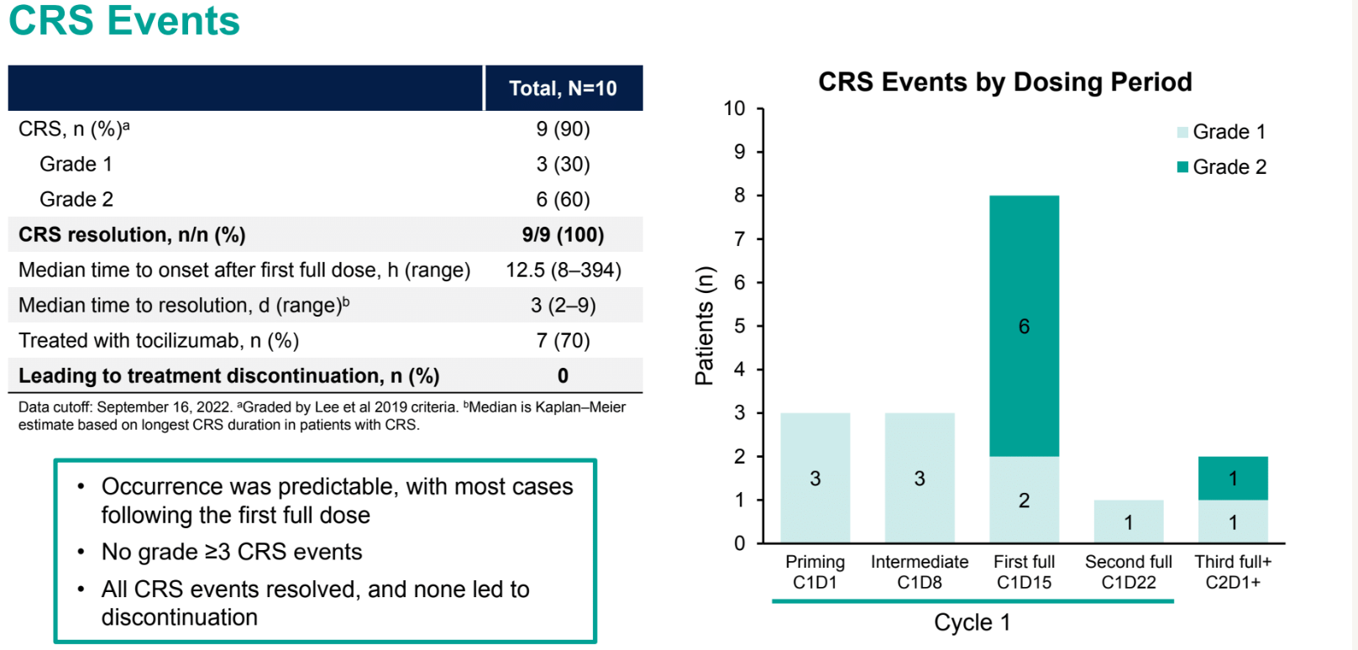
Kater A et al. Subcutaneous Epcoritamab in Patients with Richter’s Syndrome: Early Results from Phase 1b/2 Trial (EPCORE CLL-1). ASH 2022;Abstract 348.

Slide 27
QandA

Slide 28
APPENDIX

Slide 29
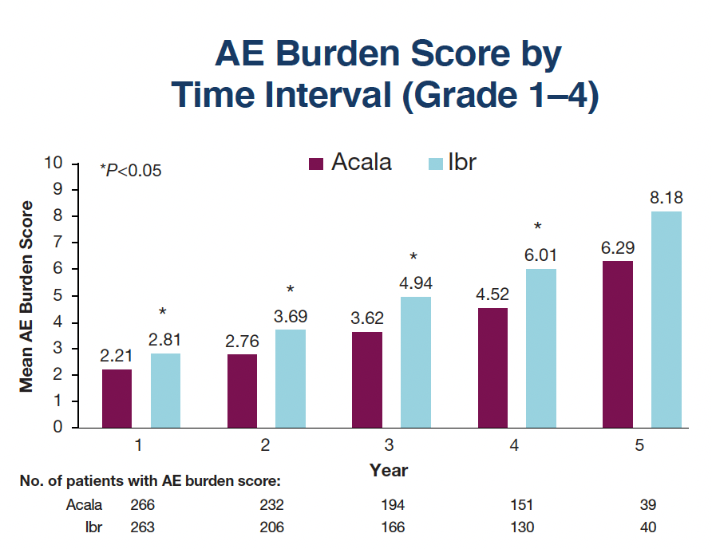
Seymour JF et al. Assessing the Burden of Adverse Events in a Head-to-Head Trial of Acalabrutinib Versus Ibrutinib in Previously Treated Chronic Lymphocytic Leukemia (CLL). ASH 2022; Abstract 3133.

Slide 30
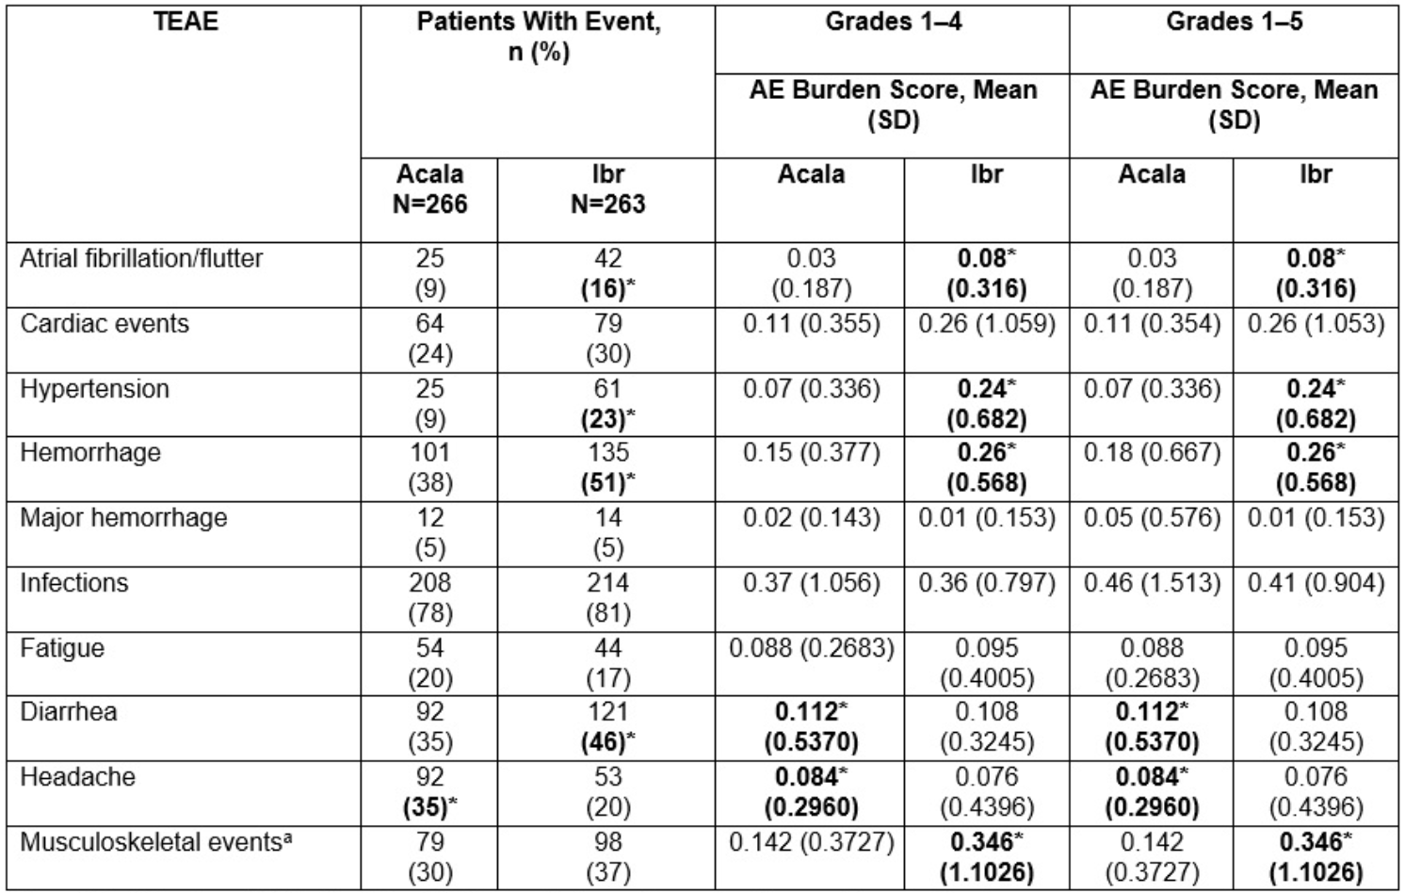
Seymour JF et al. Assessing the Burden of Adverse Events in a Head-to-Head Trial of Acalabrutinib Versus Ibrutinib in Previously Treated Chronic Lymphocytic Leukemia (CLL). ASH 2022; Abstract 3133.
AE Burden Score for Individual TEAEs and ECIs

