Slide 1
Research To Practice Year In Review 2022
Kathleen Moore, MD, MS
Virginia Kerley Cade Chair in Developmental Therapeutics
Associate Director Clinical Research
Stephenson Cancer Center
Associate Director, GOG Partners
GOG Foundation BOD

Slide 2
PARP inhibitors are changing the course of disease for patients with BRCAm ovarian cancer: PFS data is groundbreaking globally
PRIMA: HRd BRCAm¹
SOLO1: BRCAm³
ATHENA-MONO: HRd BRCAm⁵
100
HR: 0.45 (95% CI, 0.32–0.64)
100
56.0 vs 13.8 mo
HR: 0.33 (95% CI, 0.25–0.43)
100
NR vs 14.7 mo
HR: 0.40 (95% CI, 0.21–0.75)
90
90
90
80
80
80
70
70
70
Rucaparib (n=91)
60
Niraparib (n=152)
60
Olaparib (n=260)
60
50
50
50
Progression-free survival (%)
Progression-free survival (%)
Progression-free survival (%)
40
40
40
30
30
Placebo (n=131)
30
20
20
20
Placebo (n=24)
10
Placebo (n=71)
10
10
0
0
4
8
12
16
20
24
28
32
36
40
44
48
52
56
60
0
0
6
12
18
24
30
36
42
48
54
60
66
72
78
0
0
3
6
9
12
15
18
21
24
27
30
33
36
39
Time from randomization (months)
Time from randomization (months)
Time from randomization (months)
PRIME: BRCAm²
PAOLA-1: HRd BRCAm⁴
100
NR (22.3–NE) vs 10.8 (8.3–19.3) mo
HR: 0.40 (95% CI, 0.23–0.68; P<0.001)
100
46.1 vs 19.2 mo
HR: 0.41 (95% CI, 0.32–0.54)
90
90
80
80
Olaparib + bevacizumab (n=255)
70
Niraparib (n=85)
70
60
60
50
50
Progression-free survival (%)
Progression-free survival (%)
40
40
30
30
Placebo (n=40)
20
20
10
10
0
Placebo + bevacizumab (n=132)
0
0
3
6
9
12
15
18
21
24
27
30
33
36
0
12
24
36
48
60
72
80
Time from randomization (months)
Time from randomization (months)
BRCA, BRCA DNA repair associated gene; BRCAm, BRCA mutated; CI, confidence interval; HR, hazard ratio; HRd, homologous recombination deficient; mo, months; NE, not estimable; NR, not reached; PARP, poly (ADP-ribose) polymerase.
1. González-Martín A et al. ESMO Congress 2022; Abstract 530P. 2. Li N et al. SGO Annual Meeting on Women’s Cancer 2022; Abstract LBA 5. 3. Bradley W et al. SGO Virtual Annual Meeting on Women’s Cancer 2021; Abstract 10520. 4. Ray-Coquard I et al. ESMO Congress 2022; Abstract LBA29. 5. Monk BJ et al. ASCO Annual Meeting 2022; Abstract LBA5500.

Slide 3
SOLO 1: Maintenance olaparib provided a clinically meaningful OS benefit versus placebo in BRCAmut EOC
SOLO-1: OS^{1,2}
100
Olaparib (N=260)
Placebo (N=131)
90
80
73.1%
Events, n (%)
84 (32.3)
65 (49.6)
67.0%
Median OS,
months
NR
75.2
70
60
63.4%
HR 0.55 (95% CI 0.40–0.76); P=0.0004*
Olaparib
50
Overall survival (%)
46.5%
40
30
Placebo
44.3% of patients in the placebo group received subsequent PARPi therapy, compared with 14.6% of patients in the olaparib group
20
10
0
0
6
12
18
24
30
36
42
48
54
60
66
72
78
84
90
96
102
No. at risk
Months since randomization
Olaparib
260
252
246
236
227
214
203
194
185
177
170
165
159
157
153
79
21
0
Placebo
131
128
125
114
108
100
97
92
87
80
73
67
60
54
52
21
6
0
*HR for median OS was not statistically significant due to the alpha assignment of 0.0001 (P<0.0001 required to declare statistical significance)
1. DiSilvestro P et al. Presented at: ESMO Annual Meeting 2022. 2. Di Silvestro.P, et al. 2022 J Clin Oncol.

Slide 4
PAOLA-1: Olaparib + bevacizumab provided a clinically meaningful OS benefit vs placebo + bevacizumab in the HRD-positive population (inclusive of BRCA)
100
PAOLA-1: OS (ITT) ¹
100
PAOLA-1: OS (HRD-positive) ¹
90
90
80
80
5-year OS rate
70
70
65.5%
60
5-year OS rate
60
50
47.3%
50
Patients who survived (%)
Patients who survived (%)
48.4%
40
40
30
41.5%
30
20
20
10
10
0
0
0
12
24
36
48
60
72
80
0
12
24
36
48
60
72
80
No. at risk
Time from randomization (months)
No. at risk
Time from randomization (months)
Olaparib+bevacizumab
537
530
528
517
503
480
463
440
420
398
376
357
347
329
308
295
286
276
262
217
169
113
82
40
19
4
0
Olaparib+bevacizumab
255
253
253
252
252
244
238
231
225
215
205
200
195
189
183
176
174
170
164
142
116
83
62
32
17
4
0
Placebo+bevacizumab
269
267
264
261
250
242
229
220
208
199
188
179
166
160
154
146
139
132
121
96
76
51
37
20
5
2
0
Placebo+bevacizumab
132
130
129
128
126
121
117
114
109
105
100
96
91
89
86
82
79
77
70
59
44
29
21
9
2
1
0
Olaparib+ bevacizumab
(N=537)
Placebo+ bevacizumab (N=269)
Olaparib+ bevacizumab (N=255)
Placebo+ bevacizumab (N=132)
Events, n (%) [55% maturity]
288 (53.6)
158 (58.7)
Events, n (%)
93 (36.5)
69 (52.3)
Median OS, months
56.5
51.6
HR 0.92 (95% CI 0.76-1.12);
P=0.4118
Median OS, months
75.2 (unstable)*
57.3
HR 0.62 (95% CI 0.45-0.85)
5-year OS rate, %
47.3
41.5
5-year OS rate, %
65.5
48.4
*Median unstable; <50% data maturity
Ray-Coquard I et al. Presented at: ESMO Annual Meeting 2022

Slide 5
Are we now beginning to see the possibility of cure for patients with advanced ovarian cancer and a BRCA mutation? TFST may be a surrogate for those who are cured.
SOLO-1: Time to first subsequent therapy^{1,2}
100
Olaparib (N=260)
Placebo (N=131)
90
80
Events, n (%)
135 (51.9)
98 (74.8)
70
Median TFST, months
64.0
15.1
60
51.2%
HR 0.37 (95% CI 0.28–0.48)
Patients free from first subsequent therapy of death (%)
45.3%
50
40
Olaparib
30
20
22.5%
Placebo
10
20.6%
0
0
6
12
18
24
30
36
42
48
54
60
66
72
78
84
90
96
102
No. at risk
Months since randomization
Olaparib
Placebo
260
131
240
114
223
79
203
55
190
45
160
39
147
32
141
28
132
26
125
25
119
25
115
24
111
24
102
23
75
18
31
4
5
1
0
0
In the olaparib arm 45% of patients who were still alive at 7 years had yet to receive any subsequent treatment
1. DiSilvestro P et al. J Clin Oncol 2022.

Slide 6
PAOLA1: Updated PFS at 5 years: HRD-positive population
100
 | Olaparib + bevacizumab (N=255) | Placebo + bevacizumab (N=132)
Events, n (%) | 136 (53.3) | 104 (78.8)
Median PFS, months | 46.8 | 17.6
5-year PFS rate, % | 46.1 | 19.2
 | HR: 0.41 (95% CI: 0.32–0.54)
90
80
70
60
5-year PFS rate
Patients free from disease progression and death (%)
50
46.1%
40
30
20
Olaparib or placebo for up to 2 years
19.2%
10
0
0
12
24
36
48
60
72
80
Time from randomisation (months)
No. at risk
Olaparib + bevacizumab
Placebo + bevacizumab
255
132
252
129
242
118
236
103
223
91
214
79
194
62
183
52
165
41
162
37
147
34
143
30
138
29
127
25
123
24
119
24
117
21
112
20
103
19
79
15
63
13
40
8
31
6
8
2
5
0
3
0
Ray-Coquard I, et al. Presented at European Society for Medical Oncology Annual Meeting, 9–13 September, 2022; Abstract #LBA29

Slide 7
PRIMA: Niraparib maintenance therapy significantly improved PFS vs placebo in the overall population¹
Investigator-assessed PFS in the overall population
TEAs reported in ≥20% of patients
Population | Niraparib mPFS | Placebo mPFS | Hazard ratio (95% CI)
Overall population (N=733) | 13.8 months | 8.2 months | 0.66 (0.56, 0.79)
Overall population (N=728)ª
100
Niraparib (n=484)
Placebo (n=244)
90
^{b}
67.1
4.9
Niraparib any-grade TEAE
80
1-year
PFS rate
2-year
PFS rate
3-year
PFS rate
4-year
PFS rate
^{c}
65.1
19.7
Niraparib grade ≥3 TEAE
70
58.3
29.9
Placebo any-grade TEAE
60
54%
^{d}
43.2
7.8
Estimated survival function (%)
41.7
21.3
Placebo grade ≥3 TEAE
50
36.6
31.1
40
36%
27.5
29%
24%
16.8
30
39%
25.6
15.2
20
22%
24.6
32.4
10
18%
14%
24.4
13.1
0
20.7
25.4
0
2
4
6
8
10
12
14
16
18
20
22
24
26
28
30
32
34
36
38
40
42
44
46
48
50
52
54
56
58
60
^{e}
20.5
9.0
Patients at risk
Time since randomization (months)
19.6
24.6
Niraparib
Placebo
487
246
462
226
407
191
342
151
317
125
279
103
244
92
217
78
204
77
181
66
168
57
162
55
152
51
141
48
136
43
135
43
129
40
121
40
114
37
108
37
95
36
60
16
57
15
44
10
21
7
17
3
15
3
4
2
2
1
1
0
0
Patients (%)
Niraparib reduced the risk of progression or death by 34% versus placebo
Adverse event findings were consistent with the primary analysis, with no new safety signals
Gonzales-Martin A, et al. Presented at European Society for Medical Oncology Annual Meeting; 9th–13th September 2022; Paris, France; abstract #530P

Slide 8
ATHENA-MONO: Rucaparib monotherapy maintenance treatment significantly improved investigator-assessed PFS versus placebo in the ITT population
Investigator-assessed PFS in the ITT population
Most common TEAEs (≥15% any grade)ª
100
 | Rucaparib | Placebo
mPFS (months) | 20.2 | 9.2
 | HR 0.52 (95% CI: 0.40, 0.68)
Rucaparib (n=425)
Placebo (n=110)
90
96.7
92.7
80
56.2
30.3
55.8
37.3
70
63.0%
46.6
9.1
42.6
8.2
60
27.8
7.3
Progression-free survival (%)
45.1%
24.9
28.2
50
24.0
20.9
40
23.8
0.9; Grade ≥3
30
42.1%
23.5
11.8
25.4%
21.2
5.5
20
20.2
22.7
Cumulative event rate
Rucaparib: 53.9% Placebo: 70.3%
20.0
14.5
10
19.3
15.5
Any grade
0
17.9
14.5
Grade ≥3
0
3
6
9
12
15
18
21
24
27
30
33
36
39
16.2
10.0
Patients at risk (events)
Time since randomization (months)
Incidence (%)
Rucaparib
Placebo
427 (0)
111 (0)
398 (15)
97 (11)
351 (75)
72 (34)
298 (101)
60 (44)
245 (149)
42 (61)
213 (176)
39 (64)
190 (193)
31 (69)
151 (207)
18 (75)
114 (214)
14 (76)
67 (224)
8 (78)
42 (226)
5 (78)
23 (229)
3 (78)
7 (230)
1 (78)
0 (230)
0 (78)
Rucaparib reduced the risk of progression or death by 48% versus placebo
Adverse event findings were consistent with the primary analysis, with no new safety signals
, hazard ratio; ITT, intention-to-treat; MedDRA, Medical Dictionary for Regulatory Activities; (m)PFS, (median) progression-free survival; TEAE, treatment-emergent adverse event
Monk JM, et al. J Clin Oncol 2022. doi: http://ascopubs.org/doi/full/10.1200/JCO.22.01003 [Epub ahead of print]

Slide 9
PFS benefit of PARPi maintenance decreased in BRCAwt/HRd cohorts compared with BRCAm, but improvement still seen
PRIMA: HRd BRCAwt¹
PAOLA-1: HRd non-BRCAm³
ATHENA-MONO: HRd BRCAwt⁴
100
100
28.1 vs 16.6 mo
HR: 0.43 (95% CI, 0.28–0.66)
100
20.3 vs 9.2 mo
HR: 0.58 (95% CI, 0.33–1.01)
90
HR 0.66 (95% CI, 0.44–1.00)
90
90
80
80
80
70
70
Olaparib + bevacizumab (n=97)
70
60
60
60
Rucaparib (n=94)
50
50
Progression-free survival (%)
Progression-free survival (%)
50
40
Niraparib (n=95)
40
Progression-free survival (%)
30
30
Placebo + bevacizumab (n=55)
40
20
20
30
10
Placebo (n=55)
10
20
Placebo (n=25)
0
0
10
0
4
8
12
16
20
24
28
32
36
40
44
48
52
56
60
0
3
6
9
12
15
18
21
24
27
30
33
36
39
42
45
0
0
3
6
9
12
15
18
21
24
27
30
33
36
39
Time from randomization (months)
Time from randomization (months)
Time from randomization (months)
PRIME: Non-BRCAm/HRd²
100
24.8 (14.0–NE) vs 11.1 (8.3–13.8) mo
HR: 0.58 (95% CI, 0.36–0.93; P=0.022)
90
80
70
Niraparib (n=85)
60
50
Progression-free survival (%)
40
30
20
Placebo (n=47)
10
0
0
3
6
9
12
15
18
21
24
27
30
33
36
39
Time from randomization (months)
1 González-Martín A et al. ESMO Congress 2022; Abstract 530P. 2. Li N et al. SGO Annual Meeting on Women’s Cancer 2022; Abstract LBA 5. 3. Ray-Coquard I et al. N Engl J Med. 2019;381(25):2416–2428. 4. Monk BJ et al. ASCO Annual Meeting 2022; Abstract LBA5500.

Slide 10
PARPi maintenance is less effective in HRp disease, with mixed PFS results observed across trials
PRIMA: HRp¹
PAOLA-1: HRD-negative/unknown³
ATHENA-MONO: HRD-negative⁴
100
HR 0.65 (95% CI, 0.49–0.87)
100
16.9 vs 16.0 mo
HR: 0.92 (95% CI, 0.72–1.17)
100
12.1 vs 9.1 mo
HR: 0.65 (95% CI, 0.45–0.95)
90
90
90
80
80
80
70
70
70
60
60
60
50
50
50
Progression-free survival (%)
Progression-free survival (%)
Olaparib + bevacizumab (N=282)
Progression-free survival (%)
Rucaparib (n=189)
40
40
40
30
Niraparib (n=169)
30
30
20
20
Placebo + bevacizumab (N=137)
20
10
Placebo (n=80)
10
10
Placebo (n=49)
0
0
4
8
12
16
20
24
28
32
36
40
44
48
52
56
60
0
0
0
3
6
9
12
15
18
21
24
27
30
33
36
39
0
3
6
9
12
15
18
21
24
27
30
33
36
39
42
45
Time from randomization (months)
Time from randomization (months)
Time from randomization (months)
PRIME: Non-BRCAm/HRp²
100
14.0 (11.9–NE) vs 5.5 (2.9–7.3) mo
HR: 0.41 (95% CI, 0.25–0.65; P<0.001)
90
80
70
60
Niraparib (N=85)
50
Progression-free survival (%)
40
30
Placebo (N=42)
20
10
0
0
3
6
9
12
15
18
21
24
27
30
33
36
Time from randomization (months)
BRCA, BRCA DNA repair associated gene; BRCAm, BRCA mutated; CI, confidence interval; HR, hazard ratio; HRD, homologous recombination deficiency; HRp, homologous recombination proficient; mo, months; NE, not estimable; PARPi, poly (ADP-ribose) polymerase inhibitor; PFS, progression-free survival.
1. González-Martín A et al. ESMO Congress 2022; Abstract 530P. 2. Li N et al. SGO Annual Meeting on Women’s Cancer 2022; Abstract LBA 5. 3. Ray-Coquard I et al. ESMO Congress 2019; Abstract 3955. 4. Monk BJ et al. ASCO Annual Meeting 2022; Abstract LBA5500.

Slide 11
No randomized clinical trial data are yet available to directly demonstrate the efficacy contribution of bevacizumab to 1L PARPi maintenance
No olaparib monotherapy arm in
Ongoing trials will allow a direct comparison of 1L PARPi with and without bevacizumab
PAOLA-1¹
NIRVANA-1⁵
AGO-OVAR 28⁶
MITO25⁷
Niraparib ± bevacizumab as maintenance after complete cytoreduction
Niraparib vs niraparib + bevacizumab as maintenance after platinum + bevacizumab
Chemotherapy ± bevacizumab followed by rucaparib maintenance ± bevacizumab or bevacizumab alone
No bevacizumab combination arm in
SOLO1²
PRIMA³
ATHENA-MONO⁴
But what evidence is available to guide clinical practice for today? OVARIO!
1. Ray-Coquard I, et al. N Engl J Med 2019;381:2416–242; 2. Moore K, et al. N Engl J Med 2018;379:2495–2505. 3. Gonzalez-Martin A, et al. N Engl J Med 2019;381:2391–2402; 4. Monk BJ, et al. Int J Gynecol Cancer 2021;31:1589–1594; 5. ClinicalTrials.gov. Available at: https://clinicaltrials.gov/ct2/show/NCT05183984 (Accessed November 2022); 6. ClinicalTrials.gov. Available at: https://clinicaltrials.gov/ct2/show/NCT05009082 (Accessed November 2022); 7. ClinicalTrials.gov. Available at: https://clinicaltrials.gov/ct2/show/NCT03462212 (Accessed November 2022)

Slide 12
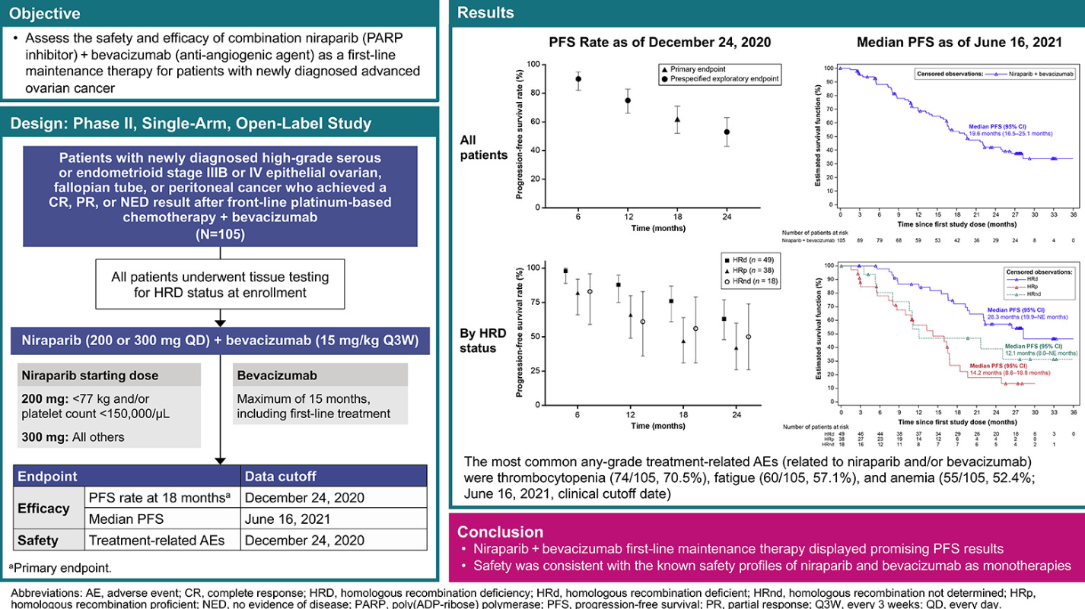
OVARIO: Single Arm Phase 2 of Maintenance Niraparib + Bevacizumab
Hardesty et al. Gynecol Oncol 2022; 166(2)

Slide 13
ASCO 2022 Guidelines Caution Use of PARPi as Treatment in BRCA+ Recurrent Disease: Why?
PARPi monotherapy should not be routinely offered to patients for the treatment of recurrent platinum sensitive EOC. (Type: Evidence-based, benefits outweigh harms; Evidence quality: Intermediate; Strength of recommendation: Moderate.) Evidence on PARPi use in this setting is evolving. Any decision to proceed with PARPi treatment in select populations (BRCA +, PARPi naive, PSOC) should be individualized
ARIEL4¹ (ITT population)
SOLO-3² (BRCAm PSR, ≥3 prior lines)
1.0
100
0.9
90
0.8
80
70
0.7
70
0.6
60
Probability
50
56
0.5
Patients free from death (%)
34
0.4
40
0.3
Chemotherapy
30
26
Chemotherapy
0.2
20
Olaparib
0.1
Rucaparib
10
0.0
0
5
10
15
20
25
30
35
40
45
50
55
66
0
0
3
6
9
12
15
18
21
24
27
30
33
36
39
42
45
48
51
54
57
60
63
66
69
72
At Risk (Events)
Censor +
Rucaparib
Months
Chemotherapy
No. at risk
Months since randomization
Rucaparib
233 (0)
200 (27)
169 (56)
129 (95)
102 (114)
76 (131)
49 (146)
39 (150)
28 (158)
15 (163)
5 (167)
1 (167)
0 (167)
Olaparib
90
89
85
81
71
63
56
47
44
41
37
31
30
27
23
20
16
12
9
7
6
2
0
0
0
Chemotherapy
116 (0)
103 (9)
87 (23)
77 (33)
65 (42)
50 (52)
32 (66)
29 (68)
19 (73)
12 (74)
2 (76)
0 (77)
Chemotherapy
42
35
33
32
29
28
26
25
22
19
18
17
16
16
13
12
10
8
3
2
1
0
0
0
0
ARIEL4¹
SOLO-3²
Median OS, months
Rucaparib
19.4
Chemotherapy
25.4
Median OS, months
Olaparib
29.9
Chemotherapy
39.4
HR 1.31 (95% CI 1.00–1.73)
HR 1.33 (95% CI 0.84–2.18)
1. Clovis Dear Health Care Provider Letter (Rucaparib), May 2022. 2.Leath C, et al. Presented at IGCS Annual Global Meeting, September 2022; Tew WP, Kohn E, et al: PARP inhibitors in the management of ovarian cancer: ASCO guideline rapid recommendation update. J Clin Oncol 2022: DOI https://doi. org/10.1200/JCO.22. 01934

Slide 14
ARIEL 4 provides an excellent example of the impact subsequent therapy and cross over can have……

Slide 15
How do you interpret this in light of the fact that for the IIT group: 19% of patients randomized to chemotherapy received no further therapy as compared to 42% of patients randomized to rucaparib?
This is not interpretable data for OS
Rucaparib arm: 42.7% NFT
CT arm: 23.7% NFT
CT arm: 91% of FT = Rucaparib
Rucaparib arm: 38.5% NFT
CT arm: 16.1% NFT
CT arm: 96% of FT = Rucaparib
Rucaparib arm: 48.5% NFT
CT arm: 15.4% NFT
CT arm: 63% of FT = Rucaparib
Rucaparib arm: 76% of FT = plat

Slide 16
Could BRCA reversions contribute to worse OS outcomes with PARPi vs chemotherapy in late line relapsed OC?
22% of patients in the olaparib arm of SOLO-3 had BRCA reversions detected in their ctDNA at disease progression³
BRCA reversions are a mechanism of resistance to PARPi inhibitors and platinum-based chemotherapy¹
In SOLO-3, no responses to olaparib were seen for patients with BRCA reversions identified at baseline²
4% (3)
3% (1)
18% (12)
Olaparib arm n=68*
Chemotherapy arm n=29*
Reversion mutation present at baseline
Reversion mutation acquired on treatment
*Evaluable patients who had paired plasma samples collected at baseline and disease progression
1. Leath CA, et al. IGCS Annual Global Meeting, September 29 to October 1, 2022. 2. Penson RT, et al. Society of Gynecologic Oncology 2022 Annual Meeting on Women’s Cancer; 18–21 March 2022; abstract 26; 3. Lukashchuk N, et al. J Clin Oncol 2022; 40 (Suppl 16): abstr 5559 and poster presented at American Society of Clinical Oncology (ASCO) Annual Meeting 2022; 3–7 June 2022; poster 438.

Slide 17
MEDIOLA: Can PARPi Combinations Be Used Instead of Chemotherapy?
 | Olaparib plus durvalumab and bevacizumab N=31 | Olaparib plus durvalumab N=32
Median (range) age, years | 64.0 (33–77) | 68.5 (40–86)
Age group (years), n (%)
<50 | 3 (9.7) | 4 (12.5)
≥50–<65 | 14 (45.2) | 8 (25.0)
≥65 | 14 (45.2) | 20 (62.5)
Race, n (%)
White | 20 (64.5) | 24 (75.0)
Asian | 10 (32.3) | 3 (9.4)
Other | 1 (3.2) | 0
Missing | 0 | 5 (15.6)
Platinum sensitivity,‡ n (%)
>6–12 months | 17 (54.8) | 14 (43.8)
>12 months | 14 (45.2) | 18 (56.3)
Number of prior lines of chemotherapy, n (%)
1 | 20 (64.5) | 24 (75.0)
2 | 11 (35.5) | 8 (25.0)
Patients on study treatment§ at final DCO (17 September 2021), n (%)
Olaparib | 5 (16.1) | 0
Durvalumab | 4 (12.9) | 0
Bevacizumab | 2 (6.5) | N/A
Olaparib 300 mg po bid
Treatment to disease progression
Primary endpoints
DCR at 24 weeks†
Safety and tolerability
Triplet
Durvalumab 1.5 g IV q4w
Patient population
Secondary endpoints include:
Confirmed non-gBRCAm high-grade serous PSR OC
1–2 prior lines of PBC
PARP inhibitor naïve
IO agent naïve
Bevacizumab
10 mg/kg IV q2w
OS
DCR at 56 weeks†
PFS (RECIST 1.1)
ORR (RECIST 1.1)
DoR
Sequential enrolment*
Olaparib 300 mg po bid
Doublet
Exploratory endpoints include:
Durvalumab 1.5 g IV q4w
Tumour genetics and immunology biomarkers
Tumour assessments: every 8 weeks
Survival follow-up: treatment discontinuation, monthly for 4 months, then every 2–3 months thereafter
*Doublet cohort enrolment commenced once triplet cohort enrolment was complete; †DCR is defined as the percentage of patients with at least one visit response of complete or partial response, or stable disease which is maintained until the RECIST 1.1 assessment at 24 weeks (primary endpoint) or 56 weeks (secondary endpoint); ‡Time to progression after completion of platinum therapy; §Data are not mutually exclusive as patients could continue study treatment(s) despite discontinuation of other(s).
bid, twice daily; DoR, duration of response; IO, immuno-oncology; IV, intravenous; N/A, not applicable; ORR, objective response rate; po, by mouth; q2w, every 2 weeks; q4w, every 4 weeks; RECIST, Response Evaluation Criteria in Solid Tumours.
.
Susana Banerjee
Notes:
Sources:
Study design
Patient population:
Doublet combination: D081kc00001-revised-csp-v5, p453, 454, (457 and ESMO mini oral for IO agent naïve)
Triplet combination: D081kc00001-revised-csp-v5, p411, 412, (414 and ESMO 2020 mini oral for IO agent naive)
Cohorts:
Sequential enrollment: D081kc00001-revised-csp-v5, p81
Treatment: Doublet combination: D081kc00001-revised-csp-v5, p453; Triplet combination: D081kc00001-revised-csp-v5, p410 (IV not stated, but appears correct based on p405)
Tumor assessments: D081kc00001-revised-csp-v5, p113
Survival follow-up: D081kc00001-revised-csp-v5, p427 (see data checked ESMO 2022 abstract – text confirmed by Caroline)
Endpoints:
D081kc00001-revised-csp-v5, p91,92, 191 (PFS), 192 (ORR)
DCR definition: D081kc00001-revised-csp-v5, p190,191
Demographics:
MEDIOLA_PSC_2stg_Tables_06Apr2022, p19, 26, 50, 52, 49, 12

Slide 18
Mediola: Plat Sensitive/BRCAwt
Triplet cohort demonstrates high ORR and not LOH-dependent
100
Olaparib + durvalumab + bevacizumab
Olaparib + durvalumab
80
ORR = 87.1% (95% CI 70.2–96.4)
Median DOR = 11.1 months (IQR 7.4–16.4)
ORR = 34.4% (95% CI 18.6–53.2)
Median DOR = 6.9 months (IQR 5.4–11.1)
60
40
20
Best % change in target lesion size
0
-20
-40
-60
-80
Confirmed ORR = 77.4% (95% CI 58.9–90.4)
Confirmed ORR = 31.3% (95% CI 16.1–50.0)
-100
 | Olaparib + durvalumab + bevacizumab |  | Olaparib + durvalumab
Genomic instability status* subgroup | ORR (95% CI), % | n/N patients | ORR (95% CI), % | n/N patients
LOH-positive | 100.0 (69.2–100.0) | 10/10 | 50.0 (18.7–81.3) | 5/10
LOH-negative | 75.0 (34.9–96.8) | 6/8 | 16.7 (0.4–64.1) | 1/6
LOH-unknown | 84.6 (54.6–98.1) | 11/13 | 31.3 (11.0–58.7) | 5/16
*GIS, as determined by Foundation Medicine tumour analysis; must have genome-wide LOH ≥14, a somatic BRCA1 and/or BRCA2 mutation, or a mutation in ATM, BRIP1, PALB2, RAD51C, BARD1, CDK12, CHEK1, CHEK2, FANCL, PPP2R2A, RAD51B, RAD51D or RAD54L to be considered positive. At the time of the DCO, the prespecified cut-off for genome-wide LOH of 14% was used¹; GIS, genomic instability status; IQR, interquartile range; LOH, loss of heterozygosity. Drew et al ESMO 2020; Abstract 814MO

Slide 19
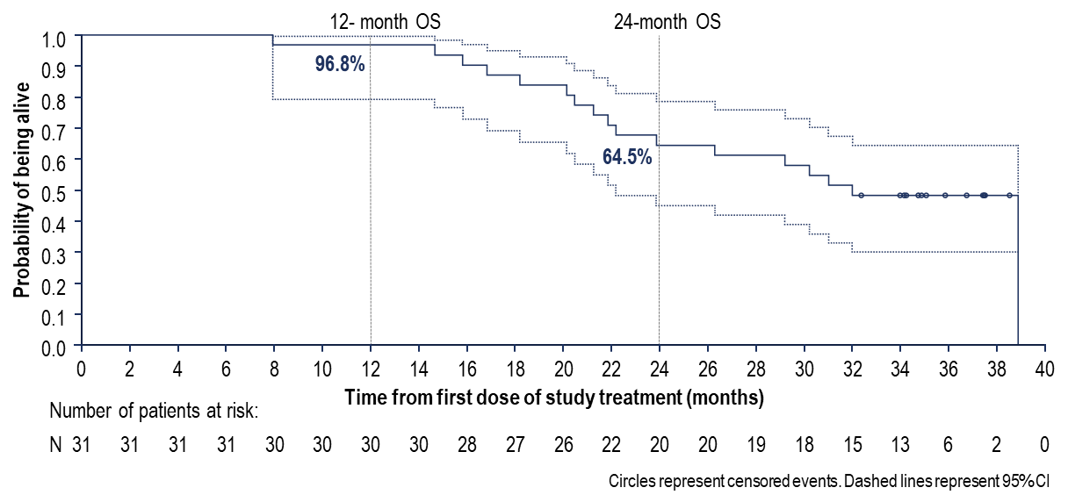
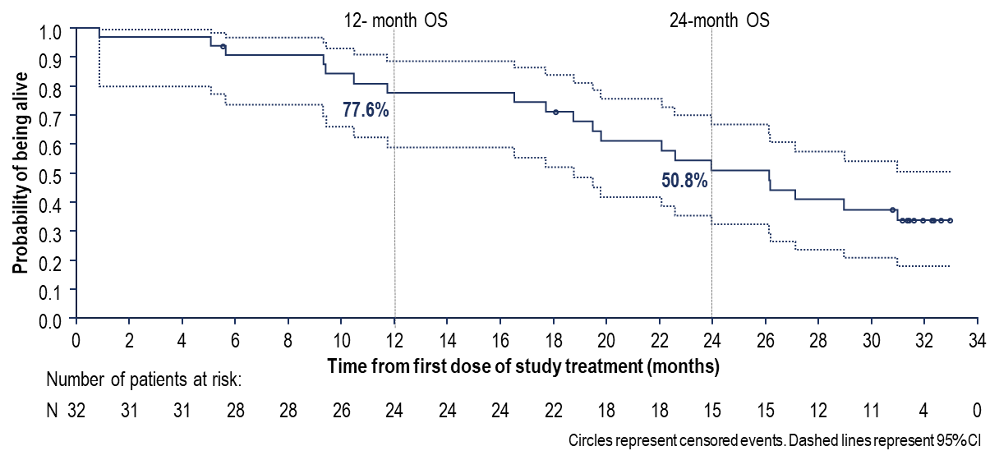
Median OS and 56-week DCR presented 2022
Olaparib plus durvalumab and bevacizumab
Olaparib plus durvalumab
 | Olaparib plus durvalumab and bevacizumab
Median follow-up for OS, months | 31.9
Events, n | 17
Median OS (95% CI), months | 31.9 (22.1–NC)
56-week DCR (90% CI), % | 38.7 (24.1–55.0)
 | Olaparib plus durvalumab
Median follow-up for OS, months | 23.2
Events, n | 20
Median OS (95% CI), months | 26.1 (18.7–NC)
56-week DCR (90% CI), % | 9.4 (2.6–22.5)
Circles represent censored events. Dashed lines represent 95% CI.
Comparisons are not randomized; doublet cohort enrolment commenced once triplet cohort enrolment was complete.
NC, not calculable.
Susana Banerjee
Notes:
Source:
KM: MEDIOLA_PSC_2stg_Figures_30Mar2022, p26
Inset table/OS rates: MEDIOLA_PSC_2stg_Tables_06Apr2022, p193

Slide 20
Prior PARPi: Can you repeat PARPi? OREO
Pujade-Lauraine et al. ESMO 2021 LBA33

Slide 21
Pujade-Lauraine et al. ESMO 2021 LBA33

Slide 22
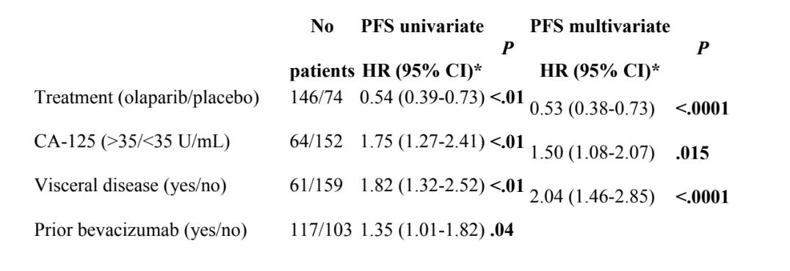
1.45 (1.00-1.84) .0052
Pujade-Lauraine et al. ESMO 2021 LBA33; Selle et al. ASCO 2022

Slide 23
PARPI Conclusions: We should remain circumspect about recent OS data from trials investigating PARPi as maintenance or treatment in relapsed OC
Recent OS data from SOLO-1 and PAOLA-1 indicate that 1L olaparib maintenance may enhance the potential for cure in some patients
HRD testing is essential to predict the likely magnitude of benefit from 1L PARPi maintenance in individual patients
For some patients, maintenance after relapse may be the first opportunity to receive a PARPi
There was a survival difference between PARPi maintenance and placebo in SOLO-2, although not statistically significant
PARPi maintenance for BRCAwt patients with relapsed OC
We need to consider carefully how to interpret the OS data from NOVA and ARIEL3
PARPI after PARPI is an option but OREO doesn’t answer use of PARPI after front line PARPi
PARPi as late-line treatment for patients with relapsed OC
Recent data have led to the withdrawal of late-line treatment indications for rucaparib, olaparib and niraparib (ARIEL4, SOLO-3 and QUADRA)
Combination data has been done in BRCAwt and without comparison to chemotherapy so more information is needed

Slide 24
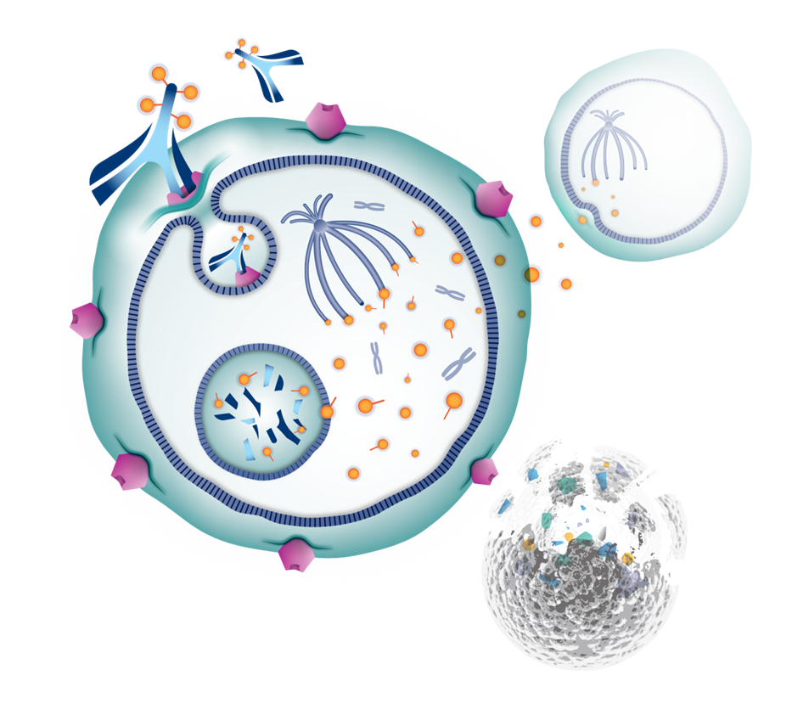
Mirvetuximab Soravtansine (MIRV)
The antibody portion of MIRV binds to FRα found on the surface of epithelial ovarian cancer cells
MIRV is internalized via endocytosis
MIRV is degraded within the lysosome to release its cytotoxic payload (DM4)
DM4 disrupts tubulin resulting in mitotic arrest and apoptosis
DM4 also diffuses through the lipophilic cell membrane allowing bystander killing on adjacent tumor cells
1
2
4
3
5

Slide 25
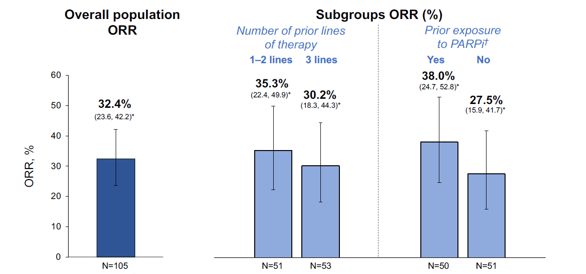
SORAYA: Single Arm Phase 3 of Mirvetuximab in PROC, 1-3 priors (prior bevacizumab mandatory)
Data cutoff: November 16, 2021.
The denominator for the percentage is the number of patients in the investigator-assessed population in each analysis. Patients without at least 1 postbaseline RECIST assessment were treated as not evaluable.
*95% exact CI is estimated by Clopper-Pearson method (Clopper-Pearson exact CI). †Prior PARPi exposure was uncertain for 4 patients in the
investigator-assessed population.
CI, confidence interval; ORR, confirmed objective response rate; PARPi, poly ADP-ribose polymerase inhibitor; RECIST, Response Evaluation Criteria in Solid Tumors.

Slide 26
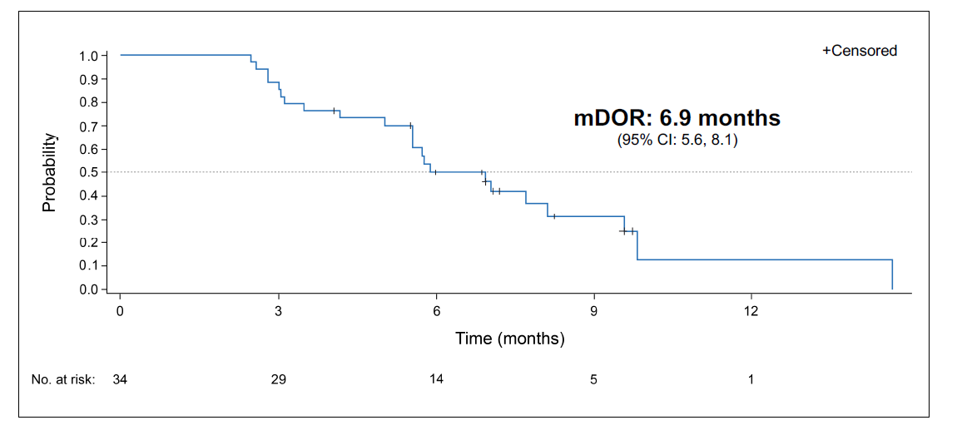
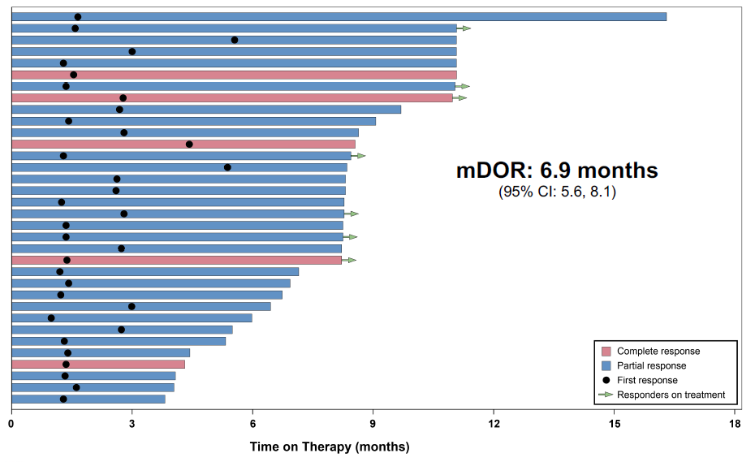
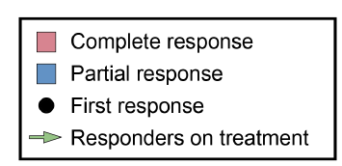
SORAYA Duration of Response
mDOR: 6.9 months (95% CI: 5.6, 8.1)
1.0
0.9
0.8
0.7
0.6
0.5
0.4
0.3
0.2
0.1
0.0
+ Censored
Probability
0
3
6
9
12
0
3
6
9
12
15
18
Time on Therapy (months)
Time (months)
No. at risk:
34
29
14
5
1

Slide 27
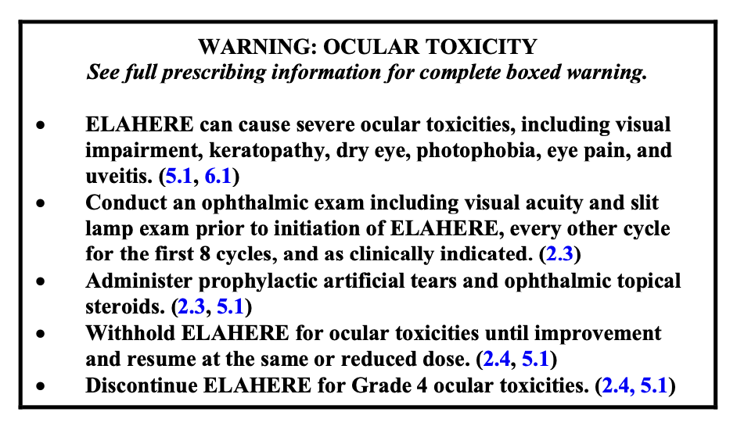
Treatment-Related Adverse Events (TRAE’s)
Adverse events were primarily low-grade, reversible ocular and gastrointestinal events
Serious (grade ≥3) TRAEs occurred in 9% of patients
TRAEs led to dose delays in 33% of patients and dose reductions in 20% of patients
9% discontinued treatment due to TRAEs; one patient discontinued due to an ocular TRAE
Treatment-Related Adverse Events (≥10%) (N=106)
TRAEs, n (%) | All grades | Grade 3 | Grade 4
Blurred vision | 43 (41) | 6 (6) | 0
Keratopathyª | 31 (29) | 8 (8) | 1 (1)
Nausea | 31 (29) | 0 | 0
Dry eye | 26 (25) | 2 (2) | 0
Fatigue | 25 (24) | 1 (1) | 0
Diarrhea | 23 (22) | 2 (2) | 0
Asthenia | 16 (15) | 1 (1) | 0
Photophobia | 14 (13) | 0 | 0
Peripheral neuropathy | 14 (13) | 0 | 0
Decreased appetite | 14 (13) | 1 (1) | 0
Neutropenia | 14 (13) | 2 (2) | 0
Vomiting | 12 (11) | 0 | 0
ªThe grouped preferred term “Keratopathy” includes the following preferred terms: corneal cyst, corneal disorder, corneal epithelial microcysts, keratitis, keratopathy, limbal stem cell deficiency, corneal opacity, corneal erosion, corneal pigmentation, corneal deposits, keratitis interstitial, and punctate keratitis.Data cutoff: April 29, 2022.
Matulonis et al, SGO 2022, ASCO 2022, IGCS 2022
Notes:
Table, Treatment-Related Adverse Events (row order)
DOF t-relae-soc-pt-grd/pg1
DOF t-relae-soc-pt-grd/pg2
DOF t-relae-soc-pt-grd/pg2-3
DOF t-relae-soc-pt-grd/pg15
DOF t-relae-soc-pt-grd/pg3
DOF t-relae-soc-pt-grd/pg23-24
DOF t-relae-soc-pt-grd/pg15
DOF t-relae-soc-pt-grd/pg24
DOF t-relae-soc-pt-grd/pg3-4
DOF t-relae-soc-pt-grd/pg27
DOF t-relae-soc-pt-grd/pg44
DOF t-relae-soc-pt-grd/pg32-33
DOF t-relae-soc-pt-grd/pg16
Bullet 1, Adverse
Matulonis 2022/pg14/bullet1
Bullet 2, Serious
DOF t-summary-safety/pg2/SAE related
Bullet 3, TRAEs
T14.3.1.1_ADAE_TREF18/pg3
Bullet 4, Ten
DOF t-summary-safety/pg4-5/TEAE… related
Bullet 4.1, One
DOF SORAYA – IMGN853-0417 CSR/pg97/P2
Bullet 5, One death
DOF SORAYA - IMGN853-0417 CSR/pg98/Table28/row4
Bullet 5.1, Respiratory
DOF SORAYA - IMGN853-0417 CSR/pg97/P3
Footnote a
DOF allTables04May2022/pg 28/Table 4 footnote
Footnote b
DOF SORAYA – IMGN853-0417 CSR/pg121/sec12.3.1.3.6/P2
Data cutoff
DOF allTables04May2022, top right corner

Slide 28
FORWARD II: Mirvetuximab + Bevacizumab ORRª in the Overall Population and by FRα Expression Level Subgroups
Overall Population
FRα Expression^{b}
52%
(95% CI, 38.6–64.5)
44%
(95% CI, 35.6–53.6)
39%
(95% CI, 25.8–53.9)
CR, 8%
CR, 6%
PR, 44%
CR, 0%
31%
(95% CI, 9.1–61.4)
PR, 38%
PR, 39%
CR, 23%
PR, 8%
CR, complete response; FRα, folate receptor alpha; ORR, objective response rate; PR, partial response.
ªInvestigator assessed. ^{b}Low, 25% to 49%; medium, 50% to 74%; high ≥75% of tumor cells with ≥2+ staining intensity.
Data cutoff: June 21, 2021.
(N=126)
(n=62)
(n=51)
(n=13)
UNPUBLISHED DATA - DO NOT COPY OR DISTRIBUTE
Notes:
Annotations:
Graph:
IMGN853-402-CSR/pg354/Table14.2.1.5

Slide 29
ORRª in Subgroups by BEV Treatment Status, Platinum-Free Interval, and Prior Lines of Therapy
Overall Population
Prior Exposure to BEV
Platinum-Free Interval
No. Prior Lines of Therapy
63%
(95% CI, 42.4–80.6)
58%
(95% CI, 44.9–70.9)
48%
(95% CI, 30.2–66.9)
CR, 7%
44%
(95% CI, 35.6–53.6)
CR, 10%
44%
(95% CI, 33.4–54.2)
PR, 56%
PR, 48%
41% (95% CI, 29.8–53.8)
32% (95% CI, 20.9–44.4)
CR, 10%
CR, 5%
34% (95% CI, 17.9–54.3)
CR, 6%
CR, 7%
PR, 38%
PR, 39%
PR, 38%
CR, 3%
PR, 34%
CR, 3%
PR, 29%
PR, 31%
BEV, bevacizumab; CR, complete response; ORR, objective response rate; PR, partial response; mo, months.
ªInvestigator assessed.
Data cutoff: June 21, 2021.
(N=126)
(n=60)
(n=66)
(n=31)
(n=94)
(n=27)
(n=70)
(n=29)
UNPUBLISHED DATA - DO NOT COPY OR DISTRIBUTE
Notes:
Annotations:
Graph:
Overall: IMGN853-402-CSR/pg354/Table14.2.1.5
FRa expression: IMGN853-402-CSR/pg350/Table14.2.1.3
Platinum status: IMGN853-402-CSR/pg353/Table14.2.1.4
Prior lines of therapy: IMGN853-402-CSR/pg347/Table14.2.1.2
Footnote b
Moore 2018/pg48/Table1/footnote b

Slide 30
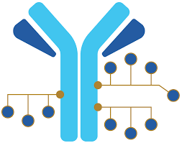
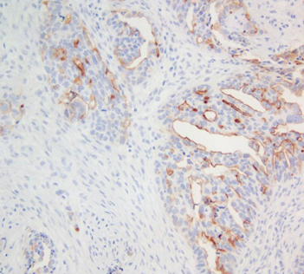
Upifitamab Rilsodotin (UpRi) – First-in-Class ADC Targeting NaPi2b
= Antigen-expressing cell
AF-HPA
AF
Antibody: Humanized monoclonal anti-NaPi2b¹
Linker: Polymer scaffold; cleavable ester linker²
Payload: AF-HPA (DolaLock-controlled bystander effect)¹
Drug-to-Antibody Ratio: ~10
Intracellular metabolism
Upon ADC internalization into tumor cells and efficient release of payload, AF-HPA payload is metabolized to AF that remains highly potent but loses the ability to cross the cell membrane, locking it in the tumor, controlling the bystander effect, and consequently limiting impact on adjacent healthy cells^{2,3}
UpRi
NaPi2b Is a Sodium-Dependent Phosphate Transporter Broadly Expressed in Ovarian Cancer With Limited Expression in Healthy Tissues⁴
NaPi2b IHC assay in development – an optimal diagnostic assay would be robust, predictive, reproducible, easily able to distinguish a wide range of expression using TPS scoring method²
NaPi2b expressed by tumor cells in two-thirds of patients with high-grade serous ovarian cancer²
NaPi2b is a lineage antigen (not an oncogene)¹
2/3
%
0
1 or 2 or 3
ADC, antibody drug conjugate; AF, auristatin F; AF-HPA, auristatin F-hydroxypropylamide; IHC, immunohistochemistry; NaPi2b, sodium-dependent phosphate transport protein 2B; TPS, tumor proportion score; UpRi, upifitamab rilsodotin.
1. Bodyak ND et al. Mol Cancer Ther. 2021;20(5):885–895. 2. Mersana. Data on File. 2022. 3. Tolcher AW et al. ASCO Annual Meeting 2019; Abstract 3010. 4. Lin K et al. Clin Cancer Res. 2015;21(22):5139–5150.

Slide 31
Best Response by UpRi Dose Group
Similar Tumor Reduction in Both Dose Groups: Two-thirds of Patients Had Reductions in Target Tumor Lesions by RECIST 1.1
100
90
Dose Group 36
80
49/73 (67%) Patients Had a Target Lesion Reduction From Baseline
Dose Group 43
70
PD
60
UpRi <33 mg/m²
50
40
PD
PD
30
PD
PD
PD
PD
Progressive Disease
20
SD
PD
SD
SD
PD
SD
SD
PD
10
SD
SD
PD
PD
SD
Change in Target Lesion From Baseline (%)
SD
SD
PD
PD
0
-10
SD
SD
SD
SD
SD
PD
SD
SD
SD
SD
SD
SD
-20
Partial Response
PD
SD
SD
SD
SD
-30
PD
SD
SD
SD
-40
SD
SD
PR
PR
-50
uPR
uPR
PR
PR
PR
PD
SD
PR
PR
PR
PR
-60
SD
PD
-70
PR
PR
PR
-80
PR
PR
-90
Complete Response
SD
uPR
-100
SD
TPS
L
CR
CR
PR
H
L
ND
L
L
ND
L
L
H
ND
L
L
L
L
L
H
H
L
H
L
H
H
L
L
H
ND
H
H
L
H
H
H
ND
ND
H
L
L
H
ND
H
L
H
H
L
H
ND
ND
H
H
ND
H
L
H
H
H
ND
H
H
H
H
ND
H
H
H
L
H
H
ND
ND
H
H
H
Data cut: June 10, 2021. Analysis with 73 evaluable patients. Two patients excluded as post-baseline tumor measurement shows “Not Measurable”, yet “PD” was assigned by investigator in response dataset. There were 22 unevaluable patients: 4 in Dose Group 36, 2 patient withdrawals (1 enrolled in hospice), 2 patient deaths; 18 in Dose Group 43, 5 patient withdrawals, 1 clinical progression, 3 due to adverse events, 8 deaths, 1 had not reached first scan.
CR, complete response; H, high; L, low; ND, not yet determined; PD, progressive disease; PR, partial response; RECIST, Response Evaluation Criteria in Solid Tumors; SD, stable disease; TPS, tumor proportion score; uPR, unconfirmed partial response; UpRi, upifitamab rilsodotin.

Slide 32
GOG-3049 / ENGOT-OV71-NSGO-CTU Phase 3 Study of UpRi Monotherapy Maintenance vs Placebo in Recurrent Platinum-Sensitive Ovarian Cancer
Key Enrollment Criteria
CR, PR, or SD as best response following platinum in recurrent disease
2–4 prior lines of platinum (including the immediately preceding platinum)
NaPi2b-high (TPS ≥75)
Prior PARPi therapy only required for BRCAmut
UpRi IV Q4W
Primary Endpoint
PFS by BICR
Secondary Endpoints
PFS by Investigator
ORR
OS
Randomize 2:1
N=350
Placebo
Informed by FDA Feedback and CHMP Scientific Advice; Plans to Initiate in 2022
BICR, blinded independent central review; BRCAmut, breast cancer susceptibility gene mutated; CHMP, Committee for Medicinal Products for Human Use; CR, complete response; FDA, Food and Drug Administration; IV, intravenous; NaPi2b, sodium-dependent phosphate transport protein 2B; ORR, overall response rate; OS, overall survival; PARPi, poly (ADP-ribose) polymerase inhibitor; PFS, progression-free survival; PR, partial response; Q4W, every 4 weeks; SD, stable disease; TPS, tumor proportion score; UpRi, upifitamab rilsodotin.

Slide 33
Conclusions
The approval of antibody drug conjugates for the treatment of Her2+ breast cancer and Hodgkin lymphoma has created great enthusiasm for the technology as a proven paradigm.
Antibody drug conjugates against novel targets are in development for a large number of solid tumors and blood cancers.
The possibilities for developing and utilizing these agents are limited only by the discovery of suitable targets, both highly expressed on and relatively specific to cancer cells.
ADCs allow more precise delivery of chemotherapy to cancer cells, which should improve effectiveness relative to toxicity.

Slide 34
APPENDIX

Slide 35
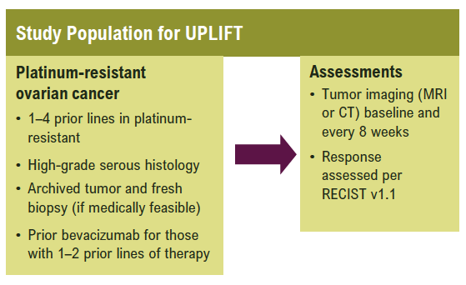
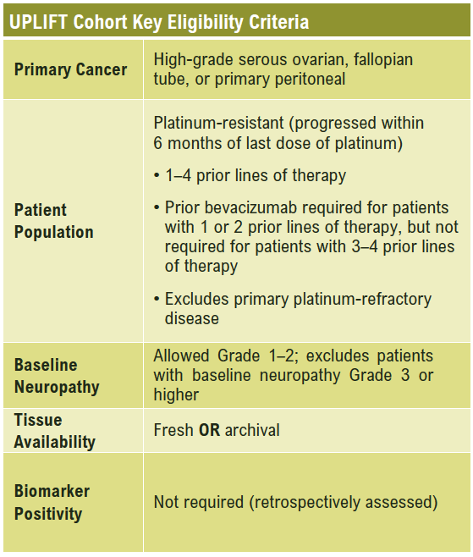
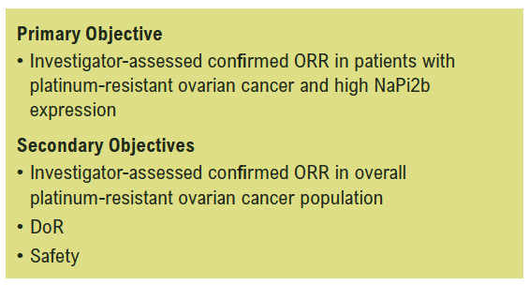
UPLIFT (ENGOT-ov67/GOG-3048): A Pivotal Cohort Evaluating Upiﬁtamab Rilsodotin (XMT-1536; UpRi), a NaPi2b-Directed Dolaflexin ADC for Platinum-Resistant Ovarian Cancer
Richardson DL et al. SGO 2022;Abstract 585.

