Slide 1
Beyond The Guidelines: Urologic Oncology
Investigators Provide Perspectives on the
Optimal Management of Prostate Cancer
Part 2 of a 2-Part CME Satellite Symposium Series Held in Conjunction
with the American Urological Association Annual Meeting 2023 (AUA2023)
Sunday, April 30, 2023
6:00 PM – 8:00 PM
Faculty
Himisha Beltran, MD
Stephen J Freedland, MD
Fred Saad, MD
Neal D Shore, MD
Moderator
Matthew R Smith, MD, PhD

Slide 2





Faculty
Himisha Beltran, MD
Associate Professor of Medicine
Lank Center for Genitourinary Oncology and
the Division of Molecular and Cellular Oncology
Director of Translational Research, Medical
Oncology
Dana-Farber Cancer Institute
Boston, Massachusetts
Fred Saad, MD
Professor and Chief of Urology
Director of GU Oncology
Raymond Garneau Chair in Prostate Cancer
University of Montreal Hospital Center (CHUM)
Director, Prostate Cancer Research
Montreal Cancer Institute/CRCHUM
Montréal, Québec, Canada
Stephen J Freedland, MD
Staff Physician, Durham VA Medical Center
Durham, North Carolina
Professor of Urology
Warschaw, Robertson, Law Families Chair in
Prostate Cancer
Director, Center for Integrated Research on Cancer
and Lifestyle (CIRCL)
Associate Director for Education and Training
Samuel Oschin Comprehensive Cancer Institute
Cedars-Sinai Medical Center
Los Angeles, California
Neal D Shore, MD
Director, CPI
Carolina Urologic Research Center
Chief Medical Officer, Surgery/Urology
GenesisCare
Medical Director, CUSP: Clinical Research
Consortium
Myrtle Beach, South Carolina
Moderator
Matthew R Smith, MD, PhD
Claire and John Bertucci Endowed Chair
in Genitourinary Cancers
Professor of Medicine
Harvard Medical School
Director, Genitourinary Malignancies Program
Massachusetts General Hospital Cancer Center
Boston, Massachusetts

Slide 3
Dr Beltran — Disclosures
Advisory Committee | Amgen Inc, Bayer HealthCare Pharmaceuticals, Blue Earth Diagnostics, Curie Therapeutics, Daiichi Sankyo Inc, Foundation Medicine, Loxo Oncology Inc, a wholly owned subsidiary of Eli Lilly & Company, Merck, Oncorus, Pfizer Inc, Sanofi
Contracted Research | Bristol Myers Squibb, Circle Pharma, Daiichi Sankyo Inc, Novartis
Data and Safety Monitoring Board/Committee | AstraZeneca Pharmaceuticals LP

Slide 4
Dr Freedland — Disclosures
Consulting Agreements | Astellas, AstraZeneca Pharmaceuticals LP, Bayer HealthCare Pharmaceuticals, Janssen Biotech Inc, Merck, Myovant Sciences, Pfizer Inc, Sanofi
Speakers Bureau | AstraZeneca Pharmaceuticals LP, Sanofi

Slide 5
Dr Saad — Disclosures
Consultant | AbbVie Inc, Advanced Accelerator Applications, Astellas, AstraZeneca Pharmaceuticals LP, Bayer HealthCare Pharmaceuticals, Janssen Biotech Inc, Lilly, Merck, Myovant Sciences, Novartis, Pfizer Inc, Tolmar
Grant/Research Support (Institution) | Advanced Accelerator Applications, Astellas, AstraZeneca Pharmaceuticals LP, Bayer HealthCare Pharmaceuticals, Bristol Myers Squibb, Exelixis Inc, Janssen Biotech Inc, Merck, Novartis, Pfizer Inc, Sanofi

Slide 6
Dr Shore — Disclosures
Consulting Agreements | AbbVie Inc, AIkido Pharma Inc, Alessa Therapeutics, Amgen Inc, Arquer Diagnostics, Asieris Pharmaceuticals, Astellas, AstraZeneca Pharmaceuticals LP, Bayer HealthCare Pharmaceuticals, Boston Scientific Corporation, Bristol Myers Squibb, CG Oncology, Clarity Pharmaceuticals, Clovis Oncology, Dendreon Pharmaceuticals Inc, Exact Imaging, Exact Sciences Corporation, FerGene, Ferring Pharmaceuticals, FIZE Medical, Foundation Medicine, Genentech, a member of the Roche Group, GenesisCare, Guardant Health, ImmunityBio, Incyte Corporation, Invitae, Janssen Biotech Inc, Lantheus, Lilly, MDxHealth, Merck, Minomic, Myovant Sciences, Myriad Genetic Laboratories Inc, NGM Biopharmaceuticals, Nonagen Bioscience, Novartis, Nymox Pharmaceutical Corporation, Pacific Edge, Pfizer Inc, Photocure, PlatformQ, ProFound Therapeutics, Promaxo, Propella Therapeutics Inc, Protara Therapeutics, Sanofi, Sesen Bio, Specialty Networks, Telix Pharmaceuticals Limited, Tolmar, UroGen Pharma, Vaxiion Therapeutics, Vessi Medical
Contracted Research | Astellas, AstraZeneca Pharmaceuticals LP, Bayer HealthCare Pharmaceuticals, Bristol Myers Squibb, Candel Therapeutics, CG Oncology, Dendreon Pharmaceuticals Inc, DisperSol Technologies LLC, Eric Pharmaceuticals, Exact Imaging, Exelixis Inc, FKD Therapeutics Oy, Forma Therapeutics, Genentech, a member of the Roche Group, Guardant Health, Janssen Biotech Inc, Jiangsu Yahong Meditech, Johnson & Johnson Pharmaceuticals, Medivation Inc, a Pfizer Company, Merck Sharp & Dohme LLC, MT Group, Myovant Sciences, Novartis, OncoCellMDx, Pacific Edge, Palette Life Sciences, Pfizer Inc, Plexxikon Inc, POINT Biopharma, Propella Therapeutics Inc, RhoVac ApS, Seagen Inc, STEBA Biotech NV, Theralase Technologies Inc, UroGen Pharma, Urotronic, US Biotest Inc, Vaxiion Therapeutics, Veru Inc, Zenflow

Slide 7
Dr Smith — Disclosures
Advisory Committee and Consulting Agreements | Bayer HealthCare Pharmaceuticals, Janssen Biotech Inc, Lilly, Pfizer Inc
Contracted Research (to Institution) | Bayer HealthCare Pharmaceuticals, Janssen Biotech Inc, Lilly, Pfizer Inc

Slide 8
Commercial Support
This activity is supported by educational grants from Astellas and Pfizer Inc, AstraZeneca Pharmaceuticals LP, Bayer HealthCare Pharmaceuticals, Janssen Biotech Inc, administered by Janssen Scientific Affairs LLC, Lilly, and Merck.
Research To Practice CME Planning Committee Members,
Staff and Reviewers
Planners, scientific staff and independent reviewers for Research To Practice have no relevant conflicts of interest to disclose.

Slide 9
Agenda
Module 1 – Management Approaches for Nonmetastatic Prostate Cancer —
Dr Freedland
Module 2 – Optimizing the Care of Patients with Metastatic Hormone-Sensitive Prostate Cancer (mHSPC) — Dr Saad
Module 3 – Therapeutic Considerations for Patients with Newly Diagnosed Metastatic CRPC (mCRPC) — Dr Shore
Module 4 – Contemporary Management of mCRPC in Patients Harboring an HRR Gene Alteration — Dr Smith
Module 5 – Current and Emerging Strategies in the Treatment of Recurrent mCRPC — Dr Beltran

Slide 10
Prostate Cancer Survey Respondents
Faculty
Himisha Beltran, MD
Stephen J Freedland, MD
Fred Saad, MD
Neal D Shore, MD
Matthew R Smith, MD, PhD
Clinical Investigators
Michael Ahdoot, MD
Brian F Chapin, MD
Raoul S Concepcion, MD
E David Crawford, MD
Sia Daneshmand, MD
Leonard G Gomella, MD
Jason Hafron, MD
Gautam Jayram, MD
Ashish M Kamat, MD, MBBS
Vitaly Margulis, MD
Joshua J Meeks, MD, PhD
Anirban P Mitra, MD, PhD
David S Morris, MD
Mark Preston, MD, MPH
Robert Svatek, MD
Stephen B Williams, MD, MS
Alfred Witjes, MD, PhD

Slide 11
MODULE 1: Management Approaches for
Nonmetastatic Prostate Cancer

Slide 12

Cases from Contributing Urologists

Slide 13



A 66-year-old man presents with Gleason 8 (4 + 4) prostate adenocarcinoma (PSA 12.7 ng/mL). A bone scan is negative. CT imaging reveals uptake in the pelvic nodes. What approach to primary therapy would you most likely recommend for this patient?
External beam radiation therapy (EBRT)
13
Radical prostatectomy
6
Survey of urologic oncology clinical investigators

Slide 14

A 61-year-old man presents with Gleason 8 (4 + 4) prostate adenocarcinoma (PSA 8 ng/mL) and undergoes RALP (robotically assisted laparoscopic prostatectomy). Final pathology reveals T3bN1 disease with 2/10 positive lymph nodes. Regulatory and reimbursement issues aside, would you recommend hormonal therapy at this point?
No
7
Yes, ADT + abiraterone
8
Yes, ADT
7
How long would you continue the hormonal therapy?
6 months
12 months
18 months
24 months
24 months
24 months
24 months
24 months
24 months
24 months
24 months
24 months
24 months minimum
At least 24 months
24-36 months
Survey of urologic oncology clinical investigators

Slide 15



A 64-year-old man underwent a radical prostatectomy 5 years ago for Gleason 9
(4 + 5) prostate adenocarcinoma (PSA 4.8 ng/mL). Pathology showed T2N0 disease with negative margins. His postsurgical PSA was initially undetectable but rose to 0.2 ng/mL. He undergoes salvage EBRT (45 Gray in 25 fractions) to the pelvic and prostate fossa and receives 6 months of ADT. His PSA rises to 0.23 ng/mL. Bone and CT scans are negative. PSMA PET reveals a lesion in the right anterior first rib. In addition to radiation therapy, regulatory and reimbursement issues aside, what would be your most likely treatment recommendation?
ADT + abiraterone
6
ADT + apalutamide
5
Observation
4
ADT + enzalutamide
3
ADT alone
2
ADT + darolutamide
2
Survey of urologic oncology clinical investigators

Slide 16
Management Approaches for Nonmetastatic Prostate Cancer
Stephen J. Freedland, MD
Professor of Urology
Director, Center for Integrated Research on Cancer and Lifestyle
Cedars-Sinai Medical Center
Los Angeles, CA USA

Slide 17
Outline
ADT
  When and how
NHTs in nmCSPC
NHTs in nmCRPC
Summary

Slide 18
ADT – When and how

Slide 19
Key unanswered questions for ADT
When to start ADT
How to deliver ADT
  Intermittent vs. continuous
  Combined androgen blockade vs. ADT alone
  GnRH agonist vs. antagonist

Slide 20
Agonist vs. Antagonist
Agonist
Pros
  Convenience (once every 3-6 months shot)
  Cost effective
  Tradition
  Works well
Cons
  No oral option
  T surge
  Time to T nadir
  CV risk
  Occasional T escape
Antagonist
Pros
  Rapid T suppression
  Rapid T return
  Reduced CV risk?
  Oral
  Better T suppression
Cons
  Expensive
  Logistically harder

Slide 21
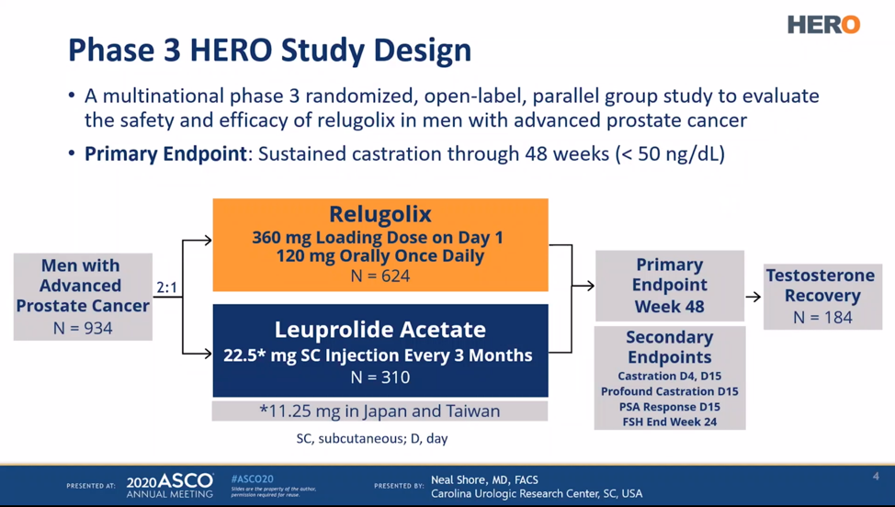
Phase 3 HERO Trial: Relugolix vs. Leuprolide
Shore, et al. NEJM, 2020

Slide 22
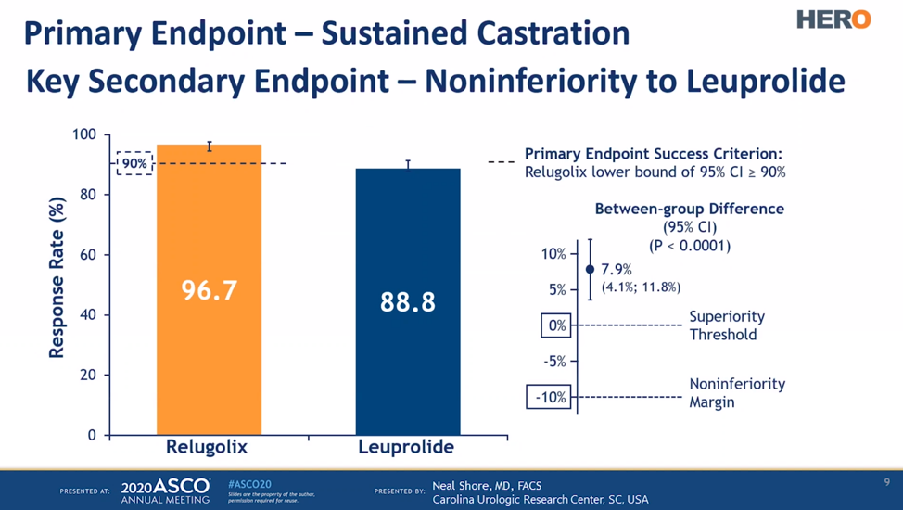
Phase 3 HERO Trial: Relugolix vs. Leuprolide
Shore, et al. NEJM, 2020

Slide 23
Phase 3 HERO Trial: Relugolix vs. Leuprolide
Shore, et al. NEJM, 2020

Slide 24
Phase 3 HERO Trial: Relugolix vs. Leuprolide
Shore, et al. NEJM, 2020

Slide 25
Novel hormonal therapies for nmCspc

Slide 26
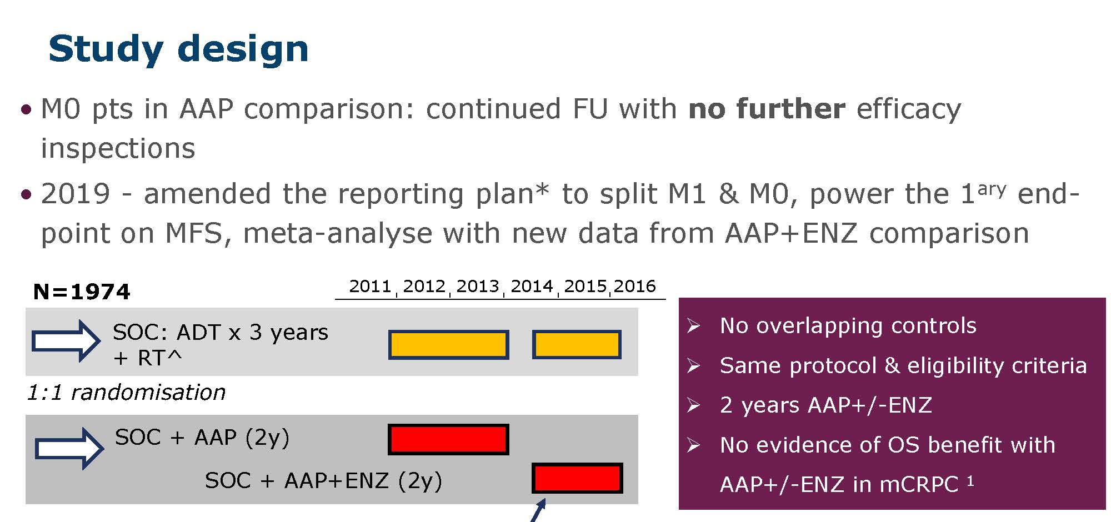
STAMPEDE: Abiraterone ±
Enzalutamide in nmCSPC
2019 – amended the reporting plan* to split M1 & M0, power the primary
end-point on MFS, meta-analyse with new data from AAP+ENZ comparison
Attard, et al. Lancet, 2022

Slide 27
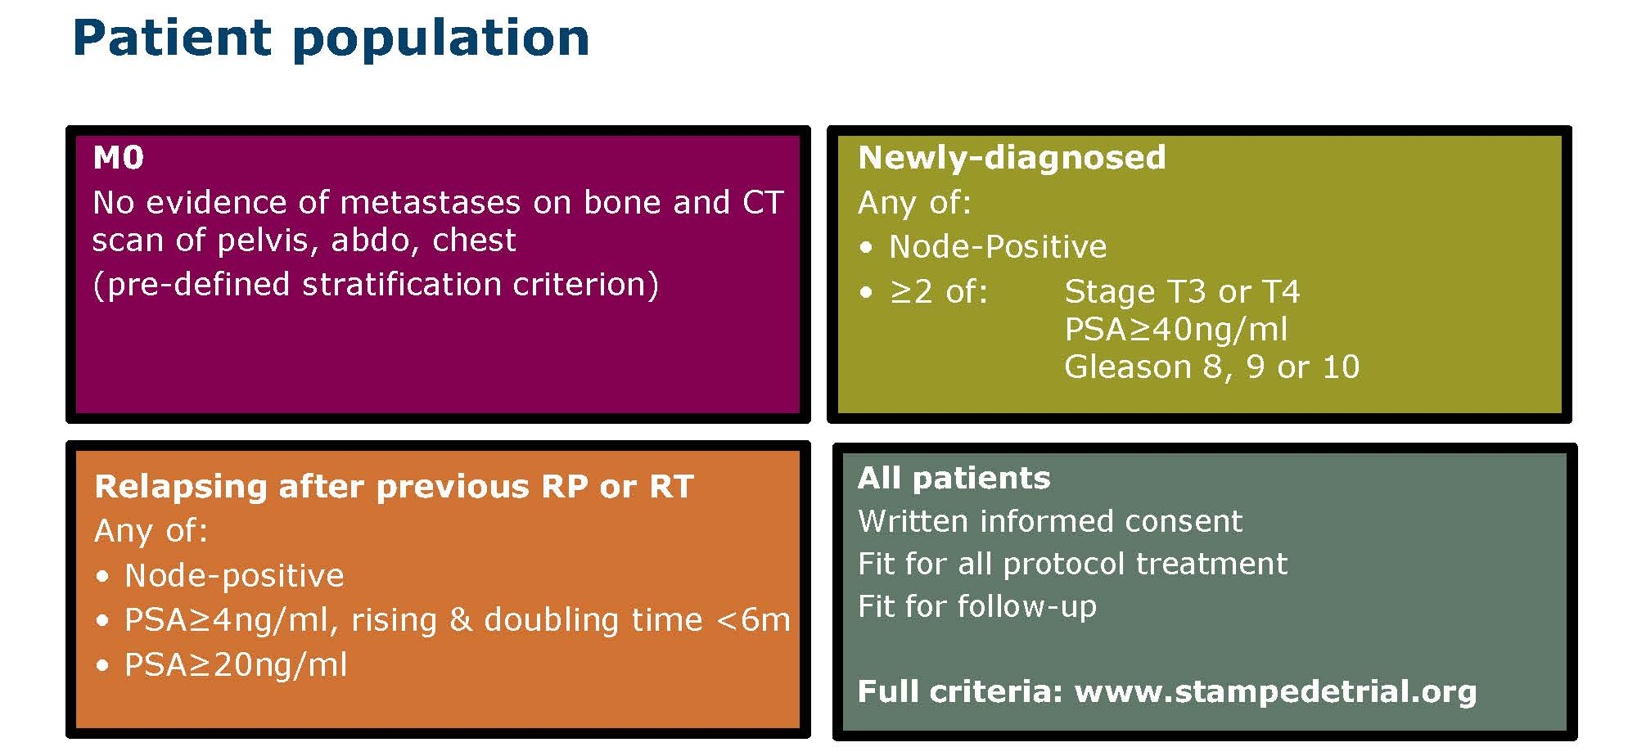
STAMPEDE: Abiraterone ±
Enzalutamide in nmCSPC
Attard, et al. Lancet, 2022

Slide 28
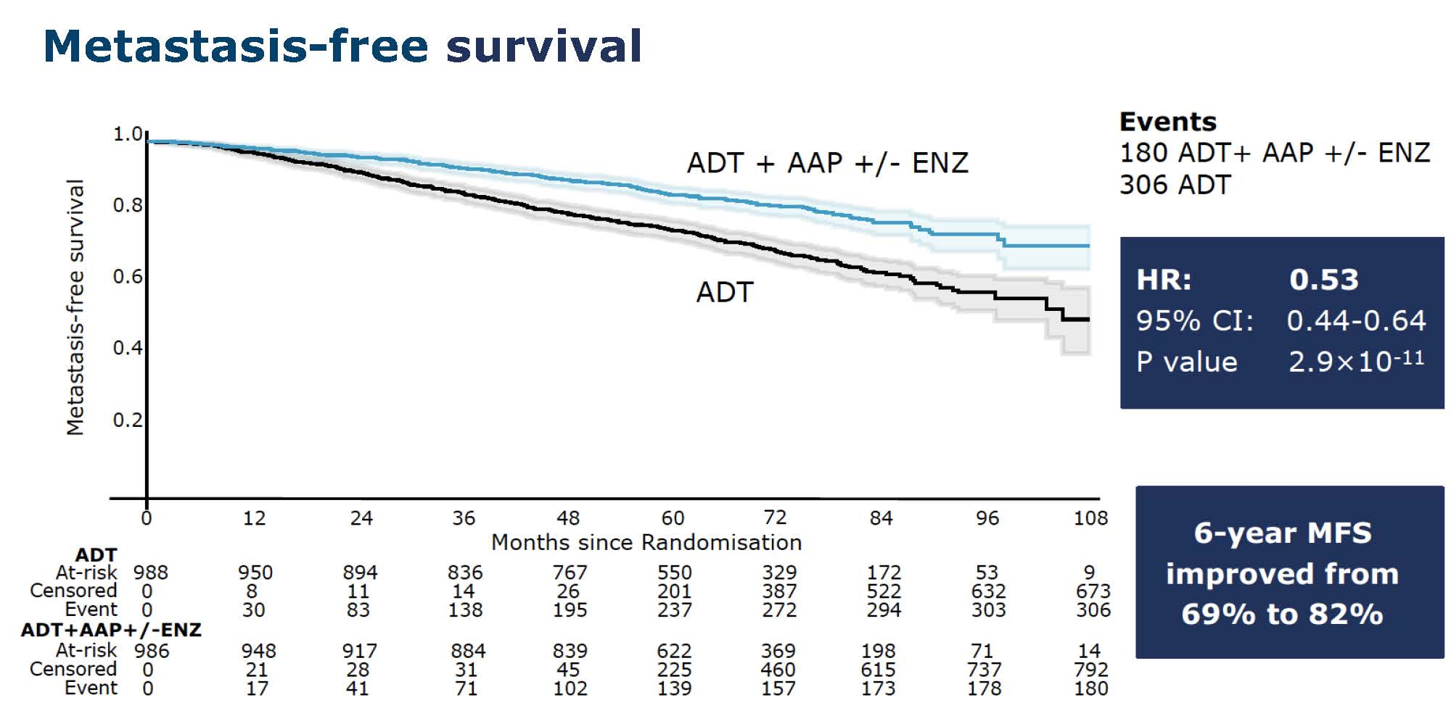
STAMPEDE: Abiraterone ±
Enzalutamide in nmCSPC
Attard, et al. Lancet, 2022

Slide 29
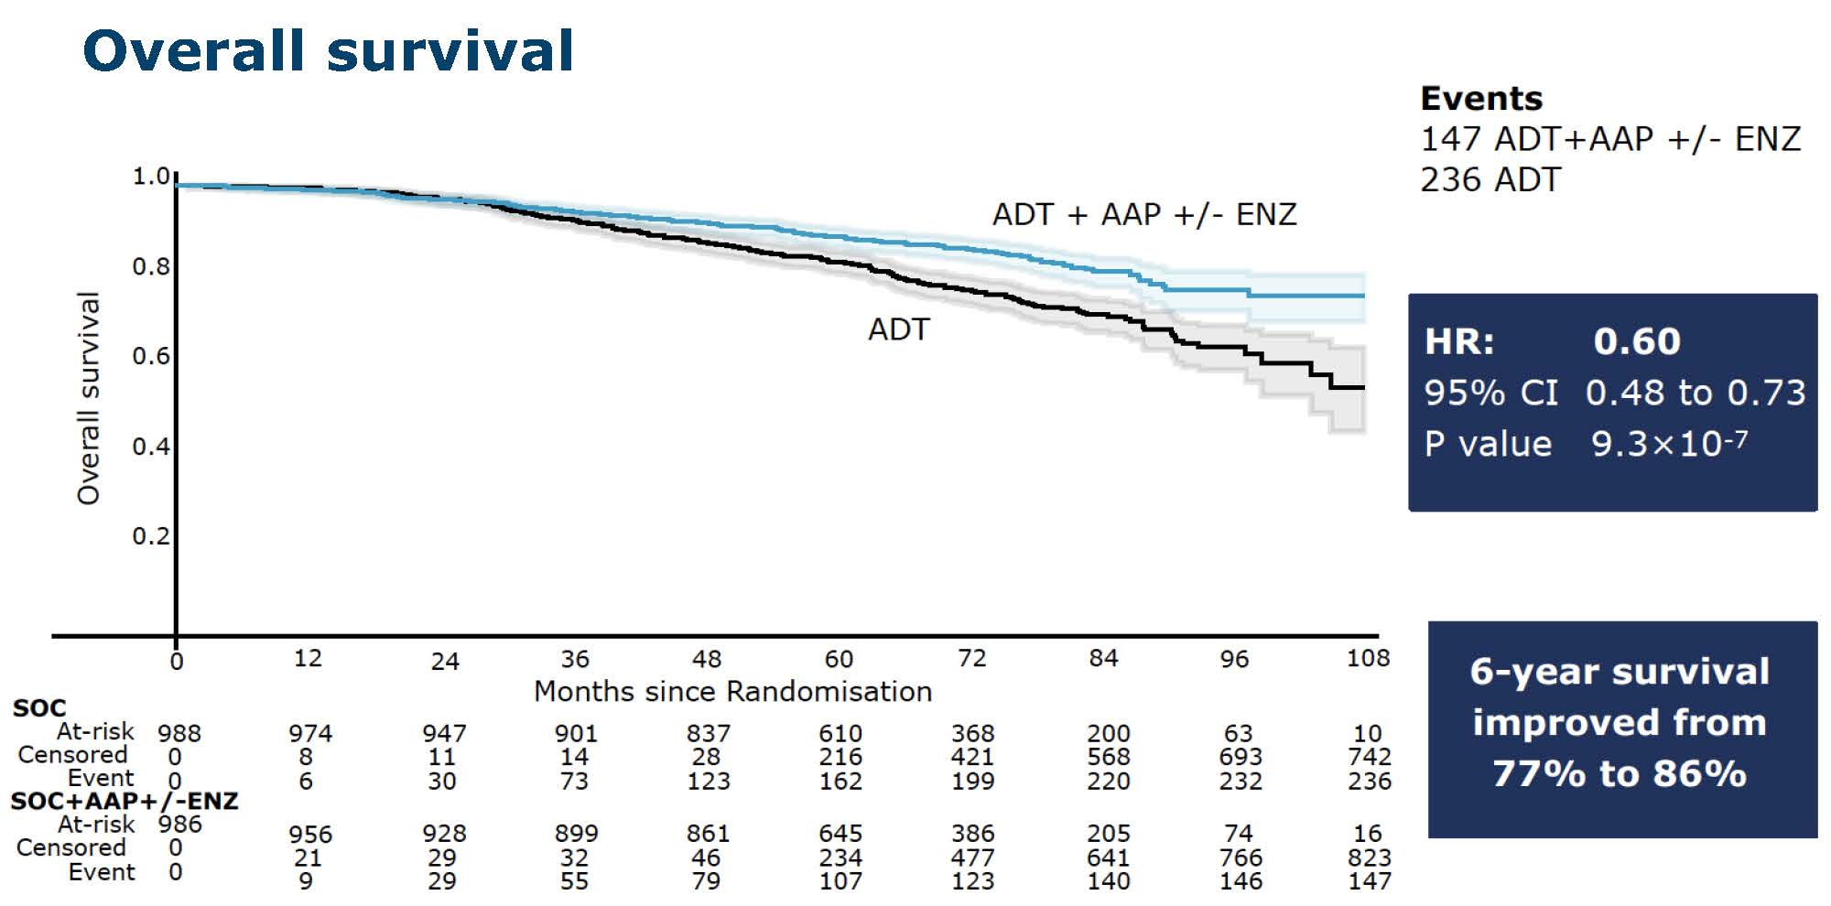
STAMPEDE: Abiraterone ±
Enzalutamide in nmCSPC
Attard, et al. Lancet, 2022

Slide 30
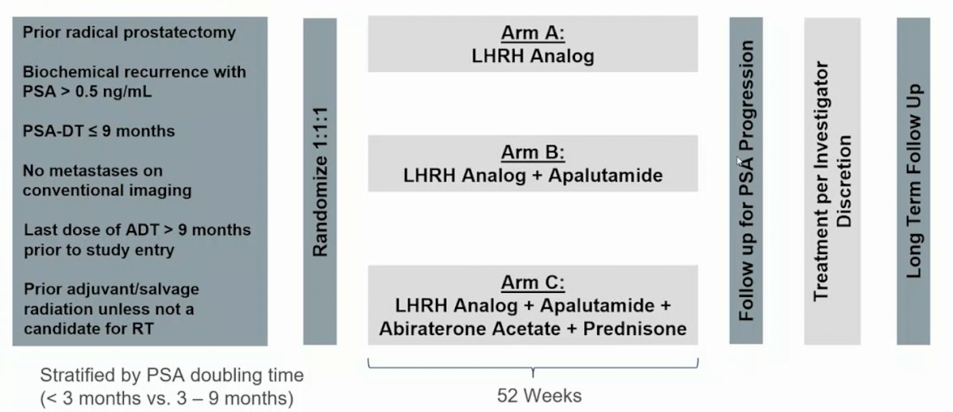
PRESTO: Apalutamide for high-risk BCR
Follow up for PSA Progression
Aggarwal, et al. ESMO, 2022

Slide 31
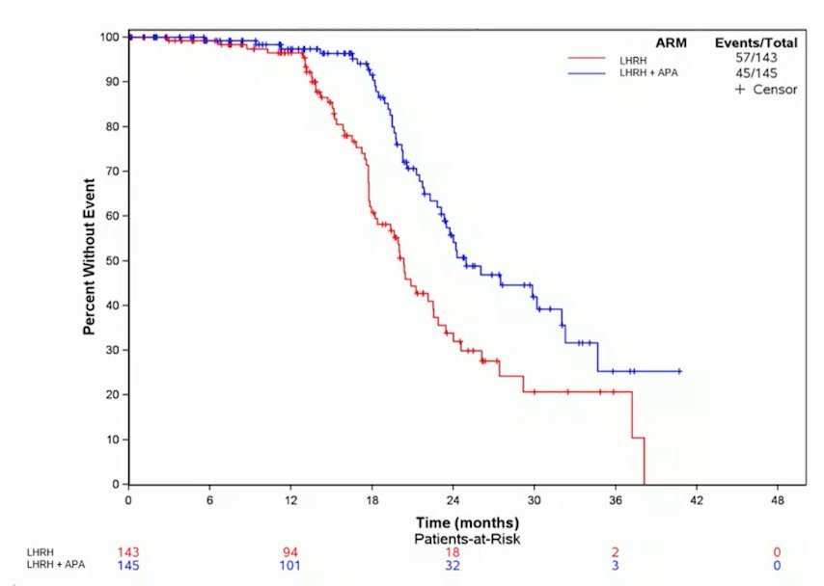
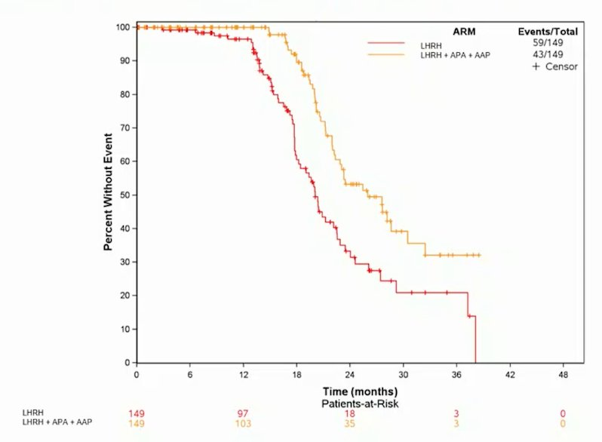
PRESTO: Apalutamide for high-risk BCR
HR = 0.52 (95% CI 0.35-0.77)
HR = 0.48 (95% CI 0.32-0.71)
Aggarwal, et al. ESMO, 2022

Slide 32
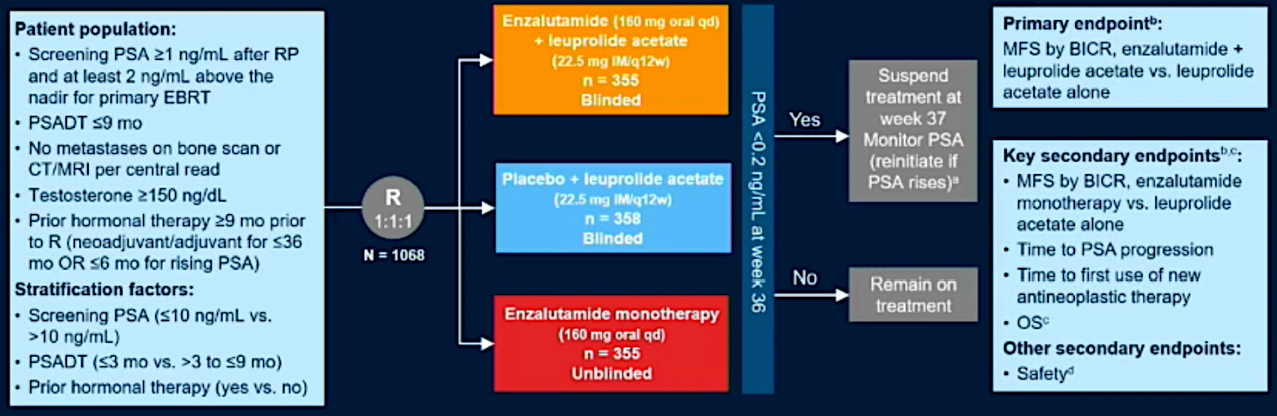
EMBARK: Enzalutamide for high-risk BCR
BCR = biochemical recurrence
Shore, et al. AUA, 2023

Slide 33
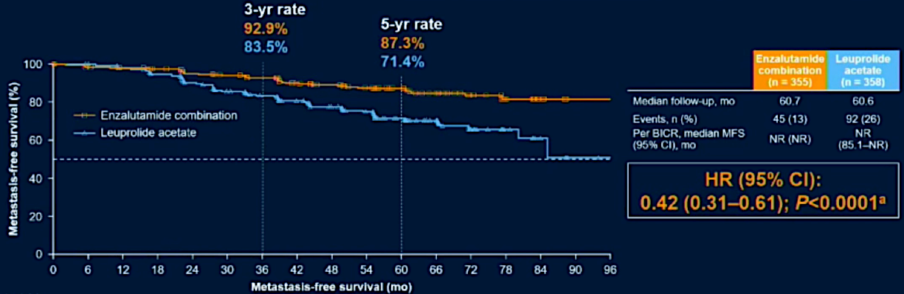
EMBARK: MFS with Enza Combination vs. Leuprolide
Shore, et al. AUA, 2023

Slide 34
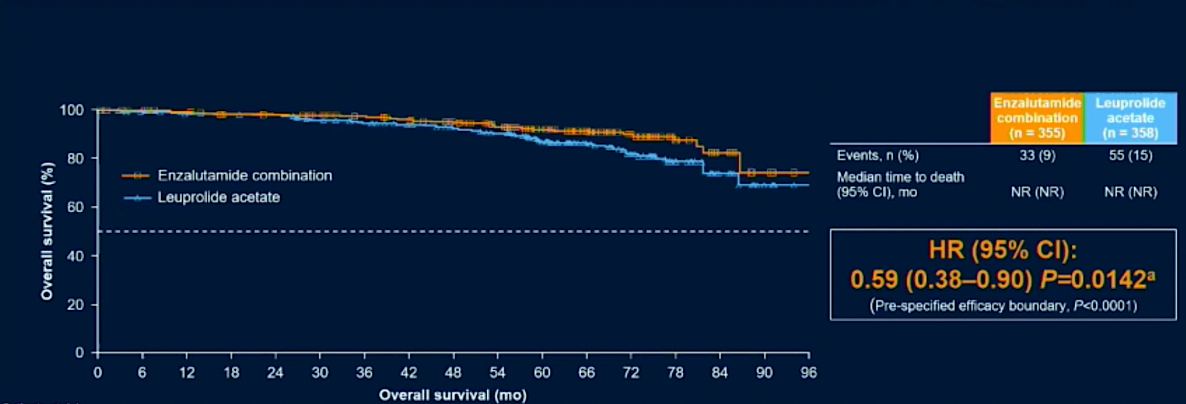
EMBARK: Interim OS for Enza combination vs leuprolide
Shore, et al. AUA, 2023

Slide 35
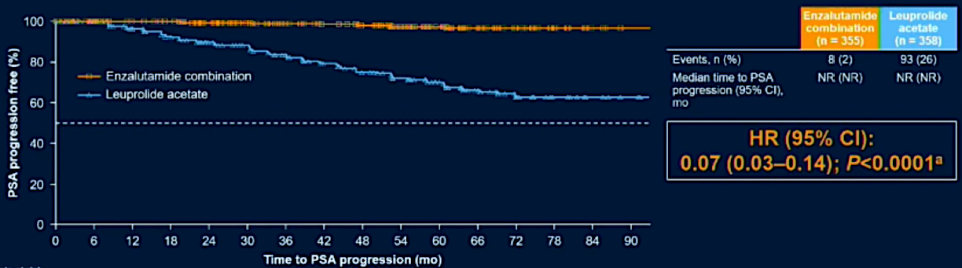
EMBARK: Time to PSA Progression with Enza Combination vs. Leuprolide
Shore, et al. AUA, 2023

Slide 36
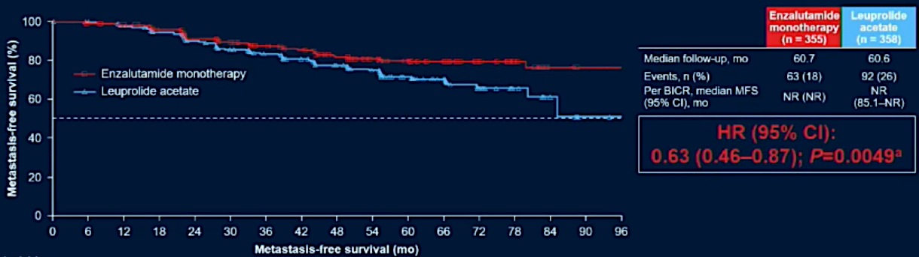
EMBARK: MFS with Enza Monotherapy vs. Leuprolide
Shore, et al. AUA, 2023

Slide 37
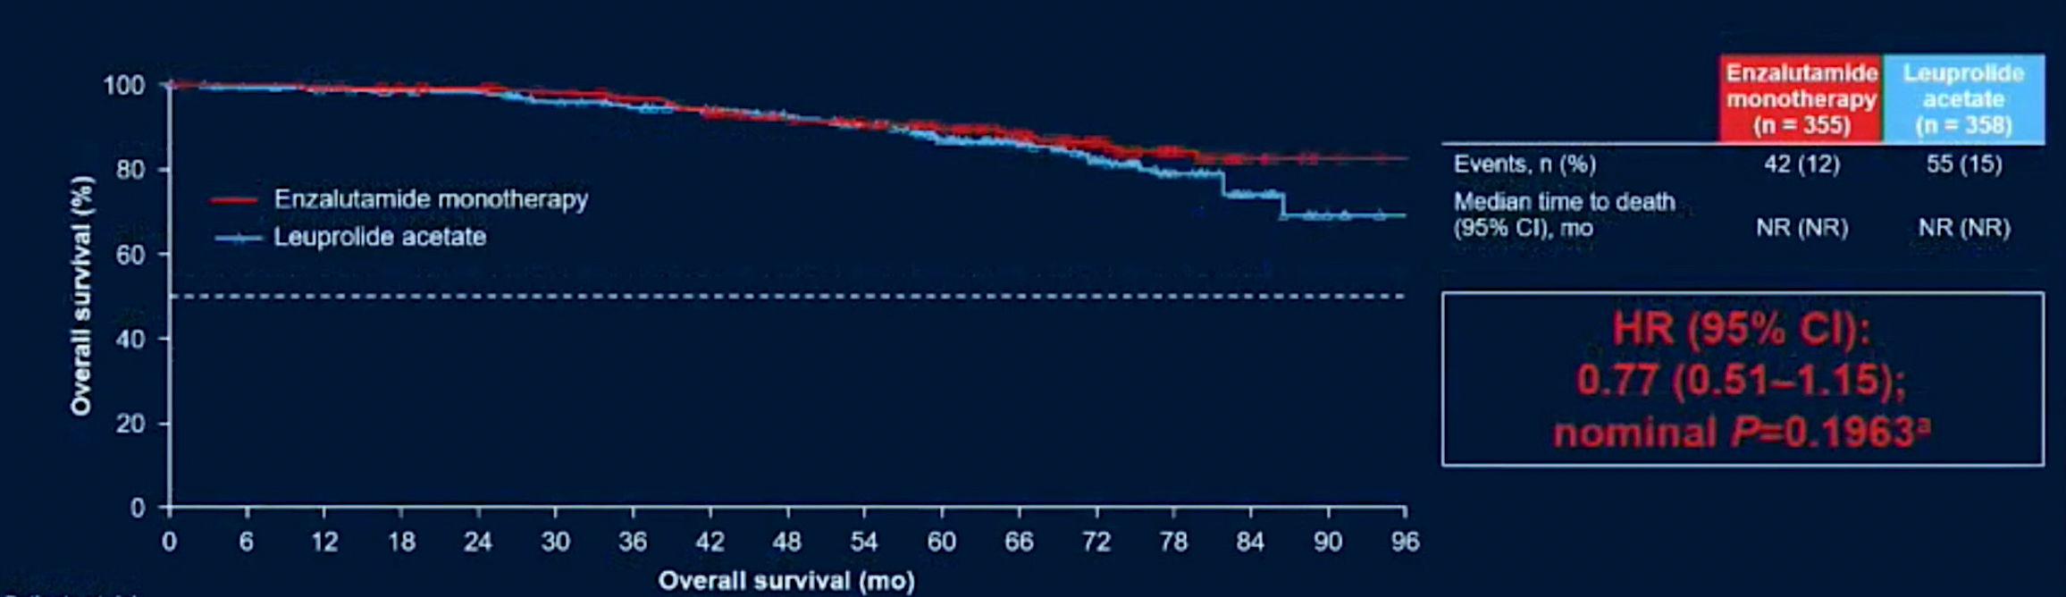
EMBARK: Interim OS of Enza monotherapy vs leuprolide
Shore, et al. AUA, 2023

Slide 38
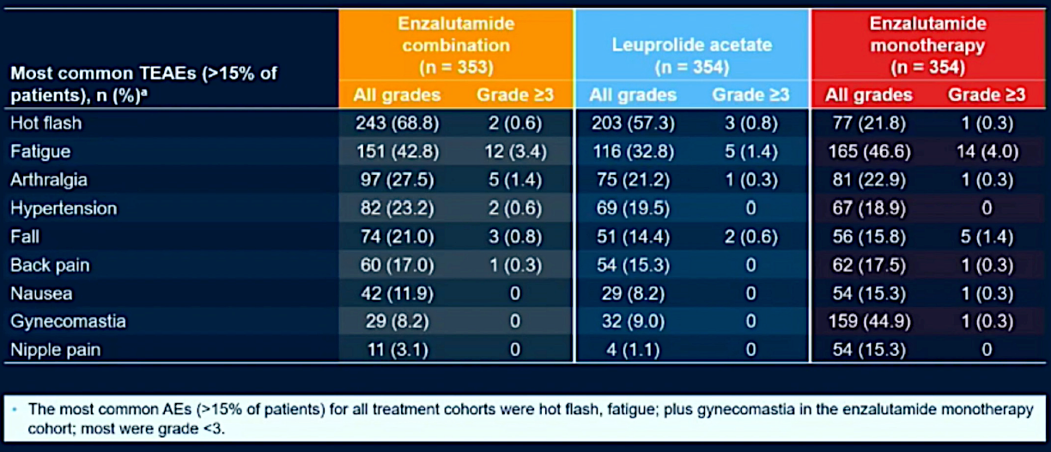
EMBARK: Most Common Treatment-Emergent Adverse Events
Shore N et al. AUA 2023;Abstract LBA02-09.
Shore, et al. AUA, 2023

Slide 39
Novel hormonal therapies for nmCRPC

Slide 40
PROSPER: Enzalutamide for nmCRPC
Phase III, multicenter, randomized, double-blind, placebo-controlled study
Patients
R
A
N
D
O
M
I
Z
E
D
2:1
Enzalutamide
160 mg orally daily
n=933
1401 patients with non-metastatic CRPC
CT/bone scan negative
PSADT <10 months
Primary Endpoint
Metastasis Free Survival (MFS)
(HR 0.72)
Placebo orally daily
n=468
Sternberg et al, NEJM 2020

Slide 41
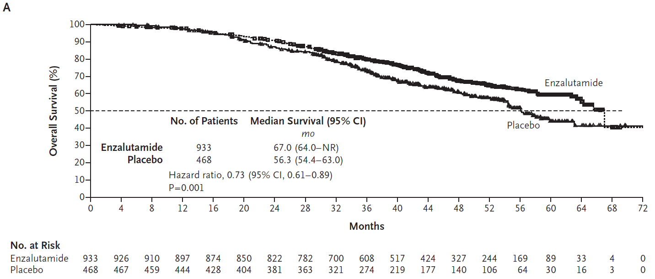
PROSPER: Enzalutamide for nmCRPC — OS
Sternberg et al, NEJM 2020

Slide 42
SPARTAN: Apalutamide for nmCRPC
Phase III, multicenter, randomized, double-blind, placebo-controlled study
Patients
R
A
N
D
O
M
I
Z
E
D
2:1
Apalutamide
240 mg orally daily
n=806
1207 patients with non-metastatic CRPC
CT/bone scan negative
PSADT <10 months
Primary Endpoint
Metastasis Free Survival (MFS)
(HR 0.7)
Placebo orally daily
n=401
Smith et al, Eur Urol 2021

Slide 43
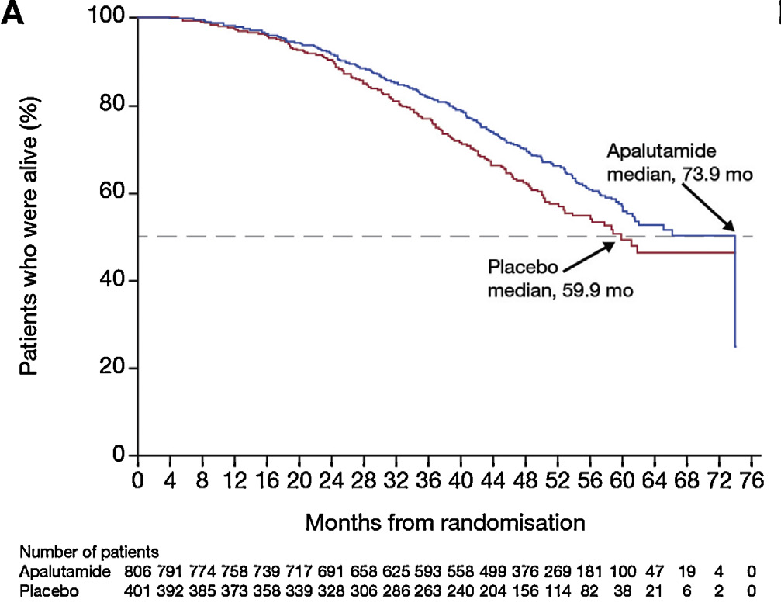
SPARTAN: Apalutamide for nmCRPC — OS
HR=0.78, p=0.016
Smith et al, Eur Urol 2021

Slide 44
ARAMIS: Darolutamide for nmCRPC
Phase III, multicenter, randomized, double-blind, placebo-controlled study
Patients
R
A
N
D
O
M
I
Z
E
D
2:1
Darolutamide
600 mg orally daily (BID)
n=955
1509 patients with non-metastatic CRPC
CT/bone scan negative
PSADT <10 months
Primary Endpoint
Metastasis Free Survival (MFS)
(HR 0.71)
Placebo orally daily (BID)
n=554
Fizazi et al, NEJM 2020

Slide 45
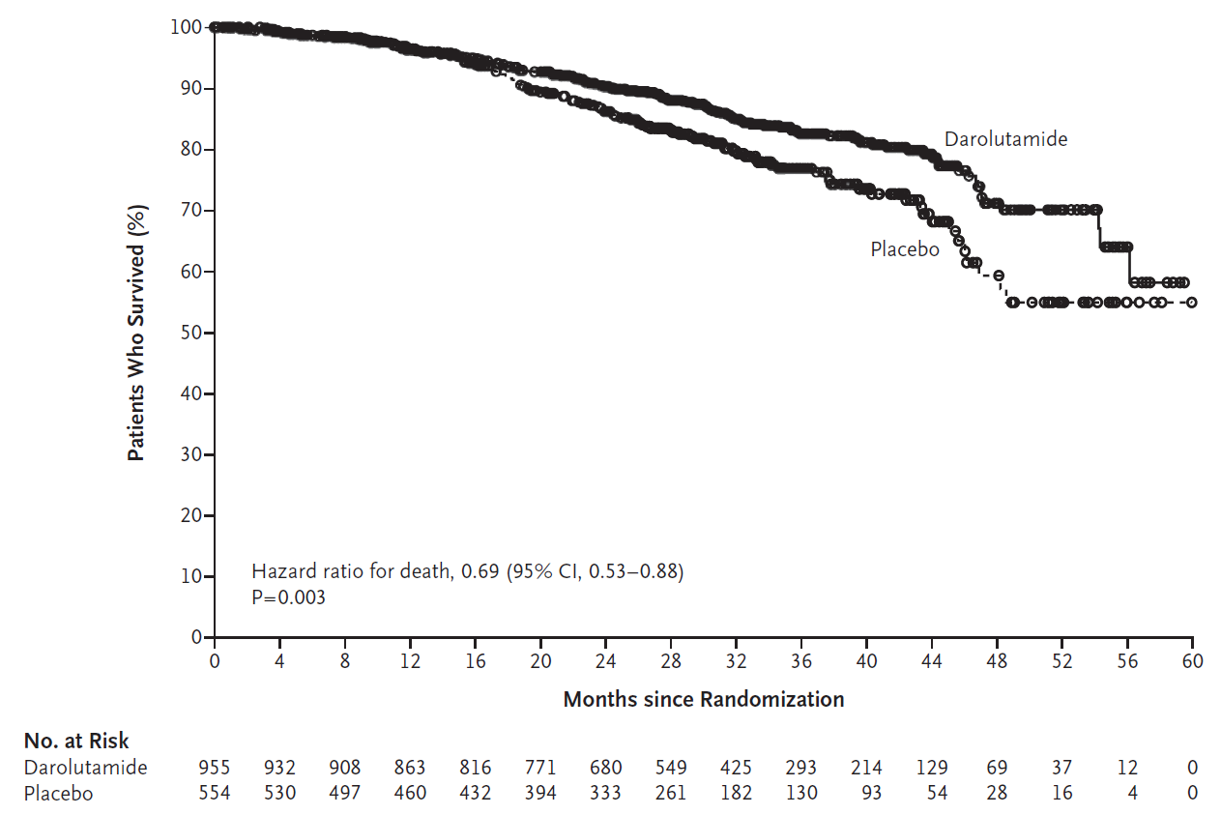
ARAMIS: Darolutamide for nmCRPC — OS
Fizazi et al, NEJM 2020

Slide 46
Summary
For men requiring ADT, relugolix is a new SOC option
In patients with high-risk BCR, EMBARK establishes a new SOC of ADT + enzalutamide
In patients with high-risk nmCRPC, treatment with NHTs are SOC and improve MFS and OS
The field of advanced PC is rapidly changing

Slide 47
MODULE 2: Optimizing the Care of Patients with Metastatic Hormone-Sensitive Prostate Cancer (mHSPC)

Slide 48
In general, which systemic therapy would you recommend for a 65-year-old patient presenting de novo with Gleason 8 prostate cancer and 3 asymptomatic bone metastases?
ADT + abiraterone
9
ADT + apalutamide
5
ADT + enzalutamide
3
ADT + darolutamide
2
ADT with docetaxel and darolutamide
2
ADT alone
1
Survey of urologic oncology clinical investigators

Slide 49
In general, which systemic therapy would you recommend for a 65-year-old patient presenting de novo with Gleason 8 prostate cancer and multiple bone and liver metastases?
ADT with docetaxel and
secondary hormonal therapy
15
ADT + docetaxel
3
ADT + enzalutamide
2
ADT + apalutamide
1
ADT + abiraterone
1
Survey of urologic oncology clinical investigators

Slide 50
For a patient with metastatic castration-sensitive prostate cancer (CSPC) for whom you have elected to use a novel antiandrogen therapy in combination with ADT (without docetaxel), do you have a preferred agent?
Yes, abiraterone
10
Yes, enzalutamide
6
Yes, apalutamide
3
Yes, darolutamide
2
No
1
Survey of urologic oncology clinical investigators

Slide 51
A 79-year-old man presents with high-volume metastatic CSPC. His pretreatment PSA is 173.2 ng/mL. CT and bone scans show widespread osseous metastases involving the skull, thoracic spine, proximal humerus, ribs, sternum and lumbar spine. Regulatory and reimbursement issues aside, what would be your most likely treatment recommendation?
ADT + darolutamide + docetaxel
14
ADT + abiraterone
3
ADT + apalutamide
1
ADT + darolutamide
1
ADT + enzalutamide
1
ADT + radium-223 and
secondary hormonal therapy
1
Survey of urologic oncology clinical investigators

Slide 52

An 84-year-old man underwent robotic prostatectomy 11 years ago for pT3b, N0, Gleason 9 (4 + 5) prostate cancer. The patient was lost to follow-up and returned to the office several years later with a PSA of 80.82 ng/mL. CT scan reveals thoracolumbar and pelvic bone metastases. A bone scan shows additional extensive bony metastases. Regulatory and reimbursement issues aside, what would be your most likely treatment recommendation?
ADT + abiraterone
5
ADT + darolutamide + docetaxel
4
ADT + abiraterone + docetaxel
4
ADT + apalutamide
4
ADT + darolutamide
2
ADT + enzalutamide
2
ADT alone
1
Survey of urologic oncology clinical investigators

Slide 53


Optimizing the Care of Patients with Metastatic Hormone-Sensitive Prostate Cancer (mHSPC)
Fred Saad MD FRCS
Professor and Chairman of Urology
Director of GU Oncology
Raymond Garneau Chair in Prostate Cancer
University of Montreal Hospital Center
Montreal, QC, Canada

Slide 54
The prostate cancer landscape
Newly diagnosed mHSPC
ADT
Primary progressive mHSPC
Localised or locally advanced prostate cancer
Biochemical recurrence
mCRPC
Terminal disease
(death)
ADT
ADT
nmCRPC
Almost all will progress to mCRPC and die of prostate cancer

Slide 55
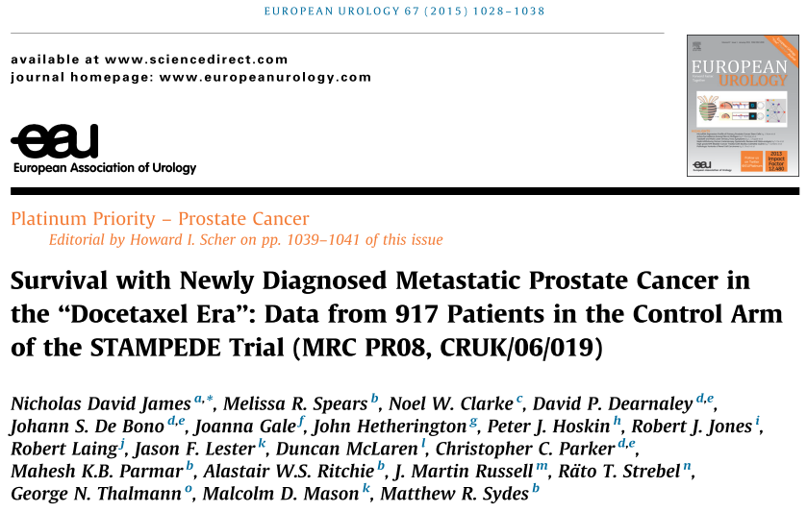
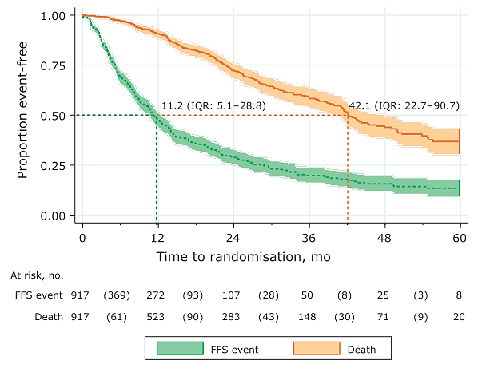
STAMPEDE control arm (ADT)
FFS and OS
We can do better
James ND et al. Eur Urol. 2015;67:1028-38.

Slide 56
Local control does make a difference (in some)

Slide 57
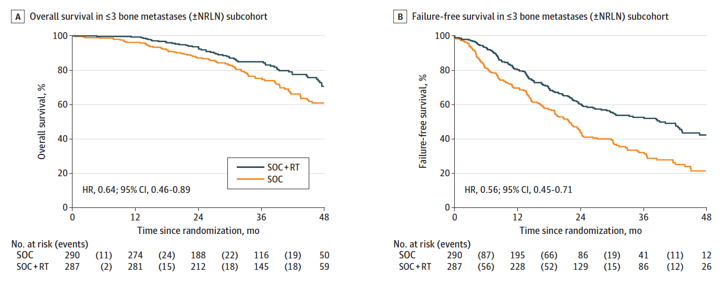
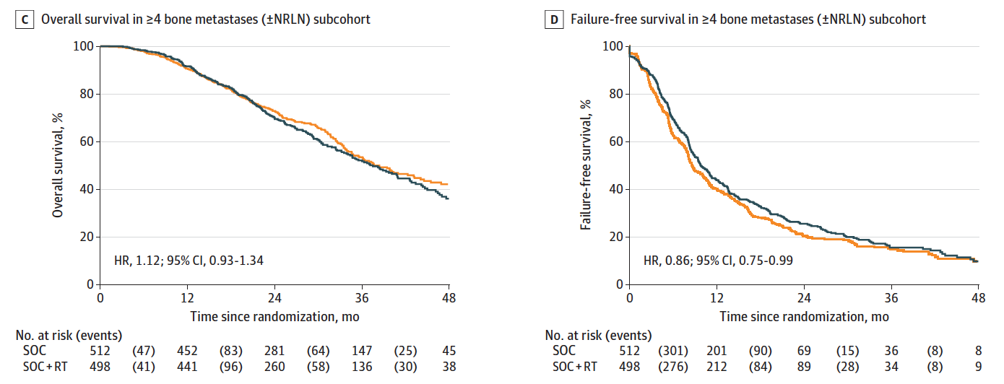
STAMPEDE: Prostate Radiotherapy for mCSPC
Failure Free Survival
Overall Survival
< 4 bone metastases
> 4 bone metastases
Adnan A et al. JAMA Oncol. doi:10.1001/jamaoncol.2020.7857
Published online February 18, 2021.

Slide 58
Role of Effective Systemic Therapy
mCRPC
ADT
ADT +
ADT-independent clones AR-dependent cells

Slide 59
CHAARTED: Docetaxel in mHSPC
OS – High Volume
OS – Low Volume
1.0
HR, 0.63
(95% CI, 0.50–0.79)
p <0.0001
1.0
HR, 1.04
(95% CI, 0.70–1.55)
p = 0.86
0.8
0.8
ADT + doce
(median OS 51.2 mo)
ADT + doce
(median OS 63.5 mo)
0.6
0.6
ADT alone
(median OS NR)
Proportion alive
Proportion alive
0.4
ADT alone
(median OS 34.4 mo)
0.4
0.2
0.2
ADT + doce
ADT alone
ADT + doce
ADT alone
0.0
0.0
12
24
36
48
60
72
84
96
108
12
24
36
48
60
72
84
96
108
No. at risk
ADT + doce
ADT alone
OS months
OS months
263
239
202
151
91
41
16
5
2
0
134
127
112
94
64
26
12
2
0
0
250
215
156
104
59
19
9
1
0
0
143
137
122
94
67
26
12
1
0
0
16.8 months
0 months
Kyriakopoulos CE, et al. J Clin Oncol 2018;36:1080-1087.

Slide 60
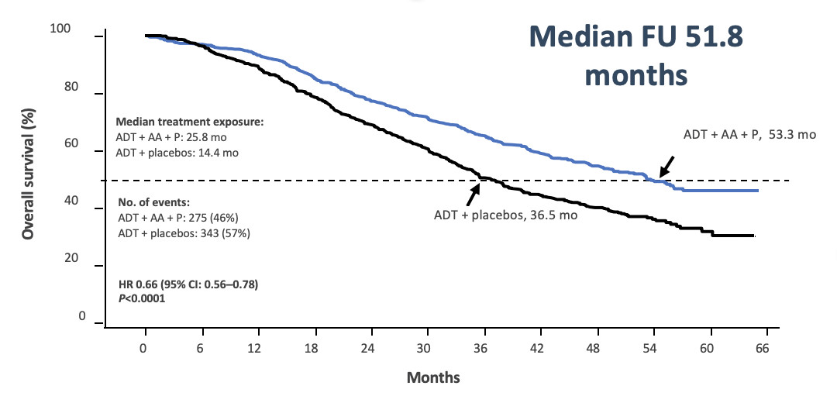
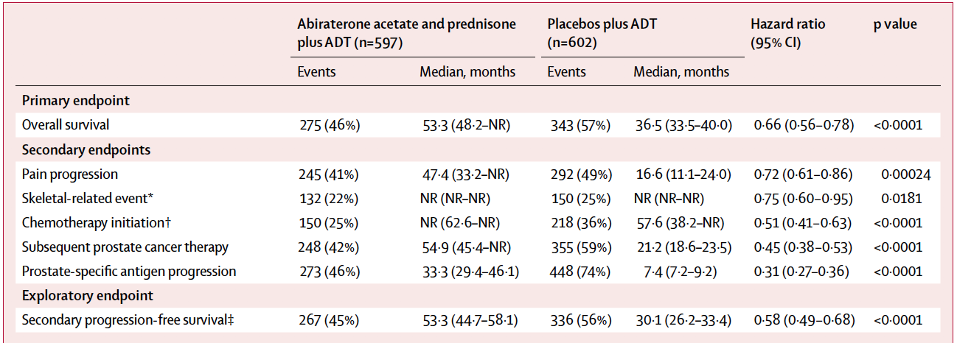
LATITUDE: Abiraterone in high risk mCNPC
Fizazi K, et al. Lancet Oncol 2019;20:686;

Slide 61
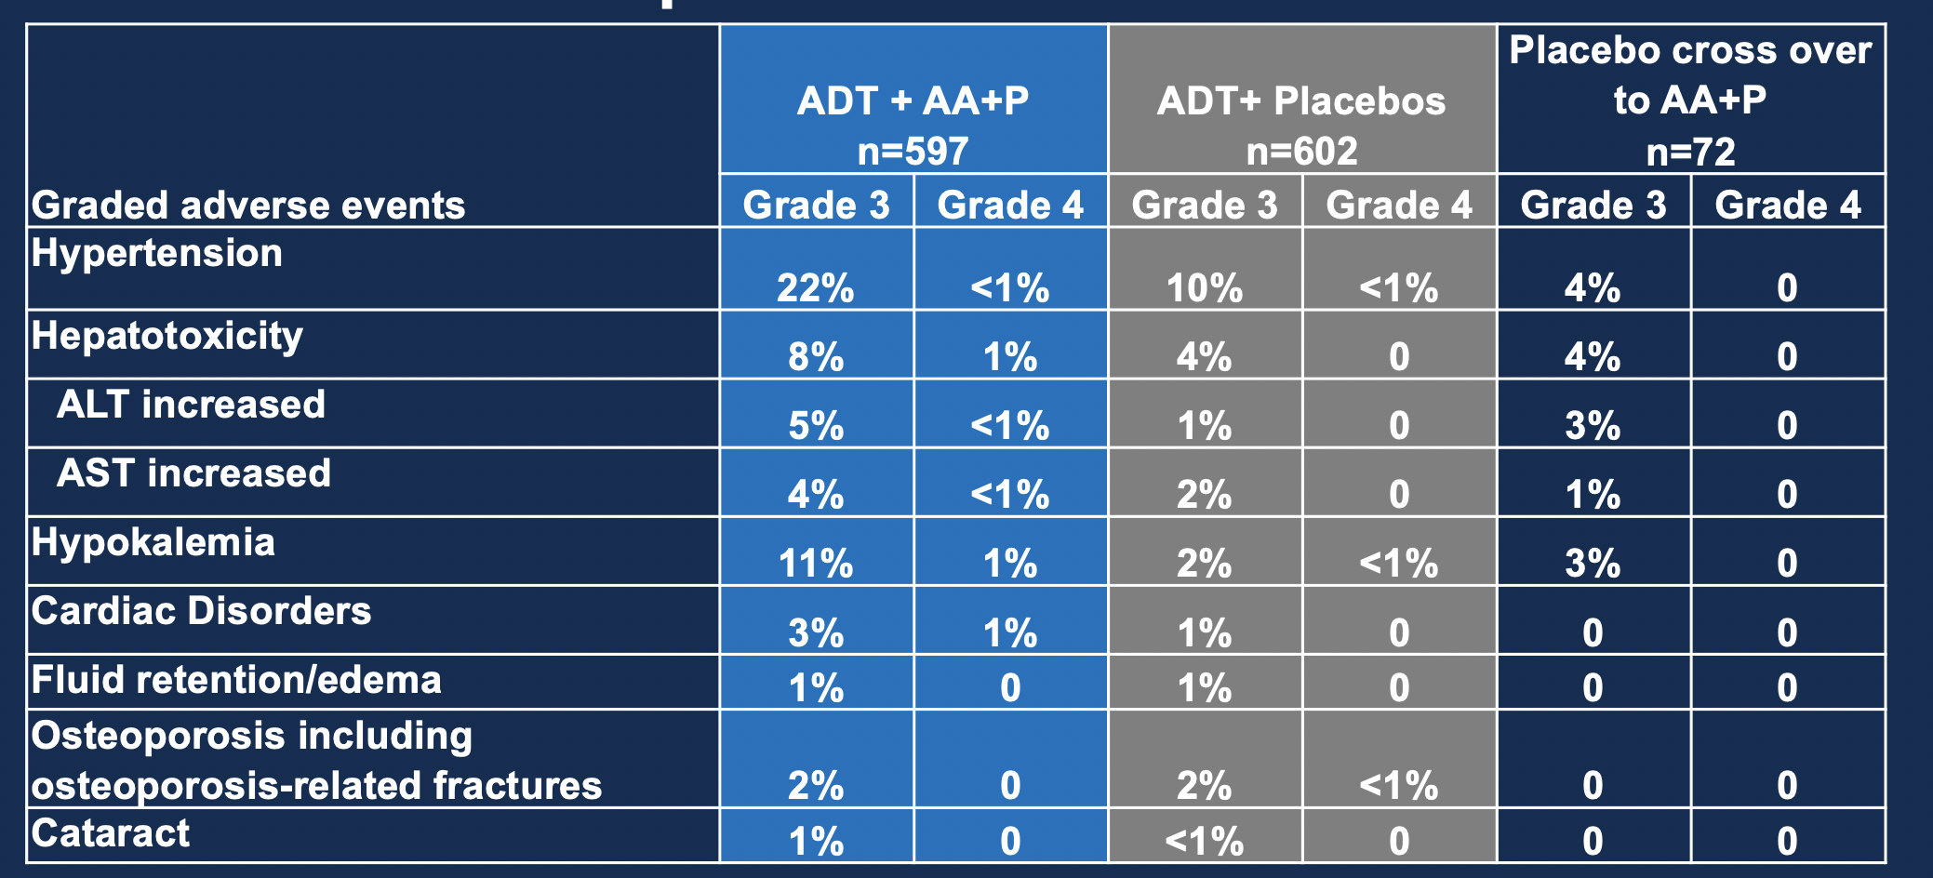
Why I prefer NOT to use abiraterone in mHSPC
Even if ‘only’ 5mg prednisone in mHSPC
ADT + AA + P
(n = 597)
ADT + placebos
(n = 602)
Adverse Events
Grade 3
Grade 4
Grade 3
Grade 4
%
%
Hypertension
20
0
10
0.2
Hypokalemia
10
0.8
1
0.2
ALT increased
5
0.3
1
0
AST increased
4
0.2
1
0
Hyperglycemia
4
0.2
3
0
Bone pain
3
0
3
0
Cardiac disorder
3
0.8
1
0
Anemia
2
0.5
4
0.2
Back pain
2
0
3
0
Fatigue
2
0
2
0
Spinal cord compression
2
0
1
0.5
Fizazi K, et al. Lancet Oncol 2019;20:686;

Slide 62
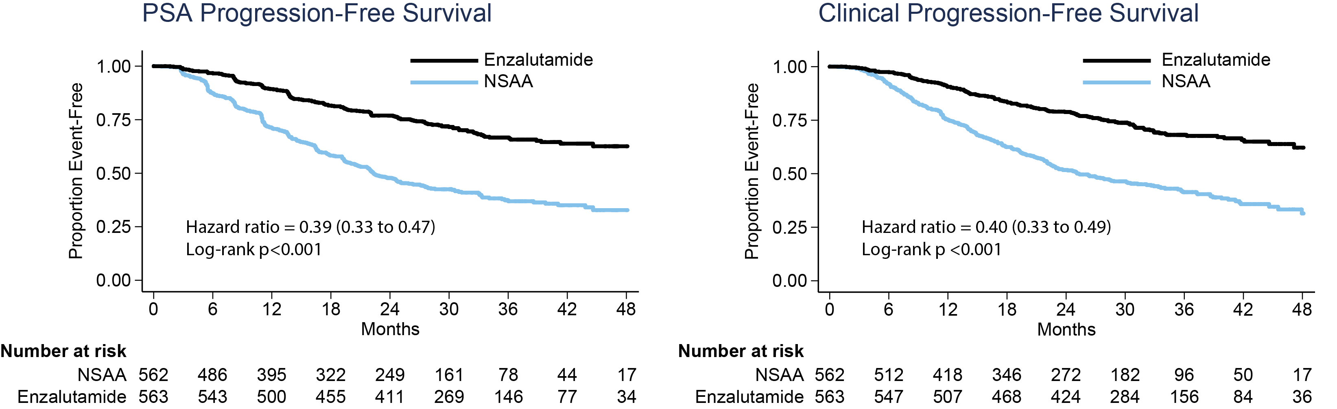
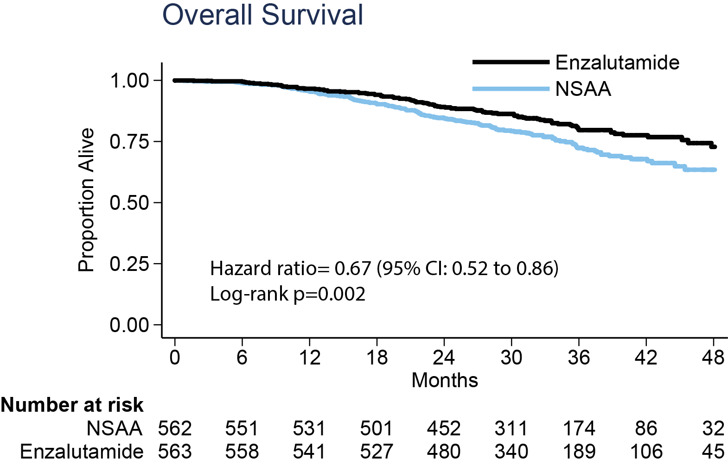
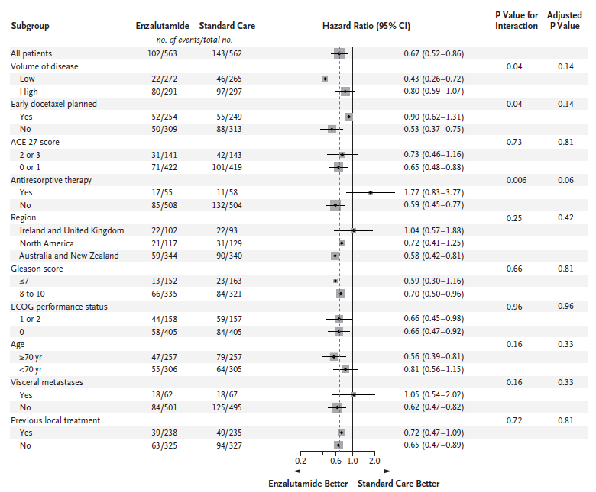
ENZAMET: Enzalutamide in all-comers
Progression free survival
Overall survival
Davis, I et al. Engl J Med. 2019 Jul 11;381(2):121-131.

Slide 63
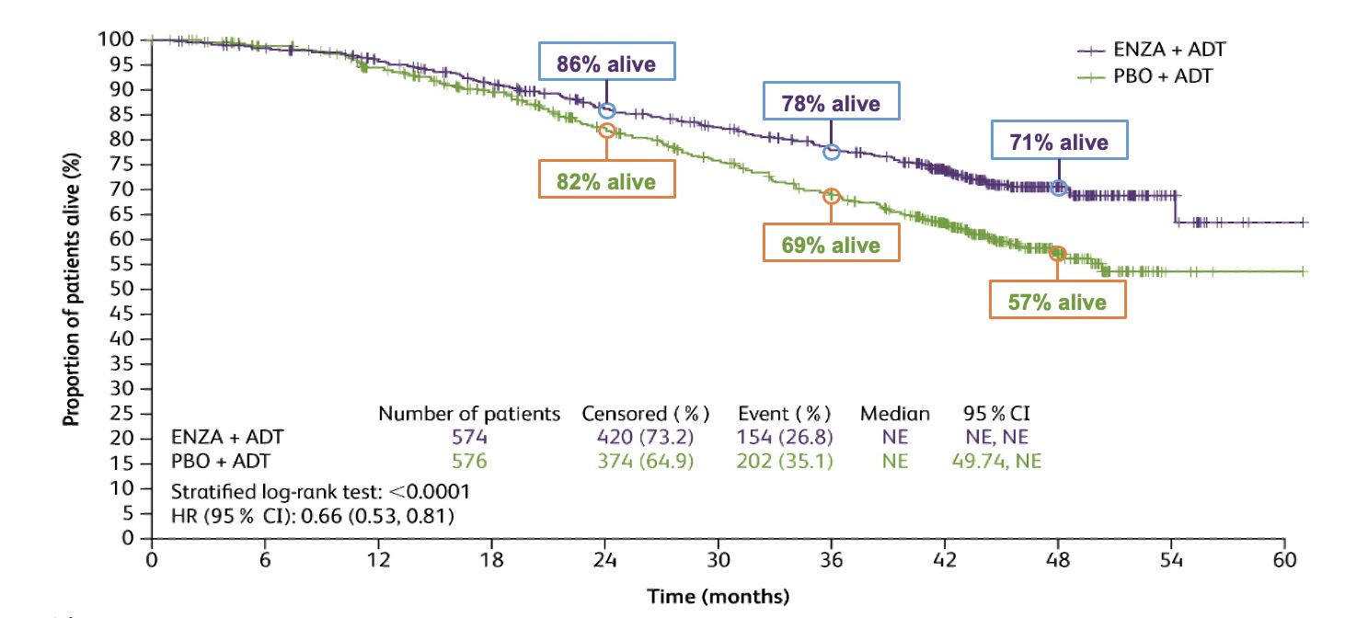
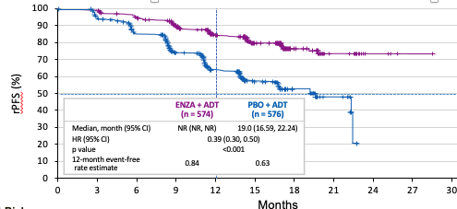
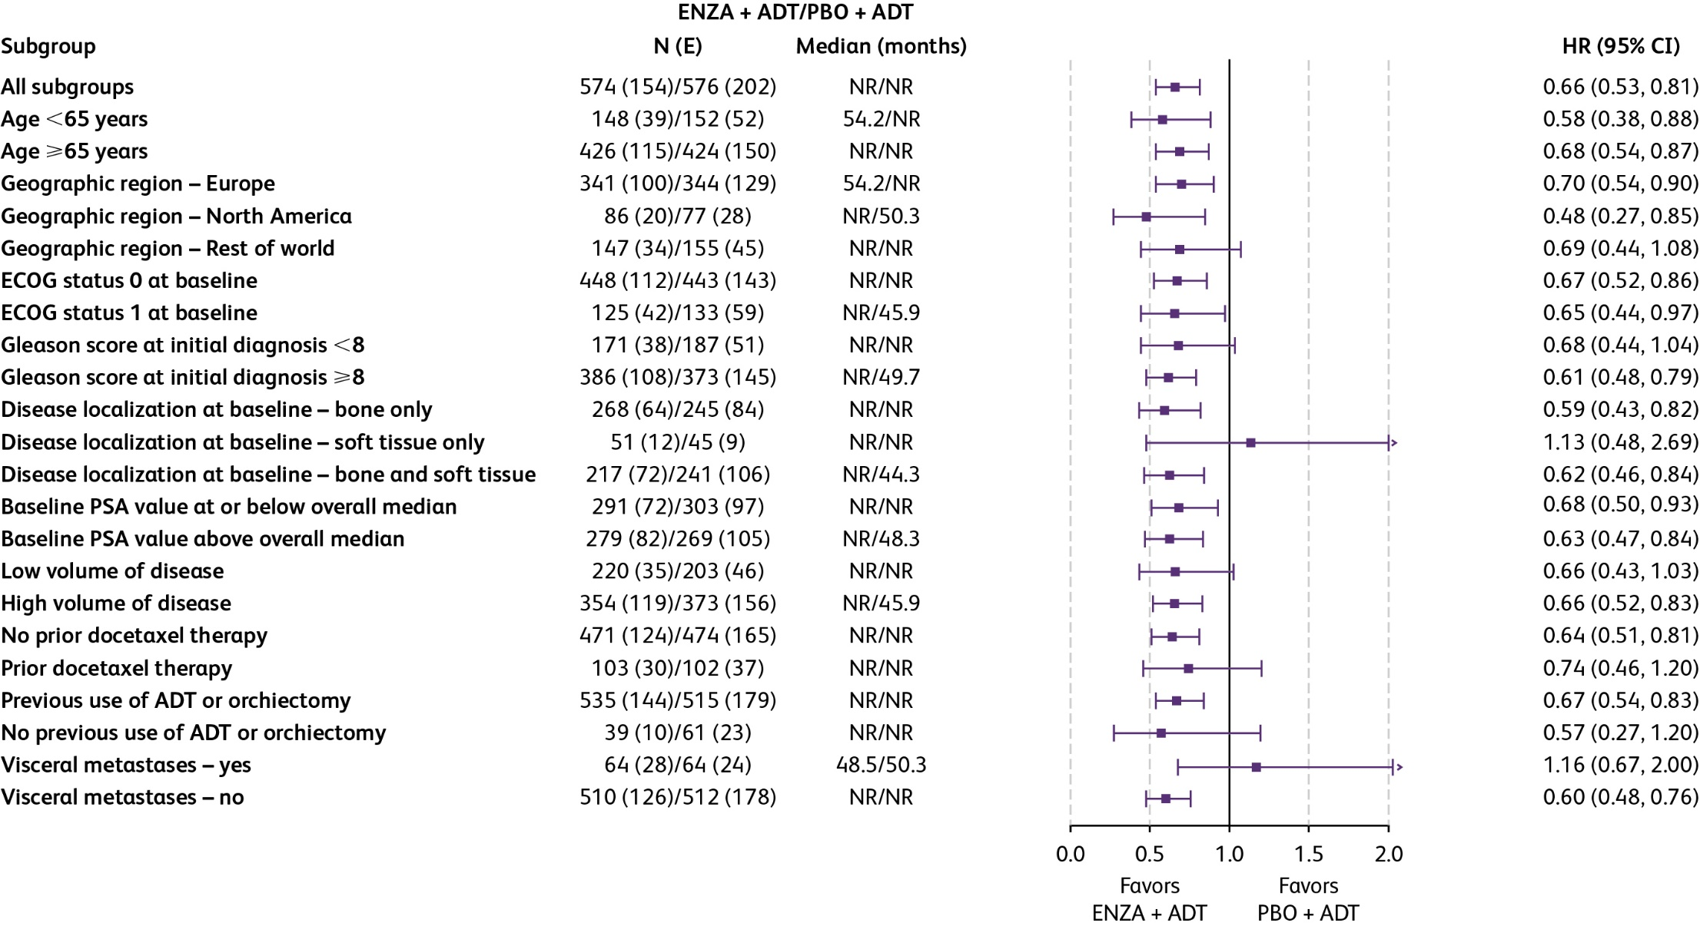
ARCHES: Enzalutamide in all-comers mCSPC
Progression free survival
Overall survival

Slide 64
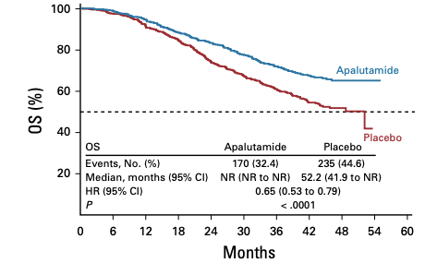
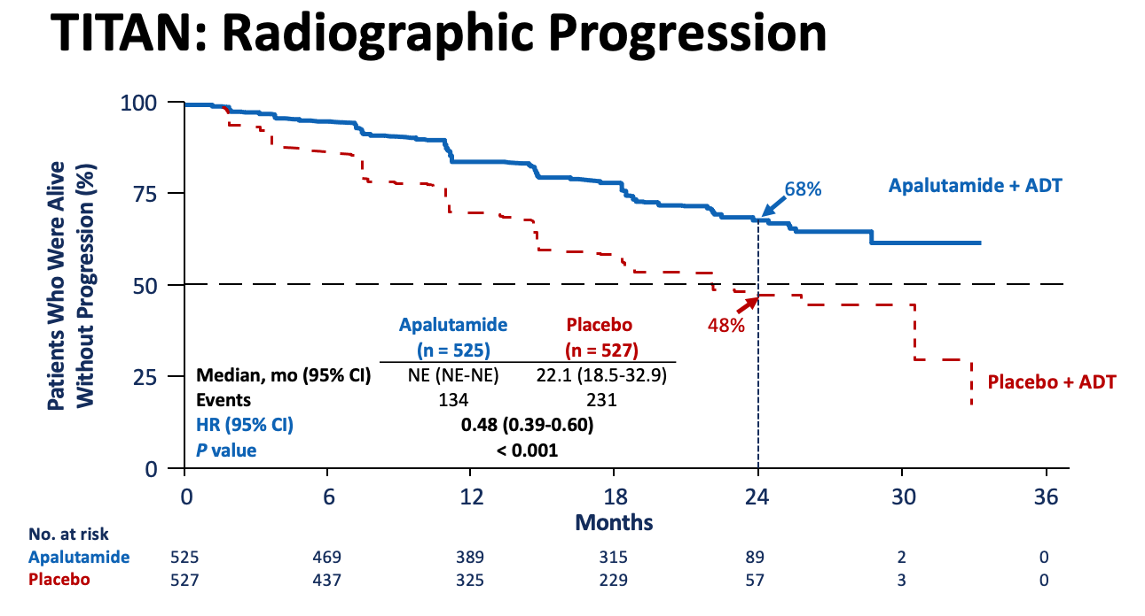
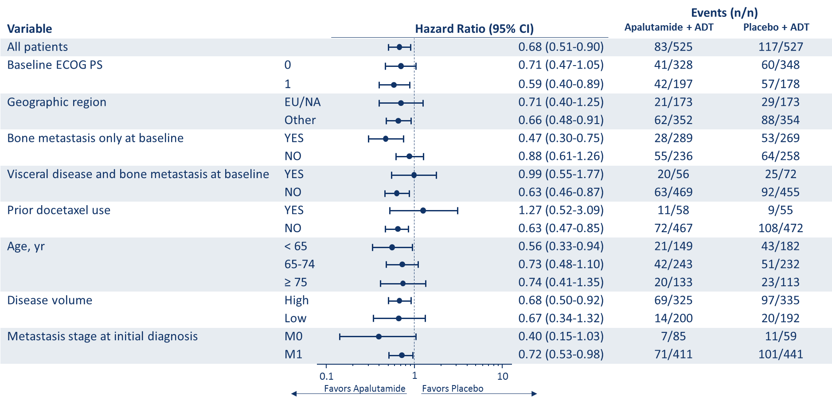
TITAN: Apalutamide in all-comers mCSPC
Progression free survival
Overall survival
Chi K et al. N Engl J Med. 2019 Jul 4;381(1):13-24. Chi K et al. J Clin Oncol 2021 Apr 29;JCO2003488.

Slide 65
PSA Responses Over Time
PSA Responses Over Time
Decline | 3 months |  | 6 months |  | 12 months
 | APA* | PBO | APA^{ᶶ} | PBO | APA^{ᶶ} | PBO
PSA ≥50% ↓ | 89% | 41% | 90% | 49% | 90% | 52%
PSA ≥90% ↓ | 58% | 13% | 67% | 18% | 71% | 22%
PSA ≤0.2 ng/mL | 51% | 18% | 61% | 21% | 65% | 23%
*P < 0.0001 for APA vs. PBO.
Data from the TITAN study: Chi K et al. N Engl J Med. 2019 Jul 4;381(1):13-24.
Chowdhury et al. AUA 2020. Oral Presentation PD10.

Slide 66
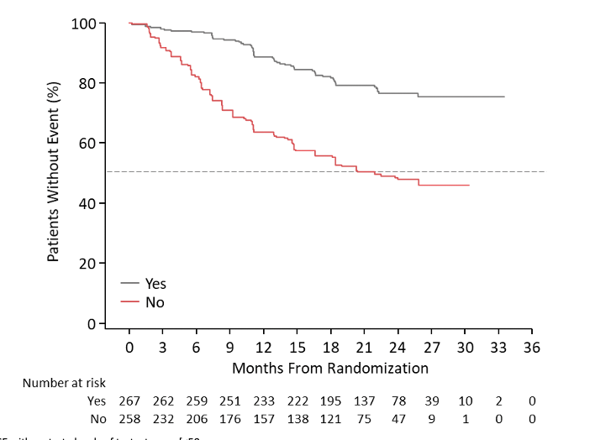
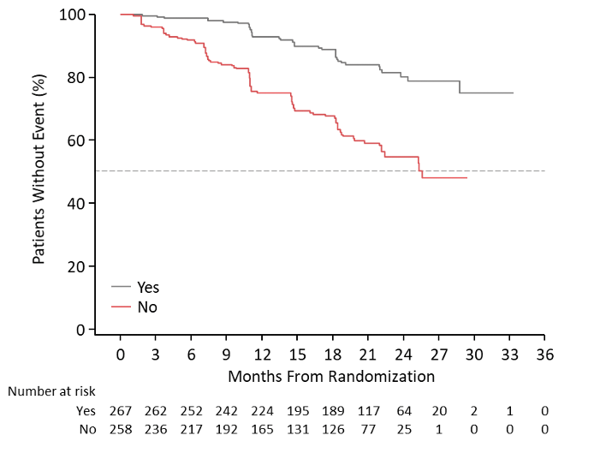
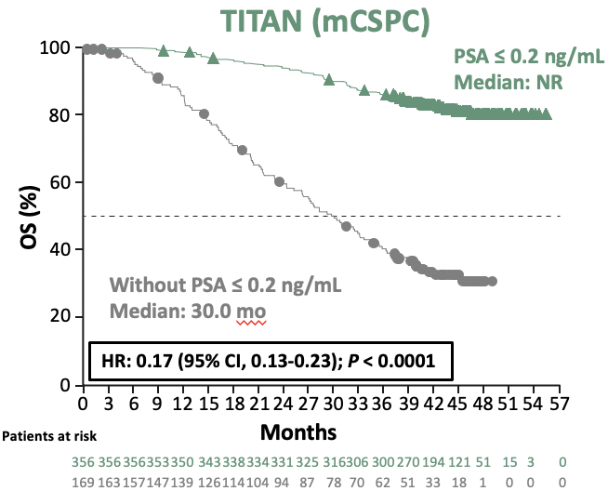
Patients who achieved reduction of PSA ≤0.2 ng/mL by 3 months
Time to mCRPC
Time to Radiographic progression
Overall survival
HR: 0.34 (0.25-0.47; p<0.0001)
HR: 0.33 (0.23-0.47; p<0.0001)
Data from the TITAN study: Chi K et al. N Engl J Med. 2019 Jul 4;381(1):13-24.
Chi KN, et al. Oral presentation at AUA Annual Meeting (Virtual), September 10-13, 2021

Slide 67
Can combinations further improve outcome?

Slide 68


Design of PEACE-1 (2x2)
Key Eligibility Criteria
De novo mCSPC
Distant metastatic disease by ≥ 1 lesion on bone scan and/or CT scan
ECOG PS 0 -2
On-Study Requirement
Continuous ADT
Permitted
ADT ≤ 3 months
Stratification
ECOG PS (0 vs 1-2)
Metastatic sites (LN vs bone vs visceral)
Type of castration (orchidectomy vs LHRH agonist vs LHRH antagonist)
Docetaxel (yes vs no)
Nov 2013 – Dec 2018
SOC
(n = 296)
SOC+Abiraterone
(n = 292)
RANDOMIZATION
1:1:1:1
SOC+Radiotherapy
(n = 293)
n = 1173
SOC+Abiraterone+
Radiotherapy
(n = 292)
ECOG PS, Eastern Cooperative Oncology Group performance status
Karim Fizazi

Slide 69
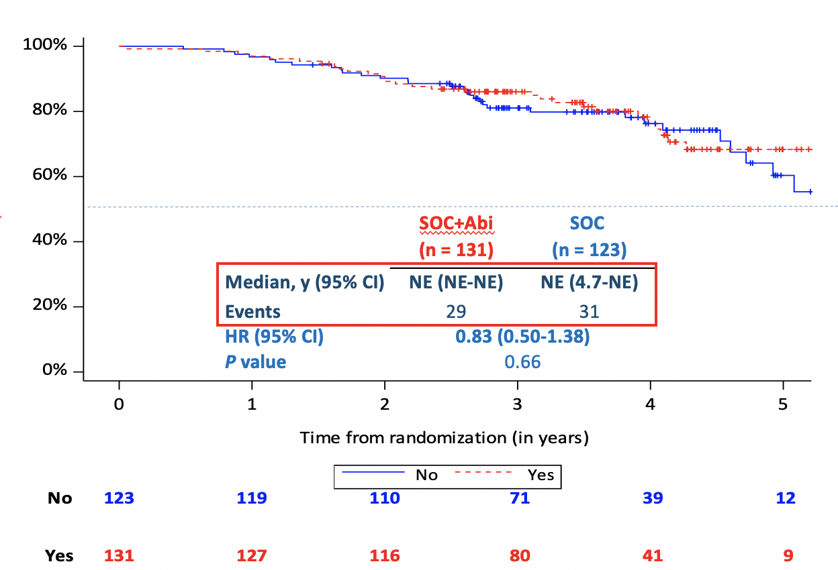
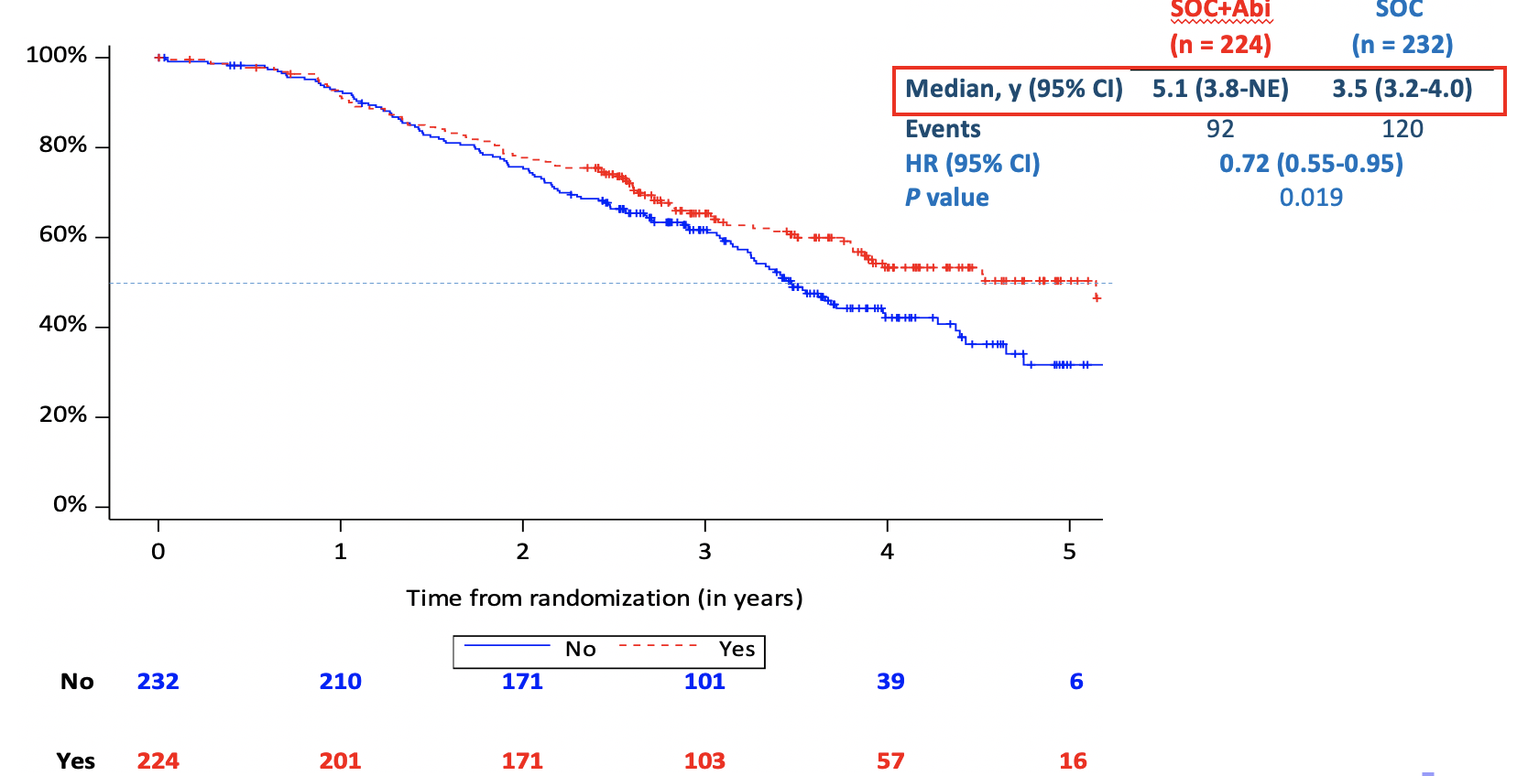
ADT/docetaxel +/- abiraterone population
High-volume patients
Low-volume patients

Slide 70
ARASENS Study Design
Global, randomized, double-blind, placebo-controlled, phase 3 study (NCT02799602)
Docetaxel × 6
Endpoints
Primary: Overall Survival
Secondary
Time to CRPC
Time to pain progression
SSE-free survival
Time to first SSE
Time to initiation of subsequent systemic antineoplastic therapy
Time to worsening of disease-related physical symptoms
Time to initiation of opioid use for ≥7 consecutive days
Safety
Patients (N=1306)
mHSPC
ECOG PS 0 or 1
Candidates for ADT and docetaxel
Stratification
Extent of disease: M1a vs M1b vs M1c
ALP < vs ≥ ULN
Darolutamide 600 mg twice daily + ADT
1:1
randomization
(N=1305*)
Primary analysis
Placebo twice daily + ADT
Docetaxel × 6
FPFV: Nov 2016
LPFV: June 2018
Data cut-off
Oct 25, 2021
The primary analysis was planned to occur after ~509 deaths
Secondary efficacy endpoints were tested hierarchically

Slide 71
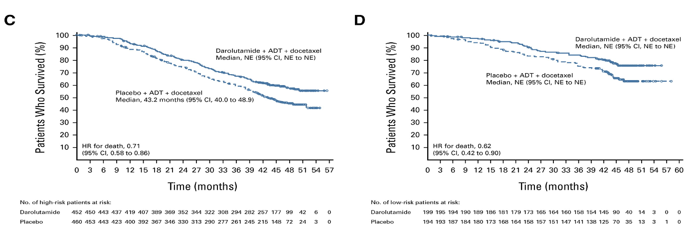
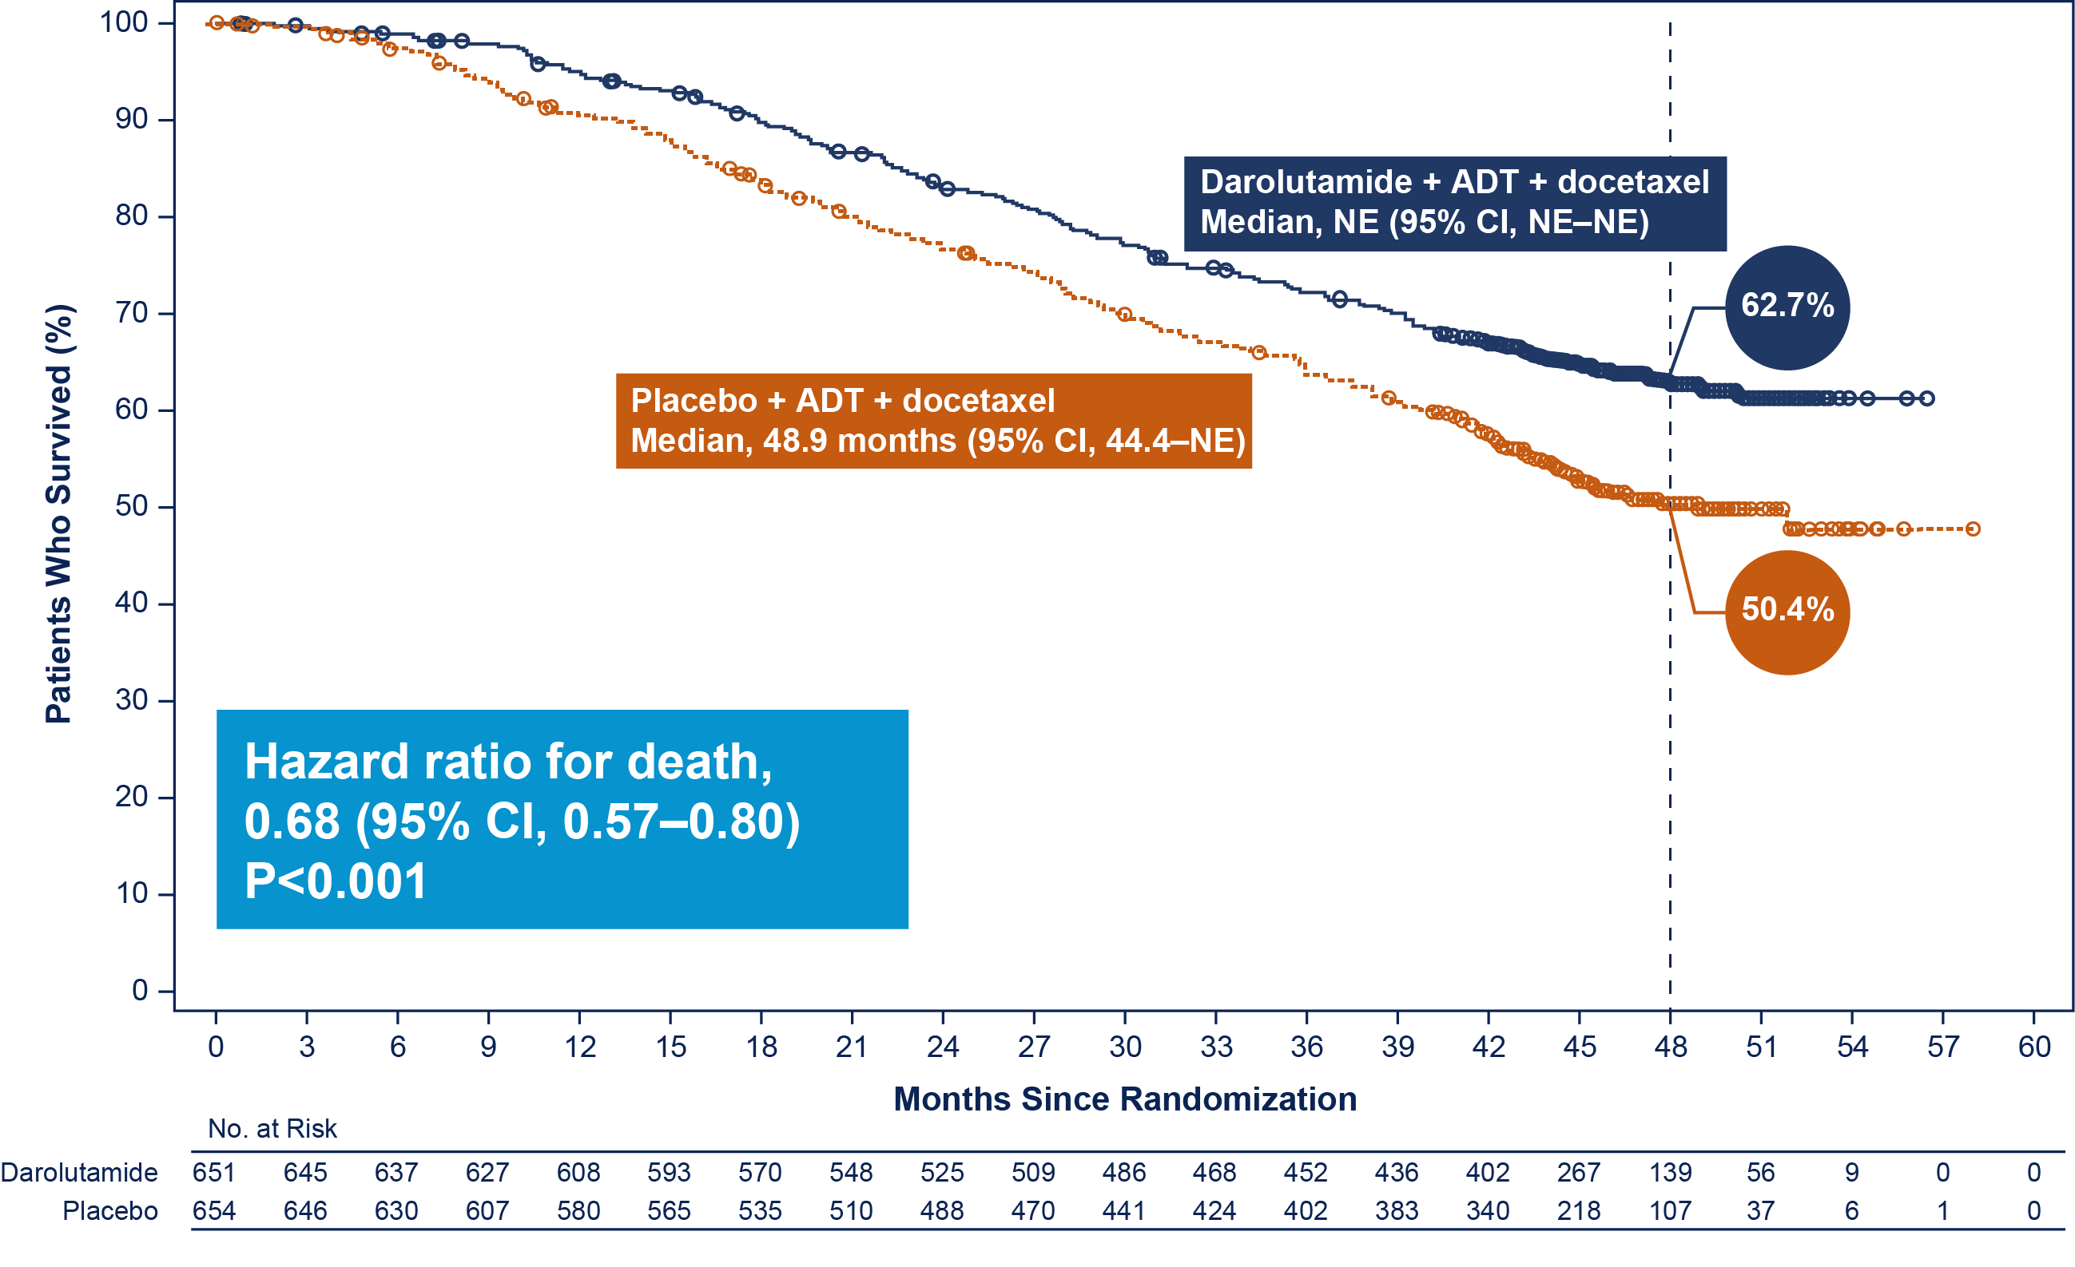
High Risk
ARASENS: Overall Survival
Low Risk

Slide 72
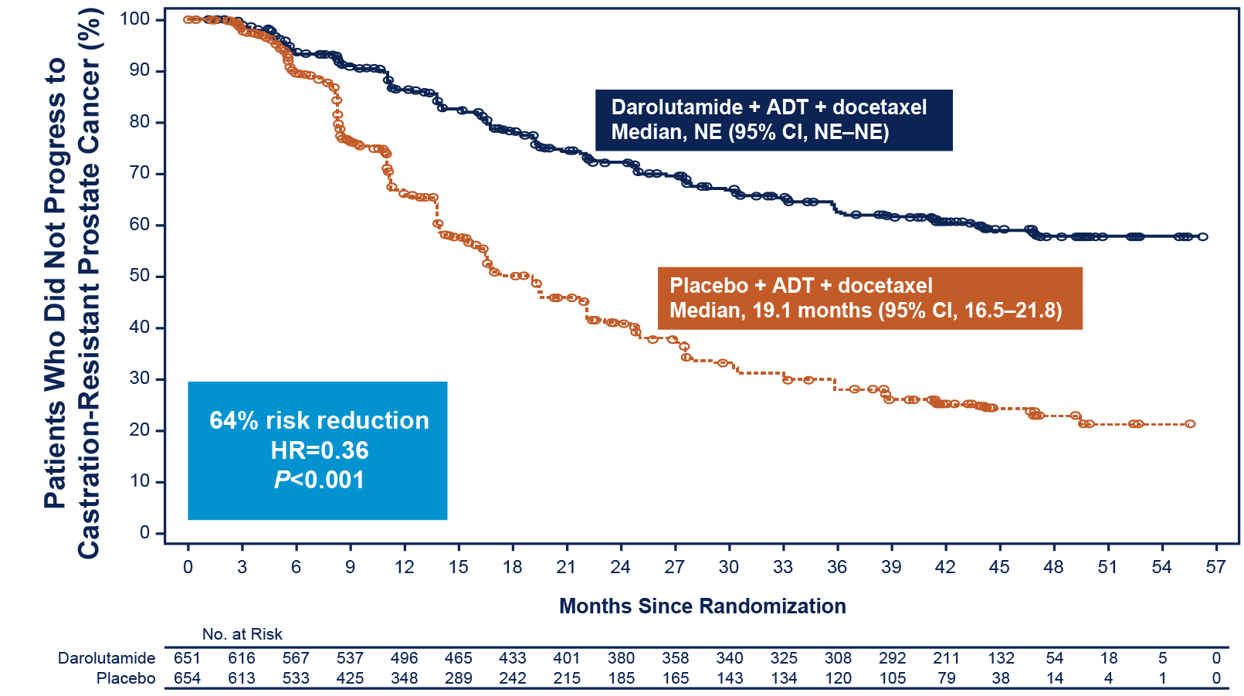
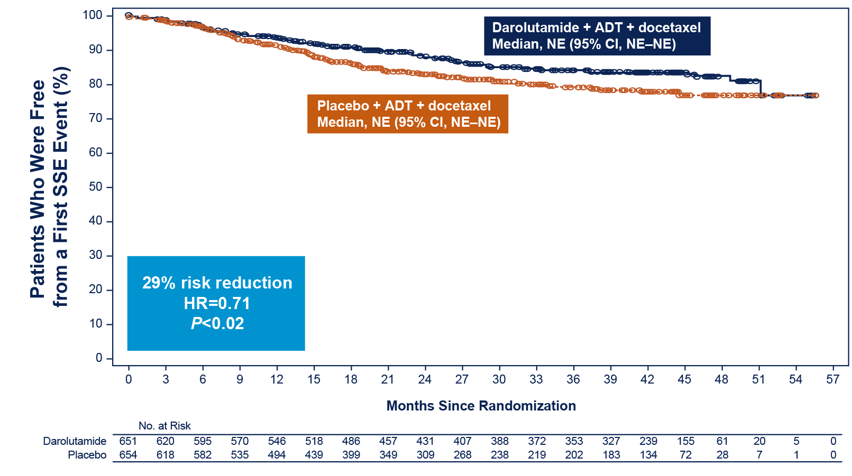
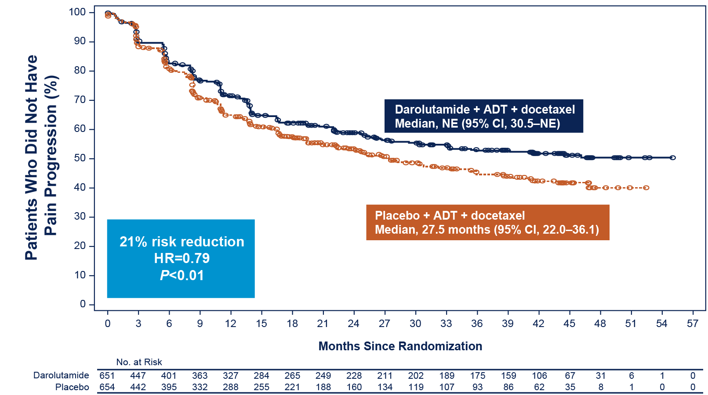
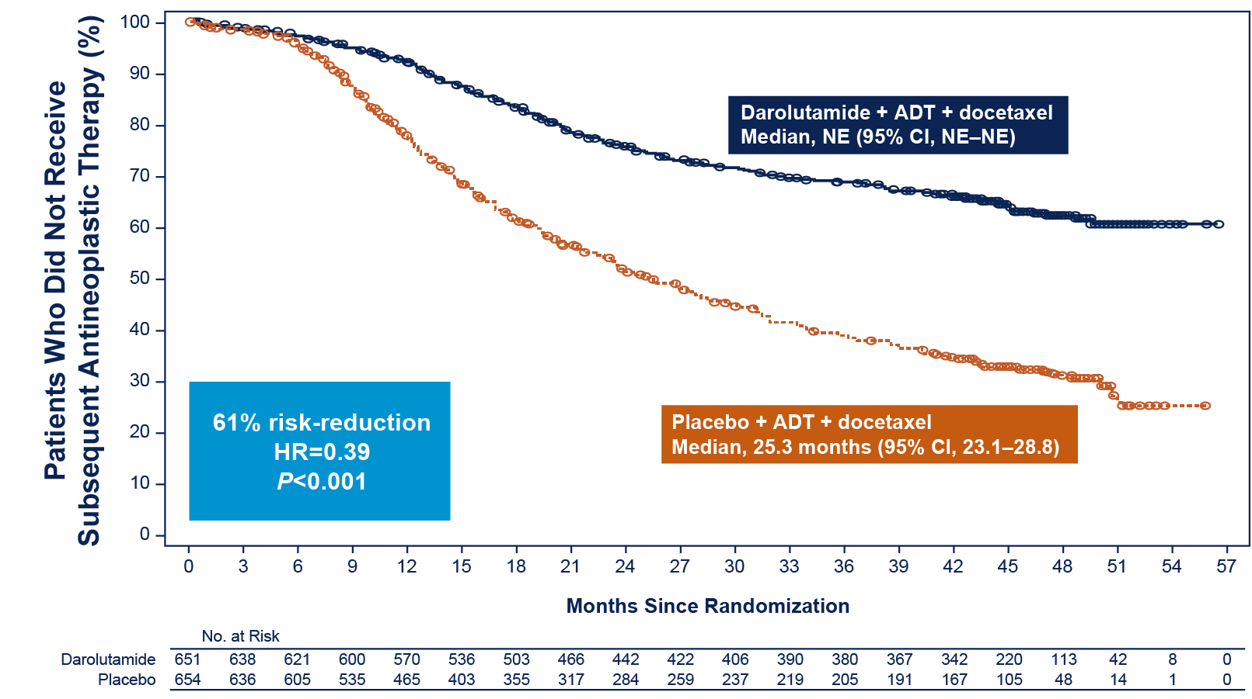
Darolutamide significantly improved key secondary efficacy endpoints
Time to CRPC
Time to first SSE
Time to pain progression
Time to first subsequent antineoplastic therapy
Two-sided P values are presented.

Slide 73
Objective: Undetectable (≤0.2) PSA Levels
Saad et al. AUA 2022

Slide 74
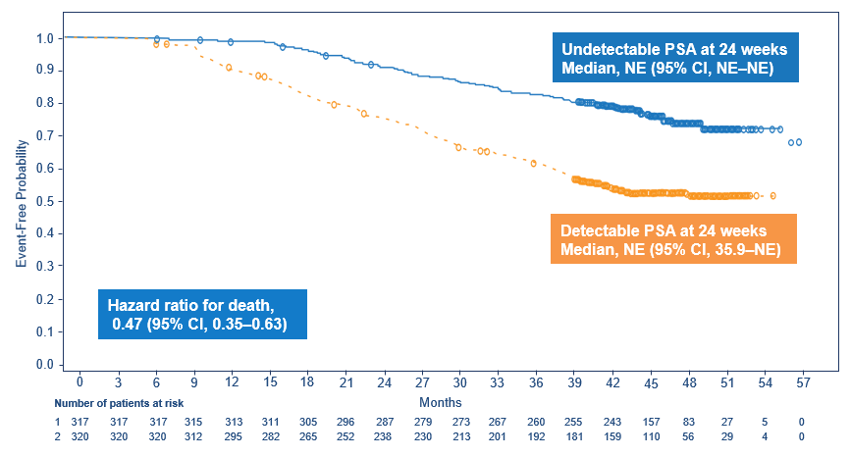
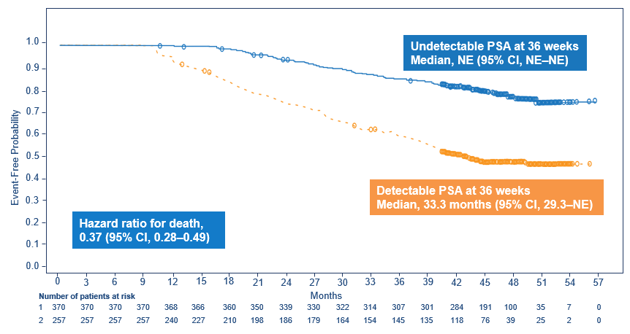
Results: Overall Survival
Undetectable PSA at 24 and 36 weeks was associated with a
53% and 63% reduction in the risk of death
Darolutamide + ADT + docetaxel
Undetectable vs detectable PSA at 24 weeks
Undetectable vs detectable PSA at 36 weeks
Saad et al. AUA 2022

Slide 75
Future and more questions
Patients with mCSPC are at high risk of rapid progression to mCRPC and early death
  Treatment beyond ADT is recommended in all patients
  Adding NHT must be considered in patients who receive ADT + docetaxel
Further intensification in some (trials ongoing)
  Role of PARPi, radioligand therapy, immunotherapy etc.
BUT De-intensification may make sense in some patients
  Back to the concept of intermittant (but more intensive) therapy
A multi D approach and research should be considered in all patients

Slide 76
MODULE 3: Therapeutic Considerations for Patients with Newly Diagnosed Metastatic CRPC (mCRPC)

Slide 77

A 65-year-old man receiving ADT for M0 disease after radical prostatectomy is found to have asymptomatic bone metastases. Genetic testing is negative for homologous recombination repair (HRR) mutations. Regulatory and reimbursement issues aside, which systemic treatment would you most likely recommend?
Abiraterone
6
Sipuleucel-T
6
Enzalutamide
4
Abiraterone + olaparib
2
ADT + apalutamide
1
Docetaxel
1
Docetaxel + abiraterone
1
None
1
Survey of urologic oncology clinical investigators

Slide 78
A 65-year-old man receiving ADT for M0 disease after radical prostatectomy is found to have widespread, moderately symptomatic bone metastases. Genetic testing is negative for HRR mutations. Regulatory and reimbursement issues aside, which systemic treatment would you most likely recommend?
Docetaxel and secondary hormonal therapy
9
Radium-223 + secondary hormonal therapy
4
Enzalutamide
3
Abiraterone
3
Abiraterone + olaparib
2
Radium-223 chloride
1
Survey of urologic oncology clinical investigators

Slide 79
Therapeutic Considerations for Patients with Newly Diagnosed Metastatic CRPC (mCRPC)
Neal Shore, MD,FACS
GenesisCare,US
Carolina Urologic Research Center
Myrtle Beach, South Carolina

Slide 80
Overview
Key efficacy and safety findings with sipuleucel-T
Biologic basis for combining PARP inhibitors with ARSI for PCa
Data with combination therapy (PARPi/ARSI): PROpel, MAGNITUDE and TALAPRO-2 studies (without HRR gene mutations)
Biologic rationale for CDK4/6 inhibitors in PCa
Study Design – CYCLONE 2 trial: abi/pred with or without abemaciclib

Slide 81
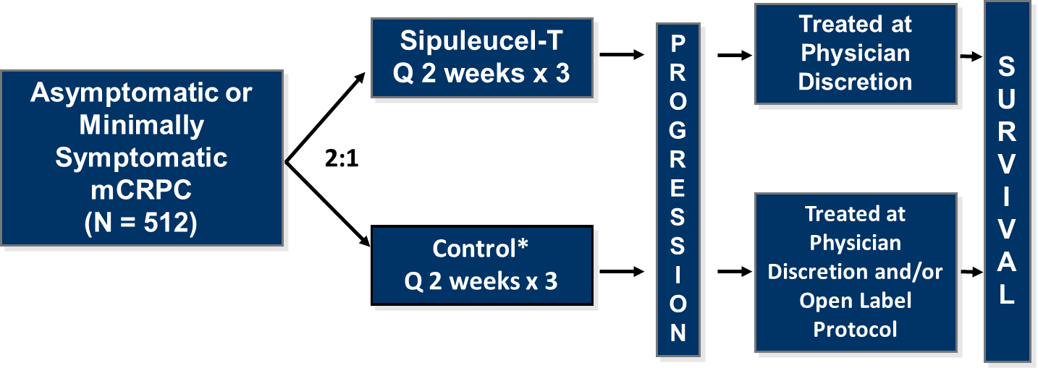
IMPACT, Phase 3 Study, NCT00065442
(Immunotherapy Prostate Adenocarcinoma Treatment)
Endpoints for IMPACT
Primary endpoint: Overall Survival
Secondary endpoint: Time to Objective Disease Progression
* Control was nonactivated, autologous peripheral blood mononuclear cell
Note: Open label protocol: Control patients could have opted to receive active treatment with cryopreserved product
Kantoff PW, Higano CS, Shore ND, et al. Sipuleucel-T immunotherapy for castration-resistant prostate cancer. N Engl J Med. 2010;363(5):411-422. https://doi.org/10.1056/NEJMoa1001294.

Slide 82
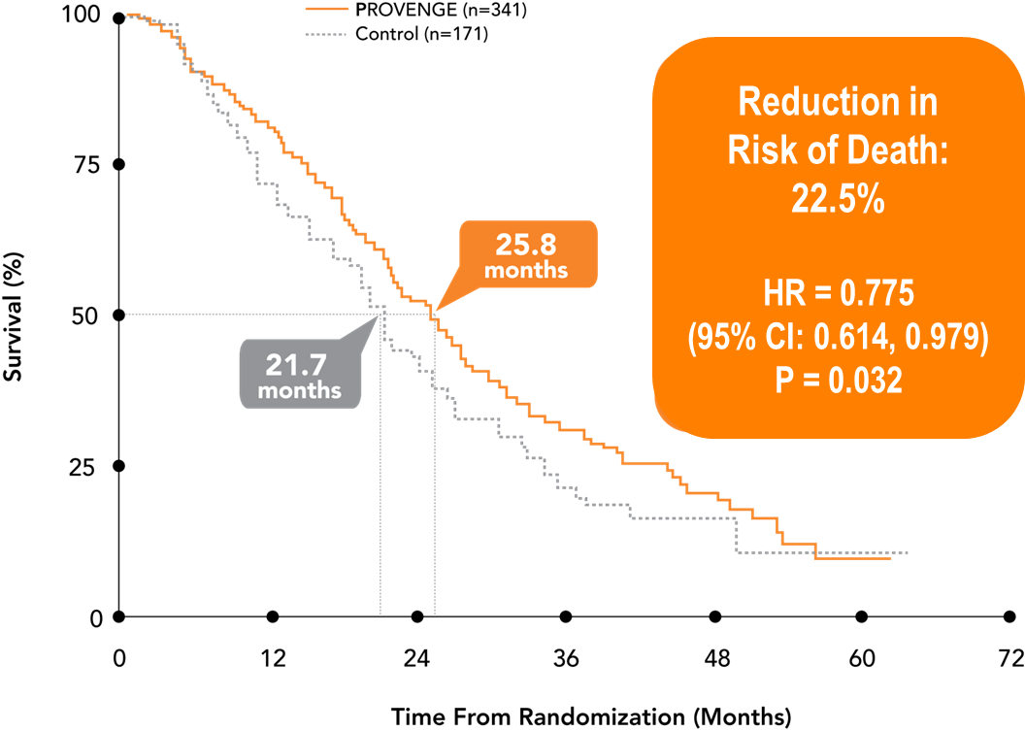
IMPACT Primary Endpoint: Overall Survival
IMPACT: Overall Survival
Sipuleucel-T (n=341)
13.0 m
7.1 m
5.4 m
2.8 m
Kantoff PW, Higano CS, Shore ND, et al. N Engl J Med. 2010;363(5):411-422. https://doi.org/10.1056/NEJMoa1001294.
Schellhammer PF, Chodak G, Whitmore JB, et al. Urology. 2013;81(6):1297-1302. https://doi.org/10.1016/j.urology.2013.01.061.

Slide 83

IMPACT: Safety Profile
Most Common AEs (≥15%) in the sipuleucel-T Group*
Chills
Fatigue
Fever
Back
pain
Nausea
Joint
ache
Headache
Sip-T
(n=601)
53.1%
41.1%
31.3%
29.6%
21.5%
19.6%
18.1%
Control
(n=303)
10.9%
34.7%
9.6%
28.7%
14.9%
20.5%
6.6%
The majority of adverse events reported with sipuleucel-T (67.4%) were mild to moderate and consistent with a response to immunotherapy
Sipuleucel-T does not require dosage adjustments, monitoring of liver/kidney function, or concomitant steroids
1.5% of patients in the pivotal trial discontinued treatment with sipuleucel-T due to adverse events
91.8% of patients in the sipuleucel-T group received a complete course of therapy
*All grades reported in ≥15% of patients randomized to Sipuleucel-t; the safety analysis is based on 601 patients with prostate cancer in the Sipuleucel-t group who underwent at least 1 leukapheresis procedure in Phase 3 clinical trials.
AE=adverse events.
Notes:
Provenge PI/p8/ Table 1
Provenge PI/p7/ para4/ line 1
Provenge PI/p7/ para1/ lines 1-3
Provenge PI/p7/ para4/ line 1
Provenge PI/p8/ Table 1

Slide 84

PROCEED: Commitment Study, NCT0136890
(Sipuleucel-T Registry for the Observation, Collection, and Evaluation of Experience Data)
Primary Endpoint:
Subject Incidence of Cerebrovascular Events
Secondary Endpoint:
Overall Survival
Higano CS, Armstrong AJ, Sartor AO, et al. Cancer. 2019;125:4172-4180. https://doi.org/10.1002/cncr.32445.

Slide 85

PROCEED: Serious Adverse Events
The most common SAEs were disease progression, cerebrovascular accident, chills, syncope and device-related infection, pulmonary embolism and pyrexia
Higano CS, Armstrong AJ, Sartor AO, et al. Real-world outcomes of sipuleucel-T treatment in PROCEED, a prospective registry of men with metastatic castration-resistant prostate cancer. Cancer. 2019;125:4172-4180. https://doi.org/10.1002/cncr.32445.

Slide 86
PROCEED: Overall Survival by Baseline PSA Quartile
The hazard ratios for each quartile versus the lowest quartile were:
  Q2 vs Q1, 1.6 (95% CI, 1.3-1.9)
  Q3 vs Q1, 2.0 (95% CI, 1.7-2.4)
  Q4 vs Q1, 3.0 (95% CI, 2.6-3.6)
Abbreviations: CI, confidence interval; lte, less than or equal to; PSA: prostate-specific antigen; Q#, #th quartile;
Higano CS, Armstrong AJ, Sartor AO, et al. Real-world outcomes of sipuleucel-T treatment in PROCEED, a prospective registry of men with metastatic castration-resistant prostate cancer. Cancer. 2019;125:4172-4180. https://doi.org/10.1002/cncr.32445.

Slide 87
McKay et al: Overall Survival
Direct Adjusted Survivor Functions
McKay RR, Hafron JM, Ferro C, et al. A Retrospective Observational Analysis of Overall Survival with Sipuleucel-T in Medicare Beneficiaries Treated for Advanced Prostate Cancer. Adv Ther. 2020;37(12):4910-4929. https://doi.org/10.1007/s12325-020-01509-5.

Slide 88
McKay et al: Medicare Analyses
Top-Line Results
We analyzed data from male Medicare beneficiaries who started mCRPC treatment in 2014 and received either sipuleucel-T or androgen-receptor signaling pathway inhibitors (ASPIs) and who either had 3 years of data available or died during that time.
We observed that sipuleucel-T use was independently associated with longer overall survival (OS), after controlling for known confounders, regardless of line of use.
  Comparing first-line use, we observed a 13.9-month difference in OS
    34.9 months of OS with sipuleucel-T (n=647) and
    21.0 months of OS with ASPIs (n=4,810)
    Adjusted hazard ratio, 0.56 (95%CI: 0.494-0.627)
  Comparing any-line use, we observed a 14.5-month difference in OS
    35.2 months of OS in patients who ever received sipuleucel-T (n=906) and
    20.7 months of OS in patients who received ASPIs and never sipuleucel-T (n=5,092)
    Adjusted hazard ratio, 0.59 (95%CI: 0.527-0.651)
McKay RR, Hafron JM, Ferro C, et al. Adv Therapy. https://doi.org/10.1007/s12325-020-01509-5

Slide 89


Phase 3 trial of PARPi + AR signaling inhibitor in 1st line mCRPC setting
PROpel: Abiraterone + Olaparib ¹
Published
MAGNITUDE: Abiraterone + Niraparib ²
Presented
TALAPRO-2: Enzalutamide + Talazoparib
Presented
CASPAR: Enzalutamide + Rucaparib Enrolling
1- Clarke NW et al., NEJM Evidence. 2022 Aug 23;1(9):EVIDoa2200043.
2- Chi KN et al., JCO. 2022 Feb 20;40(6_suppl):12–12. Kim Chi, (2022 Genitourinary cancers symposium (ASCO GU). Abstract #12)

Slide 90

PROpel: phase III trial of olaparib and abiraterone versus placebo and abiraterone as first-line therapy for patients with metastatic <br />castration-resistant prostate cancer

Slide 91

PROpel: rationale for combining olaparib and abiraterone

Slide 92

Slide 5

Slide 93

PROpel primary endpoint: rPFS by investigator-assessment
PROpel primary endpoint: rPFS by investigator assessment

Slide 94

PROpel: rPFS by blinded independent central review*

Slide 95

PROpel: conclusions

Slide 96

Phase 3 MAGNITUDE study: First results of niraparib (NIRA) with abiraterone acetate and prednisone (AAP) as first-line therapy in patients (pts) with metastatic castration-resistant prostate cancer (mCRPC) with and without homologous recombination repair (HRR) gene alterations

Slide 97

Slide 3

Slide 98

MAGNITUDE HRR BM– : Prespecified Early Futility Analysis <br />No Benefit of NIRA + AAP in HRR BM– Patients

Slide 99

TALAPRO-2: Phase 3 study of talazoparib plus enzalutamide versus placebo plus enzalutamide as first-line treatment in patients with metastatic castration-resistant prostate cancer

Slide 100

TALAPRO-2: A Randomized, Double-blind, Placebo-Controlled Study<br />

Slide 101

TALAPRO-2: Rationale for Combining Talazoparib and Enzalutamide1-8<br />

Slide 102

TALAPRO-2 Primary Endpoint: rPFS by BICR<br />Treatment with talazoparib plus enzalutamide resulted in a 37% reduced risk of progression or death

Slide 103

TALAPRO-2: rPFS by BICR in HRR-nondeficient by Prospective Tumor Tissue Testing<br />A 34% risk reduction was seen in patients without HRR gene alterations detected by prospective tumor tissue testing

Slide 104
CYCLONE 1: Results of a Phase II Trial of Abemaciclib for Patients with Heavily Pretreated mCRPC
 | Abemaciclib monotherapy (n = 44)
Overall response rate without concurrent bone progression | 6.8%
Stable disease | 40.9%
Disease control rate | 47.7%
Median radiographic progression-free survival | 2.7 months
Median time to PSA progression | 6.5 months
Median overall survival | 7.6 months
Treatment-related adverse events (TRAEs) experienced by ≥50% of patients: Diarrhea (79.5%), decreased appetite (52.3%) and fatigue (50%)
Grade 3 TRAEs in ≥5% of patients: Neutropenia (22.7%), anemia (6.8%), fatigue (6.8%) and diarrhea (6.8%)
Author Conclusions: Abemaciclib demonstrated modest but objective single-agent clinical activity in heavily pretreated progressive mCRPC. The safety profile of abemaciclib was consistent with the experience in breast cancer. Although the primary endpoint was not formally met, the single agent activity observed in this late line mCRPC setting validates CDK4/6 as a therapeutic target in advanced PC.
Agarwal N et al. AACR 2023;Abstract CT159.

Slide 105
Rationale to Study Abemaciclib in Metastatic Prostate Cancer
1
2
3
The Androgen Receptor (AR) signaling pathway plays a pivotal role in normal prostate gland development as well as prostate carcinogenesis (4).
Preclinical and human models suggest a relationship between the cellular AR level in both primary and metastatic disease and disease progression to castration resistant PCa (CRPC) (5-7).
The transition from clinically localized prostate cancer to castration resistance (CRPC) involves a complex interplay of molecules and is attributed to aberrant AR signaling (4).
Abemaciclib is a potent and selective oral inhibitor of CDK4&6 that is approved for the treatment of early and advanced/metastatic HR+/HER2- breast cancer (1).
As with estrogen receptor signaling pathway in breast cancer, evidence exists that the AR signaling pathway activates the CDK4 & 6-cyclin D1 axis to sustain prostate cancer cell proliferation and survival (2,3).
In both hormone sensitive and castration resistance prostate cancer cell models, Abemaciclib has demonstrated in vitro activity, as single agent and in combination with AR blocker agents, limiting cellular proliferation (Lilly/ICOS, file data).
HYPOTHESIS: dual inhibition of the AR axis and cell cycle entry with the coadministration of abiraterone and Abemaciclib may inhibit the proliferation of prostate cancer cells and delay progression of anti-androgen resistant disease.
References: 1. Verzenio package insert, 2021; 2. Knudsen et al. 1998; 3. Xu et al. 2006; 4. Lonergan et al. 2011; 5, Hershall et al. 2001; 6. Ricciardelli et. al, 2005; 7. Chen CD et. al. 2004

Slide 106


Slide 107
MODULE 4: Contemporary Management of mCRPC in Patients Harboring an HRR Gene Alteration

Slide 108
In general, what is the optimal approach to mutation testing for possible use of a PARP inhibitor for a patient with mCRPC?
Multigene germline and somatic/
next-generation sequencing (NGS)
12
Germline BRCA; if negative, multigene somatic (eg, NGS)
5
Multigene somatic/NGS
4
Germline BRCA
1
Survey of urologic oncology clinical investigators

Slide 109
Regulatory and reimbursment issues aside, for patients with mCRPC and a germline BRCA mutation to whom you are planning to administer a PARP inhibitor, do you have a preference as to which one?
20
Yes, olaparib
No
2
Survey of urologic oncology clinical investigators

Slide 110
In general, when adminstering a PARP inhibitor to a patient with metastatic prostate cancer, do you use prophylactic antiemetic/gastrointestinal medication?
No
12
Yes
10
Survey of urologic oncology clinical investigators

Slide 111
A 72-year-old man presented with Gleason 8 (4 + 4) prostate adenocarcinoma 2 years ago. CT and bone scans were negative. He underwent proton beam therapy with 2 years of ADT planned. The PSA nadir was 0.1 ng/mL, and PSA rose to 11 ng/mL 1 year later. CT scan shows uptake in a lung nodule, a retroperitoneal node and sclerosis in bones. A bone scan is negative. Genetic testing reveals a BRCA2 germline mutation. Family history is negative for other cancers. Regulatory and reimbursement issues aside, which systemic treatment would you most likely recommend?
Abiraterone + olaparib
8
Olaparib
4
Docetaxel + darolutamide
2
Abiraterone
2
Enzalutamide + talazoparib
2
Abiraterone + niraparib
1
Docetaxel + abiraterone
1
Docetaxel
1
Survey of urologic oncology clinical investigators

Slide 112


A 67-year-old man presents with Gleason 9 (5 + 4) prostate adenocarcinoma (PSA 12 ng/mL). CT and bone scans show spine and pelvis lesions and small positive lymph nodes in the pelvis. Germline testing is negative, but somatic testing from biopsy reveals a BRCA1 mutation. Family history includes the patient’s mother having breast cancer. Regulatory and reimbursement issues aside, what would be your most likely treatment recommendation?
ADT + darolutamide + docetaxel
7
ADT + abiraterone
3
ADT + abiraterone + docetaxel
3
Olaparib
2
ADT + apalutamide
2
Abiraterone + niraparib
1
Enzalutamide + talazoparib
1
ADT + docetaxel
1
Abiraterone + olaparib
1
ADT + enzalutamide
1
Survey of urologic oncology clinical investigators

Slide 113
Management of mCRPC Patients Harboring HRR Gene Alterations
Research To Practice
April 30, 2023
Matthew R. Smith, M.D., Ph.D.
Professor of Medicine, Harvard Medical School
Director, MGH Genitourinary Malignancies Program
Claire and John Bertucci Endowed Chair in Genitourinary Oncology

Slide 114
Incidence of HRR Gene Mutations in Prostate Cancer and Indications for Testing

Slide 115
HRR Genes and Metastatic Prostate Cancer

Slide 116
Prostate NCCN Guidelines v 1.2023
NCCN Practice Guidelines: Prostate Cancer. Version 1.2023. https://www.nccn.org/professionals/physician_gls/pdf/prostate.pdf.

Slide 117
PARP Inhibitors for HRR-Deficient mCRPC

Slide 118
PARP Inhibition: “Synthetic Lethality”

Slide 119
Comparison of Different PARP Inhibitors
Carney B, et al. Nat Commun 2018; 9: 176.

Slide 120
Summary of PARPi Monotherapy Trials in mCRPC
Study and treatment | Prior therapy | HRR status criteria; Sample type | Primary endpoint | Results
TOPARP-A¹ Olaparib 400 mg BID (N=50) | 1–2 taxane CT regimens; 98% had prior NHT | Deficiency not required; tumor | Composite response rate | 33% overall; 88% (14 of 16) with DDR gene alterations
TOPARP-B² Olaparib 300 mg or 400 mg BID, randomized 1:1 (N=98) | 1–2 taxane CT regimens; 88%–92% had prior NHT | Deleterious germline or somatic DDR gene alterations; tumor | Composite response rate | 39.1% 300-mg cohort; 54.3% 400-mg cohort
TRITON2³ Rucaparib 600 mg BID (N=115) | 1 taxane and 1–2 NHT | Deleterious germline or somatic BRCA1/2 alteration; tumor or plasma | ORR by blinded independent radiology review | 43.5% (27 of 62)
GALAHAD⁴ Niraparib 300 mg QD (N=289) | ≥1 taxane and ≥1 NHT | Deleterious germline or somatic alteration in ≥1 of 8 prespecified DDR genes; tumor or plasma | ORR in patients with BRCA mutation and measurable disease | 34.2% (26 of 76 measurable BRCA cohort) 10.6% (5 of 47 measurable non-BRCA cohort)
TALAPRO-1⁵ Talazoparib 1 mg QD (N=128) | 1–2 CT regimens (≥1 taxane) and ≥1 NHT | Deleterious germline or somatic alterations in ≥1 of 11 prespecified DDR-HRR genes; tumor or plasma | ORR by blinded independent review | 29.8% (31 of 104)
1. Mateo J et al. N Engl J Med. 2015;373:1697-708; 2. Mateo J et al. Lancet Oncol. 2020;21:162-174; 3. Abida W et al. J Clin Oncol. 2020;38:3763-3772; 4. Smith MR et al. Lancet Oncol. 2022;23:362-373; 5. de Bono JS et al. Lancet Oncol. 2021;22:1250-1264.

Slide 121
Pivotal Trials of PARPi Monotherapy

Slide 122
Olaparib: PROfound, Randomized Phase 3 Study
Measurable disease

Slide 123
PROfound: rPFS and OS in Whole Population (A+B)

Slide 124
PROfound: Gene-by-Gene, rPFS and OS Analyses

Slide 125
Olaparib for HRR-Mutated mCRPC
FDA granted full approval to olaparib for the treatment of patients with

Slide 126
Rucaparib: TRITON2 and TRITON3 Studies

Slide 127
TRITON2: Objective Response Rate (ORR)
Best Change From Baseline in Sum of Target Lesions in Patients With BRCA 1/2 Alteration (N = 56)

Slide 128
Rucaparib for BRCA1/2-Mutated mCRPC

Slide 129
TRITON3: Randomized Phase III Trial
Bryce A et al NEJM 2023; 388; 719-32. NCT02975934.

Slide 130

TRITON3: rPFS in ITT Population
Bryce A et al NEJM 2023; 388; 719-32.

Slide 131
TRITON3: rPFS in BRCA1/2 and ATM Subgroups
Bryce A et al NEJM 2023; 388; 719-32.

Slide 132


TRITON3: rPFS by Control Treatment in BRCA1/2 Subgroup
Rucaparib vs Docetaxel
Rucaparib vs ARPI
Bryce A et al NEJM 2023; 388; 719-32.

Slide 133
PARPi-Based Combinations
(PROpel, MAGNITUDE, & TALAPRO-2)

Slide 134

PROpel: Phase III Trial of Abiraterone +/– Olaparib
Saad F et al. ASCO GU 2022; abstr 11; NCT03732820.

Slide 135



PROpel: Radiographic Progression-Free Survival
Clarke NW et al. NEJM Evidence; 2022.

Slide 136

MAGNITUDE: Phase III Trial of Abi +/– Niraparib
Chi KN et al. ASCO GU 2022; abstr 12; NCT03748641.

Slide 137




MAGNITUDE: Radiographic Progression-Free Survival
Chi KN et al. ASCO GU 2022; abstr 12.

Slide 138
TALAPRO-2: Phase III Trial of Enza +/– Talazoparib
Agarwal N et al. Future Oncol. 2022;18:425-436; NCT03395197.

Slide 139
TALAPRO-2: Phase III Trial of Enza +/– Talazoparib
All-comers cohort | rPFS 21.9 mo → NR | HR 0.63 (0.51-0.78) | P <0.001
HRR mutated | rPFS 16.4 → 27.9 mo | HR 0.46 (0.30-0.70) | P <0.001
HRR wild-type | rPFS 16.6 → 25.8 mo | HR 0.66 (0.49-0.91) | P = 0.009
Agarwal N et al. ASCO GU 2023; abstr LBA17.

Slide 140
Conclusions
Germline and somatic DNA-repair mutations are common in mCRPC patients, and should be assayed
Olaparib is approved for HRR-mutated mCRPC, and Rucaparib is approved for BRCA1/2-mutated mCRPC
PROpel (Abi + Olap) improved rPFS in unselected mCRPC; MAGNITUDE (Abi + Nira) improved rPFS only in HRRm mCRPC
TALAPRO-2 (Enza + Tala) improved rPFS in unselected mCRPC pts, and in HRRm as well as HRRwt subgroups
No PARP inhibitor–based combination is FDA approved yet in prostate cancer

Slide 141
FDA Advisory Committee Supports the Approval of First-Line Olaparib plus Abiraterone and Prednisone for BRCA-Mutated mCRPC
Press Release: April 28, 2023
The US FDA Oncologic Drugs Advisory Committee (ODAC), by a vote of 11 to 1 with one abstention, supported FDA approval of olaparib plus abiraterone and prednisone or prednisolone (abi/pred) for the first-line treatment of adult patients with BRCA-mutated (BRCAm) metastatic castration-resistant prostate cancer (mCRPC). The committee voted that FDA should restrict use of olaparib plus abi/pred to these BRCAm mCRPC patients, recommending against approval beyond this patient population.
In August 2022, the FDA accepted the supplemental New Drug Application for olaparib plus abi/pred for priority review based on positive results from the pivotal Phase 3 PROpel trial.
https://finance.yahoo.com/news/fda-advisory-committee-vote-lynparza-213000796.html

Slide 142
MODULE 5: Current and Emerging Strategies in the Treatment of Recurrent mCRPC

Slide 143
For a 71-year-old man with PSMA-positive bone-only mCRPC who has experienced disease progression on multiple lines of systemic therapy, including ADT, enzalutamide and sipuleucel-T, which of the following therapies would you generally recommend first?
¹⁷⁷Lu-PSMA-617
15
Radium-223 chloride
7
Survey of urologic oncology clinical investigators

Slide 144
To what extent do you believe the dry mouth associated with ¹⁷⁷Lu-PSMA-617 is problematic for patients?
It is very problematic
1
It is somewhat problematic
12
It is not very problematic
3
It is not at all problematic
3
Survey of urologic oncology clinical investigators

Slide 145
Current and Emerging Strategies in the Treatment of Recurrent mCRPC
Himisha Beltran, MD
Dana Farber Cancer Institute

Slide 146
Treatment Landscape of mCRPC continues to evolve
Abiraterone
Post-docetaxel (2011)
Pre-docetaxel (2012)
mHSPC (2018)
Radium-223
mCRPC with symptomatic bone mets
Darolutamide
nmCRPC (2019)
Darolutamide + docetaxel
mHSPC (2022)
Docetaxel
Pembrolizumab
MSI-H/dMMR
Cabazitaxel
F18-DCFPyl
PET imaging
agent
2004 2010 2011 2012 2013 2014 2017 2018 2019 2020 2021 2022
Relugolix
Enzalutamide
Post-docetaxel (2012)
Pre-docetaxel (2017)
nmCRPC (2019)
mHSPC (2020)
Apalutamide
nmCRPC (2018)
mHSPC (2019)
Rucaparib
BRCAm mCRPC
Olaparib
HRRm mCRPC
Sipuleucel-T
¹⁷⁷Lu-PSMA-617
PSMA+ mCRPC

Slide 147

¹⁷⁷Lu-PSMA-617
PSMA (prostate-specific membrane antigen): cell surface receptor involved in folate uptake and cell migration, proliferation, and survival
Overexpressed in nearly all HSPC and ~80% of mCRPC
Also expressed in normal prostate, proximal renal tubules, small intestine, salivary glands
177Lu-PSMA-617: β-emitting radioligand conjugated to small peptide that binds to PSMA
FDA approved for PSMA-positive mCRPC previously treated with AR pathway inhibition and taxane
  Select patients using gallium GA 68 PSMA PET
  7.4 GBq (200 mCi) IV Q6W for up to 6 doses or until PD/unacceptable toxicity

Slide 148


TheraP Trial- Phase 2 study ¹⁷⁷Lu-PSMA-617 vs Cabazitaxel
Secondary endpoint: PSA PFS
  PSA response
      ¹⁷⁷Lu-PSMA = 66%
      Cabazitaxel = 37%
Primary endpoint: PSA ≥ 50% response
Hofman M, et al. ASCO® 2020. Presentation 5500.

Slide 149
Phase 3 VISION trial (Lu-PSMA-617)
Eligible patients
Previous treatment with both
  ≥ 1 ARPI
  1–2 taxane regimens
Protocol-permitted SoC planned before randomization
  Excluding chemotherapy, immunotherapy, radium-223,
  or other investigational drugs
ECOG PS 0–2
Life expectancy > 6 months
PSMA-positive mCRPC on PET/CT
with ⁶⁸Ga-PSMA-11
Alternate primary endpoints
¹⁷⁷Lu-PSMA-617 prolonged OS and
improved rPFS¹
Secondary endpoints
The incidence of TEAEs of CTCAE grade 3 or above was higher with ¹⁷⁷Lu-PSMA-617, but health-related quality of life and pain were not adversely affected¹
Protocol-permitted SoC +
¹⁷⁷Lu-PSMA-617 (n = 551)
7.4 GBq (200 mCi) every 6 weeks
4 cycles, up to 6 cycles
rPFS
HR, 0.40
OS
HR, 0.62
2:1
99.2% CI:
0.29, 0.57;
p < 0.001
95% CI:
0.52, 0.74;
p < 0.001
Protocol-permitted SoC
alone (n = 280)
Required ⁶⁸Ga—PSMA-11 PET-CT with
at least one PSMA-positive lesion and no PSMA-negative soft tissue or visceral lesions >1cm or lymph nodes >2.5cm
Sartor et al NEJM 2021

Slide 150
¹⁷⁷Lu-PSMA-617: Phase 3 VISION Trial of ¹⁷⁷Lu-PSMA-617 in Patients With PSMA+ mCRPC With Prior AR Pathway Inhibitor and Taxane-Based Chemotherapy
100
rPFS
 | ¹⁷⁷Lu-PSMA-617 + SC (N=551) | SC alone (N=280)
Demographics
Median age (range), years | 70 (48-94) | 71.5 (40-89)
Prior AR pathway inhibitor, % 1 2 >2 Prior taxane therapy, % 1 2 | 54 39 7 59 40 | 46 46 9 56 44
Safety | (n=529) | (n=205)
Most common (>25%) AEs, % | Fatigue (43), dry mouth (39), nausea (35), anemia (32)
Most common (>5%) grade 3/4 AEs, % | Anemia (13), thrombocytopenia (8%), lymphopenia (8%), fatigue (6%)
AEs leading to dose reduction or discontinuation
Dose reductions due to AEs, % | 6 (grade ≥3, 2) |  | Not applicable
Discontinuations due to AEs, % | 12 (grade ≥3, 7) |  | Not applicable
90
80
70
¹⁷⁷Lu-PSMA-617 + SC
60
Median rPFS, 8.7 months
Percent of patients without
disease progression
50
Hazard ratio for progression or death,
40
0.40 (99.2% CI, 0.29-0.57)
30
P<.001
20
SC alone
10
Median rPFS, 3.4 months
0
0
2
4
6
8
10
12
14
16
18
20
22
Months since randomization
No. at Risk
¹⁷⁷Lu-PSMA-617 + SC
385
362
272
215
182
137
88
71
49
21
6
1
SC alone
196
1
19
36
19
14
13
7
7
3
2
0
0
100
OS
90
80
¹⁷⁷Lu-PSMA-617 + SC
70
Median OS, 15.3 months
60
Hazard ratio for death,
Percent of patients alive
50
SC alone
0.62 (95% CI, 0.52-0.74)
40
Median OS,
11.3 months
P<.001
30
20
10
0
0
2
4
6
8
10
12
14
16
18
20
22
24
26
28
30
32
Months since randomization
No. at Risk
¹⁷⁷Lu-PSMA-617 + SC
551
535
506
470
425
377
332
289
236
166
1
SC alone
280
238
203
173
155
133
1
12
63
36
15
5
2
0
17
98
73
51
33
16
6
2
0
0
0
From de Sartor O, et al. N Engl J Med. 2021;385:1091-1103. Copyright © 2021 Massachusetts Medical Society. Reprinted with permission from Massachusetts Medical Society.
Median time to the first skeletal event was also longer with ¹⁷⁷Lu-PSMA-617 than standard care (SC; 11.5 vs 6.8 months; P<.001)
Sartor O, et al. N Engl J Med. 2021;385:1091-1103.

Slide 151


TheraP trial -- ¹⁷⁷Lu-PSMA-617 improved PSA response rate and progression-free survival compared with cabazitaxel in men with mCRPC. Used both PSMA and FDG for eligibility. ~70% of screened pts were PSMA positive.
PSMA and FDG imaging parameters were evaluated as predictive and prognostic biomarkers in this patient population.
Buteau et al, Lancet Oncol 2022

Slide 152

Odds of PSA response to ¹⁷⁷Lu-PSMA-617 versus cabazitaxel significantly higher for SUVmean of 10 or higher compared with those with SUVmean of less than 10 (odds ratio [OR] 12·19 [95% CI 3·42. –58·76] vs 2·22 [1·11–4·51].
SUVmean also correlates with outcomes in VISION (Kuo et al, ASCO 2022)
* Of note: Quantitative PET parameters used for SUVmean calculation require specialised software and are not yet routinely available in most clinics
Buteau et al, Lancet Oncol 2022

Slide 153

FDG volume in TheraP prognostic
Buteau et al, Lancet Oncol 2022

Slide 154


Loss of PSMA Expression in a Subset of CRPC
12.6% (VISION) + 28% (TheraP) were not eligible for Lu-PSMA due to PSMA-negative disease
PSMA-low biopsies may reveal NEPC
Tosoian et al, 2016
Bakht et al, Nat Cancer 2023
Hofman et al. Lancet Oncol 2018, Thang et al, Eur Urol Oncol 2018
PSMA negative disease associated with poor prognosis (median OS 2.5 mo in TheraP)

Slide 155


AR Regulation of PSMA
Co-regulators
AR
FOLH1*
Projected PSMA regulation models
FOLH1
*FOLH1 gene encodes PSMA protein
Evans et al PNAS 2011
AR negative prostate cancer associates with loss of PSMA expression
But there are exceptions to this rule
Bakht et al, Nat Cancer 2023

Slide 156


Patient selection for PSMA-directed therapy
Expression of the target (PSMA)
Other biomarkers of response (tumor features, drug features, drug mechanism)
Mechanisms of resistance (guide next therapy)
TheraP trial--Hofman et al, Lancet 2021

Slide 157
Other drugs that target PSMA
Radionuclide therapies
  ²²⁵Ac-PSMA-617, ¹⁷⁷Lu-J591, ²²⁵Ac-J591, ⁹⁰Y, others
Bispecific T Cell Engager-- AMG160, BAY2010112, REGN5678
CAR-T –CART-PSMA-TGFβRDN, P-PSMA-101
PSMA-ADC
Is there cross resistance between drugs?
Optimal combination therapies?

Slide 158
Phase III PMSAfore Trial Meets Primary Endpoint with
¹⁷⁷Lu-PSMA-617 for PSMA-Positive mCRPC
Press Release: December 5, 2022
“Today, [it was announced that] the pivotal Phase III PSMAfore study with ¹⁷⁷Lu-PSMA-617, a prostate-specific membrane antigen (PSMA)-targeted radioligand therapy, met its primary endpoint. ¹⁷⁷Lu-PSMA-617 demonstrated a statistically significant and clinically meaningful improvement in radiographic progression-free survival (rPFS) in patients with PSMA-positive metastatic castration-resistant prostate cancer (mCRPC) after treatment with androgen-receptor pathway inhibitor (ARPI) therapy, compared to a change in ARPI. No unexpected safety findings were observed in PSMAfore; data are consistent with the already-well established safety profile of ¹⁷⁷Lu-PSMA-617.
This is the second positive read-out for ¹⁷⁷Lu-PSMA-617 in a Phase III trial following the VISION study, where patients with PSMA-positive mCRPC who received ¹⁷⁷Lu-PSMA-617 plus standard of care after being treated with ARPI and taxane-based chemotherapy had a statistically significant reduction in risk of death. The PSMAfore results continue to support the important role of ¹⁷⁷Lu-PSMA-617 in treating patients with prostate cancer. The Phase III data will be presented at an upcoming medical meeting and discussed with the US Food and Drug Administration (FDA) in 2023 for regulatory approval.”
https://www.globenewswire.com/en/news-release/2022/12/05/2567028/0/en/Novartis-PluvictoTM-shows-statistically-significant-and-clinically-meaningful-radiographic-progression-free-survival-benefit-in-patients-with-PSMA-positive-metastatic-castration-re.html

Slide 159
Radiopharmaceuticals: Radium-223 (α-emitting isotope, bone targeted)
ALSYMPCA: Symptomatic mCRPC With Bone Metastases
OS
HR: 0.70 (95% Cl: 0.58-0.83; P <.001)
Time to First Symptomatic Skeletal Event
HR: 0.66 (95% Cl: 0.52-0.83; P <.001)
100
80
60
40
20
0
100
80
Radium-223
(median time to first SSE: 15.6 mo)
Radium-223
(median OS: 14.9 mo)
60
Survival (%)
Patients Without SSE (%)
40
Placebo
(median time to first SSE: 9.8 mo)
Placebo
(median OS: 11.3 mo)
20
0
0 3 6 9 12 15 18 21 24 27 30 33 36 39
0 3 6 9 12 15 18 21 24 27 30
Mo Since Randomization
Mo Since Randomization
FDA approved for CRPC with symptomatic bone metastases and no known visceral metastases
Most common AEs: bone pain, nausea, anemia (no between-group differences)
Seems feasible to give ¹⁷⁷Lu-PSMA-617 after Radium-223 – 1/3 pts in VISION had radium 223 (must have been >6 mo prior). Also supported by retrospective RALU study (Rahbar et al)- both safety and efficacy data
Parker. NEJM. 2013;369:213; Rahbar et al, J Nucl Med 2023

Slide 160
Cabazitaxel vs Abiraterone or Enzalutamide for mCRPC: CARD Study
Cabazitaxel (25 mg/m² body-surface area IV every 3 weeks)
+ prednisone daily and GCSF
(n = 129)
Patients with mCRPC who had previously received docetaxel and an androgen-signaling–targeted inhibitor (abiraterone or enzalutamide)
R
1:1
Either abiraterone (1000 mg) + prednisone daily
or 160 mg of enzalutamide daily
(n = 126)
Abiraterone or docetaxel for mCSPC allowed
Progression ≤12 mo on abiraterone or enzalutamide, before or after docetaxel
Primary endpoint: imaging-based PFS
Secondary endpoints: survival, response, and safety
de Wit R, et al. N Engl J Med. 2019;381:2506-2518.

Slide 161


Cabazitaxel vs Abiraterone or Enzalutamide for mCRPC Imaging-Based PFS and OS
Imaging-based PFS
Median OS
Confirmed limited efficacy when sequencing ARPI (cross resistance)
de Wit R, et al. N Engl J Med. 2019;381:2506-2518.

Slide 162

Precision Medicine in Advanced Prostate Cancer
Ku et al., Nat Rev Urol, 2019

Slide 163
Genomic Testing Considerations
Primary tumor Advantages: non-invasive, HRD alterations tend to be early events Disadvantages: tissue quality (in PROfound, quality control failures in 31%), heterogeneity
Metastatic tumor Advantages: captures acquired alterations and tissue phenotype Disadvantages: invasive, bone metastatic biopsies for NGS are challenging
Liquid biopsy (ctDNA) Advantages: non-invasive, reflects matched tumor biopsy Disadvantages: dependent on tumor content, deletions (eg, BRCA2) not as robust as mutations, misses complex structural rearrangements, can be confounded by clonal hematopoiesis (particularly for ATM)
Germline testing (blood/saliva) Noninvasive, family implications, somatic testing should not replace germline
Mateo et al Nat Cancer 2020

Slide 164


Slide 165

Identification of patients for pembrolizumab
57 yo with mCRPC s/p abiraterone, sip-T, docetaxel, enzalutamide, ARV110, with POD. No response to darolutamide
4/7/21; PSA 39.79 ng/ml, pembrolizumab #1
4/28/21: PSA 104.7 ng/ml, pembrolizumab #2
5/19/21: PSA 91.13 ng/ml
6/2/21: PSA 56.73
6/23/21: PSA 45.54
7/14/21: PSA 11.8 ng/ml
8/2021: PSA 5.18 ng/ml
PD-L1: Combined Positive Score (CPS) --- Negative
Genomic testing of metastatic bx failed
Primary tumor bx unsuccessful

Slide 166


Cabozantinib + Atezolizumab (COSMIC-021)
Tumor Response per Investigator by RECIST v1.1
ORR was 32% among all 44 CRPC patients and 33% among 36 patients with high-risk clinical features (visceral and/or extra-pelvic lymph node metastases)
The disease control rate among all 44 CRPC pts was 80%
IO for biomarker unselected mCRPC has limited activity. Multiple IO combos have been investigated
Patnaik A, et al. Cancer Discov. 2017;7:750-765. Agarwal N, et al. GU ASCO 2020

Slide 167
New and Emerging Therapies for mCRPC
Targeting the AR – e.g., AR-degraders, ODM-208, BAT
  AR is still key driver of mCRPC
PSMA therapies – e.g., Ac-PSMA, T-cell engagers, CAR-T
  PSMA may still be expressed in patients post-¹⁷⁷Lu-PSMA-617
Other cell surface targets – e.g., TROP2, B7-H3, DLL3
  Potential role for biomarkers selection/molecular imaging
Targeting non-AR driven disease – e.g, NEPC
Targeting other genomic alterations – e.g, PTEN (AKTi)
Rationale combination strategies
  mCRPC is a biologically heterogeneous disease

