Slide 1
Second Opinion: Investigators Discuss How They and Their Colleagues Apply Available Clinical Research in the Care of Patients with Prostate Cancer
A CME Symposium Held in Conjunction with the 2023 ASCO® Annual Meeting
Saturday, June 3, 2023
7:00 PM – 9:00 PM CT
Faculty
Emmanuel S Antonarakis, MD
Prof Karim Fizazi, MD, PhD
Rana R McKay, MD
Alicia K Morgans, MD, MPH
A Oliver Sartor, MD
Moderator
Neil Love, MD

Slide 2




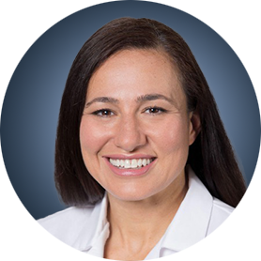

Faculty
Emmanuel S Antonarakis, MD
Clark Endowed Professor of Medicine
Division of Hematology, Oncology and Transplantation
University of Minnesota
Minneapolis, Minnesota
Alicia K Morgans, MD, MPH
Associate Professor of Medicine
Harvard Medical School
Medical Director, Survivorship Program
Dana-Farber Cancer Institute
Boston, Massachusetts
Prof Karim Fizazi, MD, PhD
Head of Service and Full Professor
Institut Gustave Roussy
University of Paris Saclay
Villejuif, France
A Oliver Sartor, MD
Director of Radiopharmaceutical Clinical Trials
Professor, Department of Oncology
Mayo Clinic in Rochester, Minnesota
Rochester, Minnesota
Rana R McKay, MD
Associate Professor of Medicine and Urology
Associate Director, Translational Sciences
Co-Lead, Genitourinary Oncology Program
University of California San Diego
Moores Cancer Center
La Jolla, California
Moderator
Neil Love, MD
Research To Practice
Miami, Florida

Slide 3
Dr Antonarakis — Disclosures
Advisory Committee | Amgen Inc, AstraZeneca Pharmaceuticals LP, Bayer HealthCare Pharmaceuticals, Janssen Biotech Inc, Merck, Sanofi, Tempus
Consulting Agreements | Aadi Bioscience, AIkido Pharma Inc, Blue Earth Diagnostics, CM Propel, Corcept Therapeutics, EcoR1 Capital LLC, Foundation Medicine, HOOKIPA Pharma Inc, KeyQuest Health, MacroGenics Inc, Menarini Silicon Biosystems, z-Alpha
Contracted Research | Astellas, AstraZeneca Pharmaceuticals LP, Bristol Myers Squibb, Constellation Pharmaceuticals, Merck, Orion Corporation, Sanofi
Patent Holder | QIAGEN
Nonrelevant Financial Relationship | European Association of Urology (UROwebinar), Ismar Healthcare NV

Slide 4
Prof Fizazi — Disclosures
Advisory Committee | Arvinas, CureVac, Orion Corporation
Data and Safety Monitoring Board/Committee | Lilly
Consulting Agreements (with My Institution) | Advanced Accelerator Applications, Amgen Inc, Astellas, AstraZeneca Pharmaceuticals LP, Bayer HealthCare Pharmaceuticals, Clovis Oncology, Daiichi Sankyo Inc, Janssen Biotech Inc, Merck Sharp & Dohme LLC, Novartis, Pfizer Inc, Sanofi

Slide 5
Dr McKay — Disclosures
Consulting Agreements | AstraZeneca Pharmaceuticals LP, Aveo Pharmaceuticals, Bayer HealthCare Pharmaceuticals, Bristol Myers Squibb, Caris Life Sciences, Dendreon Pharmaceuticals Inc, Exelixis Inc, Johnson & Johnson Pharmaceuticals, Lilly, Merck, Myovant Sciences, Novartis, Pfizer Inc, Sanofi, Seagen Inc, Sorrento Therapeutics, Telix Pharmaceuticals Limited, Tempus
Contracted Research | AstraZeneca Pharmaceuticals LP, Exelixis Inc, Oncternal Therapeutics, Tempus

Slide 6
Dr Morgans — Disclosures
Consulting Agreements | Advanced Accelerator Applications, Astellas, AstraZeneca Pharmaceuticals LP, Bayer HealthCare Pharmaceuticals, Exelixis Inc, Foundation Medicine, Janssen Biotech Inc, Lantheus, Merck, Myovant Sciences, Novartis, Pfizer Inc, Sanofi, Telix Pharmaceuticals Limited
Contracted Research | Bayer HealthCare Pharmaceuticals, Myovant Sciences, Pfizer Inc
Data and Safety Monitoring Board/Committee | Gilead Sciences Inc

Slide 7
Dr Sartor — Disclosures
Consultant | Advanced Accelerator Applications, Amgen Inc, ARTbio, Astellas, AstraZeneca Pharmaceuticals LP, Bayer HealthCare Pharmaceuticals, Blue Earth Diagnostics, Clarity Pharmaceuticals, Clovis Oncology, Constellation Pharmaceuticals, Convergent Therapeutics Inc, Dendreon Pharmaceuticals Inc, EMD Serono Inc, Foundation Medicine, Fusion Pharmaceuticals, Genzyme Corporation, Hengrui Therapeutics Inc, ITM Isotopen Technologien München AG, Janssen Biotech Inc, Merck, Morphimmune, Myovant Sciences, Myriad Genetic Laboratories Inc, Noria Therapeutics Inc, NorthStar Rx LLC, Novartis, Noxopharm, Pfizer Inc, POINT Biopharma, Progenics Pharmaceuticals Inc, Ratio Therapeutics, Sanofi, Telix Pharmaceuticals Limited, TeneoBio, Tessa Therapeutics, Theragnostics, z-Alpha
Equity Interests | Telix Pharmaceuticals Limited
Grant/Research Support | Advanced Accelerator Applications, Amgen Inc, Arvinas, AstraZeneca Pharmaceuticals LP, Bayer HealthCare Pharmaceuticals, Constellation Pharmaceuticals, Invitae, Janssen Biotech Inc, Lantheus, Merck, Novartis, Progenics Pharmaceuticals Inc, TeneoBio
Nonrelevant Financial Relationship | Ratio Therapeutics

Slide 8
Commercial Support
This activity is supported by educational grants from AstraZeneca Pharmaceuticals LP, Bayer HealthCare Pharmaceuticals, Janssen Biotech Inc, administered by Janssen Scientific Affairs LLC, Lilly, Merck, and Sanofi.
Research To Practice CME Planning Committee Members,
Staff and Reviewers
Planners, scientific staff and independent reviewers for Research To Practice have no relevant conflicts of interest to disclose.

Slide 9



Neeraj Agarwal, MD, FASCO
Professor of Medicine
Senior Director for Clinical Research Innovation
Huntsman Cancer Institute Presidential Endowed Chair of Cancer Research
Director, Center of Investigational Therapeutics
Director, Genitourinary Oncology Program
Huntsman Cancer Institute, University of Utah (NCI-CCC)
Salt Lake City, Utah
David S Morris, MD
President and Co-Director of Advanced Therapeutics Center Urology Associates
Nashville, Tennessee
Sandy Srinivas, MD
Professor of Oncology
Clinical Research Leader, GU Oncology
Stanford University
Stanford, California

Slide 10
Agenda
Module 1 – Current Management of Nonmetastatic Prostate Cancer —
Dr Morgans
Module 2 – New Considerations in Treatment Intensification for Metastatic Hormone-Sensitive Prostate Cancer (mHSPC) — Prof Fizazi
Module 3 – Available and Emerging Strategies for Newly Diagnosed Metastatic Castration-Resistant Prostate Cancer (mCRPC) — Dr McKay
Module 4 – Identification and Management of mCRPC with a Homologous Recombination Repair (HRR) Gene Abnormality — Dr Antonarakis
Module 5 – Management of Progressive mCRPC — Dr Sartor

Slide 11
  ASCO 2023 Oral Abstracts — Prostate Cancer
Bossi A et al. Prostate irradiation in men with de novo, low-volume, metastatic, castration-sensitive prostate cancer (mCSPC): Results of PEACE-1, a phase 3 randomized trial with a 2x2 design. ASCO 2023;Abstract LBA5000.
Armstrong AJ et al. Development and validation of an AI-derived digital pathology-based biomarker to predict benefit of long-term androgen deprivation therapy with radiotherapy in men with localized high-risk prostate cancer across multiple phase III NRG/RTOG trials. ASCO 2023;Abstract 5001.
Ravi P et al. Prognostic impact of PSA nadir (n) ≥0.1 ng/mL within 6 months (m) after completion of radiotherapy (RT) for localized prostate cancer (PCa): An individual patient-data (IPD) analysis of randomized trials from the ICECAP collaborative. ASCO 2023;Abstract 5002.
Olmos D et al. Presence of somatic/germline homologous recombination repair (HRR) mutations and outcomes in metastatic castration-resistant prostate cancer (mCRPC) patients (pts) receiving first‑line (1L) treatment stratified by BRCA status. ASCO 2023;Abstract 5003.

Slide 12
  ASCO 2023 Oral Abstracts — Prostate Cancer
Fizazi K et al. TALAPRO-2: Phase 3 study of talazoparib (TALA) + enzalutamide (ENZA) versus placebo (PBO) + ENZA as first-line (1L) treatment for patients (pts) with metastatic castration-resistant prostate cancer (mCRPC) harboring homologous recombination repair (HRR) gene alterations. ASCO 2023;Abstract 5004.
Sandhu S et al. LuPARP: Phase 1 trial of 177Lu-PSMA-617 and olaparib in patients with metastatic castration resistant prostate cancer (mCRPC). ASCO 2023;Abstract 5005.

Slide 13
Agenda
Module 1 – Current Management of Nonmetastatic Prostate Cancer —
Dr Morgans
Module 2 – New Considerations in Treatment Intensification for Metastatic Hormone-Sensitive Prostate Cancer (mHSPC) — Prof Fizazi
Module 3 – Available and Emerging Strategies for Newly Diagnosed Metastatic Castration-Resistant Prostate Cancer (mCRPC) — Dr McKay
Module 4 – Identification and Management of mCRPC with a Homologous Recombination Repair (HRR) Gene Abnormality — Dr Antonarakis
Module 5 – Management of Progressive mCRPC — Dr Sartor

Slide 14
Case Presentation: 71-year-old man diagnosed with localized prostate cancer who underwent a radical prostatectomy in 2010 experiences rising PSA from 0.18 to 0.4 – PSA doubling time 7 months, PSMA PET negative for other sites of disease
Dr David Morris (Nashville, Tennessee)

Slide 15
Case Presentation: 73-year-old man with M0 HSPC with PSA persistence after radical prostatectomy received ADT intensification with abiraterone/prednisone and went to the ER with hypertension, palpitations, headache and abnormal LFTs
Dr Sandy Srinivas (Stanford, California)

Slide 16
Current Management of Non-metastatic Prostate Cancer
Alicia Morgans, MD, MPH
Medical Director, Survivorship Program
Dana-Farber Cancer Institute

Slide 17
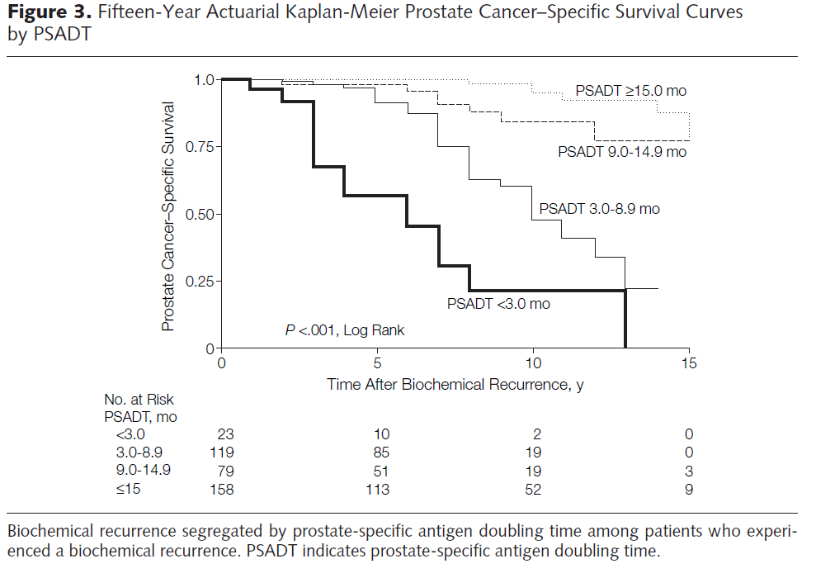
PSA Doubling Time Influences Risk of Recurrence
Freedland SJ, et al. JAMA. 2005.

Slide 18
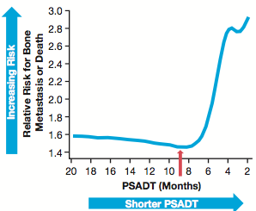
Risk of Metastases Increases as PSADT Falls in nmCRPC
Smith MR, et al. J Clin Oncol. 2013.
Small EJ, et al. Poster 161. GU ASCO 2018.

Slide 19
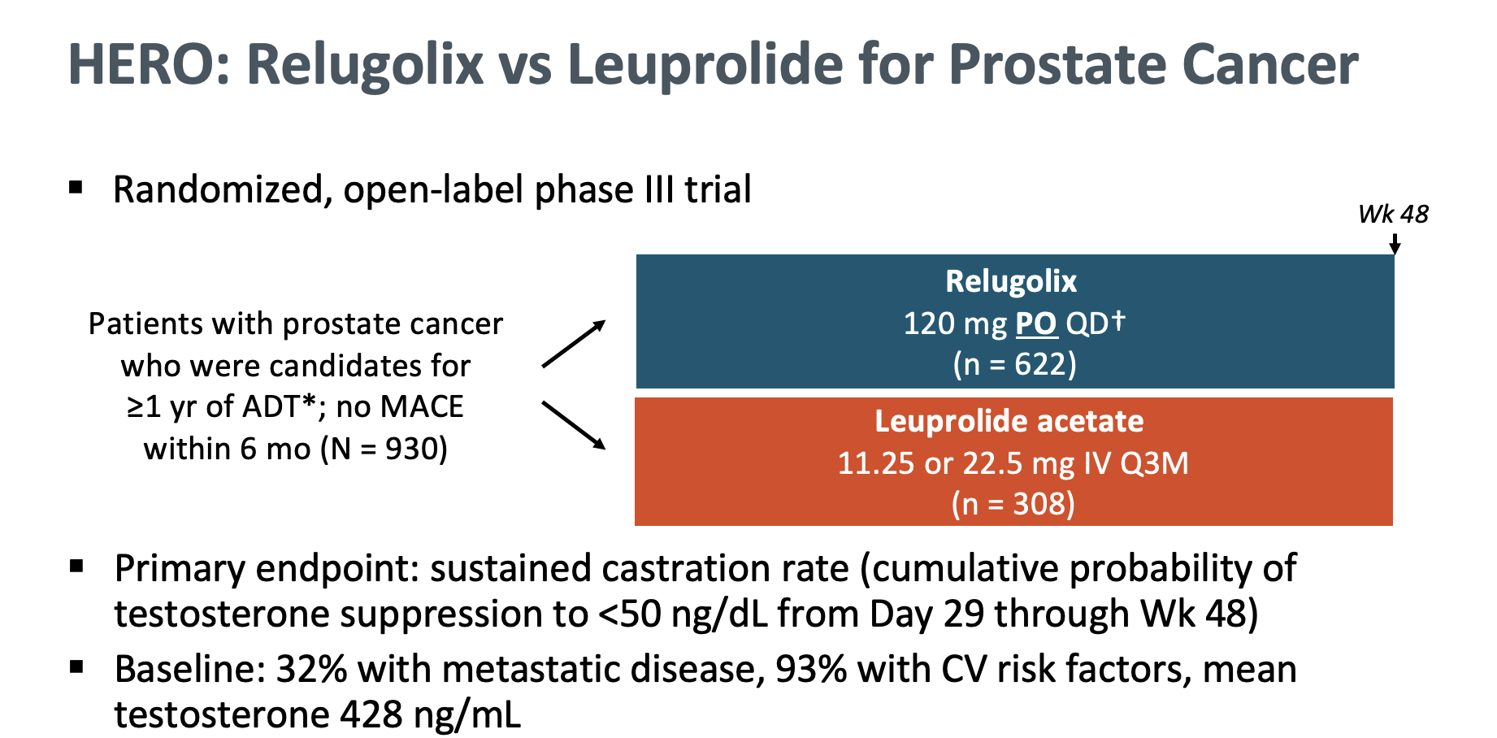
Shore et al. NEJM 2020 382(23):2187-2196.

Slide 20
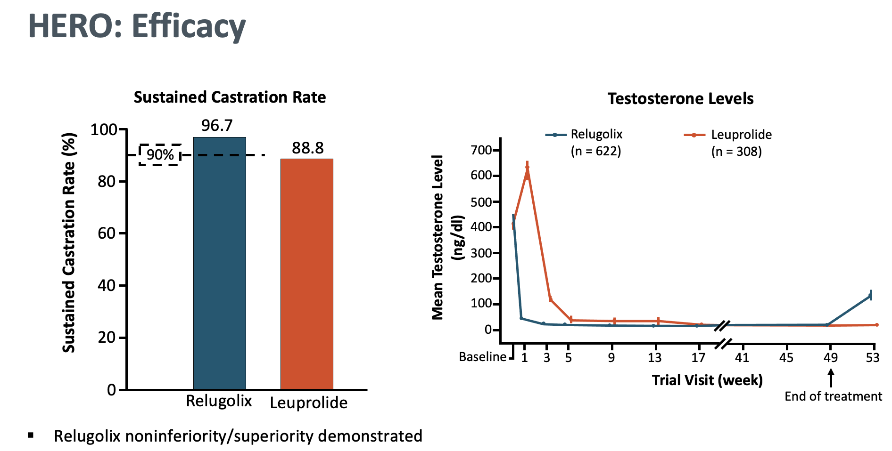
Shore et al. NEJM 2020 382(23):2187-2196.

Slide 21
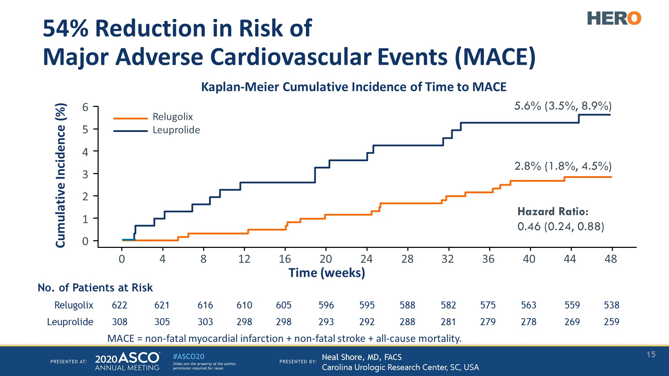
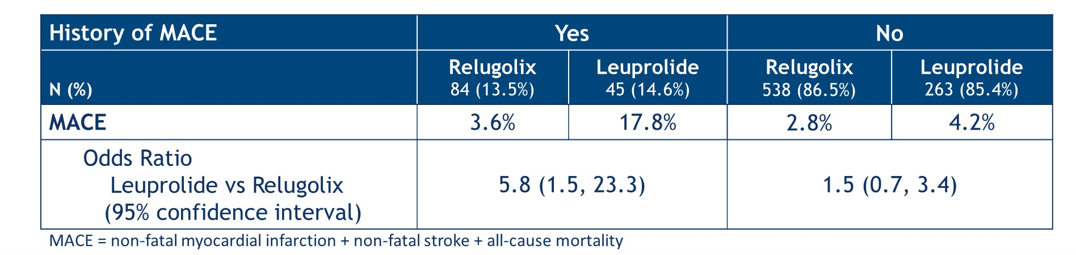
Cardiovascular events in the HERO trial
Shore et al. NEJM 2020 382(23):2187-2196.

Slide 22

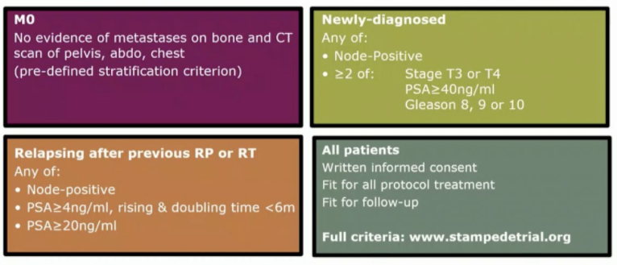

Attard G, et al. ESMO 2021.

Slide 23
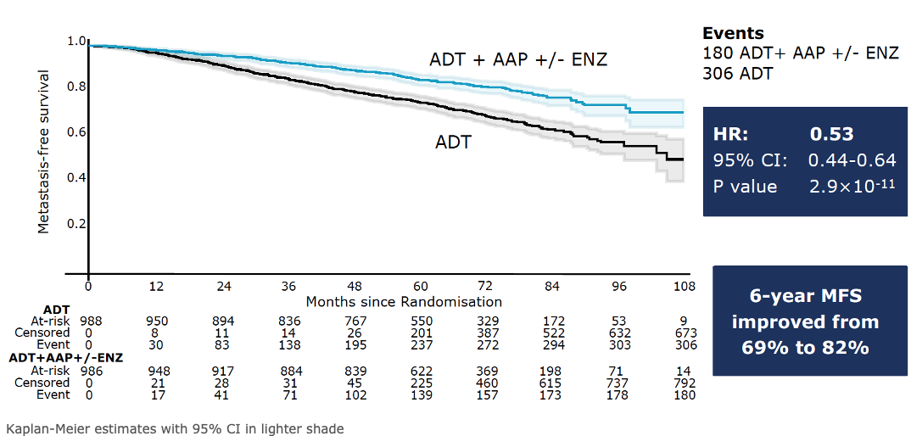
STAMPEDE non-metastatic cohort: MFS
Attard G, et al. ESMO 2021.; Attard G, et al. Lancet, 2022.

Slide 24
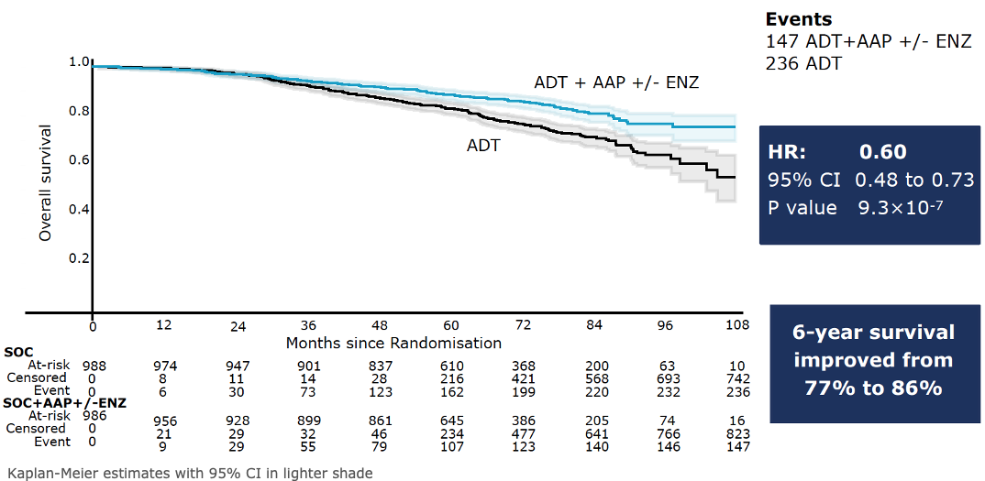
STAMPEDE non-metastatic cohort: OS
ADT
ADT+AAP+/-ENZ
Attard G, et al. ESMO 2021.; Attard G, et al. Lancet, 2022.

Slide 25
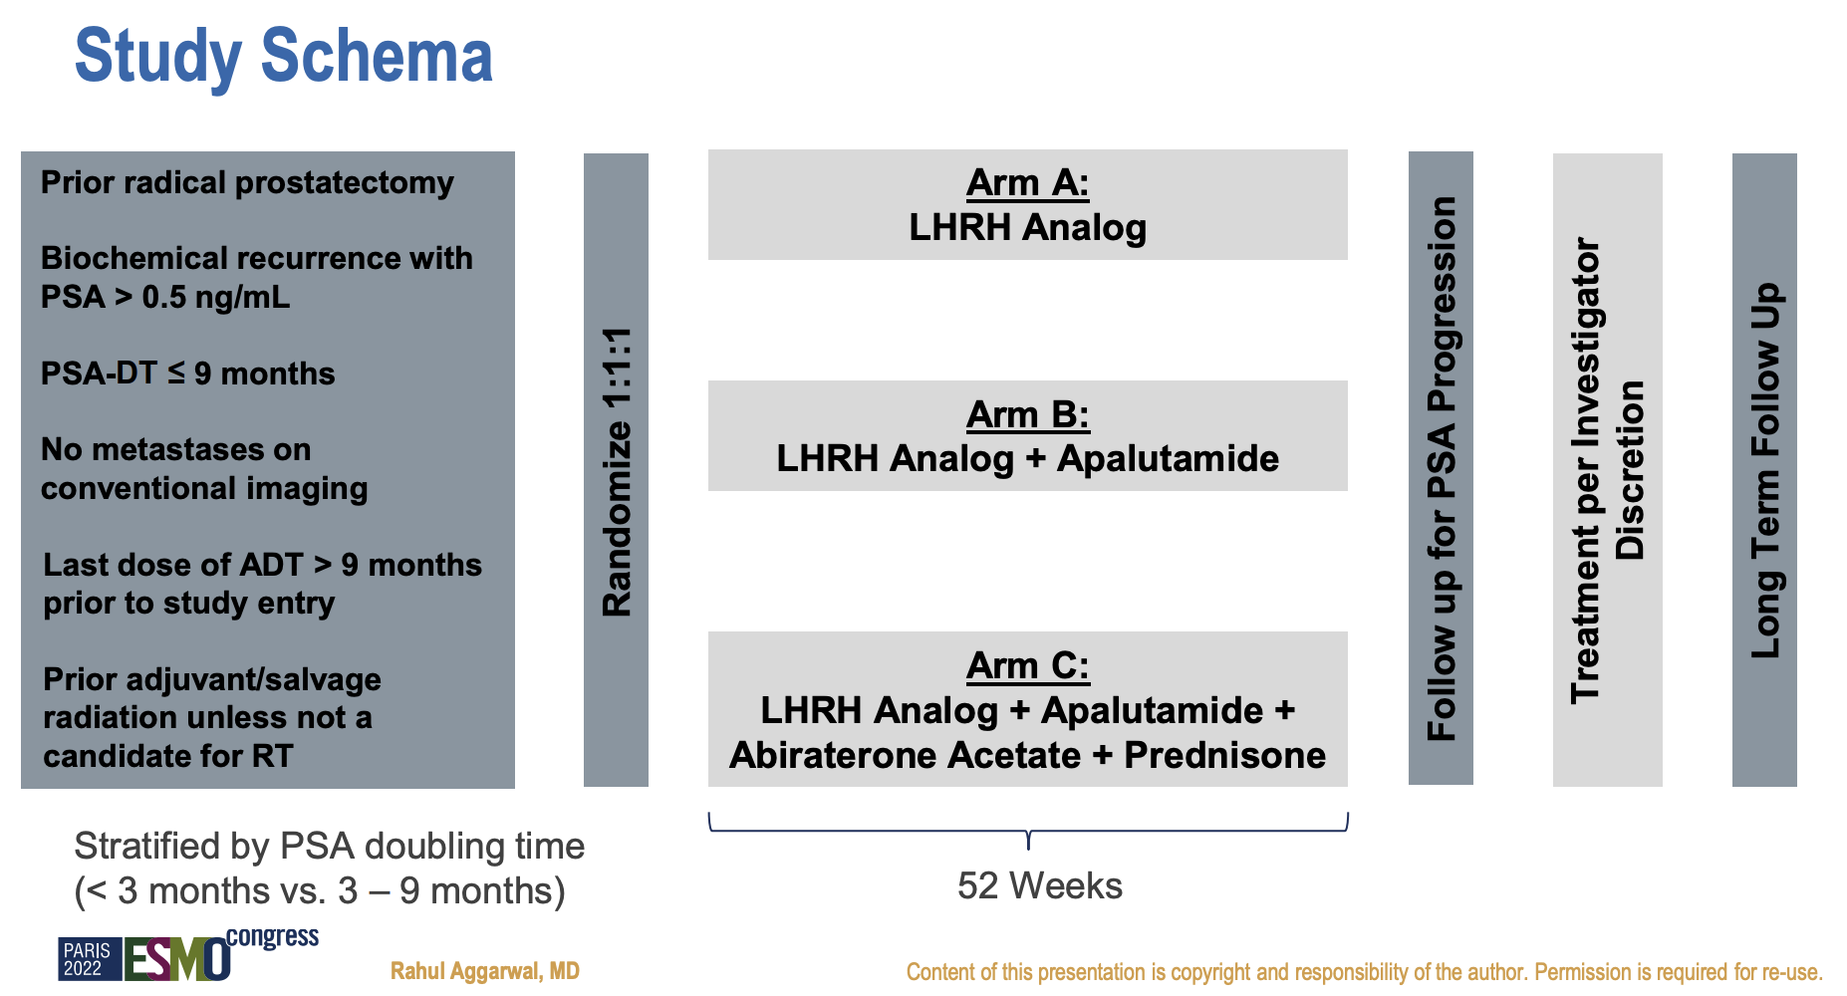
PRESTO Study Schema
Aggarwal R et al. ESMO 2022;Abstract LBA63.

Slide 26
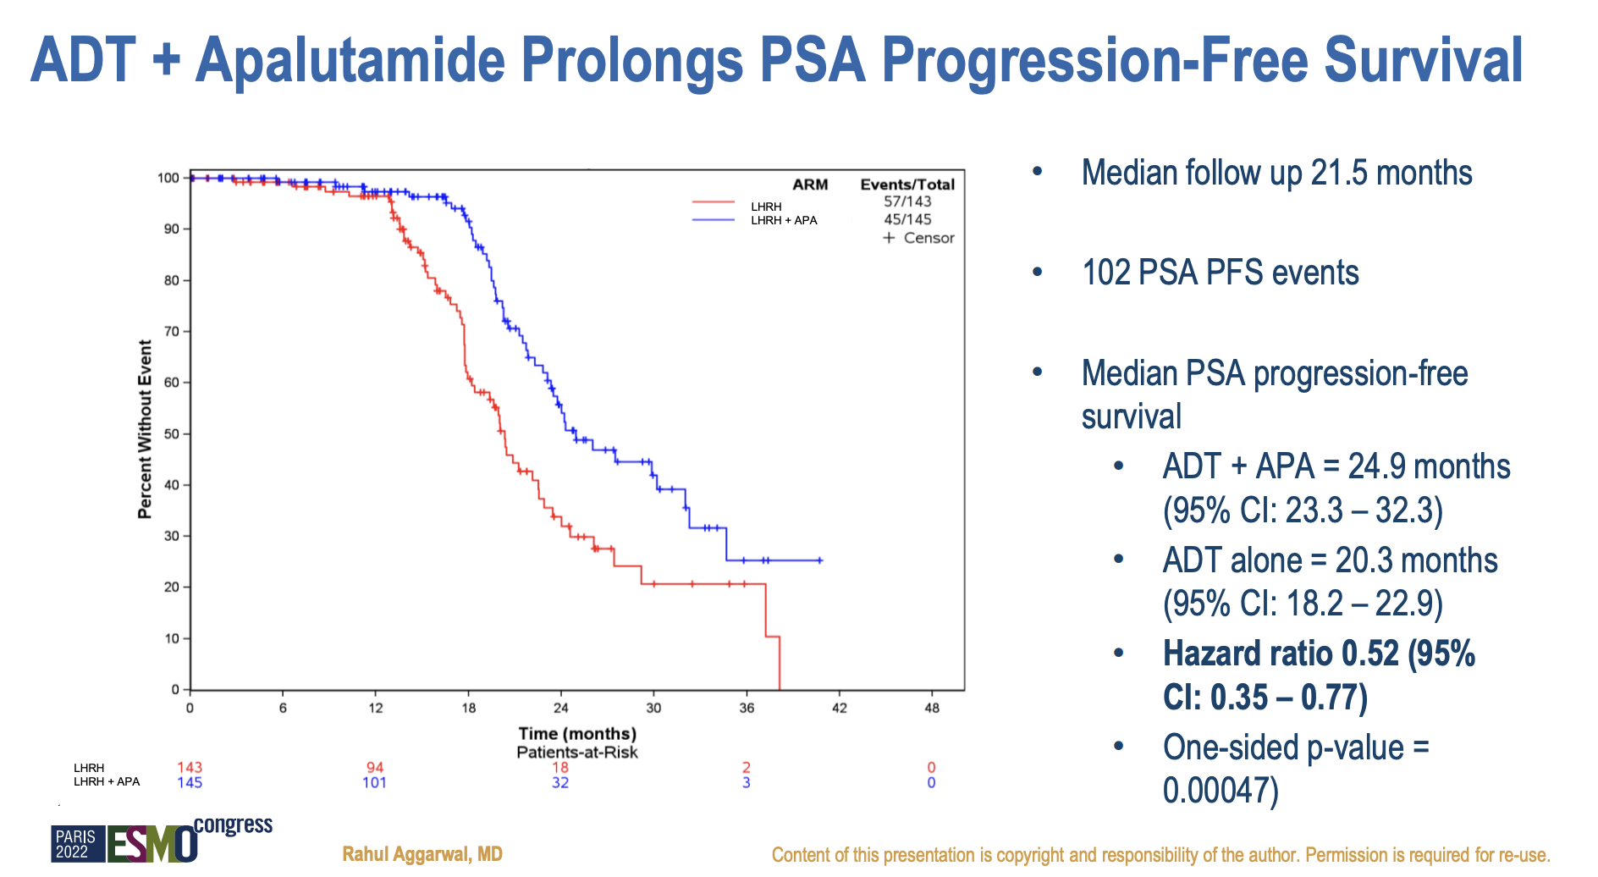
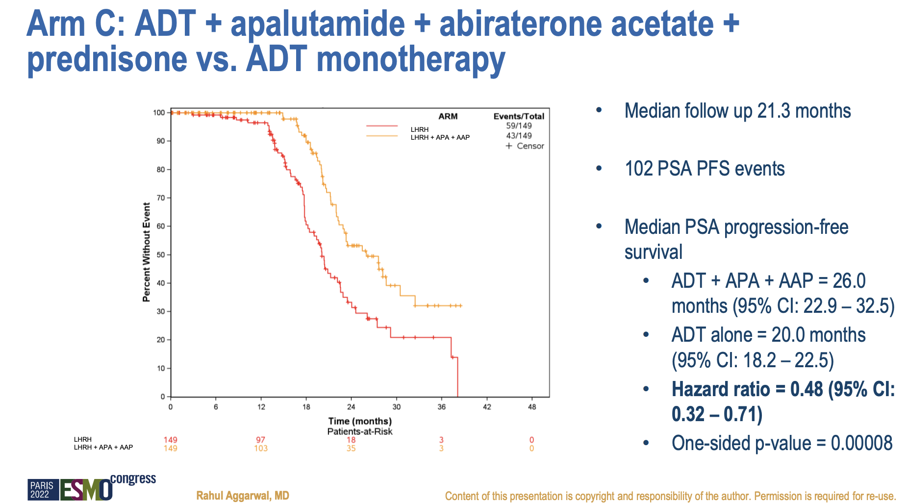
Aggarwal R et al. ESMO 2022;Abstract LBA63.

Slide 27
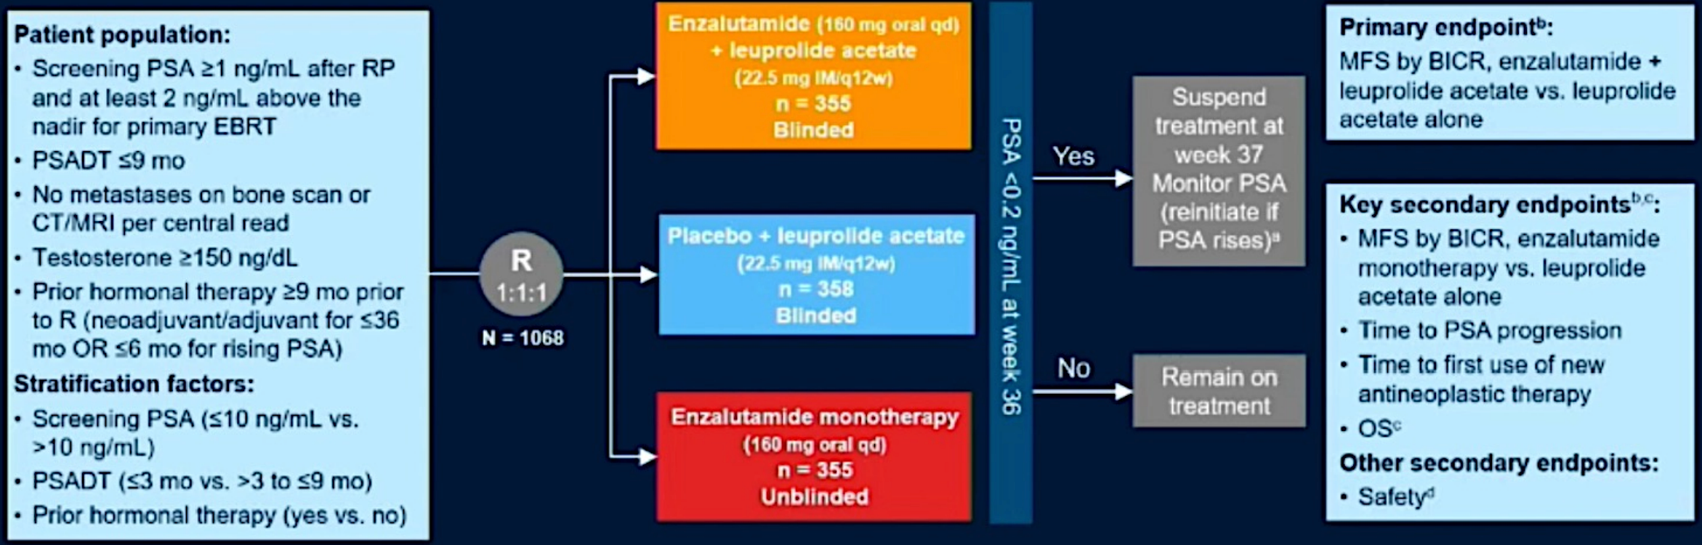
EMBARK: Enzalutamide for high-risk BCR
Shore N, et al. AUA, 2023.

Slide 28
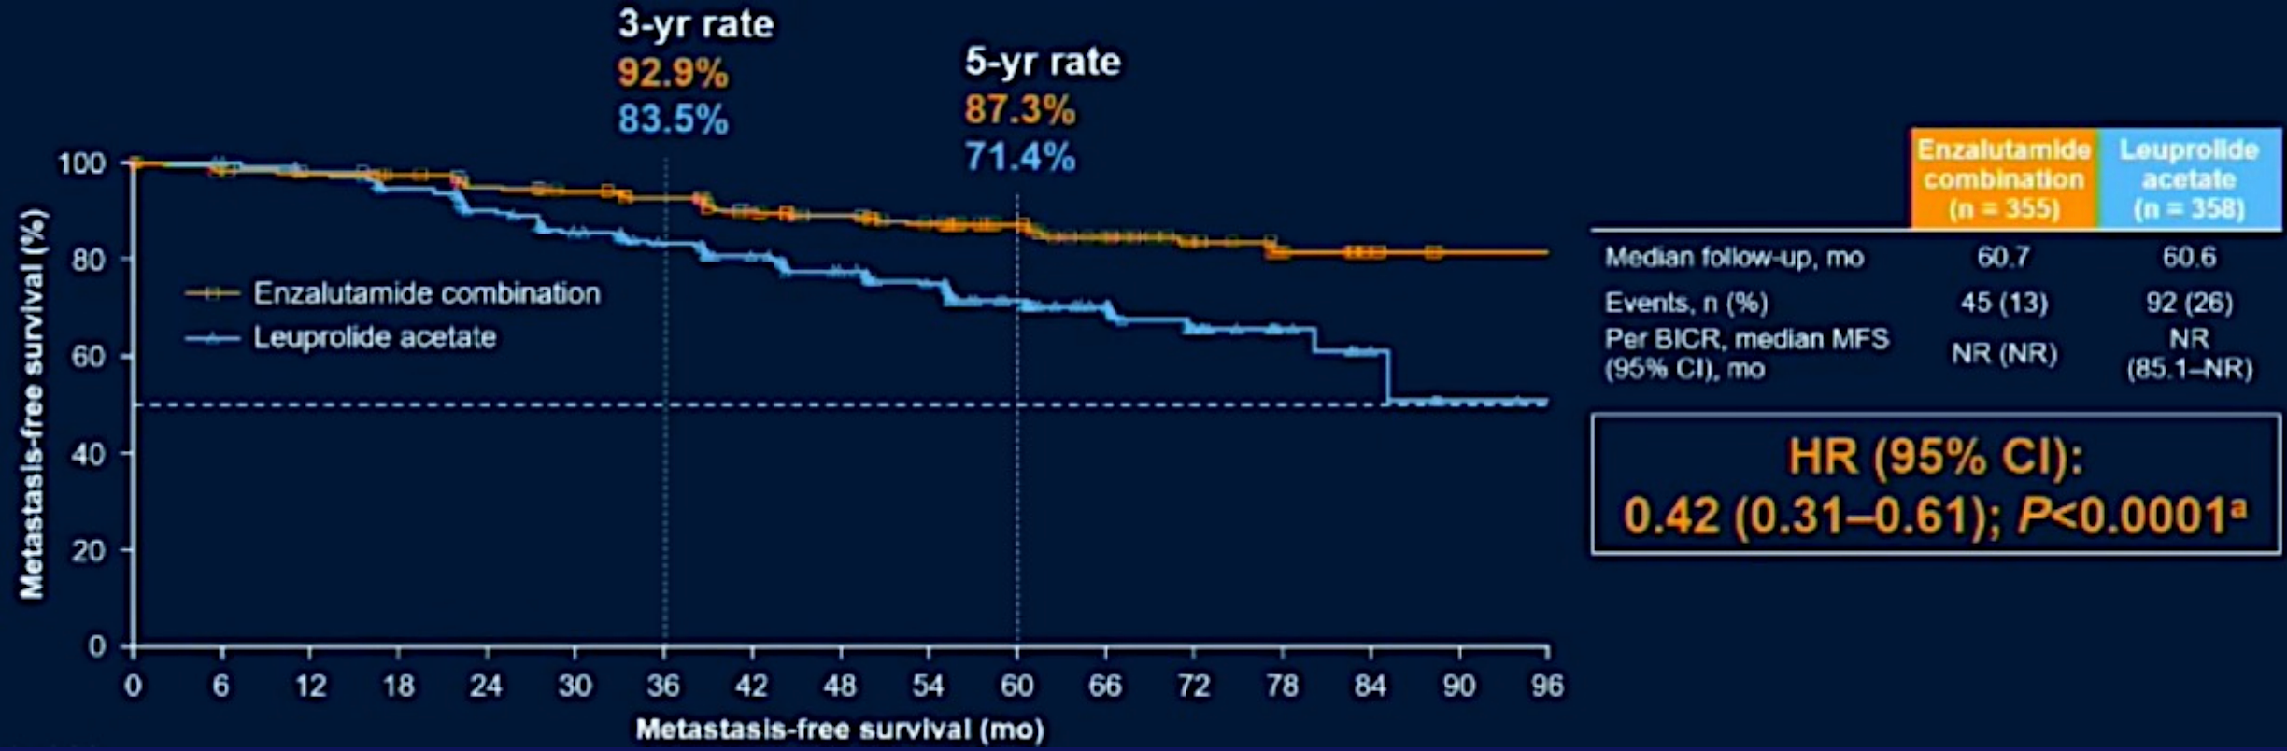
EMBARK MFS: Enzalutamide + ADT vs ADT
Shore N, et al. AUA, 2023.

Slide 29
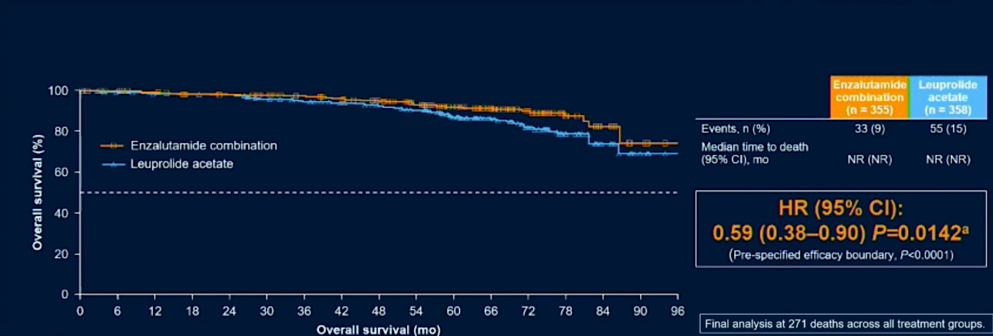
EMBARK OS: Enzalutamide + ADT vs ADT
Shore N, et al. AUA, 2023.

Slide 30
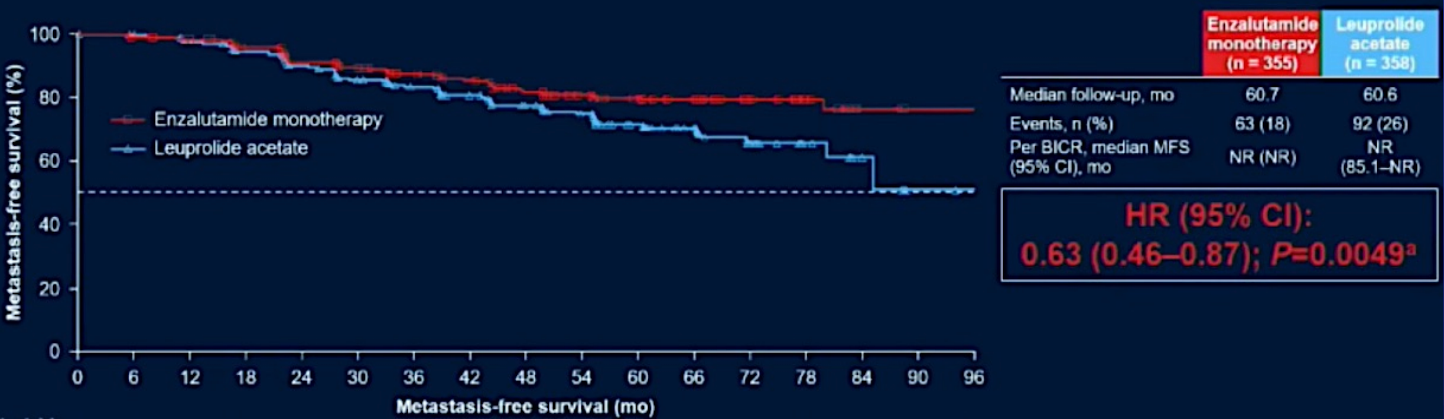
EMBARK MFS: Enzalutamide vs ADT
Shore N, et al. AUA, 2023.

Slide 31
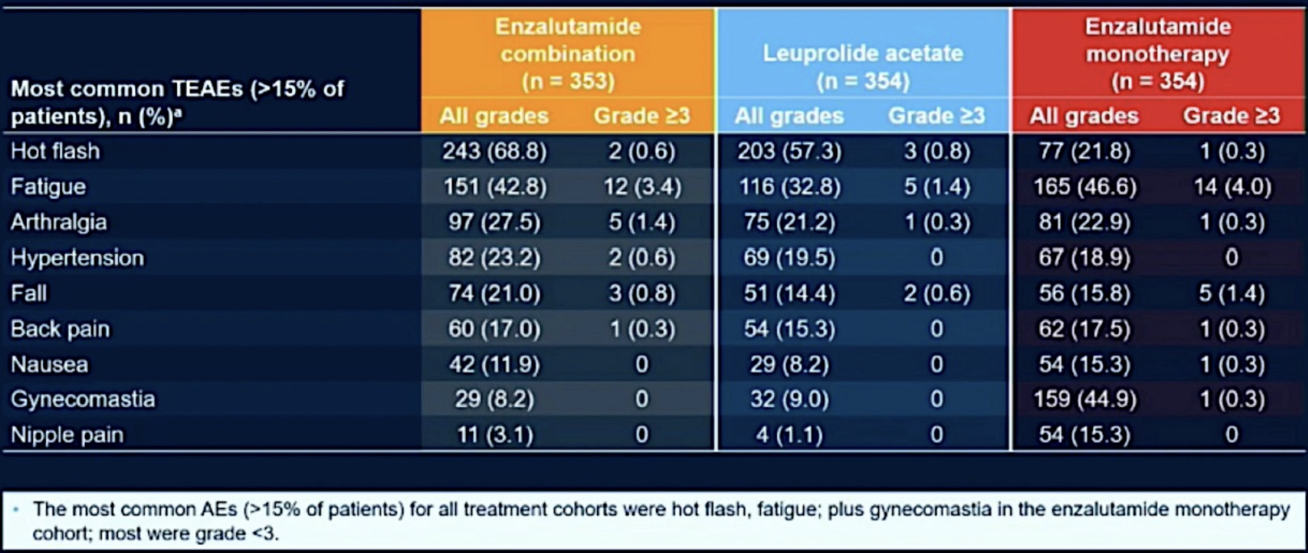
EMBARK: Treatment Emergent AEs
Shore N, et al. AUA, 2023.

Slide 32
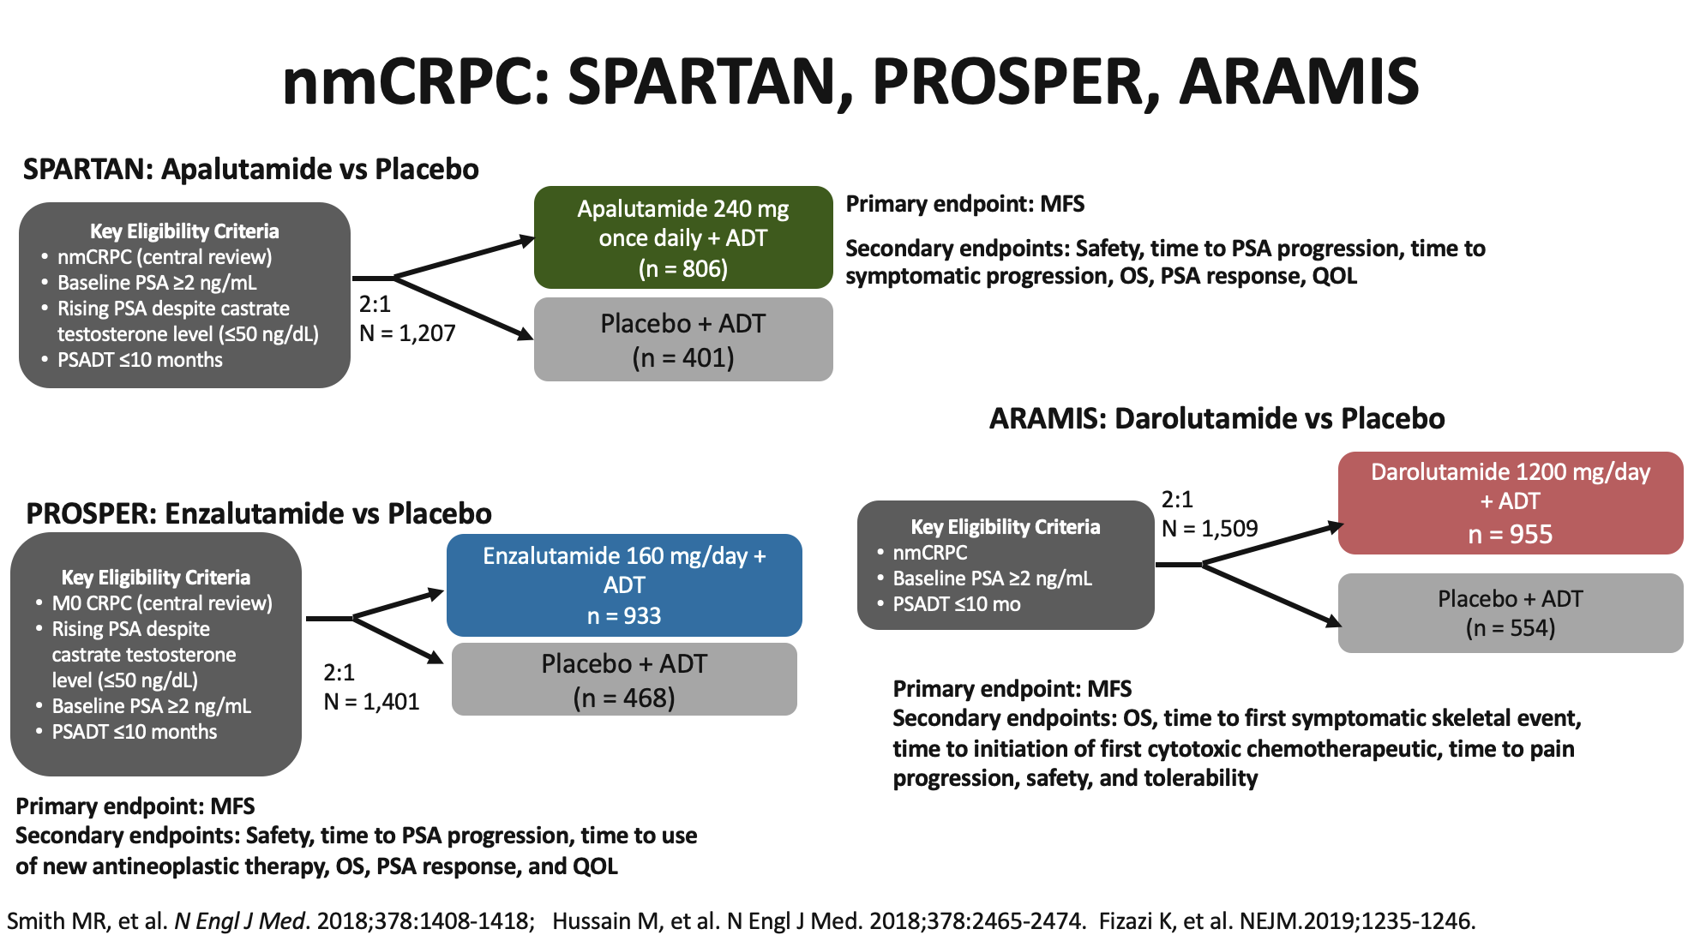

Slide 33
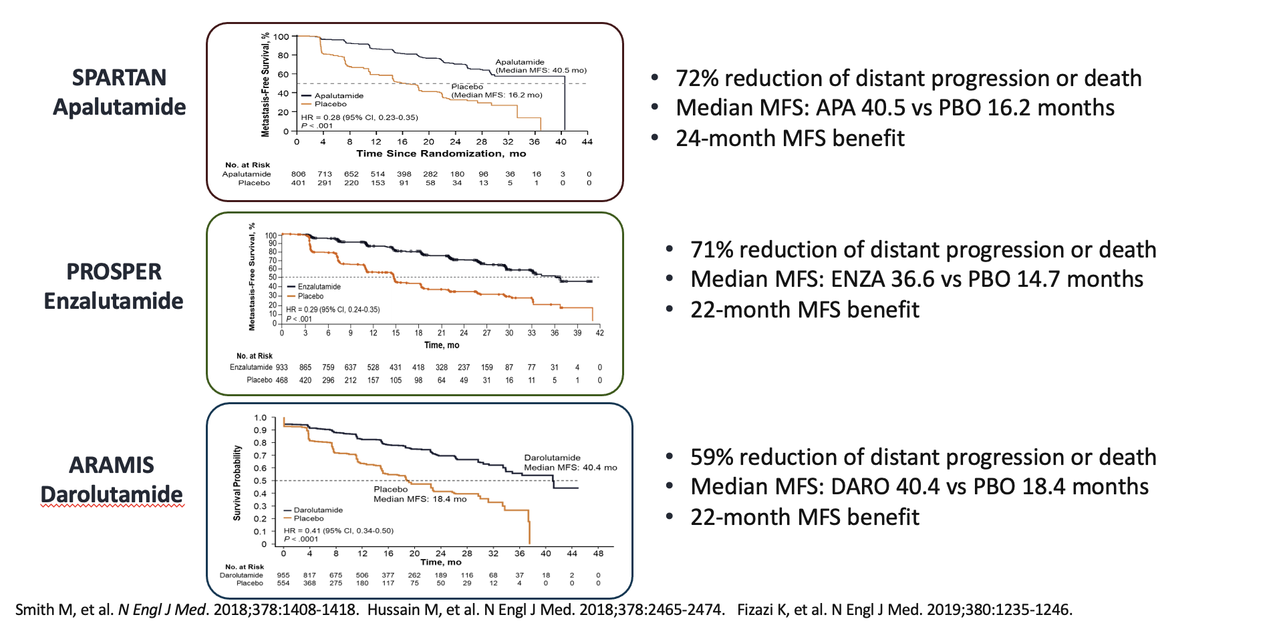
Primary Endpoint: Metastasis Free Survival

Slide 34
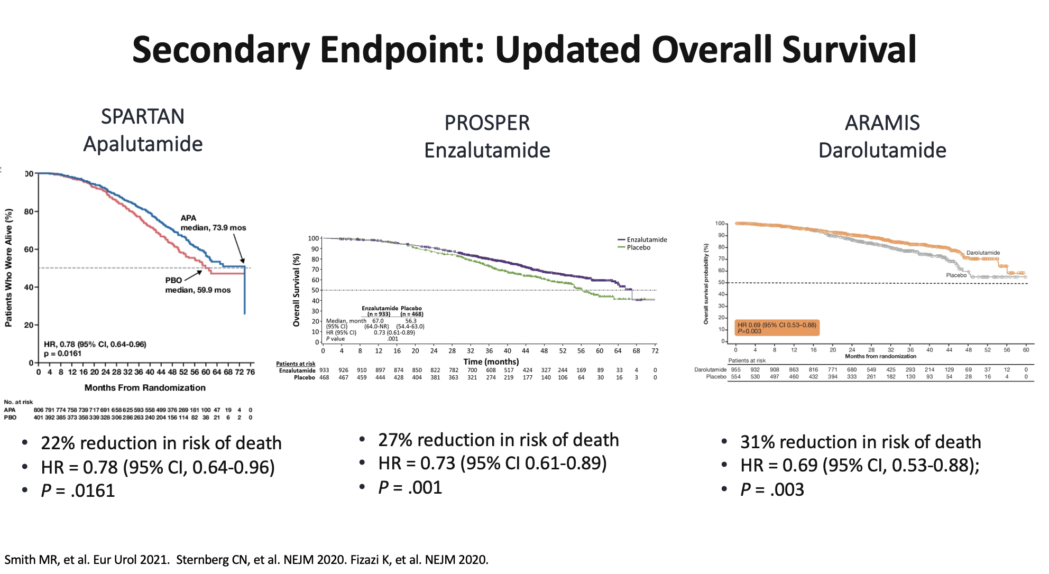

Slide 35
Summary
Patient selection for intensified treatment is critical in balancing risks and benefits of treatment.
Abiraterone in addition to ADT in combination with EBRT prolongs OS in high risk, locally advanced prostate cancer
Intensified treatment with ADT+ apalutamide prolongs PFS in high risk BCR
Intensified treatment with ADT + enzalutamide prolongs MFS in high risk BCR
Intensified treatment with ADT and enzalutamide, apalutamide, or darolutamide prolongs MFS and OS in nmCRPC

Slide 36
Agenda
Module 1 – Current Management of Nonmetastatic Prostate Cancer —
Dr Morgans
Module 2 – New Considerations in Treatment Intensification for Metastatic Hormone-Sensitive Prostate Cancer (mHSPC) — Prof Fizazi
Module 3 – Available and Emerging Strategies for Newly Diagnosed Metastatic Castration-Resistant Prostate Cancer (mCRPC) — Dr McKay
Module 4 – Identification and Management of mCRPC with a Homologous Recombination Repair (HRR) Gene Abnormality — Dr Antonarakis
Module 5 – Management of Progressive mCRPC — Dr Sartor

Slide 37
Case Presentation: 64-year-old man with localized prostate cancer and biochemical recurrence 5 years after neoadjuvant and adjuvant leuprolide and IMRT to the whole pelvis
Dr Neeraj Agarwal (Salt Lake City, Utah)

Slide 38
Case Presentation: 82-year-old man who underwent radical prostatectomy 15 years ago and received RT and ADT for biochemical recurrences is now diagnosed with M0 CRPC with quickly rising PSA levels
Dr David Morris (Nashville, Tennessee)

Slide 39

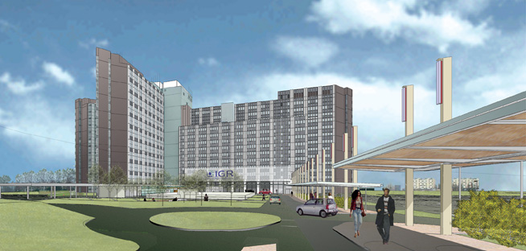
Treatment Intensification in M1 Prostate Cancer
Karim Fizazi, MD, PhD
Institut Gustave Roussy
Villejuif, France

Slide 40
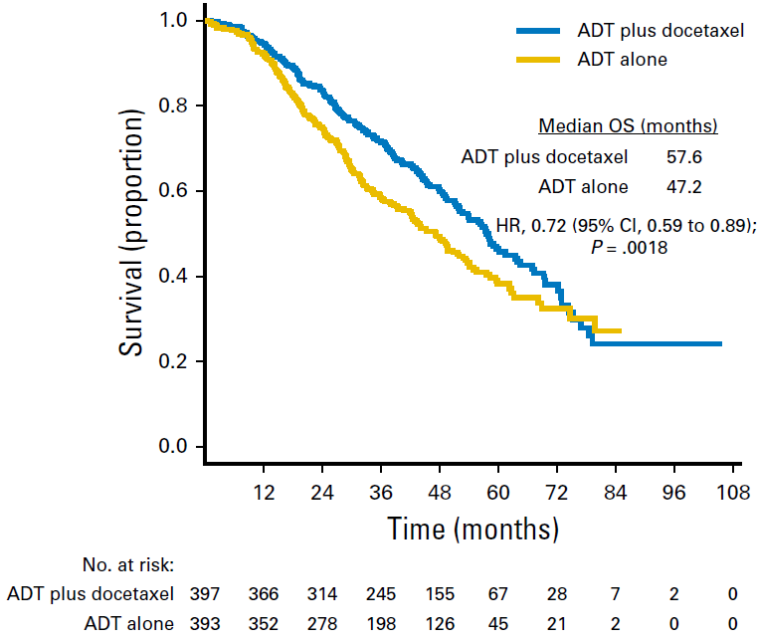
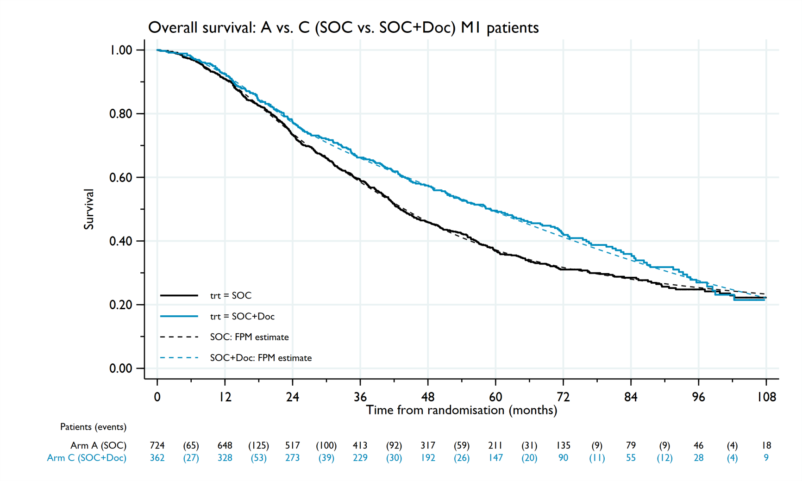
CHAARTED and STAMPEDE: Lower OS benefit of docetaxel in long-term analysis
HR 0.81
95% CI 0.69 – 0.95
P = 0.009
Non-PH 0.016
Kyriakopoulos CE, J Clin Oncol 2018
Clarke N, Ann Oncol. 2019

Slide 41
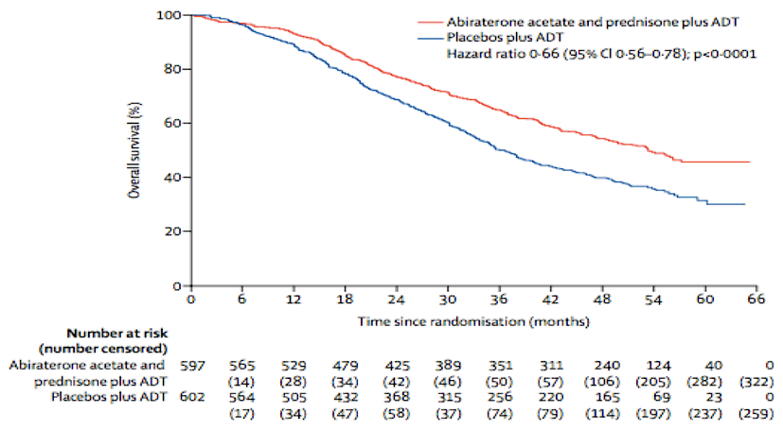
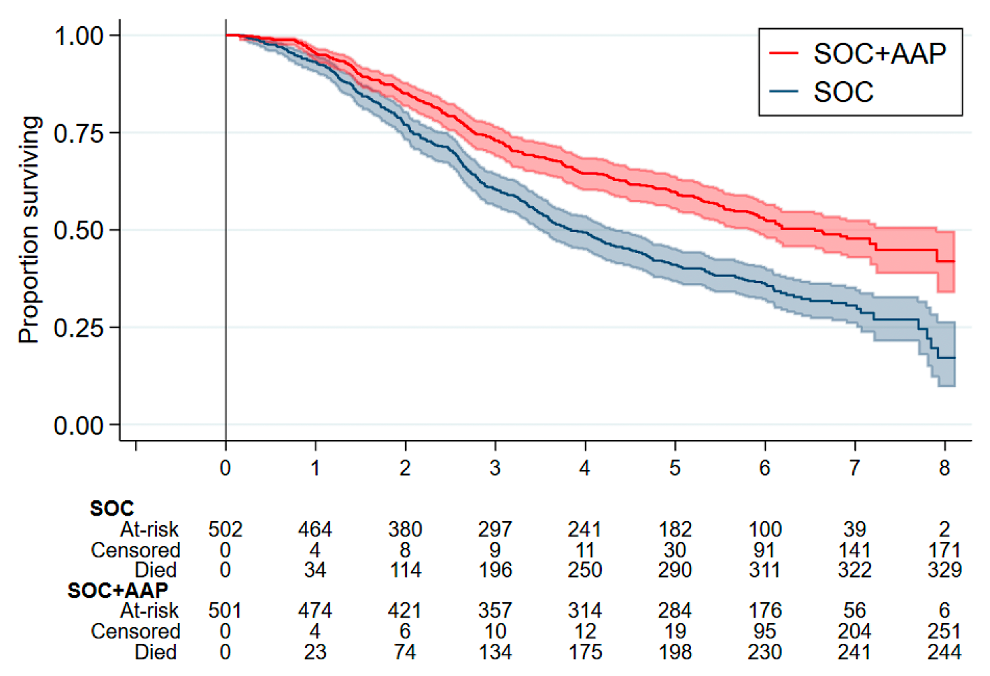
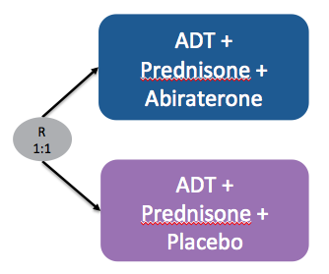
Long-term follow-up confirms
OS benefit with Abiraterone in mCSPC
LATITUDE
STAMPEDE
Study | N | Follow up | OS abiraterone | HR OS | 95% CI
LATITUDE | 1199 | 52 mo | 53.3 mo | 0.66 | 0.56-0.78
STAMPEDE | 1003 | 72 mo | 79 mo | 0.60 | 0.50-0.71
Fizazi K, et al. Lancet Oncol 2019; 20: 686-700
James ND, et al. Ann Oncol 2020; 31 (suppl_4): S507-S549

Slide 42
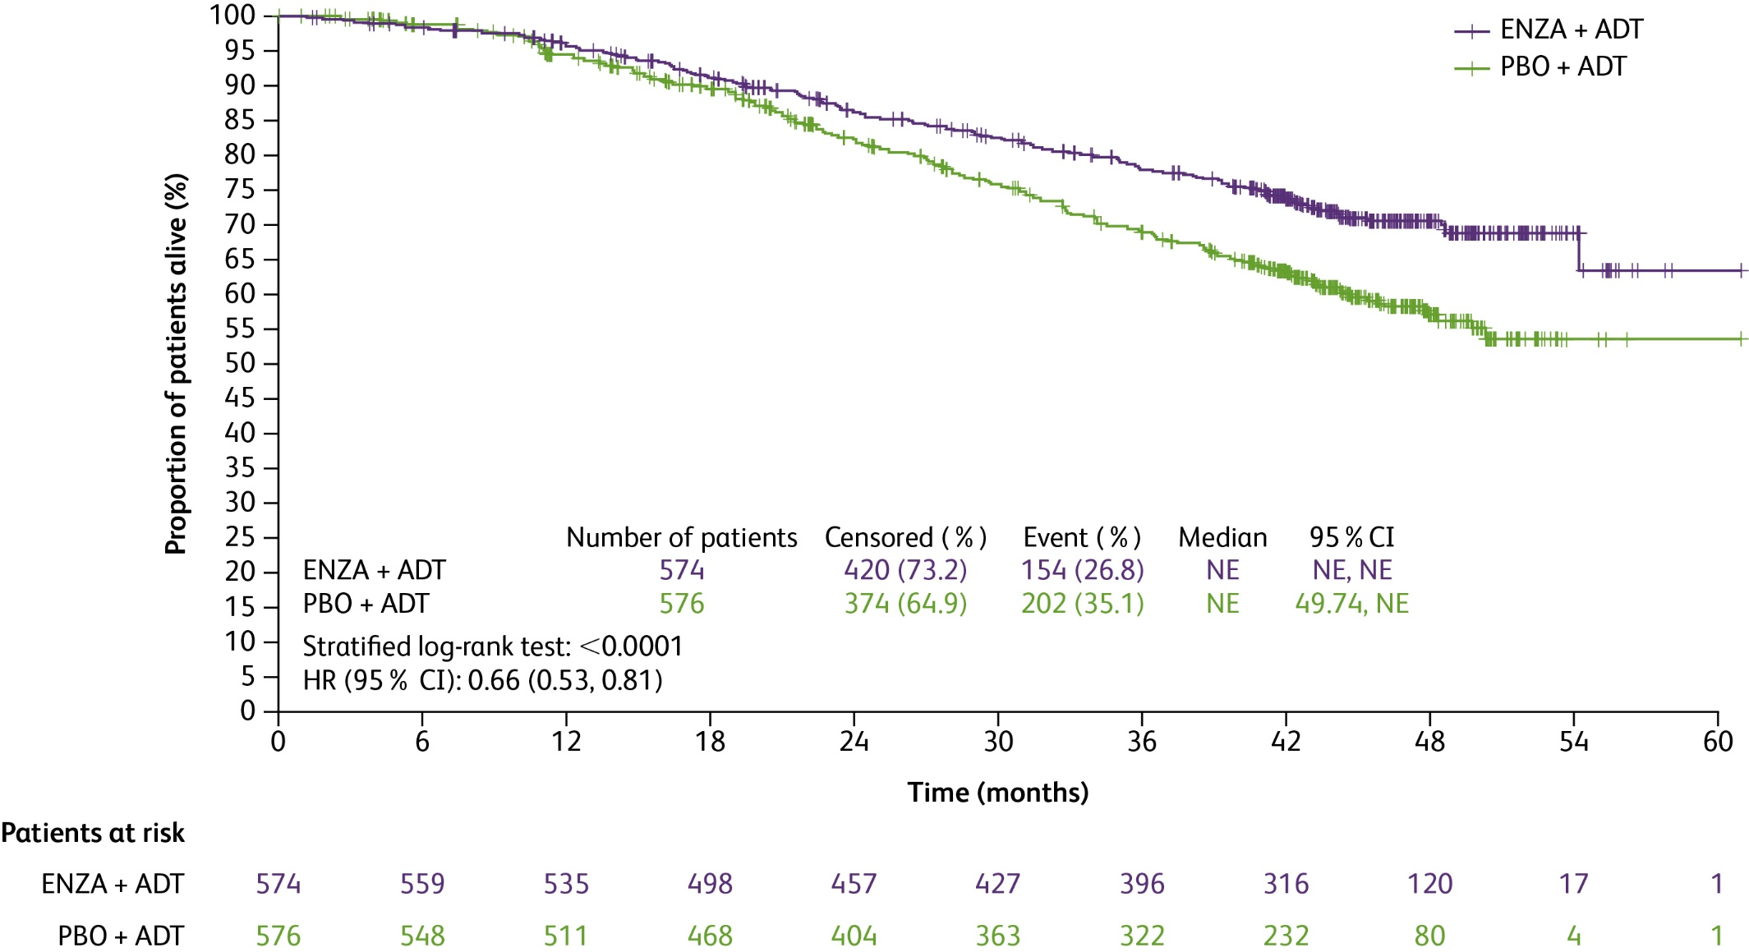
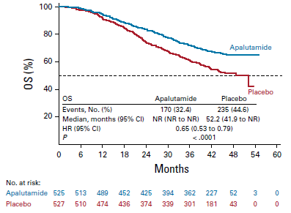
ADT + ARPI > ADT in M1 CSPC
ENZAMET (Enzalutamide)
ARCHES (Enzalutamide)
TITAN (Apalutamide)
Davis I, NEJM 2019
Armstrong A, ESMO 2021
Chi K, J Clin Oncol 2021

Slide 43
Should the systemic treatment differ according to timing and metastatic burden?

Slide 44





Timing and burden of metastases in M1 CSPC
De novo
Low burden
De novo
High burden
M1 Castrate-Sensitive
Prostate Cancer (mCSPC)
Recurrence
Low burden
Recurrence
High burden

Slide 45
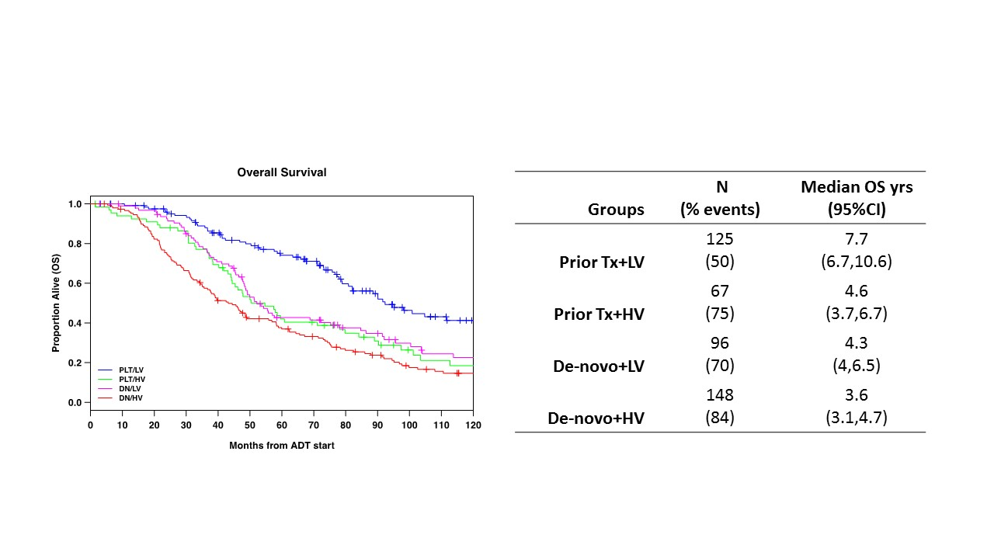
The outlier: M1 relapse and oligo
Gravis G, Eur Urol 2018
Francini E, Prostate 2018

Slide 46
Docetaxel effect in mCSPC: Timing of metastases is more important than « Volume »
Subgroup | Progression free survival |  |  | Overall survival
 | Number of events/ patients | % difference (95% CI) | Change from baseline | Number of events/ patients | % difference (95% CI) | Change from baseline
Disease volume x timing of diagnosis
Low volume, metachronous | 107/229 | -1% (-15 to 12%) | 48% to 47% | 70/229 | 0% (-10 to 12%) | 72% to 72%
Low volume, synchronous | 346/582 | 8% (1 to 15%) | 37% to 45% | 267/582 | 8% (0 to 16%) | 52% to 60%
High volume, metachronous | 92/132 | 11% (-2 to 24%) | 14% to 25% | 78/132 | 10% (-1 to 26%) | 28% to 38%
High volume, synchronous | 856/1044 | 12% (7 to 16%) | 11% to 23% | 736/1044 | 12% (7 to 18%) | 26% to 39%
Disease volume x clinical T stage
Low volume, cT-stage 1-3 | 302/569 | 5% (-2 to 12%) | 41% to 46% | 225/569 | 4% (-3 to 11%) | 58% to 62%
Low volume, cT-stage 4 | 61/85 | 12% (-6 to 29%) | 24% to 36% | 51/85 | 16% (-3 to 36%) | 38% to 54%
High volume, cT-stage 1-3 | 562/709 | 8% (4 to 13%) | 14% to 22% | 484/709 | 6% (0 to 12%) | 29% to 35%
High volume, cT-stage 4 | 157/192 | 27% (17 to 37%) | 8% to 35% | 136/192 | 35% (24 to 47%) | 20% to 55%
Vale C, ASCO 2022 (Abst 5070)

Slide 47
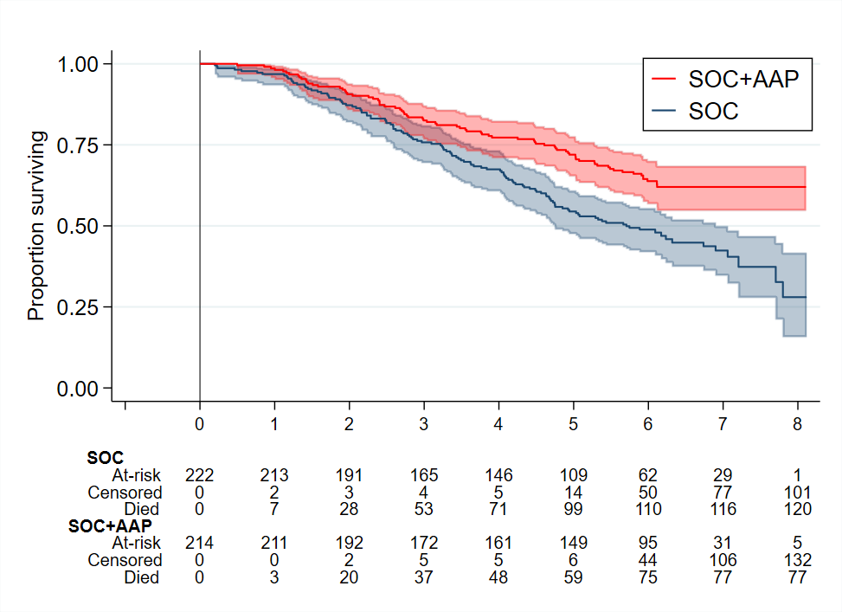
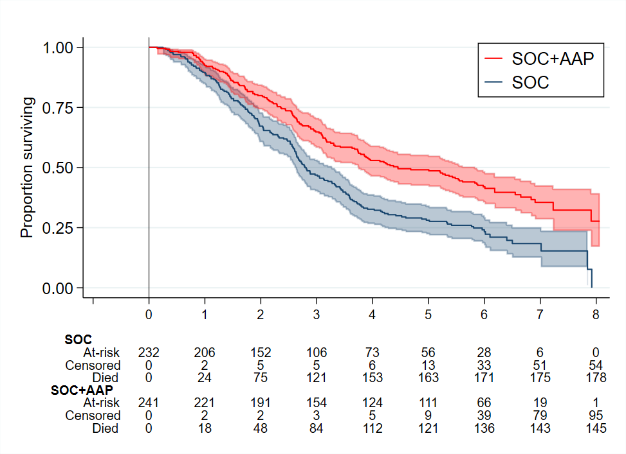
Second generation ARPI active
regardless of M1 burden (mostly de novo pts)
Low risk
High risk
HR 0.55 (0.41-0.76)
p=0.00001
HR 0.54 (0.43-0.69)
P<0.00001
HR 0.66 (0.44-0.98)
p=0.041
HR 0.54 (0.41-0.70)
P<0.001
James N, ESMO 2020

Slide 48
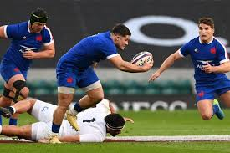
Should we intensify even more systemic treatment for men with mCSPC?
Taxanes and Second generation AR pathway inhibitors playing together?

Slide 49

Design of PEACE-1 (2x2)
Key Eligibility Criteria
De novo mCSPC
Distant metastatic disease by ≥ 1 lesion on bone scan and/or CT scan
ECOG PS 0 -2
On-Study Requirement
Continuous ADT
Permitted
ADT ≤ 3 months
Stratification
ECOG PS (0 vs 1-2)
Metastatic sites (LN vs bone vs visceral)
Type of castration (orchidectomy vs LHRH agonist vs LHRH antagonist)
Docetaxel (yes vs no)
Nov 2013 – Dec 2018
SOC
(n = 296)
SOC+Abiraterone
(n = 292)
RANDOMIZATION
1:1:1:1
SOC+Radiotherapy
(n = 293)
n = 1173
SOC+Abiraterone+
Radiotherapy
(n = 292)
ECOG PS, Eastern Cooperative Oncology Group performance status
Karim Fizazi

Slide 50
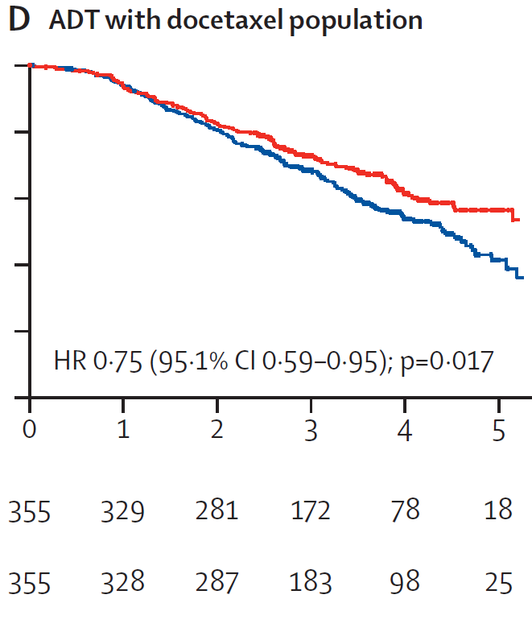
PEACE-1: ADT+Docetaxel+Abiraterone > ADT+Docetaxel
Median OS = 4.43 y vs NR
Median rPFS = 2.03 vs 4.46 y
Fizazi K, Lancet 2022

Slide 51

Triplet PEACE-1 OS results in the context of recent data
Median Overall Survival
(de novo High-Volume mCSPC)
ADT alone
33 m CHAARTED (Kyriakopoulos CE, JCO 2018)
34 m GETUG-15 (Gravis G Eur Urol 2018)
35 m STAMPEDE (Clarke NW, Ann Oncol 2019)
40 m STAMPEDE doce (Clarke Ann Oncol 2019)
42 m PEACE-1
44 m GETUG-15 (Gravis G Eur Urol 2018)
48 m CHAARTED (Kyriakopoulos CE, JCO 2018)
ADT+docetaxel
ADT+abiraterone
53 m LATITUDE (Fizazi K Lancet Oncol 2019)
53 m? STAMPEDE Abi (James N ESMO 2020)
ADT+docetaxel+abiraterone
61 m PEACE-1
Karim Fizazi

Slide 52
PEACE-1: Grade 3-5 Toxicity on study treatments
(ADT+docetaxel safety population)
Toxicity, n (%) | SOC (+/- RXT) + Abiraterone (n=346) | SOC (+/- RXT) (n=350)
Neutropenia | 34 (10) | 32 (9)
Febrile neutropenia | 18 (5) | 19 (5)
Liver | 20 (6) | 2 (1)
Hypertension | 76 (22) | 45 (13)
Hypokalemia | 11 (3) | 1 (0)
Cardiac | 6 (2) | 5 (1)
Fatigue | 10 (3) | 15 (4)
Gastro-intestinal | 14 (4) | 18 (5)
Grade 5 | 7 (2) | 3 (1)
Karim Fizazi
Fizazi K, Lancet 2022

Slide 53
ARASENS Study Design
Global, randomized, double-blind, placebo-controlled phase III study (NCT02799602)
Docetaxel × 6
Endpoints
Primary: OS
Secondary
Time to CRPC
Time to pain progression
SSE-free survival
Time to first SSE
Time to initiation of subsequent systemic antineoplastic therapy
Time to worsening of disease-related physical symptoms
Time to initiation of opioid use for ≥7 consecutive days
Safety
Patients (N=1306)
mHSPC
ECOG PS 0 or 1
Candidates for ADT and docetaxel
Stratification
Extent of disease: M1a vs M1b vs M1c
ALP < vs ≥ ULN
Darolutamide 600 mg twice daily + ADT
1:1
randomization
(N=1305*)
Primary analysis
Placebo twice daily + ADT
Docetaxel × 6
FPFV: Nov 2016
LPFV: Jun 2018
Data cut-off
Oct 25, 2021
The primary analysis was planned to occur after ~509 deaths
Secondary efficacy endpoints were tested hierarchically

Slide 54
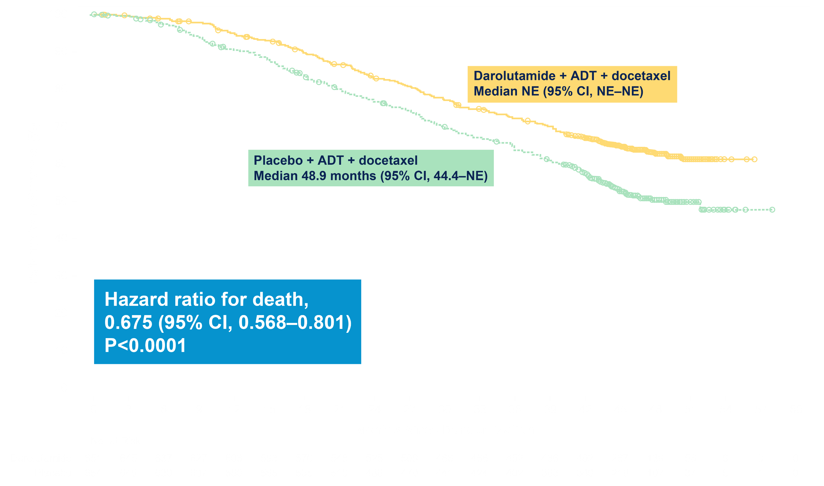
ARASENS Primary Endpoint*: Overall Survival
Darolutamide significantly reduced the risk of death by 32.5%
Smith M NEJM 2022

Slide 55
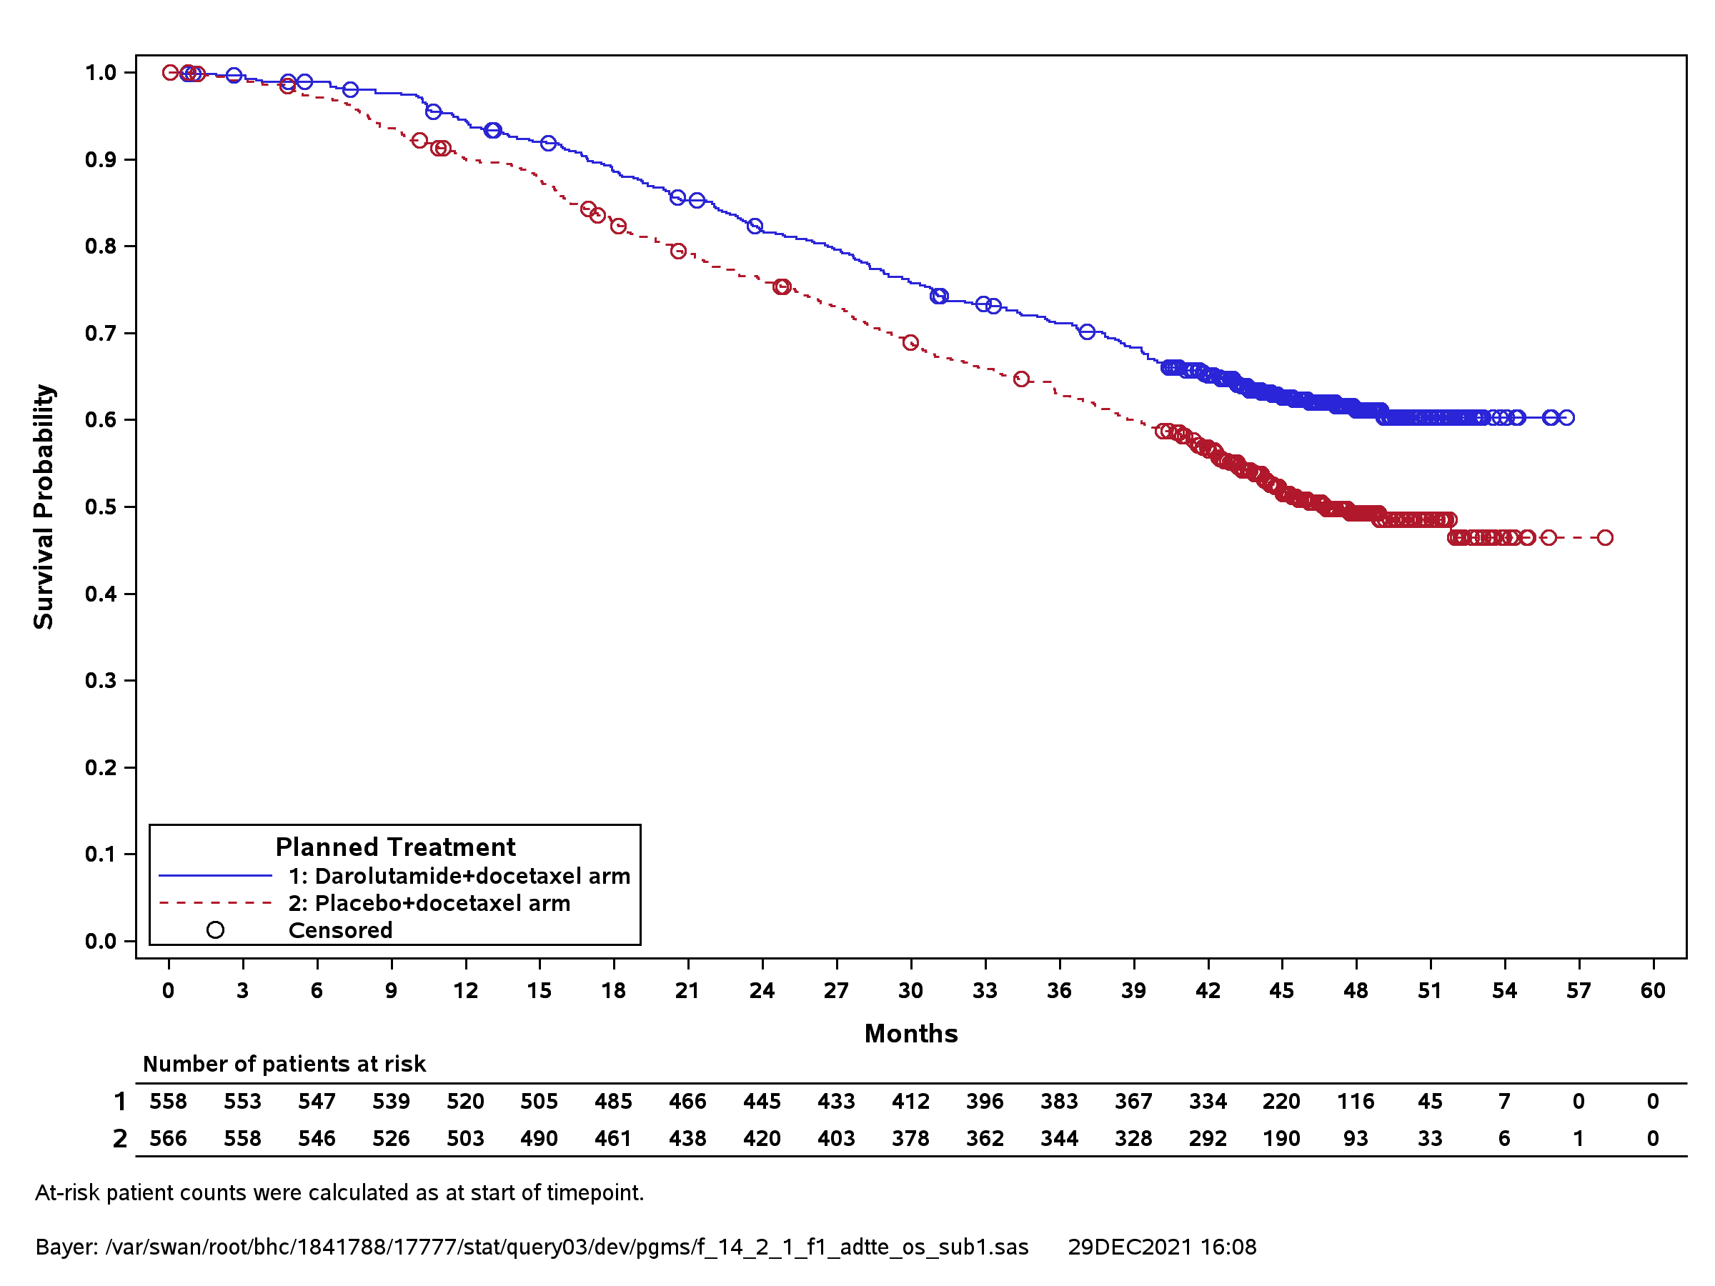
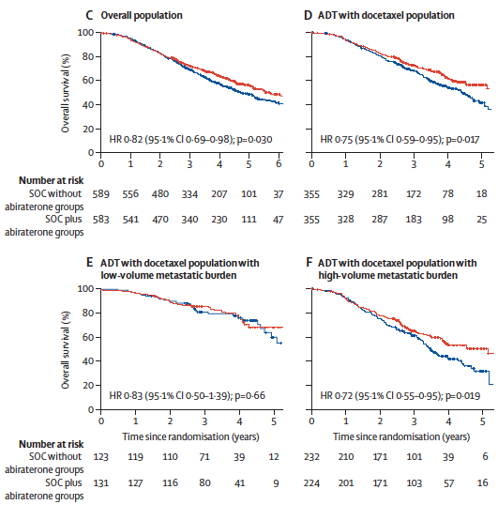
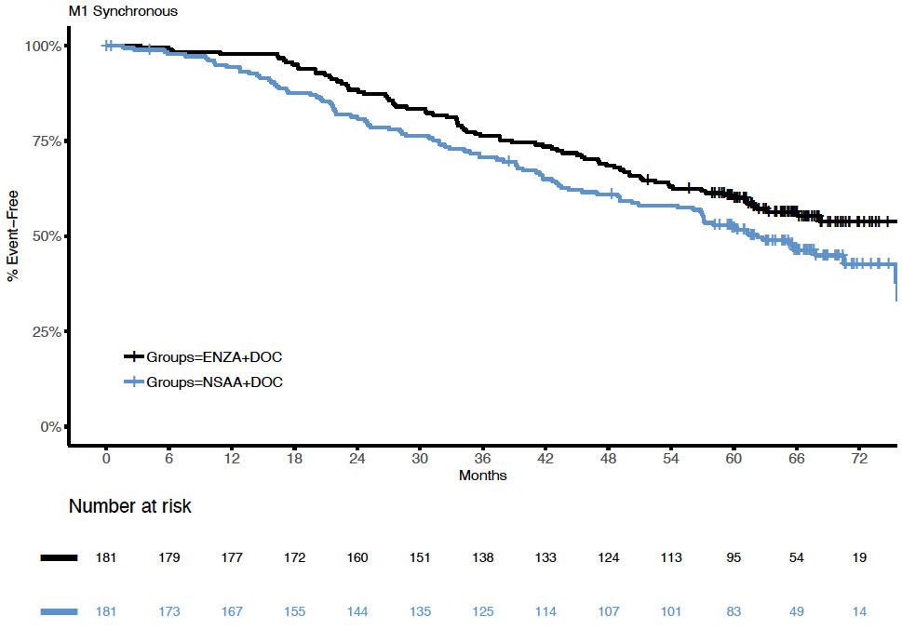
Consistent OS benefit with Triplet treatment in men with de novo mCSPC
ADT + Doc + Abi > ADT + Doc
PEACE-1 (All De novo)
ADT + Doc + Daro > ADT + Doc
ARASENS (All De novo)
ADT + Doc + Enza > ADT + Doc
ENZAMET
HR: 0.71
(95% CI: 0.59-0.85)
HR: 0.73
(95% CI: 0.595-0.99)
Fizazi K Lancet 2022; Smith M NEJM 2022; Davis I ASCO 2022

Slide 56
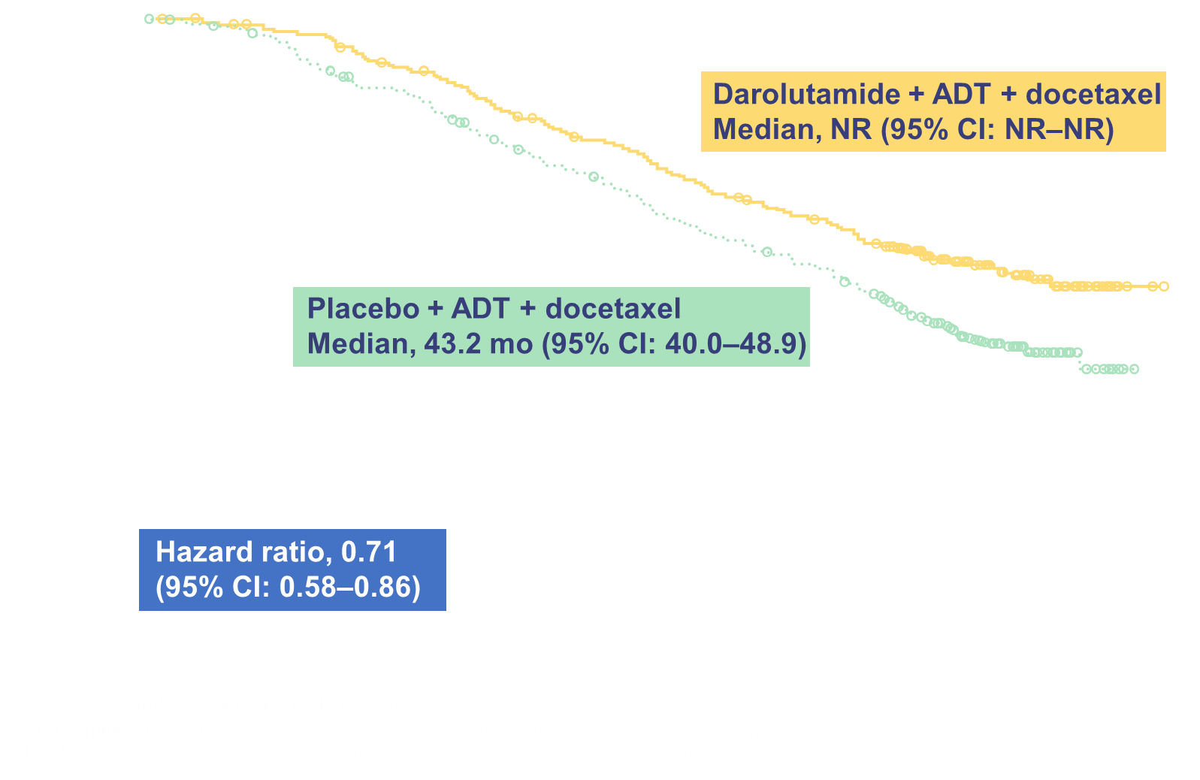
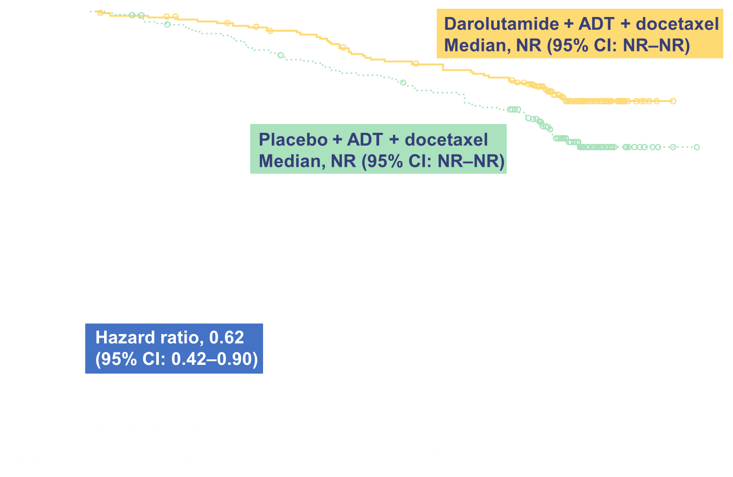
ARASENS RISK Subgroups: Overall Survival
High-risk mHSPC
Low-risk mHSPC
Maha Hussain, MD

Slide 57
Many reasons to choose a Triplet
(in fit mCSPC men)?
The triplet efficacy makes sense: both ARSI and Taxanes active after one has failed:
  COU 301/AFFIRM (ARSI post-taxane)
  CARD (Taxane post-ARSI)
Poly-therapy needed to target heterogeneity (less resistant cells)
If an ADT-ARSI doublet is used for CSPC, then docetaxel will be used anyway when mCRPC occurs! Why not use it earlier (mCSPC) with more efficacy and less toxicity?
At the end of the day, 6 cycles of docetaxel is short and mostly well tolerated with G-CSF support

Slide 58
Take-Home Message: M1 CSPC
Current standard (2023):
  De novo, High Volume:
    Fit: ADT+docetaxel+abiraterone/pred or Darolutamide (or Enza)
    Unfit for Docetaxel: ADT+NHT
  De novo, Low Volume:
    At least ADT+NHT (PEACE-1 RT data: tomorrow!)
    Discuss systemic triplet on a one by one basis (young, fit, bone)?
  Relapse (LV or HV): ADT+NHT ? (scarce data)
  Frail/very elderly patients: ADT alone ?
Next-generation trial stratified on clinical/molecular biomarkers (PEACE-6 and others)

Slide 59
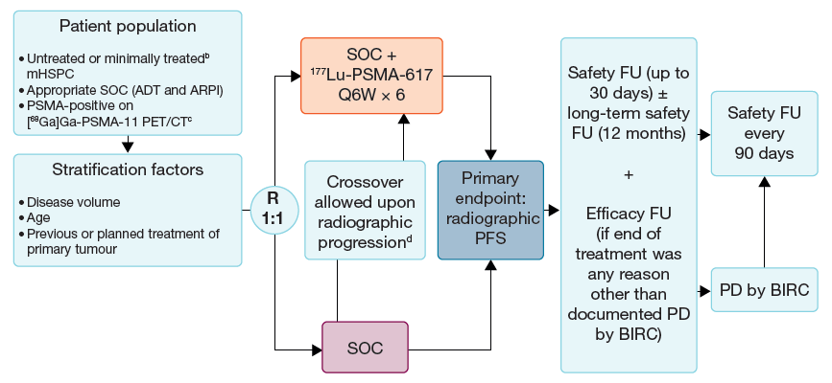
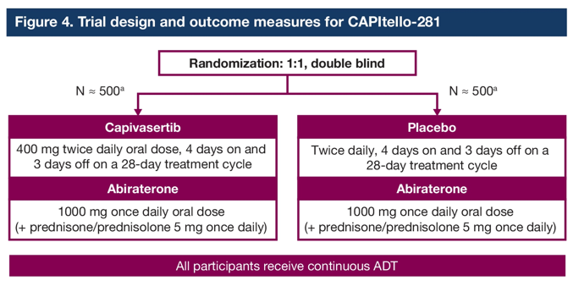
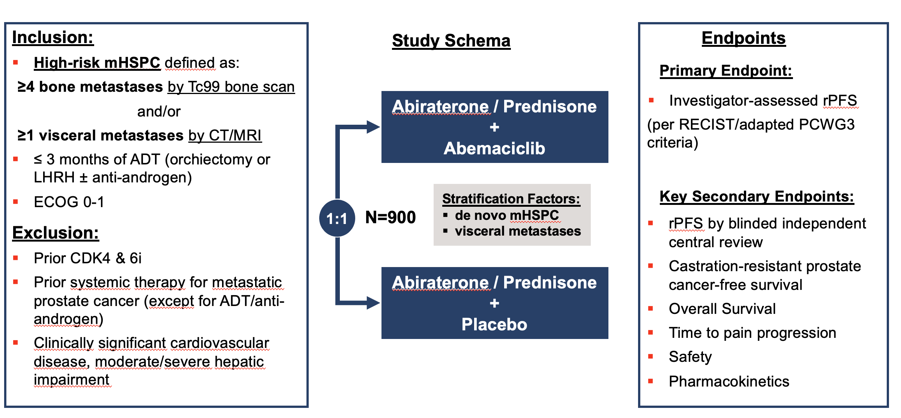
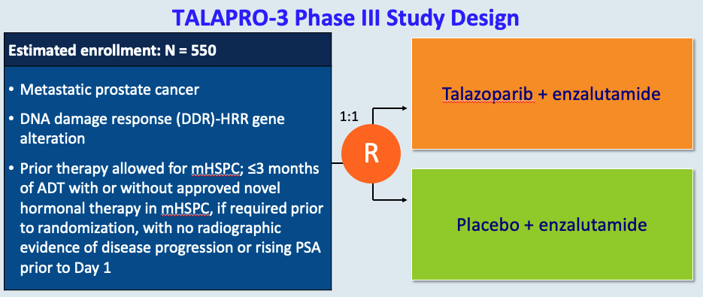
Examples of ongoing trials in mCSPC
Capivasertib: Akt inhibitor (PTEN loss)
PSMAddition
Crabb et al. JCO 2020; Crabb et al. ASCO GU 2022
Sartor O et al. ASCO GU 2023
Abemaciclib: CDK4/6 inhibitor
Talazoparib: PARP inhibitor
CYCLONE 3
Smith MR et al. ASCO GU 2023
Agarwal N et al. ASCO 2022

Slide 60

The PEACE-6 program:
Current European trials in M1 CSPC
Oligo-M1
R
A
N
D
O
M
I
Z
E
D
SOC
SOC+ RXT to mets
Ongoing
Vulnerable
SOC (ADT)
Patients with de novo M1 CaP
(+/- M1 relapse after local treatment)
SOC + Darolutamide
Good responders
(6-8 months PSA)
SOC
De-escalation
Planned
Poor responders
(6-8 months PSA)
SOC
SOC + Lu-PSMA
Notes:
60

Slide 61
Agenda
Module 1 – Current Management of Nonmetastatic Prostate Cancer —
Dr Morgans
Module 2 – New Considerations in Treatment Intensification for Metastatic Hormone-Sensitive Prostate Cancer (mHSPC) — Prof Fizazi
Module 3 – Available and Emerging Strategies for Newly Diagnosed Metastatic Castration-Resistant Prostate Cancer (mCRPC) — Dr McKay
Module 4 – Identification and Management of mCRPC with a Homologous Recombination Repair (HRR) Gene Abnormality — Dr Antonarakis
Module 5 – Management of Progressive mCRPC — Dr Sartor

Slide 62
Case Presentation: 64-year-old man diagnosed with metastatic HSPC and PSMA positivity in the pubic ramus, bilateral external iliac nodes and lungs
Dr Sandy Srinivas (Stanford, California)

Slide 63

Available and Emerging Strategies for Newly Diagnosed Metastatic CRPC (mCRPC)
Rana R. McKay, MD
Associate Professor of Medicine and Urology
Moores Cancer Center
University of California San Diego
@DrRanaMcKay

Slide 64
Objectives
Clinical and biologic factors impacting the selection of therapy for newly diagnosed mCRPC
Findings from clinical trial and real-world data sets exploring the efficacy and safety of sipuleucel-T for mCRPC
Data sets defining the role of secondary hormonal therapies for patients with mCRPC, including among those who have received one of these agents in an earlier disease setting
Role of the CDK4/6 pathway in prostate cancer proliferation and resistance to AR-targeted therapy
Available efficacy and safety findings with CDK4/6 inhibitors for mCRPC
Design, eligibility criteria and primary and secondary endpoints of the Phase II/III CYCLONE 2 trial evaluating first-line abiraterone and prednisone with or without abemaciclib for mCRPC

Slide 65
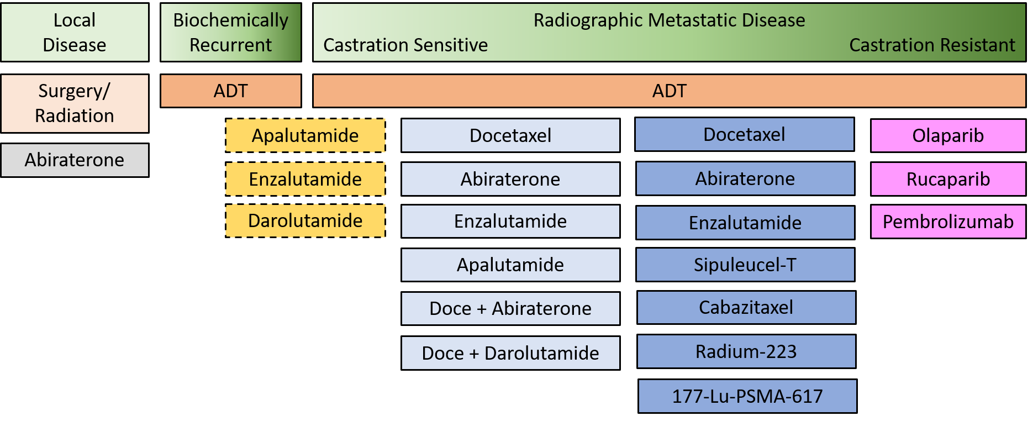
Treatment Landscape for Advanced Prostate Cancer
All NCCN options for mCRPC
ADT is still the mainstay of therapy…but treatments have evolved for different disease states
NCCN Guidelines Version 1.2023
@DrRanaMcKay

Slide 66
Factors that Impact Treatment Decision
Disease Factors
Prior treatments
Clinical Factors
Symptoms
Comorbidities
Drug Factors
Mechanism of action
Sites of metastasis
Gleason score
Performance status
Concurrent medications
Genomic features
Cost
Mode of administration
Burden of disease
Disease kinetics
@DrRanaMcKay

Slide 67
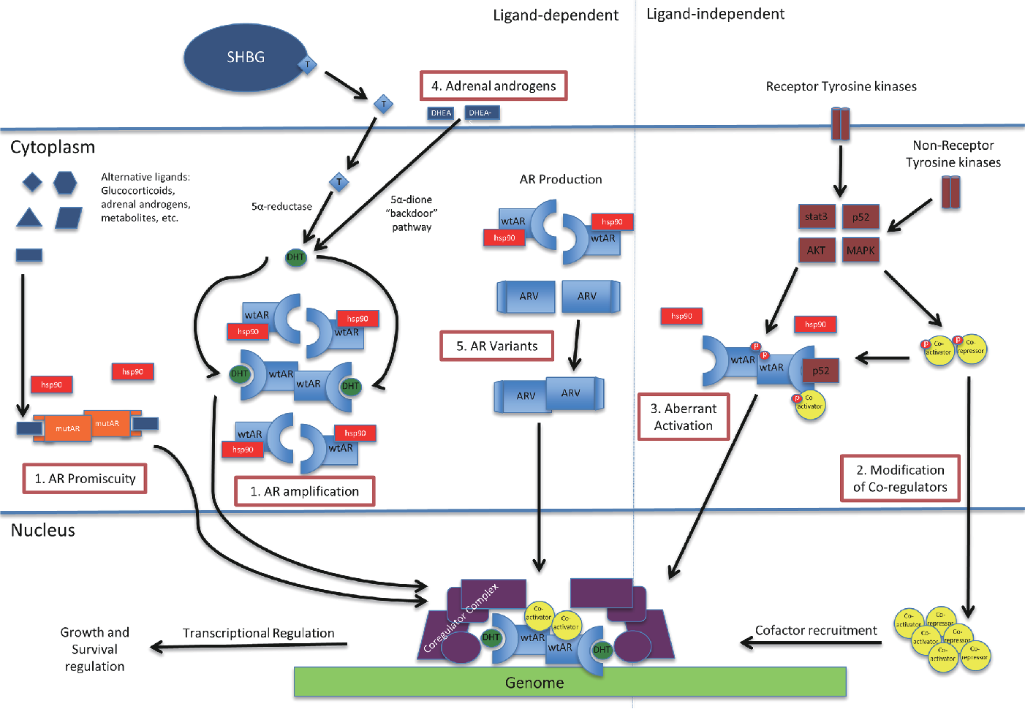
Mechanisms of Resistance in Castration Resistant Prostate Cancer
Chandrasekar et al, Transl Androl Urol, 2015
@DrRanaMcKay

Slide 68
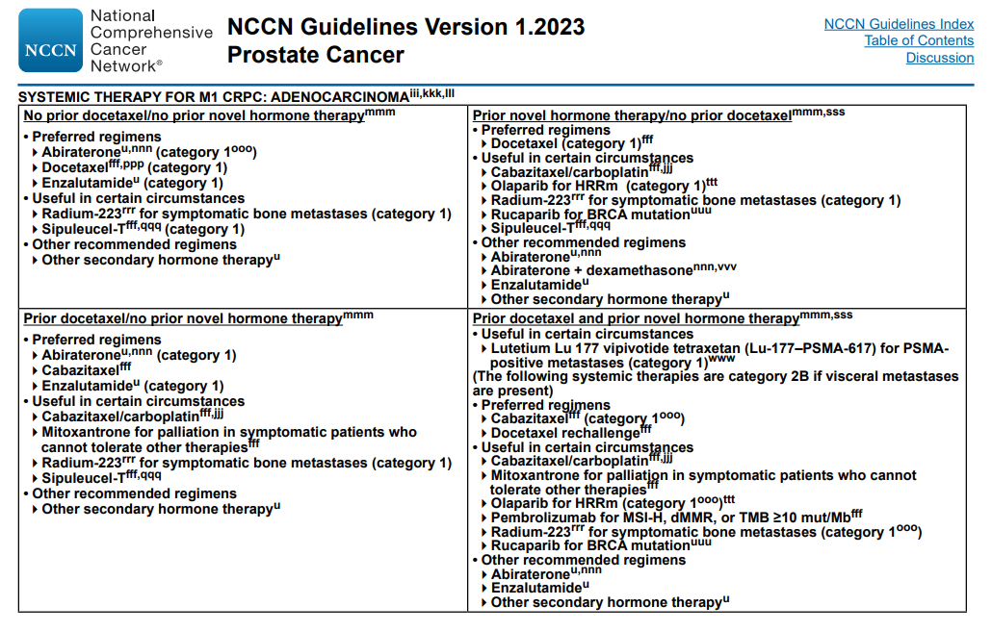
NCCN Guidelines – Systemic Therapy for M1 CRPC

Slide 69
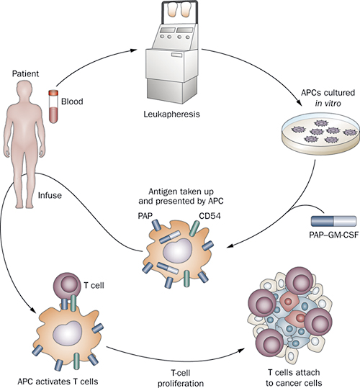
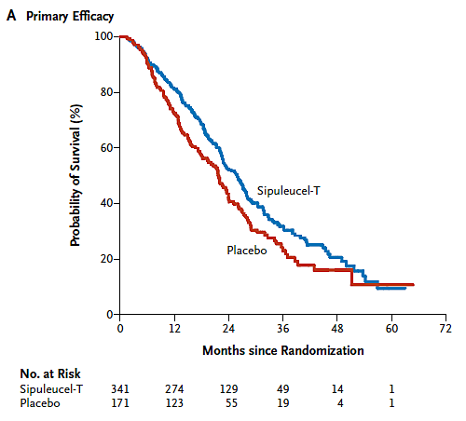
Sipuleucel-T
Median OS
25.8 months Sipuleucel-T
21.7 months Placebo
HR 0.78 (95% CI 0.61, 0.98)
Time to progression 3.7 vs. 3.6 months
PSA50 2.6% vs. 1.3%

Slide 70
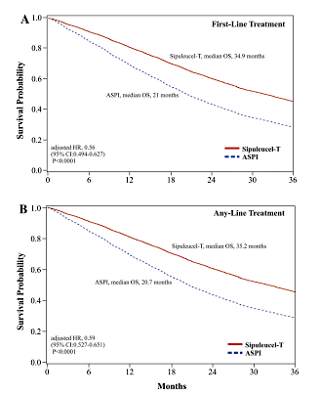



Role of Sipuleucel-T in the Modern Era
Prospective
Concurrent or Sequential ARTA
Prospective
Sipuleucel-T +/- Radium-223
Retrospective
First-Line Any Line
Retrospective
Concurrent/Sequential ARTA
Antonarakis et al, CCR, 2023
Hafron et al, Adv Ther, 2022
McKay et al, Adv Ther, 2020

Slide 71


Slide 72

Best PSA Response to Therapy with Enzalutamide in Patients with mCRPC
McKay RR et al. Clin Cancer Res 2021;27(13):3610-9.

Slide 73

Mechanisms Driving Resistance to Enzalutamide in Patients with mCRPC
McKay RR et al. Clin Cancer Res 2021;27(13):3610-9.

Slide 74



Cell Cycle
Wolgemuth et al, Journal of Developmental Biology, 2013

Slide 75

Cross Talk Between Cell Cycle and AR Pathway
Androgen receptors, like the estrogen receptors, are key regulators of cell cycle and instrumental in the regulation of the transcription of genes that allow for G1 to S transition
Inhibition of CDK4/6 triggers G1 arrest of cell cycle
Inhibiting both CDK4 and CDK6 essential to effectively impair the G1/S transition
In prostate cancer, inhibition of both CDK4/6 and AR signaling may disrupt the feed forward loop involving these two pathways
Kase et al, Onco Targets Ther, 2020

Slide 76
Available CDK4/6 Inhibitors
 | Abemaciclib¹ | Ribociclib² | Palbociclib³
Disease state(s) with FDA approval | HR+, HER2- EBC HR+, HER2- MBC | HR+, HER2- MBC | HR+, HER2- MBC
Preliminary/published data in prostate cancer | TBD | Yes⁴ | No⁵
CDK4 (IC50, nM)⁵ | 2 | 10 | 11
CDK6 (IC50, nM)⁵ | 9.9 | 39 | 15
CDK9 (IC50, nM)⁵ | 57 | NR | NR
Little or no inhibitory activity for CDK1, 2, 5 and 7
1. Abemaciclib PI. 2. Ribociclib PI. 3. Palbociclib PI. 4. de Kouchkovsky et al, Clin Cancer Res, 2022. 5. Palmbos et al, Clin Cancer Res. 2021. 5. Gelbert et al, Invest New Drugs, 2014.

Slide 77
Available CDK4/6 Inhibitors
 | Abemaciclib¹ | Ribociclib² | Palbociclib³
Dose | 200 mg BID | 600 mg QD | 125 mg QD
Route | PO (w or w/o food) | PO (w or w/o food) | PO (w or w/o food)
Dosing schedule | Continuous | 3 wks on/1 wk off | 3 wks on/1 wk off
Half-life | 18.3 hours | 32 hours | 29 (+/- 5) hours
Primary Metabolism | Liver | Liver | Liver
CNS Penetration | Yes | No | Uncertain
Myelosuppression | + | ++ | ++
GI Toxicity | ++ | + | +
LFTs | + | + | -
QTc Prolongation | - | + | -
Pneumonitis | + (rare) | + (rare) | + (rare)
1. Abemaciclib PI. 2. Ribociclib PI. 3. Palbociclib PI.

Slide 78
CYCLONE 1: Abemaciclib in Men with Heavily Pretreated Metastatic Castration-Resistant Prostate Cancer (mCRPC)
Agarwal N et al.
AACR 2023;Abstract CT159.

Slide 79
CYCLONE 1: Results of a Phase II Trial of Abemaciclib for Patients with Heavily Pretreated mCRPC
 | Abemaciclib monotherapy (n = 44)
Overall response rate without concurrent bone progression | 6.8%
Stable disease | 40.9%
Disease control rate | 47.7%
Median radiographic progression-free survival | 2.7 months
Median time to PSA progression | 6.5 months
Median overall survival | 7.6 months
Treatment-related adverse events (TRAEs) experienced by ≥50% of patients: Diarrhea (79.5%), decreased appetite (52.3%) and fatigue (50%)
Grade 3 TRAEs in ≥5% of patients: Neutropenia (22.7%), anemia (6.8%), fatigue (6.8%) and diarrhea (6.8%)
Author Conclusions: Abemaciclib demonstrated modest but objective single-agent clinical activity in heavily pretreated progressive mCRPC. The safety profile of abemaciclib was consistent with the experience in breast cancer. Although the primary endpoint was not formally met, the single agent activity observed in this late line mCRPC setting validates CDK4/6 as a therapeutic target in advanced PC.
Agarwal N et al. AACR 2023;Abstract CT159.

Slide 80

mCRPC: Cyclone 2
Cyclone 2: First Line mCRPC
NCT03706365
Smith et al, GU ASCO, 2022

Slide 81
Take Home Message
Many treatment options are available for patients with mCRPC and treatment is dependent on clinical features, prior therapy exposure, and genomics
Germline and somatic tumor profiling is indicated for all patients with mCRPC
Sequencing of ARSI is generally not recommended in mCRPC
Novel therapies including CDK4/6 inhibitors are currently in development in mCRPC

Slide 82
Agenda
Module 1 – Current Management of Nonmetastatic Prostate Cancer —
Dr Morgans
Module 2 – New Considerations in Treatment Intensification for Metastatic Hormone-Sensitive Prostate Cancer (mHSPC) — Prof Fizazi
Module 3 – Available and Emerging Strategies for Newly Diagnosed Metastatic Castration-Resistant Prostate Cancer (mCRPC) — Dr McKay
Module 4 – Identification and Management of mCRPC with a Homologous Recombination Repair (HRR) Gene Abnormality — Dr Antonarakis
Module 5 – Management of Progressive mCRPC — Dr Sartor

Slide 83
Case Presentation: 53-year-old man with mCRPC s/p enzalutamide receives olaparib – somatic BRCA2 mutation, TP53 mutation on liquid biopsy
Dr Neeraj Agarwal (Salt Lake City, Utah)

Slide 84
Case Presentation: 72-year-old man with high-grade localized prostate cancer treated with proton beam therapy + ADT for 2 years now has rising PSA and CT scan positive for retroperitoneal node – somatic BRCA2, TP53, FOXA1 and MEN1 mutations, MSS
Dr David Morris (Nashville, Tennessee)

Slide 85
Identification and Management of mCRPC with HRR Abnormalities
Research To Practice
June 3, 2023
Emmanuel S. Antonarakis, M.D.
Clark Endowed Professor of Medicine
Division of Hematology/Oncology & Transplantation, University of Minnesota
Associate Director of Translation, Masonic Cancer Center

Slide 86
Incidence of HRR mutations in PCa, and Indications for testing

Slide 87
What are the relevant HRR Genes?
“First Tier” | “Second Tier” | “Third Tier”
BRCA2 (6–8%) | BARD1 (1%) | ATM (5–7%)
BRCA1 (1–2%) | BRIP1 (1–2%) | CDK12 (5–7%)
PALB2 (1–2%) | RAD51C (1%) | CHEK2 (2–3%)
RAD51B (1%) | RAD51D (1%) | CHEK1 (1%)
RAD54L (1%) | FANCL (1–2%)

Slide 88
HRR Genes and Metastatic Prostate Cancer

Slide 89
Prostate NCCN Guidelines v 1.2023
NCCN Practice Guidelines: Prostate Cancer. Version 1.2023. https://www.nccn.org/professionals/physician_gls/pdf/prostate.pdf.

Slide 90
PARP inhibitors for HRR-deficient mCRPC

Slide 91
PARP Inhibition: “Synthetic Lethality”

Slide 92
Different PARP inhibitors tested in PCa
Carney B, et al. Nat Commun 2018; 9: 176.

Slide 93
Summary of PARPi monotherapy trials in mCRPC
Study and treatment | Prior therapy | HRR status criteria; Sample type | Primary endpoint | Results
TOPARP-A¹ Olaparib 400 mg BID (N=50) | 1–2 taxane CT regimens; 98% had prior NHT | Deficiency not required; tumor | Composite response rate | 33% overall; 88% (14 of 16) with DDR gene alterations
TOPARP-B² Olaparib 300 mg or 400 mg BID, randomized 1:1 (N=98) | 1–2 taxane CT regimens; 88%–92% had prior NHT | Deleterious germline or somatic DDR gene alterations; tumor | Composite response rate | 39.1% 300-mg cohort; 54.3% 400-mg cohort
TRITON2³ Rucaparib 600 mg BID (N=115) | 1 taxane and 1–2 NHT | Deleterious germline or somatic BRCA1/2 alteration; tumor or plasma | ORR by blinded independent radiology review | 43.5% (27 of 62)
GALAHAD⁴ Niraparib 300 mg QD (N=289) | ≥1 taxane and ≥1 NHT | Deleterious germline or somatic alteration in ≥1 of 8 prespecified DDR genes; tumor or plasma | ORR in patients with BRCA mutation and measurable disease | 34.2% (26 of 76 measurable BRCA cohort) 10.6% (5 of 47 measurable non-BRCA cohort)
TALAPRO-1⁵ Talazoparib 1 mg QD (N=128) | 1–2 CT regimens (≥1 taxane) and ≥1 NHT | Deleterious germline or somatic alterations in ≥1 of 11 prespecified DDR-HRR genes; tumor or plasma | ORR by blinded independent review | 29.8% (31 of 104)
1. Mateo J et al. N Engl J Med. 2015;373:1697-708; 2. Mateo J et al. Lancet Oncol. 2020;21:162-174; 3. Abida W et al. J Clin Oncol. 2020;38:3763-3772; 4. Smith MR et al. Lancet Oncol. 2022;23:362-373; 5. de Bono JS et al. Lancet Oncol. 2021;22:1250-1264.

Slide 94
Pivotal trials of PARPi monotherapy

Slide 95
Olaparib: PROfound, Randomized Phase 3 Study

Slide 96
PROfound: rPFS and OS in whole population (A+B)

Slide 97
PROfound: Gene-by-gene, rPFS and OS analyses

Slide 98
Olaparib for HRR-mutated mCRPC

Slide 99
Rucaparib: TRITON2 and TRITON3 studies

Slide 100
TRITON2: Objective response rate (ORR)

Slide 101
Rucaparib for BRCA1/2-mutated mCRPC

Slide 102
TRITON3: Randomized phase III trial
Ryan CJ et al. ASCO GU 2019; abst TPS389; NCT02975934.

Slide 103

TRITON3: rPFS in ITT population
Fizazi K, et al. NEJM 2023; 388: 719-32.

Slide 104
TRITON3: rPFS in BRCA1/2 and ATM subgroups
Fizazi K, et al. NEJM 2023; 388: 719-32.

Slide 105
PARPi–based combinations
(PROpel, MAGNITUDE, & TALAPRO-2)

Slide 106

PROpel: Phase III Trial of Abiraterone +/– Olaparib
Saad F et al. ASCO GU 2022; abstr 11; NCT03732820.

Slide 107



PROpel: Radiographic progression-free survival
Saad F et al. NEJM Evidence; 2022.

Slide 108

MAGNITUDE: Phase III Trial of Abi +/– Niraparib
Chi KN et al. ASCO GU 2022; abstr 12; NCT03748641.

Slide 109




MAGNITUDE: Radiographic progression-free survival
Chi KN et al. J Clin Oncol 2023.

Slide 110
TALAPRO-2: Phase III Trial of Enza +/– Talazoparib
Agarwal N et al. Future Oncol. 2022;18:425-436; NCT03395197.

Slide 111
TALAPRO-2: Phase III Trial of Enza +/– Talazoparib
 | TALA + ENZA (N=402) | PBO + ENZA (N=403)
Events, n | 151 | 191
Median (95% CI), months | NR (27.5–NR) | 21.9 (16.6–25.1)
HR (95% CI) | 0.63 (0.51–0.78); P<0.001
Agarwal N et al. ASCO GU 2023; abstr LBA17.

Slide 112

ODAC Meeting (on PROpel) – 4/28/2023
In an 11-to-1 vote, the FDA’s Oncologic Drugs Advisory Committee (ODAC) voted the
indication of the PARP inhibitor olaparib in combination with abiraterone
acetate and prednisone or prednisolone for the initial treatment of patients with
metastatic castration-resistant prostate cancer (mCRPC) should be restricted to patients
whose tumors harbor a BRCA mutation.¹

Slide 113


FDA Decision (on PROpel) – 5/31/2023
On May 31, 2023, the Food and Drug Administration approved olaparib with abiraterone and prednisone for adult patients with deleterious or suspected deleterious BRCA-mutated (BRCAm) metastatic castration-resistant prostate cancer (mCRPC), as determined by an FDA-approved companion diagnostic test.

Slide 114
Conclusions
Germline and somatic HRR mutations are common in mCRPC
Olaparib is approved for HRR-mutated metastatic CRPC, and Rucaparib is approved for BRCA1/2-mutated mCRPC
PROpel (Abi + Olap) improved rPFS in unselected mCRPC; MAGNITIDE (Abi + Nira) improved rPFS only in HRRm mCRPC
TALAPRO-2 (Enza + Tala) improved rPFS in unselected mCRPC patients, and in HRRm as well as HRRwt subgroups
Abi + Olap became FDA-approved for BRCA1/2-altered mCRPC

Slide 115
Agenda
Module 1 – Current Management of Nonmetastatic Prostate Cancer —
Dr Morgans
Module 2 – New Considerations in Treatment Intensification for Metastatic Hormone-Sensitive Prostate Cancer (mHSPC) — Prof Fizazi
Module 3 – Available and Emerging Strategies for Newly Diagnosed Metastatic Castration-Resistant Prostate Cancer (mCRPC) — Dr McKay
Module 4 – Identification and Management of mCRPC with a Homologous Recombination Repair (HRR) Gene Abnormality — Dr Antonarakis
Module 5 – Management of Progressive mCRPC — Dr Sartor

Slide 116
Case Presentation: 77-year-old man with multiregimen- refractory mCRPC and a gBRCA2 mutation receives olaparib with a sustained response for several years
Dr Sandy Srinivas (Stanford, California)

Slide 117
Case Presentation: 65-year-old man with multiregimen-refractory PSMA-positive metastatic CRPC currently on a clinical trial due to scarcity of lutetium Lu 177 vipivotide tetraxetan
Dr Neeraj Agarwal (Salt Lake City, Utah)

Slide 118
Management of Progressive mCRPC
With Emphasis on Radium-223, Cabazitaxel, and PSMA-617 Lu-177
Oliver Sartor, MD
Director of Radiopharmaceutical Clinical Trials
Mayo Clinic
Rochester, MN

Slide 119
Standard Therapies Today:
New hormonal agents are moving earlier and earlier leaving a changed CRPC
Castrate sensitive
Metastatic Castrate Resistant
Localized
Disease
Local Therapy
+/- ADT +/-
abiraterone
or no therapy
Non-metastatic
CRPC
Enzalutamide
Darolutamide
Apalutamide
Radiographic
Metastases:
ADT resistant
“Pre-chemo”
Sipuleucel-T
Abiraterone
Enzalutamide
Radiographic
Metastases:
ADT resistant
1st-Line
Chemo
Docetaxel
Radiographic
Metastases:
ADT resistant
Post-chemo
Cabazitaxel
Abiraterone
Enzalutamide
Rising PSA
Salvage Rx,
+/-ADT or ADT
or no therapy
Overt
Metastases
ADT +
Docetaxel
or Abiraterone
or Apalutamide
or Enzalutamide
or “triplet”
Rucaparib or
Olaparib or
Radium-223 or Pembrolizumab or 177Lu-PSMA-617 for selected cancers
Early use of novel hormones now proven in multiple settings

Slide 120
Mechanisms of Action
Radium-223
  Alpha emitter that binds to bone stroma (hydroxyapatite) targeting areas of active bone turnover (blastic lesions)
Cabazitaxel
  Binds to tubulin and inhibits microtubular function
PSMA-617 Lu-177
  Beta emitter that binds to PSMA on the cell surface

Slide 121

2013
Pretreatments ADT or ADT + Docetaxel
Population: Bone scan positive and symptomatic (excludes viscera)
Control Arm “Standard of Care” excluding Chemotherapy

Slide 122

Overall Survival ALSYMPCA
Parker et al. NEJM 369: 213-23, 2013

Slide 123
Radium-223 only goes to bone stroma!
Radium-223 moved the field forward but lack of positive trials since 2013 is problematic given the dramatically changing landscape
Radium-223 needs new trials to remain relevant for today’s patient

Slide 124

2019
Pretreatments ADT + docetaxel + abiraterone or enzalutamide
Population: mCRPC without selection
Control of “alternate” abiraterone or enzalutamide

Slide 125


CARD: Cabazitaxel phase III trial
CARD met both primary endpoint PFS and secondary OS endpoint
OS: HR 0.64 (95% CI 0.46-0.89)
rPFS: HR 0.54 (95% CI 0.40-0.73)

Slide 126




Other Recently Reported Trials Investigating Cabazitaxel for mCRPC
CABASTY¹
OSTRICh²
¹ Oudard S et al. ESMO 2022;Abstract 1363MO; ² van der Zande K et al. ASCO 2021;Abstract 5059.

Slide 127
Cabazitaxel is an important step forward in the post-docetaxel space since 2010 when TROPIC trial improved OS vs mitoxantrone
Limitation is that only about 50% of mCRPC patients in the USA are treated with chemotherapy

Slide 128
2021
Pretreatments ADT + abiraterone/enzalutamide/both + docetaxel/cabazitaxel/both
Population: PSMA PET positive (87% of screened)
Control Arm “Standard of Care” excluding Chemotherapy

Slide 129
VISION: ¹⁷⁷Lu-PSMA-617 Phase III trial
VISION met both primary endpoints of OS and rPFS
OS: HR 0.62 (95% CI 0.52-0.74)
rPFS: HR 0.40 (95% CI 0.29-57)
 | ¹⁷⁷Lu-PSMA-617 + SoC (n=551) | SoC alone (n=280)
Median OS, months | 15.3 | 11.3
HR (95% CI) | 0.62 (0.52–0.74)
P value, one-sided | <0.001
 | ¹⁷⁷Lu-PSMA-617 + SoC (n=385) | SoC alone (n=186)
Median rPFS, months | 8.7 | 3.4
HR (95% CI) | 0.40 (0.29–0.57)
P value, one-sided | <0.001
100
100
90
90
80
70
80
60
70
Event-free probability (%)
50
60
40
Event-free probability (%)
30
50
20
40
10
¹⁷⁷Lu-PSMA-617 + SoC (n/N=343/551)
30
0
SoC alone (n/N=187/280)
20
0
2
4
6
8
10
12
14
16
18
20
22
24
26
28
30
32
10
¹⁷⁷Lu-PSMA-617 + SoC (n/N=254/385)
Number still at risk
Time from randomisation (months)
0
SoC alone(n/N=93/196)
¹⁷⁷Lu-PSMA-617
+ SoC
551
535
506
470
425
377
332
289
236
166
112
63
36
15
5
2
0
0
1
2
3
4
5
6
7
8
9
10
11
12
13
14
15
16
17
18
19
20
21
22
23
SoC alone
280
238
203
173
155
133
117
98
73
51
33
16
6
2
0
0
0
Number still at risk
Time from randomisation (months)
¹⁷⁷Lu-PSMA-617
+ SoC
385
373
362
292
272
235
215
194
182
146
137
121
88
83
71
51
49
37
21
18
6
1
1
0
SoC alone
196
146
119
58
36
26
19
14
14
13
13
11
7
7
7
4
3
3
2
2
0
0
0
0

Slide 130

PSA Decline at <12 weeks and Overall Survival
Armstrong et al. Annals of Oncology (2022) 33 (suppl_7): S616-S652.
[

Slide 131

PSMA-617 Lu-177 vs cabazitaxel in mCRPC (TheraP) randomized phase 2 trial
Hofman et al. ASCO 2022
HR=0.97 (95% CI, 0.70-1.4)
QOL better with PSMA
PSMA PET selected patients

Slide 132
New important prechemotherapy theranostic trials in mCRPC
Announced positive
PSMAfore
  PSMAfore: A Phase III, Open-label, Multi-Center, Randomized Study Comparing 177Lu-PSMA-617 vs. a Change of Androgen Receptor-directed Therapy in the Treatment of Taxane Naïve Men With Progressive mCRPC
SPLASH
  A Phase 3, Open-Label, Randomized Study Evaluating Metastatic Castrate Resistant Prostate Cancer Treatment Using PSMA [Lu-177]-PNT2002 Therapy After Second-line Hormonal Treatment (SPLASH)
ECLIPSE
  A Multi-Center, Open-Label, Randomized Phase 3 Trial Comparing the Safety and Efficacy of 177Lu-PSMA-I&T Versus Hormone Therapy in Patients With mCRPC
Completed accrual

Slide 133
PSMA-617 Lu-177 is an important step forward but the supply chain has been hugely problematic
Therapy has been well tolerated as a whole and this therapy will move earlier in the treatment paradigm

Slide 134



What are we missing? AR-driven only 45-50% of the story and much more than neuroendocrine!
Science May 2022

