Slide 1
Targeted Therapy for Colorectal Cancer

Slide 2
Targeted Therapy for Colorectal Cancer
Wells Messersmith, MD
Professor and Head, Medical Oncology
Chief Medical Officer, Oncology Services

Slide 3
PD-1 Blockade in dMMR/MSI-H rectal cancer
Dostarlimab, an anti–PD-1 monoclonal antibody, was administered every 3 weeks for 6 months in patients with stage II or III rectal adenocarcinoma
Cercek, NEJM 2022

Slide 4
PD-1 Blockade in dMMR/MSI-H rectal cancer
Cercek, ASCO 2022

Slide 5
PD-1 Blockade in dMMR/MSI-H rectal cancer
Cercek, NEJM 2022

Slide 6
PD-1 Blockade in dMMR/MSI-H rectal cancer
Biopsy Specimens of the Rectum before and after PD-1 Blockade and Viable Tumor Cell Content.
Increased T-cells (CD8) and B cells after treatment.
Cercek, NEJM 2022

Slide 7
Dual Blockade in dMMR/MSI-H rectal cancer
Primary Objectives- Safety and feasibility-3-year disease-free survival (DFS)
Secondary Objectives- Major and complete pathologic response rate in post-treatment surgical specimen-Circulating tumor DNA dynamics
Chalabi, ESMO 2022

Slide 8
Major pathologic response in 95% of patients; 67% pCR
Chalabi, ESMO 2022

Slide 9
Dual Blockade in dMMR/MSI-H rectal cancer
NICHE-2 study: pts with non-metastatic dMMR CC were treated with one dose of ipilimumab (1mg/kg) and two doses of nivolumab (3mg/kg) and underwent surgery within 6 weeks of registration.
Major pathologic response in 95% of patients; 67% pCR
Chalabi, ESMO 2022

Slide 10
KEYNOTE-177: first line immunotherapy
Diaz, Lancet Oncol 2022

Slide 11
KEYNOTE-177: first line immunotherapy
Diaz, Lancet Oncol 2022

Slide 12
KEYNOTE-177: first line immunotherapy
Benefit seen across all subgroups.
Diaz, Lancet Oncol 2022

Slide 13
CheckMate 142: 1L/2L immunotherapy in dMMR
Overman, 2022

Slide 14
CheckMate 142: 1L/2L immunotherapy in dMMR
Overman, 2022

Slide 15
CheckMate 142: 1L/2L immunotherapy in dMMR
Overman, 2022

Slide 16
CheckMate 142: 1L/2L immunotherapy in dMMR
Overman, 2022

Slide 17
Targeting BRAF MT mCRC: BEACON
Results of Safety Lead-In led to the introduction of an additional primary endpoint of ORR and an interim OS analysis to allow for early assessment
Patients with BRAF^{V600E} mCRC with disease progression after 1 or 2 prior regimens; ECOG PS of 0 or 1;
and no prior treatment with any RAF inhibitor, MEK inhibitor, or EGFR inhibitor
Phase 3
Primary
Endpoints:
Safety Lead-in
Triplet therapy ENCO + BINI + CETUX n = 205
ENCO + BINI + CETUX
N = 30
Encorafenib 300 mg PO daily
Binimetinib 45 mg PO bid
Cetuximab standard weekly dosing
Triplet vs Control
OS
R
1:1:1
Doublet therapy
ENCO + CETUX n = 205
Overall Survival
Control arm
FOLFIRI + CETUX, or irinotecan + CETUX n = 205
ORR
(Blinded Central Review)
A separate Safety Lead-in cohort of n=7 in Japan was enrolled subsequently. Results will be reported at a later time.
Secondary Endpoints: Doublet vs Control OS & ORR, PFS, Safety
Randomization was stratified by ECOG PS (0 vs. 1), prior use of irinotecan (yes vs. no), and cetuximab source (US-licensed vs. EU-approved).
Kopetz et al. N Engl J Med 2019; 381:1632-1643

Slide 18
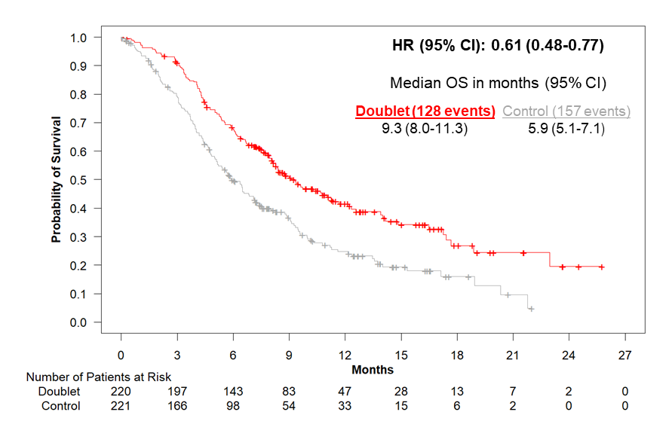
Overall Survival: ENCO/CETUX vs Control
ENCO/CETUX
CONTROL
EC
Tabernero J et al. J Clin Oncol 2021 Feb 1;39(4):273-284.

Slide 19
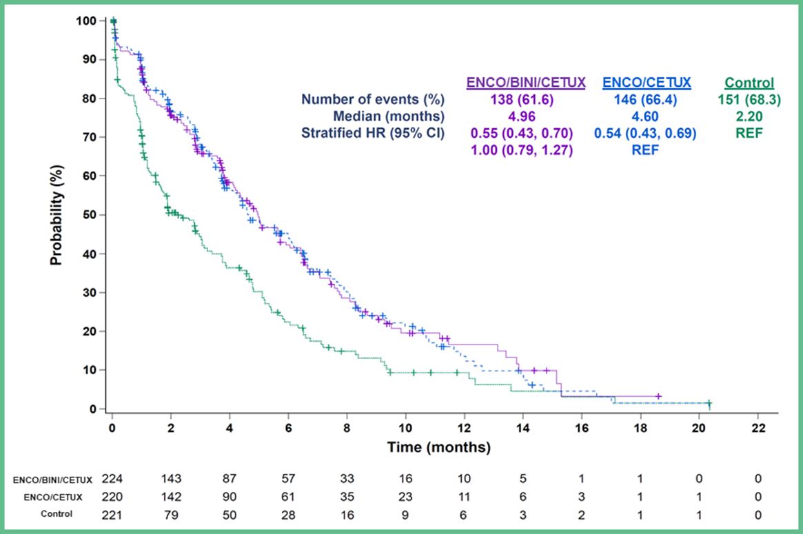
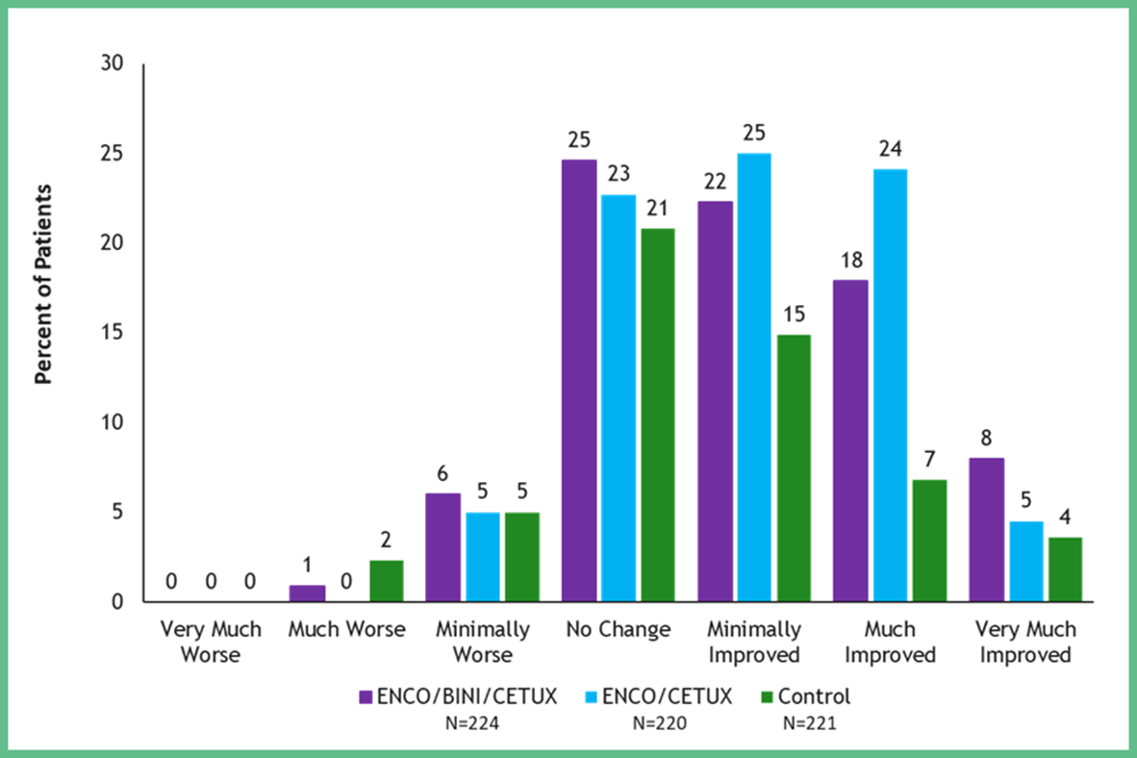
QoL in BEACON Study
Time to Definitive Deterioration in EORTC QLQ-C30 Global Health Status
Perception of Change in Symptoms in Patient Global Impression of Change (PGIC)

Slide 20
Targeting BRAF MT mCRC in the 1L setting: BREAKWATER
BREAKWATER (NCT04607421) is an ongoing, open-label, global, multicenter, randomized phase 3 study evaluating 1L EC ± chemotherapy vs SOC chemotherapy alone in participants with BRAF V600E-mutant mCRC
Safety Lead-In Participants who have received ≤1 prior treatment for mCRC
Phase 3 Participants who have not received prior systemic treatment for mCRC
Cohort 1 (n=30)
Encorafenib 300 mg QD + cetuximab 500 mg/m² Q2W + FOLFIRI Q2W in 28-day cycles
Primary Endpoint
Safety (frequency of DLTs)
Secondary Endpoints
Safety (AEs, dose interruptions/ modifications/discontinuations) PKs Antitumor activity by investigator (ORR, DOR, TTR, PFS, OS)
Arm A (n≈235)
Encorafenib + cetuximab
Primary Endpoint
PFS by BICR
Secondary Endpoints
OS ORR, DOR, and TTR by BICR and by investigator PFS by investigator Safety PROs Biomarkers
R
Arm B (n≈235)
Encorafenib + cetuximab + mFOLFOX6
Cohort 2 (n=27)
Encorafenib 300 mg QD + cetuximab 500 mg/m² Q2W + mFOLFOX6 Q2W in 28-day cycles
Control (n≈235)
mFOLFOX6/FOLFOXIRI/ CAPOX ± bevacizumab
Inclusion Criteria | Exclusion Criteria
BRAF V600E-mutant mCRC (blood or tumor tissue) ≤1 prior systemic treatment for mCRC Evaluable disease (RECIST 1.1) ECOG PS 0 or 1 Adequate BM, hepatic, and renal function | Prior treatment with BRAF or EGFR inhibitors or both oxaliplatin and irinotecan Symptomatic brain metastases MSI-H or dMMR tumorsª
Here we present an updated analysis from the BREAKWATER SLI, including updated safety and antitumor activity data by BICR, as well as preliminary biomarker data
Data cutoff: September 5, 2022.
ªUnless patient ineligible to receive immune checkpoint inhibitors due to pre-existing medical condition.
BICR, blinded independent central review; BM, bone marrow; DLT, dose-limiting toxicity; dMMR, deficient mismatch repair; EC, encorafenib + cetuximab; MSI-H, microsatellite instability-high; PK, pharmacokinetic; Q2W, every 2 weeks; QD, once daily; SLI, safety lead-in; SOC, standard of care.
Kopetz S et al. 2023 ASCO GI Cancers Symposium; Abstract 119.
Scott Kopetz, MD, PhD

Slide 21
Overview of Response by Blinded Review
 | 1L |  | 2L
 | EC + mFOLFOX6 | EC + FOLFIRI | EC + mFOLFOX6 | EC + FOLFIRI
Confirmed best overall response, n (%) | n=19 | n=12 | n=8 | n=18
ORR, % (95% CI) | 68.4 (46.0, 84.6) | 75.0 (46.8, 91.1) | 37.5 (13.7, 69.4) | 44.4 (24.6, 66.3)
CR | 1 (5.3) | 2 (16.7) | 0 | 1 (5.6)ª
PR | 12 (63.2) | 7 (58.3) | 3 (37.5) | 7 (38.9)
SD | 4 (21.1) | 2 (16.7) | 5 (62.5) | 7 (38.9)
PD | 1 (5.3) | 0 | 0 | 0
Non-CR/non-PD^{b} | 0 | 1 (8.3) | 0 | 2 (11.1)
Not evaluable^{c} | 1 (5.3) | 0 | 0 | 1 (5.6)
Responders | n=13 | n=9 | n=3 | n=8
mTTR, weeks (range) | 6.9 (5.9–30.0) | 7.0 (6.1–42.7) | 6.9 (6.4–23.1) | 13.0 (6.1–47.3)
mDOR, months (95% CI) | 9.8 (6.9, NE) | 12.4 (6.9, NE) | NE (5.6, NE) | 9.9 (5.5, NE)
≥6 months, n (%) | 7 (53.8) | 6 (66.7) | 1 (33.3) | 4 (50.0)
Benchmark: Encorafenib and Cetuximab in BEACON: 20%
Kopetz S et al. 2023 ASCO GI Cancers Symposium; Abstract 119.
Scott Kopetz, MD, PhD

Slide 22
Progression-Free Survival
1L EC + mFOLFOX6
1L EC + FOLFIRI
100
100
90
90
mPFS: NE (13.8, NE)
80
80
70
70
60
60
PFS (%)
PFS (%)
50
50
40
40
30
30
20
mPFS: 11.1 (8.5, NE)
20
10
EC + mFOLFOX6 (n=19)
10
EC + FOLFIRI (n=12)
0
0
0.0
5.0
10.0
15.0
20.0
0.0
5.0
10.0
15.0
20.0
No. at risk
Time (months)
No. at risk
Time (months)
EC + mFOLFOX6
19
14
6
3
0
12
10
7
2
0
EC +
FOLFIRI
2L EC + mFOLFOX6
2L EC + FOLFIRI
100
100
90
90
80
80
70
70
mPFS: 12.6 (6.9, NE)
60
60
50
50
PFS (%)
PFS (%)
40
40
30
30
20
20
10
EC + mFOLFOX6 (n=8)
mPFS: 10.8 (4.3, NE)
10
EC + FOLFIRI (n=18)
0
0
No. at risk
0.0
5.0
Time (months)
10.0
15.0
0.0
5.0
Time (months)
10.0
15.0
8
3
3
0
No. at risk
EC + mFOLFOX6
EC + FOLFIRI
18
12
6
1
Data cutoff: September 5, 2022.
BICR, blinded independent central review; EC, encorafenib and cetuximab; NE, not estimable.
Kopetz S et al. 2023 ASCO GI Cancers Symposium; Abstract 119.
Scott Kopetz, MD, PhD

Slide 23
What is next for BRAF MT mCRC?
Neoadjuvant
Adjuvant
First line
Second/ Third line
BRAF/EGFR refractory
FOXTROT4
Phase II
Alliance Phase II/III
BREAKWATER
Phase III (MSS)
BEACON
Phase III
Multiple Phase I/II studies
SEAMARK Phase II (MSI)
BRAF combo + PD1
Phase Ib/II (MSS)
SWOG2107
Rand Phase II
Not a comprehensive list….
Completed
Enrolling
Scott Kopetz, MD, PhD

Slide 24
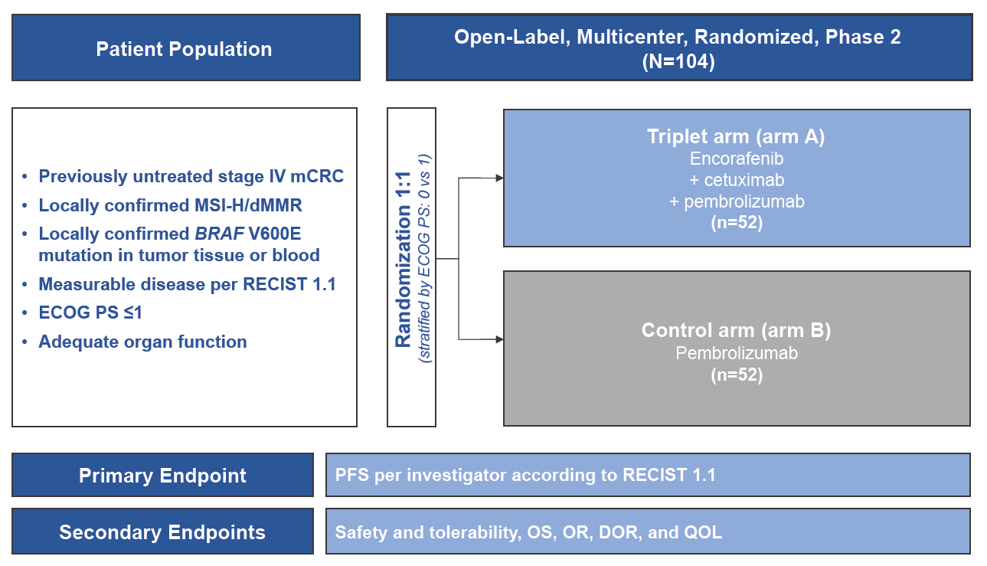
SEAMARK Phase 2 Study: Immunotherapy +/- Encorafenib/Cetuximab in BRAF^{V600E}, MSI-H
Study chairs: E. Elez, V. Morris
Encorafenib is indicated in combination with cetuximab, for the treatment of adult patients with metastatic colorectal cancer (CRC) with a BRAF V600E mutation, who have received prior systemic therapy

Slide 25
S2107 Study Schema: Encorafenib/Cetuximab +/- Nivolumab
pMMR / MSS, BRAF^{V600E} metastatic and/or unresectable
colorectal patients with ≥1 prior line of systemic therapy
R
R
Arm 1
Arm 2
Encorafenib +
cetuximab +
nivolumab
N= 75 participants
2:1 randomization (Arm 1: Arm 2)
Encorafenib +
cetuximab
Primary endpoint: PFS
Encorafenib is indicated in combination with cetuximab, for the treatment of adult patients with metastatic colorectal cancer (CRC) with a BRAF V600E mutation, who have received prior systemic therapy
PI: Van Morris

Slide 26
Primary analysis of MOUNTAINEER: A phase 2 study of tucatinib and trastuzumab for HER2-positive mCRC
John H. Strickler, Andrea Cercek, Salvatore Siena, Thierry Andre, Kimmie Ng, Eric Van Cutsem, Christina Wu, Andrew Scott Paulson, Joleen M. Hubbard, Andrew L. Coveler, Christos Fountzilas, Adel Kardosh, Pashtoon Murtaza Kasi, Heinz-Josef Lenz, Kristen Ciombor, Elena Elez, David L. Bajor, Michael Stecher, Wentao Feng, Tanios S. Bekaii-Saab
European Society of Medical Oncology World Congress on Gastrointestinal Cancer. Jun 29-Jul 2, 2022. Abstract LBA-2

Slide 27
MOUNTAINEER: Global, Open-Label, Phase 2 Trial
Key Eligibility Criteria
≥2L mCRC
HER2+ per local IHC/ISH/NGS testing
RAS wild-type
Measurable disease per RECIST 1.1
Prior fluoropyrimidines, oxaliplatin, irinotecan, and anti-VEGF mAb
Cohort A (n=45)
Tucatinib 300 mg PO BID
+
Trastuzumab 6 mg/kg Q3W (loading dose 8 mg/kg C1D1)^{a,b}
Cohort B (n=41)
Tucatinib 300 mg PO BID
+
Trastuzumab 6 mg/kg Q3W (loading dose 8 mg/kg C1D1)^{a,b}
Endpoints
Efficacy
Assessed in patients who received any amount of study treatment and had HER2+ tumors^{e}
1. Primary: Confirmed ORR in Cohorts A+B (RECIST 1.1 per BICR)
2. Secondary:
Cohorts A+B: DOR per BICR, PFS per BICR, and OS
Cohort C: ORR by 12 weeks of treatment (RECIST 1.1 per BICR)
Safety presented in Cohorts A+B who received any amount of study treatment
R^{c}
Expansion
Cohort C (n=31)
Tucatinib 300 mg
PO BID^{a,d}
MOUNTAINEER began as a US Investigator-Sponsored Trial and initially consisted of a single cohort (Cohort A) and was expanded globally to include patients randomised to receive tucatinib + trastuzumab (Cohort B) or tucatinib monotherapy (Cohort C)
Data cut-off for current analysis, March 28, 2022
a Each treatment cycle is 21 days; b Patients remained on therapy until evidence of radiographic or clinical progression, unacceptable toxicity, withdrawal of consent, or study closure; c Stratification: Left sided tumor primary vs other; d Patients were allowed to cross over and receive tucatinib and trastuzumab if they experienced radiographic progression at any time point or if they had not achieved a PR or CR by week 12; e Patients had HER2+ tumors as defined by one or more protocol required local tests: IHC 3+ (n=46), amplification by ISH (n=36), or amplification by NGS (n=69)
2L+, second line and later; BICR, blinded independent central review; BID, twice a day; C1D1, cycle 1 day 1; CR, complete response; DOR, duration of response; HER2, human epidermal growth receptor 2; IHC, immunohistochemistry; ISH, in situ hybridization; mAb, monoclonal antibody; mCRC, metastatic colorectal cancer; NGS, next-generation sequencing; ORR, objective response rate; OS, overall survival; PFS, progression-free survival; PO, orally; Q3W, every 3 weeks; PR, partial response; R, randomisation; RAS, rat sarcoma virus; RECIST, Response Evaluation Criteria in Solid Tumors; US, United States; VEGF, vascular endothelial growth factor.
https://clinicaltrials.gov/ct2/show/NCT03043313
Strickler, ESMO 2022

Slide 28
Tucatinib + Trastuzumab: Efficacy Outcomes
Responses | Tucatinib + Trastuzumab Cohorts A+B n=84
Best overall response per BICRª, n (%)
CR | 3 (3.6)
PR | 29 (34.5)
SD^{b} | 28 (33.3)
PD | 22 (26.2)
Not available^{c} | 2 (2.4)
cORR per BICR, % (95% CI)^{d} | 38.1 (27.7, 49.3)
cORR per Investigator, % (95% CI)^{d} | 42.9 (32.1, 54.1)
Median time to objective response per BICR^{e}, months (range) | 2.1 (1.2, 9.8)
DCR^{f} per BICR, n (%) | 60 (71.4)
Median DOR per BICR, months (95% CI) | 12.4 (8.5, 20.5)
a Confirmed best overall response assessed per RECIST 1.1; b Includes SD and non-CR/non-PD; c Includes patients with no post-baseline response assessment and patients whose disease assessments are not evaluable; d Two-sided 95% exact confidence interval, computed using the Clopper-Pearson method (1934); e Time from the start of study treatment (Cohort A) or date of randomisation (Cohort B) to the first documentation of objective response (CR or PR that is subsequently confirmed); f Defined as sum of CR, PR, and SD
BICR, blinded independent central review; cORR, confirmed objective response rate; CR, complete response; DCR, disease control rate; PD, progressive disease; PR, partial response; RECIST, Response Evaluation Criteria in Solid Tumors; SD, stable disease.
Data cutoff: 28 Mar 2022
Strickler, ESMO 2022

Slide 29
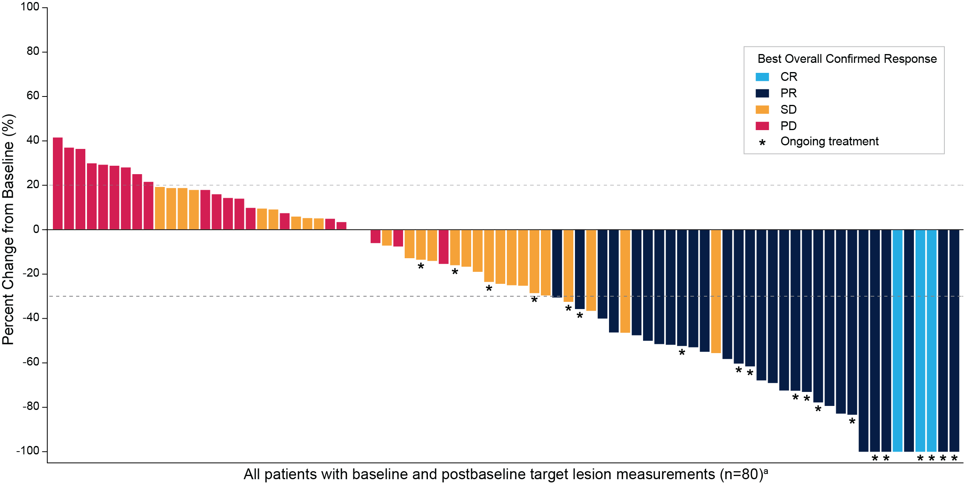
Tucatinib + Trastuzumab: Change in Tumor Size
Maximum Change in Tumor Size
Patients with reduction in tumor burden: n=52/80 (65.0%)
a Four patients who did not have baseline and/or post-baseline target lesion measurements are excluded
CR, complete response; PD, progressive disease; PR, partial response; SD, stable disease.
Data cutoff: 28 Mar 2022
Strickler, ESMO 2022

Slide 30
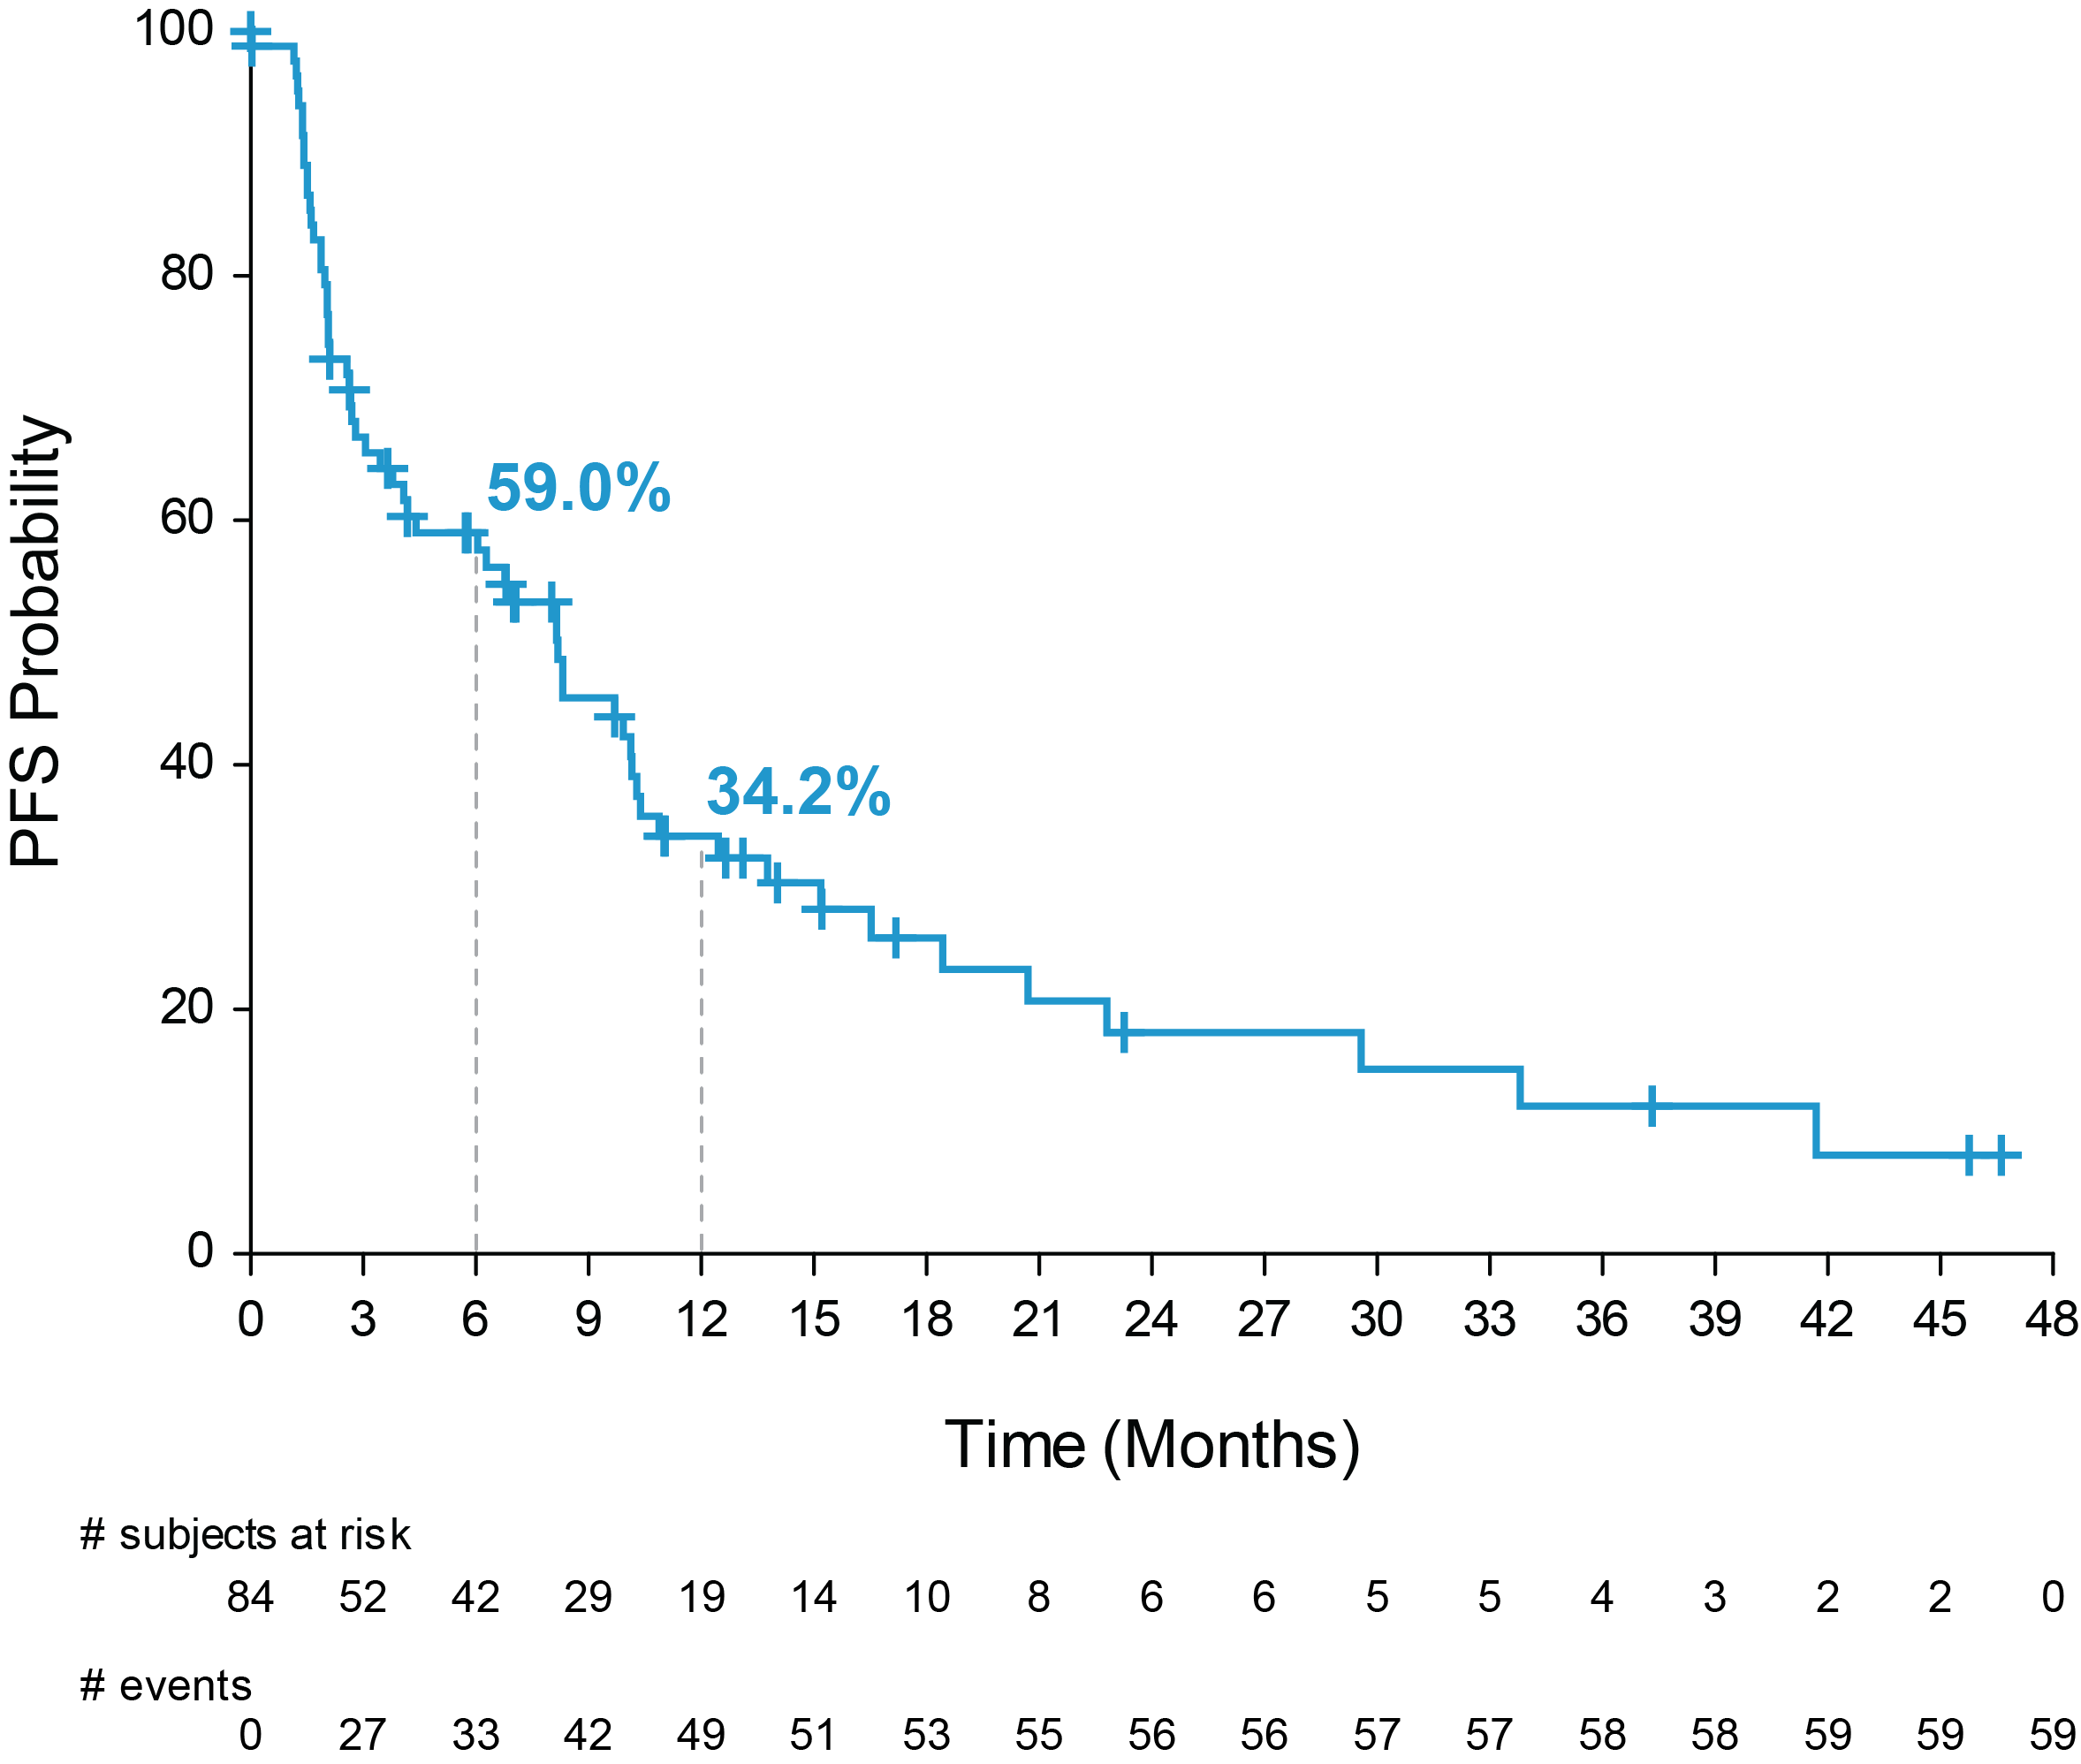
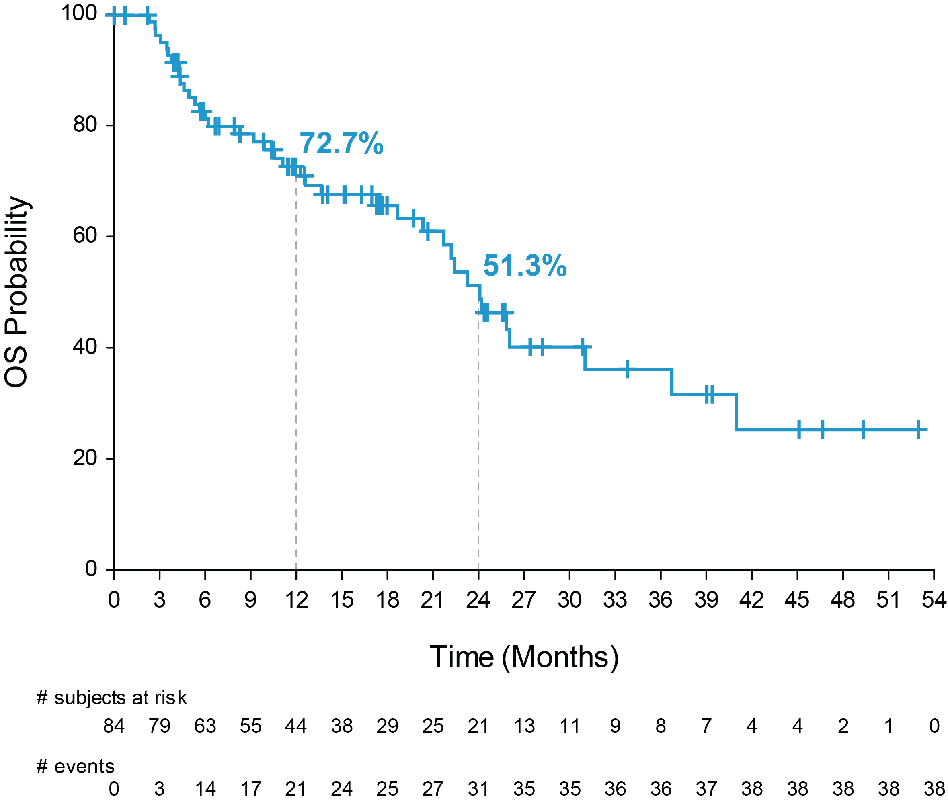
Tucatinib + Trastuzumab: PFS and OS
Progression-free Survival per BICR
Overall Survival
Tucatinib + Trastuzumab | Events | Median PFS | 95% CI
Cohorts A+B | 59/84 | 8.2 months | 4.2, 10.3
Tucatinib + Trastuzumab | Events | Median OS | 95% CI
Cohorts A+B | 38/84 | 24.1 months | 20.3, 36.7
Median follow-up for Cohorts A+B was 20.7 months (IQR, 11.7, 39.0)
BICR, blinded independent central review; IQR, interquartile range; OS, overall survival; PFS, progressive-free survival.
Data cutoff: 28 Mar 2022
Strickler, ESMO 2022

Slide 31
Tucatinib Monotherapy: ORR by 12 Weeks of Treatment
Responses | Tucatinib Monotherapy
 | Cohort C (n=30)
Best Overall Response per BICRª, n (%)
CR | 0
PR | 1 (3.3)
SD | 23 (76.7)
PD | 4 (13.3)
Not available^{b} | 2 (6.7)
ORR per BICR, % (95% CI)^{c} | 3.3 (0.1, 17.2)
ORR per Investigator, % (95% CI)^{c} | 3.3 (0.1, 17.2)
DCR^{d} per BICR | 24 (80.0)
a Best overall response assessed per RECIST 1.1 by 12 weeks of treatment or before start of cross-over if the patient crosses over earlier than 12 weeks. No confirmation needed; b Includes patients with no post-baseline response assessment and patients whose disease assessment are not evaluable; c Two-sided 95% exact confidence interval, computed using the Clopper-Pearson method (1934); d Defined as sum of CR, PR, and SD
BICR, blinded independent central review; CR, complete response; DCR, disease control rate; ORR, objective response rate; PD, progressive disease; PR, partial response; RECIST, Response Evaluation Criteria in Solid Tumors; SD, stable disease.
Data cutoff: 28 Mar 2022
Strickler, ESMO 2022
Notes:
t14-03-06-02-eff-or-12w-bicr-fas-cpre
t14-03-05-02-eff-or-12w-inv-fas-cpre
*DCR: CR+PR+SD

Slide 32
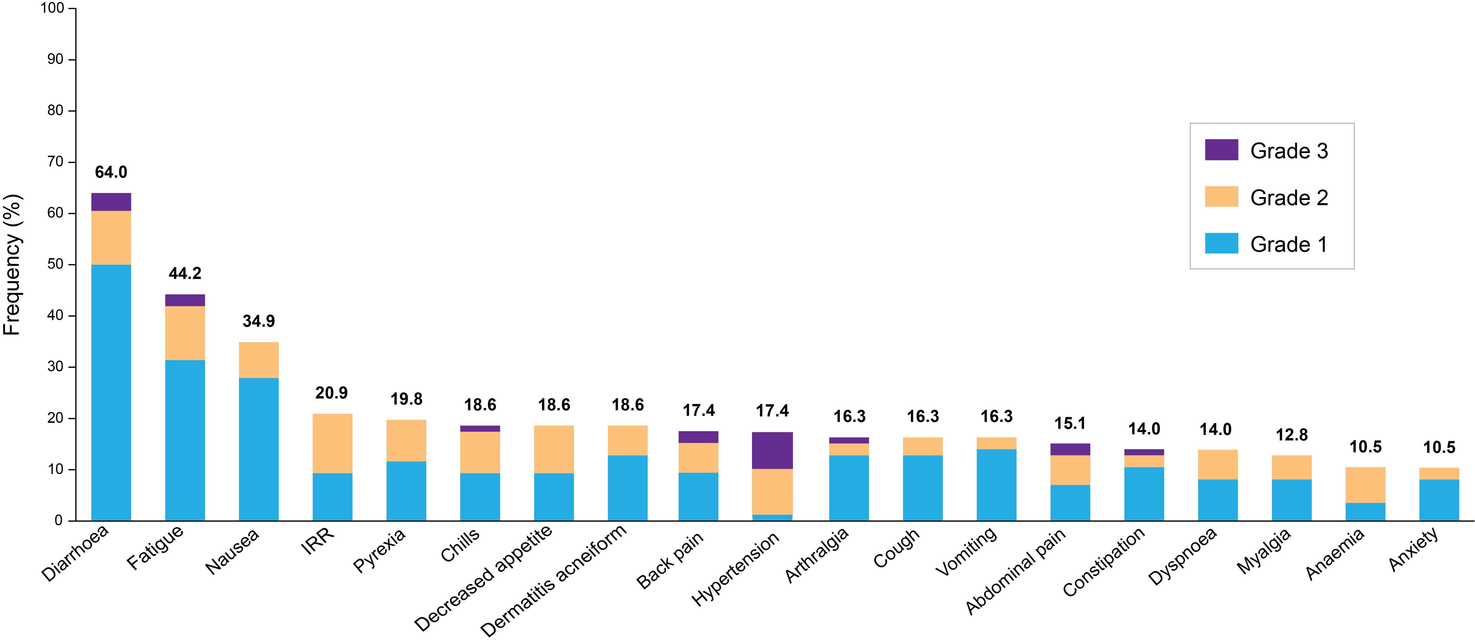
Most Common TEAEs (≥10%) for Tucatinib + Trastuzumab
Most Common Treatment-emergent Adverse Events (≥10%)
Most common tucatinib-related AEs (≥10%): diarrhoea (52.3%), fatigue (29.1%), nausea (18.6%), and dermatitis acneiform (17.4%)
Grade ≥3 tucatinib-related AEs (≥2%): alanine aminotransferase increase (2.3%) and diarrhoea (2.3%)
AE, adverse event; IRR, infusion-related reaction; TEAE, treatment-emergent adverse event.
Data cutoff: 28 Mar 2022
Strickler, ESMO 2022

Slide 33
MOUNTAINEER-03: Global, Randomised, Open-Label, Phase 3 Trial
Key Eligibility Criteria
HER2+ 1L mCRC assessed by central IHC/ISH testing
RAS wild-type
Measurable disease per RECIST 1.1
ECOG Performance Status 0-1
Treated, stable central nervous system metastases permitted
Tucatinib + Trastuzumab + mFOLFOX6^{b}
(n≈200)
Endpoints
Primary
PFS per RECIST 1.1 (BICR)
Secondary^{c}
OS
Confirmed ORR per RECIST 1.1 (BICR)
Rª
mFOLFOX6^{b} ± Bevacizumab or Cetuximab
(n≈200)
a Stratification: Primary tumor sidedness, liver metastases; b Levoleucovorin may be given in place of leucovorin; c Alpha-controlled
1L, first line; BICR, blinded independent central review; ECOG, Eastern Cooperative Oncology Group; HER2, human epidermal growth factor receptor 2; IHC, immunohistochemistry; ISH, in situ hybridization; mCRC, metastatic colorectal cancer; mFOLFOX6, 5-fluorouracil, leucovorin, and oxaliplatin; ORR, objective response rate; OS, overall survival; PFS, progression-free survival; R, randomisation; RAS, rat sarcoma virus; RECIST, Response Evaluation Criteria in Solid Tumors.
https://clinicaltrials.gov/ct2/show/NCT05253651
Strickler, ESMO 2022

Slide 34
Targeting KRAS G12C Mutations: Adagrasib
Yaeger, NEJM 2023

Slide 35
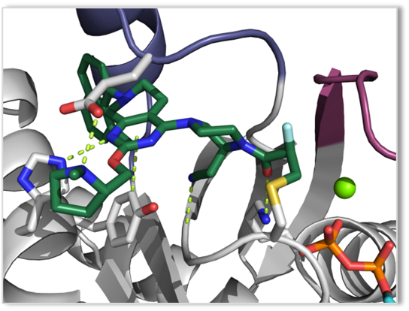
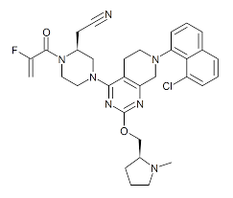
Targeting KRAS G12C Mutations: Adagrasib
- KRAS^{G12C} mutations act as oncogenic drivers and occur in approximately 14% of NSCLC (adenocarcinoma), 3-4% of CRC, and 1-2% of several other cancers¹⁻³
- Adagrasib is a covalent inhibitor of KRAS^{G12C} that irreversibly and selectively binds KRAS^{G12C} in its inactive, GDP-bound state⁴
- Adagrasib was optimized for desired properties of a KRAS^{G12C} inhibitor:
Potent covalent inhibitor of KRAS^{G12C} (cellular IC₅₀: ~5 nM)
High selectivity (>1000X) for the mutant KRAS^{G12C} protein vs wild-type KRAS
Favorable PK properties, including oral bioavailability, long half-life (~24 h), and extensive tissue distribution
Adagrasib Crystal Structure
1. Zehir A, Benayed R, Shah RH, et al. Nat Med. 2017;23(6):703–713. 2. Schirripa M, Nappo F, Cremolini C, et al. Clin Colorectal Cancer. 2020;S1533-0028(20)30067-0. 3. NIH TCGA: The Cancer Genome Atlas. 4. Hallin J, Engstrom LD, Hargis L, et al. Cancer Discov. 2020;10(1): 54-71.
Johnson, EORTC NCI AACR 2020.

Slide 36
Targeting KRAS G12C Mutations: Adagrasib
Yaeger, NEJM 2023

Slide 37
Adagrasib and Cetuximab
Yaeger, NEJM 2023

Slide 38
Targeting KRAS G12C Mutations: Adagrasib
Yaeger, NEJM 2023

Slide 39
Targeting KRAS G12C Mutations: Sotorasib
Kuboki, ESMO 2022

Slide 40
Targeting KRAS G12C Mutations: Sotorasib
Kuboki, ESMO 2022

Slide 41
Targeting KRAS G12C Mutations: Sotorasib
Kuboki, ESMO 2022

Slide 42
Targeting KRAS G12C Mutations: Sotorasib
Kuboki, ESMO 2022

Slide 43
Thank you!

Slide 44
APPENDIX

Slide 45
2022;7(3):100477

Slide 46
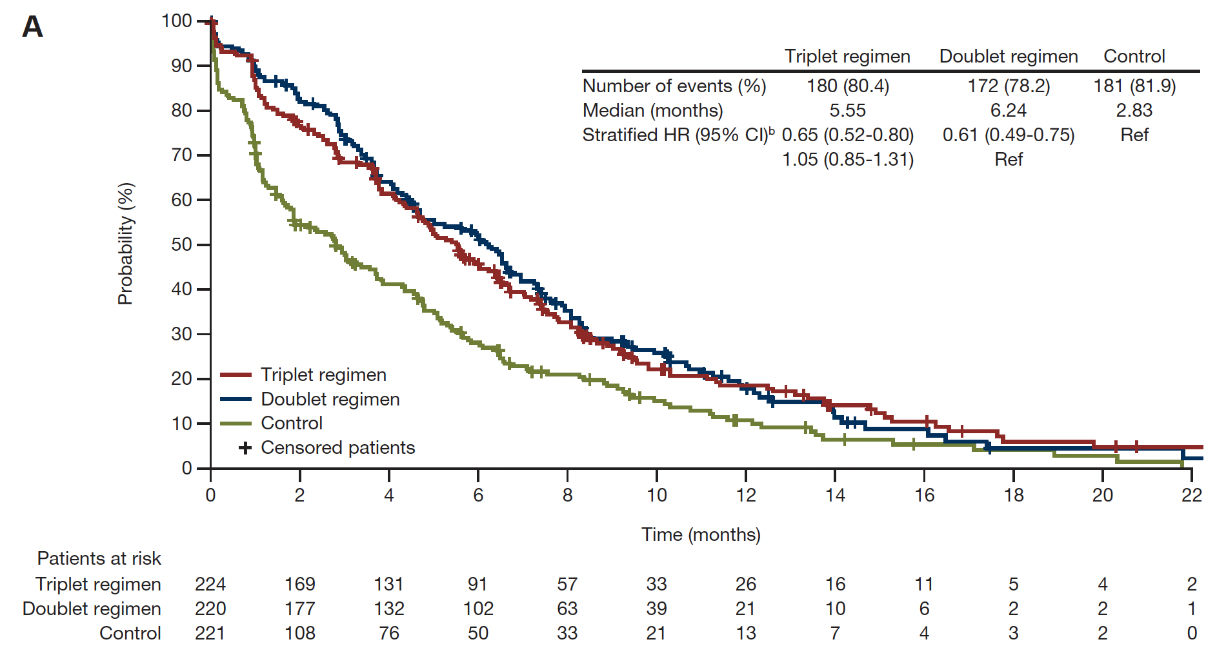
BEACON CRC Median Time to Definitive Deterioration: EORTC Global Health Status
Kopetz S et al. ESMO Open 2022;7(3):100477.

Slide 47
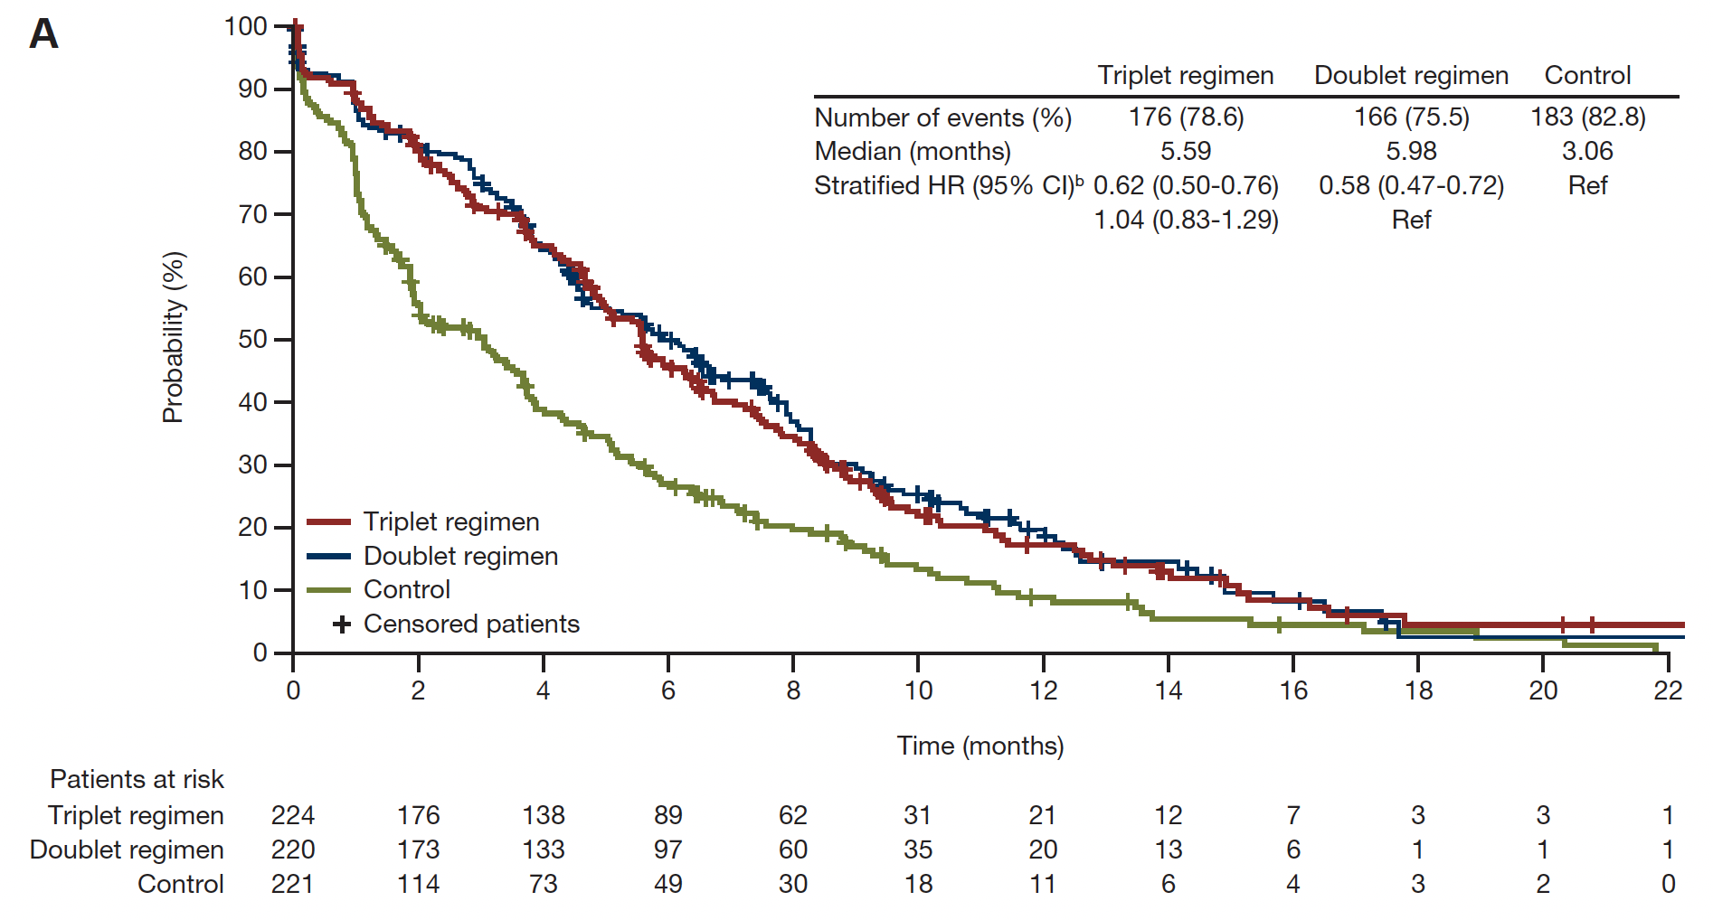
BEACON CRC Median Time to Definitive Deterioration: FACT-C Functional Well-Being
Kopetz S et al. ESMO Open 2022;7(3):100477.

Slide 48
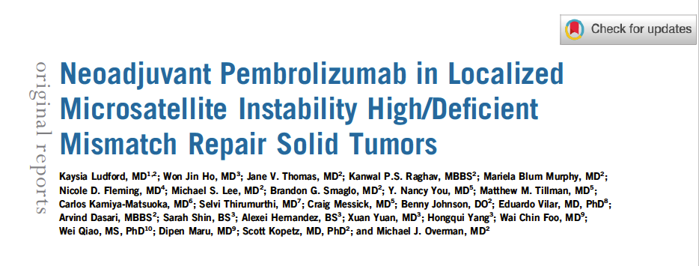
J Clin Oncol 2023;January 9;[Online ahead of print].

Slide 49
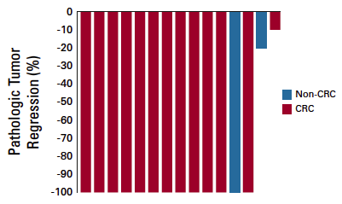
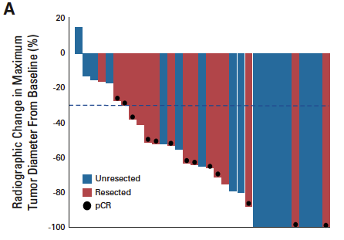
Tumor Responses After Neoadjuvant Pembrolizumab
Pathologic Response in Patients with Resection (n = 17)
Radiographic Response (n = 33)
ORR = 82%
pCR = 65%
Endoscopic complete response was seen in 12/19 patients (63%) evaluable for response.
Ludford K et al. J Clin Oncol 2023;January 9;[Online ahead of print].

Slide 51
Strickler JH et al. ESMO 2022;Abstract LBA27.

Slide 52
Strickler JH et al. ESMO 2022;Abstract LBA27.

