Slide 1
Other Therapeutic Considerations in Colorectal Cancer
Pashtoon Kasi, MD, MS
Director, Colon Cancer Research
Director, Precision Medicine Research for Liquid Biopsies
pmk4001@med.cornell.edu
@pashtoonkasi

Slide 2
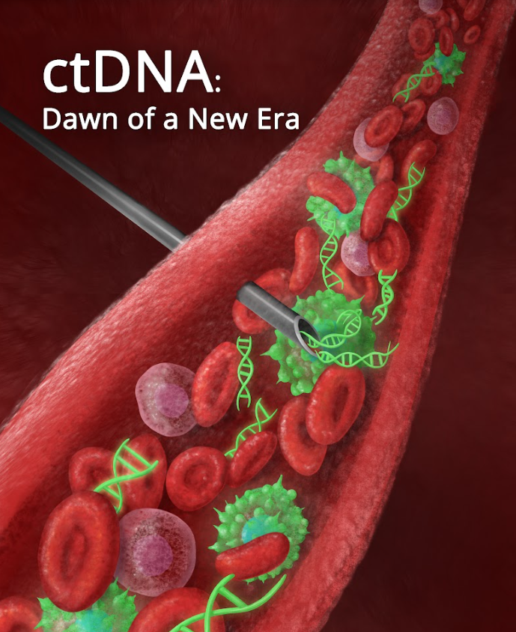
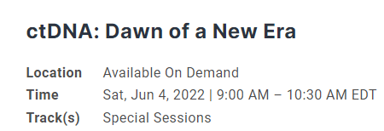
1

Slide 3
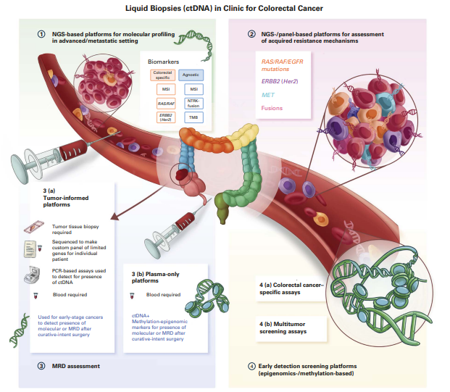
1
Malla M, Loree JM, Kasi PM, Parikh AR.
Using Circulating Tumor DNA in Colorectal Cancer: Current and Evolving Practices.
J Clin Oncol. 2022 Aug 20;40(24):2846-2857. PMID: 35839443.

Slide 4
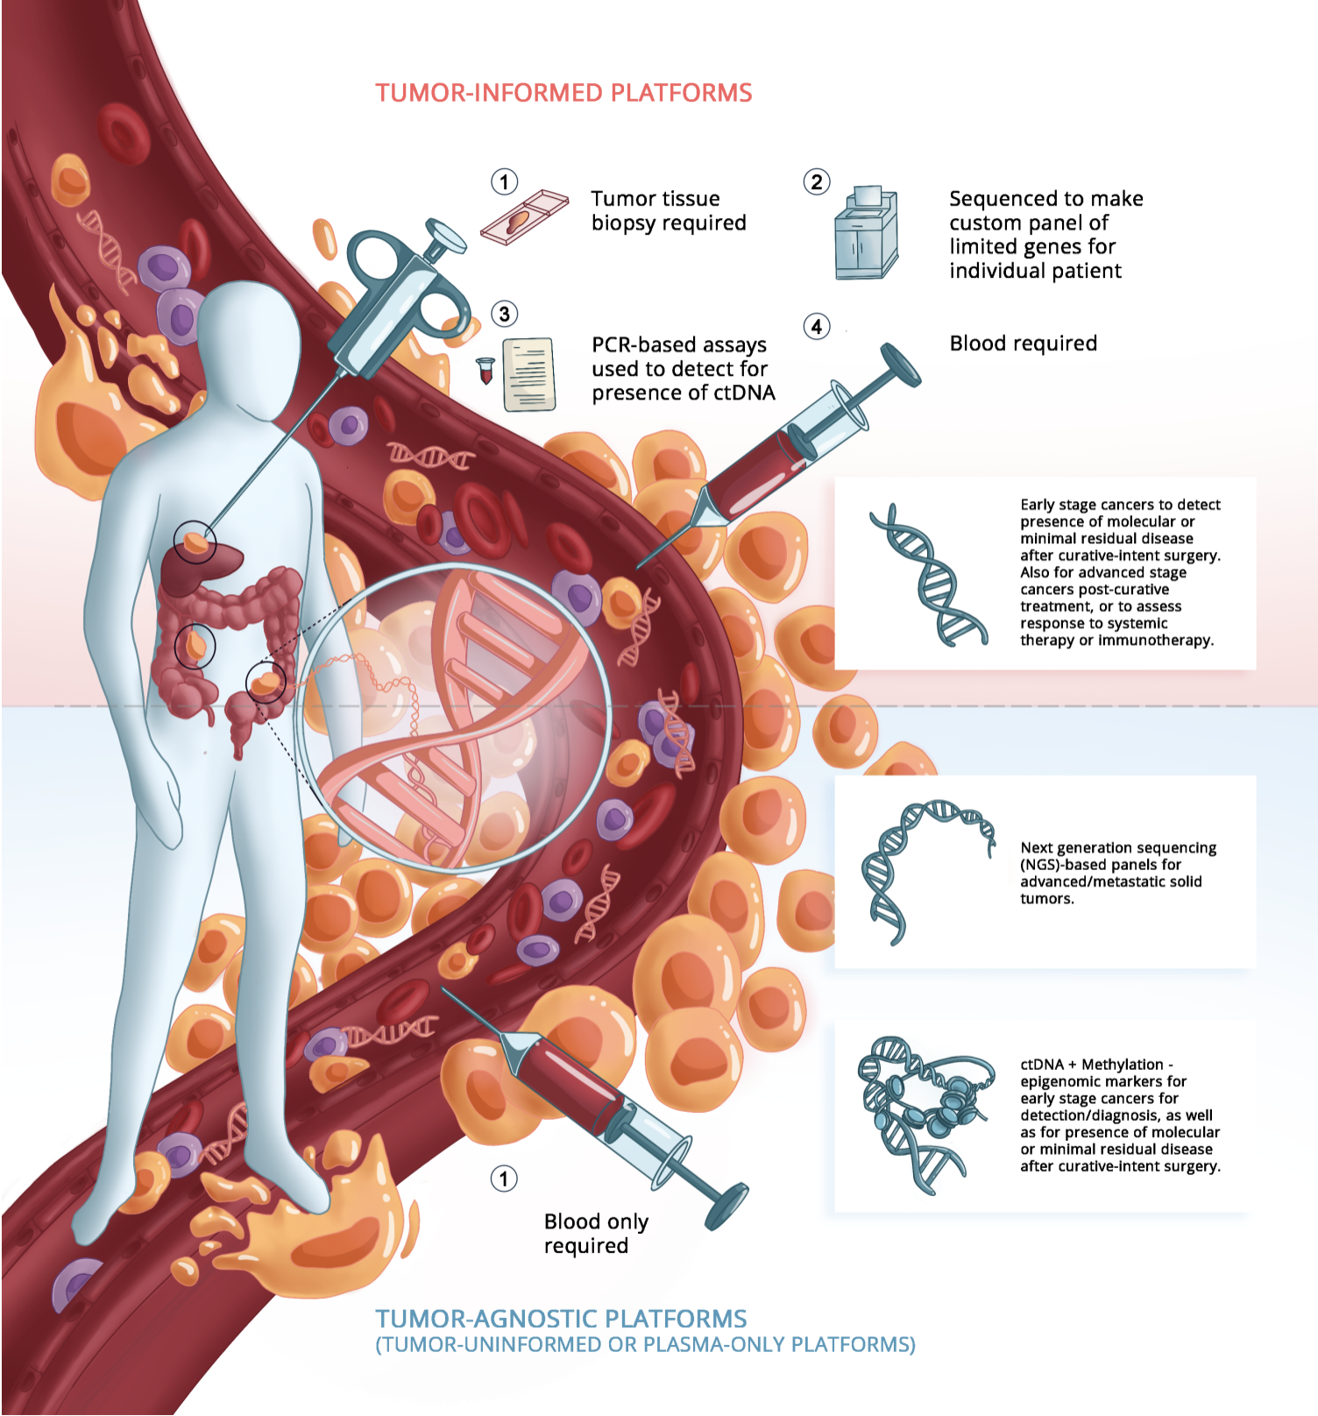
1
Tumor-informed Platforms
Versus
Tumor-agnostic
(tumor-uninformed or
plasma-only)
Platforms
Kasi PM. ctDNA Assays: Exploring Their Clinical Use in Oncology Care. January 2022. ASCO Daily News.

Slide 5
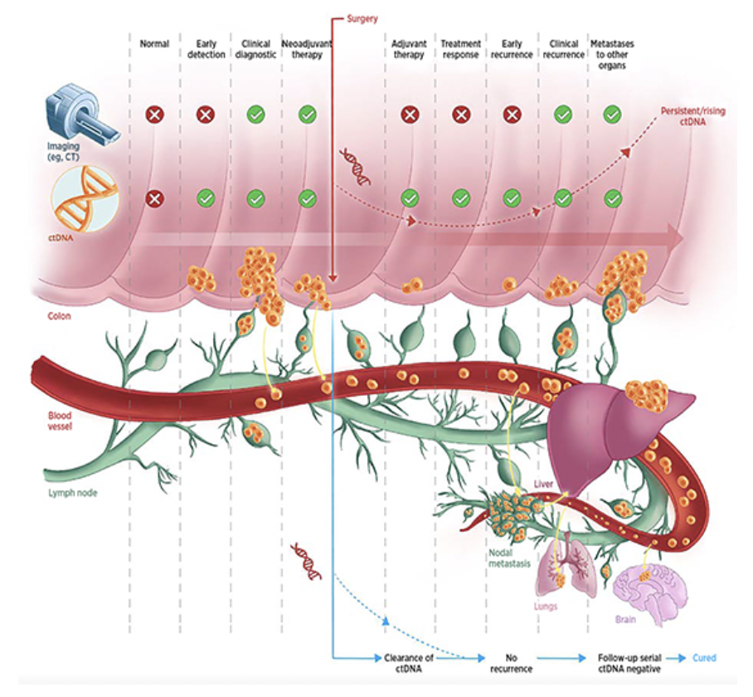
1
Diagnosis
Minimal Residual Disease
Treatment Response
Acquired Resistance
Kasi PM. ctDNA Assays: Exploring Their Clinical Use in Oncology Care. January 2022. ASCO Daily News.

Slide 6
2
Cohen SA et al.
Real-world monitoring of circulating tumor DNA reliably predicts cancer recurrence in patients with resected stages I-III colorectal cancer.
ESMO 2022; Abstract 319MO

Slide 7
2
Recurrence-free survival
Cohen SA et al.
Real-world monitoring of circulating tumor DNA reliably predicts cancer recurrence in patients with resected stages I-III colorectal cancer.
ESMO 2022; Abstract 319MO

Slide 8
Conclusion/Key Takeaways
2
Feasibility of using liquid biopsies in patients with resected stage II/III colon cancer
Higher MRD rates for stage III versus stage II
ctDNA testing in patients with stage II CRC may identify patients with high risk of recurrence, enabling timely therapeutic decision-making to ultimately improve patient outcomes
Enrollment in clinical trials (CIRCULATE-US) – escalation/de-escalation for ctDNA positive versus negative respectively.
Cohen SA et al.
Real-world monitoring of circulating tumor DNA reliably predicts cancer recurrence in patients with resected stages I-III colorectal cancer.
ESMO 2022; Abstract 319MO

Slide 9
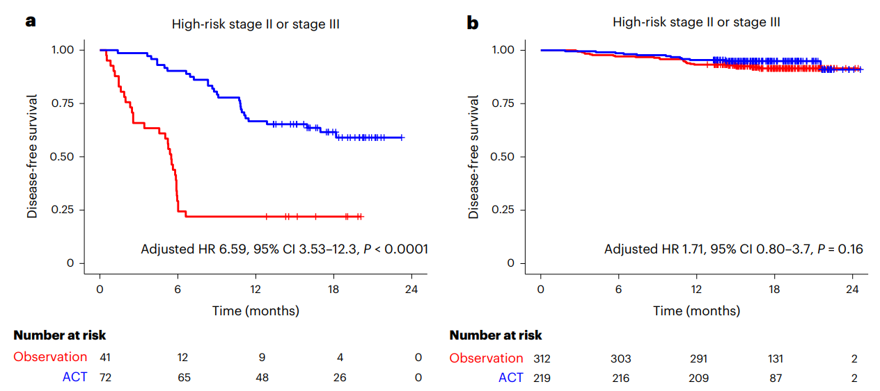
3
Kotani D et al.
Molecular residual disease and efficacy of adjuvant chemotherapy in patients with colorectal cancer.
Nat Med 2023;29(1):127-34.

Slide 10
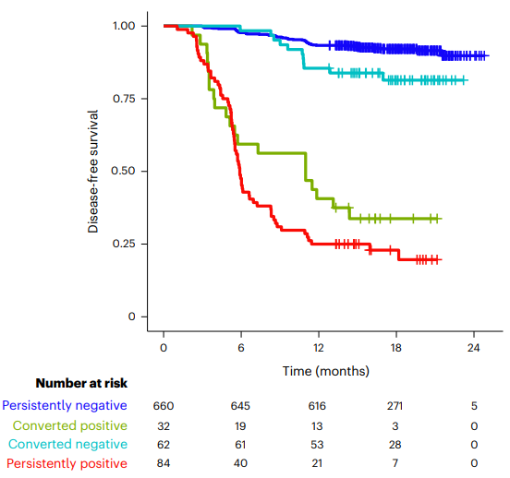
3
Kotani D et al.
Molecular residual disease and efficacy of adjuvant chemotherapy in patients with colorectal cancer.
Nat Med 2023;29(1):127-34.

Slide 11
Conclusion/Key Takeaways
3
Large dataset again showing the feasibility of using minimal residual disease (MRD) testing in patients with resected colorectal cancer
Beyond prognostic; predictive of benefit from adjuvant chemotherapy?
ctDNA+ is more than predictive/prognostic → persistence of disease.
Kotani D et al.
Molecular residual disease and efficacy of adjuvant chemotherapy in patients with colorectal cancer.
Nat Med 2023;29(1):127-34.

Slide 12
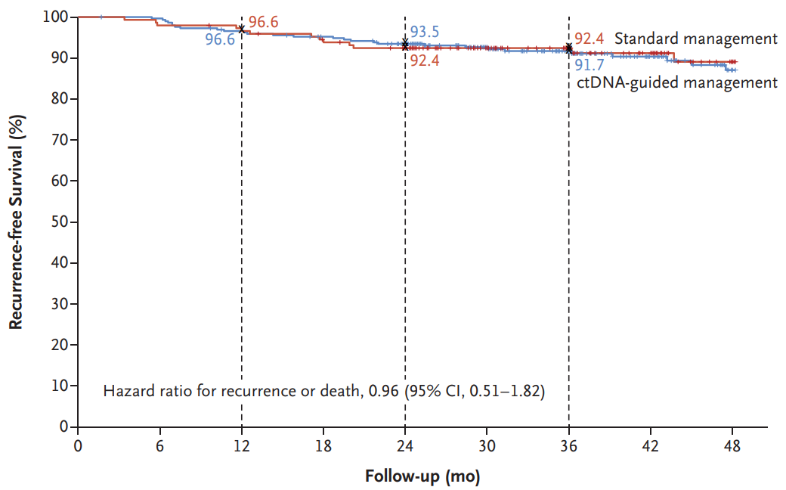
4
Tie J et al.
Circulating tumor DNA analysis guiding adjuvant therapy in Stage II colon cancer.
N Engl J Med 2022;386(24):2261-72.

Slide 13
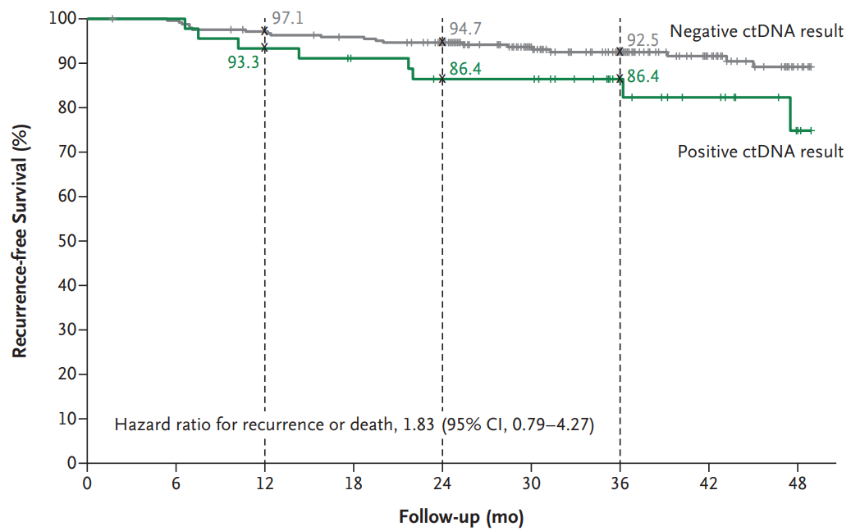
4
Tie J et al.
Circulating tumor DNA analysis guiding adjuvant therapy in Stage II colon cancer.
N Engl J Med 2022;386(24):2261-72.

Slide 14
Conclusion/Key Takeaways
4
A ctDNA-guided approach to the treatment of stage II colon cancer reduced adjuvant chemotherapy use without compromising recurrence-free survival.
Real-world utility especially in stage-II colon cancer where the ctDNA is positive.
Tie J et al.
Circulating tumor DNA analysis guiding adjuvant therapy in Stage II colon cancer.
N Engl J Med 2022;386(24):2261-72.

Slide 15
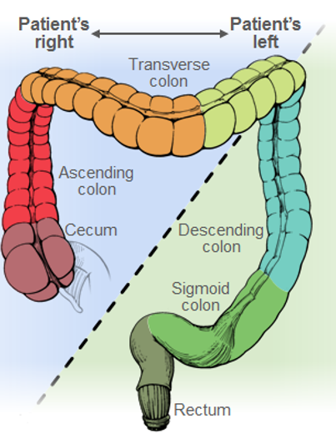
7 key practice questions
5
1. For patients with previously untreated, initially unresectable mCRC who are candidates for chemotherapy plus bevacizumab, is doublet (folinic acid, FU, and oxaliplatin [FOLFOX], or folinic acid, FU, and irinotecan [FOLFIRI]) or triplet (folinic acid, FU, oxaliplatin, and irinotecan [FOLFOXIRI]) cytotoxic chemotherapy recommended?
2a. In the first-line setting, are outcomes for patients with microsatellite instability-high (MSI-H) or deficient mismatch repair (dMMR) mCRC improved with pembrolizumab immunotherapy versus chemotherapy with or without bevacizumab or cetuximab?
2b. Is pembrolizumab recommended as later-line therapy for patients with microsatellite stable (MSS) or proficient mismatch repair (pMMR) mCRC and high tumor mutational burden (TMB = 10 mutations/ Mb)?
3. For patients with treatment-naive RAS wild-type mCRC, are anti–epidermal growth factor receptor (EGFR) antibodies (ie, panitumumab and cetuximab) recommended for patients with right-sided or left-sided primary tumors?
Morris VK et al.
Treatment of metastatic colorectal cancer: ASCO guideline.
J Clin Oncol 2023;41(3):678-700.

Slide 16
7 key practice questions
5
4. For patients with previously treated BRAF V600E– mutant mCRC, does treatment with encorafenib plus cetuximab result in better outcomes compared with chemotherapy plus targeted therapy?
5. For patients with colorectal peritoneal metastases, are outcomes improved with cytoreductive surgery (CRS) with or without hyperthermic intraperitoneal chemotherapy (HIPEC) plus chemotherapy, compared with chemotherapy alone?
6. For patients with unresectable liver-limited mCRC, are liver-directed therapies stereotactic body radiation therapy (SBRT) and selective internal radiation therapy (SIRT) recommended?
7. For patients with mCRC and potentially curable oligometastatic liver metastases, is perioperative chemotherapy recommended?
Morris VK et al.
Treatment of metastatic colorectal cancer: ASCO guideline.
J Clin Oncol 2023;41(3):678-700.

Slide 17
Conclusion/Key Takeaways
5
Doublet/Triplet chemo as options
Candidate for anti-EGFR versus anti-VEGF
Pembrolizumab – MSI-High
Encorafenib/anti-EGFR – BRAF V600E
Cytoreductive surgery – peritoneal metastases
Liver metastases
Perioperative chemo/surgery
Surgery alone
SBRT
SIRT
Morris VK et al.
Treatment of metastatic colorectal cancer: ASCO guideline.
J Clin Oncol 2023;41(3):678-700.

Slide 18
6
Yoshino T et al.
Panitumumab (PAN) plus mFOLFOX6 versus bevacizumab (BEV) plus mFOLFOX6 as first-line treatment in patients with RAS wild-type (WT) metastatic colorectal cancer (mCRC): Results from the phase 3 PARADIGM trial. ASCO 2022;Abstract LBA1.

Slide 19
6
Yoshino T et al.
Panitumumab (PAN) plus mFOLFOX6 versus bevacizumab (BEV) plus mFOLFOX6 as first-line treatment in patients with RAS wild-type (WT) metastatic colorectal cancer (mCRC): Results from the phase 3 PARADIGM trial. ASCO 2022;Abstract LBA1.

Slide 20
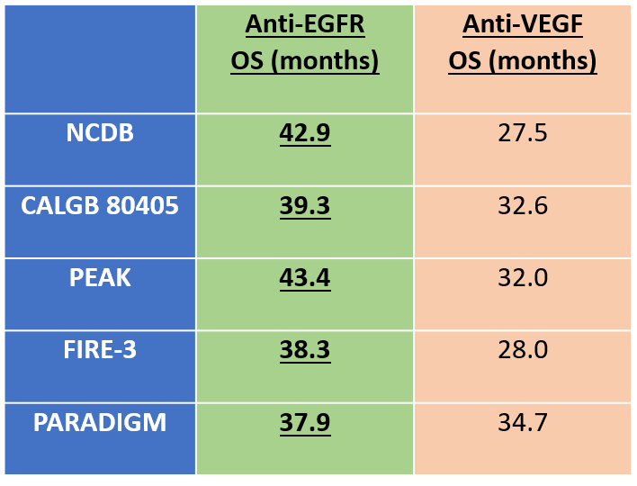
Conclusion/Key Takeaways
6
Selection of the patient for anti-EGFR – tissue
LEFT
RAS-wildtype
BRAF-wildtype
HER2-negative
Role for liquid biopsies?
Yoshino T et al.
Panitumumab (PAN) plus mFOLFOX6 versus bevacizumab (BEV) plus mFOLFOX6 as first-line treatment in patients with RAS wild-type (WT) metastatic colorectal cancer (mCRC): Results from the phase 3 PARADIGM trial. ASCO 2022;Abstract LBA1.

Slide 21
7
Shitara K et al.
Negative hyperselection of patients with RAS wild-type metastatic colorectal cancer for panitumumab: A biomarker study of the phase III PARADIGM trial.
DOI: 10.1200/JCO.2023.41.4_suppl.11 Journal of Clinical Oncology 41, no. 4_suppl (February 01, 2023)

Slide 22
7
Shitara K et al.
Negative hyperselection of patients with RAS wild-type metastatic colorectal cancer for panitumumab: A biomarker study of the phase III PARADIGM trial.
DOI: 10.1200/JCO.2023.41.4_suppl.11 Journal of Clinical Oncology 41, no. 4_suppl (February 01, 2023)

Slide 23
Conclusion/Key Takeaways
7
 | Anti-EGFR OS (months) | Anti-VEGF OS (months)
NCDB | 42.9 | 27.5
CALGB 80405 | 39.3 | 32.6
PEAK | 43.4 | 32.0
FIRE-3 | 38.3 | 28.0
PARADIGM | 37.9 | 34.7
PARADIGM (ctDNA hyper-selected) | 42.1 | 35.5
Selection of the patient for anti-EGFR – tissue
LEFT
RAS-wildtype
BRAF-wildtype
HER2-negative
Role for liquid biopsies (YES)
Shitara K et al.
Negative hyperselection of patients with RAS wild-type metastatic colorectal cancer for panitumumab: A biomarker study of the phase III PARADIGM trial.
DOI: 10.1200/JCO.2023.41.4_suppl.11 Journal of Clinical Oncology 41, no. 4_suppl (February 01, 2023)

Slide 24
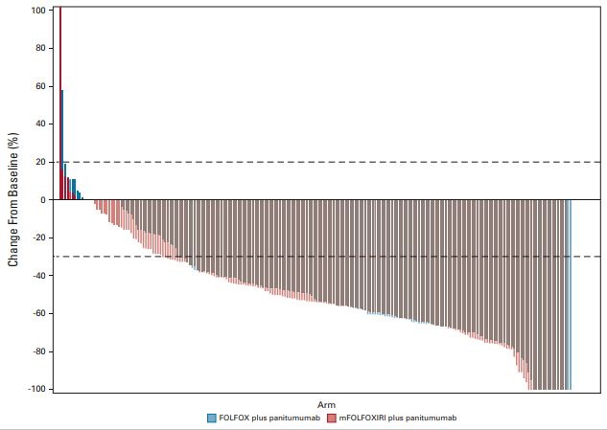
8
Rossini D, et al. Upfront Modified Fluorouracil, Leucovorin, Oxaliplatin, and Irinotecan Plus Panitumumab Versus Fluorouracil, Leucovorin, and Oxaliplatin Plus Panitumumab for Patients With RAS/BRAF Wild-Type Metastatic Colorectal Cancer: The Phase III TRIPLETE Study by GONO.
J Clin Oncol. 2022 Sep 1;40(25):2878-2888.

Slide 25
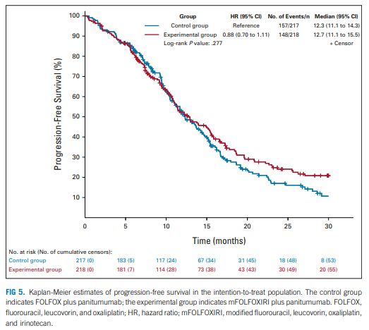
8
Rossini D, et al. Upfront Modified Fluorouracil, Leucovorin, Oxaliplatin, and Irinotecan Plus Panitumumab Versus Fluorouracil, Leucovorin, and Oxaliplatin Plus Panitumumab for Patients With RAS/BRAF Wild-Type Metastatic Colorectal Cancer: The Phase III TRIPLETE Study by GONO.
J Clin Oncol. 2022 Sep 1;40(25):2878-2888.

Slide 26
Conclusion/Key Takeaways
8
Selection of the patient for anti-EGFR – tissue
LEFT
RAS-wildtype
BRAF-wildtype
HER2-negative
Role for liquid biopsies (YES)
Rossini D, et al. Upfront Modified Fluorouracil, Leucovorin, Oxaliplatin, and Irinotecan Plus Panitumumab Versus Fluorouracil, Leucovorin, and Oxaliplatin Plus Panitumumab for Patients With RAS/BRAF Wild-Type Metastatic Colorectal Cancer: The Phase III TRIPLETE Study by GONO.
J Clin Oncol. 2022 Sep 1;40(25):2878-2888.

Slide 27
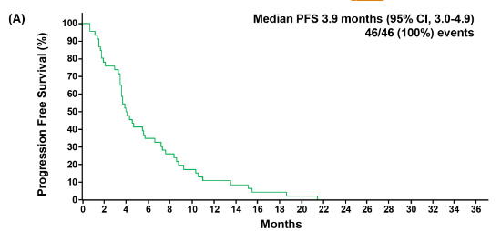
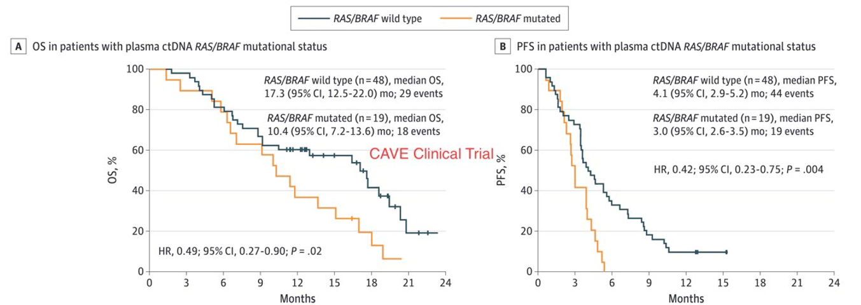
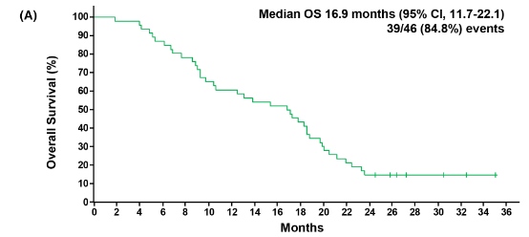
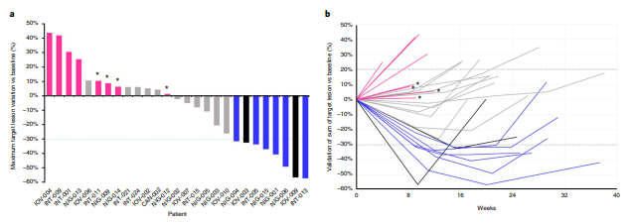
EGFR-Rechallenge
9
CAVE
CRICKET
CHRONOS
Martini G, et al. Cetuximab as third-line rechallenge plus either irinotecan or avelumab is an effective treatment in metastatic colorectal cancer patients with baseline plasma RAS/BRAF wild-type circulating tumor DNA: Individual patient data pooled analysis of CRICKET and CAVE trials.
Cancer Med. 2023 Mar 7.

Slide 28
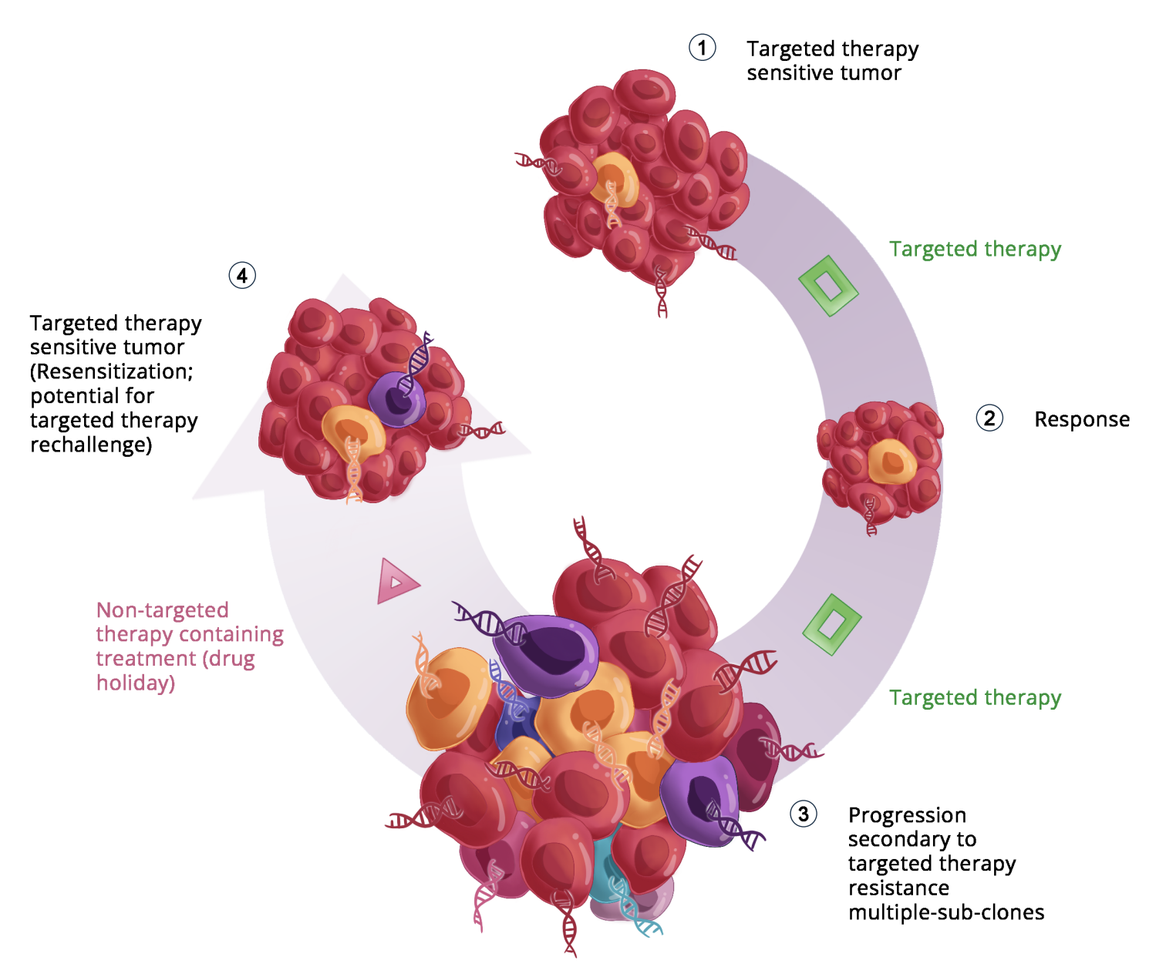
9
Resensitization or Rechallenge
Kasi PM. ctDNA Assays: Exploring Their Clinical Use in Oncology Care. January 2022. ASCO Daily News.

Slide 29
Conclusion/Key Takeaways
9
Anti-EGFR rechallenge is an option for patients with liquid RAS/RAF-wildtype HER2-negative colorectal cancer (ZERO Mutation ctDNA triage).
While the benefit is not tremendous in ctDNA negative, the ones who are ctDNA+ derive only harm/toxicity.
Can at least spare the toxicity to those who don’t need it.
Martini G, et al. Cetuximab as third-line rechallenge plus either irinotecan or avelumab is an effective treatment in metastatic colorectal cancer patients with baseline plasma RAS/BRAF wild-type circulating tumor DNA: Individual patient data pooled analysis of CRICKET and CAVE trials.
Cancer Med. 2023 Mar 7.

Slide 30
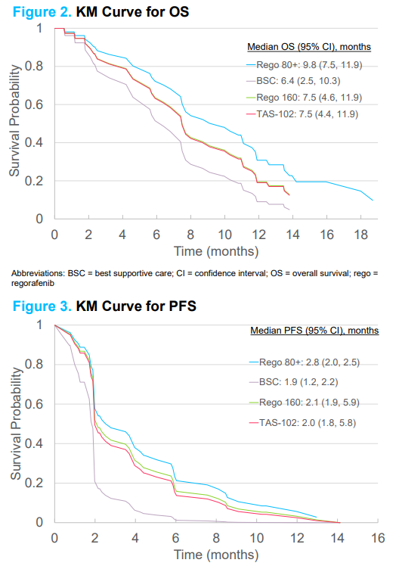
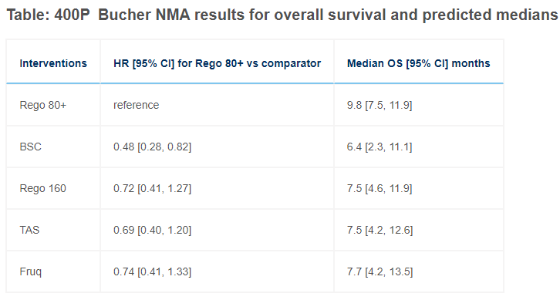
10
ESMO World Congress GI 2022. Bekaii-Saab et al.
10. Burnett H et al. Impact of regorafenib dose optimization on comparative outcomes in the treatment of relapsed/refractory metastatic colorectal cancer (mCRC). ESMO 2022;Abstract 400P.

Slide 31
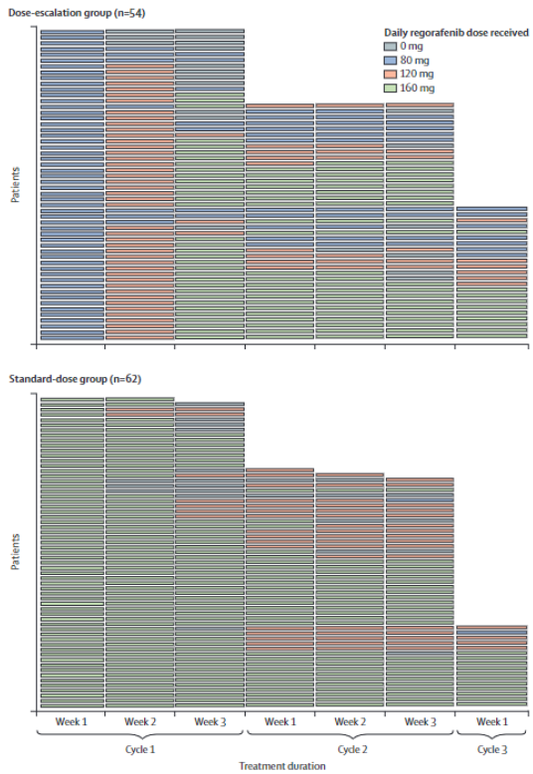
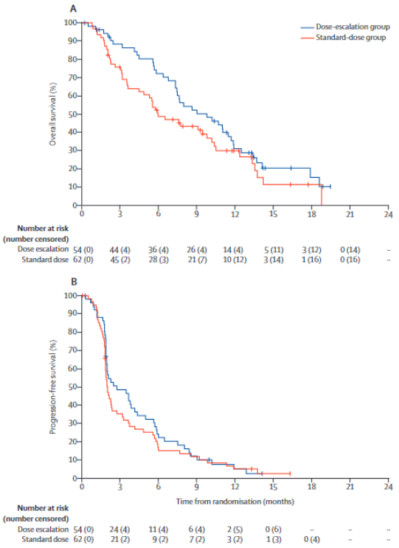
Conclusion/Key Takeaways
10
With TKIs, less is more.
ReDOS strategy of 80 mg starting dose with weekly escalation as tolerated, and pre-emptive versus reactive treatment with clobetasol should/is clinical practice.
10. Burnett H et al. Impact of regorafenib dose optimization on comparative outcomes in the treatment of relapsed/refractory metastatic colorectal cancer (mCRC). ESMO 2022;Abstract 400P.
Notes:
https://www.postersessiononline.eu/173580348_eu/congresos/WCGIC2022/aula/-P_44_WCGIC2022.pdf

Slide 32
Sunlight:
FTD/TPI+/-BEV
11
Median OS:
10.8m versus 7.5m
Median PFS:
5.6m versus 2.4m
Tabernero J et al. Trifluridine/tipiracil plus bevacizumab for third-line treatment of refractory metastatic colorectal cancer: The phase 3 randomized SUNLIGHT study. Gastrointestinal Cancers Symposium 2023; Abstract 4.

Slide 33
Sunlight:
FTD/TPI+/-BEV
11
Benefit across subsets and patient population.
Delayed time to deterioration in global health status.
Tabernero J et al. Trifluridine/tipiracil plus bevacizumab for third-line treatment of refractory metastatic colorectal cancer: The phase 3 randomized SUNLIGHT study. Gastrointestinal Cancers Symposium 2023; Abstract 4.

Slide 34
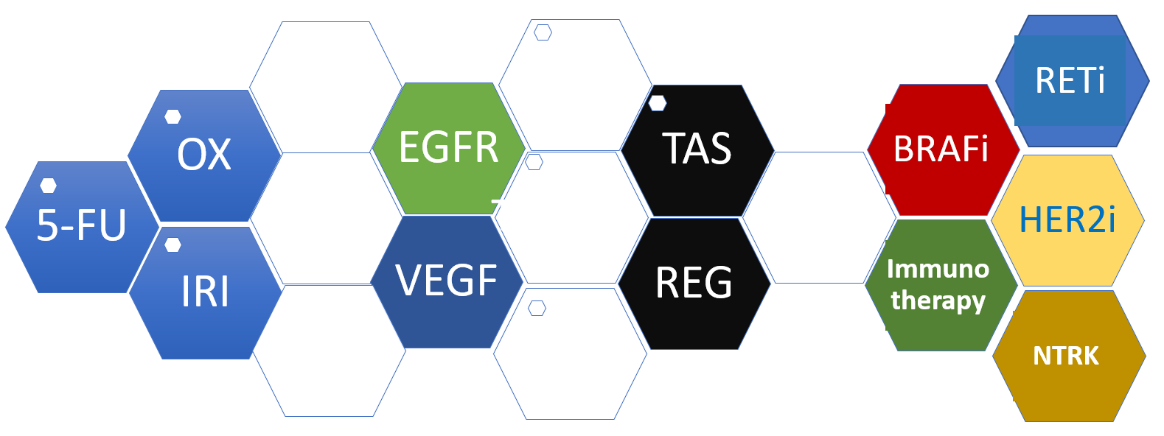
Conclusion/Key Takeaways
11
TAS-102+BEV or FTD/TPI+BEV represents a new standard of care.
3rd line or post-progression on maintenance CAPE+BEV for those getting triplet+biologic.
PFS and OS very meaningful.
Was already in use since NCCN guideline inclusion in 2022.
Kasi PM et al. Colorectal Cancer. Lancet Oct 2019.
10. Burnett H et al. Impact of regorafenib dose optimization on comparative outcomes in the treatment of relapsed/refractory metastatic colorectal cancer (mCRC). ESMO 2022;Abstract 400P.
Notes:
https://www.postersessiononline.eu/173580348_eu/congresos/WCGIC2022/aula/-P_44_WCGIC2022.pdf

Slide 35
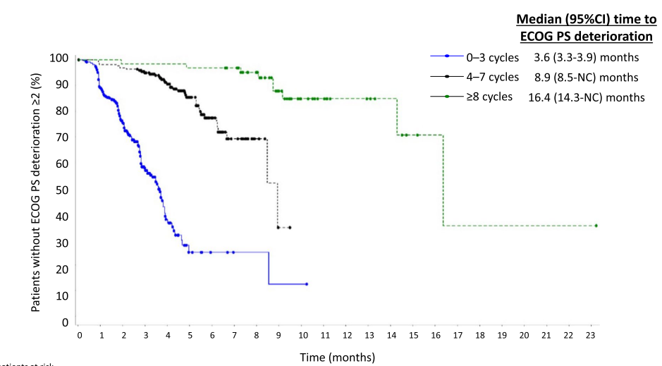
12
12. Taieb J et al. Safety and efficacy of trifluridine/tipiracil in previously treated metastatic colorectal cancer: Final results from the phase IIIb single-arm PRECONNECT study by duration of therapy. BMC Cancer 2023;23(1):94

Slide 36
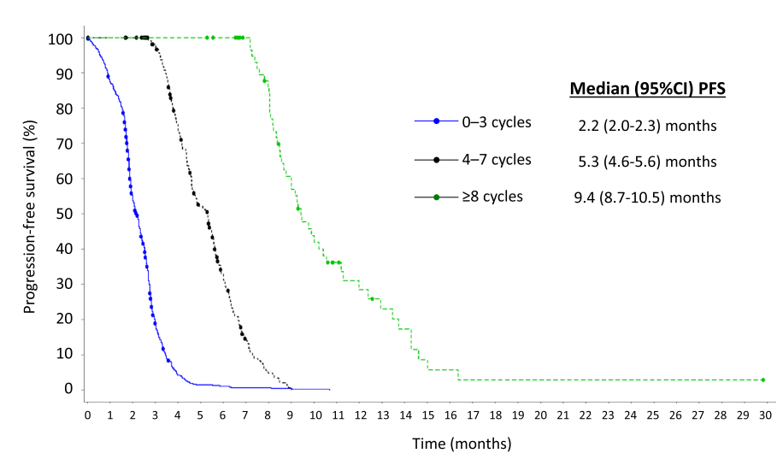
12
12. Taieb J et al. Safety and efficacy of trifluridine/tipiracil in previously treated metastatic colorectal cancer: Final results from the phase IIIb single-arm PRECONNECT study by duration of therapy. BMC Cancer 2023;23(1):94

Slide 37
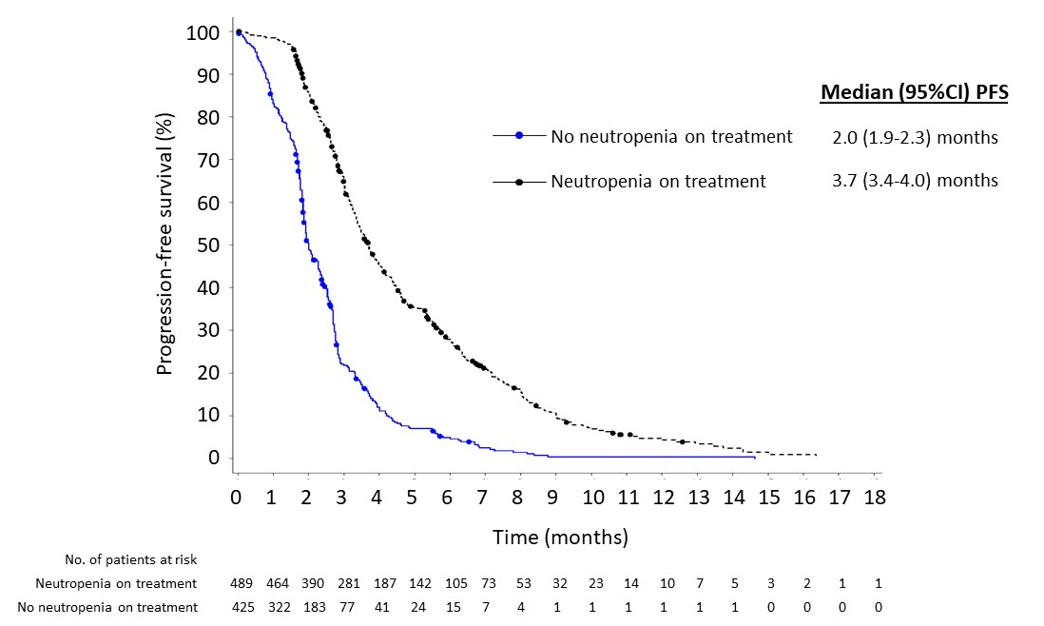
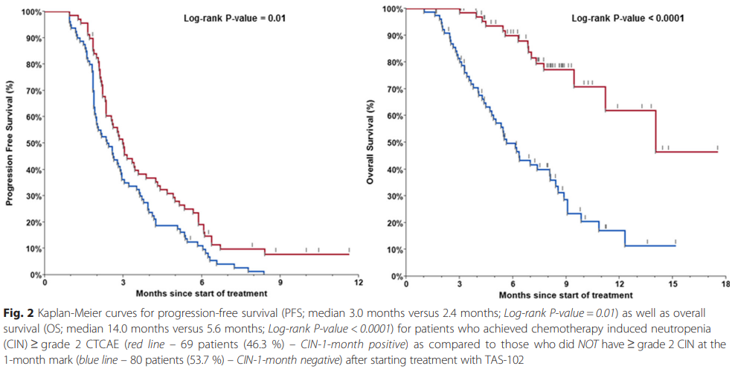
Conclusion/Key Takeaways
12
Kasi PM et al. Colorectal Cancer. Lancet Oct 2019.
TAS-102 or FTD/TPI and now with the recent SUNLIGHT DATA on this oral systemic therapy with BEV patients rarely have to come off due to toxicity.
Chemotherapy-induced neutropenia – not necessarily an adverse issue.
Kasi PM. BMC Cancer. 2016. PMID: 27412464.
10. Burnett H et al. Impact of regorafenib dose optimization on comparative outcomes in the treatment of relapsed/refractory metastatic colorectal cancer (mCRC). ESMO 2022;Abstract 400P.

Slide 38
Fruquintinib (FRESCO-2)
13
Dasari NA et al. FRESCO-2: A global phase III multiregional clinical trial (MRCT) evaluating the efficacy and safety of fruquintinib in patients with refractory metastatic colorectal cancer. ESMO 2022;Abstract LBA25

Slide 39
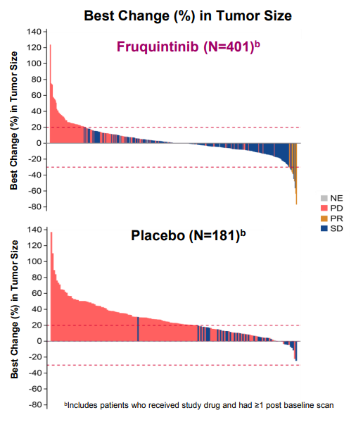
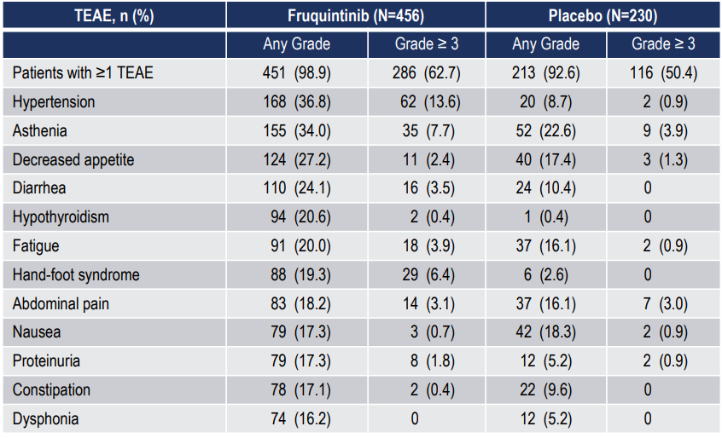
13
Dasari NA et al. FRESCO-2: A global phase III multiregional clinical trial (MRCT) evaluating the efficacy and safety of fruquintinib in patients with refractory metastatic colorectal cancer. ESMO 2022;Abstract LBA25

Slide 40
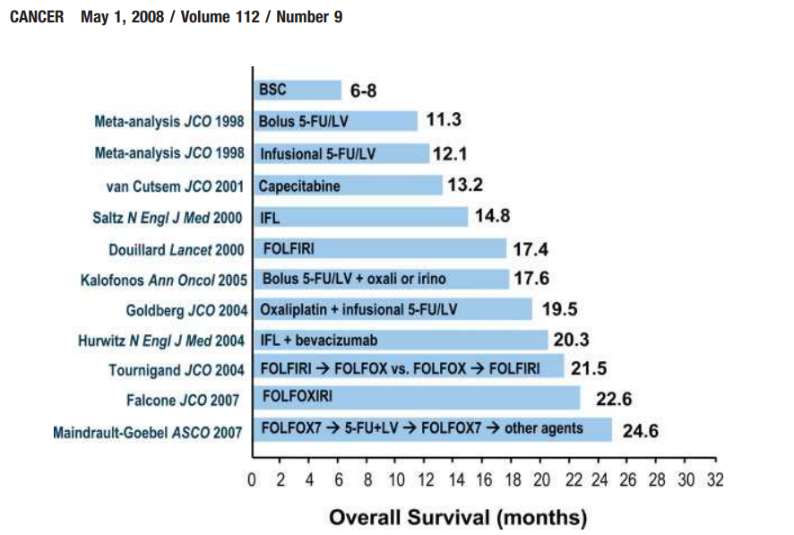
Conclusion/Key Takeaways
13
Advances in patients with colorectal cancer has been a continuum of care.
“FRESCO-2 results are consistent with FRESCO and should support a new treatment option in refractory mCRC.”
Dasari NA et al. FRESCO-2: A global phase III multiregional clinical trial (MRCT) evaluating the efficacy and safety of fruquintinib in patients with refractory metastatic colorectal cancer. ESMO 2022;Abstract LBA25.

Slide 41
14
El-Khoueiry A. Botensilimab, a novel innate/adaptive immune activator, plus balstilimab (anti-PD-1) for metastatic heavily pretreated microsatellite stable colorectal cancer.
ESMO World GI 2022.

Slide 42
14
El-Khoueiry A. Botensilimab, a novel innate/adaptive immune activator, plus balstilimab (anti-PD-1) for metastatic heavily pretreated microsatellite stable colorectal cancer.
ESMO World GI 2022.

Slide 43
Conclusion/Key Takeaways
14
Whether it is novelty of bot/bal, or the lung-only metastases biology, it is for the first time we are seeing activity of an immunotherapy-based regimen in pMMR/MSS metastatic colorectal cancer.
El-Khoueiry A. Botensilimab, a novel innate/adaptive immune activator, plus balstilimab (anti-PD-1) for metastatic heavily pretreated microsatellite stable colorectal cancer.
ESMO World GI 2022.

