Slide 1
Meet The Professor Optimizing the Management of Colorectal Cancer
Christopher Lieu, MD Associate Professor of Medicine Associate Director for Clinical Research Co-Director, GI Medical Oncology University of Colorado Cancer Center Aurora, Colorado

Slide 2
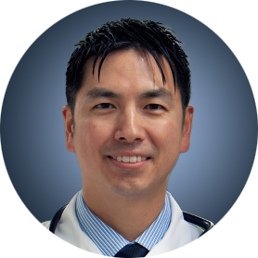
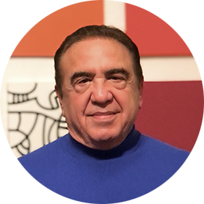
Meet The Professor Program Participating Faculty
Stacey A Cohen, MD
Associate Professor
Fred Hutchinson Cancer Center
University of Washington
Seattle, Washington
Christopher Lieu, MD Associate Professor of Medicine Associate Director for Clinical Research Co-Director, GI Medical Oncology University of Colorado Cancer Center Aurora, Colorado
Arvind Dasari, MD, MS
Associate Professor
Department of Gastrointestinal Medical Oncology
The University of Texas
MD Anderson Cancer Center
Houston, Texas
John Strickler, MD
Associate Professor
Duke University
Durham, North Carolina
Dustin Deming, MD
ACI/Schwenn Family Associate Professor
University of Wisconsin Carbone Cancer Center
Madison, Wisconsin
MODERATOR
Neil Love, MD Research To Practice Miami, Florida

Slide 3
Commercial Support
This activity is supported by educational grants from Lilly, Natera Inc, and Seagen Inc.
Research To Practice CME Planning Committee Members, Staff and Reviewers
Planners, scientific staff and independent reviewers for Research To Practice have no relevant conflicts of interest to disclose.

Slide 4
Dr Lieu — Disclosures
Consulting Agreement | Amgen Inc

Slide 5
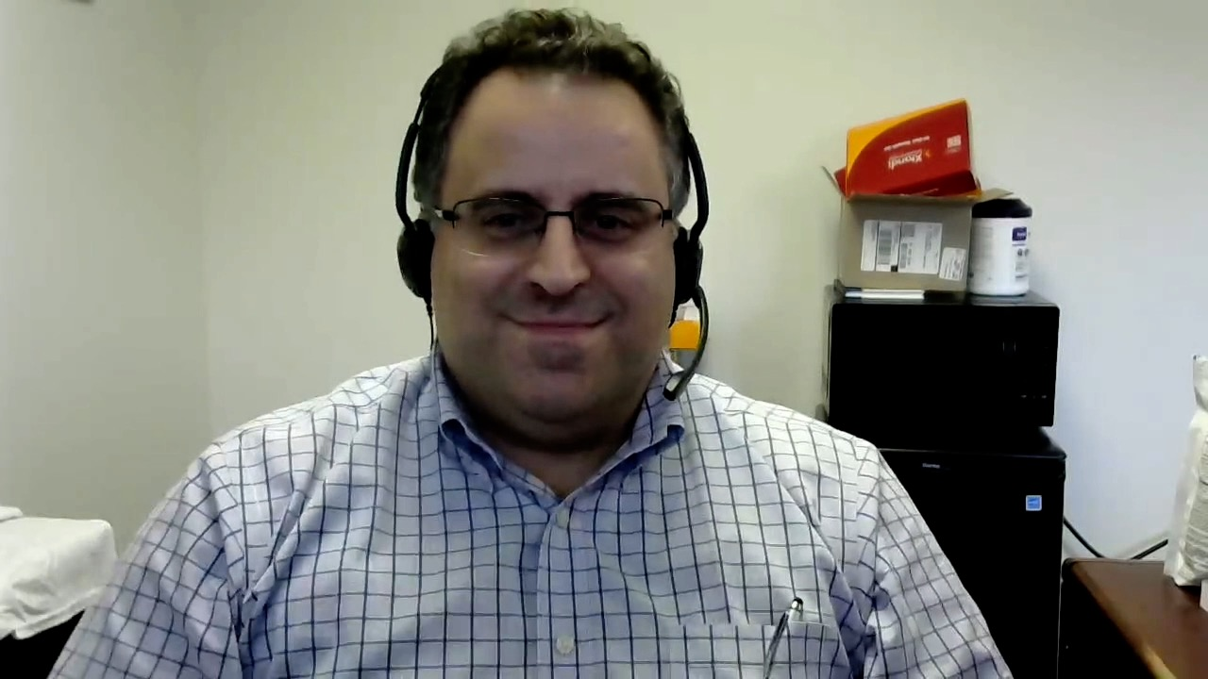
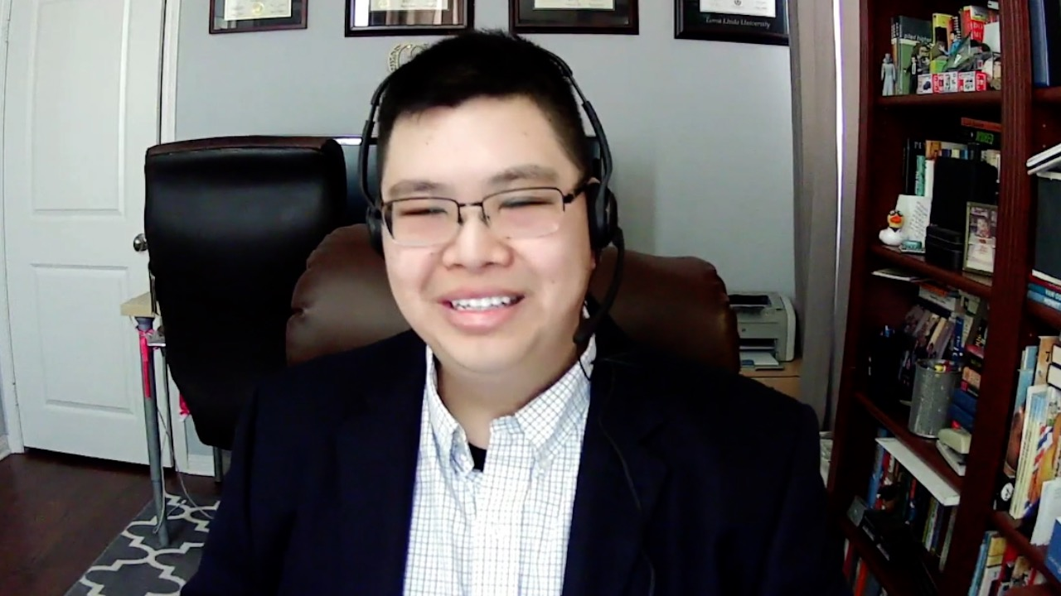
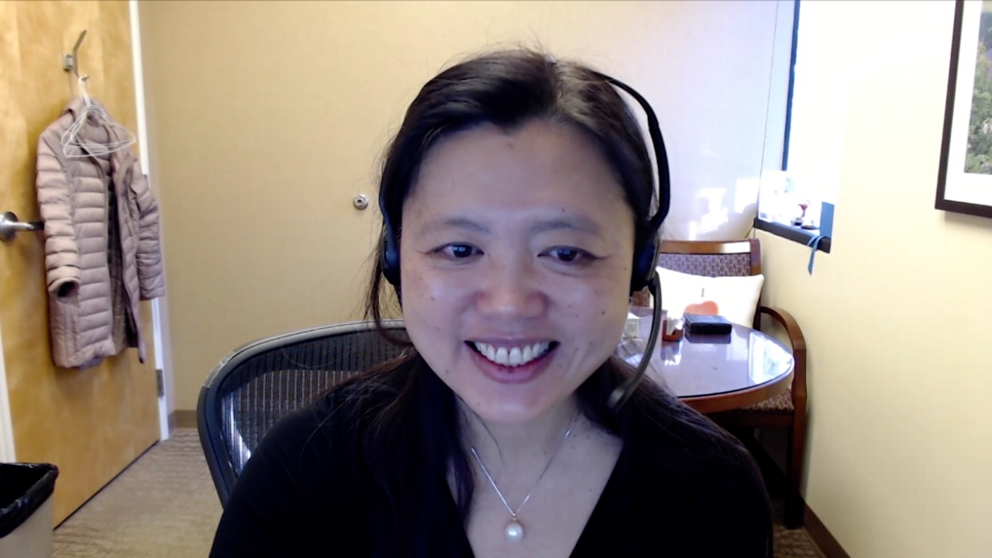
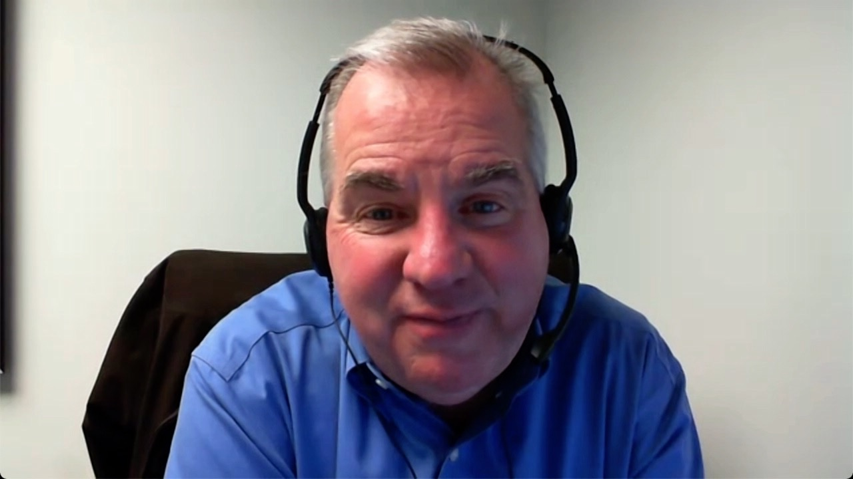
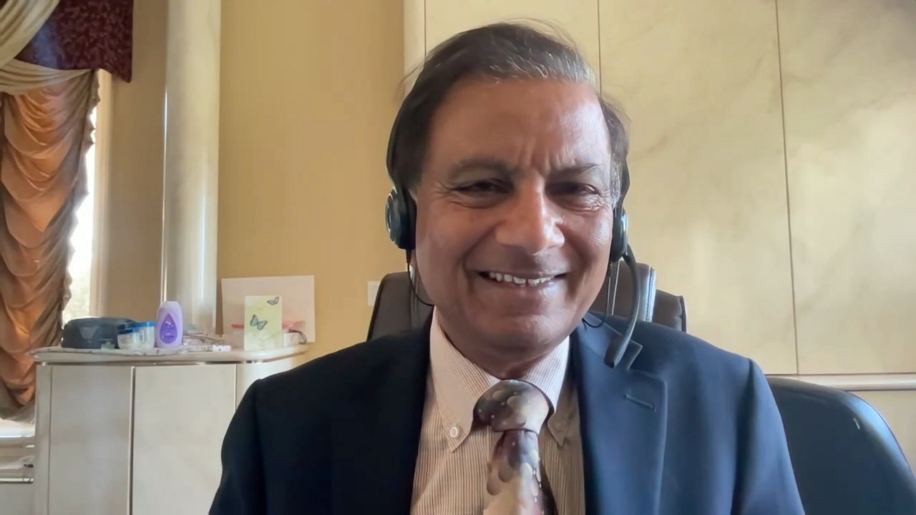
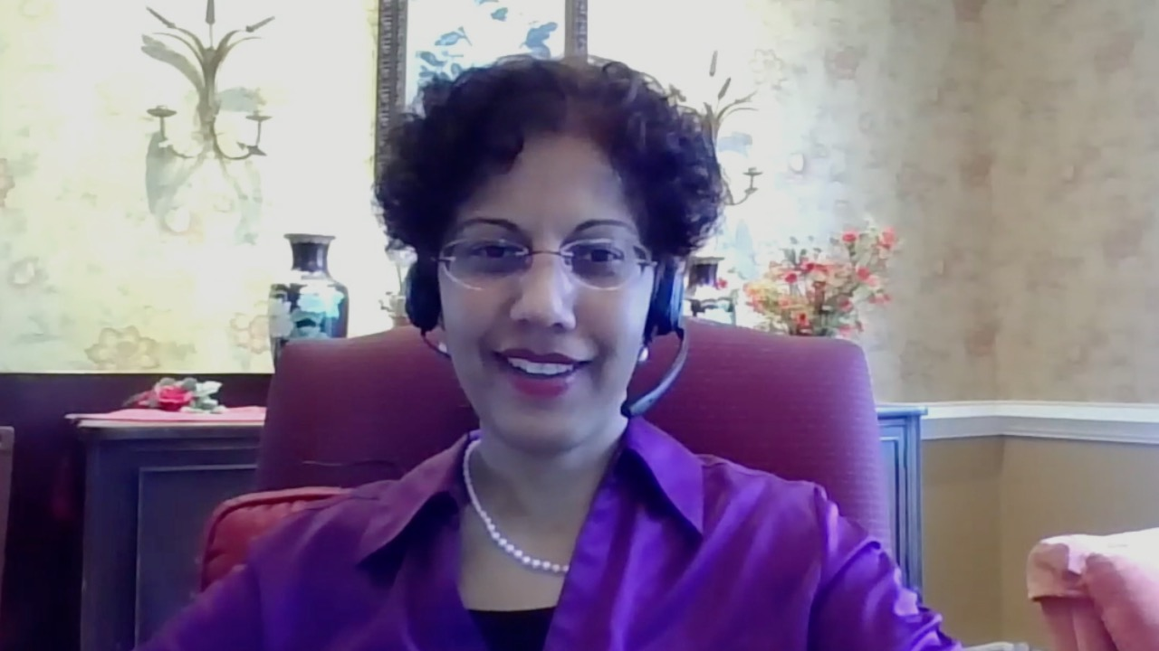
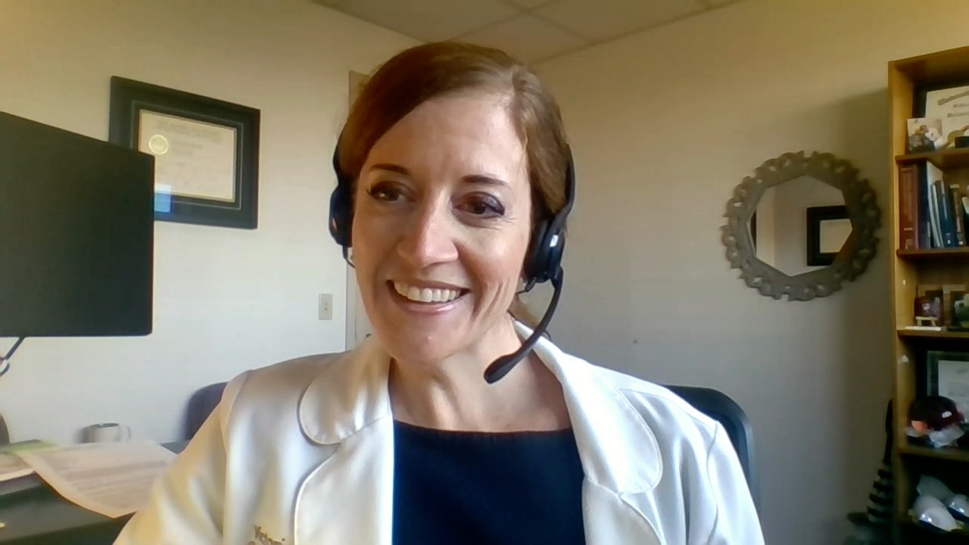
Georges Azzi, MD
Holy Cross Health
Fort Lauderdale, Florida
Eric H Lee, MD, PhD
Compassionate Cancer Care Medical Group
Fountain Valley, California
Gigi Chen, MD John Muir Health Pleasant Hill, California
William R Mitchell, MD
Southern Oncology Specialists
Charlotte, North Carolina
Sunil Gandhi, MD
Florida Cancer Specialists
Lecanto, Florida
Priya Rudolph, MD, PhD
Georgia Cancer Specialists
Athens, Georgia
Victoria Giffi, MD
Meritus Hematology and Oncology Specialists
Hagerstown, Maryland
Swati Vishwanathan, MD
United Hospital Center WVU Medicine
Bridgeport, West Virginia

Slide 6
Meet The Professor with Dr Lieu
Introduction: Early-Onset Colorectal Cancer
MODULE 1: Localized Disease
MODULE 2: Metastatic Disease
MODULE 3: HER2-Positive Disease
MODULE 4: MSI-H Disease; BRAF-Mutant Disease
MODULE 5: Journal Club with Dr Lieu
MODULE 6: Appendix

Slide 7
Meet The Professor with Dr Lieu
Introduction: Early-Onset Colorectal Cancer
MODULE 1: Localized Disease
MODULE 2: Metastatic Disease
MODULE 3: HER2-Positive Disease
MODULE 4: MSI-H Disease; BRAF-Mutant Disease
MODULE 5: Journal Club with Dr Lieu
MODULE 6: Appendix

Slide 8
Lancet Oncol 2022;23(3):e116-28.

Slide 9
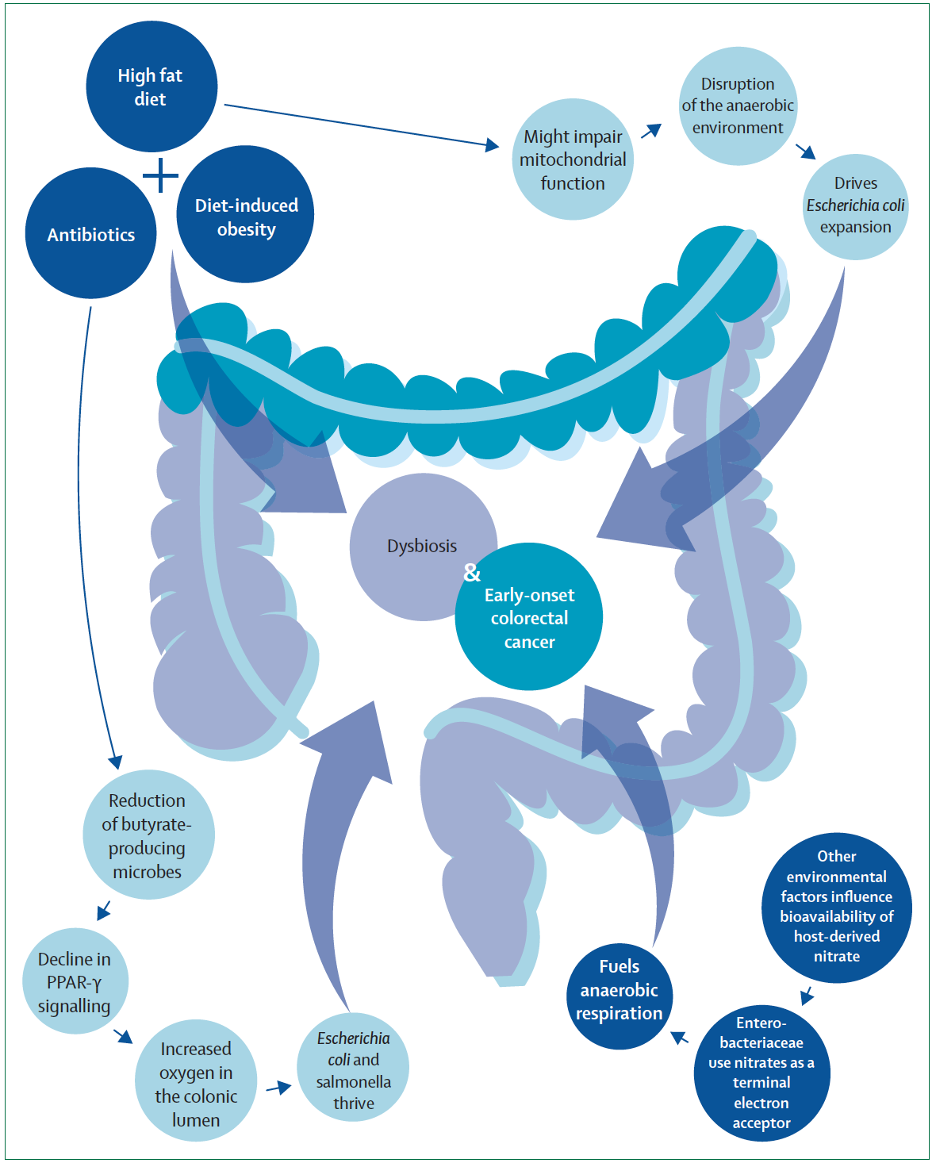
Factors Associated with Dysbiosis and Early-Onset Colorectal Cancer
Eng C et al. Lancet Oncol 2022;23(3):e116-28.

Slide 10
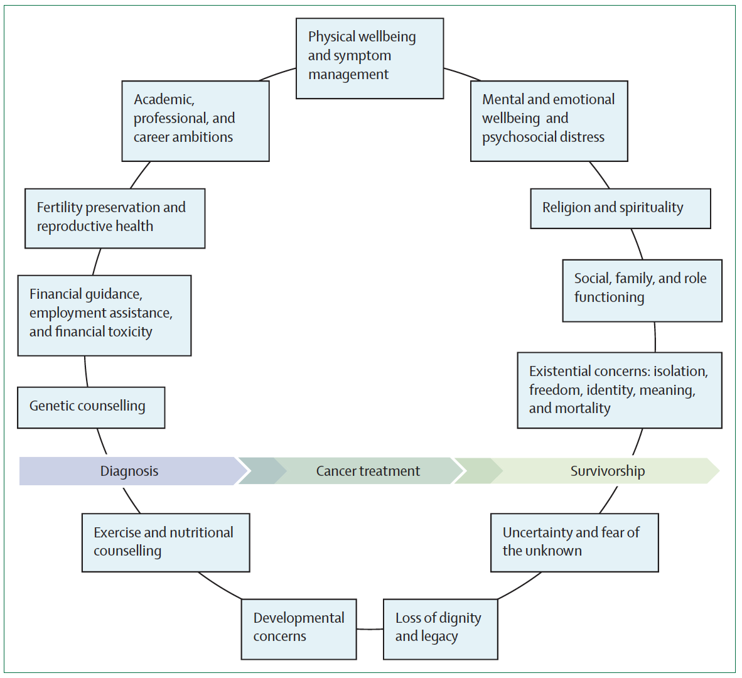
Proposed Conceptual Framework for Cancer Care for Early-Onset Colorectal Cancer
Eng C et al. Lancet Oncol 2022;23(3):e116-28.

Slide 11
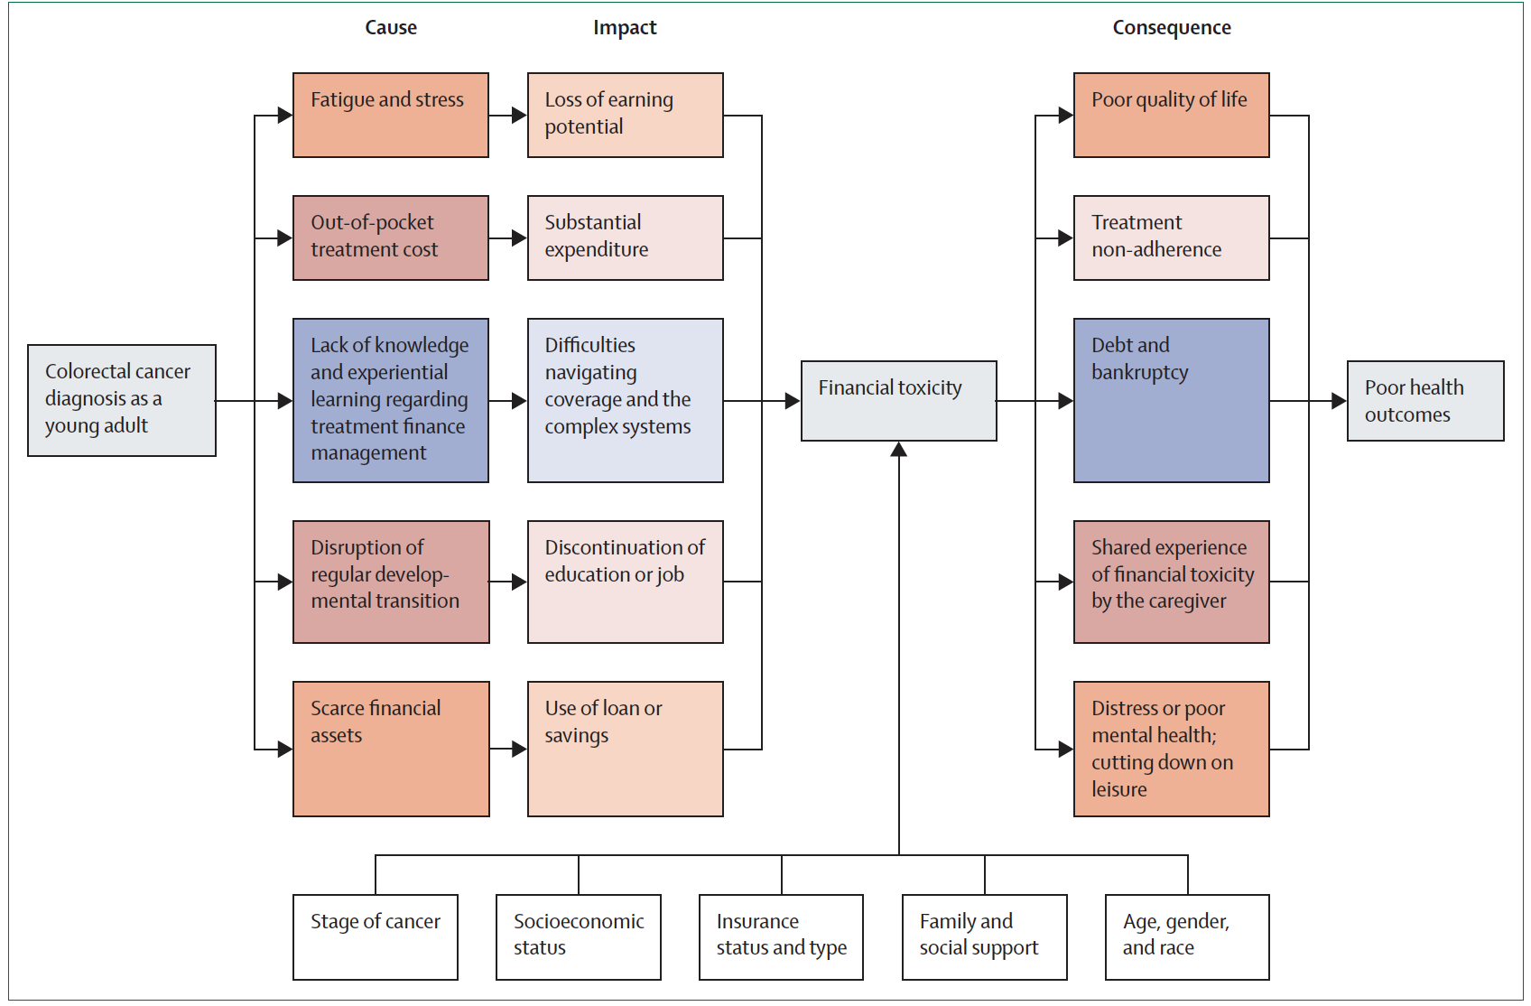
Economic Consequences of Cancer Treatment for Adults with Colorectal Cancer
Eng C et al. Lancet Oncol 2022;23(3):e116-28.

Slide 12
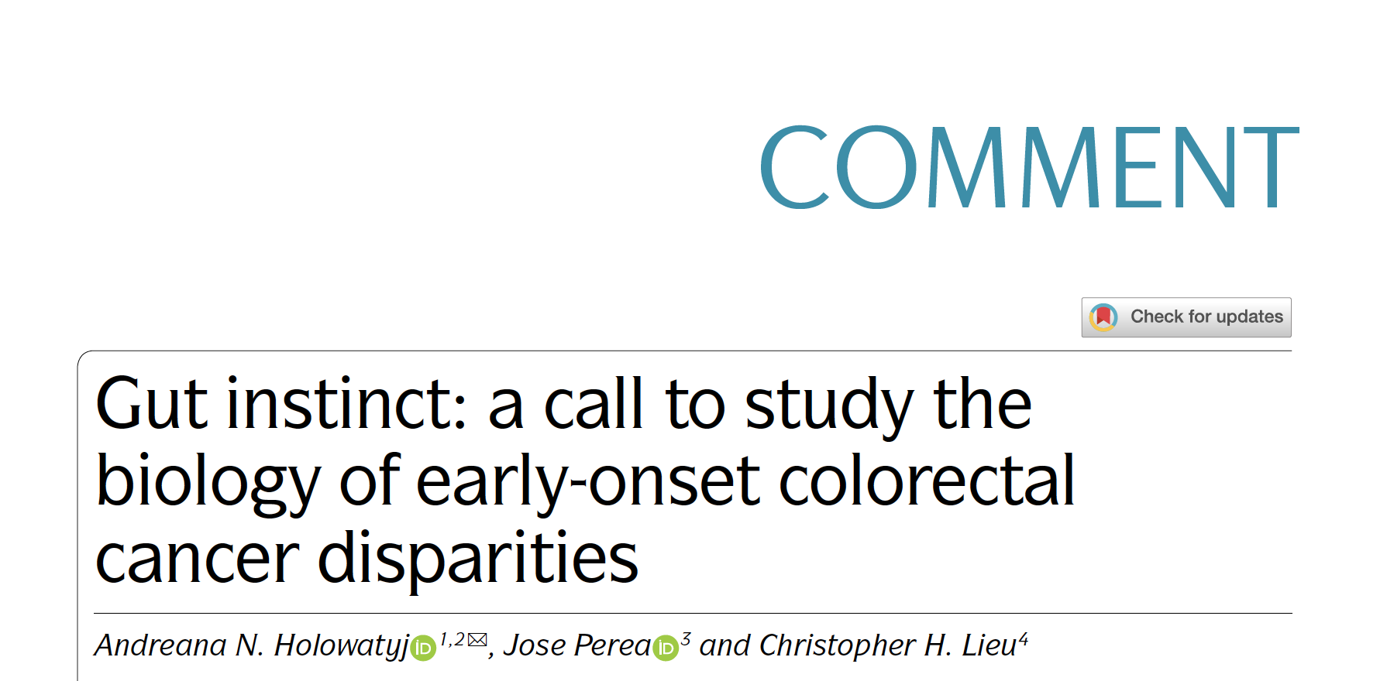
Nat Rev Cancer 2021 Jun;21(6):339-40.

Slide 13
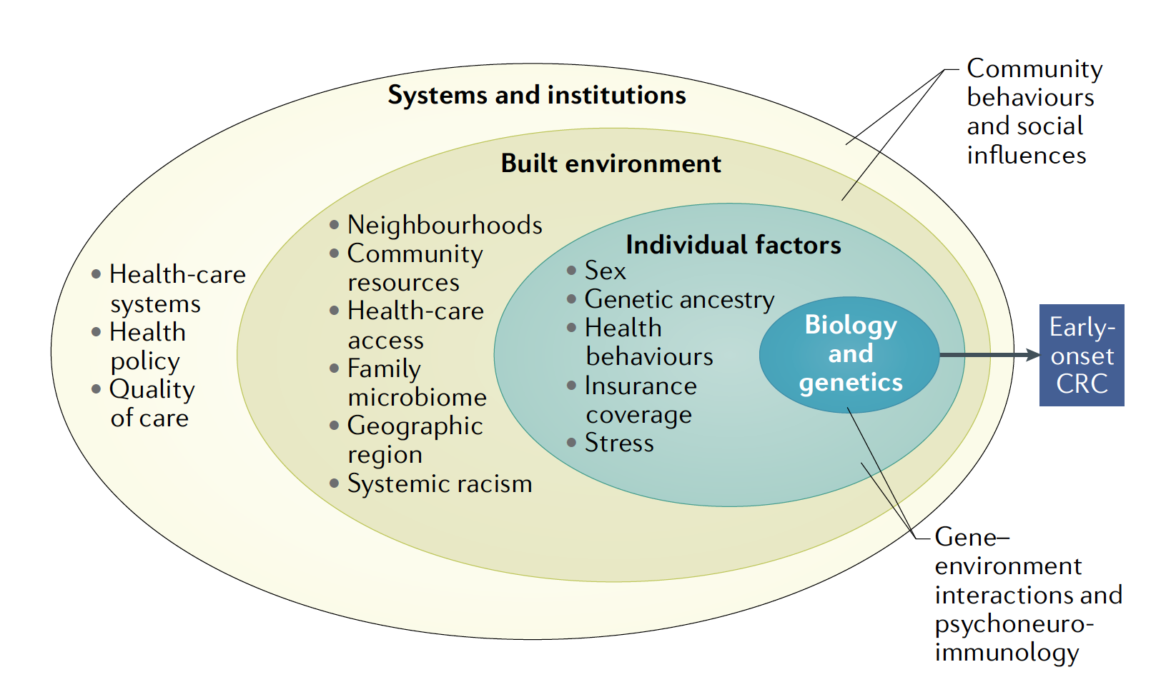
Multilevel Factors and Domains Contributing to Early-Onset CRC Disparities
Holowatyj AN et al. Nat Rev Cancer 2021;21(6):339-40.

Slide 14
Meet The Professor with Dr Lieu
Introduction: Early-Onset Colorectal Cancer
MODULE 1: Localized Disease
Dr Mitchell: 36-year-old woman with left-sided T3N0 Grade II obstructing adenocarcinoma of the colon
Dr Rudolph: 50-year-old woman with Stage II pMMR sigmoid colon cancer with focal intramural lymphovascular invasion, s/p 6 cycles of adjuvant capecitabine
MODULE 2: Metastatic Disease
MODULE 3: HER2-Positive Disease
MODULE 4: MSI-H Disease; BRAF-Mutant Disease
MODULE 5: Journal Club with Dr Lieu
MODULE 6: Appendix

Slide 15
Case Presentation: 36-year-old woman with left-sided T3N0 Grade II obstructing adenocarcinoma of the colon
Dr William Mitchell (Charlotte, North Carolina)

Slide 16
Case Presentation: 50-year-old woman with Stage II pMMR sigmoid colon cancer with focal intramural lymphovascular invasion, s/p 6 cycles of adjuvant capecitabine
Dr Priya Rudolph (Athens, Georgia)

Slide 17
In general, in which settings, if any, do you order a circulating tumor DNA (ctDNA) assay for your patients with colorectal cancer (CRC) outside of a clinical trial?
Stage II after surgery, Stage III after adjuvant tx, any stage after definitive management
Stage II after surgery
Stage II after surgery, Stage III after adjuvant tx, metastatic during tx
Stage II after surgery
Across any stage, but only in specific circumstances

Slide 18
A patient presents with Stage II CRC with no high-risk features and undergoes R0 resection. What would be your approach to adjuvant therapy?
Order ctDNA assay, then decide
Order ctDNA assay, then decide
Order ctDNA assay, then decide
Order ctDNA assay, then decide
Observation

Slide 19
If a ctDNA assay was ordered for a patient with Stage II CRC with no high-risk features who underwent an R0 resection, what would be your approach to treatment if the results were…?
Negative
Positive
Observation
FOLFOX/CAPOX
Observation
FOLFOX/CAPOX
Observation
FOLFOX/CAPOX
Observation
FOLFOX/CAPOX
Observation
FOLFOX/CAPOX

Slide 20
For a patient with CRC and a solitary hepatic metastasis who receives neoadjuvant FOLFOX and undergoes hepatic resection, would you assess ctDNA as part of the postoperative workup?
Yes
No
Yes
Yes, if patient agreeable to additional “adjuvant” tx
No

Slide 21
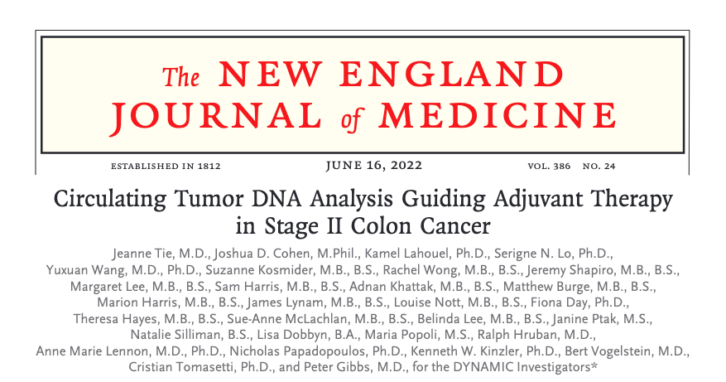

Slide 22
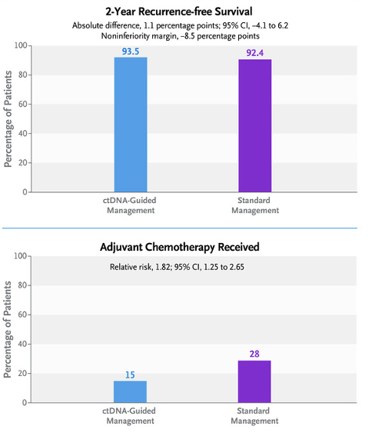
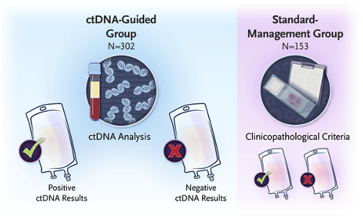
DYNAMIC: Results Summary
Tie J et al. N Engl J Med 2022;386(24):2261-72.

Slide 23
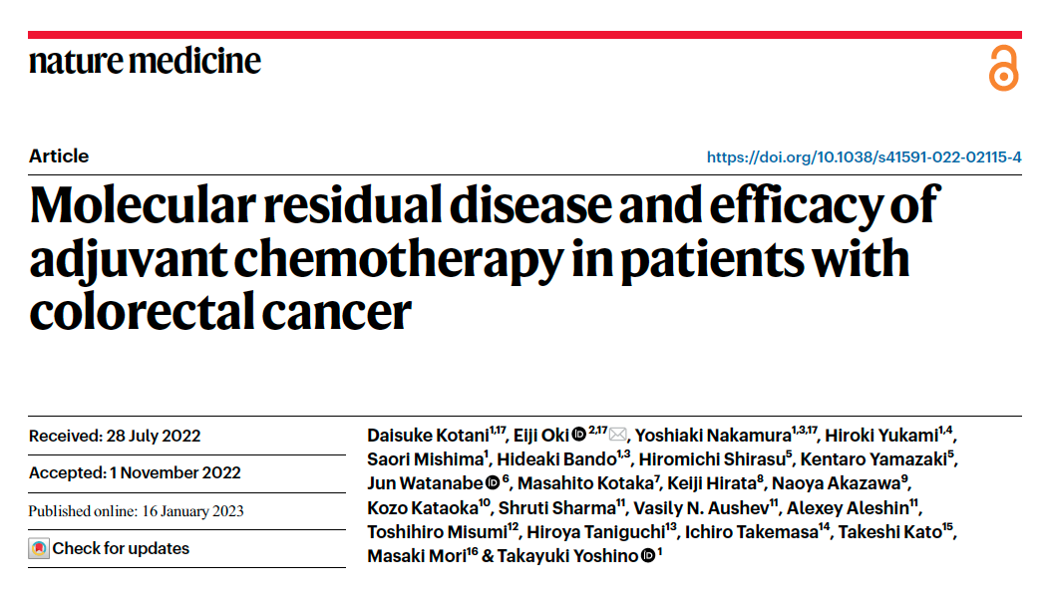
2023 Jan 16;[Online ahead of print].

Slide 24
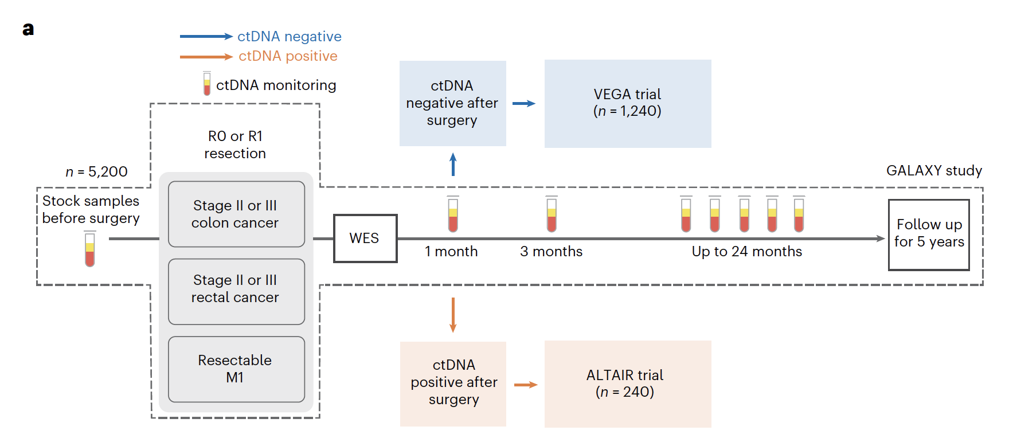
Overview of the CIRCULATE-JAPAN Study
Kotani D et al. Nat Med 2023 Jan 16;[Online ahead of print].

Slide 25
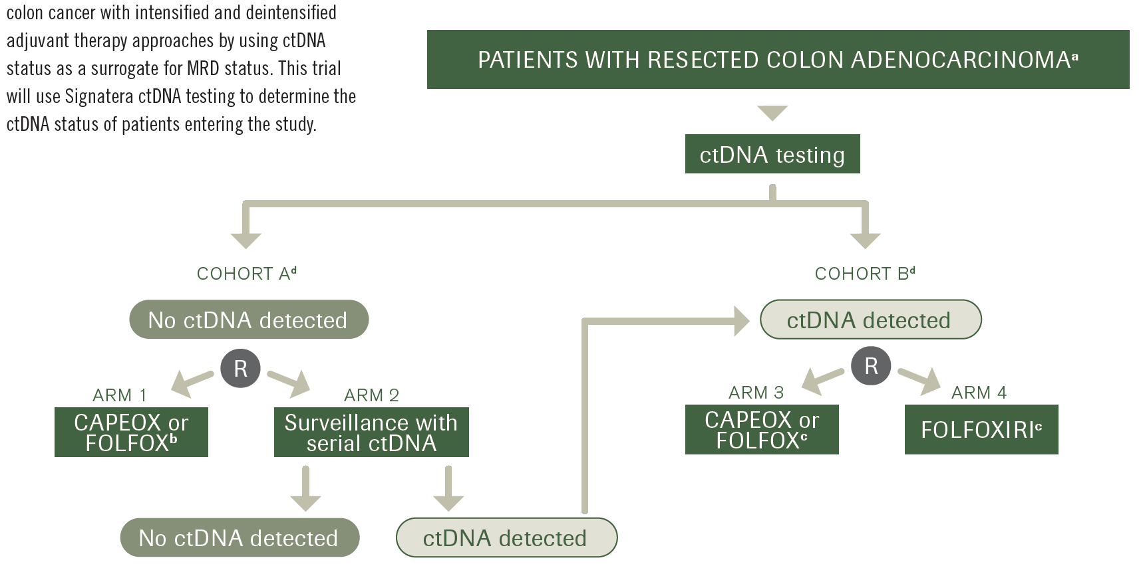
CIRCULATE-US
Sahin IH et al. Oncology 2022;36(10):604-9.

Slide 26
Meet The Professor with Dr Lieu
Introduction: Early-Onset Colorectal Cancer
MODULE 1: Localized Disease
MODULE 2: Metastatic Disease
Dr Lee: 84-year-old woman with pan-RAS WT metastatic rectal cancer with poor tolerance to chemotherapy, now receiving regorafenib with slowly progressive disease
Dr Vishwanathan: 62-year-old man with recurrent MSS, HER2-negative, RAS WT rectal cancer, currently receiving TAS-102/bevacizumab
MODULE 3: HER2-Positive Disease
MODULE 4: MSI-H Disease; BRAF-Mutant Disease
MODULE 5: Journal Club with Dr Lieu
MODULE 6: Appendix

Slide 27
Case Presentation: 84-year-old woman with pan-RAS WT metastatic rectal cancer with poor tolerance to chemotherapy, now receiving regorafenib with slowly progressive disease
Dr Eric Lee (Fountain Valley, California)

Slide 28
Case Presentation: 62-year-old man with recurrent MSS, HER2-negative, RAS WT rectal cancer, currently receiving TAS-102/bevacizumab
Dr Swati Vishwanathan (Bridgeport, West Virginia)

Slide 29
What is your usual first-line treatment recommendation for a clinically stable 60-year-old patient with microsatellite stable (MSS), pan-RAS wild-type, BRAF wild-type metastatic CRC (mCRC) if the tumor is…?
Right sided
Left sided
FOLFOXIRI + bev
FOLFOX/CAPOX + cetuximab
FOLFOX/CAPOX + bev
FOLFOX/CAPOX + cetuximab
FOLFOX/CAPOX + bev
FOLFOX/CAPOX + bev
FOLFOX/CAPOX + bev
FOLFOX/CAPOX + panitumumab
FOLFOX/CAPOX + bev
FOLFOX/CAPOX + panitumumab
FOLFOXIRI = FOLFOX/irinotecan; bev = bevacizumab

Slide 30
What is your preferred sequence for administering regorafenib and TAS-102 with or without bevacizumab for your patients with multiregimen-relapsed mCRC?
TAS-102 +/- bev → regorafenib
TAS-102 +/- bev → regorafenib
TAS-102 +/- bev → regorafenib
TAS-102 + bev → regorafenib
TAS-102 +/- bev → regorafenib

Slide 31
In general, when you administer TAS-102 for mCRC, do you add bevacizumab?
Yes
Yes
Yes
Yes
Yes

Slide 32
For a patient with mCRC who has received EGFR antibody-containing therapy and experienced disease progression, are there any circumstances in which you will rechallenge with the same or a different EGFR antibody later in the treatment course?
Yes, if new chemo partner
Yes, if no other tx options and ctDNA is negative for resistance mutations
Yes, after tx holiday if liquid biopsy does not show alterations
Yes, if ctDNA is negative for resistance mutations
Yes, if prior response or durable SD and ≥4 mos since last given

Slide 33
Abstract LBA1

Slide 34
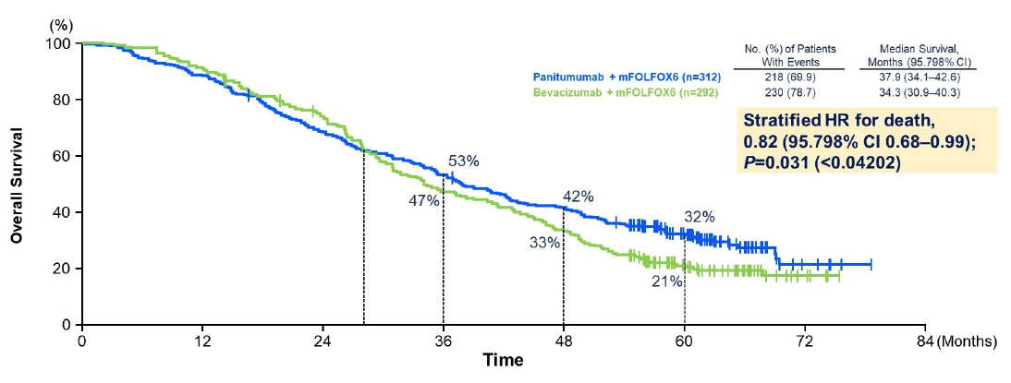
PARADIGM: Overall Survival in Left-Sided Population (Primary Endpoint 1)
Yoshino T et al. ASCO 2022;Abstract LBA1.

Slide 35
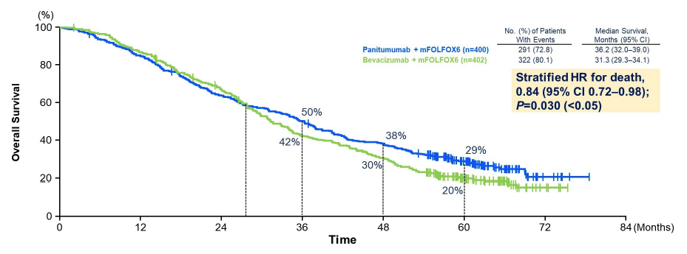
PARADIGM: Overall Survival in Overall Population (Primary Endpoint 2)
Yoshino T et al. ASCO 2022;Abstract LBA1.

Slide 36
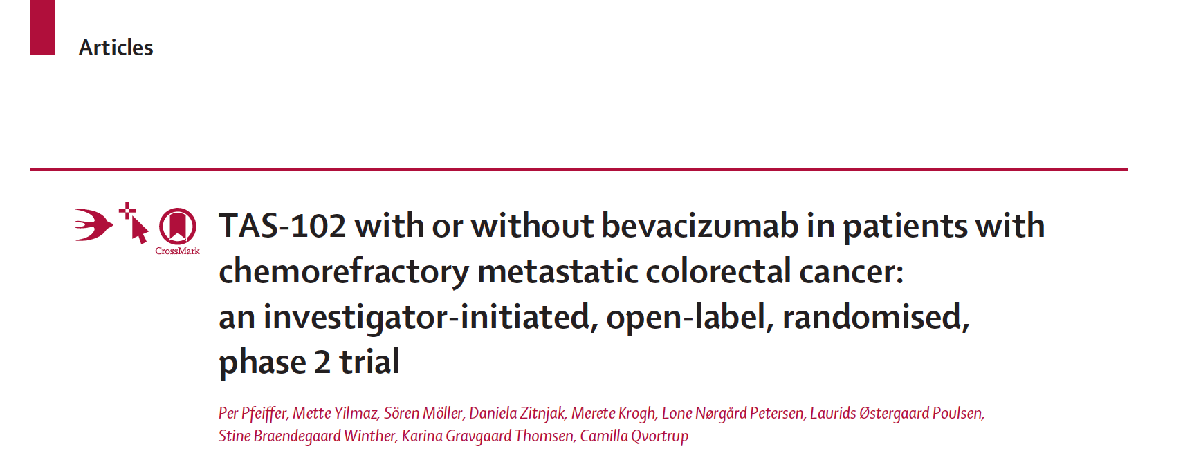
Lancet Oncol 2020;21(3):412-20.

Slide 37
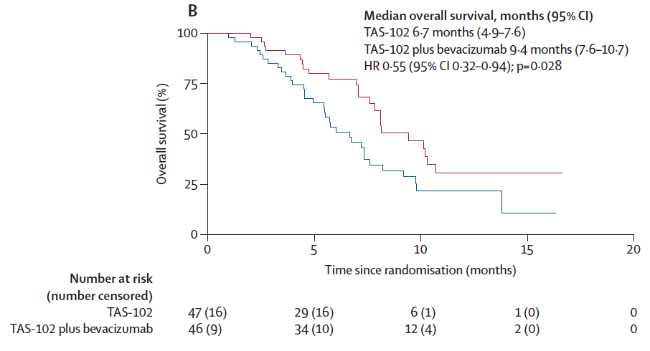
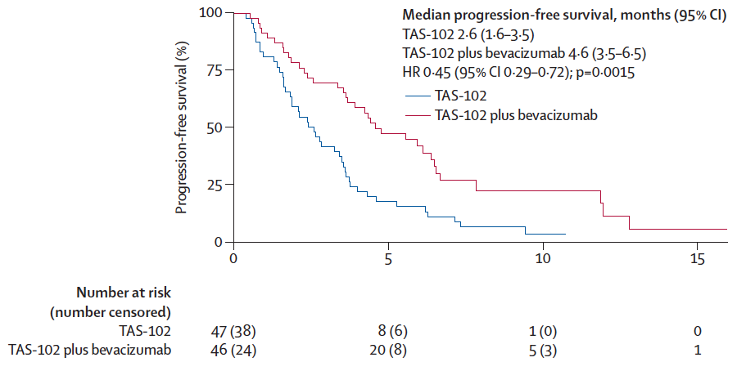
TAS-102 with or without Bevacizumab for Refractory mCRC
Pfeiffer P et al. Lancet Oncol 2020;21(3):412-20.

Slide 38
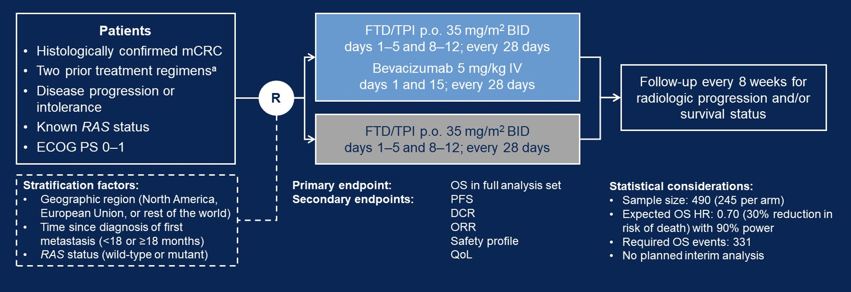
SUNLIGHT Phase III Study Design
FTD/TPI = trifluridine/tipiracil
Tabernero J et al. Gastrointestinal Cancers Symposium 2023;Abstract 4.

Slide 39
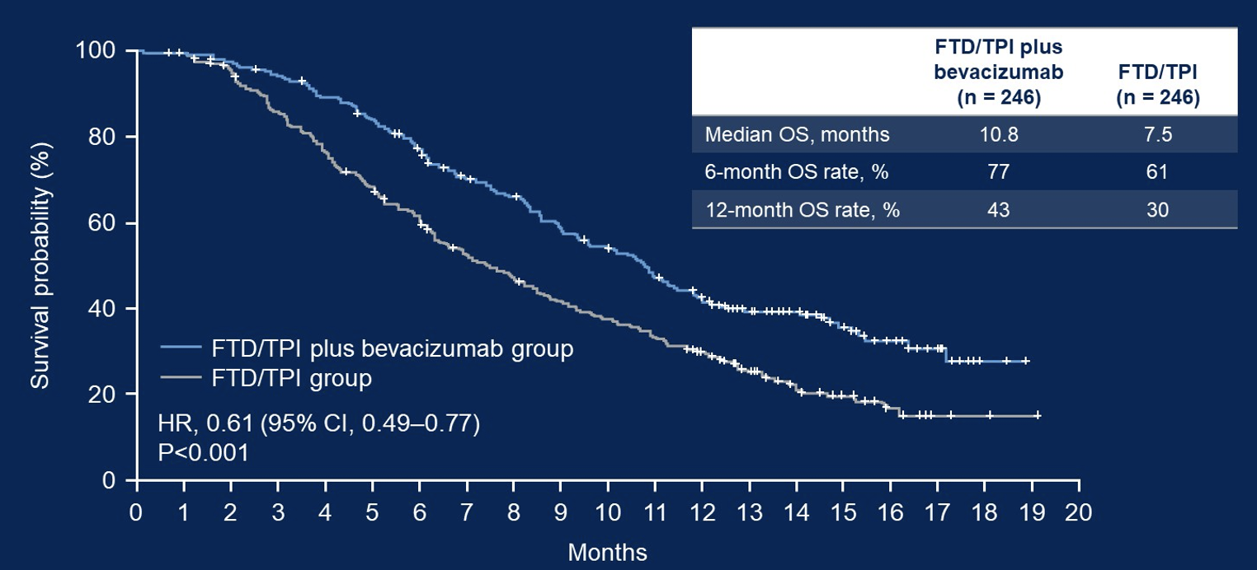
SUNLIGHT: Overall Survival in Full Analysis Set (Primary Endpoint)
Tabernero J et al. Gastrointestinal Cancers Symposium 2023;Abstract 4.

Slide 40
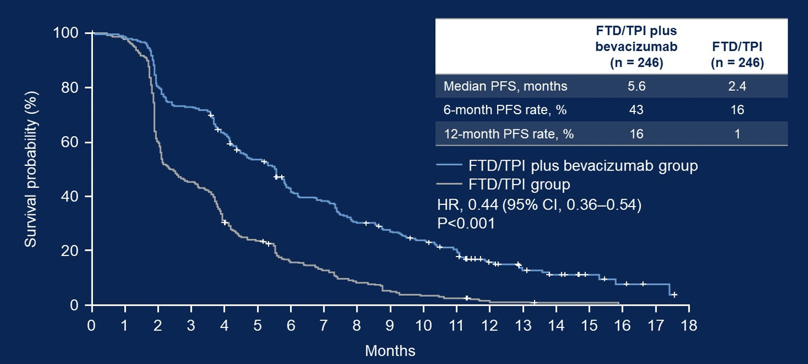
SUNLIGHT: Progression-Free Survival in Full Analysis Set
Tabernero J et al. Gastrointestinal Cancers Symposium 2023;Abstract 4.

Slide 41
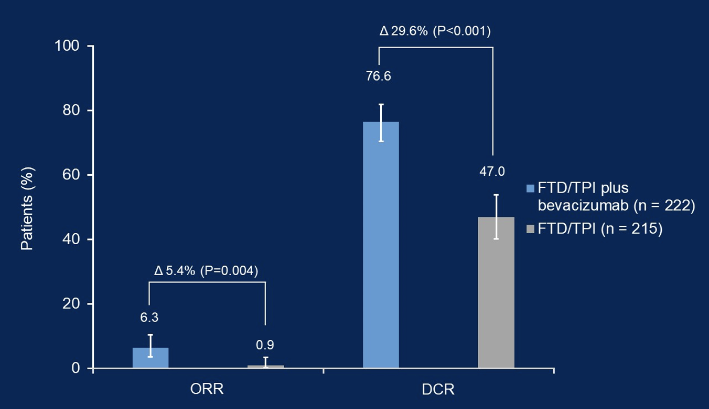
SUNLIGHT: ORR and DCR for Patients Evaluable for Tumor Response
ORR = overall response rate; DCR = disease control rate
Tabernero J et al. Gastrointestinal Cancers Symposium 2023;Abstract 4.

Slide 42
Fruquintinib Global Phase III FRESCO-2 Study Has Met Its Primary Endpoint in Metastatic Colorectal Cancer Press Release: August 8, 2022
“[Manufacturer] today announces that the pivotal global Phase 3 FRESCO-2 trial evaluating the investigational use of fruquintinib met its primary endpoint of overall survival (“OS”) in patients with advanced, refractory metastatic colorectal cancer (“CRC”).
The FRESCO-2 study was a multi-regional clinical trial conducted in the U.S., Europe, Japan and Australia that investigated fruquintinib plus best supportive care (“BSC”) vs placebo plus BSC in patients with metastatic CRC who had progressed on standard chemotherapy and relevant biologic agents and who had progressed on, or were intolerant to, TAS-102 and/or regorafenib. In addition to OS, a statistically-significant improvement in progression-free survival (“PFS”), a key secondary endpoint, was observed. The safety profile of fruquintinib in FRESCO-2 was consistent with previously reported studies.”
https://www.hutch-med.com/fresco-2-met-primary-endpoint/

Slide 43
Meet The Professor with Dr Lieu
Introduction: Early-Onset Colorectal Cancer
MODULE 1: Localized Disease
MODULE 2: Metastatic Disease
MODULE 3: HER2-Positive Disease
Dr Chen: 54-year-old woman with RAS WT, HER2-amplified metastatic colon adenocarcinoma
Dr Gandhi: 66-year-old woman with multiregimen-relapsed RAS WT, HER2-positive metastatic rectal cancer, now receiving trastuzumab/tucatinib
MODULE 4: MSI-H Disease; BRAF-Mutant Disease
MODULE 5: Journal Club with Dr Lieu
MODULE 6: Appendix

Slide 44
Case Presentation: 54-year-old woman with RAS WT, HER2-amplified metastatic colon adenocarcinoma
Dr Gigi Chen (Pleasant Hill, California)

Slide 45
Case Presentation: 66-year-old woman with mutiregimen-relapsed RAS WT, HER2-positive metastatic rectal cancer, now receiving trastuzumab/tucatinib
Dr Sunil Gandhi (Lecanto, Florida)

Slide 46
Regulatory and reimbursement issues aside, for a patient with HER2-overexpressing or amplified mCRC, in which line of therapy would you generally administer anti-HER2 therapy?
Second line
Second line
Third line or beyond
Second line
Second line

Slide 47
Regulatory and reimbursement issues aside, what would be your most likely anti-HER2 treatment for a patient with HER2-positive mCRC in the scenarios below?
Initial targeted therapy
Second line targeted therapy
Tucatinib + trastuzumab
Trastuzumab deruxtecan
Tucatinib + trastuzumab
Trastuzumab deruxtecan
Trastuzumab/pertuzumab
Tucatinib + trastuzumab
Tucatinib + trastuzumab
Trastuzumab deruxtecan
Tucatinib + trastuzumab
Trastuzumab deruxtecan

Slide 48
Regulatory and reimbursement issues aside, what would be your most likely anti-HER2 treatment for a patient with HER2-positive mCRC and brain metastases?
Tucatinib + trastuzumab
Trastuzumab deruxtecan
Tucatinib + trastuzumab
Tucatinib + trastuzumab
Tucatinib + trastuzumab

Slide 49
Regulatory and reimbursement issues aside, what would be your likely second-line treatment for a patient with pan-RAS wild-type, MSS, HER2-positive mCRC who receives FOLFOX/bevacizumab and experiences disease progression after receiving 9 months of maintenance bevacizumab?
Tucatinib + trastuzumab
Tucatinib + trastuzumab
FOLFIRI/CAPIRI + bev
Tucatinib + trastuzumab
Trastuzumab/ pertuzumab

Slide 50
Gastrointestinal Cancers Symposium 2022;Abstract 119.

Slide 51
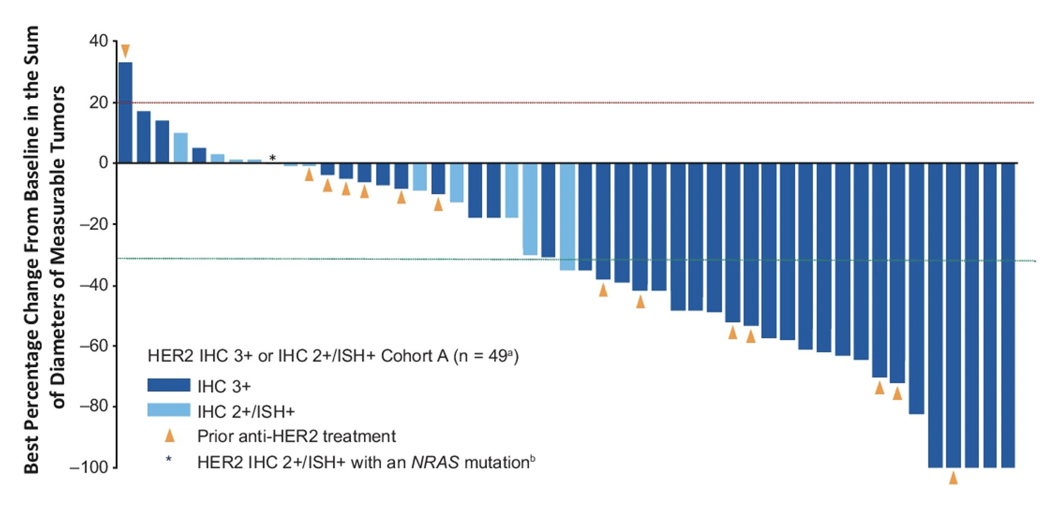
DESTINY-CRC01 Primary Endpoint: Objective Response Rate (ORR) in Cohort A (IHC 3+ or IHC 2+/ISH+, N = 53)
ORR: 45.3%
Median duration of response: 7 mo
Yoshino T et al. Gastrointestinal Cancers Symposium 2022;Abstract 119.

Slide 52
Abstract LBA2

Slide 53
MOUNTAINEER: Tucatinib with Trastuzumab Efficacy Outcomes
Strickler JH et al. ESMO GI 2022;Abstract LBA-2.

Slide 54
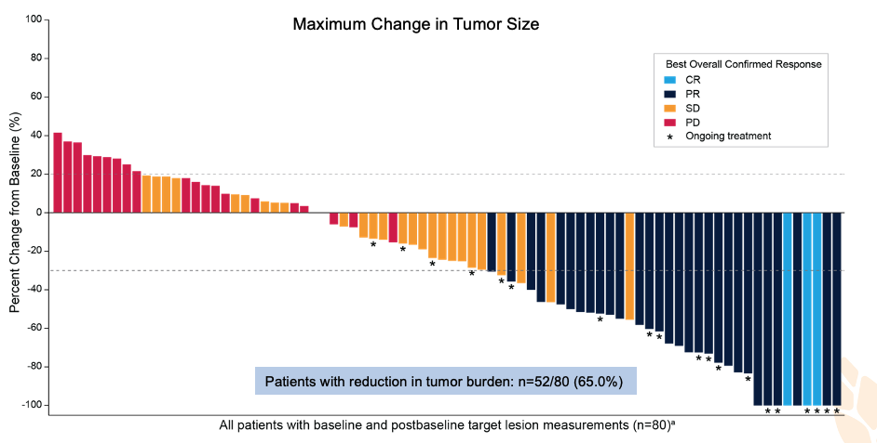
MOUNTAINEER: Tucatinib with Trastuzumab Change in Tumor Size
Strickler JH et al. ESMO GI 2022;Abstract LBA-2.

Slide 55
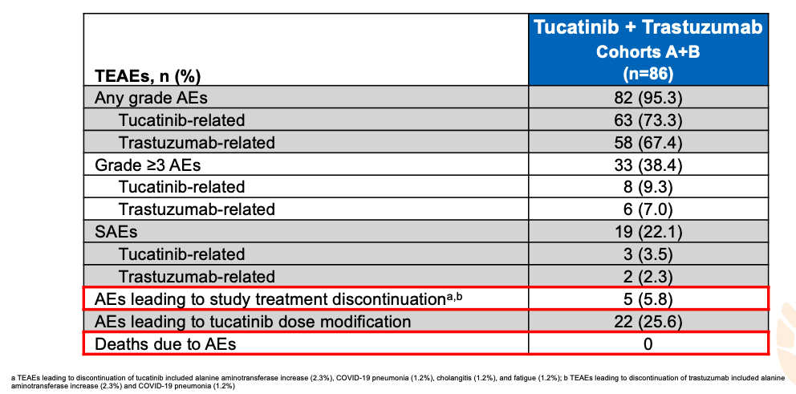
MOUNTAINEER: Tucatinib with Trastuzumab Safety Summary
Strickler JH et al. ESMO GI 2022;Abstract LBA-2.

Slide 56
Abstract LBA27

Slide 57
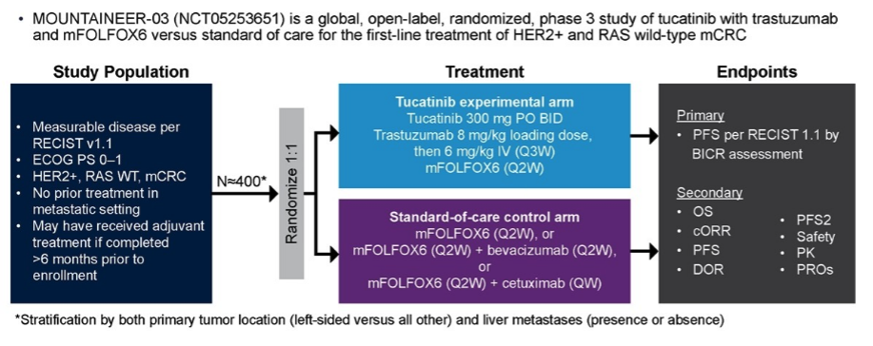
MOUNTAINEER-03 Ongoing Phase III Trial
Andre T et al. ESMO 2022;Abstract 438TiP.

Slide 58
Meet The Professor with Dr Lieu
Introduction: Early-Onset Colorectal Cancer
MODULE 1: Localized Disease
MODULE 2: Metastatic Disease
MODULE 3: HER2-Positive Disease
MODULE 4: MSI-H Disease; BRAF-Mutant Disease
Dr Giffi: 77-year-old woman with HER2-negative, BRAF V600E-mutant, MSS metastatic colon cancer, s/p mFOLFOX/bevacizumab → maintenance 5-FU/bevacizumab
Dr Azzi: 78-year-old man with metastatic rectal adenocarcinoma, s/p FOLFIRI/bevacizumab and FOLFOX/bevacizumab, with KRAS G12C mutation identified
MODULE 5: Journal Club with Dr Lieu
MODULE 6: Appendix

Slide 59
Case Presentation: 77-year-old woman with HER2-negative, BRAF V600E-mutant, MSS metastatic colon cancer, s/p mFOLFOX/bevacizumab → maintenance 5-FU/bevacizumab
Dr Victoria Giffi (Hagerstown, Maryland)

Slide 60
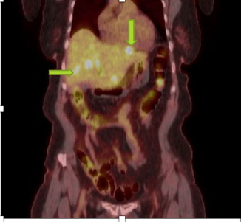
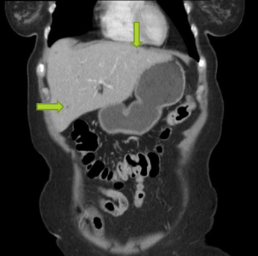
PET CT at diagnosis: Liver metastases
CT after 6 cycles of mFOLFOX/bevacizumab
showing improved metastases

Slide 61
Case Presentation: 78-year-old man with metastatic rectal adenocarcinoma, s/p FOLFIRI/bevacizumab and FOLFOX/bevacizumab, with KRAS G12C mutation identified
Dr Georges Azzi (Fort Lauderdale, Florida)

Slide 62
What is your usual first-line treatment for microsatellite instability (MSI)-high mCRC?
Pembrolizumab
Pembrolizumab
Pembrolizumab
Pembrolizumab
Nivolumab/ipilimumab if fit, otherwise pembrolizumab

Slide 63
What is your most likely first-line treatment for a younger patient with left-sided, MSS, pan-RAS wild-type, BRAF V600E-mutant mCRC?
FOLFOXIRI + bev
FOLFOXIRI + bev
FOLFOXIRI + bev
FOLFOXIRI + bev
FOLFOXIRI + bev

Slide 64
Regulatory and reimbursement issues aside, for a patient with pan-RAS wild-type mCRC with a BRAF V600E mutation, in which line of therapy would you generally administer BRAF-targeted therapy?
Second line
Second line
Second line
Second line
Second line

Slide 65
Regulatory and reimbursement issues aside, for a patient with mCRC with a BRAF V600E mutation to whom you would administer BRAF-targeted therapy, what would be your preferred treatment?
Encorafenib + cetuximab
Encorafenib + cetuximab
Encorafenib + cetuximab
Encorafenib + panitumumab
Encorafenib + panitumumab

Slide 66
In general, which KRAS G12C inhibitor would you most likely use if you were going to administer such an agent to a patient with mCRC?
Adagrasib
Adagrasib
Adagrasib
Sotorasib
Adagrasib

Slide 67
Regulatory and reimbursement issues aside, what would be your likely second-line treatment for a patient with MSS mCRC with a KRAS p.G12C mutation who receives FOLFOX/bevacizumab and experiences disease progression after receiving 9 months of maintenance bevacizumab?
Adagrasib + cetuximab
Adagrasib
FOLFIRI/CAPIRI + bev
FOLFIRI/CAPIRI + bev
FOLFIRI/CAPIRI + bev

Slide 68
COMMIT Phase III Study Schema
mFOLFOX6/bevacizumab
Estimated enrollment (N = 231) Estimated primary completion: Nov 2024
Metastatic CRC dMMR by IHC and/or MSI-high by PCR or NGS No prior systemic treatment for metastatic disease
R
Atezolizumab
Atezolizumab + mFOLFOX6/bevacizumab
Primary endpoint: Progression-free survival
Secondary endpoints: Overall survival, objective response rate, others
dMMR = mismatch repair deficient; IHC = immunohistochemistry; MSI = microsatellite instability; PCR = polymerase chain reaction; NGS = next-generation sequencing
www.clinicaltrials.gov. NCT02997228. Accessed February 2023.

Slide 69
LEAP-017 Phase III Study Design
N = 434
Primary Endpoint: Overall Survival
Secondary Endpoints: PFS, OR, DOR, Safety, others
Yoshino T et al. ESMO 2021;Abstract 506TiP.

Slide 70
CodeBreaK 300 Phase III Study Design
Primary Endpoint: PFS by BICR
Secondary Endpoints: OS, ORR, DOR, TTR
Lopez-Bravo DP et al. ESMO 2022;Abstract 437TiP.

Slide 71
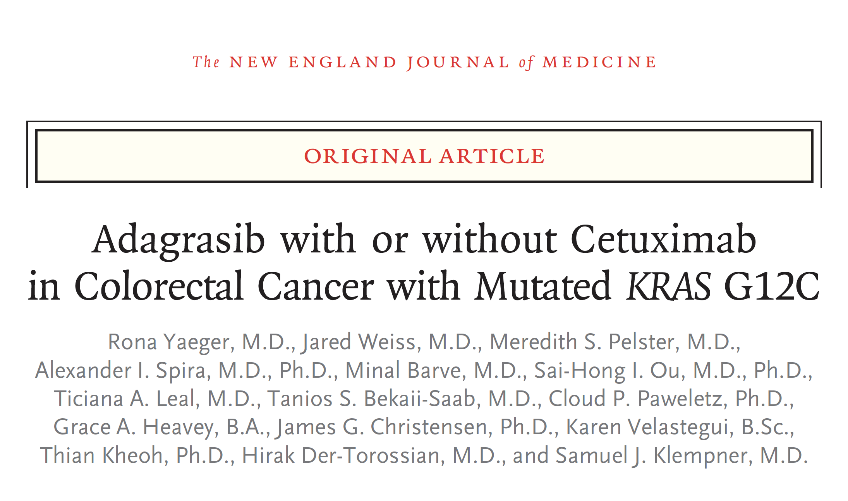
N Engl J Med 2022 Dec 21;[Online ahead of print].

Slide 72
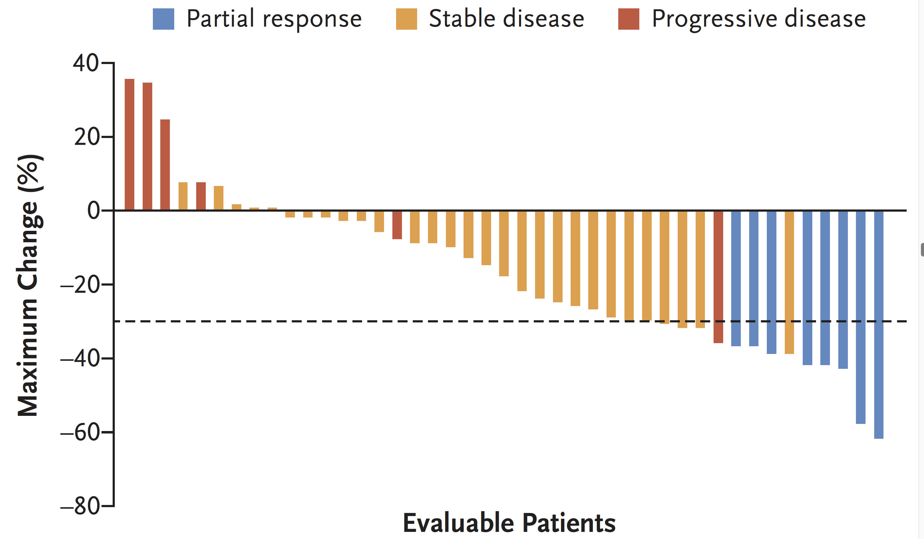
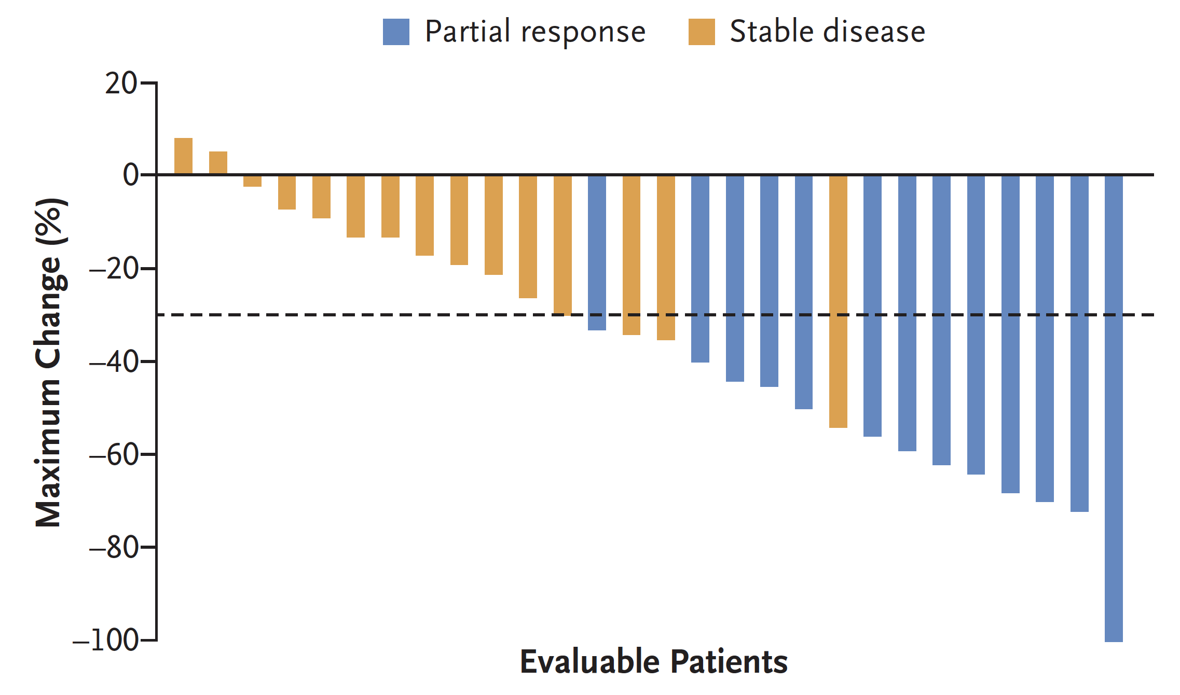
KRYSTAL-1: Response
Adagrasib
Adagrasib/cetuximab
ORR: 19%
ORR: 46%
Yaeger R et al. N Engl J Med 2022 Dec 21;[Online ahead of print].

Slide 73
KRYSTAL-10 Phase III Study Design
Adagrasib + cetuximab
Estimated enrollment (N = 420) Estimated primary completion: Sept 2023
Previously untreated advanced CRC Prior receipt of first-line treatment with fluoropyrimidine-based chemotherapy regimen containing oxaliplatin or irinotecan KRAS G12C mutation
R
1:1
FOLFIRI or mFOLFOX6
Primary endpoints: Progression-free survival, overall survival
Secondary endpoints: Safety, ORR, DoR, 1-year survival, others
www.clinicaltrials.gov. NCT04793958. Accessed January 2023. Tabernero J et al. ESMO World Congress on GI Cancers 2021;Poster 200.

Slide 74
Meet The Professor with Dr Lieu
Introduction: Early-Onset Colorectal Cancer
MODULE 1: Localized Disease
MODULE 2: Metastatic Disease
MODULE 3: HER2-Positive Disease
MODULE 4: MSI-H Disease; BRAF-Mutant Disease
MODULE 5: Journal Club with Dr Lieu
MODULE 6: Appendix

Slide 75
Clin Adv Hematol Oncol 2022 Dec;20(12):703-4.

Slide 76
Meet The Professor with Dr Lieu
Introduction: Early-Onset Colorectal Cancer
MODULE 1: Localized Disease
MODULE 2: Metastatic Disease
MODULE 3: HER2-Positive Disease
MODULE 4: MSI-H Disease; BRAF-Mutant Disease
MODULE 5: Journal Club with Dr Lieu
MODULE 6: Appendix

Slide 77
2023 Jan 16;[Online ahead of print].

Slide 78
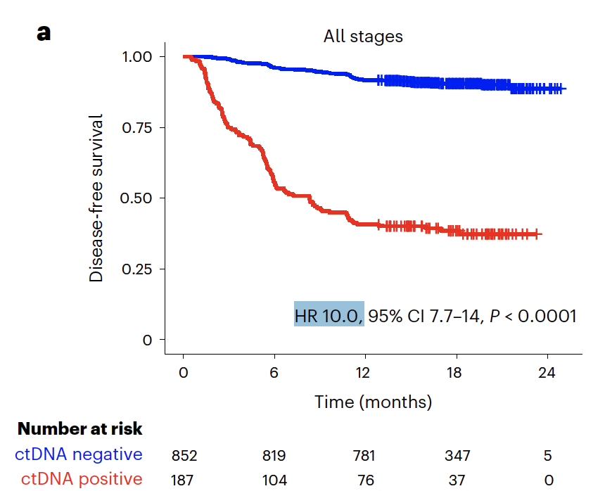
GALAXY: ctDNA-Based Minimal Residual Disease Is Predictive of Survival Outcomes Among Postsurgical Patients with CRC
Kotani D et al. Nat Med 2023 Jan 16;[Online ahead of print].

Slide 79
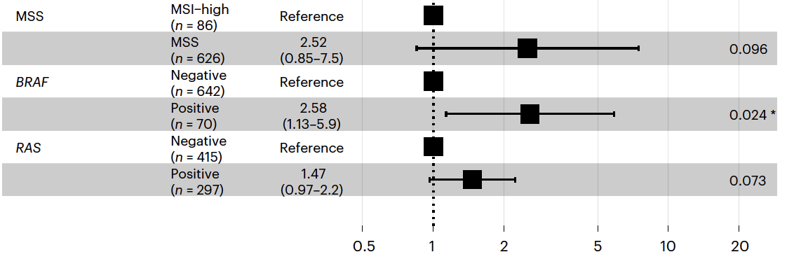
GALAXY: Forest Plot Depicting Multivariate Analysis for Recurrence in Patients with Pathological Stage II to III CRC
Hazard Ratios
Kotani D et al. Nat Med 2023 Jan 16;[Online ahead of print].

Slide 80
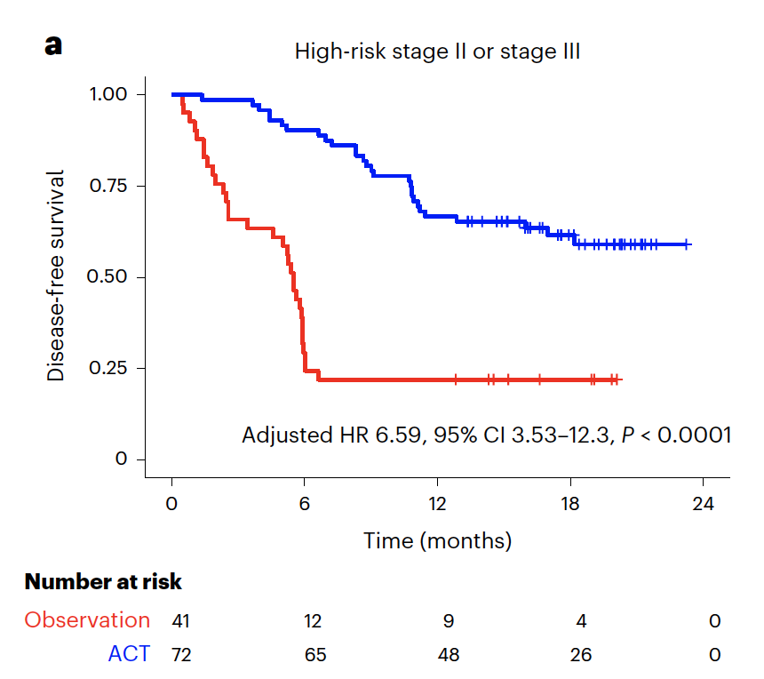
GALAXY: Disease-Free Survival — ctDNA-Positive 4 Weeks After Surgery
Kotani D et al. Nat Med 2023 Jan 16;[Online ahead of print].

Slide 81
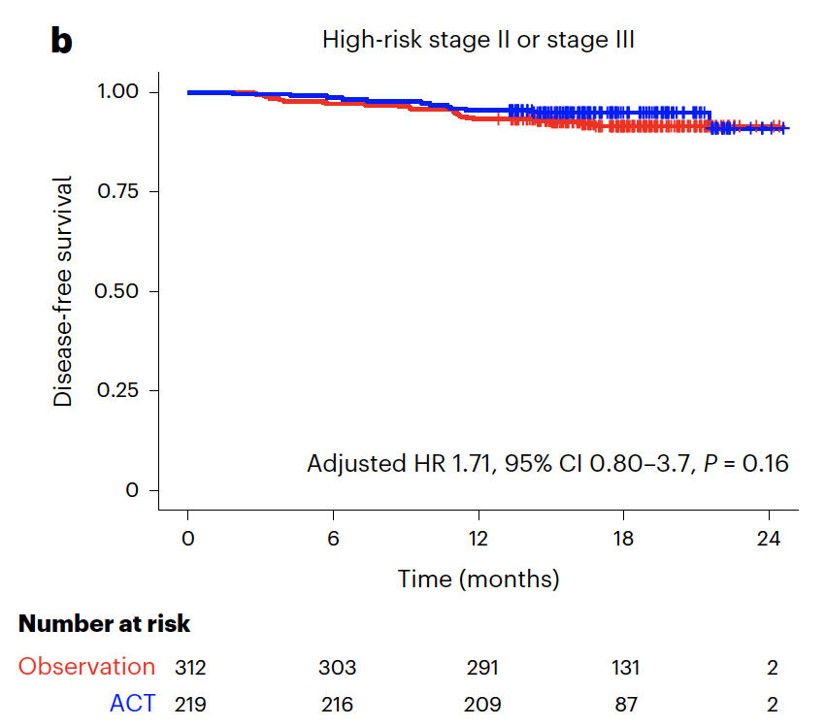
GALAXY: Disease-Free Survival — ctDNA-Negative 4 Weeks After Surgery
Kotani D et al. Nat Med 2023 Jan 16;[Online ahead of print].

Slide 82
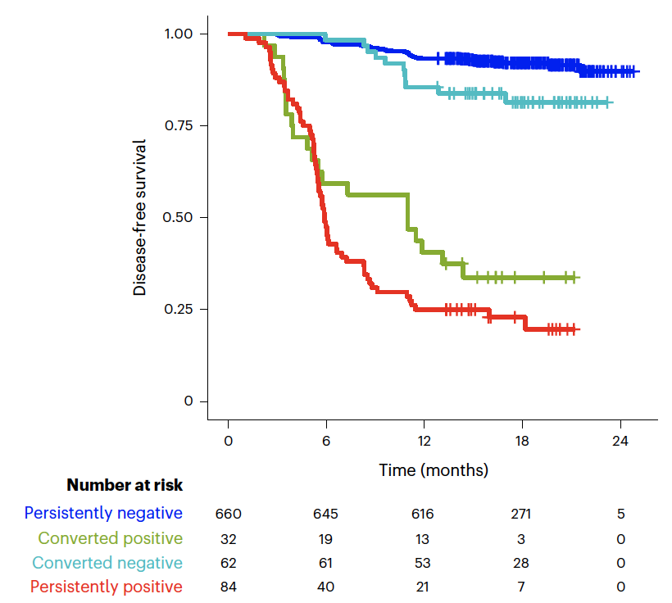
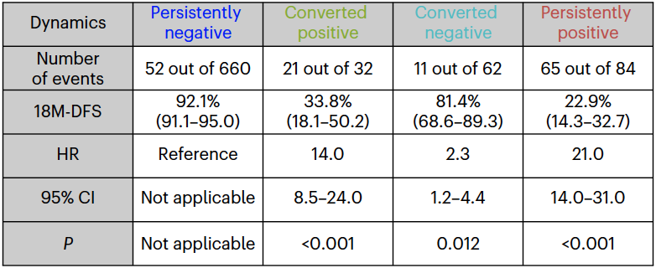
GALAXY: ctDNA-Based Treatment Response Monitoring for Postsurgical Patients with CRC
Kotani D et al. Nat Med 2023 Jan 16;[Online ahead of print].

Slide 83
BESPOKE CRC Prospective, Case-Controlled Observational Study
Estimated enrollment (N = 2,000)
Stage I-IV CRC or Stage IV CRC with oligometastatic disease eligible for post-operative systemic therapy
www.clinicaltrials.gov. NCT04264702. Accessed February 2023.
Kasi PM et al. BMJ Open 2021;11:e047831.

Slide 84
Abstract LBA1

Slide 85
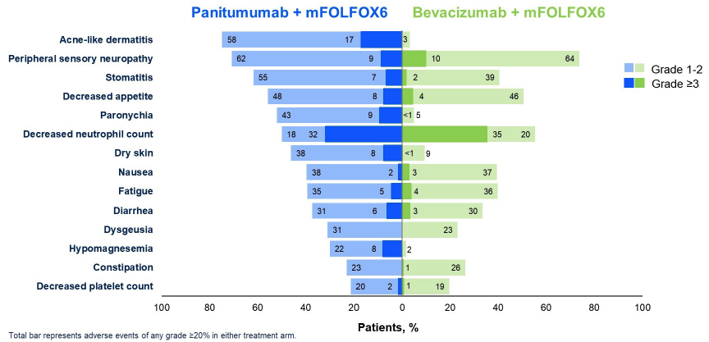
PARADIGM: Adverse Events Reported in ≥20% of Patients
Yoshino T et al. ASCO 2022;Abstract LBA1.

Slide 86
Key Studies of Anti-EGFR Rechallenge for Metastatic CRC
Study | Patients enrolled | Anti-EGFR mAb-free interval | Outcomes
PURSUIT | 50 RAS, BRAF WT | ≥4 mo interval | ORR: 14% mPFS: 3.6 mo
CRICKET | 13 RAS WT ctDNA 12 RAS mut ctDNA | ctDNA RAS/BRAF status before rechallenge ≥4 mo interval | RAS ctDNA WT vs ctDNA mut ORR: 31% vs 0% mPFS: 4 vs 1.9 mo mOS: 12.5 vs 5.2 mo
CAVE | 48 ctDNA WT: RAS, BRAF, EGFR S492R 19 ctDNA mut | >4 mo interval | ctDNA WT: mPFS: 4.1 mo mOS: 17.3 mo ctDNA mut: mPFS: 3 mo mOS: 10.4 mo
CHRONOS | 27 ctDNA WT: RAS, BRAF, EGFR-ECD | Median 11.5 mo interval | ORR: 30% mPFS: 16 wk mOS: 55 wk
mAb = monoclonal antibody; WT = wild type; mut = mutant
Doleschal B et al. Front Oncol 2022;[Online ahead of print].

Slide 87
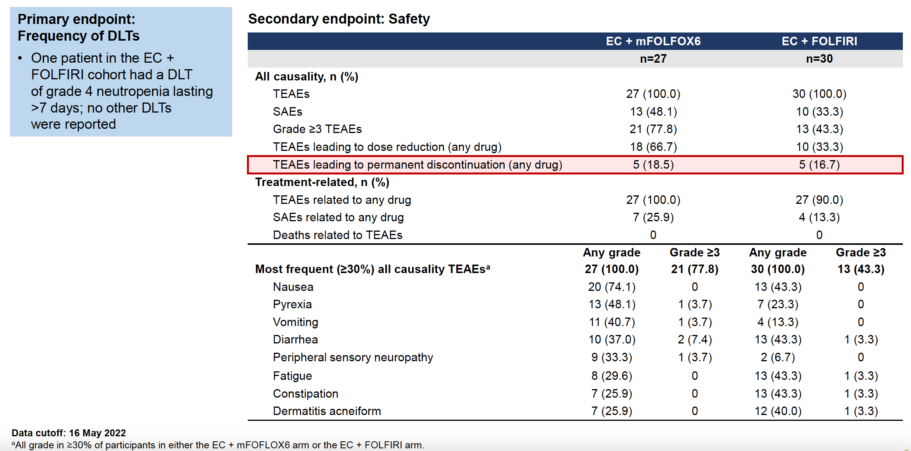
BREAKWATER Safety Lead-In: Frequency of Dose-Limiting Toxicities (DLTs) and Safety Summary
EC = encorafenib and cetuximab; TEAEs = treatment-emergent adverse events; SAEs = serious adverse events
Tabernero J et al. ESMO 2022;Abstract BBA26.

Slide 88
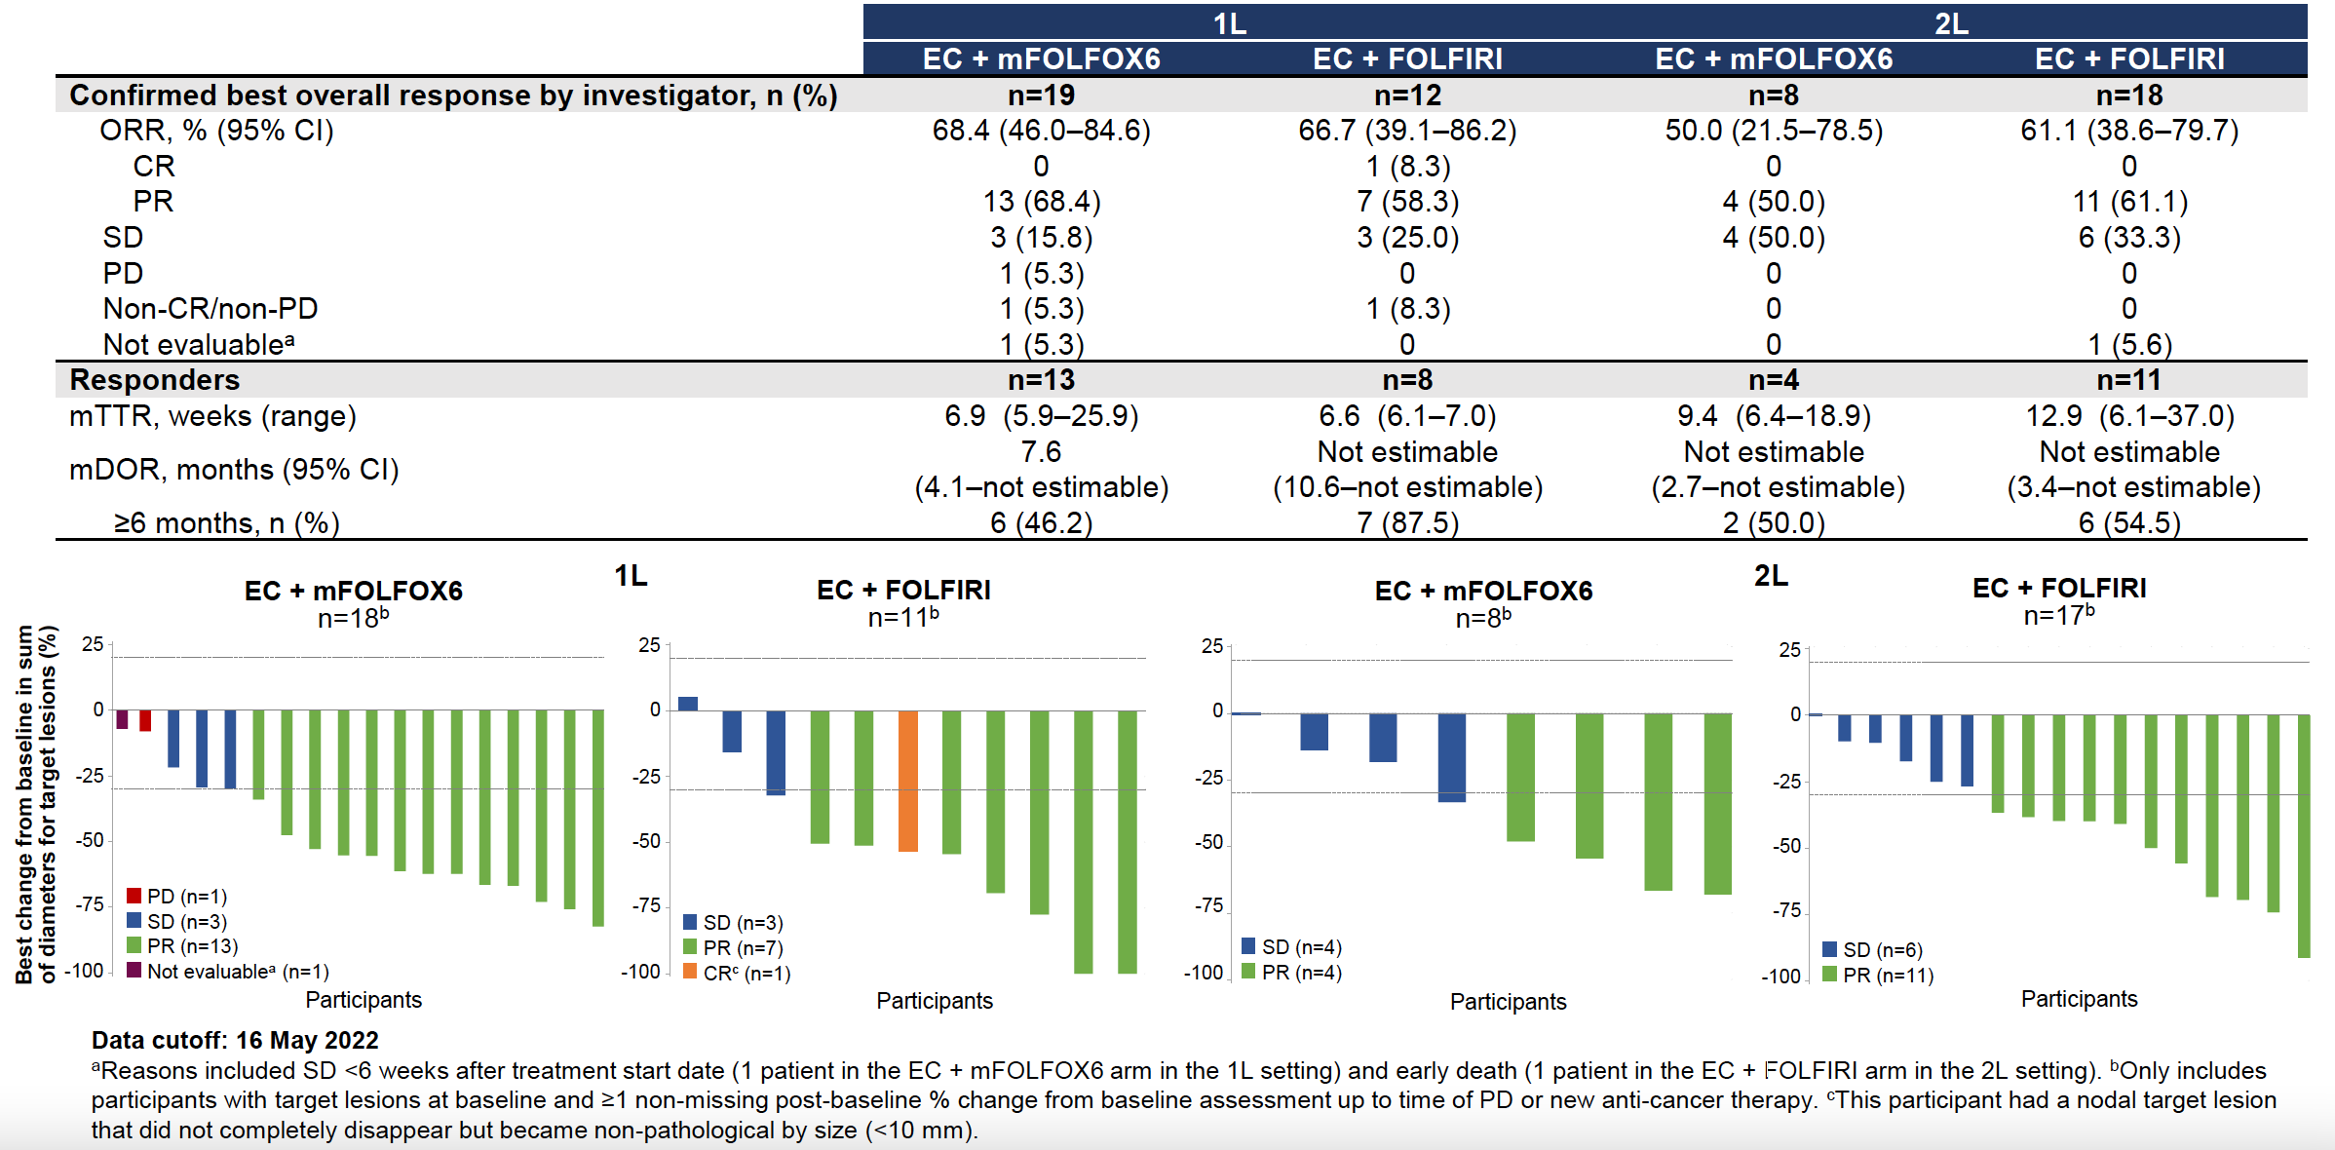
BREAKWATER Safety Lead-In: Overview of Response
Tabernero J et al. ESMO 2022;Abstract BBA26.

Slide 89
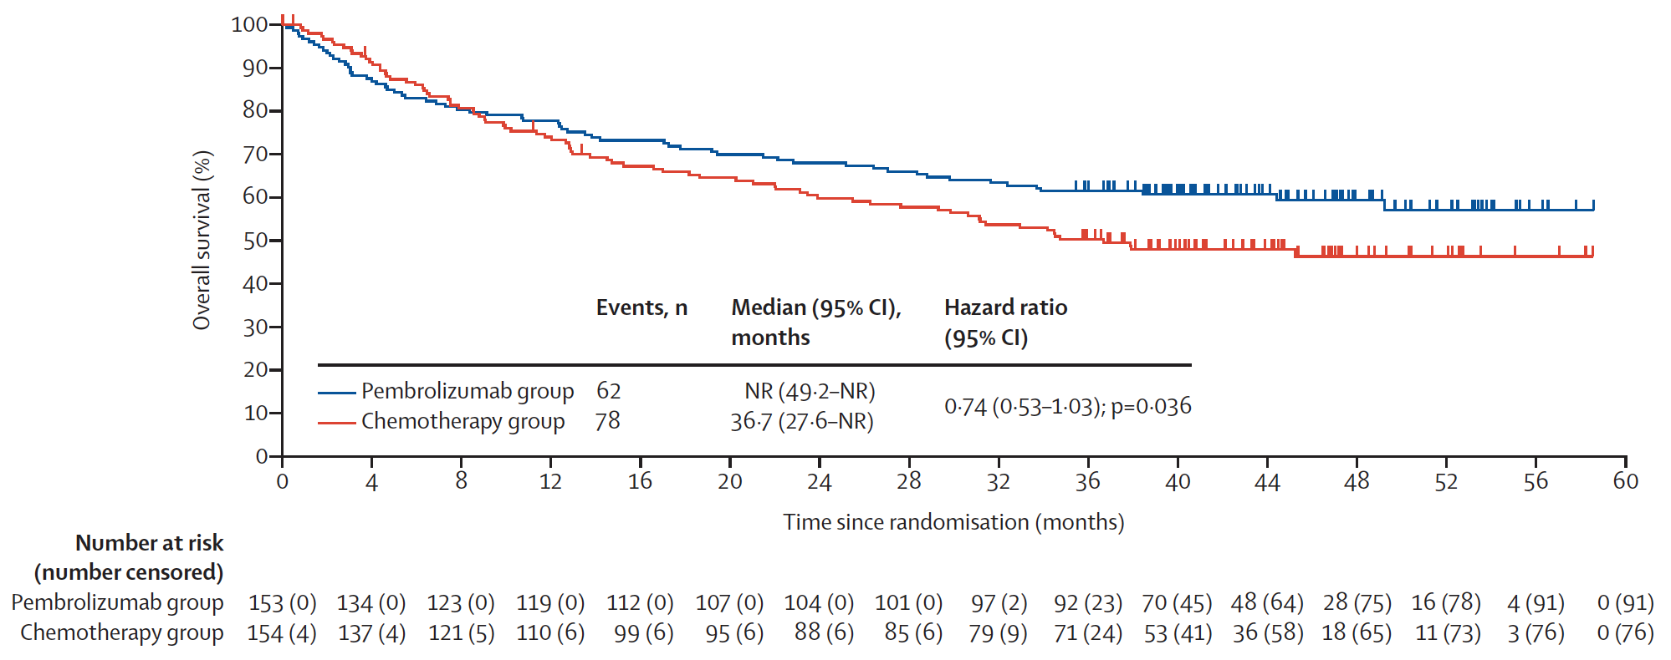
KEYNOTE-177 Coprimary Endpoint: Final Analysis of Overall Survival (Intent-to-Treat Population)
At final analysis, OS with pembrolizumab versus chemotherapy did not meet the one-sided α boundary of 0.025 required for superiority.
Diaz LA Jr et al. Lancet Oncol 2022 April 12;23(5):659-70.

Slide 90
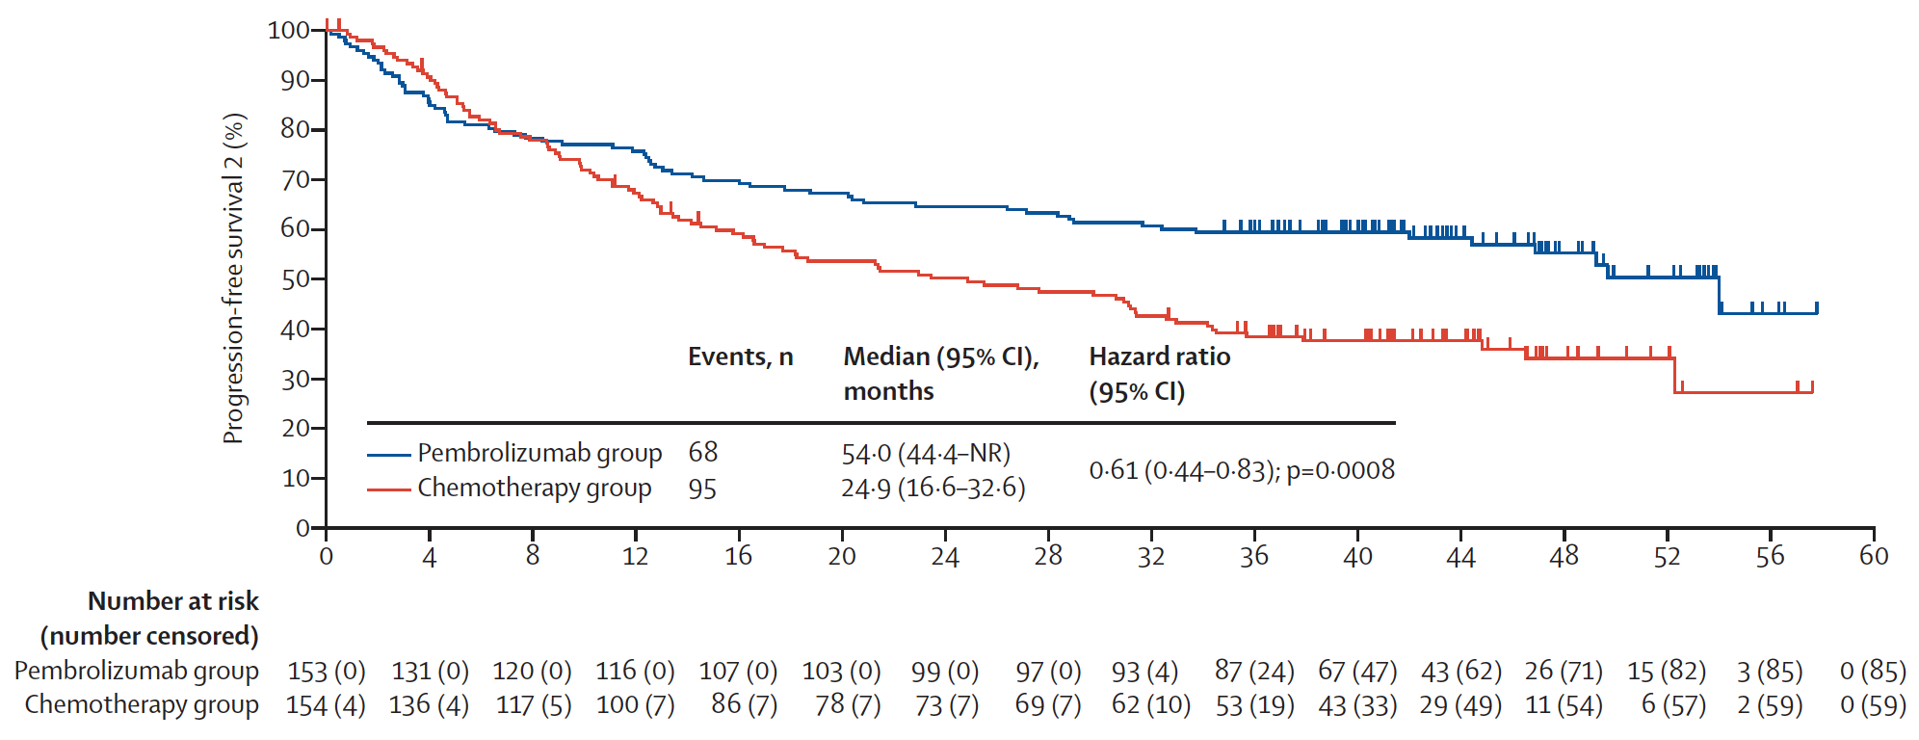
KEYNOTE-177: Time to Progression (PFS2)
At the final analysis, median progression-free survival (PFS) was longer with pembrolizumab (16.5 mo) than with chemotherapy (8.2 mo); however, because superiority was met at the second interim analysis, superiority was not formally tested at the final analysis (HR 0.59).
PFS2 = disease progression on next line of therapy after first progression
Diaz LA Jr et al. Lancet Oncol 2022 April 12;23(5):659-70.

