Slide 1
Meet The Professor
Current and Future Management of Non-Small
Cell Lung Cancer with an EGFR Mutation
Lecia V Sequist, MD, MPH
Director, Center for Innovation in Early Cancer Detection
Massachusetts General Hospital Cancer Center
The Landry Family Professor of Medicine
Harvard Medical School
Boston, Massachusetts

Slide 2







Meet The Professor Program Participating Faculty
Pasi A Jänne, MD, PhD
Director, Lowe Center for Thoracic Oncology
Director, Robert and Renée Belfer Center for Applied Cancer Sciences
Director, Chen-Huang Center for EGFR Mutant Lung Cancers
Dana-Farber Cancer Institute
Professor of Medicine
Harvard Medical School
Boston, Massachusetts
Gregory J Riely, MD, PhD
Attending
Memorial Sloan Kettering Cancer Center
New York, New York
Lecia V Sequist, MD, MPH
Director, Center for Innovation in Early
Cancer Detection
Massachusetts General Hospital Cancer Center
The Landry Family Professor of Medicine
Harvard Medical School
Boston, Massachusetts
Joel W Neal, MD, PhD
Associate Professor of Medicine
Division of Oncology, Department of Medicine
Stanford Cancer Institute
Stanford University
Palo Alto, California
David R Spigel, MD
Chief Scientific Officer
Sarah Cannon Research Institute
Nashville, Tennessee
David Planchard, MD, PhD
Head of Thoracic Cancer Group
Department of Medical Oncology
Thoracic Group
Gustave Roussy
Villejuif, France
MODERATOR
Neil Love, MD
Research To Practice

Slide 3
Commercial Support
This activity is supported by educational grants from AstraZeneca Pharmaceuticals LP, Daiichi Sankyo Inc, and Janssen Biotech Inc, administered by Janssen Scientific Affairs LLC.
Research To Practice CME Planning Committee Members,
Staff and Reviewers
Planners, scientific staff and independent reviewers for Research To Practice have no relevant conflicts of interest to disclose.

Slide 4
Dr Sequist — Disclosures
Advisory Committee | AstraZeneca Pharmaceuticals LP, Janssen Biotech Inc, Pfizer Inc, Takeda Pharmaceuticals USA Inc
Contracted Research | AstraZeneca Pharmaceuticals LP, Boehringer Ingelheim Pharmaceuticals Inc, Delfi Diagnostics, Genentech, a member of the Roche Group, Novartis
Data and Safety Monitoring Board/Committee | Genentech, a member of the Roche Group

Slide 5
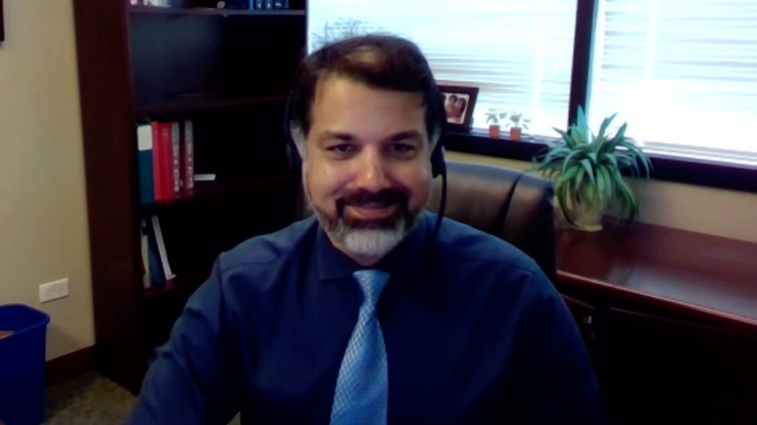
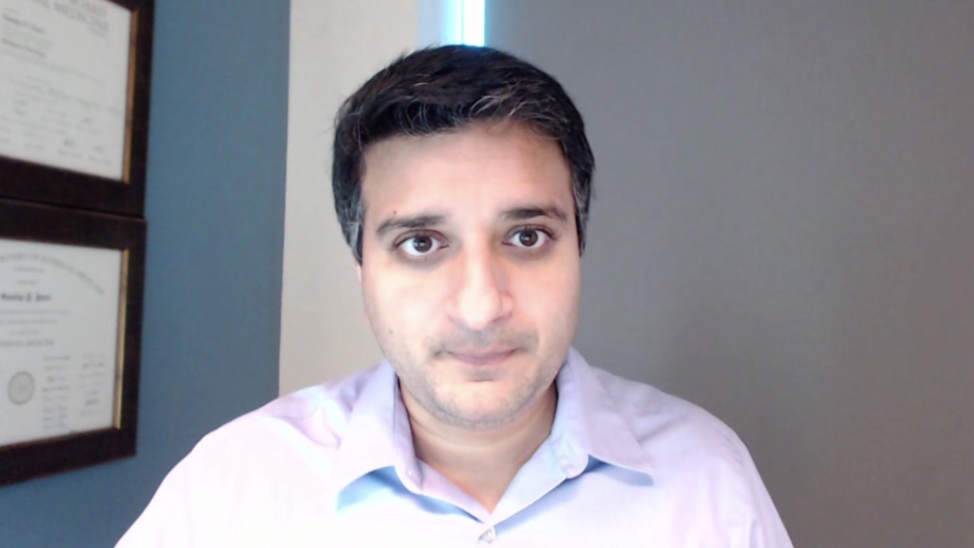

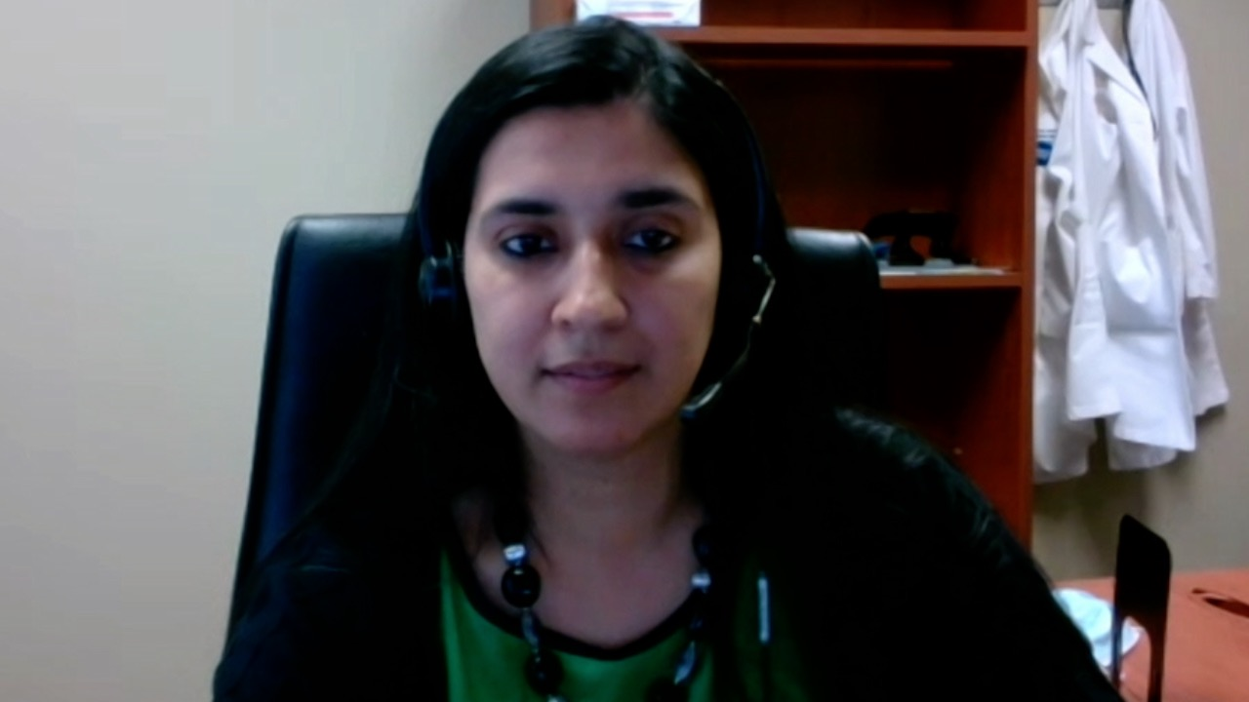
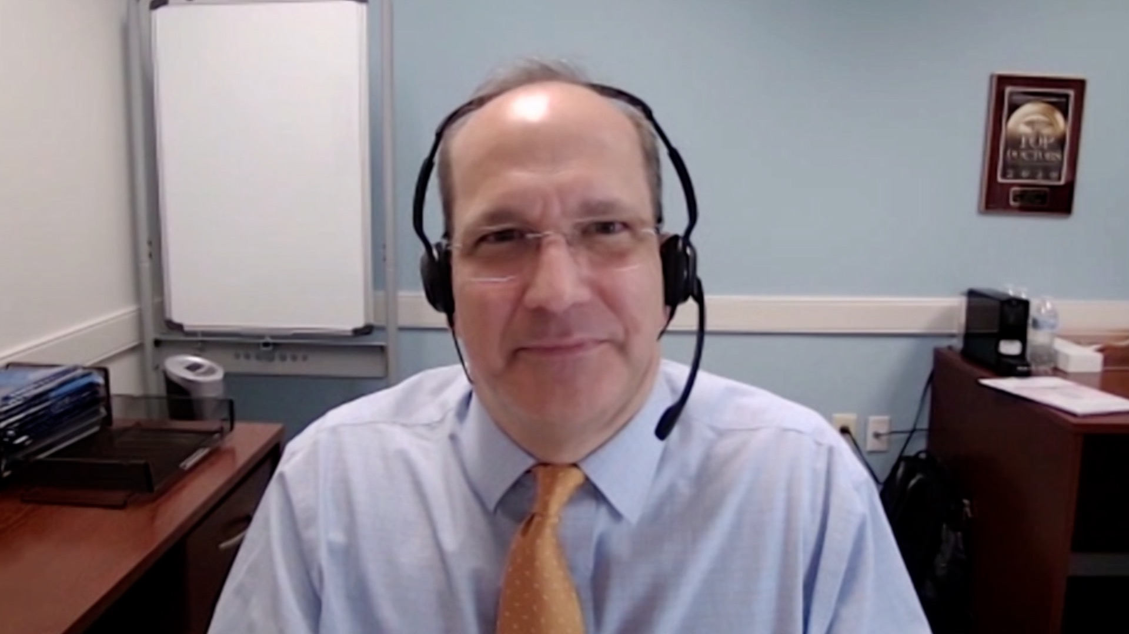


Syed M Ahmed, MD, PhD
Advocate Medical Group
Libertyville, Illinois
Sandip Patel, MD
San Diego Center for Precision Immunotherapy
San Diego, California
Gigi Chen, MD
John Muir Health
Pleasant Hill, California
Namrata I Peswani, MD
Harold C Simmons Comprehensive Cancer Center
Richardson, Texas
Justin Peter Favaro, MD, PhD Oncology Specialists of Charlotte
Charlotte, North Carolina
Priya Rudolph, MD
Georgia Cancer Specialists
Athens, Georgia
Adam R Miller, MD
Mass General/North Shore Cancer Center
Danvers, Massachusetts

Slide 6
Meet The Professor with Dr Sequist
INTRODUCTION: Journal Club with Dr Sequist – Part 1
MODULE 1: Case Presentations
MODULE 2: Faculty Survey
MODULE 3: Journal Club with Dr Sequist – Part 2
MODULE 4: Appendix of Key Publications

Slide 7
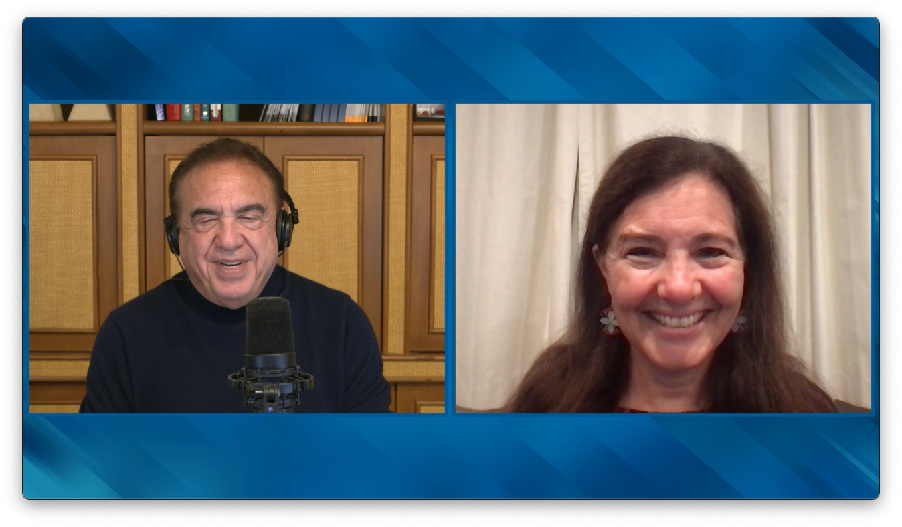

Slide 8
Patients with metastatic non-small cell lung cancer with a high PD-L1 level and an activating EGFR mutation may have a robust response to a single-agent checkpoint inhibitor.
1. Agree
2. Disagree
3. I’m not sure

Slide 9
Meet The Professor with Dr Sequist
INTRODUCTION: Journal Club with Dr Sequist – Part 1
MODULE 1: Case Presentations
MODULE 2: Faculty Survey
MODULE 3: Journal Club with Dr Sequist – Part 2
MODULE 4: Appendix of Key Publications

Slide 10
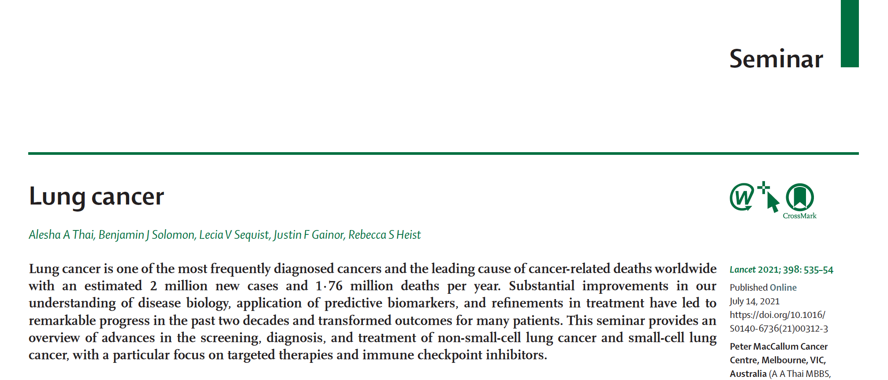

Lancet 2021;398:535-54.

Slide 11
Long Term Survival Outcomes in NSCLC Patients with Targeted Therapy and Immunotherapy: An IASLC Analysis of ASCO CancerLinQ Discovery Data
Behera M et al.
IASLC 2022;Abstract EP08.01-060.

Slide 12
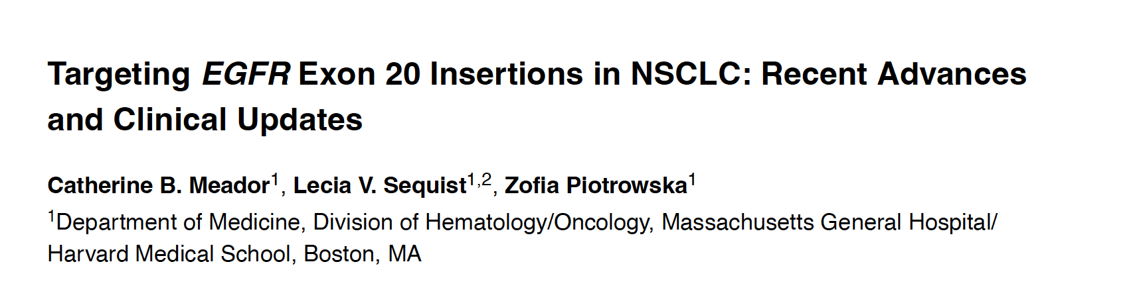
Cancer Discov 2021;11(9):2145-57.

Slide 13
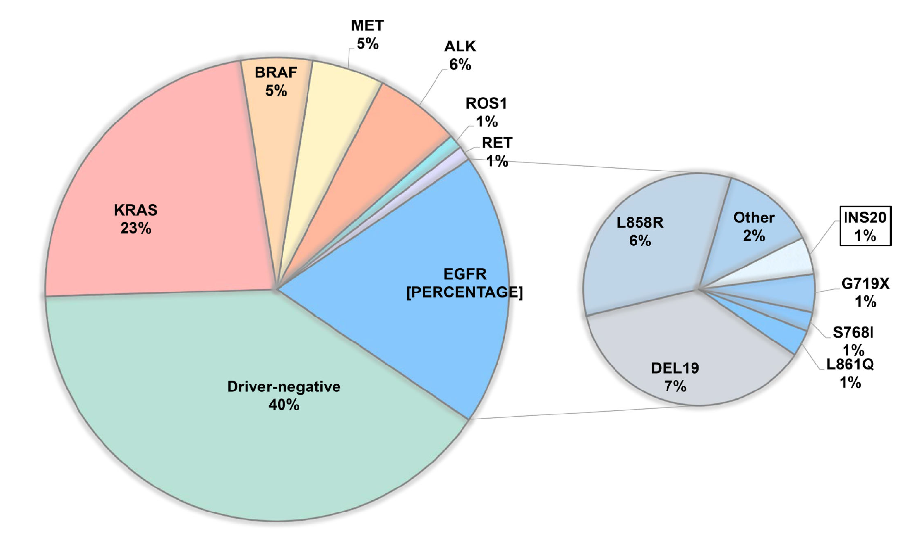
Frequency of EGFR Exon 20 Insertion Mutations
Meador CB et al. Cancer Discov 2021;11(9):2145-57.

Slide 14
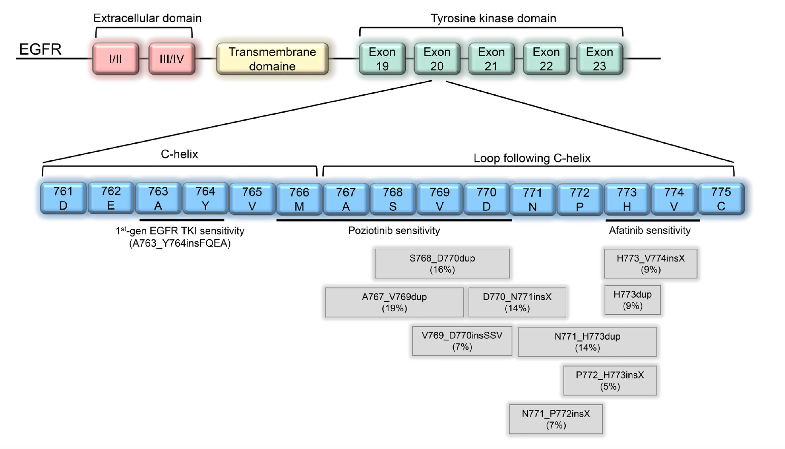
Location of EGFR Exon 20 Insertion Mutations
Transmembrane
domain
Meador CB et al. Cancer Discov 2021;11(9):2145-57.

Slide 15
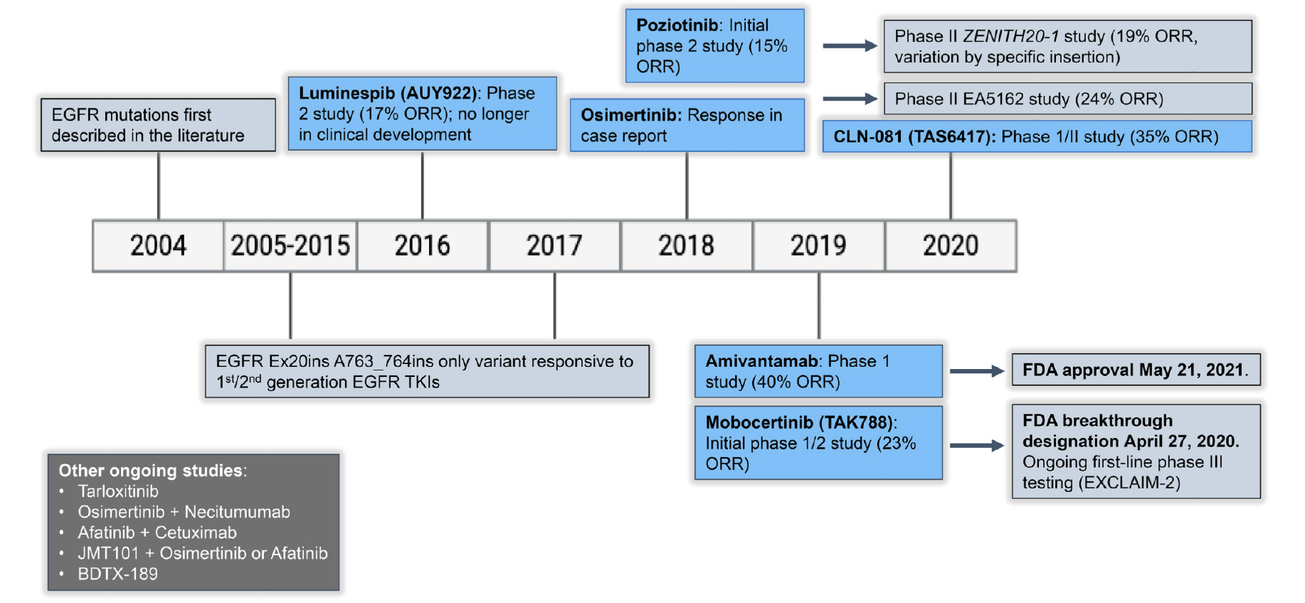
Timeline of Development of Targeted Therapies for
EGFR 20 Insertion Mutations
Tarloxotinib
Meador CB et al. Cancer Discov 2021;11(9):2145-57.

Slide 16
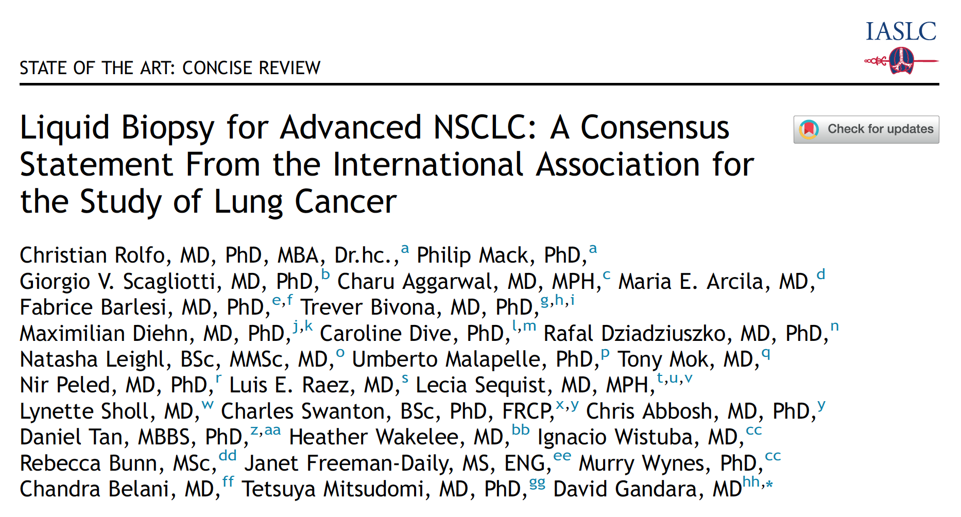
J Thorac Oncol 2021;16(10):1647-62.

Slide 17
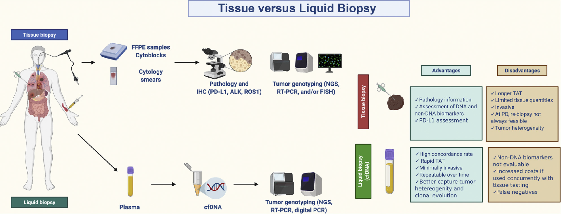
Advantages and Disadvantages of Tissue and Liquid Biopsy for Tumor Genotyping in Advanced or Metastatic NSCLC
Rolfo C et al. J Thorac Oncol 2021;16(10):1647-62.

Slide 18
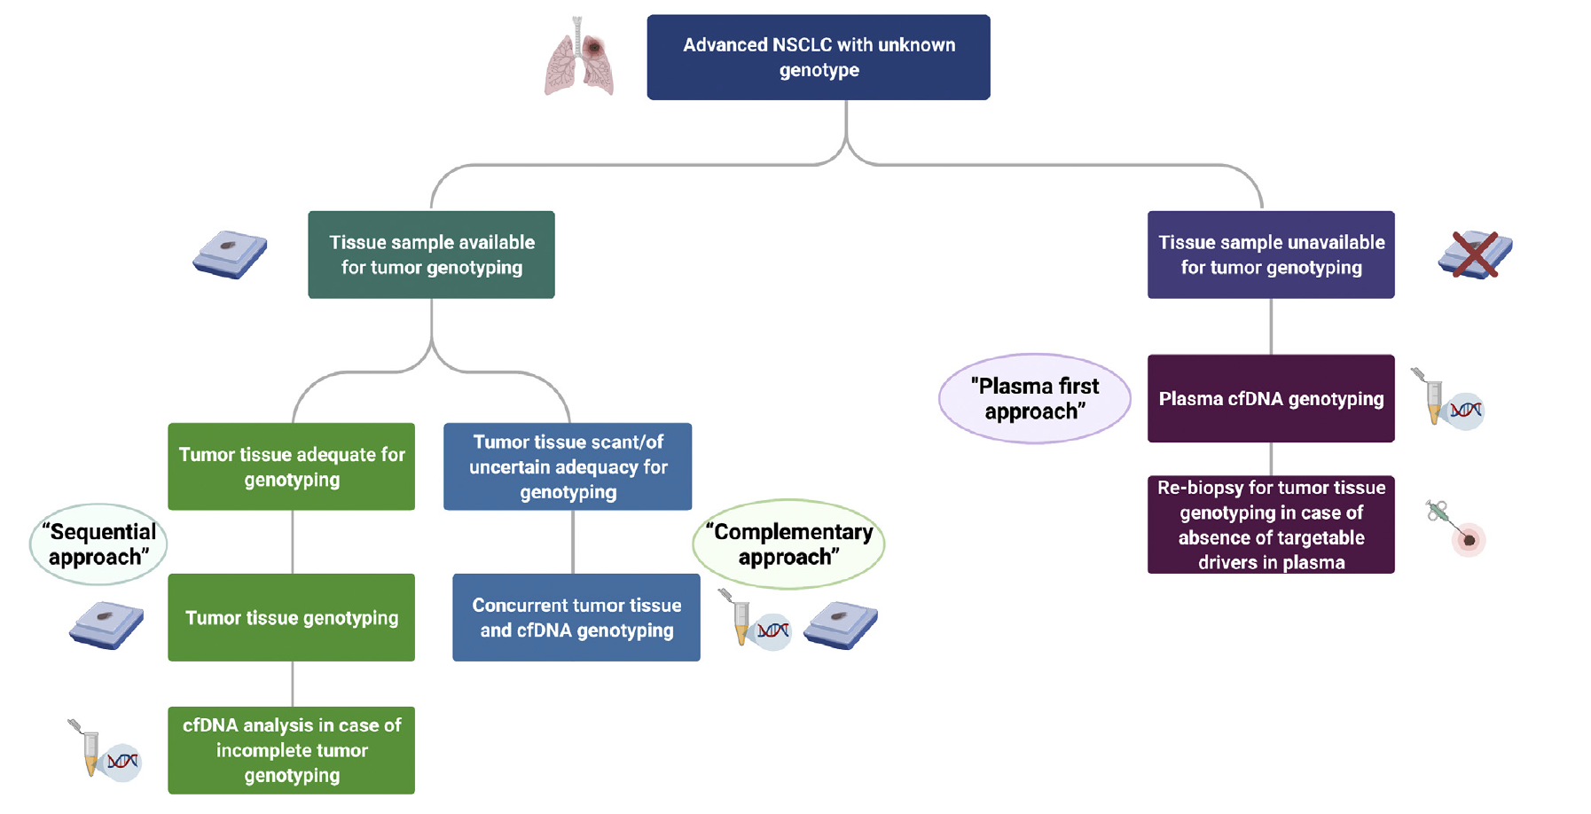
Diagnostic Algorithm for Liquid Biopsy Use in Treatment-Naïve Advanced or Metastatic NSCLC
Rolfo C et al. J Thorac Oncol 2021;16(10):1647-62.

Slide 19
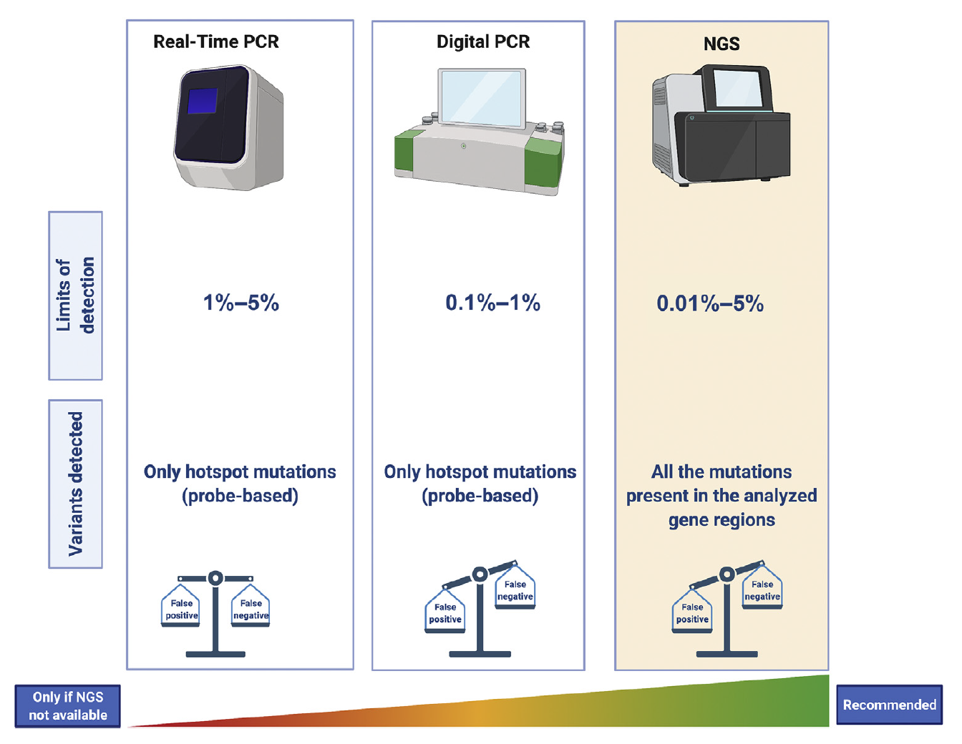
Comparison of Major Methodologies for ctDNA Analysis
Rolfo C et al. J Thorac Oncol 2021;16(10):1647-62.

Slide 20
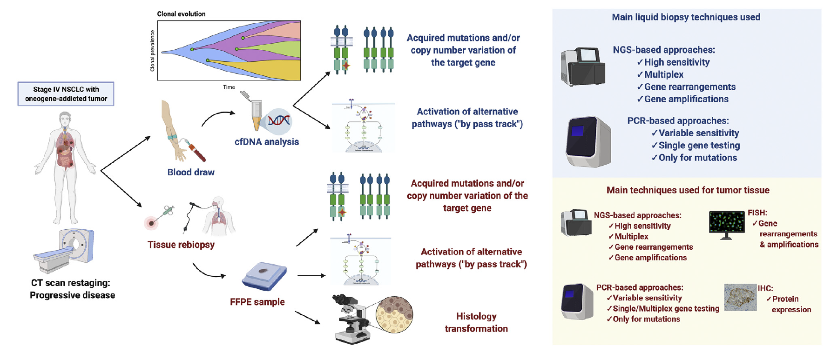
Liquid Biopsy and Tissue Rebiopsy After Acquired Resistance to Targeted Therapies for Oncogene-Addicted NSCLC
Rolfo C et al. J Thorac Oncol 2021;16(10):1647-62.

Slide 21
Meet The Professor with Dr Sequist
MODULE 1: Case Presentations
Dr Miller: 72-year-old woman with Stage IIB EGFR exon 19-mutant adenocarcinoma of the lung
Dr Rudolph: 77-year-old man with EGFR L858R-mutant metastatic adenocarcinoma of the lung develops hemoptysis from an “escape lesion” on osimertinib
Dr Patel: 72-year-old man with EGFR L858R-mutant, PD-L1-high metastatic adenocarcinoma of the lung with disease progression on pembrolizumab
Dr Favaro: 65-year-old woman with metastatic adenocarcinoma of the lung with an EGFR exon 20 insertion with multiple brain and bone metastases (PD-L1 <1%)
Dr Chen: 55-year-old woman with EGFR-mutant metastatic adenocarcinoma of the lung with disease progression after response to osimertinib x 3 years (PD-L1 TPS 80%)
Dr Peswani: 50-year-old man with EGFR exon 19-mutant adenocarcinoma of the lung with brain metastases and disease progression on both osimertinib and carboplatin/paclitaxel/pembrolizumab/bevacizumab (ROS fusion detected on RNA assay)
Dr Ahmed: 76-year-old woman with metastatic adenocarcinoma of the lung and EGFR exon 18 G719S and E709A mutations

Slide 22
Case Presentation: 72-year-old woman with Stage IIB EGFR exon 19-mutant adenocarcinoma of the lung
Dr Adam Miller (Danvers, Massachusetts)

Slide 23
Case Presentation: 77-year-old man with EGFR L858R-mutant metastatic adenocarcinoma of the lung develops hemoptysis from an “escape lesion” on osimertinib
Dr Priya Rudolph (Athens, Georgia)

Slide 24
Case Presentation: 72-year-old man with EGFR L858R-mutant, PD-L1-high metastatic adenocarcinoma of the lung with disease progression on pembrolizumab
Dr Sandip Patel (San Diego, California)

Slide 25
Case Presentation: 72-year-old man with EGFR L858R-mutant, PD-L1-high metastatic adenocarcinoma of the lung with disease progression on pembrolizumab (continued)
Dr Sandip Patel (San Diego, California)

Slide 26
Case Presentation: 65-year-old woman with metastatic adenocarcinoma of the lung with an EGFR exon 20 insertion with multiple brain and bone metastases (PD-L1 <1%)
Dr Justin Favaro (Charlotte, North Carolina)

Slide 27
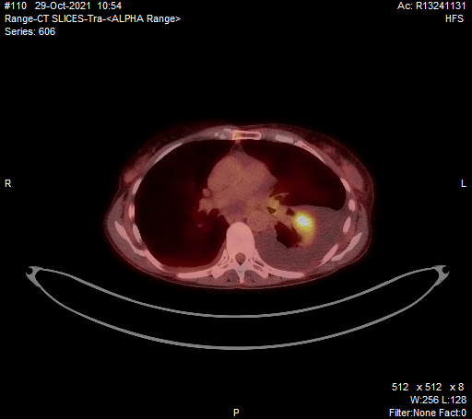
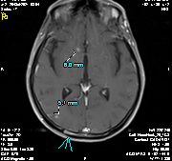

Slide 28
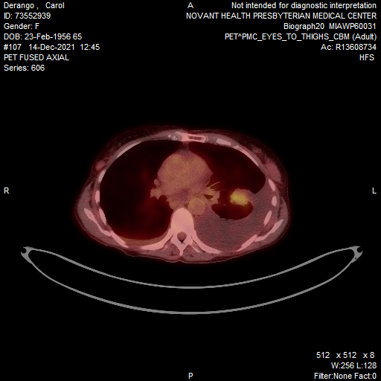

Slide 29
Case Presentation: 55-year-old woman with EGFR-mutant metastatic adenocarcinoma of the lung with disease progression after response to osimertinib x 3 years (PD-L1 TPS 80%)
Dr Gigi Chen (Pleasant Hill, California)

Slide 30
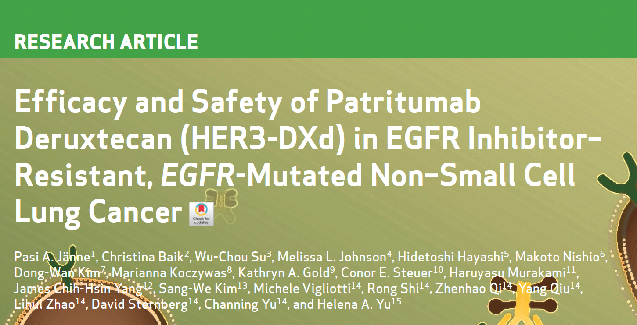
Cancer Discov 2022;12(1):74-89.

Slide 31
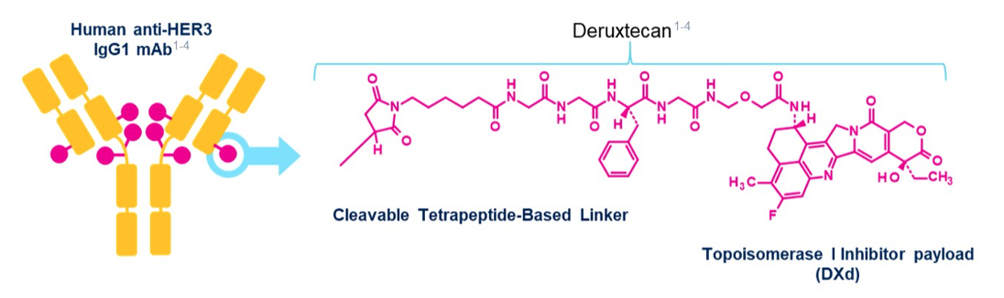
Patritumab Deruxtecan (HER3-DXd) Targeting HER3 May Address Multiple EGFR TKI Resistance Mechanisms
HER3-DXd is an antibody-drug conjugate with 3 components:
A fully human anti-HER3 IgG1 mAb (patritumab), covalently linked to:
A topoisomerase I inhibitor payload, an exatecan derivative, via
A tetrapeptide-based cleaver linker
Janne PA et al. ASCO 2021;Abstract 9007.

Slide 32
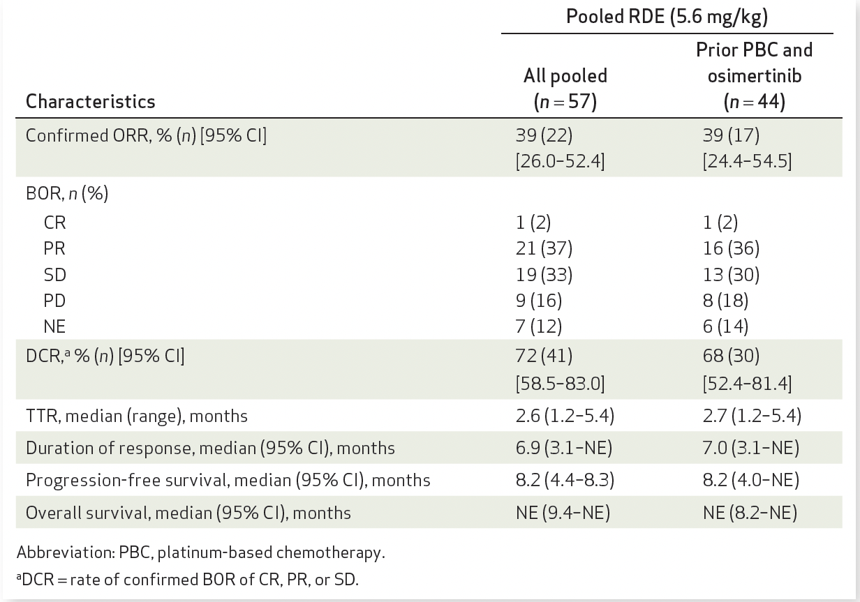
Responses by Blinded Independent Central Review
Jänne PA et al. Cancer Discov 2022;12(1):74-89.

Slide 33
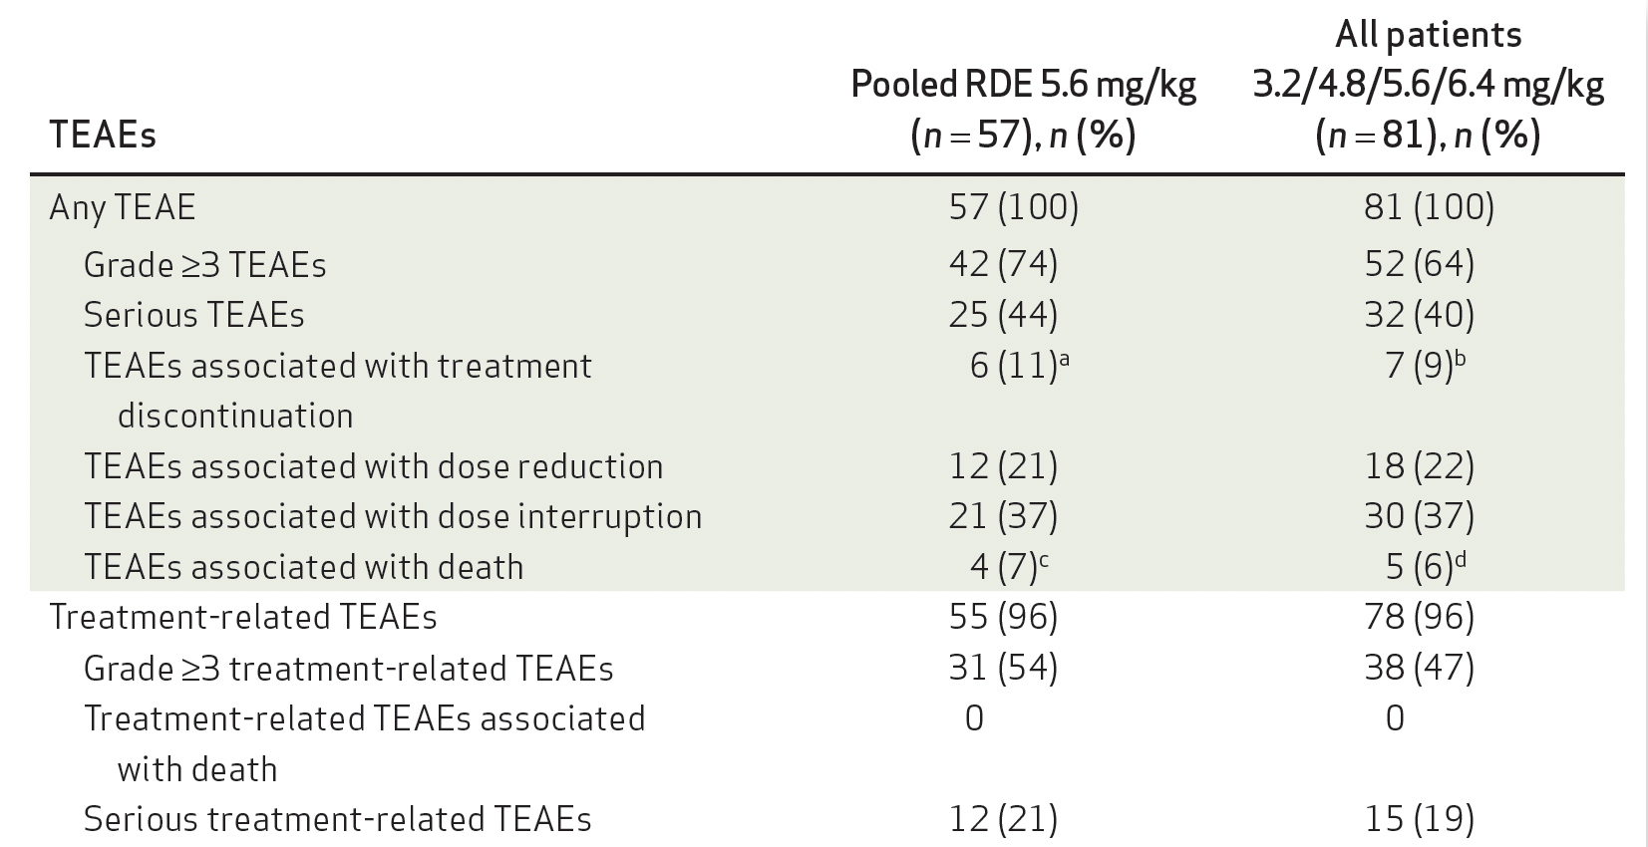
Summary of Treatment-Emergent Adverse Events (TEAEs)
RDE = recommended dose for expansion
Jänne PA et al. Cancer Discov 2022;12(1):74-89.

Slide 34

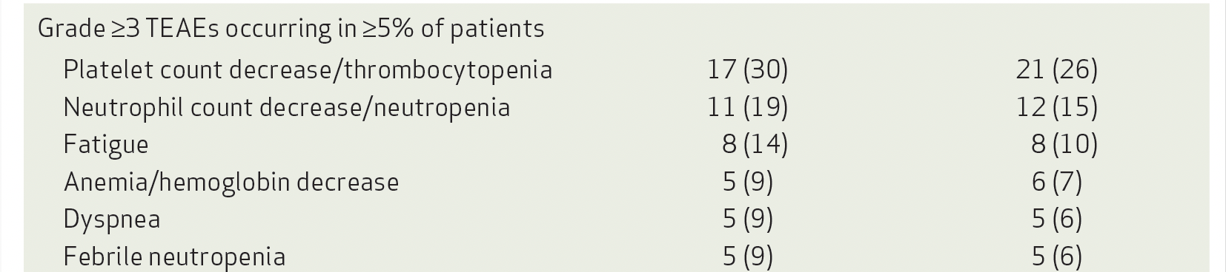
Select Grade ≥3 Treatment-Emergent Adverse Events (TEAEs)
Jänne PA et al. Cancer Discov 2022;12(1):74-89.

Slide 35
HERTHENA-Lung02: An Ongoing Phase III Trial of Patritumab Deruxtecan for NSCLC with EGFR Mutation After Failure of an EGFR TKI
Trial identifier: NCT05338970 (Open)
Estimated enrollment: 560
Eligibility
Locally advanced or metastatic nonsquamous NSCLC with EGFR activating mutation 1 or 2 prior lines of an approved EGFR TKI in the metastatic or locally advanced setting, which must include a third-generation EGFR TKI Radiographic disease progression while receiving or after receiving a third-generation EGFR TKI
Patritumab deruxtecan
R
Platinum-based chemotherapy
Primary endpoint: Progression-free survival by blinded independent central review
www.clinicaltrials.gov. Accessed June 2022.

Slide 36

Nat Rev Clin Oncol 2022 August;19(8):499-514.

Slide 37
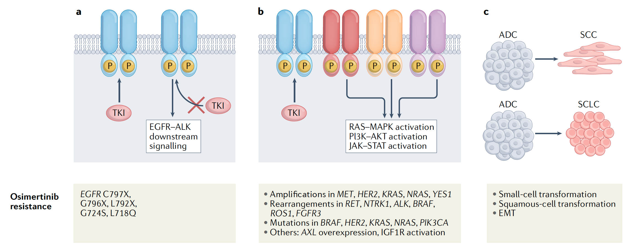
Mechanisms of Acquired Resistance to Osimertinib for
NSCLC with EGFR Mutations
Activation of Bypass and/or Downstream
Signaling Pathways
Changes in Tumor
Cell Lineage
Alterations in TKI Signaling
Cooper AJ et al. Nat Rev Clin Oncol 2022;19(8):499-514.

Slide 38
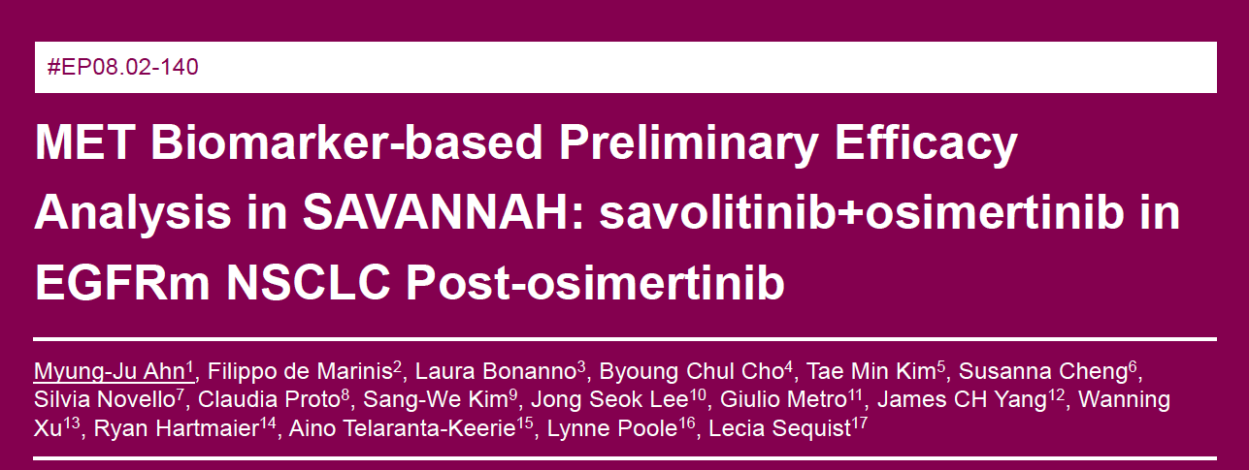
IASLC 2022

Slide 39
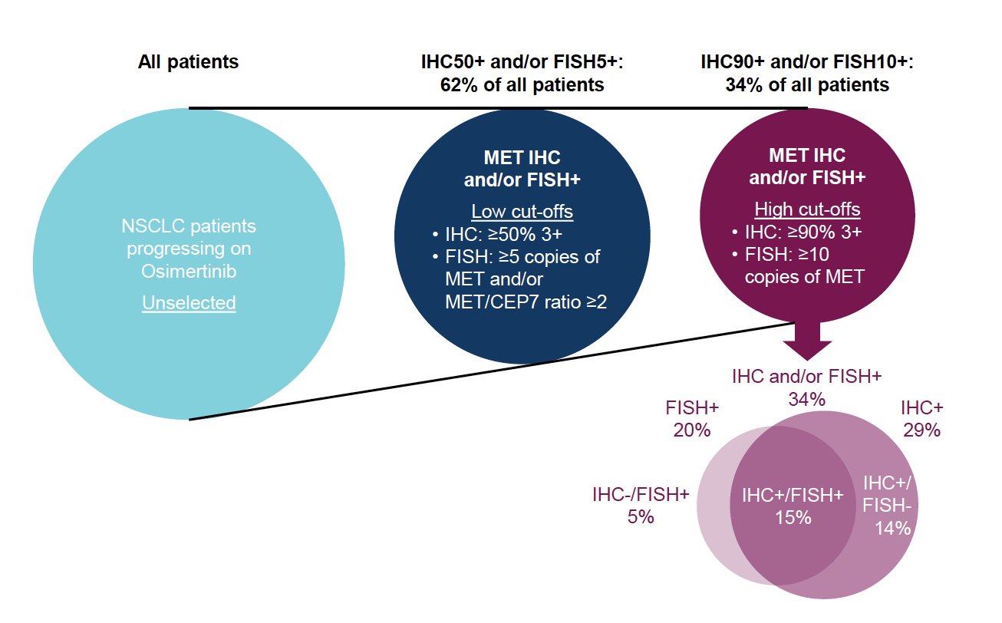
Estimated Prevalence of MET Overexpression and/or Amplification
Ahn M-J et al. IASLC 2022;Abstract EP08.02-140.

Slide 40
Case Presentation: 50-year-old man with EGFR exon 19-mutant adenocarcinoma of the lung with brain metastases and disease progression on both osimertinib and carboplatin/paclitaxel/pembrolizumab/bevacizumab (ROS fusion detected on RNA assay)
Dr Namrata Peswani (Richardson, Texas)

Slide 41
Case Presentation: 76-year-old woman with metastatic adenocarcinoma of the lung and EGFR exon 18 G719S and E709A mutations
Dr Syed Ahmed (Libertyville, Illinois)

Slide 42
Meet The Professor with Dr Sequist
INTRODUCTION: Journal Club with Dr Sequist – Part 1
MODULE 1: Case Presentations
MODULE 2: Faculty Survey
MODULE 3: Journal Club with Dr Sequist – Part 2
MODULE 4: Appendix of Key Publications

Slide 43
Adjuvant Therapy

Slide 44
Regulatory and reimbursement issues aside, in general, what adjuvant treatment, if any, would you recommend for an otherwise healthy 65-year-old patient with Stage IB nonsquamous NSCLC with an EGFR exon 19 deletion and a PD-L1 TPS of 50%?
Osimertinib
Osimertinib
None
Chemotherapy → osimertinib
Chemotherapy → osimertinib
None
TPS = tumor proportion score

Slide 45
Regulatory and reimbursement issues aside, in general, what adjuvant treatment, if any, would you recommend for an otherwise healthy 65-year-old patient with Stage IIA nonsquamous NSCLC with an EGFR exon 19 deletion and a PD-L1 TPS of 50%?
Chemotherapy → osimertinib
Chemotherapy → osimertinib
Chemotherapy → osimertinib
Chemotherapy → osimertinib
Chemotherapy → osimertinib
Chemotherapy → osimertinib

Slide 46
Locally Advanced Disease

Slide 47
What would you most likely recommend as consolidation treatment for a patient with locally advanced NSCLC who has completed chemoradiation therapy and is found to have an EGFR mutation?
Osimertinib
Osimertinib
Consider durvalumab
if PD-L1 high, or osimertinib
Osimertinib
Durvalumab or observation
Durvalumab followed by osimertinib

Slide 48
Metastatic Disease

Slide 49
A patient with locally advanced NSCLC who receives definitive chemoradiation therapy followed by 1 year of consolidation durvalumab experiences disease progression 3 months later and is found to have an EGFR exon 19 deletion. Assuming the patient is clinically stable, how long would you like to wait before starting osimertinib?
Would start now
3 mo from last
dose of ICI
Consider starting now, but
likely erlotinib for 3-6 mo
then consider switching
As long as possible depending on the disease tempo
Would start now if
local tx not possible
Would start now
ICI = immune checkpoint inhibitor therapy

Slide 50
If an asymptomatic patient with metastatic nonsquamous NSCLC with an EGFR exon 19 deletion and a PD-L1 TPS of 10% responded to first-line osimertinib followed by disease progression, what would be your second-line treatment recommendation if the patient had acquired no further actionable mutations?
Continue osimertinib
and add carboplatin/
pemetrexed
Platin/pemetrexed + bevacizumab
Carboplatin/pemetrexed + bevacizumab
Continue osimertinib
and add carboplatin/
pemetrexed
Platin/pemetrexed + pembrolizumab
Continue osimertinib
and add carboplatin/
pemetrexed

Slide 51
If an asymptomatic patient with metastatic nonsquamous NSCLC with an EGFR exon 19 deletion and a PD-L1 TPS of 10% responded to first-line osimertinib followed by disease progression, what would be your second-line treatment recommendation if the patient had acquired a MET amplification?
Continue osimertinib
and add capmatinib
or tepotinib
Continue osimertinib
and add capmatinib
or tepotinib
Continue osimertinib
and add tepotinib Carboplatin/pemetrexed/
bevacizumab
Continue osimertinib
and add crizotinib
or capmatinib
Continue osimertinib
and add capmatinib, tepotinib or savolitinib
Continue osimertinib
and add carboplatin/
pemetrexed*
* If MET highly amplified and no EGFRm, capmatinib alone; if MET and EGFRm, then osimertinib/capmatinib (cautiously)

Slide 52
If an asymptomatic patient with metastatic nonsquamous NSCLC with an EGFR exon 19 deletion and a PD-L1 TPS of 10% responded to first-line osimertinib followed by disease progression, what would be your second-line treatment recommendation if the patient had acquired a BRAF V600E mutation?
Continue osimertinib
and add carboplatin/
pemetrexed
Continue osimertinib and add dabrafenib/ trametinib
Carboplatin/
pemetrexed + bevacizumab
Continue osimertinib
and add carboplatin/
pemetrexed
Continue osimertinib and add dabrafenib/ trametinib
Continue osimertinib
and add carboplatin/
pemetrexed*
* If BRAFm alone and no EGFRm, BRAFi/MEKi

Slide 53
A patient with nonsquamous NSCLC with an EGFR exon 19 deletion and systemic and brain metastases has a good response to first-line osimertinib but experiences disease progression and is switched to chemotherapy. Would you continue the osimertinib?
Yes, indefinitely
Yes, indefinitely
Yes, indefinitely, but
depends on brain met PD
vs systemic PD
Yes, indefinitely
No
Yes, indefinitely
PD = disease progression

Slide 54
Regulatory and reimbursement issues aside, in which line of therapy would you generally offer an immune checkpoint inhibitor (alone or in combination with chemotherapy) to a patient with metastatic nonsquamous NSCLC and an EGFR exon 19 deletion? Would level of PD-L1 expression have any bearing on this decision?
Third line. No
Beyond third line. No
Beyond third line. Yes
None
Second line. No
Third line. No

Slide 55
Exon 20 Insertions

Slide 56
Regulatory and reimbursement issues aside, what would be your preferred first-line treatment for a patient with metastatic nonsquamous NSCLC with an EGFR exon 20 insertion mutation and a TPS of 10%?
Chemotherapy
Chemotherapy + bevacizumab
Chemotherapy + bevacizumab
Chemotherapy
Amivantamab
Anti-PD-1/PD-L1 and carboplatin/pemetrexed

Slide 57
Regulatory and reimbursement issues aside, in which line of therapy would you generally offer amivantamab or mobocertinib to a patient with metastatic NSCLC and an EGFR exon 20 insertion mutation?
Second line
Second line
Second line
Second line
Second line
Second line

Slide 58
For a patient with metastatic nonsquamous NSCLC with an EGFR exon 20 insertion mutation to whom you’ve made the determination to administer targeted therapy, which agent do you prefer?
Mobocertinib
Mobocertinib
Mobocertinib
Amivantamab
Amivantamab
No preference

Slide 59
If you could access amivantamab/lazertinib today, would you attempt to administer it prior to chemotherapy in select situations for your patients with metastatic nonsquamous NSCLC with an EGFR mutation experiencing disease progression on osimertinib?
Yes
Yes
Yes
Yes
Yes
No

Slide 60
Meet The Professor with Dr Sequist
INTRODUCTION: Journal Club with Dr Sequist – Part 1
MODULE 1: Case Presentations
MODULE 2: Faculty Survey
MODULE 3: Journal Club with Dr Sequist – Part 2
MODULE 4: Appendix of Key Publications

Slide 61
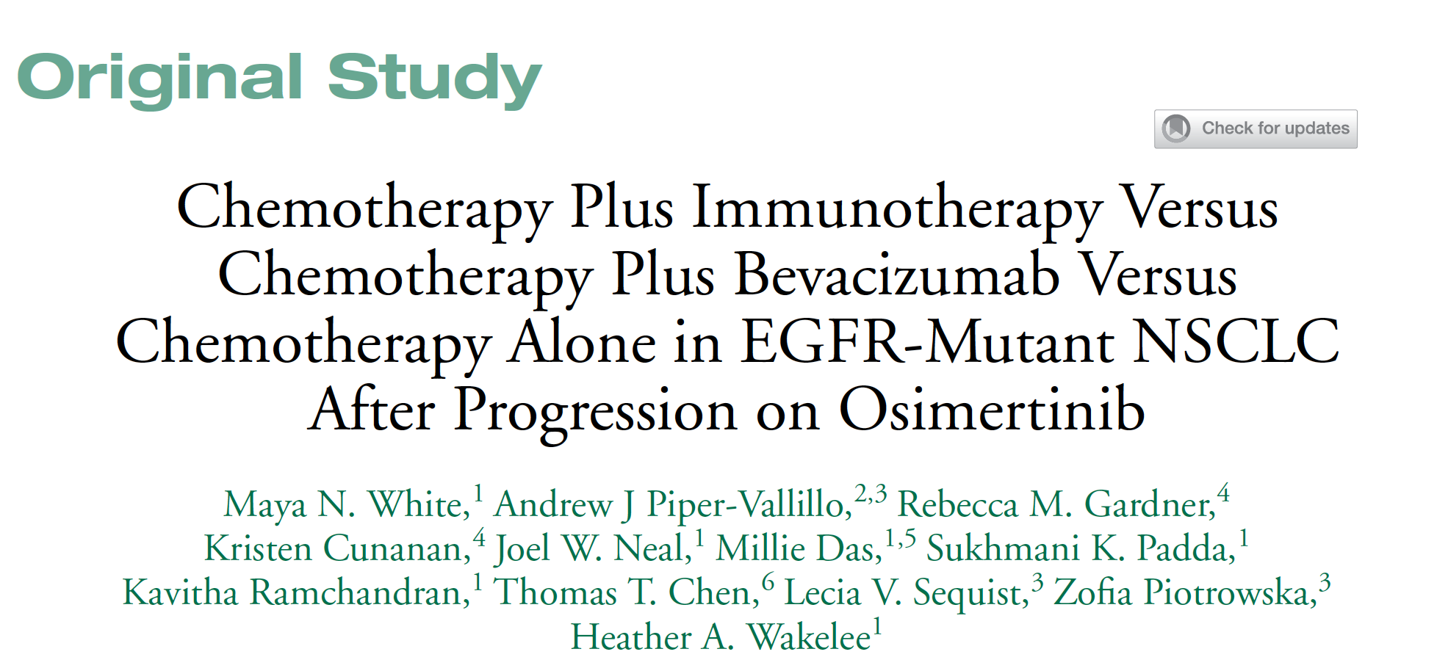
Clin Lung Cancer 2022;23(3):e210-21.

Slide 62
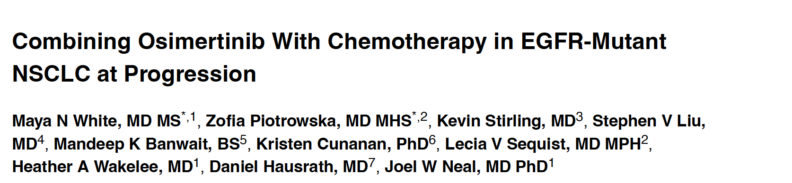
Clin Lung Cancer 2021;22(3):201-9.

Slide 63

ASCO 2022;Abstract TPS12150.

Slide 64
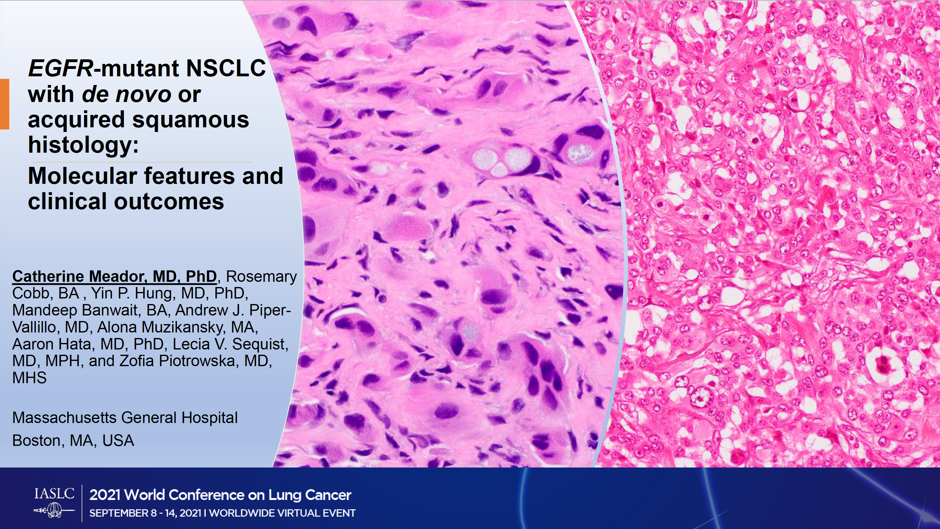
Meador C et al. IASLC 2021;Abstract MA14.07.

Slide 65
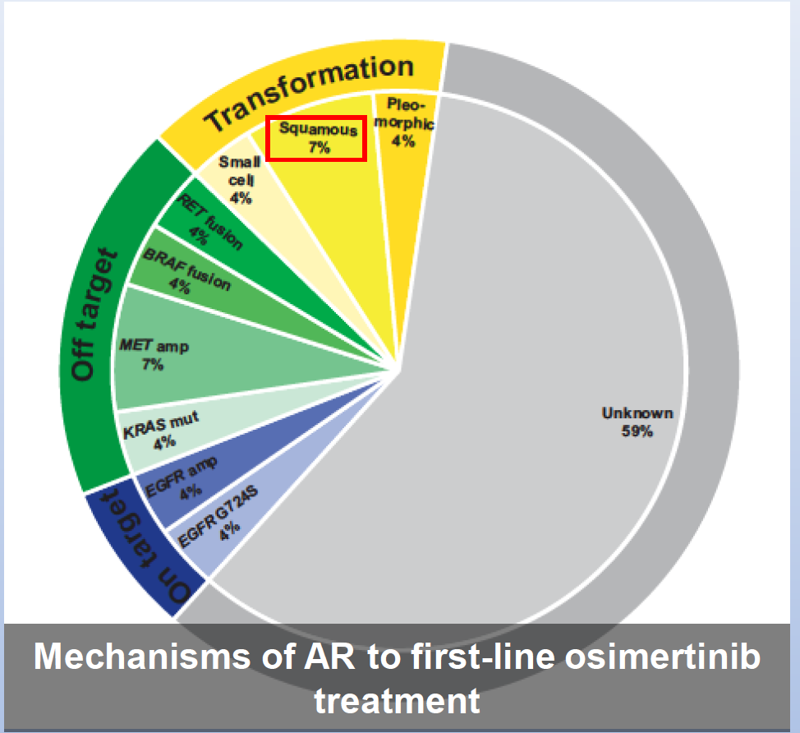
Squamous Transformation as a Mechanism of Acquired Resistance (AR) to EGFR TKIs
Meador C et al. IASLC 2021;Abstract MA14.07.

Slide 66
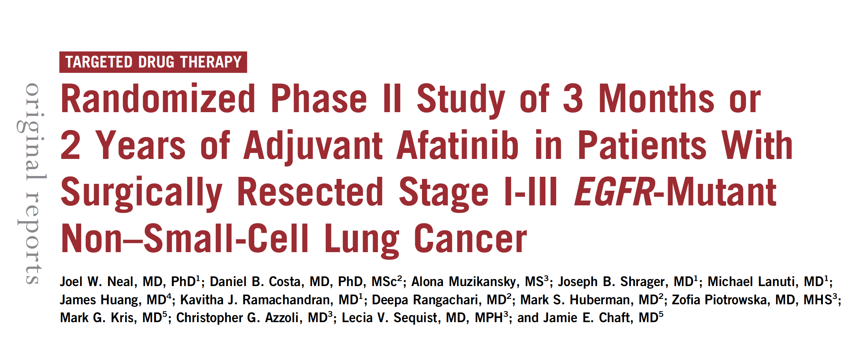
JCO Precis Oncol 2021 February 1;5:325-32.

Slide 67
Complete Evaluation of Resistance Mechanisms to First-Line Osimertinib Requires Tissue Biopsy
Piotrowska Z et al.
ASCO 2022;Abstract e21154.

Slide 68
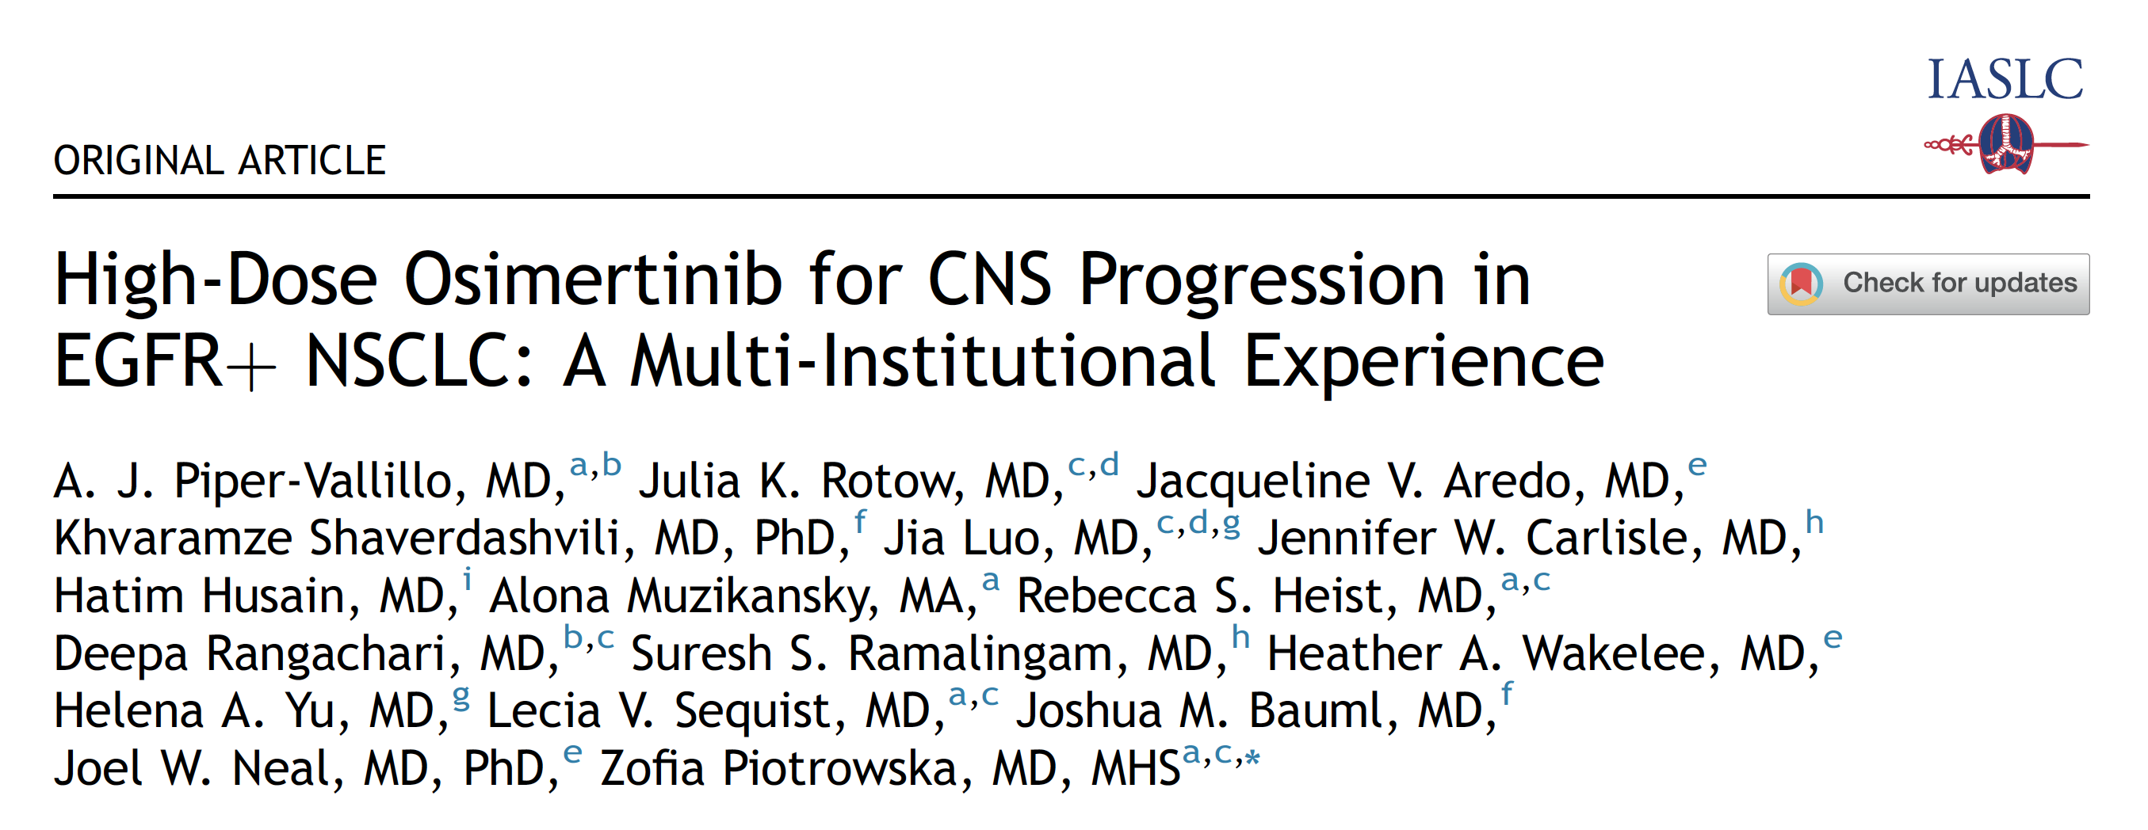
JTO Clin Res Rep 2022 April 21;3(6):100328.

Slide 69
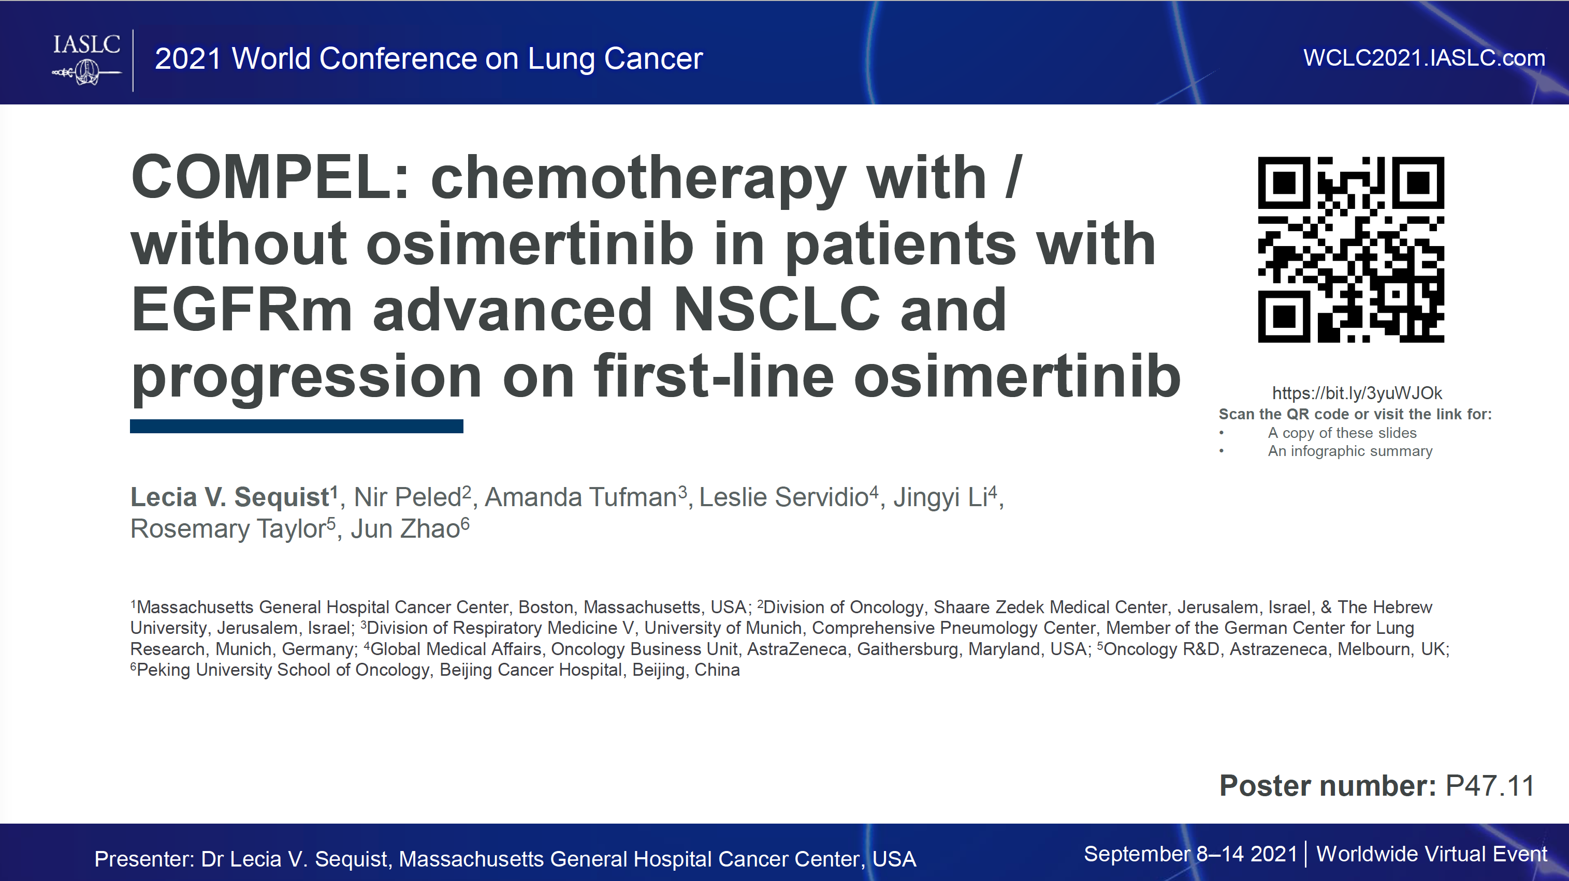

Slide 70
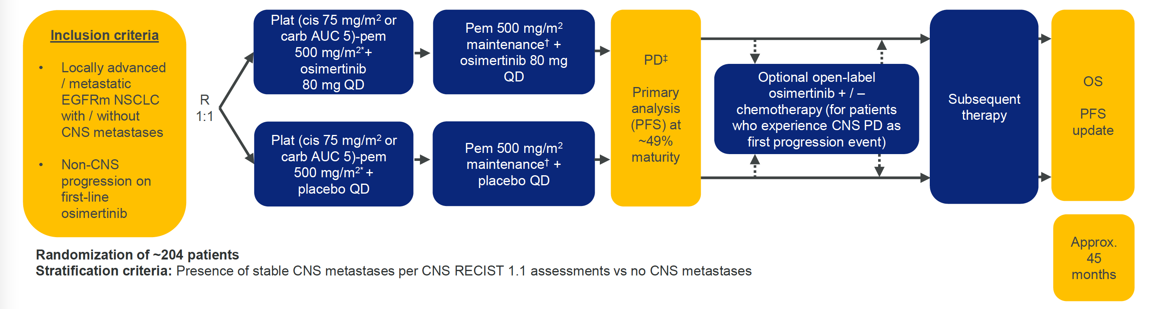
COMPEL Phase III Study Design
Sequist LV et al. IASLC 2021;Abstract P47.11.

Slide 71
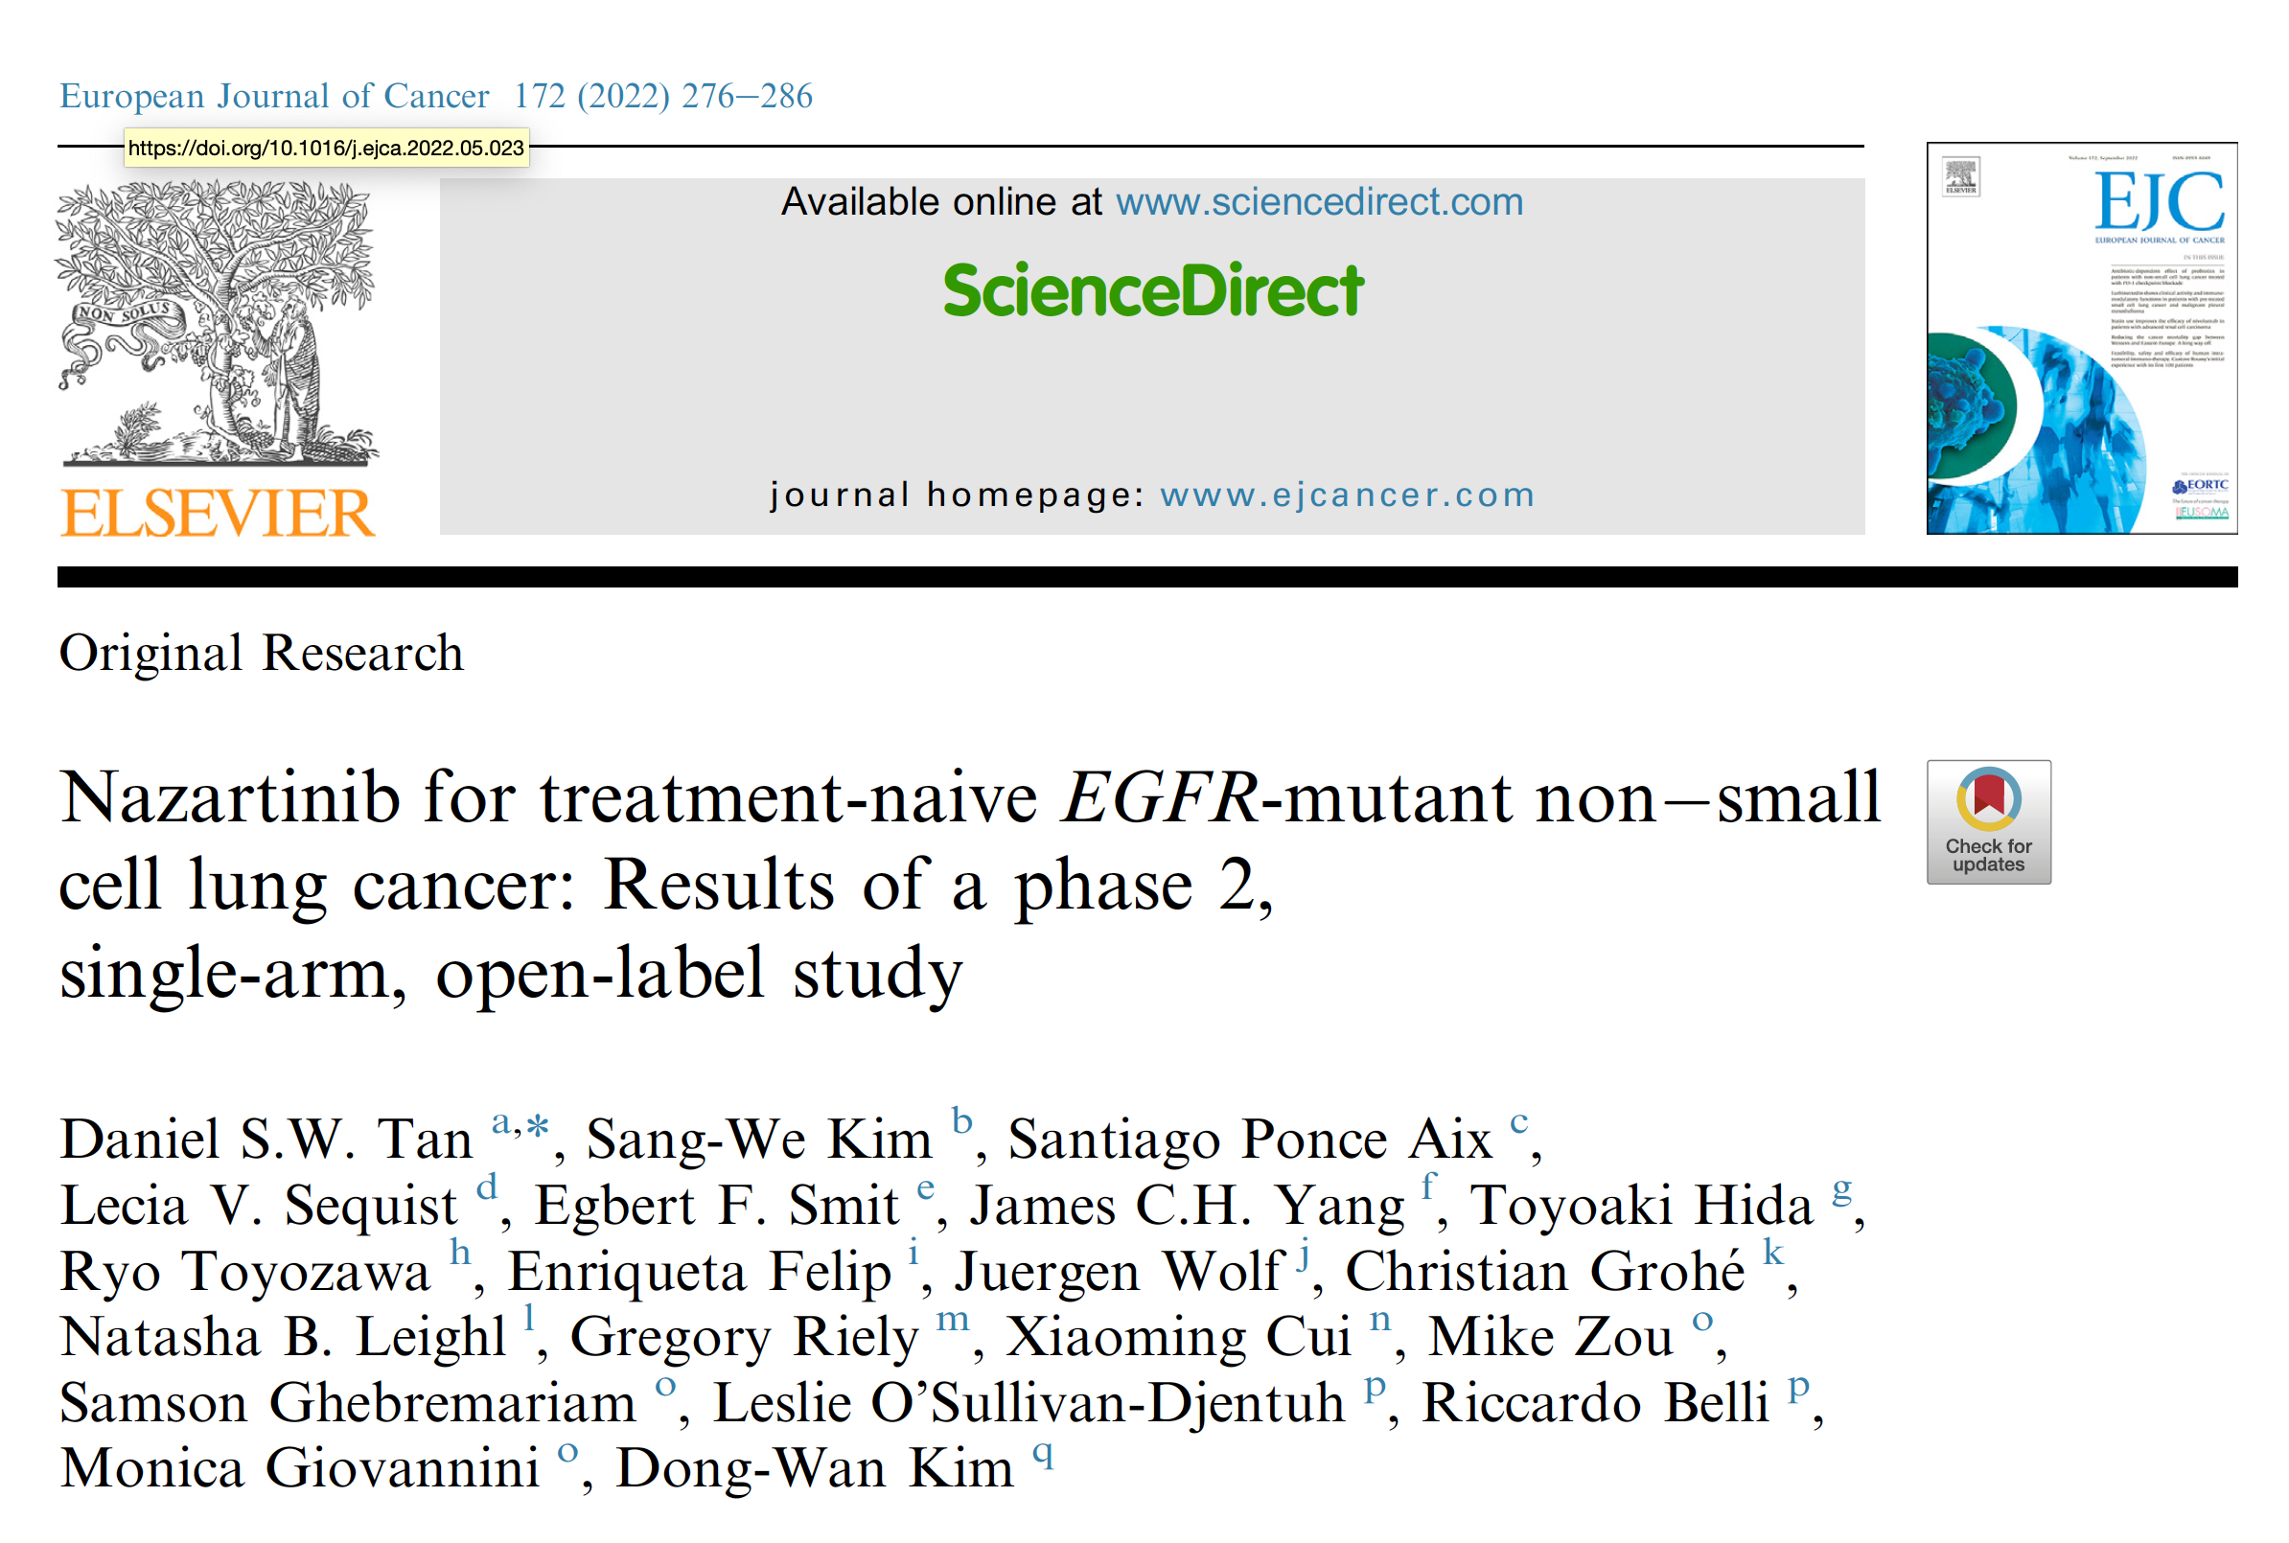

Slide 72
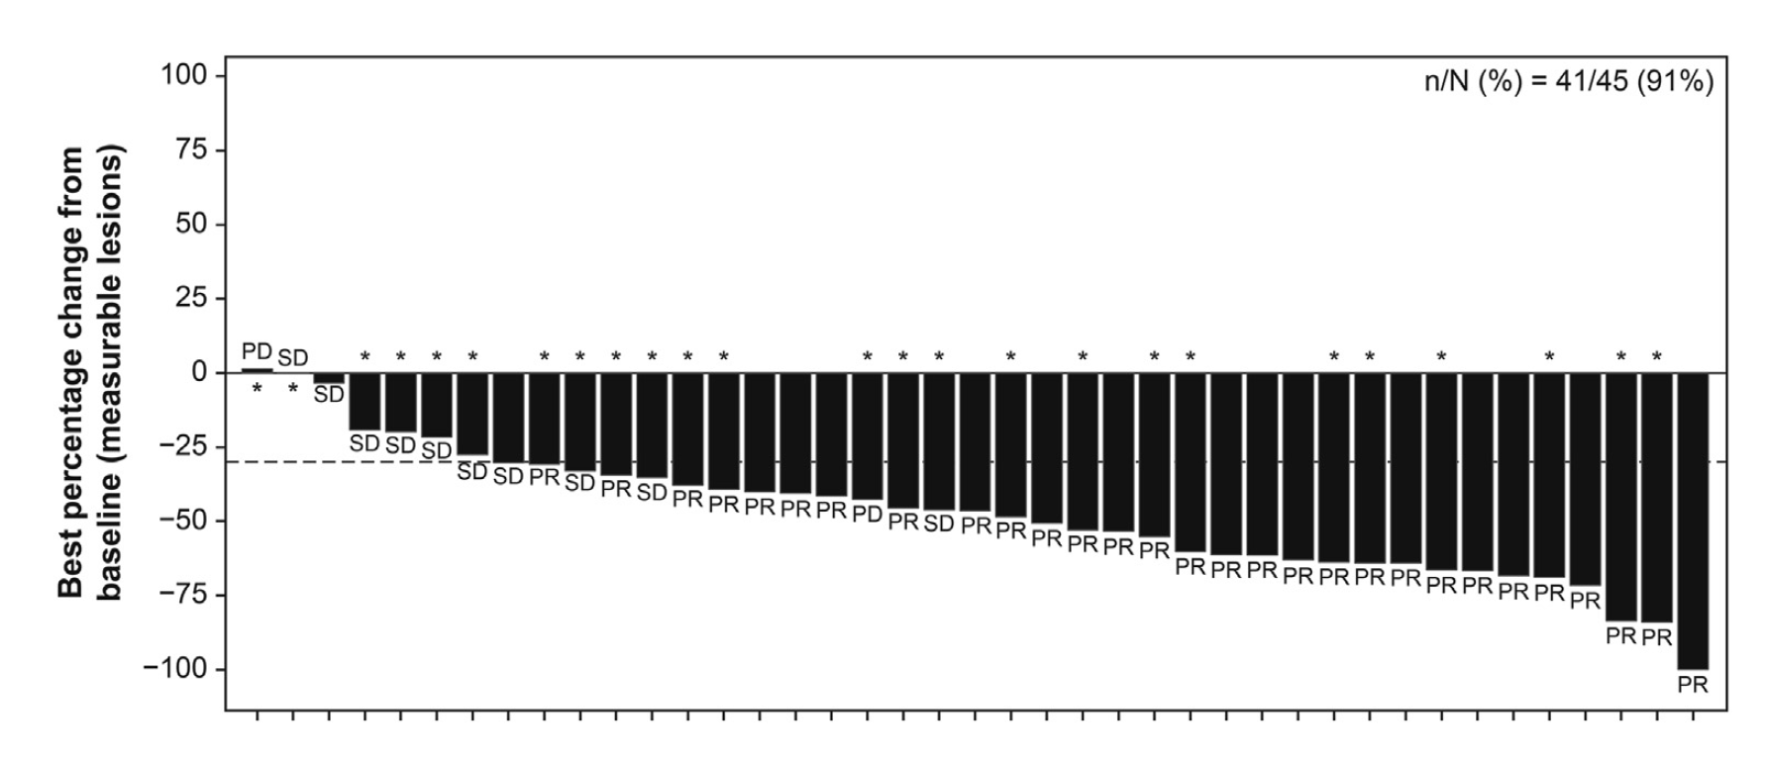
Best Change from Baseline in Sum of Longest Lesion Diameters by BIRC Assessment for All Patients
BIRC = blinded independent review committee; PD = progressive disease; SD = stable disease; PR = partial response
Tan DSW et al. Eur J Cancer 2022;172:276-86.

Slide 73
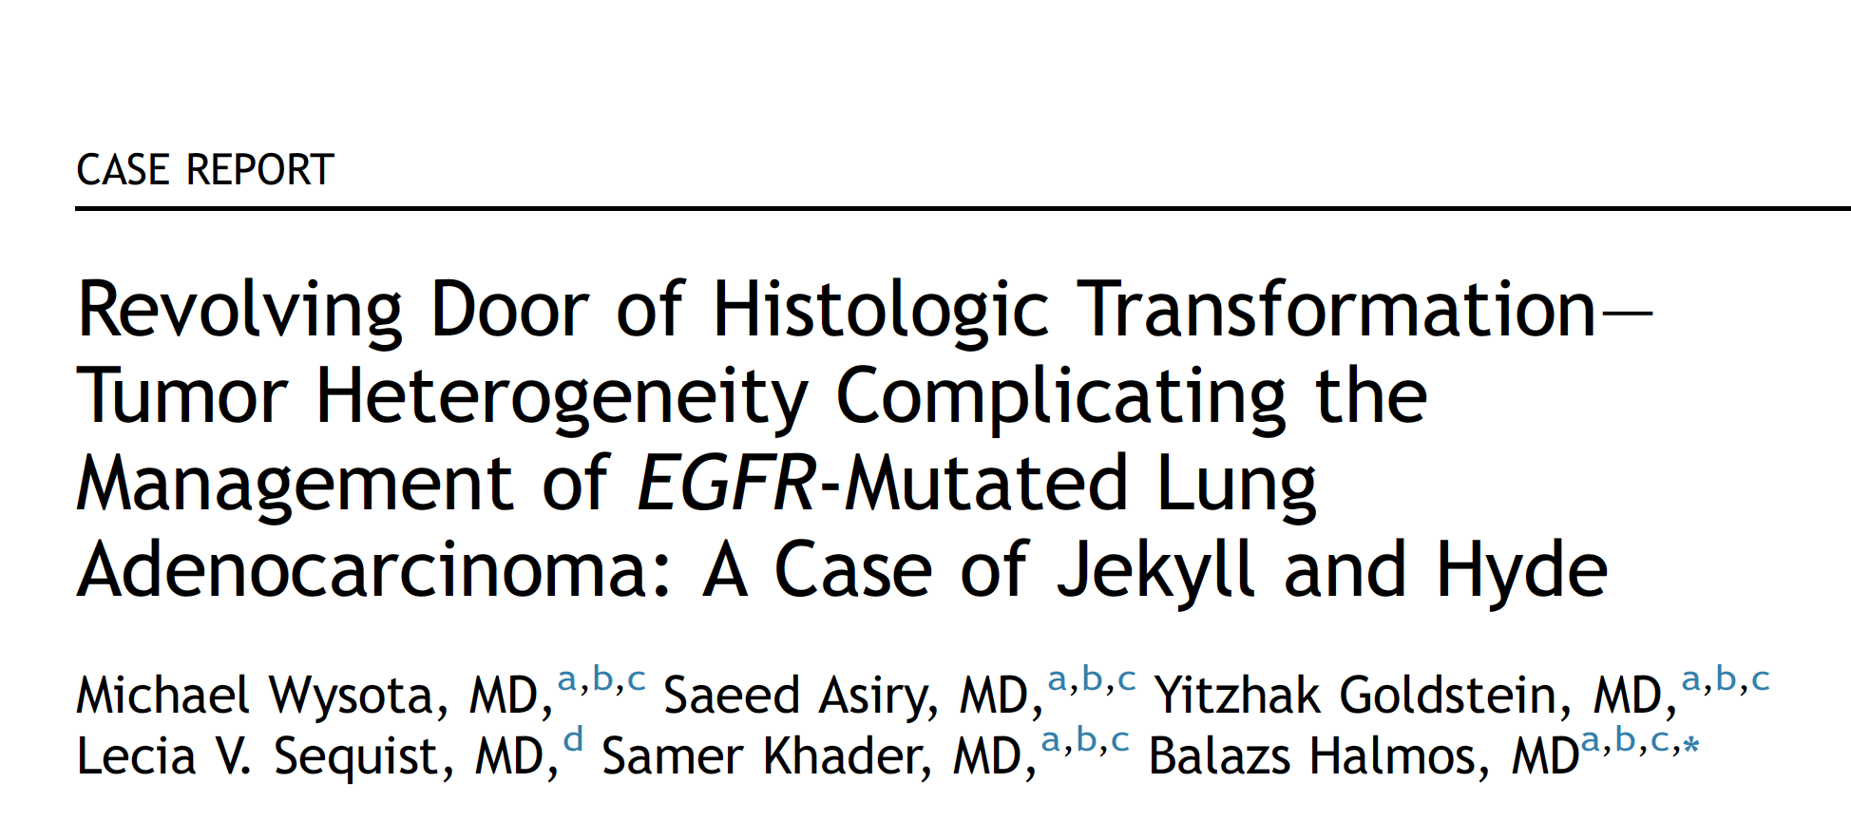
JTO Clin Res Rep 2020 December 3;2(2):100128.

Slide 74
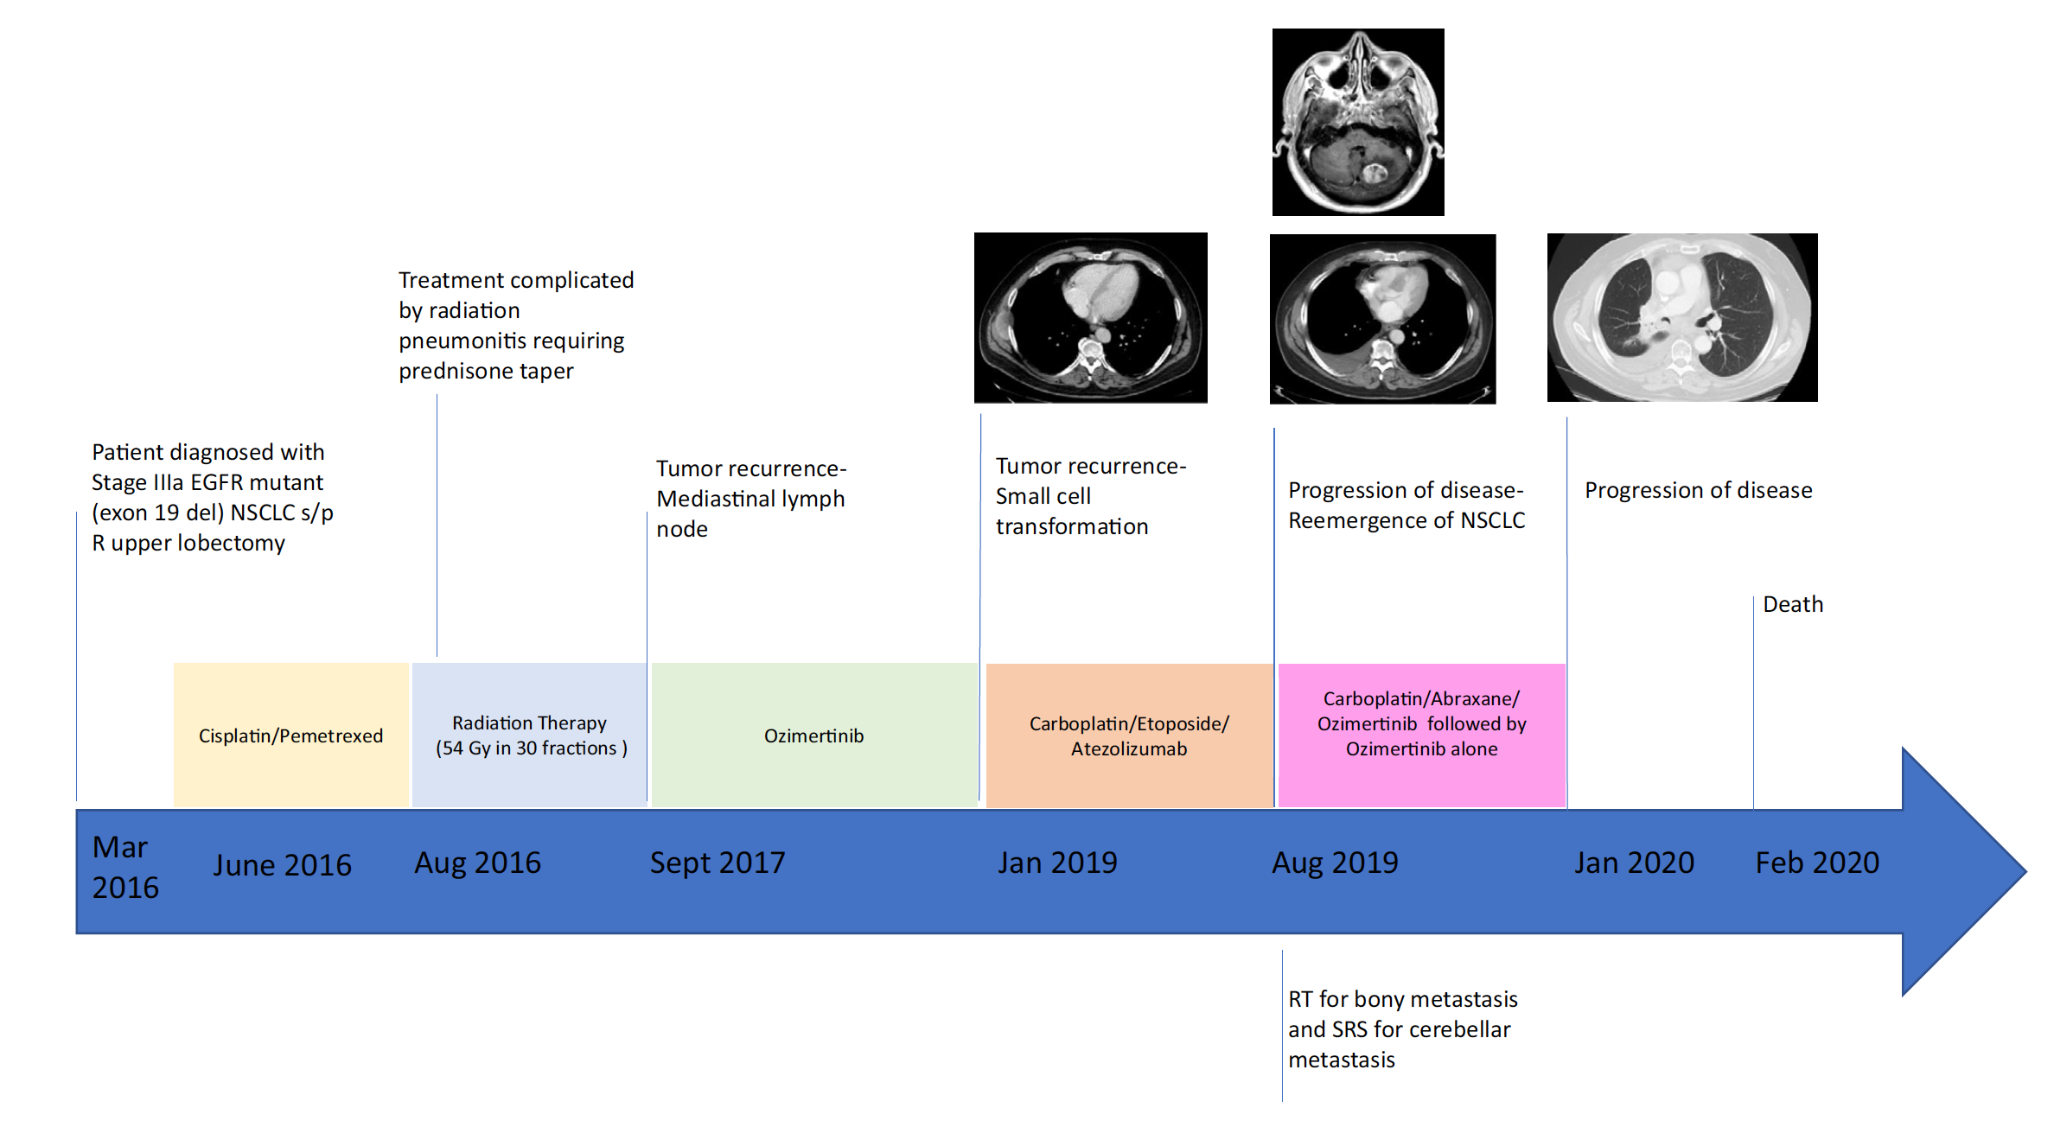
Timeline of a Patient’s NSCLC and Dates of Therapy
Osimertinib
Carboplatin/Nab Paclitaxel/Osimertinib followed by Osimertinib alone
Wysota M et al. JTO Clin Res Rep 2020 December 3;2(2):100128.

Slide 75
Effect of Participation in the EGFR Resisters Research Summit on Competence, Performance, and Professional Productivity of Young Researchers
Fowler JB et al.
ASCO 2022;Abstract e23010.

Slide 76
Meet The Professor with Dr Sequist
INTRODUCTION: Journal Club with Dr Sequist – Part 1
MODULE 1: Case Presentations
MODULE 2: Faculty Survey
MODULE 3: Journal Club with Dr Sequist – Part 2
MODULE 4: Appendix of Key Publications

Slide 77
Localized NSCLC with EGFR Mutation

Slide 78
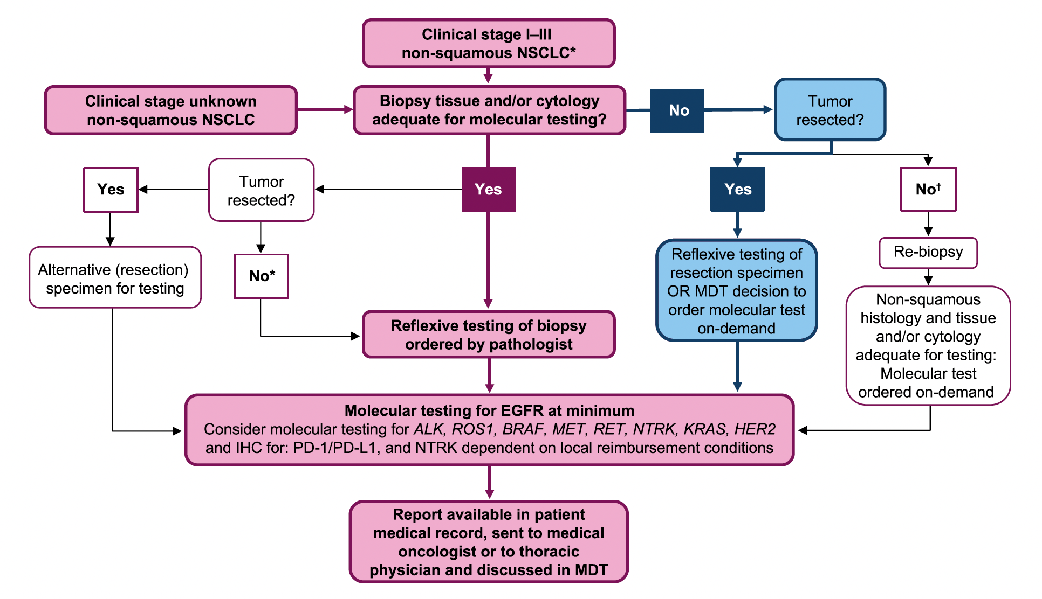
Proposed Algorithm for Molecular Testing in Patients with Stage I to Stage III NSCLC (Resectable and Unresectable)
MDT = multidisciplinary team
Aggarwal C et al. Lung Cancer 2021;162:42-53.

Slide 79
Phase III Trials of Adjuvant EGFR Inhibitors for Localized NSCLC
Study | N | Setting | Regimens | Median F/U | DFS Hazard ratio | OS Hazard ratio
BR 19 | 503 | Stage IB, II, IIA 4% mEGFR | Gefitinib x 2 y Placebo x 2 y | 56.4 mo | 1.22 | 1.24
RADIANT | 973 | Stage IB-IIIA 6.5% mEGFR | Erlotinib x 2 y Placebo x 2 y | 47 mo | 0.90 | 1.13
CTONG1104 | 222 | Stage II-IIIA (N1-N2) 100% mEGFR | Gefitinib x 2 y Cis/vin x 4 | 76.9 mo | 5-y DFS: 22.6% vs 23.2% | 0.92
IMPACT | 232 | Stage IIA-IIIB 100% mEGFR | Gefitinib x 2 y Cis/vin x 4 | 70.1 mo | 0.92 | 1.03
F/U = follow-up; DFS = disease-free survival; OS = overall survival; mEGFR = EGFR mutation-positive; cis/vin = cisplatin/vinorelbine
Melosky B et al. Ther Adv Med Oncol 2021;13:1-15. Sotelo MJ et al. World J Clin Oncol 2021;12(10):912-25.
Belluomini L et al. Cells 2021;10(10):2685.

Slide 81
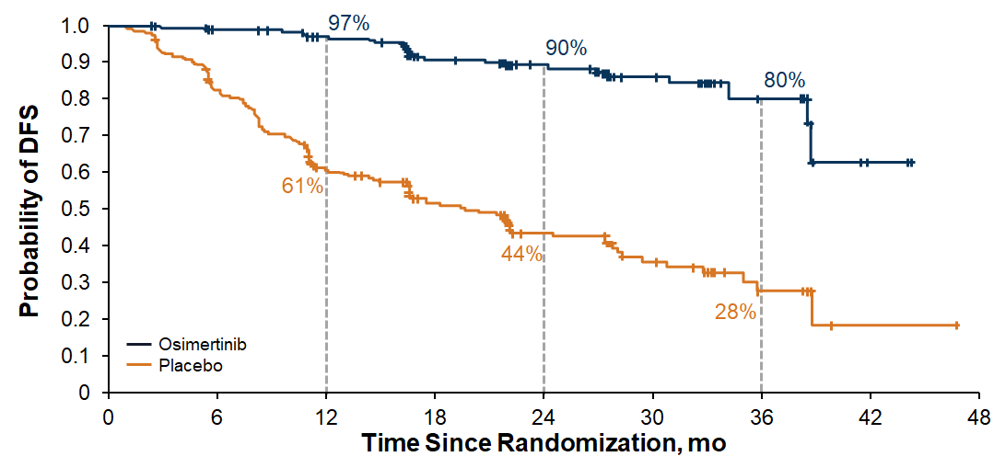
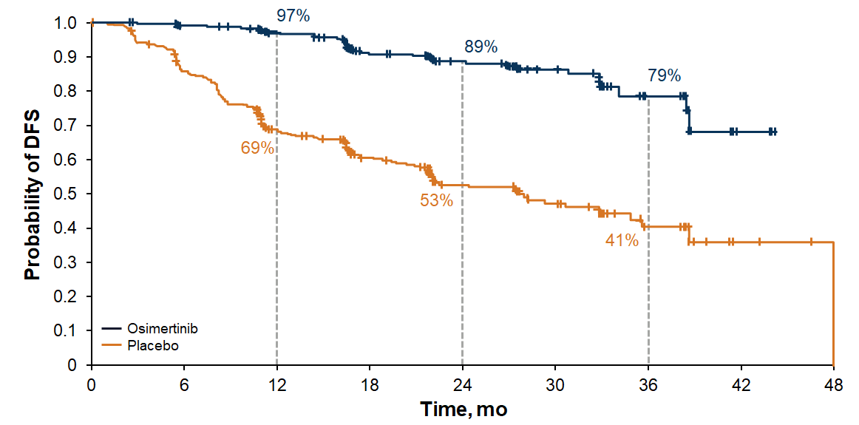

Phase III ADAURA Trial: Adjuvant Osimertinib
Disease-Free Survival (DFS)
Stage II to IIIA disease
Stage IB to IIIA disease
HR = 0.17; p < .001 → 83% reduction in risk of disease recurrence or death
HR = 0.20; p < .001 → 80% reduction in risk of disease recurrence or death

Slide 82
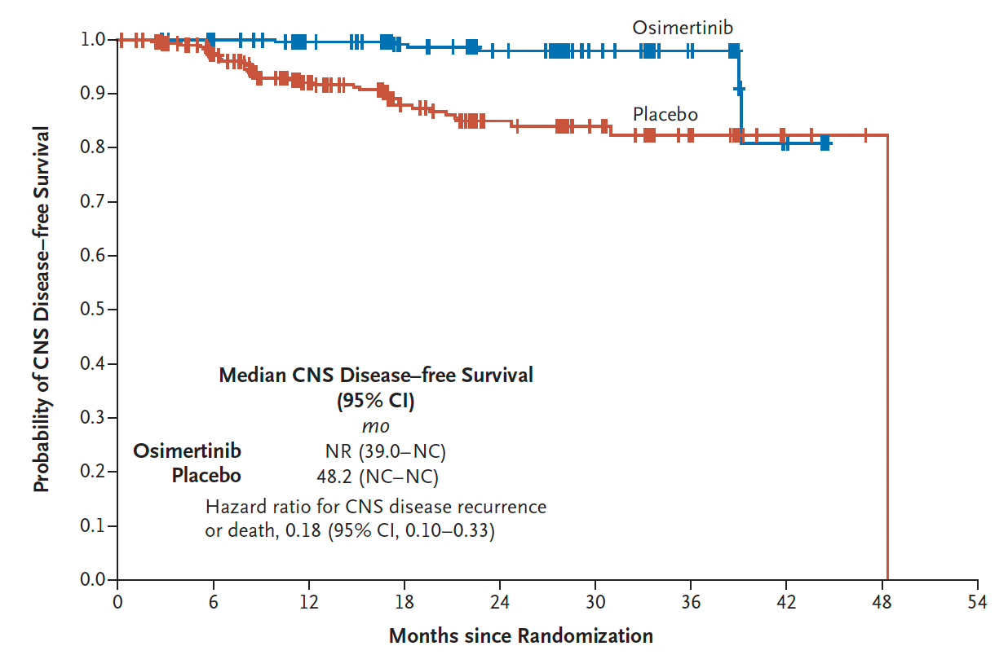
ADAURA: CNS Disease-Free Survival According to Investigator Assessment in the Overall Population
Wu Y-L et al. N Engl J Med 2020;383(18):825-35.

Slide 83
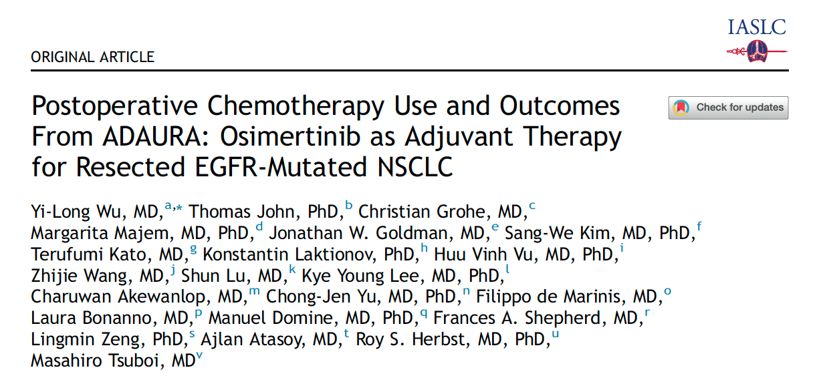
J Thorac Oncol 2022;17(3):423-33.

Slide 84
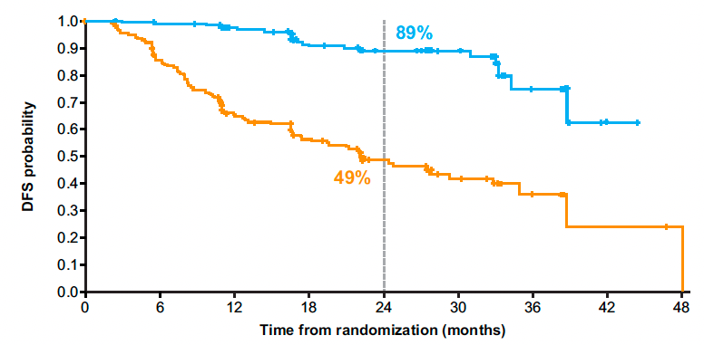
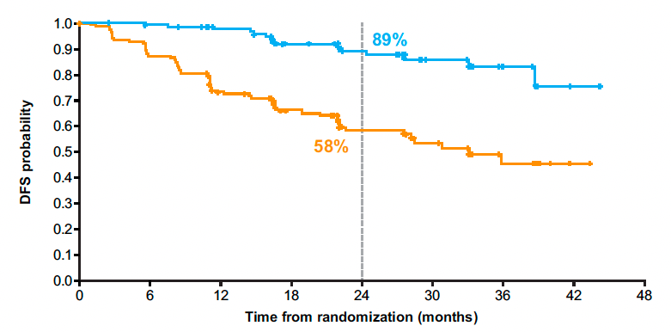
ADAURA: Updated DFS with Adjuvant Osimertinib for Patients Receiving and Not Receiving Adjuvant Chemotherapy
With adjuvant chemotherapy
Without adjuvant chemotherapy
Osimertinib
Osimertinib
Placebo
Placebo
Wu Y-L et al. J Thorac Oncol 2022;17(3):423-33.

Slide 85
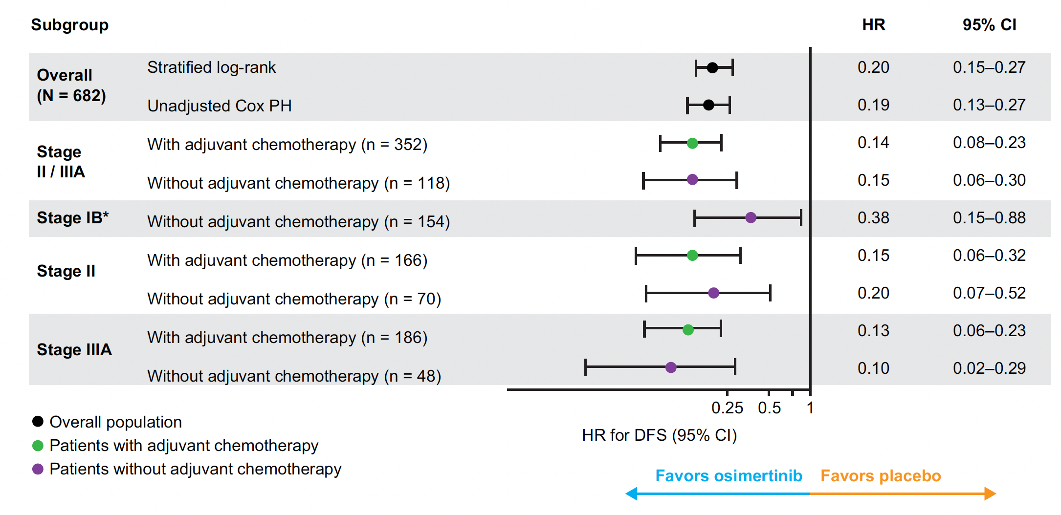
ADAURA: Updated DFS with Adjuvant Osimertinib for Patients Receiving and Not Receiving Adjuvant Chemotherapy — Subgroups
Wu Y-L et al. J Thorac Oncol 2022;17(3):423-33.

Slide 86
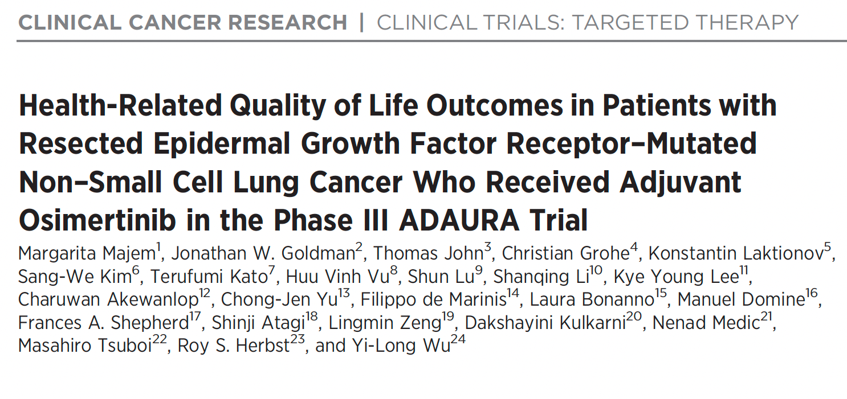
Clin Cancer Res 2022;[Online ahead of print].

Slide 87
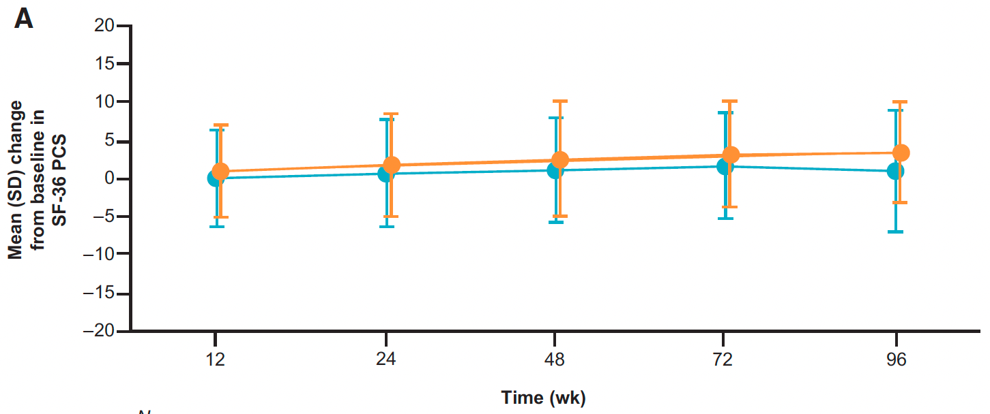
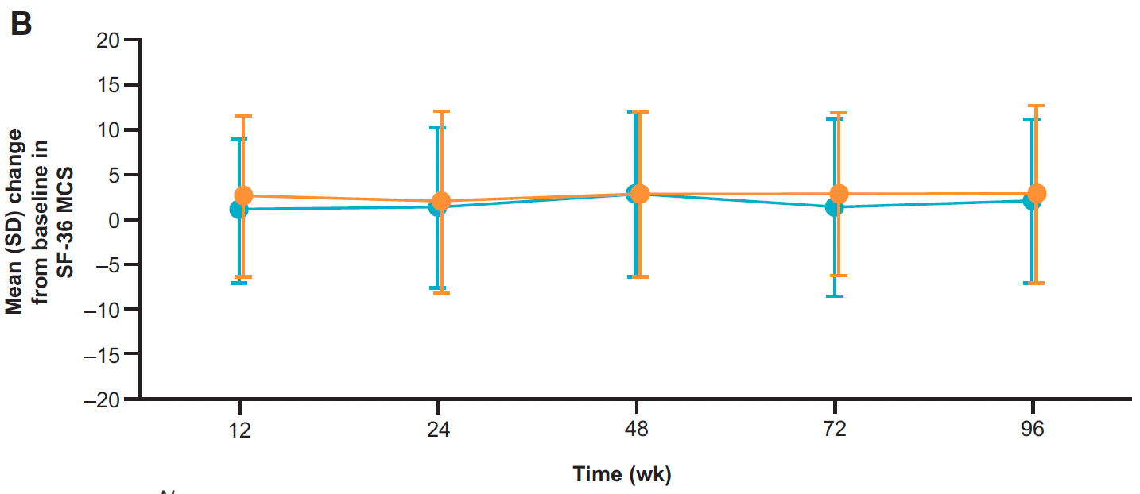
ADAURA: Health-Related Quality of Life Over Time
Physical Component Summary
Mental Component Summary
Majem M et al. Clin Cancer Res 2022;[Online ahead of print].

Slide 88
Select Ongoing Phase III Studies of TKIs for
Unresected or Unresectable NSCLC with EGFR Mutation
Study | No. of patients | NSCLC stage | Randomization | Est primary completion
NeoADAURA (NCT04351555) | 328 | Unresected II-IIIB N2 | Osimertinib Osimertinib + chemotherapy Chemotherapy | March 2024
PACIFIC-4/RTOG-3515 (NCT03833154) | 733 | Unresected IA2-IA3 | SBRT + osimertinib SBRT + durvalumab SBRT + placebo | June 2025
LAURA (NCT03521154) | 197 | Unresectable III | Chemotherapy → osimertinib maintenance Chemotherapy → placebo maintenance | January 2023
TKI = tyrosine kinase inhibitor; SBRT = stereotactic body radiation therapy
www.clinicaltrials.gov. Accessed June 2022.

Slide 89
Select Ongoing Phase III Studies of TKIs in the
Adjuvant Setting for NSCLC with EGFR Mutation
Study | No. of patients | NSCLC stage | Randomization | Est primary completion
ADAURA2 (NCT05120349) | 380 | IA2-IA3 | Osimertinib Placebo | August 2027
FORWARD (NCT04853342) | 318 | II-IIIA | Furmonertinib (AST2818) Placebo | December 2023
EVIDENCE (NCT02448797) | 320 | II-IIIA | Icotinib Standard chemotherapy | June 2022
ICTAN (NCT01996098) | 318 | IIA-IIIA | Chemotherapy → icotinib for 6 mo Chemotherapy → icotinib for 12 mo Chemotherapy | January 2020*
*Recruitment ongoing
www.clinicaltrials.gov. Accessed June 2022.

Slide 90
FDA Approves Atezolizumab as Adjuvant Treatment for NSCLC
Press Release: October 15, 2021
“The Food and Drug Administration approved atezolizumab for adjuvant treatment following resection and platinum-based chemotherapy in patients with stage II to IIIA non-small cell lung cancer (NSCLC) whose tumors have PD-L1 expression on ≥ 1% of tumor cells, as determined by an FDA-approved test.
Today, the FDA also approved the VENTANA PD-L1 (SP263) Assay as a companion diagnostic device to select patients with NSCLC for adjuvant treatment with atezolizumab.
The major efficacy outcome measure was disease-free survival (DFS) as assessed by the investigator in the primary efficacy analysis population (n = 476) of patients with stage II-IIIA NSCLC with PD-L1 expression on ≥1% of tumor cells (PD-L1 ≥1% TC). Median DFS was not reached in patients on the atezolizumab arm compared with 35.3 months on the BSC arm (HR 0.66; p = 0.004). In a pre-specified secondary subgroup analysis of patients with PD-L1 TC ≥ 50% stage II-IIIA NSCLC, the DFS HR was 0.43. In an exploratory subgroup analysis of patients with PD-L1 TC 1-49% stage II-IIIA NSCLC, the DFS HR was 0.87.
The recommended atezolizumab dose for this indication is 840 mg every 2 weeks, 1,200 mg every 3 weeks, or 1,680 mg every 4 weeks for up to 1 year.”
https://www.fda.gov/drugs/resources-information-approved-drugs/fda-approves-atezolizumab-adjuvant-treatment-non-small-cell-lung-cancer

Slide 91
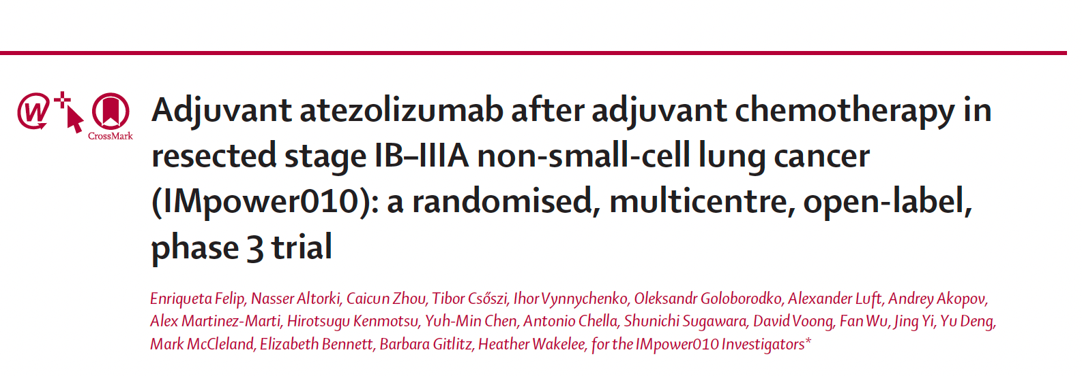
Lancet 2021;398:1344-57.

Slide 92

IMpower010 Primary Endpoint: Disease-Free Survival in the PD-L1 ≥1% Tumor Cells Stage II-IIIA Population
Felip E et al. Lancet 2021;398(10308):1344-57.

Slide 93

IMpower010: Disease-Free Survival by EGFR Mutation Status
Felip E et al. Lancet 2021;398(10308):1344-57.

Slide 94
Current and Future Management of
Metastatic NSCLC with EGFR Mutation

Slide 95

N Engl J Med 2020;382:41-50.

Slide 96

FLAURA: Overall Survival
Overall survival
 | Osimertinib (n = 279) | Comparator EGFR TKI (n = 277)
At 12 mo | 89% | 83%
At 24 mo | 74% | 59%
At 36 mo | 54% | 44%
Hazard ratio, 0.80
p = 0.046
Ramalingam SS et al. N Engl J Med 2020;382;41-50.

Slide 97
Select Ongoing Phase III Studies of First-Line Therapy for Patients with Metastatic NSCLC and Activating EGFR Mutations
Study | No. of patients | Randomization | Est primary completion
FLAURA2 | 587 | Osimertinib Osimertinib + platinum-based chemo | April 2023
MARIPOSA | 1,000 | Amivantamab + lazertiniib Osimertinib + placebo Lazertinib + placebo | April 2024
ECOG-ACRIN EA5182 | 300 | Osimertinib Osimertinib + bevacizumab | September 2025
SANOVO* | 320 | Osimertinib + savolitinib Osimertinib + placebo | November 2024
FLETEO | 680 | Osimertinib TY-9591 | May 2025
* Sensitizing EGFR mutation and c-MET overexpression
www.clinicaltrials.gov. Accessed June 2022.

Slide 98

Mechanisms of Acquired Resistance to Osimertinib
Alterations that prevent inhibition of the target receptor tyrosine
Activation of bypass and/or
downstream signalling pathways
Changes in tumour
cell lineage such as
transformation
Cooper AJ et al. Nat Rev Clin Oncol 2022;[Online ahead of print].

Slide 99

Broad Range of Resistance Mechanisms in NSCLC with EGFR Mutation After Failure of EGFR TKI Therapy
Janne PA et al. ASCO 2021;Abstract 9007.

Slide 100
ORCHARD Osimertinib + Savolitinib Interim Analysis: A Biomarker-Directed Phase II Platform Study in Patients with Advanced Non-Small Cell Lung Cancer (NSCLC) Whose Disease Has Progressed on First-Line (1L) Osimertinib
Yu HA et al.
ESMO 2021;Abstract 1239P.

Slide 101

ORCHARD Study Design
Yu HA et al. ESMO 2021;Abstract 1239P.

Slide 102


ORCHARD: Response and Duration of Response
ORR: 41%
ORR = objective response rate; DCO = data cutoff
Yu HA et al. ESMO 2021;Abstract 1239P.

Slide 103

ORCHARD: Incidence of Grade ≥3 Adverse Events
Yu HA et al. ESMO 2021;Abstract 1239P.

Slide 104
Select Ongoing Studies to Overcome Mechanisms of Resistance to EGFR TKIs for Advanced NSCLC
Study/phase | No. of patients | Eligibility | Treatment
SAVANNAH Phase II | 294 | Locally advanced/metastatic EGFR mutation MET amplified/overexpressed PD on osimertinib | Osimertinib + savolitinib
SAFFRON Phase III | 324 | Locally advanced/metastatic EGFR mutation MET amplified/overexpressed PD on osimertinib | Osimertinib + savolitinib Platinum-based doublet
COMPEL Phase III | 204 | Locally advanced/metastatic EGFR mutation Extracranial PD on first-line osimertinib | Platinum/pemetrexed + osimertinib Platinum/pemetrexed + placebo
MARIPOSA-2 Phase III | 500 | Locally advanced/metastatic EGFR mutation PD on osimertinib | Platinum-based chemotherapy + amivantamab + lazertinib Platinum-based chemotherapy
PD = disease progression
www.clinicaltrials.gov. Accessed June 2022.

Slide 105
FDA Grants Breakthrough Therapy Status to Patritumab Deruxtecan for Metastatic NSCLC with EGFR Mutation
Press Release: January 4, 2022
“Patritumab deruxtecan (U3-1402), a potential first-in-class HER3 directed antibody-drug conjugate, was granted breakthrough therapy designation by the FDA for the treatment of patients with metastatic or locally advanced, EGFR-mutant non–small cell lung cancer (NSCLC).
The regulatory decision, which is designed to accelerate the development and regulatory review process of potential new therapies, was based on data from a dose escalation study and 2 expansion cohorts from a 3-cohort trial.
Data from a phase 1 trial (NCT03260491) assessing the efficacy of patritumab deruxtecan in a heavily pretreated population of patients with EGFR-mutant NSCLC that have become resistant to other TKIs were read out at the 2021 American Society of Clinical Oncology Annual Meeting: Lung Cancer. A 5.6 mg/kg dose of the treatment resulted in a confirmed objective response rate of 39% (95% CI, 26%-52%) in a population of patients who were previously treated with a TKI and platinum-based therapy (n = 57). Additionally, treatment with patritumab deruxtecan resulted in a disease control rate of 72% (95% CI, 59%-83%), as well as a median progression-free survival of 8.2 months (95% CI, 4.0-not evaluable).
https://www.cancernetwork.com/view/fda-grants-breakthrough-therapy-status-to-patritumab-deruxtecan-for-egfr-metastatic-nsclc

Slide 106
Cancer Discov 2022;12(1):74-89.

Slide 107
Patritumab Deruxtecan (HER3-DXd) Targeting HER3 May Address Multiple EGFR TKI Resistance Mechanisms
HER3-DXd is an antibody-drug conjugate with 3 components:
A fully human anti-HER3 IgG1 mAb (patritumab), covalently linked to:
A topoisomerase I inhibitor payload, an exatecan derivative, via
A tetrapeptide-based cleaver linker
Janne PA et al. ASCO 2021;Abstract 9007.

Slide 108
Responses by Blinded Independent Central Review
Jänne PA et al. Cancer Discov 2022;12(1):74-89.

Slide 109
Summary of Treatment-Emergent Adverse Events (TEAEs)
RDE = recommended dose for expansion
Jänne PA et al. Cancer Discov 2022;12(1):74-89.

Slide 110
Select Grade ≥3 Treatment-Emergent Adverse Events (TEAEs)
Jänne PA et al. Cancer Discov 2022;12(1):74-89.

Slide 111
HERTHENA-Lung02: An Ongoing Phase III Trial of Patritumab Deruxtecan for NSCLC with EGFR Mutation After Failure of an EGFR TKI
Trial identifier: NCT05338970 (Open)
Estimated enrollment: 560
Eligibility
Locally advanced or metastatic nonsquamous NSCLC with EGFR activating mutation 1 or 2 prior lines of an approved EGFR TKI in the metastatic or locally advanced setting, which must include a third-generation EGFR TKI Radiographic disease progression while receiving or after receiving a third-generation EGFR TKI
Patritumab deruxtecan
R
Platinum-based chemotherapy
Primary endpoint: Progression-free survival by blinded independent central review
www.clinicaltrials.gov. Accessed June 2022.

Slide 112
Available Therapeutic Strategies for Patients with NSCLC Harboring an EGFR Exon 20 Insertion Mutation

Slide 113

2021;16(3):e0247620.

Slide 114
Global Exon 20 Insertion Rates
Region | EGFR exon 20 insertion among all patients with NSCLC | EGFR exon 20 insertion among patients with NSCLC and EGFR mutations
USA | 0.5%-2.6% | 5%-12%
Latin America | 1.3%-2.1% | 5%-8%
Europe | 0.3%-1.3% | 4%-12%
Asia Pacific | 0.1%-4.0% | 1%-5%
Burnett H et al. PLoS One 2021;16(3):e0247620.

Slide 115
FDA Grants Accelerated Approval to Amivantamab-vmjw for Metastatic NSCLC
Press Release: May 21, 2021
“The Food and Drug Administration granted accelerated approval to amivantamab-vmjw, a bispecific antibody directed against epidermal growth factor (EGF) and MET receptors, for adult patients with locally advanced or metastatic non-small cell lung cancer (NSCLC) with epidermal growth factor receptor (EGFR) exon 20 insertion mutations, as detected by an FDA-approved test, whose disease has progressed on or after platinum-based chemotherapy.
FDA also approved the Guardant360® CDx as a companion diagnostic for amivantamab-vmjw.
Approval was based on CHRYSALIS, a multicenter, non-randomized, open label, multicohort clinical trial (NCT02609776) which included patients with locally advanced or metastatic NSCLC with EGFR exon 20 insertion mutations. Efficacy was evaluated in 81 patients with advanced NSCLC with EGFR exon 20 insertion mutations whose disease had progressed on or after platinum-based chemotherapy. Patients received amivantamab-vmjw once weekly for 4 weeks, then every 2 weeks thereafter until disease progression or unacceptable toxicity.”
https://www.fda.gov/drugs/resources-information-approved-drugs/fda-grants-accelerated-approval-amivantamab-vmjw-metastatic-non-small-cell-lung-cancer

Slide 116

J Clin Oncol 2021;39:3391-402.

Slide 117

CHRYSALIS: Tumor Reduction and Response
Overall response rate: 40%
Clinical benefit rate: 74%
Park K et al. J Clin Oncol 2021;39:3391-402.

Slide 118

CHRYSALIS: Summary of Adverse Events (AEs) and Most Common AEs
Most Common AEs in the Safety Population
Adverse Events | Any Grade | Grade ≥3
Rash | 86% | 4%
Infusion-related reactions | 66% | 3%
Paronychia | 45% | 1%
RP2D = recommended Phase II dose
Park K et al. J Clin Oncol 2021;39:3391-402.

Slide 119

Abstract 9006

Slide 120

CHRYSALIS-2: Rationale for Combining Amivantamab and Lazertinib
Shu CA et al. ASCO 2022;Abstract 9006.

Slide 121

CHRYSALIS-2 Study Design
Shu CA et al. ASCO 2022;Abstract 9006.

Slide 122

CHRYSALIS-2: Best Antitumor Response and ORR by Prior Therapy Group
BICR = blinded independent central review; ORR = overall response rate; INV = investigator
Shu CA et al. ASCO 2022;Abstract 9006.

Slide 123

CHRYSALIS-2: Safety Profile
Shu CA et al. ASCO 2022;Abstract 9006.

Slide 124

Abstract 9007

Slide 125

EGFR Exon 20 Insertion Mutations in NSCLC
Yu H et al. ASCO 2022;Abstract 9007.

Slide 126

CLN-081-001 Study Schema
Yu H et al. ASCO 2022;Abstract 9007.

Slide 127

CLN-081-001: Baseline Characteristics
Yu H et al. ASCO 2022;Abstract 9007.

Slide 128

CLN-081-001: Safety Profile
Yu H et al. ASCO 2022;Abstract 9007.

Slide 129

CLN-081-001: Best Percent Change from Baseline and Confirmed Response by Dose Level
Yu H et al. ASCO 2022;Abstract 9007.

Slide 130

CLN-081-001: Conclusions
Yu H et al. ASCO 2022;Abstract 9007.

Slide 131
FDA Grants Accelerated Approval to Mobocertinib for Metastatic NSCLC with EGFR Exon 20 Insertion Mutations
Press Release: September 15, 2021
“The Food and Drug Administration granted accelerated approval to mobocertinib for adult patients with locally advanced or metastatic non-small cell lung cancer (NSCLC) with epidermal growth factor receptor (EGFR) exon 20 insertion mutations, as detected by an FDA-approved test, whose disease has progressed on or after platinum-based chemotherapy.
Today, the FDA also approved the Oncomine Dx Target Test as a companion diagnostic device to select patients with the above mutations for mobocertinib treatment.
Approval was based on Study 101, an international, non-randomized, open-label, multicohort clinical trial (NCT02716116) which included patients with locally advanced or metastatic NSCLC with EGFR exon 20 insertion mutations. Efficacy was evaluated in 114 patients whose disease had progressed on or after platinum-based chemotherapy. Patients received mobocertinib 160 mg orally daily until disease progression or intolerable toxicity.”
https://www.fda.gov/drugs/resources-information-approved-drugs/fda-grants-accelerated-approval-mobocertinib-metastatic-non-small-cell-lung-cancer-egfr-exon-20

Slide 132

JAMA Oncol 2021;7(12):e214761

Slide 133

Mobocertinib Activity in Patients with Platinum-Pretreated
Metastatic NSCLC with EGFRex20ins Mutation (PPP Cohort)
 | PPP cohort (n = 114) | EXCLAIM cohort (n = 96)
ORR | 35% | 32%
Duration of response | 17.5 mo | Not reached
Median PFS | 7.3 mo | 7.3 mo
Median OS | 24 mo | Not reached
PPP = platinum pretreated patients; ORR = objective response rate
Zhou C et al. JAMA Oncol 2021;7(12):e214761.

Slide 134

Summary of Adverse Events (AEs) and Most Common AEs with Mobocertinib
Zhou C et al. JAMA Oncol 2021;7(12):e214761.

