Slide 1
Hodgkin and Non-Hodgkin Lymphomas Tuesday, June 14, 2022 5:00 PM – 6:00 PM ET
What I Tell My Patients: New Treatments and Clinical Trial Options
Part 2 of a 2-Part Complimentary NCPD Webinar Series
Faculty
Christopher R Flowers, MD, MS Robin Klebig, APRN, CNP, AOCNP
Moderator
Neil Love, MD

Slide 2
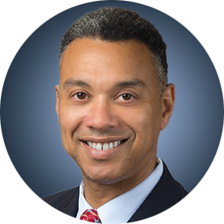
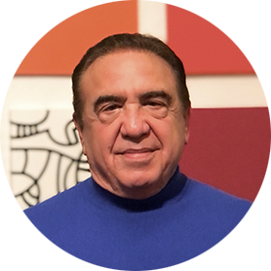
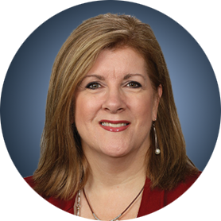
Faculty
Christopher R Flowers, MD, MS Chair, Professor Department of Lymphoma/Myeloma The University of Texas MD Anderson Cancer Center Houston, Texas
Moderator Neil Love, MD Research To Practice Miami, Florida
Robin Klebig, APRN, CNP, AOCNP Nurse Practitioner Assistant Professor of Medicine Division of Hematology Mayo Clinic Rochester, Minnesota

Slide 3
Commercial Support
This activity is supported by educational grants from ADC Therapeutics, Incyte Corporation, and Seagen Inc.
Research To Practice NCPD Planning Committee Members, Staff and Reviewers
Planners, scientific staff and independent reviewers for Research To Practice have no relevant conflicts of interest to disclose.

Slide 4
Dr Flowers — Disclosures
Consulting Agreements | AstraZeneca Pharmaceuticals LP, Bayer HealthCare Pharmaceuticals, BeiGene Ltd, Bristol-Myers Squibb Company, Celgene Corporation, Curio Science, Denovo Biopharma, Epizyme Inc, Foresight Diagnostics, Genentech, a member of the Roche Group, Genmab, Incyte Corporation, Janssen Biotech Inc, MEI Pharma Inc, MorphoSys, Pharmacyclics LLC, an AbbVie Company, Seagen Inc
Research Funding | 4D Pharma PLC, AbbVie Inc, Acerta Pharma — A member of the AstraZeneca Group, Adaptimmune, Allogene Therapeutics, Amgen Inc, Bayer HealthCare Pharmaceuticals, Burroughs Wellcome Fund, Cancer Prevention and Research Institute of Texas (CPRIT Scholar in Cancer Research), Celgene Corporation, Cellectis, Eastern Cooperative Oncology Group, EMD Serono Inc, Genentech, a member of the Roche Group, Gilead Sciences Inc, Guardant Health, Iovance Biotherapeutics, Janssen Biotech Inc, Kite, A Gilead Company, MorphoSys, National Cancer Institute, Nektar, Novartis, Pfizer Inc, Pharmacyclics LLC, an AbbVie Company, Sanofi Genzyme, Takeda Pharmaceuticals USA Inc, TG Therapeutics Inc, The V Foundation for Cancer Research, Xencor, ZIOPHARM Oncology Inc

Slide 5
Ms Klebig— Disclosures
No relevant conflicts of interest to disclose.

Slide 6
Faculty
Christopher R Flowers, MD, MS Chair, Professor Department of Lymphoma/Myeloma The University of Texas MD Anderson Cancer Center Houston, Texas
Moderator Neil Love, MD Research To Practice Miami, Florida
Robin Klebig, APRN, CNP, AOCNP Nurse Practitioner Assistant Professor of Medicine Division of Hematology Mayo Clinic Rochester, Minnesota

Slide 7
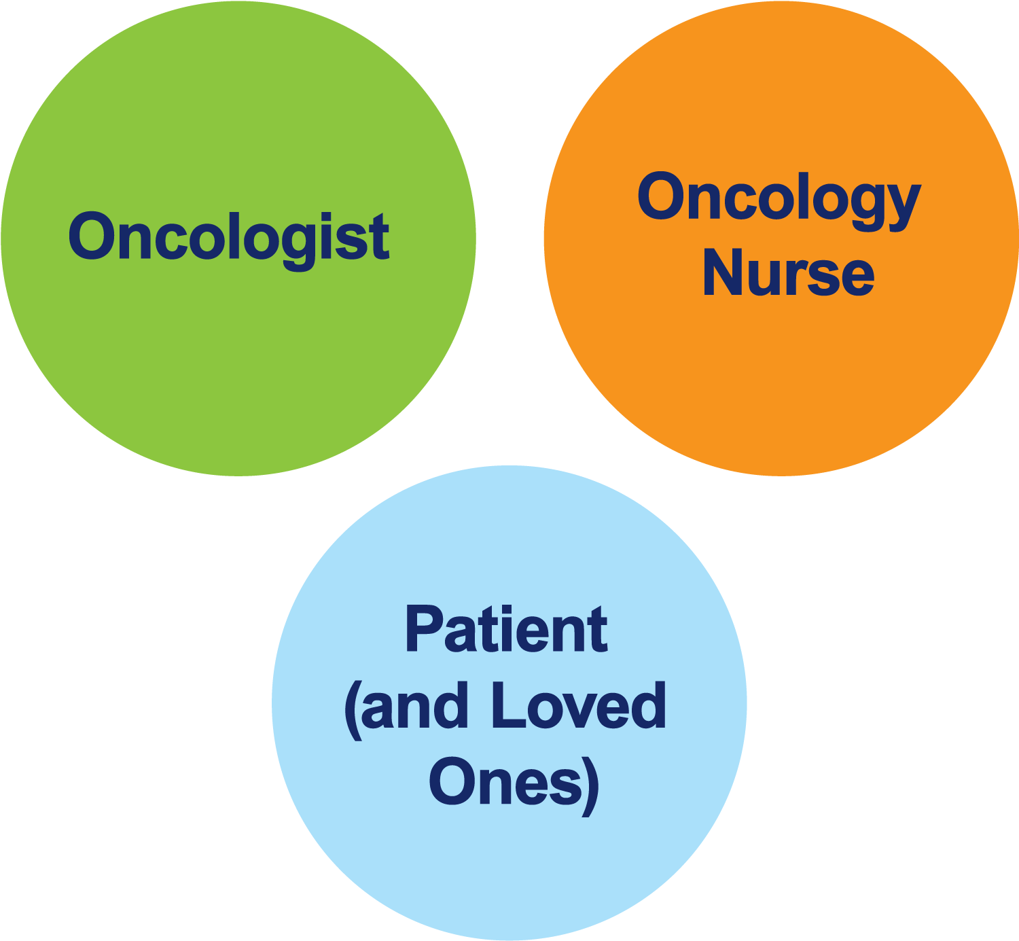
The Core Oncology Triad Developing an Individualized Oncology Strategy

Slide 8
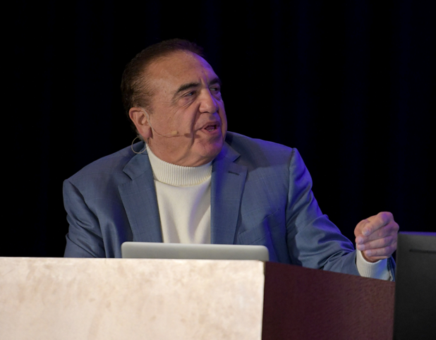
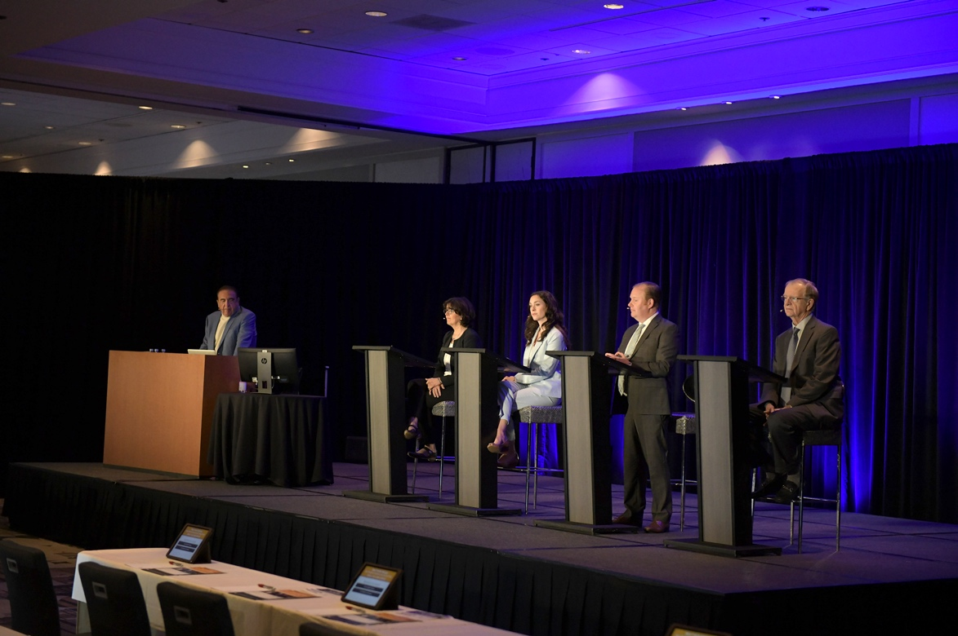
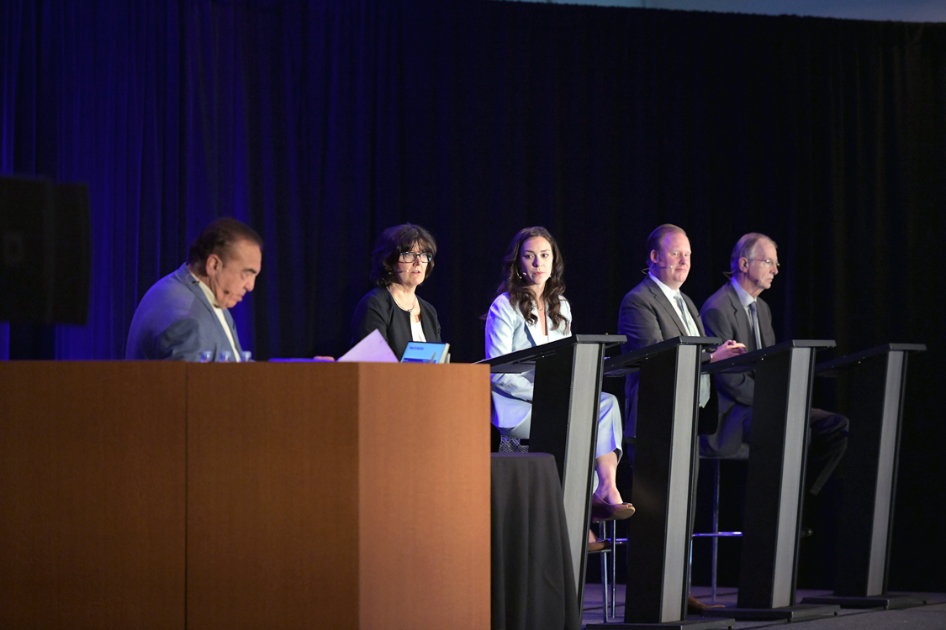
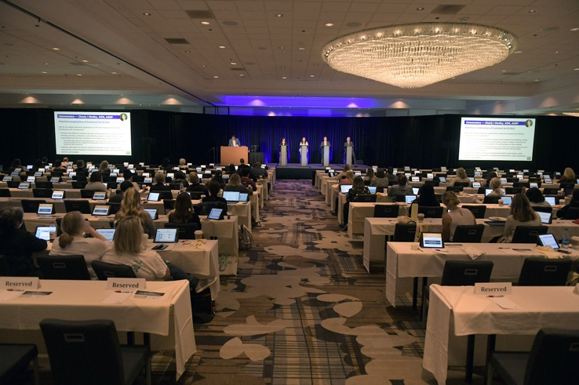

Slide 9
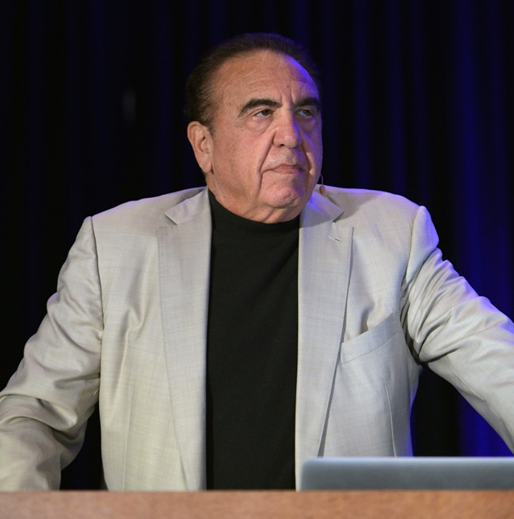
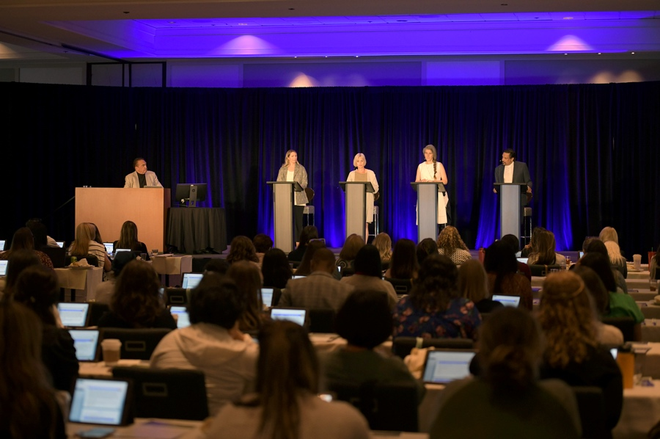
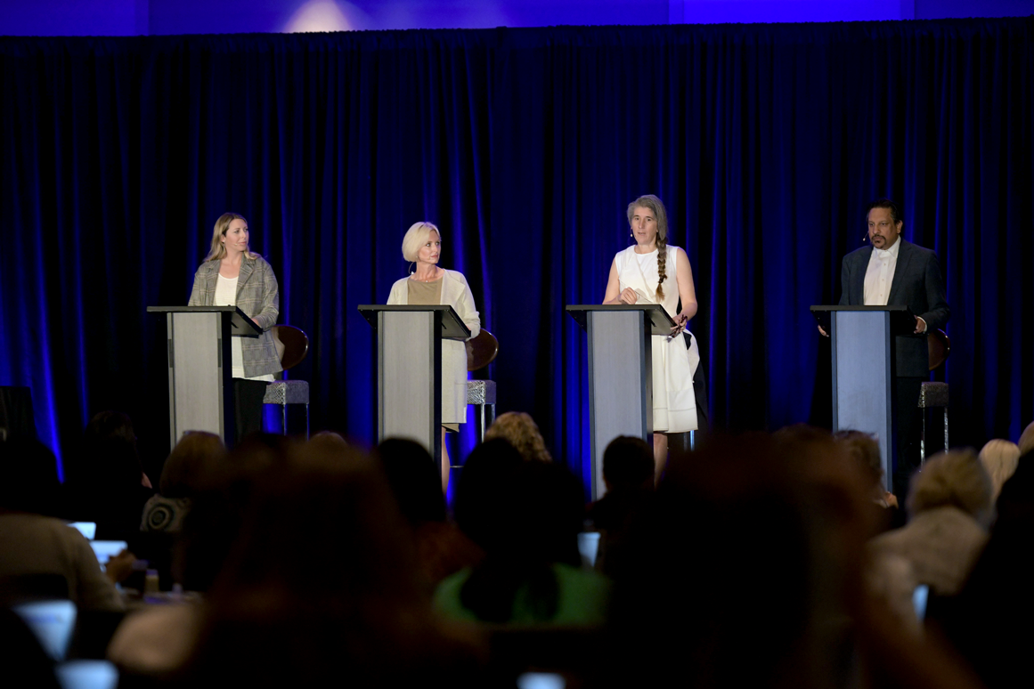
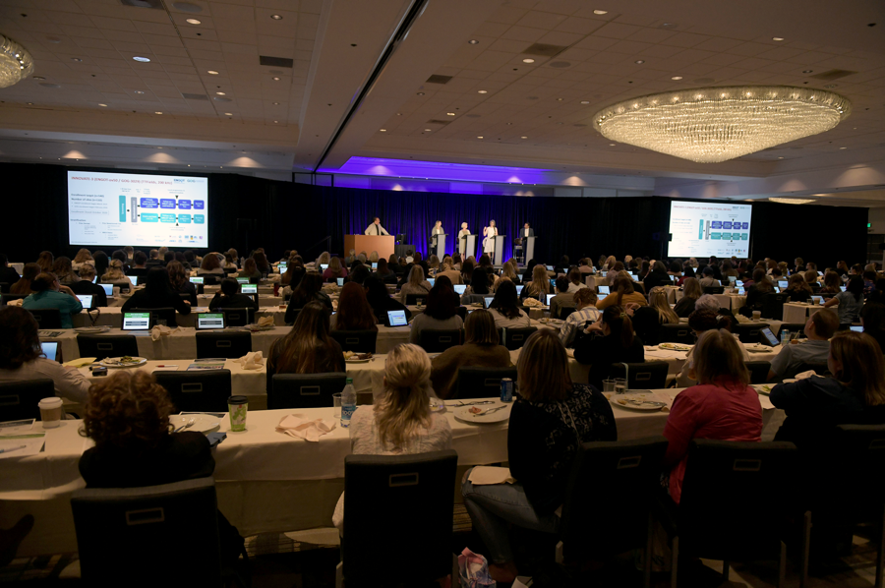

Slide 10
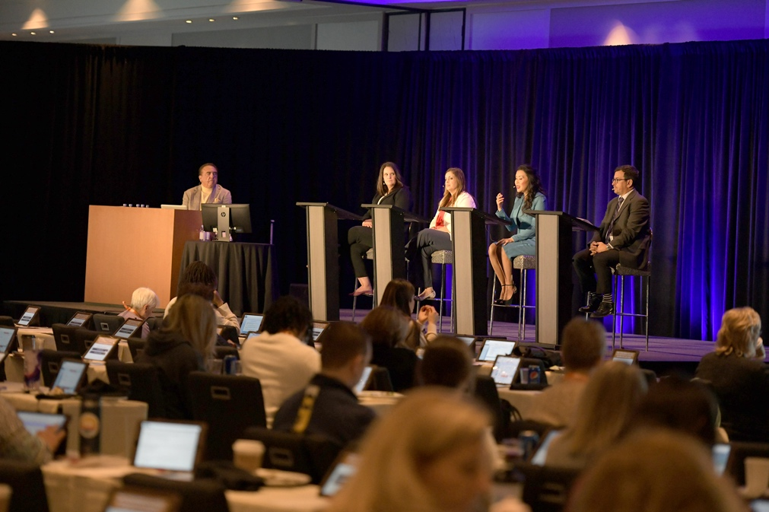
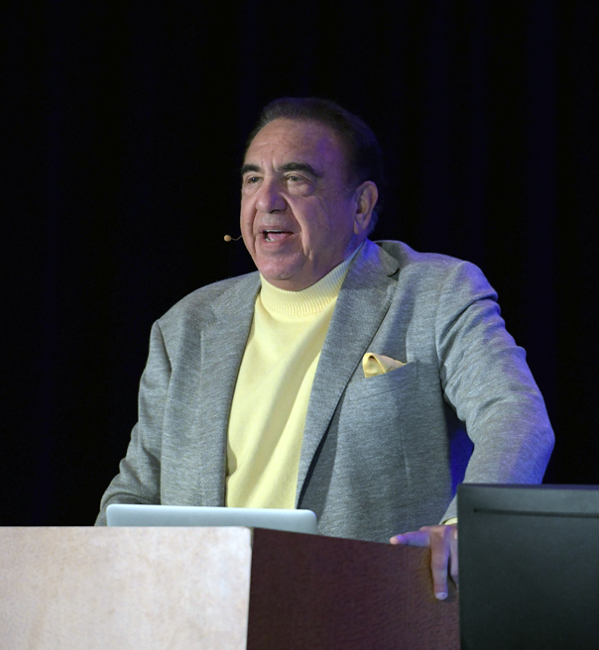
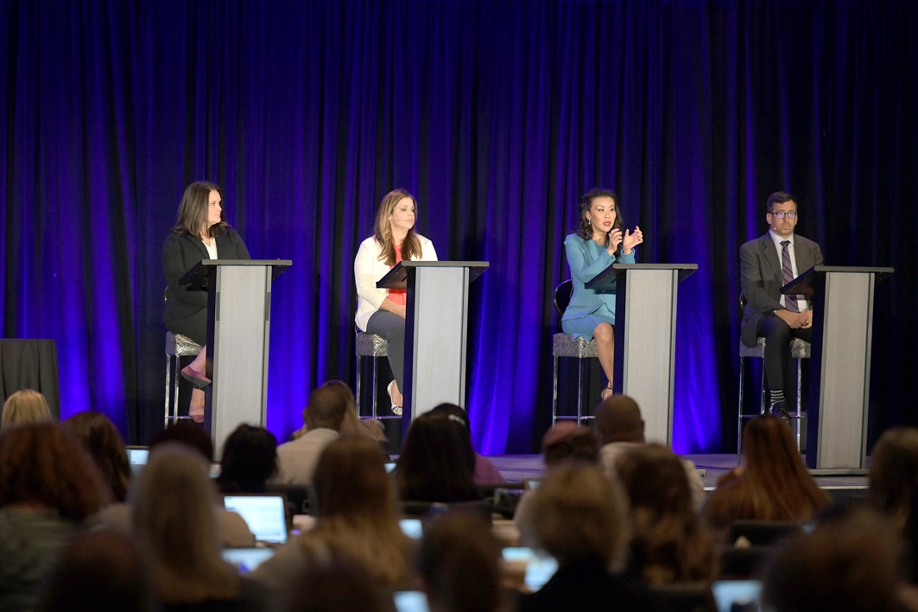
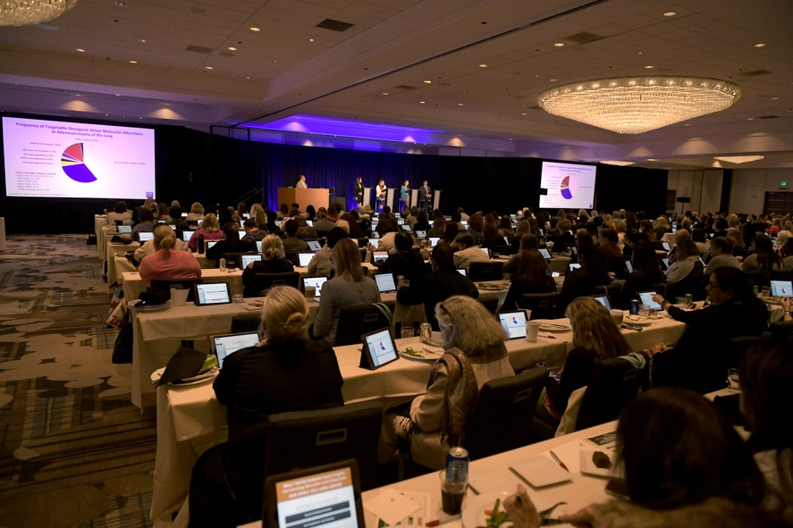
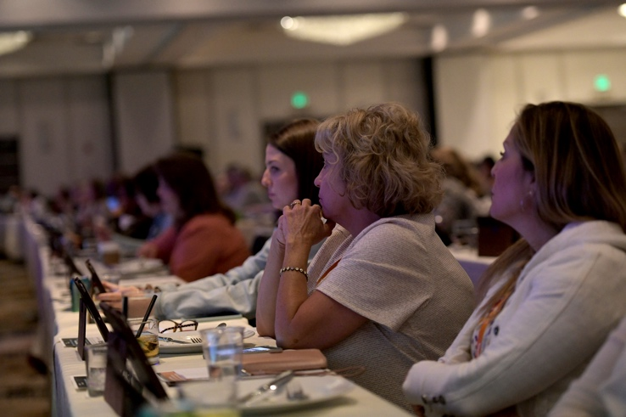

Slide 11
Agenda Management of Hodgkin and Non-Hodgkin Lymphomas
Module 1 – Diffuse Large B-Cell Lymphoma (DLBCL)
Module 2 – Hodgkin Lymphoma (HL)
Module 3 – Follicular Lymphoma (FL)
Module 4 – Mantle Cell Lymphoma (MCL)

Slide 12
Agenda Management of Hodgkin and Non-Hodgkin Lymphomas
Module 1 – Diffuse Large B-Cell Lymphoma (DLBCL)
Module 2 – Hodgkin Lymphoma (HL)
Module 3 – Follicular Lymphoma (FL)
Module 4 – Mantle Cell Lymphoma (MCL)

Slide 13
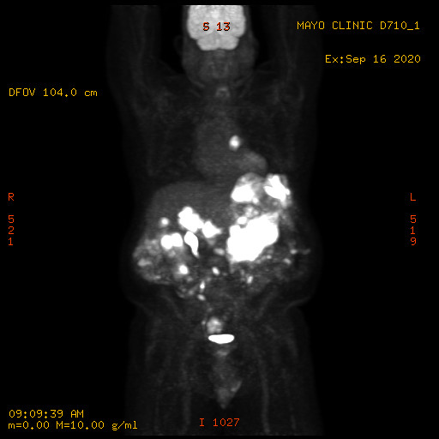
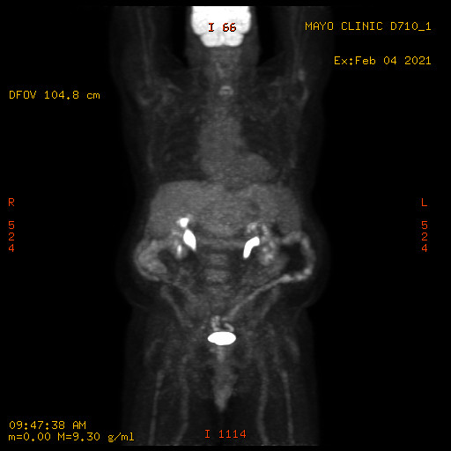
Case 1 — Robin Klebig, APRN, CNP, AOCNP
77 yo male
Lives 6 hours from Mayo Clinic
Farmer, insurance, real estate
Wife w/ depression/dementia
DLBCL-DE, stage IVB
Dx 9/2020 – treatment during COVID – challenging
R-CHOP x 6
Interim & EOT PET/CT – Deauville 1

Slide 14
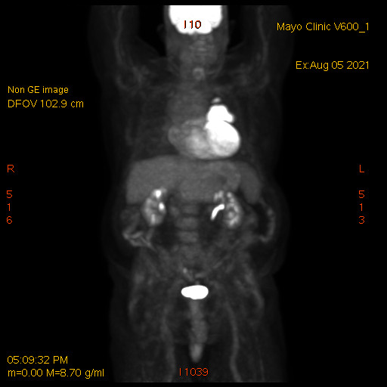
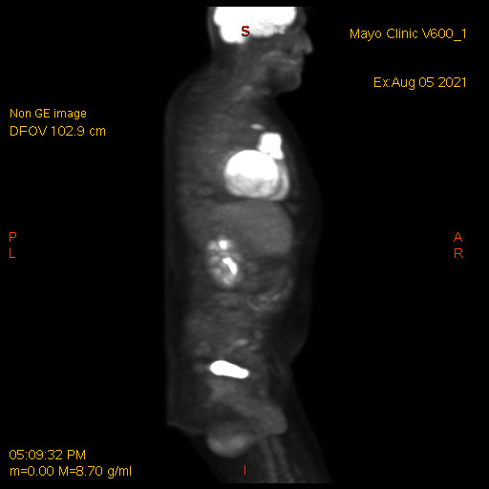
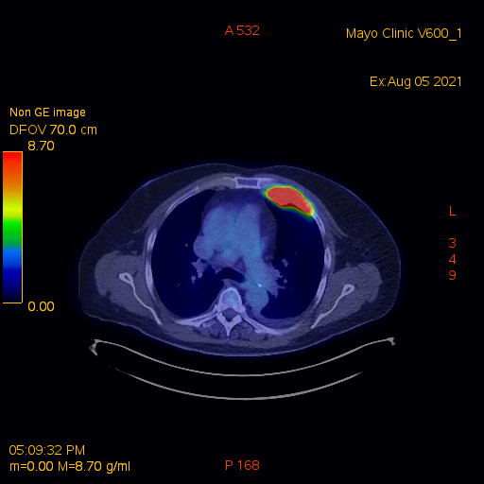
DLBCL relapse
Case 1 — Robin Klebig, APRN, CNP, AOCNP
6 months later:

Slide 15
Case 1 — Robin Klebig, APRN, CNP, AOCNP
August 2021
Initiated tafasitamab/lenalidomide
Tolerated tafasitamab well
Pruritic rash on scalp with initiation of lenalidomide
Intolerable to patient
despite topical and oral corticosteroids and diphenhydramine
Received only 2 doses of lenalidomide with each cycle
October 2021: Chest pain – ED for CT angio
Negative for PE
Demonstrated progression of chest wall mass

Slide 16
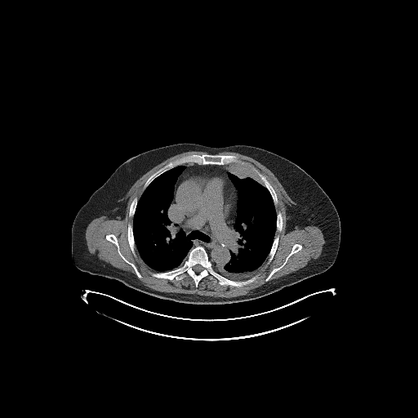
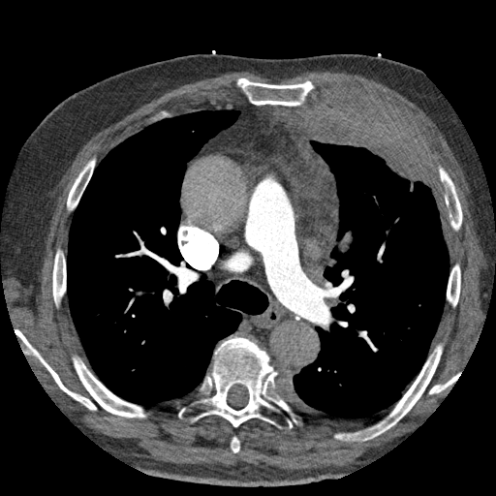
Case 1 — Robin Klebig, APRN, CNP, AOCNP
August 2021
October 2021

Slide 17
DLBCL – Plan C
Case 1 — Robin Klebig, APRN, CNP, AOCNP
Polatuzumab + BR
5 cycles
Discontinued due to complications
Fatigue
Bone pain related to pegfilgrastim
Hospitalizations
Chest pain/Afib/cardiomyopathy r/t previous anthracycline
Dehydration/diarrhea/rash
Diarrhea
Found to be due to IBD – resolved with mesalamine
Rash (sulfamethoxazole-trimethoprim)
Anorexia/weight loss
Remains in CR (Deauville 1) 6 months later…

Slide 18
Novel Agents Recently Approved for Relapsed/Refractory DLBCL
 | Pola-BR | Selinexor | Tafasitamab/ lenalidomide | Loncastuximab tesirine
Mechanism of action | Anti-CD79b ADC | XPO-1 inhibitor | Anti-CD19 MAb/immunomodulator | Anti-CD19 ADC
ORR | 45% | 28% | 58% | 48%
CR rate | 40% | 10% | 40% | 24%
PFS | 9.2 mo | 2.6 mo | 11.6 mo | 4.9 mo
DoR | 12.6 mo | 9.3 mo | 43.9 mo | 10.3 mo
OS | 12.4 mo | NR | 33.5 mo | 9.9 mo
Pola-BR = polatuzumab vedotin with bendamustine/rituximab; ADC = antibody-drug conjugate; mAb = monoclonal antibody
Content courtesy of Laurie H Sehn MD, MPH

Slide 19
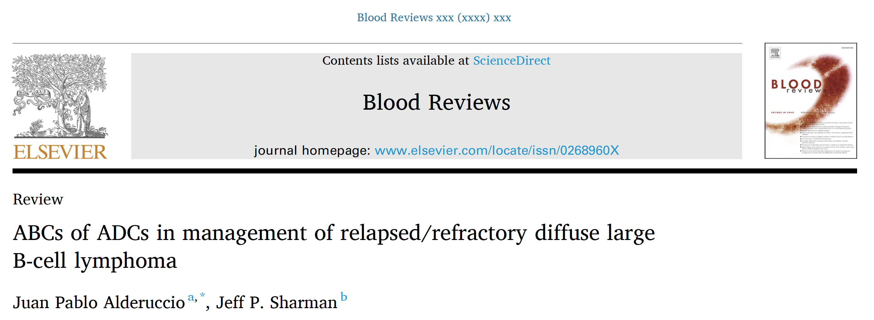
Blood Rev 2022 Apr 22;[Online ahead of print].

Slide 20
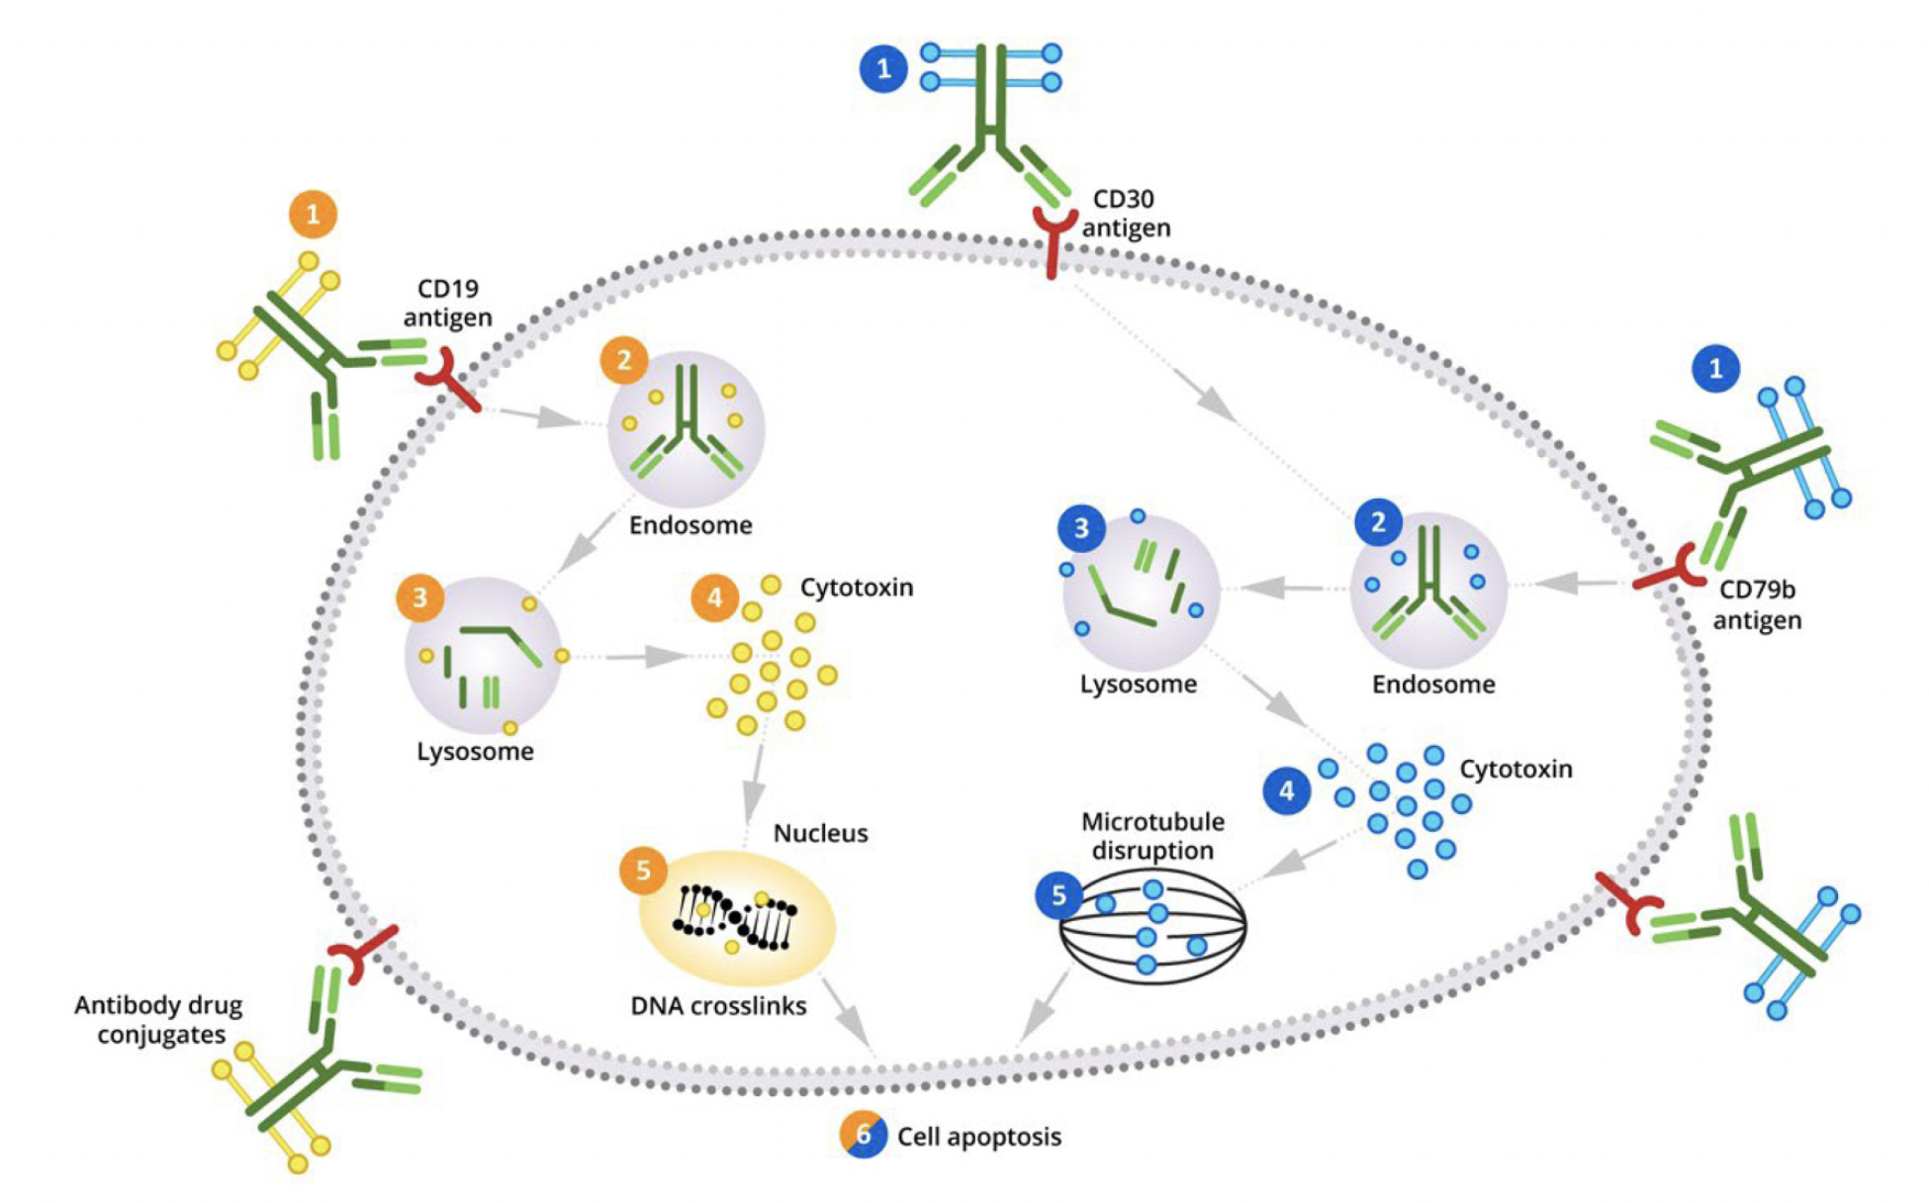
Antibody-Drug Conjugate Mechanism of Action in DLBCL
Alderuccio JP, Sharman JP. Blood Rev 2022;[Online ahead of print].

Slide 21
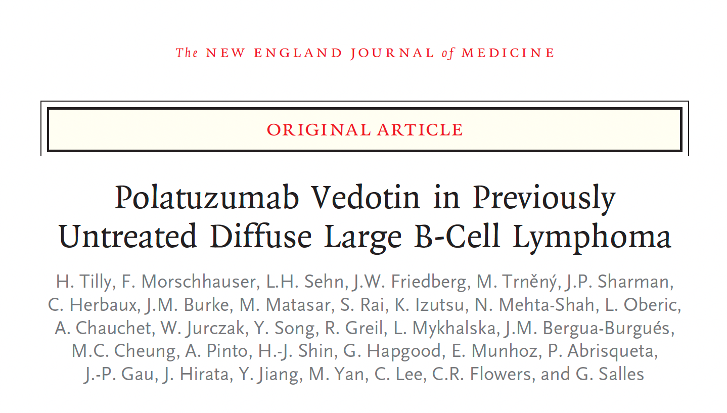
N Engl J Med 2022;386(4):351-63.

Slide 22
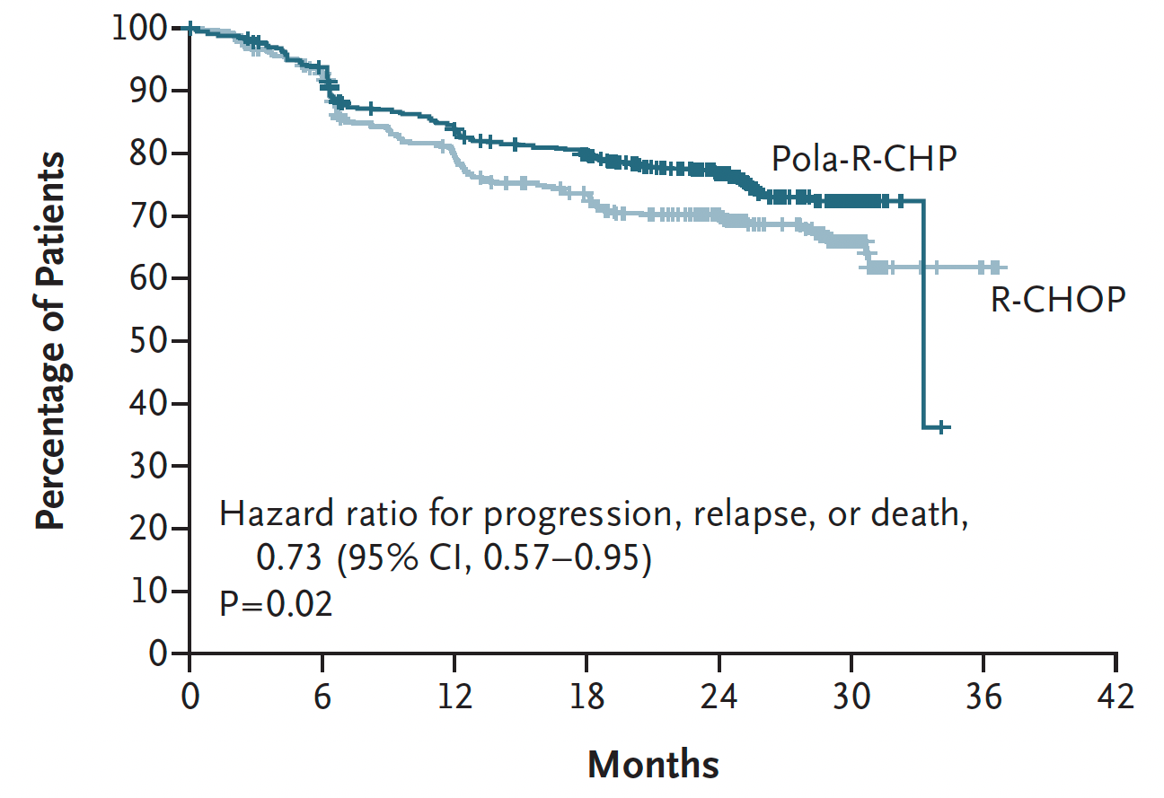
POLARIX: Investigator-Assessed Progression-Free Survival (Primary Endpoint)
Estimated 2-yrs PFS: 76.7% vs 70.2%
Tilly H et al. N Engl J Med 2022;386(4):351-63.

Slide 23
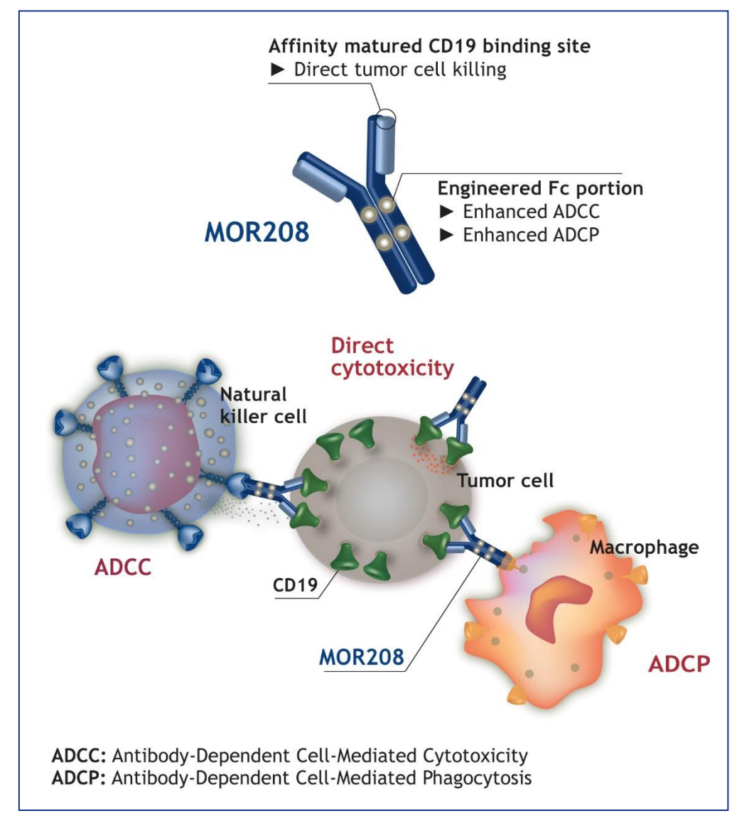
Tafasitamab (MOR208)
Tafasitamab
Lenalidomide enhances NK function with enhanced ADCC in vitro
Tafasitamab
Salles G et al. Lancet Oncol 2020;21(7):978-88.

Slide 24
Lancet Oncol 2020;21(7):978-88.
As a result of the L-MIND trial, tafasitamab in combination with lenalidomide was FDA approved for patients with relapsed or refractory DLBCL not otherwise specified, including DLBCL arising from low-grade lymphoma, who are not eligible for autologous stem cell transplant.

Slide 25
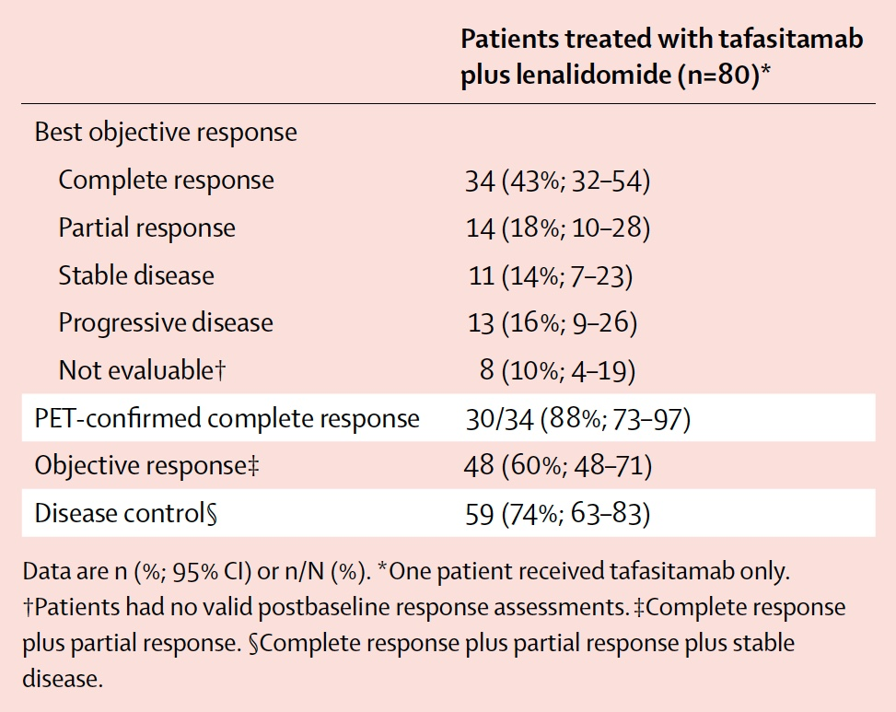
L-MIND: Best Objective Response According to Independent Radiology Committee or Clinical Review Committee
Salles G et al. Lancet Oncol 2020;21(7):978-88.

Slide 26
L-MIND: Select Adverse Events and Incidence of Infusion-Related Reactions
 | Grade 1-2 | Grade 3-4
Neutropenia | 1 (1%) | 39 (49%)
Anemia | 22 (27%) | 6 (7%)
Thrombocytopenia | 11 (14%) | 14 (18%)
Febrile neutropenia | 0 | 10 (13%)
Pneumonia | 1 (1%) | 5 (6%)
Pulmonary embolism | 0 | 4 (5%)
Treatment-emergent adverse events that led to discontinuation of tafasitamab included pneumonia, bronchitis, deep vein thrombosis and allergic dermatitis.
Infusion-related reactions (all Grade 1) were observed in 5 (6%) patients. All occurred once during the first infusion and no discontinuation of infusion was required.
Salles G et al. Lancet Oncol 2020;21(7):978-88.

Slide 27
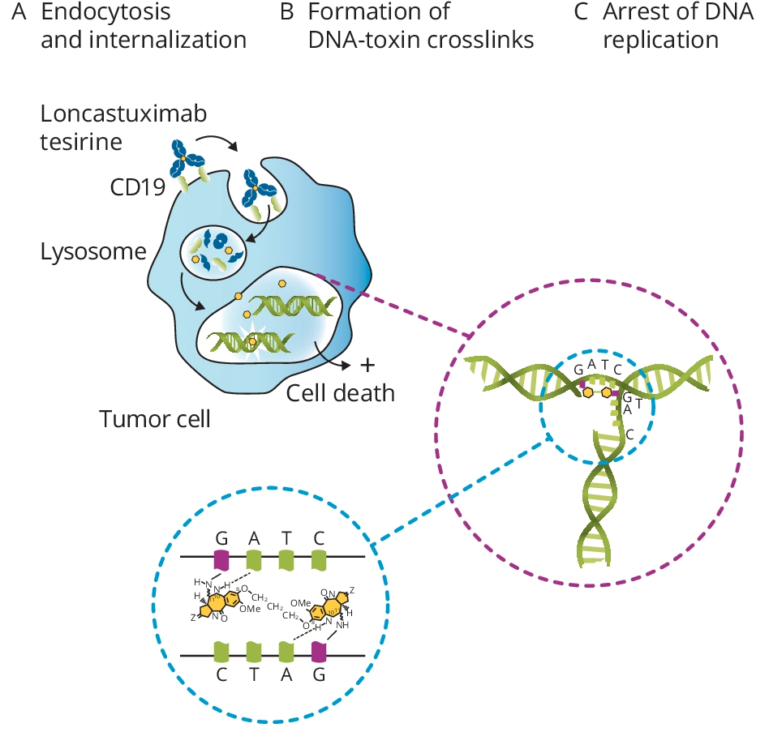
Mechanism of Action of Loncastuximab Tesirine
Hamadani M et al. ASCO 2021; Abstract TPS7574.

Slide 28
Lancet Oncol 2021;22(6):790-800.
As a result of the LOTIS-2 trial, loncastuximab tesirine was FDA approved for patients with relapsed or refractory large B-cell lymphoma after 2 or more lines of systemic therapy, including DLBCL not otherwise specified, DLBCL arising from low-grade lymphoma and high-grade B-cell lymphoma.

Slide 29
LOTIS-2: Select Treatment-Emergent Adverse Events (AEs)
Treatment-emergent AEs | Grade 1-2 | Grade 3-4
Peripheral edema* | 19% | 1%
Anemia | 16% | 10%
Thrombocytopenia | 15% | 18%
Neutropenia | 14% | 26%
Pleural effusion* | 8% | 2%
Leukopenia | 6% | 9%
* Treatment-emergent AEs considered likely to be related to the the agent’s payload included edema or effusion, symptoms in the skin or nails and liver enzyme abnormalities
Caimi PF et al. Lancet Oncol 2021;22(6):790-800.

Slide 30
Randomized Trials Comparing Second-Line CAR T-Cell to Standard Therapy for Patients with Transplant-Eligible DLBCL with Primary Refractory Disease or Relapse within 1 Year of First-Line Therapy
 | ZUMA-7 | TRANSFORM | BELINDA
CAR T-cell therapy | Axicabtagene ciloleucel | Lisocabtagene maraleucel | Tisagenlecleucel
n | 359 | 184 | 322
Pts infused in CAR arm | 94% | 98% | 96%
Median EFS | 8.3 mo vs 2 mo | 10.1 mo vs 2.3 mo | 3 mo vs 3 mo
Hazard ratio | 0.398 (p < 0.0001) | 0.349 (p < 0.0001) | 1.07 (p = 0.69)
Median follow-up | 25 mo | 6 mo | 10 mo
CR rate | 65% vs 32% | 66% vs 39% | 28% vs 28%
Grade ≥3 CRS/NT | 6%/21% | 1%/4% | 5%/3%
 | Locke et al. ASH 2021;Abstract 2 | Kamdar et al. ASH 2021;Abstract 91 | Bishop et al. ASH 2021;Abstract LBA-6
CAR = chimeric antigen receptor; EFS = event-free survival; CR = complete response; CRS = cytokine release syndrome; NT = neurotoxicity
Content courtesy of Jeremy Abramson, MD

Slide 31
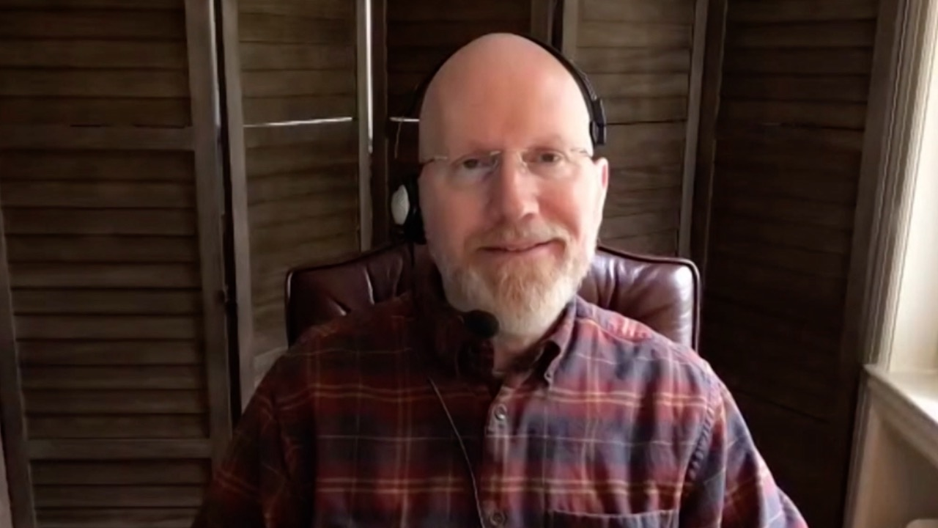
An 88-year-old woman with newly diagnosed DLBCL who developed pneumonia after the first dose of R-CHOP
Dr Erik Rupard (West Reading, Pennsylvania)

Slide 32
Agenda Management of Hodgkin and Non-Hodgkin Lymphomas
Module 1 – Diffuse Large B-Cell Lymphoma (DLBCL)
Module 2 – Hodgkin Lymphoma (HL)
Module 3 – Follicular Lymphoma (FL)
Module 4 – Mantle Cell Lymphoma (MCL)

Slide 33
Case 2 — Robin Klebig, APRN, CNP, AOCNP
75 yo female
Dx 6/2021: Stage IVA cHL – lymphadenopathy & bone lesions
PMH: Afib, CHF – apixaban & multiple cardiac meds – cleared by CV; idiopathic PN on duloxetine & gabapentin, chronic diarrhea
Rx plan: Sequential BV & AVD for older pts with untreated cHL
BV x 2 – AVD x 6 – BV x 4
C1 BV: E coli enteritis, dehydration, pneumonia despite adequate ANC (delayed C2 by 3 weeks)
C2 BV: Dx DM. Prolonged hospitalization for respiratory failure w/ hypoxia requiring intubation and pressor support (due to fluid overload w/ h/o Afib)

Slide 34
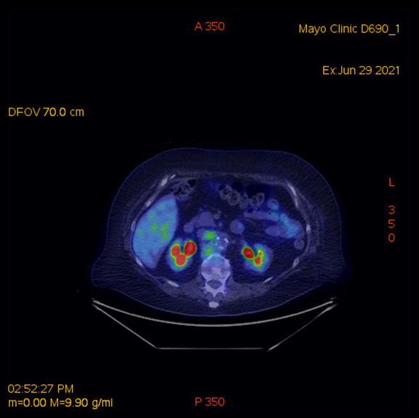
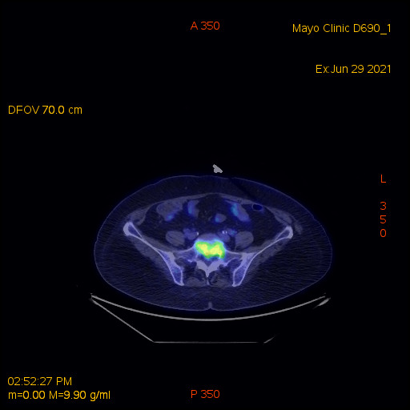
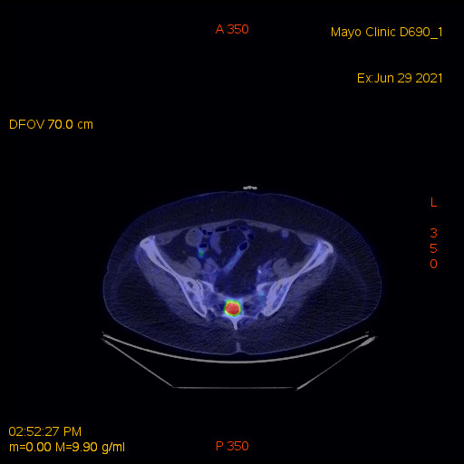
Baseline PET/CT
Case 2 — Robin Klebig, APRN, CNP, AOCNP

Slide 35
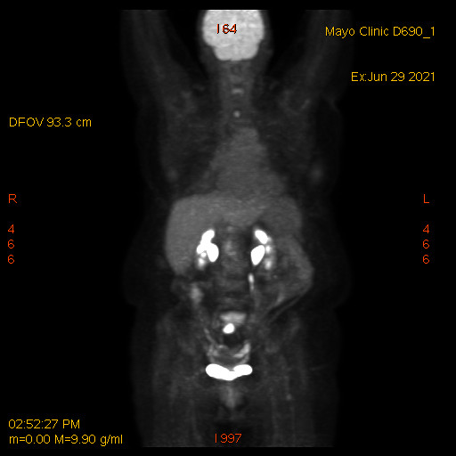
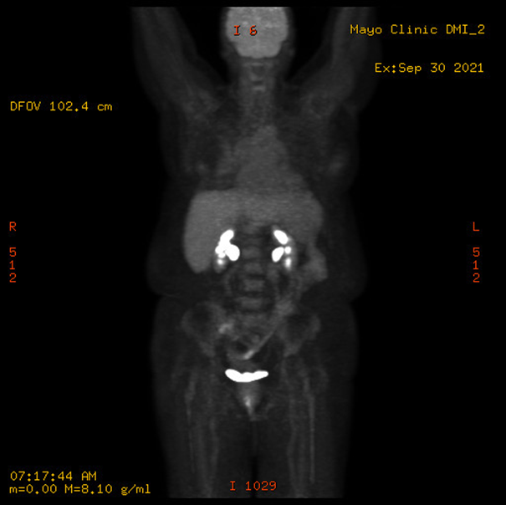
Response to 2 cycles of BV
Case 2 — Robin Klebig, APRN, CNP, AOCNP
6/29/2021
9/30/2021

Slide 36
Chemo plan continued
Case 2 — Robin Klebig, APRN, CNP, AOCNP
C1 AVD (delayed 1 week)
Had “unexpected alopecia”
Dose reductions
50% doxorubicin due to drug interactions and PS
25% vinblastine due to peripheral neuropathy
25% dacarbazine due to PS
Complications requiring dose delays due to
Diarrhea, hypomagnesemia, dehydration, Afib/RVR requiring hospitalization
Recurrence of perirectal fistula & abscess
Sudden death of daughter
No further dose reductions

Slide 37
Case 2 — Robin Klebig, APRN, CNP, AOCNP
AVD completed – FINALLY!
PET/CT – Deauville 1
C3 BV resumed 5/17/2021 still at full dose
C4 BV dose reduced to 1.2 mcg/kg due to progressive PN
Should be completing chemotherapy 7/18/2022 if all goes well…

Slide 38
Abstract 7503

Slide 39
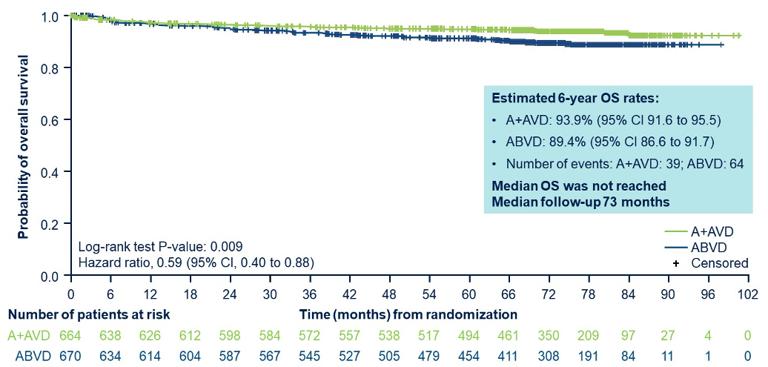
ECHELON-1: Prespecified OS Analysis After Approximately 6 Years Follow-Up
A + AVD = brentuximab vedotin and doxorubicin/vinblastine/dacarbazine; ABVD = doxorubicin/bleomycin/vinblastine/dacarbazine
Ansell SM et al. ASCO 2022;Abstract 7503.

Slide 40
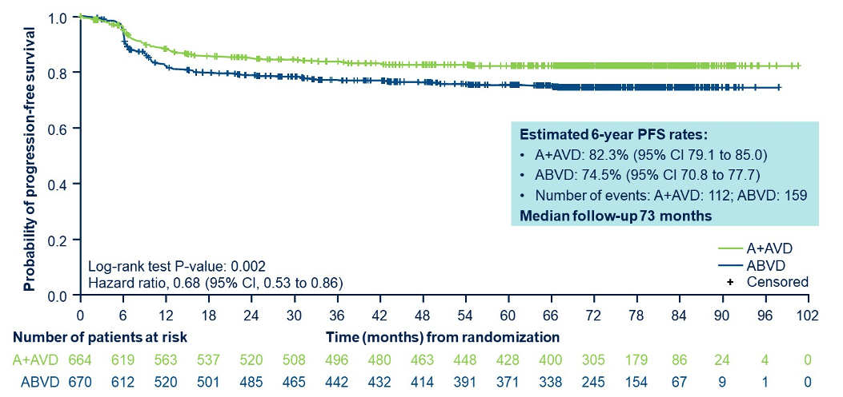
ECHELON-1: Updated PFS Analysis After Approximately 6 Years Follow-Up
In patients with peripheral neuropathy (PN) in the A + AVD and ABVD arms after 6-year follow-up, treatment-emergent PN either resolved or continued to improve in 86% and 87% (median time to resolution was 16 and 10 weeks).
Ansell SM et al. ASCO 2022;Abstract 7503.

Slide 41
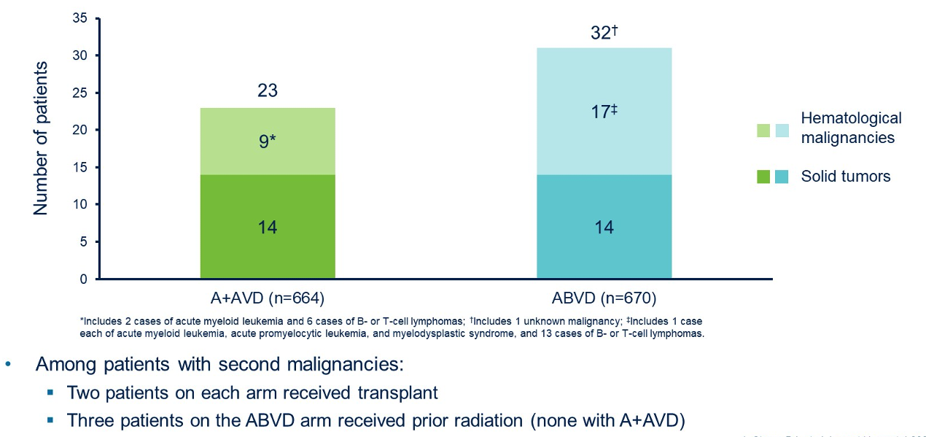
ECHELON-1: Incidence of Secondary Cancer
Ansell SM et al. ASCO 2022;Abstract 7503.

Slide 42
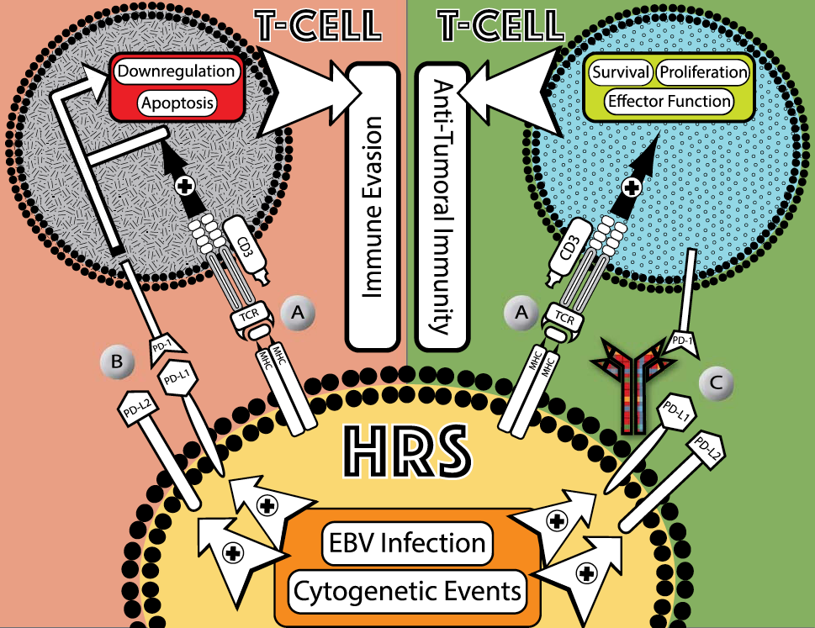
Targeting the PD-1/PD-L1 Axis in HL
HL characterized by small number of malignant Hodgkin Reed-Sternberg cells (HRS) surrounded by normal immune cells
9p24.1 chromosomal abnormalities frequently observed in HRS cells
More than 90% of HRS cells have alterations in PD-L1 and PD-L2 loci
Malignant Hodgkin and RS cells overexpress PD-L1/L2 ligands (due to cytogenetic events, infection with EBV)
Villasboas JC, Ansell SA. Cancer J 2016;22(1):17-22; Roemer MGM et al. J Clin Oncol 2016;34(23):2690-7.

Slide 43
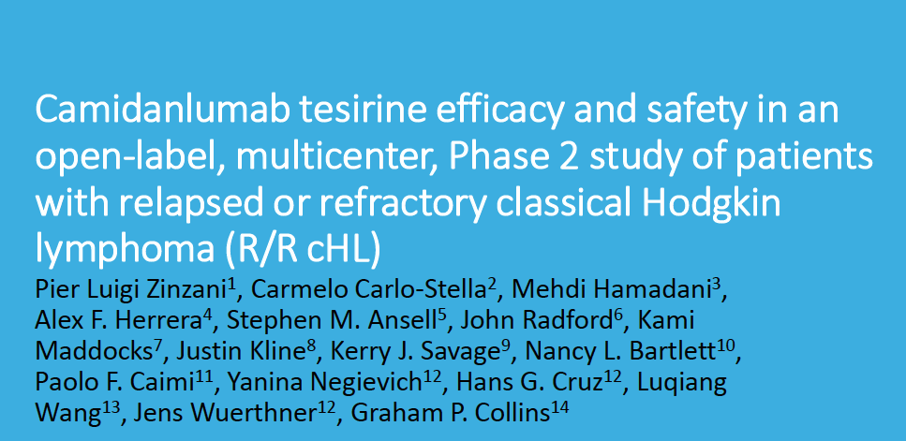
ICML Virtual Congress 2021;Abstract 075.

Slide 44
Camidanlumab Tesirine: Mechanism of Action and Study Rationale
Zinzani PL et al. ICML Virtual Congress 2021;Abstract 075.

Slide 45
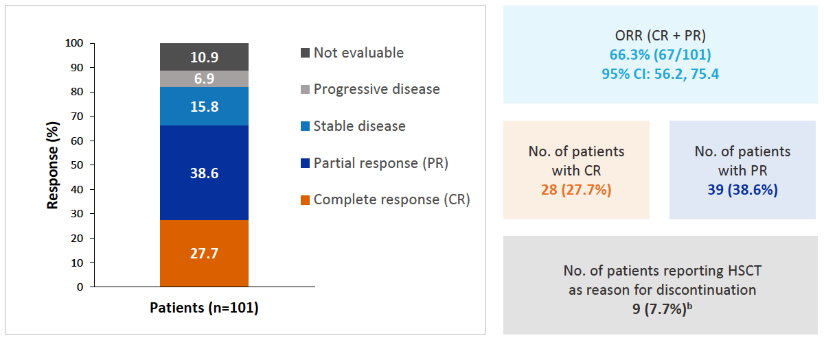
Response to Camidanlumab Tesirine for R/R cHL (Primary Study Endpoint)
Zinzani PL et al. ICML Virtual Congress 2021;Abstract 075.

Slide 46
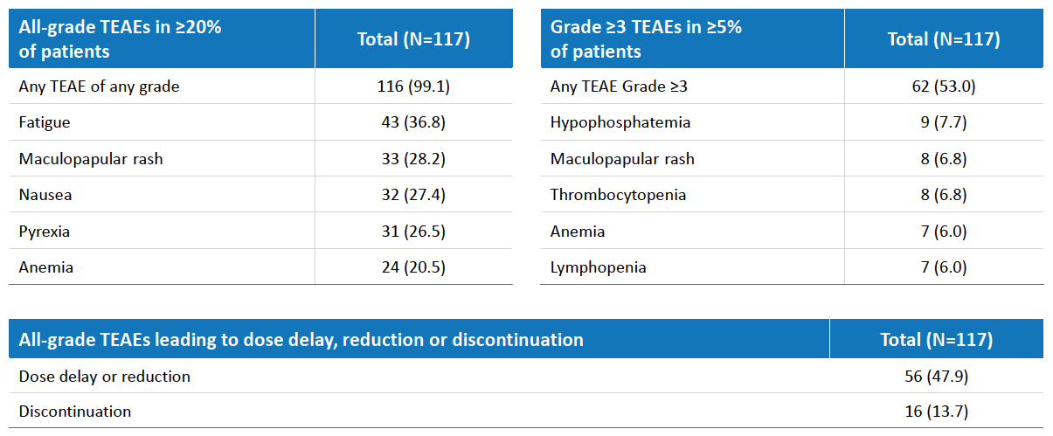
Most Common Treatment-Related Adverse Events (TEAEs) with Camidanlumab Tesirine
Zinzani PL et al. ICML Virtual Congress 2021;Abstract 075.

Slide 47
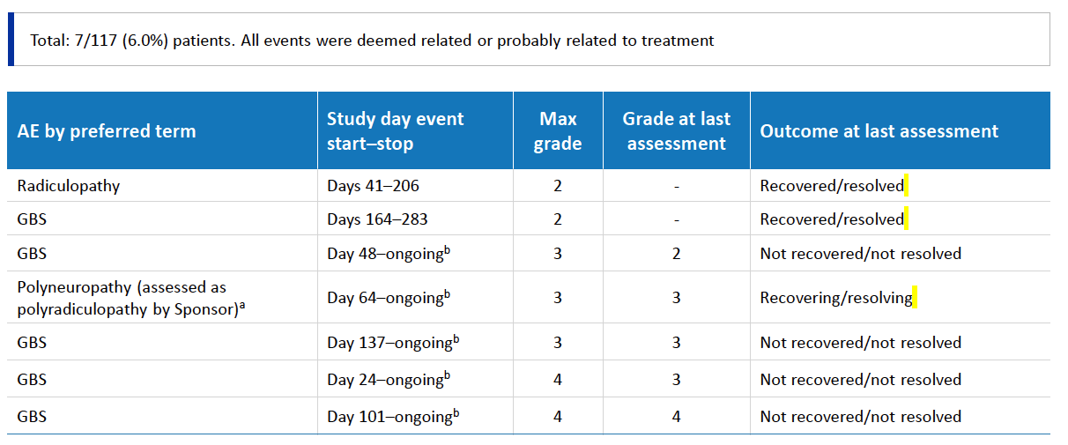
Incidence of Guillain-Barré Syndrome (GBS) and Polyradiculopathy with Camidanlumab Tesirine
Recovered/resolved
Recovered/resolved
Recovering/resolving
ª Additional events reported in the same patient included Grade 3 meningitis aseptic, which was recovering/resolving at last assessment; Grade 3 facial paralysis, not recovered/not resolved; and Grade 4 inappropriate antidiuretic hormone secretion, which recovered/resolved; all 3 events were considered related to treatment; ^{b} At last assessment prior to data cutoff.
Zinzani PL et al. ICML Virtual Congress 2021;Abstract 075.

Slide 48
Agenda Management of Hodgkin and Non-Hodgkin Lymphomas
Module 1 – Diffuse Large B-Cell Lymphoma (DLBCL)
Module 2 – Hodgkin Lymphoma (HL)
Module 3 – Follicular Lymphoma (FL)
Module 4 – Mantle Cell Lymphoma (MCL)

Slide 49
Case 3 — Robin Klebig, APRN, CNP, AOCNP
66 yo female
RN at Mayo Clinic
Dx 2009 (age 53) with follicular NHL grade 1, stage IVA
Rx: R-CHOP x 8 to PR
Notable side effects:
Hoarseness r/t GERD +/- vincristine
Painful plantar erythema, blisters & desquamation r/t doxorubicin
PET/CT showed PR after 6 cycles
Give additional 2 cycles of R-CHOP
CT at EOT: “given the limited information in regard to the meaning of the PET scan in follicular lymphoma that we will hold off on a PET”

Slide 50
Round 2
Case 3 — Robin Klebig, APRN, CNP, AOCNP
2013 (4 years later, age 57)
Progressive bilateral pelvic lymphadenopathy (inguinal/femoral)
Bx: FL grade 1
Rx: ⁹⁰Y-ibritumomab tiuxetan
Notable side effects:
Platelet nadir 53K at 5 weeks
ANC nadir 0.93 at 7 weeks
No transfusions or infections
EOT PET/CT: CR

Slide 51
Round 3
Case 3 — Robin Klebig, APRN, CNP, AOCNP
2017 (3 years later, age 60)
Progression left femoral and bilateral inguinal nodes
Bx: FL grade 1-2
Rx: Rituximab monotherapy/maintenance x 2 years
EOT CT: PR

Slide 52
Round 4
Case 3 — Robin Klebig, APRN, CNP, AOCNP
2020 (4 years later, age 64)
Significant progression of abdominopelvic lymphadenopathy concerning for transformation, SUV max 12
Bx: FL grade 1-2
BR x 6
COVID era: 10/2020-2/2021
Notable side effects: Chemobrain – decided to retire
EOT PET/CT: CR (Deauville 1)

Slide 53
Case 3 — Robin Klebig, APRN, CNP, AOCNP
Still doing well
Watching for late effects
Cardiotoxicity
Secondary malignancies
Bone marrow failure (t-MNs)

Slide 54
RELEVANCE: Study Design
International, open-label, randomized Phase III study
Lenalidomide: immunomodulatory agent with MoA complementary to rituximab
Stratified by FLIPI score (0-1 vs 2 vs 3-5),
age (>60 vs ≤60 y), lesion size (>6 vs ≤6 cm)
Responders
INDUCTION
MAINTENANCE
Lenalidomide +
rituximab (n = 513)
Rituximab
Patients with previously untreated
advanced FL requiring treatment per GELF criteria
(N = 1,030)
Total tx duration
up to 120 wk
Chemotherapy (choice of CHOP, B, or CVP) +
rituximab (n = 517)
Rituximab
Coprimary endpoints (superiority): Confirmed/unconfirmed complete response (CR/CRu) at 120 wk, PFS
Morschhauser et al. N Engl J Med 2018;379:934. Fowler et al. Lancet Oncol 2014;15:1315.
Gribben et al. J Clin Oncol 2015;33:2803.

Slide 55
RELEVANCE: PFS by IRC
Coprimary endpoint: Interim PFS (~50% Events)
1.0
 | R² | R-CT
Patients, n | 513 | 517
3-y PFS, % (95% CI) | 77 (72-80) | 78 (74-82)
0.8
0.6
Probability of PFS (IRC)
0.4
0.2
Interim PFS at median follow-up of 37.9 mo was similar in both arms
PFS benefit observed across prespecified subgroups
HR: 1.10 (95% CI: 0.85-1.43; P = .48)
0
0
6
12
18
24
30
36
42
48
54
60
66
Mos from randomization
Patients at Risk, n
R²
R-CT
513 517
435 474
409 446
393 417
364 387
282 287
174 175
107 109
49 51
13 14
0 1
0
Morschhauser et al. N Engl J Med 2018;379:934.

Slide 56
2021; Abstract 815

Slide 57
Kahl B et al. ASH 2021;Abstract 815.

Slide 58
…but 63% of patients on RR strategy remained chemo-free at 7 years
LTFU = long-term follow-up
Kahl B et al. ASH 2021;Abstract 815.

Slide 59
Obinutuzumab Short Duration Infusion Is Preferred by Healthcare Providers and Has Minimal Impact on Patient-Reported Symptoms Among Patients with Untreated, Advanced Follicular Lymphoma
Trask P et al. ASH 2021;Abstract 1345.
Background: The GAZELLE study is a prospective open label, multicenter, single arm, Phase IV study, which evaluated the safety of obinutuzumab (G) administered as a 90-minute short-duration infusion (SDI) from Cycle 2 (C2) onwards in patients with previously untreated advanced FL.
Author conclusions: Untreated, advanced FL patients had no or mild symptom severity and interference at baseline regardless of risk group. These low levels were maintained during G SDI administration. Additionally, SDI administration was preferred by providers for the time it saved, convenience, and comfort for patients, suggesting that G SDI administration can be a beneficial treatment option for untreated, advanced FL patients by minimizing patient treatment burden with no impact on health-related quality of life.

Slide 60
EZH2, a Histone Methyltransferase, in FL
In normal B-cell biology, EZH2 regulates germinal center formation
EZH2 mutations can lead to oncogenic transformation by locking B-cells in germinal state and preventing terminal differentiation
EZH2-activating mutations found in ~20% of patients with FL
Tazemetostat: Selective, oral, first-in-class EZH2 inhibitor
Whether WT or mutant, EZH2 biology relevant to FL
Germinal Center Reaction
EZH2
EZH2
EZH2
Plasma cell:
makes antibodies
Dark Zone
Light Zone
Apoptosis
Naive B-cell
Oncogenic
mutations in EZH2
Memory B-cell: remembers pathogens
X
Germinal center-derived neoplasms
Tazemetostat
Morschhauser. ICML 2019. Abstr 105.

Slide 61
Lancet Oncol 2020;21(11):1433-42.

Slide 62
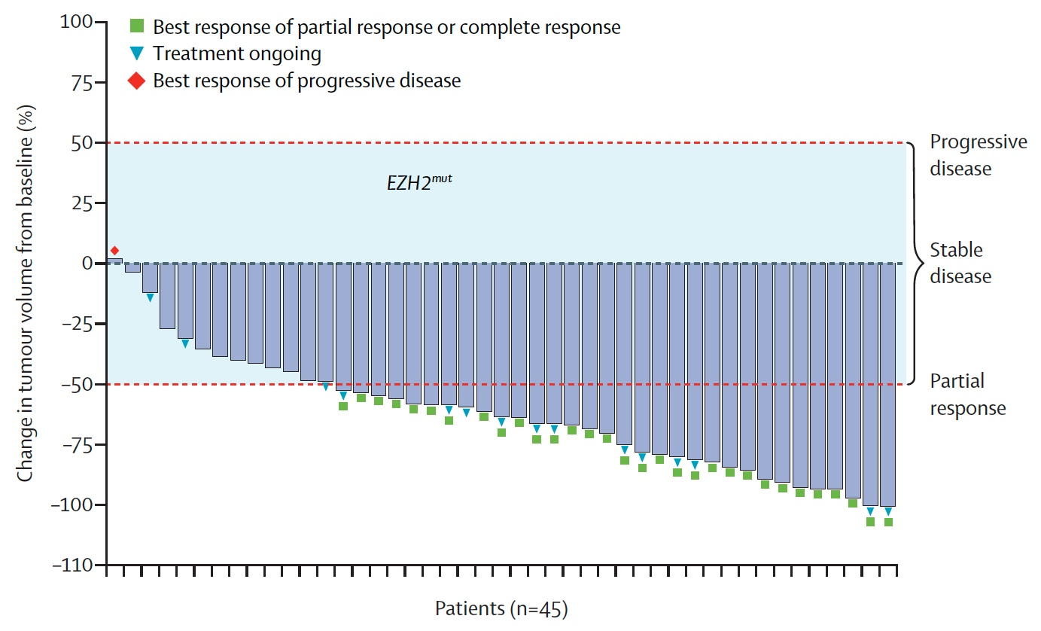
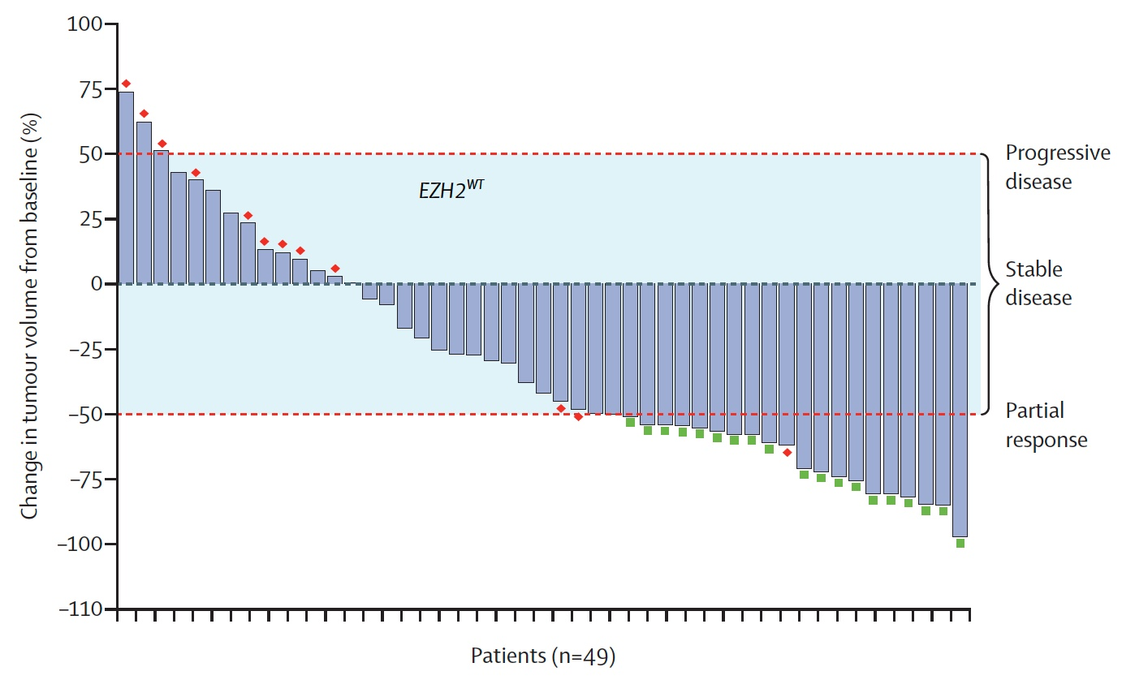
Response to Tazemetostat in Patients with R/R FL and an EZH2 Mutation or EZH2 Wild-Type Tumors
EZH2^{mut}
ORR: 69%
EZH2^{WT}
ORR: 35%
Morschhauser F et al. Lancet Oncol 2020;21(11):1433-42.

Slide 63
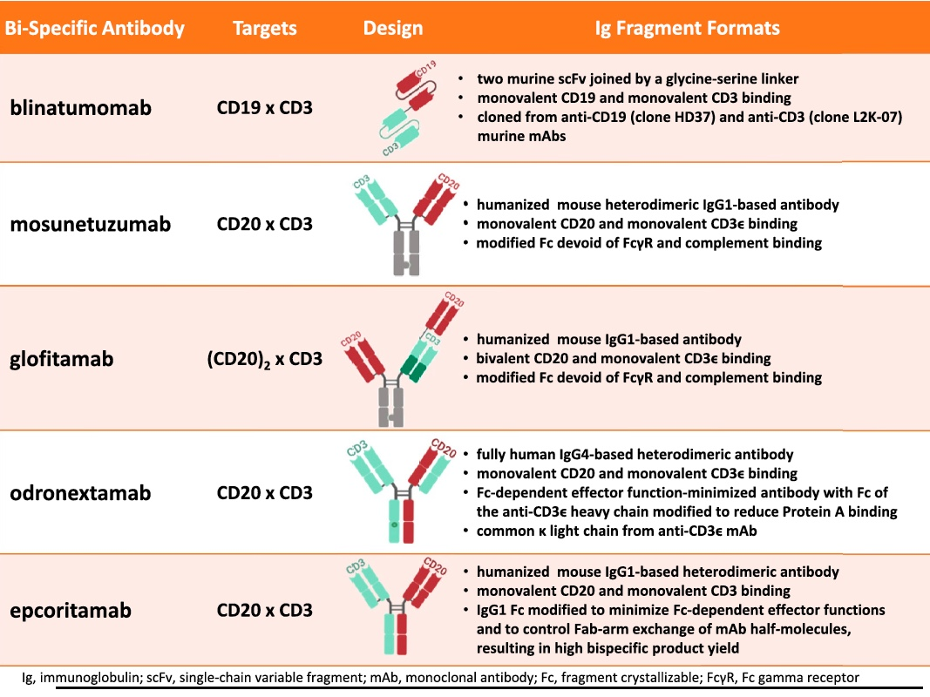
Structure of Selected Bispecific Antibodies
Schuster SJ. Hematol Oncol 2021;39(S1):113-16.

Slide 64
Response to Mosunetuzumab Monotherapy in Patients with R/R FL Who Have Received ≥2 Lines of Therapy
CR: 54 patients (60%)
ORR: 72 patients (80%)
Median DoR: 22.8 months
Median PFS: 17.9 months
Budde EL et al. ASH 2021;Abstract 127.

Slide 65
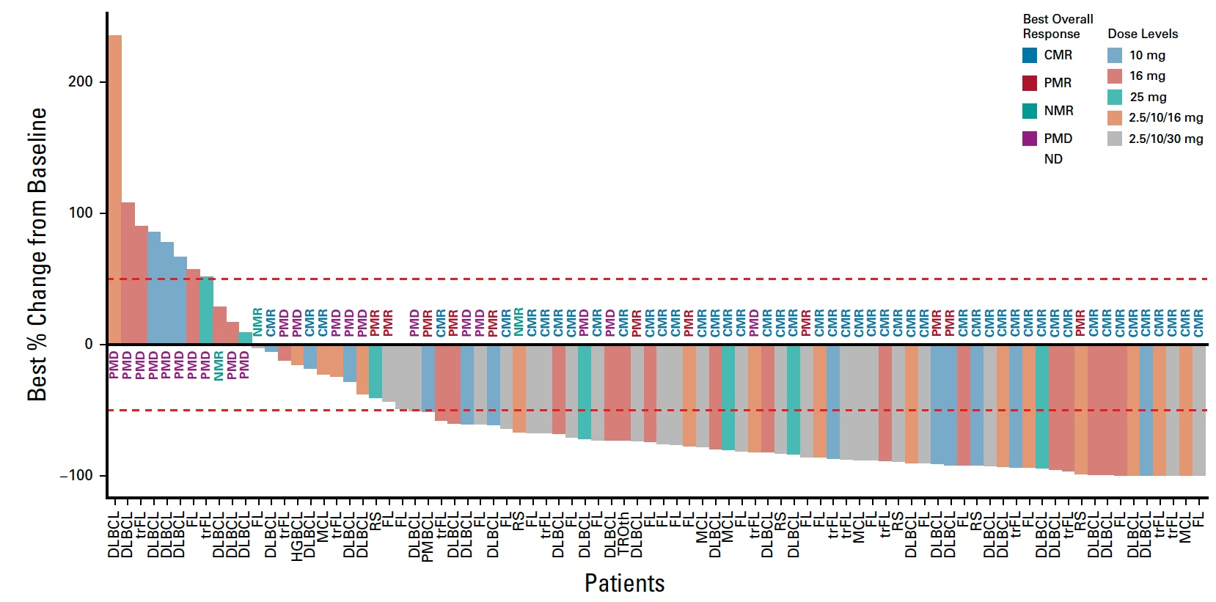
Response to Glofitamab in Patients with R/R B-Cell Lymphomas
ORR (transformed FL, N = 29): 55.2%
ORR (Grade 1-3A FL, N = 44): 70.5%
Hutchings M et al. J Clin Oncol 2021;39:1959-70.

Slide 66
Agenda Management of Hodgkin and Non-Hodgkin Lymphomas
Module 1 – Diffuse Large B-Cell Lymphoma (DLBCL)
Module 2 – Hodgkin Lymphoma (HL)
Module 3 – Follicular Lymphoma (FL)
Module 4 – Mantle Cell Lymphoma (MCL)

Slide 67
Case 4 — Robin Klebig, APRN, CNP, AOCNP
76 yo male
Retired engineer
Very active, Florida snowbird; plays better pickleball than 50-year-olds
Dx 2014 (age 69): Stage IVA mantle cell with splenomegaly, lymphadenopathy, colon, marrow & peripheral blood involvement
PMH: Melanoma, SCC, BPH
Rx: BR x 6 to CR
Rituximab maintenance x 12 cycles completed June 2017

Slide 68
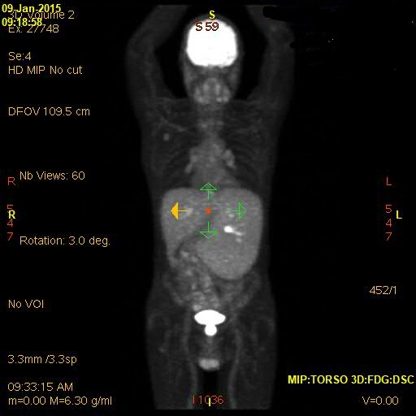
PET/CT before & after
Case 4 — Robin Klebig, APRN, CNP, AOCNP
January 9, 2015
August 27, 2015

Slide 69
Relapsed MCL
Case 4 — Robin Klebig, APRN, CNP, AOCNP
December 2020 (5 years after BR, age 75)
Upper denture rubbing against palate
Bx: Recurrent MCL
PET/CT: Involvement of palate, possible right posterior nasopharynx

Slide 70
BTKi for relapsed MCL
Case 4 — Robin Klebig, APRN, CNP, AOCNP
December 2020 – initiated acalabrutinib
Notable side effects: Headaches
1 month on treatment: Palate lesion resolved
PET/CT – difficult area to assess for CMR due to physiologic uptake in palate
Continues on therapy

Slide 71
Abstract LBA7502

Slide 72
SHINE: Phase III Study Design
BR = bendamustine/rituximab
Wang ML et al. ASCO 2022;Abstract LBA7502.

Slide 73
SHINE: Survival Outcomes
Progression-free survival (primary endpoint)
Overall survival (secondary endpoint)
Wang ML et al. N Engl J Med 2022;[Online ahead of print]; ASCO 2022;Abstract LBA7502.

Slide 74
SHINE: Adverse Events of Clinical Interest
Wang ML et al. N Engl J Med 2022;[Online ahead of print]; ASCO 2022;Abstract LBA7502.

Slide 75
N Engl J Med 2020;382(14):1331-42.

Slide 76
ZUMA-2: Response Rates, Survival and Select Safety Outcomes with Brexucabtagene Autoleucel for Mantle Cell Lymphoma
Survival and safety outcomes
12-mos PFS | 61%
12-mos OS | 83%
≥Grade 3 CRS | 15%
≥Grade 3 Neurologic events | 31%
Wang M et al. N Engl J Med 2020;382(14):1331-42.

Slide 77
Appendix of Recent Data Sets

Slide 78
Diffuse Large B-Cell Lymphoma

Slide 79
Blood Adv 2022;6(2):533-43.

Slide 80
GO29365: Phase Ib/II Study Design
Inclusion: transplant-ineligible DLBCL, ≥1 line of therapy
Exclusion: prior allo-SCT, history of transformation, current Grade >1 peripheral neuropathy
Main study
Phase Ib: Safety run-in Pola + BR
Pola + BR (n = 6)
R/R DLBCL
Pooled Pola + BR
cohorts (N = 152)
Phase II: Randomization Pola + BR vs BR
BR (n = 40)
R/R DLBCL
Randomized
Median follow-up: 48.9 months
Pola + BR (n = 40)
Extension cohort
Phase II: Extension Pola + BR
R/R DLBCL
Pola + BR (n = 106)
Median follow-up: 15.2 months
Pola = polatuzumab vedotin; BR = bendamustine/rituximab; R/R = relapsed/refractory
Pola 1.8 mg/kg on day 1 of each cycle of BR; up to 6 cycles at 3-weekly interval
Sehn LH et al. Blood Adv 2022;6(2):533-43.

Slide 81
GO29365: PFS and OS in Randomized and Extension Cohorts
Randomized
Extension cohort
100
Median PFS
100
Median PFS
80
Pola + BR (N = 40): 9.2 months
80
Pola + BR (N = 106): 6.6 months
60
BR (N = 40): 3.7 months
60
PFS (%)
PFS (%)
40
40
20
20
0
0
0
2
4
6
8
10
12
14
16
18
20
22
24
26
28
30
32
34
36
38
40
42
44
46
48
50
52
54
0
2
4
6
8
10
12
14
16
18
20
22
24
26
28
Time (months)
Time (months)
Pola+BR
100
Median OS
100
Median OS
80
Pola + BR (N = 40): 12.4 months
80
Pola + BR (N = 106): 12.5 months
60
BR (N = 40): 4.7 months
60
OS (%)
OS (%)
40
40
20
20
0
0
0
2
4
6
8
10
12
14
16
18
20
22
24
26
28
30
32
34
36
38
40
42
44
46
48
50
52
54
0
2
4
6
8
10
12
14
16
18
20
22
24
26
28
Time (months)
Time (months)
Randomized cohort:
Survival benefit persists with longer follow-up
2-y PFS 28.4%, 2-y OS 38.2%
Pooled cohort
Non-primary refractory: Median PFS 13.4 mo, median OS 32 mo
Sehn LH et al. Blood Adv 2022;6(2):533-43.

Slide 82
GO29365: Median PFS and OS in the Pooled Pola + BR Cohort According to Line of Therapy and Refractory Status
Sehn LH et al. Blood Adv 2022;6(2):533-43.

Slide 83
Lancet Oncol 2020;21(7):978-88.
As a result of the L-MIND trial, tafasitamab in combination with lenalidomide was FDA approved for patients with relapsed or refractory DLBCL not otherwise specified, including DLBCL arising from low-grade lymphoma, who are not eligible for autologous stem cell transplant.

Slide 84
L-MIND: Phase II Study Design
Sample size suitable to detect ≥15% absolute increase in ORR for tafasitamab/LEN combination versus LEN monotherapy at 85% power, 2-sided alpha of 5%
Mature data: Primary endpoint analysis with data cutoff 30 Nov 2018; minimum follow-up 12 months, median follow-up 17.3 months
ORR = objective response rate; PFS = progression-free survival; DoR = duration of response; OS = overall survival
Salles G et al. Lancet Oncol 2020;21(7):978-88.

Slide 85
FDA Grants Accelerated Approval to Loncastuximab Tesirine-lpyl for Large B-Cell Lymphoma Press Release – April 23, 2021
“The Food and Drug Administration granted accelerated approval to loncastuximab tesirine-lpyl, a CD19-directed antibody and alkylating agent conjugate, for adult patients with relapsed or refractory large B-cell lymphoma after two or more lines of systemic therapy, including diffuse large B-cell lymphoma (DLBCL) not otherwise specified, DLBCL arising from low grade lymphoma, and high-grade B-cell lymphoma.
Approval was based on LOTIS-2 (NCT03589469), an open-label, single-arm trial in 145 adult patients with relapsed or refractory DLBCL or high-grade B-cell lymphoma after at least two prior systemic regimens. Patients received loncastuximab tesirine-lpyl 0.15 mg/kg every 3 weeks for 2 cycles, then 0.075 mg/kg every 3 weeks for subsequent cycles. Patients received treatment until progressive disease or unacceptable toxicity.”
www.fda.gov/drugs/resources-information-approved-drugs/fda-grants-accelerated-approval-loncastuximab-tesirine-lpyl-large-b-cell-lymphoma

Slide 86
Lancet Oncol 2021;22(6):790-800.
As a result of the LOTIS-2 trial, loncastuximab tesirine was FDA approved for patients with relapsed or refractory large B-cell lymphoma after 2 or more lines of systemic therapy, including DLBCL not otherwise specified, DLBCL arising from low-grade lymphoma and high-grade B-cell lymphoma.

Slide 87
LOTIS-2: Phase II Trial Design
ORR = overall response rate; Lonca = loncastuximab tesirine
Caimi PF et al. Lancet Oncol 2021;22(6):790-800.

Slide 88
FDA Approves Lisocabtagene Maraleucel for R/R Large B-Cell Lymphoma Press Release – February 5, 2021
“The Food and Drug Administration approved lisocabtagene maraleucel for the treatment of adult patients with relapsed or refractory (R/R) large B-cell lymphoma after two or more lines of systemic therapy, including diffuse large B-cell lymphoma (DLBCL) not otherwise specified (including DLBCL arising from indolent lymphoma), high-grade B-cell lymphoma, primary mediastinal large B-cell lymphoma, and follicular lymphoma grade 3B.
Lisocabtagene maraleucel is a CD19-directed chimeric antigen receptor (CAR) T cell immunotherapy. It consists of autologous T cells that are genetically modified to produce a CAR protein, allowing the T cells to identify and eliminate CD19-expressing normal and malignant cells.
Efficacy was evaluated in TRANSCEND (NCT02631044), a single-arm, open label, multicenter trial that evaluated lisocabtagene maraleucel, preceded by lymphodepleting chemotherapy, in adults with R/R large B-cell lymphoma after at least two lines of therapy.”
https://www.fda.gov/drugs/resources-information-approved-drugs/fda-approves-lisocabtagene-maraleucel-relapsed-or-refractory-large-b-cell-lymphoma

Slide 89
Characteristics of Pivotal Trials of Axi-cel and Tisagenlecleucel
Roschewski M et al. N Engl J Med 2022;386(7):692-96.

Slide 90
CAR T-Cell Therapy-Associated Cytokine Release Syndrome (CRS)
CRS — May be mild or life-threatening
Occurs with CART19 activation and expansion
Dramatic cytokine elevations (IL-6, IL10, IFNɤ, CRP, ferritin)
Fevers initially (can be quite high: 105˚F)
Myalgias, fatigue, nausea/anorexia
Capillary leak, headache, hypoxia and hypotension
CRS-related mortality 3% to 10%
Varadarajan I, Lee DW. Cancer J 2019;25(3):223‐30.
Abramson JS et al. ASCO 2019 Education Book.

Slide 91
Cytokine Release Syndrome (CRS): Common Symptoms
CRS
High fevers
Rigors
Myalgia/
arthralgias
Nausea/vomiting/ anorexia
Hypotension
Dyspnea/ tachypnea/ hypoxia
Fatigue
Headache
Escalating fevers
Based on CAR T-cell experience
Diagnosis based on clinical symptoms and events

Slide 92
CAR T-Cell Therapy-Associated Neurologic Toxicity
Neurologic toxicity — May be mild or life-threatening
Mechanism unclear, referred to as immune effector cell-associated neurotoxicity syndrome (ICANS)
Encephalopathy
Seizures
Delirium, confusion, aphasia, agitation, sedation, coma
Varadarajan I, Lee DW. Cancer J 2019;25(3):223‐30.
Abramson JS et al. ASCO 2019 Education Book.

Slide 93
Example of Handwriting Deterioration Associated with Neurotoxicity from CAR T-Cell Therapy

Slide 94
ZUMA-12 Study Demonstrates 78% Complete Response Rate as Part of First-Line Treatment in Newly Diagnosed High-Risk Large B-Cell Lymphoma Press Release – December 13, 2021
“Primary results were announced from ZUMA-12, a global, multicenter, single-arm, open-label Phase 2 study evaluating axicabtagene ciloleucel as part of first-line treatment in patients with high-risk large B-cell lymphoma (LBCL). This is the first study to evaluate CAR T-cell therapy as part of first-line therapy in high-risk LBCL. The study is based on the desire to utilize potential curative treatment as quickly as possible and the hypothesis that earlier use of CAR T-cell therapy when T cells are healthier may produce better outcomes. The data were presented in an oral session during the 63rd American Society of Hematology (ASH) Annual Meeting & Exposition (Abstract #739).
After a single infusion of axicabtagene ciloleucel, 89% of evaluable patients achieved a response (ORR) (n=37 evaluable for efficacy), including 78% of patients with a complete response (CR) at a median follow-up of 15.9 months. CR rate was consistent among key subgroups. Among evaluable patients, median time to response was one month. At time of data cut-off, 73% of evaluable patients had ongoing responses. Medians for duration of response (DOR), event-free survival (EFS), and progression-free survival (PFS) were not yet reached, with 12-month estimates of 81%, 73%, and 75%, respectively, and an estimated 12-month OS rate of 91%.”
https://www.gilead.com/news-and-press/press-room/press-releases/2021/12/yescarta-zuma12-study-demonstrates-78-complete-response-rate-as-part-of-firstline-treatment-in-newly-diagnosed-highrisk-large-bcell-lymphoma

Slide 95
Nat Med 2022;[Online ahead of print].

Slide 96
Multicenter Phase II ZUMA-12 Schema: First-Line Therapy
Eligibility criteria
Age ≥ 18 years
High-risk LBCL
HGBCL, with MYC and BLCL2 and/or BCL6 translocations, or
LBCL with IPI score ≥ 3 any time before enrollment
2 cycles of anti-CD20 plus anthracycline-containing regimen
Positive interim PET (DS 4 or 5)
ECOG PS score 0 or 1
Enrollment/leukapheresis
Optional nonchemotherapy bridging therapyª
Primary endpoint
CR (complete response)^{b}
Key secondary endpoints
ORR (objective response rate)
DOR (duration of response)
EFS (event-free survival)
PFS
OS
Safety
CAR T cells in blood and cytokine levels in serum
Conditioning chemotherapy +
axi-cel infusion
Conditioning
Flu 30 mg/m² i.v. and Cy 500 mg/m² i.v. on Days −5, −4, and −3
Axi-cel
Single i.v. infusion of 2 × 10⁶ CAR T cells/kg on Day 0
Neelapu SS et al. ASH 2020;Abstract 405.

Slide 97
ZUMA-12: Efficacy Results with Axi-cel as First-Line Treatment
ORR and CR in efficacy-evaluable patients (N = 37)
At median follow-up of 15.9 months, 73% of patients remained in objective response
Median DOR, EFS and PFS were not reached
Neelapu SS et al. Nat Med 2022;[Online ahead of print].

Slide 98
ZUMA-12: Adverse Events of Interest in ≥15% of Patients Receiving Treatment
Neelapu SS et al. Nat Med 2022;[Online ahead of print].

Slide 99
Long-Term (4- and 5-Year) Overall Survival in ZUMA-1, the Pivotal Study of Axicabtagene Ciloleucel (Axi-cel) in Patients with Refractory Large B-Cell Lymphoma (LBCL)
Jacobson C et al. ASH 2021;Abstract 1764.

Slide 100
ZUMA-1: Five-Year Update
5-Yr OS Rate: 42.6%
5-Yr OS Rate in Complete Responders: 64.4%
Median time to next cancer therapy: 8.7 months
Safety findings were similar to those in previous reports
Jacobson C et al. ASH 2021;Abstract 1764.

Slide 101
N Engl J Med 2022;386(7):640-54.

Slide 102
ZUMA-7: Event-Free Survival
Locke FL et al. N Engl J Med 2022;386(7):640-54.

Slide 103
ZUMA-7: Overall and Progression-Free Survival
Locke FL et al. N Engl J Med 2022;386(7):640-54.

Slide 104
ZUMA-7: Event-Free Survival Subgroup Analysis
Locke FL et al. N Engl J Med 2022;386(7):640-54.

Slide 105
ZUMA-7: Select Grade ≥3 Adverse Events
Adverse event | Axi-cel (N = 170) | Standard care (N = 168)
Pyrexia | 9% | 1%
Neutropenia | 69% | 41%
Fatigue | 6% | 2%
Anemia | 30% | 39%
Thrombocytopenia | 15% | 57%
Febrile neutropenia | 2% | 27%
Cytokine release syndrome | 6% | 0
Neurologic event | 21% | 1%
Vomiting | 0 | 1%
Locke FL et al. N Engl J Med 2022;386(7):640-54.

Slide 106
N Engl J Med 2022;386(7):629-39.

Slide 107
BELINDA: Event-Free Survival (Primary Endpoint)
Bishop MR et al. N Engl J Med 2022;386(7):629-39.

Slide 108
BELINDA: Select Grade ≥3 Adverse Events
Adverse event | Tisagenlecleucel (N = 162) | Standard care (N = 160)
Anemia | 33.3% | 57.5%
Nausea | 1.2% | 6.3%
Thrombocytopenia | 32.1% | 47.5%
Neutropenia | 40.1% | 39.4%
Cytokine release syndrome | 4.9% | 0
Hypokalemia | 4.9% | 8.8%
Diarrhea | 1.9% | 3.8%
Pyrexia | 0 | 1.9%
Vomiting | 0.6% | 1.9%
Bishop MR et al. N Engl J Med 2022;386(7):629-39.

Slide 110
TRANSFORM: Event-Free Survival per Independent Review Committee (ITT, Primary Endpoint)
Kamdar M et al. ASH 2021;Abstract 91.

Slide 111
Hodgkin Lymphoma

Slide 112
J Clin Oncol 2022;40(13):1487-96.
AUTHOR CONCLUSIONS: Compared with toxicity from earlier RT techniques, excess morbidity was not eliminated, but lower than previously reported. The elevated risk of diseases of the respiratory system was driven by diagnosis of asthma, which could in part be explained by misdiagnosis of persisting pulmonary toxicity.

Slide 113
J Clin Oncol 2021;39(20):2257-65.

Slide 114
Multicenter Pilot Study of Brentuximab Vedotin (BV) and AVD with or without Consolidative Radiation Therapy for Early-Stage, Unfavorable-Risk Hodgkin Lymphoma
Patients who achieved a negative end-of-therapy (EOT) PET-4 scan after 4 cycles of BV + AVD were studied with de-escalating radiation dose and field.
Clinical endpoint | Cohort 1 30-Gy ISRT (n = 29) | Cohort 2 20-Gy ISRT (n = 29) | Cohort 3 30-Gy CVRT (n = 29) | Cohort 4 No radiation (n = 29) | All patients (n = 114)
EOT CR rate | 27 (93%) | 29 (100%) | 27 (93%) | 28 (97%) | 111 (96%)
2-year PFS rate | 93.1% | 96.6% | 89.7% | 96.6% | 94%
“BV + AVD x four cycles is a highly active and well-tolerated treatment program for ES, unfavorable-risk Hodgkin lymphoma, including bulky disease. The efficacy of BV + AVD supports the safe reduction or elimination of consolidative radiation among PET-4–negative patients.”
Kumar A et al. J Clin Oncol 2021;39(20):2257-65.

Slide 115
Follicular Lymphoma

Slide 116
ASH 2021;Abstract 93.

Slide 117
ZUMA-5: Overall Response Rate (ORR) by Central Review
Neelapu SS et al. ASH 2021;Abstract 93.

Slide 118
ZUMA-5: PFS and Overall Survival
Neelapu SS et al. ASH 2021;Abstract 93.

Slide 119
ZUMA-5: AEs with First Occurrence After Primary Analysis Data Cutoff
Neelapu SS et al. ASH 2021;Abstract 93.

Slide 120
FDA Approves Tisagenlecleucel for Relapsed or Refractory Follicular Lymphoma Press Release: May 27, 2022
“On May 27, 2022, the Food and Drug Administration granted accelerated approval to tisagenlecleucel for adult patients with relapsed or refractory follicular lymphoma (FL) after two or more lines of systemic therapy.
The approval was based on the ELARA trial (NCT03568461), a multicenter, single-arm, open-label trial evaluating tisagenlecleucel, a CD19-directed chimeric antigen receptor (CAR) T cell therapy, in adult patients who were refractory or relapsed within 6 months after completion of two or more lines of systemic therapy (including an anti-CD20 antibody and an alkylating agent) or relapsed after autologous hematopoietic stem cell transplant.”
https://www.fda.gov/drugs/resources-information-approved-drugs/fda-approves-tisagenlecleucel-relapsed-or-refractory-follicular-lymphoma

Slide 121
Thieblemont C et al. ASH 2021;Abstract 131.

Slide 122
ELARA: Efficacy Analysis with Extended Follow-Up
CR rates are consistent and durable for the
Thieblemont C et al. ASH 2021;Abstract 131.

Slide 123
ASH 2021;Abstract 127.

Slide 124
Safety Profile of Mosunetuzumab Monotherapy for Patients with R/R FL Who Have Received ≥2 Lines of Therapy
Budde EL et al. ASH 2021;Abstract 127.

Slide 125
ASH 2021;Abstract 128.

Slide 126
Phase I/II Study of Glofitamab as Monotherapy or in Combination with Obinutuzumab for R/R FL
Myelosuppression was more common with the combination
Cytokine release syndrome rates were high and comparable, and cases were mainly low grade
Morschhauser F et al. ASH 2021;Abstract 128.

Slide 127
Mantle Cell Lymphoma

Slide 128
J Clin Oncol 2021;40:202-12.

Slide 129
Phase II Trial of Ibrutinib with Rituximab for Older Patients with MCL
Clinical endpoint | N = 48
Best overall response rate | 100%
Complete metabolic response (CMR) by PET* | 74%
3-year PFS | 87%
3-year OS | 94%
* In 26 patients who achieved CMR, 21 (81%) had bone marrow negative for MCL
0 deaths were reported on study
11 (22%) patients had Grade 3 atrial fibrillation
Grade 3-4 myelosuppression was seen in <5% of patients
Jain P et al. J Clin Oncol 2021;40:202-12.

Slide 130
ECOG-EA4181: A Phase II Study of BR with High-Dose Cytarabine with or without Acalabrutinib, and BR with Acalabrutinib as Initial Treatment for Patients ≤70 Years Old with MCL
Trial Identifier: NCT04115631 (Open)
Arm A
BR + high-dose cytarabine
Untreated histologically confirmed mantle cell lymphoma Age ≥18 and ≤70 years, PS 0-2
R
Arm B
BR + high-dose cytarabine + acalabrutinib
Arm C
BR + acalabrutinib
Primary endpoint: PET/CT complete response and peripheral blood minimal residual disease (MRD)-negative rate
www.clinicaltrials.gov. Accessed April 2022; https://ecog-acrin.org/clinical-trials/ea4181-educational-materials/

Slide 131
ECOG-EA4151: A Phase III Trial of Consolidation Therapy with Autologous Hematopoietic Cell Transplantation (HCT) Followed by Maintenance Rituximab versus Maintenance Rituximab Alone for Patients with MCL in MRD-Negative First Complete Remission
Trial Identifier: NCT03267433 (Open)
Arm A
Auto-HCT + maintenance rituximab
Histologically confirmed mantle cell lymphoma No more than 300 days from the first dose of induction chemotherapy (C1D1) until the last day of induction chemotherapy Postinduction restaging indicates MRD-negative complete remission
R
Arm B
Maintenance rituximab
Primary endpoint: Overall survival for patients in MRD-negative first remission who undergo auto-HCT followed by rituximab versus maintenance rituximab alone
www.clinicaltrials.gov. Accessed April 2022; https://ecog-acrin.org/clinical-trials/ea4151-educational-materials/

Slide 133
SYMPATICO: Efficacy Outcomes with Concurrent Ibrutinib and Venetoclax for Relapsed/Refractory MCL
Median duration of response was 32.3 months
Median PFS was 35.0 months
Median OS was also 35.0 months
ORR = overall response rate
Wang M et al. J Hematol Oncol 2021;14(1):179.

Slide 134
Blood Adv 2021;5(12):2577-85.

Slide 135
Phase I/II Study of Zanubrutinib for Relapsed/Refractory MCL
Median duration of response was 18.5 months
Median PFS was 21.1 months
ORR = overall response rate
Tam CS et al. Blood Adv 2021;5(12):2577-85.

Slide 136
Pirtobrutinib, a Next Generation, Highly Selective, Non-Covalent BTK Inhibitor in Previously Treated Mantle Cell Lymphoma: Updated Results from the Phase 1/2 BRUIN Study
Wang M et al. ASH 2021;Abstract 381.

Slide 137
BRUIN: Phase I/II Trial Schema
Wang M et al. ASH 2021;Abstract 381.

Slide 138
BRUIN: A Phase I/II Study of Pirtobrutinib — MCL Cohort
Wang M et al. ASH 2021;Abstract 381.

Slide 139
Efficacy and Safety of Parsaclisib in Patients with Relapsed or Refractory Mantle Cell Lymphoma Not Previously Treated with a BTK Inhibitor: Primary Analysis from a Phase 2 Study (CITADEL-205)
Mehta A et al. ASH 2021;Abstract 382.

Slide 140
CITADEL-205: Response per Independent Review Committee
Author conclusions: Parsaclisib monotherapy demonstrated a rapid and durable response, had an acceptable safety profile, and was generally well tolerated in BTK inhibitor–naive pts with R/R
MCL. These data suggest that parsaclisib could be a potential treatment option for pts with R/R MCL.
WG = weekly dosing group; DG = daily dosing group; ORR = objective response rate
Mehta A et al. ASH 2021;Abstract 382.

