Slide 1
Meet The Professor Current and Future Management of Chronic Lymphocytic Leukemia
Jennifer R Brown, MD, PhD CLL Center Director and Institute Physician Dana-Farber Cancer Institute Worthington and Margaret Collette Professor of Medicine in the Field of Hematologic Oncology Harvard Medical School Boston, Massachusetts

Slide 2
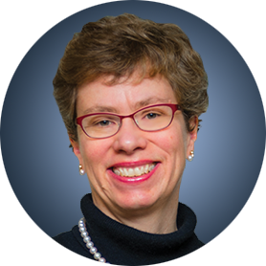
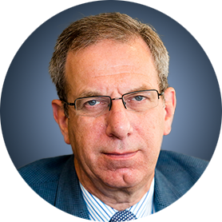
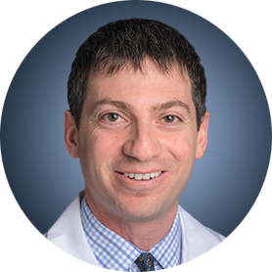
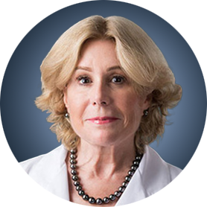
Meet The Professor Program Participating Faculty
Jennifer R Brown, MD, PhD CLL Center Director and Institute Physician Dana-Farber Cancer Institute Worthington and Margaret Collette Professor of Medicine in the Field of Hematologic Oncology Harvard Medical School Boston, Massachusetts
Peter Hillmen, MB ChB, PhD Professor of Experimental Haematology University of Leeds Honorary Consultant Haematologist Leeds Teaching Hospitals NHS Trust Leeds, United Kingdom
Matthew S Davids, MD, MMSc
Associate Professor of Medicine
Harvard Medical School
Director of Clinical Research
Division of Lymphoma
Dana-Farber Cancer Institute
Boston, Massachusetts
Susan O’Brien, MD Professor, Division of Hematology/Oncology School of Medicine UCI Chao Family Comprehensive Cancer Center Orange, California

Slide 3
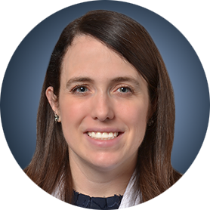
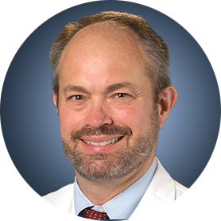
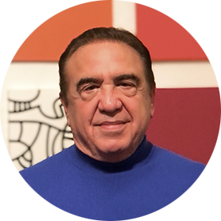
Meet The Professor Program Participating Faculty
Kerry Rogers, MD Assistant Professor in the Division of Hematology The Ohio State University Columbus, Ohio
William G Wierda, MD, PhD DB Lane Cancer Research Distinguished Professor Section Chief, Chronic Lymphocytic Leukemia Center Medical Director Department of Leukemia, Division of Cancer Medicine Executive Medical Director, Inpatient Medical Services The University of Texas MD Anderson Cancer Center Houston, Texas
Jeff Sharman, MD
Medical Director of Hematology Research
US Oncology Network
Willamette Valley Cancer Institute and Research Center
Eugene, Oregon
Moderator
Neil Love, MD Research To Practice

Slide 4
Commercial Support
This activity is supported by educational grants from AstraZeneca Pharmaceuticals LP, Genentech, a member of the Roche Group, and Pharmacyclics LLC, an AbbVie Company and Janssen Biotech Inc, administered by Janssen Scientific Affairs LLC.
Research To Practice CME Planning Committee Members, Staff and Reviewers
Planners, scientific staff and independent reviewers for Research To Practice have no relevant conflicts of interest to disclose.

Slide 5
Dr Brown — Disclosures
Consulting Agreements | AbbVie Inc, Acerta Pharma — A member of the AstraZeneca Group, BeiGene Ltd, Bristol-Myers Squibb Company, Catapult Therapeutics, Genentech, a member of the Roche Group, HUTCHMED, Janssen Biotech Inc, Juno Therapeutics, a Celgene Company, Lilly, MEI Pharma Inc, MorphoSys, Novartis, Pfizer Inc, Pharmacyclics LLC, an AbbVie Company, Rigel Pharmaceuticals Inc
Contracted Research | Gilead Sciences Inc, Loxo Oncology Inc, a wholly owned subsidiary of Eli Lilly & Company, Secura Bio, Sun Pharmaceutical Industries Ltd, TG Therapeutics Inc

Slide 6
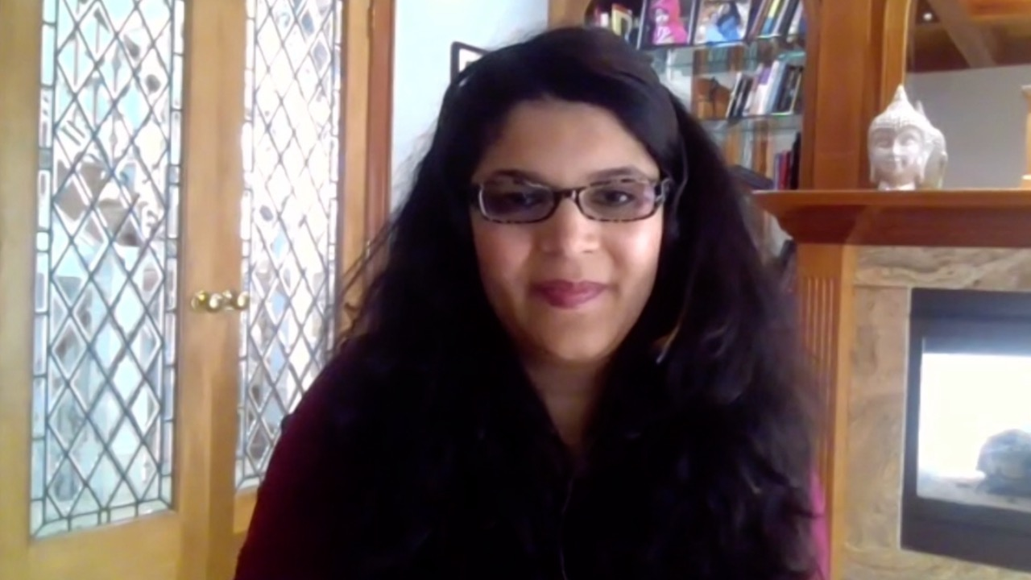
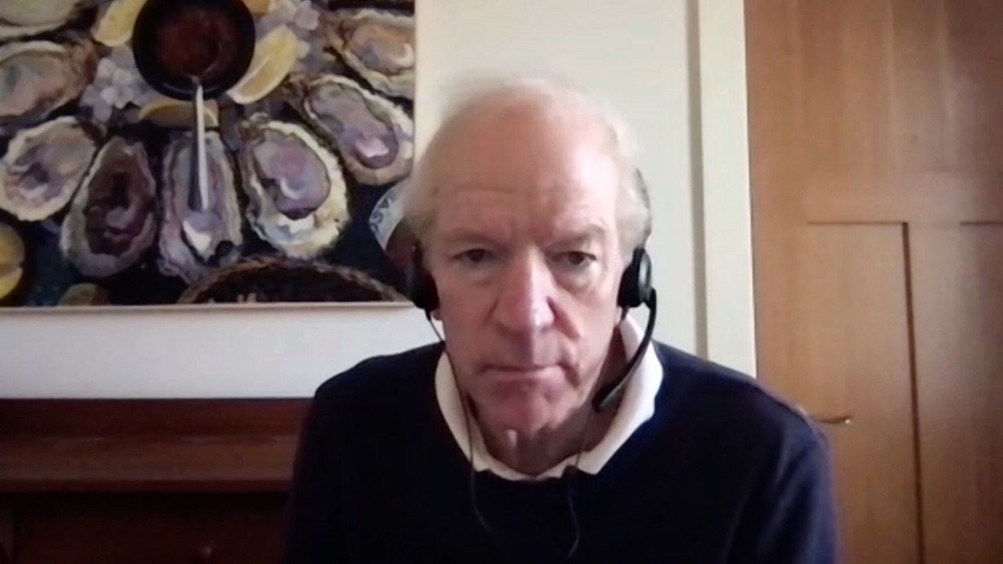
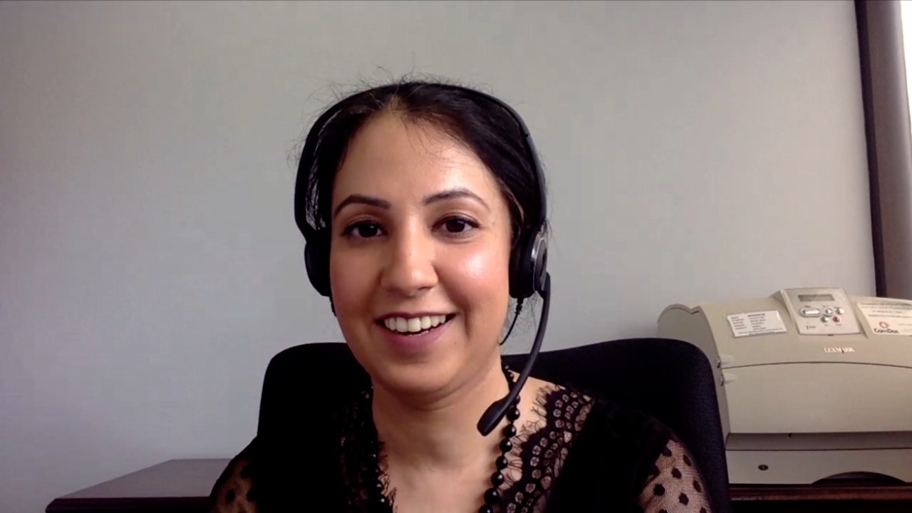
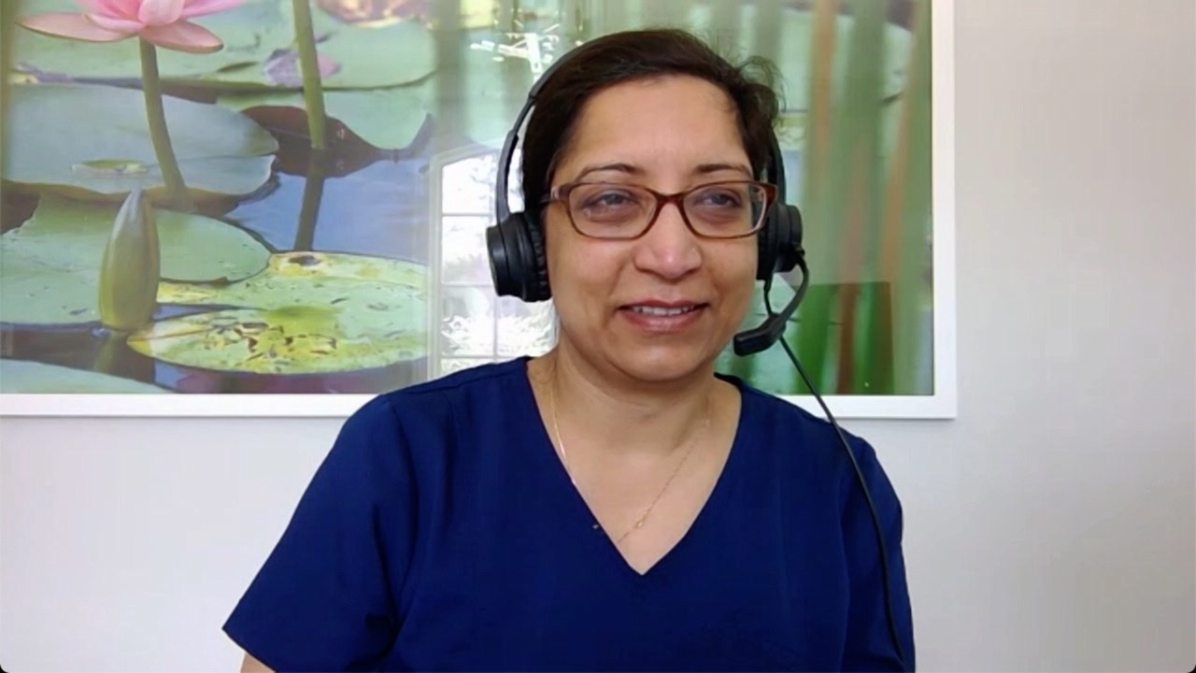
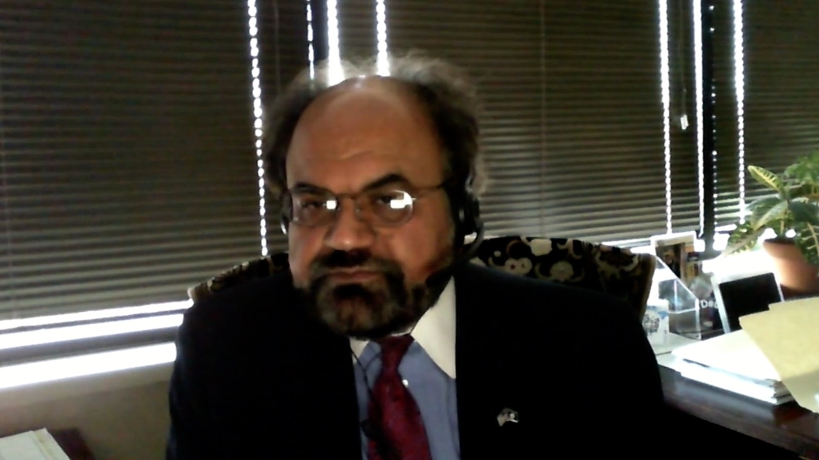
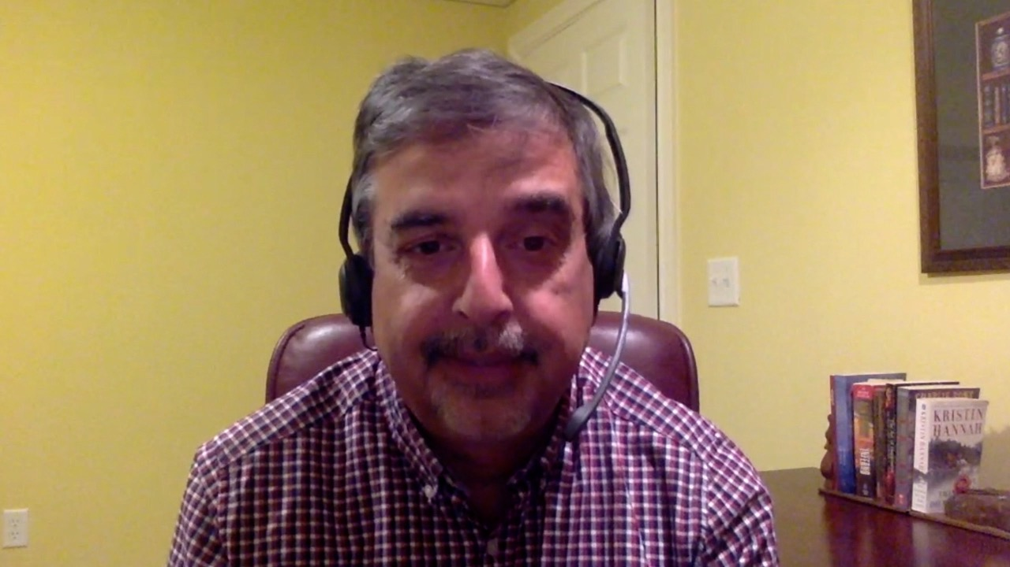
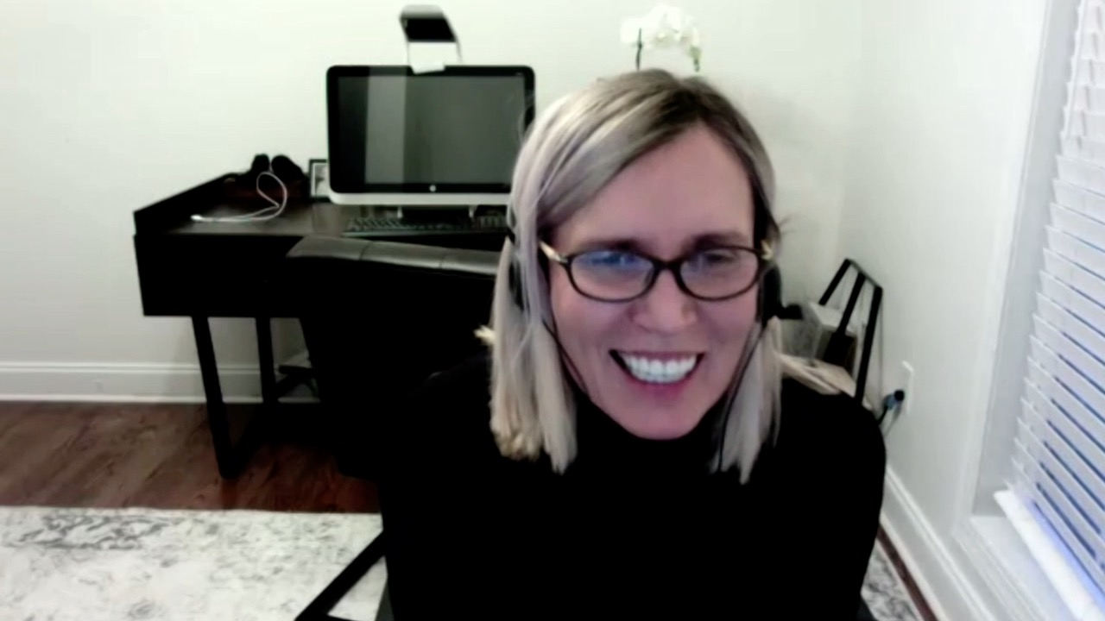
Bhavana (Tina) Bhatnagar, DO
West Virginia University Cancer Institute Schiffler Cancer Center
Wheeling, West Virginia
G Richard Polkinghorn, MD
Harold Alfond Center for Cancer Care
MaineGeneral Medical Center
Augusta, Maine
Gurveen Kaur, MD
WVU Medicine Wheeling Hospital
Wheeling, West Virginia
Rajni Sinha, MD, MRCP
Piedmont Cancer Institute
Atlanta, Georgia
Khuda Dad Khan, MD, PhD
Norton Cancer Institute
Prospect, Kentucky
Raman Sood, MD
Brooks Memorial Hospital
Dunkirk, New York
Joanna Metzner-Sadurski, MD
Self Regional Healthcare Cancer Center
Greenwood, South Carolina

Slide 7
Meet The Professor with Dr Brown
MODULE 1: Case Presentations
Dr Polkinghorn: A 68-year-old man with chronic lymphocytic leukemia (CLL) on observation for 10 years who develops angioedema
Dr Sinha: A 60-year-old woman with SLL and Bruton tyrosine kinase (BTK)-related arthralgia
Dr Khan: A 69-year-old man with CLL and hypertension, CAD, GERD and atrial fibrillation
Dr Sood: A 65-year-old man with CLL who receives obinutuzumab and venetoclax
Dr Kaur: A 70-year-old man with IGHV-mutated CLL
Dr Bhatnagar: A 70-year-old man with CLL, thrombocytopenia and possible underlying plasma cell dyscrasia
Dr Metzner-Sadurski: A 64-year-old woman with IGHV-unmutated CLL and hemolytic anemia
MODULE 2: Journal Club with Dr Brown
MODULE 3: Faculty Survey
MODULE 4: Appendix of Key Recent Data Sets

Slide 8
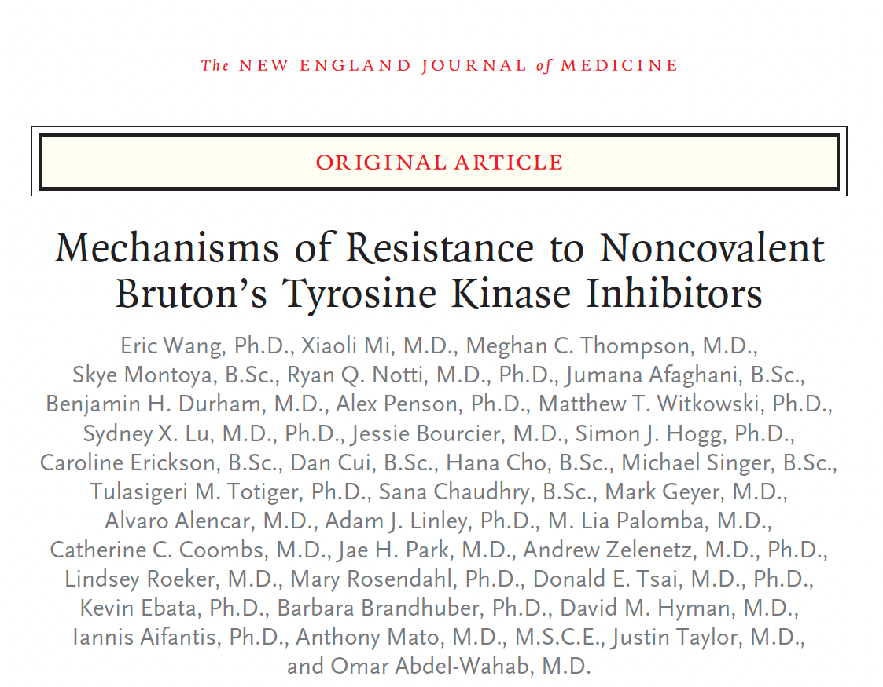
N Engl J Med 2022;386:735-43

Slide 9
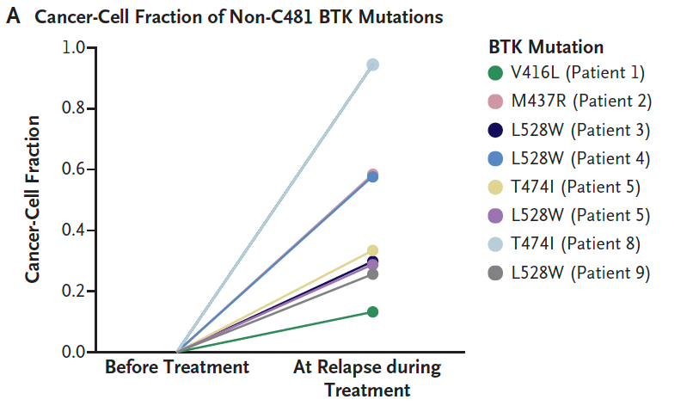
BTK Mutations in Patients with CLL with Acquired Resistance to Noncovalent BTK Inhibitors
Wang E et al. N Engl J Med 2022;386:735-43.

Slide 10
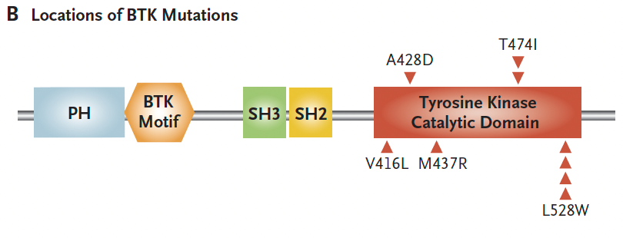
BTK Mutations in Patients with CLL with Acquired Resistance to Noncovalent BTK Inhibitors
Wang E et al. N Engl J Med 2022;386:735-43.

Slide 11
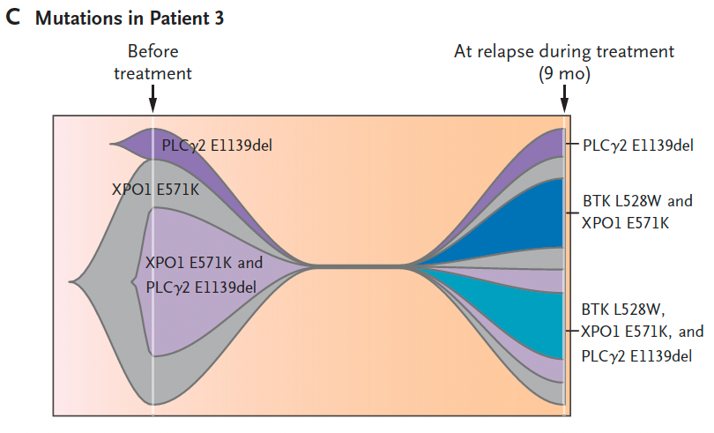
BTK Mutations in Patients with CLL with Acquired Resistance to Noncovalent BTK Inhibitors
Wang E et al. N Engl J Med 2022;386:735-43.

Slide 12
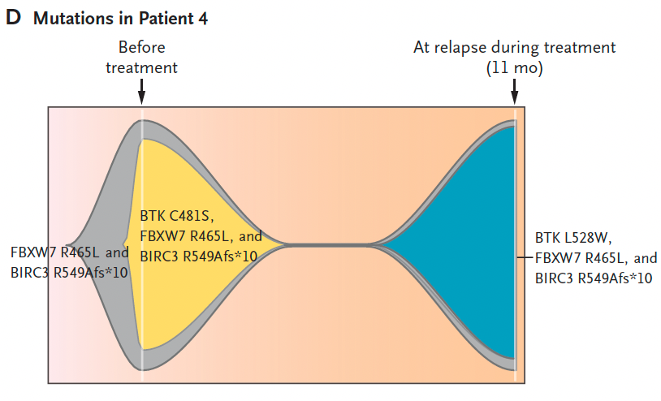
BTK Mutations in Patients with CLL with Acquired Resistance to Noncovalent BTK Inhibitors
Wang E et al. N Engl J Med 2022;386:735-43.

Slide 13
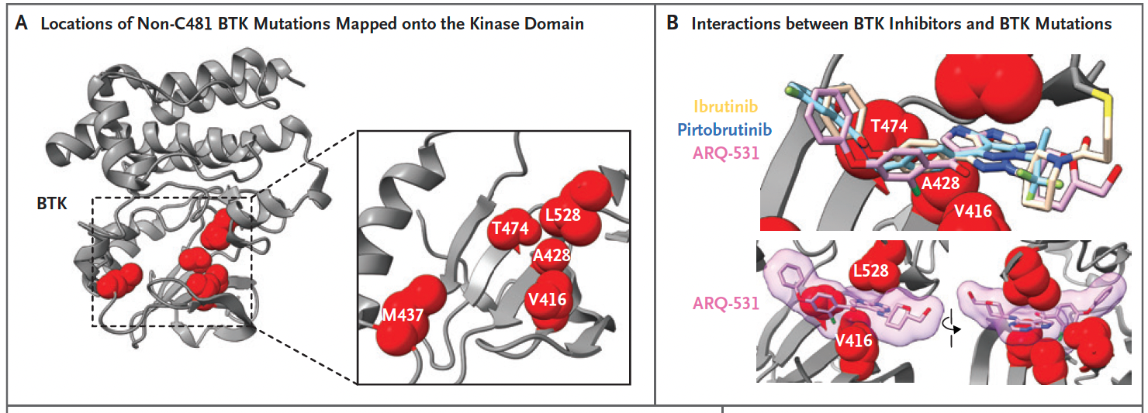
Resistance to BTK Inhibitors Conferred by BTK Mutations Outside the C481 Residue
Wang E et al. N Engl J Med 2022;386:735-43.

Slide 14
Meet The Professor with Dr Brown
MODULE 1: Case Presentations
Dr Polkinghorn: A 68-year-old man with CLL on observation for 10 years who develops angioedema
Dr Sinha: A 60-year-old woman with SLL and BTK-related arthralgia
Dr Khan: A 69-year-old man with CLL and hypertension, CAD, GERD and atrial fibrillation
Dr Sood: A 65-year-old man with CLL who receives obinutuzumab and venetoclax
Dr Kaur: A 70-year-old man with IGHV-mutated CLL
Dr Bhatnagar: A 70-year-old man with CLL, thrombocytopenia and possible underlying plasma cell dyscrasia
Dr Metzner-Sadurski: A 64-year-old woman with IGHV-unmutated CLL and hemolytic anemia
MODULE 2: Journal Club with Dr Brown
MODULE 3: Faculty Survey
MODULE 4: Appendix of Key Recent Data Sets

Slide 15
Case Presentation: A 68-year-old man with CLL on observation for 10 years who develops angioedema
Dr G Richard Polkinghorn (Augusta, Maine)

Slide 16
Case Presentation: A 60-year-old woman with SLL and BTK-related arthralgia
Dr Rajni Sinha (Atlanta, Georgia)

Slide 17
Case Presentation: A 60-year-old woman with SLL and BTK-related arthralgia (continued)
Dr Rajni Sinha (Atlanta, Georgia)

Slide 18
Case Presentation: A 69-year-old man with CLL and hypertension, CAD, GERD and atrial fibrillation
Dr Khuda Dad Khan (Prospect, Kentucky)

Slide 19
Case Presentation: A 65-year-old man with CLL who receives obinutuzumab and venetoclax
Dr Raman Sood (Dunkirk, New York)

Slide 20
Case Presentation: A 70-year-old man with IGHV-mutated CLL
Dr Gurveen Kaur (Wheeling, West Virginia)

Slide 21
Case Presentation: A 70-year-old man with CLL, thrombocytopenia and possible underlying plasma cell dyscrasia
Dr Tina Bhatnagar (Wheeling, West Virginia)

Slide 22
Case Presentation: A 64-year-old woman with IGHV-unmutated CLL and hemolytic anemia
Dr Joanna Metzner-Sadurski (Greenwood, South Carolina)

Slide 23
Meet The Professor with Dr Brown
MODULE 1: Case Presentations
Dr Polkinghorn: A 68-year-old man with CLL on observation for 10 years who develops angioedema
Dr Sinha: A 60-year-old woman with SLL and BTK-related arthralgia
Dr Khan: A 69-year-old man with CLL and hypertension, CAD, GERD and atrial fibrillation
Dr Sood: A 65-year-old man with CLL who receives obinutuzumab and venetoclax
Dr Kaur: A 70-year-old man with IGHV-mutated CLL
Dr Bhatnagar: A 70-year-old man with CLL, thrombocytopenia and possible underlying plasma cell dyscrasia
Dr Metzner-Sadurski: A 64-year-old woman with IGHV-unmutated CLL and hemolytic anemia
MODULE 2: Journal Club with Dr Brown
MODULE 3: Faculty Survey
MODULE 4: Appendix of Key Recent Data Sets

Slide 24
Front Immunol 2021;12:687458.

Slide 25
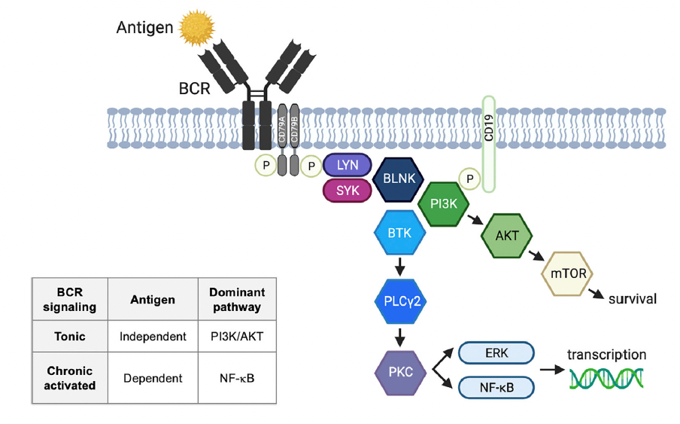
B-Cell Receptor Signaling Pathway
Ahn IE, Brown JR. Front Immunol 2021;12:687458.

Slide 26
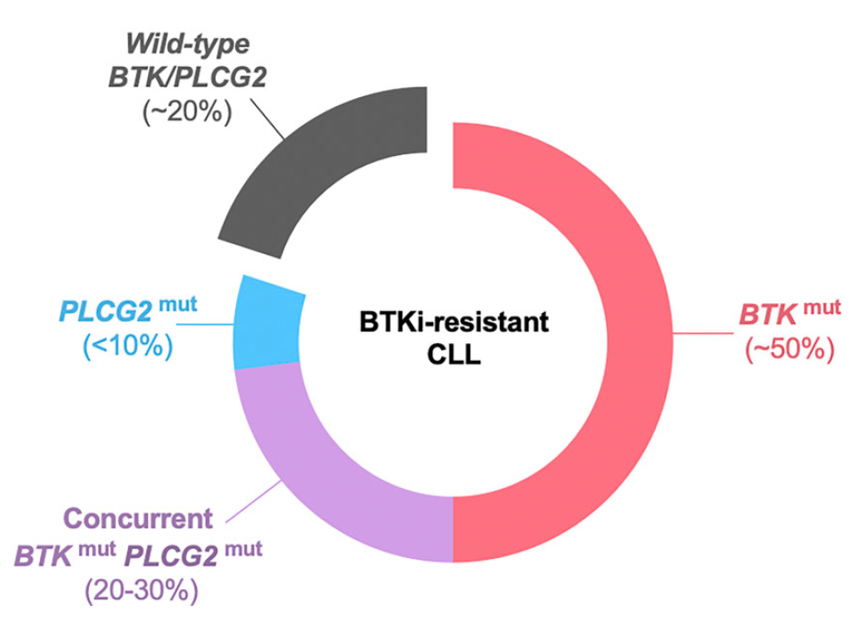
Bruton Tyrosine Kinase (BTK) and PLCG2 Mutations in BTK inhibitor (BTKi)-Resistant CLL
Ahn IE, Brown JR. Front Immunol 2021;12:687458.

Slide 27
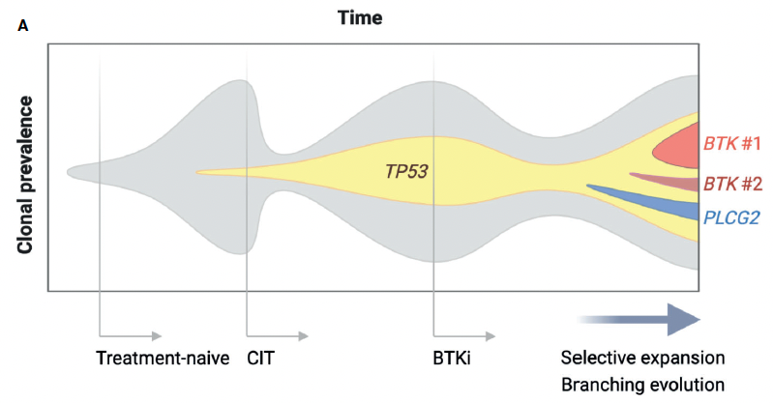
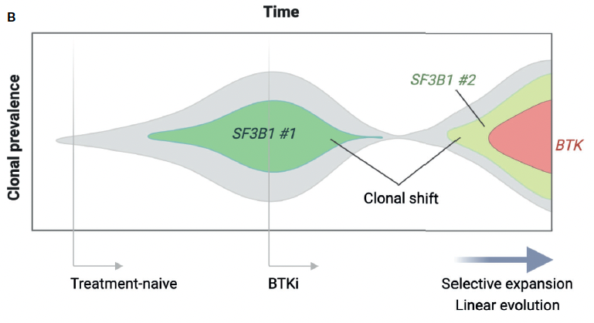
Clonal Evolution of BTKi-Resistant CLL
Ahn IE, Brown JR. Front Immunol 2021;12:687458.

Slide 28
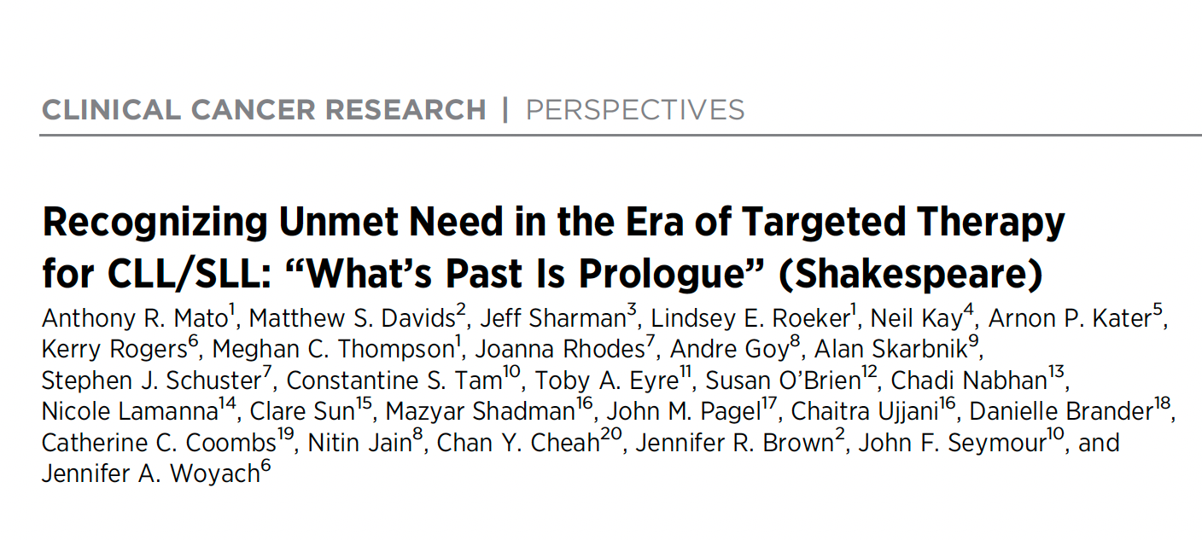
Clin Cancer Res 2022;28(4):603-8.

Slide 29
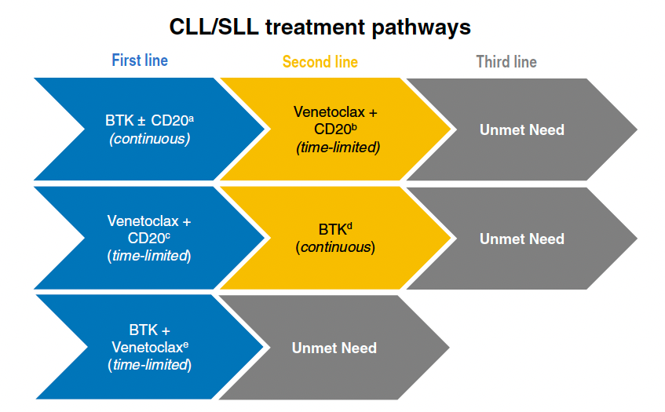
Chemotherapy-Free Sequencing Algorithms for CLL/SLL: Unmet Needs in Modern Clinical Practice
Mato AR et al. Clin Cancer Res 2022;28(4):603-8.

Slide 31
Front Oncol 2021;11:720704

Slide 32
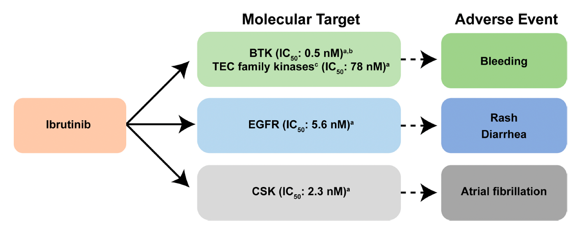
Reported Molecular Targets of Ibrutinib and Their Associated Adverse Events
O’Brien SM et al. Front Oncol 2021;11:720704.

Slide 33
Front Immunol 2021;12:804735.

Slide 34
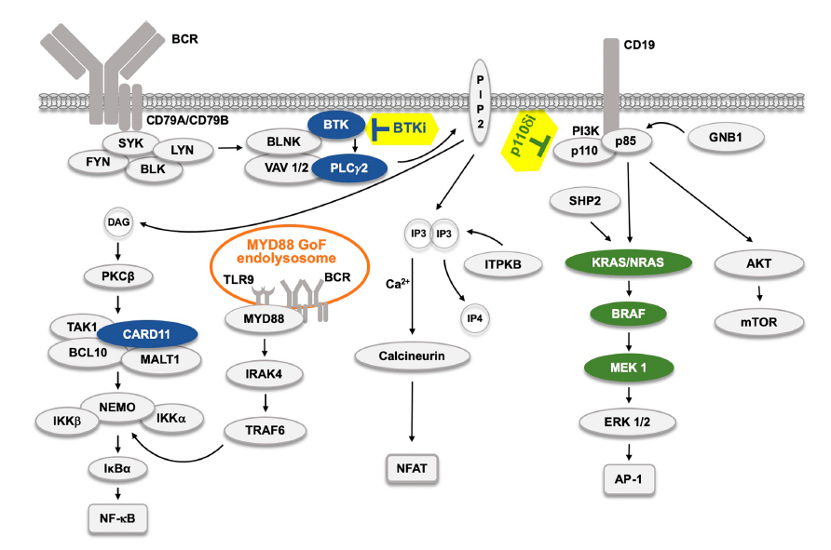
The B-Cell Receptor (BCR) Signaling Pathway and the Effect of Kinase Inhibitors
Smith CIE et al. Front Immunol 2021;12:804735.

Slide 35
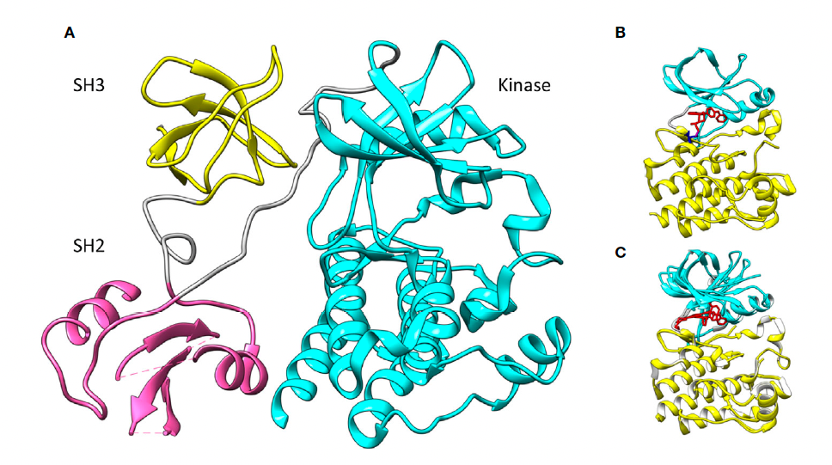
Spatial Organization of the BTK Kinase Domains
Mouse BTK SH3, SH2 and Kinase Domains
Human BTK kinase domain with ibrutinib (red) bound covalently (magenta) to C481 (blue) (5p9j)
Zain R, Vihinen M. Front Immunol 2021;12:694853.

Slide 36
IRC Determines That Zanubrutinib Demonstrates Superior Overall Response Rate versus Ibrutinib in Final Response Analysis of ALPINE Trial for CLL Press Release: April 11, 2022
“…Results from the Phase 3 ALPINE trial [were announced] showing BTK inhibitor zanubrutinib demonstrated superiority versus ibrutinib in overall response rate (ORR) as assessed by an Independent Review Committee (IRC) in adult patients with relapsed or refractory (R/R) chronic lymphocytic leukemia (CLL) or small lymphocytic lymphoma (SLL).
After achieving superiority in the primary endpoint of investigator-assessed overall response rate at the interim analysis, in this final response analysis, zanubrutinib met the primary endpoint of superiority over ibrutinib in ORR as determined by IRC, with a response rate of 80.4% versus 72.9% (2-sided p = 0.0264). ORR is defined as the combined rate of complete responses (CR) and partial responses (PR). A total of 652 patients were enrolled in the ALPINE trial across Europe (60%), the United States (17%), China (14%), New Zealand and Australia (9%) and were followed for a median of 24.2 months. The next planned analysis of ALPINE data will be the PFS final analysis.”
https://www.businesswire.com/news/home/20220411005299/en/IRC-Determines-BRUKINSA%C2%AE-Zanubrutinib-Demonstrates-Superior-Overall-Response-Rate-Versus-Ibrutinib-in-Final-Response-Analysis-of-ALPINE-Trial-in-Chronic-Lymphocytic-Leukemia

Slide 40
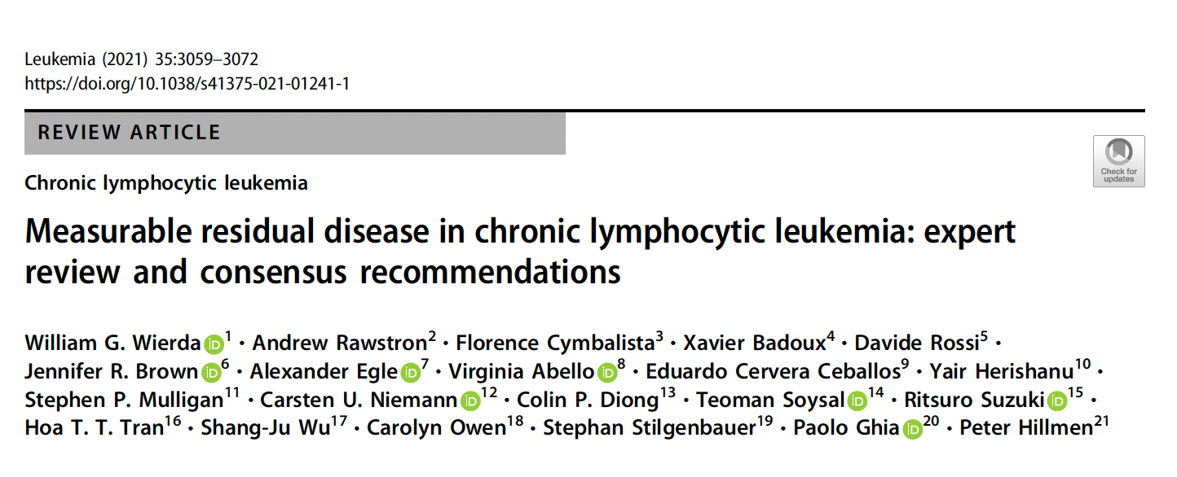

Slide 41
Allan JN et al. Haematologica 2022;107(4):984-7.

Slide 42
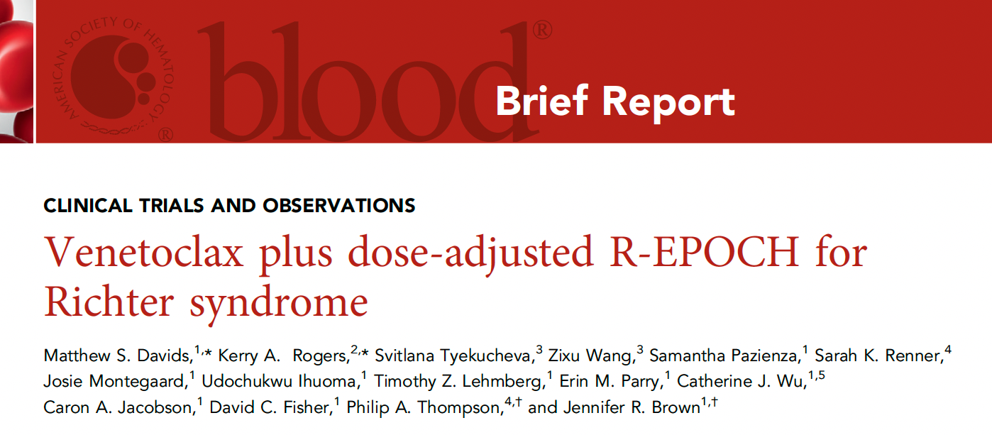
Blood 2022;139(5):686-9.

Slide 43
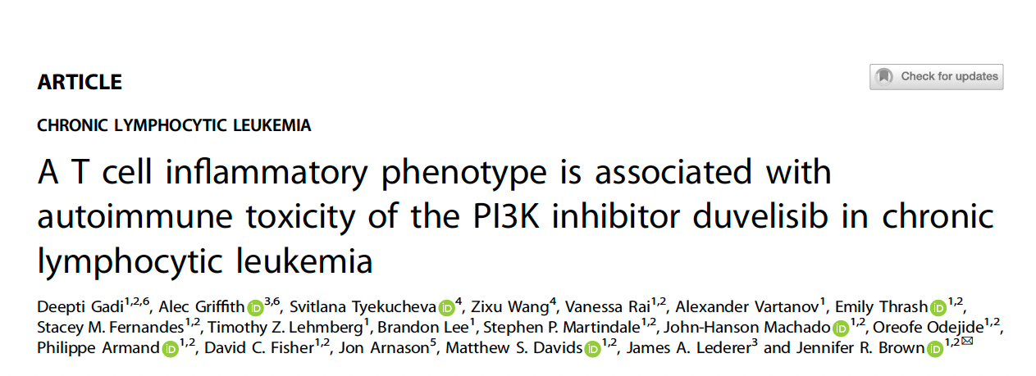
Leukemia 2022;36(3):723-32.

Slide 44
Meet The Professor with Dr Brown
MODULE 1: Case Presentations
Dr Polkinghorn: A 68-year-old man with CLL on observation for 10 years who develops angioedema
Dr Sinha: A 60-year-old woman with SLL and BTK-related arthralgia
Dr Khan: A 69-year-old man with CLL and hypertension, CAD, GERD and atrial fibrillation
Dr Sood: A 65-year-old man with CLL who receives obinutuzumab and venetoclax
Dr Kaur: A 70-year-old man with IGHV-mutated CLL
Dr Bhatnagar: A 70-year-old man with CLL, thrombocytopenia and possible underlying plasma cell dyscrasia
Dr Metzner-Sadurski: A 64-year-old woman with IGHV-unmutated CLL and hemolytic anemia
MODULE 2: Journal Club with Dr Brown
MODULE 3: Faculty Survey
MODULE 4: Appendix of Key Recent Data Sets

Slide 45
What is your usual preferred initial regimen for a 60-year-old patient with CLL with IGHV mutation but no del(17p) or TP53 mutation who requires treatment?
FCR
BR (bendamustine/rituximab)
Ibrutinib
Ibrutinib + anti-CD20 antibody
Acalabrutinib
Acalabrutinib + obinutuzumab
Venetoclax + obinutuzumab
Other

Slide 46
What is your usual preferred initial regimen for a 60-year-old patient with CLL with IGHV mutation but no del(17p) or TP53 mutation who requires treatment?
FCR
Acalabrutinib or Venetoclax/ obinutuzumab
Venetoclax/ obinutuzumab
Venetoclax/ obinutuzumab
Venetoclax/ obinutuzumab
Venetoclax/ obinutuzumab
Venetoclax/ obinutuzumab
FCR = fludarabine/cyclophosphamide/rituximab

Slide 47
Regulatory and reimbursement issues aside, what is your usual preferred initial regimen for a 60-year-old patient with CLL, unmutated IGHV and no del(17p) or TP53 mutation who requires treatment?
Ibrutinib
Ibrutinib + anti-CD20 antibody
Acalabrutinib
Acalabrutinib + obinutuzumab
Zanubrutinib
Venetoclax + obinutuzumab
Venetoclax + ibrutinib
Other

Slide 48
Regulatory and reimbursement issues aside, what would be your preferred initial regimen for a 60-year-old patient with CLL, unmutated IGHV and no del(17p) or TP53 mutation who required treatment?
Venetoclax + obinutuzumab
Acalabrutinib or Venetoclax/ obinutuzumab
Venetoclax + obinutuzumab
Venetoclax/ obinutuzumab
Venetoclax/ibrutinib
Venetoclax/ibrutinib
Venetoclax/ibrutinib

Slide 49
What is your usual preferred initial regimen for a 60-year-old patient with CLL, IGHV mutation and del(17p) or TP53 mutation who requires treatment?
FCR
BR
Ibrutinib
Ibrutinib + anti-CD20 antibody
Acalabrutinib
Acalabrutinib + obinutuzumab
Venetoclax + obinutuzumab
Other

Slide 50
What is your usual preferred initial regimen for a 60-year-old patient with CLL, IGHV mutation and del(17p) or TP53 mutation who requires treatment?
Acalabrutinib + obinutuzumab
Acalabrutinib
Acalabrutinib
Acalabrutinib
Acalabrutinib
Acalabrutinib
Acalabrutinib

Slide 51
What would be your most likely approach for a patient with newly diagnosed CLL to whom you decide to administer up-front venetoclax/obinutuzumab who has detectable MRD after completing 1 year of treatment?
Continue treatment
Discontinue treatment

Slide 52
What would be your most likely approach for a patient with newly diagnosed CLL to whom you decide to administer up-front venetoclax/obinutuzumab who has detectable MRD after completing 1 year of treatment?
Discontinue treatment
Discontinue treatment
Discontinue treatment
Discontinue treatment
Discontinue treatment
Continue treatment
Continue treatment

Slide 53
Meet The Professor with Dr Brown
MODULE 1: Case Presentations
Dr Polkinghorn: A 68-year-old man with CLL on observation for 10 years who develops angioedema
Dr Sinha: A 60-year-old woman with SLL and BTK-related arthralgia
Dr Khan: A 69-year-old man with CLL and hypertension, CAD, GERD and atrial fibrillation
Dr Sood: A 65-year-old man with CLL who receives obinutuzumab and venetoclax
Dr Kaur: A 70-year-old man with IGHV-mutated CLL
Dr Bhatnagar: A 70-year-old man with CLL, thrombocytopenia and possible underlying plasma cell dyscrasia
Dr Metzner-Sadurski: A 64-year-old woman with IGHV-unmutated CLL and hemolytic anemia
MODULE 2: Journal Club with Dr Brown
MODULE 3: Faculty Survey
MODULE 4: Appendix of Key Recent Data Sets

Slide 54
Minimal Residual Disease

Slide 55
Currently Applied Methods for MRD Assessment
Method | Sensitivity | Features | Advantages | Disadvantages
Flow cytometry
4-color flow | 10⁻⁴ | Detection of surface markers by established antibody panels | ERIC consensus guidelines available, widely accessible, relatively affordable, quantitative results relatively quick | Fresh (<48 h) PB or BM samples necessary, sufficient number of cells required to achieve sensitivity
≥6-color flow | 10⁻⁵
8-color flow | 10⁻⁶
10-color flow | 10⁻⁵
Polymerase chain reaction (PCR)
ASO PCR | 10⁻⁵ | Quantification based on allele- and pt-specific primers for hypervariable CDR3 of IgH | Good sensitivity, use of DNA (instead of fresh material), quantitative results | Pt-specific primers required, baseline reference sample necessary, relatively time and labor intensive
Next-generation sequencing
ClonoSEQ® | 10⁻⁶ | Measurement of CLL-specific IgH sequences based on consensus primers | High sensitivity, use of DNA, tracking of clones possible, quantitative results | Relatively expensive, baseline reference sample necessary, not widely used yet
Al-Sawaf O et al. Hematol Oncol Clin N Am 2021;35(4):775-91. Wierda WG et al. Leukemia 2021;35:3059-72.

Slide 56
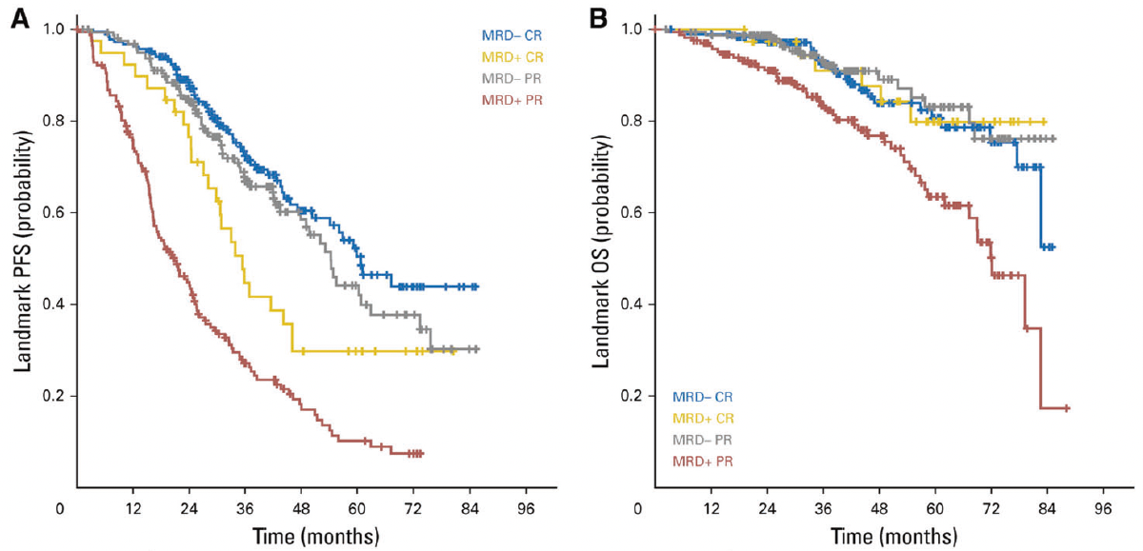
Landmark Analysis in the CLL8 and CLL10 Trials of Chemoimmunotherapy for CLL: Survival According to MRD Status
Wierda WG et al. Leukemia 2021;35:3059-72.

Slide 57
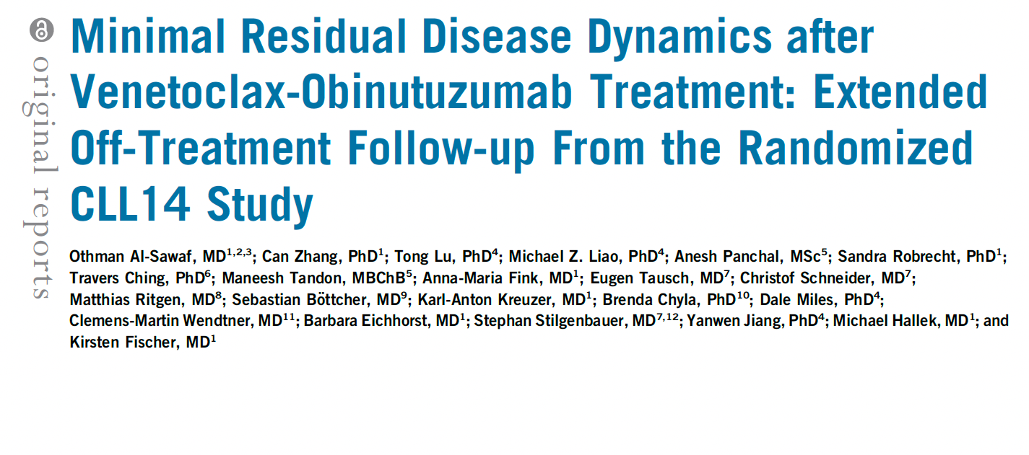
J Clin Oncol 2021;39(36):4049-60.

Slide 58
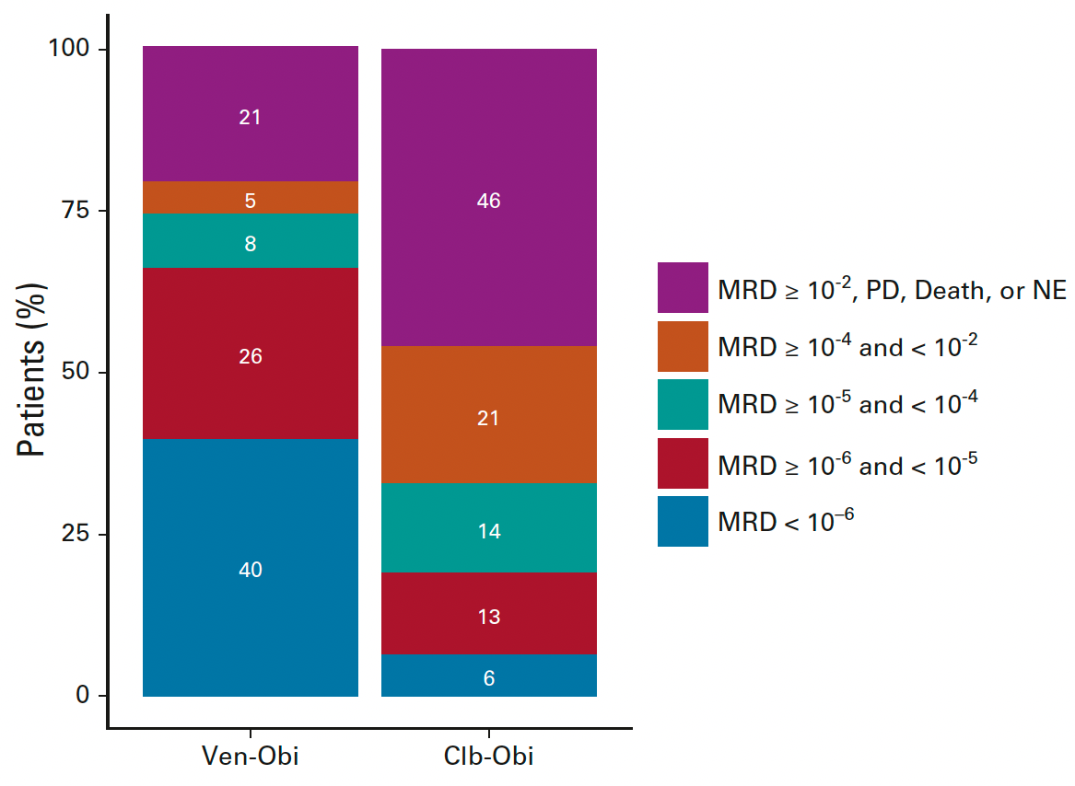
CLL14 Update: Minimum Residual Disease (MRD) Status by Next-Generation Sequencing 2 Months After Completion of Treatment
Al-Sawaf O et al. J Clin Oncol 2021;39(36):4049-60.

Slide 59
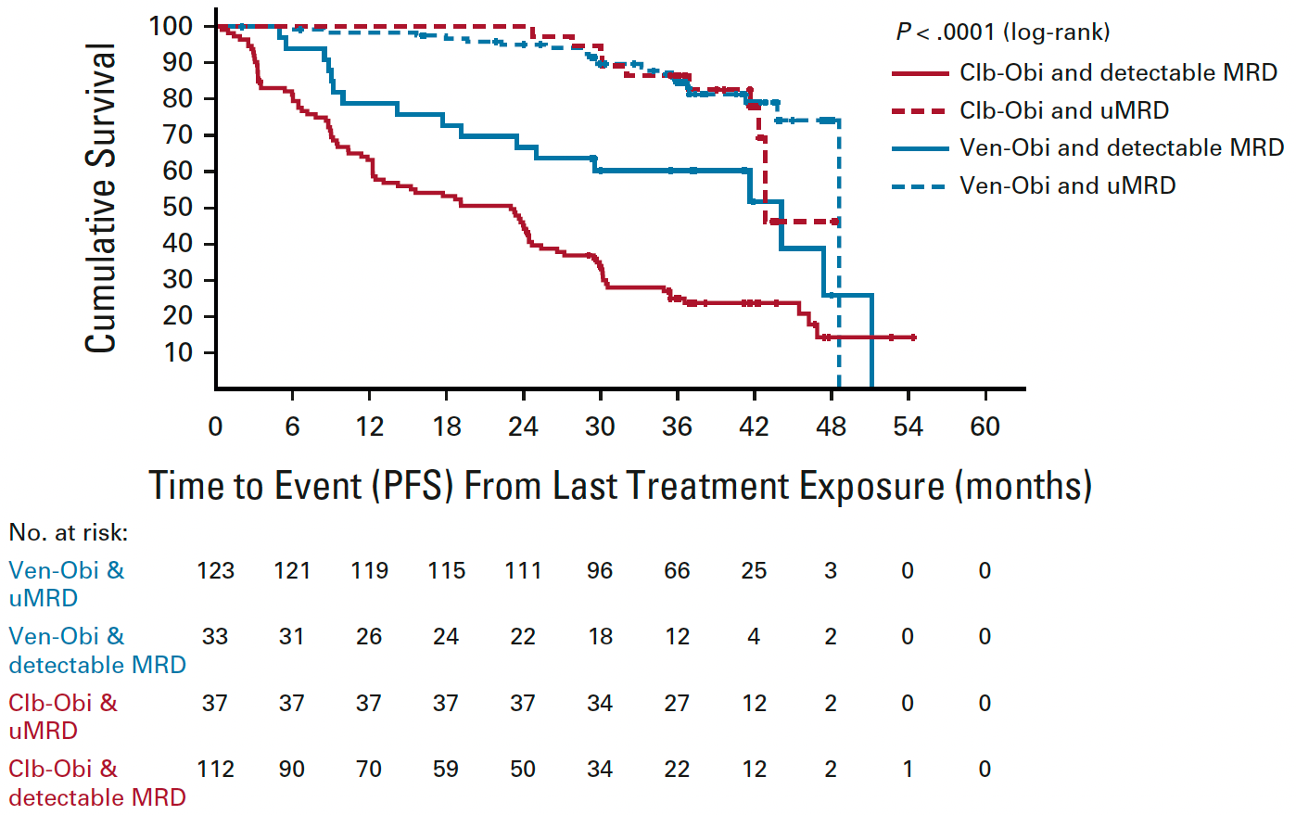
CLL14: PFS According to Bone Marrow MRD Status, from Last Treatment Exposure
Al-Sawaf O et al. J Clin Oncol 2021;39(36):4049-60.

Slide 60
Current Approach to First-Line Treatment

Slide 61
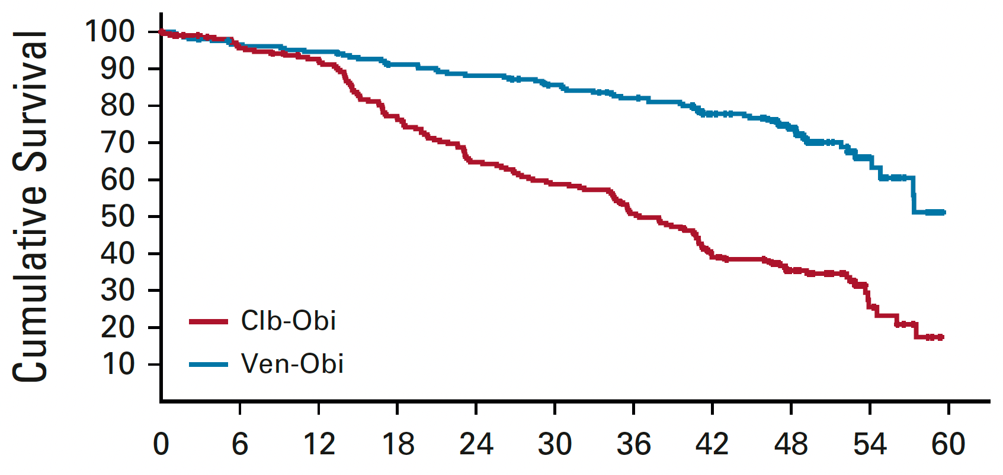
CLL14 Update: Progression-Free Survival
Median F/U: 52.4 months
PFS significantly longer for Ven-Obi in patients with TP53 aberrations and for those with and without IGHV mutations
 | Ven-Obi (n = 216) | Clb-Obi (n = 216)
Median PFS | Not reached | 36.4 mo
 | HR: 0.33, p < 0.0001
Time in Months from Randomization
Al-Sawaf O et al. J Clin Oncol 2021;39(36):4049-60.

Slide 62
ASH 2021;Abstract 639

Slide 63
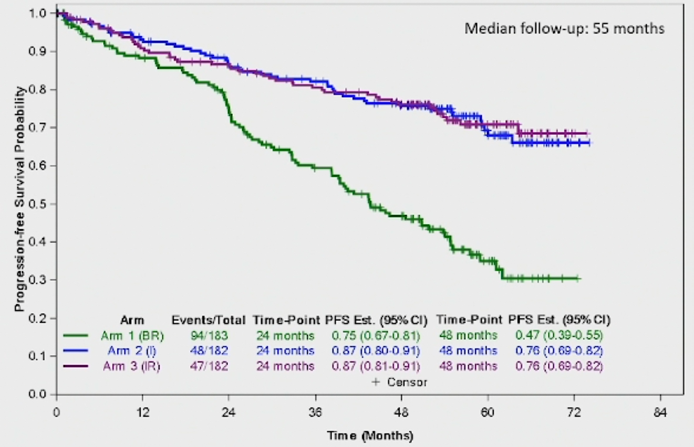
Alliance A041202: Progression-Free Survival
Pairwise comparisons | Hazard ratio | p-value
I vs BR | 0.36 | <0.0001
IR vs BR | 0.36 | <0.001
IR vs I | 0.99 | 0.96
Woyach JA et al. ASH 2021;Abstract 639.

Slide 64
Ibrutinib and Rituximab Provides Superior Clinical Outcome Compared to FCR in Younger Patients with Chronic Lymphocytic Leukemia (CLL): Extended Follow-Up from the E1912 Trial
Shanafelt TD et al. ASH 2019;Abstract 33.

Slide 65
Phase III ECOG-ACRIN E1912 Study Design
Ibrutinib + rituximab (IR)
→ ibrutinib until PD
Eligibility
Previously untreated CLL requiring treatment Ability to tolerate FCR-based therapy Age ≤70 years
R
(2:1; N = 529)
FCR
Primary endpoint: PFS
Secondary endpoints: OS, ORR, Toxicity and Tolerability
ECOG-ACRIN E1912 Physician Fact Sheet, version 01/15/16;
www.clinicaltrials.gov (NCT02048813); Shanafelt TD et al. ASH 2018;Abstract LBA-4.

Slide 66
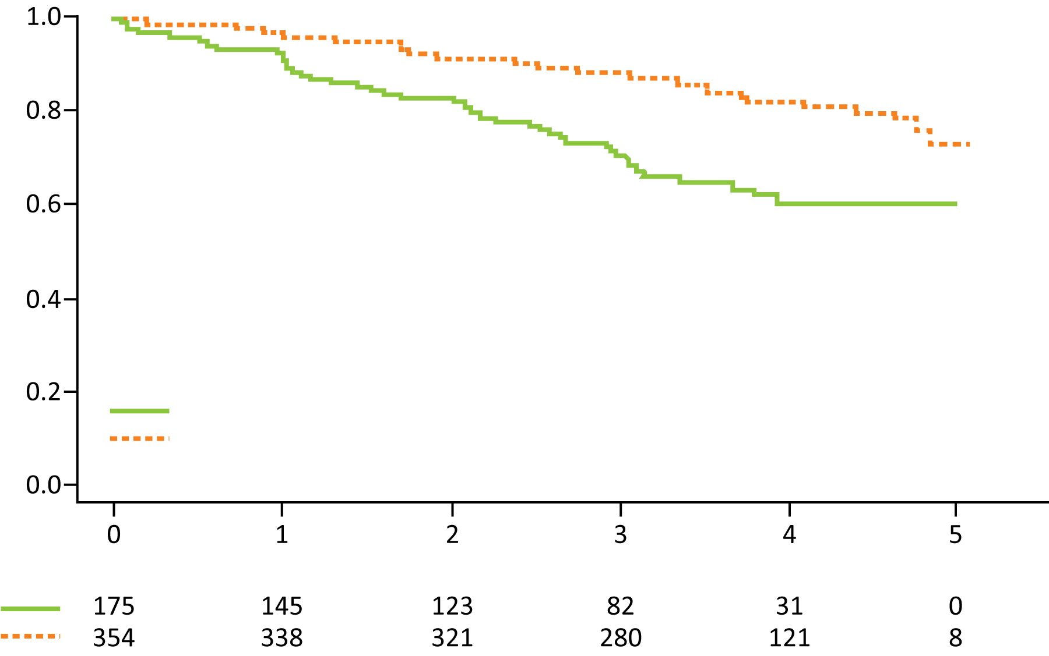
ECOG-ACRIN E1912 Extended Follow-Up: Up-Front IR Compared to FCR for Younger Patients with CLL
PFS
Probability
HR = 0.39 p < 0.0001
3-year rates: 89%, 71%
FCR (52 events/175 cases)
IR (58 events/354 cases)
Years
Number at risk
Grade ≥3 treatment-related AEs were reported in 70% of patients receiving IR and 80% of patients receiving FCR (odds ratio = 0.56; p = 0.013).
Among the 95 patients who discontinued ibrutinib, the most common cause was AE or complication.
Shanafelt TD et al. ASH 2019;Abstract 33.

Slide 67
Ibrutinib plus Rituximab Is Superior to FCR in Previously Untreated CLL: Results of the Phase III NCRI FLAIR Trial
Hillmen P et al.
ASH 2021;Abstract 642.

Slide 68
NCRI FLAIR Study Design
Hillmen P et al. ASH 2021;Abstract 642.

Slide 69
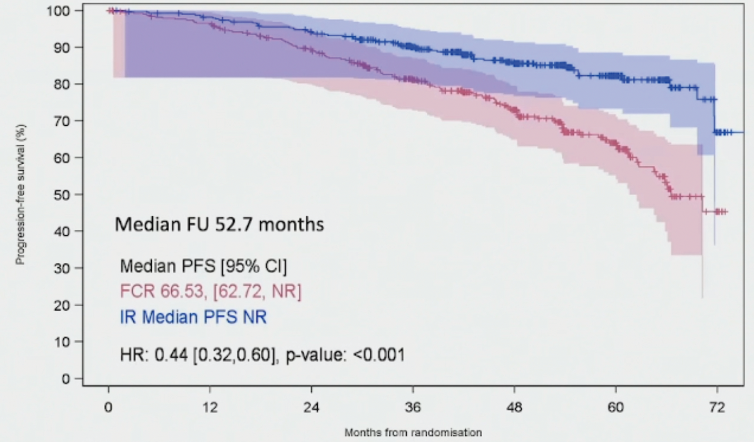
NCRI FLAIR: Progression-Free Survival
(N = 385)
(N = 386)
Hillmen P et al. ASH 2021;Abstract 642.

Slide 70
Leukemia 2022;[Online ahead of print].

Slide 71
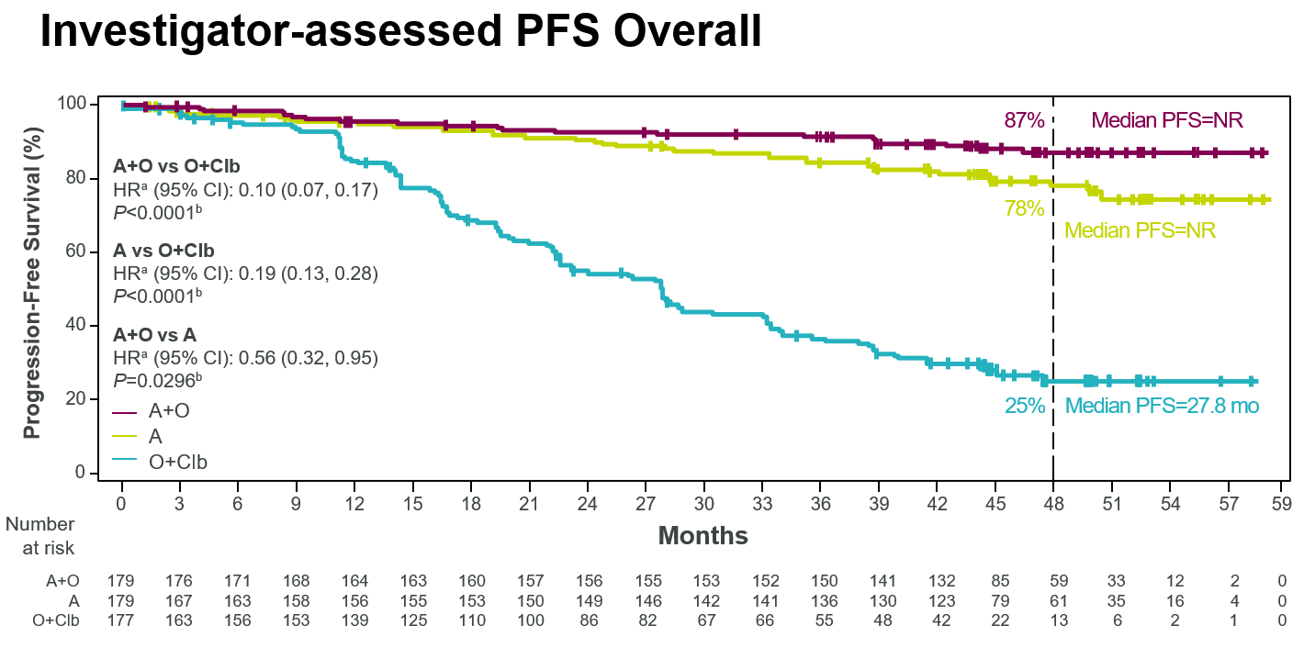
ELEVATE-TN: Investigator-Assessed PFS (Overall)
4-Year Follow-Up
Sharman JP et al. Leukemia 2022;[Online ahead of print].

Slide 73
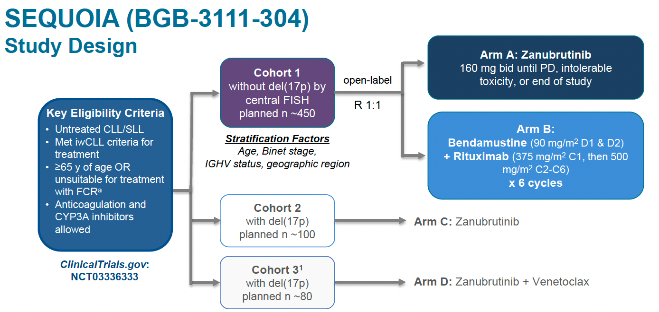
SEQUOIA Phase III Study Design
Tam CS et al. ASH 2021;Abstract 396.

Slide 74
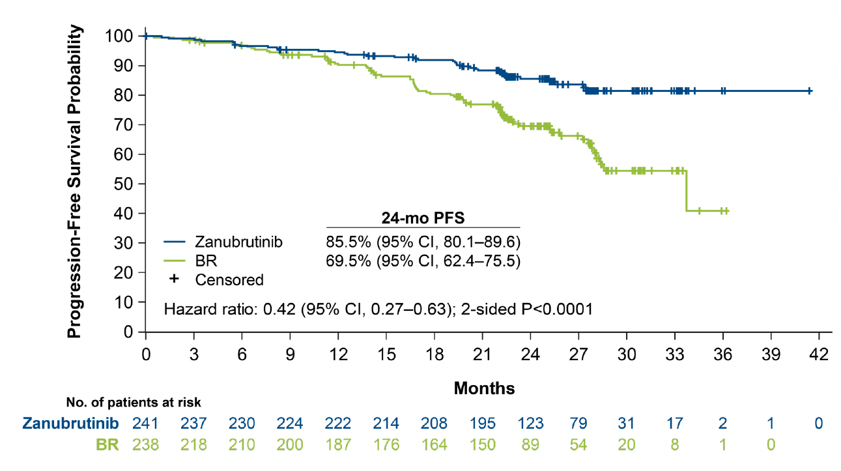
SEQUOIA: Progression-Free Survival by IRC
Tam CS et al. ASH 2021;Abstract 396.

Slide 75
SEQUOIA: Progression-Free Survival by Subgroups
Tam CS et al. ASH 2021;Abstract 396.

Slide 76
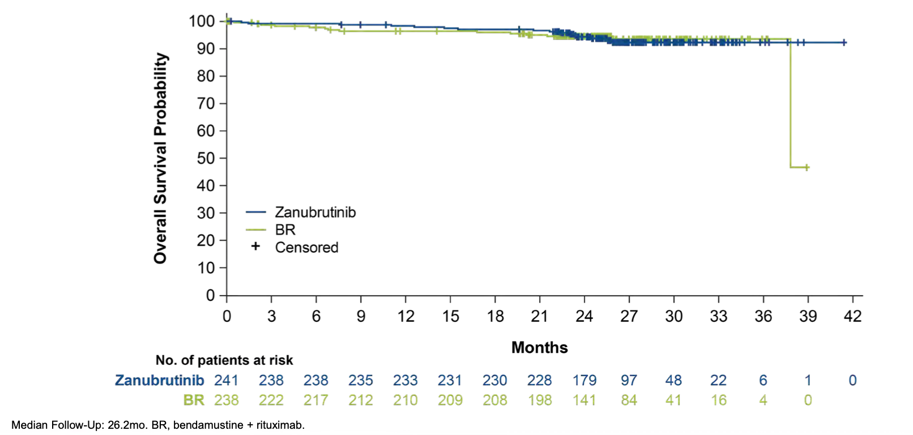
SEQUOIA: Overall Survival
Tam CS et al. ASH 2021;Abstract 396.

Slide 77
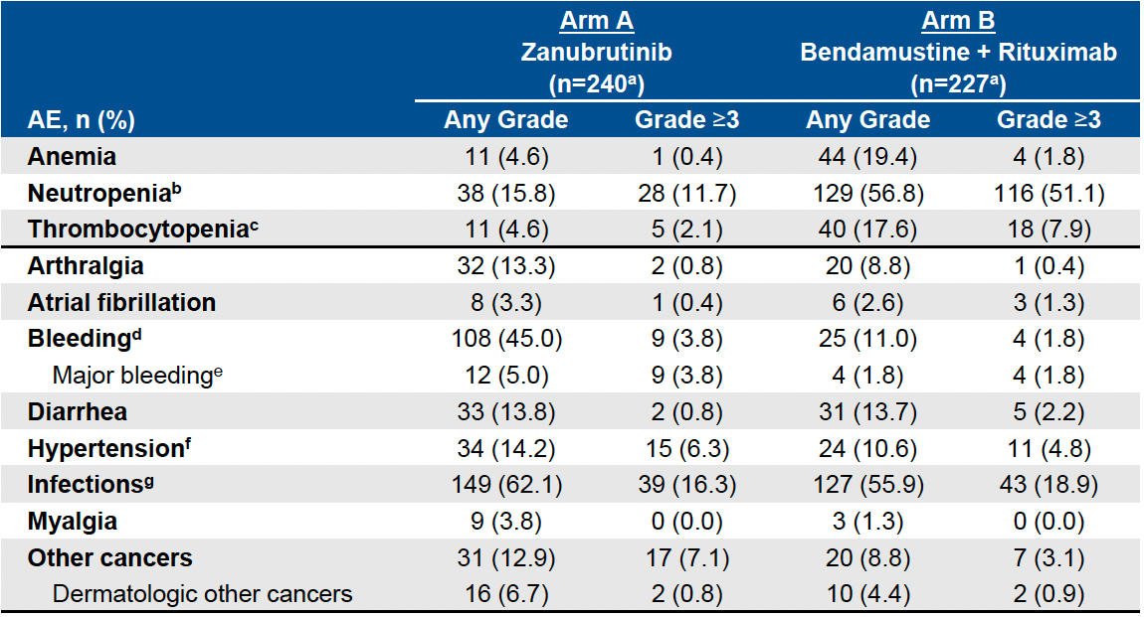
SEQUOIA: Adverse Events of Interest
Tam CS et al. ASH 2021;Abstract 396.

Slide 78
Venetoclax Combination Regimens

Slide 79
A Randomized Phase III Study of Venetoclax-Based Time-Limited Combination Treatments (RVe, GVe, GIVe) vs Standard Chemoimmunotherapy (CIT: FCR/BR) in Frontline Chronic Lymphocytic Leukemia (CLL) of Fit Patients: First Co-Primary Endpoint Analysis of the International Intergroup GAIA (CLL13) Trial
Eichhorst B et al.
ASH 2021;Abstract 71.

Slide 80
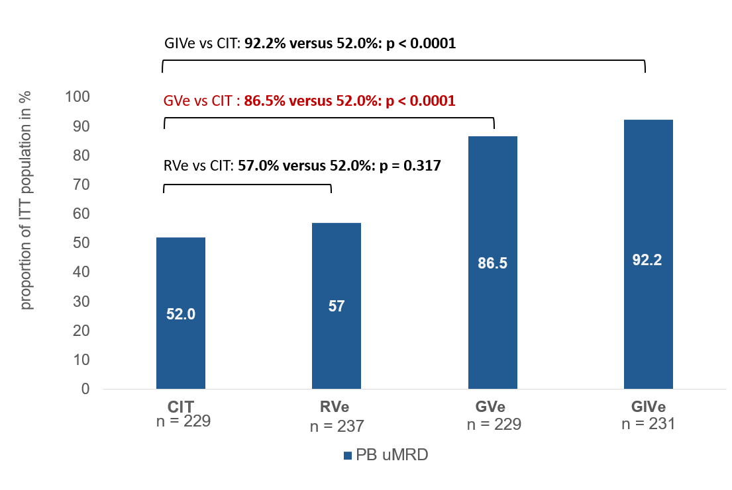
GAIA/CLL13 Coprimary Endpoint: Undetectable MRD (uMRD) (<10⁻⁴) at Month 15 in Peripheral Blood by 4-Color Flow
CIT
BR >65
≤FCR 65
RVe
Rituximab/venetoclax
GVe
Obinutuzumab/venetoclax
GIVe
Obinutuzumab/ibrutinib/venetoclax
Eichhorst B et al. ASH 2021;Abstract 71.

Slide 81
ASCO 2021;Abstract 7501

Slide 82
CAPTIVATE Study Design
Ghia P et al. ASCO 2021;Abstract 7051.

Slide 83
CAPTIVATE: Response
Ghia P et al. ASCO 2021;Abstract 7051.

Slide 84
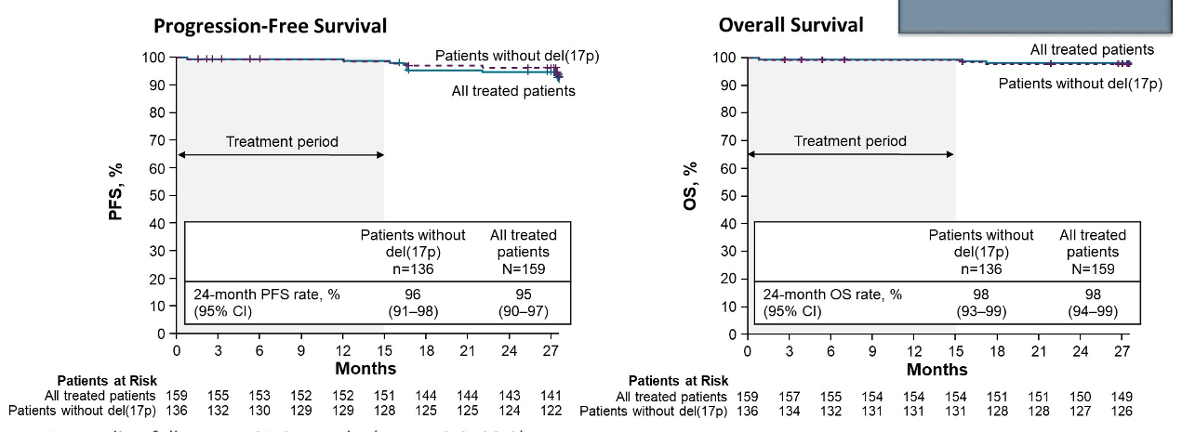
CAPTIVATE: Progression-Free and Overall Survival
Ghia P et al. ASCO 2021;Abstract 7051.

Slide 85
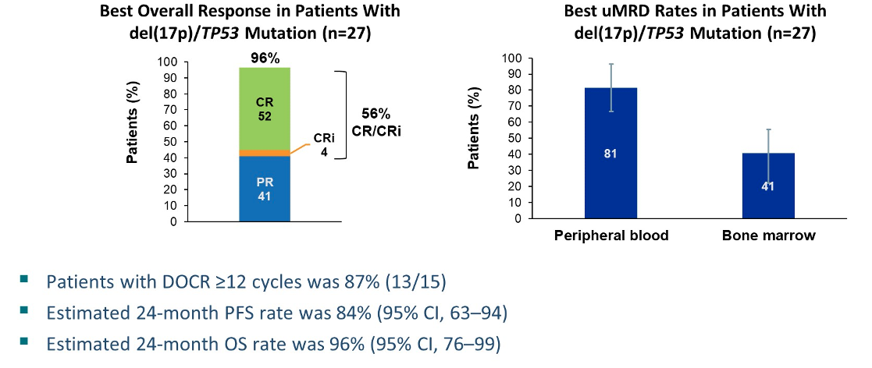
CAPTIVATE: Efficacy Outcomes for Patients with Del(17p)/TP53 Mutation
Ghia P et al. ASCO 2021;Abstract 7051.

Slide 86
First-Line Treatment with Ibrutinib (Ibr) plus Venetoclax (Ven) for Chronic Lymphocytic Leukemia (CLL): 2-Year Post-Randomization Disease-Free Survival (DFS) Results from the Minimal Residual Disease (MRD) Cohort of the Phase 2 Captivate Study
Ghia P et al.
ASH 2021;Abstract 68.

Slide 87
CAPTIVATE MRD Cohort: DFS Events in Patients with Confirmed uMRD
Ghia P et al. ASH 2021;Abstract 68.

Slide 88
CAPTIVATE MRD Cohort: Three-Year PFS Rates
Ghia P et al. ASH 2021;Abstract 68.

Slide 89
CAPTIVATE MRD Cohort: CR Rates with 24 Months Postrandomization Follow-Up
Ghia P et al. ASH 2021;Abstract 68.

Slide 90
ASH 2021;Abstract 70.

Slide 91
GLOW: Independent Review Committee (IRC)-Assessed PFS
30-month PFS: 80.5% for Ibr+Ven vs 35.8% for Clb+O
Munir T et al. ASH 2021;Abstract 70.

Slide 92
GLOW: uMRD <10⁻⁴ Rate
Munir T et al. ASH 2021;Abstract 70.

Slide 93
Fixed-Duration Ibrutinib and Venetoclax (I + V) versus Chlorambucil plus Obinutuzumab (Clb + O) for First-Line (1L) Chronic Lymphocytic Leukemia (CLL): Primary Analysis of the Phase 3 GLOW Study
Kater A et al. EHA 2021;Abstract LB1902.

Slide 94
GLOW: Study Design and Endpoints
Kater A et al. EHA 2021;Abstract LB1902.

Slide 95
GLOW: Progression-Free Survival
Kater A et al. EHA 2021;Abstract LB1902.

Slide 96
GLOW: Undetectable MRD Rate
Kater A et al. EHA 2021;Abstract LB1902.

Slide 97
GLOW: Safety
Kater A et al. EHA 2021;Abstract LB1902.

Slide 99
VISION H0141 Study Schema
Niemann CU et al. ASH 2021;Abstract 69.

Slide 100
VISION H0141: Progression-Free Survival

Slide 101
Selection of BTK Inhibitor

Slide 102
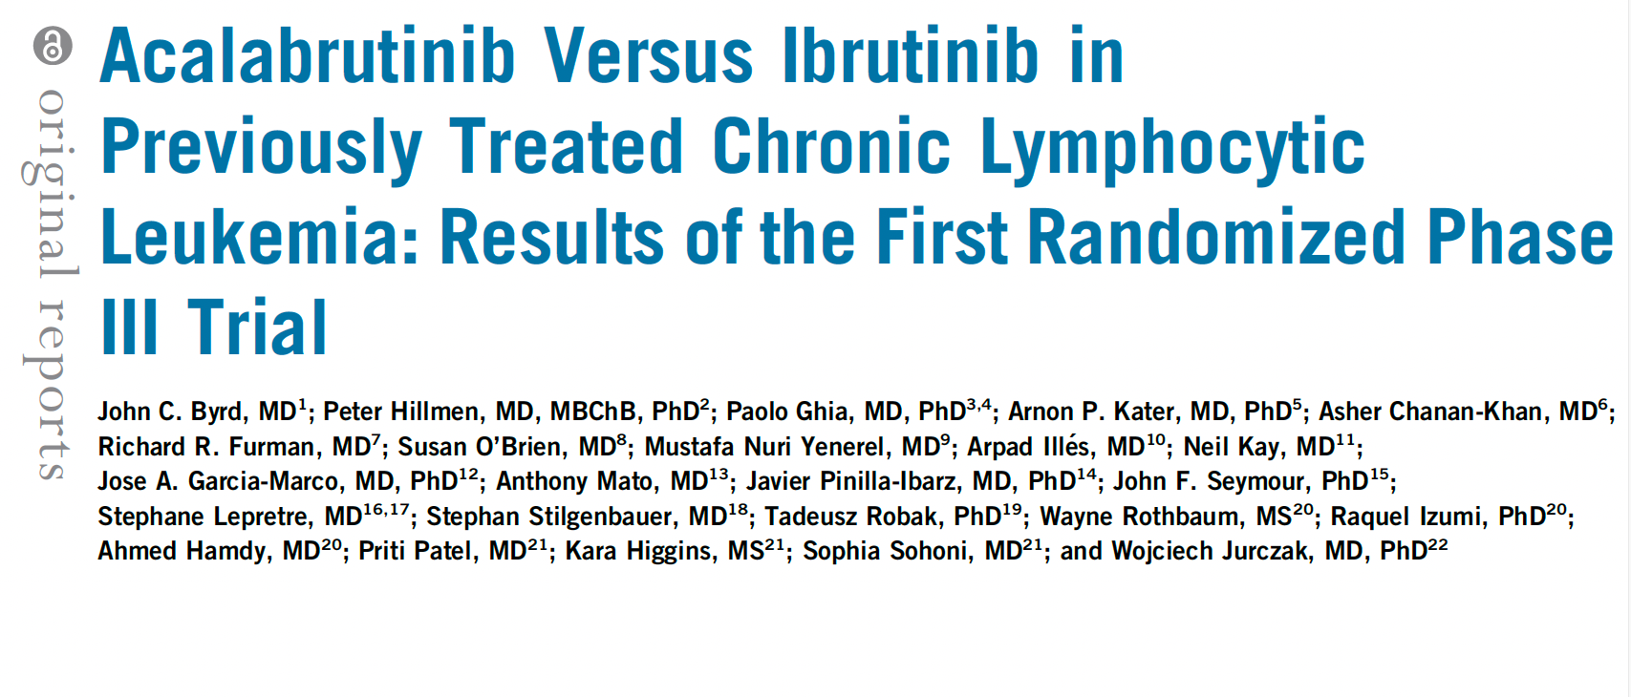
J Clin Oncol 2021;39(31):3441-52.

Slide 103
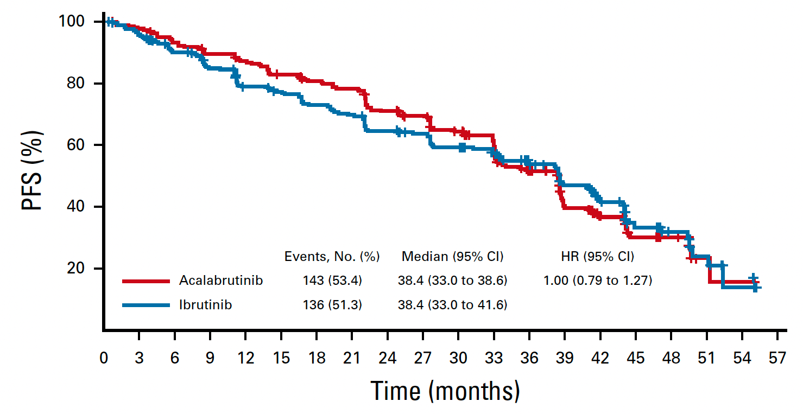
ELEVATE-RR: Independent Review Committee-Assessed PFS
Byrd JC et al. J Clin Oncol 2021;39(31):3441-52.

Slide 104
ELEVATE-RR: Characterization of Adverse Events with Acalabrutinib versus Ibrutinib
Seymour JF et al. ASH 2021;Abstract 3721.

Slide 105
New Acalabrutinib Formulation Enables Co-Administration with Proton Pump Inhibitors and Dosing in Patients Unable to Swallow Capsules (ELEVATE-PLUS)
Sharma S et al. ASH 2021;Abstract 4365.
Author Conclusions: Acalabrutinib maleate, administered as a tablet or suspension, is safe and well tolerated. Based on the PK (and associated variability), BTK-TO, and established exposure-efficacy/safety relationship, AMT clinical effect is expected to be comparable to acalabrutinib capsules at the approved 100-mg BID dosing, regardless of use of PPIs and ingestion of food. Additionally, AMT improves swallowing ability given the film coating and a 50% reduced volume compared with the capsule, and can be easily suspended in a small amount of water to allow dosing in patients unable to swallow tablets.

Slide 106
ELEVATE-PLUS: Pharmacokinetic Profiles of Acalabrutinib and Its Major Pharmacologically Active Metabolite Across 3 Clinical Trials
Sharma S et al. ASH 2021;Abstract 4365.

Slide 107
First Interim Analysis of ALPINE Study: Results of a Phase 3 Randomized Study of Zanubrutinib vs Ibrutinib in Patients with Relapsed/Refractory Chronic Lymphocytic Leukemia/Small Lymphocytic Lymphoma
Hillmen P et al.
EHA 2021;Abstract LBA1900.

Slide 108
ALPINE: Response and Investigator-Assessed PFS
 | Zanubrutinib (n = 207) | Ibrutinib (n = 208)
12-month event-free rate | 94.9% | 84.0%
 | HR: 0.40, p = 0.0007
ORR | 78.3% | 62.5%
ORR for del(17p) | 83.3% | 53.8%
Months from Randomization
Hillmen P et al. EHA 2021;Abstract LBA1900.

Slide 109
ALPINE: Adverse Events of Special Interest
Hillmen P et al. EHA 2021;Abstract LBA1900.

Slide 110
Relapsed/Refractory CLL

Slide 111
Blood 2021;138(10):836-46.

Slide 112
MURANO 5-Year Follow-Up: Overall and Progression-Free Survival (All Patients)
Ma S et al. Blood 2021;138(10):836-46.

Slide 113
MURANO 5-Year Follow-Up: Durability of Benefit in Deep Responders (CR or uMRD Response)
CR = complete response; uMRD = undetectable minimal residual disease
Ma S et al. Blood 2021;138(10):836-46.

Slide 114
MURANO: Grade 3 or 4 Treatment-Emergent Adverse Events (AEs) Within and Beyond 2 Years of Treatment
Ma S et al. Blood 2021;138(10):836-46.

Slide 115
MURANO: Serious AEs Within and Beyond 2 Years of Treatment
Ma S et al. Blood 2021;138(10):836-46.

Slide 116
Novel Strategies Under Investigation

Slide 117
Pirtobrutinib, a Next Generation, Highly Selective, Non-Covalent BTK Inhibitor in Previously Treated CLL/SLL: Updated Results from the Phase 1/2 BRUIN Study
Mato AR et al.
ASH 2021;Abstract 391.

Slide 118
BRUIN: Pirtobrutinib Efficacy in Patients with BTK-Pretreated CLL or Small Lymphocytic Lymphoma (SLL)
Mato AR et al. ASH 2021;Abstract 391.

Slide 119
BRUIN: Pirtobrutinib Safety Profile
Mato AR et al. ASH 2021;Abstract 391.

Slide 120
FDA Has Placed a Partial Clinical Hold on Some Combination Candidate Studies for Leukemia and Lymphoma Press Release: January 27, 2022
The FDA placed partial holds on studies of the U2 combination umbralisib and ublituximab for chronic lymphocytic leukemia (CLL) and non-Hodgkin lymphoma (NHL).
The updated overall survival (OS) preliminary results from the UNITY-CLL study showed improvement. The OS hazard ratio was 1.23, and, including COVID-19-related deaths, the ratio reached 1.04.
An OS hazard ratio above 1.00 implies a risk that the investigational therapy might be causing harm.
No new patients can be enrolled in some CLL and NHL trials, but those deriving a benefit may continue with consent.
https://www.yahoo.com/now/tg-therapeutics-falls-30-ceo-173034141.html

Slide 121
Efficacy and Safety of Ublituximab in Combination with Umbralisib (U2) in Patients with Chronic Lymphocytic Leukemia (CLL) By Treatment Status: A Sub-Analysis of the Phase 3 Unity-CLL Study
Jacobs R et al.
ASH 2021;Abstract 3726.

Slide 122
Umbralisib: A Selective Inhibitor of PI3Kδ and CK1ε
Jacobs R et al. ASH 2021;Abstract 3726.

Slide 123
Ublituximab: A Novel Glycoengineered Anti-CD20 Monoclonal Antibody
Jacobs R et al. ASH 2021;Abstract 3726.

Slide 124
UNITY-CLL: IRC-Assessed PFS by Treatment Status
Jacobs R et al. ASH 2021;Abstract 3726.

Slide 125
UNITY-CLL: Adverse Events (AEs) of Clinical Interest
Jacobs R et al. ASH 2021;Abstract 3726.

Slide 126
Lancet Haematol 2021;8:e254-66.

Slide 127
GENUINE: Progression-Free Survival (All Patients)
Time since randomization (months)
Sharman JP et al. Lancet Haematol 2021;8:e254-56.

Slide 128
GENUINE: Progression-Free Survival in Subgroups
Patients with 17p deletion, TP mutation, or both
Patients with 11q deletion
Time since randomization (months)
Time since randomization (months)
Sharman JP et al. Lancet Haematol 2021;8:e254-56.

Slide 129
Nature 2022;[Online ahead of print].

Slide 130
Analysis of CD3+ CAR+ T Cells Using CyTOF Across Multiple Time Points
“Here we studied long-lasting CD19-redirected chimeric antigen
receptor (CAR) T cells in two patients with chronic lymphocytic leukaemia who achieved a complete remission in 2010.
CAR T cells remained detectable more than ten years after infusion, with sustained remission in both patients. Notably, a highly activated CD4+ population emerged in both patients, dominating the CAR T cell population at the later time points…
…Our identification and characterization of these unexpected
CAR T cell populations provide novel insight into the CAR T cell characteristics associated with anti-cancer response and long-term remission in leukaemia.”
Melenhorst JJ et al. Nature 2022;[Online ahead of print].

Slide 131
Blood 2021;[Online ahead of print].

Slide 132
TRANSCEND CLL 004: Rates of Cytokine Release Syndrome (CRS), Neurologic Events (NE) and Rehospitalization After Liso-cel Infusion
 | All patients (N = 23) | Dose level 1 50 x 10⁶ (n = 9) | Dose level 2 100 x 10⁶ (n = 14)
CRS any grade | 17 (74%) | 7 (78%) | 10 (71%)
CRS Grade ≥3 | 2 (9%) | 0 | 2 (14%)
NE any grade | 9 (39%) | 2 (22%) | 7 (50%)
NE Grade ≥3 | 5 (21%) | 2 (22%) | 2 (14%)
Reasons for patient rehospitalization
Adverse events | 11 (48%) | 3 (33%) | 8 (57%)
CRS and/or NE | 5 (22%) | 1 (11%) | 4 (29%)
CRS and NE | 2 (9%) | 0 | 2 (14%)
NE only | 3 (13%) | 1 (11%) | 2 (14%)
Siddiqi T et al. Blood 2021;[Online ahead of print].

Slide 133
TRANSCEND CLL 004: Response and uMRD (10⁻⁴) Rates
Siddiqi T et al. Blood 2021;[Online ahead of print].

Slide 134
TRANSCEND CLL 004: Swim Lane Plot, Duration of Response and PFS
Siddiqi T et al. Blood 2021;[Online ahead of print].

