Slide 1
Meet The Professor Optimizing the Management of Metastatic Castration-Resistant Prostate Cancer
Andrew J Armstrong, MD, ScM Professor of Medicine, Surgery, Pharmacology and Cancer Biology Director of Research Duke Cancer Institute Center for Prostate and Urologic Cancers Divisions of Medical Oncology and Urology Duke University Durham, North Carolina

Slide 2
Meet The Professor Program Participating Faculty
Andrew J Armstrong, MD, ScM Professor of Medicine, Surgery, Pharmacology and Cancer Biology Director of Research Duke Cancer Institute Center for Prostate and Urologic Cancers Divisions of Medical Oncology and Urology Duke University Durham, North Carolina
Simon Chowdhury, MD, PhD Consultant Medical Oncologist London, United Kingdom
Alan H Bryce, MD
Chair, Division of Hematology and Medical Oncology
Chair, Genitourinary Disease Group
Mayo Clinic
Phoenix, Arizona
Prof Karim Fizazi, MD, PhD Head of Service and Full Professor Institut Gustave Roussy University of Paris Saclay Villejuif, France

Slide 3
Meet The Professor Program Participating Faculty
Alicia K Morgans, MD, MPH
Genitourinary Medical Oncologist
Medical Director, Survivorship Program
Dana-Farber Cancer Institute
Boston, Massachusetts
Moderator Neil Love, MD Research To Practice Miami, Florida
A Oliver Sartor, MD Laborde Professor for Cancer Research Medical Director, Tulane Cancer Center Assistant Dean for Oncology Tulane Medical School New Orleans, Louisiana

Slide 4
Commercial Support
This activity is supported by educational grants from AstraZeneca Pharmaceuticals LP, Exelixis Inc, Merck, Novartis Pharmaceuticals Corporation on behalf of Advanced Accelerator Applications, and Sanofi Genzyme.
Research To Practice CME Planning Committee Members, Staff and Reviewers
Planners, scientific staff and independent reviewers for Research To Practice have no relevant conflicts of interest to disclose.

Slide 5
Dr Armstrong — Disclosures
Advisory Committee | Advanced Accelerator Applications, Exelixis Inc, Merck, Myovant Sciences, Novartis, Pfizer Inc
Consulting Agreements | Advanced Accelerator Applications, Astellas, AstraZeneca Pharmaceuticals LP, Bayer HealthCare Pharmaceuticals, Bristol-Myers Squibb Company, Dendreon Pharmaceuticals Inc, FORMA Therapeutics, Janssen Biotech Inc, Merck, Myovant Sciences, Novartis, Pfizer Inc
Contracted Research (to Institution) | Advanced Accelerator Applications, Amgen Inc, Astellas, AstraZeneca Pharmaceuticals LP, Bayer HealthCare Pharmaceuticals, BeiGene Ltd, Bristol-Myers Squibb Company, Constellation Pharmaceuticals, Dendreon Pharmaceuticals Inc, Endocyte Inc, FORMA Therapeutics, Janssen Biotech Inc, Merck, Novartis, Pfizer Inc

Slide 6
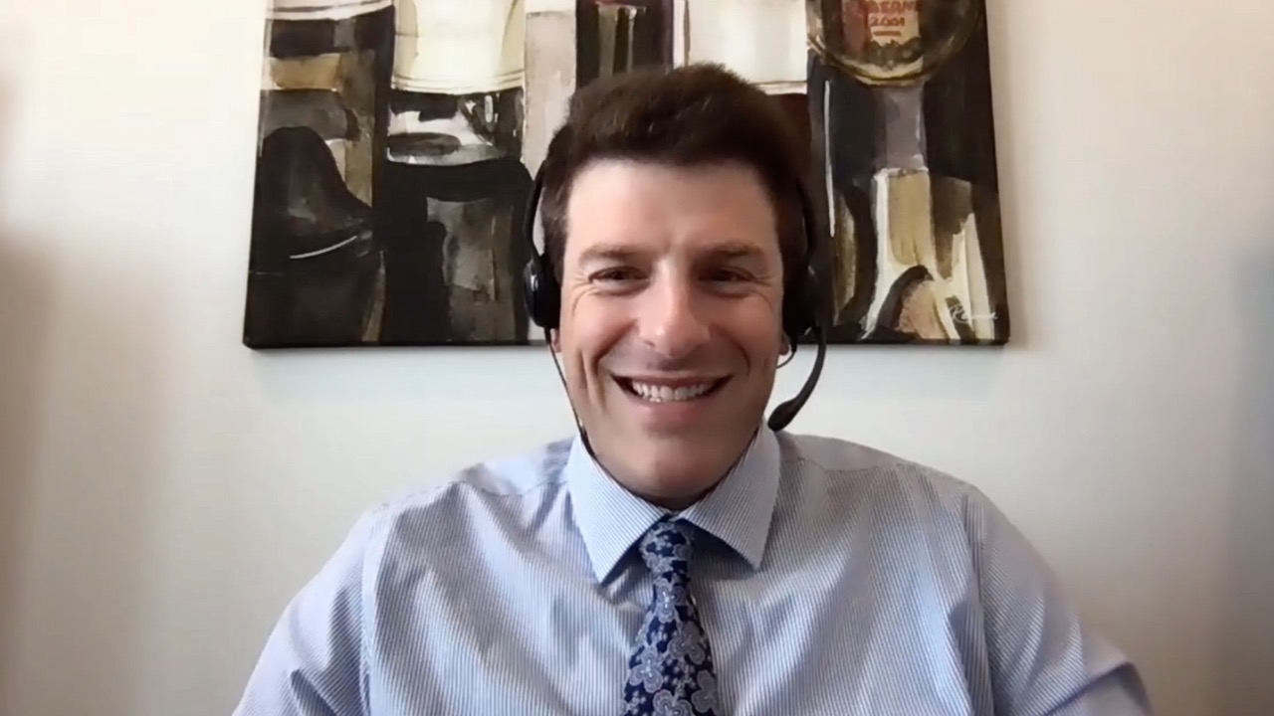
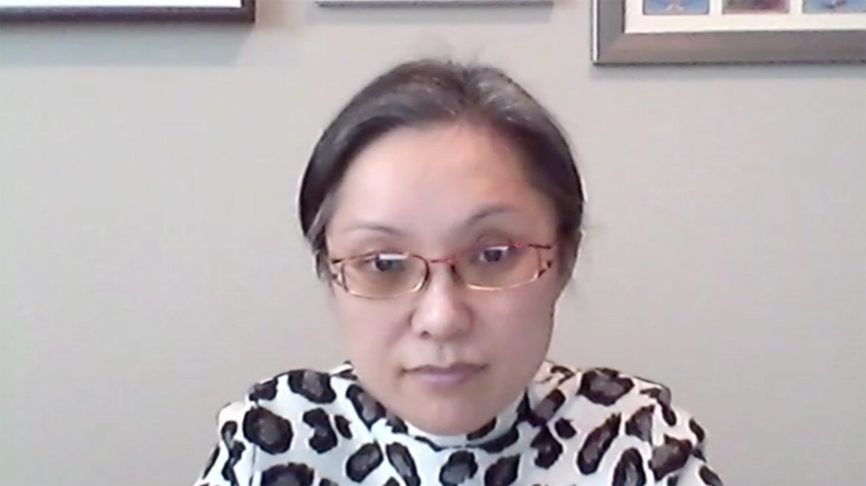
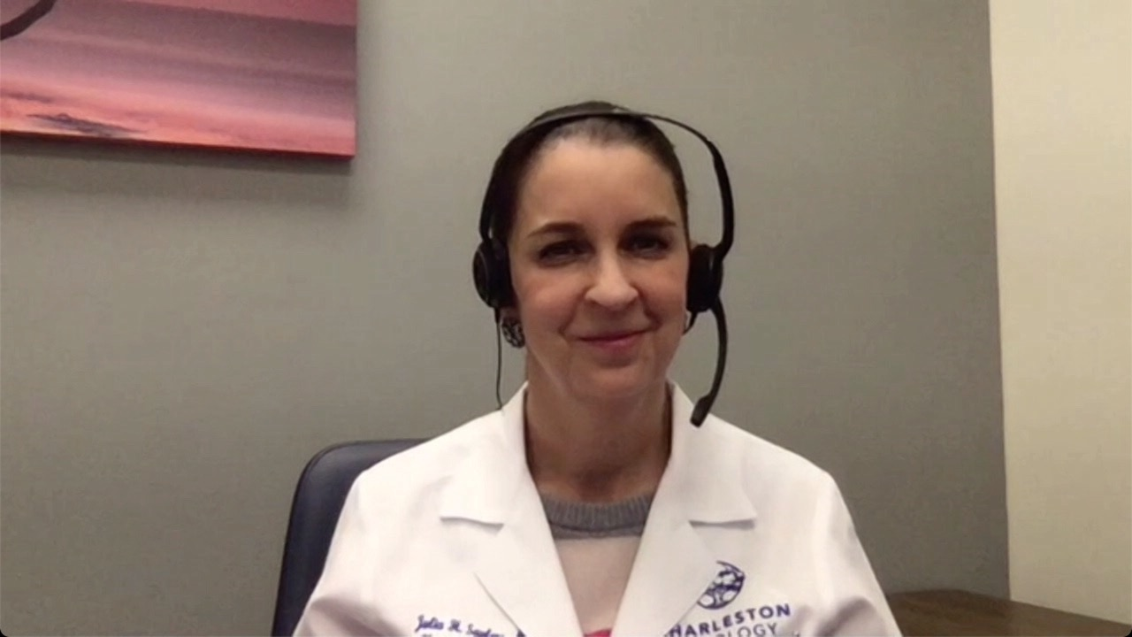
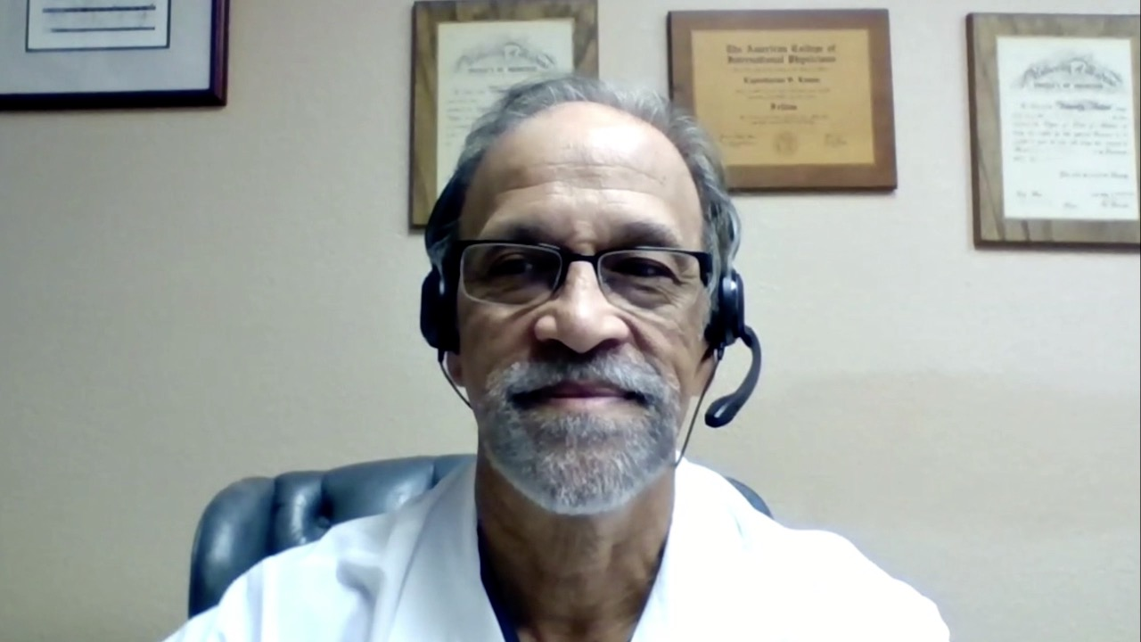
Spencer Henick Bachow, MD
Lynn Cancer Institute
Boca Raton, Florida
Yanjun Ma, MD
Tennessee Oncology
Murfreesboro, Tennessee
Sulfi Ibrahim, MD
Reid Health
Richmond, Indiana
Julia Saylors, MD
Charleston Oncology
North Charleston, South Carolina
Kapisthalam (KS) Kumar, MD
Florida Cancer Specialists
New Port Richey, Florida

Slide 7
Meet The Professor with Dr Armstrong
Introduction: Genitourinary Cancers Symposium 2022
MODULE 1: Dr Saylors — A 58-year-old man with metastatic hormone-sensitive prostate cancer, a history of breast cancer and a germline BRCA1 mutation
MODULE 2: Dr Ibrahim — A 70-year-old man with multiple prior therapies for metastatic prostate cancer, including lutetium on the VISION trial
MODULE 3: Dr Ma — An 88-year-old man with metastatic prostate cancer who received leuprolide/enzalutamide/denosumab and sipuleucel-T
MODULE 4: Dr Bachow — A 55-year-old man with metastatic adenocarcinoma of the prostate with neuroendocrine differentiation (genomic LOH high, germline PALB2 VUS)
MODULE 5: Dr Kumar — A 74-year-old man with metastatic castration-resistant prostate cancer and Lynch syndrome (BRCA VUS, MSH6 and BRAF V601E mutations)
MODULE 6: Dr Ibrahim — An 89-year-old man with mCRPC and a CHEK2 mutation
MODULE 7: Journal Club with Dr Armstrong
MODULE 8: Relevant Data Sets

Slide 8
Meet The Professor with Dr Armstrong
Introduction: Genitourinary Cancers Symposium 2022
MODULE 1: Dr Saylors — A 58-year-old man with metastatic hormone-sensitive prostate cancer, a history of breast cancer and a germline BRCA1 mutation
MODULE 2: Dr Ibrahim — A 70-year-old man with multiple prior therapies for metastatic prostate cancer, including lutetium on the VISION trial
MODULE 3: Dr Ma — An 88-year-old man with metastatic prostate cancer who received leuprolide/enzalutamide/denosumab and sipuleucel-T
MODULE 4: Dr Bachow — A 55-year-old man with metastatic adenocarcinoma of the prostate with neuroendocrine differentiation (genomic LOH high, germline PALB2 VUS)
MODULE 5: Dr Kumar — A 74-year-old man with metastatic castration-resistant prostate cancer and Lynch syndrome (BRCA VUS, MSH6 and BRAF V601E mutations)
MODULE 6: Dr Ibrahim — An 89-year-old man with mCRPC and a CHEK2 mutation
MODULE 7: Journal Club with Dr Armstrong
MODULE 8: Relevant Data Sets

Slide 9
Genitourinary Cancers Symposium 2022;Abstract 11.

Slide 10
PROpel
 | Olaparib + abiraterone (n=399) | Placebo + Abiraterone (n=397)
Events, n (%) | 157 (39.3%) | 218 (54.9)
Median rPFS (mos) | 27.6 | 16.4
HR (95% CI) | 0.61 (0.49-0.74) P<0.0001
HRR mut (n=226) HR (95% CI) | 0.50 (0.34-0.73)
Non-HRR mut (n=552) HR (95% CI) | 0.76 (0.60-0.97)
Abiraterone with olaparib or placebo in a genetically unselected population
Serum Collected for cfDNA on all patients
Tissue testing performed on ~70% of patients
All patients submitted tissue for NGS
Primary outcome: rPFS- data presented today
Secondary outcome: OS- not yet mature
Courtesy of Alan H Bryce, MD

Slide 11
Genitourinary Cancers Symposium 2022;Abstract 12.

Slide 12
MAGNITUDE
Cohort 1: HRR mutated
 | Niraparib + abiraterone (n=399) | Placebo + Abiraterone (n=397)
Number | 212 | 211
Median rPFS (mos) | 16.5 | 13.7
HR (95% CI) | 0.73 (0.56-0.96) P=0.0217
Abiraterone with or without niraparib in the pre chemotherapy setting
765 patients
Tissue and Serum for genetic testing required for entry to study
HRR gene alteration as follows:
Cohort 1: positive for HRR gene alteration
population for presented data
Cohort 2: not positive for DRD
Halted for futility
Primary outcome: rPFS
Secondary outcome: OS not yet mature
Courtesy of Alan H Bryce, MD

Slide 13
Summary Propel and Magnitude
Very Different studies- meaningful cross study comparisons are not possible
Overall survival data will be critical
The studies have not established that concurrent will be better than sequential
Prolonged treatment with a myelosuppressive drug can impact later lines of therapy
Study populations are very different on the basis of prior treatment with 1st generation API in the first line
Reflected in the striking difference in rPFS on the control arms
Method of assessing HRR status is likely to make a difference
Review of more detailed data in the respective publications will be crucial- what treatments did patients receive for mHSPC?
Courtesy of Alan H Bryce, MD

Slide 14
Genitourinary Cancers Symposium 2022;Abstract 13.

Slide 15
Smith MR et al. Genitourinary Cancers Symposium 2022;Abstract 13.

Slide 16
Smith MR et al. Genitourinary Cancers Symposium 2022;Abstract 13.

Slide 17
Smith MR et al. Genitourinary Cancers Symposium 2022;Abstract 13.

Slide 18
Smith MR et al. Genitourinary Cancers Symposium 2022;Abstract 13.

Slide 19
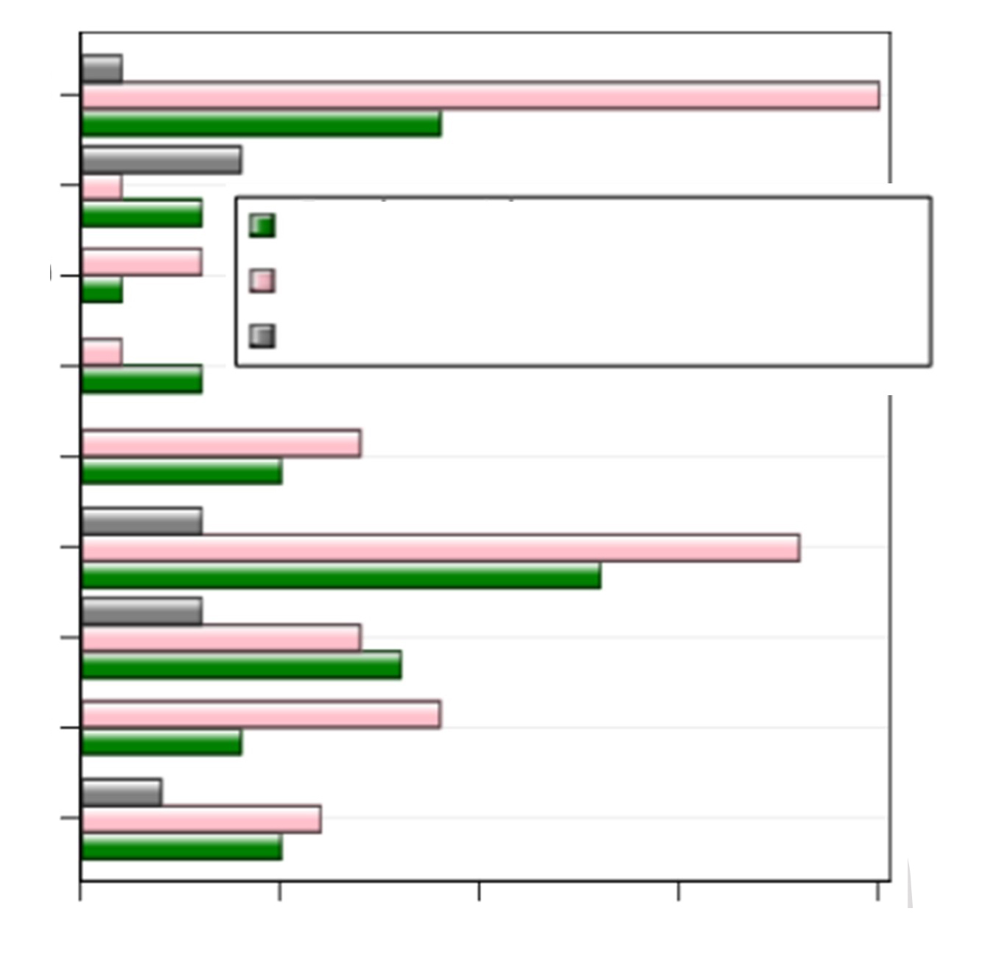
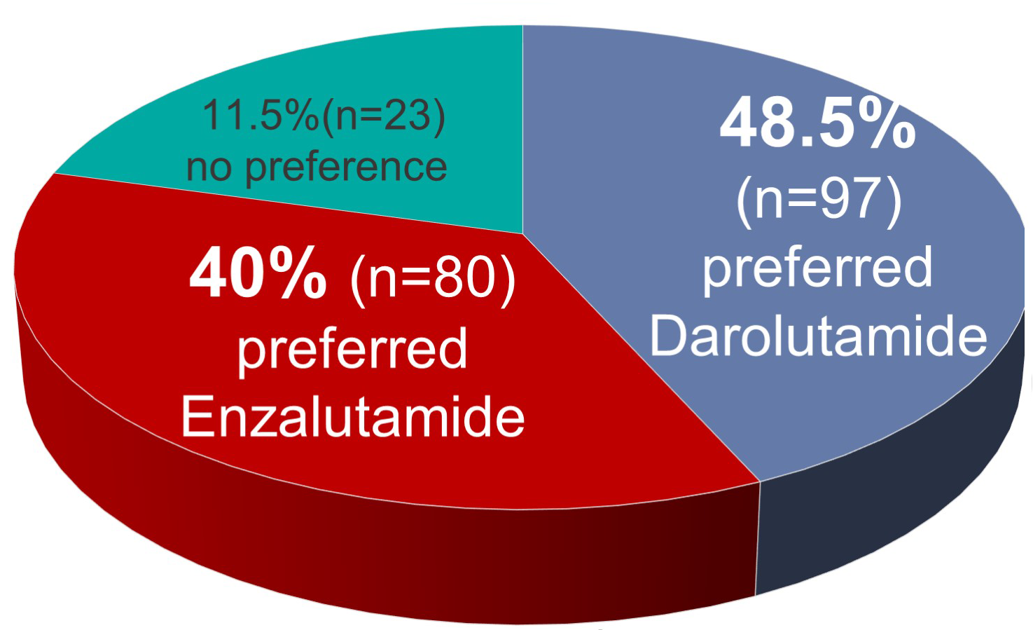
ODENZA: A Phase II Crossover Trial Evaluating Preference Between Darolutamide and Enzalutamide in Men with Asymptomatic or Mildly Symptomatic mCRPC
Main reasons for patient preference between treatments
Less tired
Easier to concentrate
Enzalutadime
Fell down less often
Darolutamide
Could do more things
No preference between treatments
Better quality of life
Medicine easier to take
Another advantage of the treatment
A side effect of the non-chosen treatment
Non-concerned
0
5
10
15
20
Colomba E et al. ASCO 2021;Abstract 5046.

Slide 20
Meet The Professor with Dr Armstrong
Introduction: Genitourinary Cancers Symposium 2022
MODULE 1: Dr Saylors — A 58-year-old man with metastatic hormone-sensitive prostate cancer, a history of breast cancer and a germline BRCA1 mutation
MODULE 2: Dr Ibrahim — A 70-year-old man with multiple prior therapies for metastatic prostate cancer, including lutetium on the VISION trial
MODULE 3: Dr Ma — An 88-year-old man with metastatic prostate cancer who received leuprolide/enzalutamide/denosumab and sipuleucel-T
MODULE 4: Dr Bachow — A 55-year-old man with metastatic adenocarcinoma of the prostate with neuroendocrine differentiation (genomic LOH high, germline PALB2 VUS)
MODULE 5: Dr Kumar — A 74-year-old man with metastatic castration-resistant prostate cancer and Lynch syndrome (BRCA VUS, MSH6 and BRAF V601E mutations)
MODULE 6: Dr Ibrahim — An 89-year-old man with mCRPC and a CHEK2 mutation
MODULE 7: Journal Club with Dr Armstrong
MODULE 8: Relevant Data Sets

Slide 21
Case Presentation: A 58-year-old man with metastatic hormone-sensitive prostate cancer, a history of breast cancer and a germline BRCA1 mutation
Dr Julia Saylors (North Charleston, South Carolina)

Slide 22
At what point, if any, do you generally recommend a PARP inhibitor to a patient with metastatic prostate cancer and a germline BRCA mutation?
After at least 1 line of both hormonal therapy and chemotherapy
After 1 line of hormonal therapy
After 1 line of hormonal therapy
After 1 line of hormonal therapy
After 1 line of hormonal therapy
After 1 line of hormonal therapy

Slide 23
A 65-year-old man with MSS prostate cancer metastatic to the bone and a germline BRCA2 mutation who is receiving abiraterone/dexamethasone for hormone-sensitive metastatic disease develops new low-volume asymptomatic bone metastases. Which systemic treatment would you most likely recommend?
Sipuleucel-T followed by olaparib or docetaxel at further progression
Olaparib
Olaparib
Olaparib
Olaparib
Olaparib

Slide 24
A 65-year-old man receiving androgen deprivation therapy (ADT) for M0 disease after radical prostatectomy (RP) is found to have asymptomatic bone metastases. Genetic testing is negative for homologous recombination repair (HRR) mutations. Regulatory and reimbursement issues aside, what systemic treatment would you most likely recommend?
Abiraterone
Enzalutamide
Docetaxel
Sipuleucel-T
Abiraterone + olaparib
Other

Slide 25
A 65-year-old man receiving ADT for M0 disease after RP is found to have asymptomatic bone metastases. Genetic testing is negative for homologous recombination repair (HRR) mutations. Regulatory and reimbursement issues aside, what systemic treatment would you most likely recommend?
Abiraterone
11
Enzalutamide
5
Sipuleucel-T
3
Abiraterone + olaparib
1
Survey of genitourinary cancer clinical investigators

Slide 26
Beyond the Guidelines: Clinical Investigator Perspectives on the Management of Prostate Cancer (Part 1 of a 2-Part Series) Thursday, February 17, 2022 7:00 PM – 9:00 PM PT
Faculty
Neeraj Agarwal, MD
Himisha Beltran, MD
Fred Saad, MD
A Oliver Sartor, MD
Moderator
Alan H Bryce, MD

Slide 28
Meet The Professor with Dr Armstrong
Introduction: Genitourinary Cancers Symposium 2022
MODULE 1: Dr Saylors — A 58-year-old man with metastatic hormone-sensitive prostate cancer, a history of breast cancer and a germline BRCA1 mutation
MODULE 2: Dr Ibrahim — A 70-year-old man with multiple prior therapies for metastatic prostate cancer, including lutetium on the VISION trial
MODULE 3: Dr Ma — An 88-year-old man with metastatic prostate cancer who received leuprolide/enzalutamide/denosumab and sipuleucel-T
MODULE 4: Dr Bachow — A 55-year-old man with metastatic adenocarcinoma of the prostate with neuroendocrine differentiation (genomic LOH high, germline PALB2 VUS)
MODULE 5: Dr Kumar — A 74-year-old man with metastatic castration-resistant prostate cancer and Lynch syndrome (BRCA VUS, MSH6 and BRAF V601E mutations)
MODULE 6: Dr Ibrahim — An 89-year-old man with mCRPC and a CHEK2 mutation
MODULE 7: Journal Club with Dr Armstrong
MODULE 8: Relevant Data Sets

Slide 29
Case Presentation: A 70-year-old man with multiple prior therapies for metastatic prostate cancer, including lutetium on the VISION trial
Dr Sulfi Ibrahim (Richmond, Indiana)

Slide 30
Regulatory and reimbursement issues aside, in which line of therapy would you administer 177Lu-PSMA-617 for patients with metastatic prostate cancer?
Third line or beyond
Third line
Third line
Third line
Third line
First line and beyond

Slide 31
If ¹⁷⁷Lu-PSMA-617 were available, in what line of therapy would you like to offer it to your patients with PSMA-positive mCRPC?
Second line
3
17
Third line
Survey of genitourinary cancer clinical investigators

Slide 32
If ¹⁷⁷Lu-PSMA-617 were available, which of the following would you generally recommend first for a patient with PSMA-positive mCRPC?
17
¹⁷⁷Lu-PSMA-617
Cabazitaxel
3
Survey of genitourinary cancer clinical investigators

Slide 33
If ¹⁷⁷Lu-PSMA-617 were available, which of the following would you generally prefer for a patient with PSMA-positive mCRPC and bone-only metastases?
19
¹⁷⁷Lu-PSMA-617
Radium-223
1
Survey of genitourinary cancer clinical investigators

Slide 34
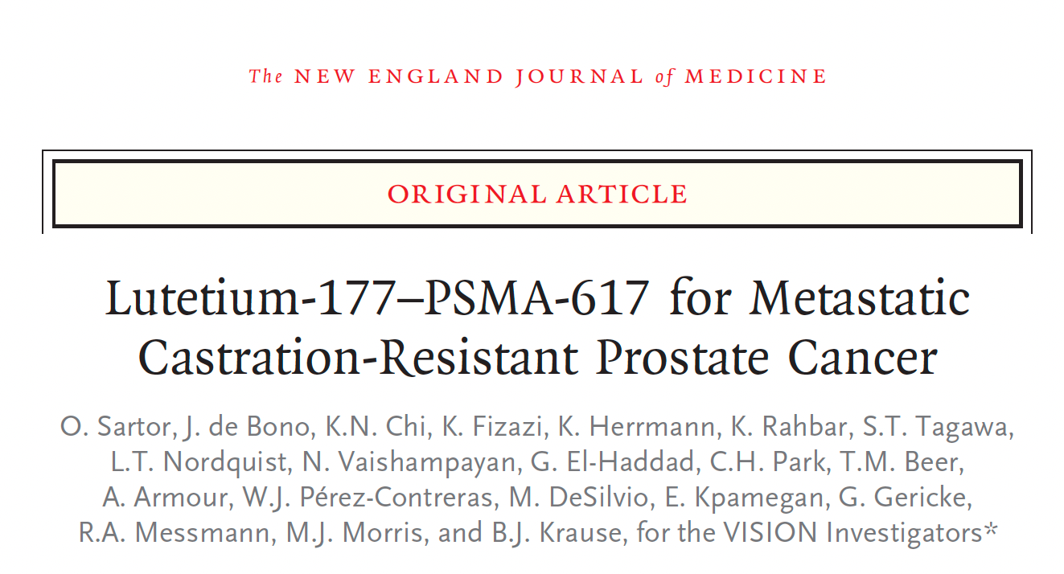
N Engl J Med 2021;385:1091-103

Slide 35
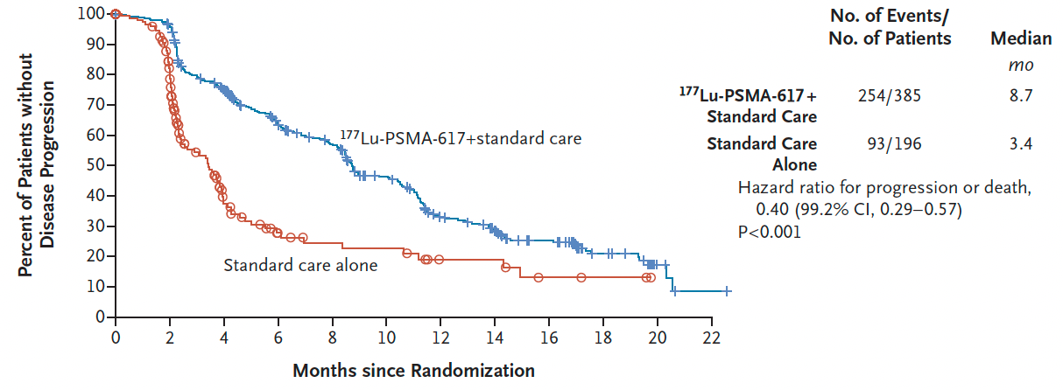
VISION: Imaging-Based Progression-Free Survival
Sartor O et al. N Engl J Med 2021;385:1091-103.

Slide 36
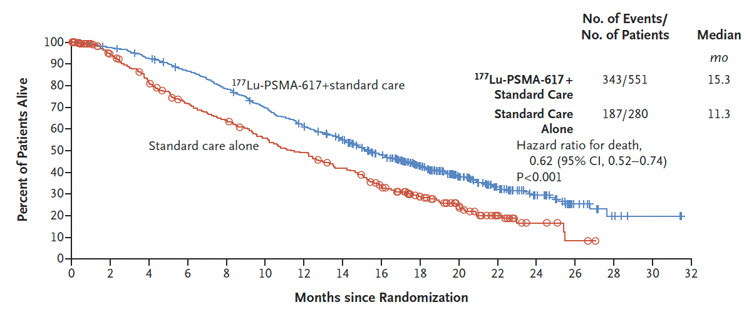
VISION: Overall Survival
Sartor O et al. N Engl J Med 2021;385:1091-103.

Slide 37
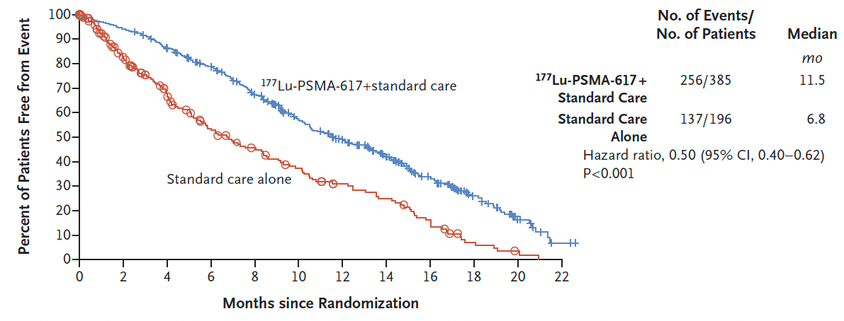
VISION: Time to First Symptomatic Skeletal Event
Sartor O et al. N Engl J Med 2021;385:1091-103.

Slide 38
177Lu-PSMA-617 (LuPSMA) versus Cabazitaxel in Metastatic Castration-Resistant Prostate Cancer (mCRPC) Progressing After Docetaxel: Updated Results Including Progression-Free Survival (PFS) and Patient-Reported Outcomes (PROs) (TheraP ANZUP 1603)¹
²
¹ Hofman MS et al. Genitourinary Cancers Symposium 2021;Abstract 6.
² Hofman MS et al. Lancet 2021;397(10276):797-804.

Slide 39
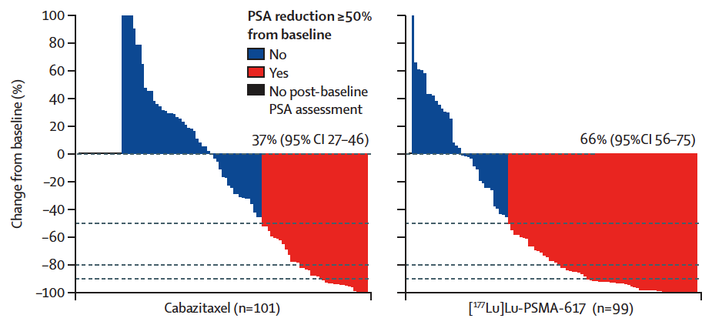
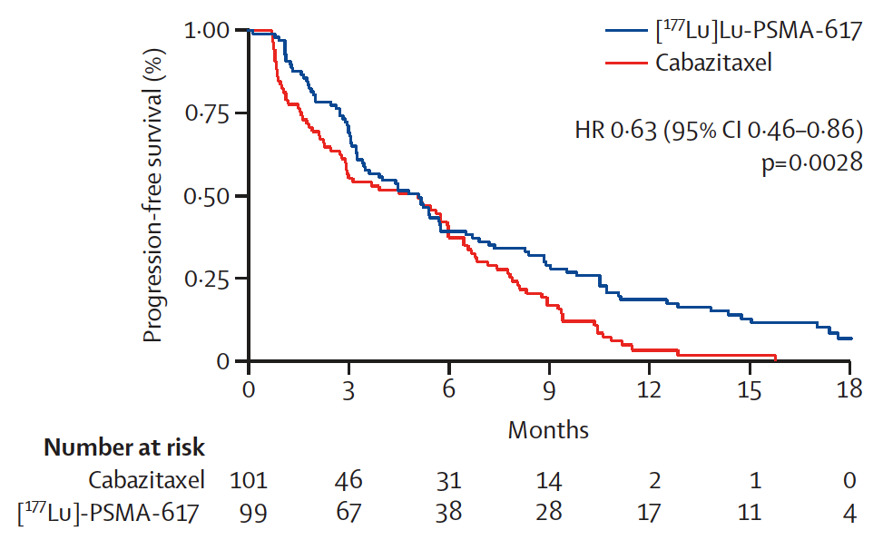
TheraP ANZUP 1603: PSA Response and PFS
PSA response
Radiographic or PSA progression-free survival
Hofman MS et al. Genitourinary Cancers Symposium 2021;Abstract 6; Hofman MS et al. Lancet 2021;397(10276):797-804.

Slide 40
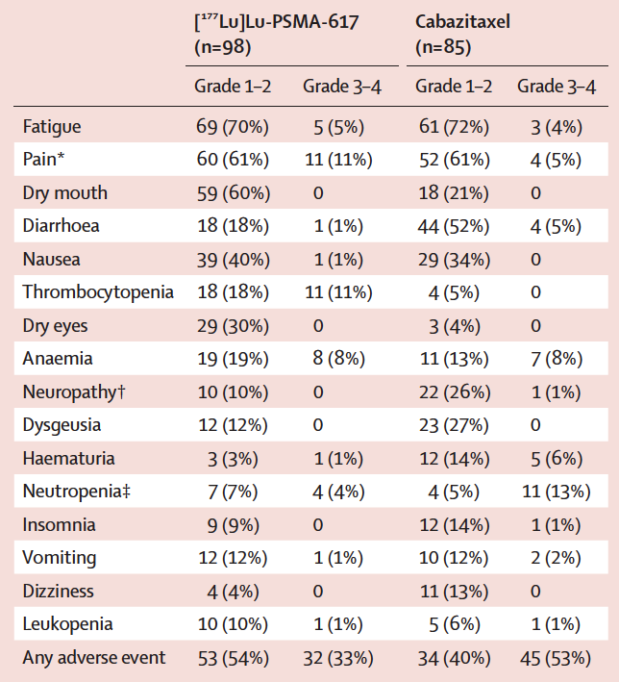
TheraP ANZUP 1603: Adverse Events
Hofman MS et al. Genitourinary Cancers Symposium 2021;Abstract 6; Hofman MS et al. Lancet 2021;397(10276):797-804.

Slide 41
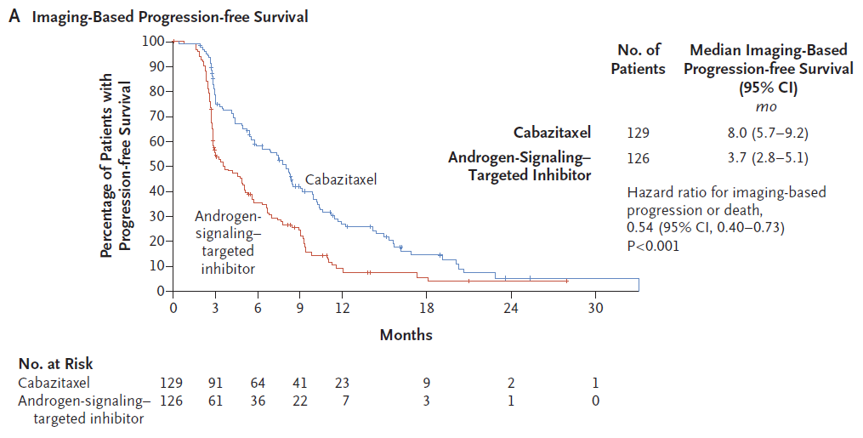
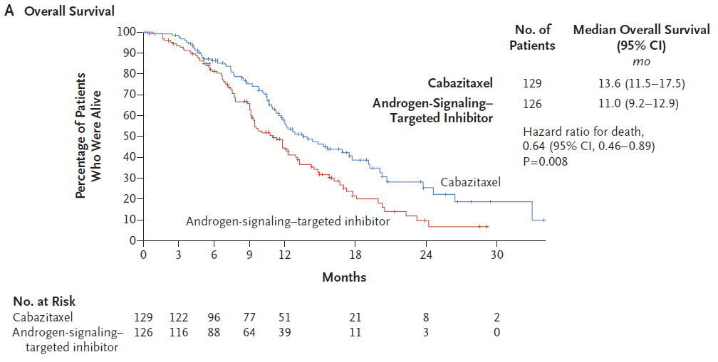
CARD: Imaging-Based PFS and OS with Cabazitaxel versus Abiraterone or Enzalutamide for mCRPC
de Wit R. et al. NEJM 2019;381:2506-18.

Slide 42
Meet The Professor with Dr Armstrong
Introduction: Genitourinary Cancers Symposium 2022
MODULE 1: Dr Saylors — A 58-year-old man with metastatic hormone-sensitive prostate cancer, a history of breast cancer and a germline BRCA1 mutation
MODULE 2: Dr Ibrahim — A 70-year-old man with multiple prior therapies for metastatic prostate cancer, including lutetium on the VISION trial
MODULE 3: Dr Ma — An 88-year-old man with metastatic prostate cancer who received leuprolide/enzalutamide/denosumab and sipuleucel-T
MODULE 4: Dr Bachow — A 55-year-old man with metastatic adenocarcinoma of the prostate with neuroendocrine differentiation (genomic LOH high, germline PALB2 VUS)
MODULE 5: Dr Kumar — A 74-year-old man with metastatic castration-resistant prostate cancer and Lynch syndrome (BRCA VUS, MSH6 and BRAF V601E mutations)
MODULE 6: Dr Ibrahim — An 89-year-old man with mCRPC and a CHEK2 mutation
MODULE 7: Journal Club with Dr Armstrong
MODULE 8: Relevant Data Sets

Slide 43
Case Presentation: An 88-year-old man with metastatic prostate cancer who received leuprolide/enzalutamide/ denosumab and sipuleucel-T
Dr Yanjun Ma (Murfreesboro, Tennessee)

Slide 44
Meet The Professor with Dr Armstrong
Introduction: Genitourinary Cancers Symposium 2022
MODULE 1: Dr Saylors — A 58-year-old man with metastatic hormone-sensitive prostate cancer, a history of breast cancer and a germline BRCA1 mutation
MODULE 2: Dr Ibrahim — A 70-year-old man with multiple prior therapies for metastatic prostate cancer, including lutetium on the VISION trial
MODULE 3: Dr Ma — An 88-year-old man with metastatic prostate cancer who received leuprolide/enzalutamide/denosumab and sipuleucel-T
MODULE 4: Dr Bachow — A 55-year-old man with metastatic adenocarcinoma of the prostate with neuroendocrine differentiation (genomic LOH high, germline PALB2 VUS)
MODULE 5: Dr Kumar — A 74-year-old man with metastatic castration-resistant prostate cancer and Lynch syndrome (BRCA VUS, MSH6 and BRAF V601E mutations)
MODULE 6: Dr Ibrahim — An 89-year-old man with mCRPC and a CHEK2 mutation
MODULE 7: Journal Club with Dr Armstrong
MODULE 8: Relevant Data Sets

Slide 45
Case Presentation: A 55-year-old man with metastatic adenocarcinoma of the prostate with neuroendocrine differentiation (genomic LOH high, germline PALB2 VUS)
Dr Spencer Bachow (Boca Raton, Florida)

Slide 46
Meet The Professor with Dr Armstrong
Introduction: Genitourinary Cancers Symposium 2022
MODULE 1: Dr Saylors — A 58-year-old man with metastatic hormone-sensitive prostate cancer, a history of breast cancer and a germline BRCA1 mutation
MODULE 2: Dr Ibrahim — A 70-year-old man with multiple prior therapies for metastatic prostate cancer, including lutetium on the VISION trial
MODULE 3: Dr Ma — An 88-year-old man with metastatic prostate cancer who received leuprolide/enzalutamide/denosumab and sipuleucel-T
MODULE 4: Dr Bachow — A 55-year-old man with metastatic adenocarcinoma of the prostate with neuroendocrine differentiation (genomic LOH high, germline PALB2 VUS)
MODULE 5: Dr Kumar — A 74-year-old man with metastatic castration-resistant prostate cancer and Lynch syndrome (BRCA VUS, MSH6 and BRAF V601E mutations)
MODULE 6: Dr Ibrahim — An 89-year-old man with mCRPC and a CHEK2 mutation
MODULE 7: Journal Club with Dr Armstrong
MODULE 8: Relevant Data Sets

Slide 47
Case Presentation: A 74-year-old man with mCRPC and Lynch syndrome (BRCA VUS, MSH6 and BRAF V601E mutations)
Dr KS Kumar (New Port Richey, Florida)

Slide 48
Immune Checkpoint Inhibitors in mCRPC
Therapy | Disease State | Disease Response
Pembrolizumab monotherapyª | Post-chemotherapy | ORR 9% PSA RR 14%
Pembrolizumab + enzalutamide^{b} | Pre-chemotherapy progressing on enzalutamide | ORR 12% PSA RR 14%
Atezolizumab + enzalutamide^{c} | Pre- and post-chemotherapy, s/p abiraterone | ORR 14% PSA RR 26%
Atezolizumab + cabozantinib^{d} | Pre-chemotherapy s/p enzalutamide or abiraterone | ORR 34% PSA RR 29%
ªJCO 2020: 38(5) 395-405. ^{b}Presented at the 2021 ASCO Annual Meeting – Virtual; June 4-8, 2021. ^{c}Sweeney C. AACR 2020. IMbassador250. ^{d}Agarwal ASCO 2020. COSMIC-021

Slide 49
Abstract LBA24

Slide 50
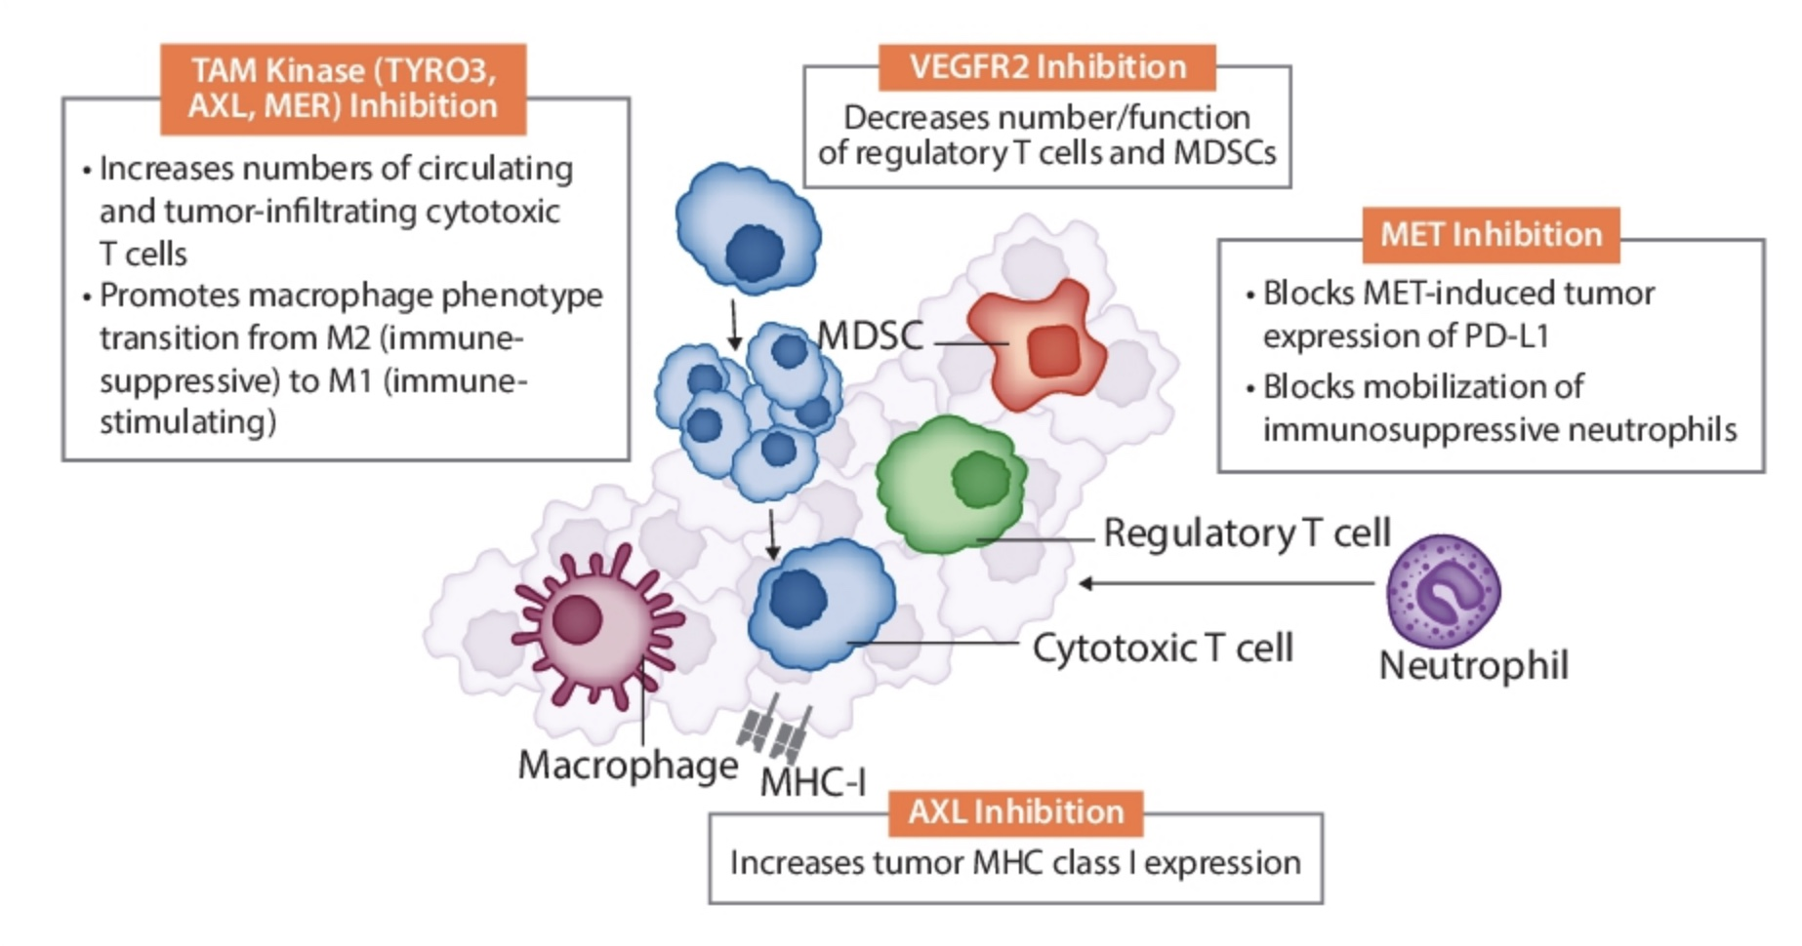
Cabozantinib Targets Pathways Associated with Tumor Immune Suppression
Agarwal N et al. ASCO 2020;Abstract 5564.

Slide 51
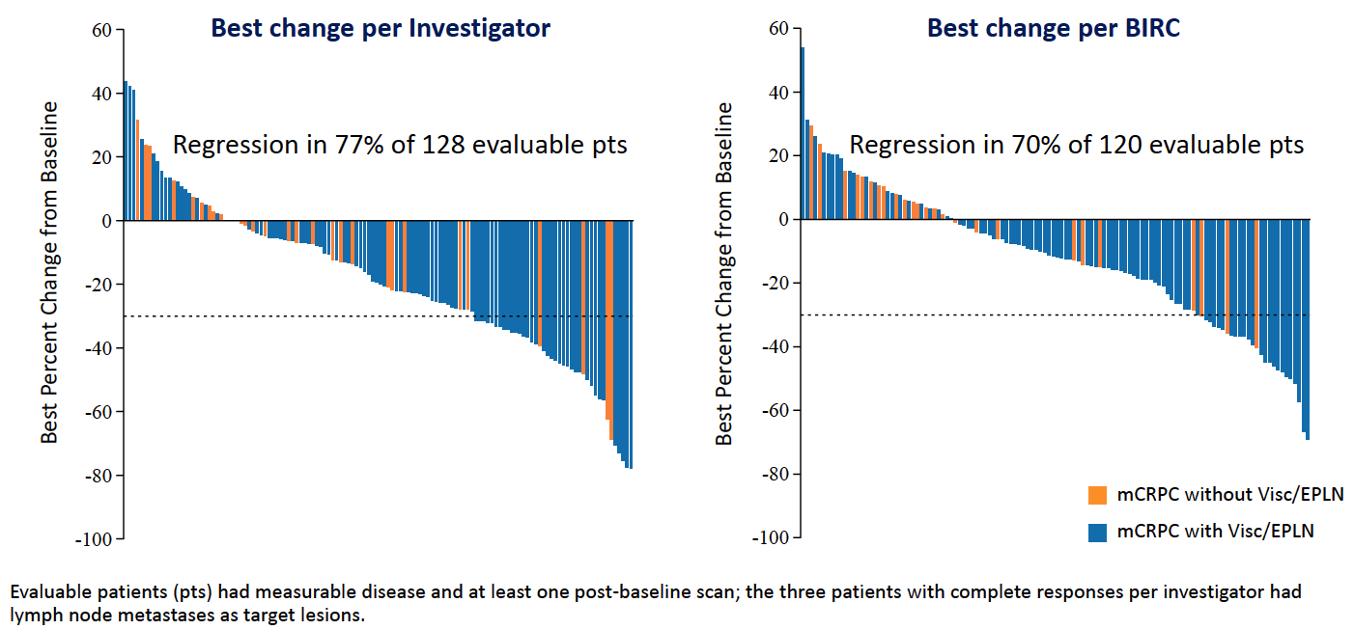
COSMIC-021: Best Change from Baseline in Sum of Target Lesions
Agarwal et al. ESMO 2021;Abstract LBA24.

Slide 52
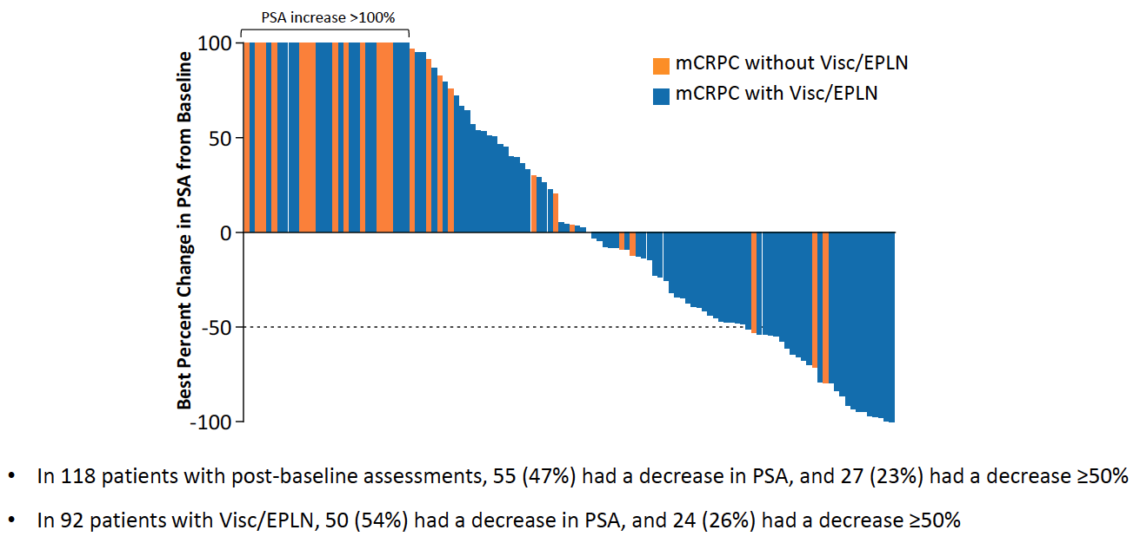
COSMIC-021: Best Change in PSA from Baseline
Agarwal et al. ESMO 2021;Abstract LBA24.

Slide 53
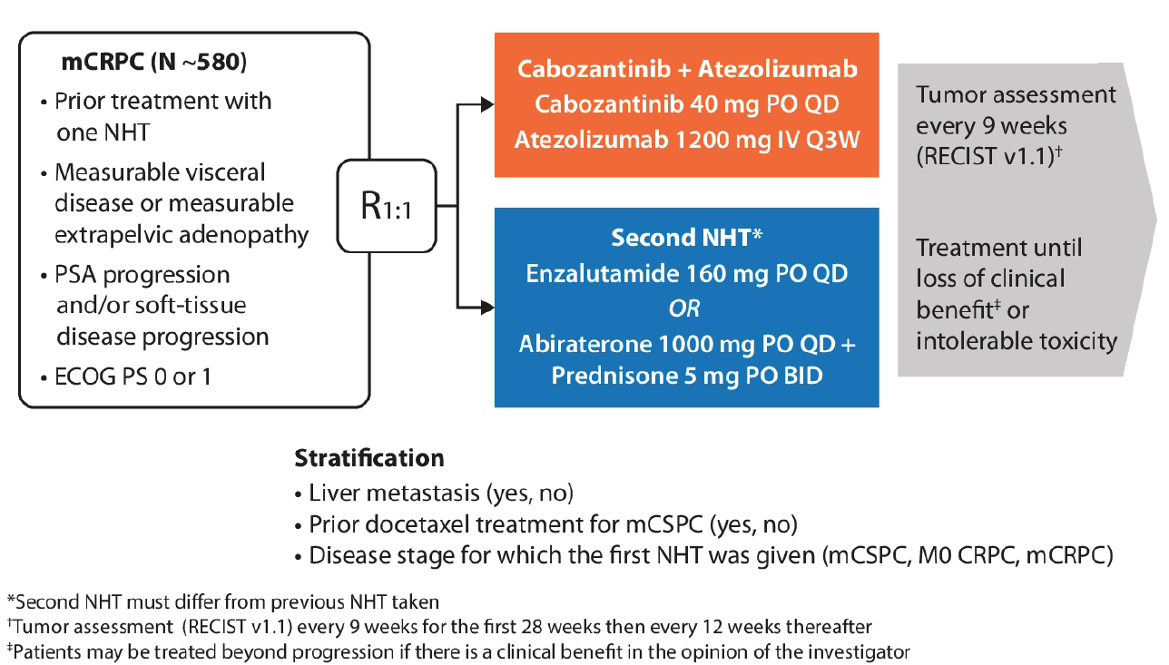
CONTACT-02: Phase III Trial Schema
Primary Endpoints:
PFS per RECIST v1.1 by BIRC
OS
Secondary Endpoint:
ORR per RECIST v1.1 by BIRC
Agarwal N et al. Genitourinary Cancers Symposium 2021;Abstract TPS190.

Slide 54
Meet The Professor with Dr Armstrong
Introduction: Genitourinary Cancers Symposium 2022
MODULE 1: Dr Saylors — A 58-year-old man with metastatic hormone-sensitive prostate cancer, a history of breast cancer and a germline BRCA1 mutation
MODULE 2: Dr Ibrahim — A 70-year-old man with multiple prior therapies for metastatic prostate cancer, including lutetium on the VISION trial
MODULE 3: Dr Ma — An 88-year-old man with metastatic prostate cancer who received leuprolide/enzalutamide/denosumab and sipuleucel-T
MODULE 4: Dr Bachow — A 55-year-old man with metastatic adenocarcinoma of the prostate with neuroendocrine differentiation (genomic LOH high, germline PALB2 VUS)
MODULE 5: Dr Kumar — A 74-year-old man with metastatic castration-resistant prostate cancer and Lynch syndrome (BRCA VUS, MSH6 and BRAF V601E mutations)
MODULE 6: Dr Ibrahim — An 89-year-old man with mCRPC and a CHEK2 mutation
MODULE 7: Journal Club with Dr Armstrong
MODULE 8: Relevant Data Sets

Slide 55
Case Presentation: An 89-year-old man with mCRPC and a CHEK2 mutation
Dr Sulfi Ibrahim (Richmond, Indiana)

Slide 56
Meet The Professor with Dr Armstrong
Introduction: Genitourinary Cancers Symposium 2022
MODULE 1: Dr Saylors — A 58-year-old man with metastatic hormone-sensitive prostate cancer, a history of breast cancer and a germline BRCA1 mutation
MODULE 2: Dr Ibrahim — A 70-year-old man with multiple prior therapies for metastatic prostate cancer, including lutetium on the VISION trial
MODULE 3: Dr Ma — An 88-year-old man with metastatic prostate cancer who received leuprolide/enzalutamide/denosumab and sipuleucel-T
MODULE 4: Dr Bachow — A 55-year-old man with metastatic adenocarcinoma of the prostate with neuroendocrine differentiation (genomic LOH high, germline PALB2 VUS)
MODULE 5: Dr Kumar — A 74-year-old man with metastatic castration-resistant prostate cancer and Lynch syndrome (BRCA VUS, MSH6 and BRAF V601E mutations)
MODULE 6: Dr Ibrahim — An 89-year-old man with mCRPC and a CHEK2 mutation
MODULE 7: Journal Club with Dr Armstrong
MODULE 8: Relevant Data Sets

Slide 57
Exposure-Adjusted Safety Analyses of the VISION Phase 3 Trial of ¹⁷⁷Lu-PSMA-617 in Patients with Metastatic Castration-Resistant Prostate Cancer
Chi KN et al.
Genitourinary Cancers Symposium 2022;Abstract 85.

Slide 58
DNA Damaging Therapies in Patients (pts) with Prostate Cancer (PC) and Pathogenic Alterations in Homologous Recombination Repair (HRR) Genes
Graham L et al.
Genitourinary Cancers Symposium 2022;Abstract 129.

Slide 59
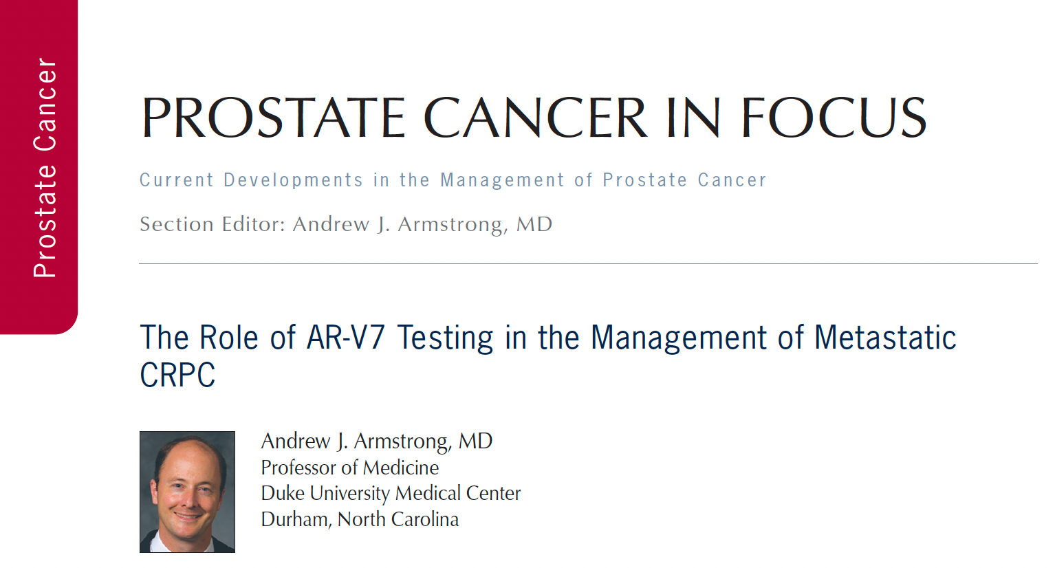
Clin Adv Hematol Oncol 2021;19(11):694-7.

Slide 60
The Courage Study: A First-in-Human Phase 1 Study of the CBP/p300 Inhibitor FT-7051 in Men with Metastatic Castration-Resistant Prostate Cancer
Armstrong AJ et al.
ASCO 2021;Abstract TPS5085.

Slide 61
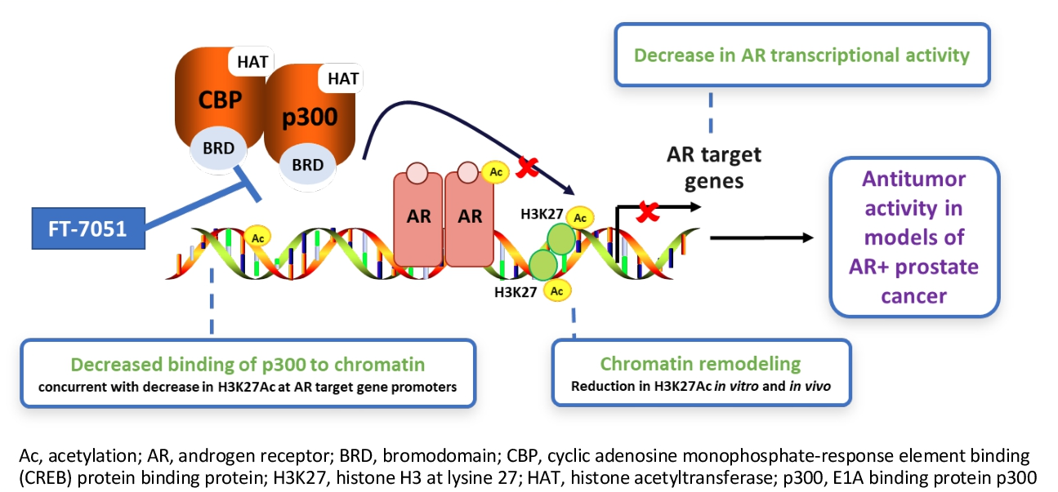
FT-7051 Mechanism of Action
Armstrong AJ et al. ASCO 2021;Abstract TPS5085.

Slide 62
Efficacy of the PD-L1 Inhibitor Avelumab in Neuroendocrine or Aggressive Variant Prostate Cancer: Results from a Phase II, Single-Arm Study
Brown LC et al.
Genitourinary Cancers Symposium 2021;Abstract 89.

Slide 63
2021, Abstract Number 12

Slide 64
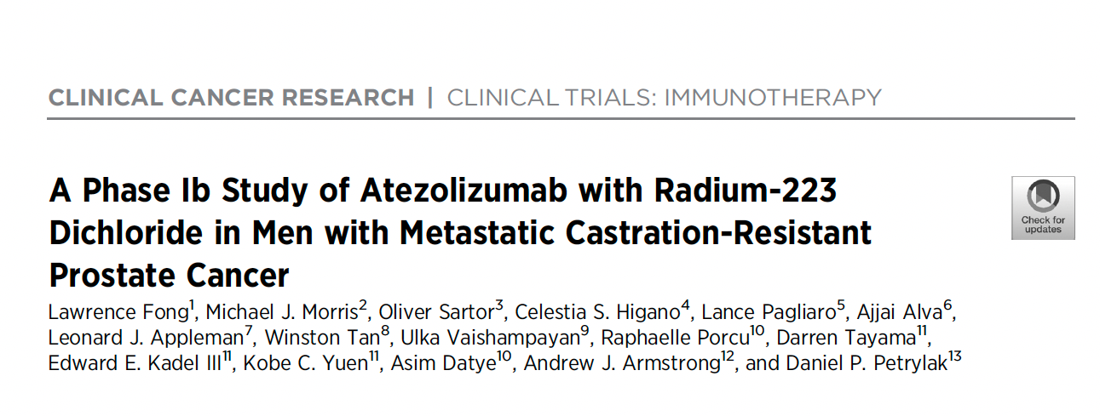
Clin Cancer Res 2021;27(17):4746-56.

Slide 65
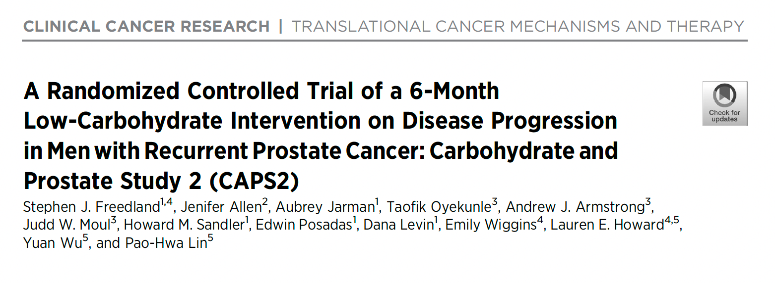
Clin Cancer Res 2021;27(6):1823

Slide 66
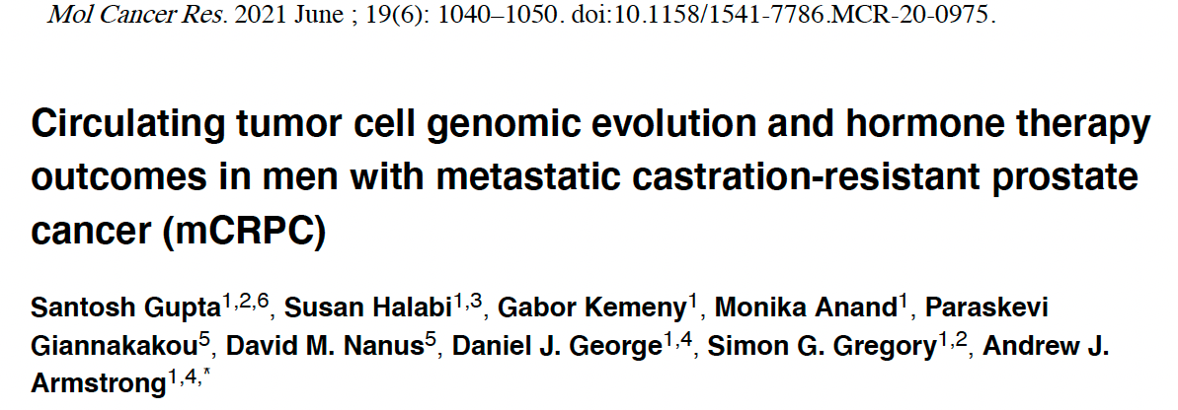

Slide 67
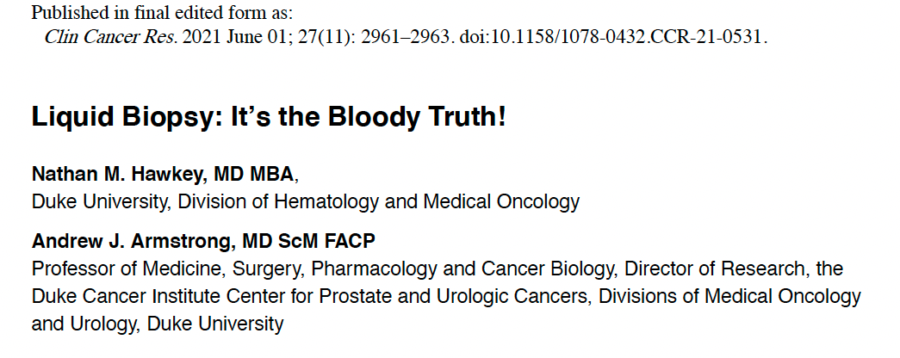
Comment on Tukachinsky H et al. Genomic analysis of circulating tumor DNA in patients with advanced prostate cancer identifies targetable BRCA alterations and AR resistance mechanisms. Clin Cancer Res 2021;27(11):3094-105.

Slide 68
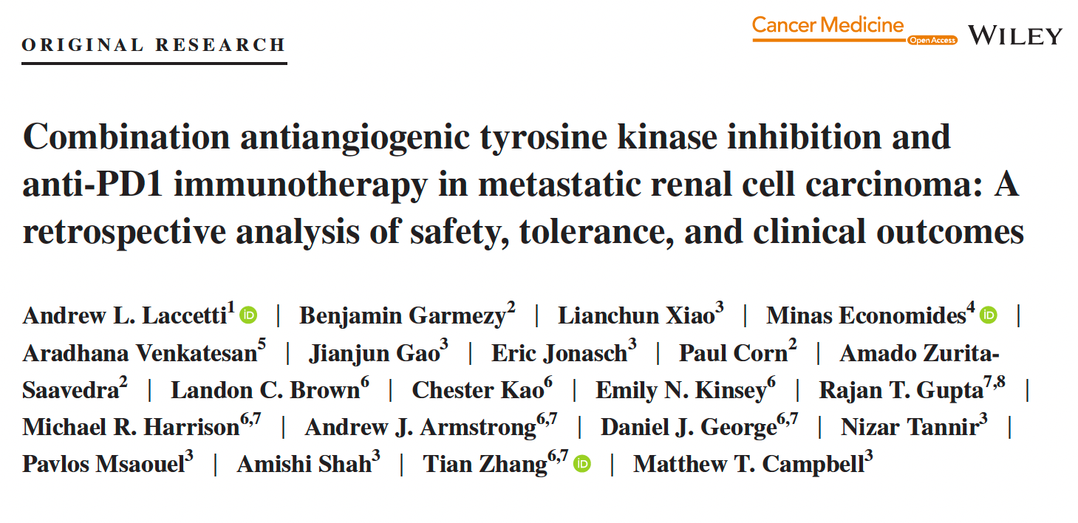
Cancer Med 2021;10(7):2341-9.

Slide 69
Development and Validation of Circulating Tumor Cell ... Enumeration as a Prognostic Biomarker in Men with Metastatic Castration-Resistant Prostate Cancer
Scher HI et al.
Genitourinary Cancers Symposium 2021;Abstract 157.

Slide 70
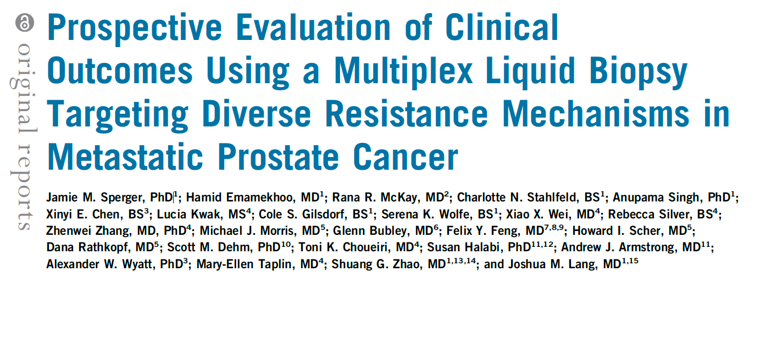
J Clin Oncol 2021;39(26):2926-37.

Slide 71
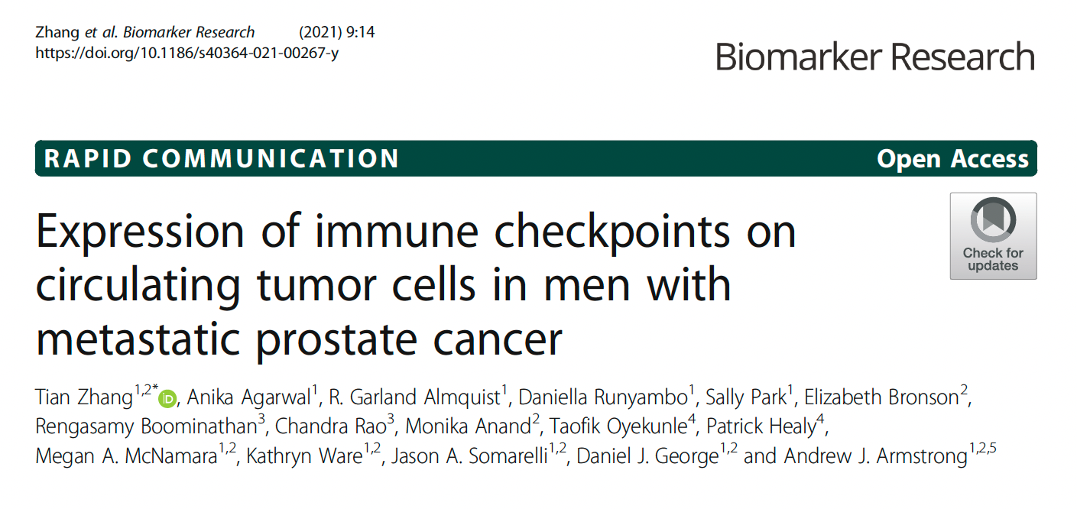

Slide 72
Meet The Professor with Dr Armstrong
Introduction: Genitourinary Cancers Symposium 2022
MODULE 1: Dr Saylors — A 58-year-old man with metastatic hormone-sensitive prostate cancer, a history of breast cancer and a germline BRCA1 mutation
MODULE 2: Dr Ibrahim — A 70-year-old man with multiple prior therapies for metastatic prostate cancer, including lutetium on the VISION trial
MODULE 3: Dr Ma — An 88-year-old man with metastatic prostate cancer who received leuprolide/enzalutamide/denosumab and sipuleucel-T
MODULE 4: Dr Bachow — A 55-year-old man with metastatic adenocarcinoma of the prostate with neuroendocrine differentiation (genomic LOH high, germline PALB2 VUS)
MODULE 5: Dr Kumar — A 74-year-old man with metastatic castration-resistant prostate cancer and Lynch syndrome (BRCA VUS, MSH6 and BRAF V601E mutations)
MODULE 6: Dr Ibrahim — An 89-year-old man with mCRPC and a CHEK2 mutation
MODULE 7: Journal Club with Dr Armstrong
MODULE 8: Relevant Data Sets

Slide 73
ESMO 2021;Abstract LBA4_PR.

Slide 74
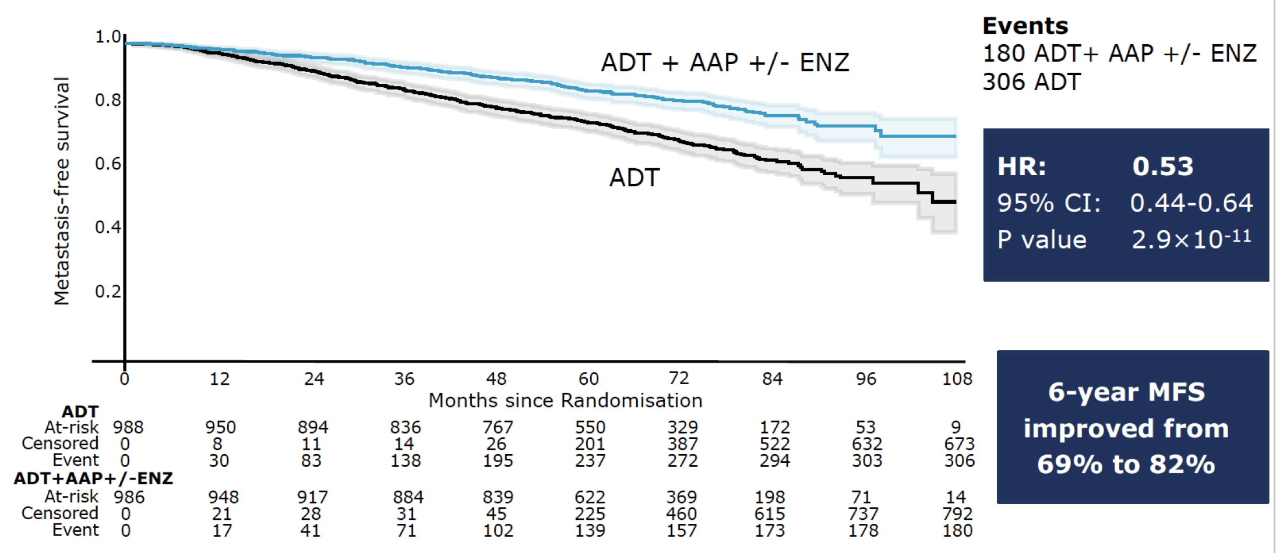
Metastasis-Free Survival with the Addition of Abiraterone Acetate and Prednisolone with or without Enzalutamide to ADT for High-Risk M0 Prostate Cancer
Attard G et al. ESMO 2021;Abstract LBA4_PR.

Slide 75
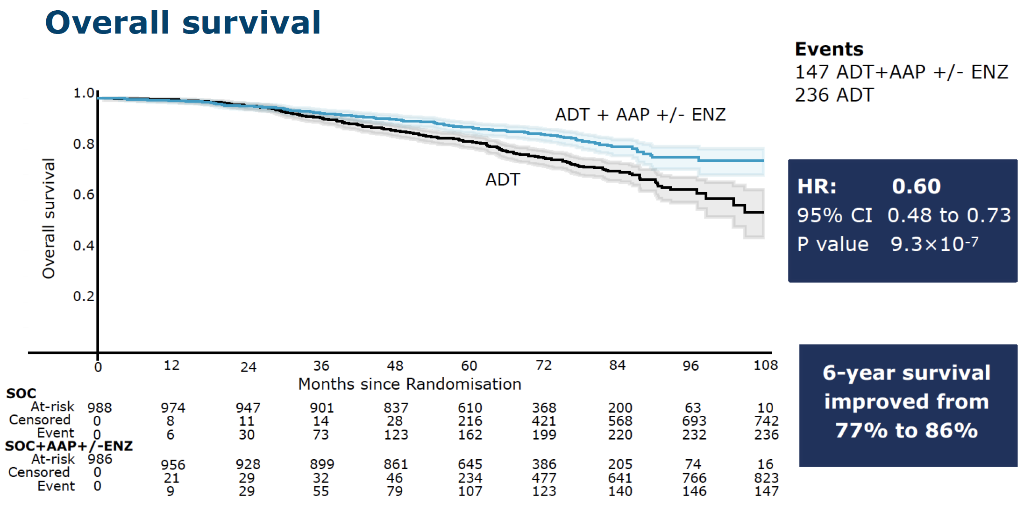
Overall Survival with the Addition of Abiraterone Acetate and Prednisolone with or without Enzalutamide to ADT for High-Risk M0 Prostate Cancer
Attard G et al. ESMO 2021;Abstract LBA4_PR.

Slide 76
N Engl J Med 2021;385:1091-103
ESMO 2021;Abstract LBA5

Slide 77
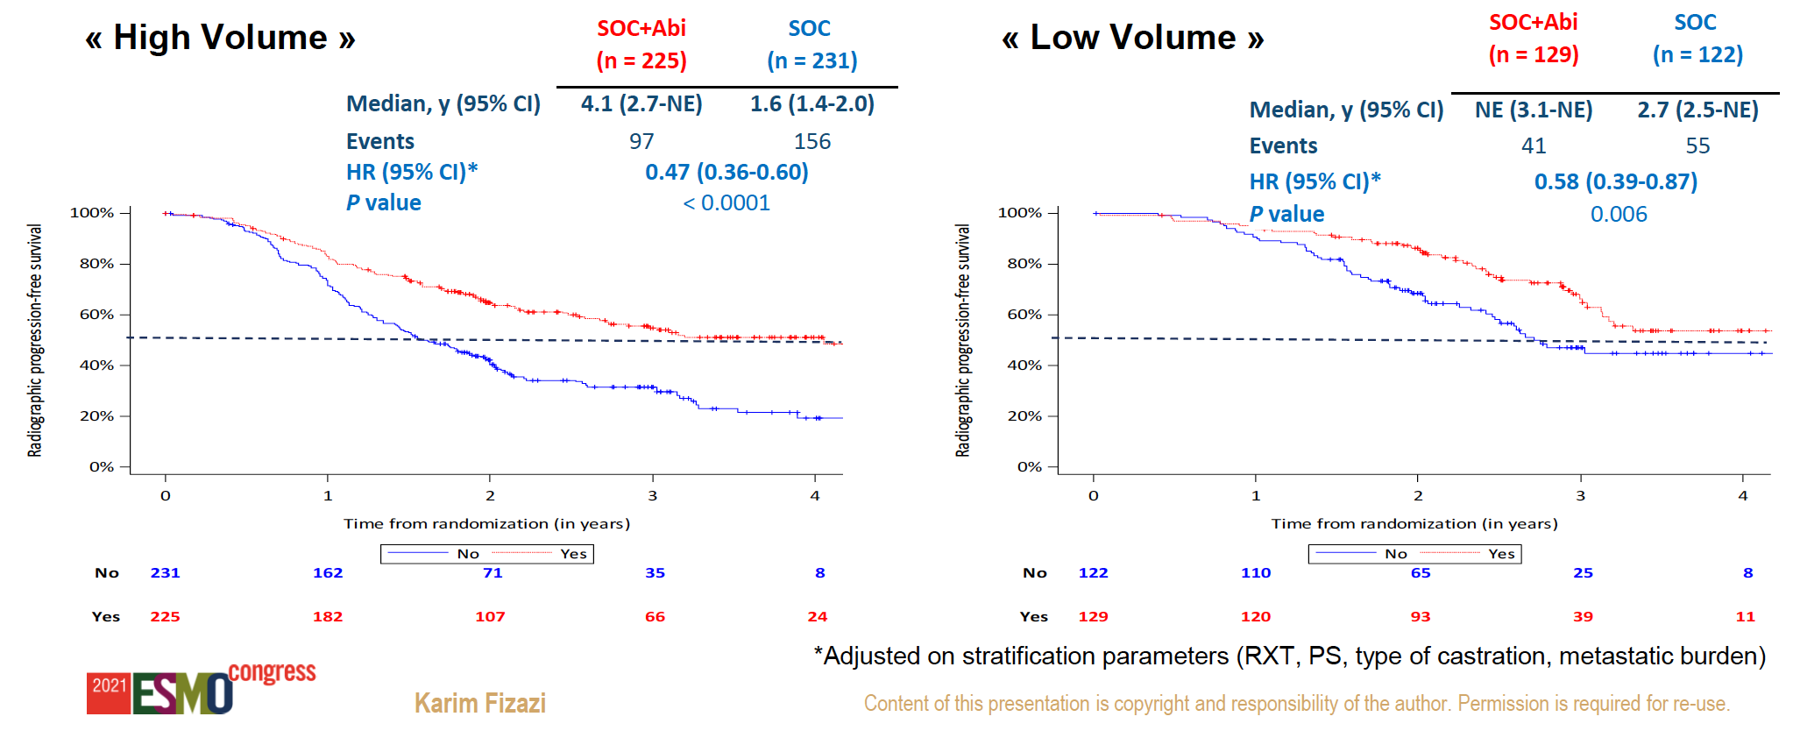
PEACE-1: Radiographic PFS (rPFS) by Metastatic Burden
Fizazi K et al. ESMO 2021;Abstract LBA5.

Slide 78
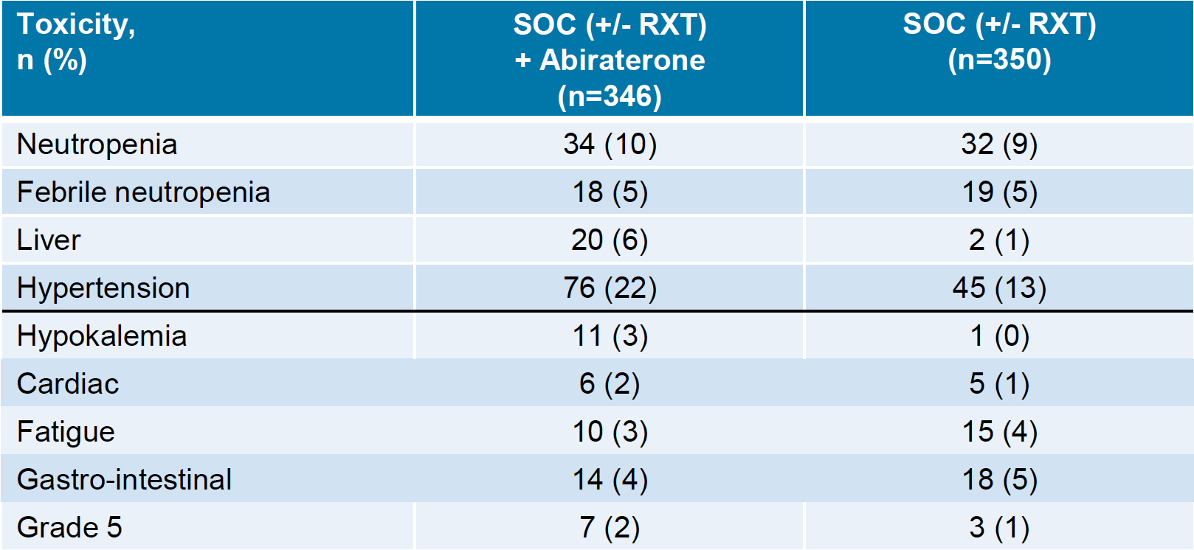
PEACE-1: Grade 3-5 Adverse Events (ADT + Docetaxel Safety Population)
Fizazi K et al. ESMO 2021;Abstract LBA5.

Slide 79
177Lu-PSMA-617 targeted radioligand therapy<br />
¹⁷⁷Lu-PSMA-617: Mechanism of Action
TARGETED TO PSMA
Morris MJ et al. ASCO 2021;Abstract LBA4.

Slide 80
N Engl J Med 2021;385:1091-103

Slide 81
VISION: Imaging-Based Progression-Free Survival
Sartor O et al. N Engl J Med 2021;385:1091-103.

Slide 82
VISION: Overall Survival
Sartor O et al. N Engl J Med 2021;385:1091-103.

Slide 83
VISION: Time to First Symptomatic Skeletal Event
Sartor O et al. N Engl J Med 2021;385:1091-103.

Slide 84
VISION: Selected Adverse Events
Sartor O et al. N Engl J Med 2021;385:1091-103.

Slide 85
177Lu-PSMA-617 (LuPSMA) versus Cabazitaxel in Metastatic Castration-Resistant Prostate Cancer (mCRPC) Progressing After Docetaxel: Updated Results Including Progression-Free Survival (PFS) and Patient-Reported Outcomes (PROs) (TheraP ANZUP 1603)¹
²
¹ Hofman MS et al. Genitourinary Cancers Symposium 2021;Abstract 6.
² Hofman MS et al. Lancet 2021;397(10276):797-804.

Slide 86
TheraP ANZUP 1603: PSA Response and PFS
PSA response
Radiographic or PSA progression-free survival
Hofman MS et al. Genitourinary Cancers Symposium 2021;Abstract 6; Hofman MS et al. Lancet 2021;397(10276):797-804.

Slide 87
TheraP ANZUP 1603: Adverse Events
Hofman MS et al. Genitourinary Cancers Symposium 2021;Abstract 6; Hofman MS et al. Lancet 2021;397(10276):797-804.

Slide 88
Abstract 577O

Slide 89
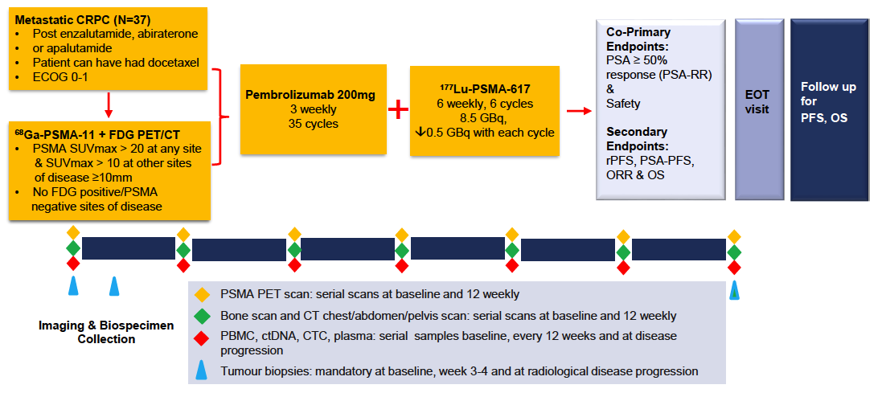
PSMA-Lutetium Radionuclide Therapy and ImmuNotherapy for Prostate CancEr (PRINCE) Trial Schema
Sandhu S et al. ESMO 2021;Abstract 577O.

Slide 90
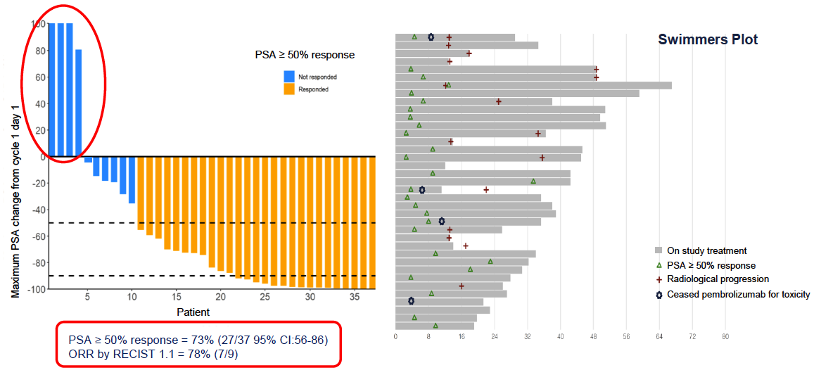
PRINCE: PSA Response Rate (Primary Endpoint)
Sandhu S et al. ESMO 2021;Abstract 577O.

Slide 91
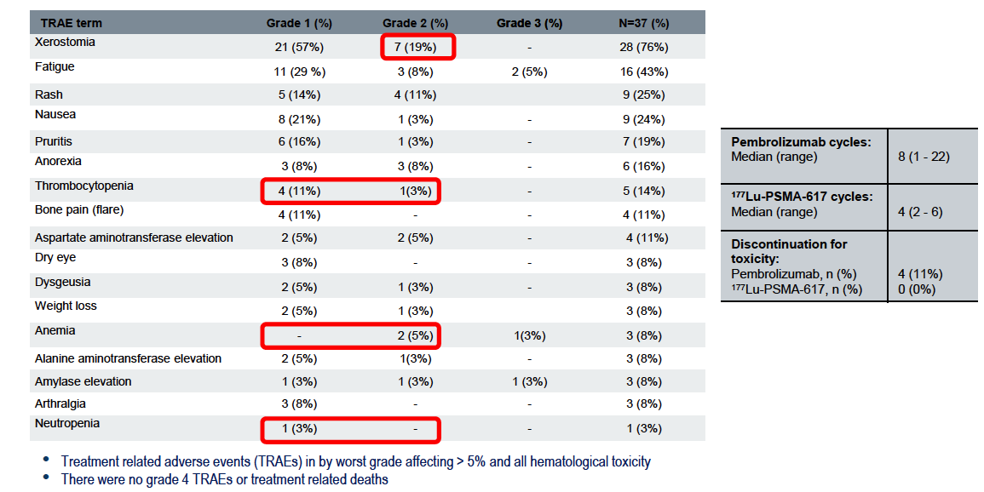
PRINCE: Treatment-Related Adverse Events
Sandhu S et al. ESMO 2021;Abstract 577O.

Slide 92
ODENZA: A Phase II Crossover Trial Evaluating Preference Between Darolutamide and Enzalutamide in Men with Asymptomatic or Mildly Symptomatic mCRPC
Main reasons for patient preference between treatments
Less tired
Easier to concentrate
Enzalutadime
Fell down less often
Darolutamide
Could do more things
No preference between treatments
Better quality of life
Medicine easier to take
Another advantage of the treatment
A side effect of the non-chosen treatment
Non-concerned
0
5
10
15
20
Colomba E et al. ASCO 2021;Abstract 5046.

Slide 93
CARD: Imaging-Based PFS and OS with Cabazitaxel versus Abiraterone or Enzalutamide for mCRPC
de Wit R. et al. NEJM 2019;381:2506-18.

Slide 94
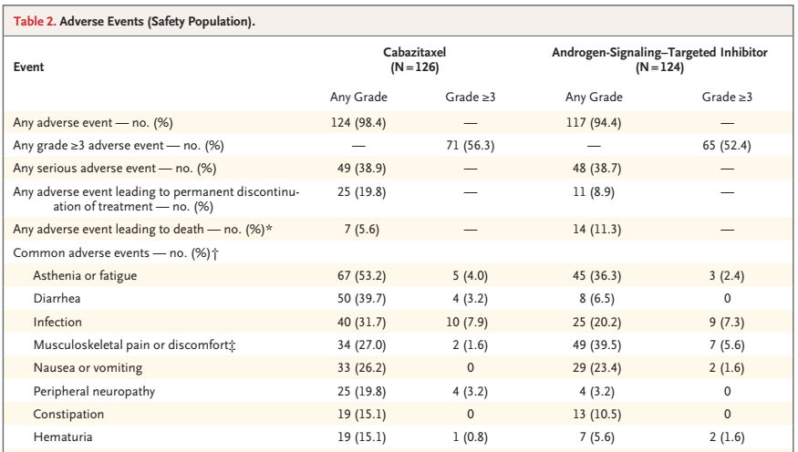
CARD: Select Adverse Events
de Wit R et al. NEJM 2019;381:2506-18.

Slide 95
ESMO Open 2021;[Online ahead of print].

Slide 96
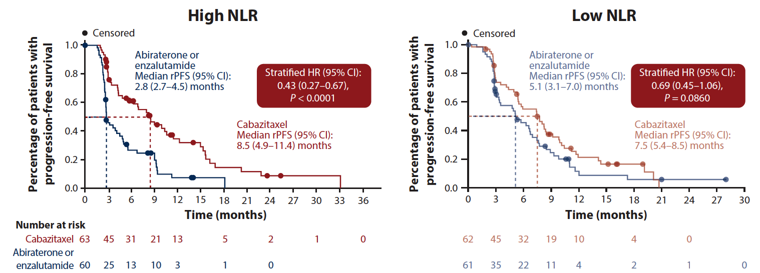
CARD: rPFS by Baseline Neutrophil-to-Lymphocyte Ratio (NLR)
de Wit R et al. ESMO Open 2021;[Online ahead of print].

Slide 97
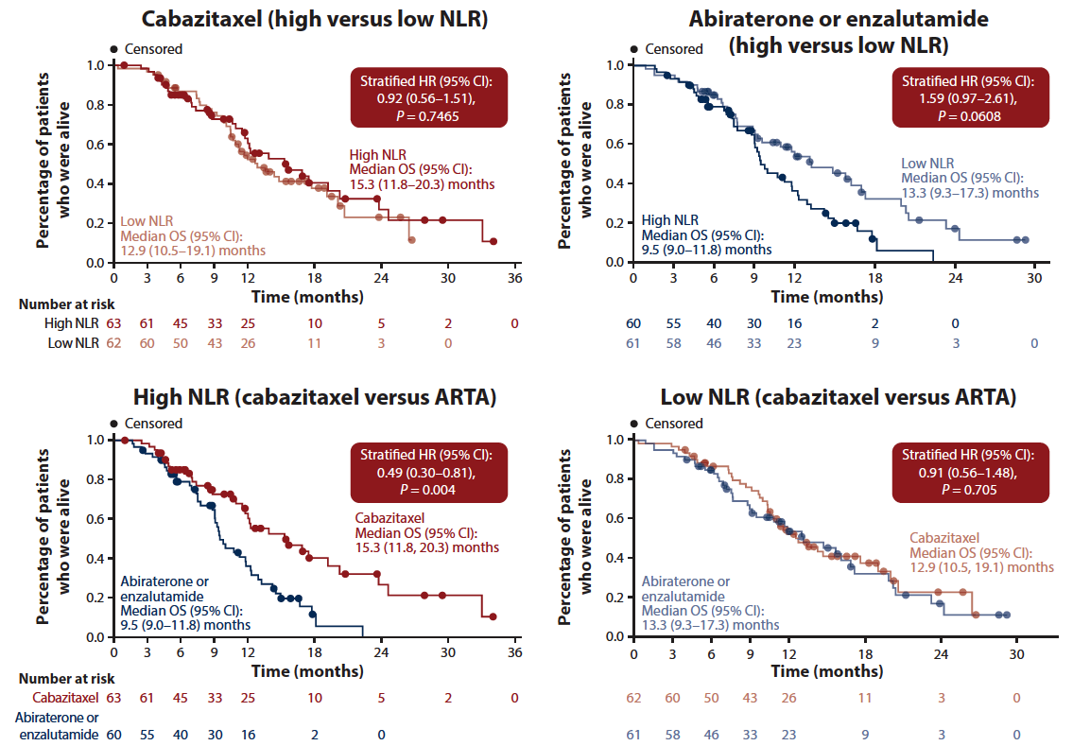
CARD: OS by Baseline NLR
de Wit R et al. ESMO Open 2021;[Online ahead of print].

Slide 98
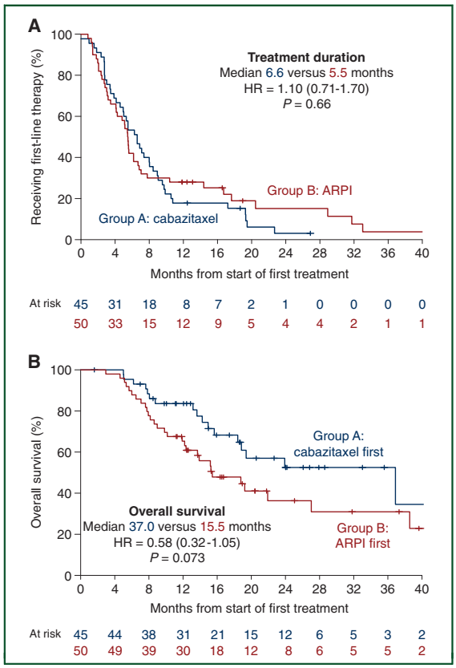
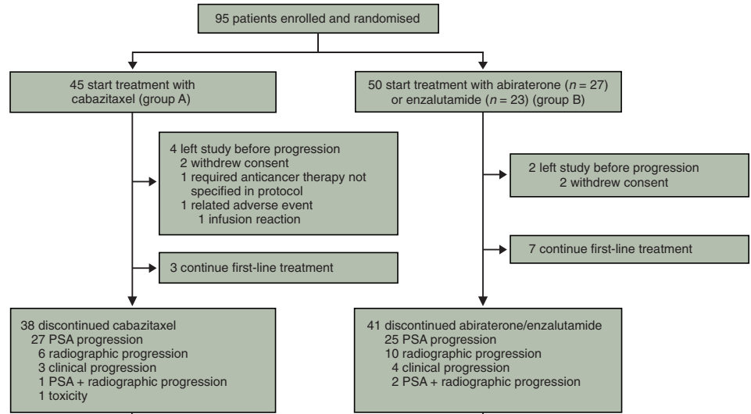
The Canadian Trial (Phase II OZM-054 Trial)
Poor prognosis:
liver mets,
CRPC <12 months,
or >3 of 6 (LDH, ECOG, visceral, albumin, ALP, <36 mo from Dx)
Annala M et al. Ann Oncol 2021;32:896-905.

Slide 99
Immune Checkpoint Inhibitors in mCRPC
Therapy | Disease State | Disease Response
Pembrolizumab monotherapyª | Post-chemotherapy | ORR 9% PSA RR 14%
Pembrolizumab + enzalutamide^{b} | Pre-chemotherapy progressing on enzalutamide | ORR 12% PSA RR 14%
Atezolizumab + enzalutamide^{c} | Pre- and post-chemotherapy, s/p abiraterone | ORR 14% PSA RR 26%
Atezolizumab + cabozantinib^{d} | Pre-chemotherapy s/p enzalutamide or abiraterone | ORR 34% PSA RR 29%
ªJCO 2020: 38(5) 395-405. ^{b}Presented at the 2021 ASCO Annual Meeting – Virtual; June 4-8, 2021. ^{c}Sweeney C. AACR 2020. IMbassador250. ^{d}Agarwal ASCO 2020. COSMIC-021

Slide 100
Abstract LBA24

Slide 101
Cabozantinib Targets Pathways Associated with Tumor Immune Suppression
Agarwal N et al. ASCO 2020;Abstract 5564.

Slide 102
COSMIC-021: Best Change from Baseline in Sum of Target Lesions
Agarwal et al. ESMO 2021;Abstract LBA24.

Slide 103
COSMIC-021: Best Change in PSA from Baseline
Agarwal et al. ESMO 2021;Abstract LBA24.

Slide 104
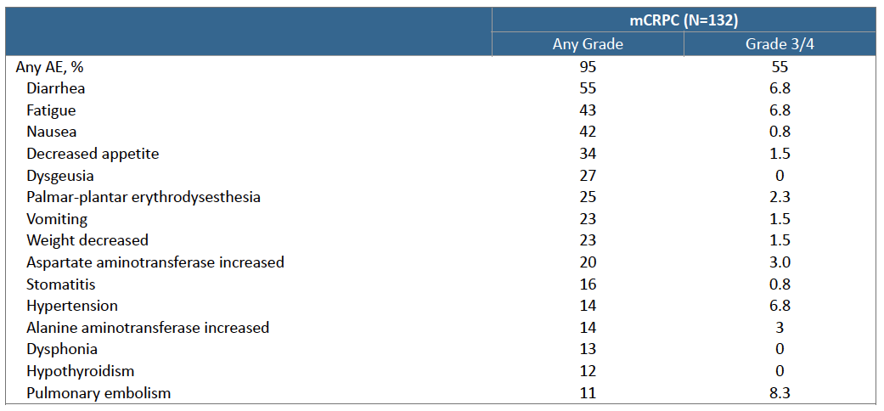
COSMIC-021: Select Treatment-Related Adverse Events
Agarwal et al. ESMO 2021;Abstract LBA24.

Slide 105
CONTACT-02: Phase III Trial Schema
Primary Endpoints:
PFS per RECIST v1.1 by BIRC
OS
Secondary Endpoint:
ORR per RECIST v1.1 by BIRC
Agarwal N et al. Genitourinary Cancers Symposium 2021;Abstract TPS190.

Slide 106
First Results from a Randomized Phase II Study of Cabazitaxel (CBZ) versus an Androgen Receptor Targeted Agent (ARTA) in Patients with Poor-Prognosis Castration-Resistant Prostate Cancer (mCRPC)
van der Zande K et al. ASCO 2021;Abstract 5059.

Slide 107
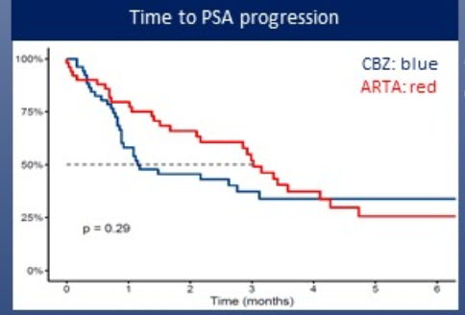
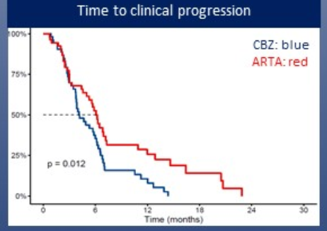
The Dutch Trial (Phase II OSTRICh Trial)
van der Zande K et al. ASCO 2021;Abstract 5059.

Slide 108
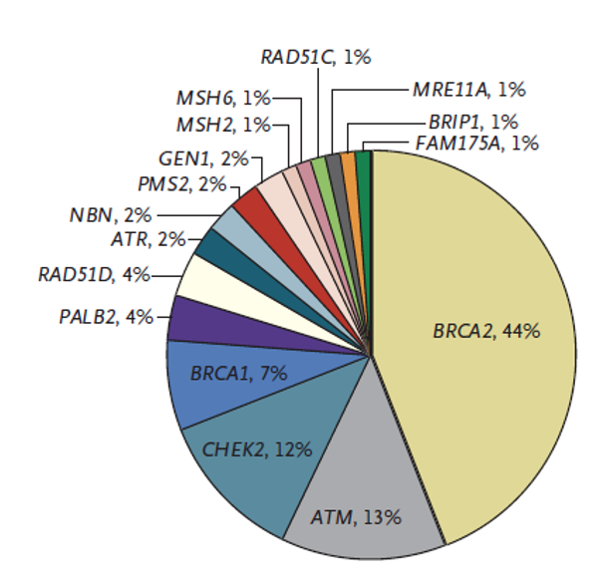
Inherited DNA Repair Gene Mutations in Men with Metastatic Prostate Cancer
Multicenter study of 692 men
Deleterious mutations were found in 82 men (11.8%) in 16 genes
Observed rate exceeded that associated with localized prostate cancer (4.6%) and general population without cancer (2.7%)
Courtesy of Matthew Smith, MD, PhD.

Slide 109
Recent FDA Approvals of PARP Inhibitors for mCRPC
PARP inhibitor | Approval date | Pivotal study
Olaparib | May 19, 2020 | PROfound
Rucaparib | May 15, 2020 | TRITON2
https://www.fda.gov/drugs/resources-information-approved-drugs/

Slide 110
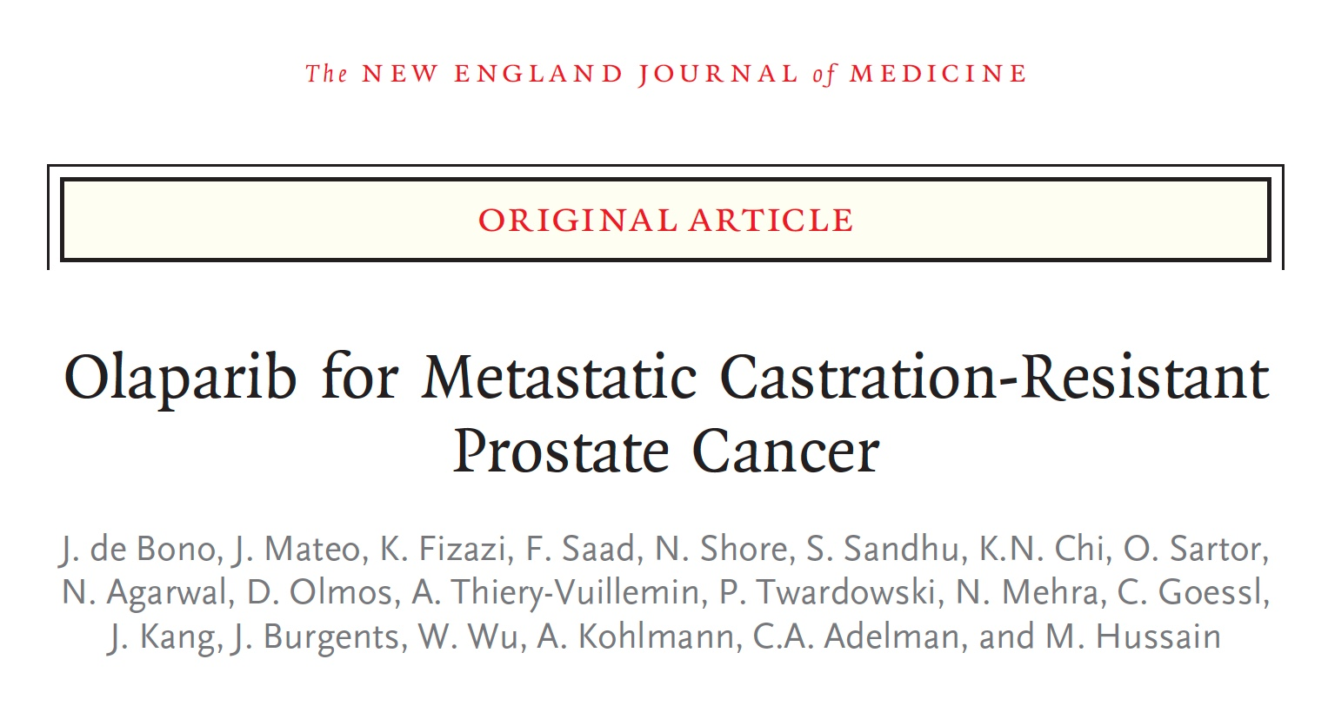
N Engl J Med 2020;382:2091-102

Slide 111
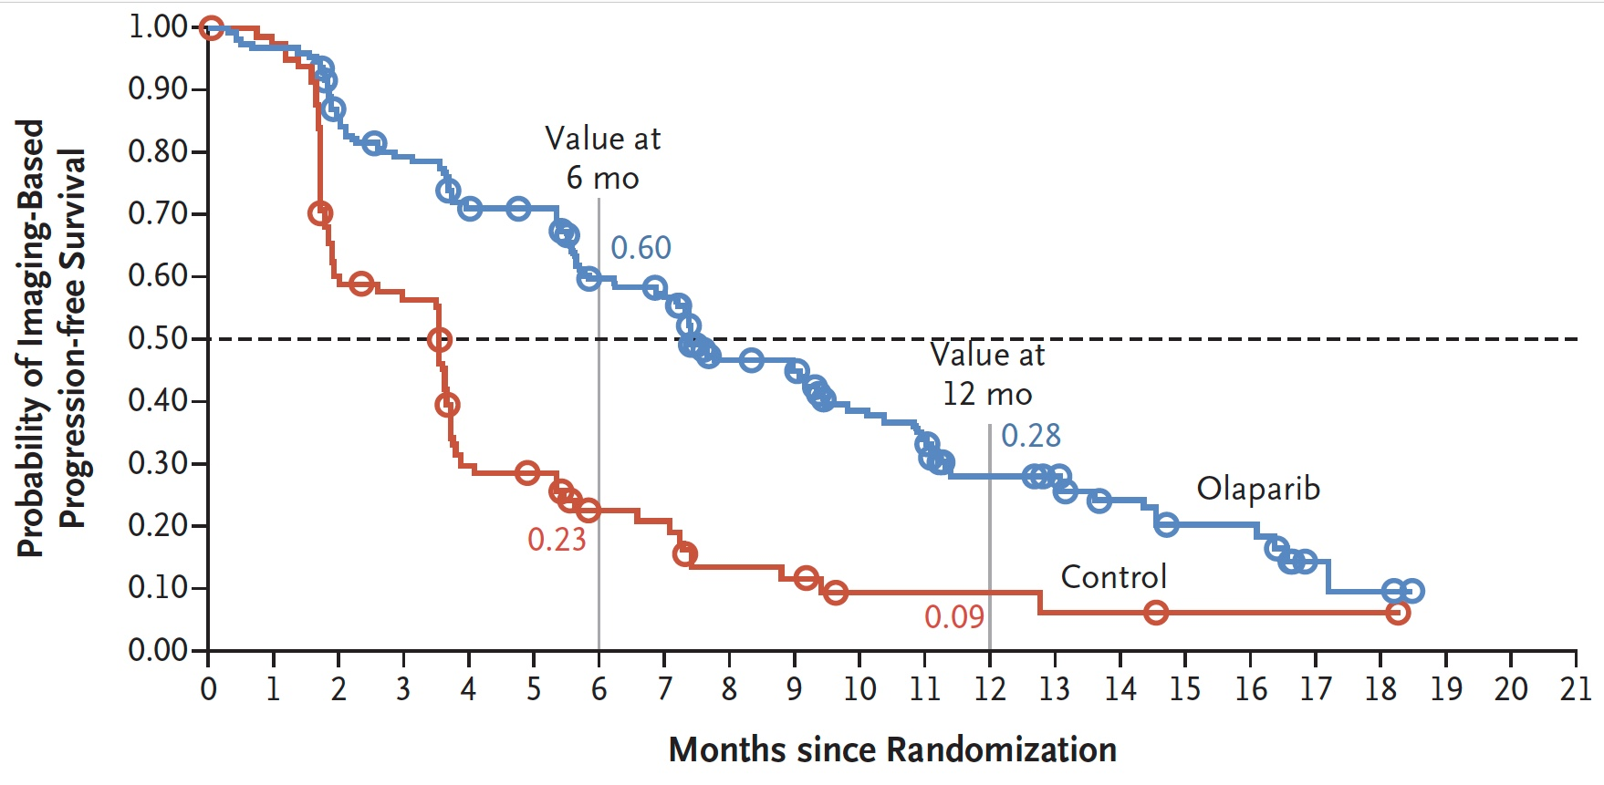
PROfound Primary Endpoint: Imaging-Based PFS with Olaparib for Patients with mCRPC Who Had at Least 1 Alteration in BRCA1, BRCA2 or ATM (Cohort A)
 | Olaparib (n = 162) | Control (n = 83) | HR | p-value
Median iPFS | 7.4 mo | 3.6 mo | 0.34 | <0.001
de Bono J et al; PROfound investigators. N Engl J Med 2020;382(22):2091-102.

Slide 112
Olaparib Antitumor Activity in PROfound
 |  | Cohort A |  | Cohorts A+B |  | BRCA1 and/or BRCA2 |  | ATM |  | CDK12
 |  | Olaparib (N=162) | Control (N=83) | Olaparib (N=256) | Control (N=131) | Olaparib (N=102) | Control (N=58) | Olaparib (N=62) | Control (N=24) | Olaparib (N=61) | Control (N=28)
rPFS | Median, months | 7.4 | 3.6 | 5.8 | 3.5 | 9.8 | 3.0 | 5.4 | 4.7 | 5.1 | 2.2
 | HR (95% CI) | 0.34 (0.25–0.47) |  | 0.49 (0.38–0.63) |  | 0.22 (0.15–0.32) |  | 1.04 (0.61–1.87) |  | 0.74 (0.44–1.31)
OS | Median OS, months | 19.1 | 14.7 | 17.3 | 14.0 | 20.1 | 14.4 | 18.0 | 15.6 | 14.1 | 11.5
 | HR (95% CI) | 0.69 (0.50–0.97) |  | 0.79 (0.61–1.03) |  | 0.63 (0.42–0.95) |  | 0.93 (0.53–1.75) |  | 0.97 (0.57–1.71)
ORR | Evaluable patients, n ORR, % | 84 33.3 | 43 2.3 | 138 21.7 | 67 4.5 | 57 43.9 | 33 0 | 30 10.0 | 10 10.0 | 34 5.9 | 12 0
PSA | Evaluable patients, n Confirmed response, % | 153 43.1 | 77 7.8 | 243 30.0 | 123 9.8 | 94 61.7 | 54 0 | 61 13.1 | 22 22.7 | 58 5.2 | 27 3.7
CTC | Evaluable patients, n Conversion, % | 52 55.8 | 22 22.7 | 78 52.6 | 32 21.9 | 29 69.0 | 17 23.5 | 25 40.0 | 3 33.3 | 14 50.0 | 5 40.0
100
100
(n=29)
100
CDK12
BRCA1 and/or BRCA2 (n=53)
ATM
(n=32)
50
BRCA1
50
50
BRCA2
Olaparib
0
0
0
-50
-50
-50
-100
-100
-100
Best percentage change in target lesions
100
(n=11)
100
(n=31)
100
(n=10)
50
50
50
Control
0
0
0
-50
BRCA1
-50
-50
-100
BRCA2
-100
-100
de Bono et al. NEJM 2020
Cohort A, BRCA1, BRCA2 and ATM alterations; Cohort A+B, all other HRR alterations; Control, physician’s choice of enzalutamide or abiraterone;
Evaluable patients: ORR, measurable disease at baseline; PSA, a valid baseline and post-baseline PSA measurement; CTC, CTC count ≥5 cells/7.5 mL at baseline
66% (n=86/131) of control patients in the overall population crossed over to olaparib treatment after their disease had progressed.² OS is not adjusted for crossover in this analysis

Slide 113
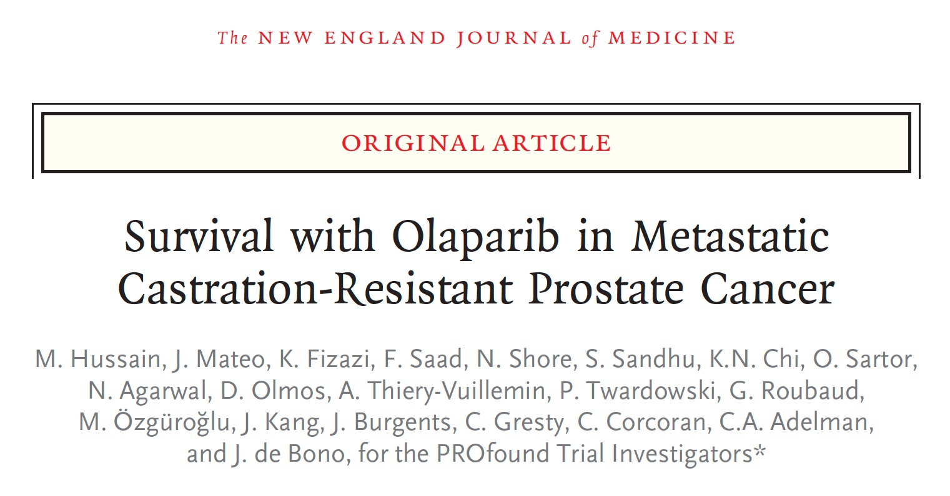
N Engl J Med 2020;383(24):2345-57.

Slide 114
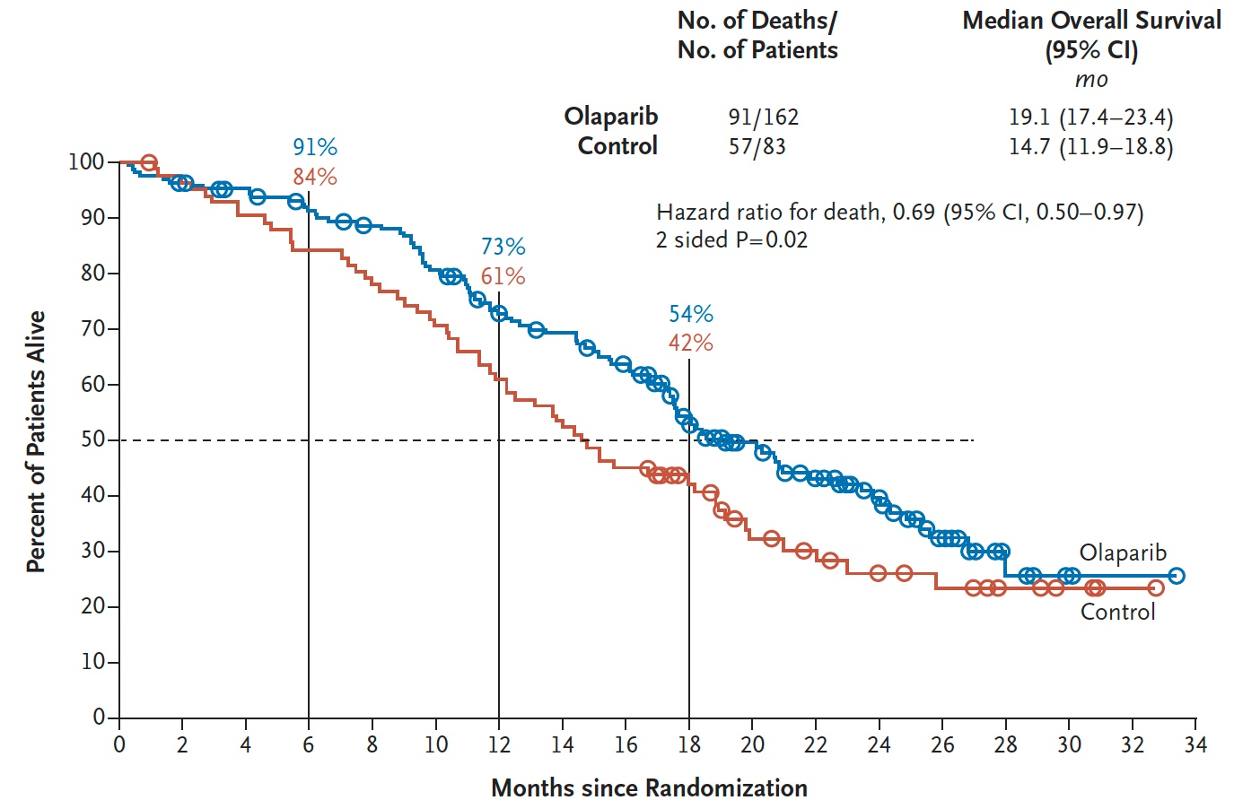
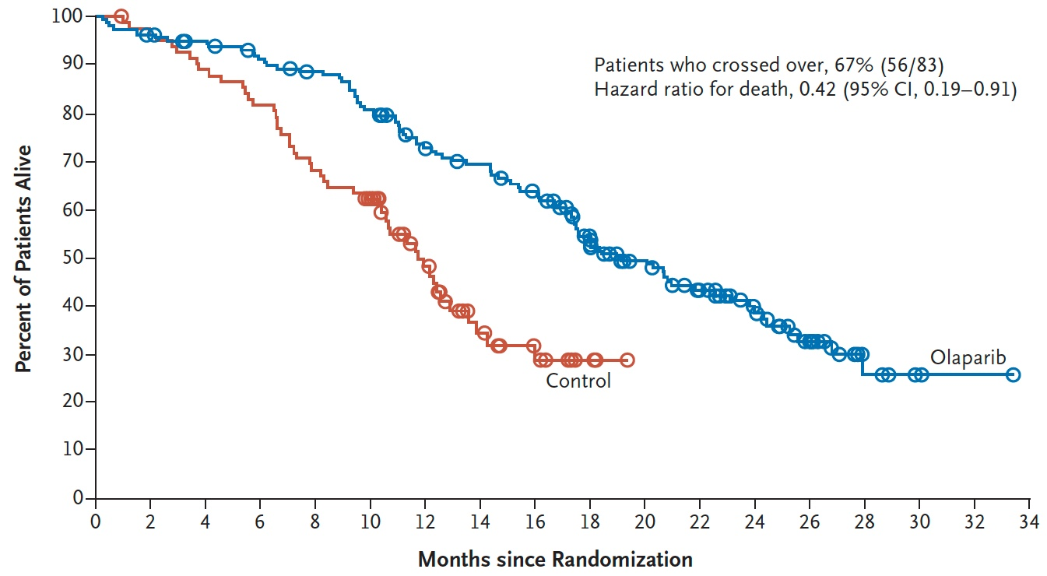
PROfound: OS with Olaparib in Patients with mCRPC Who Had at Least 1 Alteration in BRCA1, BRCA2 or ATM (Cohort A)
Overall survival
Cross-over adjusted overall survival
Hussain M et al; PROfound investigators. N Engl J Med 2020;383(24):2345-57.

Slide 115
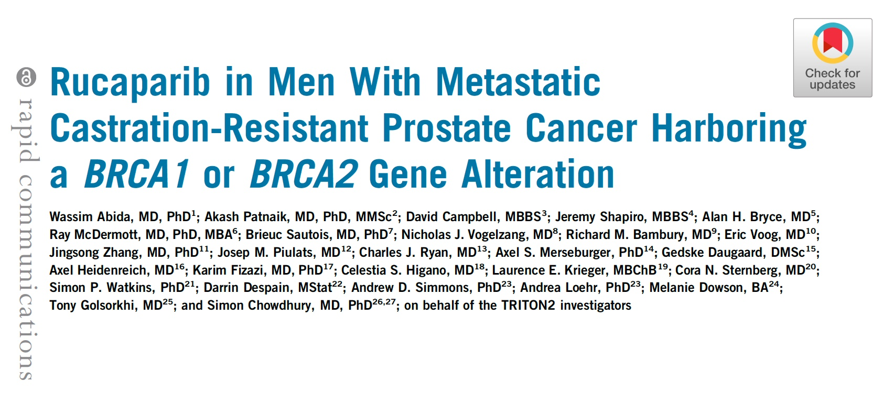
J Clin Oncol 2020;38(22):3763-72.

Slide 116
TRITON2: Response to Rucaparib in Patients with mCRPC Harboring a BRCA1 or BRCA2 Gene Alteration
ORR per independent radiology review: 43.5%
Confirmed PSA response rate: 54.8%
Abida W et al. TRITON2 investigators. J Clin Oncol 2020;38(32):3763-72.

Slide 117
Talazoparib in mCRPC (TALAPRO-1)
BRCA in blue
ATM loss in orange
PALB2 in red
de Bono JS et al. Lancet Oncol 2021;22(9):1250-64.

