Slide 1

Emerging biomarkers to predict responses to cancer immunotherapy
Solange Peters MD-PhD
Head Medical Oncology and Thoracic Clinic
Oncology Department
Lausanne University Hospital (CHUV)
Switzerland

Slide 2
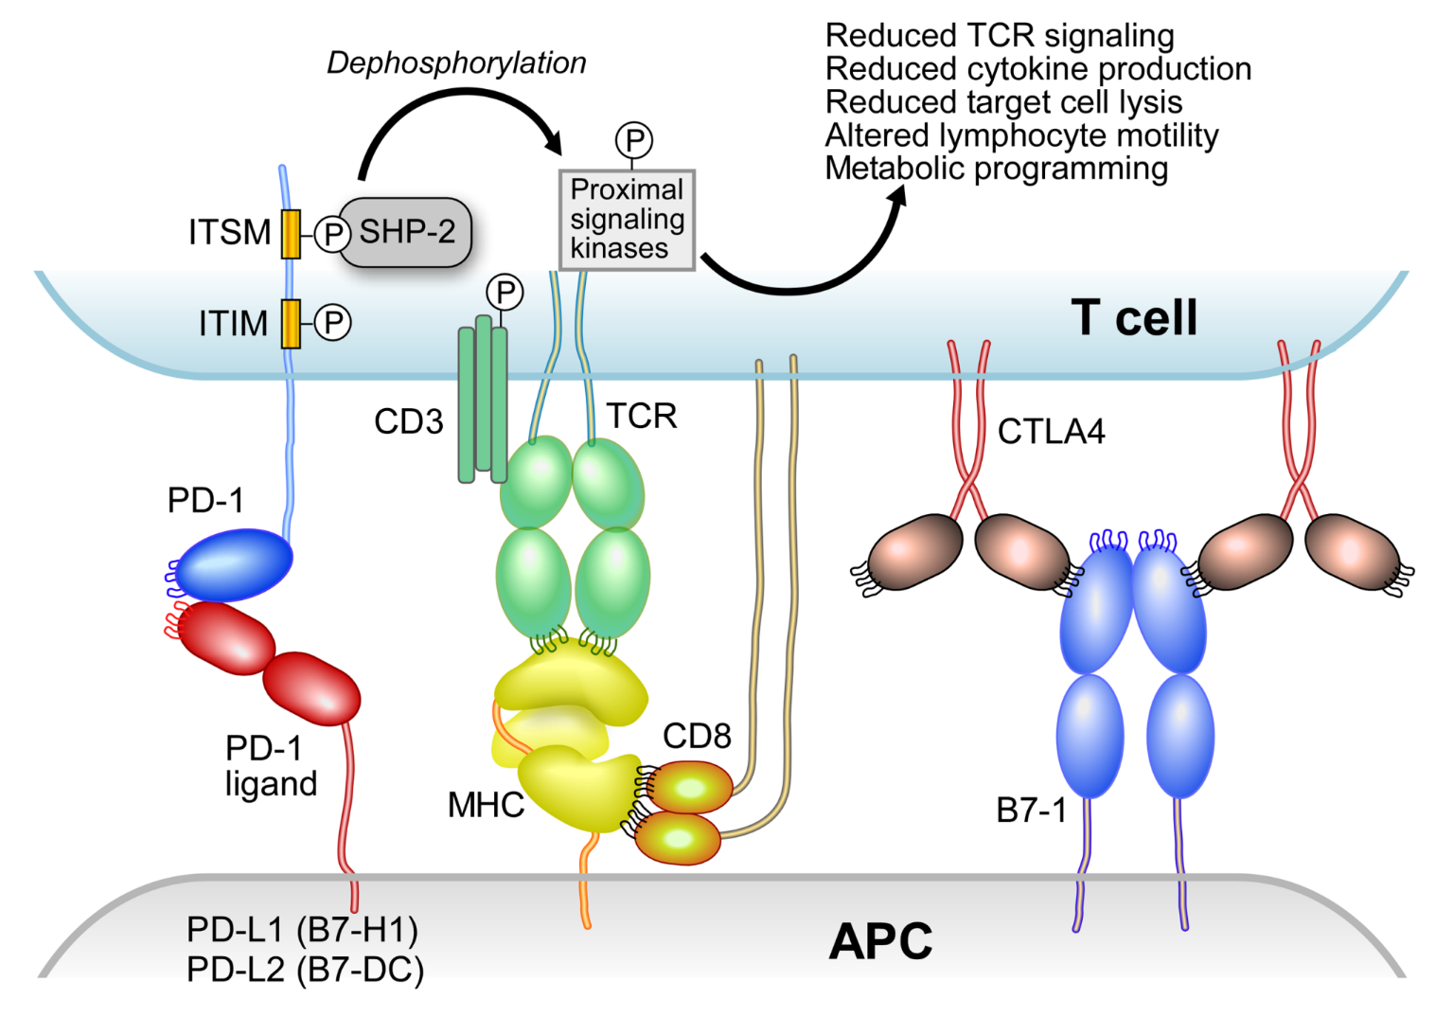
Two synapses for T-cell activation in cancer
Nivolumab
Pembrolizumab
Cemiplimab
Tislelizumab
Camrelizumab
Pidilizumab
Sintilimab
CS1001
Atezolizumab
Avelumab
Durvalumab
50-100 compounds in development
Ipilimumab
Tremelimumab
Freeman, ESMO IO 2015

Slide 3
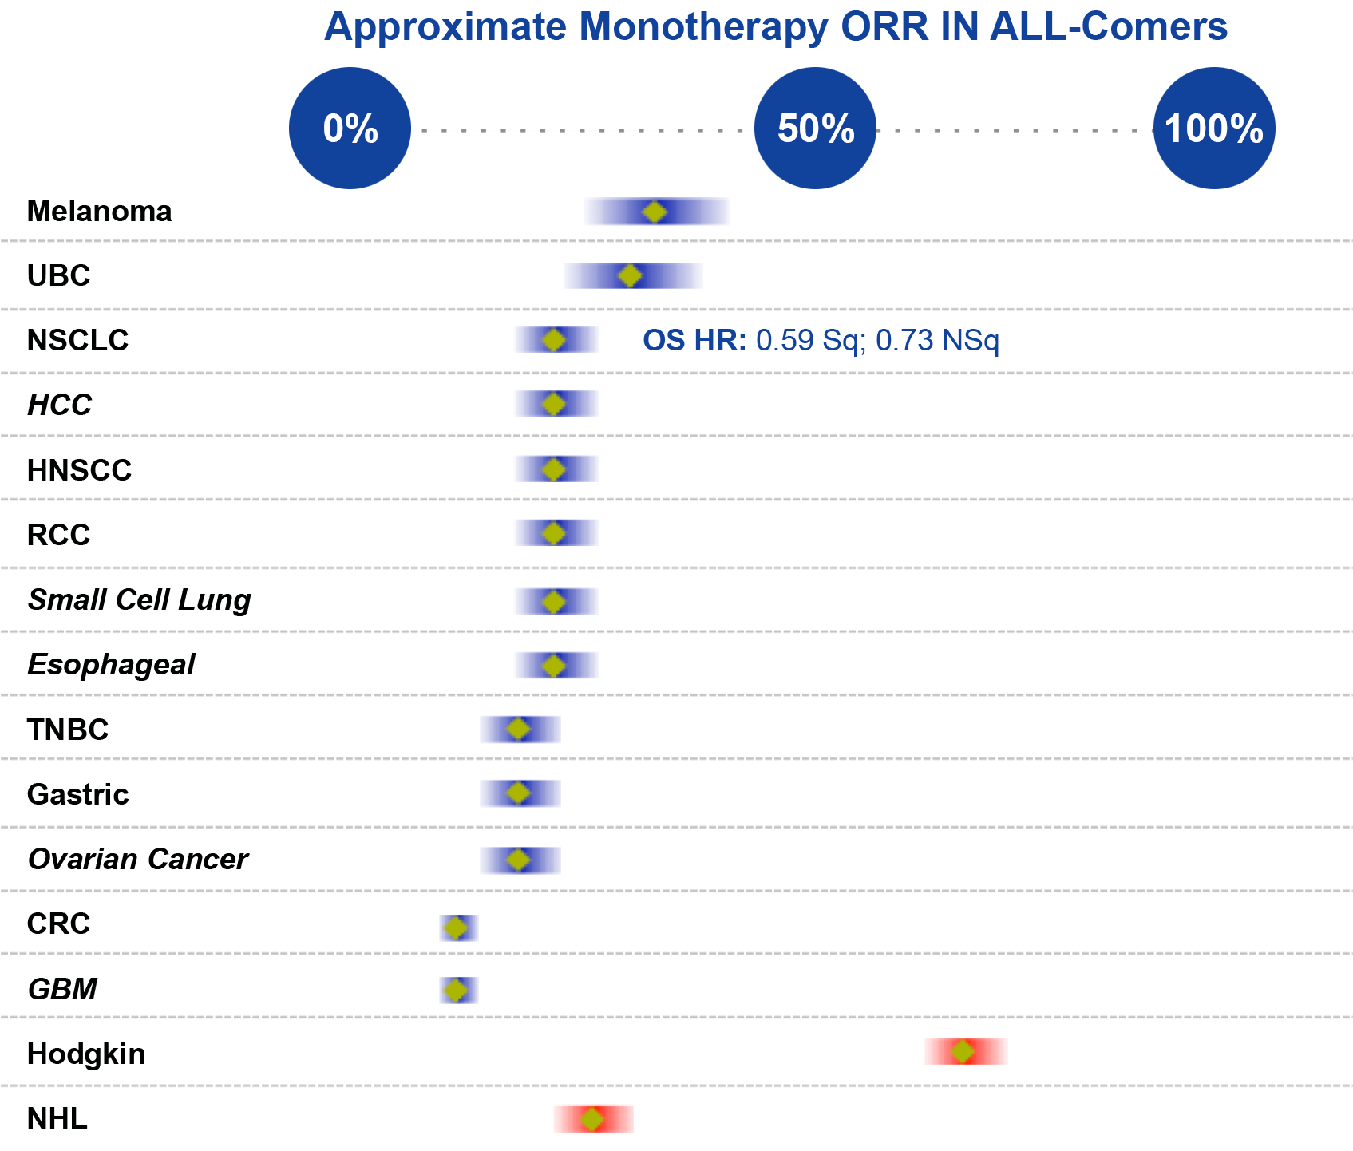






Significant clinical activity of PD-1 blockade in cancer
But only in a minority of patients
Broad Pan-Tumor Potential with anti-PD-L1/PD-1 inhibitors monotherapy for unselected patients
  Modified from D. Chen, BioScience Forum, 2015
Notes:
There has already been OS demonstrated in lung, melanoma, and RCC – but hopefully many more to come across both solid and liquid cancers, where we are already seeing early reports of significant response rates.
Despite these terrific responses to the check-point inhibitors, there remains significant room for improvement across the board.
So what is behind these differences across tumor types?
Initial studies are beginning to shed some light on this question, and one of the probable many reasons lies within the PDL1 expression patterns observed.

Slide 4
Biomarkers are needed in patient selection for IO
Not all patients respond to and benefit from these treatments
Enrich the treatment population for benefit
Avoidance of harm?
  There are toxicities from these drugs
  Alternative treatment would be better
Financial burden
Kerr, ELCC 2018; Tray, Cancer Immunology Res 2018

Slide 5
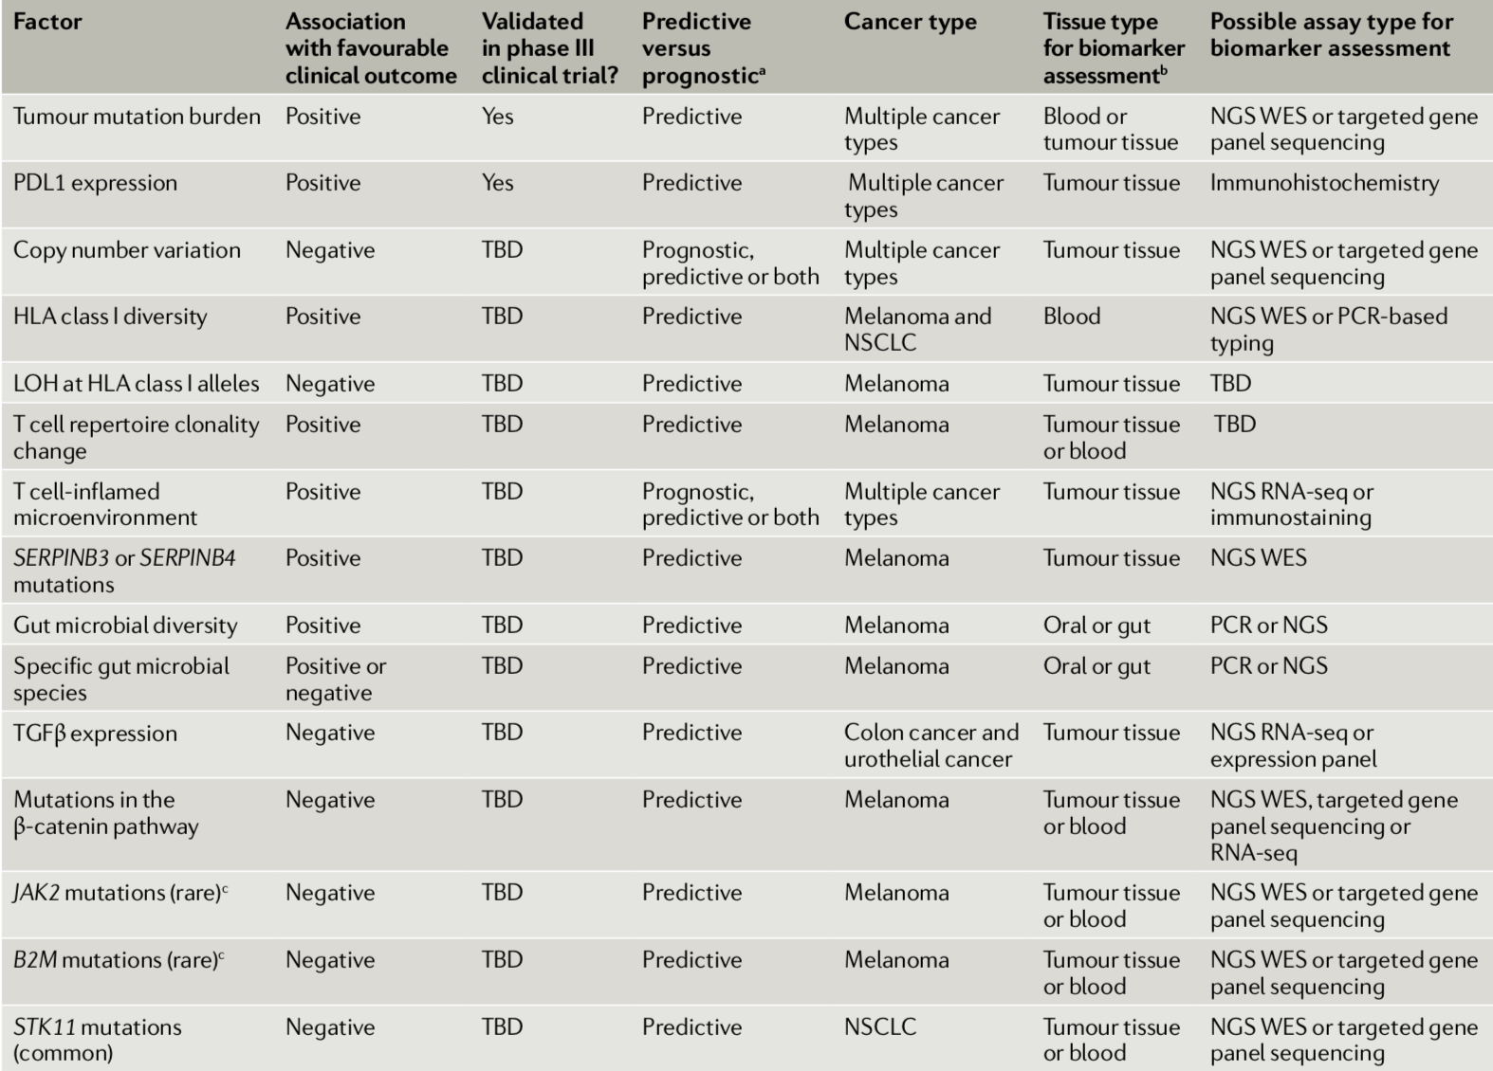
The essentials
PD-L1 and TMB
The host
T-cell repertoire, HLA and microbiome
The microenvironment
FOR RESEARCH NOT DECISON
The genetic oncongenic contexture
Havel, Nat Rev Cancer 2019
Notes:
Havel Nat Rev cancer 2019

Slide 6
The essentials
PD-L1 and TMB
Havel, Nat Rev Cancer 2019
Notes:
Havel Nat Rev cancer 2019

Slide 7
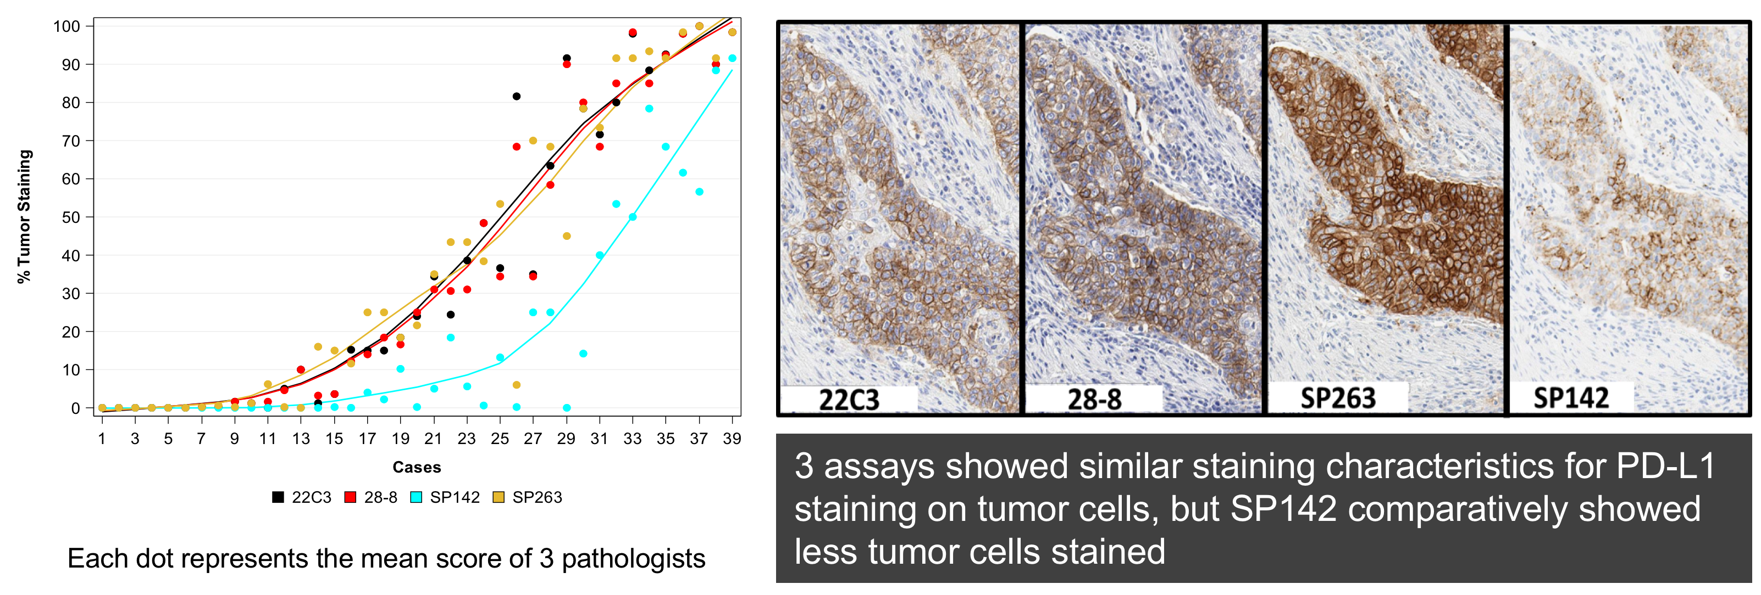
PD-L1 on tumor cells and predictive ability in NSCLC
Most NSCLC trials have shown a positive relationship between clinical benefit from PD(L)-1 inhibitors and PD-L1 expression
FNA, biopsy, large block can all be used
Heterogeneity is the background
PD-L1 expression is a continuum
Kerr, JTO 2017 and WCLC 2018
Notes:
Most data are presented for a cut off value rather than by cohorts determined by ranges of expression :

Slide 8
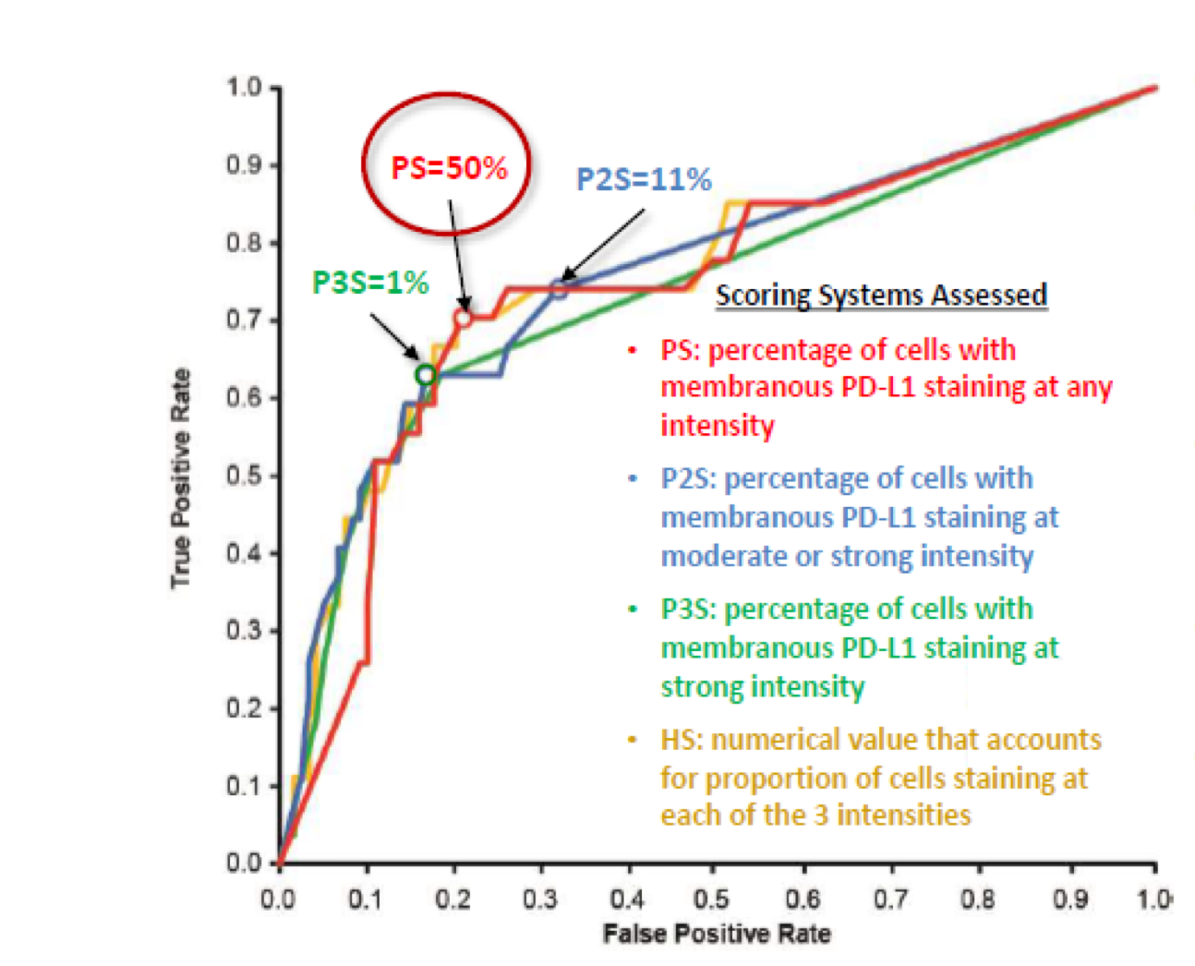
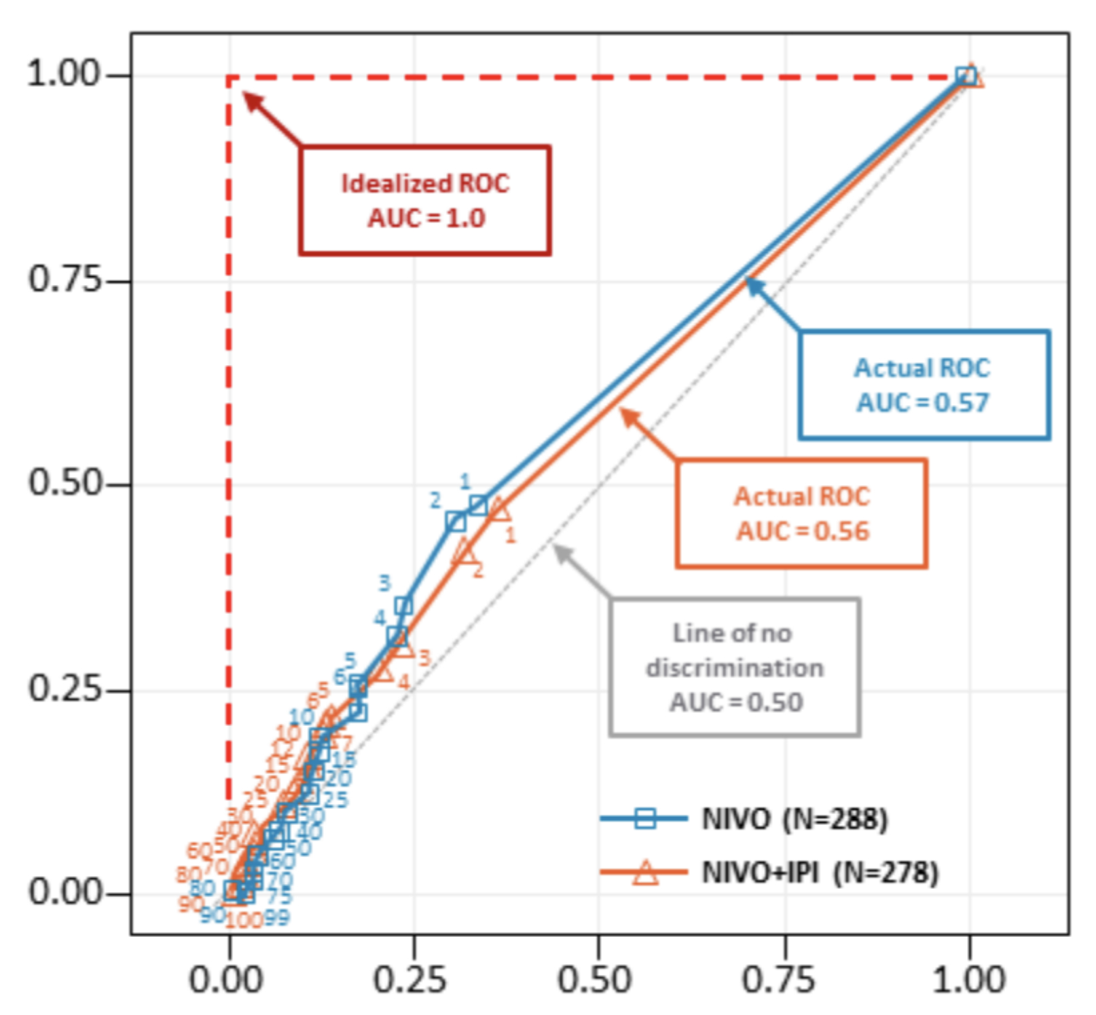
Performance of PD-L1 is variable across cancer types
NSCLC
Melanoma
True positive rate
False positive rate
The shoulder of the ROC curve is taken to be the point that achieves the best true positive and the best false positive rate
Wolchok NEJM 2017; Garon NEJM 2015

Slide 9
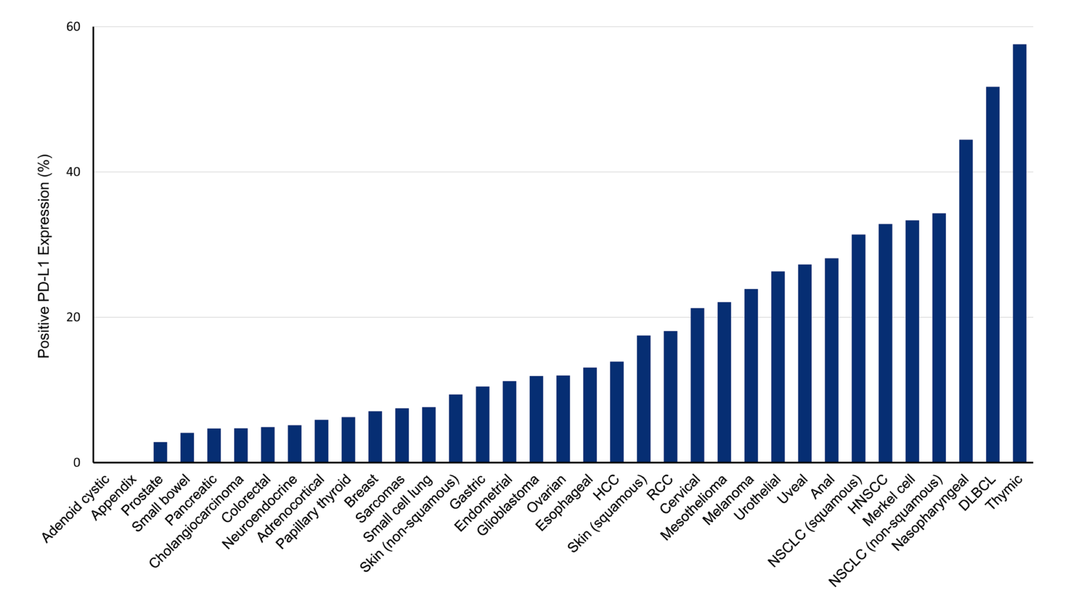
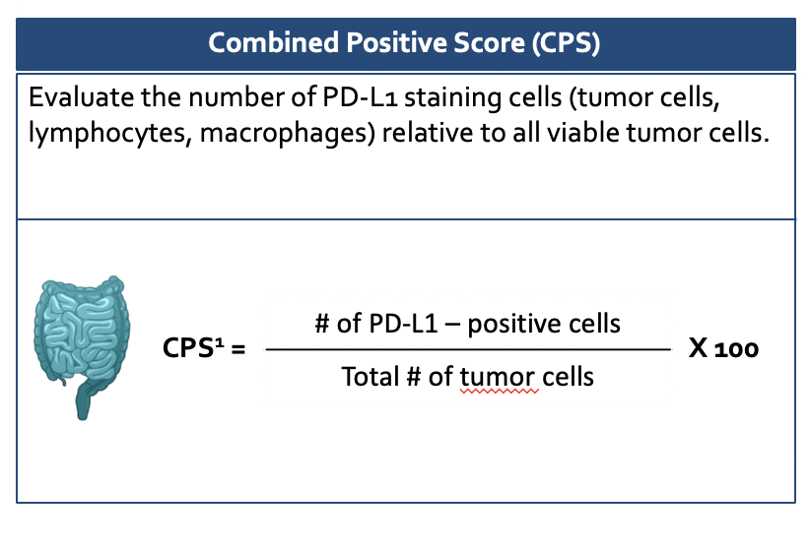
PD-L1 quantification suffers from additional complexity
1) Distinct prevalence of PD-L1 positivity on TC across tumors
2) Poor reproducibility of IC scoring in NSCLC
3) Development of the new CPS score
Yarchoan, JNCI 2019
Tsao, JTO 2018

Slide 10
PD-L1 expression is differently measured across cancers
Disease type | PD-L1 assessment | Threshold used | Clinical context
NSCLC | TC IC or TC TC | >50% >50% or >10% >1% | Stage IV frontline mono Stage III consolidation/ IV late lines mono
SCLC | CPS | >1% | Stage IV pretreated mono
Breast Cancer (Triple Negative) | IC | >1% | Frontline neoadjuvant, stage IV
Cervical Cancer | CPS | >1% | Stage IV pretreated mono
Gastric Cancer | CPS | >1%; >5% >10% | Stage IV frontline with chemo IV frontline mono
Oesophageal Cancer | CPS | >10% | Stage IV frontline Pretreated mono
HNSCC carcinoma | TC CPS | >50% >1% | Stage IV pretreated mono IV frontline mono or with chemo
UC | TC TC& IC | >1% >25% | Adjuvant Consolidation frontline
Melanoma | TC | >1% | Stage IV ipi/nivo frontline

Slide 11
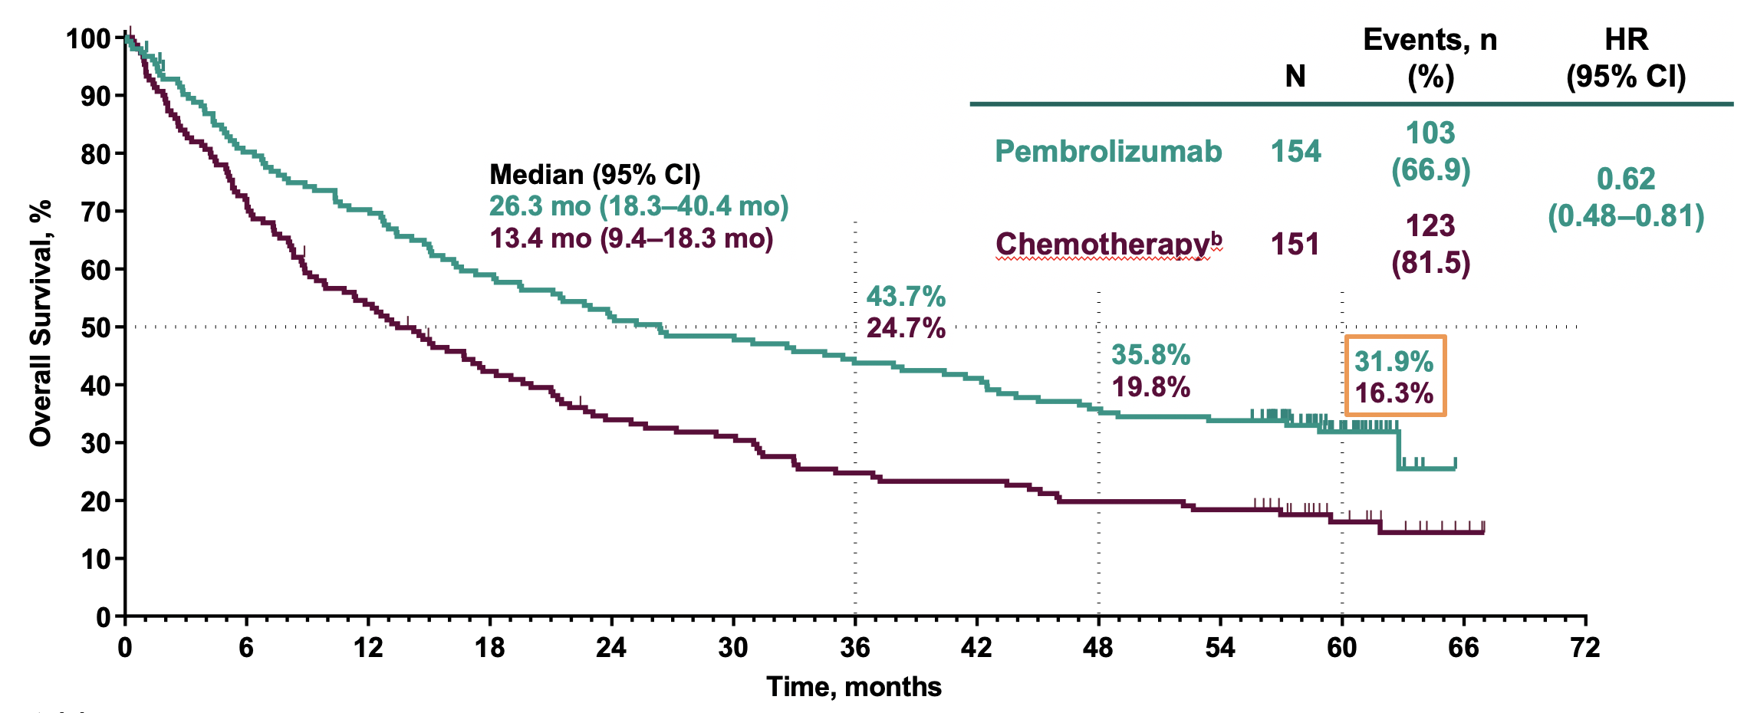
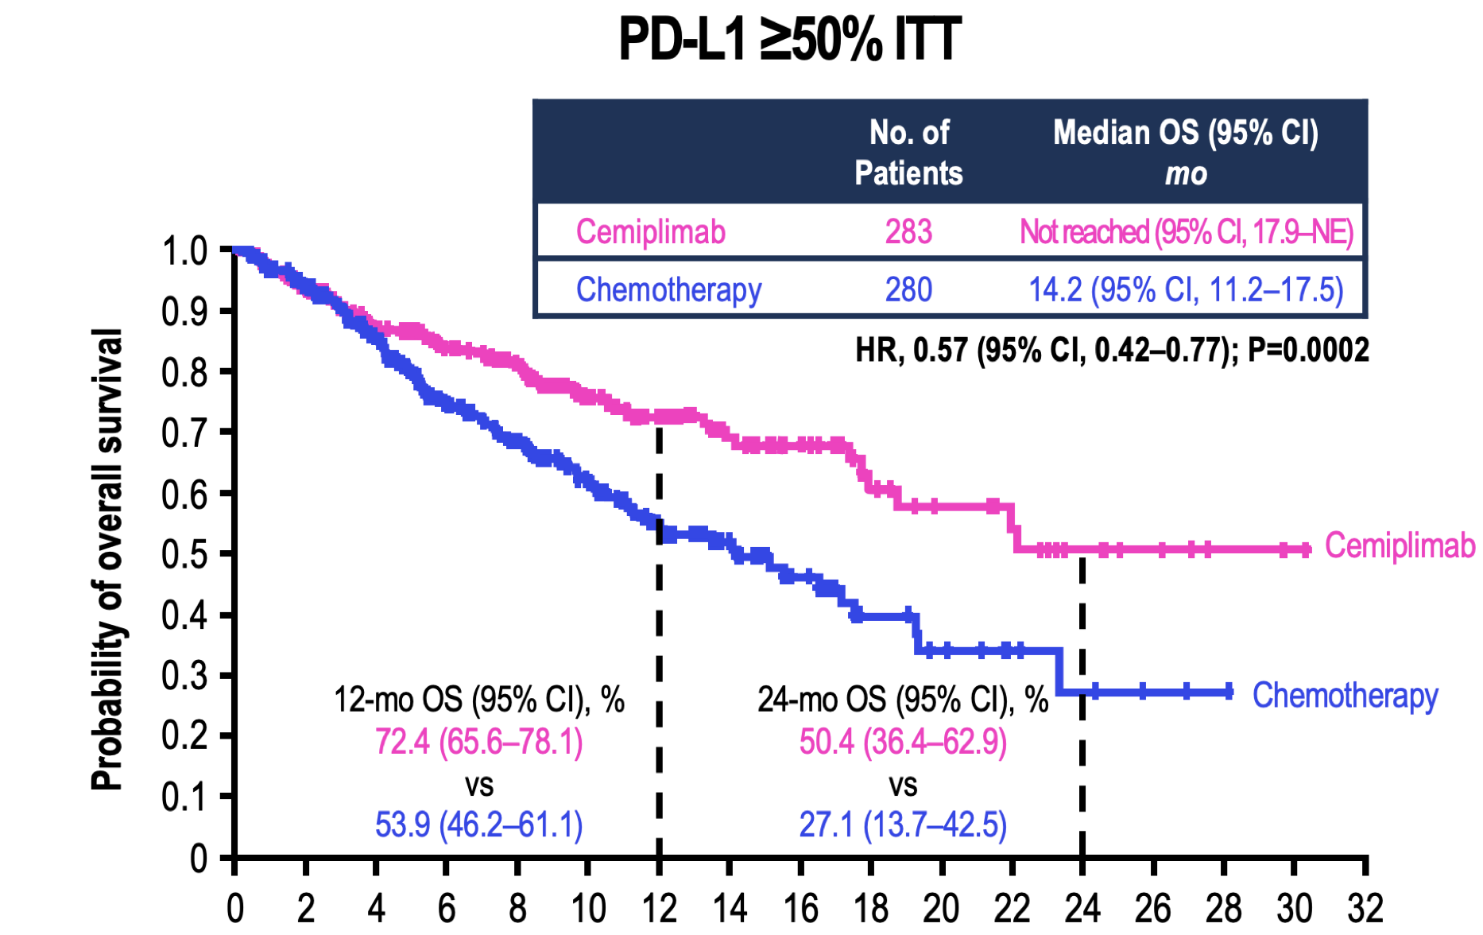
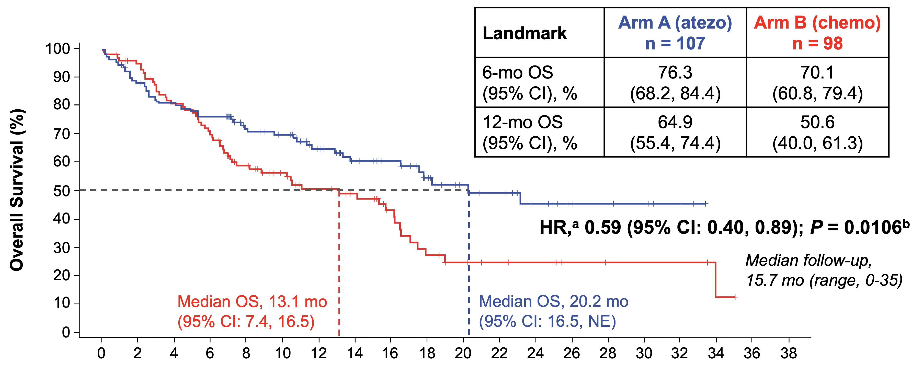
The 50% TC cut-off validated frontline in NSCLC
Pembrolizumab TC>50%
Cemiplimab
Atezolizumab TC>50% or IC>10%
HR, 0.59 (95% CI: 0.40, 0.89); P = 0.0106
Reck, WCLC 2019; Brahmer, ESMO 2020; Aguilar, Ann Oncol 2019, Herbst, NEJM 2019

Slide 12
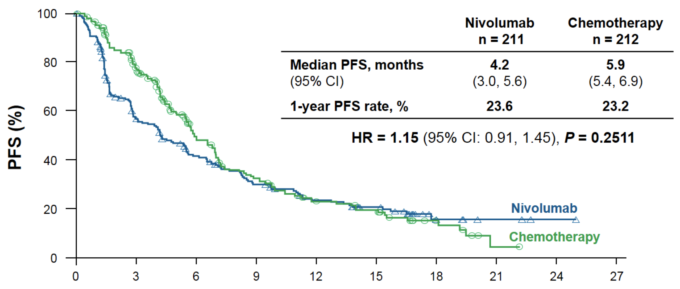
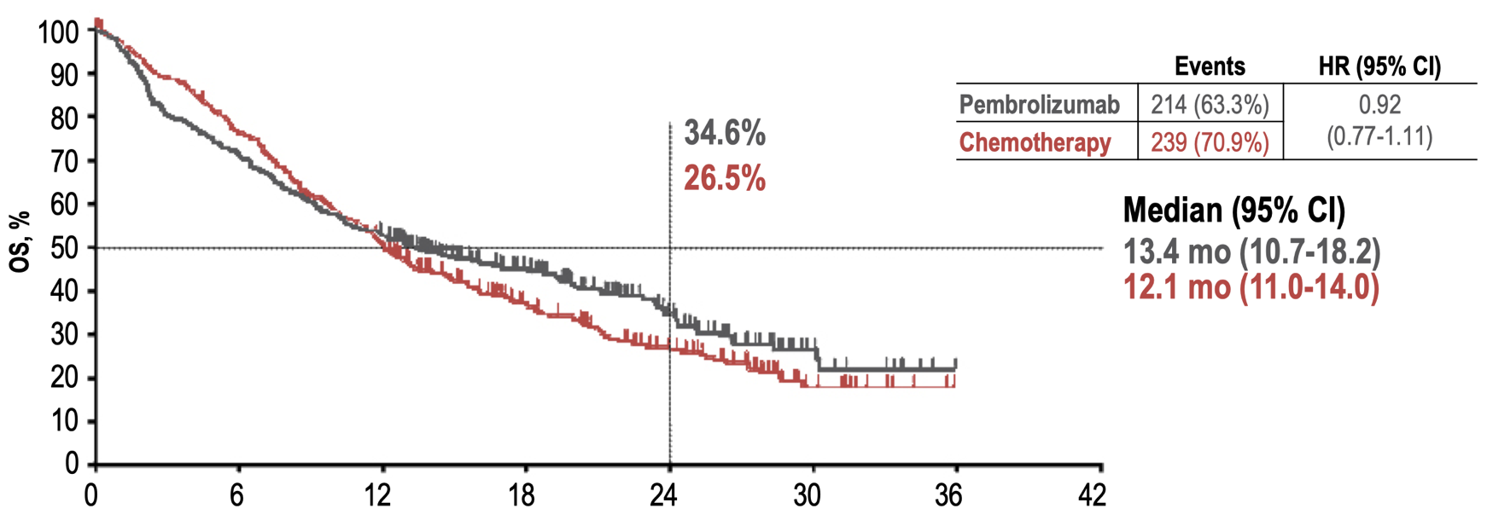
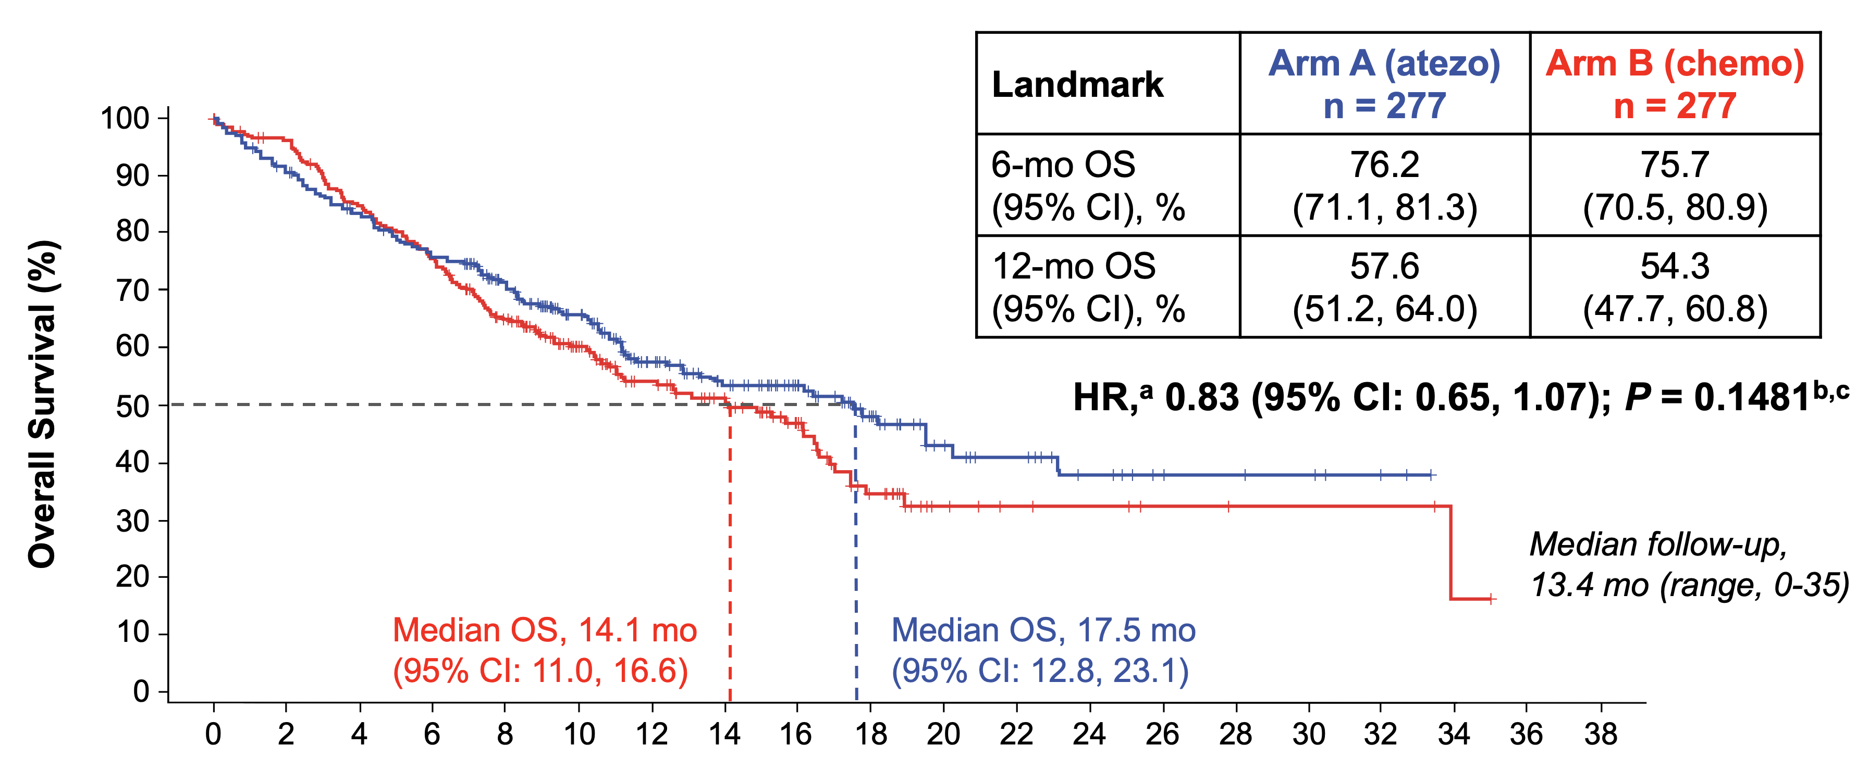
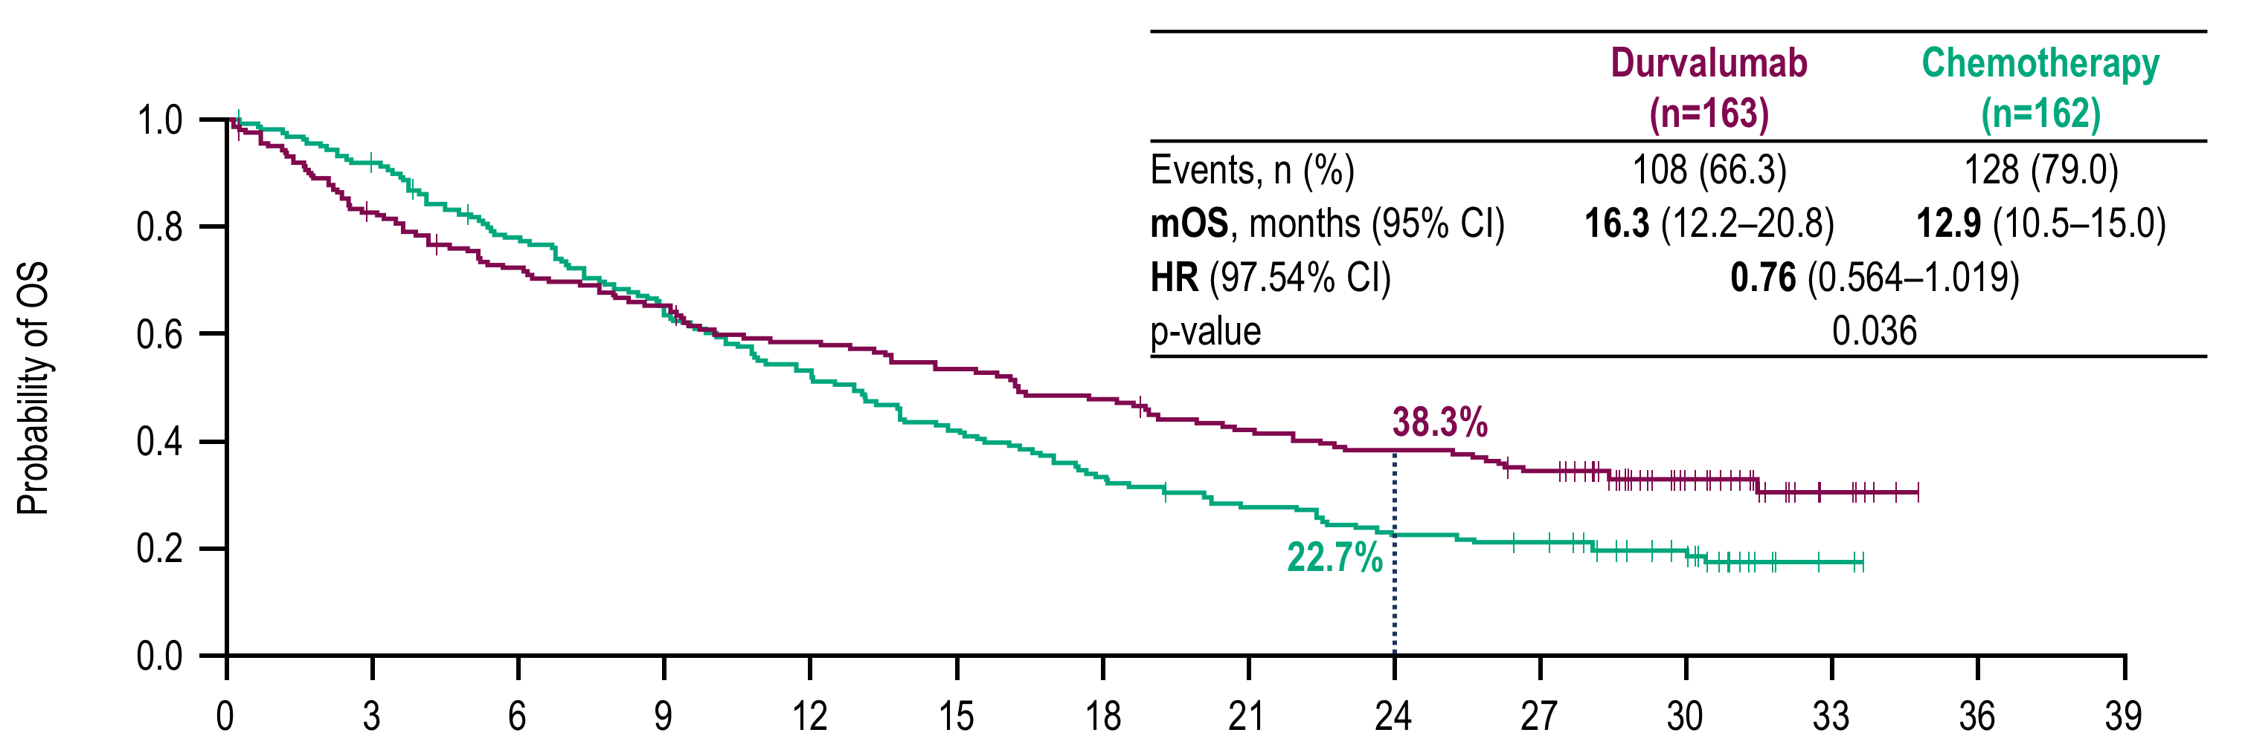
Thresholds < 50% do not favor anti-PD(L)-1 above chemo
CheckMate 026: 5% PD-L1
KEYNOTE-042: PD-L1 1-49%
HR, 0.83 (95% CI: 0.65, 1.07); P = 0.1481
MYSTIC: 25% PD-L1
IMPOWER 110: TC1/2/3 OR IC 1/ 2/3

Slide 13
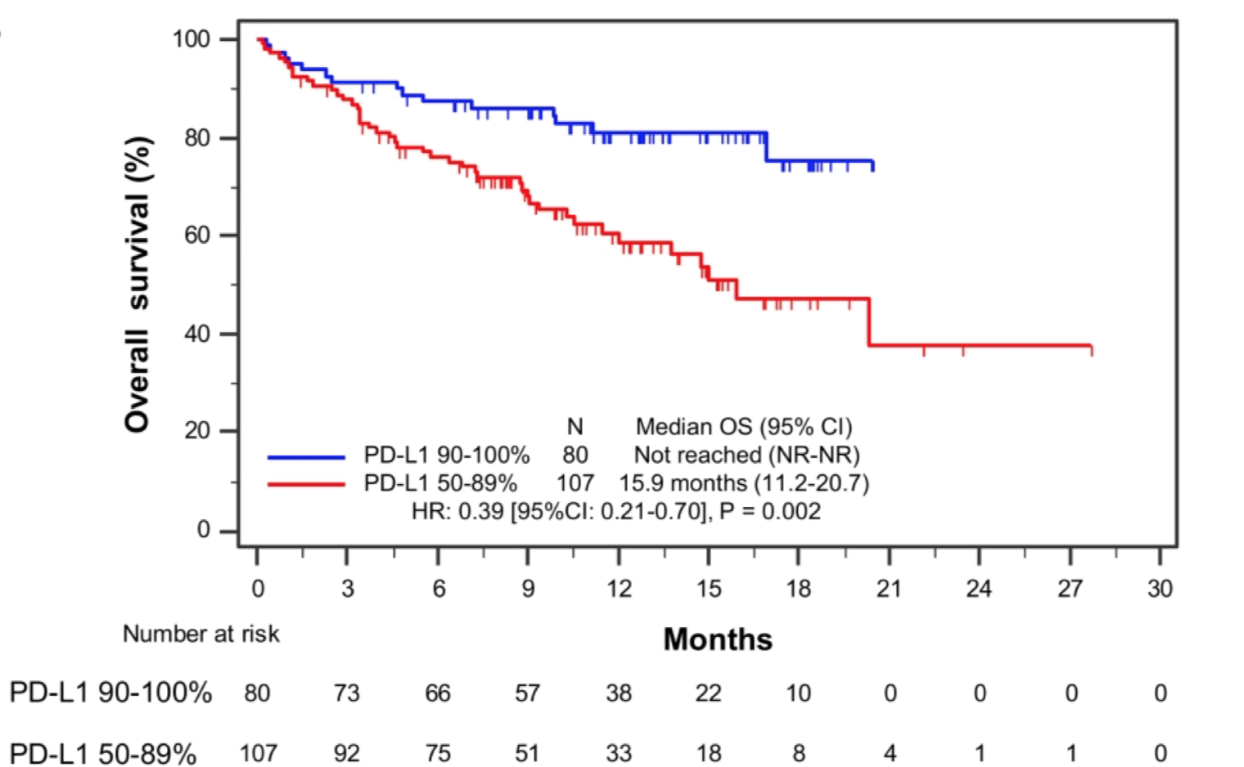
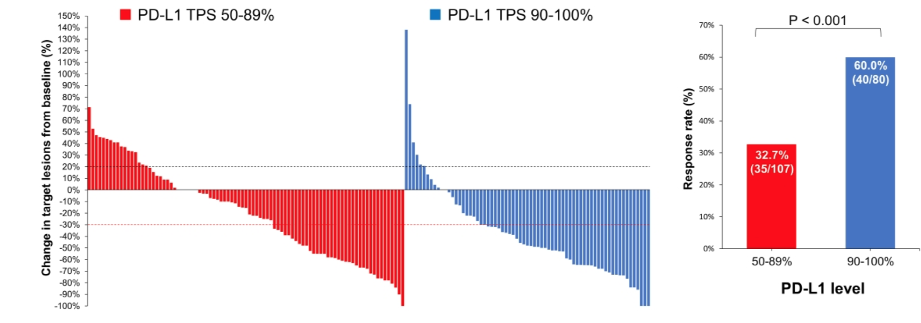
Clinical continuum: anti PD(L)-1 in very high PD-L1
Aguilar, Ann Oncol 2019
Notes:
Very high

Slide 14
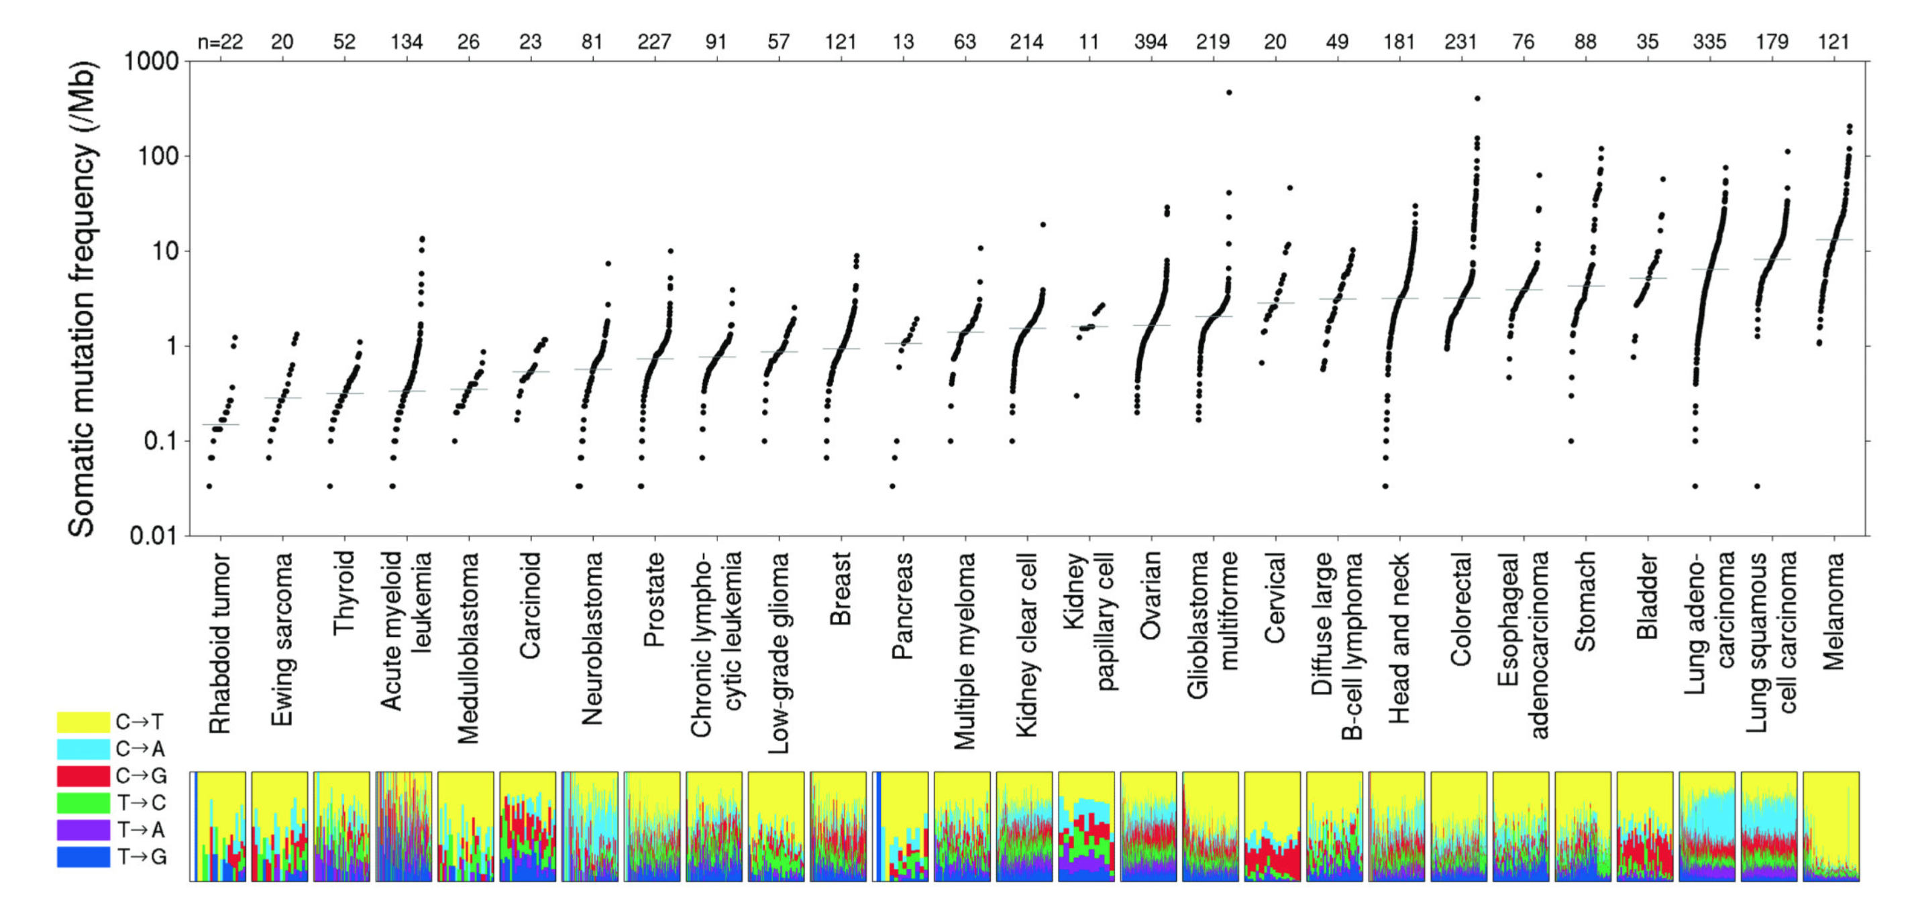
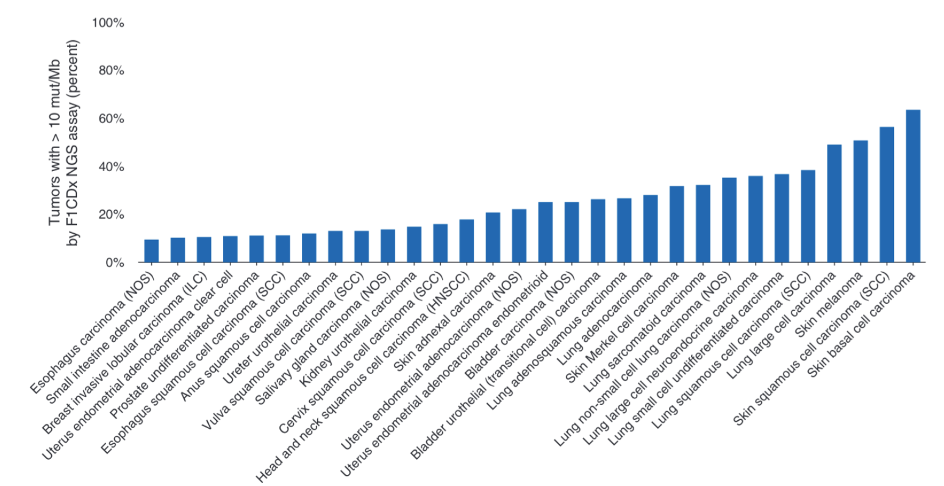
Cancer is characterized by the accumulation of mutations
Lawrence, et. al., Nature 2013
Alexandrov, et. al., Nature 2013
Chen and Peters, Ann Oncol 2020
Notes:
Figure 1. The prevalence of somatic mutations across human cancer types
Every dot represents a sample while the red horizontal lines are the median numbers of mutations in the respective cancer types. The vertical axis (log scaled) shows the number of mutations per megabase while the different cancer types are ordered on the horizontal axis based on their median numbers of somatic mutations. We would like to thank Gad Getz and colleagues for the design of this figure26.

Slide 15
TMB and Response

Slide 16
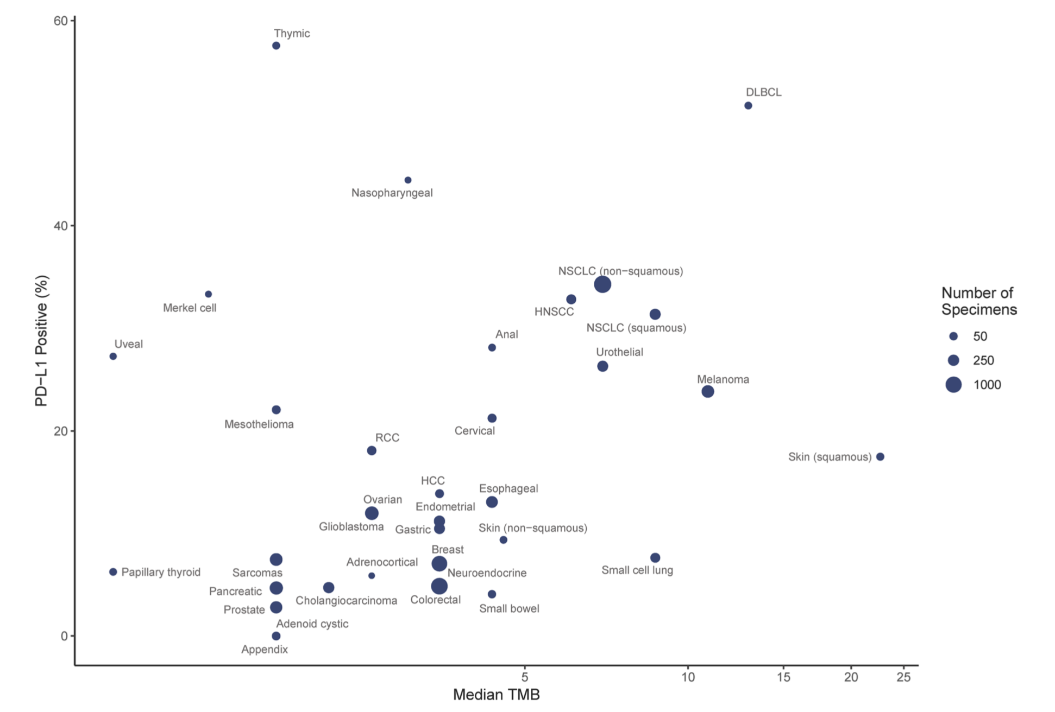
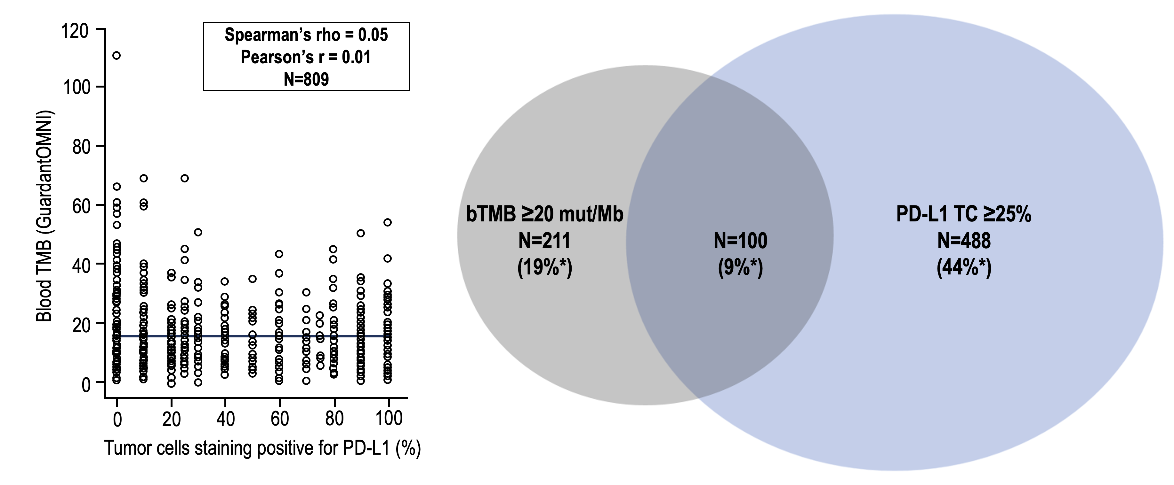
No relationship between PD-L1 and TMB for the major tumor types and NSCLC
Yarchoan JCI 2019; Peters AACR 2020
Notes:
Figure 4. Relationship between TMB and PD-L1 expression at the level of distinct tumor types. There was no relationship between the PD-L1 expression and median TMB for the major tumor types.
Yarchoan JCI 19

Slide 17
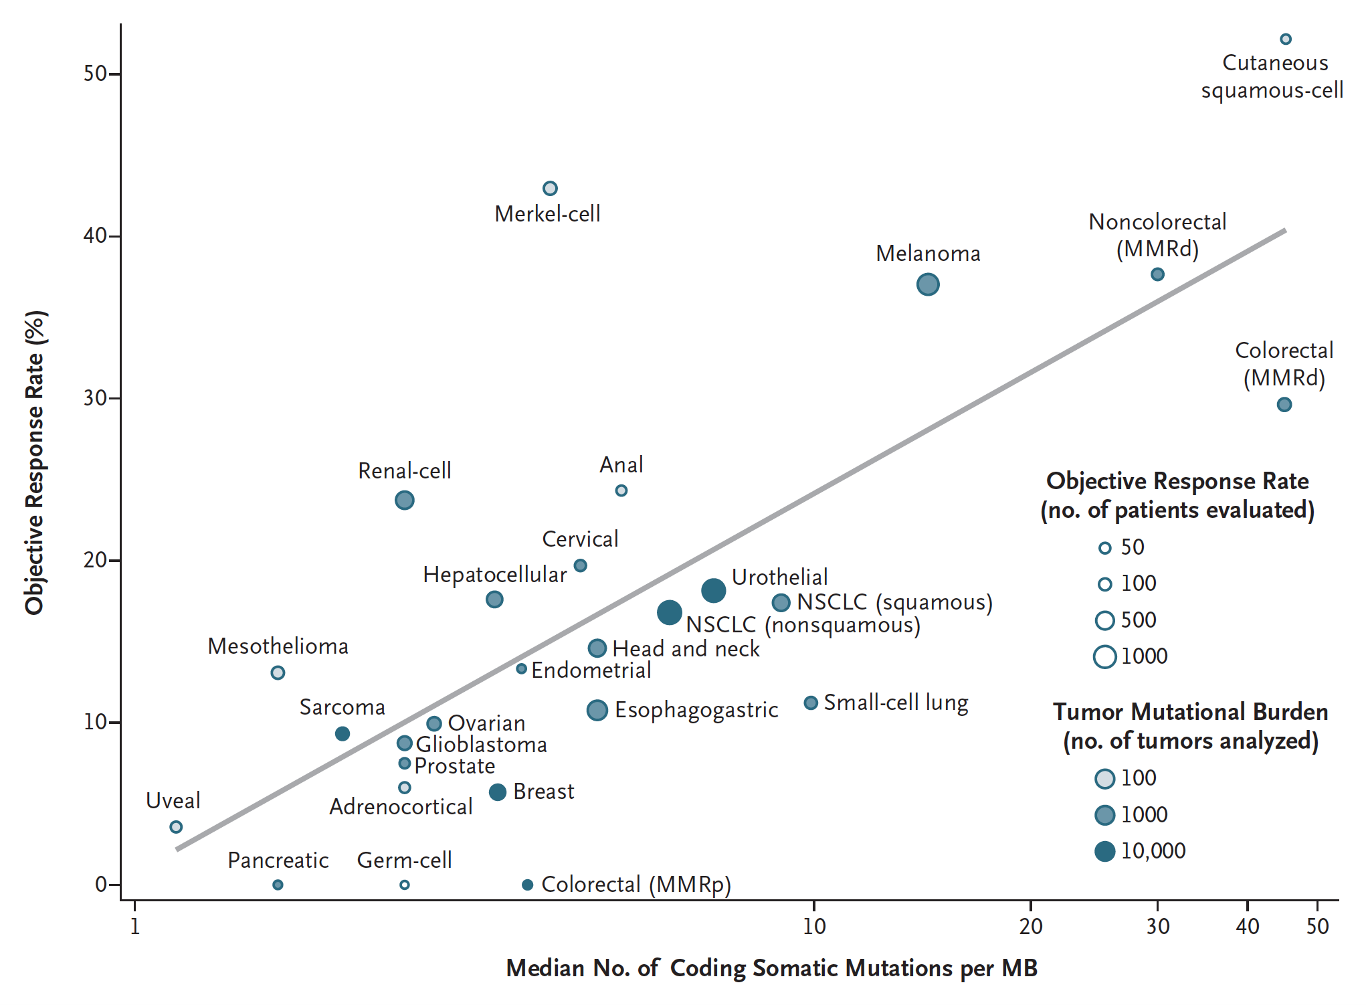
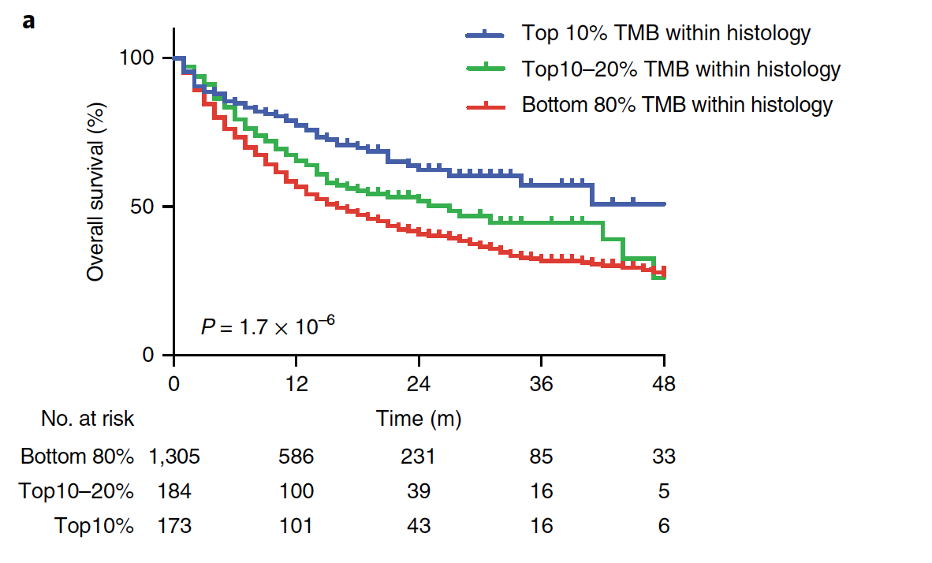
Highly mutated tumors respond better to IO
TMB: significantly associated with OS as a continuous variable and with a binary cutoff
(top 20% of each histology, HR = 0.61)
Samstein, Nat Gen 2019; Yarchoan, NEJM 2017
Notes:
Figure 1. The prevalence of somatic mutations across human cancer types
Every dot represents a sample while the red horizontal lines are the median numbers of mutations in the respective cancer types. The vertical axis (log scaled) shows the number of mutations per megabase while the different cancer types are ordered on the horizontal axis based on their median numbers of somatic mutations. We would like to thank Gad Getz and colleagues for the design of this figure26.
Association remained significant with removal of melanoma and NSCLC

Slide 18
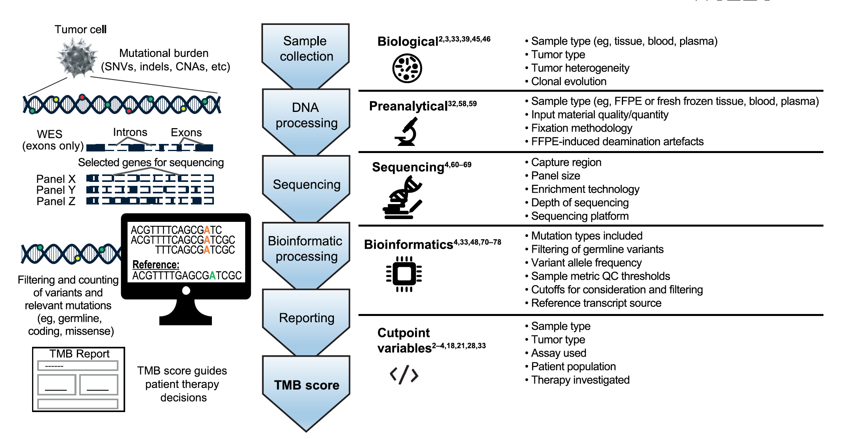
What do we know about TMB?
Tumor mutational burden (TMB) is a surrogate for neoantigen load
TMB is defined as the total number of somatic mutations in a defined region of a tumor genome
  there is no consensus as to which mutations should be included (SNV, indels, silent/synonymous)
There are several methods of measuring tissue TMB ( tTMB)
  Whole genome sequencing (WGS)
  Whole exome sequencing (WES)
  Comprehensive genomic profiling (GCP) such as Foundation One CDx, MSK-IMPACT
Rizvi, N et al, Science 2015; Chalmers et al, Genome Medicine 2017; Rizvi, H et al JCO 2018; Bevins et al Journal for immunotherapy of Cancer 2020: Kazdal JTO 2019, Stein JCO precision oncology 2019; Gandara et al. Nat Med 2018; Bazhenova, ASCO 2020; Steinzinger, Genes Chromosomes Cancer 2019
Notes:
chalmers, correlation of WES with FM and size of the genomic panel ( focuced gene panels are not as predictive
Rizvi,n TMB a surrogate for NAL
Rizvi H correlation with WES for MSK IMPACT
Gandara bTMB
bevins correlation with different CGP assays

Slide 19
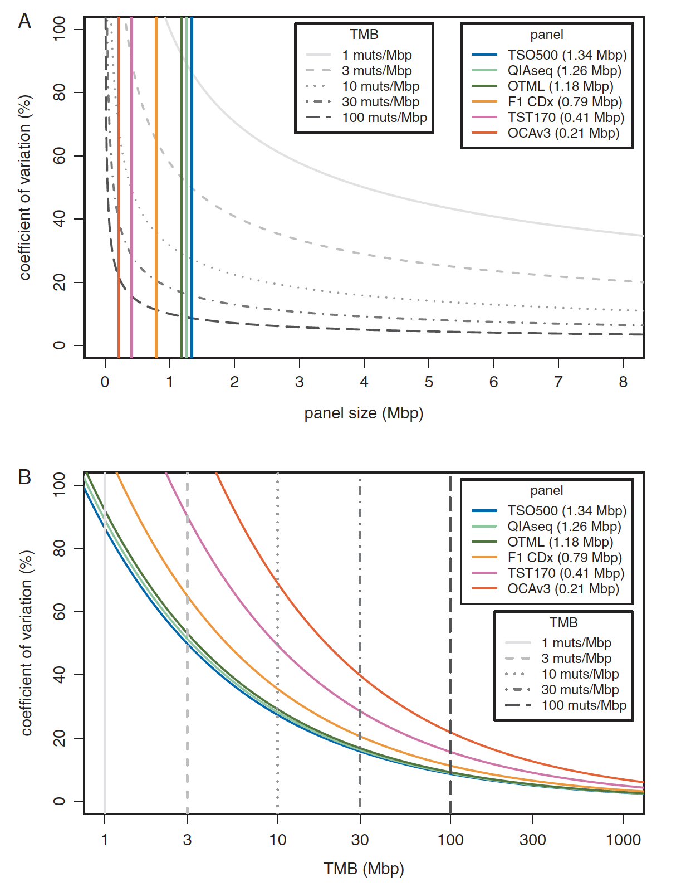
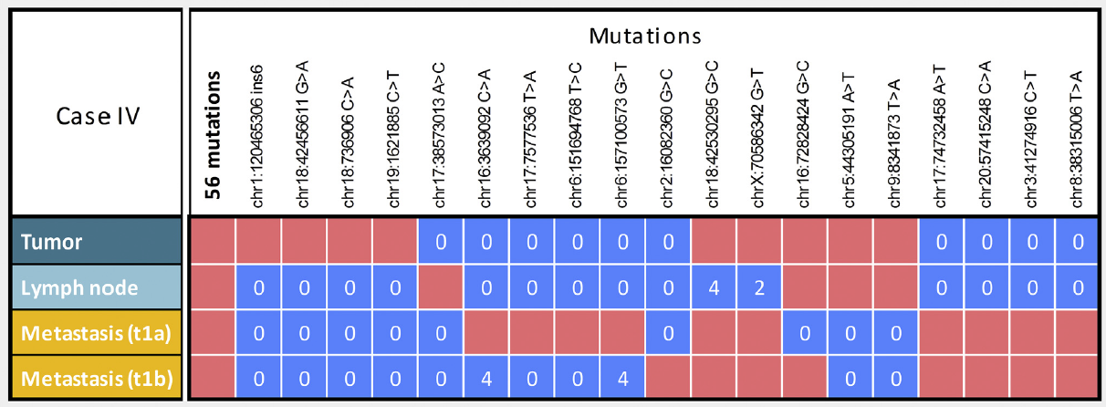
What do we know about TMB?
There is a correlation between WES and large targeted sequencing panels
  correlation is lost in more focused gene panels
Evidence of spatial heterogeneity with tTMB
Combined intratumor heterogeneity and the aggregated TMB could result in divergent TMB designation in close to 20% of patients
Blood TMB (bTMB) measured from ctDNA correlated with tTMB and may be more representative of the heterogeneity of metastatic lesions
Peters et al. AACR 2019; Kuzdal, JTO 2019; Budczies, Ann Oncol 2019
Notes:
chalmers, correlation of WES with FM and size of the genomic panel ( focuced gene panels are not as predictive
Rizvi,n TMB a surrogate for NAL
Rizvi H correlation with WES for MSK IMPACT
Gandara bTMB
bevins correlation with different CGP assays

Slide 20
Randomized IO vs. chemotherapy trials in NSCLC
Study | N | PD-L1 selected | TMB assay | TMB cut off
KEYNOTE-010¹ Pembro vs. chemo | 253 | Y | tTMB WES | 175mt
KEYNOTE-042¹ Pembro vs. chemo | 793 | Y | tTMB WES | 175mt
POPLAR² Atezo vs. chemo | 93 | N | tTMB FM1 | 16 mt/Mb
POPLAR³ Atezo vs. chemo | 92 | N | bTMB G Omni | 16 mt/Mb
OAK³ Atezo vs. chemo | 583 | N | bTMB G Omni | 16 mt/Mb
CheckMate 026⁴ Nivolumab vs chemo | 312 | Y | tTMB WES | 243mt
¹ Herbst et al ESMO 2019; ² Kowanetz et al WCLC 2016; ³ Gandara, Nature Medicine 2018; ⁴ Carbone, NEJM 2017, Bazhenova, ASCO 2020

Slide 21
Randomized IO vs. chemo in NSCLC: Impact on PFS > OS
PFS HR ( CI)
OS HR ( CI)
KEYNOTE-010
BEP
TMB H
TMB L
KEYNOTE-010
KEYNOTE-042
KEYNOTE-042
Poplar tTMB
Poplar tTMB
Poplar bTMB
Poplar bTMB
Oak bTMB
Oak bTMB
CheckMate 026
CheckMate 026
Favor IO
Favor Chemo
Favor IO
Favor Chemo
BEP biomarker evaluable population, TMB H tumor mutational burden high, TMB L tumor mutational burden low
Bazhenova, ASCO 2020

Slide 22
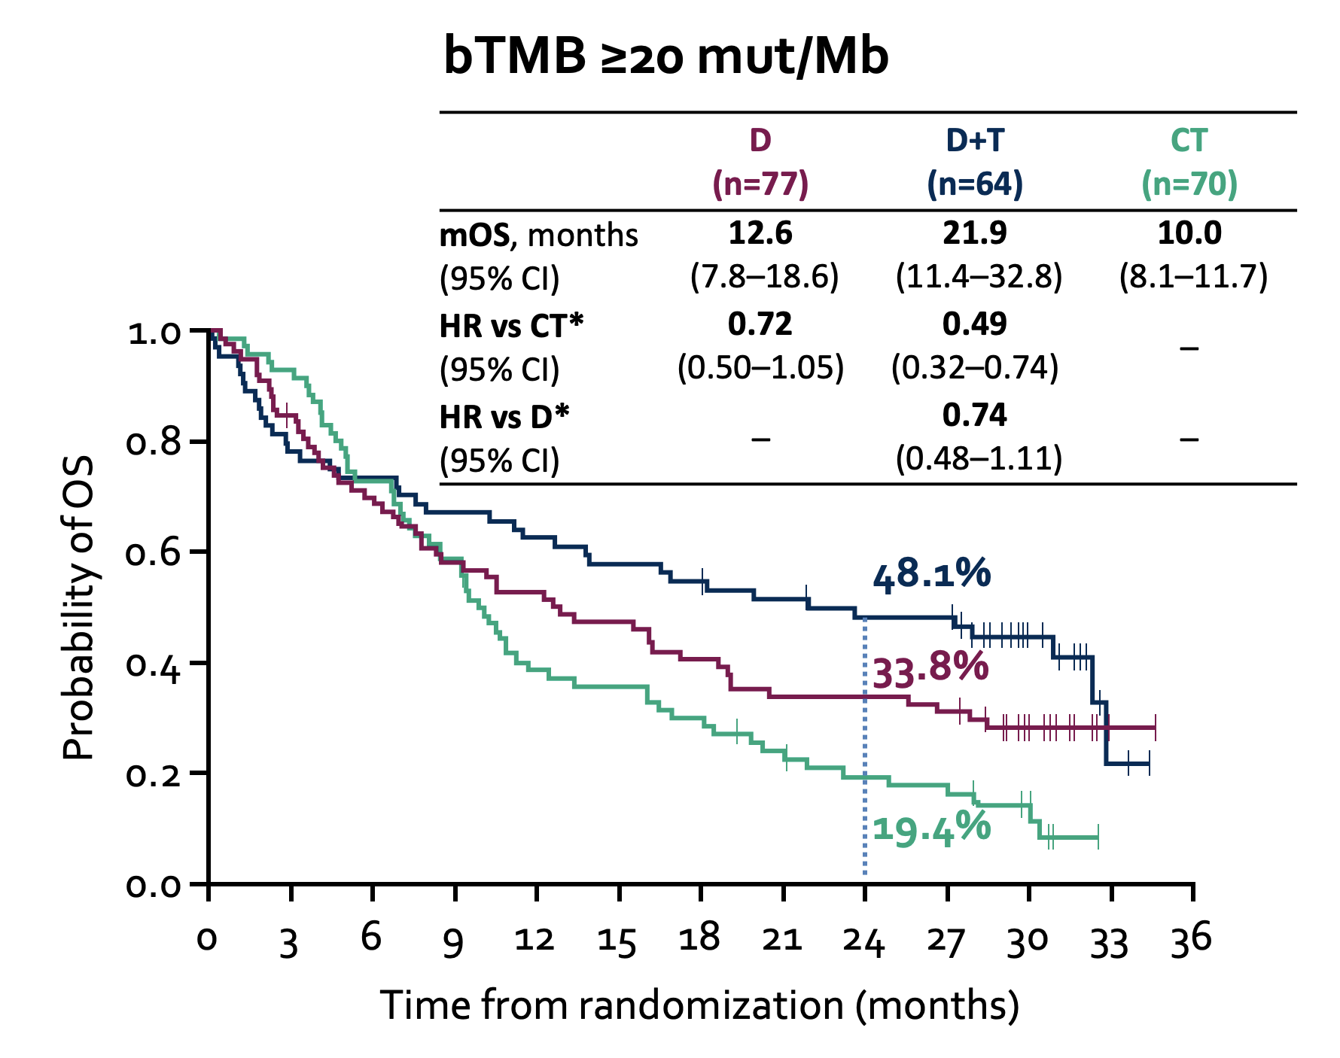
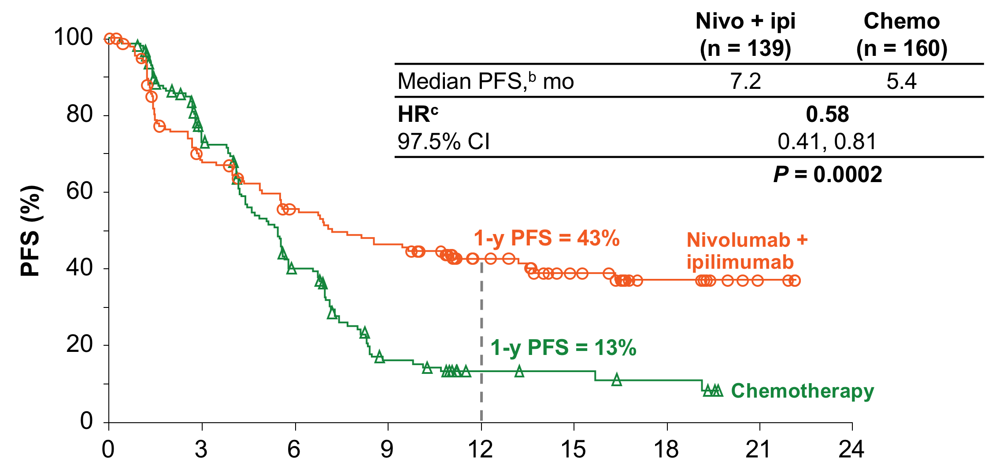
Randomized IO/IO vs chemo in NSCLC: Impact on PFS/OS
Median PFS, mo
HR vs CT
HR
HR vs D
HR 1.07 in <10Mut/Mb (FM1)
No OS difference (TMB « prognostic »)
HR 1.16 in <20Mut/Mb (G omni)
Predictive value of TMB is improved in the presence of a CTLA-4 component
CHEMO/IO trials: impact on PFS or OS is obliterated by chemo
Hellmann, NEJM 2018, Peters AACR 2019
Hellmann, NEJM 2018
Notes:
In presence of a CTLA-4 inhibitor, PD-L1 looses its predictive ability

Slide 23
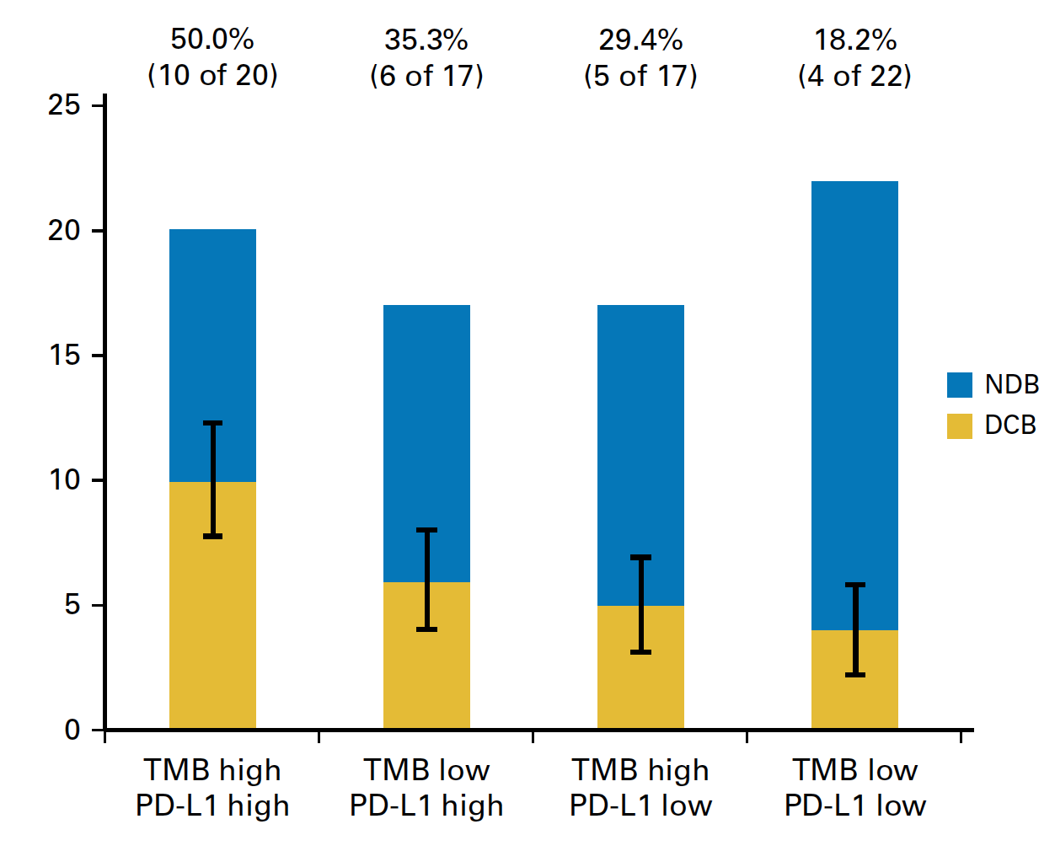
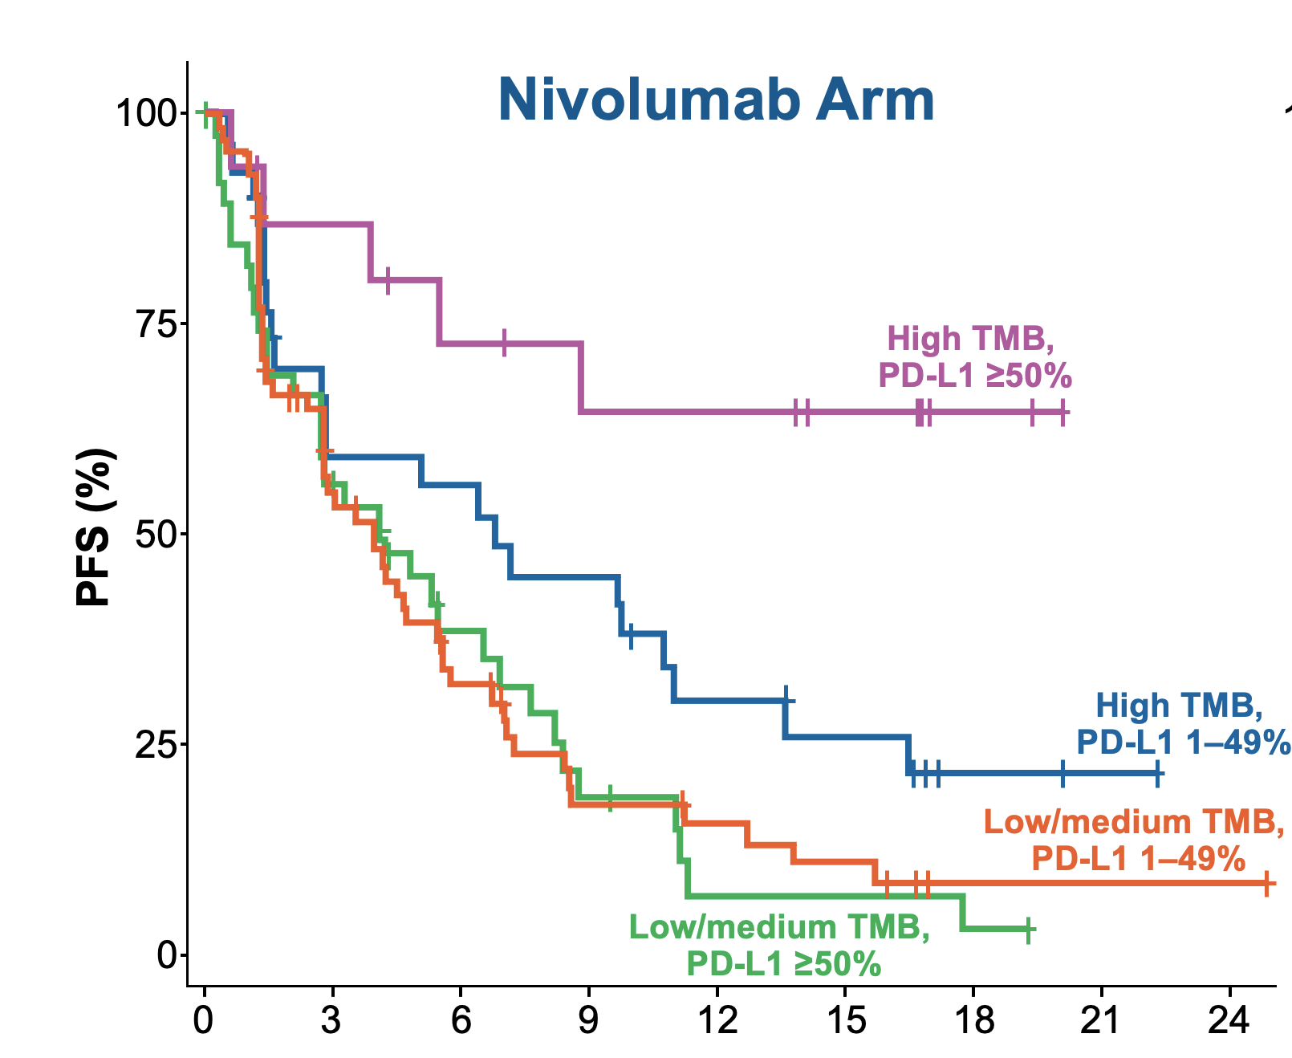
Combining PD-L1 and TMB? What about double positives?
Lung-MAP Sub-Study S1400I Trial
No durable benefit
Durable clinical benefit
Ipilimumab
L Bazhenova et al. ASCO 2019; Rizvi JCO 2018, Peters, AACR 2017
Notes:
kazdal spacial

Slide 24
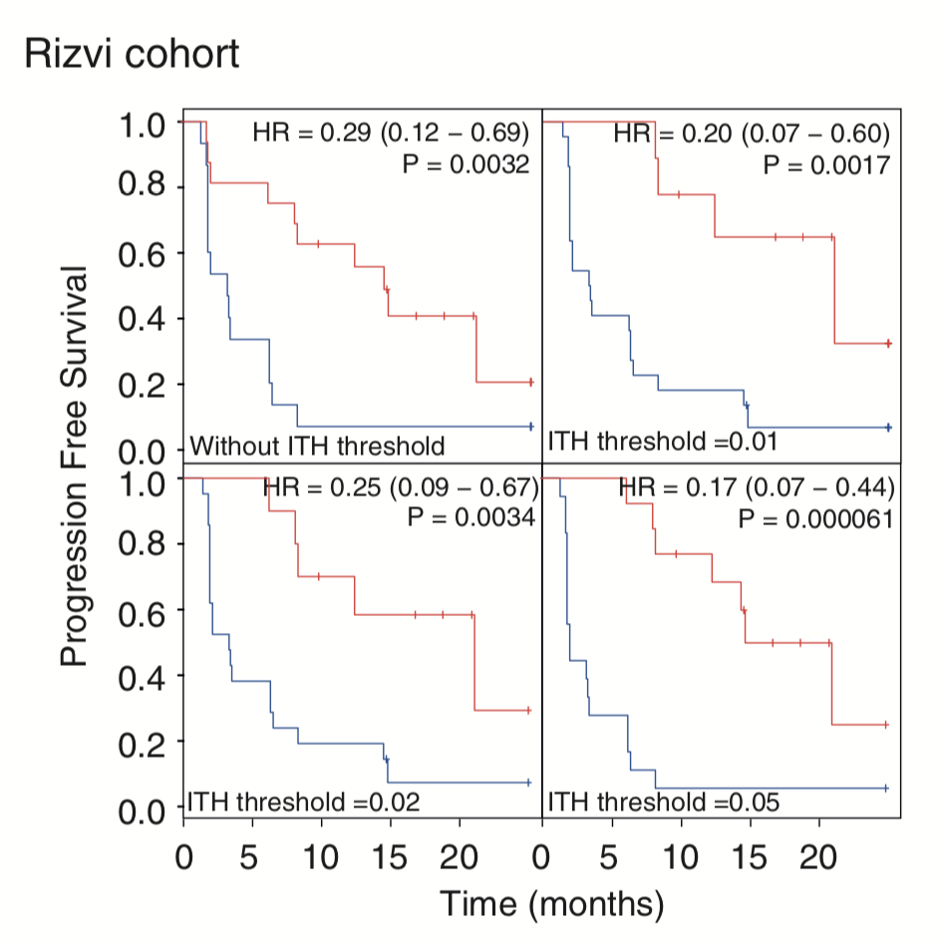
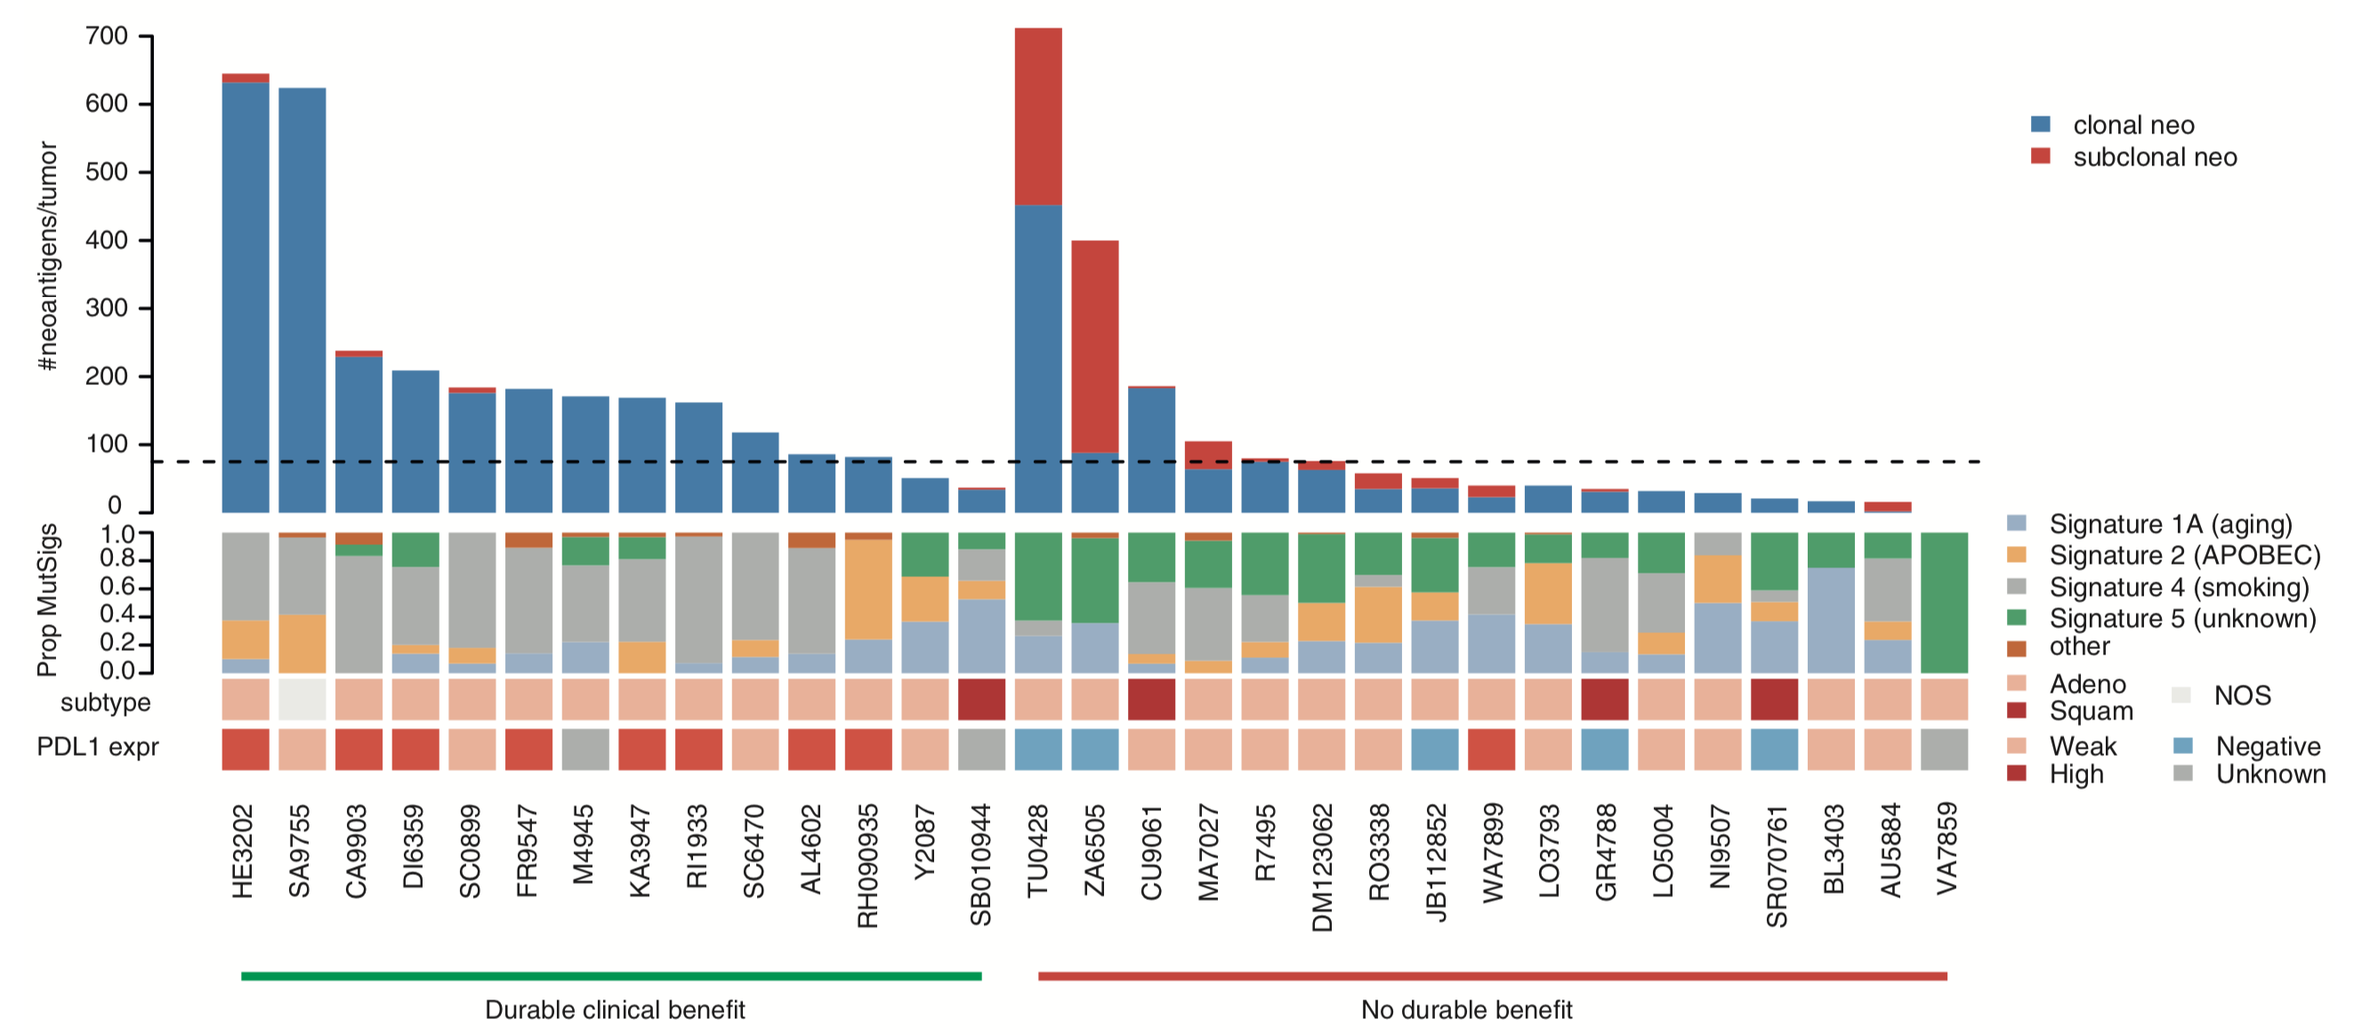
Some highly mutated NSCLC do not respond to IO
T cells reactive to subclonal neoantigens might not be generated or unable to target all tumor cells
Tumors with both a high clonal neoantigen burden and low neoantigen ITH are associated with longer PFS
McGranahan, Science, 2016
Rizvi, Science, 2015
Notes:
Indeed, it is conceivable that excessive
neoantigen heterogeneity may actively impair a productive
anti-tumor immune response

Slide 25
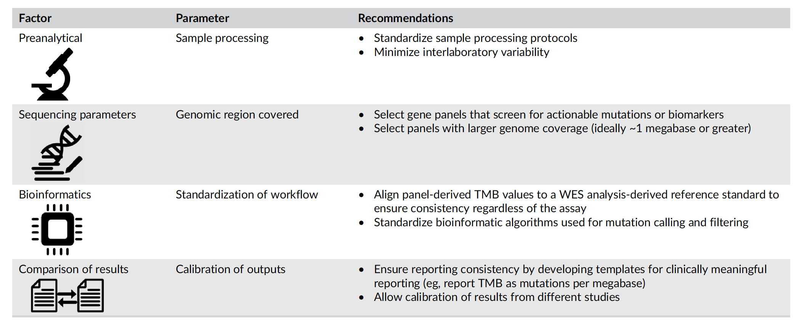
Harmonization efforts are the only way to get final answers

Slide 26
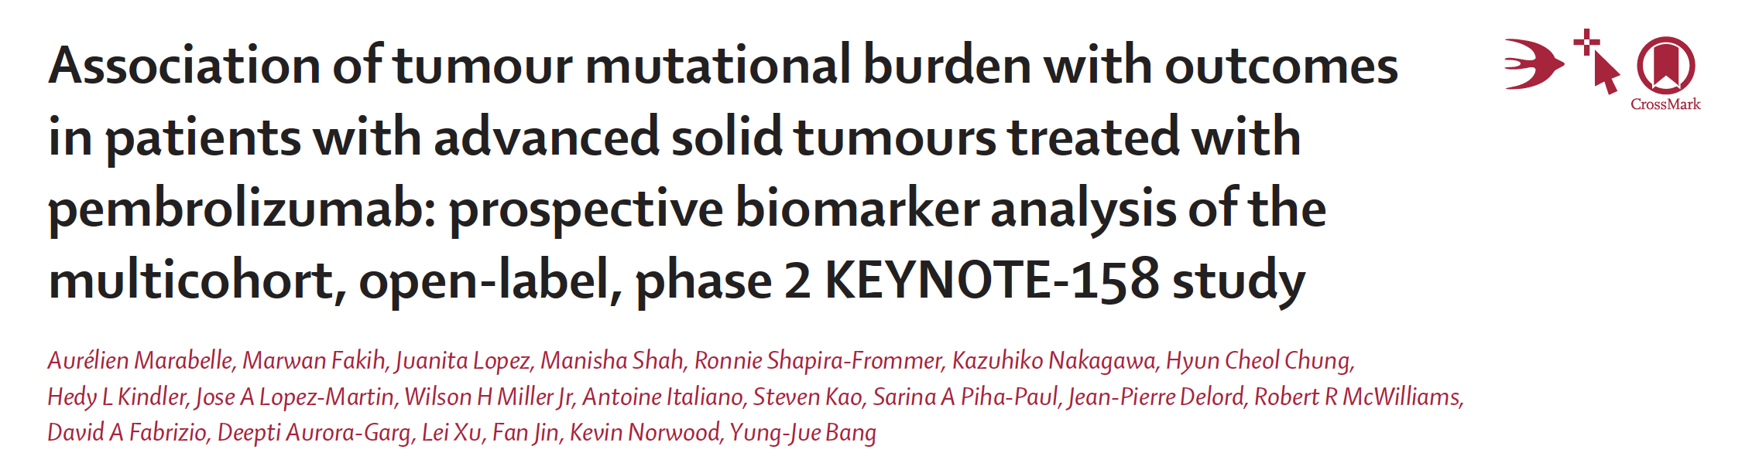
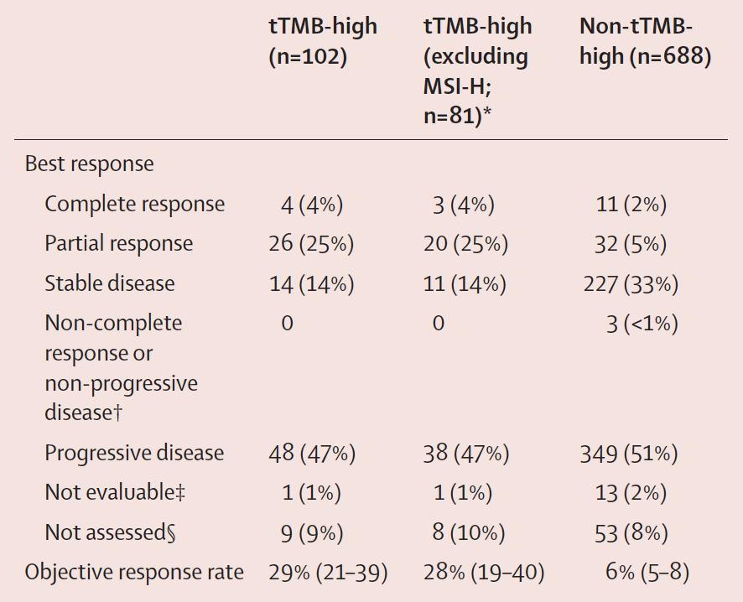
TMB and KEYNOTE-158
Multi-cohort, open-label, non-randomised, phase 2 KEYNOTE-158 study.
1066 patients enrolled, of whom 790 (75%) were evaluable for TMB
- 102 (13%) of these 790 patients had tTMB-high status (≥10 mutations per megabase using a CDx assay.
- 688 (87%) patients had non-tTMB-high status (<10 mutations per megabase)
Marabelle, Lancet Oncol 2020

Slide 27
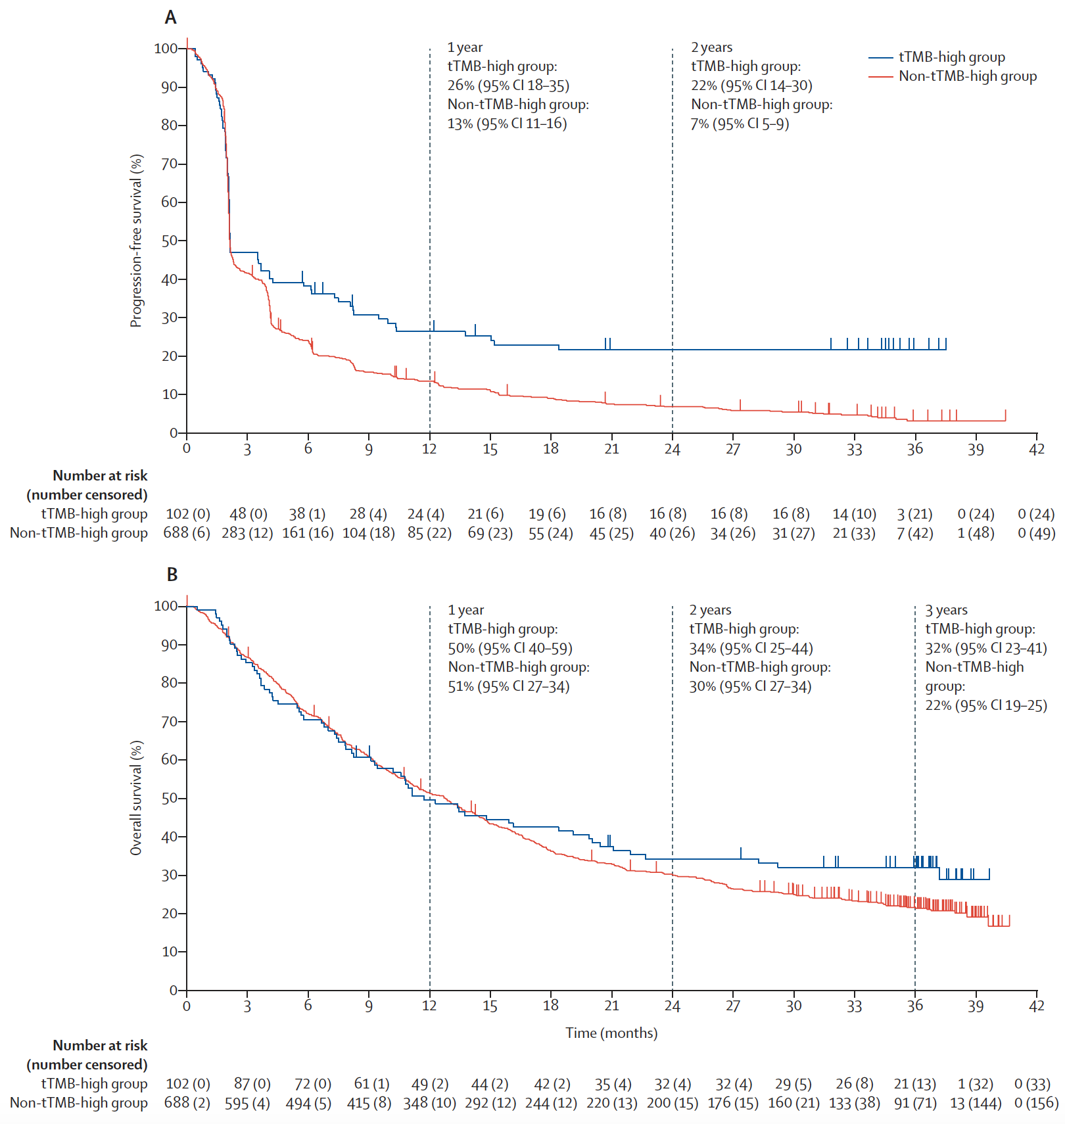
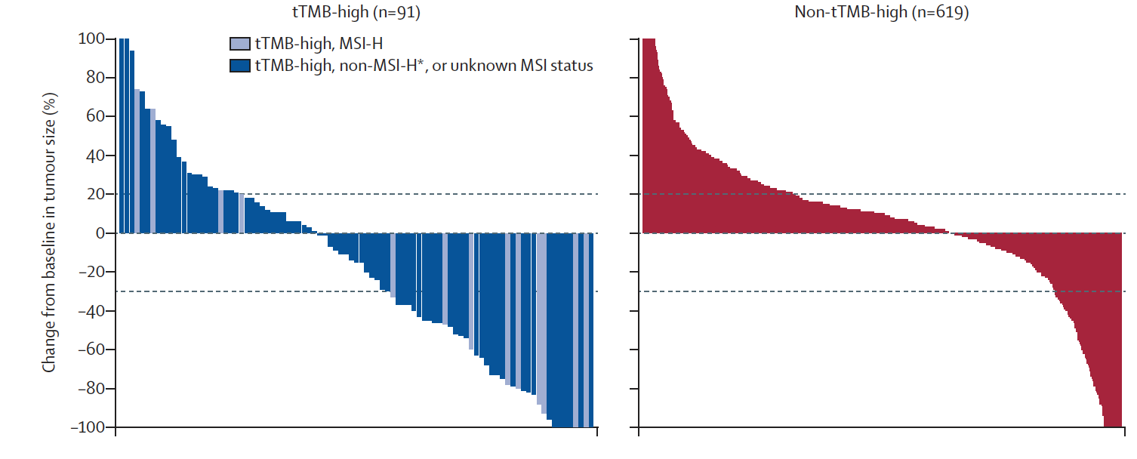

KEYNOTE-158
Marabelle, Lancet Oncol 2020

Slide 28
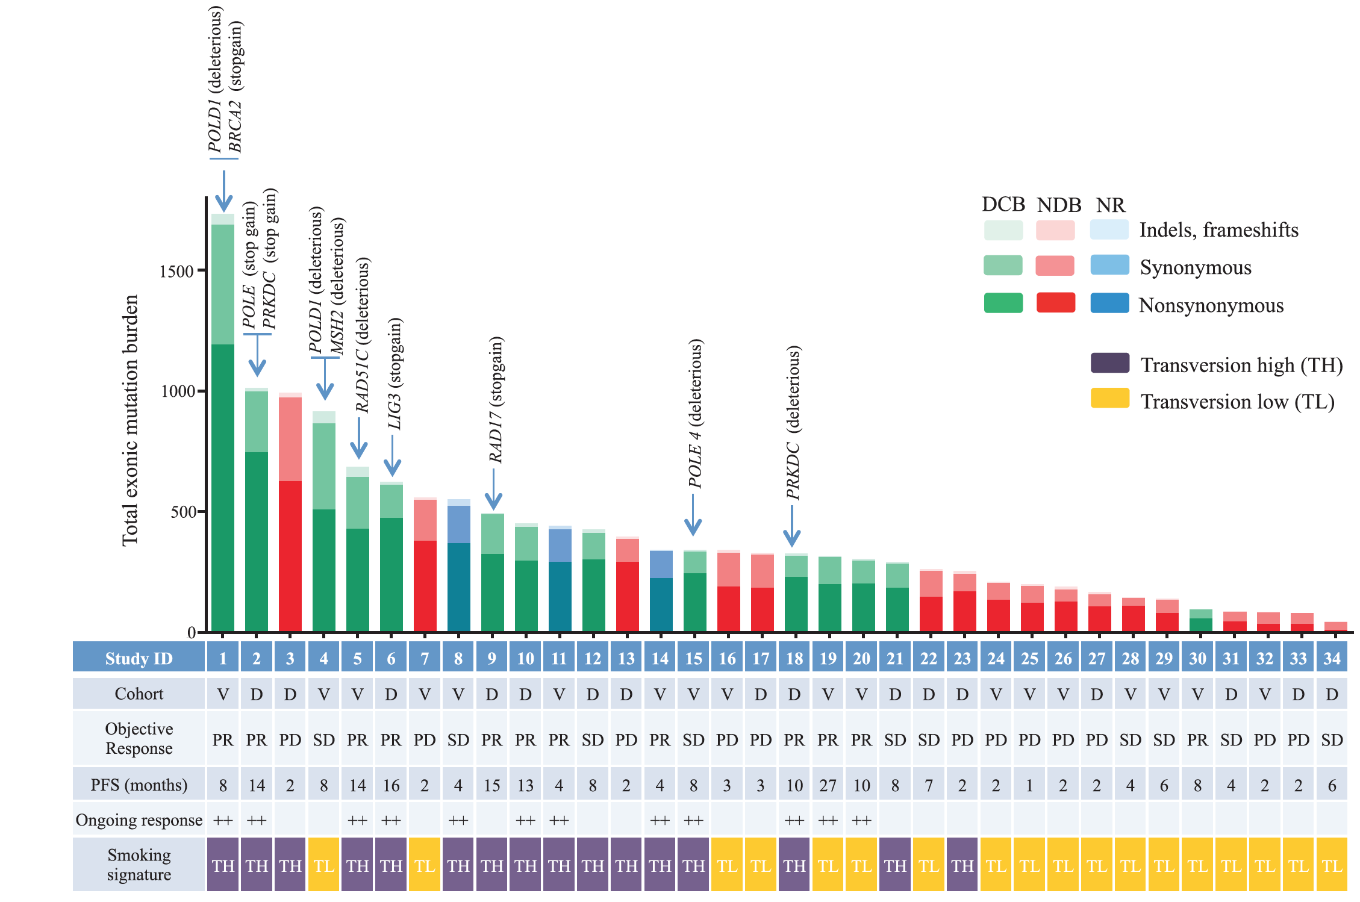
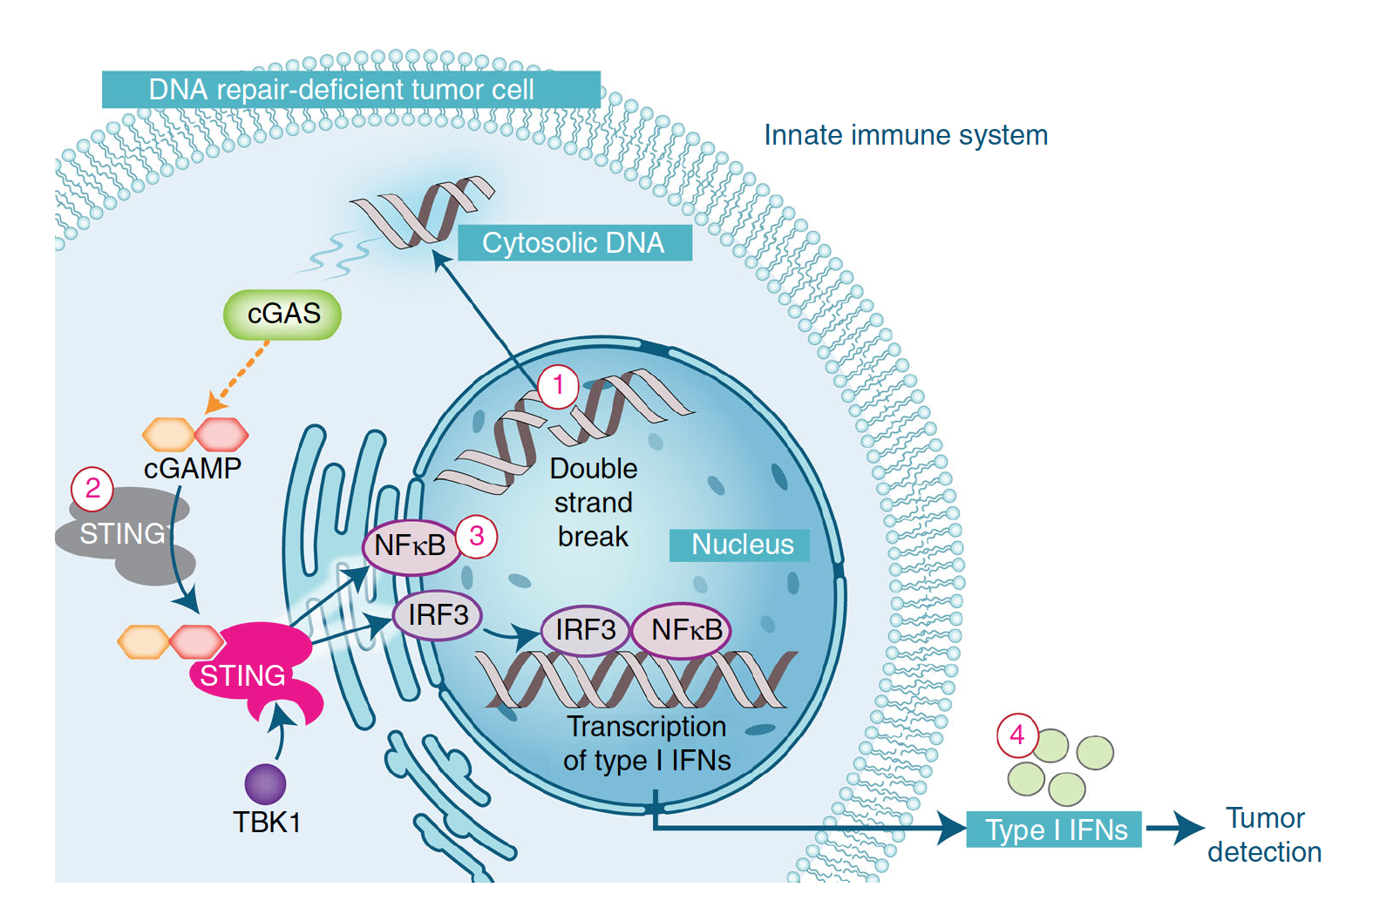
Deleterious mutations in specific DNA repair/replication genes indicate response to IO
Accumutaltion of mutations
STING hypothesis:
Detection by cGAS (Cyclic GMP-AMP synthase ), activation of STING and subsequent expression of immune-related genes, including type I interferon
Rizvi, Science 2015
Ma, Nat Comm 2018
Notes:
The presence of deleterious mutations in specific DNA repair/replication genes

Slide 29
Unique sensitizing and resistance mutations
Conway et al, Genome Medicine 2018
Notes:
the wide range of responses has demonstrated that the specific molecular and genetic characteristics must be considered to maximize treatment efficacy.
Alterations in canonical cancer pathways such as the MAPK, PI3K, and WNT-β-catenin pathways are associated with increased resistance to ICB. Conversely, activation of the WNT-β-catenin and IDO1 pathways results in suppression of T cells and NK cells in the TME.

Slide 30
MMR/MSI and Immunotherapy
Mismatch repair (MMR) genes, such as MLH-1, PMS-2, MSH-2 and MSH-6, operate in DNA repair pathways
Loss of function of these gene products results in MMR deficiency (MMR-D) which is associated with alterations in the size of microsatellites, a phenomenon known as microsatellite instability (MSI)
MSI is associated with an increased risk of CRC with unique clinical and pathological features, such as increased tumour mutational burden and higher numbers of tumour-infiltrating lymphocytes (TILs)
CRC with MSI can be categorised into two distinct phenotypes: MSI-high (MSI-H) and MSI-low (MSI-L).

Slide 31
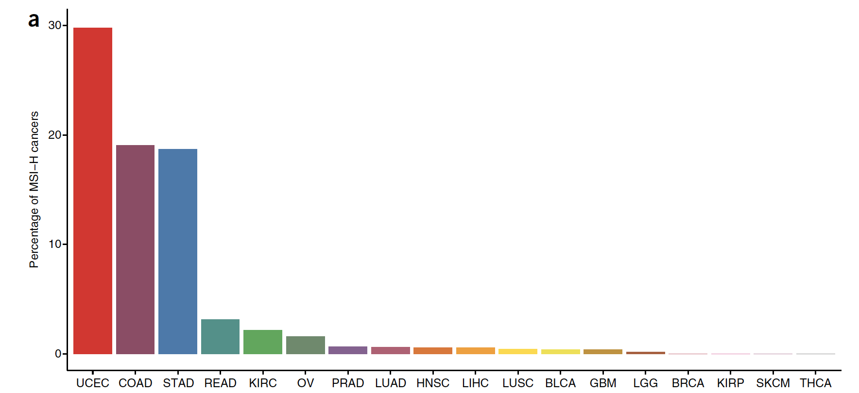
Prevalence of MSI across cancer types
UCEC, uterine corpus endometrial carcinoma (n = 437); COAD, colon adenocarcinoma (n = 294); STAD, stomach adenocarcinoma (n = 278); READ, rectal adenocarcinoma (n = 96); KIRC, kidney renal clear cell carcinoma (n = 279); OV, ovarian serous cystadenocarcinoma (n = 63); PRAD, prostate adenocarcinoma (n = 463); LUAD, lung adenocarcinoma (n = 480); HNSC, head and neck squamous cell carcinoma (n = 506); LIHC, liver hepatocellular carcinoma (n = 338); LUSC, lung squamous cell carcinoma (n = 443); BLCA, bladder urothelial carcinoma (n = 253); GBM, glioblastoma multiforme (n = 262); LGG, brain lower grade glioma (n = 513); BRCA, breast invasive carcinoma (n = 266); KIRP, kidney renal papillary cell carcinoma (n = 207); SKCM, skin cutaneous melanoma (n = 268); THCA, thyroid carcinoma (n = 484).
Hause, Nat Med 2016

Slide 32
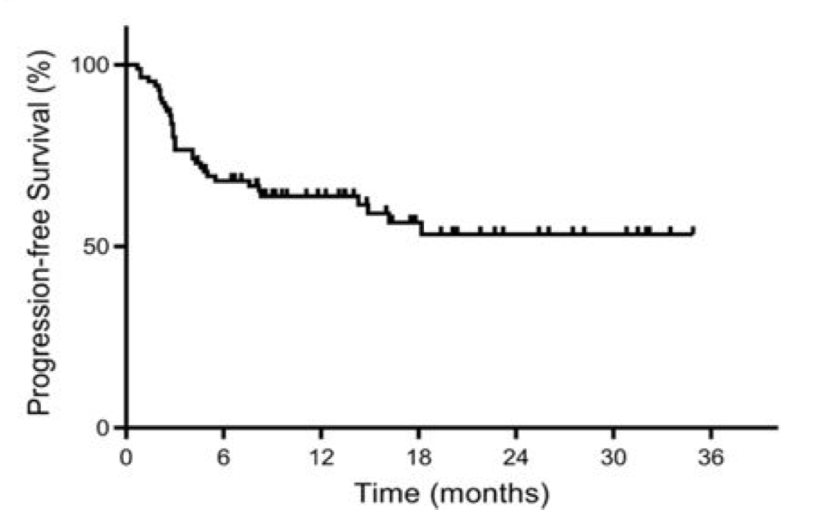
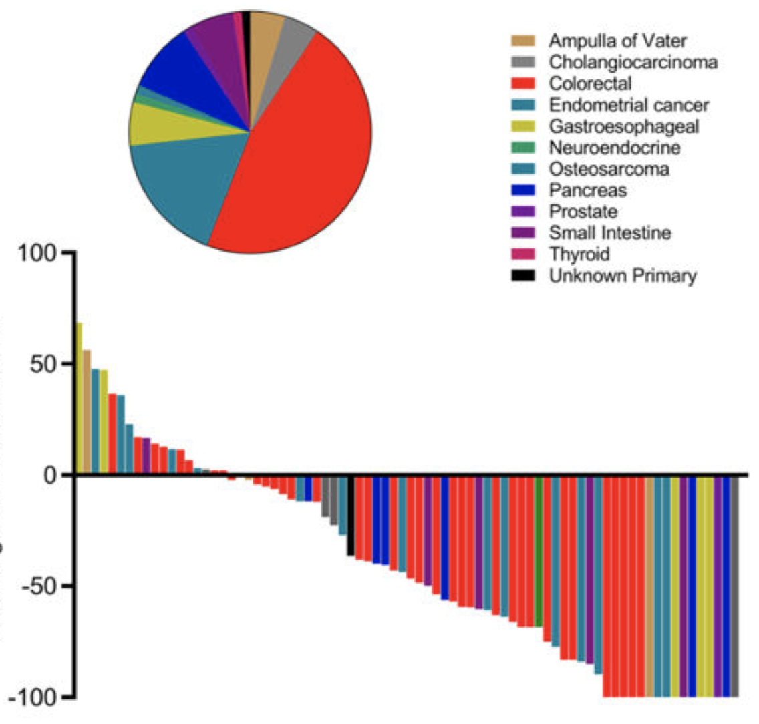
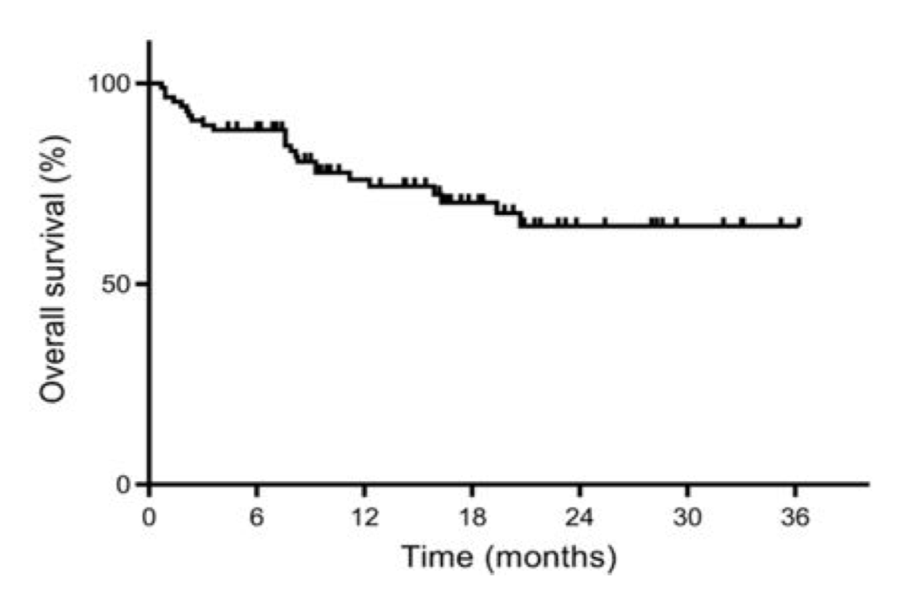
Survival and clinical response to pembrolizumab across different tumour types with mismatch repair deficiency
RR 53% of patients and complete responses in 21% of patients
Le, Science 2017
Notes:
86 pts pembro

Slide 33
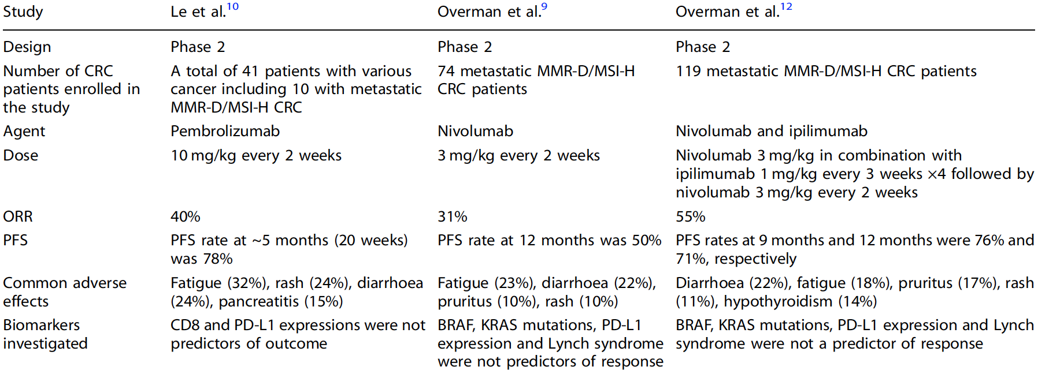
IO across MSI-H/dMMR tumour types
Pembrolizumab and nivolumab have been approved by the FDA for patients with metastatic CRC with MMR-D or MSI-H. Most recently, ipilimumab was granted approval by the FDA for use in combination with nivolumab for the treatment of MMR-D or MSI-H CRC patients who were previously treated with
chemotherapy.
Notes:
86 pts pembro

Slide 34
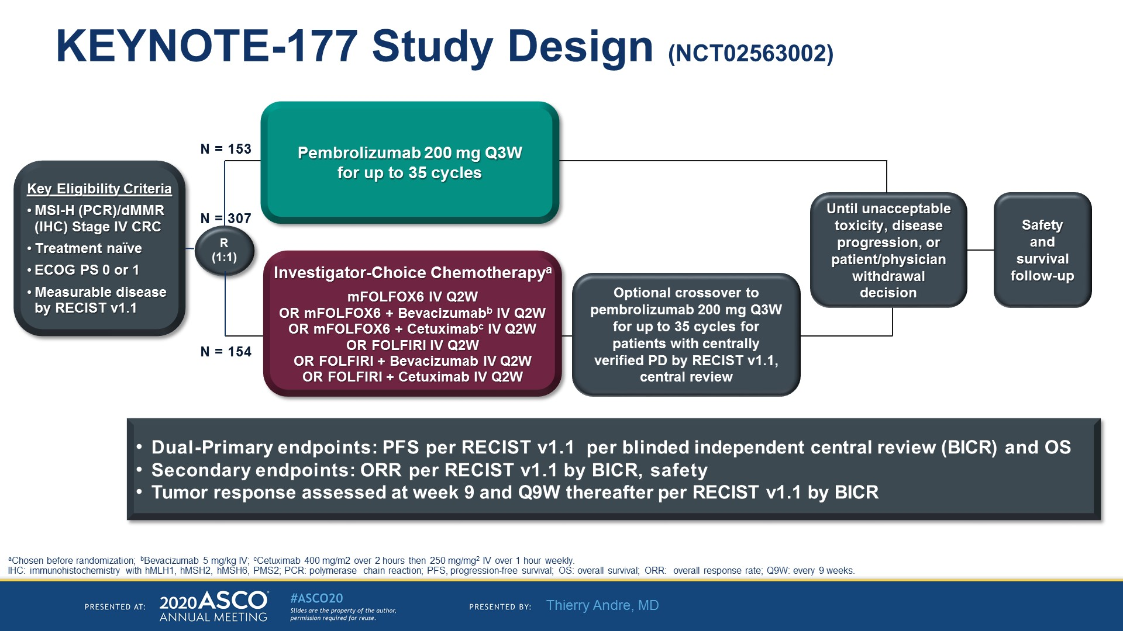
KEYNOTE-177 Study Design (NCT02563002)
Pembrolizumab in Microsatellite-Instability–High Advanced Colorectal Cancer
André T et al. N Eng J Med 2020; 383:2207-2218.
Notes:
MSI-H and dMMR tumors contain abnormalities that affect the proper repair of DNA inside the cell. The frequency of MSI-H varies across tumor types and stages, and approximately 5% of patients with metastatic colorectal cancer have MSI-H or dMMR tumors.

Slide 35
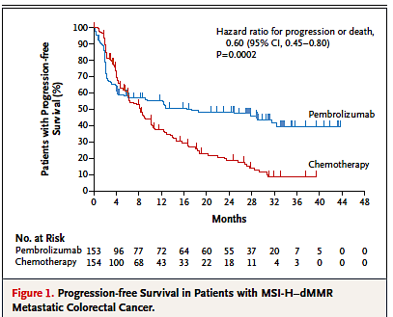
Pembrolizumab in MSI-High Advanced Colorectal Cancer
mPFS Pembro: 16.5 months
mPFS Chemo: 8.2 months
mDoR Pembro: Not reached
mDoR Chemo: 10.6 months

Slide 36
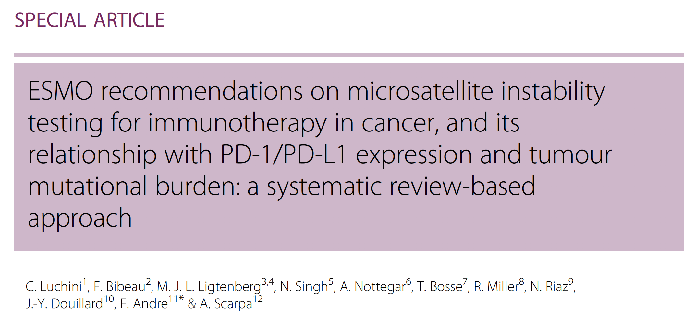

Slide 37


There is a significant microbial contribution to the total makeup of our cellular composition as well as our DNA that dramatically influences our physiology
Notes:
So how can we better understand responses to therapy and optimize treatment regimens?
37

Slide 38

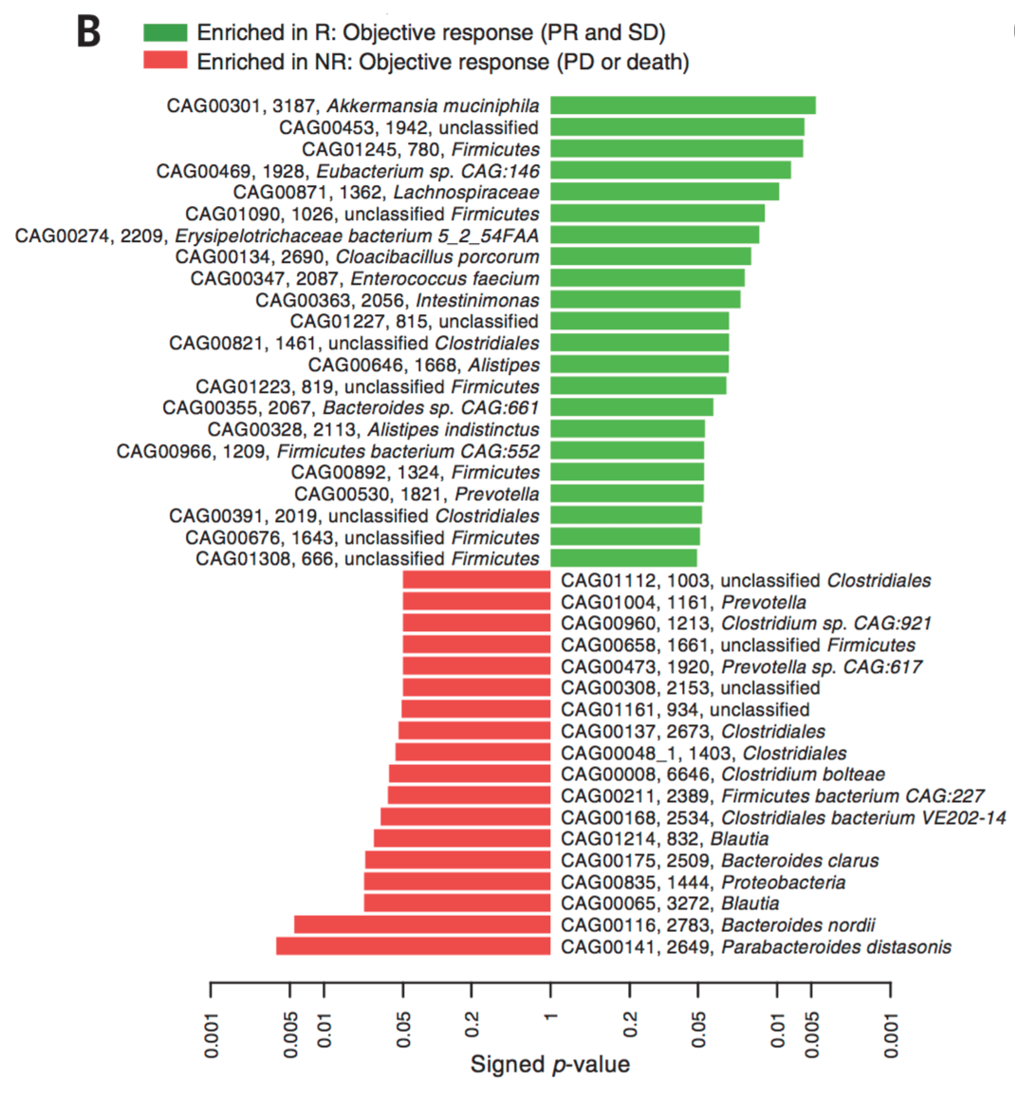
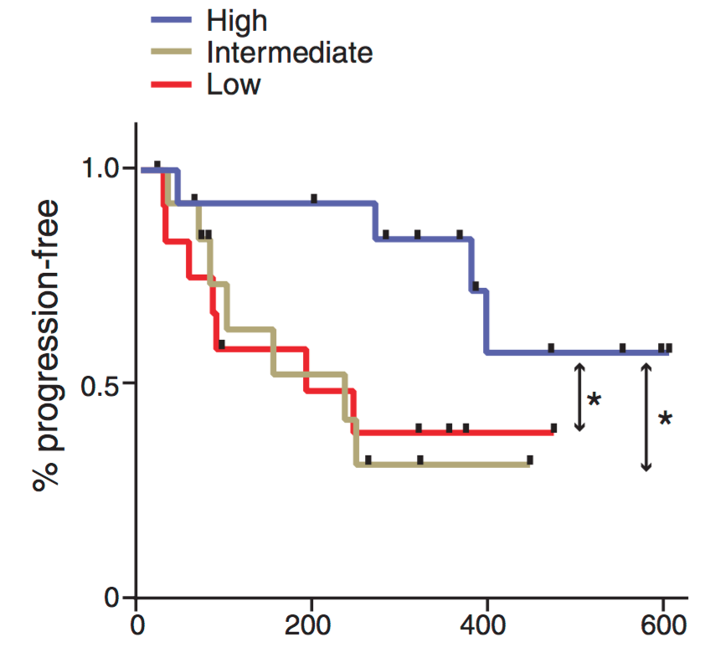
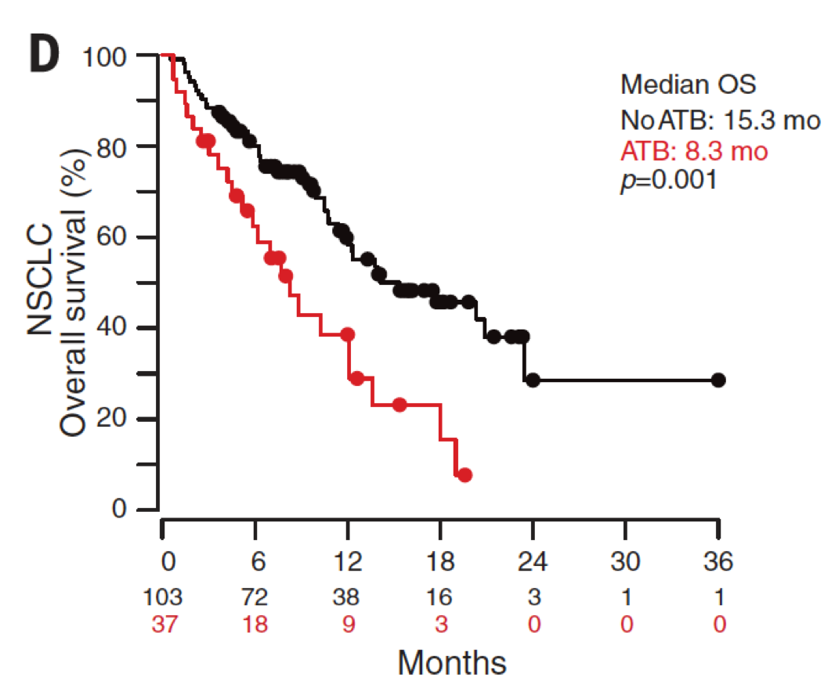
Gut microbiome and immunotherapy
PFS by fecal diversity
Notes:
(Culturomics-based analyses of fecal samples in 16 R and 16 NR NSCLC
patients (defined as the best clinical outcome) before therapy, each commensal
colony having been identified by mass spectrometry. Colored bars show
relative frequencies of each commensal in all fecal cultures in R over
NR patients, with P values of the difference shown at the right.

Slide 39
Current considerations on microbiota and response to IO
A broad diversity in microbiome is associated with better outcome with IO
Presence or absence of certain bacterial strains is associated with response/non-response to IO
Use of probiotics negatively influences the diversity of the microbiome and thus response to IO (?)
Use of antibiotics prior to start of IO negatively influences the microbiome and thus response to IO
High dietary fiber is associated with a more diverse microbiome
PPIs influence the microbiome, but little is known about their effect on IO response
Gopalaskrishnan et al., Science 2018; Routy et a., Science 2018; Takagi et al., J Clin Biochem Nutr 2018; De Filippo et al., PNAS 2010; Noh et al., J Neurogastroenterol Motl. 2018

Slide 40

Several different strategies may be used to modulate the gut microbiota
Administration of microbial consortia (and probiotics)
Fecal Microbiota Transplant (FMT)
Targeting of “detrimental” microbes
(by antibiotics / phage)
Diet & supplements
(probiotics)
Wargo, ESMO 2020
Notes:
To help answer this, we turned to our cohort of PD-1 treated patients
As mentioned, we enrolled these patients onto our protocol and profiled their oral and gut microbiomes
(click)
Patients then went onto therapy, and underwent routine restaging at 12 weeks with responses measured via RECIST
Patients were classified as responders if they had a CR, PR, or stable disease, versus non-responders if they had progressive disease
Of note, PFS was also assessed
(click)
We first compared the diversity of bacteria in the microbiome between responders and non-responders,
And found that responders to ant-PD-1 therapy had a significantly higher diversity in their gut microbiome than non-responders,
With no differences noted in the oral microbiome
(click)
We then tested the relationship of diversity with PFS in our cohort, classifying the diversity of the gut microbiome into tertiles of high, medium or low
In these studies, patients with a high diversity in the fecal microbiome had significantly prolonged PFS compared to those with intermediate or low diversity
No differences in PFS were noted when comparing diversity of the oral microbiome

Slide 41

Case 1: 59-Year-Old Man
06/16 Diagnosis: Pleomorphic Carcinoma right upper lobe
Initial Stage cT3 cN1-2 cM1
07/16 - 09/16 Cisplatin/Gemcitabine 3 cycles
28.08.2016 Re-Staging: SD lung partial response LN, PD bone (oligo)

Slide 42


Staging
Case 1 continued
06/15
08/15

Slide 43
Case 1 continued
Diagnosis: Pleomorphic Carcinoma right upper lobe
Initial Stage cT3 cN1-2 cM0-1
Cisplatin/Gemcitabine 3 cycles
Re-Staging: SD lung partial response LN, PD bone (oligo)
Upper lobe resection with pathological stage ypT3 ypN1 (1/8)

Slide 44
Case 1 continued
Diagnosis: Pleomorphic Carcinoma right upper lobe
Initial Stage cT3 cN1-2 cM0-1
Cisplatin/Gemcitabine 3 cycles
Re-Staging: SD lung partial response LN, PD bone (oligo)
Upper lobe resection with pathological stage ypT3 ypN1 (1/8)
Re-Staging: progression in bone, LN

Slide 45


Case 1 continued
Progression in Bone and LN
RT Sacrum, paravertebral, Os
PD-L1 1%, TMB 15mut/Mb
Pembrolizumab monotherapy
200mg q3w initiated

Slide 46


Emergency hospitalisation after 2 cycles
Case 1 continued
Sat O2 77%; no fever, ECOG 3-4
CRP 115, LDH 680; Leucocytes 11 G/l
MPDN 250mg iv (1d)
PDN 200mg (2d), 100mg (2d), 50mg (3d), 25mg (3d), 20mg (3d), 10mg (2d), 5mg (2d)
Large spectrum antibiotics

Slide 47

Re-Staging 2 months after complete resolution of symptoms
CR lasting until 2020
Case 1 continued

Slide 48

Thanks for your kind attention

