Slide 1












Chronic Myeloid Leukemia
Michael J. Mauro, MD
Leader, Myeloproliferative Neoplasms Program
Memorial Sloan Kettering Cancer Center
TEAM922
Notes:
Patients with BCR-ABL1 values >10% at 3 months had better outcomes if the BCR-ABL1 halving time was ≤76 days. Among the 95 patients with BCR-ABL1 values >10%, the 74 patients with a halving time of ≤76 days had significantly superior (A) OS, (B) PFS, (C) FFS, and (D) MMR compared with the 21 patients with a halving time of >76 days. For some of the patients with an assigned halving time of >76 days, their BCR-ABL1 value did not halve at any time or increased. The outcome for patients with BCR-ABL1 values ≤10% at 3 months are also plotted.

Slide 2
Imatinib changed the way we treated CML
and was the beginning of a new era
Best available therapy 5-year OS
Frontline imatinibª 93%
IFN-α or SCT plus
2nd⁻line imatinib^{b} 71%
IFN-α or SCT^{c} 63%
IFN-α 53%
Hydroxyurea 46%
Busulfan 38%
German CML study III/IIIA/IV data
1.0
0.9
2002-2008, Frontline imatinibª
0.8
0.7
0.6
1997-2008, IFN-α or SCT
plus 2nd⁻line imatinib^{b}
Survival Probability
0.5
0.4
1995-2008, IFN-α or SCT^{c}
0.3
1986-2003, IFN-α
0.2
1983-1994, Hydroxyurea
0.1
1983-1994, Busulfan
0.0
0
2
4
6
8
10
12
14
16
18
20
22
Years After Diagnosis
Adapted from Hehlmann R., German CML Study Group.

Slide 3
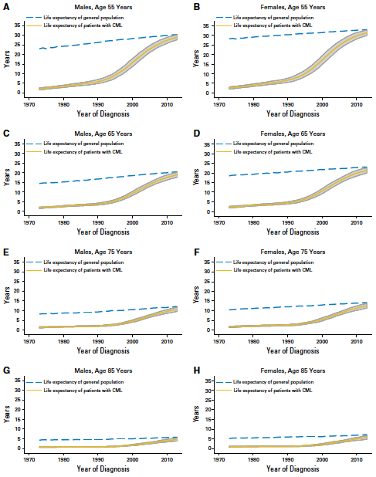
CML is an increasingly prevalent and survivable cancer
lifespan
prevalence
Number of Cases
10x greater
steady state number
of CML patients in US
by 2050
Year
Huang et al, Cancer 118:3123-3127, 2012.
Bower H et al, J Clin Oncol 34:2851-57, 2016.

Slide 4


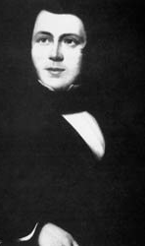

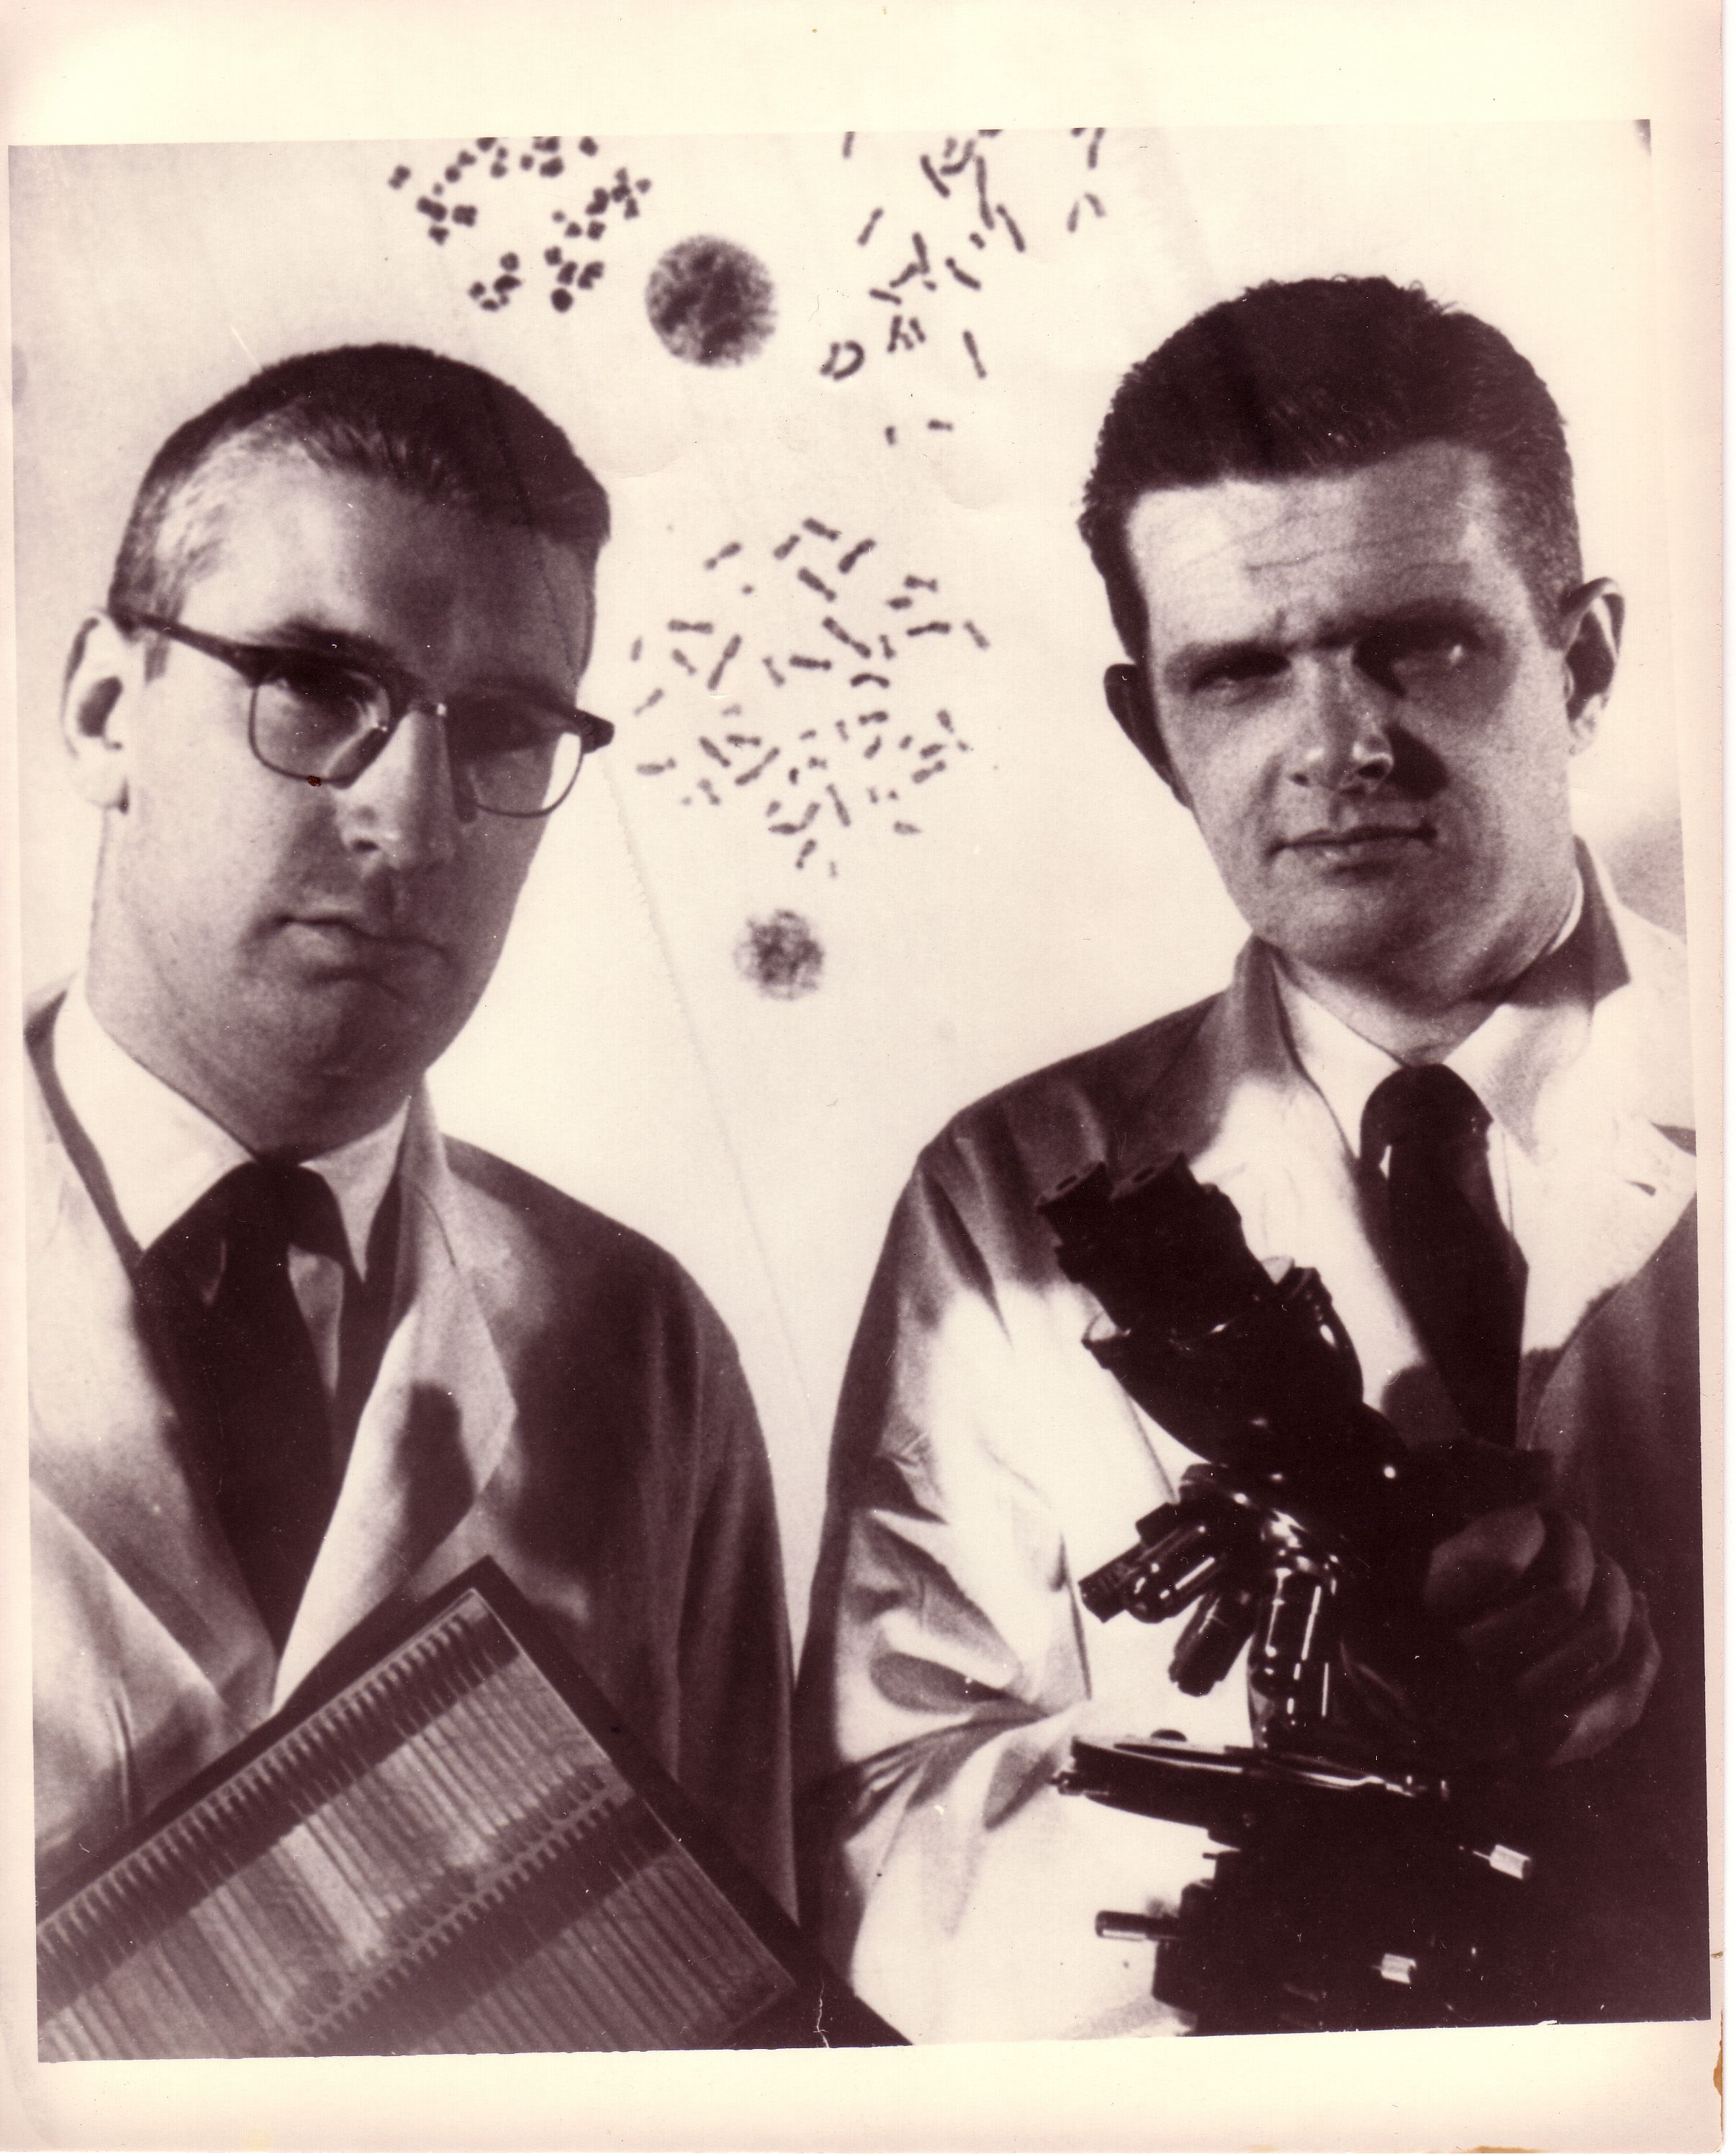
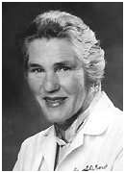
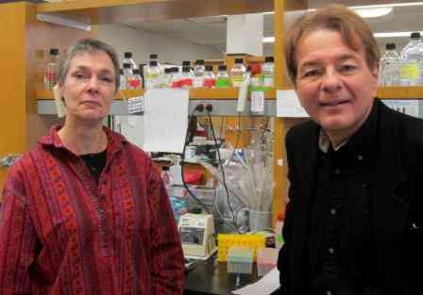
The history of CML is long, the kinase inhibitor era short
1845
1865
1879
1903
1953
1965
1968
1983
2001
2006
2012
2016
2021
First description of CML
Fowlers’s solution -1% arsenic trioxide
Staining methods for blood
Radiotherapy
Busulfan
1998: After seminal preclinical work first clinical trials commence with STI571 (imatinib); 1999, target inhibition validated, resistance identified (T315I)
Hydroxyurea
BMT
Interferon
1845:
John Hughes Bennett reported a “Case of Hypertrophy of the Spleen and Liver in which Death Took Place from Suppuration of the Blood” in the Edinburgh Medical Journal; Virchow in Germany wrote up a similar observation
Imatinib
Dasatinib
Nilotinib
1960:
Nowell & Hungerford describe the Philadelphia Chromosome
1973:
Janet Rowley
describes the
9:22 translocation
Bosutinib
Ponatinib
1983: Nora Heisterkamp and John Groffen, with others, describe the BCR-ABL fusion gene product
Generic Imatinib
Asciminib

Slide 5
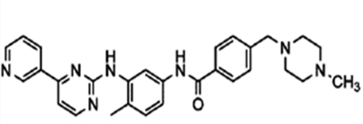
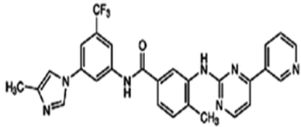
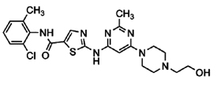
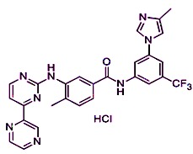
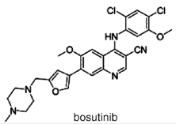
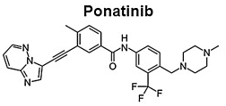
At present, five oral, small molecular kinase inhibitors approved in the US for Ph+ Leukemia: a ‘spoil of riches’; more on the way?
1st Gen. TKI
2001
Novartis
(1st line)
Imatinib (STI571)
2007/2010
BMS
(1st, 2nd line)
2007/2010
Novartis
(1st, 2nd line)
2nd Gen. TKIs
Dasatinib (BMS354825)
Nilotinib (AMN107)
South Korea
only
2012/2015
IL-YANG:
(1st, 2nd line)
2012
Pfizer
(2nd/3rd line)
Radotinib (IY5511)
Bosutinib (SKI606)
(1st/2nd/3rd line 2018?)
3rd Gen. TKI
2012
Ariad
(2nd?/3rd line)
4th Gen. TKI (allosteric): ABL001
Ponatinib (AP24534)

Slide 6
Initial Evaluation
NCCN CML Guidelines, Version 3.2021, Accessed with permission, www.nccn.org 5/1/2021

Slide 7
Initial Treatment Suggestions
NCCN CML Guidelines, Version 3.2021, Accessed with permission, www.nccn.org 5/1/2021

Slide 8
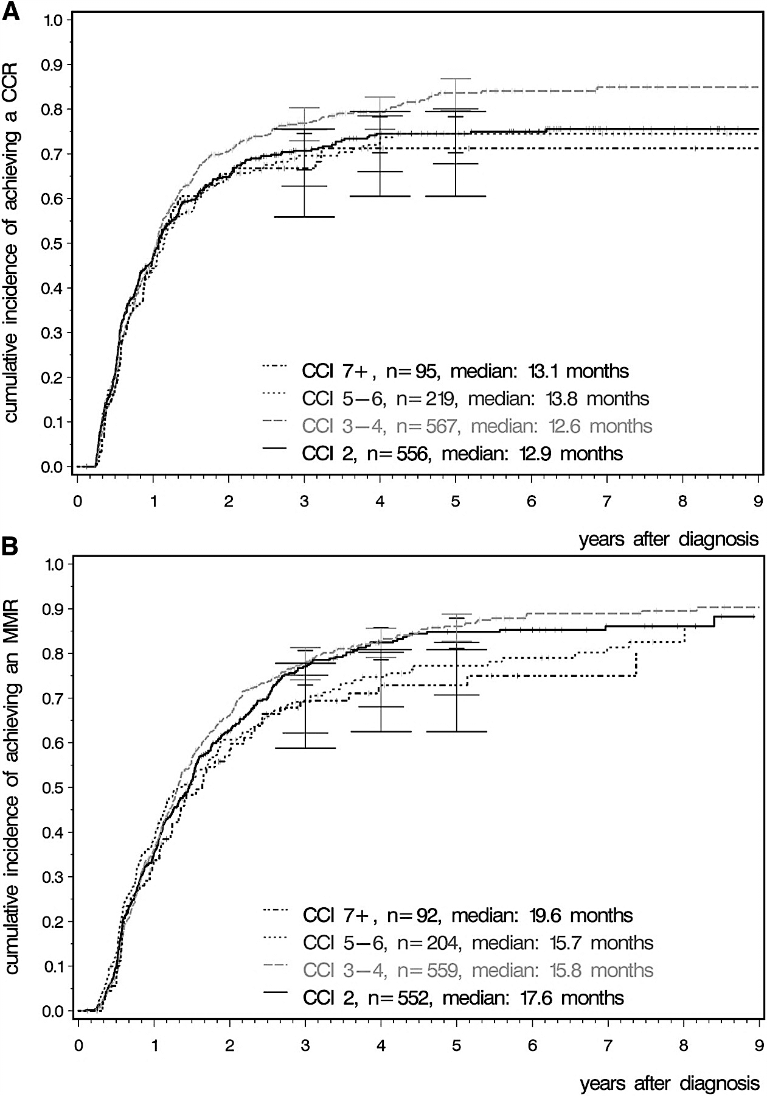
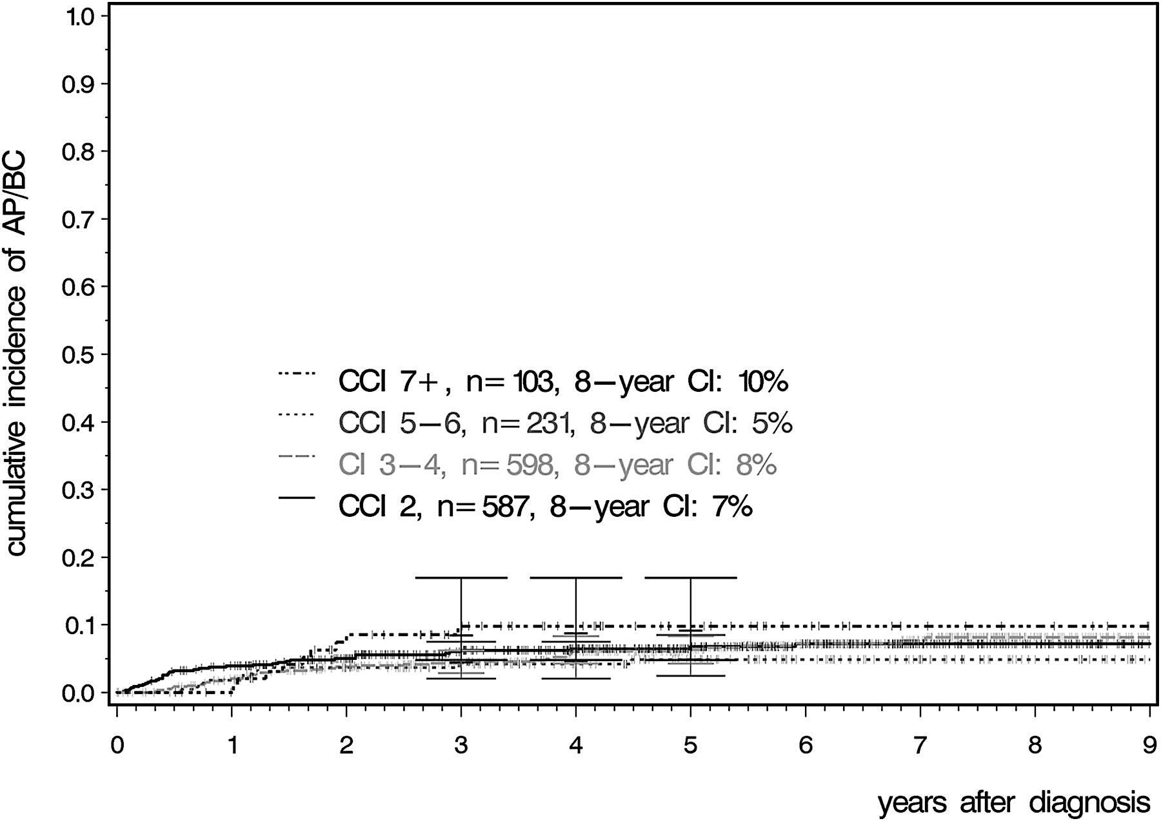

CML response not different in presence of other health problems: ‘Comorbidity Index’ Study
As measured by the Charleson Comorbidity Index (CCI)
Saußele S et al. Blood 2015;126:42-49
Notes:
Cumulative incidence of response according to CCI. (A) Cumulative incidence of CCyR. (B) Cumulative incidence of MMR.

Slide 9
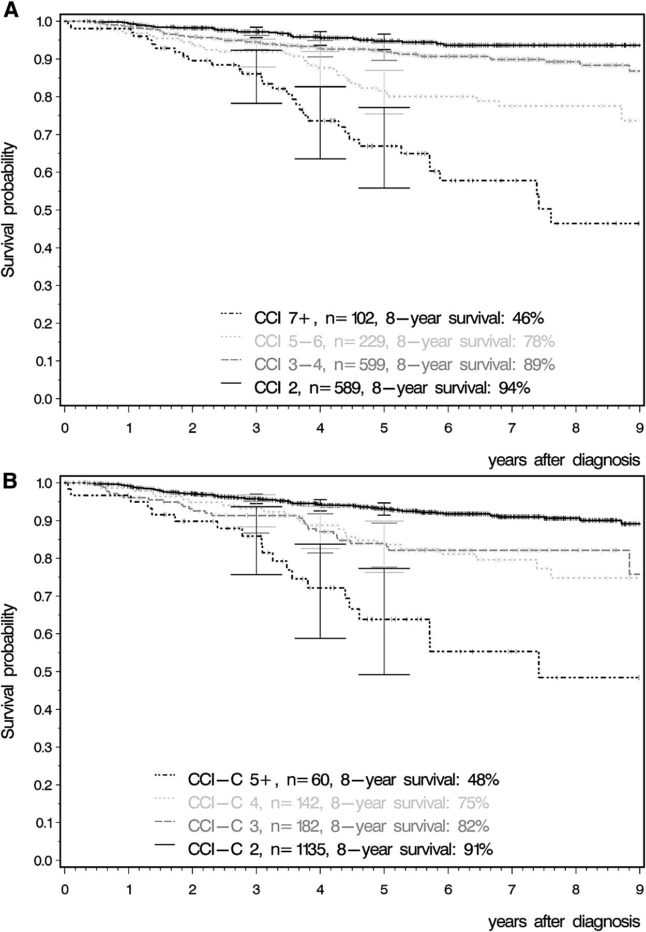
Living with CML:
Other health issues more important (impact longevity)
Charlson Comorbidity Index (CCI)
calculated age included
Internist before Hematologist:
Taking care of the whole patient
Charlson Comorbidity Index (CCI)
calculated age not included
Saußele S et al. Blood 2015;126:42-49
Notes:
Cumulative incidence of response according to CCI. (A) Cumulative incidence of CCyR. (B) Cumulative incidence of MMR.

Slide 10
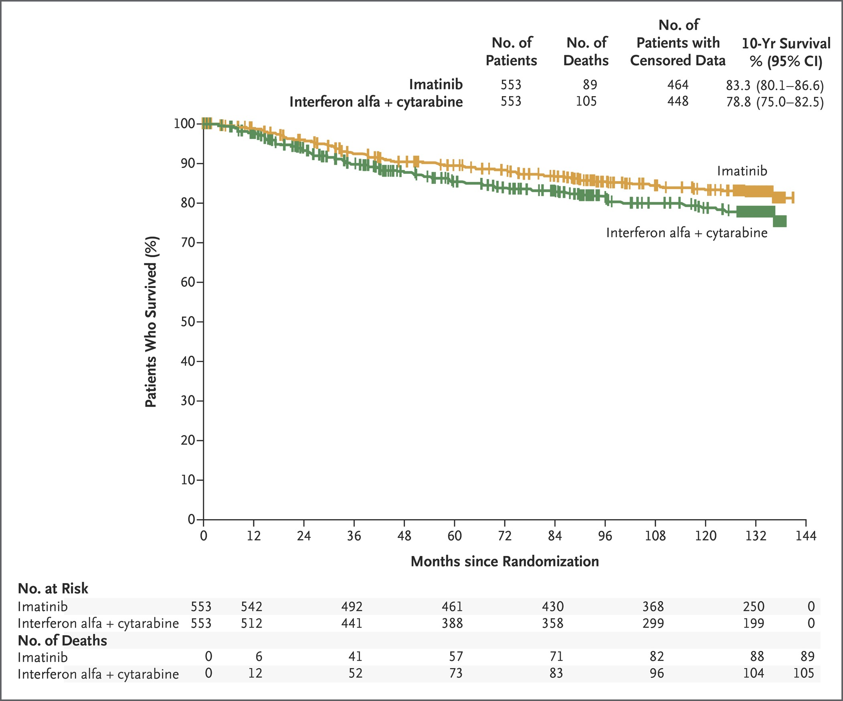

IRIS 10+ year data:
K–M Estimated Overall Survival Rates @ 10 Years (ITT)
Hochhaus A et al. N Engl J Med 2017;376:917-927

Slide 11
Dasatinib vs Imatinib (DASISION): 5y data
Outcome (%) | Dasatinib | Imatinib | P value or HR
Discontinued | 39 | 37
12m cCCyR | 77 | 66 | P=0.007
5y MMR | 76 | 64 | P=0.0022
5y MR4.5 | 42 | 33 | P=0.025
3m <10% | 84 | 64
5y AP/BP | 4.6 | 7.3
5y OS | 91 | 90 | HR 1.01
5y PFS | 85 | 86 | HR 1.06
519 pts randomized
to dasatinib (n=259) or imatinib (n=260)
Minimum follow-up: 5 yrs
AP = accelerated phase, BC = blast crisis, cCCyR = confirmed complete cytogenetic response, HR = hazard ratio,
MMR = major molecular response, OS = overall survival, PFS = progression-free survival
Cortes. JCO. 34: 2333; 2016

Slide 12
Nilotinib vs Imatinib (ENESTnd): 6y data
Outcome (%) | Nil 600 (300 BID) | Nil 800 (400 BID) | Imatinib | P value or HR
Discontinued* | 40 | 38 | 50
5y MMR* | 77 | 77 | 60 | P<0.0001
6y MR4.5 | 56 | 55 | 33 | P<0.0001
3m <10% | 91 | 89 | 67
6y AP/BP | 3.9 | 2.1 | 7.4 | P=0.06/0.003
6y OS | 92 | 96 | 92 | HR 0.9/0.46
846 pts
  nilotinib 600 (n=282)
  nilotinib 800 (n=281) or
  imatinib (n=283)
Minimum follow-up: 6 yrs
5-yr data from Larson et al ASCO 2014; Abstract #7073
Hochhaus. Leukemia 30: 1044; 2016

Slide 13
First-line Bosutinib Versus Imatinib in CML (BFORE)
Molecular Response at 12 and 18 Months
Molecular response (%)
P=0.02
P=0.01
Bosutinib
ITT: n=268
mITT: n=246
12 months
18 months
Imatinib
ITT: n=268
mITT: n=241
12 months
18 months
Randomized frontline pivotal study
Bosutinib 400 mg (n=268) vs imatinib 400 mg (n=268)
Stratified by Sokal and geographic area
P=0.01
P=0.04
P=0.11
P=0.02
P=0.02
P=0.11
Month 12
Month 18
Month 12
Month 18
Month 12
Month 18
Month 12
Month 18
MMR (ITT)
MMR (mITT)
MR⁴ (mITT)
MR^{4.5} (mITT)
MR⁴ (ITT), %
 | Bosutinib | Imatinib | P
12 mo | 20.5 | 11.6 | <0.01
18 mo | 24.6 | 18.3 | 0.08
MR^{4.5} (ITT), %
 | Bosutinib | Imatinib | P
12 mo | 7.5 | 3.0 | 0.02
18 mo | 11.9 | 8.2 | 0.16
Gambacorti-Passerini et al. ASH 2017; abstract #896

Slide 14
What is the standard?
Comparative results: imatinib 400/600, nilotinib, dasatinib
 | IRIS (IM400) | IM400 ENEST/DASISION | TIDEL I (IM600) | TIDEL II (IM600) | SPIRIT FRANCE (IM600) | ENESTnd (NIL) | DASISION (DAS)
>10%@3mo | --- | 33%/36% | 24% | 12% | --- | 9% | 16%
CCyR @12mo | 69% | 65%/73% | 88% | 87%¹ | 65% | 80% | 85%
MMR@12mo | 40% | 27%/28% | 47% | 64% | 49% | 55% | 46%
MMR@24mo | 55% | 44%/46% | 73% | 73% | 53% | 71% | 64%
MR4.5@12mo | --- | 4%/--- | 18%² | 19% | 22%² | 11% | 5%
MR4.5@24mo | --- | 9%/8% | --- | 34% | 26%² | 25% | 17%
OS@3y | 92% | 94%/93% | --- | 96% | --- | 95% | 94%
¹Inferred from MR2.0
²MR4.0 rather than MR4.5

Slide 15
Choosing your tools: comparing TKI toxicity in CML
Issue | Imatinib | Nilotinib | Dasatinib | Bosutinib | Ponatinib
Dosing | QD/BID, with food | BID, without food (2h) | QD, w/ or w/o food | QD, with food | QD, w/ or w/o food
Long term safety | Most extensive | Extensive; Emerging toxicity | Extensive; Emerging toxicity | Extensive, No emerging toxicity | More limited but increasing; Emerging toxicity
Heme toxicity | Intermediate | Least | Most severe; ASA-like effect; lymphocytosis | ~dasatinb in 2nd, 3rd line; ~nilotinib in 1st line | ⬆Thrombocytopenia ASA-like effect
Non-Heme toxicity | Edema, GI effects (diarrhea, nausea), Muscle cramps, ⬇Phos | ⬆Lipase, ⬆Bili, ⬆Chol, ⬆Glu, Fatigue, Musculo-skeletal symptoms Black box: QT prolongation | Headache (early/ transient) Pleural / pericardial effusions | Diarrhea; Transaminitis | ⬆Lipase, Pancreatitis, Rash, Hypertension Black box: vascular occlusion, heart failure, and hepatotoxicity
Emerging toxicities | Early question re: CHF ?late renal effects | Vascular events (ICVE, IHD, PAD) | ?PAH (pulmonary arterial hypertension) | ? Mild renal effects | Vascular events (ICVE, IHD, PAD, VTE)

Slide 16
Response Milestones
NCCN CML Guidelines, Version 3.2021, Accessed with permission, www.nccn.org 5/1/2021

Slide 17

‘Shrinking the iceberg’: response expectations
International Standard (IS) qPCR
Early Molecular Response:
<10% or 1-log (10x) drop from starting level
10%
Early Molecular Response
Early Molecular Response
Complete Cytogenetic Response:
<1% or 2-log (100x) drop
1%
Complete Cytogenetic Response
Complete Cytogenetic Response
Major Molecular Response:
<0.1% or 3-log (1000x) drop
0.1%
Major Molecular Response
Major Molecular Response
4-log drop (<0.01%)
0.01%
MR4
MR4
4.5 log drop, ‘MR4.5’,
Complete Molecular Remission:
<0.0032%; below the level of
detection for standard labs
0.0032%
MR4.5
‘CMR’
MR4.5
‘CMR’
The Future ?
eligible for
‘treatment free remission’
trials
MR5-6?
Plainly stated:
PCR at diagnosis = very important, like a timing chip when you run a race (where did you start?)
Early response at 3mo should be ‘on track’, 10x lower than start, ~10% (if you start ~100%)
Complete cytogenetic response (~1% on the PCR scale; 100x lower) is very important and protective
Major molecular response (MMR, ~0.1% on the PCR scale; 1000x lower) adds further protection
Deep Molecular remission: aiming for 0.01% or lower (10,000x lower than start) and staying that way

Slide 18


Monitoring for CML response needs improvement
About 1 in every 5 patients are not tested for MR at 12 months and almost half are not tested for CyR
Patients not tested for CyR at 12 months¹
Patients not tested for MR by 12 months¹
Overall (N=862)
51%
Overall
(N=862)
17%
US
(n=573)
38%
US
(n=573)
13%
Europe
(n=289)
58%
Europe
(n=289)
19%
Age <65 years at initiation of first-line TKI, patients who had switched from first-line TKI and those seen in academic centres were more likely to be monitored by 12 months (p<0.05)²
Goldberg SL, Cortes J, Gambacorti-Passerini C, et al. Cytogenetic and molecular testing in patients with chronic myeloid leukemia (CML) in a prospective observational study (SIMPLICITY). J Clin Oncol. 2014;32:5s (suppl; abstr 7050).
Goldberg SL, Cortes J, Gambacorti-Passerini C, et al. Predictors of performing response monitoring in patients with chronic-phase chronic myeloid leukemia (CP-CML) in a prospective observational study (SIMPLICITY). J Clin Oncol. 2014;32:(suppl 30; abstr 116).

Slide 19
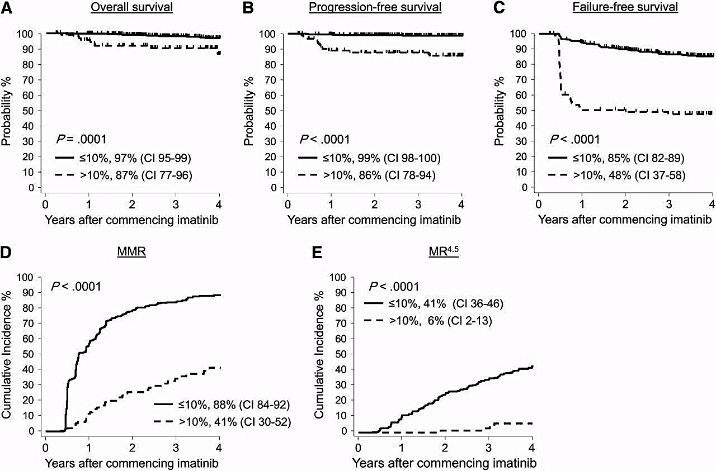
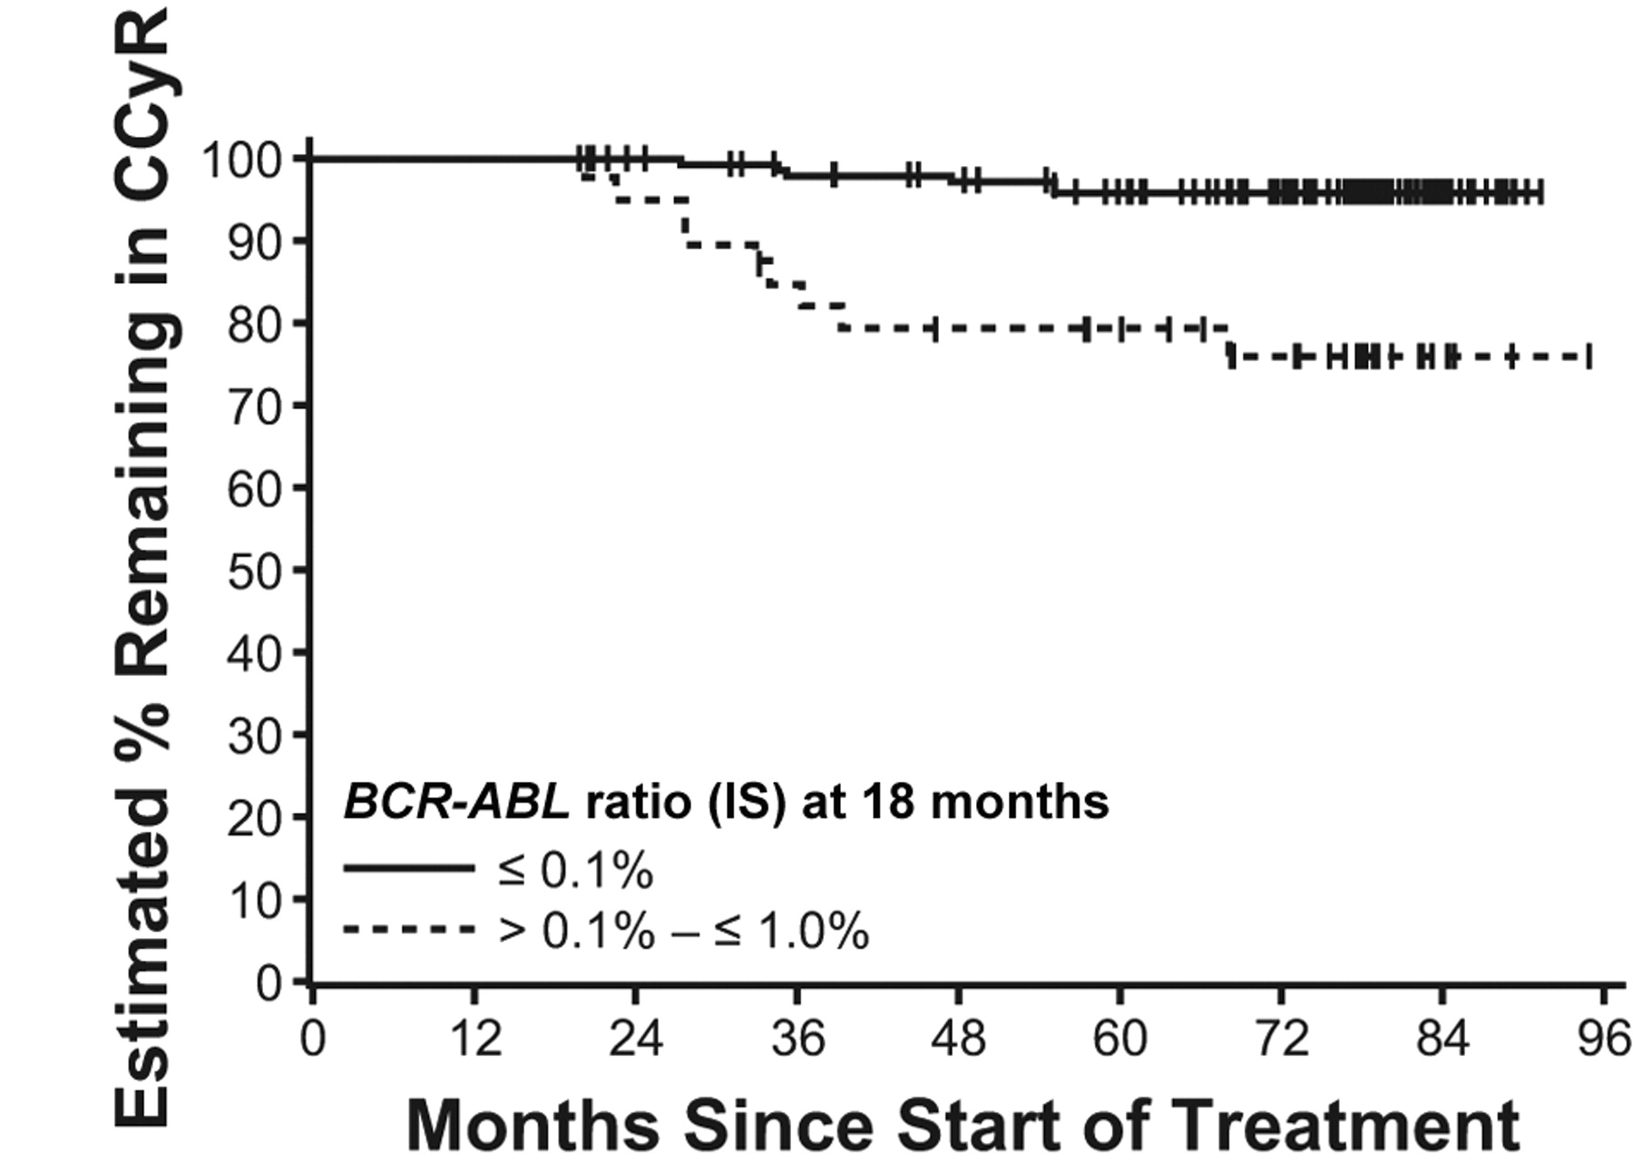
Predictive molecular tools in CML
Overall Survival Progression-Free Survival Failure-Free Survival
Early Molecular
Response (EMR)
≤ 10%
> 10%
≤ 10%
> 10%
≤ 10%
> 10%
Major Molecular Response Complete Molecular Response
≤ 10%
> 10%
≤ 10%
> 10%
Major Molecular Response (MMR)
Mutation Status

Slide 20
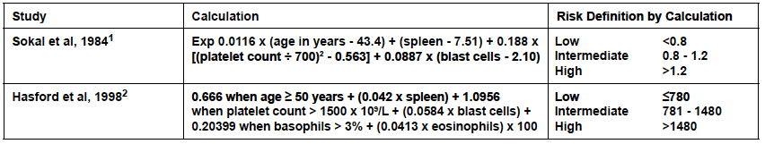
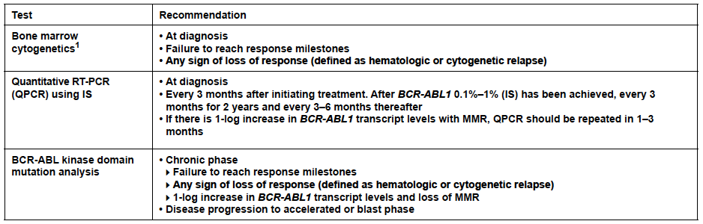
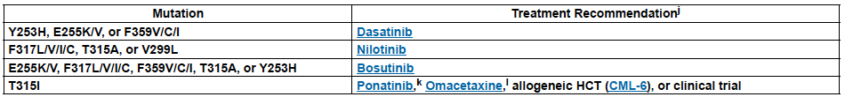
Monitoring, Resistance

Slide 21
Practical approach to a patient with resistance
(or intolerance +/- resistance)
First, determine what the disease state requires
  disease phase
  prior TKI exposure
  mutational status
    T315I unique
    Select mutations may support role of specific 2nd generation TKIs
    Predictive potential imprecise
    ‘iceberg’ phenomenon
    More detailed assays forthcoming (like ultradeep sequencing)
Next, balance therapy risk and toxicity potential with known comorbidities
  are there true ‘contraindications’?
  does risk outweigh benefit expected from therapy?
  can risk be mitigated or anticipated?
  enlist the patient’s insight, trust, and awareness

Slide 22
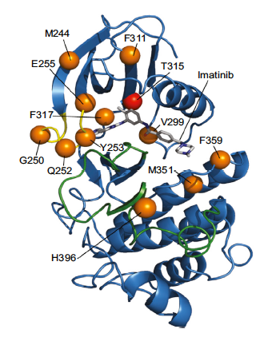
Resistance to TKIs: point mutations
>100 mutations described in imatinib and subsequent generation TKI treated patients; only a handful (~10) found at key positions account for the vast majority (~85%) of clinically observed mutations
Single and compound mutations possible
Mutations uncommon / challenging to quantify at diagnosis; felt to be driven by genetic instability of the Ph+ clone
TKI therapy may select resistant clones
The longer Bcr-Abl remains active, or the less efficiently it is inhibited, the higher the mutation rate
Bcr-Abl is still the key target for therapeutic improvement

Slide 23
Mutations: When to look
Both the European LeukemiaNet (ELN) and National Comprehensive Cancer Network (NCCN) recommend ABL kinase domain mutational analysis under certain circumstances:
Recommendations on When to Perform Mutational Analysis
ELN¹ | NCCN²
At diagnosis Only in advanced phase patients During first-line imatinib therapy In case of failure In case of an increase in BCR-ABL transcript levels leading to loss of major molecular response In any other case of suboptimal response During second-line dasatinib or nilotinib therapy In case of hematologic or cytogenetic failure | BCR-ABL transcript levels >10% by QPCR IS or less than partial cytogenetic response at 3 months Less than complete cytogenetic response at 12 or 18 months Any sign of loss of response Defined as hematologic or cytogenetic relapse or 1 log increase in BCR-ABL transcript levels and loss of major molecular response Disease progression to advanced phase
1. Soverini S et al. Blood. 2011;118:1208-1215.
2. National Comprehensive Cancer Network. NCCN Guidelines: chronic myelogenous leukemia (V.4.2013).

Slide 24
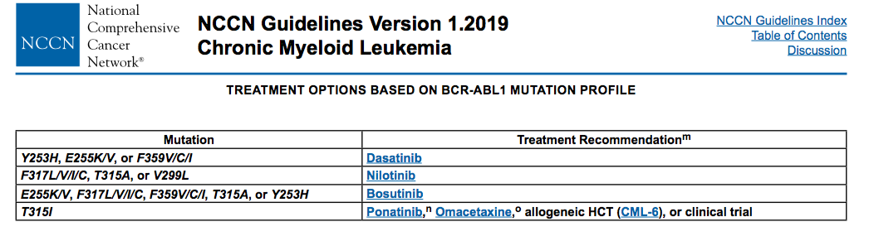
Choosing a Salvage: Mutations, Response
Mutation Guidance
Clinical condition | % Positive
Failure | 27
No CHR at 3 mo | 19
No CyR at 6 mo | 11
No PCyR at 12 mo | 17
No CCyR at 18 mo | 17
Loss CCyR | 31
Loss CHR | 50
Suboptimal | 5
No CyR at 3 mo | 7
No PCyR at 6 mo | 5
No CCyR at 12 mo | 8
No MMR at 18 mo | 0
Loss MMR | 4
Mutation analysis in 1301 pts receiving imatinib or 2nd generation TKI (GIMEMA)
Mutations present in a minority of cases
Clinical response prediction imprecise
Next-gen sequencing may tell us more
?role of early detection, low level mutations
Soverini. Blood 118:1208 and abst 112, 2011

Slide 25
Choosing a Salvage: Mutations, Response
Mutation Guidance
TKI | Dasatinib^{1,2} |  | Nilotinib |  | Bosutinib
Follow-up | 2 years^{1,2} (minimum follow-up) | 6 years³ (data lock at 6y) | 2 years⁴ (minimum follow-up) | 4 years⁵ (minimum follow-up) | 2 years⁶ (minimum follow-up)
Number of pts | 167* | 167* | 226 | 321* | 200
Discontinued, n (%) | NR | 114 (69) | 197/321 (61) | 224 (70) | 108 (54)
MCyR | 63%* | NR | 56% | 59* | 58%
CCyR | 50%* | NR | 41% | 45* | 46%
PFS, % | 80* | 49* | 64* | 57* | 81*
*Includes imatinib-intolerant patients. NR, not reported.
1. Sprycel® (dasatinib). Official prescribing information. November 2012.
2. Shah NP, et al. J Clin Oncol. 2010;28:15s (abstract 6512).
3. Shah NP, et al. Blood. 2014;123:2317-24.
4. Kantarjian HM et al. Blood. 2011;117:1141-1145.
5. Giles FJ, et al. Leukemia. 2013;27:107-12.
6. Gambacorti-Passerini C, et al. Am J Hematol. 2014 [Epub ahead of print].

Slide 26
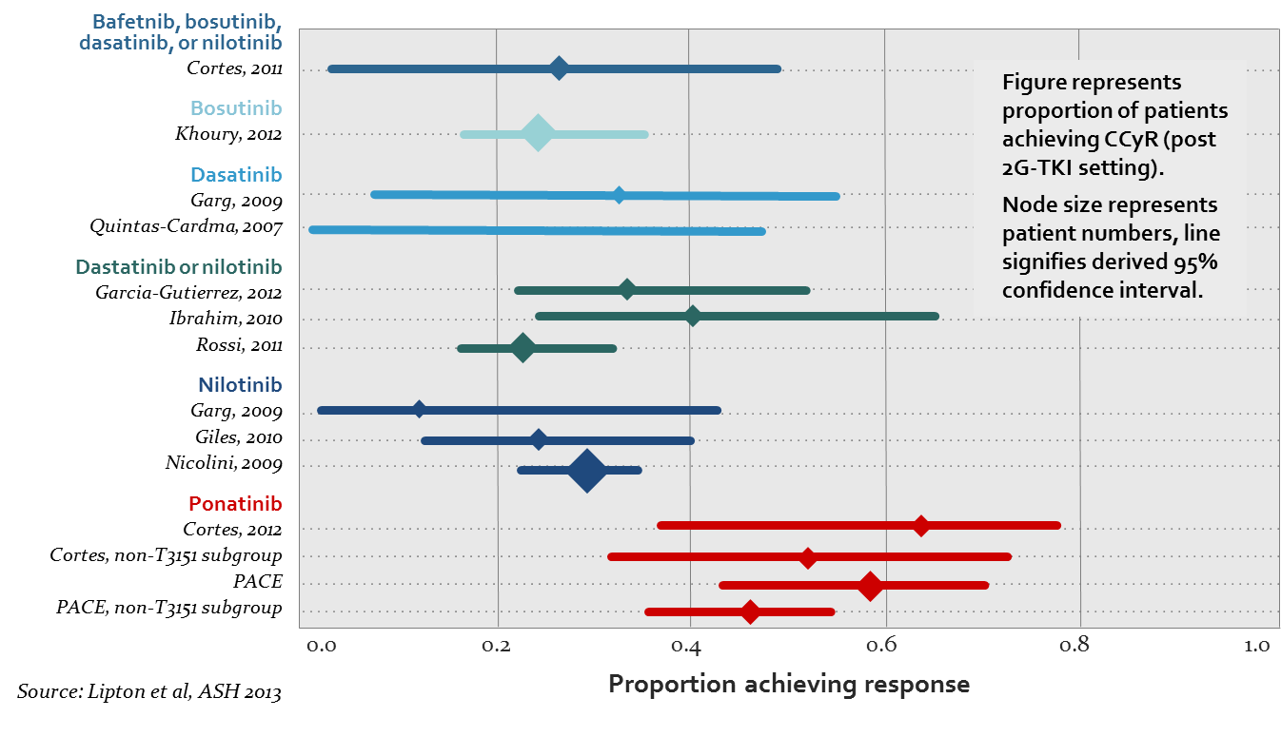
3rd line therapy:
Switch to alternate 2nd gen agent versus ponatinib favors ponatinib over ‘recycling’ 2nd gen TKIs
Bafetinib, bosutinib,
dasatinib, or nilotinib
Dasatinib or nilotinib
Lipton J, et al. ASH 2013. Abstract 4010.

Slide 27
Ponatinib response rates in 3rd- and 4th-line CP-CML
improved efficacy with earlier use
Imatinib-nilotinib
Imatinib-dasatinib
Imatinib-dasatinib-nilotinib
Imatinib-nilotinib-dasatinib
MCyR, % Patients
CCyR, % Patients
MMR, % Patients
I-N | I-D
n=33 | n=52
I-N | I-D
n=33 | n=52
I-N | I-D
n=33 | n=52
I-D-N
I-N-D
I-D-N
I-N-D
I-D-N
I-N-D
100%
100%
100%
75%
73
58
75%
67
75%
50%
46
44
50%
44
50%
46
40
37
35
33
28
25%
25%
25%
0%
0%
0%
n=68
n=46
n=68
n=46
n=68
n=46
Hochhaus et al at ASH 2013 and Kantarjian et al at ASH 2013.
Notes:
Abbreviations: CCyR, complete cytogenetic response; D, dasatinib, I, imatinib; MCyR, major cytogenetic response; MMR, major molecular response; N, nilotinib
Prior publications: Hochhaus A, et al. Am Soc Hematology Ann Meeting 2013;Abstr 2738; Kantarjian, et al. Am Soc Hematology Ann Meeting 2013;Abstr 1498
Data sources
t_14_2_4_14_6_resp_nilot (MCyR, CCyR by nilotinib subgroup: I–N, I–D–N)
t_14_2_4_14_7_resp_dasat (MCyR, CCyR by dasatinib subgroup: I–D, I–N–D)
t_14_2_7_1_2_mmr_dasat (MMR by dasatinib subgroup: I–D, I–N–D in PBT population)
t_14_2_7_1_1_mmr_nilot (MMR by nilotinib subgroup: I–N, I–D–N in PBT population)

Slide 28
Ponatinib:
Arterial and venous thrombotic events (PACE trial)
Vascular occlusive events*
Arterial occlusive events: 28%
Venous thromboembolic events: 5%
Cardio- vascular
Cerebro- vascular
Peripheral vascular
AE
5%
SAE
4%
AE
14%
SAE
11%
AE
11%
SAE
9%
AE
11%
SAE
8%
Exposure-adjusted incidence over time (per 100 patient years):
Total |  | Years
AE | SAE | 0-<1 | 1-<2 | 2-<3 | ≥3†
12 | 10 | 14.5 | 14.1 | 10.5 | 7.2
Total |  | Years
AE | SAE | 0-<1 | 1-<2 | 2-<3 | ≥3†
2 | 2 | 3.5 | 1.8 | 1.7 | 0.9
*Events occurring in patients with CP-CML. †Median follow-up 35.3 months; analysis for ≥3 years does not cover a fourth full year for all patients.
Cortes J, et al. Poster. EHA. 2015 (abstr P234).
Notes:
Median time to onset of ATEs in CP-CML: 430 (8-1339) days
Median time to onset of VTEs in CP-CML: 677 (62-1222) days
Abbreviations: AE, adverse event; CP-CML, chronic-phase chronic myeloid leukemia; SAE, serious adverse event
Data sources
t_2_ischemia_sum (incidence of ATEs)
t_2_1_vo_expadj (cumulative exposure time, exposure-adjusted incidence)
t_11_4_1_sel_ae4_cp (time to onset of ATEs in CP-CML)

Slide 29
TKIs in Development for CML
TKI | Features | Current status
Asciminib (ABL001) | Allosteric inhibitor | Ongoing phase 1 single agent (T315I) and combination Phase 3, 3rd line vs bosutinib Phase 2, early combination
Radotinib | 2nd generation | Approved in South Korea 1st and 2nd line Pending studies elsewhere
PF-114 | Ponatinib analog, not binding VEGFR | Nearing MTD Starting phase 2
HQP1351 | Active against T315I | Phase 1 completed
K0706 | 3rd generation | Phase 1 ongoing

Slide 30
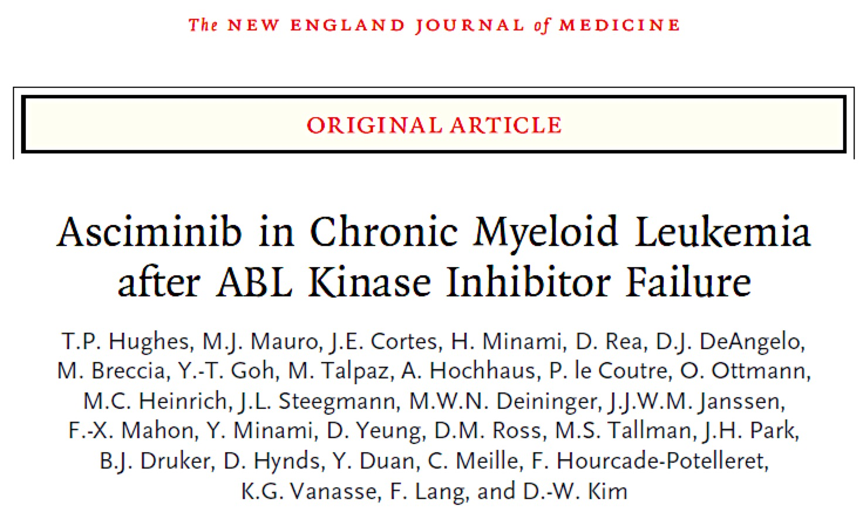

Slide 31
ABL001X2101: Study Design
A multicenter, phase 1, first-in-human study
Dose Escalation
Bayesian Logistic Regression
CML—completed
ABL001, po, BID
Dose Expansion
CML (20 mg, 40 mg)–completed
T315I mutation (150 mg)–ongoing
MTDRDE
10 mg
20 mg
40 mg
80 mg
150 mg
200 mg
Dose Escalation
CML
ABL001, po, QD
MTDRDE
Dose Expansion
CML
47 of 77 (61%) patients with CML treated with single-agent ABL001 BID were resistant to their last TKI
80 mg
120 mg
200 mg
Dose Escalation
Ph+ ALL/CML-BP
MTDRDE
Dose Expansion
Ph+ ALL/CML-BP
40 mg
80 mg
160 mg
Primary outcome: estimation of MTD/RDE
Secondary outcomes: safety, tolerability, preliminary anti-CML activity, pharmacodynamics, pharmacokinetic profile
Combo Dose Escalation
CML
ABL001+nilotinib
MTDRDE
Expansion
Combo Dose Escalation
CML
ABL001+imatinib
MTDRDE
Expansion
ALL, acute lymphocytic leukemia; BID, twice daily; BP, blast phase; CML, chronic myeloid leukemia; MTD, maximum tolerated dose; Ph+, Philadelphia chromosome-positive; po, peroral; QD, once daily; RDE, recommended dose for expansion
Combo Dose Escalation
CML
ABL001+dasatinib
MTDRDE
Expansion
Hughes TP, et al. Blood. 2016; 128 (22): [abstract 625].

Slide 32
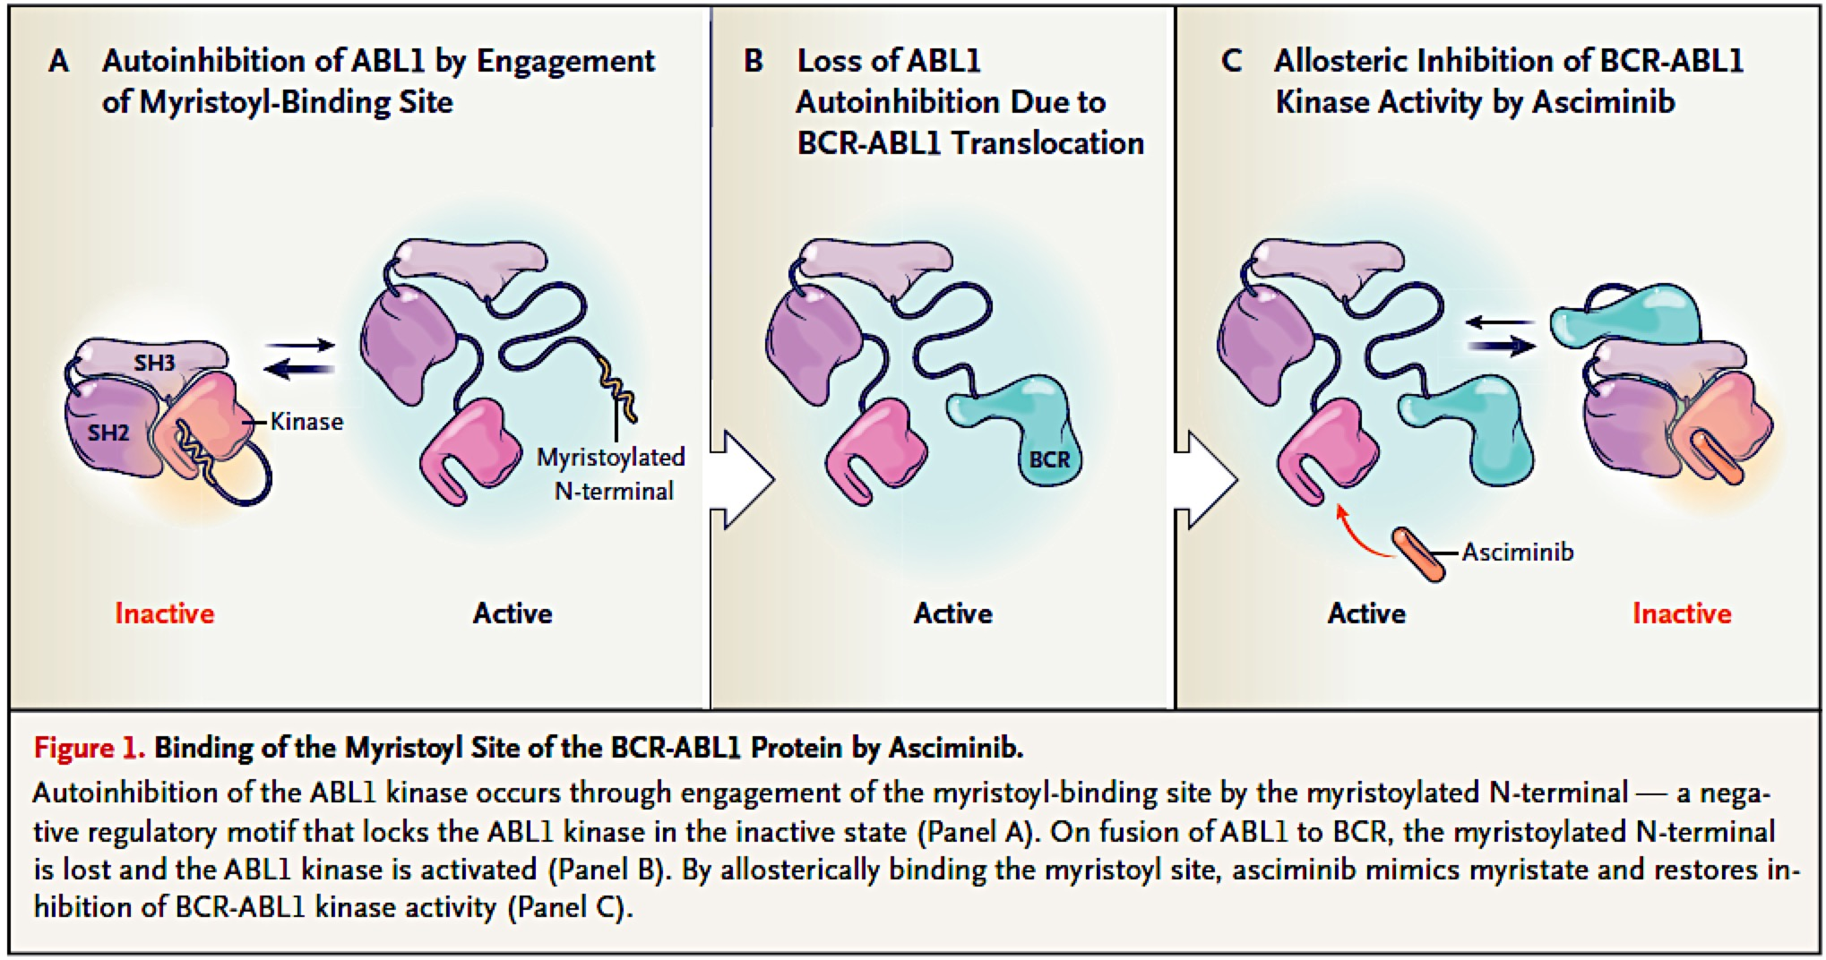
ABL001 allosterically blocks BCR-ABL1 kinase activity

Slide 33
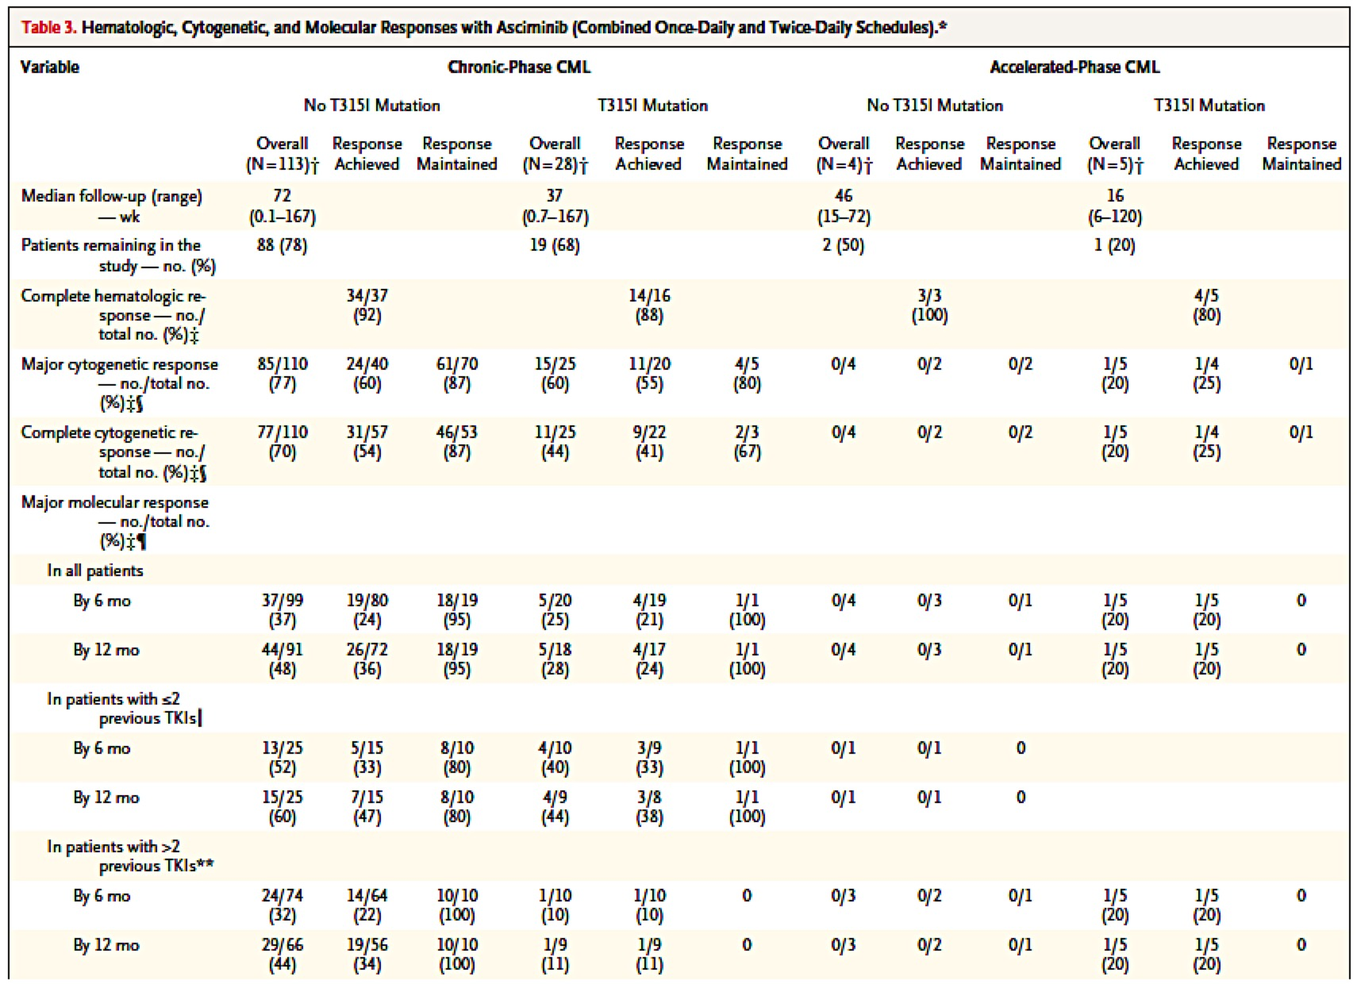
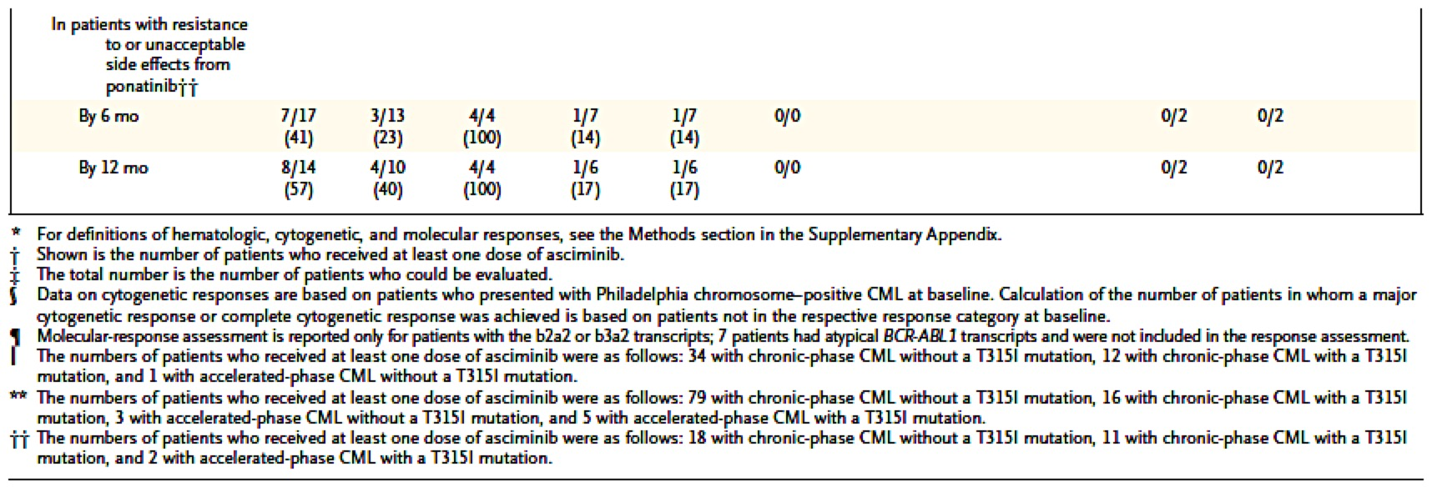
Asciminib Phase I Response (Overall)
HR
CyR
MolR

Slide 34
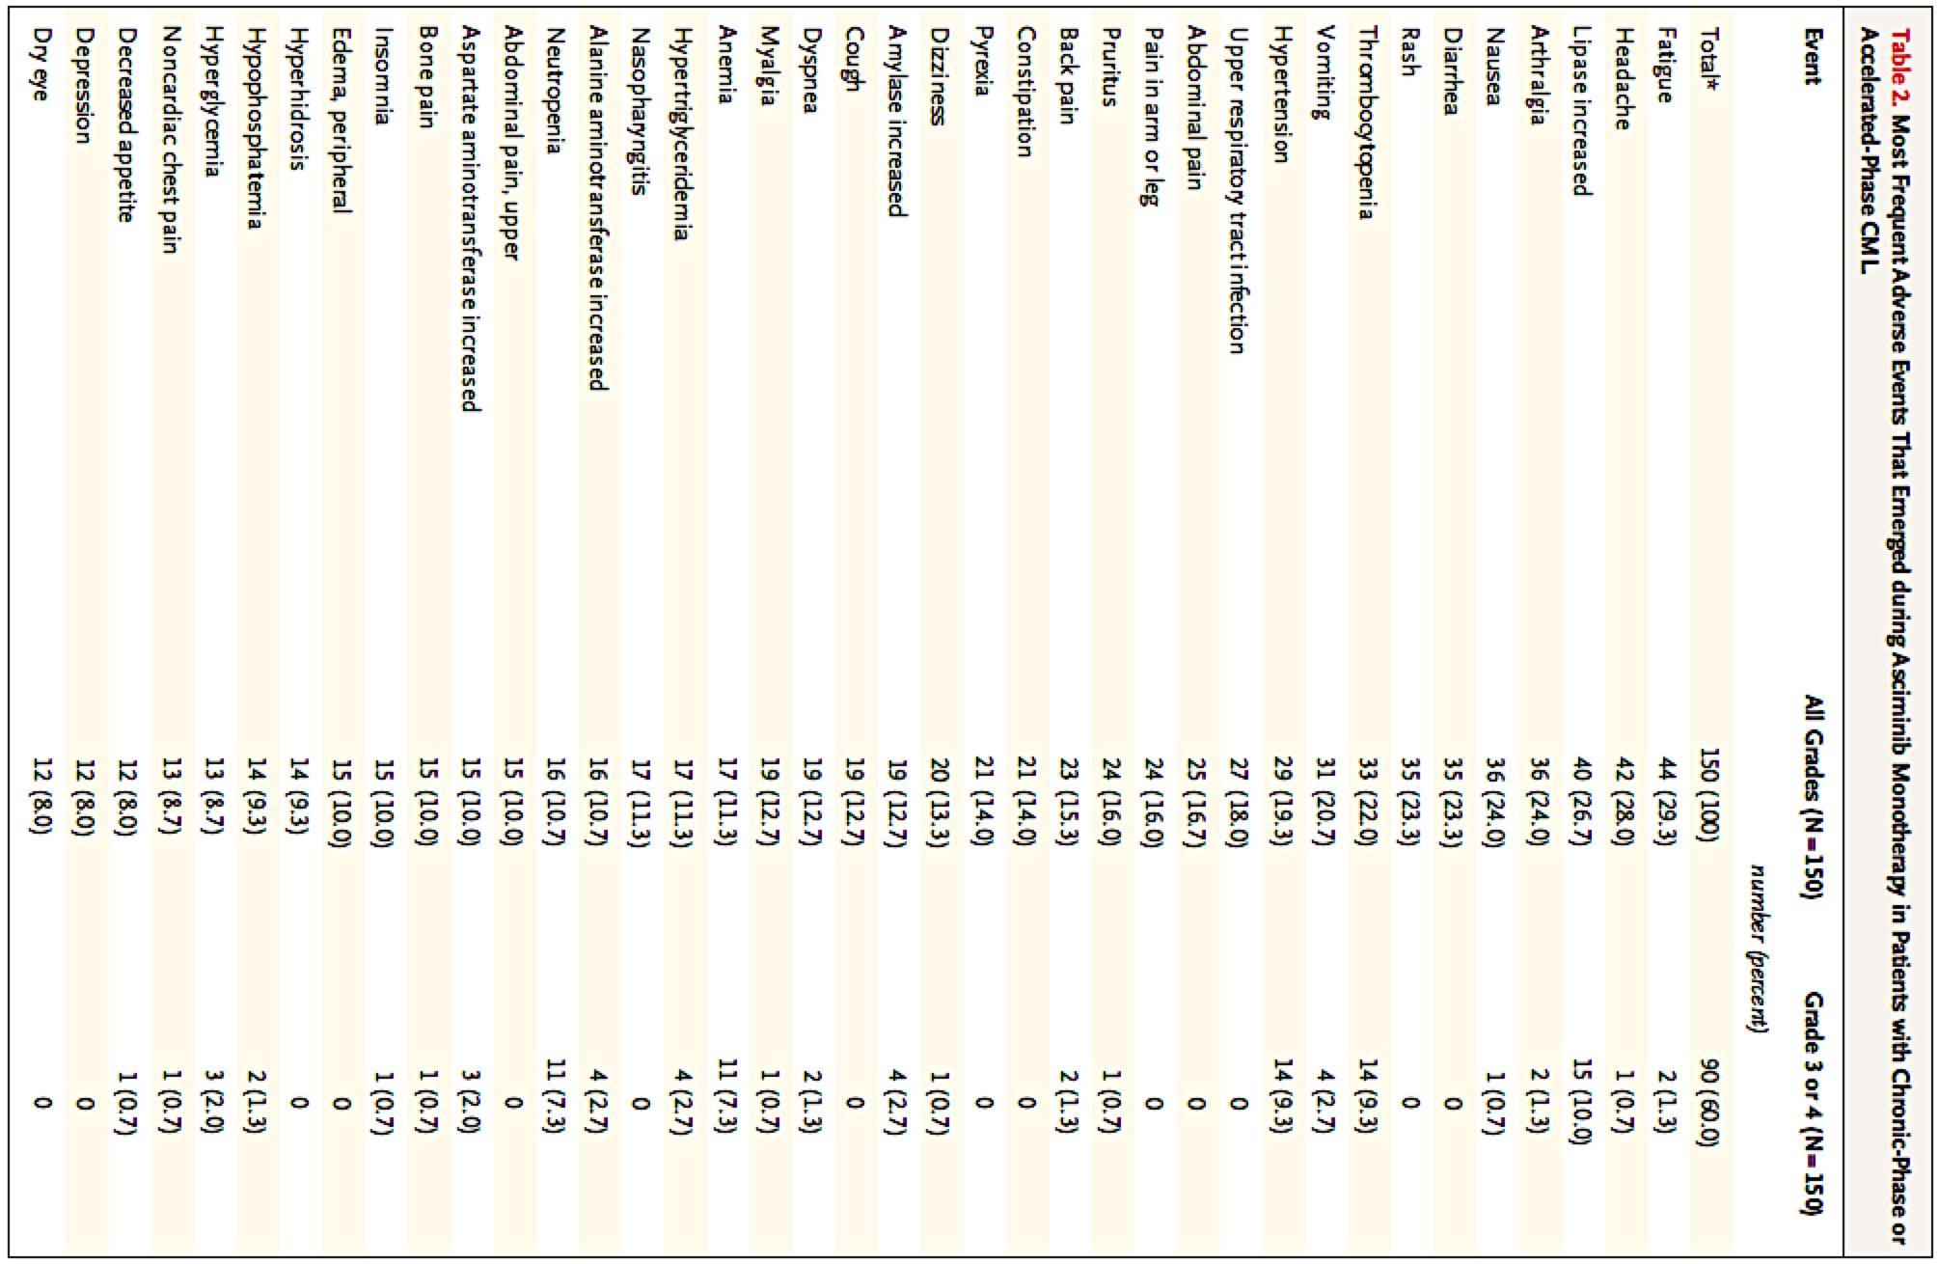
Asciminib Phase I Toxicity

Slide 35
ABL001X2101: T315I Cohort¹
Dose Escalation: CML
asciminib BID completed
MTD
RDE
Dose Expansion:
CML (20 mg and 40 mg BID) completed
10 – 200 mg BID
Dose Escalation: CML T315I asciminib BID and QD completed
MTD
RDE
Dose Expansion:
T315I mutation (200 mg BID) ongoing
20 – 200 mg BID
80 – 200 mg QD
Dose Escalation: CML
asciminib QD
MTD
RDE
Dose Expansion: CML
80 – 200 mg
Dose Escalation: Ph+ ALL/CML-BP
asciminib BID
MTD
RDE
Dose Expansion:
Ph+ ALL/CML-BP
Preclinical and clinical PK supports 200 mg BID dose of asciminib against T315I^{1,2}
40 – 280 mg
Combo Dose Escalation: CML
asciminib + NIL 300 mg BID
MTD
RDE
Dose Expansion:
CML
20 and 40 mg BID
Combo Dose Escalation: CML
asciminib + IMA 400 mg QD
MTD
RDE
Dose Expansion: CML
40, 60, and 80 mg QD; 40 mg BID
Combo Dose Escalation: CML
asciminib + DAS 100 mg QD
MTD
RDE
Dose Expansion: CML
80 mg QD; 40 mg BID
BP, blast phase; DAS, dasatinib; IMA, imatinib; NIL, nilotinib;
1. Réa D, et al. Blood. 2018;132:792 [abstract] and oral presentation at ASH 2018; 2. Schoepfer J. J Med Chem. 2018;61:8120–8135

Slide 36
ABL001X2101: T315I Cohort: Hematologic and
Cytogenetic Responses
CHRª
CCyR
5.9% (1/17)^{b} without CHR
All evaluable patients^{c,d}
Evaluable patients^{c} with > 35% Ph+ at screening
94.1% (16/17) maintained CHR
100% (15/15)
achieved CHR
Patients, %
Patients With Response, %
75.0% (15/20)
62.5% (5/8)
80.0% (16/20)
66.7% (6/9)
CHR at screening
(n = 17)
No CHR at screening
(n = 15)
By 24 weeks
By 48 weeks
.
ª Maintenance or achievement of CHR by the data cutoff, based on clinical review of laboratory parameters
^{b} One patient with persistent thrombocytosis was in CHR at screening (platelets 395K) and not in CHR during follow-up due to thrombocytosis (platelets 539K)
^{c} Evaluable patients had a cytogenetic evaluation within the specified time window or achieved a CCyR or discontinued treatment before that time window
^{d} Maintenance or achievement of CCyR
Réa D, et al. Blood. 2018;132:792 [abstract] and oral presentation at ASH 2018.

Slide 37
ABL001X2101: T315I Cohort: Cumulative Molecular Response Rates
100
200 mg BID (N = 32)ª
90
80
MMR
Median time to MMR^{a,b}: 12.2 weeks (range, 4.1–60.0 weeks)
70
MR⁴
60
MR^{4.5}
Patients With Response (%)
50
40
MMR: 36.7%
30
MR⁴: 19.4%
20
10
MR^{4.5}: 16.1%
0
0
3
6
9
12
15
18
21
Time (28-day cycles)
MMR % (N = 30): 0.0 26.7 33.3 33.3 33.3 36.7 36.7 36.7
MR⁴ % (N = 31): 0.0 6.5 16.1 19.4 19.4 19.4 19.4 19.4
MR^{4.5} % (N = 31): 0.0 0.0 12.9 12.9 16.1 16.1 16.1 16.1
MR⁴, BCR-ABL1^{IS} ≤ 0.01%; MR^{4.5}, BCR-ABL1^{IS} ≤ 0.0032%. ª One patient with atypical BCR-ABL1 transcript and no molecular data was excluded from analyses of cumulative molecular responses; 1 patient with MMR at screening was excluded from analysis of cumulative MMR. ^{b} Among patients who achieved MMR.
Réa D, et al. Blood. 2018;132:792 [abstract] and oral presentation at ASH 2018.

Slide 38
ABL001X2101: T315I Cohort: Cumulative Molecular Responses by Prior Ponatinib Exposureª
Ponatinib-Naïve
Ponatinib-R/I
100
MMR
Median (range) time to MMR^{b}:
12.2 (4.1-60.0) weeks
100
Median (range) time to MMR^{b}:
8.1 (4.4-8.1) weeks
90
90
MMR
80
MR⁴
80
MR⁴
70
MR^{4.5}
70
MR^{4.5}
MMR: 61.5%
60
60
Patients With Response (%)
50
MMR: 17.6%
50
40
MR⁴: 30.8%
40
MR⁴: 11.1%
30
30
MR^{4.5}: 5.6%
20
MR^{4.5}: 30.8%
20
10
10
0
0
0
3
6
9
12
15
18
21
0
3
6
9
12
15
18
21
Time (28-day cycles)
Time (28-day cycles)
MMR % (N = 13): 0.0 38.5 53.8 53.8 53.8 61.5 61.5 61.5
(N = 17): 0.0 17.6 17.6 17.6 17.6 17.6 17.6 17.6
MR⁴ % (N = 13): 0.0 7.7 30.8 30.8 30.8 30.8 30.8 30.8
(N = 18): 0.0 5.6 5.6 11.1 11.1 11.1 11.1 11.1
MR^{4.5} % (N = 13): 0.0 0.0 30.8 30.8 30.8 30.8 30.8 30.8
(N = 18): 0.0 0.0 0.0 0.0 5.6 5.6 5.6 5.6
ª One patient with atypical BCR-ABL1 transcript and no molecular data was excluded from analyses of cumulative molecular responses;
1 patient with MMR at screening was excluded from analysis of cumulative MMR. ^{b} Among patients who achieved MMR.
Réa D, et al. Blood. 2018;132:792 [abstract] and oral presentation at ASH 2018.

Slide 39
Efficacy and Safety Results From ASCEMBL, a Multicenter, Open-label, Phase 3 Study of Asciminib, a First-in-Class STAMP Inhibitor, vs Bosutinib in Patients with Chronic Myeloid Leukemia in Chronic Phase Previously Treated with ≥2 Tyrosine Kinase Inhibitors
ASCEMBL is a multicenter, open-label, phase 3, randomized study of asciminib vs bosutinib in patients with CML-CP, previously treated with ≥ 2 TKIs
Treatment duration: 96 weeks†
Asciminib
targets the myristoyl pocket
Asciminib 40 mg twice daily
ASCEMBL
(NCT03106779)
Randomized 2:1
(stratified by MCyR vs no MCyR at baseline*)
n = 157
Switch to asciminib allowed only for patients meeting treatment failure criteria on bosutinib‡
BCR-ABL1
Bosutinib (and other TKIs)
targets the ATP-site
Survival follow-up§
Bosutinib 500 mg once daily
N = 233
n = 76
Median duration of follow-up: 14.9 months from randomization to cutoff
CML-CP, chronic myeloid leukemia in chronic phase; MCyR, major cytogenetic response.
* At baseline, 68 (29.3%) patients were in MCyR: 46 (29.3%) patients in the asciminib arm and 22 (28.9%) in the bosutinib arm were in MCyR at baseline. † Patients will continue to receive study treatment for up to 96 weeks after the last patient’s first dose or 48 weeks after the last patient switches to asciminib, whichever is longer. ‡ Must meet the definition of treatment failure per the 2013 European LeukemiaNet recommendations. § Patients who discontinue study treatment at any time will be followed-up for survival and progression to AP/BC for up to 5 years after the last patient’s first dose.

Slide 40
Asciminib vs Bosutinib in 3rd-line CP CML:
MMR Rate at 24 Weeks
The MMR rate at 24 weeks was 25.5% with asciminib vs 13.2% with bosutinib
  Common treatment difference after adjusting for MCyR status at baseline was 12.2% (95% CI, 2.19-22.3; 2-sided P=0.029)
Among patients who achieved MMR, median time to MMR was 12.7 weeks on asciminib vs 14.3 weeks on bosutinib
Median duration of exposure was 43.4 (range, 0.1-129.9) weeks to asciminib and 29.2 (range, 1.0-117.0) weeks to bosutinib
MMR, %
n=157
n=76
Asciminib
Bosutinib

Slide 41
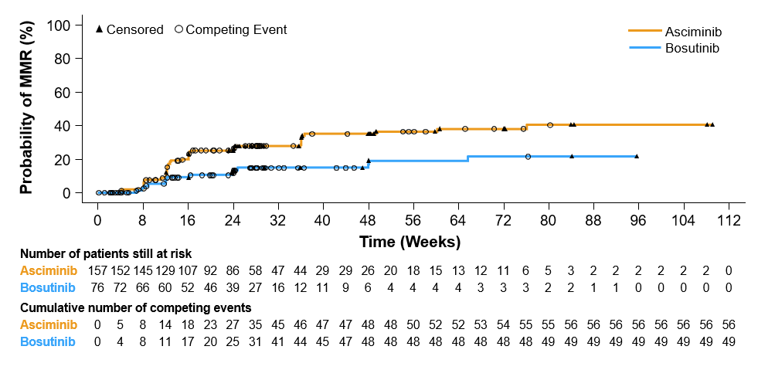
Asciminib vs Bosutinib in 3rd-line CP CML:
Cumulative Incidence of MMR
Cumulative MMR rate by 24 weeks was 27.4% with asciminib vs 14.5% with bosutinib
The difference in the cumulative incidence of MMR between treatment arms started to be evident by week 12

Slide 42
Asciminib vs Bosutinib in 3rd-line CP CML:
CCyR Rate at 24 Weeks
CCyR rate at 24 weeks was 40.8% with asciminib vs 24.2% with bosutinib
  The between-arm common treatment difference was 17.3% (95% CI, 3.62%-30.99%)
Rates of BCR-ABL1 ≤1% at week 24 among patients with BCR-ABL1 >1% at baseline:
  Asciminib (n = 142): 44.47%
  Bosutinib (n = 72): 22.22%
40.8
CCyR, %
24.2
n=103
n=62
Asciminib
Bosutinib

Slide 43
Asciminib vs Bosutinib in 3rd-line CP CML:
MR⁴ and MR^{4.5} Rates at 24 Weeks
At 24 weeks, more patients on asciminib than on bosutinib achieved MR⁴ and MR^{4.5}
  MR⁴ :17 (10.8%) patients on asciminib vs 4 (5.3%) on bosutinib
  MR^{4.5} :14 (8.9%) patients on asciminib vs and 1 (1.3%) on bosutinib
Rate, %
MR⁴
MR^{4.5}

Slide 44
Asciminib vs Bosutinib in 3rd-line CP CML:
Most Frequent All-Grade AEs (occurring in ≥20% of patients in any treatment arm)
All-grade AEs occurred in 89.7% and 96.1% of patients receiving asciminib and bosutinib, respectively
Patients*, %
ALT, alanine aminotransferase; AST, aspartate aminotransferase.
* Numbers represent counts of patients. A patient with multiple severity grades for an adverse event is only counted under the maximum grade; Medical Dictionary for Regulatory Activities version 23.0, Common Terminology Criteria for Adverse Events version 4.03. † Grouped term that includes AEs reported by investigator as thrombocytopenia and platelet count decreased. ‡ Grouped term that includes AEs reported by investigator as neutropenia, neutrophil count decreased, and febrile neutropenia.

Slide 45
Asciminib vs Bosutinib in 3rd-line CP CML:
Most Frequent Grade ≥3 AEs (occurring in ≥10% of patients in any treatment arm)
Grade ≥3 AEs occurred in 50.6% and 60.5% of patients receiving asciminib and bosutinib, respectively
Patients*, %
* Numbers represent counts of patients. A patient with multiple severity grades for an adverse event is only counted under the maximum grade; Medical Dictionary for Regulatory Activities version 23.0, Common Terminology Criteria for Adverse Events version 4.03. † Grouped term that includes AEs reported by investigator as thrombocytopenia and platelet count decreased. ‡ Grouped term that includes AEs reported by investigator as neutropenia, neutrophil count decreased, and febrile neutropenia.

Slide 46
What is the role of allografting in CML?
Status | TKIs | Transplant
Accelerated or Blast transformation has occurred | Interim treatment to best response/minimal residual disease | ASAP
Imatinib failure in chronic phase, T315I (+) | Ponatinib with caution, ABL001 (experimental) | If no response to Ponatinib/ABL001
Imatinib failure in chronic phase without clonal evolution, mutations, good response | Long-term second line TKIs | Third line post second TKI failure or beyond
IM failure in chronic phase with clonal evolution, mutations, poor response | Interim treatment to best response | Second line, taken case by case
Older age (≥65 – 70) post imatinib failure | Long-term second line TKIs | May forgo allo SCT for many yrs of QOL

Slide 47
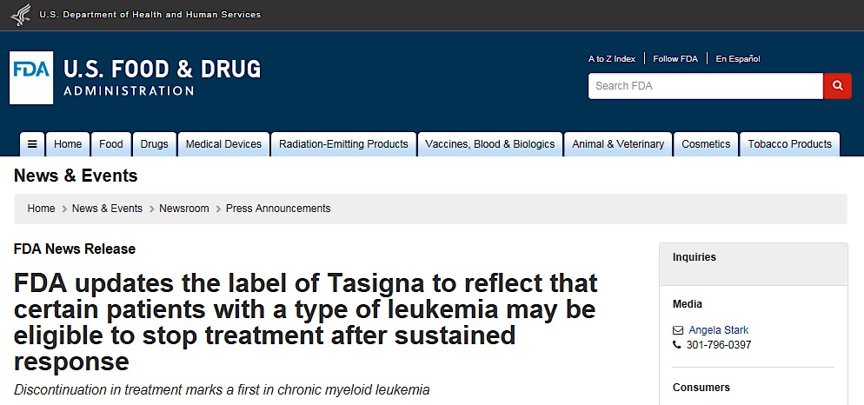
Treatment Free Remission— Option for TKI Stop— in the label for Nilotinib as of 12/17

Slide 48
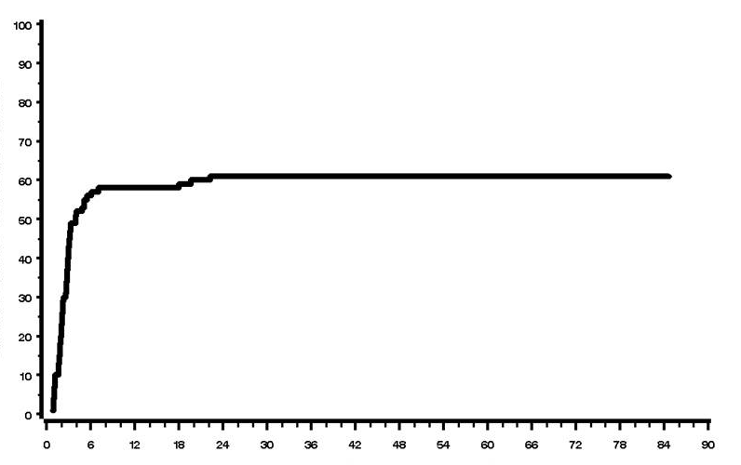
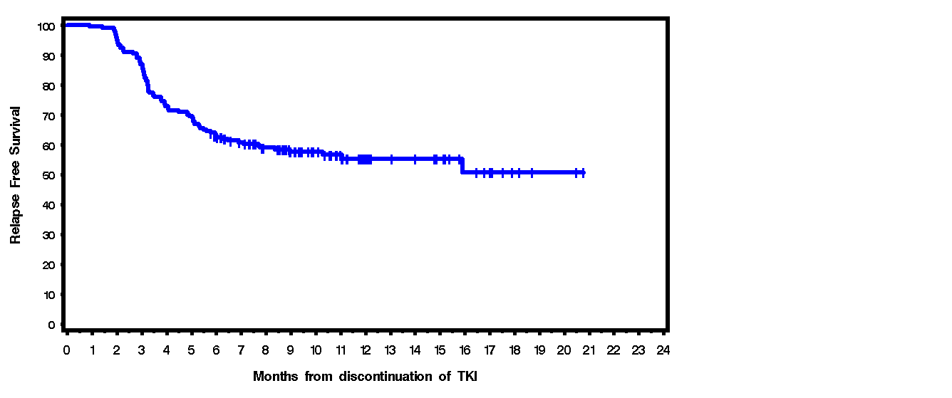

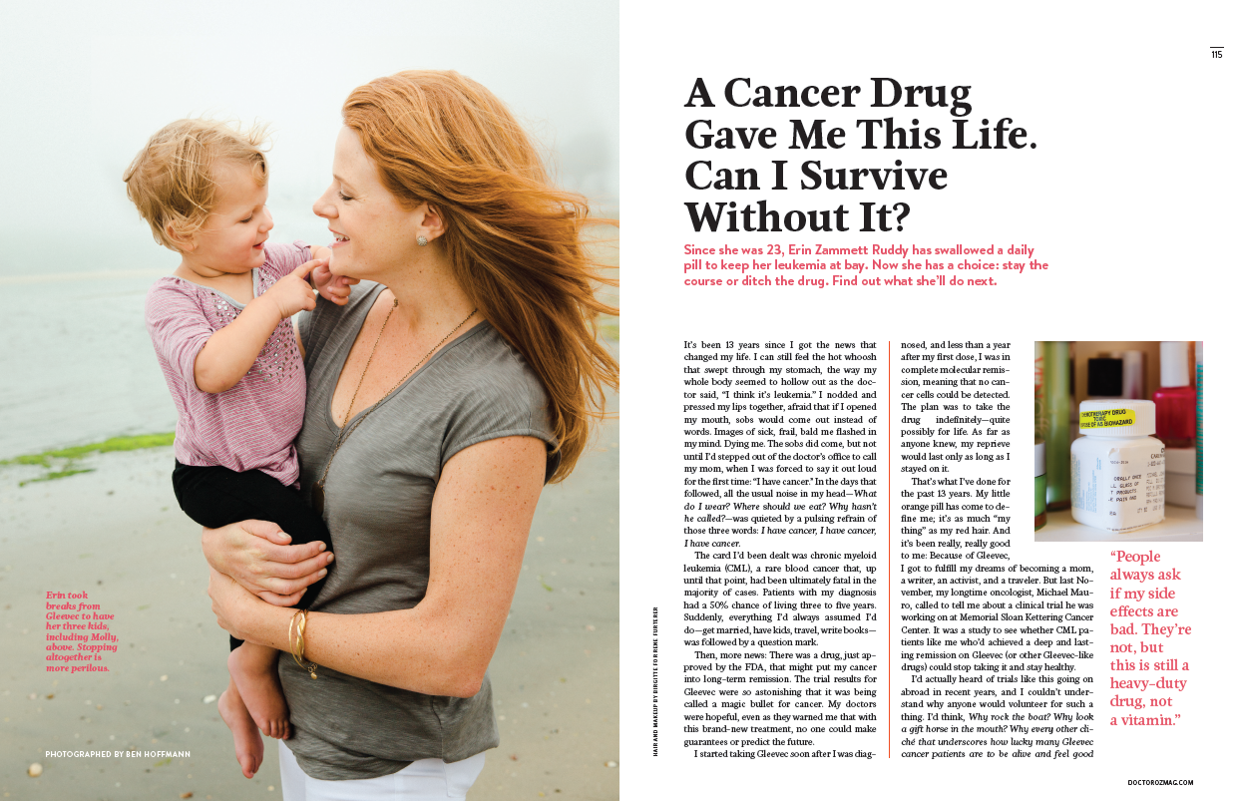
fantastic therapy + careful selection + good monitoring = fantastic outcomes…
‘treatment free remission’
100
80
60
40
20
0
EURO-SKI: Survival without loss of MMR
n=200; MR4 or greater, >2y (inclusion)
Relapses, n=86
Relapses within 6 months , n=77
Median time to molecular recurrence: 2.5 mo. (range,0.8 to 22.2)
57 out of the 61 pts restarted TKI (imatinib, n=56; dasatinib , n=1) and 55 achieved 2nd CMR at a median of 4.2 months
Median follow-up of 63 mo. :
- None of the MR patients have CML progression event
Cumulative incidence of MR
Relapse free survival
Relapse_{mol}-free survival at 6 months : 61% (54-68)
Saussele S, et al. EHA. 2014: [abstract LB-6214]
Months since stop of imatinib
0 1 2 3 4 5 6 7 8 9 10 11 12 13 14 15 16 17 18 19 20 21 22 23 24
Months from discontinuation of TKI

Slide 49
‘Treatment Free Remission’
Continues to be updated; monitoring requirements decreased

Slide 50
How I follow a recently diagnosed CML patient
CV evaluation
  Overall approach: at least age- and comorbidity-appropriate studies
  If nilotinib to be used, inclusive of peripheral/cerebral/cardiovascular
  If dasatinib to be used, ECHO to estimate pulmonary pressure
  Monitoring of BP, lipids, and glycemic control
Initial studies to include bone marrow and baseline qPCR (IS)
Lab studies every 1-2 weeks for at least 6 weeks, then less often / as indicated; frequency increased again for change in therapy
3mo assessment: qPCR (IS)
If response surpasses CCyR equivalent and blood count ‘new normal’ is acceptable/stable-> no imperative for repeat BM
Sequential molecular analyses q3mo
Repeat CV eval if/when indicated, eg for sign / symptoms

Slide 51
How I decide/navigate with my CML patients
3mo response: an opportunity to critically appraise therapy choice and response trajectory; change possible (EMR)
6mo, 12mo response: change warranted for missed milestone (EMR, CCYR)
18mo response: focus on molecular response (MMR)
Subsequent: stability of response and progression towards optimization of ‘MRD’– CMR > MR4 > MMR
  Plateau, fluctuation common
‘Treatment Free Remission’: no longer the realm of clinical trials
  ~3+y of therapy in general with ~3y of ‘optimal MRD’ (deep molecular remission) prior to consideration

Slide 52
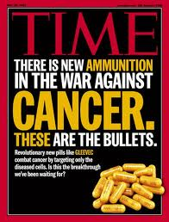
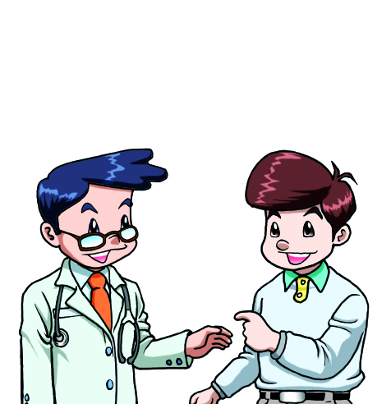
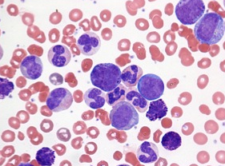
Conclusions
CML is highly treatable; ‘functional cure’ appears feasible
Generic imatinib is here; more TKIs still in development
Early response increasingly predictive of long term success
Resistance based in mutations can drive treatment choice but is likely quite complex; Novel agents in study (ABL001)
Second /third line therapy effective, needs to be carefully chosen (risk/benefit of ponatinib vs other alternatives)
SCT still needed as an option
TFR is a reality!
= Long, Happy, Healthy Life!
Many TKIs
Response
Remission
Cure?

Slide 53


Unmet need: Second TFR
By 2050, ~200,000 pts in the US living with CML
~50% failure of TFR attempt
Unclear as to next steps
Need low risk, low toxicity options given status of patients in TFR status
TKI+Ruxolitinib
Imatinib + ABL001
Several other candidate agents in development
Khoury CML Consortium plans to focus on second TFR from the clinical and biologic fronts

Slide 54
Case 1: Excellent response, Elusive TFR
Younger woman dx with CP CML at age 23
Initial therapy with imatinib + sq Ara-C (clinical trial)
longstanding single agent imatinib 400 mg for majority of time
  EMR-> MMR-> deep MR
  Pregnancy x 3 (spaced out) with imatinib cessation with each and no loss of deep MR
Once family complete, TFR attempt on study (LAST study, CML consortium)-> failed
Resumed imatinib 400mg
Awaiting ‘second TFR’ study (ABL001+imatinib)
Tolerates imatinib very well
Now ~20y on TKI therapy!

Slide 55
Case 2: Big hearted Principal’s heart in trouble
65 y.o. school principal dx with CP CML after returning from cruise in Bermuda
Initial therapy with nilotinib
Prompt CHR, EMR, CCyR, MMR
Mild dermatologic AEs; counselled about CV risk
Anginal sx-> Cath-> CABG complicated by CVA
Post CABG switch to imatinib
Slower kinetic deeper MR established on imatinib 400mg
Just initiated TFR according to NCCN guidelines+ ELN guidelines
(waited for 3y deep MR on imatinib)
Still a beloved school principal, worked through pandemic

Slide 56
Case 3: Rough start, Smooth finish
50 y.o. house painter dx with CML-CP, Int. risk
Initial therapy with nilotinib->CHR but no molecular response; mutation analysis with p-loop mutation (Y253H)
Brief dasatinib with loss of CHR
Ponatinib 45 mg on study (prior to FDA approval)-> MMR
Dose reduced to 15 mg
Molecular relapse with E255V mutation, loss of CCyR despite dose escalation back to 45 mg
Switched to ABL001 phase I study
Commenced 40 mg BID with stable disease
Dose increased to 80 mg BID with progressive improvement (MMR-> MR4-> undetectable)
Now 5 years undetectable on ABL001 80 mg BID, with no discernable toxicity
Ongoing discussion: is TFR a plausible next step
He keeps asking, ‘Any concerns about the ABL001? Anybody losing response?’

Slide 57
Appendix

Slide 58
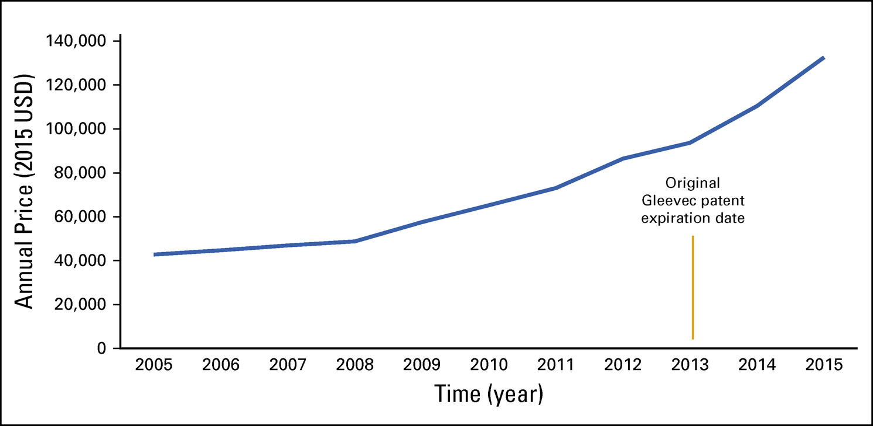
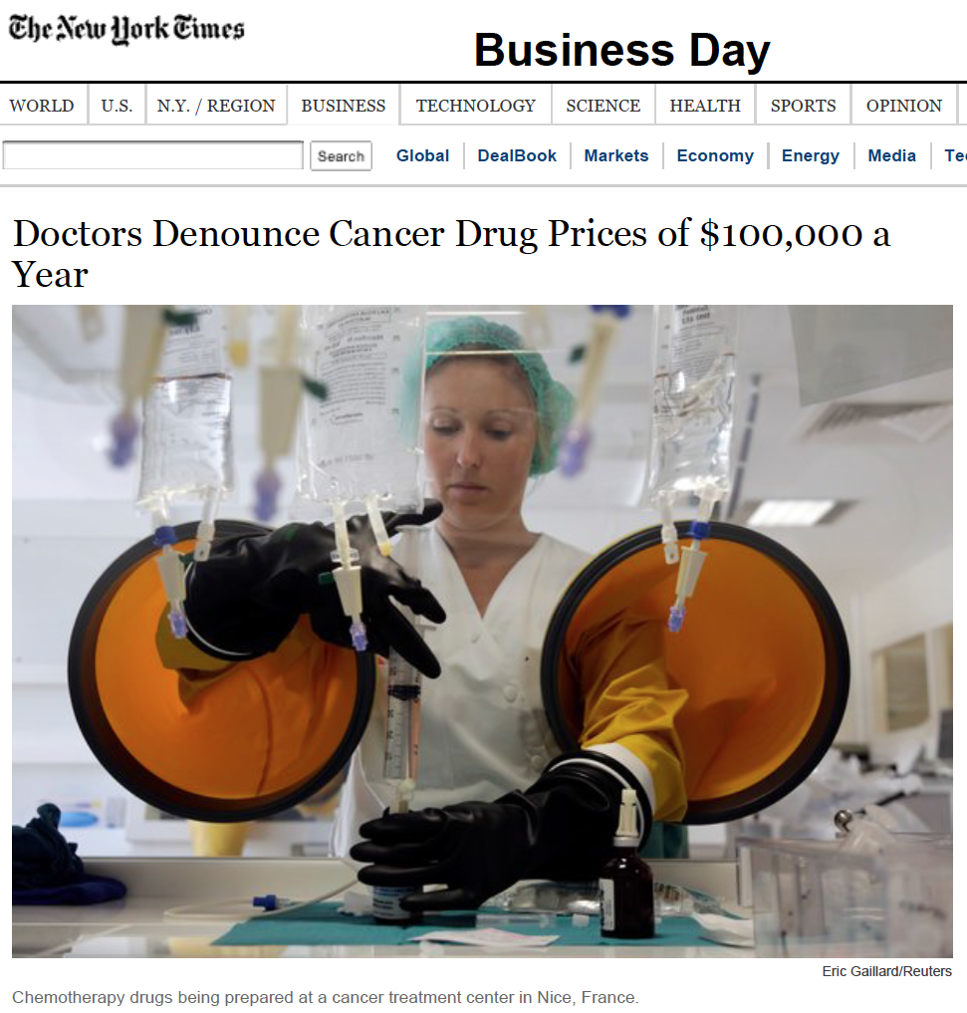
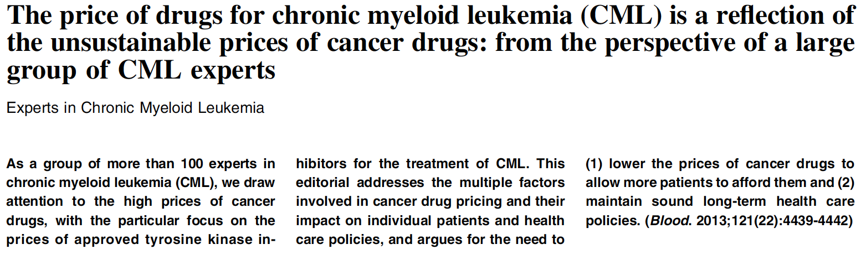

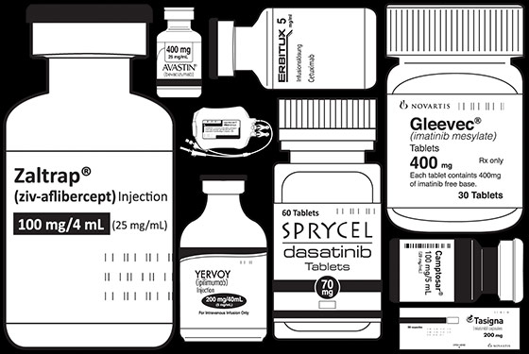
Reality check: Cost of Therapy
Fig 1. Average wholesale price of Gleevec per year at 400 mg per day—typical dosing for chronic myelogenous leukemia maintenance therapy—from 2005 to 2015, according to Redbook data.2 Prices were adjusted to 2015 USD using the US Department of Labor’s Consumer Price Index
Chen CT, Kesselheim AS, JOP 13: 352-355, 2017
Kantarjian H. Blood 121: 4439-4442, 2013
Pollack A, NY Times, Published 4/25/13
Hall S, New York Magazine, Published 10/20/13

Slide 59
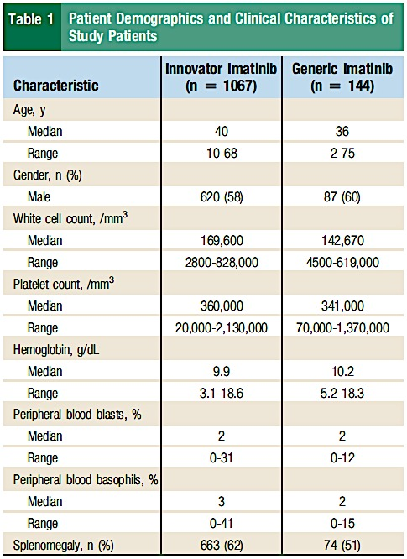
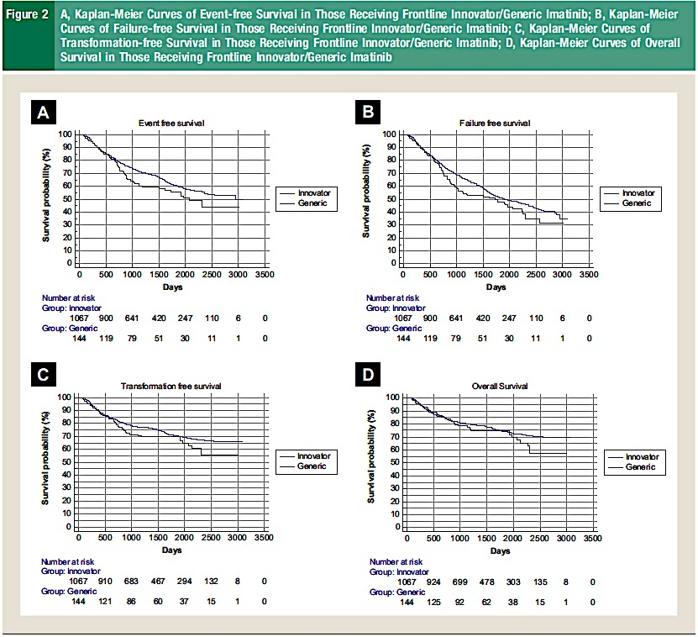
Survival of the Cheapest:
Branded imatinib vs generic, India
Danthala M et al. Clin Lymph, Myel, Leuk 17(7), 457-62, 2017

Slide 60
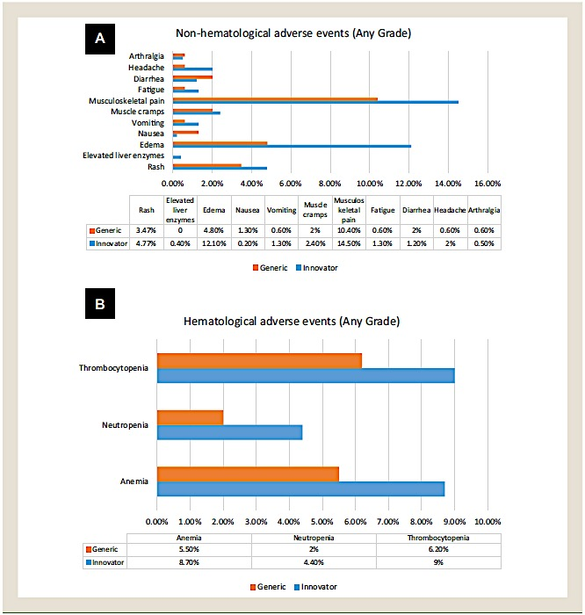
Branded vs generic imatinib: toxicity
In certain healthcare systems generic substitutions can rotate (different manufacturer with each Rx)
Closer AE monitoring?
Differences in common AEs?
Observe for tolerance, need for stepped-up response monitoring after change?
Danthala M et al. Clin Lymph, Myel, Leuk 17(7), 457-62, 2017
Danthala M et al. Clin Lymph, Myel, Leuk 17(7), 457-62, 2017

Slide 61
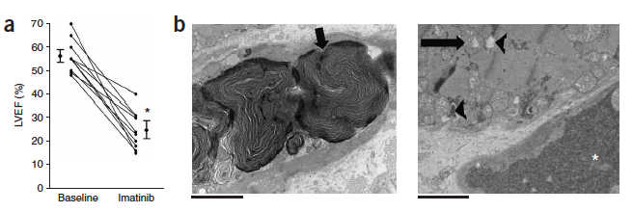
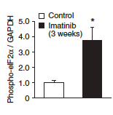
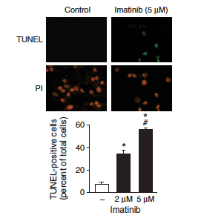
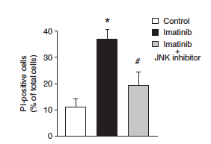
Cardiomyopathy associated with imatinib
Decreased EF
Myocyte injury
Myocyte apoptosis
Injury via endoplasmic
reticulum stress response
Mediated via c-Jun
N-terminal kinase
Kerkela R et al. Nat Med 2006; 12(8):908-16.

Slide 62
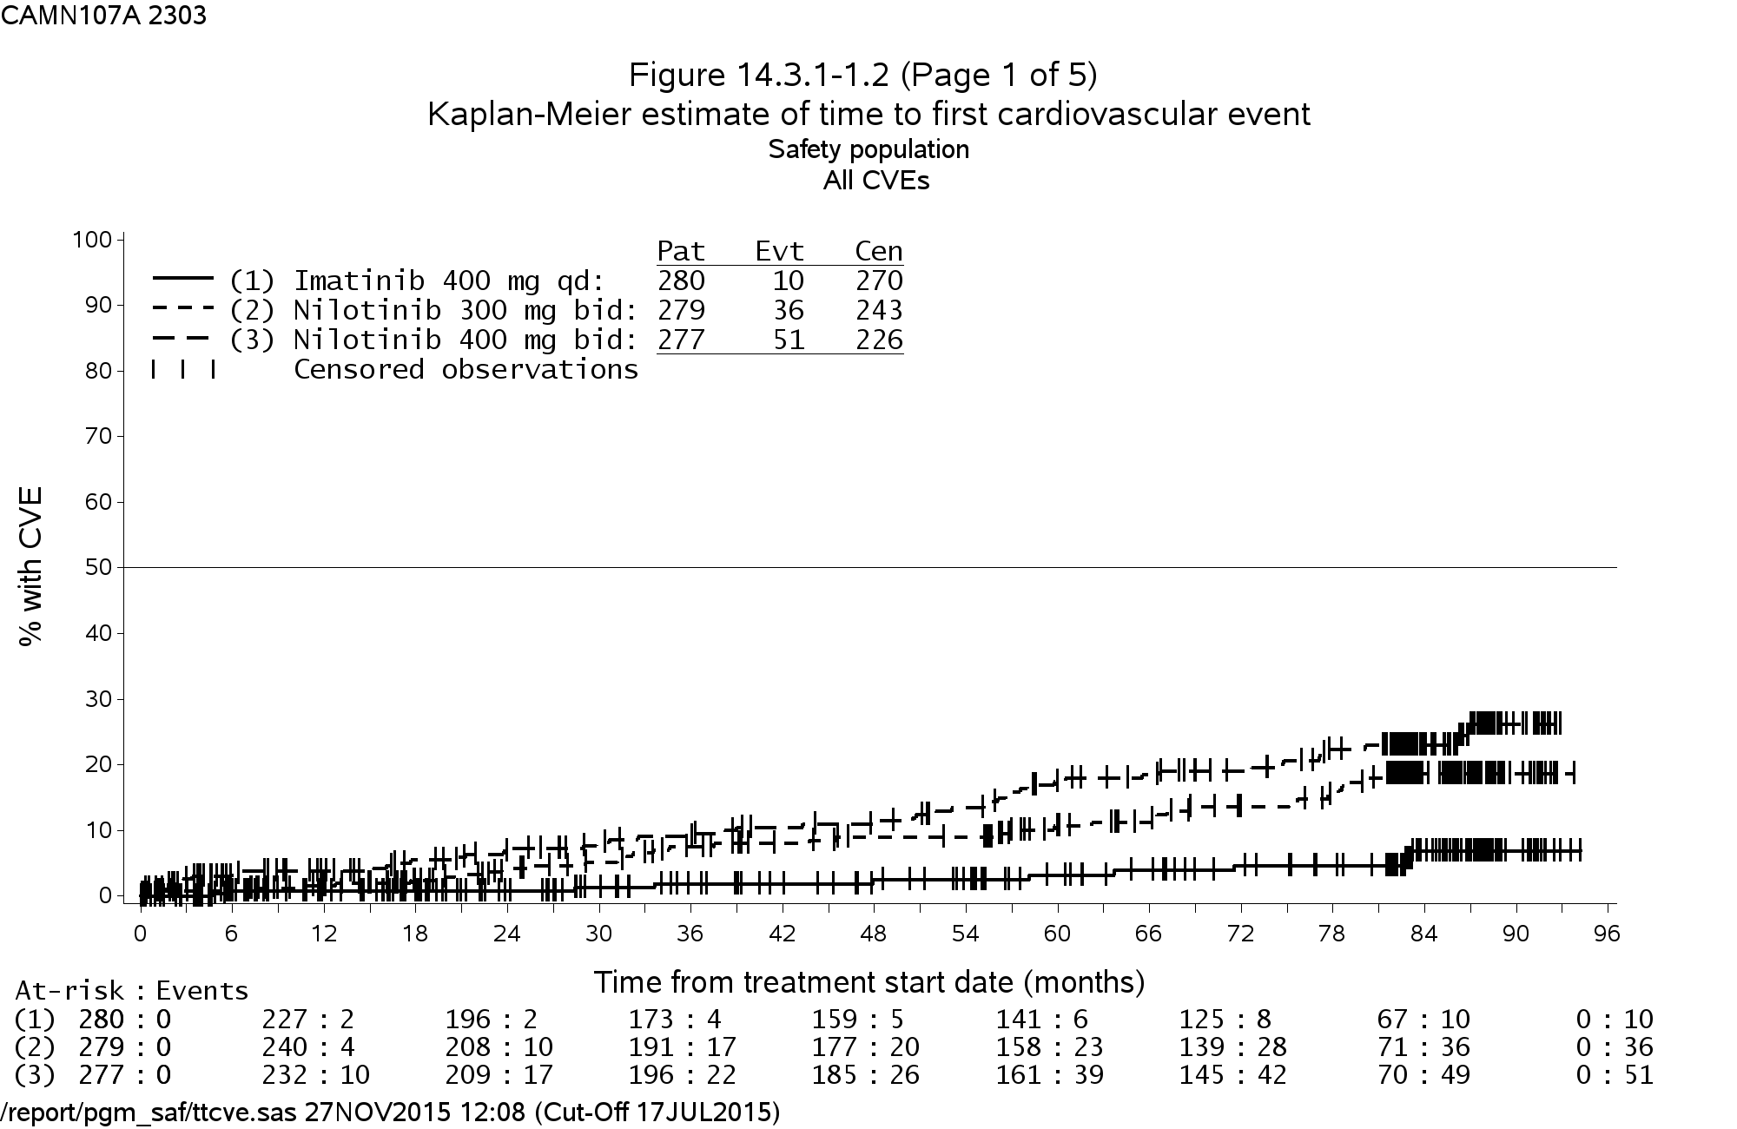
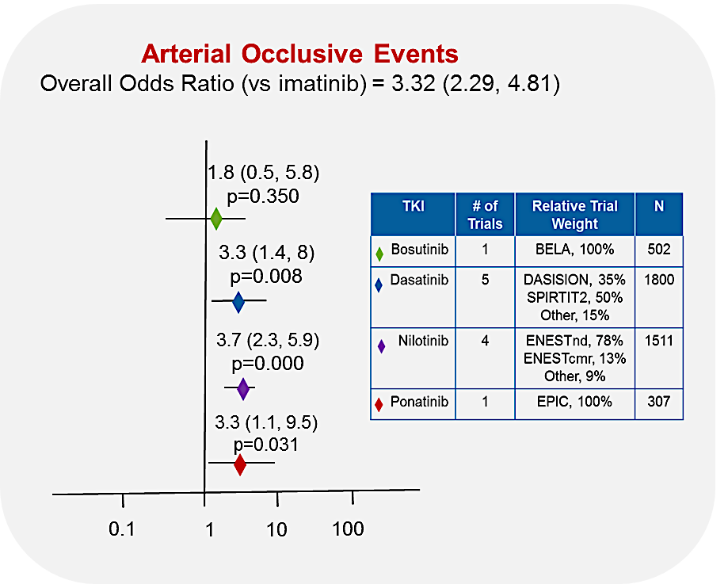
100
90
80
70
60
50
40
30
20
10
0
ENESTnd 6 year data: % with CVE
Vascular Occlusive Events:
Some TKI?
Many TKI?
 |  | Pat | Evt | Cen
 | (1) Imatinib 400 mg qd: | 280 | 10 | 270
 | (2) Nilotinib 300 mg bid: | 279 | 36 | 243
 | (3) Nilotinib 400 mg bid: | 227 | 51 | 226
 | Censored observations
0 | 6 | 12 | 18 | 24 | 36 | 42 | 48 | 54 | 60 | 66 | 72 | 78 | 84 | 90 | 96
Time from Treatment Start Date (Months)
At-risk: Events
(1) | 280:0 | 227:2 | 196:2 | 173:4 | 159:5 | 141:6 | 125:8 | 67:10 | 0:10
(2) | 279:0 | 240:0 | 208:10 | 191:17 | 177:20 | 158:23 | 139:28 | 71:36 | 0:36
(3) | 277:0 | 232:10 | 209:17 | 196:22 | 185:26 | 161:39 | 145:42 | 70:49 | 0:51
Mechanism remains unclear
Further follow-up of recent trials (BFORE, etc) important
Hochhaus et al., Leukemia 2016
Haguet et al. Expert Opin Drug Saf. 2016

Slide 63
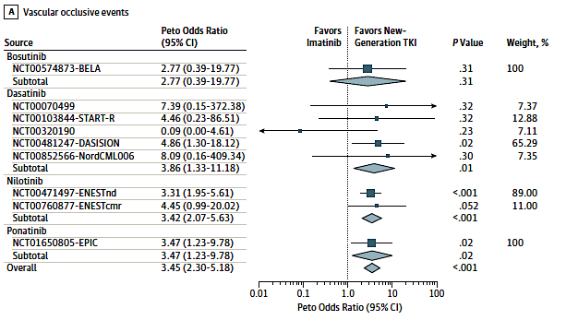
Meta-analysis: imatinib versus subsequent generation TKIs, VOEs
Douxfils J et al, Lancet Oncology, 2016

Slide 64
TKI (adult dose)¹ | Cardiovascular, pulmonary, and metabolic disorder summary¹ | Reported in the literature² |  |  |  |  |  | Careful monitoring and caution advised for certain patients¹
 |  | Pleural effusion | Pericardial effusion | AOD | VT | PH | Fasting glucose ↑
Imatinib (400–600 mg QD) | •CHF and left ventricular dysfunction •Rare pulmonary toxicity | – | – | –* | – | – | # | •Patients with cardiac disease and risk factors for cardiac failure
Dasatinib (100–140 mg QD) | •PAH, pleural effusions, pneumonitis •QT prolongation | ++ | +/- | +/-* | – | +/- | – | •Patients with pre-existing cardiopulmonary disease and those who may develop QT prolongation
Nilotinib (300–400 mg BID) | •QT prolongation (boxed warning) •Cardiac and arterial vascular occlusive events •Hyperlipidemia or hyperglycemia •Sudden deaths •Rare pleural effusions | – | – | ++ | – | – | ++ | •Patients at risk for hyperlipidemia or hyperglycemia •Avoid in patients with long QT syndrome, hypokalemia, or hypomagnesemia
Bosutinib (500 mg QD) | •Cardiovascular, pulmonary, and metabolic toxicities are generally low •Rare pleural effusions | – | – | +/-* | – | – | – | •Patients with cardiovascular risk factors
Ponatinib (45 mg QD) | •Vascular occlusion (boxed warning) •Heart failure (boxed warning) •Hypertension •Arrhythmias •Possible pulmonary hypertension | – | – | ++ | +/- | – | – | •Patients with hypertension or pre-existing cardiopulmonary disease •Patients at risk for arrhythmias or heart failure
CV/Vascular AEs
Overview
++ >20% of patients in ≥2 different studies
+ >5% of patients in ≥2 different studies
+/- 1–5% of patients in ≥1 study
– <1% of patients
# Potential beneficial effect³
Frequency of AEs
(any grade):^{2,3}
1. Medeiros B, et al. Blood Rev 2018;32:289–99;
2. Valent P, et al. Blood 2015;125:901–6;
3. Agostino NM, et al. J Oncol Pharm Pract 2011;17:197–202

Slide 65


Role of additional markers of clonal hematopoiesis
Coronary Artery Disease:
Traditional RF and ARCH mutations
ARCH mutations in NIL patients:
Association with AOD?
Jaiswal S et al, NEJM 371: 2488-98, 2014; Hadzijusufovic E et al, Leukemia 2017 epub 9/8/2017

Slide 66
OPTIC Study:
a dose-optimization study of 3 starting doses of Ponatinib (PON)
Background
PON demonstrated deep and long-lasting responses and survival in patients with CP CML resistant/intolerant to second-generation TKI therapy (PACE; NCT01207440)
Here we present the primary analysis of OPTIC (NCT02467270), an ongoing, randomized, phase 2 trial with a novel response-based dosing regimen of PON in pts with resistant/intolerant CP CML
Aims
Evaluate the safety and efficacy of ponatinib response–based dosing regimens in patients with resistant/intolerant CP CML
Methods
Patients with CP CML resistant/intolerant to ≥2 TKIs or with the BCR-ABL1 T315I mutation were randomized to PON starting doses of 45 mg (cohort A; 45 mg → 15 mg), 30 mg (B; 30 mg → 15 mg), and 15 mg (C) once daily
Doses were reduced to 15 mg with achievement of ≤1% BCR-ABL1^{IS} in cohorts A and B
The primary endpoint is ≤1% BCR-ABL1^{IS} at 12 months; secondary endpoints include cytogenetic and molecular responses and safety outcomes
CP-CML, chronic phase chronic myeloid leukemia; IS, international scale; PON, ponatinib; TKI, tyrosine kinase inhibitor.

Slide 67
OPTIC Study:
a dose-optimization study of 3 starting doses of Ponatinib (PON)
Responseª | Cohort A 45 mg | Cohort B 30 mg | Cohort C 15 mg
BCR-ABL1^{IS} ≤1% at 12 months, % (n/N) | 44 (41/93) | 29 (27/93) | 23 (21/91)
BCR-ABL1^{IS} ≤1% by 12 months, by mutation status at baseline % (n/N) | 52 (48/93) | 35 (33/93) | 25 (23/91)
Response in pts with T315I mutation | 60 (15/25) | 25 (5/20) | 11 (2/19)
Response in pts without T315I mutation | 48 (32/66) | 38 (28/73) | 30 (21/71)
Survival probability at 36 months, % (95% CI)
PFS | 73 (58, 84) | 66 (48, 80) | 70 (55, 80)
OS | 89 (79, 95) | 89 (77, 95) | 92 (82, 96)
ªIncludes all pts who are randomized and with measurable BCR-ABL1^{IS} at BL
283 patients were randomized
Cohort A
n=94
Cohort B
n=95
Cohort C
n=94
Most common grade ≥3 TEAEs
Thrombocytopenia 17%
Neutropenia
17%
Anemia
7%
AOE / Serious AOEs
Cohort A
10% / 4%
Cohort B
5% / 4%
Cohort C
3% / 3%
Dose reductions / discontinuations
Cohort A
46% / 19%
Cohort B
35% / 16%
Cohort C
32% / 14%
The OPTIC primary analysis demonstrates the optimal benefit:risk profile for PON was achieved with a response-based dosing regimen starting with 45 mg/d, followed by dose reduction to 15 mg/d upon achieving ≤1% BCR-ABL1^{IS}
AOE, arterial occlusive events; IS, international scale; OS, overall survival; PFS, progression free survival; PON, ponatinib; pts, patients; TEAE, treatment-emergent adverse event.

Slide 68

Asciminib Phase I Patient Characteristics, Disposition

Slide 69

Asciminib Phase I Response- Categorical Shift

Slide 70
STIM trial long-term follow-up / molecular recurrence
N=61; Median follow-up = 63 mo.
4 patients died after molecular recurrence (MR) of CML-unrelated causes
MR : 80% within mo. 1-3, 15% within mo. 4-7 and 5% (n=3) within mo. 18 to 22
Median time to MR : 2.5 mo. (range,0.8 to 22.2)
57 out of the 61 pts restarted TKI (imatinib, n=56; dasatinib , n=1) and 55 achieved 2nd CMR at a median of 4.2 months
Median follow-up of 63 mo. :
- None of the MR patients have CML progression event
Cumulative incidence of MR
Months since stop of imatinib
Number at risk: 100 44 41 38 38 38 38 37 29 25 19 11 5 1 0
ª (Pleural mesothelioma, metastatic gastric adenocarcinoma, acute renal failure, cerebral hemorrhage; one case of each)
Mahon FX et al, ASH 2015 Abstract #345

Slide 71


Treatment free remission (TFR) Studies: survival w/o loss of MMR: ~60%
100
12 mo: 61.1%
(95% CI: 45.6-76.6)
36mo: 61%
80
60
Survival without MMR loss %
40
A-STIM
20
STOP 2G TKI
0
0
6
12
18
24
30
36
42
100
Months since 2G-TKI discontinuation
Stable cCMR before stop
Unstable cCMR before stop
80
60
Molecular Relapse-Free Survival (%)
40
20
A-STIM
0
12
24
36
48
60
72
84
Time (months)
AUSTRALASIAN CML8
Rousselot P et al., J Clin Oncol. 2014 Feb 10;32(5):424-30
Rea D, et al. Blood (ASH) 2012: Abstract 916
Ross DM et al. Blood. 2013 Jul 25;122(4):515-22

Slide 72

What is really happening with TFR?
Patients who maintain MR^{4.5} off imatinib commonly have evidence of BCR-ABL when assessed with a more sensitive genomic DNA based test
Ten patients with loss of CMR had rising gDNA PCR levels, whereas a generally stable gDNA level was detectable in 7/8 patients with sustained CMR (follow-up 12-41 months)
Ross et al, Leukemia 2010

Slide 73
Do Adverse Events Occur With TKI Withdrawal?
N=200; 222 AEs in 98 patients were reported
57 AEs in 31 patients were related to treatment stop, no grade 4
 | Patients All Grade (n) | Patients Grade 3 (n) | AEs All Grade (n) | AEs Grade 3 (n)
Musculoskeletal pain, joint pain, arthralgia | 23 | 3 | 39 | 6
Other (sweating, skin disorders, folliculitis, depressive episodes, fatigue, urticaria, weight loss) | 8 | 0 | 18 | 3
Musculoskeletal pain in CML patients after discontinuation of imatinib:
a tyrosine kinase inhibitor withdrawal syndrome?
J. Richter et al. J Clin Oncol. 2014 Sep 1;32(25):2821-3.
Tyrosine kinase inhibitor withdrawal syndrome: a matter of c-kit ?
Response to Richter et al.
Ph. Rousselot et al.
Mahon FX et al, Blood 2014 124:151

Slide 74
Most Important : if Paradise is Lost, is it Regained?
Cumulative incidence of regained MR^{4.5} in A-STIM retreated pts after loss of MMR
With >500 patients reported and very large numbers under investigation, single case of transformation resulting from TFR trial
Percent MR^{4.5}
Median time to regain deep molecular remission: 7.3 mo
One patient with CML>15y experienced lymphoid blast crisis 8.5 mo from regained MMR after restarting imatinib
Rousselot P et al., J Clin Oncol. 2014 Feb 10;32(5):424-30.
.

Slide 75




    Thank you for your attention!
    Questions?
    maurom@mskcc.org
    212-639-3107

