Slide 1
Asco 2021 updates - gu cancers
Arjun Balar, M.D.
Associate Professor of Medicine
Director – Genitourinary Medical Oncology Program
Medical Director – Clinical Trials Office
Perlmutter Cancer Center

Slide 2
Prostate cancer updates

Slide 3
Phase 3 study of ¹⁷⁷Lu-PSMA-617 in patients with metastatic castration-resistant prostate cancer (VISION)
Presenter: Michael J. Morris, Memorial Sloan Kettering Cancer Center
Co-authors: J. de Bono, K. N. Chi, K. Fizazi, K. Herrmann, K. Rahbar,
S. T. Tagawa, L. T. Nordquist, N. Vaishampayan, G. El-Haddad, C. H. Park, T. M. Beer, W. J. Pérez-Contreras, M. DeSilvio, E. Kpamegan, G. Gericke, R. A. Messmann, B. J. Krause, O. Sartor, for the VISION investigators
6 June 2021

Slide 4
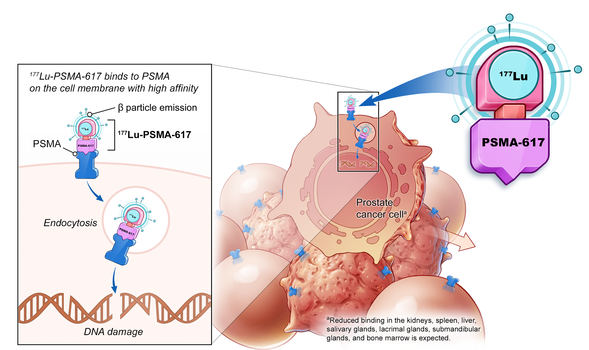
¹⁷⁷Lu-PSMA-617 targeted radioligand therapy
Prostate cancer cell and neighbouring
cell death

Slide 5
Open-label study of protocol-permitted standard of care ± ¹⁷⁷Lu-PSMA-617 in adults with PSMA-positive mCRPC
Eligible patients
Previous treatment with both
  ≥ 1 androgen receptor
  pathway inhibitor
  1 or 2 taxane regimens
Protocol-permitted standard of care (SOC) planned before randomization
  Excluding chemotherapy immunotherapy, radium-223, investigational drugs
ECOG performance status 0–2
Life expectancy > 6 months
PSMA-positive mCRPC on PET/CT
with ⁶⁸Ga-PSMA-11
Protocol-permitted SOC +
¹⁷⁷Lu-PSMA-617
7.4 GBq (200 mCi) every 6 weeks
4 cycles, increasable to 6
Treatment
Follow-up
Final analysis
2:1
Protocol-permitted SOC
alone
  Randomization stratified by
    ECOG status (0–1 or 2)
    LDH (high or low)
    Liver metastases (yes or no)
    Androgen receptor pathway inhibitors in SOC (yes or no)
  CT/MRI/bone scans
    Every 8 weeks (treatment)
    Every 12 weeks (follow-up)
    Blinded independent central review

Slide 6
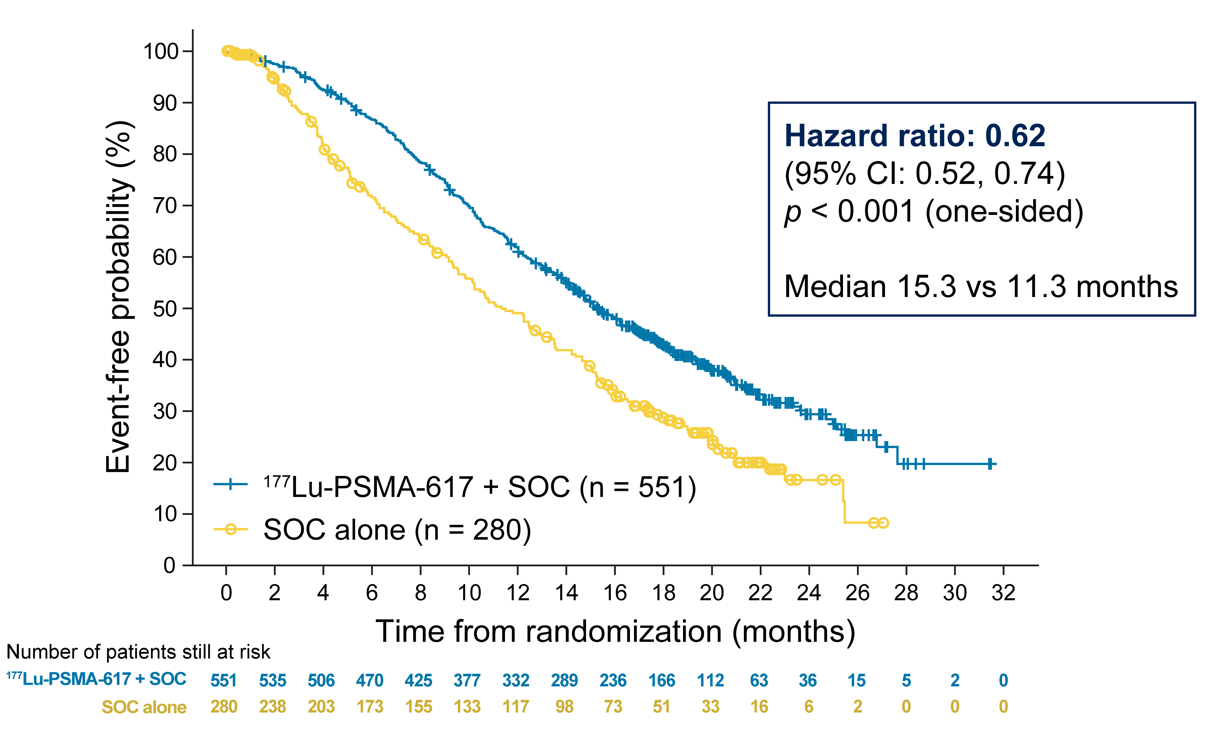
Primary endpoints: ¹⁷⁷Lu-PSMA-617 prolonged OS
Primary
analysis
  All randomized
  patients
  (N = 831)

Slide 7
Secondary endpoint: RECIST v1.1 responses favored the ¹⁷⁷Lu-PSMA-617 arm in patients with measurable disease
46.9%
45.3%
41.8%
¹⁷⁷Lu-PSMA-617 + SOC (n = 184)
35.3%
SOC alone (n = 64)
13.0%
9.2%
3.1%
4.7%
0.0%
0.5%
Complete
response
Partial
response
Stable
disease
Progressive
disease
Unknown
Best overall response per RECIST v1.1

Slide 8
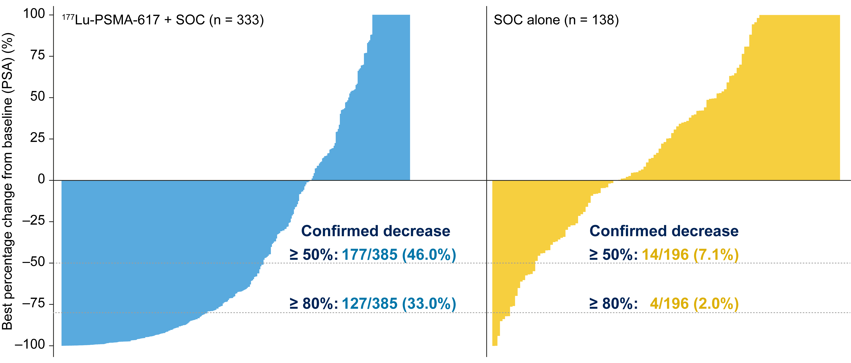
Secondary endpoint: PSA responses favored the
¹⁷⁷Lu-PSMA-617 arm among evaluable patients

Slide 9
Treatment-emergent adverse events grouped as topics of interest: no unexpected or concerning safety signals
Patients, n (%) | All grades |  |  | Grade 3–5
 | ¹⁷⁷Lu-PSMA-617 + SOC (n = 529) | SOC alone (n = 205) |  | ¹⁷⁷Lu-PSMA-617 + SOC (n = 529) | SOC alone (n = 205)
Fatigue | 260 (49.1) | 60 (29.3) |  | 37 (7.0) | 5 (2.4)
Bone marrow suppression | 251 (47.4) | 36 (17.6) |  | 124 (23.4) | 14 (6.8)
Leukopenia Lymphopenia Anemia Thrombocytopenia | 66 (12.5) 75 (14.2) 168 (31.8) 91 (17.2) | 4 (2.0) 8 (3.9) 27 (13.2) 9 (4.4) |  | 13 (2.5) 41 (7.8) 68 (12.9) 42 (7.9) | 1 (0.5) 1 (0.5) 10 (4.9) 2 (1.0)
Dry mouth | 208 (39.3) | 2 (1.0) |  | 0 (0.0) | 0 (0.0)
Nausea and vomiting | 208 (39.3) | 35 (17.1) |  | 8 (1.5) | 1 (0.5)
Renal effects | 46 (8.7) | 12 (5.9) |  | 18 (3.4) | 6 (2.9)
Second primary malignancies | 11 (2.1) | 2 (1.0) |  | 4 (0.8) | 1 (0.5)
Intracranial hemorrhage | 7 (1.3) | 3 (1.5) |  | 5 (0.9) | 2 (1.0)

Slide 10
VISION study conclusions
  Adding ¹⁷⁷Lu-PSMA-617 to safely combinable standard of care in patients with mCRPC after androgen receptor pathway inhibition and chemotherapy
      Extended overall survival
      Delayed radiographic disease progression
  ¹⁷⁷Lu-PSMA-617 was well tolerated
  These findings warrant adoption of ¹⁷⁷Lu-PSMA-617 as a new treatment option
  in patients with mCRPC

Slide 11
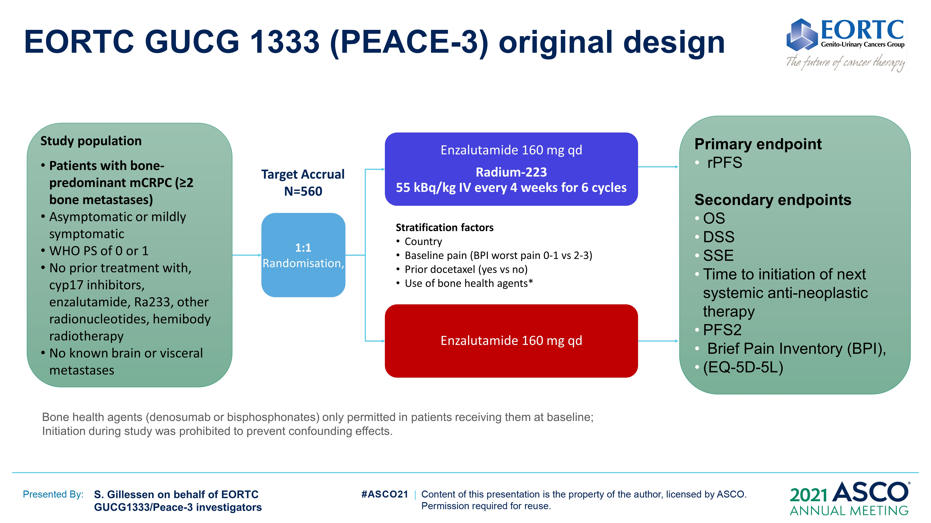
EORTC GUCG 1333 (PEACE-3) original design
Content of this presentation is the property of the author, licensed by ASCO. Permission required for reuse.

Slide 12
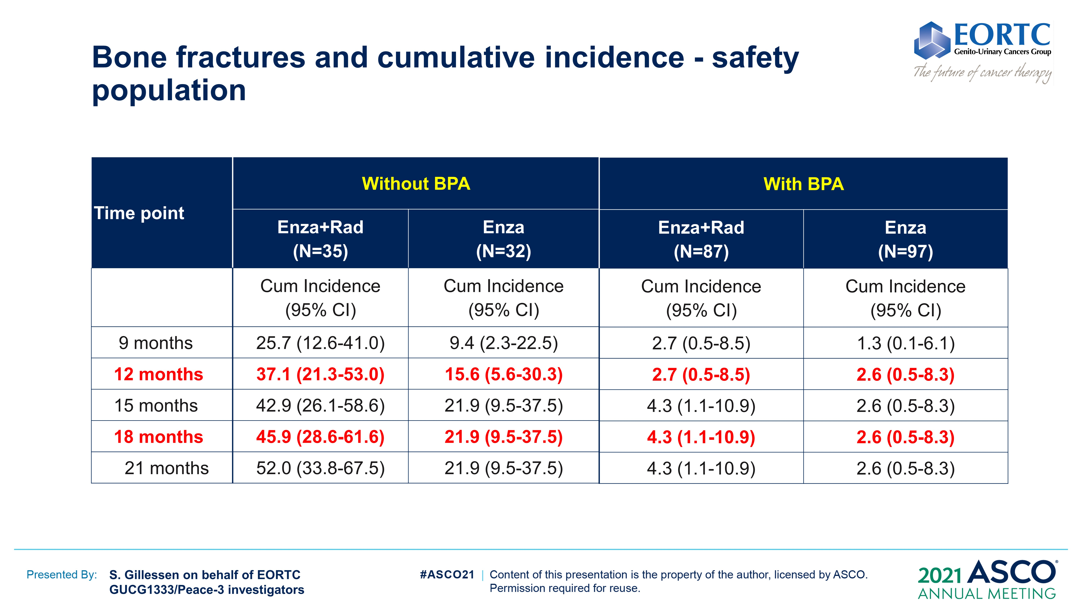
Bone fractures and cumulative incidence - safety population
Content of this presentation is the property of the author, licensed by ASCO. Permission required for reuse.

Slide 13
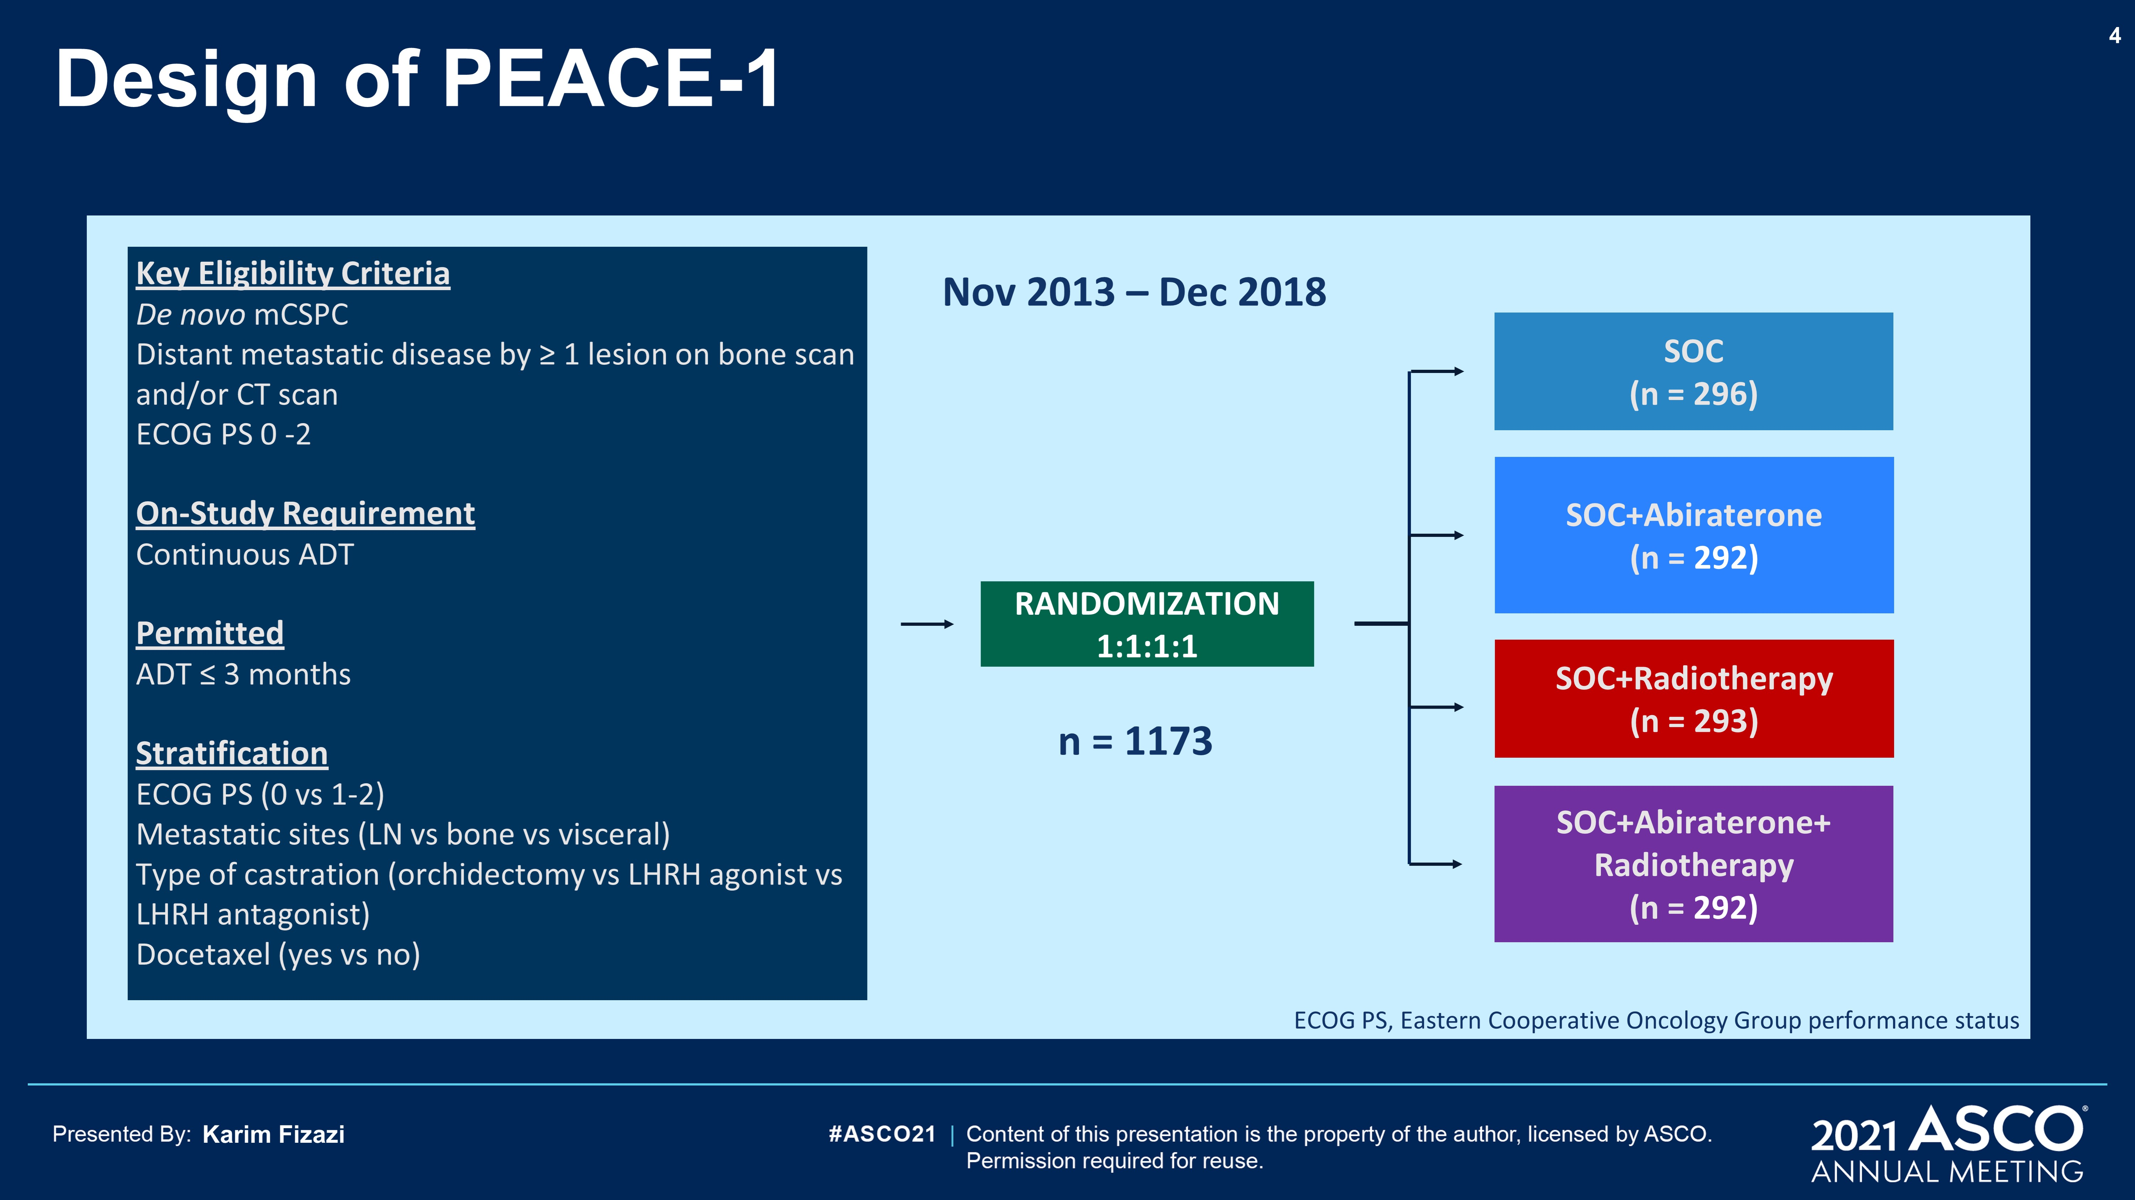
Design of PEACE-1
Content of this presentation is the property of the author, licensed by ASCO. Permission required for reuse.

Slide 14
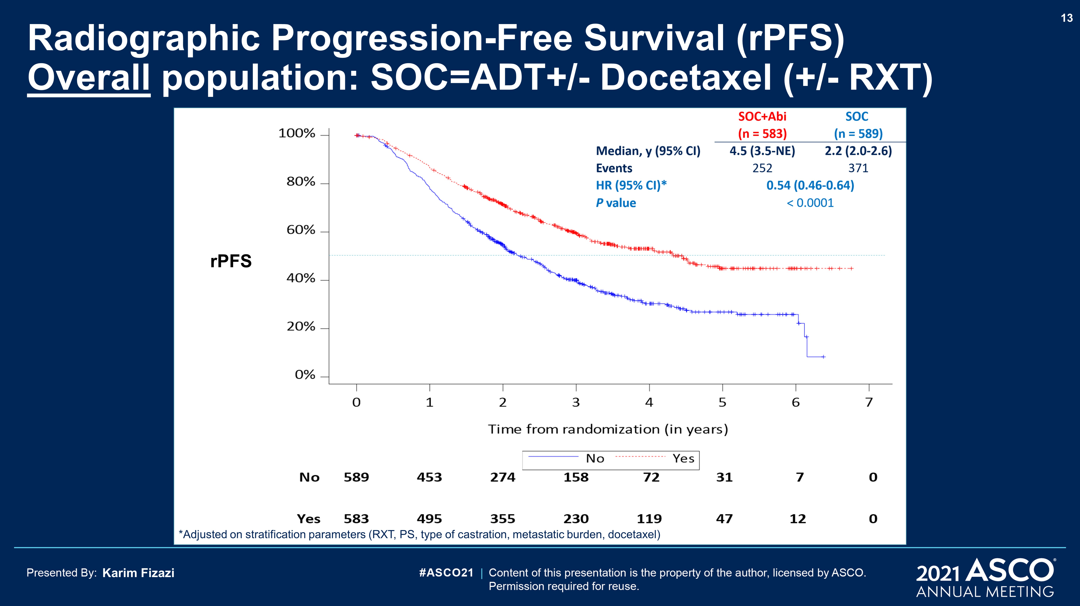
Content of this presentation is the property of the author, licensed by ASCO. Permission required for reuse.

Slide 15
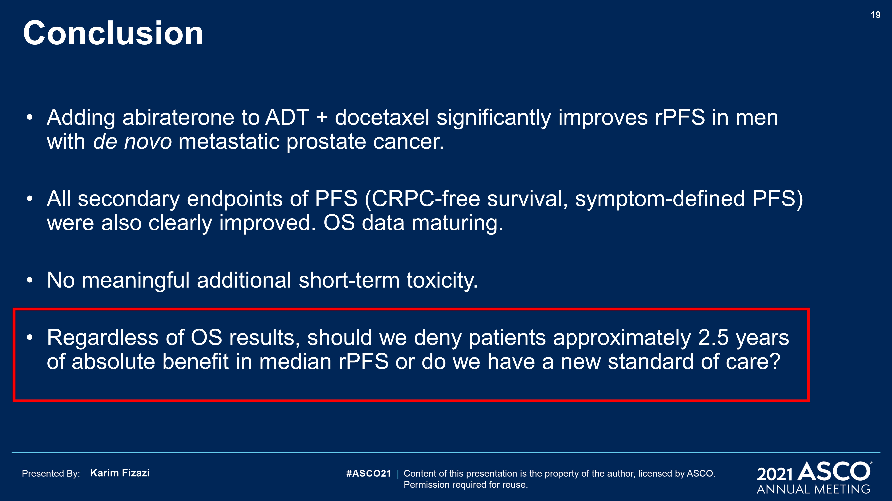
Conclusion
Content of this presentation is the property of the author, licensed by ASCO. Permission required for reuse.

Slide 16
Darolutamide (DARO) tolerability from extended follow up and treatment response in the phase 3 ARAMIS trial
DARO remained well tolerated with extended treatment at the recommended dose of 600 mg twice daily
Long-term treatment with DARO extends survival and delays disease progression in men with nmCRPC
Majority of patients on DARO showed a ≥50% decline in PSA from baseline
Fizazi K et al. ASCO 2021;Abstract 5079.

Slide 17
Interim results of AASUR: apalutamide (A)+ abiraterone acetate + prednisone (AA+P) + leuprolide with stereotactic ultrahypofractionated radiation (UHRT) in very high risk, node negative prostate cancer (PCa).
Phase II trial with 64 pts with very high risk PCa treated with A, AA+P, and leuprolide with prostate/seminal vesicle-directed RT
Compared to historic controls with the long course ADT, AASUR demonstrated impressive 3-yr bRFS and limited toxicities
The safety profile of this regimen was consistent with the known AE profile of the androgen receptor signaling inhibitors and RT
McBride SM et al. ASCO 2021;Abstract 5012.

Slide 18
Bladder cancer updates

Slide 19
Pembrolizumab in combination with gemcitabine and concurrent hypofractionated radiation therapy as bladder sparing treatment for muscle-invasive urothelial cancer of the bladder: A multicenter phase 2 trial
Arjun V. Balar¹, Matthew I. Milowsky², Peter H. O'Donnell³, Ajjai S Alva⁴, Marisa Kollmeier⁵, Tracy L Rose², Sean Pitroda³, Samuel D. Kaffenberger⁴, Jonathan E. Rosenberg⁵, Kaitlyn Francese¹, Tsivia Hochman¹, Judith D Goldberg¹, Sarah Griglun¹, Dayna Leis¹, Gary D. Steinberg⁷, James Wysock⁷, Peter B. Schiff¹, Nicholas J. Sanfilippo⁶, Samir S. Taneja⁷ and William C. Huang⁷
¹Laura and Isaac Perlmutter Cancer Center at NYU Langone Health and The NYU Grossman School of Medicine, New York, NY; ²The University of North Carolina at Chapel Hill (UNC-CH) School of Medicine and UNC Lineberger Comprehensive Cancer Center, Chapel Hill, NC; ³The University of Chicago Comprehensive Cancer Center, Chicago, IL; ⁴University of Michigan Rogel Cancer Center, Ann Arbor, MI; ⁵Memorial Sloan Kettering Cancer Center, New York, NY; ⁶Weill Cornell Medicine, New York, NY; ⁷Department of Urology at NYU Langone Health and The NYU Grossman School of Medicine, New York, NY

Slide 20
TREATMENT SCHEMA
Assessment of Response
KEY ELIGIBILITY CRITERIA
UC Histology
Mixed Allowed
cT2-T4aN0M0
ECOG PS 0 or 1
RC ineligible/ refusing
No Perioperative ChemoTx
4 WEEKS CHEMORADIATION
52 Gy x 20 Fx Bladder Only
w Gemcitabine 27 mg/m2
Twice Weekly
TUR
of Tumor Bed
+
UCy
Pembro
200 mg IV
Maximal TURBT
12 Wks
Post-RT
2-3 Wks
3-4 Wks
Pembrolizumab
200 mg IV every 3 weeks for 3 doses
CT/MR AP w Contrast
5 Years Disease Surveillance on Study beginning post-RT
Imaging:
CT/MR AP Q3 months for 18 months, Q6 months for 18 months, Q12 months for 24 months.
Cystoscopy/Cytology
Q3 months for 12 months, Q4 months for 12 months, Q6 months for 3 years

Slide 21
Bladder-Intact Disease-Free Survival
All Patients (N=54)
Bladder Intact Disease Free Survival – Phase II Cohort
With Number of Subjects at Risk
100
80
1 year estimated BIDFS rate: 89% (95% CI 0.76 – 0.95)
60
Probability of Recurrence or Death
(%)
40
20
A
t Risk:
0
48
39
26
19
9
3
0
0
6
12
18
24
30
36
Months to Recurrence or Death
Median Follow up All Patients: 15.5 months (1.6 months – 56.5 months)

Slide 22
Safety
 | Grade 1 and 2 | %
Fatigue | 12 | 25.0%
Rash Maculopapular | 11 | 22.9%
Alanine Aminotransferase | 5 | 10.4%
Pruritus | 5 | 10.4%
Aspartate Aminotransferase | 4 | 8.3%
Diarrhea | 4 | 8.3%
Anorexia | 3 | 6.3%
Arthralgia/Arthritis | 4 | 8.3%
Chills/Cold/Flu | 3 | 6.3%
Nausea | 3 | 6.3%
Dyspnea | 2 | 4.2%
Malaise | 2 | 4.2%
Myalgia | 2 | 4.2%
Cough | 1 | 2.1%
Creatinine Increased | 1 | 2.1%
Cystitis | 1 | 2.1%
Dry Skin | 1 | 2.1%
Elevated LFTs | 1 | 2.1%
Fever | 1 | 2.1%
Gastrointestinal Disorder | 1 | 2.1%
Hyperglycemia | 1 | 2.1%
Hypothyroidism | 1 | 2.1%
Immune Disorder, Other | 1 | 2.1%
Infection - Other | 1 | 2.1%
Retinopathy | 1 | 2.1%
 | Gr 3 | % | Gr 4 | %
Immune-related Protein-losing enteropathy | 1 | 2.1% |  | 0%
Immune-related Polyneuropathy | 1 | 2.1% |  | 0%
Neutropenia | 1 | 2.1% |  | 0%
Urinary Tract Infection | 1 | 2.1% |  | 0%
Colonic Perforation |  |  | 1 | 2.1%
Toxicities: Suspected Related to Pembrolizumab (N=48)
Efficacy Cohort
9 of 48 patients (19%) were treated with systemic corticosteroids for the management of an immune-related adverse event
3 Arthritis/Arthralgia
2 Transaminitis
1 Nephritis
1 Protein-losing enteropathy
1 Polyneuropathy (after lead-in pembrolizumab)
1 Colonic perforation

Slide 23
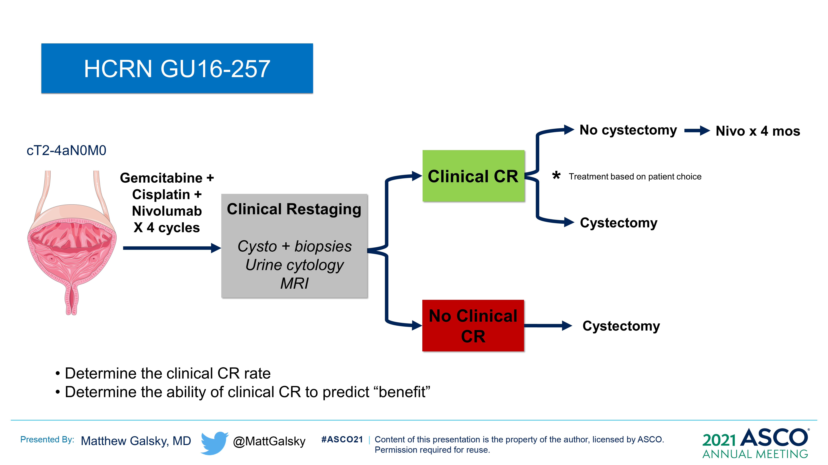
Slide 12
Content of this presentation is the property of the author, licensed by ASCO. Permission required for reuse.

Slide 24
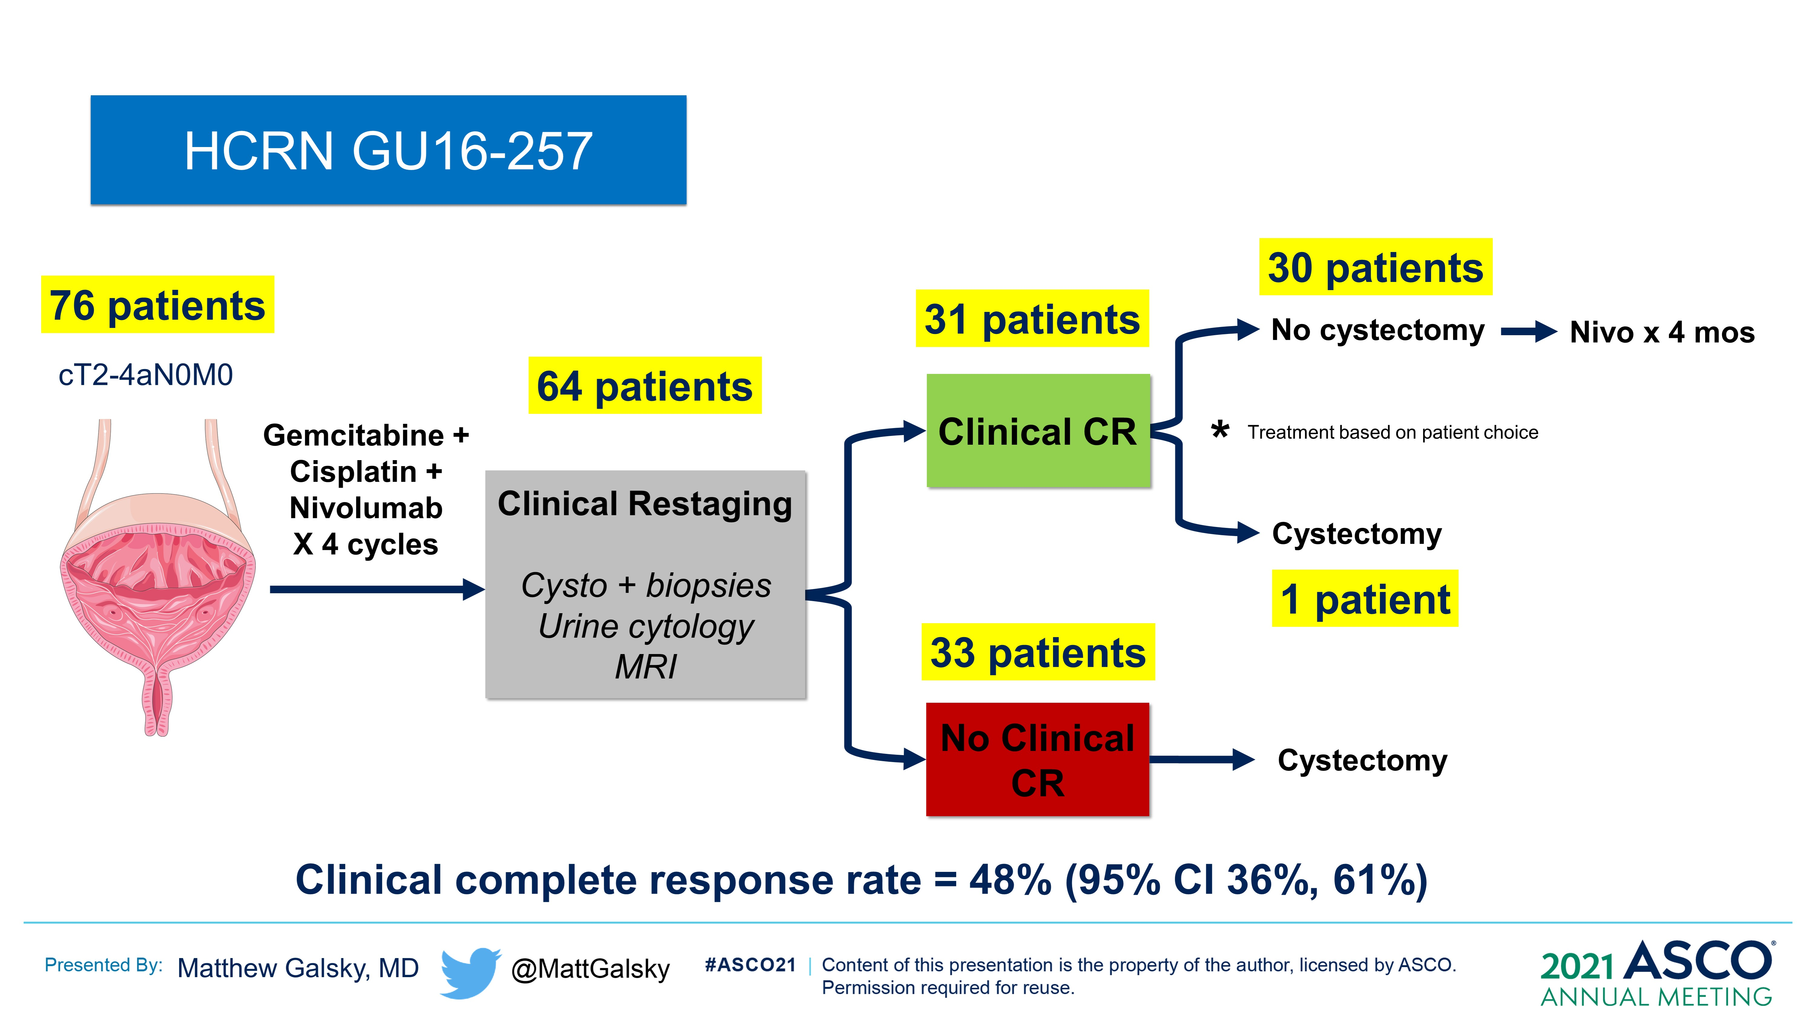
Slide 21
Content of this presentation is the property of the author, licensed by ASCO. Permission required for reuse.

Slide 25
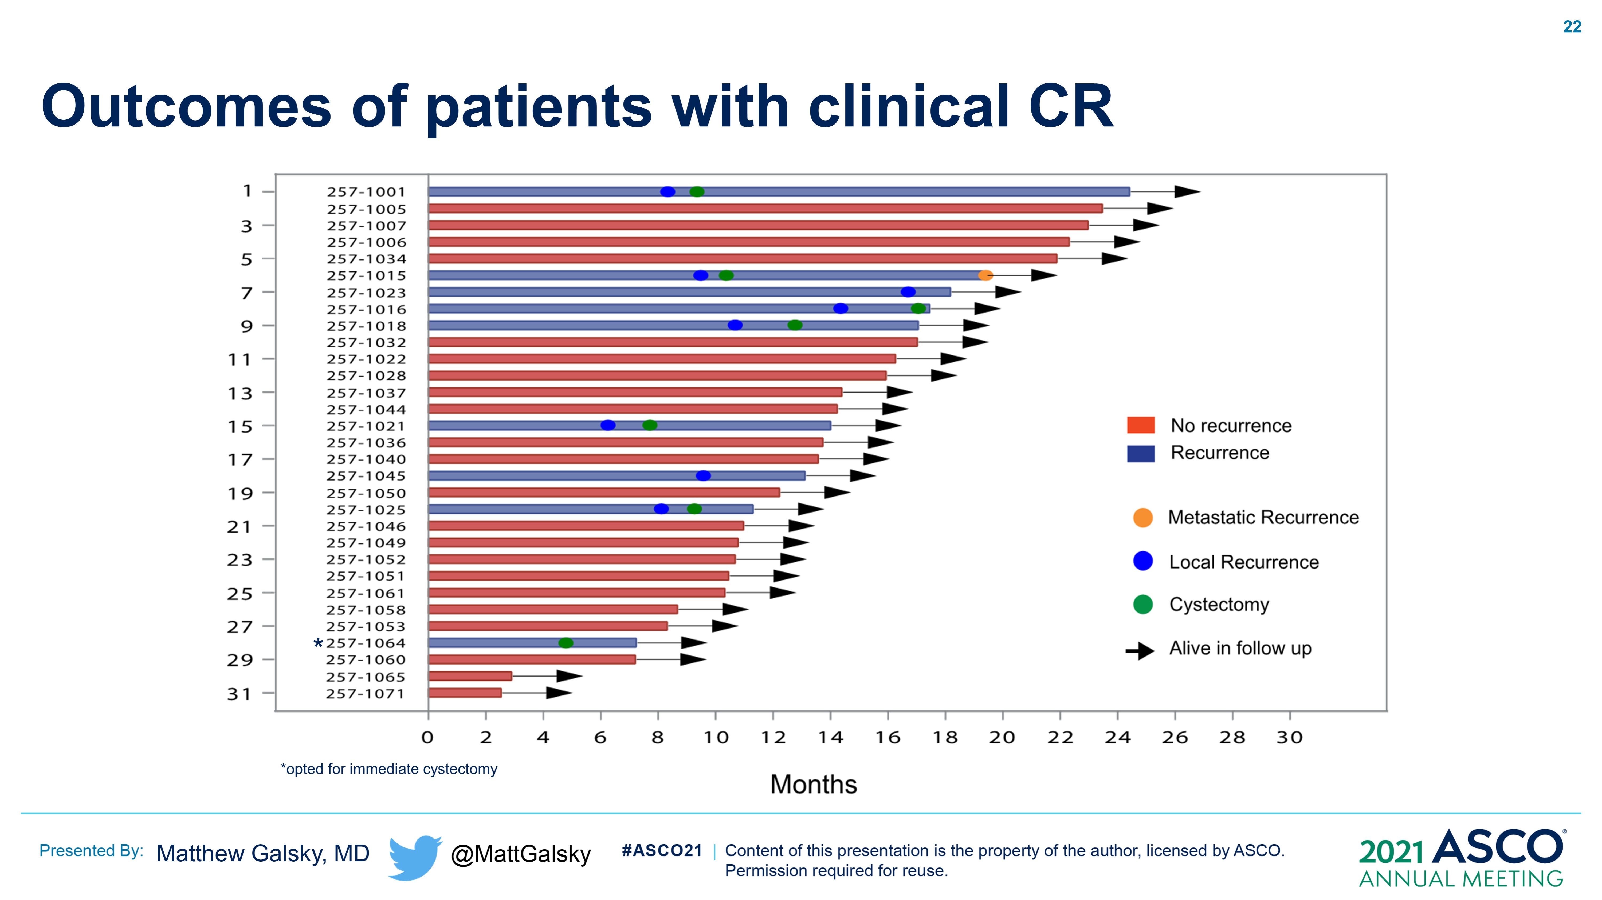
Outcomes of patients with clinical CR
Content of this presentation is the property of the author, licensed by ASCO. Permission required for reuse.

Slide 26
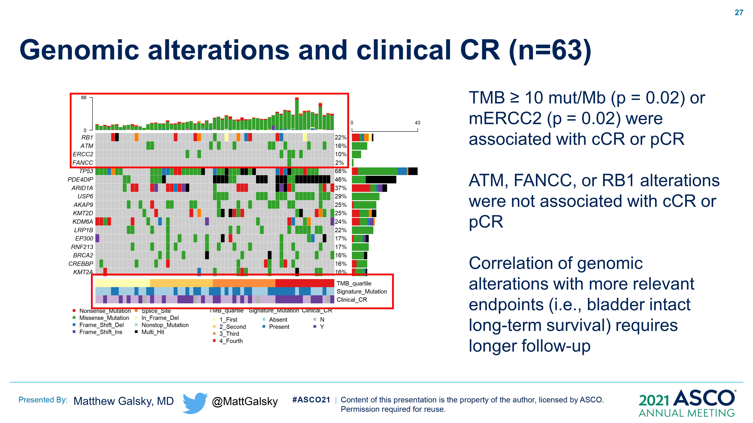
Genomic alterations and clinical CR (n=63)
Content of this presentation is the property of the author, licensed by ASCO. Permission required for reuse.

Slide 27
KEYNOTE-052 Study Design
Key Eligibility Criteria
Histologically or cytologically confirmed locally advanced/metastatic UC of the renal pelvis, ureter, bladder, or urethra
Measurable disease based on RECIST v1.1 per independent central review
No prior systemic chemotherapy for UCª
Ineligible for cisplatin-based chemotherapy
ECOG PS 0-2
Disease status and tumor response assessed by CT/MRI
9 weeks after first Pembrolizumab dose, then Q6W for 12 months and Q12W thereafter^{b}
N = 370
Pembrolizumab
200 mg IV Q3W
Primary end point: confirmed ORR per RECIST v1.1 by independent radiology review
Secondary end points: PFS and DOR per RECIST v1.1 by independent radiology review, OS, safety
End points analyzed for the overall population, patients with PD-L1 CPS ≥10 and CPS <10^{c}
ªPatients who received adjuvant/neoadjuvant platinum-based chemotherapy before/after radical cystectomy and experienced recurrence >12 months after completion were eligible to participate. ^{b}Until disease progression, start of new anticancer treatment, withdrawal of consent, or death. ^{c}CPS defined as the number of PD-L1–staining cells (tumor cells, lymphocytes, macrophages) divided by the total number of viable tumor cells, multiplied by 100.
Notes:
KEYNOTE-052 enrolled patients with RECIST-measurable, locally advanced or metastatic UC, with no prior systemic chemotherapy for UC and ECOG PS 0, 1, or 2 who were ineligible for cisplatin-based chemotherapy
370 patients enrolled and received pembrolizumab 200 mg intravenously every
3 weeks for up to 2 years
The primary end point was confirmed objective response rate per RECIST v1.1 by independent radiology review
Key secondary end points were progression-free survival and duration of response per RECIST v1.1 by independent radiology review, overall survival (OS), and safety
Response was assessed by computed tomography or magnetic resonance imaging 9 weeks after the first pembrolizumab dose, then every 6 weeks for 12 months, and every 12 weeks thereafter

Slide 28
Kaplan-Meier Estimates of OS
100
 | Events, n | Median, months (95% CI)
Overall | 305 | 11.3 (9.7-13.1)
100
 | Events, n | Median, months (95% CI)
CPS ≥10 | 75 | 18.5 (12.2-28.5)
CPS <10 | 221 | 9.7 (7.6-11.5)
90
90
80
80
70
70
46.9%
60
60
24.3%
Overall Survival, %
Overall Survival, %
35.8%
50
50
15.4%
31.9%
40
31.5%
40
12.9%
30
22.1%
19.0%
30
20
20
10
10
0
0
0
6
12
18
24
30
36
42
48
54
60
66
0
6
12
18
24
30
36
42
48
54
60
66
Months
Months
No. at risk
370 247 173 138 115 92 80 71 64 34 5
No. at risk
110 83 66 55 51 41 38 36 31 19 1
251 158 103 79 60 47 38 32 30 14 4
Data cutoff: September 26, 2020.
Notes:
Median OS was 11.3 months for the overall population, 18.5 months for patients with combined positive score (CPS) ≥10, and 9.7 months for those with CPS <10

Slide 29
Kaplan-Meier Estimates of OS by Best Response: Overall Population
94.1%
88.0%
100
100%
50.0%
41.7%
90
66.7%
80
70
60
Overall Survival, %
50
40
30
 | Events, n | Median, months (95% CI)
Overall CR | 8 | NR
Overall PR | 45 | 35.9 (27.6-53.7)
20
10
0
0
6
12
18
24
30
36
42
48
54
60
66
Months
No. at risk
35 35 35 35 35 34 32 31 28 19 2
72 72 64 56 48 41 36 31 29 13 3
Data cutoff: September 26, 2020.
Notes:
Median overall survival (OS) was not reached for patients with complete response (CR)

Slide 30
Kaplan-Meier Estimates of OS by Best Response and CPS Status
100
100%
100
90
100%
90.9%
90
72.4%
100%
61.9%
80
80
70
70
51.7%
60
47.6%
60
50
Overall Survival, %
Overall Survival, %
50
40
40
30
30
 | Events, n | Median, months (95% CI)
CPS ≥10 CR | 4 | NR
CPS <10 CR | 2 | NR
 | Events, n | Median, months (95% CI)
CPS ≥10 PR | 17 | 38.6 (24.2-NE)
CPS <10 PR | 27 | 34.8 (22.3-53.7)
20
20
10
10
0
0
0
6
12
18
24
30
36
42
48
54
60
66
0
6
12
18
24
30
36
42
48
54
60
66
Months
Months
No. at risk
23 23 23 23 23 22 20 20 17 13 1
10 10 10 10 10 10 10 9 9 6 1
No. at risk
29 29 26 23 21 16 15 13 11 4 0
42 42 37 32 26 24 20 17 17 8 3
Data cutoff: September 26, 2020.
Notes:
Median OS was not reached for patients with CR regardless of CPS status
Median OS was longer for patients with a best response of partial response (PR) with CPS ≥10 than those with CPS <10

Slide 31
Avelumab first-line (1L) maintenance for advanced urothelial carcinoma (UC): clinical and genomic subgroups from the JAVELIN Bladder 100 trial
An OS and PFS benefit was seen with avelumab 1L maintenance plus BSC versus BSC alone across several subgroups including those with:
Upper or lower tract disease
metastatic disease, unresectable locally advanced disease or lymph node only disease
PD-L1 tumors who received 1L gemcitabine + carboplatin
Tumor genomic subtypes except luminal
Powles T et al. ASCO 2021;Abstract 4520.

Slide 32
Renal cell carcinoma updates

Slide 33
CheckMate 9ER: Study design
CheckMate 9ER
Stratification factors:
IMDC risk score
Tumor PD-L1 expressionª
Geographic region
N = 651
Key inclusion criteria^{1,2}
  Previously untreated advanced or metastatic RCC
  Clear cell component
  Any IMDC risk group
NIVO 240 mg IV Q2W
+ CABO 40 mg PO QD
R
1:1
Treat until RECIST v1.1–defined progression or unacceptable toxicity^{b}
SUN 50 mg PO QD,
cycle of 4 weeks on/
2 weeks off
Primary endpoint: PFS
Secondary endpoints: OS, ORR, and safety
Median study follow-up, 18.1 months (range, 10.6–30.6 months)
ªDefined as the percent of positive tumor cell membrane staining in a minimum of 100 evaluable tumor cells per validated Dako PD-L1 immunohistochemistry 28-8 pharmDx assay.
^{b}NIVO dosing may not exceed a total of 2 years (from cycle 1); CABO and SUN treatment may continue beyond 2 years in the absence of progression or unacceptable toxicity.
Patients may be treated beyond progression.
IMDC, International Metastatic Renal Cell Carcinoma Database Consortium; IV, intravenously; ORR, objective response rate; PD-L1, programmed death ligand 1; PFS, progression-free survival; PO, orally; Q2W, every 2 weeks; QD, once daily; RECIST, Response Evaluation Criteria in Solid Tumors.
1. Clinicaltrials.gov/ct2/show/NCT03141177. Accessed June 8, 2020; 2. Choueiri TK et al. Poster presented at the American Society of Clinical Oncology Annual Meeting 2018. TPS4598.

Slide 34
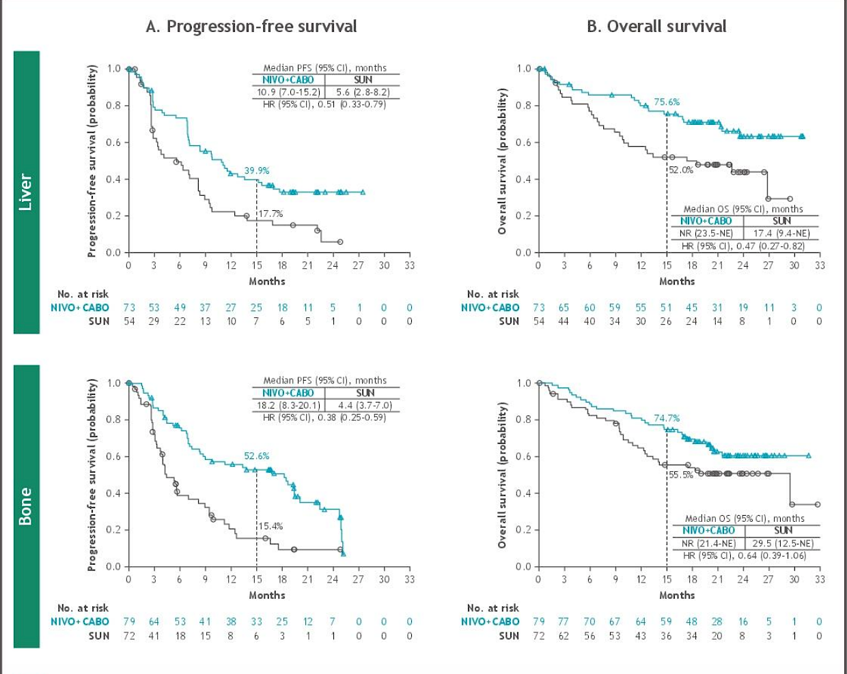

Slide 35
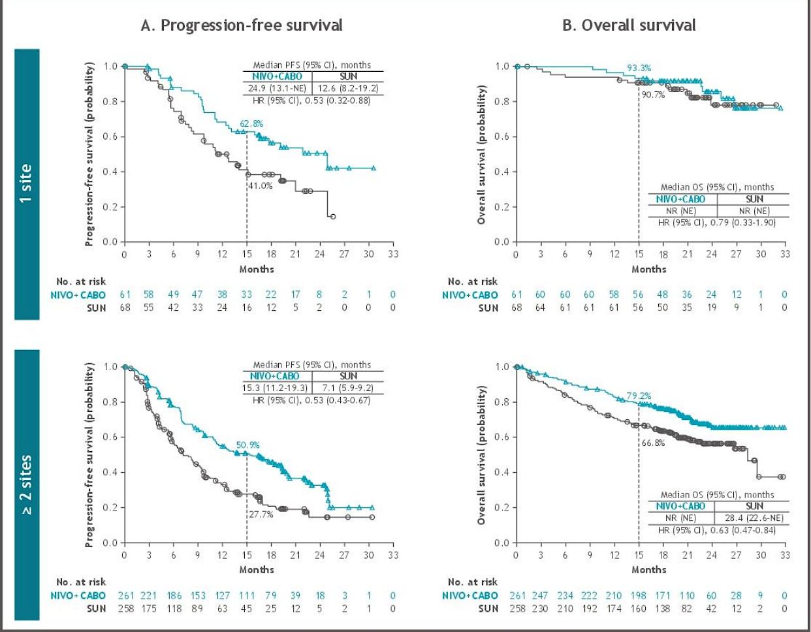

Slide 36
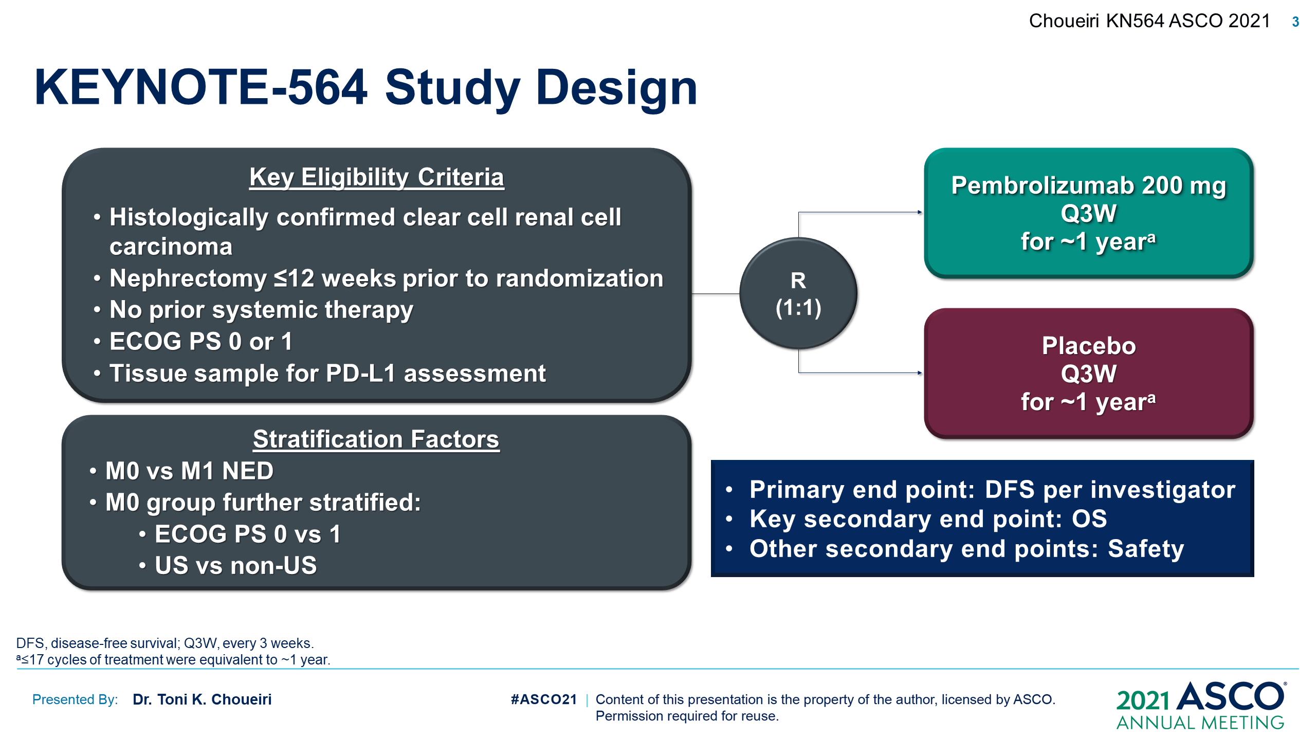

Slide 37
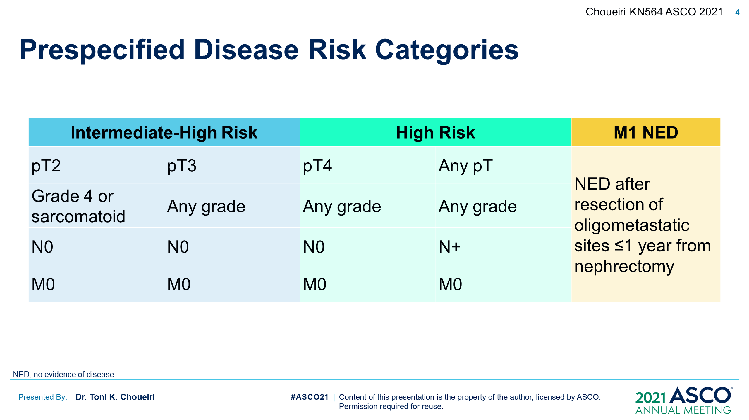

Slide 38
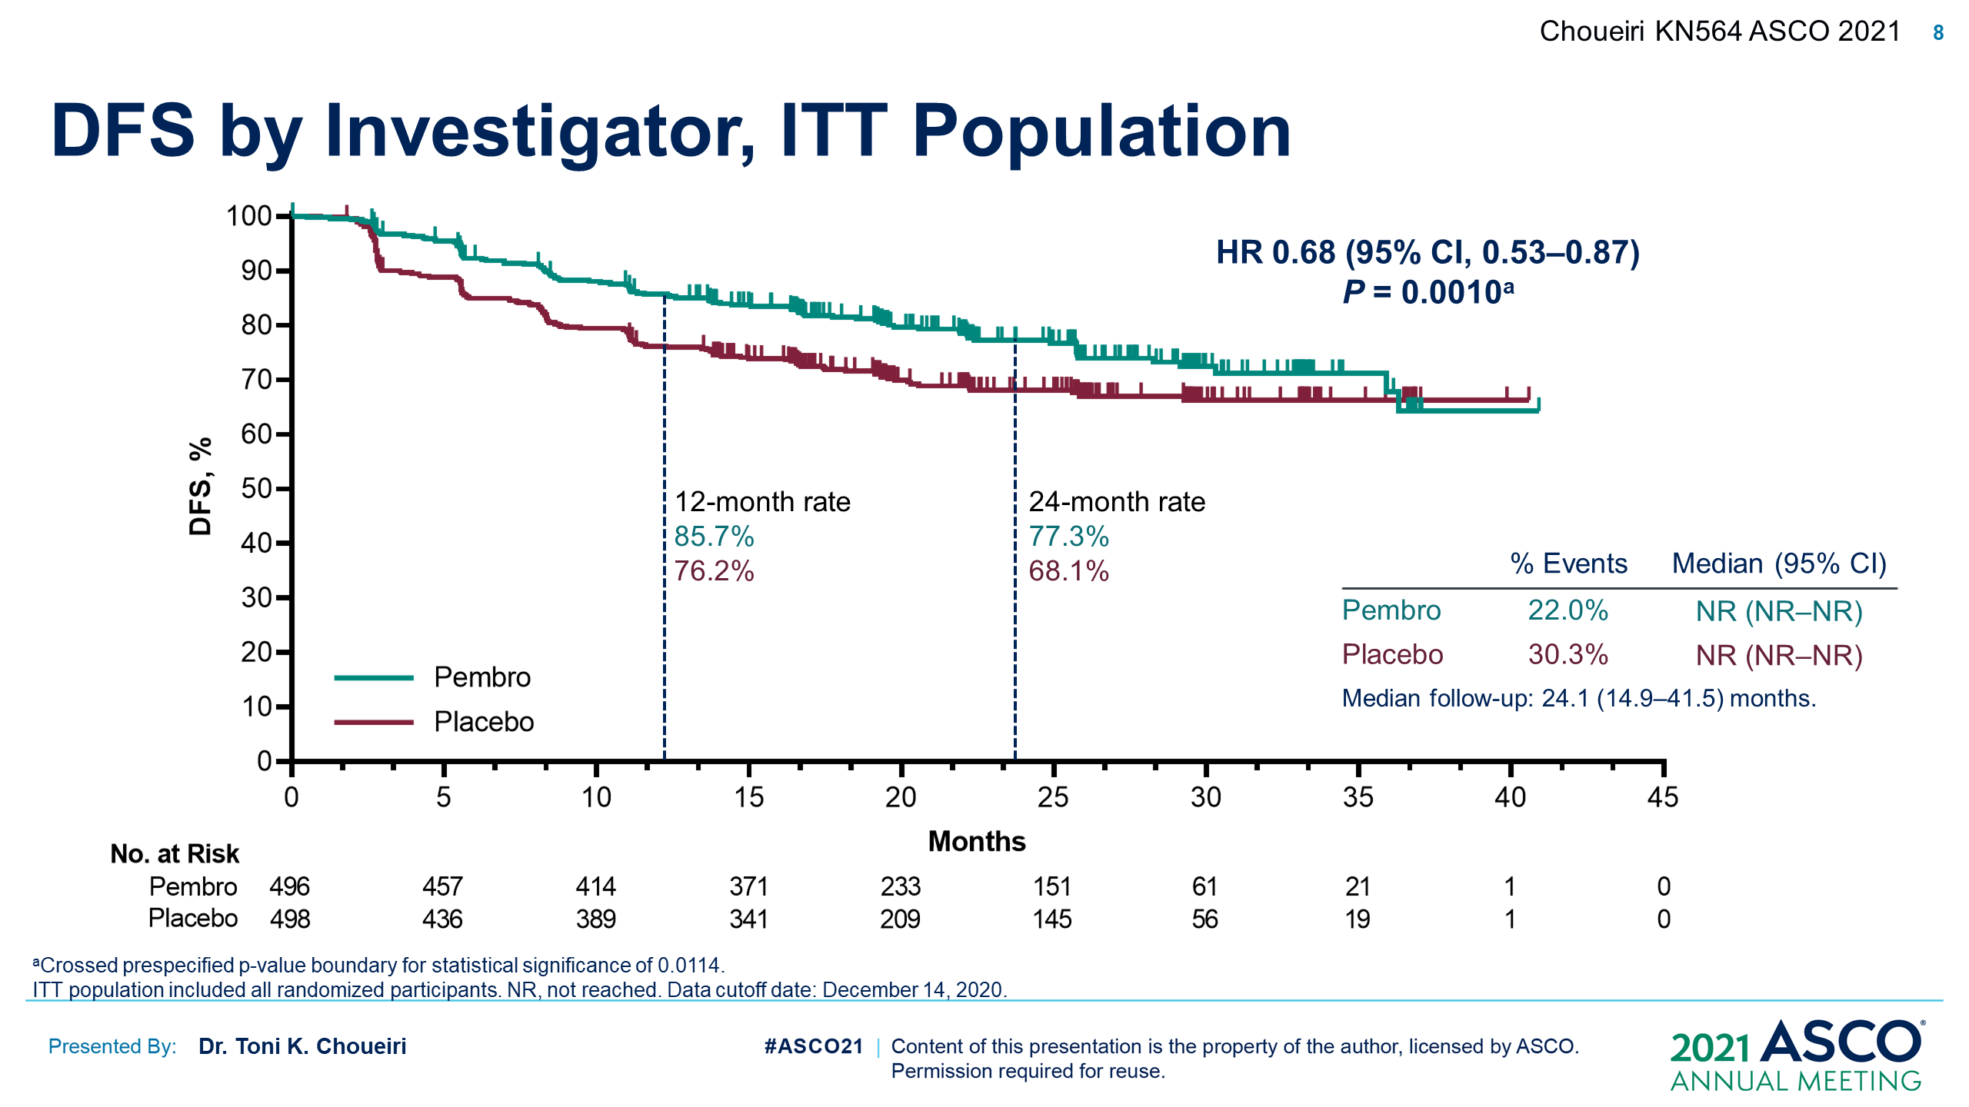

Slide 39
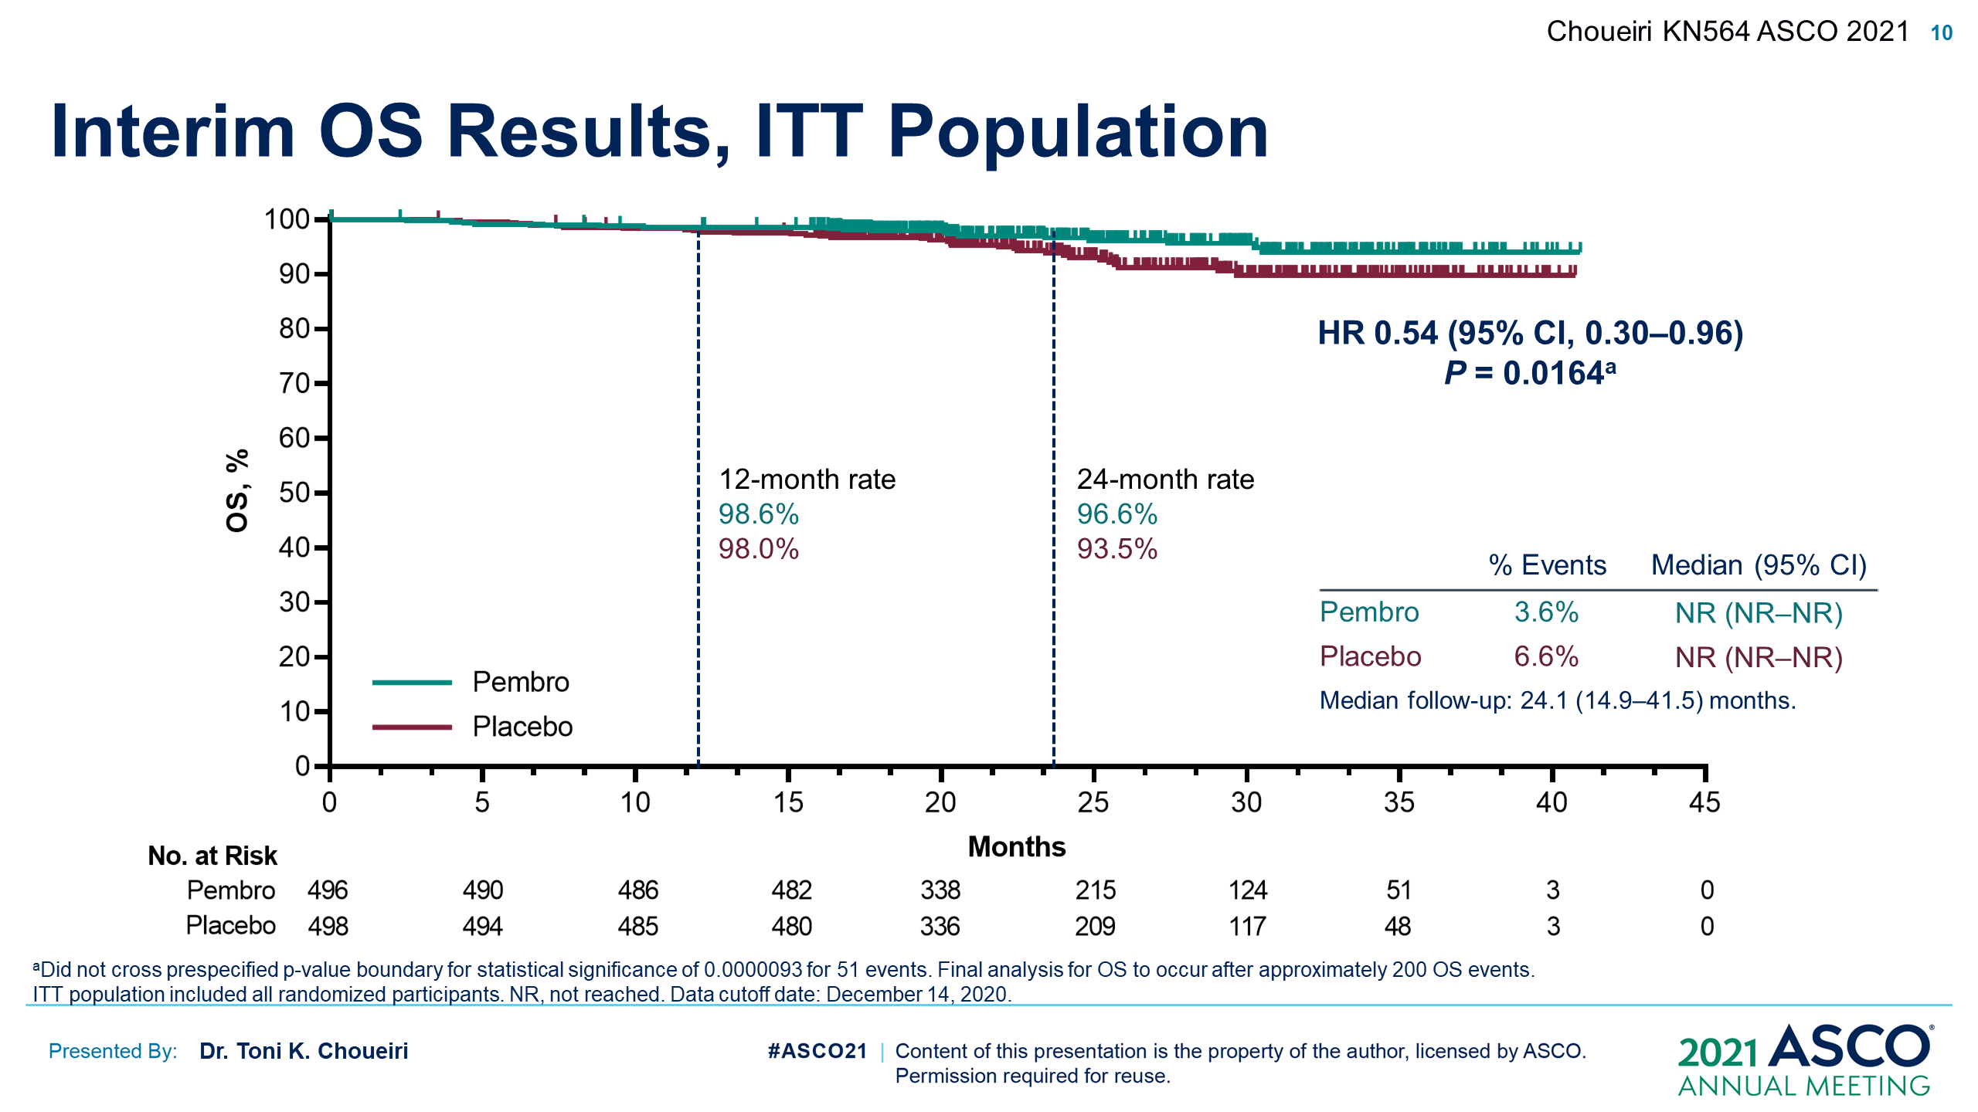

Slide 40
KEYNOTE-426 Study Design
Pembrolizumab 200 mg IV Q3W
for up to 35 cycles
(approximately 2 years)
+
Axitinib 5 mg orally twice dailyª
n = 432
Key Eligibility Criteria
Newly diagnosed or recurrent
stage IV clear cell RCC
No previous systemic treatment for advanced disease
Measurable disease per
RECIST v1.1
R (1:1)
N = 861
Sunitinib 50 mg orally once daily
for first 4 weeks of each 6-week cycle^{b}
n = 429
Stratification Factors
IMDC risk group
(favorable vs intermediate vs poor)
Geographic region
(North America vs Western Europe vs ROW)
End Points
Dual primary: OS and PFS (RECIST v1.1, BICR ) in ITT
Key secondary: ORR (RECIST v1.1, BICR ) in ITT
Other secondary: DOR (RECIST v1.1), safety
ªAxitinib dose could be increased to 7 mg, then 10 mg, twice daily if safety criteria were met; dose could be reduced to 3 mg, then 2 mg, twice daily to manage toxicity. ^{b}Sunitinib dose could be decreased to 37.5 mg, then 25 mg, once daily for the first 4 weeks of each 6-week cycle to manage toxicity. Data cutoff: January 11, 2021.
Notes:
Adult patients with newly diagnosed stage IV or recurrent RCC with clear cell histology who were treatment naive for advanced disease, had measurable disease according to RECIST v1.1, and had a Karnofsky performance status score of ≥70 at baseline and were randomly assigned 1:1 to receive either pembrolizumab + axitinib or sunitinib
Primary end points were OS and PFS by BICR per RECIST v1.1. Secondary end points were ORR, DOR, and safety. Because efficacy end points were met in the first interim analysis, no alpha was allocated and nominal P values are reported

Slide 41
OS in the ITT Population
End of Pembrolizumab Treatment
100
81%
72%
67%
59%
90
63%
54%
80
70
60
Overall Survival, %
50
40
 | Median (95% CI), months
Pembro + Axitinib | 45.7 (43.6-NR)
Sunitinib | 40.1 (34.3-44.2)
30
HR, 0.73 (95% CI, 0.60-0.88)
P < 0.001ª
20
10
0
0
6
12
18
24
30
36
42
48
54
No. at risk
Months
432
407
384
345
318
286
259
141
16
0
429
336
306
252
0
ªBecause superiority of pembrolizumab + axitinib was shown at the first interim analysis, no alpha was allocated to OS; only nominal P values are reported. Data cutoff: January 11, 2021.
379
279
224
110
12
Notes:
OS benefit was retained; HR was 0.73 favoring pembro + axi
Though there was a lot of censoring after 36 months, OS was stable at landmarks including past the end of pembrolizumab + axitinib treatment at 24 months

Slide 42
PFS in the ITT Population
100
End of Pembrolizumab Treatment
90
80
48%
35%
70
60
33%
20%
Progression-Free Survival, %
29%
15%
50
HR, 0.68 (95% CI, 0.58-0.80)
P < 0.0001ª
40
30
 | Median (95% CI), months
Pembro + Axitinib | 15.7 (13.6-20.2)
Sunitinib | 11.1 (8.9-12.5)
20
10
0
0
6
12
18
24
30
36
42
48
54
Months
No. at risk
432
298
233
180
136
110
80
28
0
0
429
244
155
107
72
47
28
10
0
0
ªBecause superiority of pembrolizumab + axitinib was shown at the first interim analysis, no alpha was allocated to PFS; only nominal P values are reported. Data cutoff: January 11, 2021.
Notes:
PFS benefit was retained
Median PFS was 15.7 months with pembrolizumab + axitinib and was 11.1 months with sunitinib. The hazard ratio was 0.68.
The estimated 36-month PFS rate was 29% versus 15% in the pembrolizumab + axitinib and sunitinib arms, respectively

Slide 43
Health-related quality-of-life analysis from the phase III CLEAR trial of lenvatinib (LEN) plus pembrolizumab (PEMBRO) or everolimus (EVE) versus sunitinib (SUN) in advanced RCC
LEN+PEMBRO demonstrated similar or improved HRQoL and disease-related symptom scores supporting its tolerability compared with SUN
LEN+EVE resulted in similar or worse HRQoL and symptom scores compared with patients treated with SUN
Motzer RJ et al. ASCO 2021;Abstract 4502.

Slide 44
Nivolumab plus cabozantinib in patients with non-clear cell RCC
Cabozantinib plus nivolumab had an acceptable safety profile and showed promising efficacy in metastatic non-clear cell RCC patients with papillary, unclassified, or translocation associated histologies
Adverse evets were consistent with the profile of this combination in non-clear cell RCC
Lee C-H et al. ASCO 2021;Abstract 4509.

Slide 45
Phase 2 study of belzutifan (MK-6482) for Von Hippel-Lindau (VHL) disease-associated ccRCC
Belzutifan demonstrated clinical activity in treatment-naïve patients with VHL disease-associated RCC
  Confirmed ORR 49.2%
Favorable safety profile was reported in patients with VHL disease-associated RCC
Srinivasan R et al. ASCO 2021;Abstract 4555.

Slide 46
Conclusions
Prostate Cancer
  ¹⁷⁷Lu-PSMA-617 in patients with metastatic castration-resistant prostate cancer likely a new standard of care
  Bone protecting agents significantly reduce SRE when 2nd-generation AR-antagonists/Radium-223 combined
  Up-front Multimodal therapy in advanced HSPC improves PFS. Impacts on OS unknown.
Bladder Cancer
  Bladder Preservation therapy in MIBC gaining new ground, leveraging combination strategies with chemotherapy and chemoradiation.
  Responses (especially CRs) to immunotherapy in first-line metastatic urothelial cancer are durable and lead to long-term survival
Renal Cell Carcinoma
  Adjuvant Pembrolizumab improves DFS and trend towards OS benefit in high-risk RCC after surgery and could be a new standard of care
  Subgroup analyses of CM—ER highlights the unique activity of cabozanitib/nivolumab in high-risk clinical subgroups over sunitinib (liver, bone and extensive disease).
  Long-term follow up confirms benefit of 1st-line axitinib/pembrolizumab over sunitinib but PFS durability likely not the same as Ipi/nivo.

