Slide 1
What Urologists Want To Know: Addressing Current Questions and Controversies in the Management of Bladder Cancer A Virtual CME Satellite Symposium During the American Urological Association (AUA) 2021 Annual Meeting Monday, September 13, 2021 11:00 AM – 12:30 PM ET
Faculty
Arjun Balar, MD Ashish M Kamat, MD, MBBS
Guru Sonpavde, MD Robert Svatek, MD
Moderator
Neil Love, MD

Slide 2
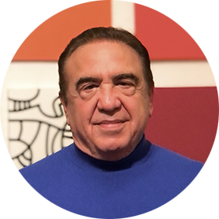
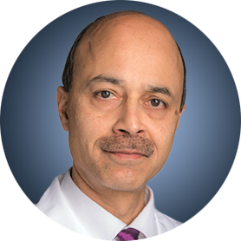
Faculty
Arjun Balar, MD Associate Professor, Department of Medicine Director, Genitourinary Medical Oncology Program Medical Director, Clinical Trials Office NYU Perlmutter Cancer Center New York, New York
Robert Svatek, MD Associate Professor Department of Urology UT Health Science Center San Antonio, Texas
Ashish M Kamat, MD, MBBS Professor of Urologic Oncology (Surgery) Wayne B Duddlesten Professor of Cancer Research Department of Urology, Division of Surgery The University of Texas MD Anderson Cancer Center Houston, Texas
Moderator Neil Love, MD Research To Practice Miami, Florida
Guru Sonpavde, MD Bladder Cancer Director Dana-Farber Cancer Institute Associate Professor of Medicine Harvard Medical School Boston, Massachusetts

Slide 3
Commercial Support
This activity is supported by educational grants from Astellas and Seagen Inc, AstraZeneca Pharmaceuticals LP and Janssen Biotech Inc, administered by Janssen Scientific Affairs LLC.

Slide 4
Dr Love — Disclosures
Dr Love is president and CEO of Research To Practice. Research To Practice receives funds in the form of educational grants to develop CME activities from the following companies: AbbVie Inc, Adaptive Biotechnologies Corporation, ADC Therapeutics, Agios Pharmaceuticals Inc, Alexion Pharmaceuticals, Amgen Inc, Array BioPharma Inc, a subsidiary of Pfizer Inc, Astellas, AstraZeneca Pharmaceuticals LP, Aveo Pharmaceuticals, Bayer HealthCare Pharmaceuticals, BeiGene Ltd, Blueprint Medicines, Boehringer Ingelheim Pharmaceuticals Inc, Bristol-Myers Squibb Company, Celgene Corporation, Clovis Oncology, Coherus BioSciences, Daiichi Sankyo Inc, Eisai Inc, Epizyme Inc, Exact Sciences Inc, Exelixis Inc, Five Prime Therapeutics Inc, Foundation Medicine, Genentech, a member of the Roche Group, Gilead Sciences Inc, GlaxoSmithKline, Grail Inc, Halozyme Inc, Helsinn Healthcare SA, ImmunoGen Inc, Incyte Corporation, Ipsen Biopharmaceuticals Inc, Janssen Biotech Inc, administered by Janssen Scientific Affairs LLC, Jazz Pharmaceuticals Inc, Karyopharm Therapeutics, Kite, A Gilead Company, Lilly, Loxo Oncology Inc, a wholly owned subsidiary of Eli Lilly & Company, Merck, Novartis, Novocure Inc, Oncopeptides, Pfizer Inc, Pharmacyclics LLC, an AbbVie Company, Puma Biotechnology Inc, Regeneron Pharmaceuticals Inc, Sanofi Genzyme, Seagen Inc, Sumitomo Dainippon Pharma Oncology Inc, Taiho Oncology Inc, Takeda Oncology, Tesaro, A GSK Company, TG Therapeutics Inc, Turning Point Therapeutics Inc and Verastem Inc.

Slide 5
Research To Practice CME Planning Committee Members, Staff and Reviewers
Planners, scientific staff and independent reviewers for Research To Practice have no relevant conflicts of interest to disclose.

Slide 6
Dr Balar — Disclosures
Consulting Agreements | Astellas, AstraZeneca Pharmaceuticals LP, Bristol-Myers Squibb Company, EMD Serono Inc, Genentech, a member of the Roche Group, Gilead Sciences Inc, Immunomedics Inc, Incyte Corporation, Janssen Biotech Inc, Merck, Pfizer Inc, Seagen Inc
Contracted Research | Astellas, AstraZeneca Pharmaceuticals LP, Bristol-Myers Squibb Company, Clovis Oncology, Genentech, a member of the Roche Group, Gilead Sciences Inc, Immunomedics Inc, Incyte Corporation, Janssen Biotech Inc, Merck, Pfizer Inc, Seagen Inc
Ownership Interest | GT Biopharma Inc

Slide 7
Dr Kamat — Disclosures
No relevant conflicts of interest to disclose.

Slide 8
Dr Sonpavde — Disclosures
Advisory Committee | Astellas, AstraZeneca Pharmaceuticals LP, Bicycle Therapeutics, Bristol-Myers Squibb Company, EMD Serono Inc, Exelixis Inc, G1 Therapeutics, Genentech, a member of the Roche Group, Gilead Sciences Inc, Immunomedics Inc, Infinity Pharmaceuticals Inc, Janssen Biotech Inc, Lilly, Loxo Oncology Inc, a wholly owned subsidiary of Eli Lilly & Company, Merck, Pfizer Inc, Sanofi Genzyme, Scholar Rock, Seagen Inc
Consulting Agreements (Paid) | AstraZeneca Pharmaceuticals LP, Debiopharm Group, EMD Serono Inc
Consulting Agreements (Unpaid) | Bavarian Nordic, Bristol-Myers Squibb Company, G1 Therapeutics, QED Therapeutics, Seagen Inc
Travel Cost | AstraZeneca Pharmaceuticals LP, Bristol-Myers Squibb Company
Writing/Editor Fees | Elsevier Practice Update Bladder Cancer Center of Excellence

Slide 9
Dr Svatek — Disclosures
Consulting Agreement | Ferring Pharmaceuticals
Contracted Research | Japan BCG Laboratory, Rapamycin Holdings

Slide 10
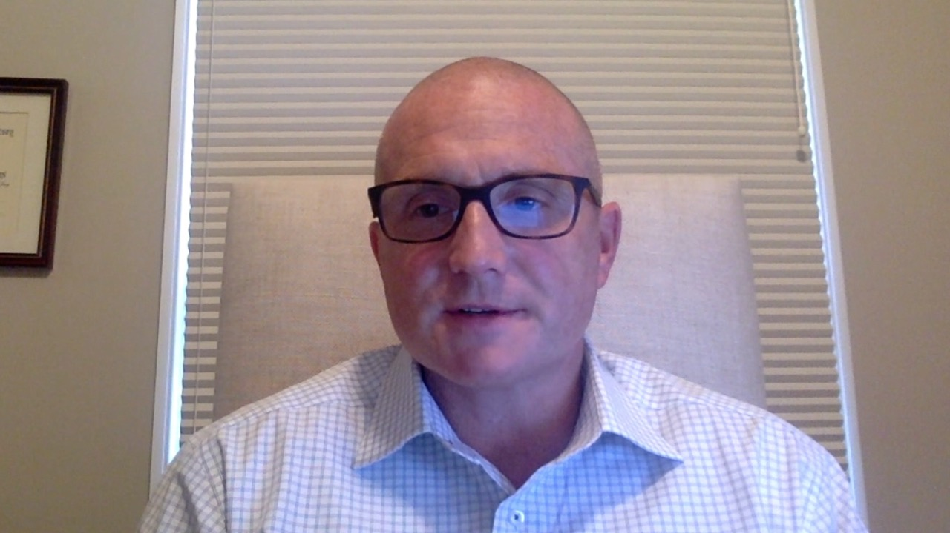
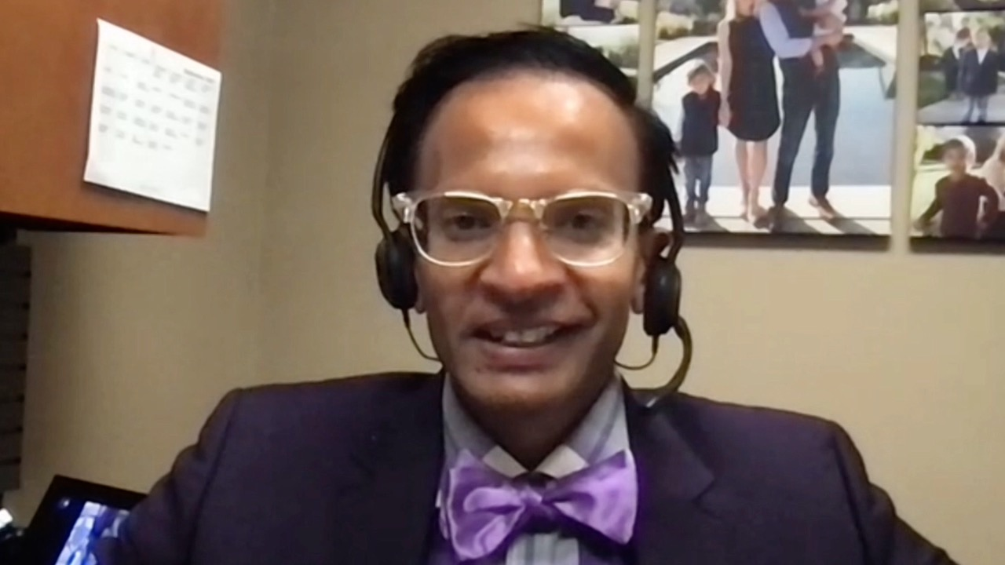
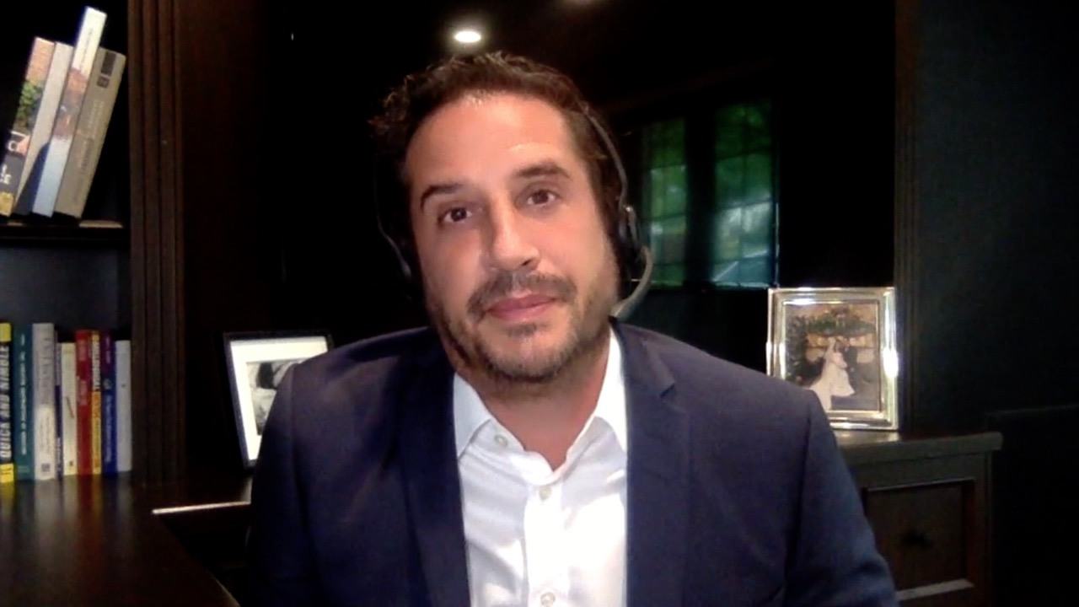
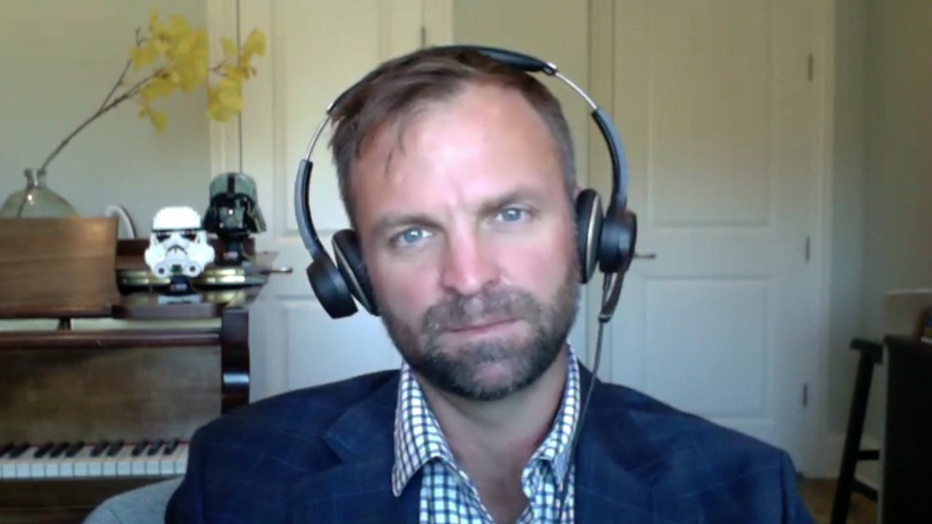
Gordon A Brown, DO
Associate Professor of Urology
Rowan University SOM
Medical Director of Advanced Therapeutics
New Jersey Urology
Director of Robotic Surgery
Jefferson Health New Jersey
Sewell, New Jersey
Sulfi Ibrahim, MD
Hematology/Oncology
Reid Health
Richmond, Indiana
Jason Hafron, MD
Chief Medical Officer
Director of Clinical Research
Michigan Institute of Urology
Professor of Urology
Oakland University William Beaumont School of Medicine
Bloomfield, Michigan
David S Morris, MD
President and Co-Director of Advanced Therapeutics Center
Urology Associates
Nashville, Tennessee

Slide 11
Agenda
Introduction: Personalized Continuing Medical Education
Module 1: Non-Muscle-Invasive Urothelial Bladder Cancer (UBC)
Dr Morris: A 79-year-old man with BCG-refractory non-muscle-invasive bladder cancer
Dr Brown: A 65-year-old man with high-risk non-muscle-invasive UBC
Dr Hafron: A 58-year-old man with high-risk, BCG-refractory non-muscle-invasive bladder cancer
Dr Morris: An 86-year-old man with recurrent high-grade noninvasive papillary carcinoma
Module 2: Neoadjuvant and Adjuvant Treatment of Muscle-Invasive UBC
Dr Ibrahim: An 84-year-old man with muscle-invasive bladder cancer who declines cystectomy
Dr Hafron: A 77-year-old man with Gleason 4 + 3 adenocarcinoma of the prostate and urothelial carcinoma
Module 3: Treatment of Metastatic UBC
Dr Ibrahim: A 70-year-old woman with metastatic UBC – PD-L1 30%
Dr Brown: A 55-year-old woman with muscle-invasive bladder cancer

Slide 12
Agenda
Introduction: Personalized Continuing Medical Education
Module 1: Non-Muscle-Invasive Urothelial Bladder Cancer (UBC)
Dr Morris: A 79-year-old man with BCG-refractory non-muscle-invasive bladder cancer
Dr Brown: A 65-year-old man with high-risk non-muscle-invasive UBC
Dr Hafron: A 58-year-old man with high-risk, BCG-refractory non-muscle-invasive bladder cancer
Dr Morris: An 86-year-old man with recurrent high-grade noninvasive papillary carcinoma
Module 2: Neoadjuvant and Adjuvant Treatment of Muscle-Invasive UBC
Dr Ibrahim: An 84-year-old man with muscle-invasive bladder cancer who declines cystectomy
Dr Hafron: A 77-year-old man with Gleason 4 + 3 adenocarcinoma of the prostate and urothelial carcinoma
Module 3: Treatment of Metastatic UBC
Dr Ibrahim: A 70-year-old woman with metastatic UBC – PD-L1 30%
Dr Brown: A 55-year-old woman with muscle-invasive bladder cancer

Slide 13
At what point in your oncology career were you in 2007?
Clinical practice
Residency or fellowship
Medical school
College
High school
Before high school
Other
N = 59
Survey of live webinar audience

Slide 14
Urol Clin N Am 48 (2021) 195-202

Slide 15
Key Events in Their Upbringing That Have Shaped the Lives of Millennials
Quarles J, Hafron J. Urol Clin N Am 48 (2021) 195-202.

Slide 16
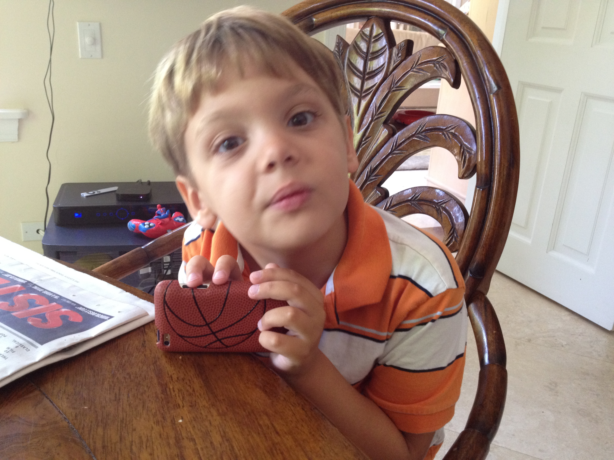

Slide 17
Understanding the millennial physician
Dr Jason Hafron

Slide 18
Agenda
Introduction: Personalized Continuing Medical Education
Module 1: Non-Muscle-Invasive Urothelial Bladder Cancer (UBC)
Dr Morris: A 79-year-old man with BCG-refractory non-muscle-invasive bladder cancer
Dr Brown: A 65-year-old man with high-risk non-muscle-invasive UBC
Dr Hafron: A 58-year-old man with high-risk, BCG-refractory non-muscle-invasive bladder cancer
Dr Morris: An 86-year-old man with recurrent high-grade noninvasive papillary carcinoma
Module 2: Neoadjuvant and Adjuvant Treatment of Muscle-Invasive UBC
Dr Ibrahim: An 84-year-old man with muscle-invasive bladder cancer who declines cystectomy
Dr Hafron: A 77-year-old man with Gleason 4 + 3 adenocarcinoma of the prostate and urothelial carcinoma
Module 3: Treatment of Metastatic UBC
Dr Ibrahim: A 70-year-old woman with metastatic UBC – PD-L1 30%
Dr Brown: A 55-year-old woman with muscle-invasive bladder cancer

Slide 19
Case Presentation – Dr Morris: A 79-year-old man with BCG-refractory non-muscle-invasive bladder cancer
2009: Robot-assisted laparoscopy for Gleason 3+4 prostate cancer
2011: Gross hematuria → TURBT: High-grade T1 → BCG induction
2013: Recurrence with CIS → Re-induction BCG → Maintenance BCG intermittently until 2017
8/2017: Recurrence on biopsy → Valrubicin
12/2018: Recurrence on biopsy → Patient declines cystectomy
Re-induction BCG → NED until 1/2021: CIS recurrence
Patient refuses cystectomy due to heart disease
4/2021: Pembrolizumab
After 2 treatments: Jaundice, with abnormal labs (total bilirubin: 11, AST: 850, ALT: 727) → High-dose steroids
Questions
Do you have any suggestions about how to monitor and manage side effects of early induction therapy with immune checkpoint inhibitors (ICIs)? How rare is immune-related hepatic toxicity with ICIs?
How do you counsel patients who are receiving ICIs about which side effects should prompt them to call?
Dr David Morris

Slide 20
Do you think it is okay for urologists to administer a checkpoint inhibitor?
Yes
No
N = 65
Survey of live webinar audience

Slide 21
Case Presentation – Dr Brown: A 65-year-old man with high-risk non-muscle-invasive UBC
Initial diagnosis of T1 disease → complete resection
BCG induction plus maintenance therapy → recurrence of carcinoma in situ within bladder within 6 months
Offered participation in a clinical trial, pembrolizumab or additional intravesical therapies such as docetaxel and gemcitabine
Elected pembrolizumab therapy → discontinued after 4th dose due to development of hypothyroidism
Intravesicle therapy with docetaxel and gemcitabine
Currently NED
Questions
What are your thoughts in terms of the side effect profile and management of immunotherapy in patients with high-risk non-muscle-invasive bladder cancers?
How can we operationalize more consistently the use of immunotherapy in our bladder cancer clinics amongst urology practices across the country?
Dr Gordon Brown

Slide 22
Lancet Oncol 2021;22:919-30

Slide 23
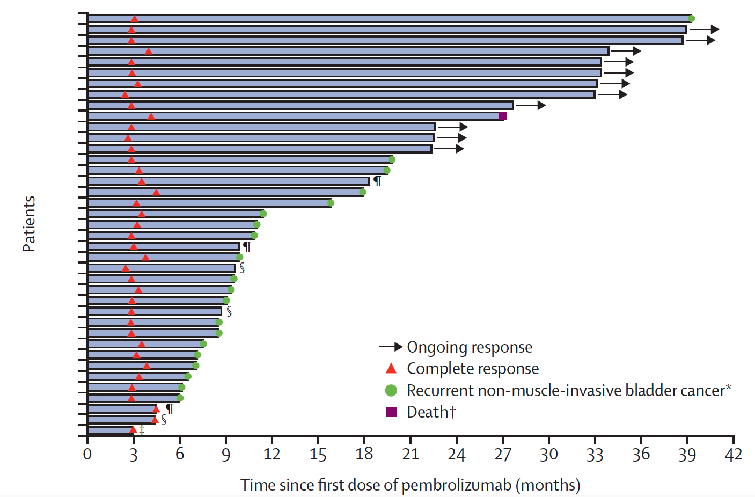
KEYNOTE-057: Response, Duration of Response and Summary of Adverse Events
Serious AEs 8%
AEs leading to treatment interruption: 13%
IRAEs: 22%
Grade 3/4 IRAEs: 3%
CR at 3 months: 41%
Median duration of CR: 16.2 mo
Balar AV et al. Lancet Oncol 2021;22:919-30.

Slide 24
Case Presentation – Dr Hafron: A 58-year-old man with high-risk, BCG-refractory non-muscle-invasive bladder cancer
Dr Jason Hafron
Presents with asymptomatic gross hematuria
Cystoscopy: Erythematous area, right lateral wall of bladder and papillary tumor
Transurethral resection: CIS and pTa high-grade urothelial carcinoma
BCG x 6 → Cystoscopy 6 weeks later: Persistent CIS → BCG x 6 → Maintenance BCG x 3
Cystoscopy 12 months later: CIS
Patient declines cystectomy
Pembrolizumab q3w x 4, but develops pneumonia x 2
Questions
Would you stop the pembrolizumab for this recurrent pneumonia? Is this a true side effect of pembrolizumab?
Would you consider changing him from q 3 week dosing of pembrolizumab to q 6 weeks? Would that reduce his risk of pulmonary issues?
If the patient were to fail pembrolizumab and still refuse cystectomy, what else is there to offer this patient?

Slide 25
Case Presentation – Dr Morris: An 86-year-old man with recurrent high-grade non-invasive papillary carcinoma
5/2019: Presents with hematuria and diagnosed with low-grade noninvasive papillary carcinoma (Ta) in the left ureter
Distal ureterectomy and reimplant, with negative margins
Six months later, surveillance cystoscopy: High-grade Ta bladder lesion → Resected
BCG induction not completed due to unplanned heart event and surgery
After recovery, cystoscopy revealed numerous new high-grade Ta recurrences
Re-induction BCG x 6 and Blue-Light cystoscopy, confirming high-grade Ta → Resected
FGFR mutation identified and enrolled on a clinical trial of erdafitinib for localized disease
Questions
Is Blue Light technology worth the extra cost for all populations or just those who may have a CIS history? Is it something that should be exclusionary only in the most complex situations just because of the added cost for potential delay and progression down the road?
Dr David Morris

Slide 26
Pembrolizumab for the Treatment of Patients with High-Risk (HR) Non-Muscle-Invasive Bladder Cancer (NMIBC) Unresponsive to Bacillus Calmette-Guérin: Extended Follow-Up of KEYNOTE-057 Cohort A
Balar AV et al. Genitourinary Cancers Symposium 2021;Abstract 451.

Slide 27
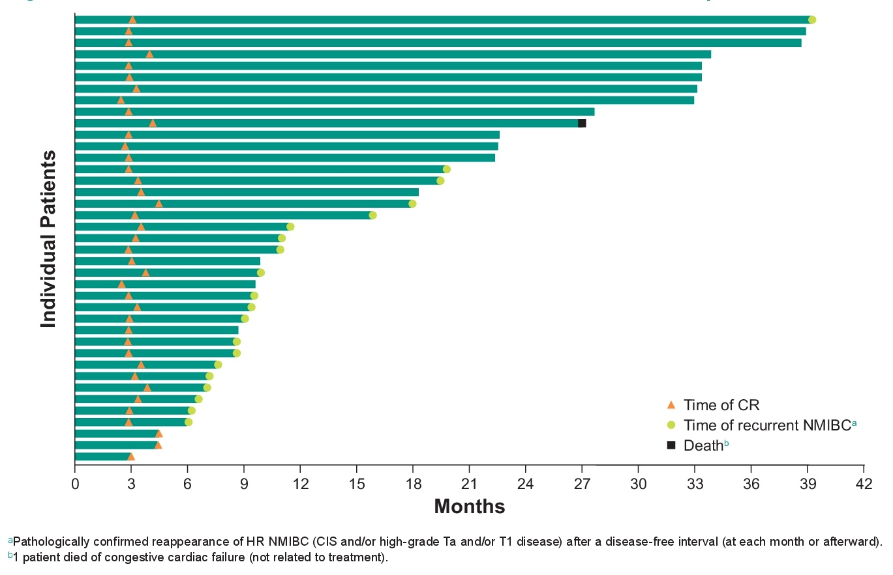
Extended Follow-Up of KEYNOTE-057: Response, Time to Response and Recurrence of HR NMIBC in Patients Who Experienced a CR
CR: 40.6%
Balar AV et al. Genitourinary Cancers Symposium 2021;Abstract 451.

Slide 28
Agenda
Introduction: Personalized Continuing Medical Education
Module 1: Non-Muscle-Invasive Urothelial Bladder Cancer (UBC)
Dr Morris: A 79-year-old man with BCG-refractory non-muscle-invasive bladder cancer
Dr Brown: A 65-year-old man with high-risk non-muscle-invasive UBC
Dr Hafron: A 58-year-old man with high-risk, BCG-refractory non-muscle-invasive bladder cancer
Dr Morris: An 86-year-old man with recurrent high-grade noninvasive papillary carcinoma
Module 2: Neoadjuvant and Adjuvant Treatment of Muscle-Invasive UBC
Dr Ibrahim: An 84-year-old man with muscle-invasive bladder cancer who declines cystectomy
Dr Hafron: A 77-year-old man with Gleason 4 + 3 adenocarcinoma of the prostate and urothelial carcinoma
Module 3: Treatment of Metastatic UBC
Dr Ibrahim: A 70-year-old woman with metastatic UBC – PD-L1 30%
Dr Brown: A 55-year-old woman with muscle-invasive bladder cancer

Slide 29
Case Presentation – Dr Ibrahim: An 84-year-old man with muscle-invasive bladder cancer (MIBC) who declines cystectomy
Dr Sulfi Ibrahim
Diagnosed with MIBC, declines cystectomy
Clinical trial of concurrent chemoradiation therapy with gemcitabine twice weekly and atezolizumab
Completed therapy 6 months ago, NED

Slide 30
Selection of patients for neoadjuvant therapy
Dr David Morris

Slide 31
Do you generally agree that neoadjuvant therapy should be the standard treatment for patients with invasive bladder cancer?
Yes
No
N = 72
Survey of live webinar audience

Slide 32
Case Presentation – Dr Hafron: A 77-year-old man with Gleason 4 + 3 adenocarcinoma of the prostate and urothelial carcinoma
Dr Jason Hafron
Presented with urinary frequency, urgency and elevated PSA
Prostate biopsy: Gleason 4 + 3 adenocarcinoma of the prostate
Cystoscopy: Papillary bladder cancer
Transurethral resection: T2 high-grade transitional cell carcinoma of the bladder with angiolymphatic invasion
Neoadjuvant cisplatin/gemcitabine x 4 → robotic cystoprostatectomy, bilateral lymph node dissection
PT3a adenocarcinoma of the prostate, Gleason 4 + 3, 1/18 nodes positive
Bladder pathology: T0
Questions
Since he has already received cisplatin/gemcitabine x 4, would you consider adjuvant chemotherapy or immunotherapy, or would you just observe this patient with N1 disease following resection?
What are the indications for adjuvant treatment with immune checkpoint inhibitors (ICIs) today? What is the duration of adjuvant ICI treatment?
What is the best interval for using pembrolizumab – q3wks or q6wks? Is the q6wks interval associated with less symptoms?

Slide 33
FDA Approves Nivolumab for Adjuvant Treatment of Urothelial Carcinoma Press Release – August 19, 2021
“The Food and Drug Administration approved nivolumab for the adjuvant treatment of patients with urothelial carcinoma (UC) who are at high risk of recurrence after undergoing radical resection.
This is the first FDA approval for adjuvant treatment of patients with high-risk UC. The results supporting this approval also supported the conversion of nivolumab’s accelerated approval for advanced/metastatic UC to a regular approval.
Nivolumab was investigated in CHECKMATE-274 (NCT02632409), a randomized, double-blind, placebo-controlled trial in patients who were within 120 days of radical resection of UC of the bladder or upper urinary tract (renal pelvis or ureter) at high risk of recurrence. Patients were randomized (1:1) to receive nivolumab 240 mg or placebo by intravenous infusion every 2 weeks until recurrence or until unacceptable toxicity for a maximum treatment duration of 1 year.”
https://www.fda.gov/drugs/resources-information-approved-drugs/fda-approves-nivolumab-adjuvant-treatment-urothelial-carcinoma

Slide 34
First Results from the Phase 3 CheckMate 274 Trial of Adjuvant Nivolumab vs Placebo in Patients Who Underwent Radical Surgery for High-Risk Muscle-Invasive Urothelial Carcinoma (MIUC)
Bajorin DF et al. Genitourinary Cancers Symposium 2021;Abstract 391.

Slide 35
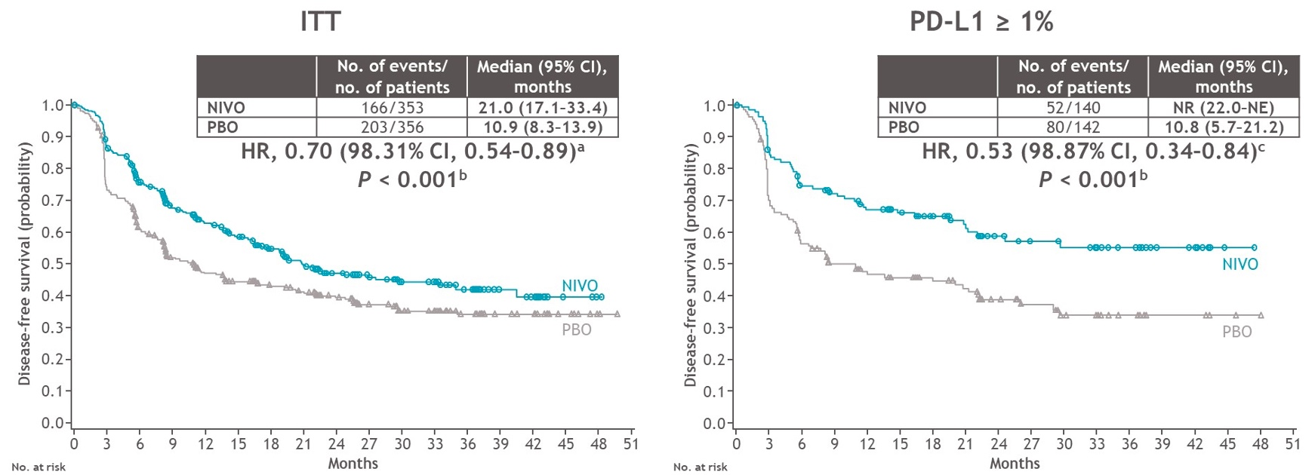
CheckMate 274: Disease-Free Survival in the ITT and PD-L1 ≥1% Populations
Bajorin DF et al. Genitourinary Cancers Symposium 2021;Abstract 391.

Slide 37
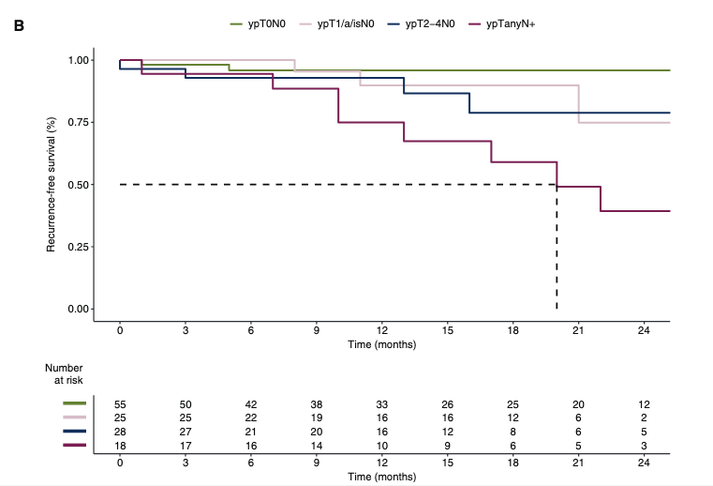
PURE-01: Recurrence-Free Survival (RFS) by ypTypN Stage
RFS | 12 mo | 24 mo
Overall (n = 126) | 90.5% | 78.3%
ypT0ypN0 (n = 55) | 95.9% | 95.9%
ypT_{1/a/is}ypN0 (n = 25) | 89.8% | 74.9%
ypT2-4 ypN0 (n = 28) | 92.9% | 78.8%
ypTanyN+ (n = 18) | 74.9% | 39.3%
Bandini M et al. Ann Oncol 2020;31(12):1755-63.

Slide 38
Agenda
Introduction: Personalized Continuing Medical Education
Module 1: Non-Muscle-Invasive Urothelial Bladder Cancer (UBC)
Dr Morris: A 79-year-old man with BCG-refractory non-muscle-invasive bladder cancer
Dr Brown: A 65-year-old man with high-risk non-muscle-invasive UBC
Dr Hafron: A 58-year-old man with high-risk, BCG-refractory non-muscle-invasive bladder cancer
Dr Morris: An 86-year-old man with recurrent high-grade noninvasive papillary carcinoma
Module 2: Neoadjuvant and Adjuvant Treatment of Muscle-Invasive UBC
Dr Ibrahim: An 84-year-old man with muscle-invasive bladder cancer who declines cystectomy
Dr Hafron: A 77-year-old man with Gleason 4 + 3 adenocarcinoma of the prostate and urothelial carcinoma
Module 3: Treatment of Metastatic UBC
Dr Ibrahim: A 70-year-old woman with metastatic UBC – PD-L1 30%
Dr Brown: A 55-year-old woman with muscle-invasive bladder cancer

Slide 39
Urologists’ questions about second- and later-line therapies and management of side effects
Dr David Morris

Slide 40
Case Presentation – Dr Ibrahim: A 70-year-old woman with metastatic UBC – PD-L1 30%
Metastatic UBC, PD-L1 30%
Cisplatin/gemcitabine
Clinical trial of nivolumab and sitravatinib → PD
Enfortumab vedotin, with response
Ocular toxicity, with conjunctiva erythema
Skin toxicity, with pruritic rash on upper and lower extremities, that is not responding to methylprednisolone dose pack and dose reduction
Questions
What is the optimal management of the dermatologic toxicity with enfortumab vedotin? Is it dose holds? Is it a higher dose of corticosteroids?
If the dermatologic toxicity continues to be a significant quality of life issue for her, is that a reason to consider switching therapy now that sacituzumab is also approved for urothelial carcinoma so I have another option that I can use to treat her?
Dr Sulfi Ibrahim

Slide 41
FDA Grants Regular Approval to Enfortumab Vedotin-ejfv for Locally Advanced or Metastatic Urothelial Cancer Press Release – July 9, 2021
“The Food and Drug Administration approved enfortumab vedotin-ejfv, a Nectin-4-directed antibody and microtubule inhibitor conjugate, for adult patients with locally advanced or metastatic urothelial cancer who
have previously received a programmed death receptor-1 (PD-1) or programmed death-ligand (PD-L1) inhibitor and platinum-containing chemotherapy, or
are ineligible for cisplatin-containing chemotherapy and have previously received one or more prior lines of therapy.
Trial EV-301 was an open-label, randomized, multicenter trial required to confirm the clinical benefit of the 2019 accelerated approval.
Efficacy for patients ineligible for cisplatin-containing chemotherapy was evaluated in Cohort 2 of EV-201, a single-arm, multi-cohort, international trial in 89 patients with locally advanced or metastatic urothelial cancer who received a prior PD-1 or PD-L1 inhibitor and were ineligible for cisplatin-containing chemotherapy.”
https://www.fda.gov/drugs/resources-information-approved-drugs/fda-grants-regular-approval-enfortumab-vedotin-ejfv-locally-advanced-or-metastatic-urothelial-cancer

Slide 42
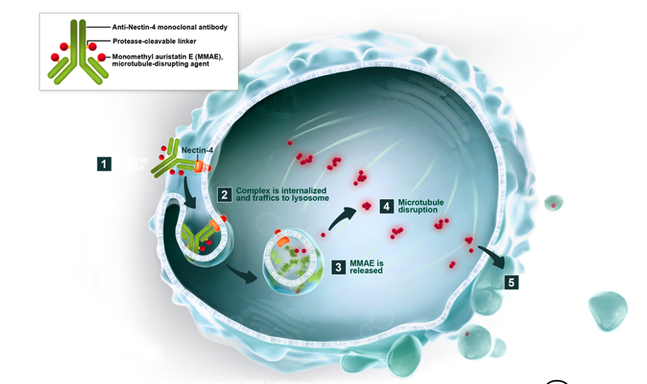
Enfortumab Vedotin: Nectin-4-Targeted Therapy
Courtesy of Jonathan E Rosenberg, MD

Slide 43
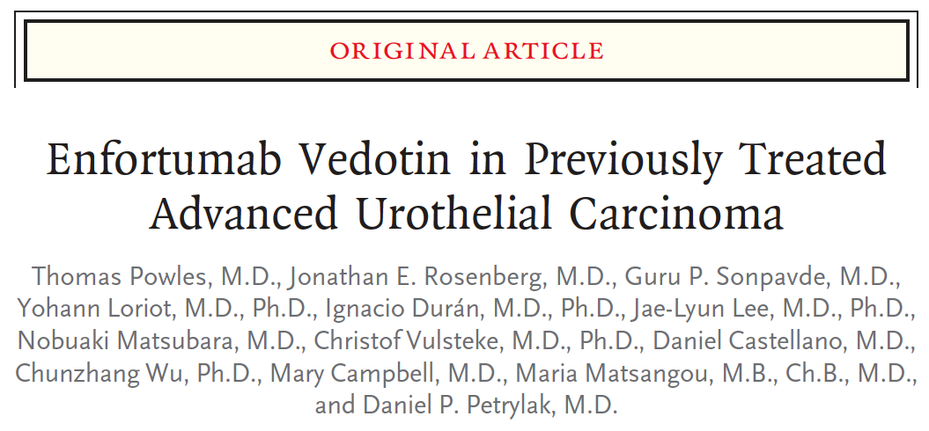
N Engl J Med 2021;384(12):1125-35.

Slide 44
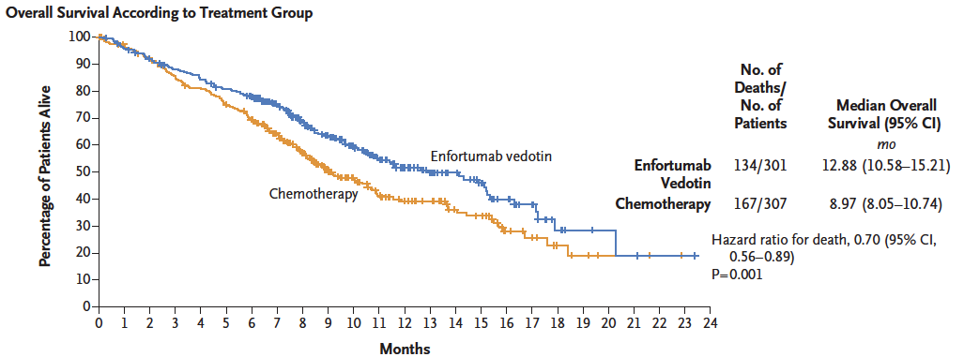
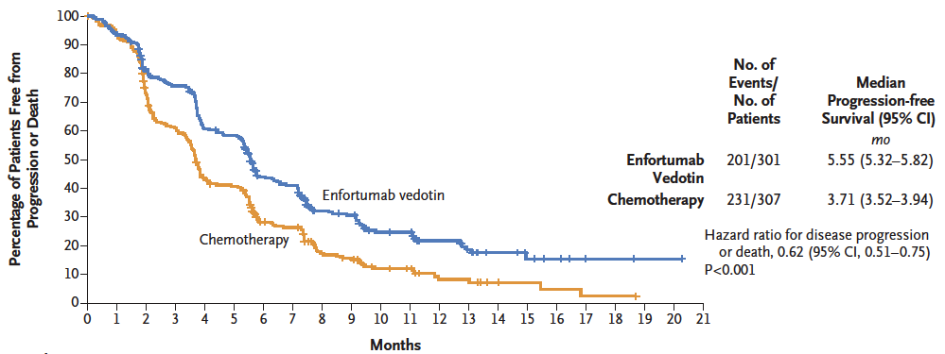
EV-301: Survival and Response Analyses
 | EV (n = 301) | Chemo (n = 307)
ORR | 40.6% | 17.9%
DCR | 71.9% | 53.4%
Incidence of treatment-related adverse events was similar in the 2 groups:
93.9% versus 91.8%
Incidence of events of Grade 3 or higher was also similar in the 2 groups:
51.4% versus 49.8%
Powles T et al. N Engl J Med 2021;384(12):1125-35.

Slide 45
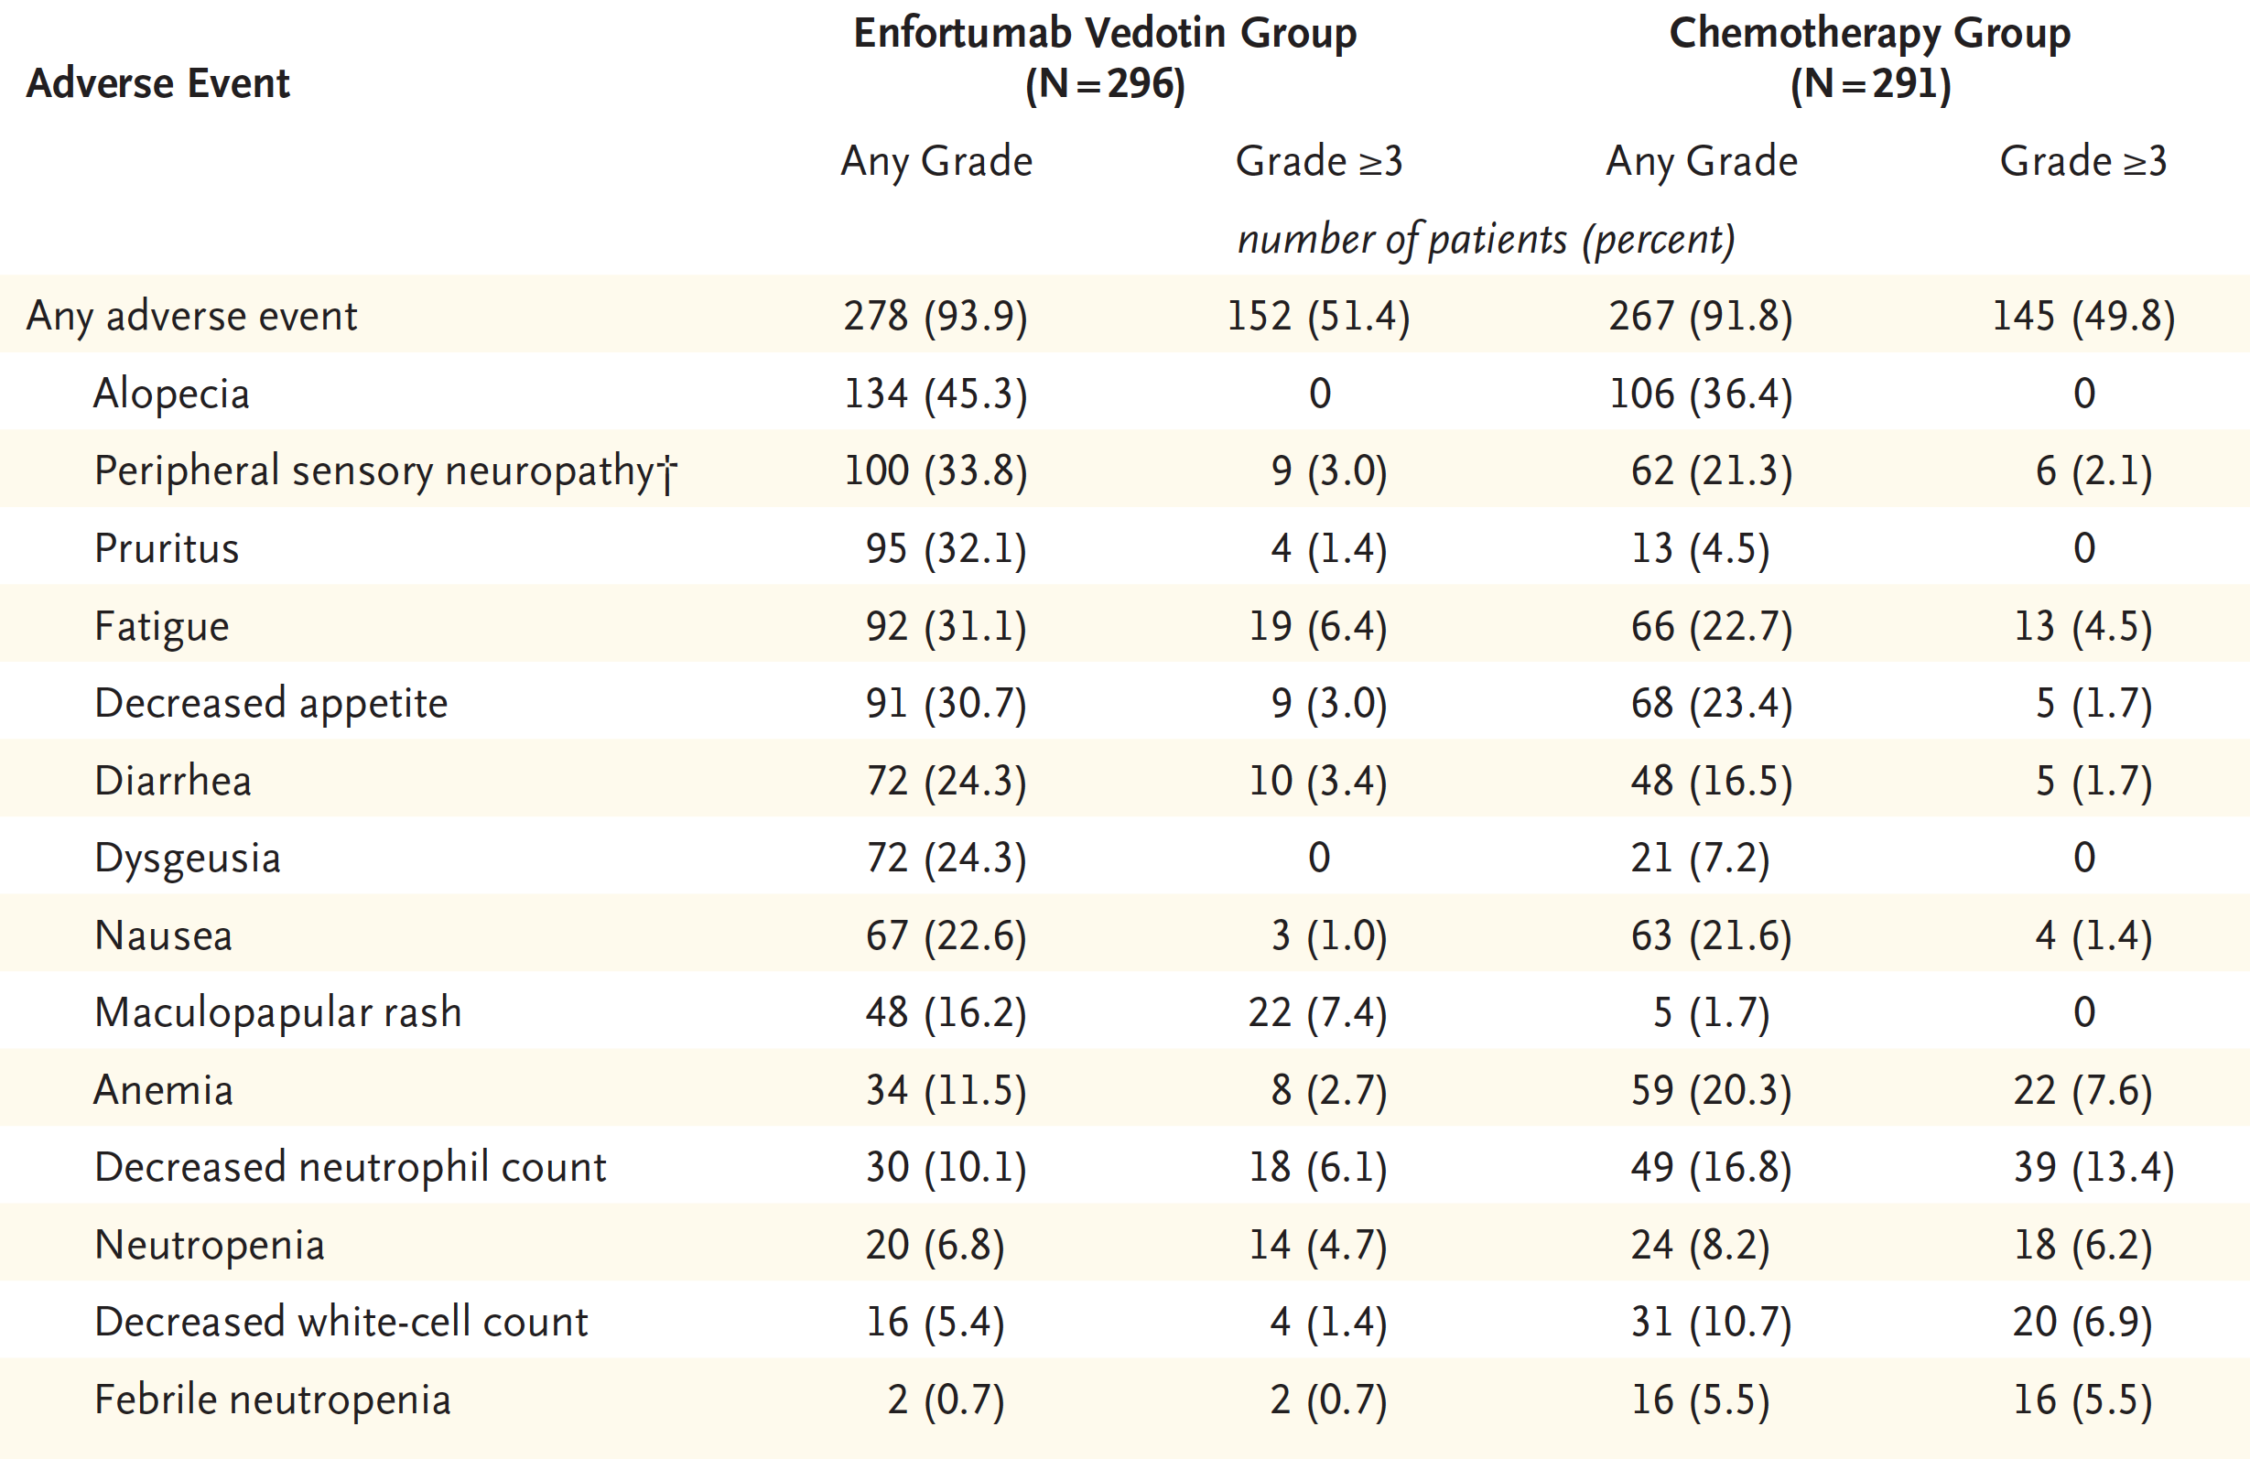
EV-301: Enfortumab Vedotin Safety Analysis
Powles T et al. N Engl J Med 2021;384(12):1125-35.

Slide 46
FDA Grants Accelerated Approval to Sacituzumab Govitecan for Advanced Urothelial Cancer Press Release – April 13, 2021
“The Food and Drug Administration granted accelerated approval to sacituzumab govitecan for patients with locally advanced or metastatic urothelial cancer (mUC) who previously received a platinum-containing chemotherapy and either a programmed death receptor-1 (PD-1) or a programmed death-ligand 1 (PD-L1) inhibitor.
Efficacy and safety were evaluated in TROPHY (IMMU-132-06; NCT03547973), a single-arm, multicenter trial that enrolled 112 patients with locally advanced or mUC who received prior treatment with a platinum-containing chemotherapy and either a PD-1 or PD-L1 inhibitor. Patients received sacituzumab govitecan, 10 mg/kg intravenously, on days 1 and 8 of a 21-day treatment cycle.”
https://www.fda.gov/drugs/resources-information-approved-drugs/fda-grants-accelerated-approval-sacituzumab-govitecan-advanced-urothelial-cancer

Slide 47
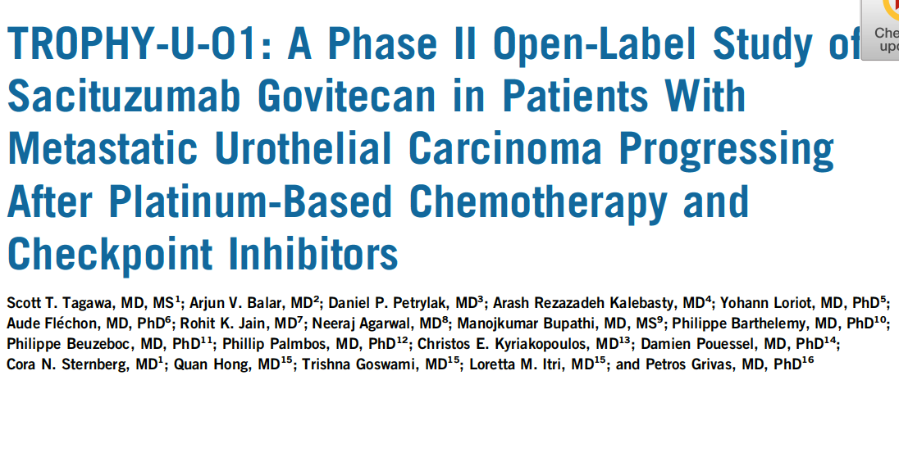
of
J Clin Oncol 2021;[Online ahead of print].

Slide 48
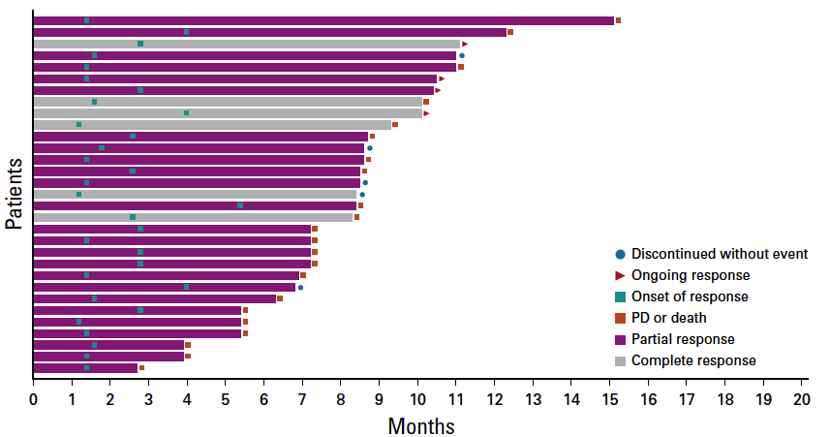
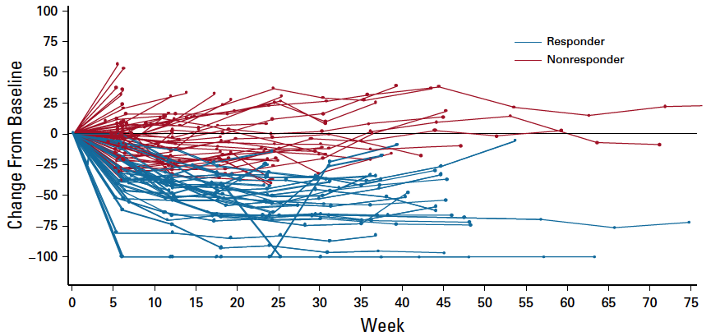
TROPHY U-01 (Cohort 1): ORR, Duration of Response and Survival
Median DOR: 7.2 mo
Median time to onset of response: 1.6 mo
ORR: 27% (31/113)
Median PFS: 5.4 mo Median OS: 10.9 mo
Tagawa ST et al. J Clin Oncol 2021;[Online ahead of print]; Loriot Y et al. ESMO 2020;Abstract LBA24.

Slide 49
FGFR3 Genomic Alterations in Muscle-Invasive Bladder Cancer
Genomics of MIBC: TCGA
In muscle-invasive disease, FGFR3 mutations in ~20% of tumors, but protein and/or gene overexpression in ~50%
Activating mutations of FGFR3 in ~75% of low-grade papillary bladder tumors
FGFR3-TACC3 fusions enriched in young, Asian, non-smokers, upper tract tumors (invasive, high grade)
Preclinical evidence for activity of FGFR inhibitors in selected cells with FGFR alterations
Courtesy of Guru Sonpavde, MD
Robertson AG et al. Cell 2017;171(3):540-56; Cappellen D et al. Nat Genet 1999;23:18-20; Nassar A et al. JCO Precis Oncol 2018; Gust KM et al. Mol Cancer Ther 2013;12:1245-54; Grünewald S et al. Int J Cancer 2019; Sfakianos JP et al. Eur Urol 2015;68(6):970-7.

Slide 50
Erdafitinib in Locally Advanced or Metastatic Urothelial Carcinoma (mUC): Long-Term Outcomes in BLC2001
Siefker-Radtke AO et al. ASCO 2020;Abstract 5015.

Slide 51
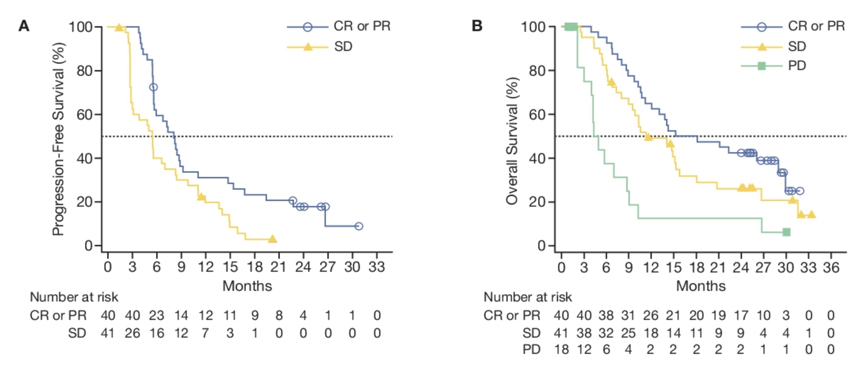
BLC2001: Survival with Erdafitinib
Median PFS: 5.5 months
Median OS: 11.3 months
Siefker-Radtke AO et al. ASCO 2020;Abstract 5015.

Slide 52
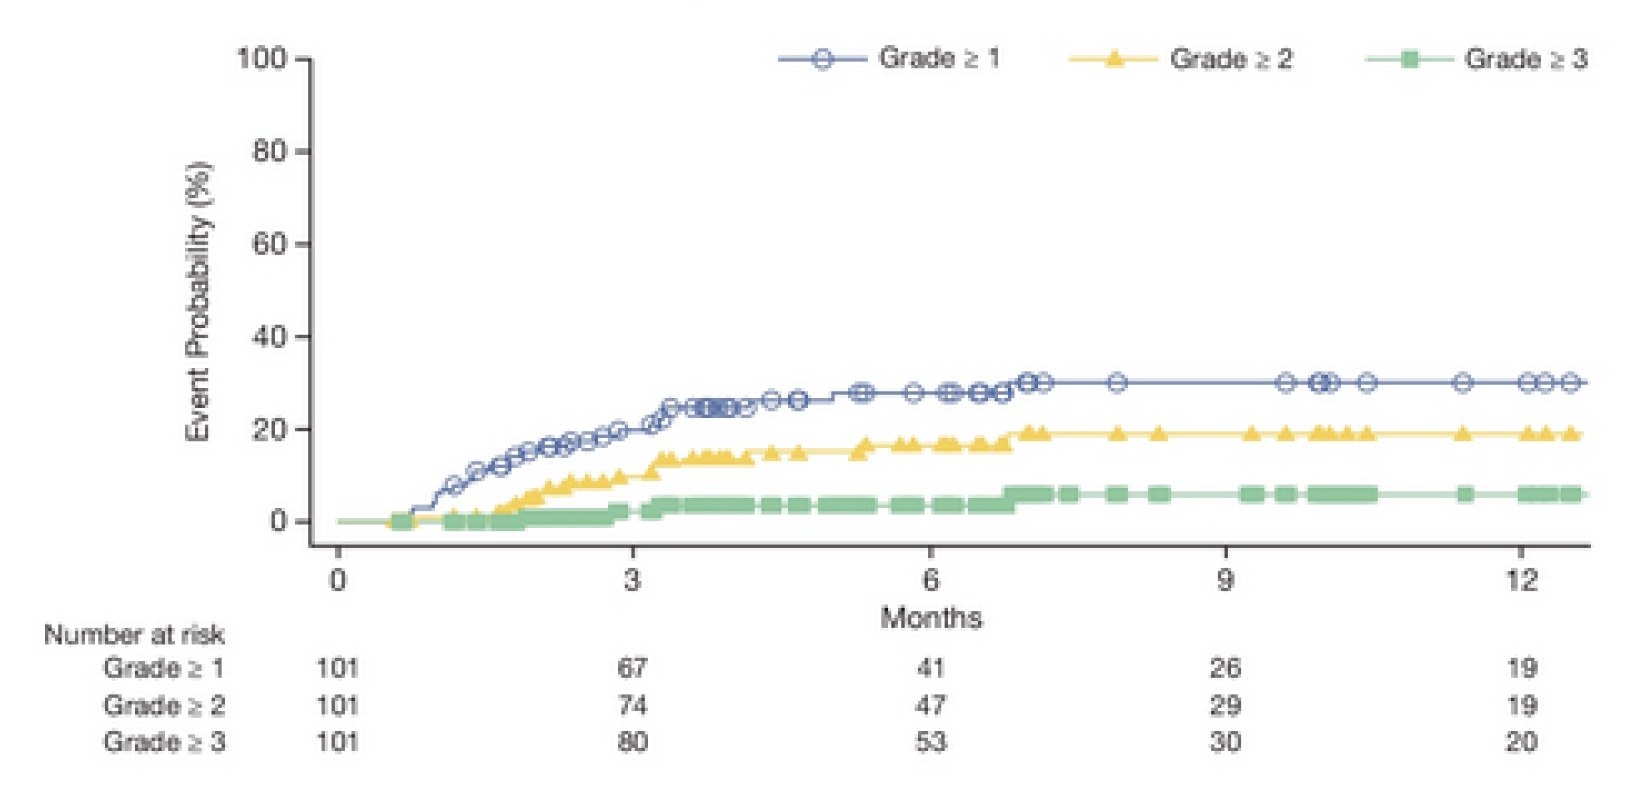
BLC2001: Central Serous Retinopathy (CSR)
CSR rate: 27% (Grade 1/2: 85%)
CSR within first 3 months: 70%
Dose reduction for CSR: 13%
Dose interruption for CSR: 8%
Treatment discontinuation for CSR: 3%
Siefker-Radtke AO et al. ASCO 2020;Abstract 5015.

Slide 53
Case Presentation – Dr Brown: A 55-year-old woman with muscle-invasive bladder cancer
High-grade T2 bladder cancer s/p nephroureterectomy
Recurrent disease with muscle-invasive disease
Currently, receiving neoadjuvant chemotherapy, with plans for cystectomy and urinary diversion
Questions
In the setting of patients who have a solitary kidney disease with a recently diagnosed muscle-invasive bladder cancer, how do you approach the use of neoadjuvant therapy? Is there a role for immunotherapy in lieu of their reduced GFR?
What is your opinion on the choice of urinary diversion in solitary kidney disease? She’s desiring of a continent diversion, either Indiana pouch or Studer versus ileal loop. Would there be any thoughts as to concerns around a continent diversion in a patient with a solitary functional renal unit?
Dr Gordon Brown

Slide 54
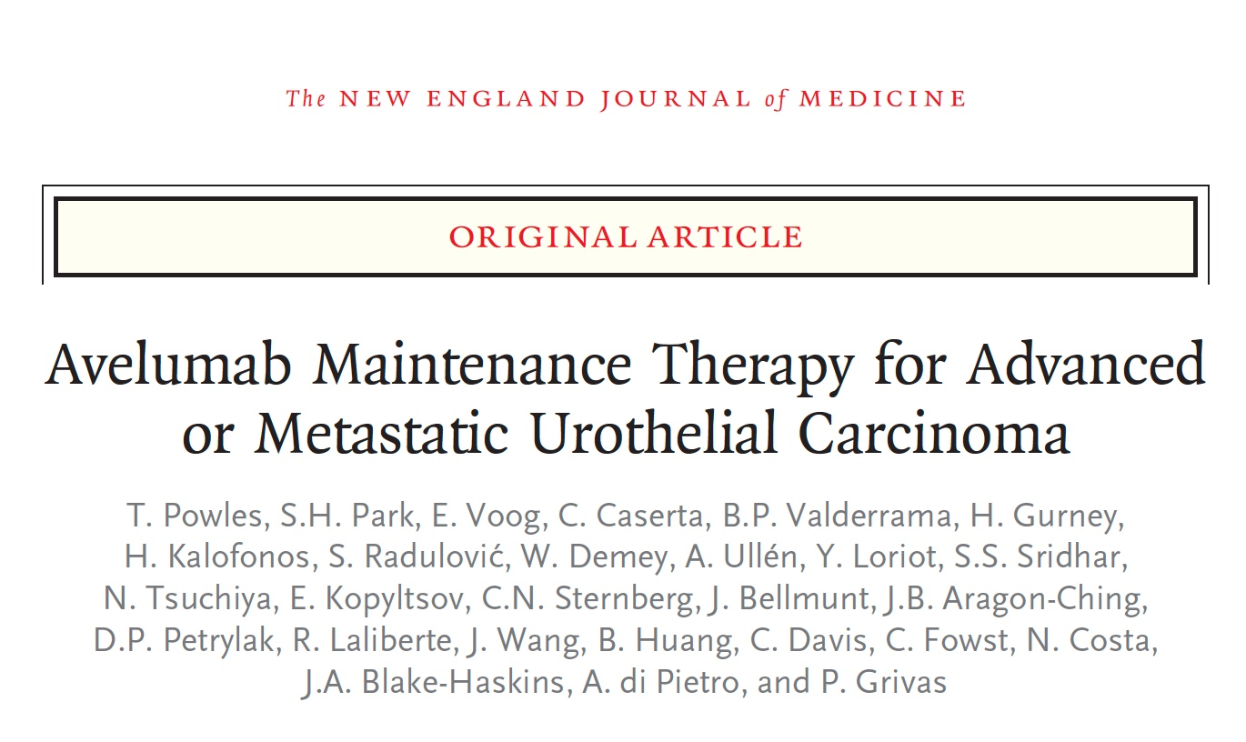
N Engl J Med 2020;383:1218-30.

Slide 55
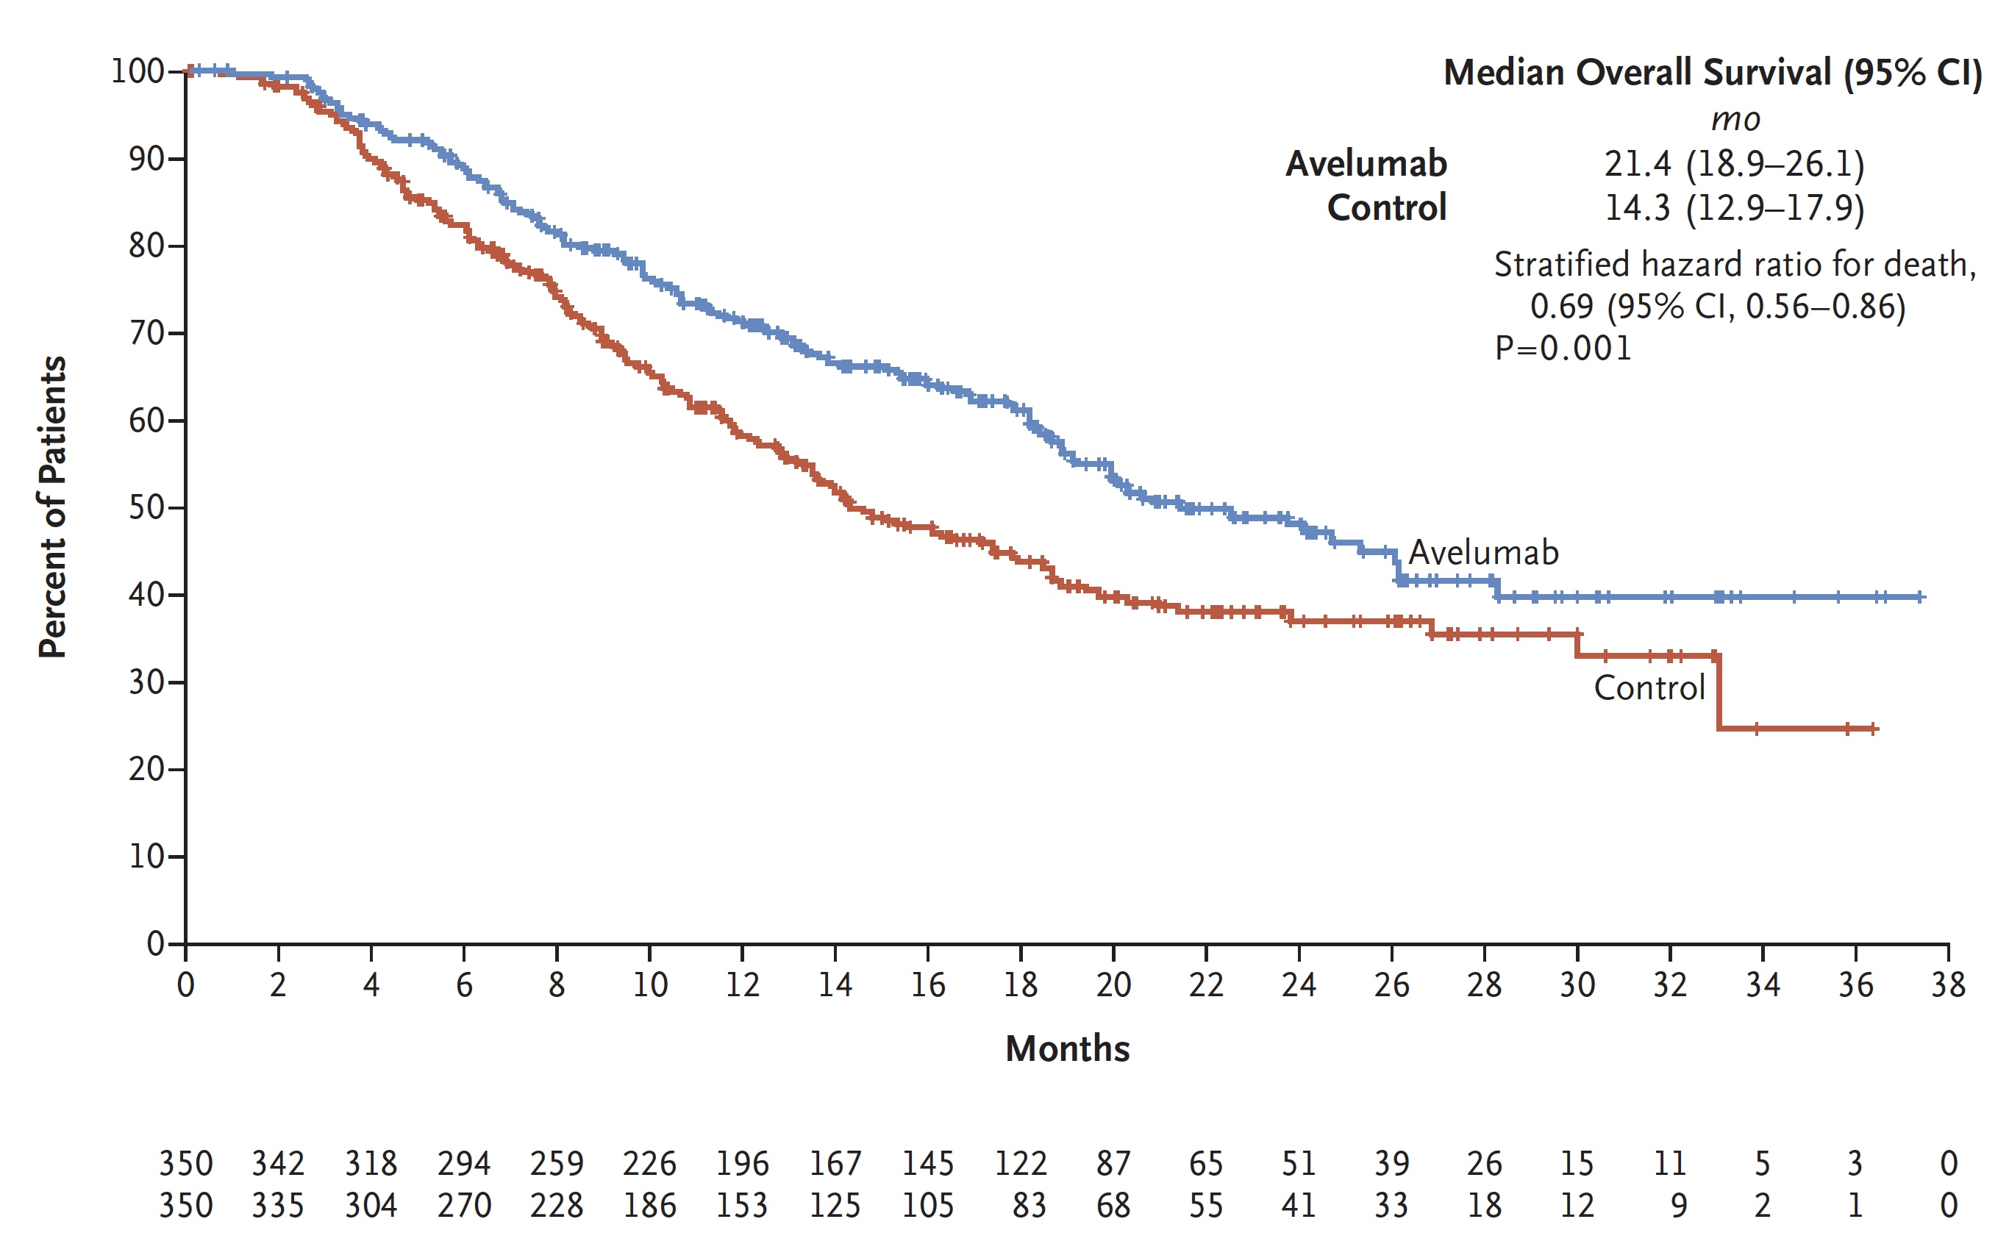
JAVELIN Bladder 100 Primary Endpoint: Overall Survival
 | Overall | PD-L1-positive
Avelumab | 21.4 mo | NE
Control | 14.3 mo | 17.1 mo
Hazard ratio (p-value) | 0.69 (p = 0.001) | 0.56 (p < 0.001)
Powles T et al. N Engl J Med 2020;383:1218-30.

Slide 57
DANUBE Coprimary Endpoint: OS with durvalumab vs chemotherapy in the PD-L1-high population
 | Durvalumab (n=209) | Chemotherapy (n=207)
Median OS, months (95% CI) | 14.4 (10.4–17.3) | 12.1 (10.4–15.0)
HR (95% CI) | 0.89 (0.71–1.11)
Log-rank P value* | 0.3039
1.0
0.8
0.6
55%
Probability of OS
0.4
51%
36%
0.2
29%
Durvalumab
0.0
Chemotherapy
0
3
6
9
12
15
18
21
24
27
30
33
36
39
42
45
48
51
Number at risk
Time from randomization (months)
Durvalumab
209
176
143
123
112
97
87
81
74
68
66
63
61
39
19
6
1
0
Chemotherapy
207
186
161
126
101
86
74
66
57
51
48
44
42
27
16
8
2
0
Powles T et al. ESMO 2020;Abstract 6970.

Slide 58
DANUBE Coprimary Endpoint: OS with durvalumab + tremelimumab vs chemotherapy in the ITT population
 | Durvalumab + Tremelimumab (n=342) | Chemotherapy (n=344)
Median OS, months (95% CI) | 15.1 (13.1–18.0) | 12.1 (10.9–14.0)
HR (95% CI) | 0.85 (0.72–1.02)
Log-rank P value* | 0.0751
1.0
0.8
58%
0.6
Probability of OS
39%
0.4
51%
0.2
29%
Durvalumab + Tremelimumab
0.0
Chemotherapy
0
3
6
9
12
15
18
21
24
27
30
33
36
39
42
45
48
51
Number at risk
Time from randomization (months)
Durvalumab + Tremelimumab
342
292
246
224
197
173
153
140
133
118
108
99
89
61
33
12
0
0
Chemotherapy
344
311
273
216
168
136
119
107
95
86
81
71
68
46
27
11
2
0
Powles T et al. ESMO 2020;Abstract 6970.

Slide 59
Ongoing Phase III Trials of Immunotherapy Combinations for UBC
Trial identifier | N | Setting | Treatment arms
POTOMAC (NCT03528694) | 1,019 | High-risk, BCG-naïve, non-muscle invasive | Durvalumab + BCG (induction + maintenance) Durvalumab + BCG (induction only) BCG
NIAGARA (NCT03732677) | 1,050 | Neoadjuvant/ adjuvant, muscle invasive | Chemotherapy + durvalumab → surgery → durvalumab Chemotherapy alone → surgery
NILE (NCT03682068) | 1,292 | Unresectable, first line | Durvalumab + standard chemotherapy Durvalumab + tremelimumab + standard therapy Standard chemotherapy
www.clinicaltrials.gov. Accessed September 2021.

Slide 60
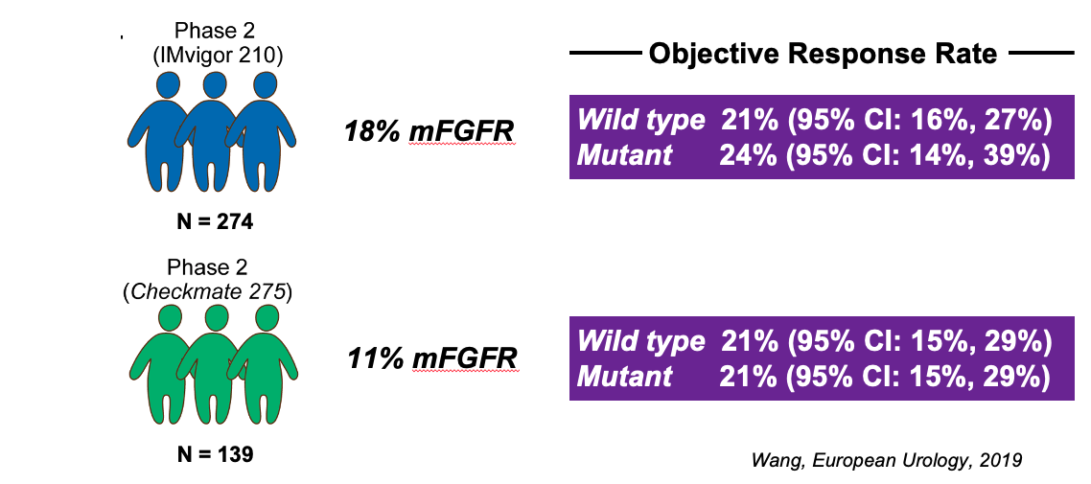
Are FGFR3 Alterations Associated with Resistance to PD-1/PD-L1 Blockade in Large Clinical Trial Cohorts?
Courtesy of Matthew D Galsky, MD.

Slide 61
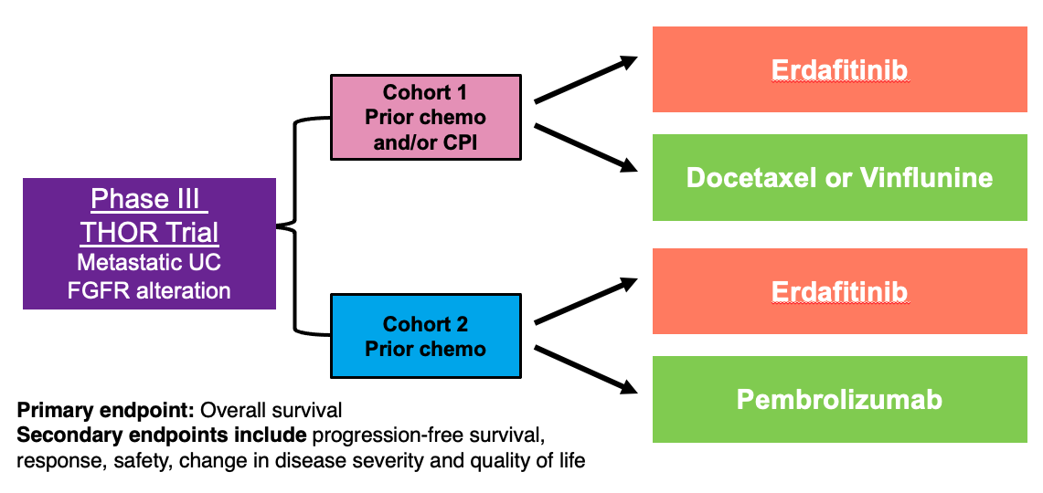
Ongoing Phase III THOR Trial Design

