Slide 1
Please note, these are the actual video-recorded proceedings from the live CME event and may include the use of trade names and other raw, unedited content. Select slides from the original presentation are omitted where Research To Practice was unable to obtain permission from the publication source and/or author. Links to view the actual reference materials have been provided for your use in place of any omitted slides.

Slide 2
Challenging Cases in
Prostate Cancer
Oncologist and Nurse Investigators
Consult on Actual Patients from the
Practices of the Invited Faculty
Thursday, April 25, 2013
6:30 AM – 8:00 AM
Washington, DC
Faculty
William K Oh, MD
Doris Pindilli, MS, APN-C, AOCNP
A Oliver Sartor, MD
Victoria Sinibaldi, MS, CRNP
Moderator
Neil Love, MD

Slide 3

Challenging Cases
Oncologist and Nurse Investigators
Consult on Actual Patients from the
Practices of the Invited Faculty

Slide 4
Themes — Challenging Cases in Oncology
A 10-hour Integrated Curriculum
Challenges associated with the incorporation of new research findings and newly approved agents into practice
Patient education on potential risks and benefits of specific oncologic treatments
Monitoring and management of treatment side effects and toxicities

Slide 5
Themes — Challenging Cases in Oncology
A 10-hour Integrated Curriculum
Participation in ongoing clinical trials as an important patient option
Psychosocial impact of cancer diagnosis and treatment — why all patients, even those with the same disease, are different
Strategies to cope with the stress of being an oncology professional

Slide 6


Slide 7


Slide 8


Slide 9


Slide 10
Agenda
Module 1: Sequencing systemic therapy for patients with castration-resistant prostate cancer (CRPC) 48 yo man with metastatic PC (mPC) treated with docetaxel, sipuleucel-T and is currently receiving abiraterone — Ms Pindilli 79 yo man who underwent radical prostatectomy 20 years ago with positive margins and develops bone metastases 16 years later — Ms Sinibaldi

Slide 11
Agenda
Module 2: Novel bone-directed strategies – Radium-223 65 yo man initially diagnosed with mPC and nodal involvement who received radium-223/docetaxel on a clinical trial — Ms Sinibaldi
Module 3: Role of chemotherapy in the management of mPC 79 yo man diagnosed with mPC 12 years ago treated with abiraterone and is currently receiving enzalutamide — Ms Pindilli

Slide 12
New Agents/Regimens Recently Approved by the FDA
Cancer Type | Agent | Approval Date
Colorectal | Bev on progression | 1/13
 | Regorafenib | 9/12
 | Aflibercept | 8/12
Prostate | Enzalutamide | 8/12
 | Abiraterone | 4/11
 | Cabazitaxel | 6/10
 | Sipuleucel-T | 4/10
NHL: ALCL | Brentuximab vedotin | 8/11
NHL: T-cell lymphoma | Romidepsin | 11/09
 | Pralatrexate | 9/09
Cancer Type | Agent | Approval Date
Lung | Nab paclitaxel | 10/12
 | Crizotinib | 8/11
Breast | T-DM1 | 2/13
 | Everolimus | 7/12
 | Pertuzumab | 6/12
 | Eribulin | 11/10
Multiple myeloma | Pomalidomide | 2/13
 | Carfilzomib | 7/12
www.fda.gov

Slide 13
MODULE 1: SEQUENCING SYSTEMIC THERAPY FOR PATIENTS WITH CASTRATION-RESISTANT PROSTATE CANCER (CRPC)

Slide 14
Case (from the practice of Ms Pindilli)
48 yo computer engineer with mPC received docetaxel and then sipuleucel-T (sip-T)
  Develops rigors and pains with each dose of sip-T
  Significant decline in PSA
Currently receiving abiraterone
  Experienced problems with corticosteroids including weight gain and increased abdominal girth with moon face
During treatment, he went on a spiritual pilgrimage with his brother to India
  Likes to see his scans and practices meditation, visualizing the disappearance of the tumors
Notes:
14
14
14

Slide 15
Prostate Cancer Progression
Primary localized disease
PSA-only relapse
Metastatic disease
Death

Slide 16
Mechanism of action and available clinical trial data for sipuleucel-T

Slide 17
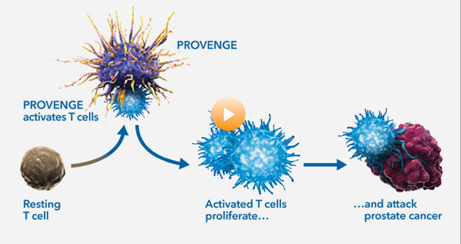
Mechanism of Action for Sipuleucel-T
Sipuleucel-T
Sipuleucel-T
www.provengehcp.com

Slide 18
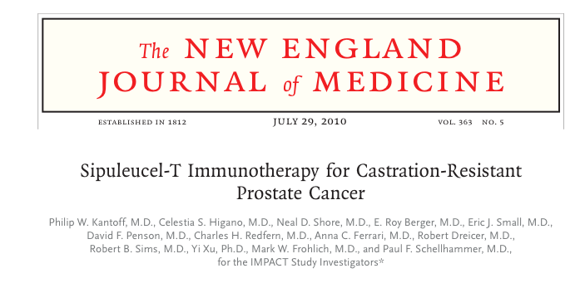

Slide 19
Updated Results of the Phase III IMPACT Trial of Sipuleucel-T for mCRPC
Sipuleucel-T
(n = 341)
Eligibility (n = 512)
Asymptomatic or minimally symptomatic mCRPC
2:1
R
Placebo
(n = 171)
Median time to objective progression:
14.6 versus 14.4 weeks
Median overall survival: 25.8 versus 21.7 months
Kantoff P et al. ASCO GU Symposium 2010;Abstract 8; Kantoff P et al.
N Engl J Med 2010;363(5):411-22.

Slide 20
Possible Side Effects Associated with Sipuleucel-T
Chills
Pyrexia
Headaches
Influenza-like illness
Myalgia
Hypertension
Hyperhidrosis
Groin pain
Serious AEs ≥Grade 4 were well balanced between both arms
Kantoff P et al. ASCO GU Symposium 2010;Abstract 8.

Slide 21
Response assessment in patients
receiving immunotherapy
Notes:
21
21

Slide 22
Case (from the practice of Ms Sinibaldi)
79 yo man who underwent radical prostatectomy in 1993 at age 59, with positive margins
  PSA rising, 3 years later
Received salvage radiation therapy
  PSA rising
Received a series of endocrine therapies including intermittent androgen deprivation
2009: Developed bone metastases
  Received additional lines of hormonal therapy
  PSA rising 4 months ago
Treated with enzalutamide rather than abiraterone due to concerns about the requirement for corticosteroid administration
  PSA declining; He is feeling relatively well
Notes:
22
22
22

Slide 23
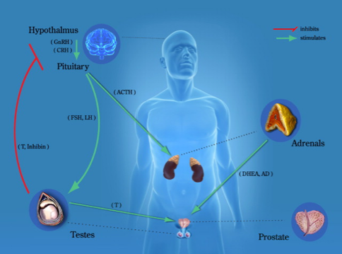
The Endocrine Axis in Prostate Cancer
Notes:
23
23

Slide 24
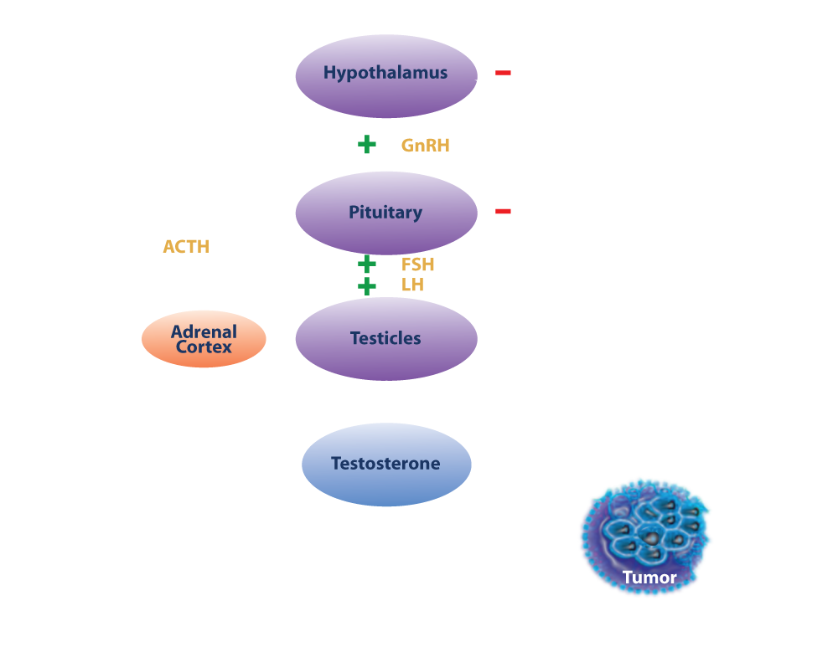
The Endocrine Axis in Prostate Cancer

Slide 25
JPR7: Intermittent Androgen Suppression for Rising PSA After Radiotherapy
Continuous androgen
deprivation (CAD)
Pelvic RT completed
>1 y prior
PSA >3 ng/mL and
> post-RT nadir
R
Intermittent androgen
suppression (IAS)
 | CAD (n = 696) | IAS (n = 690)
Median OS | 9.1 y | 8.8 y
7-y cumulative disease-related death rate | 15% | 18%
Patients with IAS experienced better global QoL, but benefit not universal
Crook JM et al. N Engl J Med 2012;367(10):895-903.

Slide 26
SWOG-S9346 (INT-0162): Intermittent versus Continuous Androgen Deprivation in Hormone-Sensitive mPC
Continuous androgen deprivation (CAD)
Newly diagnosed mPC
PSA >5 ng/mL
Induction with goserelin + bicalutamide x 7 mos
R*
Intermittent androgen deprivation (IAD)
* If PSA <4 ng/mL on months 6 and 7
_{g}
 | CAD (n = 765) | IAD (n = 770)
Median OS | 5.8 y | 5.1 y
Hussain M et al. N Engl J Med 2013;368(14):1314-25.

Slide 27
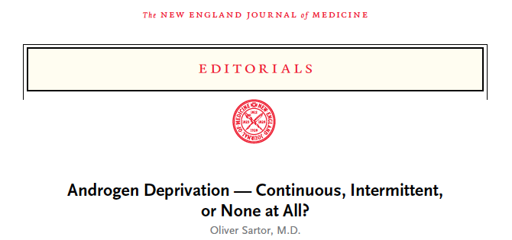
“…In addition to knowing little about which men in this population would benefit from treatment as compared with no treatment, we know little regarding the best possible timing of androgen-deprivation therapy for those clearly in need of treatment.
Does early androgen-deprivation therapy in asymptomatic men with rising PSA levels provide more benefit than treatment in symptomatic men with metastases? This question bedevils our field, and we are no closer to an answer now than we were before.”
Sartor O. N Engl J Med 2012;367(10):945-6.

Slide 28
Differential mechanisms of action and side-effect profiles of abiraterone and enzalutamide

Slide 29

Differential Mechanism of Action of Abiraterone versus Enzalutamide
Enzalutamide+ Abiraterone
Acetate
Abiraterone
Acetate
Enzalutamide
Testosterone
Testosterone
Testosterone
Androgen Receptor
Androgen Receptor
Androgen Receptor
Notes:
29
29

Slide 30
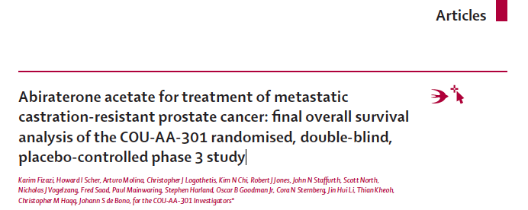
Notes:
30
30

Slide 31
Phase III COU-AA-301 Study
Abiraterone
+ Prednisone
(n = 797)
Eligibility (n = 1,195)
Histologically/cytologically confirmed mCRPC Failure of docetaxel ≤2 prior chemotherapies PSA progression
2:1
R
Placebo + Prednisone
(n = 398)
Median overall survival: 15.8 versus 11.2 months
Fizazi K et al. Lancet Oncol 2012;13(10):983-92.

Slide 32
FDA Approves the Expanded Use of Abiraterone Acetate in Combination with Prednisone for mCRPC
“On December 10, 2012, the Food and Drug Administration (FDA) approved an expanded indication for abiraterone acetate in combination with prednisone for the treatment of patients with metastatic castration-resistant prostate cancer before chemotherapy.”
The approval was based on the Phase III
COU-AA-302 trial.
http://www.cancer.gov/cancertopics/druginfo/fda-abirateroneacetate
Notes:
32
32

Slide 33
Possible Side Effects Associated with Abiraterone
All Grade
Arthralgia
Urinary tract infection
Fluid retention or edema
Hypokalemia
Cardiac disorders
  Atrial fibrillation
LFT abnormalities
Hypertension
Grade 3/4 Adverse Events
Fatigue
Anemia
Back pain
Bone pain
Fizazi K et al. Lancet Oncol 2012;13(10):983-92;
Ryan CJ et al. Proc ASCO 2012;Abstract LBA4518.
Notes:
33
33

Slide 34
FDA Approves Enzalutamide for mCRPC
“On August 31, 2012, the Food and Drug Administration (FDA) approved enzalutamide for the treatment of patients with metastatic castration-resistant prostate cancer who have previously received docetaxel.”
The approval was based on the Phase III AFFIRM trial
http://www.cancer.gov/cancertopics/druginfo/fda-enzalutamide
Notes:
34
34

Slide 35

Primary, secondary, and quality-of-life endpoint results from the Phase III AFFIRM study of MDV3100, an androgen receptor signaling inhibitor
De Bono JS et al. Proc ASCO 2012;Abstract 4519
Notes:
35
35

Slide 36
Phase III AFFIRM Study
Enzalutamide (160 mg/d)
(n = 800)
Eligibility (n = 1,199)
Patients with mCRPC Failure of docetaxel-based chemotherapy
2:1
R
Placebo
(n = 399)
De Bono JS et al. Proc ASCO 2012;Abstract 4519.

Slide 37
Phase III AFFIRM Study Results in Favor of Enzalutamide
Median overall survival:
  18.4 versus 13.6 months
PSA progression-free survival:
  8.3 versus 3.0 months
Time to first skeletal-related event:
  16.7 versus 13.3 months
Objective response rate:
  28.9% versus 3.8%
QoL response (10-point increase in overall score):
  43.2% versus 18.3%
De Bono JS et al. Proc ASCO 2012;Abstract 4519.
Notes:
37
37

Slide 38
Possible Side Effects Associated with Enzalutamide
Fatigue
Cardiac disorders
Myocardial infarction
Liver function abnormalities
Seizures
De Bono JS et al. Proc ASCO 2012;Abstract 4519.
Notes:
38
38

Slide 39
Possible Side Effects Associated with Enzalutamide: Seizures
_{g}
CASE | 1 | 2 | 3 | 4 | 5
Time on study | 2 months | 10 months | 2 months | 5 months | 10 months
On study drug? | Yes | Yes | Yes | Off trial drug for 26 days | Yes
Seizure type | Focal onset | Generalized | Complex partial status | Focal onset | Unknown, fall not witnessed
Recurrence | No | No | No | No | No
Potential confounding factors | Large 5 x 4-cm temporal lobe brain metastases | IV lidocaine inadvertently administered just before seizure | Atrophy and leukoaraiosis on brain MRI; nil else | Multiple CNS metastases: Eye, meninges, cerebellar | Alcohol excess; started on haloperidol 7 days prior
De Bono JS et al. Proc ASCO 2012;Abstract 4519.
Scher HI for the AFFIRM Investigators. N Engl J Med 2012;367(13):1187-97.
Notes:
39
39

Slide 40
Ongoing Phase III PREVAIL Study
Target accrual (n = 1,680)
Histologically confirmed PC Ongoing ADT No prior chemotherapy Asymptomatic/mildly symptomatic
Enzalutamide
2:1
R
Placebo
Primary endpoints: Overall survival, progression-free survival
www.clinicaltrials.gov; April 2013 (NCT01212991)

Slide 41
Sequential use of secondary hormonal agents and ongoing investigations of combination strategies

Slide 42
Ongoing Phase II Trial of Enzalutamide in Combination with Abiraterone
Target accrual (n = 60)
Histologically/cytologically confirmed CRPC Bone metastases Ongoing androgen deprivation therapy
Enzalutamide
+
Abiraterone
Primary endpoints:
  Nature, frequency and severity of adverse events
  Safety
www.clinicaltrials.gov; April 2013 (NCT01650194)

Slide 43
MODULE 2: NOVEL BONE-DIRECTED
STRATEGIES — RADIUM-223

Slide 44
Case (from the practice of Ms Sinibaldi)
65 yo man initially diagnosed with mPC and nodal involvement in 2006
  Responded to an LHRH agonist
2009: Widespread bone metastases
  Received multiple therapies including ketoconazole, sipuleucel-T, abiraterone and radium-223/docetaxel on a clinical trial
  Experienced pain relief but also myelosuppression
Currently receiving enzalutamide

Slide 45
Mechanism of action and administration of radium-223

Slide 46
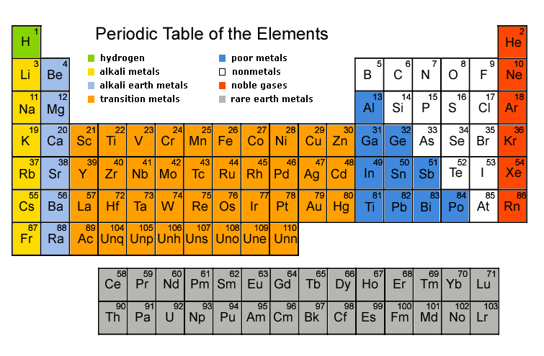
Radium Acts as a Calcium Mimetic
Calcium
Strontium
Barium
Radium
McDevitt MR et al. Eur J Nucl Med 1998;25(9):1341-51.

Slide 47
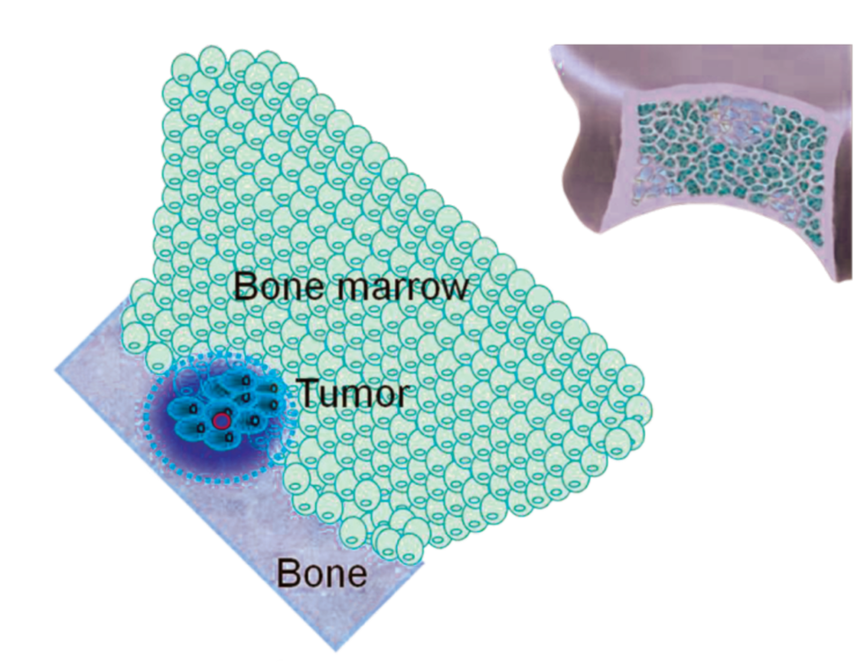
Mechanism of Action of and Administration of Radium-223
Radium-223 is a short-range but high-energy alpha-emitting particle
It targets osteoblastic bone metastases by acting as a calcium mimetic
2-10 cell diameter range of alpha-particle
Radium-223
Perez et al. Principles and Practice of Radiation Oncology. 5th ed.
Lippincott Williams & Wilkins; 2007.

Slide 48
Available clinical trial data and ongoing trials with radium-223

Slide 49
Phase III ALSYMPCA Trial
Radium-223
+
Best supportive care
(n = 614)
Eligibility (n = 921)
Confirmed symptomatic CRPC ≥2 bone metastases No visceral metastases Post docetaxel/unfit for docetaxel
2:1
R
Placebo
+
Best supportive care
(n = 307)
Median overall survival: 14.9 versus 11.3 months
Time to first skeletal-related event: 15.6 versus 9.8 months
Bone pain Grade >3: 18% versus 23%
Parker C et al. Proc ESMO 2012;Abstract 898PD.

Slide 50
Possible Side Effects Associated with Radium-223
Bone pain
Diarrhea
Nausea
Vomiting
Constipation
Anemia
Neutropenia
Thrombocytopenia
Parker C et al. Proc ESMO 2012;Abstract 898PD.
Notes:
50
50

Slide 51
Side effects and toxicities of radium-223 versus existing radiopharmaceuticals

Slide 52
Side-Effect Profile of Radium-223 versus Other Radiopharmaceuticals
Radiopharmaceutical | Side effects
Radium-223 (clinical) | Minor GI toxicities; mild neutropenia/thrombocytopenia¹
Strontium-89 (clinical) | Increased but tolerable hematologic toxicity²
Samarium-153 (clinical) | Significant leukopenia and thrombocytopenia³
¹ Harrison MR et al. Cancer Manag Res 2013;5:1-14;
² Porter AT et al. Int J Radiat Biol Phys 1993;25(5):805-13;
³ Harrison MR et al. Cancer Manag Res 2013;5:1-14.
Notes:
52
52

Slide 53
Potential use of radium-223 with other systemic therapies
(eg, hormonal therapy, chemotherapy, other bone-directed agents)

Slide 54
Potential Use of Radium-223 with Other Systemic Therapies (A Phase I/II Trial)
Radium-223
+
Docetaxel
Target accrual (n = 60)
Histologically/cytologically confirmed mCRPC ≥2 bone metastases Eligible for docetaxel
R
Docetaxel only
Primary endpoint:
  Assessment of dose-limiting toxicities
  Safety
www.clinicaltrials.gov; April 2013 (NCT01106352)

Slide 55
MODULE 3: ROLE OF CHEMOTHERAPY
IN THE MANAGEMENT OF mPC

Slide 56
Case (from the practice of Ms Pindilli)
79 yo man diagnosed 12 years ago with mPC
Received multiple systemic treatments including abiraterone on a clinical trial
Received several alternative therapies
Currently receiving enzalutamide
2005: Together with his wife, adopted a 3-month old daughter
Spending time with his family is his greatest concern

Slide 57
Phase III TAX-327 Study of Docetaxel
Docetaxel q 3 wk
+ Prednisone
N = 1,006
Patients with mCRPC Increasing PSA
1:1
R
Docetaxel q wk
+ Prednisone
Mitoxantrone
+ Prednisone
Median overall survival: 19.2 versus 17.8 versus 16.3 months
50% decrease in serum PSA: 45% versus 48% vs 32%
Pain reduction: 35% versus 31% versus 22%
Improved QoL: 22% versus 23% versus 13%
Berthold DR et al. J Clin Oncol 2008;26(2):242-245;
Tannock IF et al. N Engl J Med 2004;351:1502-12.

Slide 58
Phase III TROPIC Study of Cabazitaxel
Cabazitaxel
+
Prednisone
(n = 378)
Eligibility (n = 755)
Patients with progressive mCRPC during or after treatment with a docetaxel-based regimen
1:1
R
Mitoxantrone
+
Prednisone
(n = 377)
Median overall survival: 15.1 versus 12.7 months
Median progression-free survival: 2.8 vs 1.4 months
Most common AE > Grade 3 with cabazitaxel: neutropenia, diarrhea
www.clinicaltrials.gov; April 2013 (NCT00417079)
De Bono JS et al. Lancet 2010;376(9747):1147-1154.

Slide 59
Possible Side Effects Associated with Docetaxel and Cabazitaxel
Neutropenia
Leukopenia
Anemia
Diarrhea
Febrile neutropenia
Fatigue
Asthenia
Back pain
Nausea
Vomiting
Hematuria
Abdominal pain
Peripheral neuropathy
De Bono JS et al. Lancet 2010;376(9747):1147-1154.
Notes:
59
59

