Slide 1
Please note, these are the actual video-recorded proceedings from the live CME event and may include the use of trade names and other raw, unedited content. Select slides from the original presentation are omitted where Research To Practice was unable to obtain permission from the publication source and/or author. Links to view the actual reference materials have been provided for your use in place of any omitted slides.

Slide 2
Challenging Cases in
Non-Hodgkin Lymphoma
Oncologist and Nurse Investigators
Consult on Actual Patients from the
Practices of the Invited Faculty
Thursday, April 25, 2013
12:00 PM – 1:30 PM
Washington, DC
Faculty
Andrew M Evens, DO, MSc
Amy Goodrich, CRNP-AC
Mollie Moran, MSN, CNP, AOCNP
Lauren C Pinter-Brown, MD
Moderator
Neil Love, MD

Slide 3
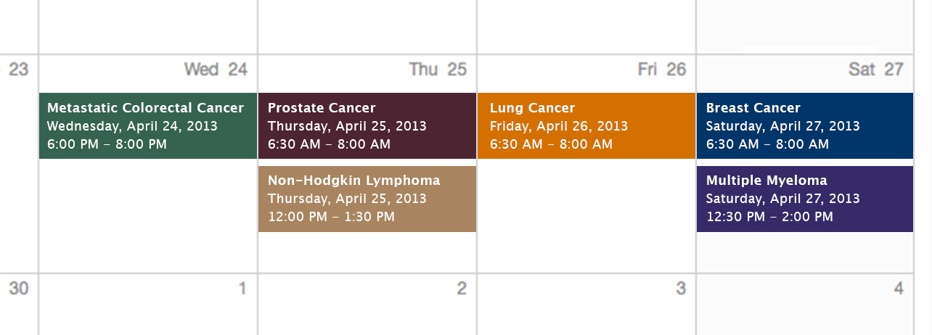
Challenging Cases
Oncologist and Nurse Investigators
Consult on Actual Patients from the
Practices of the Invited Faculty

Slide 4
Themes — Challenging Cases in Oncology
A 10-Hour Integrated Curriculum
Challenges associated with the incorporation of new research findings and newly approved agents into practice
Patient education on potential risks and benefits of specific oncologic treatments
Monitoring and management of treatment side effects and toxicities

Slide 5
Themes — Challenging Cases in Oncology
A 10-Hour Integrated Curriculum
Participation in ongoing clinical trials as an important patient option
Psychosocial impact of cancer diagnosis and treatment — why all patients, even those with the same disease, are different
Strategies to cope with the stress of being an oncology professional

Slide 6
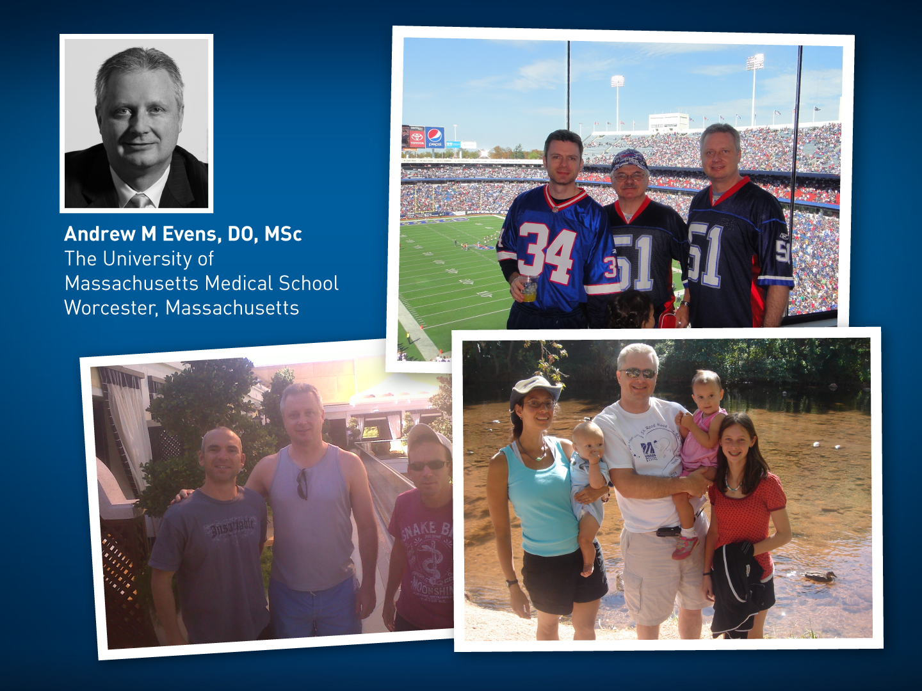

Slide 7
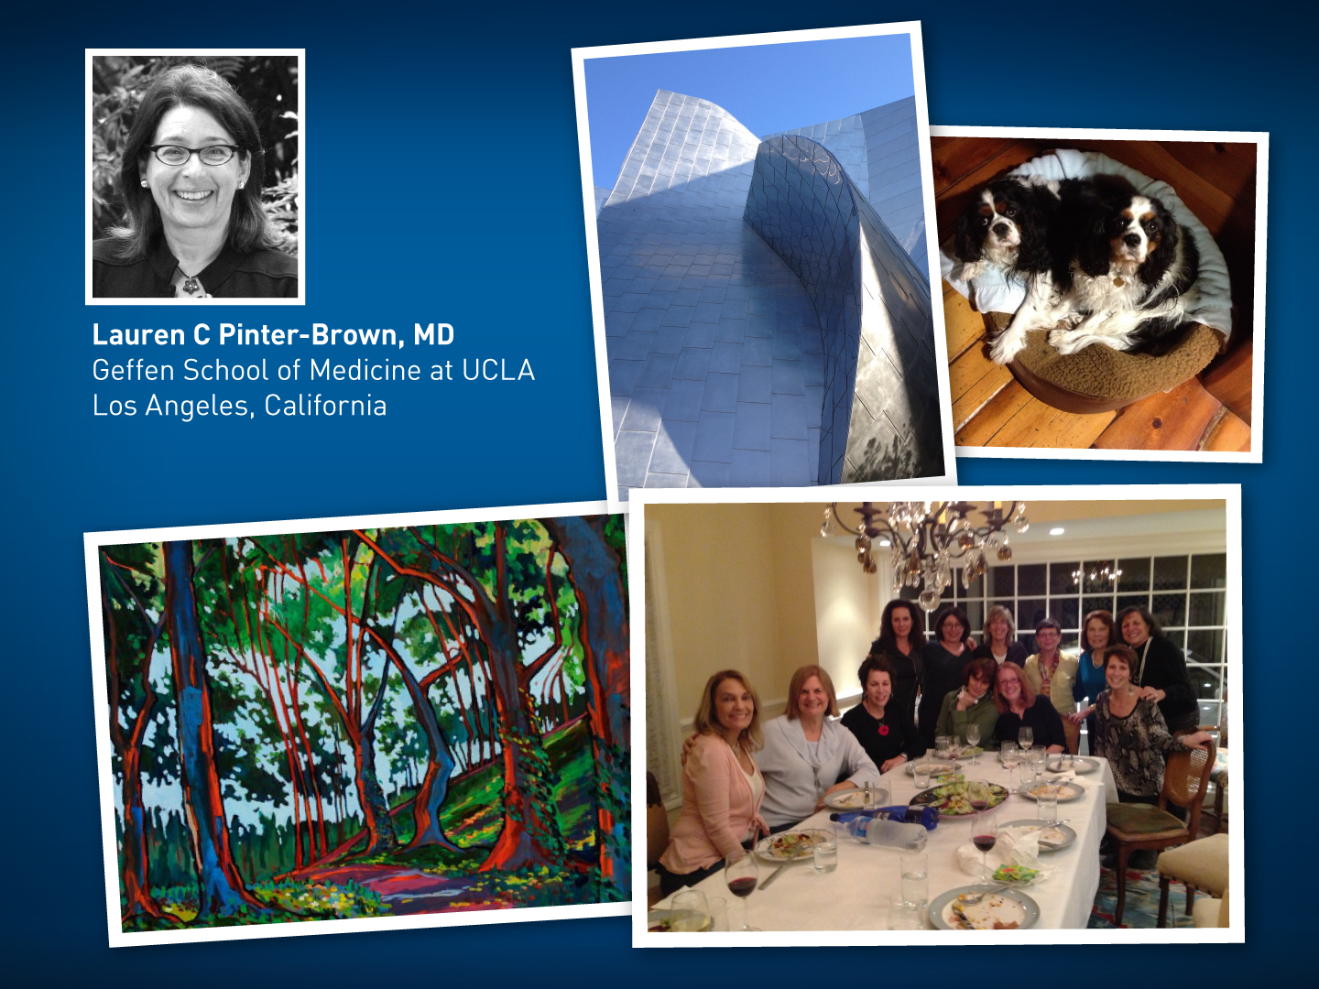

Slide 8


Slide 9
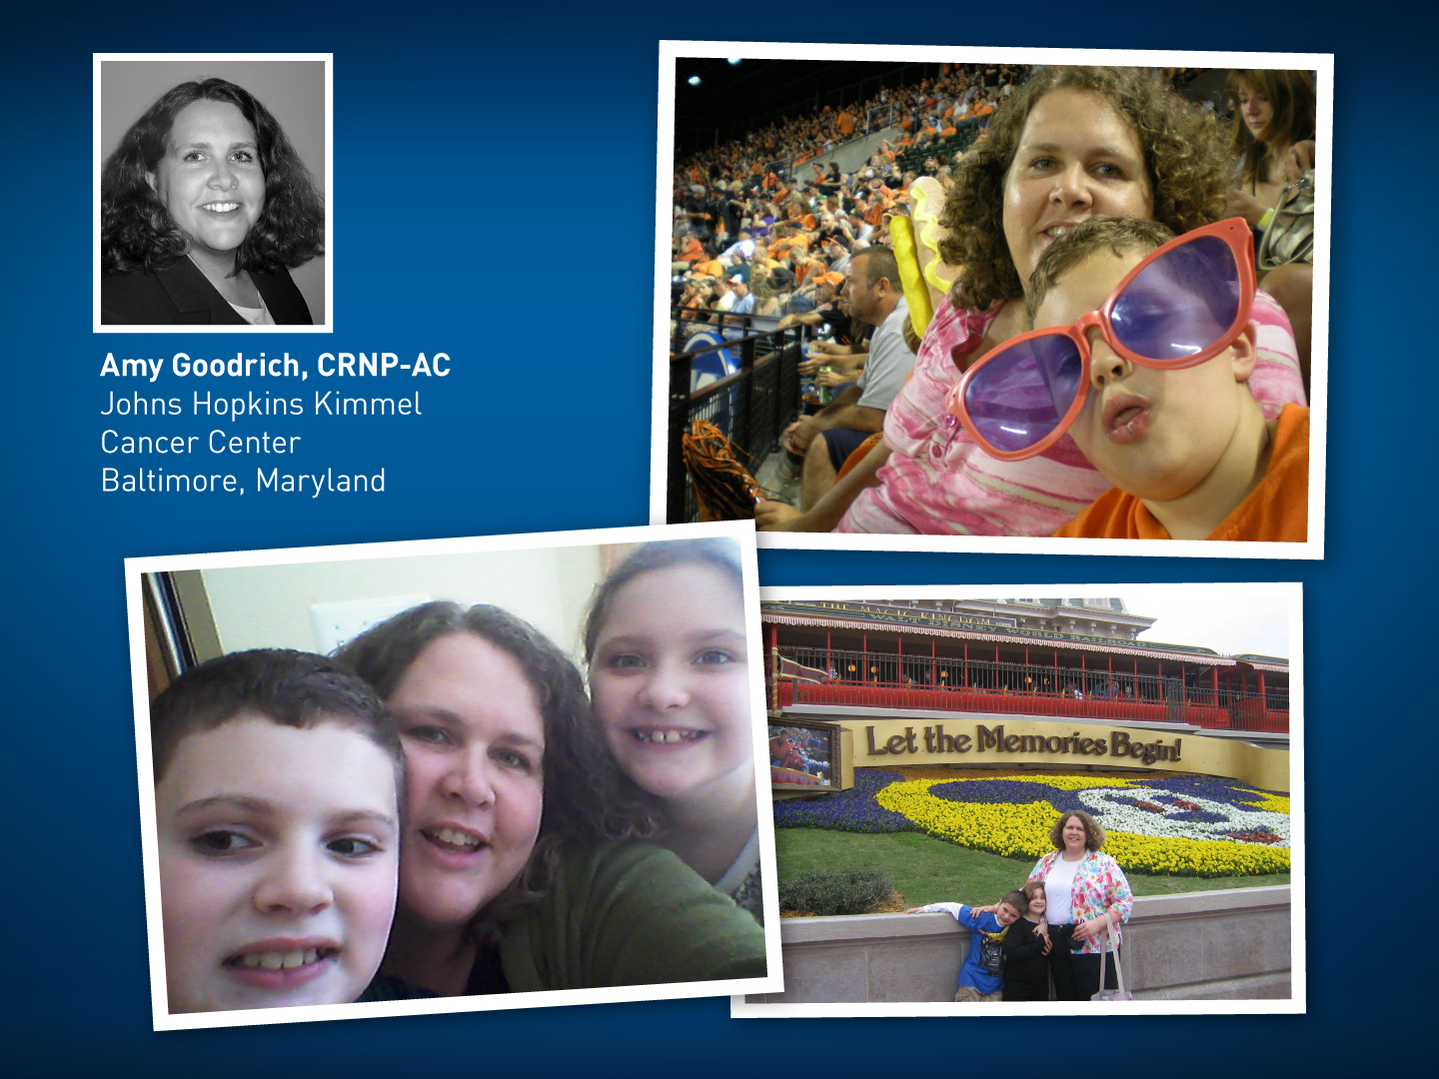

Slide 10
Agenda
Module 1: Follicular Lymphoma: 67 yo factory worker with Grade I-II FL — Ms Moran
Module 2: Chronic Lymphocytic Leukemia: 55 yo car salesman with 13q del CLL — Ms Goodrich
Module 3: T-Cell Lymphoma: 77 yo retired office worker with extranodal PTCL — Ms Goodrich
Module 4: Mantle-Cell Lymphoma: 61 yo fertilizer factory manager with recurrence of MCL — Ms Moran

Slide 11
New Agents/Regimens Recently Approved by the FDA
Cancer Type | Agent | Approval Date
Colorectal | Bev on progression | 1/13
 | Regorafenib | 9/12
 | Aflibercept | 8/12
Prostate | Enzalutamide | 8/12
 | Abiraterone | 4/11
 | Cabazitaxel | 6/10
 | Sipuleucel-T | 4/10
NHL: ALCL | Brentuximab vedotin | 8/11
NHL: T-cell lymphoma | Romidepsin | 11/09
 | Pralatrexate | 9/09
Cancer Type | Agent | Approval Date
Lung | Nab paclitaxel | 10/12
 | Crizotinib | 8/11
Breast | T-DM1 | 2/13
 | Everolimus | 7/12
 | Pertuzumab | 6/12
 | Eribulin | 11/10
Multiple myeloma | Pomalidomide | 2/13
 | Carfilzomib | 7/12
www.fda.gov

Slide 12
MODULE 1: FOLLICULAR LYMPHOMA (FL)

Slide 13
Case (from the practice of Ms Moran)
2011: 65 yo woman with abdominal pain and diffuse lymphadenopathy
  Biopsy: Grade I/II FL, bone marrow positive
  Lenalidomide/rituximab on clinical trial
    Increased painful lymphadenopathy resolved with lenalidomide dose reduction to 15 mg PO days 1-21
Eight months later: In ER with abdominal pain, fevers, nausea, vomiting
  Acute bowel perforation at the transverse colon; resection
  Pathology: FL involvement
Lenalidomide discontinued

Slide 14
Indications for watchful waiting
or rituximab (R) monotherapy

Slide 15
“Watchful Waiting” vs Initiation of Treatment
Candidates for “Watchful Waiting”
Asymptomatic; low bulk, slowly progressive disease; no impending organ compromise
Indicators to Initiate Treatment for Stage II-IV FL
Development of symptoms
  Fever, sweats, weight loss, pain
Cytopenias
Massive splenomegaly
Impairment of major organ function
Bulky adenopathy
  One lymph node >7 cm
  Three lymph nodes >3 cm
Pleural effusions or ascites
Marked blood lymphocytosis
Press OW, Palanca-Wessels MC. J Clin Oncol 2013;[Epub ahead of print].

Slide 16
Commonly used induction
regimens for patients receiving
active treatment for FL (eg, R-CHOP, bendamustine/R [BR])

Slide 18
StiL NHL 1-2003 Phase III Study
Bendamustine
+ Rituximab (BR)
Eligibility
Untreated indolent NHL or MCL (N = 549)
R
R-CHOP
Rummel MJ et al. Lancet 2013;381;1203-10.

Slide 19
Key Findings from StiL NHL 1-2003
Median follow-up: 45 months
BR vs R-CHOP
  Median PFS (all pts): 69.5 vs 31.2 months
  Median PFS (FL pts): 39% reduction in risk of progression
BR
Erythematous
skin reactions
R-CHOP
Alopecia
Infections
Peripheral neuropathy
Stomatitis
Hematologic toxicity
Rummel MJ et al. Lancet 2013;381;1203-10.

Slide 20
Key Findings from the BRIGHT Study
Median follow-up: 18 months
BR vs R-CHOP or R-CVP
  Complete remission rate: BR noninferior to
  R-CHOP/R-CVP
BR
Lymphopenia
Nausea
R-CHOP or R-CVP
Alopecia
Neutropenia
Leukopenia
Constipation
Most common investigator-reported nonhematologic Grade 3/4 AE: infusion-related reactions (13 and 8)
Flinn IW et al. Proc ASH 2012;Abstract 902.

Slide 22
PRIMA: Study Design
INDUCTION
MAINTENANCE
Rituximab maintenance
375 mg/m²
every 8 weeks
for 2 years
CR/CRu
PR
High
tumor burden
untreated
follicular
lymphoma
Rituximab
+
CVP or
CHOP or
FCM
R
1:1
Observation
PD/SD
off study
36-month PFS: 75% vs 58%
2-year CR: 72% vs 52%
Salles G et al. Lancet 2010;377:42-51.

Slide 23
E4402 (RESORT) Phase III Study
CR
or
PR
R maintenance
Eligibility (N = 545)
Indolent NHL No prior lymphoma Tx Stage III or IV Low tumor burden
Rituximab (R)
R
R re-treatment at progression
Time to Treatment Failure: No difference
Time to Cytotoxic Treatment: Favors maintenance R
No benefit in QOL with maintenance R
Kahl BS et al. Proc ASH 2011;Abstract LBA-6.

Slide 24
Novel agents and regimens
under investigation for FL

Slide 25
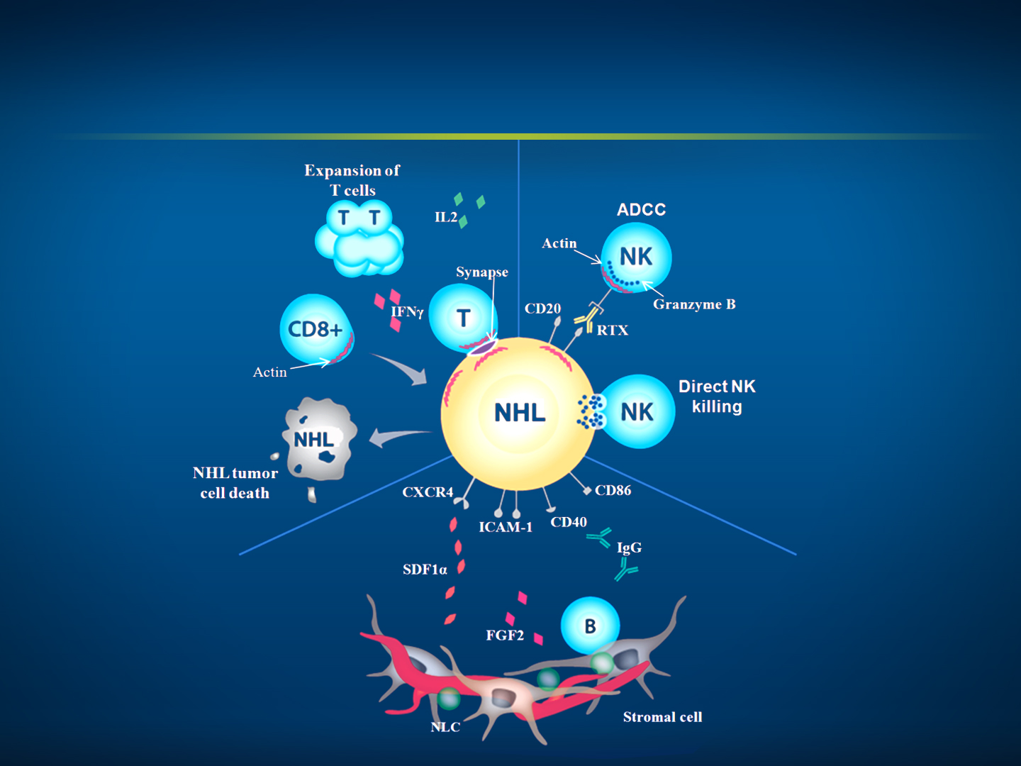
Lenalidomide:
Mechanism of action in lymphoma
T-Cell Effects
Immune synapse formation
T cell activation and proliferation
CD8+ T effector cell activity
NK-Cell Effects
Immune synapse formation
ADCC
Direct NK-mediated killing
B-CLL Cell Effects
APC function
CXCR4 expression
Microenvironmental Effects
FGF2
Altered cytokine levels
IgG production

Slide 26

Lenalidomide and Rituximab for Untreated Indolent Lymphoma: Final Results of a Phase II Study
Fowler NH et al.
Proc ASH 2012;Abstract 901.
Patients with FL (N = 46)
ORR 98%
Complete Response 87%
Estimated 2-yr PFS 89%
≥Grade 3 Neutropenia 40%

Slide 27
RELEVANCE Phase III Study
Target Accrual: 1,000 (Active, recruiting)
Lenalidomide +
Rituximab
Eligibility
Grade I, II or IIIa untreated Stage II-IV FL In need of treatment
R
R-CHOP, R-CVP
or BR
PR or CR
Maintenance R
q2 mos x 12
www.clinicaltrials.gov, April 2013
clinicaltrials.gov Identifier: NCT01650701

Slide 28
Challenges in caring for patients
with limited financial and social support resources

Slide 29
MODULE 2: CHRONIC LYMPHOCYTIC LEUKEMIA

Slide 30
Case (from the practice of Ms Goodrich)
2002: A 55 yo car salesman with long-term alcoholism diagnosed with 13q del CLL
2007: Nephrectomy for early-stage kidney cancer
Lost to follow-up between 2008 and 2010
  Returns with lymphocytosis and bulky adenopathy
Fludarabine/cyclophosphamide/rituximab (FCR) x 2
  Discontinued due to cytopenias
BR x 4 cycles
  Interrupted by rehab stays
  In remission for 1 year after BR
2011: Alemtuzumab begun, intermittent binge drinking
Mini-allogeneic transplant resulted in complete remission
2013: Patient dies from acute alcohol binge

Slide 31
Selection of induction therapy
for younger and older patients requiring treatment for CLL
(FCR versus FR versus BR)

Slide 32
Common Induction Regimens in CLL
Regimen | ORR | Median PFS
FCR (fludarabine, cyclophosphamide, rituximab) | 90% | 52 mos
FR (fludarabine, rituximab) | 84% | 42 mos
BR (bendaumustine, rituximab) | 88% | 34 mos
Wierda WG. J Clin Oncol 2012;30(26):3162-4.

Slide 33
Toxicity Issues
Common Concerns
Prolonged myelosuppression
Treatment-related myeloid neoplasia
Fludarabine
F(C)R difficult to tolerate in older patients
Immunosuppression
Renal excretion
Exacerbation of AIHA
Bendamustine
Rash
Hypersensitivity

Slide 34
German CLL10 Phase III Study Design
Target Accrual: 564 (Active, not recruiting)
FCR
Eligibility
Untreated B-cell CLL Binet Stage C Binet Stage A/B with B symptoms or constitutional symptoms
R
BR
Primary Endpoint: PFS after 24 months
www.clinicaltrials.gov, April 2013
clinicaltrials.gov Identifier: NCT00769522

Slide 35
Clinical research with lenalidomide
in the treatment of CLL

Slide 36
German CLLM1 Phase III Study Design
Target Accrual: 200 (Active, recruiting)
Lenalidomide maintenance to PD, toxicity, withdrawal
Eligibility
Untreated high-risk CLL
FCR
FR
FC
BR
R
≥PR + MRD ≥10⁻²
or MRD ≥10⁻⁴ - <10⁻²
+ unmutated IGHV or
17p del or
TP53 mutation
Primary Endpoint: PFS
Placebo
www.clinicaltrials.gov, April 2013
clinicaltrials.gov Identifier: NCT01556776

Slide 37
Novel agents and regimens
under investigation for CLL

Slide 38
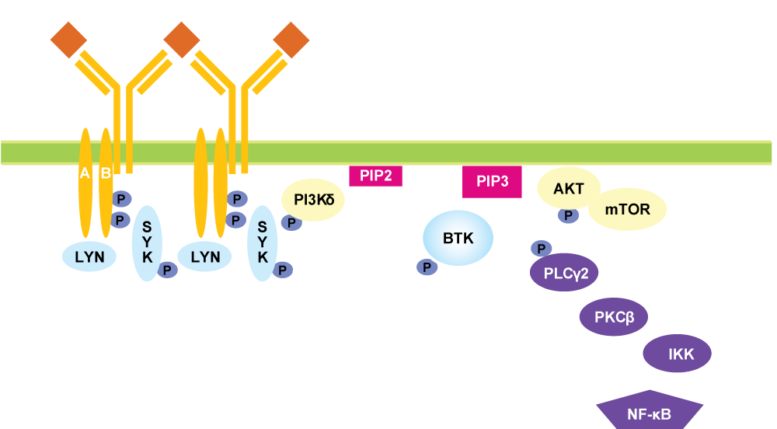
Antigen-Dependent B-Cell Receptor Signaling and Its Targeting by Small-Molecule Inhibitors
Adapted from Wiestner A. J Clin Oncol 2013;31:128.

Slide 39
Ibrutinib (PCI-32765): BCR Signaling Inhibitor
Oral inhibitor of Bruton’s tyrosine kinase (BTK)
No cytotoxic effect on T cells or NK cells
Highly active in:
  FL
  CLL
  MCL
  DLBCL
Main toxicities
  Primarily Grade 1/2 (minimal Grade 3/4)
  Diarrhea, fatigue, nausea, dyspepsia, myalgia, cough/respiratory, headache
ORR in R/R B-cell lymphomas and CLL: 60%
  Advani, JCO 2013

Slide 40
FDA Grants Breakthrough Therapy Designations for Ibrutinib in 3 Different B-Cell NHLs
“On April 8, 2013, the Food and Drug Administration (FDA) granted an additional Breakthrough Therapy Designation for the investigational oral agent ibrutinib as monotherapy for the treatment of CLL or small lymphocytic lymphoma patients with deletion of the short arm of chromosome 17 (deletion 17p).
In February 2013, FDA granted Breakthrough Therapy Designations for ibrutinib as a monotherapy for the treatment of patients with relapsed or refractory MCL and as a monotherapy for the treatment of patients with Waldenstrom's macroglobulinemia (WM), both of which are also B-cell malignancies.”
http://ir.pharmacyclics.com/releasedetail.cfm?releaseid=754820
Notes:
40
40

Slide 41
Idelalisib (GS-1101, CAL-101): BCR Signaling Inhibitor
Oral inhibitor of PI3Kα
Rapid and sustained reduction in lymphadenopathy in CLL
  Transient lymphocytosis
Bendamustine and/or rituximab + idelalisib in R/R CLL
  High ORR: ~80%
  2-yr PFS: 63%
  2-yr OS: 84%
Toxicities
  Febrile neutropenia
  Pneumonia
  Transaminase elevation
  Diarrhea
  Pyrexia
Ongoing Phase III studies
  NCT01539512: GS‑1101/placebo + R
  NCT01569295: GS‑1101/placebo + BR
Coutre SE et al. Proc ASH 2012;Abstract 191.

Slide 42
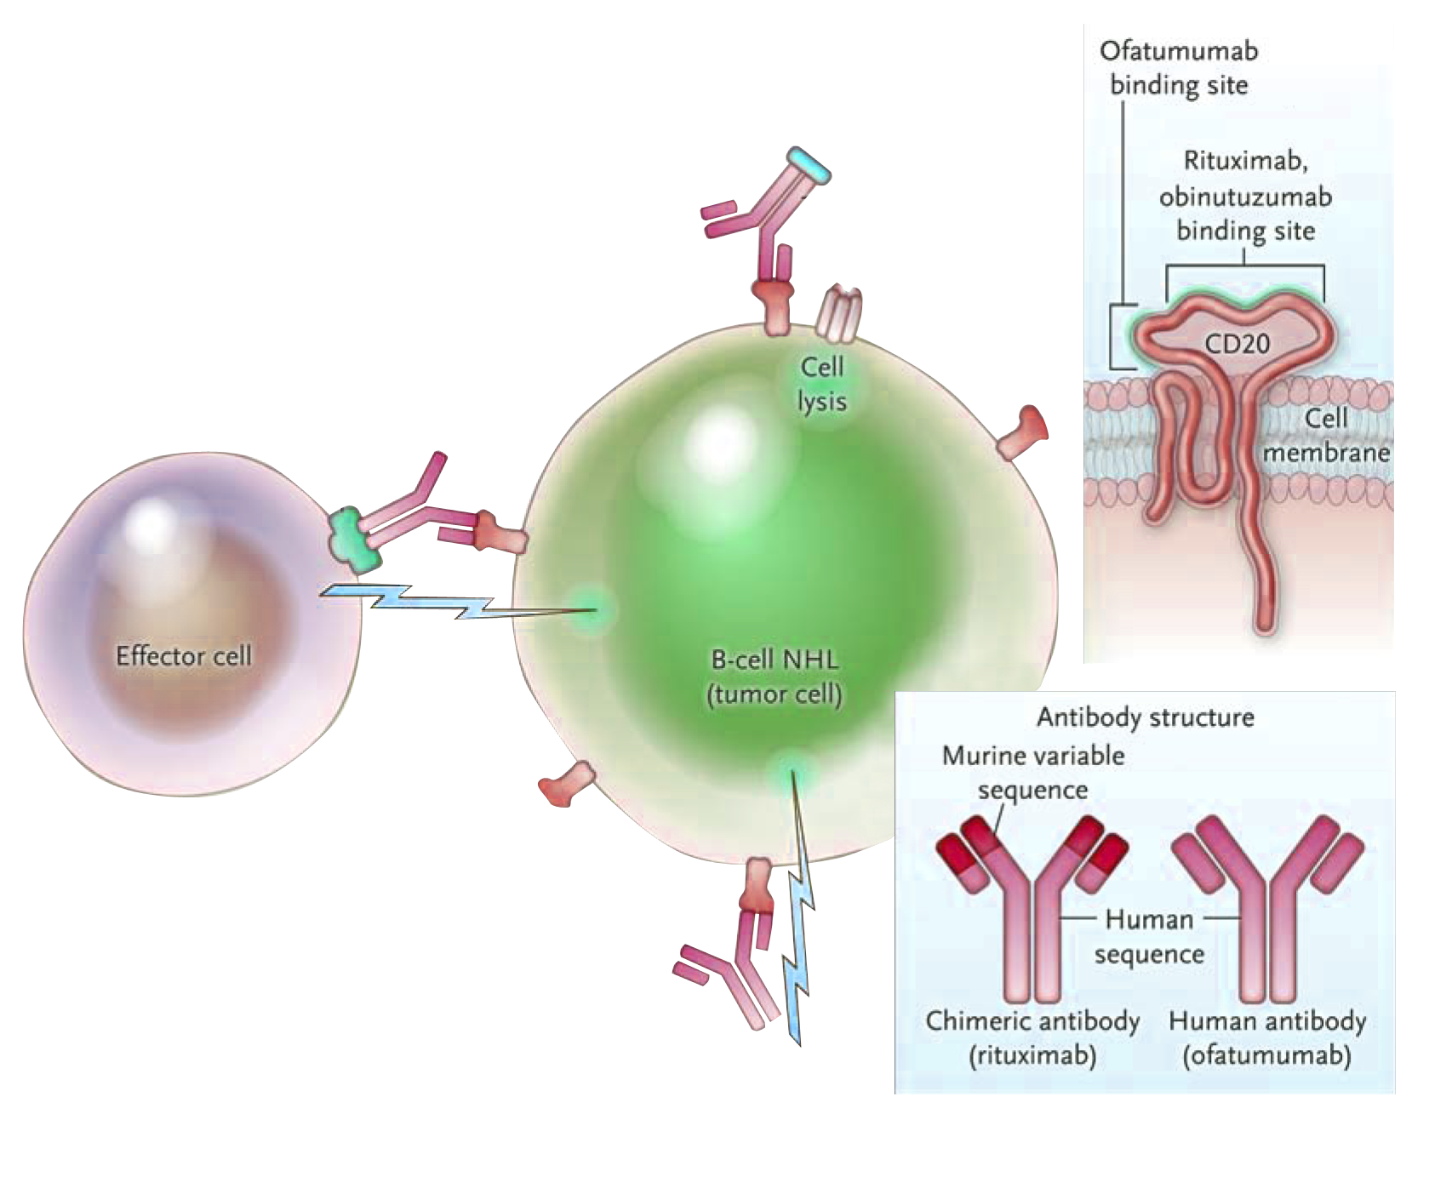
Mechanisms of Action of Anti-CD20 Antibodies
Complement-mediated lysis
C1q
binding
MAC
FcγRIIIa
ADCC
CD20
antigen
Direct effects
Antibody binding induces antiproliferative signaling, apoptosis and cell-growth inhibition
Adapted from Maloney DG. N Engl J Med 2012;366:2008-2016.

Slide 43
Obinutuzumab (GA101)
A novel glycoengineered Type II CD20 monoclonal antibody
  Developed for the treatment of B-cell cancers:
  NHL and CLL
Distinct mechanism of action compared to other
anti-CD20s, including rituximab
  Compared with rituximab, it mediates less complement-dependent cytotoxicity (CDC)
  More potent than the Type I antibody rituximab in inducing cell death via nonclassical induction of apoptosis cytotoxicity
    More direct cytotoxicity
    More antibody-dependent cell-mediated cytotoxicity
Cang S et al. J Hematol Oncol 2012;5:64.

Slide 44
German CLL11 Phase III Study
Target Accrual: 786 (Active, recruiting)
Chlorambucil +
Obinutuzumab
Eligibility
Previously untreated CD20+ B-cell CLL
R
Chlorambucil +
Rituximab
Chlorambucil
Primary Endpoint: PFS
Press release, January 30, 2013
Improvement in PFS with addition of obinutuzumab to chlorambucil vs chlorambucil alone
www.clinicaltrials.gov, April 2013
clinicaltrials.gov Identifier: NCT01010061

Slide 45
Treatment for patients with alcoholism and/or other substance abuse issues

Slide 46
MODULE 3: T-CELL LYMPHOMA (TCL)

Slide 47
Case (from the practice of Ms Goodrich)
A 77 yo man presents with symptoms of gastric outlet obstruction
  Diagnosis: Extranodal peripheral TCL (PTCL)
Response to CHOP followed by quick recurrence
ICE (ifosfamide/carboplatin/etoposide)
  “Maintenance” pralatrexate
    Mucositis
Primary tumor-related symptomatology: Respiratory, due to extensive pulmonary involvement
During treatment his daughter was divorced
  Daughter and 8-year-old granddaughter move in with the patient and his wife
Disease progression
  Patient eventually enters hospice and dies

Slide 48
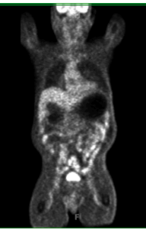
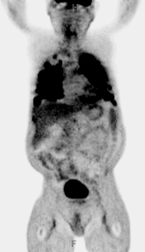
Case: Complete Response to CHOP Followed by Quick Recurrence
November 2011
April 2012
Courtesy of A Goodrich.

Slide 49
Classification and
presentation of PTCL

Slide 50
Classification of PTCL
PTCL is a heterogeneous group of aggressive mature T-/NK-cell lymphomas
CTCL is a subgroup of PTCL consisting of several diseases that originate in the skin and are primarily slow growing
PTCL (Mature T-/NK-cell
Neoplasms)
Cutaneous
Extranodal
Nodal
Leukemic
Mycosis Fungoides
(MF)
NK/TCL
Nasal Type
Peripheral TCL-NOS
Adult T-Cell
Leukemia/Lymphoma
Transformed
MF
Enteropathy- Associated TCL
Anaplastic Large Cell
Lymphoma (ALK +/-)
Aggressive NK-Cell Leukemia
Sézary Syndrome
Hepatosplenic TCL
Angioimmunoblastic
TCL
T-Cell Prolymphocytic
Leukemia
Primary Cutaneous CD30+ T-Cell Disorders
Subcutaneous
Panniculitis-Like TCL
T-Cell Large Granular
Lymphocytic Leukemia
Primary Cutaneous Gamma/Delta TCL
Aggressive
Indolent
Adapted from Swerdlow SH et al. WHO Classification of Tumours of Haematopoietic and Lymphoid Tissues 2008.

Slide 51
Sequencing available systemic treatment options for PTCL
and advanced CTCL

Slide 52
Treatment of PTCL: NCCN Guidelines
Induction therapy
  ALK-positive ALCL: CHOP or CHOEP +/- RT
  All other histologies: Clinical trial preferred or multiagent chemotherapy +/- RT
Second-line therapy
  All subtypes: Clinical trial preferred or second-line chemotherapy
  Stem cell transplant for appropriate candidates
Adapted from NCCN Guidelines Non-Hodgkin’s Lymphomas v1.2013.

Slide 53
Approved Agents in Relapsed/Refractory PTCL
Pralatrexateª N = 109 | Outcomes | Romidepsin^{b} N = 130
3 | Median prior Rx | 2
29% | ORR | 25%
11% | CR | 11%
18% | PR | 11%
10.1 months | Median duration of response | 28 months
3.5 months | Median PFS | 4 months
ª O’Connor OA et al. J Clin Oncol 2011;29(9):1182-1189; ^{b} Coiffier B et al. Proc ASH 2012;Abstract 3641.

Slide 54
Histone Deacetylase Inhibitor Romidepsin Exerts Pleiotropic Effects
Histone acetylation/
transcription induction²
Gene regulation¹
Protein acetylation³
Romidepsin
Cell-cycle arrest⁴
Activation of apoptosis⁴
Anti-angiogenesis⁵
1. Peart MJ et al. Proc Nat Acad Sci 2005;102:3697-3702. 2. Bolden JE et al. Nat Rev Drug Discov 2006;5:769-784. 3. Wang Y et al. Biochem Biophys Res Commun 2007;356:998-1003. 4. Celgene Corp. Data on file. 5. Kwon HJ et al. Int J Cancer 2002;97:290-296.

Slide 55
Pralatrexate Mechanism of Action
Pralatrexate is a selective antifolate designed to accumulate preferentially in cancer cells
Entry | Selectively enters cells expressing RFC-1, a protein that is overexpressed on cancer cells
Accumulation | Once inside cancer cells, pralatrexate is efficiently polyglutamylated, which leads to high intracellular drug retention
Inhibition | Acting on the folate pathway, pralatrexate interferes with DNA synthesis and triggers cancer cell death
Pralatrexate, package insert; Abramovits W et al. Skinmed 2012;10(4):244-6.

Slide 56
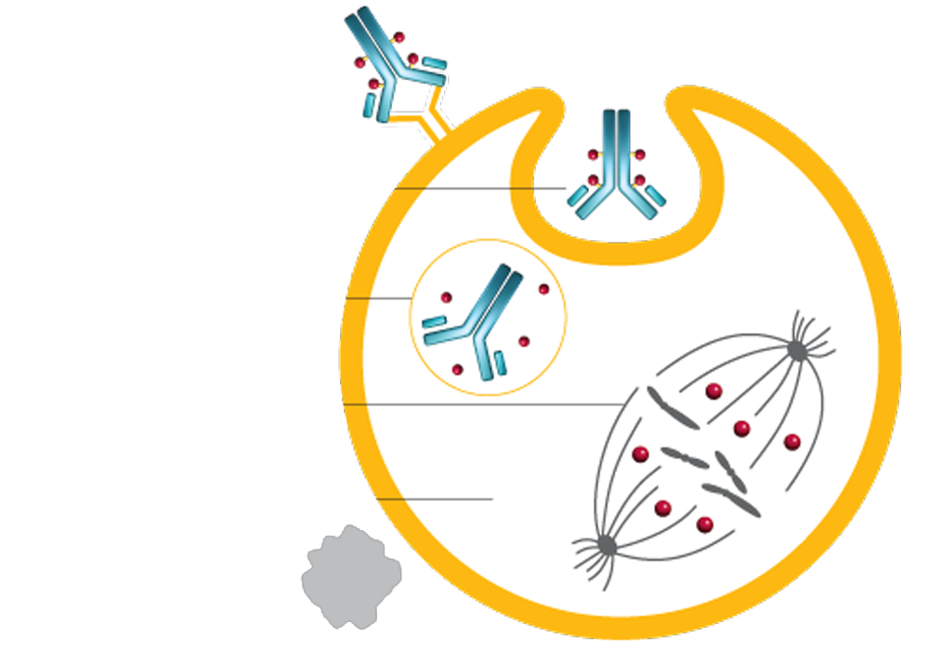
Mechanism of Action of Brentuximab Vedotin
Brentuximab vedotin is an antibody drug conjugate (ADC) targeted to cells expressing CD30 on their surface
1
ADC binds to CD30 and initiates internalization of the ADC-CD30 complex
2
MMAE is released
3
MMAE binds to tubulin and disrupts the microtubule network
4
Cell cycle arrested
5
Apoptosis (cell death)
Courtesy of Julie M Vose, MD, MBA.

Slide 57
End-of-life planning and counseling patients regarding hospice

Slide 58
MODULE 4: MANTLE-CELL LYMPHOMA (MCL)

Slide 59
Case (from the practice of Ms Moran)
A 61 yo man presented 3 years ago with nausea and reflux
  Endoscopy and colonoscopy: Characteristic of MCL, confirmed by biopsy
  Widespread lymphadenopathy
R-hyper-CVAD: Response with recurrence 6 months later
BR for 6 cycles: Complete response
Now off treatment for 18 months
Patient is a manager at a fertilizer factory
  Accustomed to “being in charge”
    Difficult to accept help when ill from treatment
    Still working but now places a greater emphasis on family, particularly his grandchildren

Slide 60
Treatment options for
newly diagnosed MCL

Slide 61
SWOG-S1106 Phase II Study in Younger Patients with Untreated MCL
Target Accrual: 180 (Active, recruiting)
R-hyper-CVAD → ASCT
Eligibility
Previously untreated Stage III-IV or bulky Stage II MCL Age ≤65 Eligible for ASCT
R
BR → ASCT
Primary Endpoint: PFS at 2 yrs
www.clinicaltrials.gov, April 2013
clinicaltrials.gov Identifier: NCT01412879

Slide 62
ECOG-E1411 Phase II Study in Older Patients with Untreated MCL
Target Accrual: 332 (Active, recruiting)
BR → R
Eligibility
Previously untreated MCL Age ≥60 No CNS mets
R
BVR → R
BR → LR
Primary Endpoint: PFS at 2 yrs
BVR → LR
www.clinicaltrials.gov, April 2013
clinicaltrials.gov Identifier: NCT01415752

Slide 63
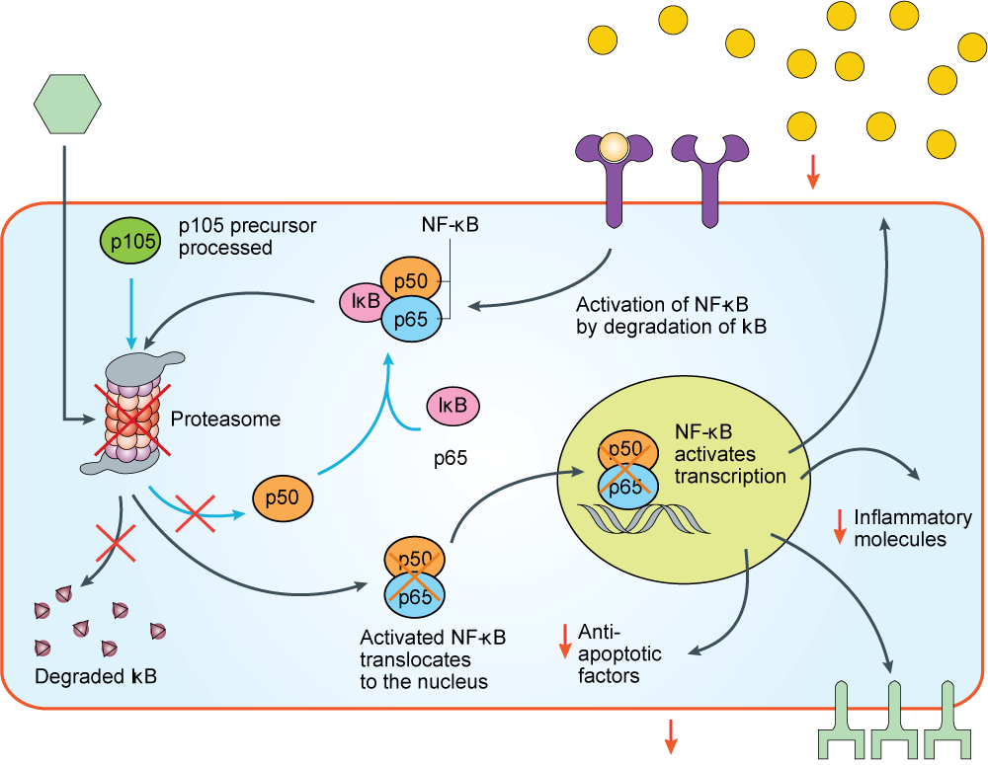
Mechanisms of Action of Proteasome Inhibitors
Adapted from Paramore A, Frantz S. Nat Rev Drug Discov 2003;2(8):611-2.

Slide 64
Benefits and risks of
maintenance therapy in MCL

Slide 65
European MCL Maintenance Study
R maintenance
375 mg/m² q2m
R-CHOP
Eligibility
R
CR/CRu or PR
R
>60 yo with Stage
II-IV MCL
Not eligible for HDT
R-FC
IFN maintenance
Kluin-Nelemans HC et al. N Engl J Med 2012;367:520-31.
Notes:
65

Slide 66
Key Findings in the European MCL Study
Induction Phase (N = 532 ITT)
Overall survival: R-CHOP > R-FC
Maintenance Phase (N = 274)
Remission duration: R > IFN-alpha
  Reduced risk of progression or death by 45%
  All patients
    R: 75 mos
    IFN-alpha: 27 mos
  Responding to R-CHOP
    R: Not reached
    IFN-alpha: 36 mos
In patients responding to R-CHOP, maintenance rituximab improved overall survival
Grade 1/2 infection with maintenance R
Kluin-Nelemans HC et al. N Engl J Med 2012;367:520-31.

