Slide 1
Please note, these are the actual video-recorded proceedings from the live CME event and may include the use of trade names and other raw, unedited content. Select slides from the original presentation are omitted where Research To Practice was unable to obtain permission from the publication source and/or author. Links to view the actual reference materials have been provided for your use in place of any omitted slides.

Slide 2

Challenging Cases in
Multiple Myeloma
Oncologist and Nurse Investigators
Consult on Actual Patients from the
Practices of the Invited Faculty
Saturday, April 27, 2013
12:30 PM – 2:00 PM
Washington, DC
Faculty
Elizabeth Bilotti, MSN, APRN, BC
Sagar Lonial, MD
Tiffany Richards, MS, ANP-BC, AOCNP
A Keith Stewart, MBChB
Moderator
Neil Love, MD

Slide 3
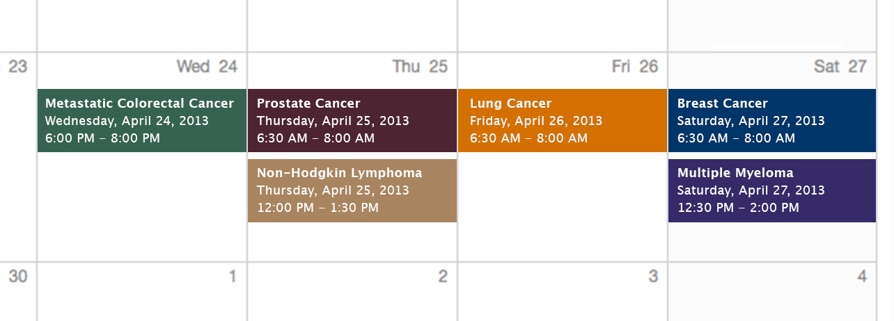
Challenging Cases
Oncologist and Nurse Investigators
Consult on Actual Patients from the
Practices of the Invited Faculty

Slide 4
Themes — Challenging Cases in Oncology
A 10-Hour Integrated Curriculum
Challenges associated with the incorporation of new research findings and newly approved agents into practice
Patient education on potential risks and benefits of specific oncologic treatments
Monitoring and management of treatment side effects and toxicities

Slide 5
Themes — Challenging Cases in Oncology
A 10-Hour Integrated Curriculum
Participation in ongoing clinical trials as an important patient option
Psychosocial impact of cancer diagnosis and treatment — why all patients, even those with the same disease, are different
Strategies to cope with the stress of being an oncology professional

Slide 6
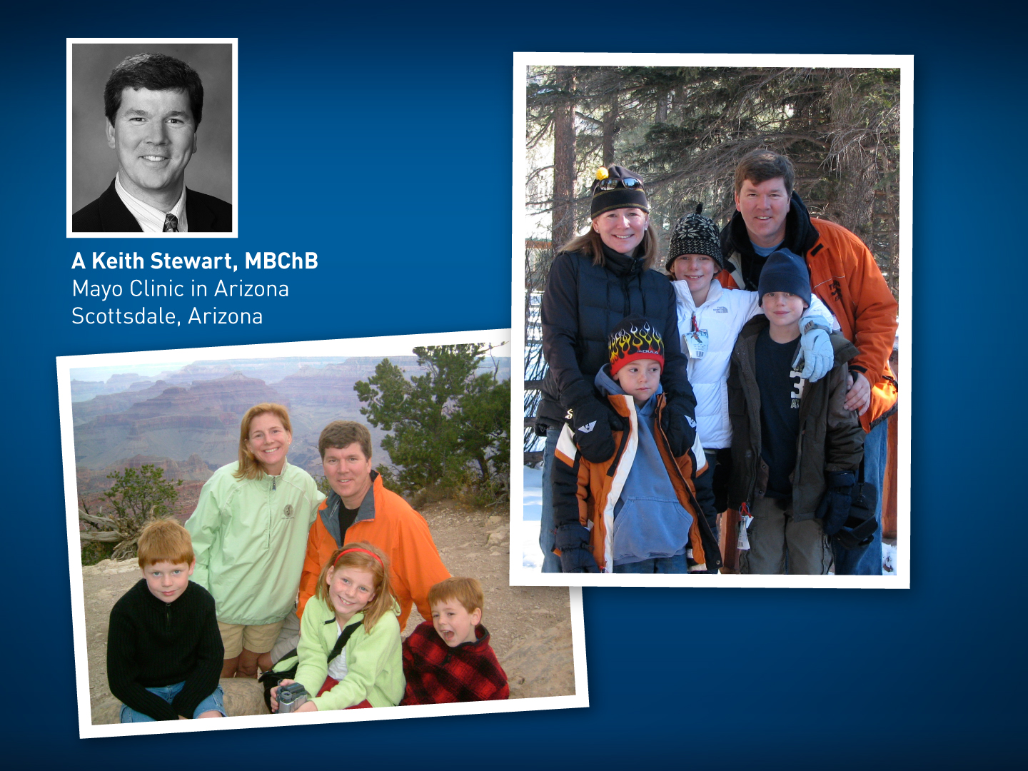

Slide 7
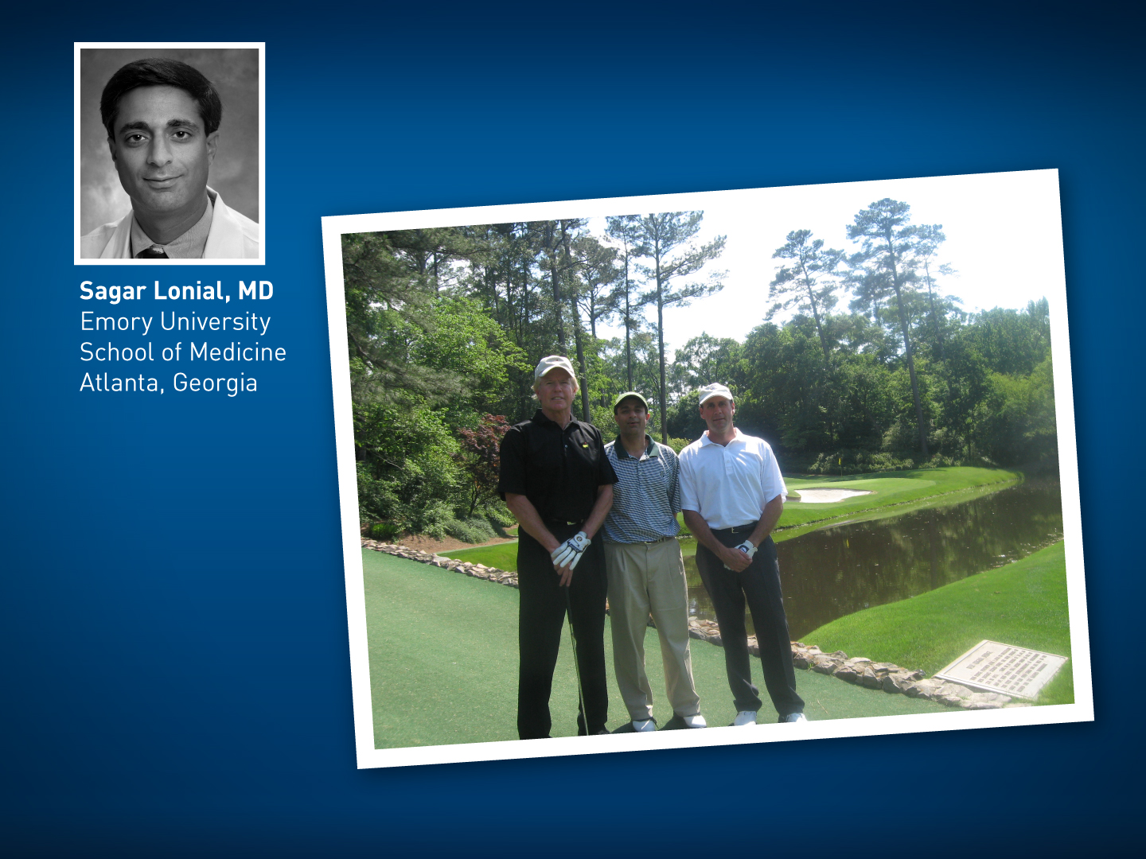

Slide 8


Slide 9


Slide 10
Agenda
Module 1: Induction and maintenance therapy for transplant-eligible MM 39 yo woman presented with a chest wall mass noted during pregnancy with her first child that on biopsy proved to be a plasmacytoma — Ms Richards
Module 2: Novel proteasome inhibitors in MM 73 yo woman was diagnosed in 2005 with MM and lytic disease and received thalidomide/dexamethasone followed by transplant — Ms Bilotti

Slide 11
Agenda
Module 3: Treatment for patients ineligible for a transplant 85-year-old woman was diagnosed with asymptomatic MM in 2002 and was observed off treatment until 2009 when she was started on lenalidomide/ dexamethasone — Ms Richards
Module 4: Other emerging and investigational approaches in MM 82-year-old woman was diagnosed with MM in 2007 and received multiple lines of treatment. In 2010 she enrolled on a clinical trial of single-agent pomalidomide, which she is still receiving and tolerating well after 33 cycles — Ms Bilotti

Slide 12
New Agents/Regimens Recently Approved by the FDA
Cancer Type | Agent | Approval Date
Colorectal | Bev on progression | 1/13
 | Regorafenib | 9/12
 | Aflibercept | 8/12
Prostate | Enzalutamide | 8/12
 | Abiraterone | 4/11
 | Cabazitaxel | 6/10
 | Sipuleucel-T | 4/10
NHL: ALCL | Brentuximab vedotin | 8/11
NHL: T-cell lymphoma | Romidepsin | 11/09
 | Pralatrexate | 9/09
Cancer Type | Agent | Approval Date
Lung | Nab paclitaxel | 10/12
 | Crizotinib | 8/11
Breast | T-DM1 | 2/13
 | Everolimus | 7/12
 | Pertuzumab | 6/12
 | Eribulin | 11/10
Multiple myeloma | Pomalidomide | 2/13
 | Carfilzomib | 7/12
www.fda.gov

Slide 13
MODULE 1: Induction and Maintenance Therapy for Transplant-Eligible MM

Slide 14
Case (from the practice of Ms Richards)
A 39 yo woman with a chest wall mass noted during pregnancy
  Biopsy: Plasmacytoma
  Bone marrow biopsy: MM with del(17p), t(4;14)
CyBorD followed by autologous transplant
  Complete response
Subcutaneous bortezomib maintenance therapy
She is an attorney whose supervisor was not very supportive of her taking leave from work to come to doctor visits
Recently promoted and now has a new boss who is very understanding of her situation

Slide 15
Multiple Myeloma Treatment Course
Transplant-Eligible
Transplant-Ineligible
Induction therapy
Induction therapy
Stem cell transplant
Maintenance therapy
Maintenance therapy
Relapsed disease
Relapsed disease

Slide 16
Role of common genetic abnormalities in patient risk assessment and therapeutic decision-making

Slide 17
Risk Stratification of Myeloma Using FISH and Conventional Karyotyping
Standard riskª
1. Hyperdiploidy
2. t(11;14)
3. t(6;14)
High risk^{b}
1. 17p deletion
2. t(4;14)
3. t(14;16)
4. t(14;20)
5. Deletion 13 or hypodiploidy by conventional karyotyping
ª None of the high-risk features can be present.
^{b} Any one high-risk feature is sufficient to classify disease as high risk.
Rajkumar SV. Am J Hematol 2011;86(1):57-65.

Slide 18
Rationale for the use of
3-drug combinations (versus 2)
in the induction setting

Slide 19
Preferred Induction Regimens:
Transplantation Eligible
RD/Rd: Lenalidomide/dexamethasone
VD: Bortezomib/dexamethasone
VRD: Bortezomib/lenalidomide/dexamethasone
VTD: Bortezomib/thalidomide/dexamethasone
CyBorD: Bortezomib/cyclophosphamide/dexamethasone
PAD: Bortezomib/doxorubicin/dexamethasone
NCCN. Clinical practice guidelines in oncology: multiple myeloma. v.1.2013.
Notes:
19

Slide 20
Acute and chronic toxicities associated with commonly
used induction regimens
(eg, RVD, VTD, CyBorD)

Slide 21
Grade ≥3 Toxicities Associated with Commonly Used Induction Regimens: Transplant Eligible
RVD
Peripheral neuropathy
Fatigue
Neuropathic pain
Lymphopenia
Thrombocytopenia
CyBorD
Thrombocytopenia
Neutropenia
Anemia
Peripheral neuropathy
VTD
Peripheral neuropathy
Rash
Constipation
GI toxicity
Deep vein thrombosis
Infections
Cavo M et al. Lancet 2010;376(9758):2075-85.
Rosinol L et al. Blood 2012;120(8):1589-96.
Richardson PG et al. Blood 2010;116(5):679-686.
Reeder CB et al. Leukemia 2009;23(7):1337-1341.

Slide 22
Impact of subcutaneous administration and/or weekly dosing of bortezomib on its efficacy and safety profile

Slide 23
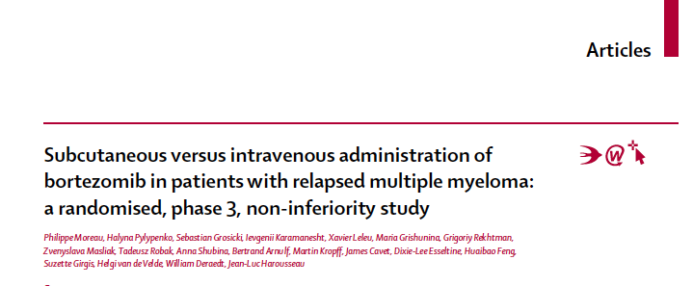

Slide 24

SC Injection Site Rotation
Within the same cycle
Injections at the same site should be avoided
Alternate between
  Right and left abdomen
  Upper and lower quadrant
  or between
  Right and left thigh
  Proximal and distal sites
8
1
7
2
R
L
6
3
5
4
Moreau P et al. Proc ASH 2010;Abstract 312.
Notes:
24

Slide 25
Subcutaneous (SC) Administration of Bortezomib: Local Side Effects of Injections
In Phase III noninferiority trial of SC versus IV bortezomib:
  ≥1 SC injection site reaction: 6% pts
  Most common reaction: redness (57% pts)
  Injection site reactions 100% resolved in median of 6 days
Moreau P et al. Lancet Oncol 2011;12(5):431-40.
Moreau P et al. Proc ASH 2010;Abstract 312.
Notes:
25
25
25

Slide 26
Phase III Noninferiority Trial of Subcutaneous versus Intravenous Bortezomib
SubQ Bortezomib
(n = 148)
N = 222
Relapsed MM
1-3 prior lines of therapy
2:1
R
Intravenous Bortezomib
(n = 74)
Best response (up to 10 cycles): 52% vs 52%
Median PFS: 9.3 vs 8.4 mos
1-yr OS: 76% vs 78%
Moreau P et al. Lancet Oncol 2011;12(5):431-40.
Arnulf B et al. Haematologica 2012;97(12):1925-8.

Slide 27
Known risks and benefits of
maintenance therapy in MM

Slide 29
Post-Transplant Maintenance Lenalidomide
 | IFM 2005-02¹ (N = 614) |  | CALGB-100104² (N = 460)
 | Lenalidomide | Placebo | Lenalidomide | Placebo
Median PFS¹, TTP² | 41 mos | 23 mos | 46 mos | 27 mos
3-yr OS | 80% | 84% | 88% | 80%
¹Attal M et al. N Eng J Med 2012;366:1782-91.
²McCarthy PL et al. N Engl J Med 2012;366:1770-81.

Slide 30
IFM 2005-02: Secondary Primary Cancers
Lenalidomide: 3.1 SPMs per 100 patient years
Placebo: 1.2 SPMs per 100 patient years
Attal M et al. N Eng J Med 2012;366:1782-91.

Slide 31
Cumulative Outcomes
“The cumulative incidence risk of second primary cancers was greater in the lenalidomide group than in the placebo group (P = 0.0008). The cumulative incidence risks of progressive disease and death were greater in the placebo group (P < 0.001 for progression and P = 0.002 for death). All P values are two-sided.”
McCarthy PL et al. N Engl J Med 2012;366:1770-81.

Slide 32
Clinical Trials of Maintenance
Therapy with Bortezomib

Slide 33
Risks of Maintenance Therapy (MT)
Lenalidomide
12% discontinue treatment due to AEs
Neutropenia
Anemia
Thrombocytopenia
Grade 3-5 nonhematologic AEs, including infection
Second primary malignancies
Bortezomib
Dose reductions or delays may be required
Grade 3-4 peripheral neuropathy: ~5%
Infections
Cardiac events
Ludwig H et al. Blood 2012;119(13):3003-15.

Slide 34
MODULE 2: Novel Proteasome
Inhibitors in MM

Slide 35
Case (from the practice of Ms Bilotti)
2005: A 65 yo woman with MM and lytic disease
  Thalidomide/dexamethasone followed by ASCT
2008: Relapse
Single-agent carfilzomib on a clinical trial
  VGPR
  Receives >50 treatment cycles over 5 years
  Developed persistent Grade 1 sensory neuropathy after thalidomide, which has not changed
She has 2 adult daughters, loves to travel and recently visited China

Slide 36
Integration of carfilzomib into
the MM treatment algorithm

Slide 37
FDA Approval of Carfilzomib for Patients with Relapsed/Refractory Multiple Myeloma
“On July 20, 2012, the US Food and Drug Administration granted accelerated approval of carfilzomib injection for the treatment of MM in patients who have received at least 2 prior therapies, including bortezomib and an immunomodulatory agent, and have demonstrated disease progression on or within 60 days of the completion of the last therapy.”
The approval was based on results of the Phase II single-arm study in 266 patients with relapsed MM who had received at least 2 prior therapies.
http://www.cancer.gov/cancertopics/druginfo/fda-carfilzomib

Slide 38
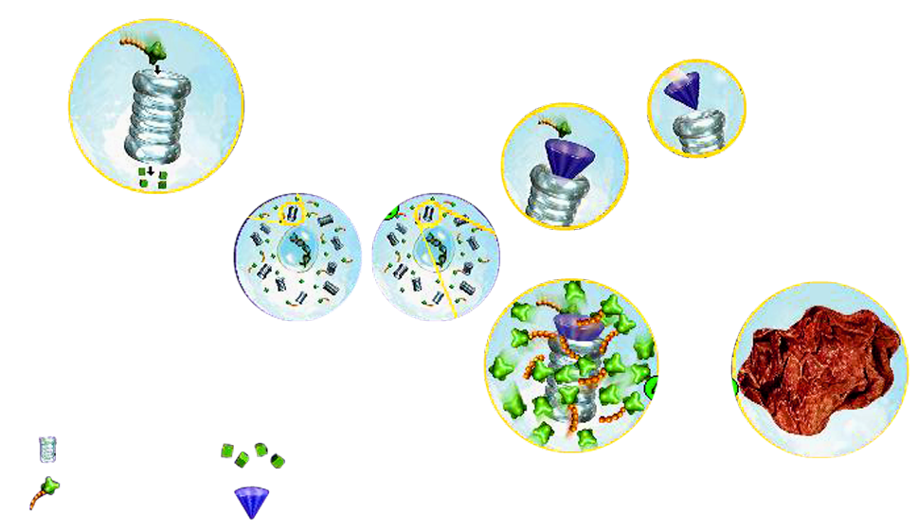
Cellular Impact of Proteasome Inhibition in Nonclinical Studies¹⁻⁴
Cancer cells depend upon proteins regulated by the proteasome for proliferation, metastasis, and survival
3
Inhibition of the proteasome by bortezomib prevents the degradation of intracellular proteins, affecting multiple signaling cascades within cells
1
Proteasomes are enzyme complexes that degrade intracellular proteins in a regulated manner in all cells, both healthy and cancerous
2
4
5
Proteasome
Degraded proteins
Intracellular proteins (signals) tagged for degradation
The disruption of signaling cascades in cancer cells can lead to cancer cell death and inhibit tumor growth
Bortezomib
Adapted from ¹ Invest New Drugs 2000;18:109-121. ² Physiol Rev 2002;82:373-428. ³ Sci Am 2001;284:63-73. ⁴ Cell 1998;92:367-384.

Slide 39
Key Biochemical and Pharmacologic Differences between Carfilzomib and Bortezomib
Properties | Bortezomib | Carfilzomib
20S proteasome | β5 mainly | β5 mainly
IC₅₀S (nM) Chymotrypsin Trypsin Caspase | 2.4-7.9 590-4,200 24-74 | 6 3,600 2,400
Binding kinetics | Slowly reversible | Irreversible
Jain S et al. Core Evidence 2011;6:43-57.
Notes:
39
39

Slide 40
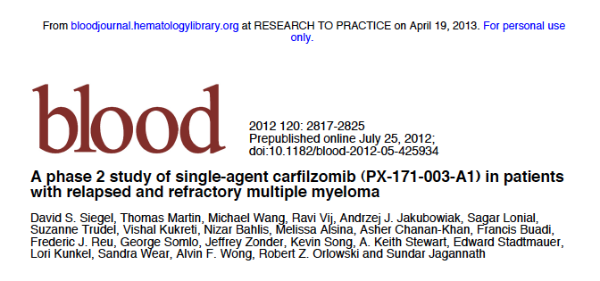
Siegel DS et al. Blood 2012;120(14):2817-25.

Slide 41
Phase II Study of Carfilzomib (CFZ) Monotherapy
N = 266
Relapsed/refractory MM
≥2 regimens for relapsed
MM
Refractory to most recent
Tx including bortezomib
Intravenous CFZ
20 mg/m² twice wkly for 3 of 4 wks in cycle 1, then 27 mg/m² for ≤12 cycles
ORR:
  All patients: 23.7%
  Patients with adverse cytogenetics (n = 71): 29.6%
Siegel DS et al. Blood 2012;120(14):2817-25.

Slide 42
Possible Side Effects Associated with Carfilzomib
Grade ≥3 adverse events are mainly hematologic
  Low rates of neutropenia
Nonhematologic adverse events include
  Fatigue
  Nausea
  Dyspnea
Infrequent peripheral neuropathy
Siegel DS et al. Blood 2012;120(14):2817-25.
Notes:
42
42

Slide 43
Phase I/II Study of Front-Line Carfilzomib (CFZ) in Combination with Lenalidomide and Dexamethasone
Continued
lenalidomide
recommended
(off protocol)
CRd
Induction
CRd
Maintenance
Transplant-eligible and ineligible patients
LEN Cycles 25+
CRd Cycles 1–4
CRd Cycles 5–8
CRd Cycles 9–24
Transplant-eligible with ≥PR
may undergo ASCT
After a median of 12 cycles:
  nCR = 62% sCR = 42%
Grade ≥3 PN = 0%
Jakubowiak AJ et al. Blood 2012;120(9):1801-9.

Slide 44
Other novel proteasome inhibitors under development (eg, ixazomib)

Slide 45
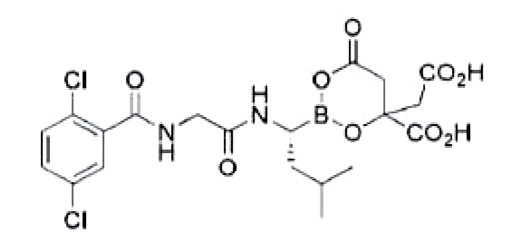
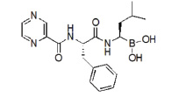
Key Features of Ixazomib and Bortezomib
Compound | Chemical | Binding | Adm | Status
Bortezomib | Boronate | Reversible | IV/SC | FDA approved
Ixazomib | Boronate | Reversible | Oral/IV | Phase 1-3
Ixazomib
Bortezomib
Adapted from Fostier K et al. OncoTargets and Therapy 2012;5:237-44.

Slide 46
Phase 1/2 Study of Weekly MLN9708, an Investigational Oral Proteasome Inhibitor,
in Combination with Lenalidomide and Dexamethasone in Patients with Previously Untreated Multiple Myeloma
Kumar SK et al.
Proc ASH 2012;Abstract 332.

Slide 47
Phase I/II Study of Weekly Ixazomib Combined with Lenalidomide and Dexamethasone in Previously Untreated MM
Induction: up to 12 x 28-day treatment cycles
Maintenance
1
8
15
22
28
MLN9708
MLN9708
MLN9708
MLN9708 maintenance
Days 1, 8, 15
28-day cycles
Dex 40 mg
Dex 40 mg
Dex 40 mg
Dex 40 mg
Lenalidomide 25 mg, days 1–21
ORR = 92% ≥VGPR = 55%
Grade 3 PN = 3%
Kumar SK et al. Proc ASH 2012;Abstract 332.

Slide 48
Optimal use of bone-directed
therapy for patients with
documented lytic disease

Slide 50
MRC Myeloma IX Study
Zoledronic acid (ZOL)
(n = 981)
N = 1,960
Newly diagnosed Stage I-III MM
1:1
R
Bisphosphonate continued until disease progression
Clodronate
(n = 979)
  ZOL reduced skeletal-related events (SREs) vs CLO
    In patients with and without bone lesions at baseline
ZOL reduced risk of disease progression and death vs CLO
Davies FE et al. Proc ASCO 2011;Abstract 8011.

Slide 51
MODULE 3: Treatment for Patients Ineligible for a Transplant

Slide 52
Case (from the practice of Ms Richards)
2002: A 74 yo woman diagnosed with asymptomatic MM
  Observed off treatment
2009: Lenalidomide/dexamethasone
  Experienced a response and continues to receive therapy without problems
She lives with her son and is completely independent
Loves to travel, particularly to India where she visits family

Slide 53
Preferred Induction Regimens:
Transplantation Ineligible
Rd: Lenalidomide/low-dose dexamethasone
VD: Bortezomib/dexamethasone
MPV: Melphalan/prednisone/bortezomib
MPR: Melphalan/prednisone/lenalidomide
MPT: Melphalan/prednisone/thalidomide
NCCN. Clinical practice guidelines in oncology: multiple myeloma. v.1.2013.
Notes:
53

Slide 54
Preemptive dose reductions for elderly patients or those with significant comorbidities

Slide 55
Treatment Algorithm for Elderly Frail Patients
Risk factors
Age over 75 years Mild, moderate or severe frailty: Patients needing help for household tasks and personal care Comorbidities Cardiac dysfunction Pulmonary dysfunction Hepatic dysfunction Renal dysfunction
GO-GO | MODERATE-GO | SLOW-GO
No risk factors DOSE LEVEL 0 | At least one risk factor DOSE LEVEL -1 | At least one risk factor plus occurrence of Grade 3-4 nonhematologic AE DOSE LEVEL -2
Palumbo A et al. Blood 2011;118:4519-29.
Notes:
55
55
55

Slide 56
Preemptive Dose Reductions for Patients of Advancing Age
Agent | DOSE LEVEL 0 | DOSE LEVEL -1 | DOSE LEVEL -2
Dexamethasone | 40 mg/d d 1, 8, 15, 22 / 4 wk | 20 mg/d d 1, 8, 15, 22 / 4 wk | 10 mg/d d 1, 8, 15, 22 / 4 wk
Melphalan | 0.25 mg/kg or 9 mg/m² d 1-4 / 4-6 wk | 0.18 mg/kg or 7.5 mg/m² d 1-4 / 4-6 wk | 0.13 mg/kg or 5 mg/m² d 1-4 / 4-6 wk
Thalidomide | 100 mg/d | 50 mg/d | 50 mg qod
Lenalidomide | 25 mg/d d 1-21 / 4 wk | 15 mg/d d 1-21 / 4 wk | 10 mg/d d 1-21 / 4 wk
Bortezomib | 1.3 mg/m² twice weekly d 1, 4, 8, 11 / 3 wk | 1.3 mg/m² once weekly d 1, 8, 15, 22 / 5 wk | 1.3 mg/m² once weekly d 1, 8, 15, 22 / 5 wk
Prednisone | 60 mg/m² d 1-4 or 50 mg qod | 30 mg/m² d 1-4 or 25 mg qod | 15 mg/m² d 1-4 or 12.5 mg qod
Cyclophosphamide | 100 mg/d d1-21 / 4 wk or 300 mg/m²/d d 1, 8, 15 / 4 wk | 50 mg/d d1-21 / 4 wk or 150 mg/m²/d d 1, 8, 15 / 4 wk | 50 mg/d d1-21 / 4 wk or 75 mg/m²/d d 1, 8, 15 / 4 wk
Palumbo A et al. Blood 2011;118:4519-29.
Notes:
56
56
56

Slide 57
MODULE 4: Other Emerging and Investigational Approaches in MM

Slide 58
Case (from the practice of Ms Bilotti)
2007: A 76 yo woman diagnosed with MM with hypertension and severe osteoporosis, who received:
  Lenalidomide/dexamethasone
  Bortezomib: Experienced significant peripheral neuropathy (PN)
  Lenalidomide/vorinostat/dexamethasone
2010: Clinical trial of pomalidomide
  No new treatment-emergent toxicities
  Stable PN
She is a widow, accompanied to the clinic by her daughter and has a store selling antiques

Slide 59
Similarities and differences
between thalidomide, lenalidomide
and pomalidomide

Slide 60
IMiDs
Thalidomide
Teratogenicity, peripheral neuropathy, constipation, sedation, rash, VTE
Oral 100-200 mg/d
Lenalidomide
Myelosuppression
VTE
Oral 15-25 mg/d
Pomalidomide
Myelosuppression
VTE
Oral 1-4 mg/d

Slide 61
Recent FDA approval of pomalidomide and integration into clinical practice

Slide 62
FDA Approves Pomalidomide for MM
“On February 8, 2013, the Food and Drug Administration (FDA) granted accelerated approval to pomalidomide for the treatment of patients with multiple myeloma who have received at least two prior therapies, including lenalidomide and bortezomib, and have demonstrated disease progression on or within 60 days of completion of the last therapy.
The approval was based on the results of the Phase I/II MM-002 trial.”
http://www.cancer.gov/cancertopics/druginfo/fda-pomalidomide
Notes:
62
62

Slide 63

Pomalidomide in Combination with
Low-Dose Dexamethasone: Demonstrates a Significant Progression Free Survival and Overall Survival Advantage, in Relapsed/Refractory MM: A Phase 3, Multicenter, Randomized, Open-Label Study
Dimopoulos MA et al.
Proc ASH 2012;Abstract LBA-6.

Slide 64
Phase III MM-003 Trial Design
POM + LoDEX (n = 302) POM: 4 mg/d, d1-21 LoDEX: 40 mg 20 mg (>75 y) d1, 8,15, 22 (28-d cycle)
Eligibility (n = 455)
Primary refractory or relapsed and refractory MM At least 2 prior therapies Failed LEN and BORT
R
HiDEX (n = 153) (≤75 years) 40 mg 20 mg (>75 y) d1-4, 9-12, 17-20 (28-d cycle)
PFS: 50-55% reduction in risk of disease progression
OS: ~45% reduction in risk of death
Dimopoulos MA et al. Proc ASH 2012;Abstract LBA-6.

Slide 65
Side effects and toxicities
of pomalidomide

Slide 66
Select Adverse Events (AEs)
Grade 3/4 AEs | POM + LoDEX (n = 300) | HiDEX (n = 149)
Hematologic Neutropenia Febrile neutropenia Anemia Thrombocytopenia | 42% 7% 27% 21% | 15% 0% 29% 24%
Nonhematologic Infections Hemorrhage | 24% 3% | 23% 5%
Dimopoulos MA et al. Proc ASH 2012;Abstract LBA-6.

Slide 67
Other agents and strategies
under investigation in relapsed
and refractory MM

Slide 68
Other Agents Under Investigation in Relapsed/Refractory MM
Proteasome inhibitors
Marizomib
Histone deacetylase (HDAC) inhibitors
Panobinostat
Vorinostat
Monoclonal antibodies
Elotuzumab
Siltuximab
BT062
Signal transduction modulators
Perifosine
Moreau P et al. Semin Hematol 2012;49:Suppl 1:33-46.
Notes:
68
68

Slide 69


Slide 70
