Slide 1
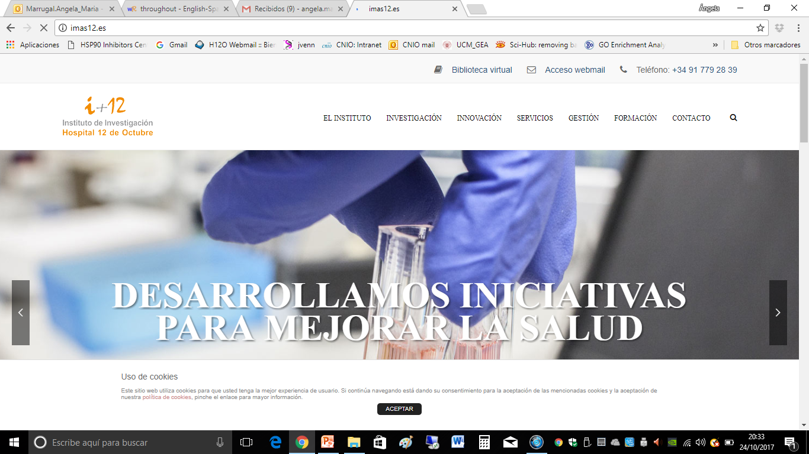
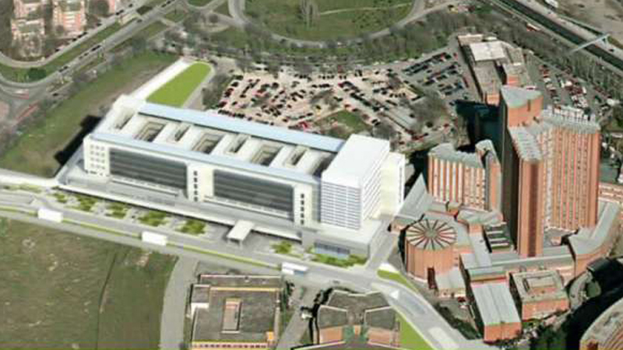
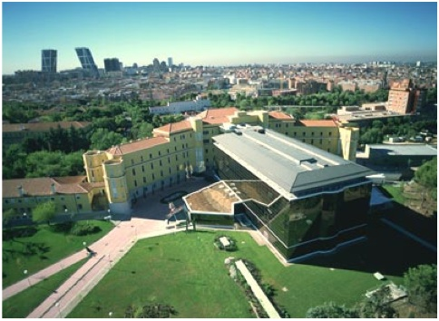

Year in Review — Clinical Investigator Perspectives on the Most Relevant New Datasets and Advances in Oncology: Immunotherapy and other Non-Targeted Approaches for Lung Cancer Edition
Luis Paz-Ares
Hospital Universitario 12 de Octubre

Slide 2
Agenda
Early Stage NSCLC
Unresectable stage III
SCLC
Notes:
2

Slide 3
Agenda
Early Stage NSCLC
Unresectable stage III
SCLC
Notes:
3

Slide 4
CheckMate 816: Study design
Primary analysis population
Key Eligibility Criteria
Newly diagnosed, resectable, stage IB (≥4 cm)–IIIA NSCLC (per TNM 7th edition)
ECOG performance status 0–1
No known sensitising EGFR
mutations or ALK alterations
Stratified by
stage (IB–II vs IIIA),
PD-L1 (≥1% vs <1%) and sex
NIVO 360 mg Q3W
+
chemo Q3W (3 cycles)
N=358
Surgery (within 6 weeks post-treatment)
Optional adjuvant chemo ± RT
R
1:1
Radiologic restaging
Chemo Q3W (3 cycles)
NIVO 3 mg/kg Q2W (3 cycles)
+ IPI 1 mg/kg (cycle 1 only)
Primary end points
Secondary end points
Exploratory end points
pCR by BIPR
EFS by BICR
MPR by BIPR
OS
Time to death or distant metastases
ORR by BICR
Predictive biomarkers (PD-L1, TMB, ctDNA)
Forde PM, et al. NEJM 2022

Slide 5
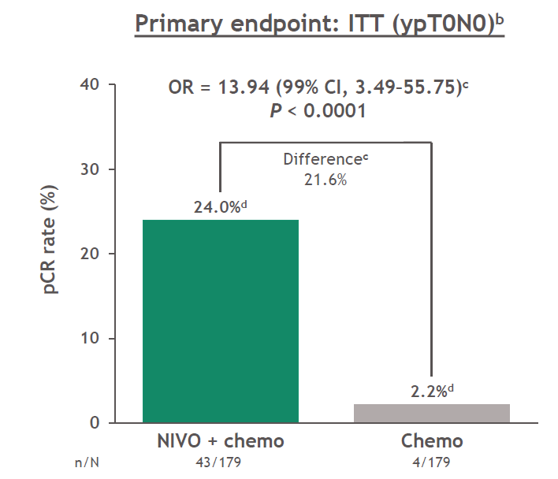
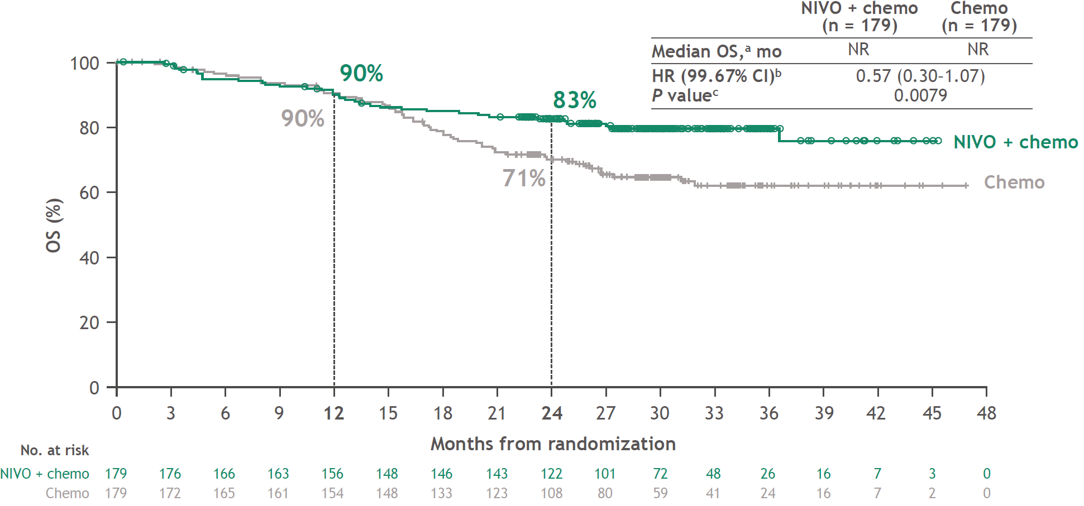
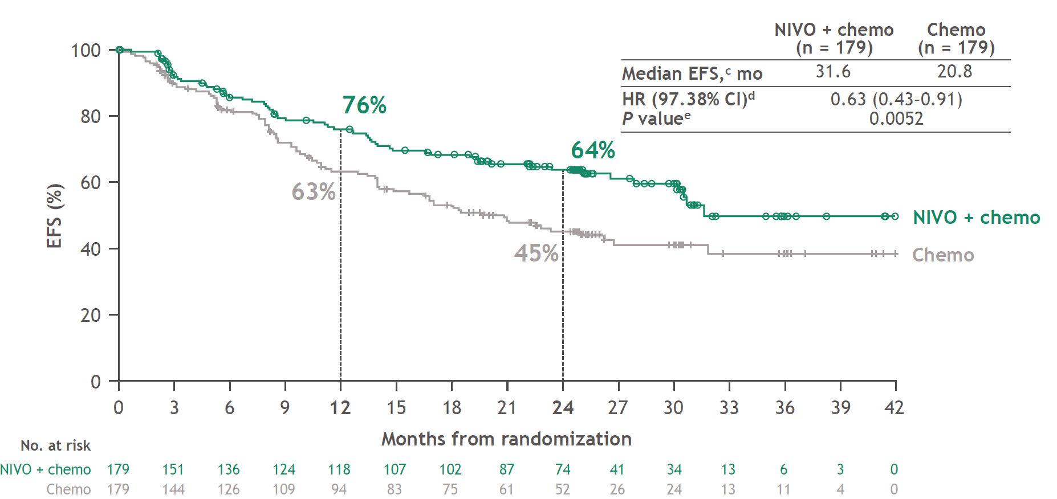
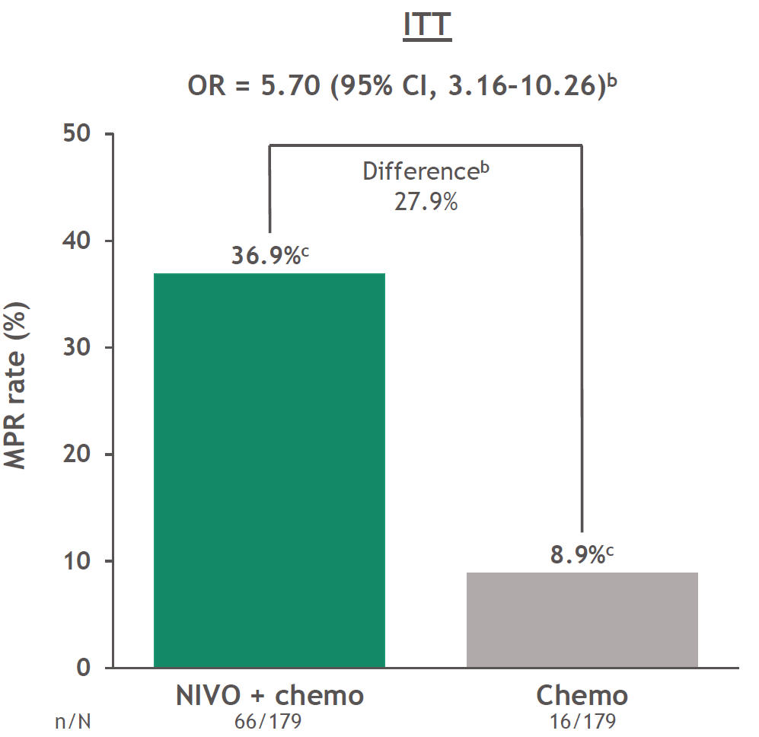
CheckMate 816: efficacy results
Pathological outcomes
EFS outcomes‡§
OS outcomes‡§
OR 13.94 (99% CI 3.49, 55.75)*
P<0.0001
 | Nivolumab + CT (n=179) | CT (n=179)
Median EFS, months | 31.6 | 20.8
HR (97.38% CI)¶ | 0.63 (0.43, 0.91)
P-value║ | 0.0052
Difference
21.8%
24.0%
 | Nivolumab + CT (n=179) | CT (n=179)
Median OS, months | NR | NR
HR (99.67% CI)* | 0.57 (0.30, 1.07)
P-value† | 0.0079
2.2%
OR 5.70 (99% CI 3.16, 10.26)†
Difference
28.0%
36.9%
8.9%
Forde PM, et al. NEJM 2022

Slide 6
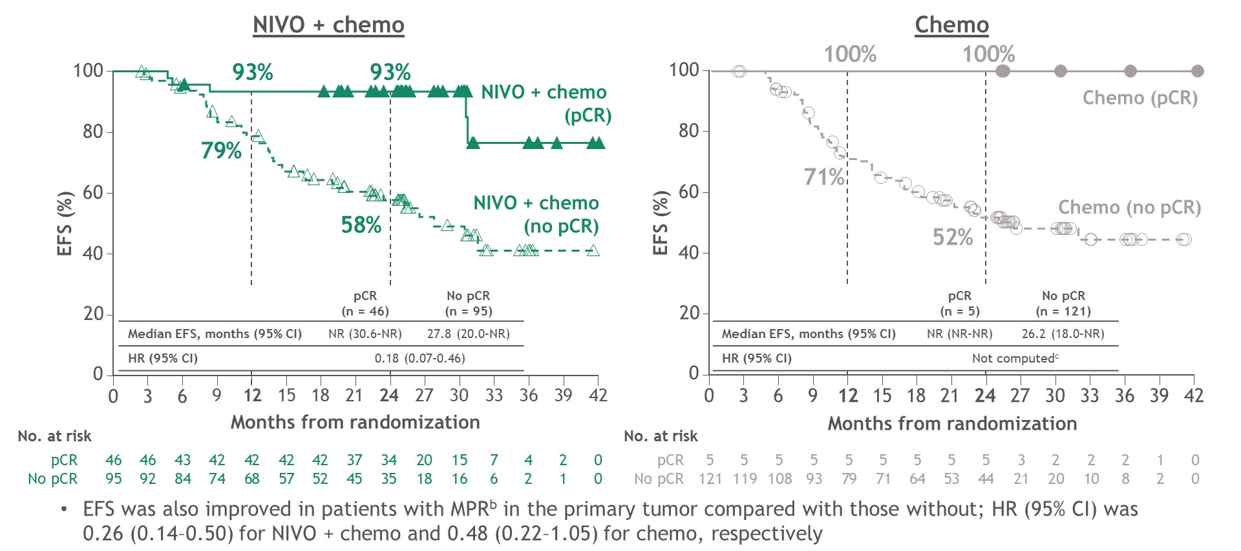
Outcome by pCR: CM 816
Provencio et al. ASCO 2022

Slide 7
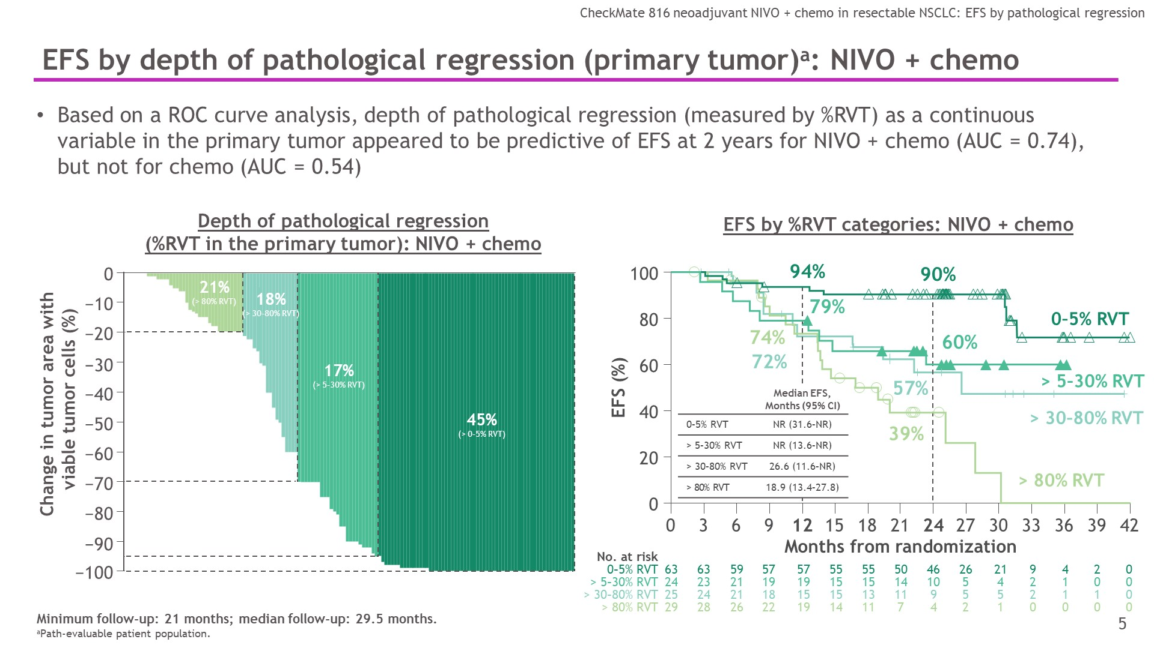
Outcome by pCR: CM 816
RVT = residual viable tumor
Provencio et al. ASCO 2022

Slide 8
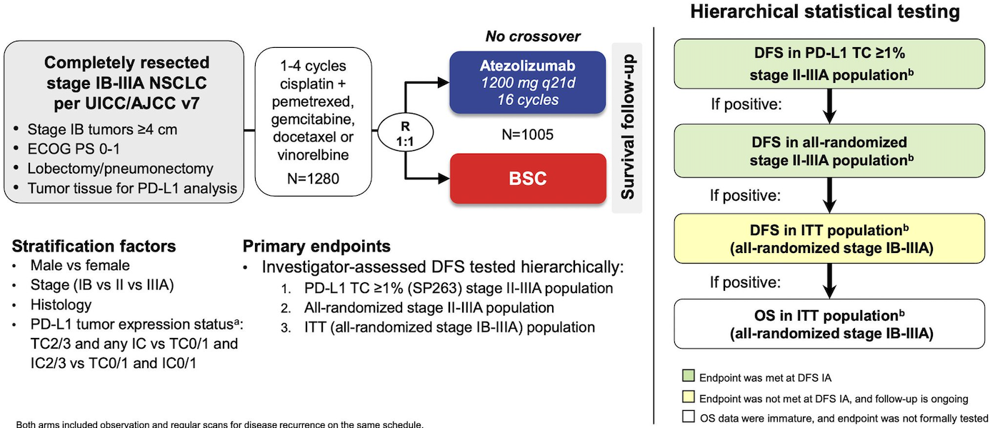
IMpower010: Study design
Wakelee HA, et al. J Clin Oncol. 2021:39(15 suppl):8500.

Slide 9
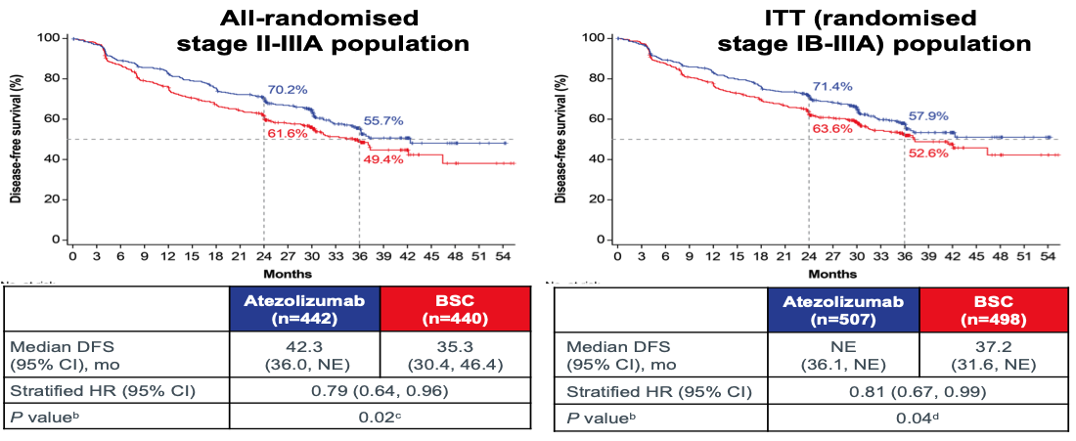
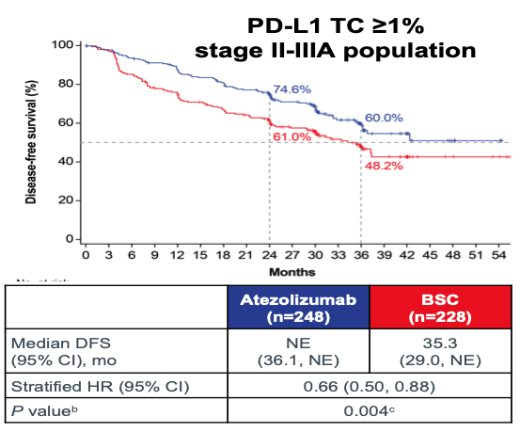
IMpower010: Disease-Free Survival
Wakelee HA, et al. J Clin Oncol. 2021:39(15 suppl):8500.

Slide 10
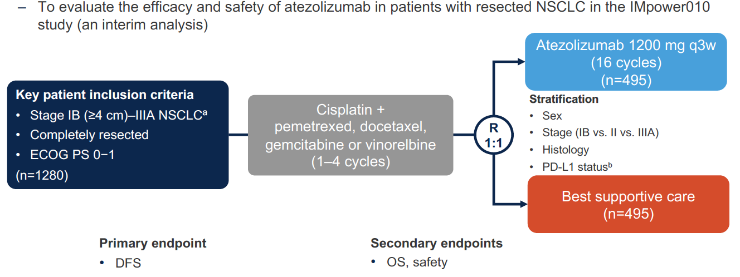
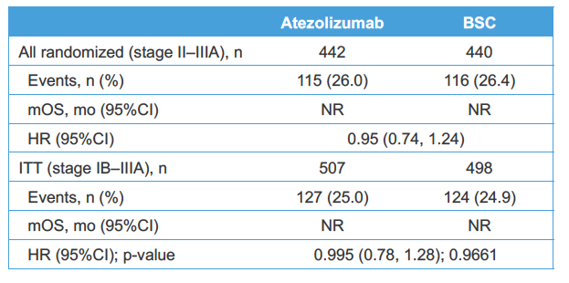
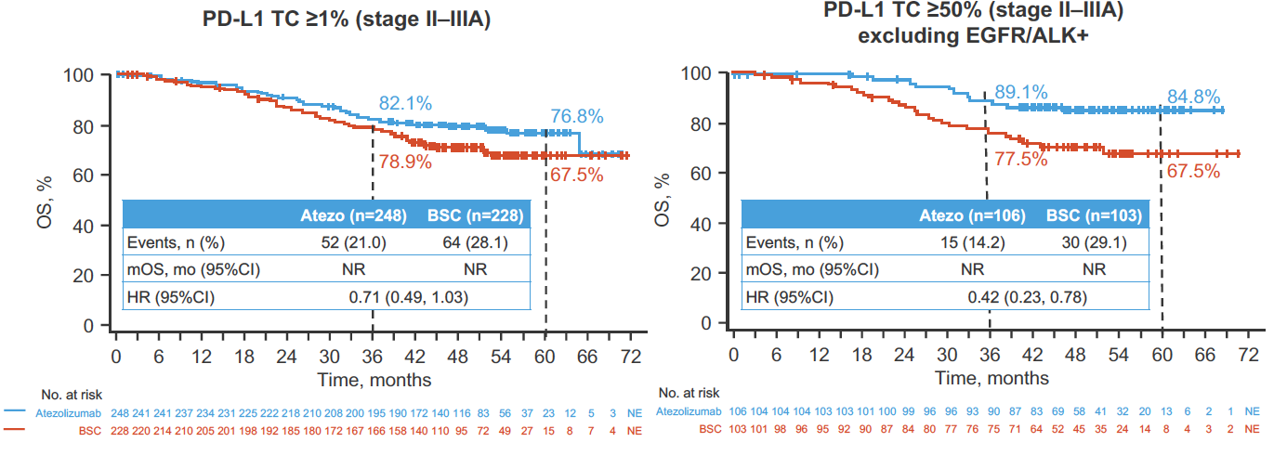
IMpower010 Trial: OS analysis
Wakelee H et al. WCLC 2022

Slide 11
KEYNOTE-091/PEARLS: Study design
Randomised, triple-blind, Phase 3 trial
Eligibility for Registration
Confirmed stage IB (T ≥4 cm), II or IIIA NSCLC (per TNM 7th edition)
Complete surgical resection with negative margins (R0)
Provision of tumor tissue for
PD-L1 testing
Eligibility for Randomisation
No evidence of disease
ECOG PS 0 or 1
Adjuvant chemotherapy
  Considered for stage IB
  (T ≥4 cm)
  Strongly recommended for stage II and IIIA
  Limited to ≤4 cycles
PD-L1 testing
done centrally using
PD-L1 IHC
22C3 pharmDx
Pembrolizumab 200 mg Q3W
for ≤18 cycles (~1 y)
R
1:1
Placebo 200 mg Q3W
for ≤18 cycles (~1 y)
Stratification factors
Disease stage (IB vs II vs IIIA)
PD-L1 TPS (<1% vs 1–49% vs ≥50%)
Receipt of adjuvant chemotherapy (yes vs no)
Geographic region (Asia vs Eastern Europe vs
Western Europe vs rest of world)
Dual primary end points
DFS in the overall population
DFS in the PD-L1 TPS ≥50%
population
Secondary end points
DFS in the PD-L1 TPS ≥1% population
OS in the overall, PD-L1 TPS ≥50% and
PD-L1 TPS ≥1% populations
Lung cancer-specific survival in the
overall population
Safety
Paz-Ares L et al ESMO Virtual Plenary 2022; O´Brien M et al. Lancet Oncol 2022

Slide 12
PEARLS Trial: DFS in ITT and PD-L1 ≥50% Populations
Paz-Ares L et al ESMO Virtual Plenary 2022; O´Brien M et al. Lancet Oncol 2022

Slide 13
Ongoing Phase 3 perioperative IO trials
KEYNOTE-671 NCT03425643 N=786
Stage II–IIB (N2)
CT + pembro
Pembro 39 wk
EFS
OS
Tislelizumab NCT04379635 N=380
Stage II–IIIA
CT + tislelizumab
Tislelizumab*
EFS MPR
R
S
R
S
CT + placebo
Placebo 39 wk
CT + placebo
Placebo*
CT + nivo
CheckMate 816 NCT02998528 N=350
Stage IB–IIIA
R
S
JS001-028-III NCT04158440 N=406
Stage IIIA
CT + toripalimab
Toripalimab†
EFS
MPR
Nivo + ipi
EFS
pCR
R
S
CT + placebo
Placebo†
CT
IMpower030 NCT03456063 N=450
Stage II–IIIB (N2)
CT + atezo
Atezo 48 wk
CheckMate 77T NCT04025879 N=452
Stage IIA–IIIB (N2)
CT + nivo
Nivo 1 y
R
S
EFS
MPR
R
S
EFS
CT + placebo
Placebo 48 wk
CT + placebo
Placebo 1 y
AEGEAN NCT03800134 N=800
Stage IIA–IIIB (N2)
CT + durva
Durva 48 wk
R
S
EFS
MPR
CT + placebo
Placebo 48 wk
CT = chemotherapy; S = surgery.
*Up to 12 cycles of 21 or 42 days. †Duration not specified.

Slide 14
Ongoing Phase 3 perioperative IO trials
KEYNOTE-671 NCT03425643 N=786
Stage II–IIB (N2)
CT + pembro
Pembro 39 wk
EFS
OS
Tislelizumab NCT04379635 N=380
Stage II–IIIA
CT + tislelizumab
Tislelizumab*
EFS MPR
R
S
R
S
CT + placebo
Placebo 39 wk
CT + placebo
Placebo*
CT + nivo
CheckMate 816 NCT02998528 N=350
Stage IB–IIIA
R
S
JS001-028-III NCT04158440 N=406
Stage IIIA
CT + toripalimab
Toripalimab†
EFS
MPR
Nivo + ipi
EFS
pCR
R
S
CT + placebo
Placebo†
CT
IMpower030 NCT03456063 N=450
Stage II–IIIB (N2)
CT + atezo
Atezo 48 wk
CheckMate 77T NCT04025879 N=452
Stage IIA–IIIB (N2)
CT + nivo
Nivo 1 y
R
S
EFS
MPR
R
S
EFS
CT + placebo
Placebo 48 wk
CT + placebo
Placebo 1 y
AEGEAN NCT03800134 N=800
Stage IIA–IIIB (N2)
CT + durva
Durva 48 wk
R
S
EFS
MPR
CT + placebo
Placebo 48 wk
CT = chemotherapy; S = surgery.
*Up to 12 cycles of 21 or 42 days. †Duration not specified.

Slide 15
Durvalumab plus chemotherapy significantly improved pathologic complete response in AEGEAN Phase III trial in resectable non-small cell lung cancer
Phase 3 KEYNOTE-671 Trial met Primary Endpoint of Event-Free Survival (EFS) in patients with Resectable Stage II, IIIA, or IIB Non-Small Cell Lung Cancer
Notes:
15

Slide 16
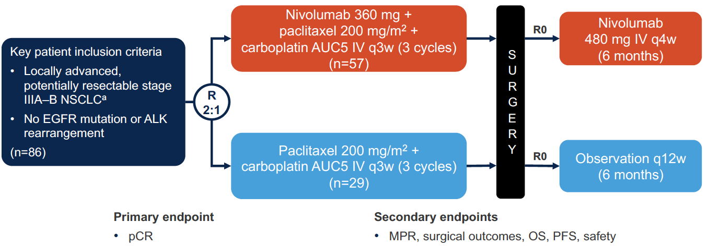
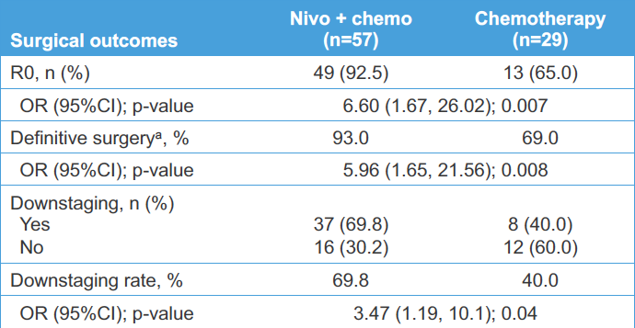
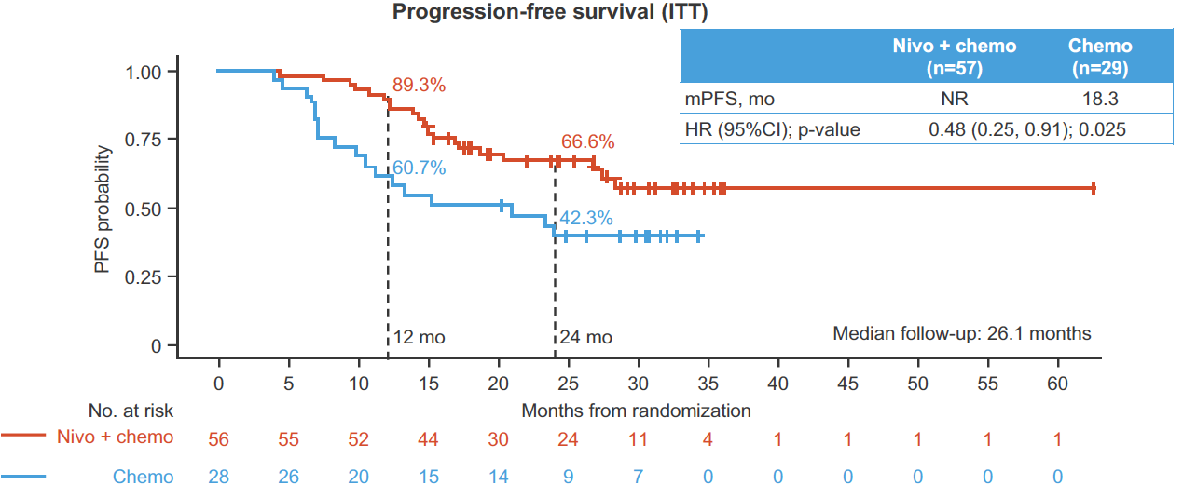
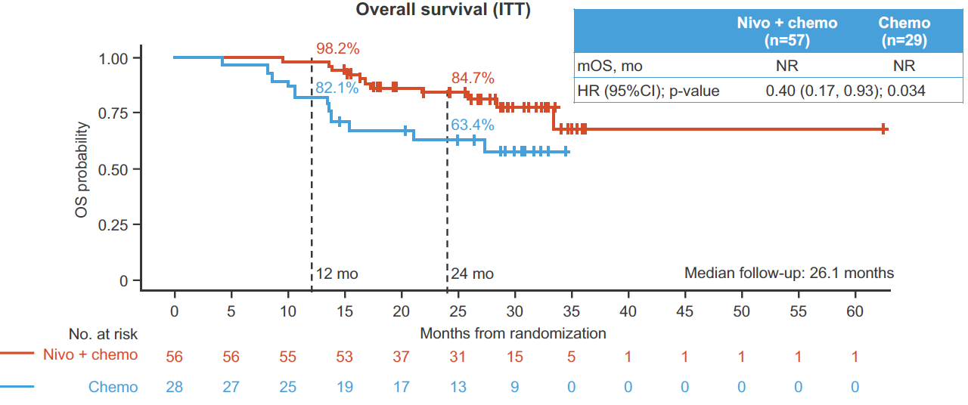
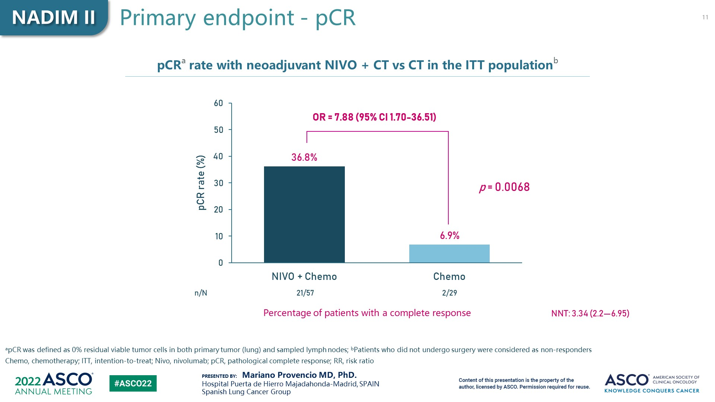
NADIM II Trial: PFS and OS analysis
M Provencio et al. ASCO 2022 & WCLC 2022

Slide 17
Take home – Early stages
Neoadjuvant chemo-IO (CM 816) improves pCR rates, EFS and OS in early stage resectable NSCLC
  Outcome after pCR appears favourable, despite absence of adjuvant therapy
Adjuvant IO decreases the probability of relapse (Atezo, Pembro) and appears to improve survival (Atezo)
  Benefit proportional to PD-L1 expression (Atezo, Pembro??)
Perioperative IO improves outcomes in resectable NSCLC
  Nadim (pCR, EFS, OS), Aegean (pCR) and KN 671 (EFS)
  Actual data awaited
Notes:
17

Slide 18
Agenda
Early Stage NSCLC
Unresectable stage III
SCLC
Notes:
18

Slide 19
PACIFIC: Study Design
Phase III, Randomized, Double-blind, Placebo-controlled, Multicenter, International Study
Patients with stage III, locally advanced, unresectable NSCLC who have not progressed following definitive platinum-based cCRT
(≥2 cycles)
18 years or older
WHO PS score 0 or 1
Estimated life expectancy of
≥12 weeks
Archived tissue was collected
All-comers population
Durvalumab
10 mg/kg q2w for
up to 12 months
N=476
Co-primary endpoints
PFS by BICR using RECIST v1.1*
OS
1–42 days
post-cCRT
2:1 randomization,
stratified by age, sex, and smoking history
N=713
Key secondary endpoints
ORR (per BICR)
DoR (per BICR)
Safety and tolerability
PROs
R
Placebo
10 mg/kg q2w for
up to 12 months
N=237
*Defined as the time from randomization (which occurred up to 6 weeks post-cCRT) to the first documented event of tumor progression or death in the absence of progression.
ClinicalTrials.gov number: NCT02125461 BICR, blinded independent central review; cCRT, concurrent chemoradiation therapy; DoR, duration of response;
NSCLC, non-small cell lung cancer; ORR, objective response rate; OS, overall survival; PFS, progression-free survival; PROs, patient-reported outcomes;
PS, performance status; q2w, every 2 weeks; RECIST, Response Evaluation Criteria in Solid Tumors; WHO, World Health Organization

Slide 20
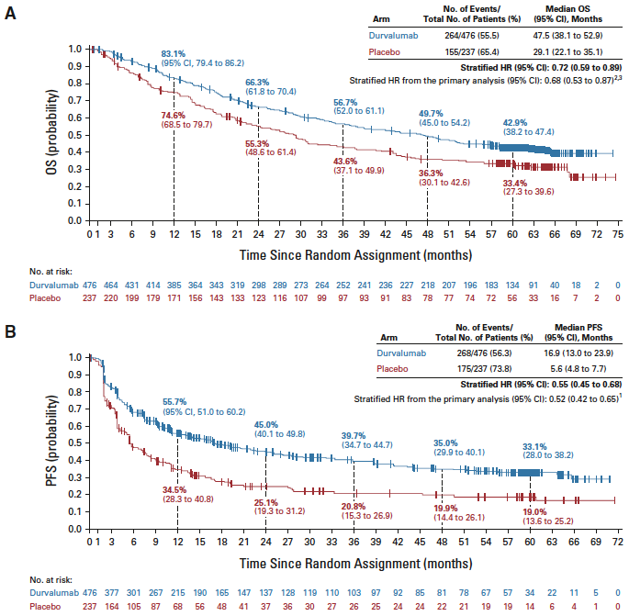
PACIFIC Trial: 5 Years Outcome
Treatment effect (RR [95% CI])¶:
1.78 (1.27–2.51)
Spigel DR et al. JCO 2022

Slide 21
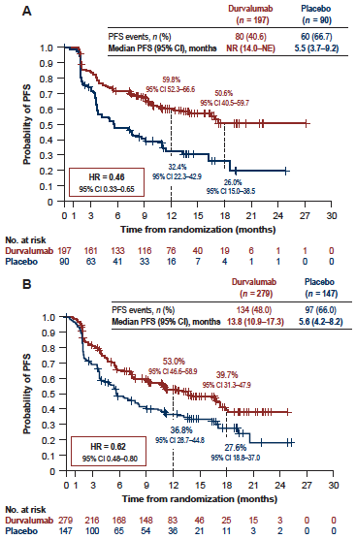
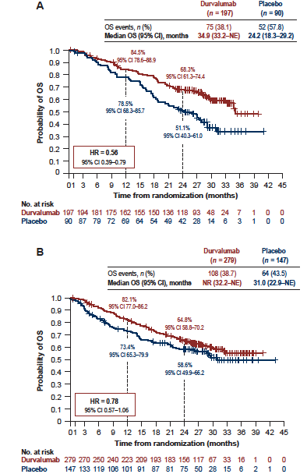
PACIFIC Trial: Outcome by stage
Stage
IIIA-N2
Stage
No IIIA-N2
Senan S et al. ESMO Open 2022

Slide 22
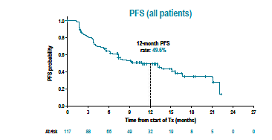
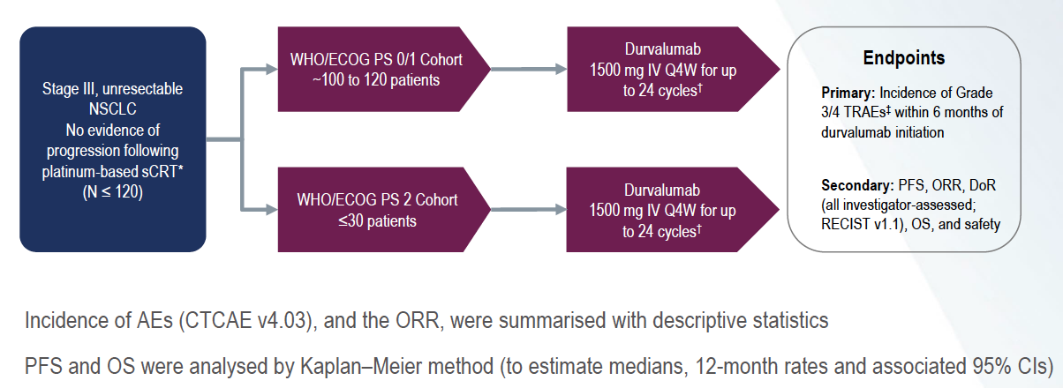
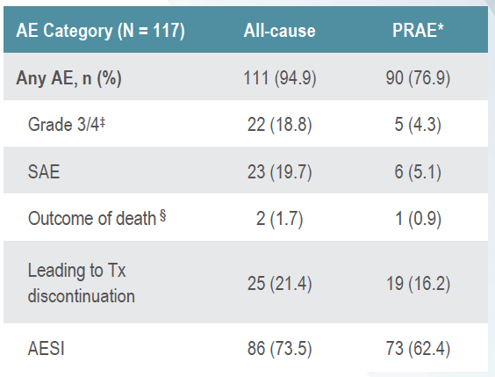
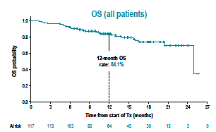
Pacific-6 Trial
Garassino M et al. JTO 2022

Slide 23
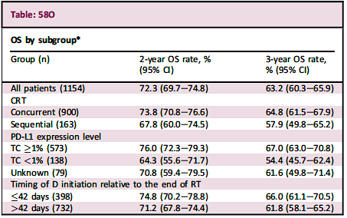
Pacific-R Study: Interim Results
Girard et al. ESMO-IO 2022

Slide 24
COAST: Phase 2, randomised open-label study
Study treatment up to 12 months
CONTROL
Durvalumab 1500 mg IV
monotherapy Q4W
Primary Endpoint
ORR by investigator assessment (RECIST v1.1)
Secondary Endpoints
Safety
DoR
DCR
PFS by investigator assessment (RECIST v1.1)
OS
PK
Immunogenicity
Locally advanced, unresectable, Stage III NSCLC
1–42 days
post-cCRT
ARM A
Durvalumab 1500 mg IV Q4W
+ oleclumab 3000 mg IV
No progression
after prior cCRT
Randomised 1:1:1
Stratification by histology
ECOG PS 0 or 1
Oleclumab Q2W for cycles 1 and 2, then Q4W starting cycle 3
N=189 randomised
(adenocarcinoma and
non-adenocarcinoma)
ARM B
Durvalumab 1500 mg IV Q4W
+ monalizumab 750 mg IV Q2W
A planned sample size of 60 patients per arm was designed to provide acceptable precision in estimating antitumour activities in an early phase setting
Between Jan 2019 and Jul 2020, 189 patients were randomised of whom 186 received D (n=66), D+O (n=59) or D+M (n=61)
As of 17 May 2021, all patients had a minimum of 10 months potential follow-up and the median actual follow-up was
11.5 months (range, 0.4–23.4; all patients)
Herbst RS et al. J Clin Oncol 2022

Slide 25
PFS by investigator assessment
(interim analysis; ITT population)
 | D | D+O | D+M
Events/patients, n | 38/67 | 22/60 | 21/62
mPFS, months (95% CI)ª | 6.3 (3.7–11.2) | NR (10.4–NE) | 15.1 (13.6–NE)
HR (95% CI)^{b,c} | – | 0.44 (0.26–0.75) | 0.65 (0.49–0.85)
1.0
0.9
0.8
0.7
0.6
0.5
0.4
0.3
0.2
0.1
0
72.7%
PFS probability
64.8%
39.2%
0
2
4
6 8 10 12 14
Time from randomisation (months)
16
18
20
No. at risk
D | 67 | 50 | 32 | 32 | 20 | 16 | 13 | 9 | 7 | 3 | 0
D+O | 60 | 49 | 46 | 40 | 37 | 30 | 22 | 13 | 9 | 5 | 0
D+M | 62 | 55 | 46 | 44 | 41 | 35 | 25 | 11 | 6 | 1 | 1
Herbst RS et al. J Clin Oncol 2022

Slide 26
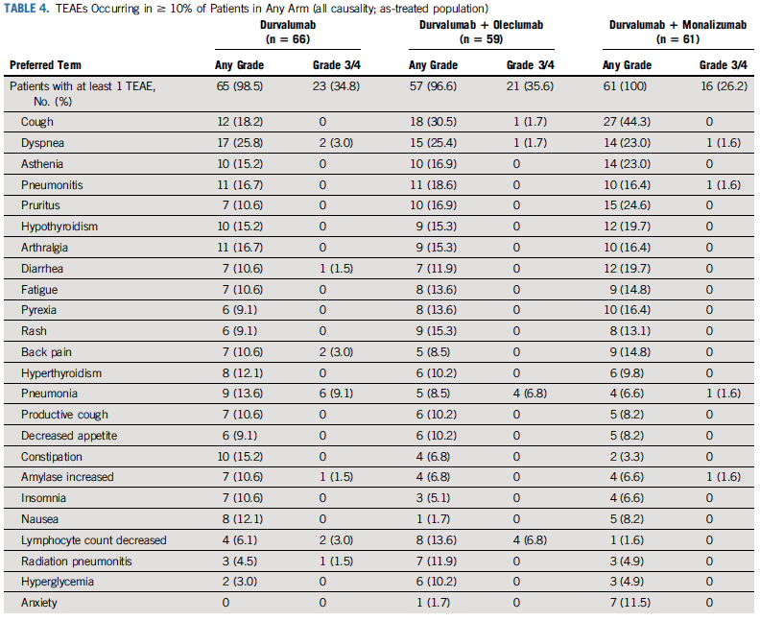
COAST trial: Safety (TEAEs > 10% patients)
Herbst RS et al. J Clin Oncol 2022

Slide 27
Take home – Unresectable Stage III
Durvalumab consolidation therapy (Pacific regimen) has a remarkable long term impact in unresectable stage III patient outcomes
  Improved 5 year PFS (19% v 33%) and OS (33% v 43%)
  Validation in RWD
  Valid strategy as well following sequential chemo-radiotherapy
Strategies of further treatment optimization include:
  Consolidation with combination IO (durvalumab plus monalizumab or oleclumab) based on the encouraging Coast phase II results
  Concurrent chemo-radio-immunotherapy approaches
Notes:
27

Slide 28
Agenda
Early Stage NSCLC
Unresectable stage III
SCLC
Notes:
28

Slide 29
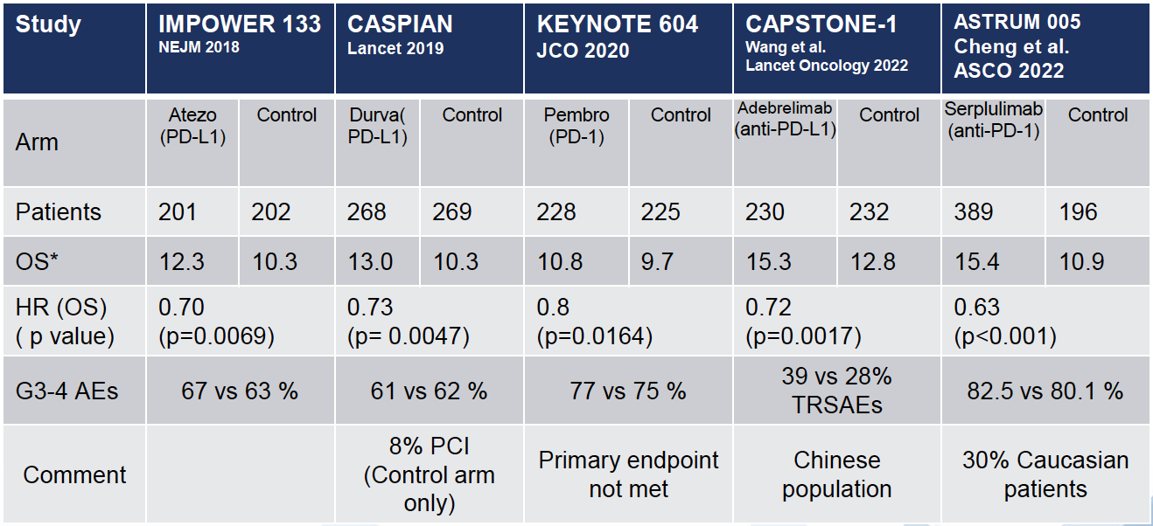
Summary: Chemo-Immunotherapy in SCLC
F Blackhall. ESMO 2022

Slide 30
Caspian Trial – OS after 3 years
Paz-Ares et al. ESMO Open 2022

Slide 31
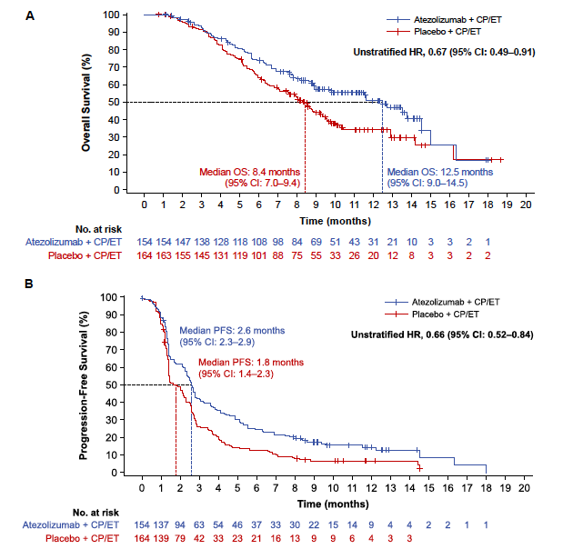
IMpower133 Trial: Maintenance Atezolizumab
M Reck et al. JTO 2022
Notes:
Reference:
Chen Y, Paz-Ares L, Dvorkin M, et al. First-line durvalumab plus platinum-etoposide in extensive-stage small cell lung cancer (CASPIAN): Impact of brain metastases on treatment patterns and outcomes [poster]. Presented at: American Society of Clinical Oncology (ASCO) Annual Meeting (Virtual); May 29-31, 2020.
Chen Y et al ASCO 2020 poster/ Table 3
Chen Y et al ASCO 2020 poster/ safety results/ bullet 1 and 2.

Slide 32
ATLANTIS trial: Study design
DOX 40 mg/m² D1*
Lurbinectedin 2 mg/m² D1 q3w *
SCLC
1 prior chemotherapy line (additional biologic lines allowed)
ECOG PS ≤ 2
Measurable/ non-measurable per RECIST
Pts with CTFI <30 d excluded
Primary endpoint
OS
600 patients
1:1 Randomization
Stratified:
ECOG (0 vs ≥1)
CTFI (≥ 180, 179-90, <90)
CNS involvement (Y/N)
Prior PDL1/PD1 (Y/N)
Investigator preference for control arm
Disease Progression
Unacceptable Toxicity
Randomization
Follow-up
Topotecan 1.5 mg/m² D1-5 q3w
OR, CAV combination D1, q3w
Treatment period
Follow up period
Screening Up to 28D
Primary prophylaxis with G-CSF is mandatory in both arms
* Maximum 10 cycles, lurbinectedin to be continued at 3.2 mg/m² D1 q3w
Paz-Ares et al. WCLC 2021 (PL02.03); Aix et al. Lancet Resp Med 2023
Notes:
Adjust font size and placement as needed to fit your content.

Slide 33
ATLANTIS Trial | Lurbinectedin + Doxorubicin
Overall Survival and Progression-free Survival
Progression-free Survival
PFS HR=0.831
OS HR=0.967
mPFS 4.0 months
mOS 8.6 months
PFS 4.0 months
mOS 7.6 months
Paz-Ares et al. WCLC 2021 (PL02.03); Aix et al. Lancet Resp Med 2023

Slide 34
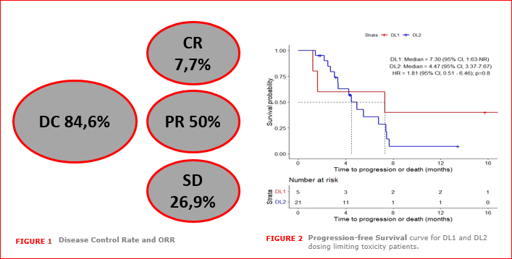
2SMALL Phase I/II trial: Lurbinectedin plus Atezolizumab
Objective responses (ORR) were observed in 15 pts (57.7%), including complete responses (CR) in 2 pts (7.7%), partial response (PR) in 13 pts (50%). Stable disease (SD) was observed in 7 pts (26.9%) and 3 pts (11.54%) were in progressive disease (PD). Disease control rate (DC) was 84.61%,
Ponce et al. SITC 2021

Slide 35
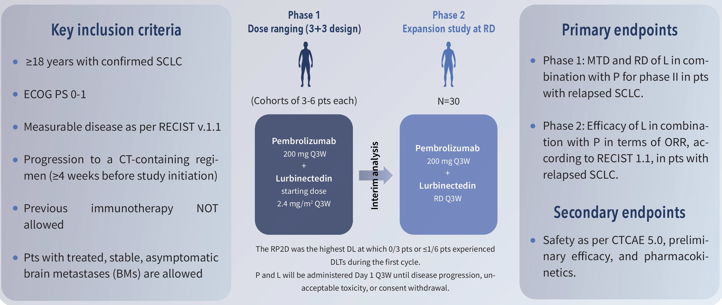
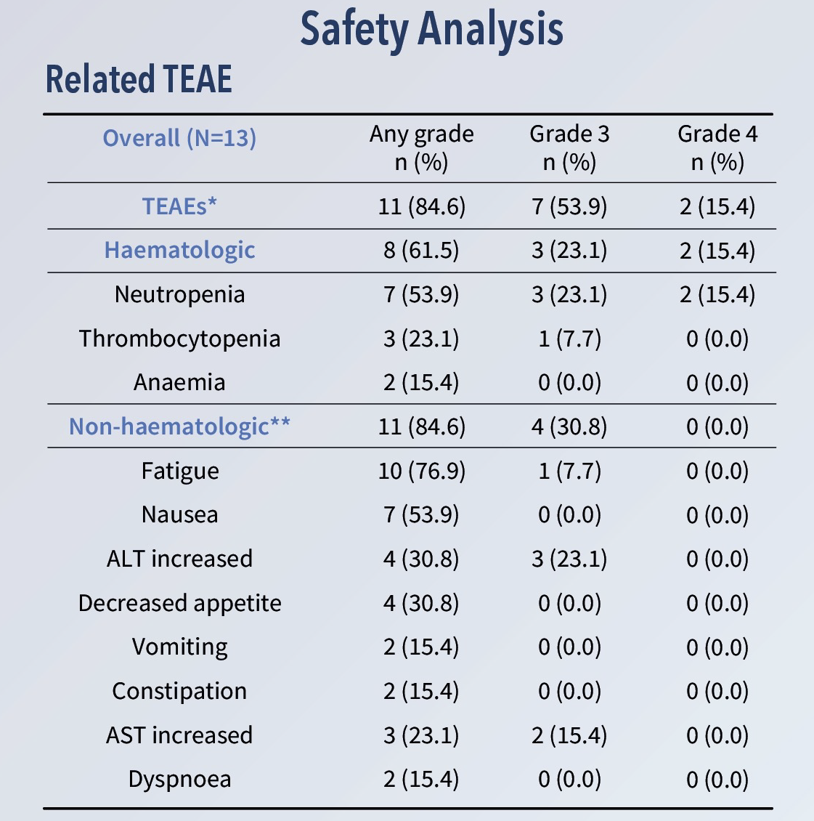
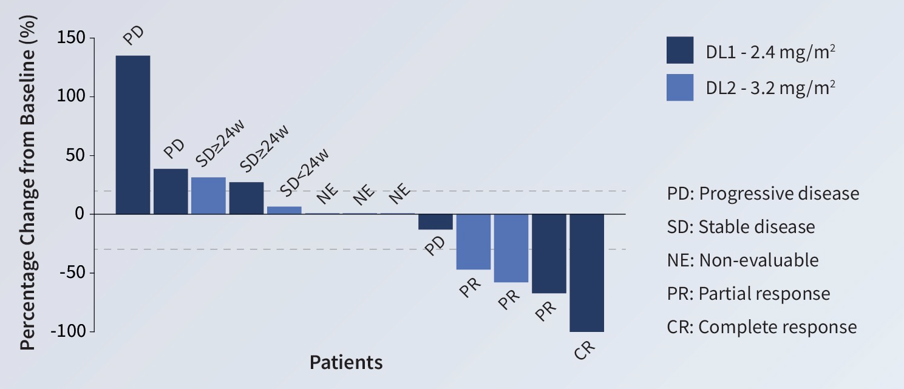
LUPER Phase I/II trial: Lurbinectedin plus Pembrolizumab
RR: 31%
Calles A et al. ASCO 2022

Slide 36
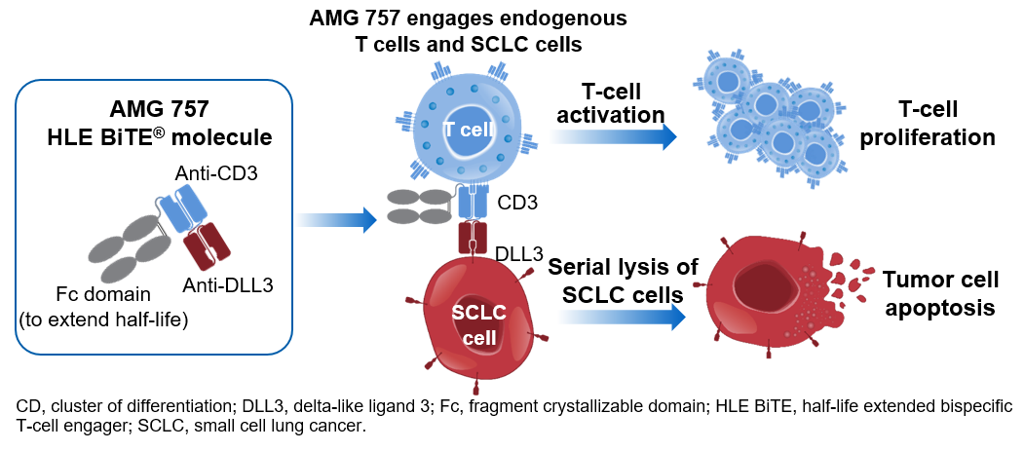
AMG 757: A Half-life Extended BiTE® (bispecific T-cell engager) Immuno-oncology Therapy Targeting DLL3 for SCLC
BiTE molecules engage a patient’s own T cells to attack and eradicate cancer cells^{1–3}
1.Stieglmaier J, et al. Expert Opin Biol Ther. 2015;15:1093-1099. 2. Einsele H, et al. Cancer. 2020;126:3192-3201.
3. Bargou R, et al. Science. 2008;321:974-977.

Slide 37
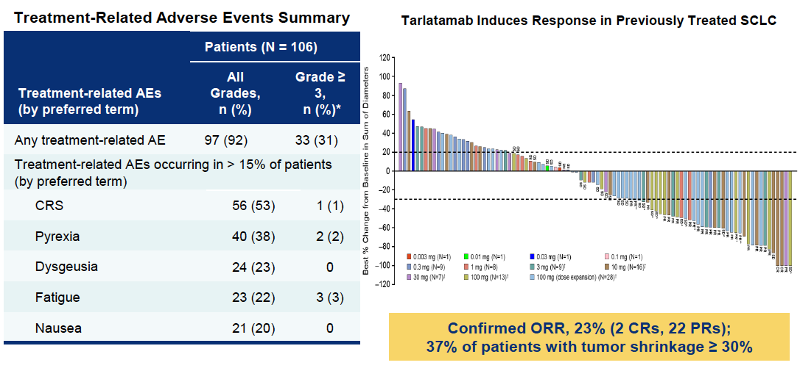
Tarlatamab FIH- Response and Safety
Paz-Ares et al. J Clin Oncol 2023

Slide 38
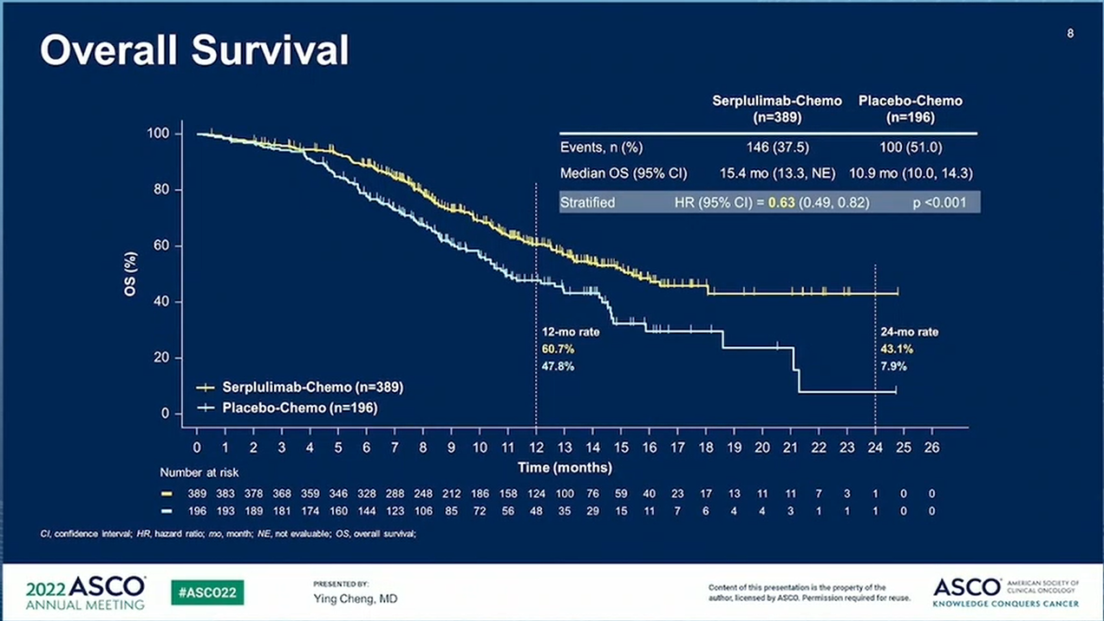
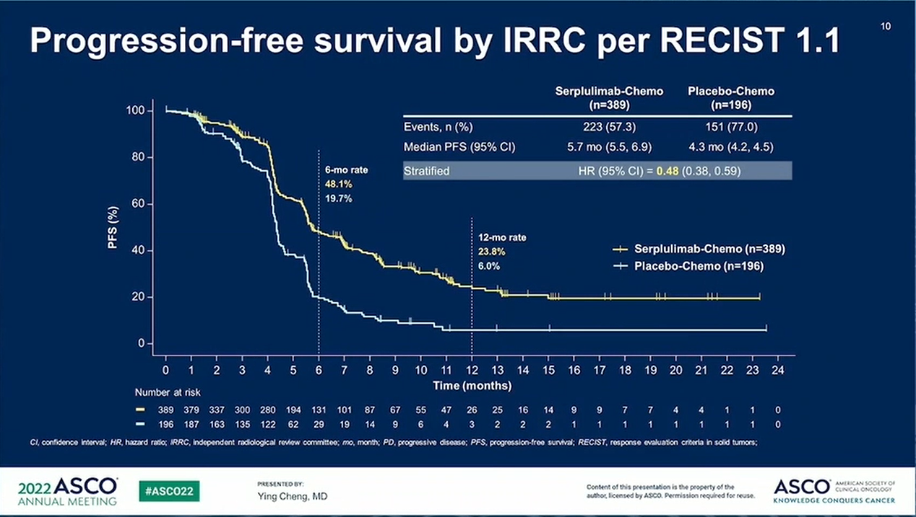
Tarlatamab- PFS and OS in relapsed SCLC
Progression-free survival
Overall survival
1.0
mPFS 3.7 mo (95%CI 2.1, 5.3)
1.0
mOS 13.2 mo (95%CI 8.8, NE)
0.8
0.8
0.6
0.6
PFS probability
OS probability
0.4
0.4
0.2
0.2
0
0
0
2
4
6
8
10
12
14
16
18
0
2
4
6
8
10
12
14
16
18
20
22
24
26
No. at risk
Time, months
No. at risk
Time, months
102
55
35
25
19
17
11
8
5
0
102
88
74
60
49
40
25
15
13
9
4
2
1
0
Paz-Ares et al. J Clin Oncol 2023

Slide 39
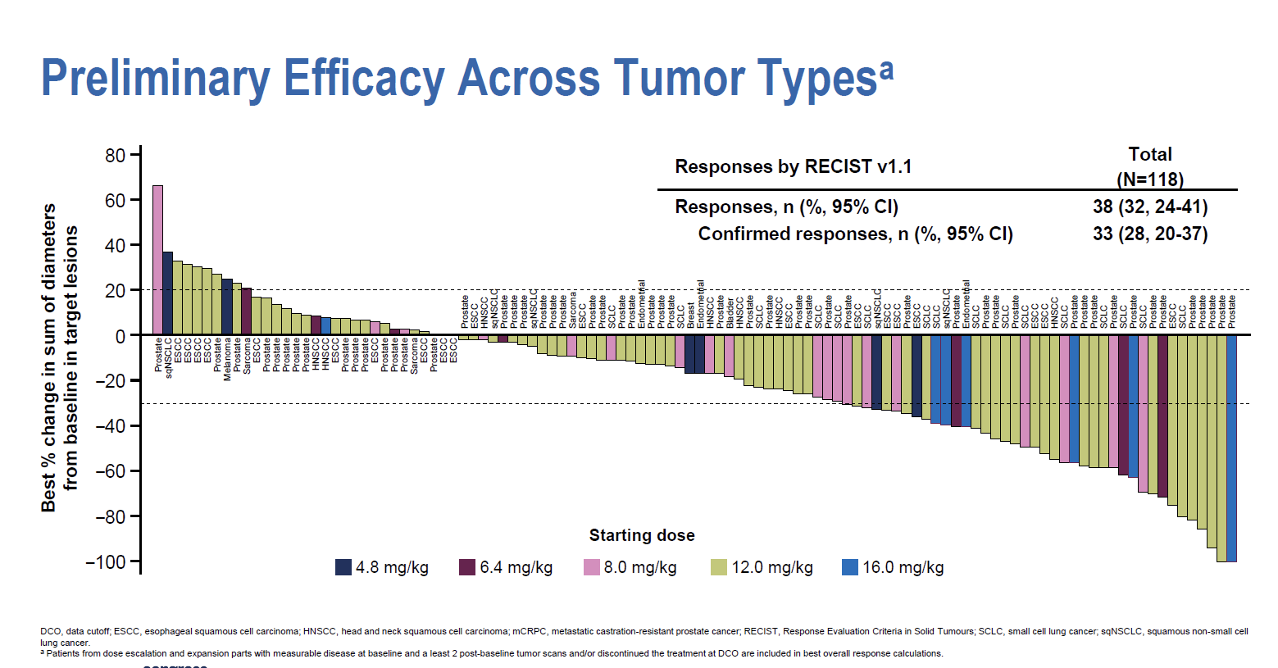
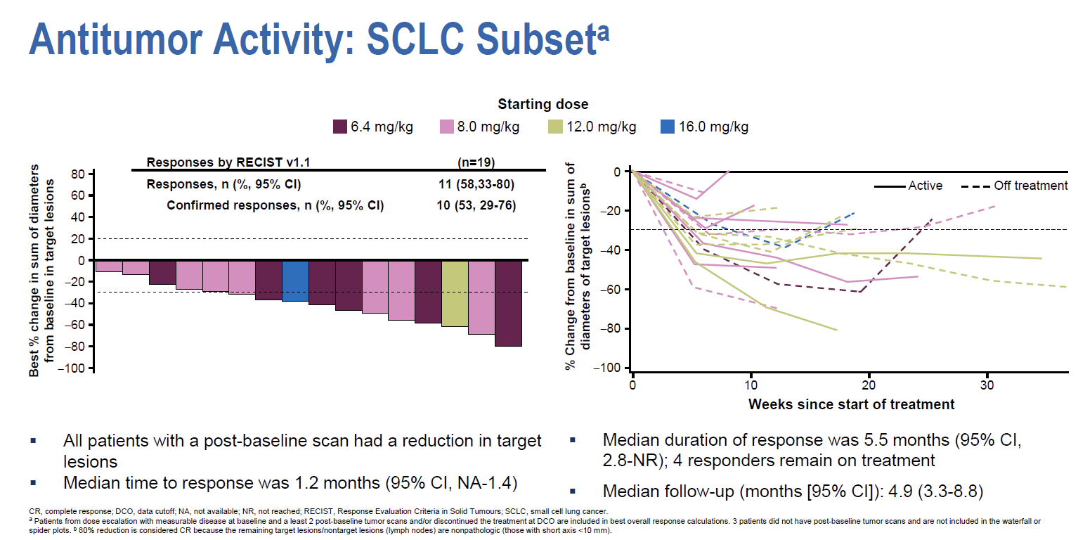
DS 7300- An ADC targeting B7H3
T Doi et al. ESMO 2022

Slide 40
Take home – SCLC
  PE plus PD-L1/PD-1 blockade represents the standard of care in front-line SCLC-EE
    Substantial impact in the long term: Tripled survival at 3 years
Encouraging preliminary data with a number of approaches in the relapse setting
  Lurbinectedin in combination with IO (atezolizumab, pembrolizumab) but not with doxorubicin (ATLANTIS trial)
  Tarlatamab and DS 7300.
Notes:
40

Slide 41
Gracias
lpazaresr@seom.org
L Paz-Ares, Hospital Universitario 12 de Octubre, Spain Institution, Country, Twitter Handle

Slide 42
Appendix

Slide 43
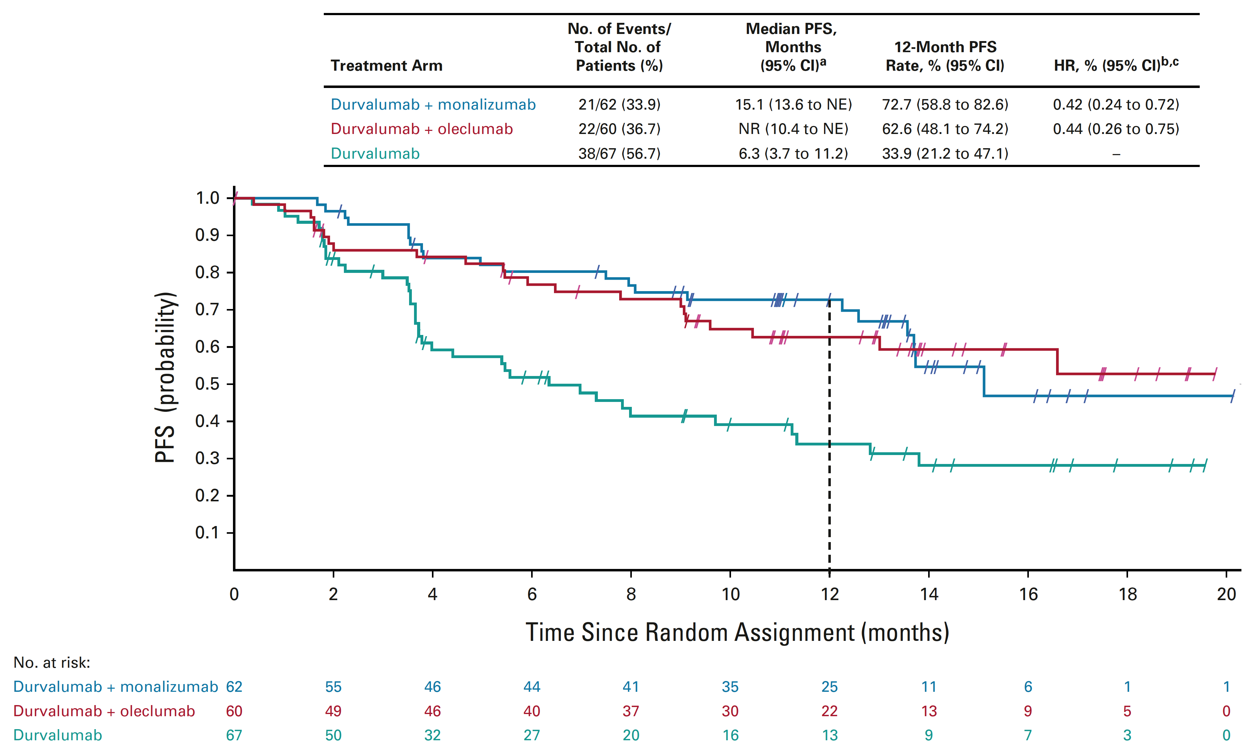
COAST: Phase 2, Randomised Open-Label Study 12-Month Follow-Up

