Slide 1
Selected Highlights in Advanced Prostate Cancer: 2022-2023
Oliver Sartor, MD
Laborde Professor of Cancer Research
Medical Director Tulane Cancer Center
Departments of Medicine and Urology
Assistant Dean for Oncology
Tulane Medical School
New Orleans, Louisiana

Slide 2
PARP Inhibitors

Slide 3
Improved Survival: Phase III Olaparib Trial (PROfound) in Prostate Cancer
Sept 20, 2020

Slide 4
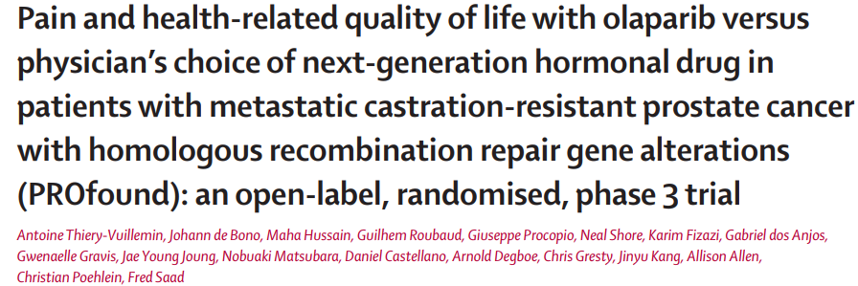
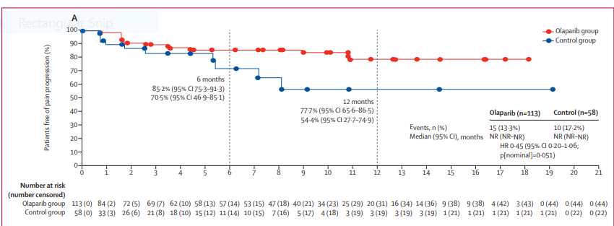

Slide 5
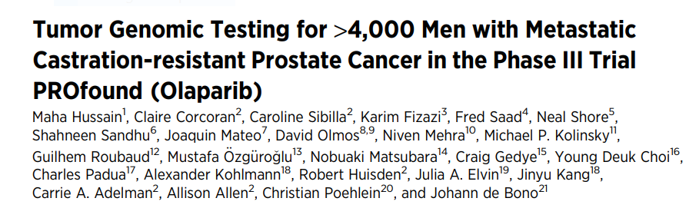
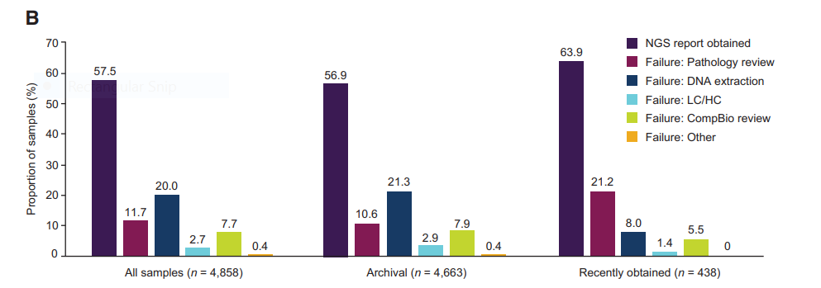

Slide 6
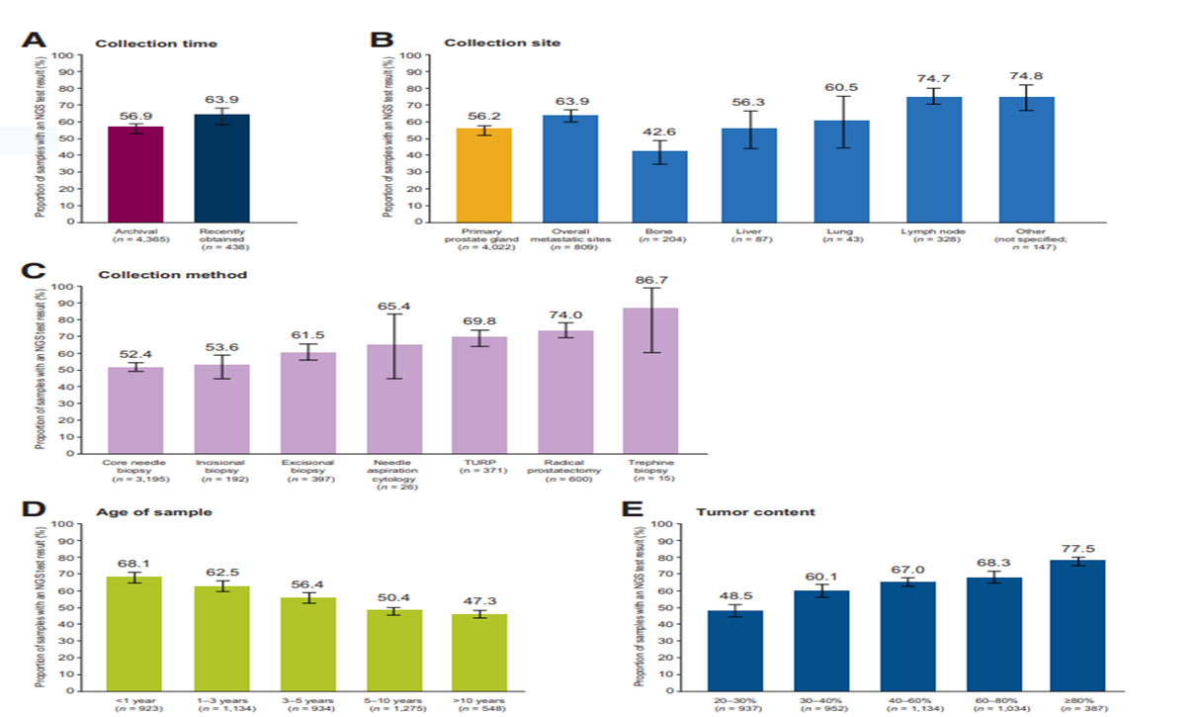

Slide 7
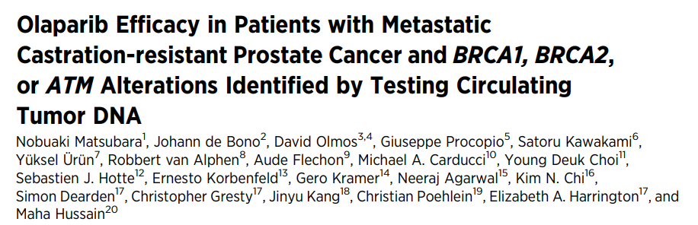
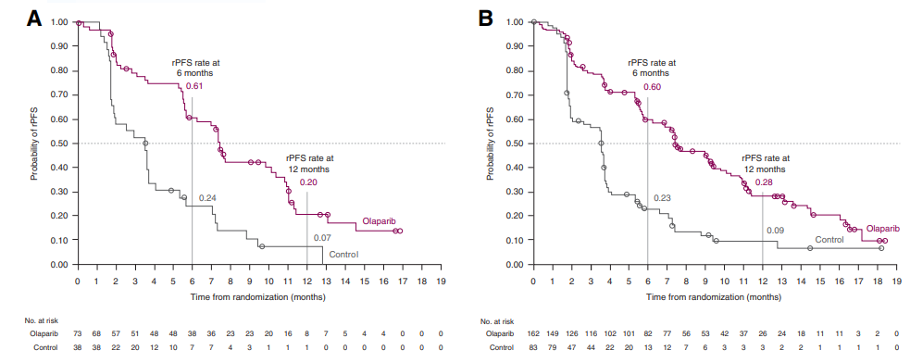
CCR 2023

Slide 8
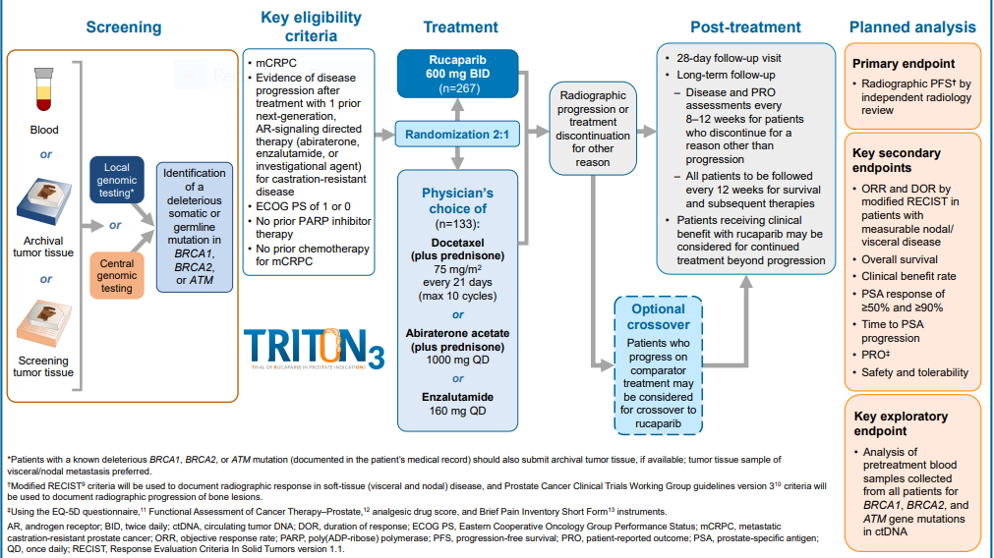
Triton 3: Rucaparib versus Physician Choice
Fizazi et al. NEJM 2/16/23

Slide 9
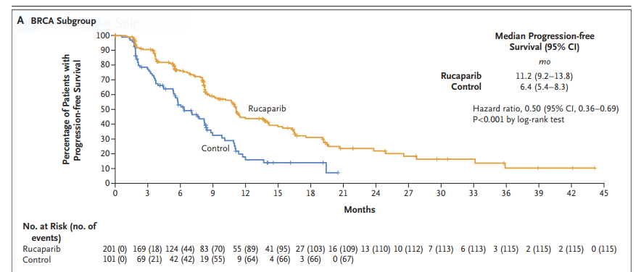
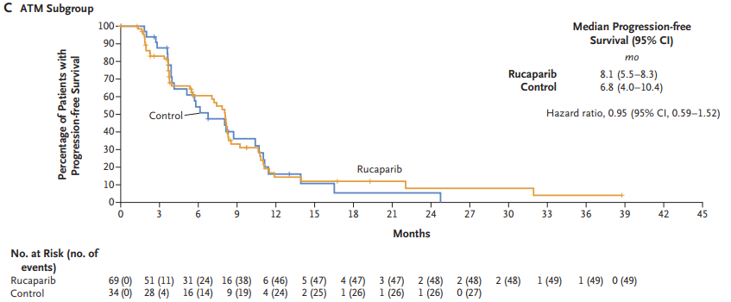
Triton 3
Fizazi et al. NEJM 2023

Slide 10
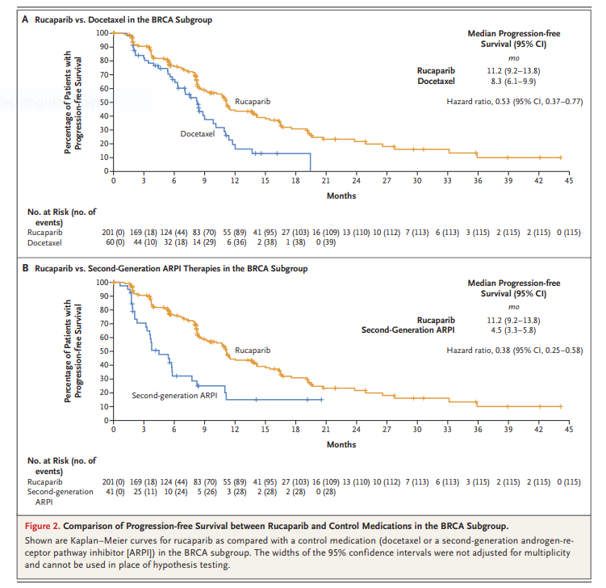
Triton 3: NEJM Fizazi et al. 2023

Slide 11
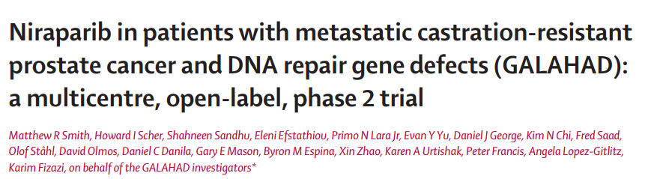
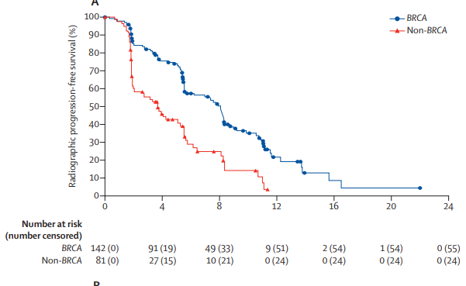

Slide 12
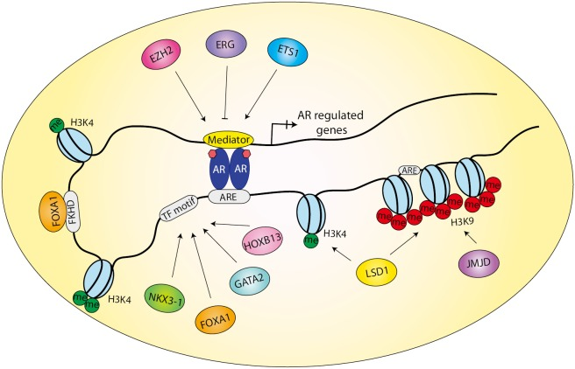
Combination PARP + AR Pathway Inhibition
AR signaling enhances DNA damage repair
ADT upregulated PARP-mediated repair and pre-clinical studies indicate potential synergy between ADT and PARP inhibition
PARP1
JF Goodwin, et al. Cancer Discov 3:1254, 2013; WR Polkinghorn, et al. Cancer Discov 3:1245, 2013; M Asim, e al. Nat Commun 8: 374, 2017; MJ Schiewer , et al. Cancer Discov 2:1134, 2012

Slide 13
HRR mutations were determined after randomization
Clarke et al. 2023

Slide 14
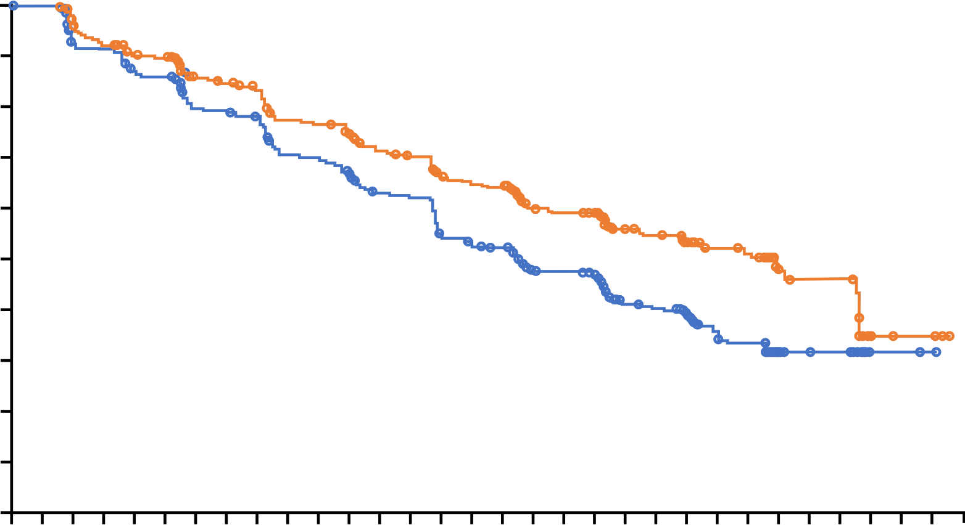
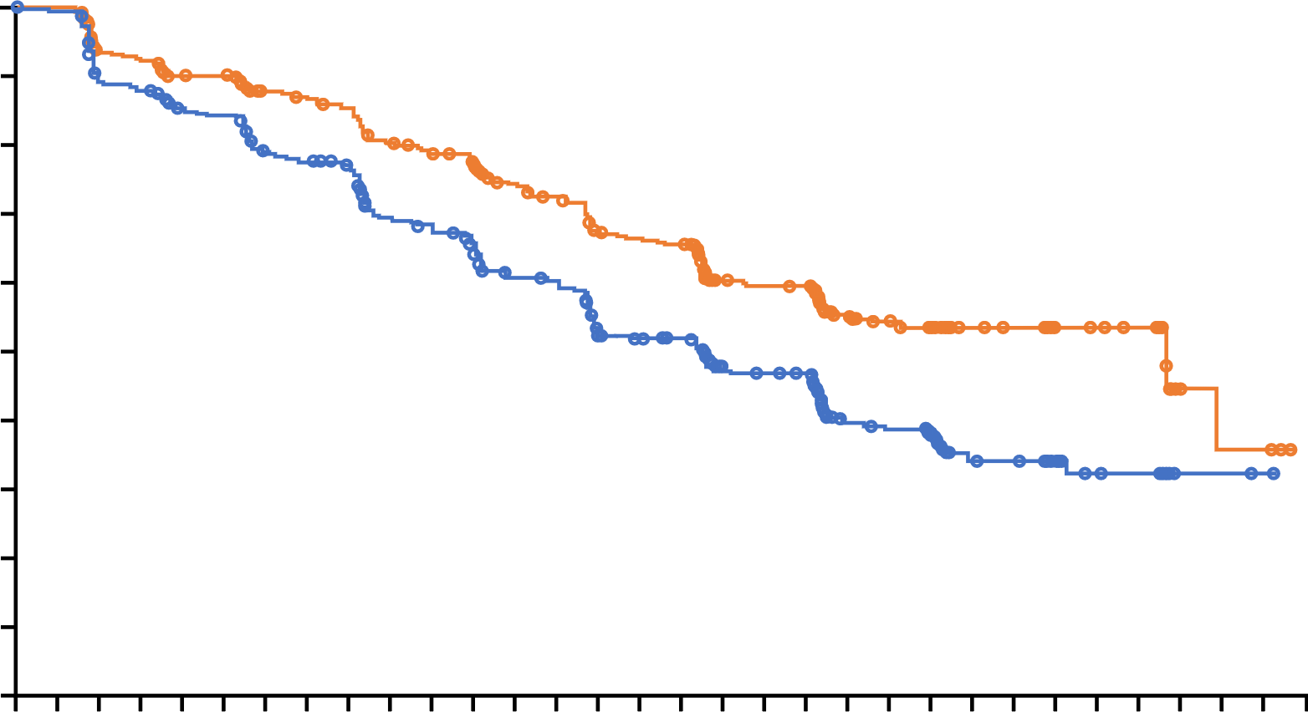
PROpel: primary rPFS results (DCO1)¹
Abiraterone + olaparib significantly prolonged rPFS versus abiraterone + placebo in the ITT population
rPFS by investigator assessment (INV)
rPFS by blinded independent central review (BICR)
 | Abiraterone + olaparib (n=399) | Abiraterone + placebo (n=397)
Events, n (%) | 168 (42.1) | 226 (56.9)
Median, months | 24.8 | 16.6
HR (95% CI) P value | 0.66 (0.54‒0.81) <0.0001
 | 2-sided boundary for significance 0.0324
 | Abiraterone + olaparib (n=399) | Abiraterone + placebo (n=397)
Events, n (%) | 157 (39.3) | 218 (54.9)
Median, months | 27.6 | 16.4
HR (95% CI) P value | 0.61 (0.49‒0.74); <0.0001 (nominal)
1.0
1.0
0.9
0.9
0.8
0.8
0.7
0.7
0.6
0.6
0.5
Probability of rPFS
0.5
Probability of rPFS
0.4
0.4
0.3
0.3
0.2
0.2
0.1
∆ 8.2 months
0.1
∆ 11.2 months
0.0
0
2
4
6
8
10
12
14
16
18
20
22
24
26
28
30
0.0
0
2
4
6
8
10
12
14
16
18
20
22
24
26
28
30
Time from randomization (months)
Time from randomization (months)
Number of patients at risk:
Number of patients at risk:
399
397
395
393
367
359
354
356
340
338
337
334
313
306
309
303
301
297
277
266
274
264
265
249
251
232
244
228
227
198
221
190
219
186
170
143
167
141
163
137
104
87
100
84
87
73
59
45
57
43
28
21
26
17
26
16
5
2
4
2
4
1
0
0
Abiraterone + olaparib
Abiraterone + placebo
Abiraterone + olaparib
Abiraterone + placebo
399
397
389
388
353
345
347
340
332
322
331
319
314
294
309
289
303
282
283
251
275
245
267
226
249
209
240
204
221
177
217
172
215
168
165
131
161
126
159
124
96
73
89
70
80
62
55
39
53
38
30
21
28
16
26
15
5
2
4
2
4
1
0
0
DCO1: 30 July 2021
Median duration of follow-up for investigator-assessed rPFS for censored patients was 19.3 months in the abiraterone and olaparib arm and 19.4 months in the abiraterone and placebo arm (19.3 and 19.2 months, respectively for blinded independent central review).
CI, confidence interval; HR, hazard ratio; ITT, intention-to-treat population.
1. Clarke N et al. NEJM Evidence 2022;EVIDoa2200043.
Professor Noel Clarke

Slide 15

PROpel: rPFS in subgroups (DCO1; investigator-assessed)¹
rPFS benefit observed across all subgroups
 | Events/ Number of patients, n | Median rPFS, months |  |  |  | HR (95% CI)
All patients | 394/796 | 24.8 | 16.6 |  |  | 0.66 (0.54–0.81)
Age at randomization, years
<65 | 106/227 | NR | 16.4 |  |  | 0.51 (0.35–0.75)
≥65 | 288/569 | 22.0 | 16.7 |  |  | 0.78 (0.62–0.98)
Site of distant metastases
Bone only | 177/434 | 27.6 | 22.2 |  |  | 0.73 (0.54–0.98)
Visceral | 71/105 | 13.7 | 10.9 |  |  | 0.62 (0.39–0.99)
Other | 146/257 | 20.5 | 13.7 |  |  | 0.62 (0.44–0.85)
Docetaxel treatment at mHSPC stage
Yes | 95/189 | 27.6 | 13.8 |  |  | 0.61 (0.40–0.92)
No | 299/607 | 24.8 | 16.8 |  |  | 0.71 (0.56–0.89)
HRRm status*
HRRm | 116/226 | NR | 13.9 |  |  | 0.50 (0.34–0.73)
Non-HRRm | 268/552 | 24.1 | 19.0 |  |  | 0.76 (0.60–0.97)
BRCAm status*
BRCAm | 42/85 | NR | 8.4 |  |  | 0.23 (0.12–0.43)
Non-BRCAm | 342/693 | 24.1 | 19.0 |  |  | 0.76 (0.61–0.94)
Results by BICR were consistent and can be found in the supplement
0.1
Abiraterone + olaparib better
1
10
Abiraterone + placebo better
DCO1: 30 July 2021
*HRRm and BRCAm status was determined after randomization and before primary analysis using aggregated results from tumour tissue and plasma ctDNA tests. Aggregate subgroup analyses are post hoc and exploratory.
Results shown are by investigator assessment
1. Clarke N et al. NEJM Evidence 2022;EVIDoa2200043. Copyright © (2022) Massachusetts Medical Society. Reprinted with permission from the Massachusetts Medical Society
Professor Noel Clarke

Slide 16
PROpel: OS at final analysis (DCO3)
In the ITT population, median OS was >7 months longer in the abiraterone + olaparib arm
1.0
 | Abiraterone + olaparib (n=399) | Abiraterone + placebo (n=397)
Events, n (%) | 176 (44.1) | 205 (51.6)
Median, months | 42.1 | 34.7
HR (95% CI) P value | 0.81 (0.67–1.00) 0.0544
 | 2-sided boundary for significance 0.0377
 | 47.9% maturity
0.9
0.8
0.7
0.6
0.5
Probability of OS
0.4
0.3
0.2
∆ 7.4
months
0.1
0.0
0
2
4
6
8
10
12
14
16
18
20
22
24
26
28
30
32
34
36
38
40
42
44
46
48
Number of patients at risk:
Time from randomization (months)
Abiraterone + olaparib
Abiraterone + placebo
399
397
399
395
391
388
385
383
374
376
364
370
349
355
334
337
318
316
312
305
298
301
283
282
273
254
258
241
253
225
246
213
226
201
192
157
135
119
96
84
63
53
29
25
10
7
2
0
0
0
DCO3: 12 October 2022.
Median (range) duration of follow-up for censored patients at DCO3 was 36.6 months (8.3–47.0) in the abiraterone + olaparib arm and 36.5 months (2.9–45.3) in the abiraterone + placebo arm.
Professor Noel Clarke

Slide 17
PROpel: OS in HRRm and non-HRRm subgroups (DCO3)
A trend towards OS benefit was observed across HRRm and non-HRRm subgroups
HRRm (28.4 % of ITT population)
Non-HRRm (69.3% of ITT population)
 | Abiraterone + olaparib (n=111) | Abiraterone + placebo (n=115)
Events, n (%) | 48 (43.2) | 69 (60.0)
Median, months | NR | 28.5
HR (95% CI) | 0.66 (0.45–0.95)
 | Abiraterone + olaparib (n=279) | Abiraterone + placebo (n=273)
Events, n (%) | 123 (44.1) | 132 (48.4)
Median, months | 42.1 | 38.9
HR (95% CI) | 0.89 (0.70–1.14)
1.0
1.0
0.9
0.9
0.8
0.8
0.7
0.7
0.6
0.6
0.5
0.5
Probability of OS
Probability of OS
0.4
0.4
0.3
0.3
0.2
0.2
0.1
0.1
0.0
0
2
4
6
8
10
12
14
16
18
20
22
24
26
28
30
32
34
36
38
40
42
44
46
48
0.0
0
2
4
6
8
10
12
14
16
18
20
22
24
26
28
30
32
34
36
38
40
42
44
46
48
Number of patients at risk:
Time from randomization (months)
Number of patients at risk:
Time from randomization (months)
111
115
111
113
107
109
105
107
102
105
96
105
94
99
90
92
87
86
86
82
83
80
79
77
77
70
73
66
72
57
70
53
62
51
55
40
42
32
22
22
14
12
7
4
1
1
1
0
0
0
Abiraterone + olaparib
Abiraterone + placebo
Abiraterone + olaparib
Abiraterone + placebo
279
273
279
273
275
270
271
267
263
262
260
256
247
247
236
237
223
222
218
216
207
214
198
198
190
177
179
168
175
162
170
155
160
145
134
114
92
84
73
59
48
39
22
21
9
6
1
0
0
0
DCO3: 12 October 2022.
HRRm status was determined after randomization and before primary analysis using aggregated results from tumour tissue and plasma ctDNA tests. Aggregate subgroup analyses are post hoc and exploratory. 18 patients had unknown HRRm status.
Professor Noel Clarke

Slide 18
Chi et al. ASCO GU 2022

Slide 19
MAGNITUDE: No benefit of niraparib in those with no HRR mutations
Chi et al. ASCO GU 2022

Slide 21
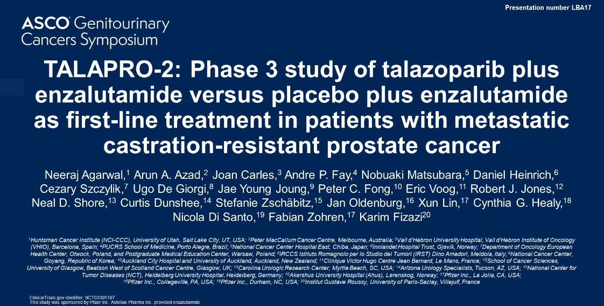

Slide 22
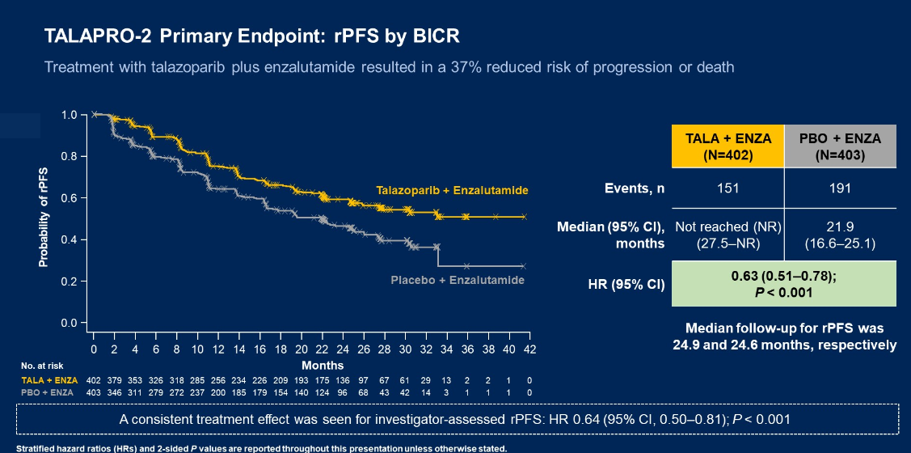

Slide 23
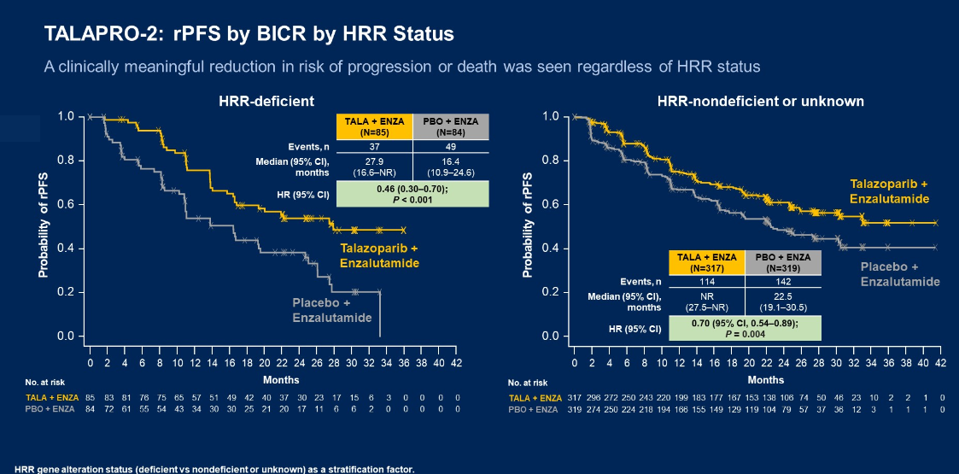

Slide 24
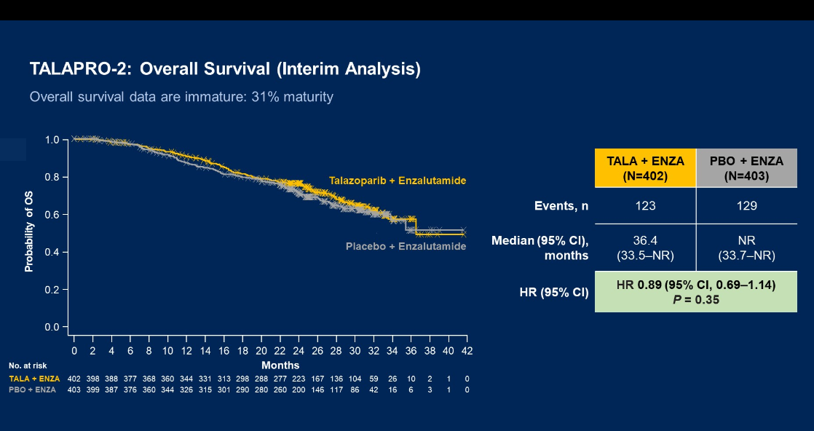

Slide 25
Summary
Combination therapies with PARP are not FDA approved but trials are positive for rPFS
  No OS shown yet in the overall analyses……
  BRCA mutated subsets are substantially positive
  How important is the primary endpoint of rPFS?
    FDA to decide

Slide 26
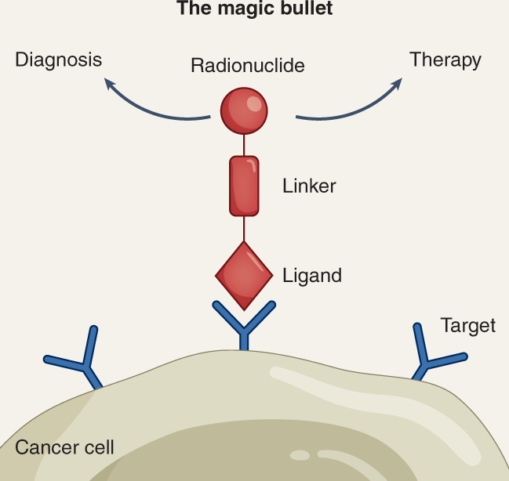
Theranostics:
See it…. Treat it…..Love it!
Cell surface target, a ligand, a linker, and an isotope

Slide 27
Published 6/23/21
FDA Approved 3/23/22

Slide 28
VISION: ¹⁷⁷Lu-PSMA-617 Phase III trial
VISION met both primary endpoints of OS and rPFS
OS: HR 0.62 (95% CI 0.52-0.74)
rPFS: HR 0.40 (95% CI 0.29-57)
 | ¹⁷⁷Lu-PSMA-617 + SoC (n=551) | SoC alone (n=280)
Median OS, months | 15.3 | 11.3
HR (95% CI) | 0.62 (0.52–0.74)
P value, one-sided | <0.001
 | ¹⁷⁷Lu-PSMA-617 + SoC (n=385) | SoC alone (n=186)
Median rPFS, months | 8.7 | 3.4
HR (95% CI) | 0.40 (0.29–0.57)
P value, one-sided | <0.001
100
100
90
90
80
70
80
60
70
Event-free probability (%)
50
60
40
Event-free probability (%)
30
50
20
40
10
¹⁷⁷Lu-PSMA-617 + SoC (n/N=343/551)
30
0
SoC alone (n/N=187/280)
20
0
2
4
6
8
10
12
14
16
18
20
22
24
26
28
30
32
10
¹⁷⁷Lu-PSMA-617 + SoC (n/N=254/385)
Number still at risk
Time from randomisation (months)
0
SoC alone(n/N=93/196)
¹⁷⁷Lu-PSMA-617
+ SoC
551
535
506
470
425
377
332
289
236
166
112
63
36
15
5
2
0
0
1
2
3
4
5
6
7
8
9
10
11
12
13
14
15
16
17
18
19
20
21
22
23
SoC alone
280
238
203
173
155
133
117
98
73
51
33
16
6
2
0
0
0
Number still at risk
Time from randomisation (months)
¹⁷⁷Lu-PSMA-617
+ SoC
385
373
362
292
272
235
215
194
182
146
137
121
88
83
71
51
49
37
21
18
6
1
1
0
SoC alone
196
146
119
58
36
26
19
14
14
13
13
11
7
7
7
4
3
3
2
2
0
0
0
0
Note: OS positive (HR 0.63) in rPFS subset and rPFS positive (HR 0.43) in OS subset

Slide 29
Kuo et al. Clin Oncol 40, 2022 (suppl 16; abstr 5002)

Slide 30
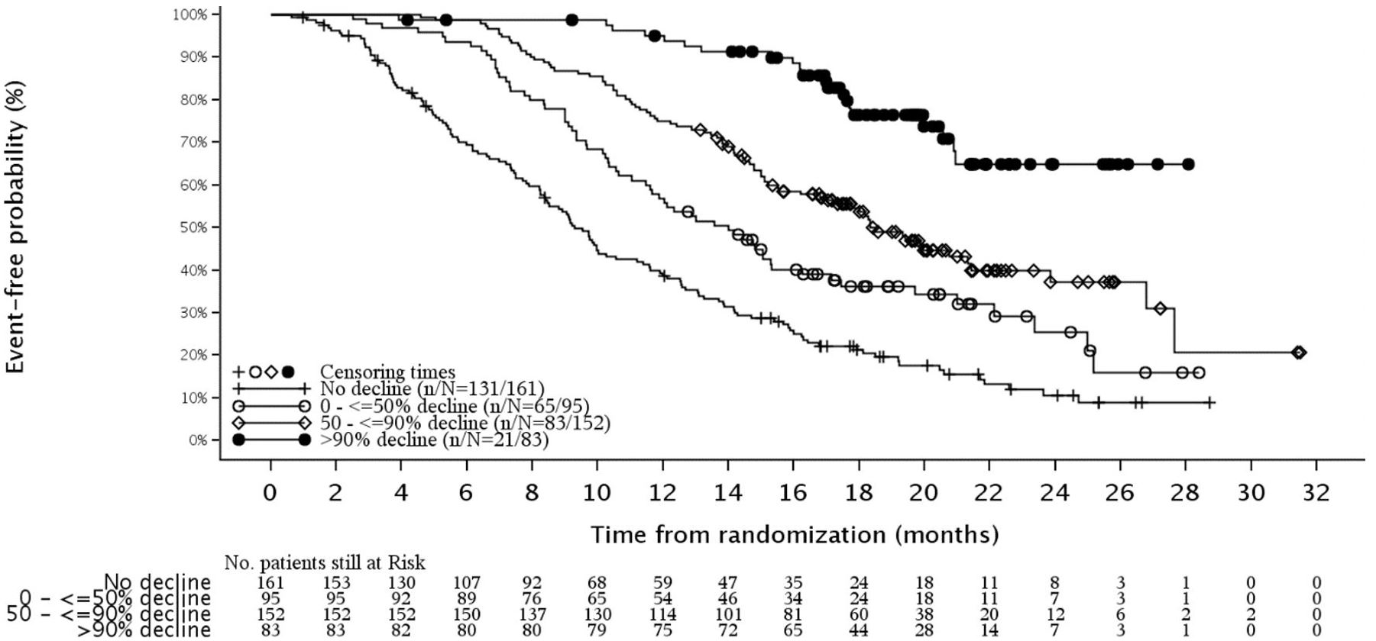
PSA decline at <12 weeks and Overall Survival
Armstrong et al. Annals of Oncology (2022) 33 (suppl_7): S616-S652.
[
Pluvicto = lutetium Lu 177 vipivotide tetraxetan

Slide 31
¹⁷⁷Lu-PSMA-617 shows statistically significant and clinically meaningful radiographic progression-free survival benefit in patients with PSMA-positive metastatic castration-resistant prostate cancer
Dec 05, 2022
Ad hoc announcement pursuant to Art.53LR
Phase III PSMAfore trial with ¹⁷⁷Lu-PSMA-617 met the primary endpoint of radiographic progression-free survival for patients with PSMA-positive mCRPC who have been treated with androgen-receptor inhibitor (ARPI) therapy
¹⁷⁷Lu-PSMA-617 becomes the first PSMA-targeted radioligand therapy to demonstrate clinical benefit in mCRPC patients before taxane-based chemotherapy, addressing a significant unmet need

Slide 32
TheraP Trial: Randomized phase II trial comparing cabazitaxel versus ¹⁷⁷Lu-PSMA-617 (ANZUP 1603)
N = 200
Key Eligibility Criteria
Progressive mCRPC after docetaxel treatment
⁶⁸Ga-PSMA-11 PET/CT positive scan and no discordant sites by ¹⁸F-FDG PET determined by central reader
ECOG PS 0-2
¹⁷⁷Lu-PSMA-617 q 6 wks x 6
R 1:1
Cabazitaxel
Primary Endpoint: PSA response
Hofman MS et al. BJU Int. 124 (suppl) 1:5-13, Nov 2019

Slide 33
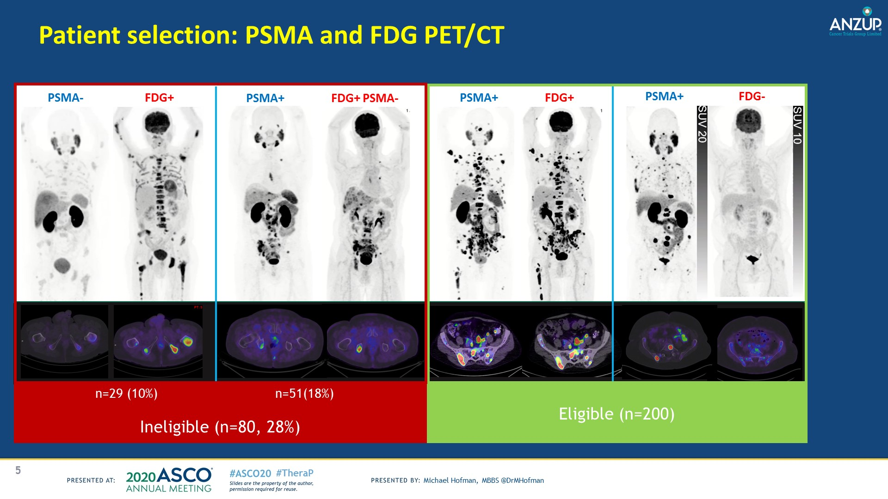
Patient selection in Australian PSMA 617 Trials

Slide 35
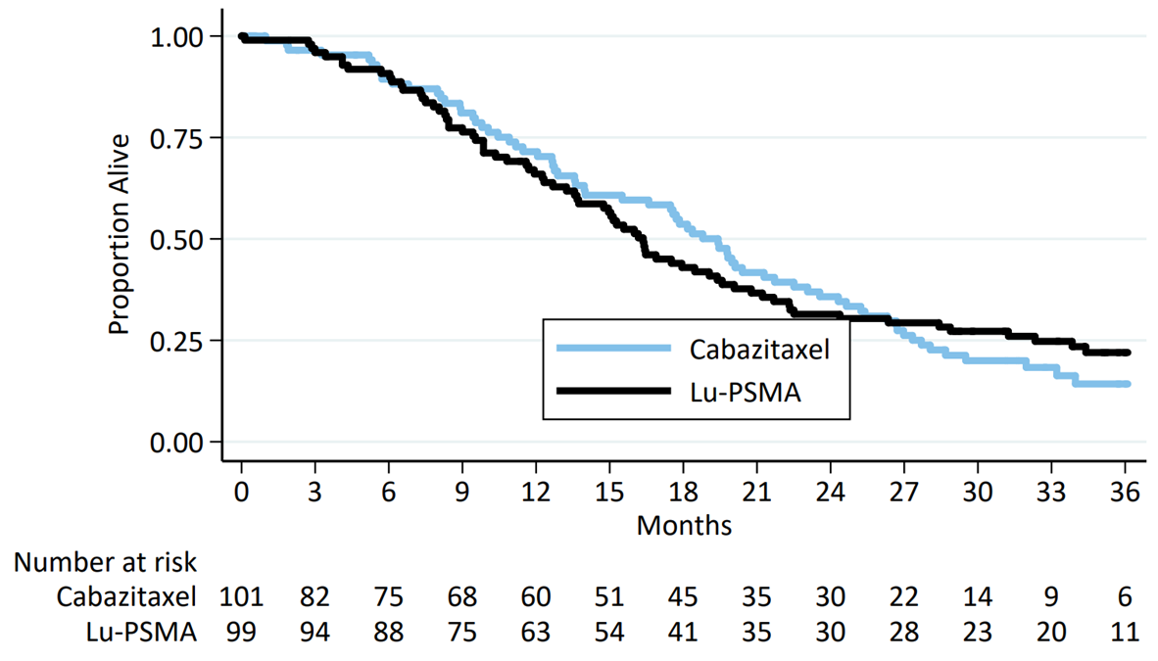
Survival in TheraP after 3 years
Hofman et al. ASCO 2022
HR=0.97 (95% CI, 0.70-1.4) P=0.99

Slide 36
Synergistic opportunities with radiopharmaceuticals

Slide 37
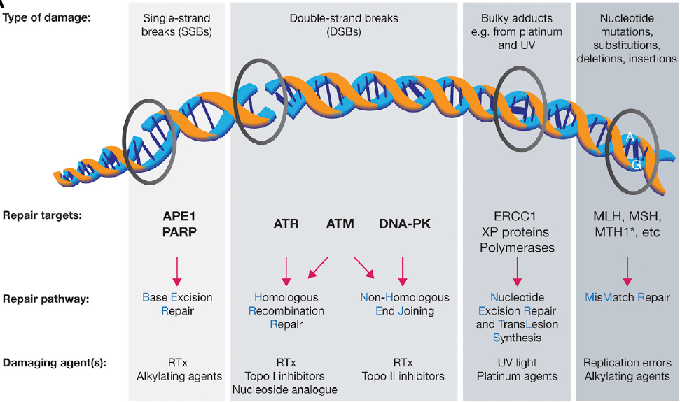
Targeting DNA damage repair pathways in combination with radionuclides
O’Connor, Molecular Cell 60, November 19, 2015

Slide 38
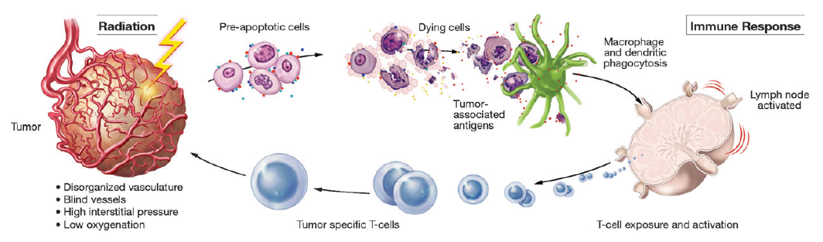
Antigen release from radiated tumor: Synergy with immunotherapies?
Kamrava et al., Molecular Biosystems: 5:1249–1372, 2009

Slide 39
Sequencing Radiopharmaceuticals

Slide 40
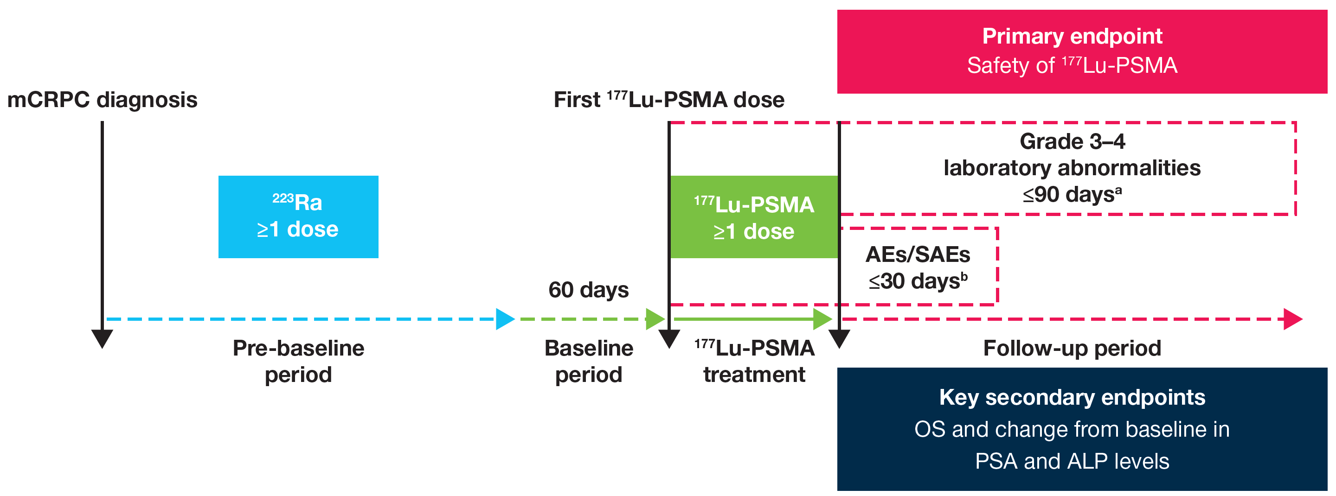
Safety and Effectiveness of ¹⁷⁷Lu-PSMA after ²²³Ra: The RALU Study
Data were retrospectively collected from Sep 2021 – Mar 2022
ªMeasured from start of ¹⁷⁷Lu-PSMA therapy up to 90 days after last administration. ^{b}Measured from start of ¹⁷⁷Lu-PSMA therapy up to 30 days after last administration
AEs, adverse events; ALP, alkaline phosphatase; mCRPC, metastatic castration-resistant prostate cancer; OS, overall survival; PSA, prostate-specific antigen; SAEs, serious AEs
PRIMARY OBJECTIVE: To investigate the safety and clinical effectiveness of ¹⁷⁷Lu-PSMA treatment in pts with prior ²²³Ra therapy
POSTHOC ANALYSES: To provide evidence for the safety and clinical effectiveness of two PSMA ligands,
¹⁷⁷Lu-PSMA-617 and ¹⁷⁷Lu-PSMA-I&T, in pts with prior ²²³Ra therapy

Slide 41
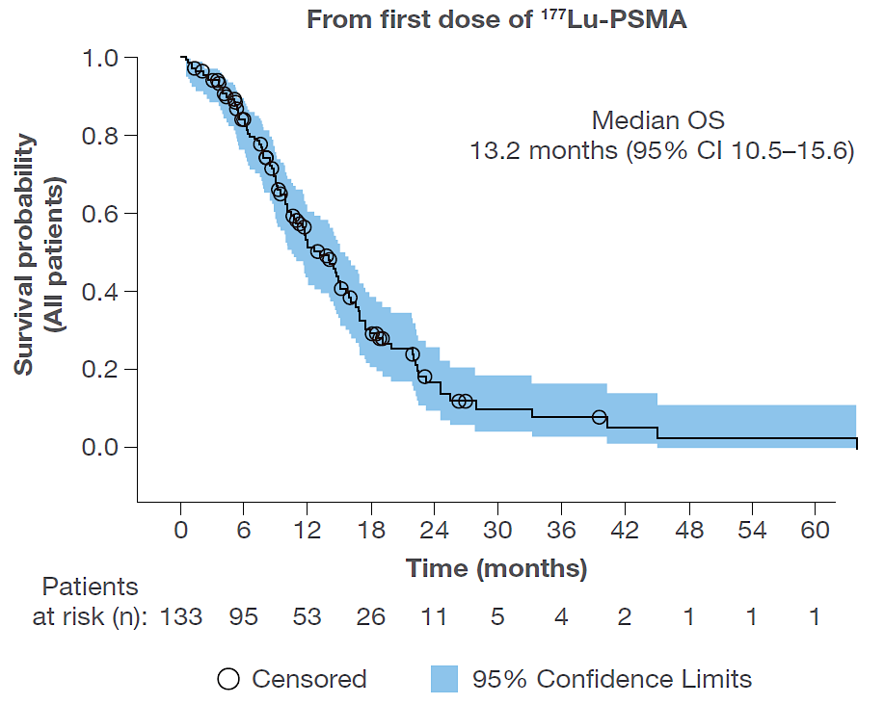
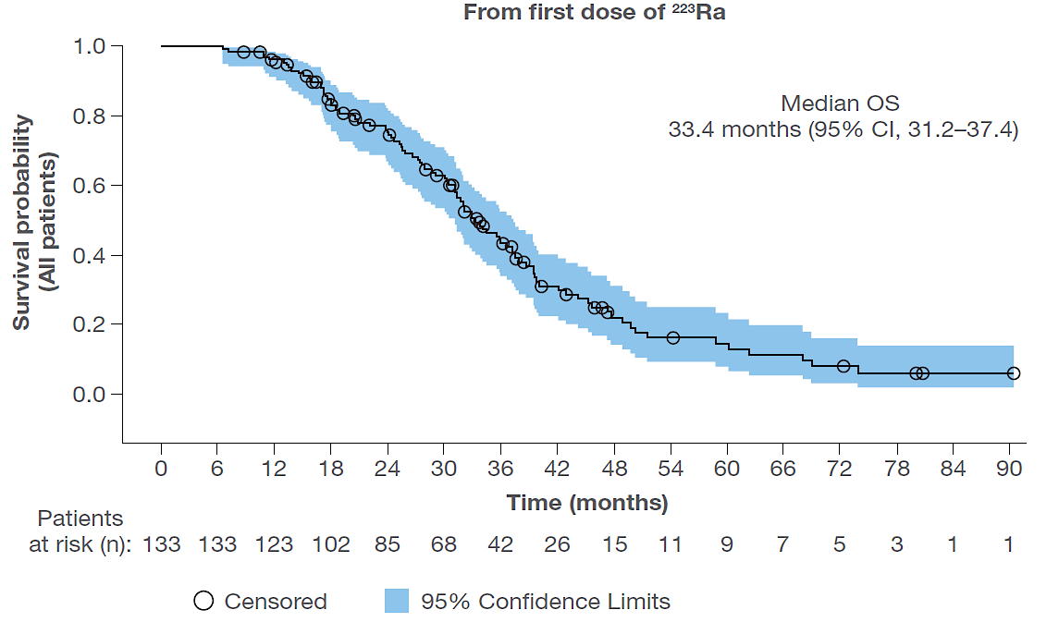
RALU Overall Survival – All Patients
CI, confidence interval; OS, overall survival; PSMA, prostate-specific membrane antigen

Slide 42
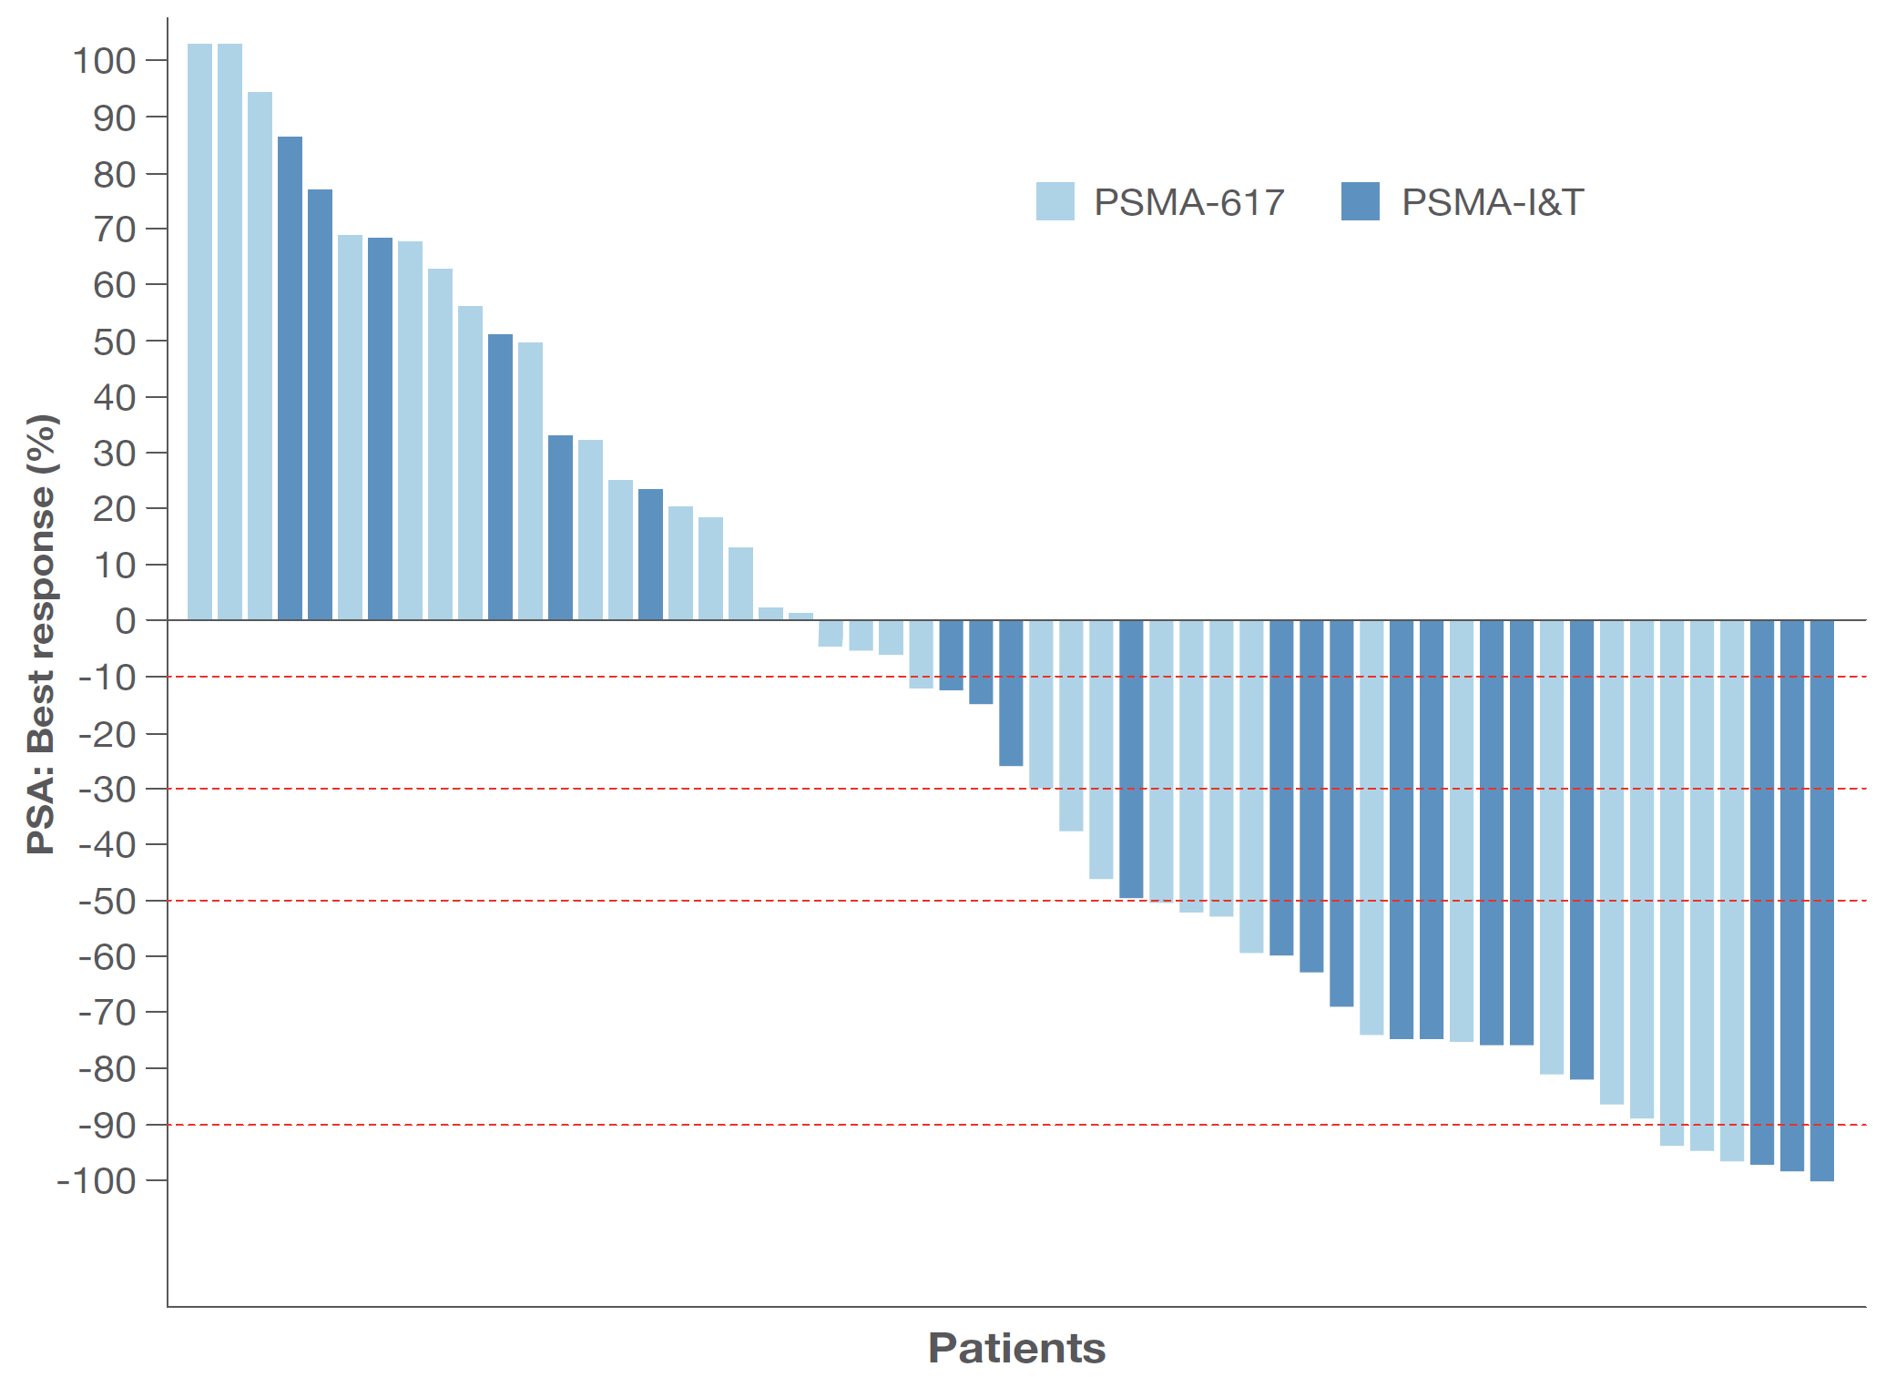
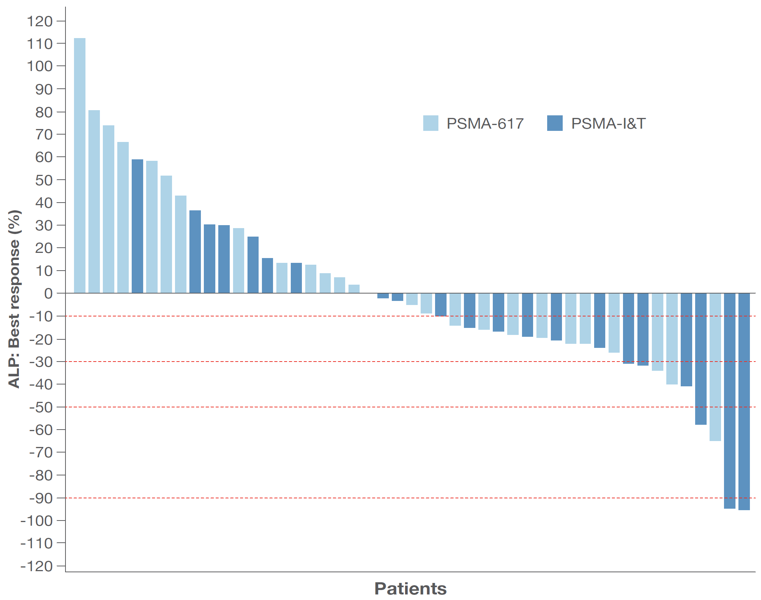
RALU PSA and ALP Response
PSA: Best response
ALP: Best response
Proportion of patients with a ≥50% decline in PSA:
Proportion of patients with a ≥50% decline in ALP:
All patients
42% (23/55)
¹⁷⁷Lu-PSMA-617
35% (12/34)
¹⁷⁷Lu-PSMA-I&T
52% (11/21)
All patients
9% (4/47)
¹⁷⁷Lu-PSMA-617
4% (1/25)
¹⁷⁷Lu-PSMA-I&T
14% (3/22)
ALP, alkaline phosphatase; PSA, prostate-specific antigen; PSMA, prostate-specific membrane antigen

Slide 43
Targeted Alphas

Slide 44
Radio-conjugates: PSMA targeted alpha emitters (Actinium-225) as 9th line treatment
Kratochwil et a. J Nuc Med 57: 1-4, 2016

Slide 45
Chemotherapy

Slide 46
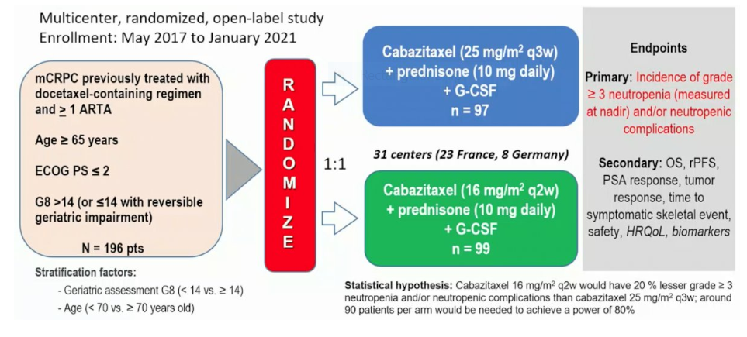
Cabasty Trial
Oudard et al. ESMO 2022

Slide 47
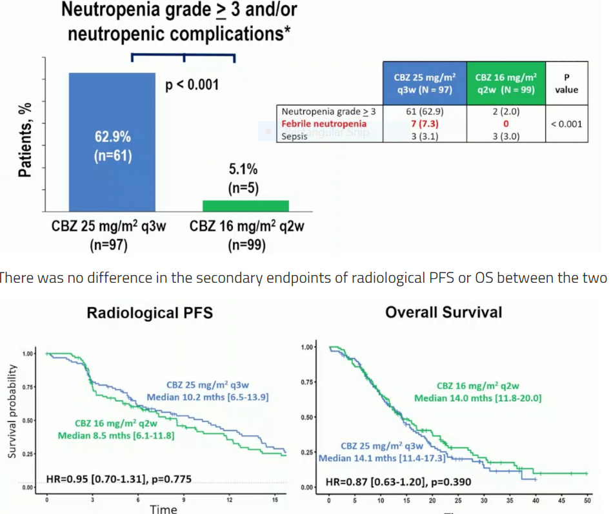

Slide 48
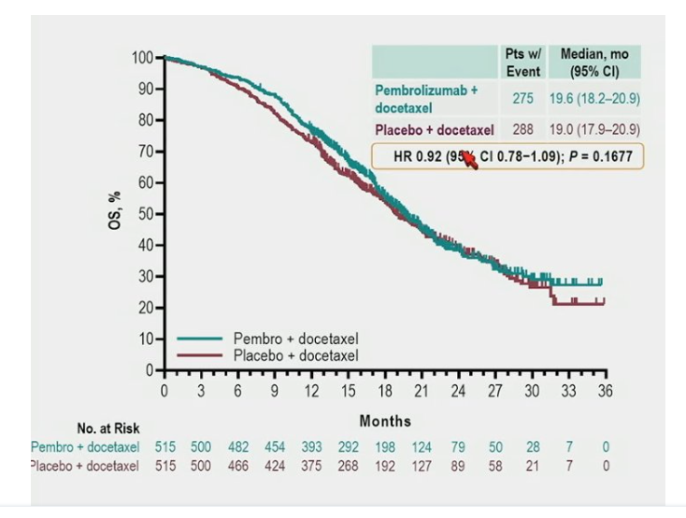
Docetaxel +/- Pembrolizumab
Petrylak et al. ASCO GU 2023
HR 0.92 (95% CI 0.78-1.09); P = 0.1677

