Slide 1
Year in Review: Optimizing use of Hormonal Therapy In Prostate Cancer Tanya Dorff, MD Associate Professor of Medicine Section Chief, Genitourinary Cancer Program

Slide 2
PRESTO: intensified therapy in biochemically recurrent prostate cancer
: PSA PFS, with PSA progression defined as nadir + 2 ng/mL during or > 0.2 ng/mL following treatment confirmed on repeat measurement (> 2 wks)
Aggarwal ESMO 2022; Abstract LBA63

Slide 3
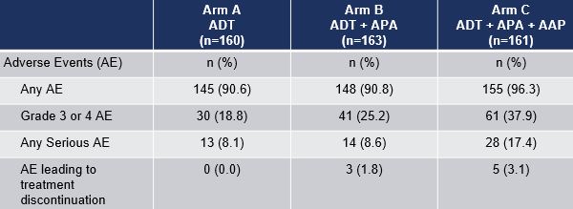
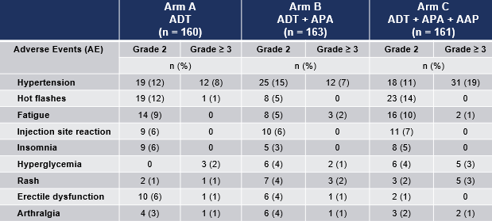
Apalutamide prolonged PSA PFS
Aggarwal ESMO 2022; Abstract LBA63

Slide 4
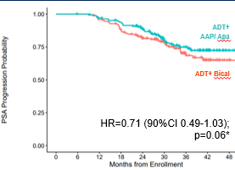
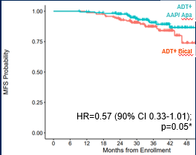
FORMULA509: apalutamide (+ abi) with salvage XRT
PSA >0.5
3 year MFS 84.3% vs. 66.1%
Absolute improvement
18.2% at 3 years (NNT = 5)= 5
Nguyen ASCO GU 2023; Abstract 303

Slide 5
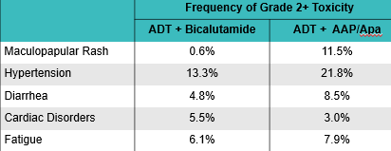
Toxicities with intensified therapy in FORMULA509
Nguyen ASCO GU 2023; Abstract 303

Slide 6
STAMPEDE meta-analysis in non-metastatic prostate CA
Analyzed new data from two randomized controlled phase 3 trials from a multi-arm, multistage platform protocol to assess standard-of-care (radiation therapy plus 3 years of ADT) to standard-of-care plus abiraterone acetate plus prednisolone with or without enzalutamide for two years in the non-metastatic, high-risk M0 patient population as defined by conventional imaging
Results showed that men with high-risk non-metastatic prostate cancer who receive ADT with combination therapy have significantly better metastases-free survival and overall survival than those who receive ADT alone
2 years of abiraterone and prednisolone added to ADT and, if indicated, radiotherapy is a potential new standard treatment for non-metastatic prostate cancer with high-risk features
Attard G et al Lancet 2022

Slide 7
STAMPEDE meta-analysis: non-metastatic
Attard G et al Lancet 2022

Slide 8
Deep PSA responses with apalutamide in nmCRPC: SPARTAN
90% achieved PSA reduction >50% by 6 mo (median time 1 mo)
PSA nadir <0.2 achieved by 32%
Saad F et al Eur Urol 2022

Slide 9
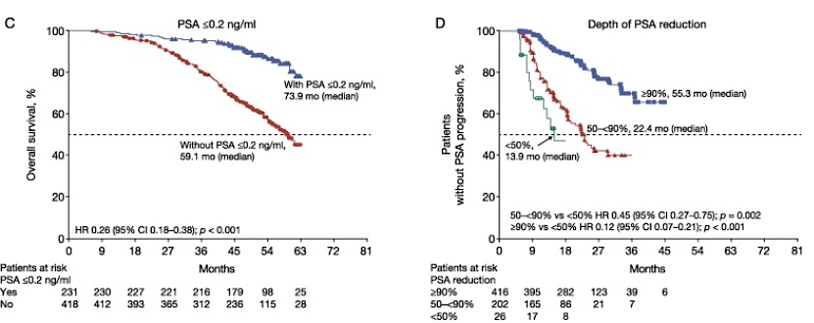
Deep PSA responses were associated with improved survival
Saad F et al Eur Urol 2022

Slide 10
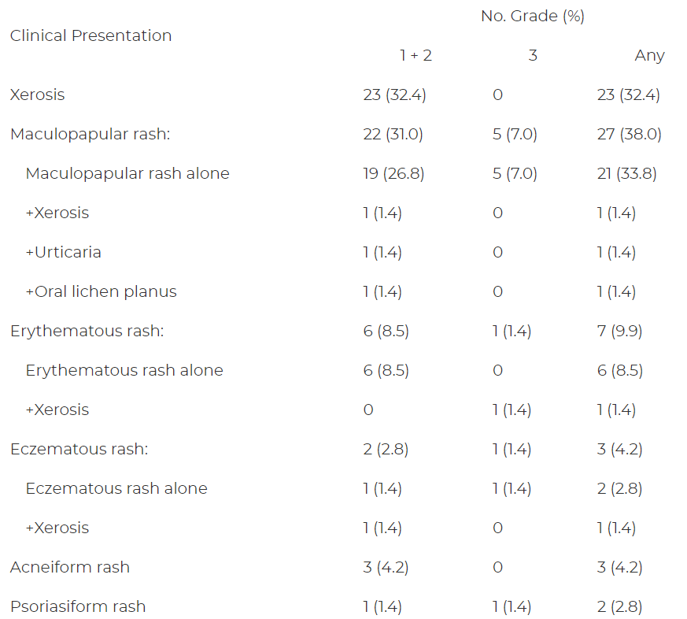
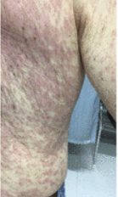
Dermatologic AE with apalutamide
Pan et al. J Urol 2022

Slide 11
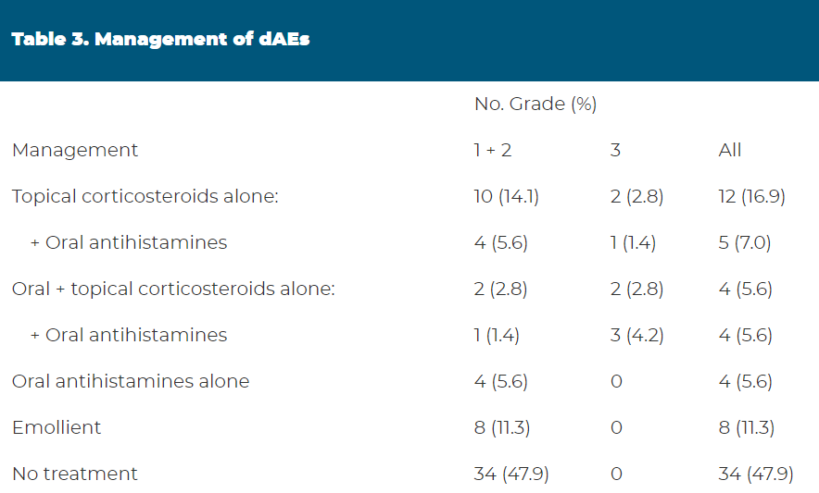
Dermatologic toxicities with apalutamide
Treated rash resolved quicker (mean of 74.7 [SD=68.7] days) than untreated rash (124.5 [SD=171.6] days).
Pan et al. J Urol 2022

Slide 12
LATITUDE: visceral metastases
Baciarello et al. Eur J Cancer 2022

Slide 13
Quality of life with docetaxel or abiraterone in mHSPC (STAMPEDE)
No difference in cognitive or emotional; differences in social and physical function favored abiraterone
Rush HL et al. J Clin Oncol 2022

Slide 14
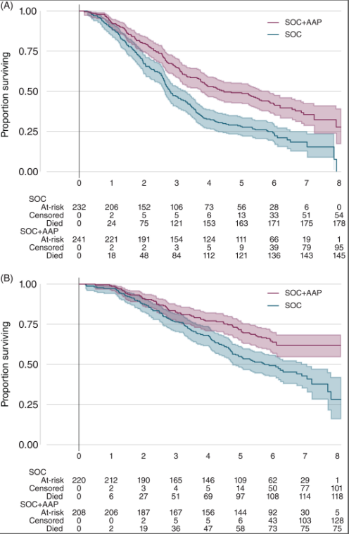
5 year f/u STAMPEDE Abiraterone
high-risk disease defined as at least two of: ≥3 bone metastases; visceral metastases; Gleason score ≥8
A: high risk OS
B: low risk OS
James et al. Int J Cancer 2022

Slide 15
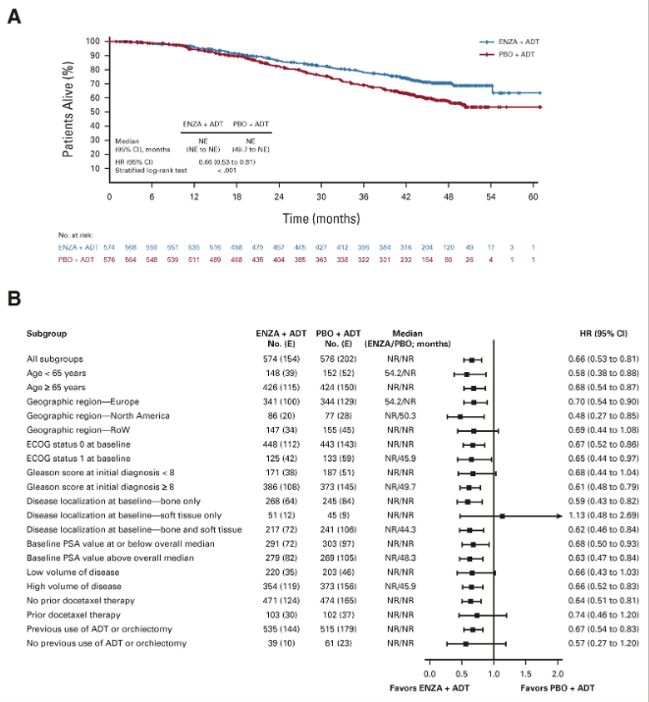
Enzalutamide in mHSPC
Armstrong et al. J Clin Oncol 2022

Slide 16
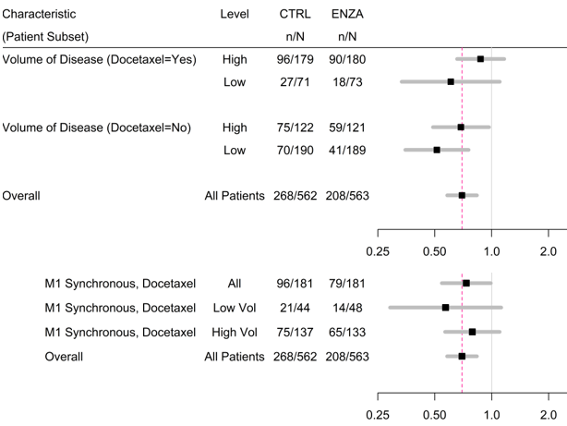
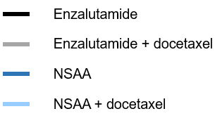
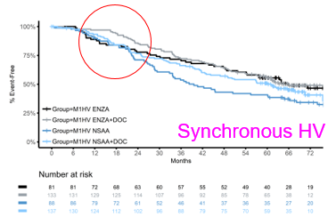
Not much early diff for other subsets but after 18 mo monotx does worse
ENZAMET update ASCO 2022
Davis ID et al ASCO 2022;Abstract LBA5004

Slide 17
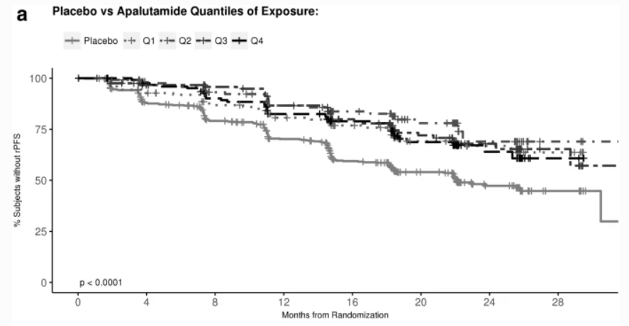
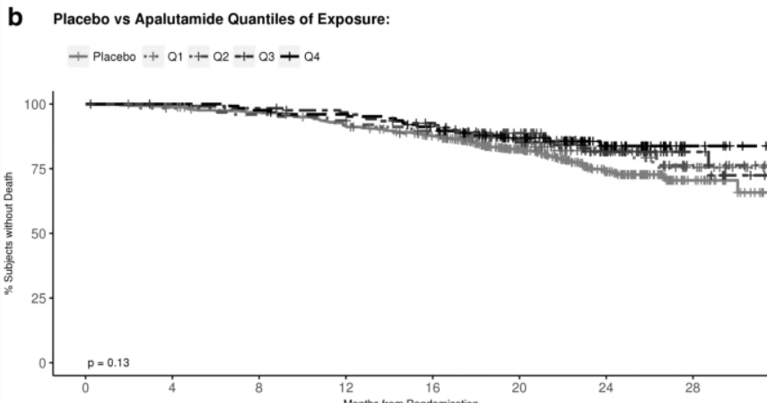
Exposure-response relationship apalutamide mHSPC
Plasma levels achieve steady-state between 4-8 weeks
AUC calculated for each patient during steady state
A: PFS
B: OS
T'jollyn H et al Chemother Pharmacol 2022

Slide 18
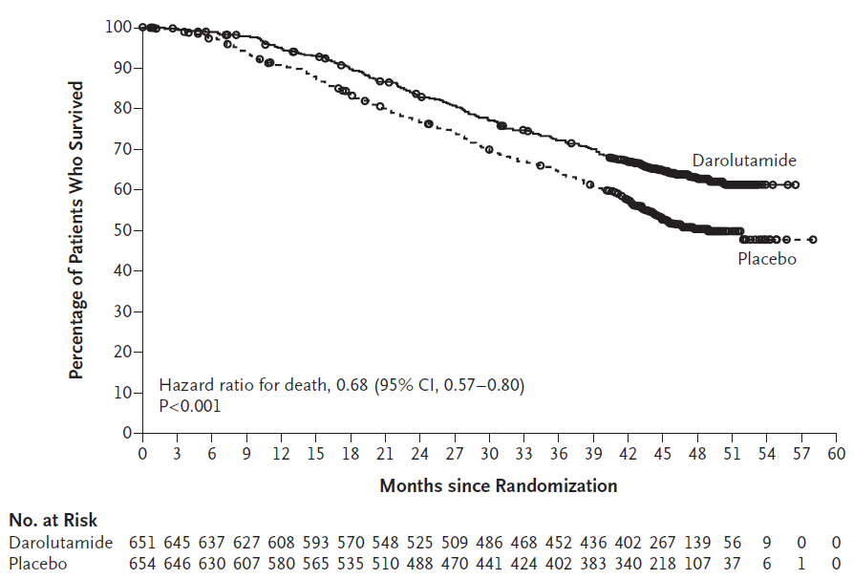
ARASENS: ADT + doce +/- darolutamide
For OS the HR 0.68; 95% CI, 0.57 to 0.80; P<0.001
Appropriate age representation:
47% age 65-74
16% age 75-84
Not diverse racially
Toxicity was acceptable:
Febrile neutropenia 7.8% on each arm
Death due to AE 4% on each arm
Smith MR et al. N Engl J Med 2022.

Slide 19
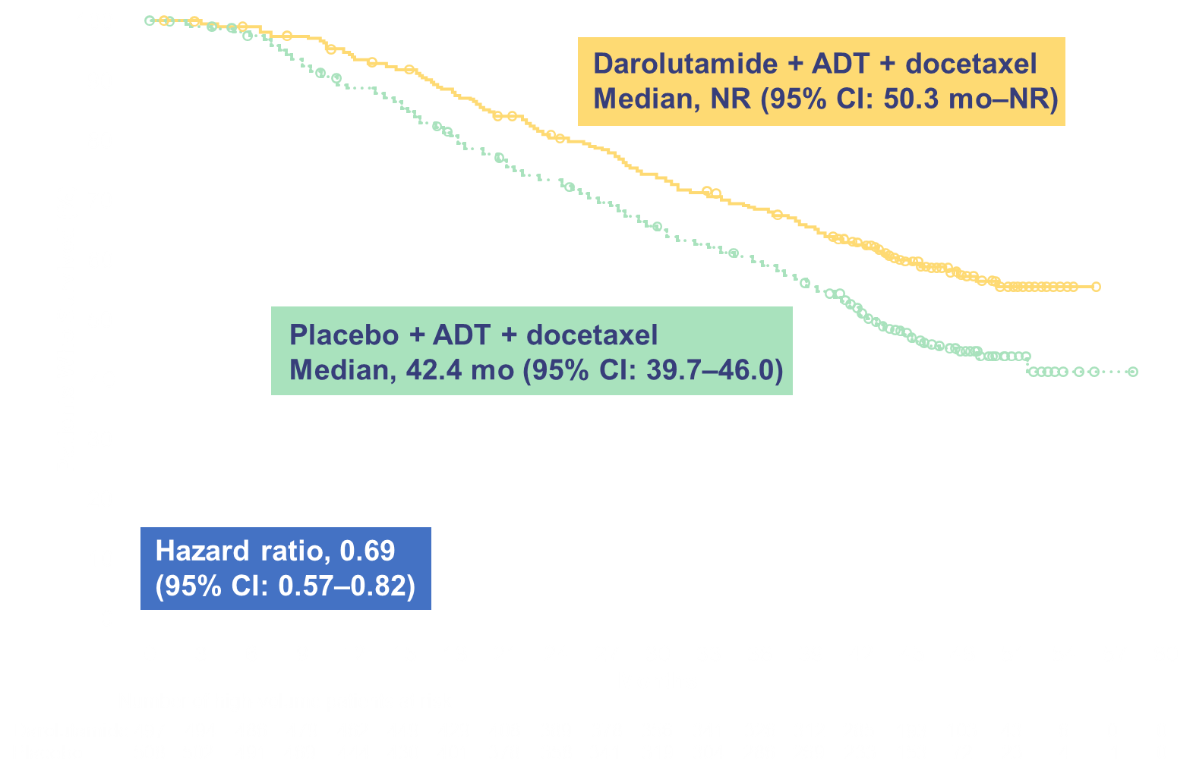
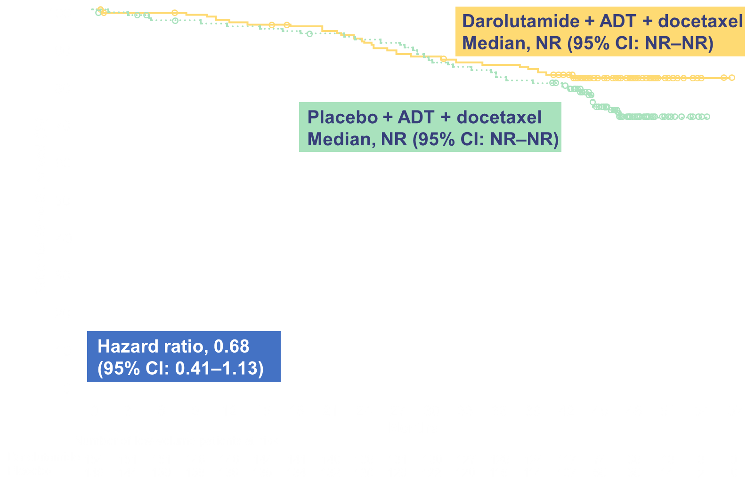
ARASENS VOLUME Subgroups: Overall Survival
High-volume mHSPC
Low-volume mHSPC
Analysis by unstratified Cox regression model. CI, confidence interval; NR, not reached.
Maha Hussain, MD, FACP, FASCO

Slide 20
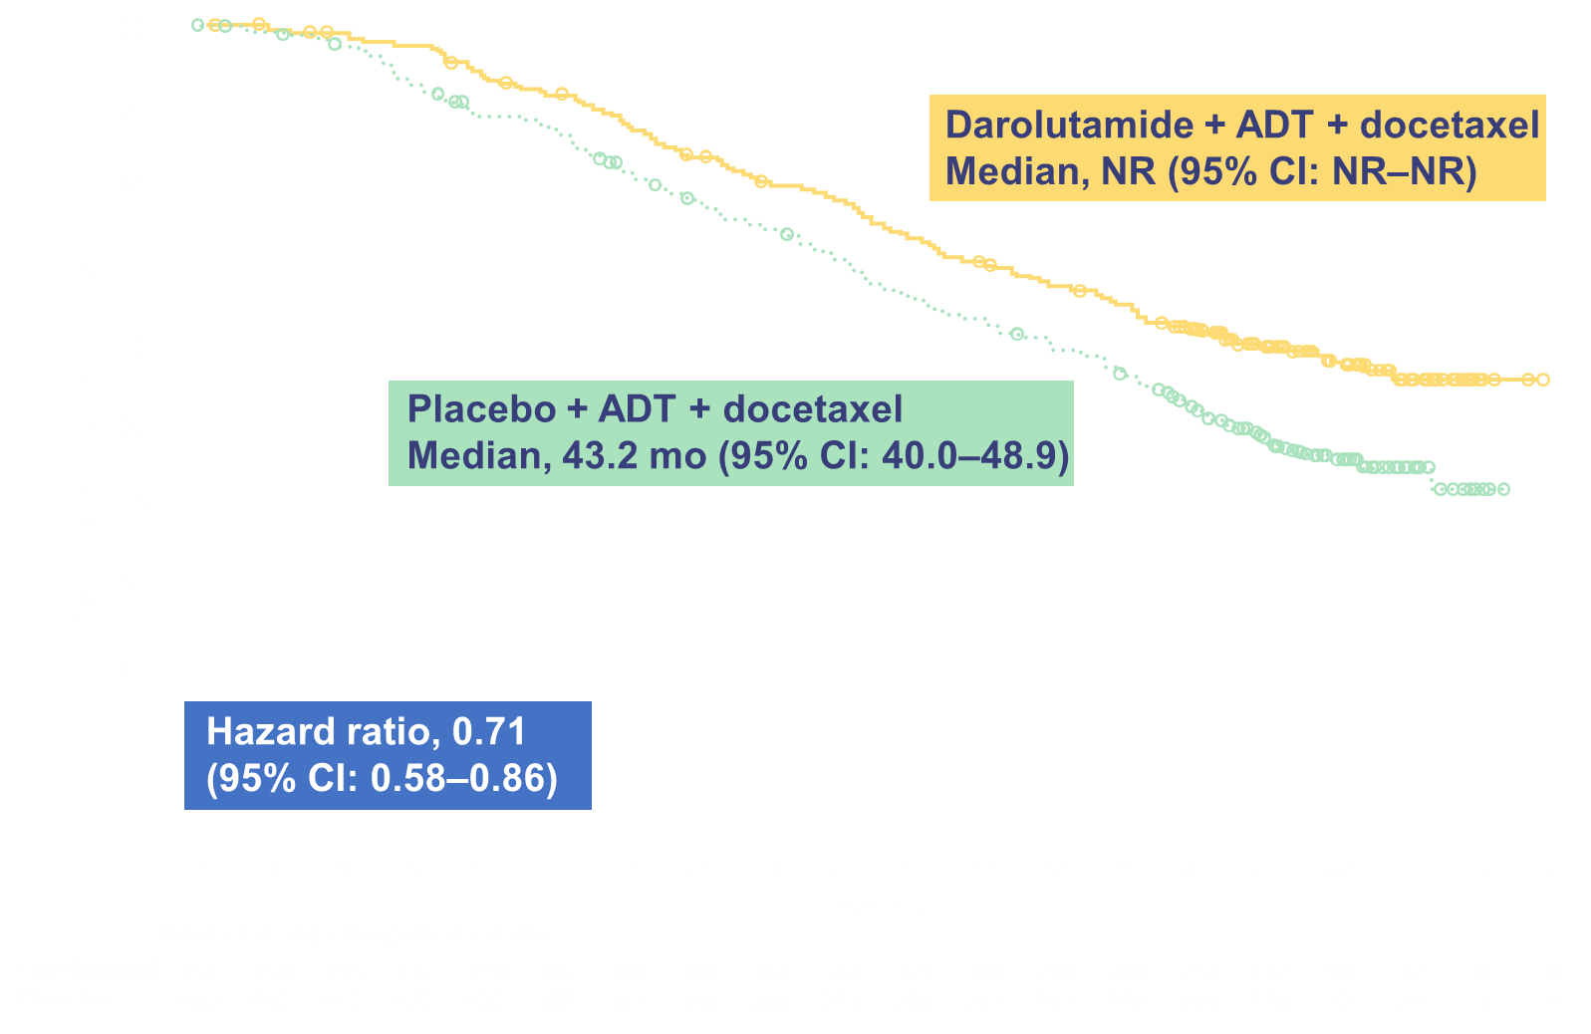
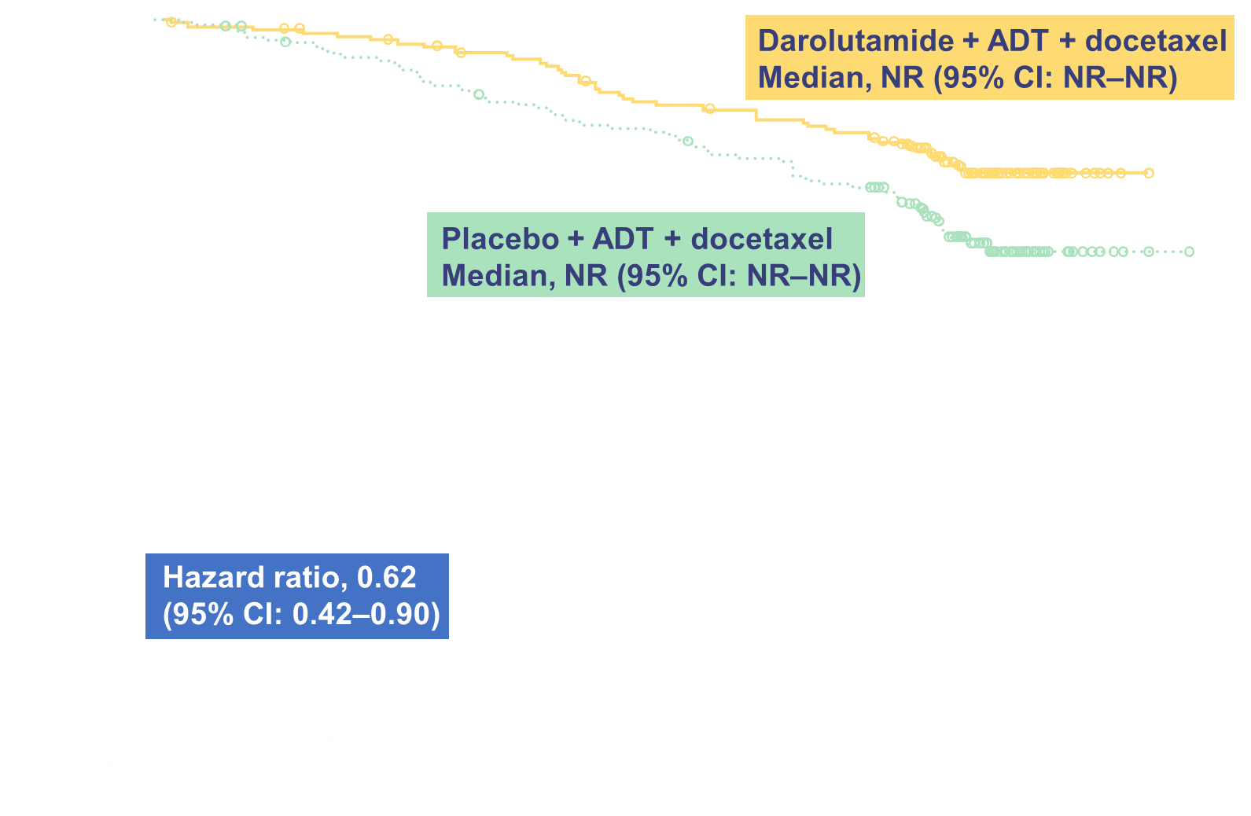
ARASENS RISK Subgroups: Overall Survival
High-risk mHSPC
Low-risk mHSPC
Maha Hussain, MD, FACP, FASCO

Slide 21
PEACE-1: ADT +/- abiraterone +/- RT to prostate primary. AND +/- docetaxel
Stepwise and factorial design:
Check for no interaction b/w abi and RT
Compare ADT (+/- RT) +/- abi
Trial amended to allow doce based on evolving standard of care
Compare abiraterone in doce vs no doce populations
Fizazi Lancet 2022

Slide 22
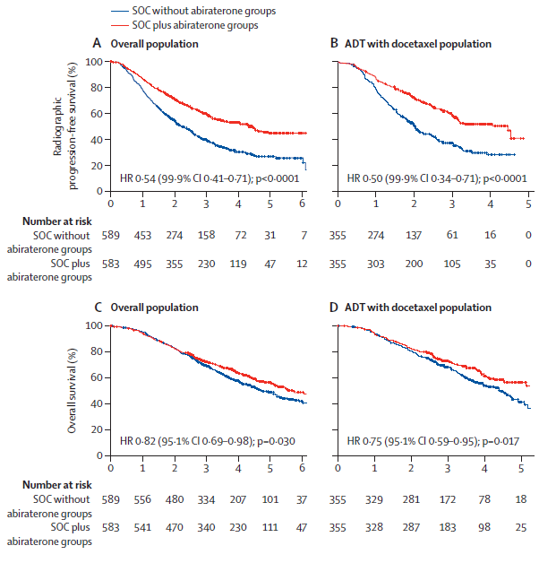
PEACE-1: ADT +/- abiraterone +/- RT to prostate primary. AND +/- docetaxel
No interaction between abi and RT
Overall + for abi (triple)
HR stronger for high volume (0.72; CI 0.55 – 0.95) than low volume (0.83; CI 0.50 – 1.39)
Fizazi Lancet 2022

Slide 23
Up-front intensification: THE new paradigm in mHSPC
Up front intensification with ARTA
ADT (LHRH)
AND
Abiraterone or
Apalutamide or
Darolutamide or
Enzalutamide
Eligible for Docetaxel
AND?
Docetaxel x 6 doses
No prior primary tx?
AND??
Consider radiation to prostate primary
Metastasis directed therapy for oligomet?
Or.. Consider a triplet trial

Slide 24
Ongoing mHSPC trials with triplets
Name/Sponsor | ARTA | 3rd agent | Design (n)
AMPLITUDE | Abiraterone | Niraparib | Randomized, HRR+ (788)
TALAPRO-3 | Enzalutamide | Talazoparib | Randomized HRR+ (550)
City of Hope PCF | Abiraterone | Talazoparib | Single arm, Unselected (70)
PSMAddition | Lu177-PSMA-617 | Any ARTA | Randomized, PSMA PET + (1126)
KEYNOTE-991 | Enzalutamide | Pembrolizumab | Randomized (1232)
NCT03951831 | n/a (ADT + Doce) | Cemiplimab | Single arm (20)
MSKCC | Abi/Enza | Atezolizumab | SBRT, Single arm (44)
CABIOS | Abiraterone | Cabozantinib, Nivolumab | Single arm (22)
CASCARA (U Minn) | Abiraterone | Cabazi + Carbo | Single arm (60)
Capitello-281 | Abiraterone | Capivasertib | Randomized, PTEN def (1000)
CYCLONE-3 | Abiraterone | Abemaciclib | Randomized, unselected (900)

Slide 25
Conclusions
Up-front intensification in mHSPC has been a huge advance
Doublet (AR targeted agent) for most
Triplet (with docetaxel) for some (esp hi volume)
Future state: Biomarkers may identify populations in whom a novel triplet may be highly successful (ex: PARP, PTEN)

