Slide 1
Recent Advances in Medical Oncology:
Prostate Cancer
Wednesday, July 1, 2020
5:00 PM – 6:00 PM ET
Faculty
Robert Dreicer, MD, MS
Daniel P Petrylak, MD
Christopher Sweeney, MBBS
Moderator
Neil Love, MD

Slide 2



Faculty
Robert Dreicer, MD, MS
Section Head, Medical Oncology
Deputy Director, University of Virginia Cancer Center
Associate Director for Clinical Research
Professor of Medicine and Urology
University of Virginia School of Medicine
Charlottesville, Virginia
Christopher Sweeney, MBBS
Professor, Medicine
Harvard Medical School
Medical Oncologist
Dana-Farber Cancer Institute
Boston, Massachusetts
Daniel P Petrylak, MD
Professor of Internal Medicine (Medical Oncology) and Urology
Yale University
New Haven, Connecticut

Slide 3
Potential Conflicts of Interest
USF Health endorses the standards of the ACCME that require everyone in a position to control the content of an accredited educational activity to disclose all financial relationships with commercial interests that are related to the content of the educational activity. All accredited activities must be balanced, independent of commercial bias, and promote improvements or quality in healthcare. All recommendations involving clinical medicine must be based on evidence accepted within the medical profession.
USF Health will identify, review, and resolve all conflicts of interest that speakers, authors, or planners disclose prior to an educational activity being delivered to learners. Disclosure of a relationship is not intended to suggest or condone bias in any presentation, but is made to provide participants with information that might be of potential importance to their evaluation of a presentation.

Slide 4
Non-Faculty Disclosures
USF Health CPD Staff and Research To Practice CME Planning Committee Members, Staff, and Reviewers have no relevant conflicts to disclose.

Slide 5

Accreditation
USF Health is accredited by the Accreditation Council for Continuing Medical Education (ACCME) to provide continuing medical education for physicians.
Audio Program: USF Health designates this enduring activity for a maximum of 2 AMA PRA Category 1 CreditsTM. Physicians should claim only the credit commensurate with the extent of their participation in the activity.
Video Program: USF Health designates this enduring activity for a maximum of 1.5 AMA PRA Category 1 CreditsTM. Physicians should claim only the credit commensurate with the extent of their participation in the activity.

Slide 6

American Board of Internal Medicine (ABIM) —
Maintenance of Certification (MOC)
Successful completion of these CME activities, which includes participation in the evaluation components and short post-tests, enables the participant to earn up to 2 (audio) and 1.5 (video) Medical Knowledge MOC points in the American Board of Internal Medicine’s (ABIM) Maintenance of Certification (MOC) program. Participants will earn MOC points equivalent to the amount of CME credits claimed for each activity. It is the CME activity provider’s responsibility to submit participant completion information to ACCME for the purpose of granting ABIM MOC credit.
Please note, these programs have been specifically designed for the following ABIM specialty: medical oncology.

Slide 7
American Board of Internal Medicine (ABIM) —
Maintenance of Certification (MOC)
For ABIM MOC points, your information will be shared with the ABIM through USF Health's ACCME Program and Activity Reporting System (PARS). Please allow 6-8 weeks for MOC points to appear on your ABIM records.
Personal information and data sharing: Research To Practice and USF Health aggregate deidentified user data for program-use analysis, program development, activity planning and site improvement. We may provide aggregate and deidentified data to third parties, including commercial supporters. We do not share or sell personally identifiable information to any unaffiliated third parties or commercial supporters. Please see our privacy policy at ResearchToPractice.com/Privacy-Policy for more information.

Slide 8
How to Use This CME Activity
Audio Program: This CME activity consists of an audio component. To receive CME credit and ABIM MOC points, the participant should review the CME information, listen to the MP3s, review the downloadable slide sets, complete the Post-test with a score of 80% or better and fill out the Educational Assessment and Credit Form located at ResearchToPractice.com/ASCOProstate20/CME. The corresponding video program is available as an alternative at ResearchToPractice.com/ASCOProstate20/Video.
Video Program: This CME activity consists of a video component. To receive CME credit and ABIM MOC points, the participant should review the CME information, watch the video, complete the Post-test with a score of 80% or better and fill out the Educational Assessment and Credit Form located at ResearchToPractice.com/ASCOProstate20/Video/CME. The corresponding audio program is available as an alternative at ResearchToPractice.com/ASCOProstate20.

Slide 9
Dr Love — Disclosures
Dr Love is president and CEO of Research To Practice. Research To Practice receives funds in the form of educational grants to develop CME activities from the following commercial interests: AbbVie Inc, Acerta Pharma — A member of the AstraZeneca Group, Adaptive Biotechnologies, Agendia Inc, Agios Pharmaceuticals Inc, Amgen Inc, Array BioPharma Inc, a subsidiary of Pfizer Inc, Astellas, AstraZeneca Pharmaceuticals LP, Bayer HealthCare Pharmaceuticals, Biodesix Inc, bioTheranostics Inc, Blueprint Medicines, Boehringer Ingelheim Pharmaceuticals Inc, Boston Biomedical Inc, Bristol-Myers Squibb Company, Celgene Corporation, Clovis Oncology, Daiichi Sankyo Inc, Dendreon Pharmaceuticals Inc, Eisai Inc, EMD Serono Inc, Exelixis Inc, Foundation Medicine, Genentech, a member of the Roche Group, Genmab, Genomic Health Inc, Gilead Sciences Inc, GlaxoSmithKline, Grail Inc, Guardant Health, Halozyme Inc, Helsinn Healthcare SA, ImmunoGen Inc, Incyte Corporation, Infinity Pharmaceuticals Inc, Ipsen Biopharmaceuticals Inc, Janssen Biotech Inc, administered by Janssen Scientific Affairs LLC, Jazz Pharmaceuticals Inc, Kite, A Gilead Company, Lexicon Pharmaceuticals Inc, Lilly, Loxo Oncology Inc, a wholly owned subsidiary of Eli Lilly & Company, Merck, Merrimack Pharmaceuticals Inc, Myriad Genetic Laboratories Inc, Natera Inc, Novartis, Oncopeptides, Pfizer Inc, Pharmacyclics LLC, an AbbVie Company, Prometheus Laboratories Inc, Puma Biotechnology Inc, Regeneron Pharmaceuticals Inc, Sandoz Inc, a Novartis Division, Sanofi Genzyme, Seattle Genetics, Sirtex Medical Ltd, Spectrum Pharmaceuticals Inc, Taiho Oncology Inc, Takeda Oncology, Tesaro, A GSK Company, Teva Oncology, Tokai Pharmaceuticals Inc, Tolero Pharmaceuticals and Verastem Inc.

Slide 10
Dr Dreicer — Disclosures
Advisory Committee | Astellas, Eisai Inc, Janssen Biotech Inc, Novartis, Orion Corporation, Pfizer Inc, Seattle Genetics, Vizuri Health Sciences
Contracted Research | Bristol-Myers Squibb Company, Exelexis Inc, Pfizer Inc, Seattle Genetics

Slide 11
Dr Petrylak — Disclosures
Consulting Agreements | Advanced Accelerator Applications, Amgen Inc, Astellas, AstraZeneca Pharmaceuticals LP, Bayer HealthCare Pharmaceuticals, Bicycle Therapeutics, Boehringer Ingelheim Pharmaceuticals Inc, Bristol-Myers Squibb Company, Clovis Oncology, Exelixis Inc, Incyte Corporation, Janssen Biotech Inc, Lilly, Pfizer Inc, Pharmacyclics LLC, an AbbVie Company, Roche Laboratories Inc, Seattle Genetics, UroGen Pharma
Contracted Research | Advanced Accelerator Applications, Astellas, AstraZeneca Pharmaceuticals LP, Bayer HealthCare Pharmaceuticals, Bristol-Myers Squibb Company, Clovis Oncology, Endocyte Inc, Genentech, a member of the Roche Group, Innocrin Pharmaceuticals Inc, Lilly, Merck, Novartis, Pfizer Inc, Progenics Pharmaceuticals Inc, Roche Laboratories Inc, Sanofi Genzyme, Seattle Genetics
Ownership Interest | Bellicum Pharmaceuticals Inc, Tyme Inc

Slide 12
Dr Sweeney — Disclosures
Consulting Agreements | Astellas, Bayer HealthCare Pharmaceuticals, Genentech, a member of the Roche Group, Lilly, Pfizer Inc, Sanofi Genzyme
Contracted Research | Astellas, Bayer HealthCare Pharmaceuticals, Dendreon Pharmaceuticals Inc, Janssen Biotech Inc, Pfizer Inc, Sanofi Genzyme

Slide 13
Agenda
Module 1: M0 Castration-Resistant Prostate Cancer (PC) — Dr Petrylak
Endocrine treatment for patients with cardiovascular disease
SPARTAN, ARAMIS and PROSPER trials and implications
Module 2: Metastatic Hormone-Sensitive PC — Dr Sweeney
Secondary hormonal therapy versus chemotherapy
LATITUDE, ARCHES, TITAN and ENZAMET trials and implications
Module 3: Castration-Resistant Metastatic PC — Dr Dreicer
Cabazitaxel versus secondary endocrine treatment
Radium-223
PARP inhibitors
Module 4: ASCO Journal Club
ARV-110 PROTAC® degrader (Abstract 3500)
¹⁷⁷Lu-PSMA-617 (Abstract 5500)
PSMA imaging (Abstract 5501)

Slide 14
Module 1: M0 Castration-Resistant Prostate Cancer (PC) — Dr Petrylak
Endocrine treatment for patients with cardiovascular disease
SPARTAN, ARAMIS and PROSPER trials and implications

Slide 15
A 65-year-old man s/p radical prostatectomy followed by radiation therapy for PSA-only recurrence (M0) receives an LHRH agonist for further PSA progression. Regulatory and reimbursement issues aside, what would be your most likely treatment recommendation if the patient responded but then experienced PSA progression to a PSA level of 3.4 ng/dL with a doubling time of 10 months?
Continue LHRH agonist
and add apalutamide
Continue LHRH agonist
and add enzalutamide
Continue LHRH agonist
and add darolutamide
Continue LHRH agonist alone
Continue LHRH agonist
and add abiraterone
Survey of 50 US-based medical oncologists, June 2020

Slide 16
How would you compare the efficacy of enzalutamide, apalutamide and darolutamide in patients with M0 prostate cancer?
The efficacy is about the same
Enzalutamide is more efficacious
Apalutamide is more efficacious
Darolutamide is more efficacious
Other
I don’t know
Survey of 50 US-based medical oncologists, June 2020

Slide 17
How would you compare the tolerability of enzalutamide, apalutamide and darolutamide in patients with M0 prostate cancer?
The tolerability is about the same
Darolutamide is more tolerable
Apalutamide is more tolerable
Enzalutamide is more tolerable
Other
I don’t know
Survey of 50 US-based medical oncologists, June 2020

Slide 18
In general, which endocrine treatment would you prefer for an 84-year-old man with prostate cancer (PC) and a history of atrial fibrillation, sick sinus syndrome, pacemaker placement and hypertension?
Darolutamide
Enzalutamide
Apalutamide
Abiraterone/prednisone
Other
N = 45
Survey of live webinar audience

Slide 19
Case Presentation – Dr Petrylak: A man with M0 prostate cancer
84-year-old man
Past medical history which includes atrial fibrillation, sick sinus syndrome, pacemaker placement, and hypertension.
Radical prostatectomy in 2010. Gleason 4+3=7. pT3aN0M0
2012 status post the placement of a urethral sling for stress incontinence
PSA rose in 2013, was started on androgen blockade

Slide 20
Case Presentation – Dr Petrylak: A man with M0 prostate cancer (cont)
PSA 3/18/2019 = 6.99; 9/20/2019 = 9.44; 3/19/2020 = 24.2; imaging negative for metastatic disease
Started enzalutamide in 4/2020, PSA 6/2020=3

Slide 21
Next-Generation Antiandrogens
Darolutamide 3%
Enzalutamide 29%*
Apalutamide 19%*
Apalutamide (ARN-509)
General chemical structure
for Darolutamide (ODM-201)
No CYP inhibition or induction with therapeutic doses
Compound | AR-WT affinity Ki (nM) | Antagonism AR-WT IC50 (nM) | Antagonism AR T878A IC50 (nM) | Antagonism AR F877L IC50 (nM) | Proliferation VCaP IC50 (nM)
Enzalutamide | 78 | 155 | 296 | agonist | 400
Apalutamide | 53 | 168 | 1130 | agonist | 300
Darolutamide | 9 | 65 | 700 | 66 | 500
Moilanen A et al. Sci Rep 2015; 5: 12007.
Courtesy of Robert Dreicer, MD, MS
Moilanen A et al. Sci Rep 2015; 5:12007. Courtesy of Daniel P Petrylak, MD
Notes:
21

Slide 22
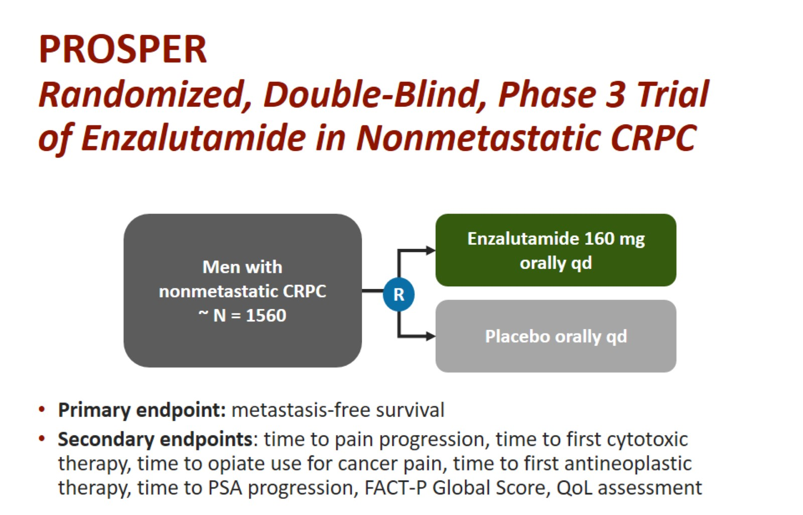
PROSPER
Randomized, Double-Blind, Phase 3 Trial of Enzalutamide in Nonmetastatic CRPC
ClinicalTrials.gov. NCT02003924.
Courtesy of Daniel P Petrylak, MD

Slide 23
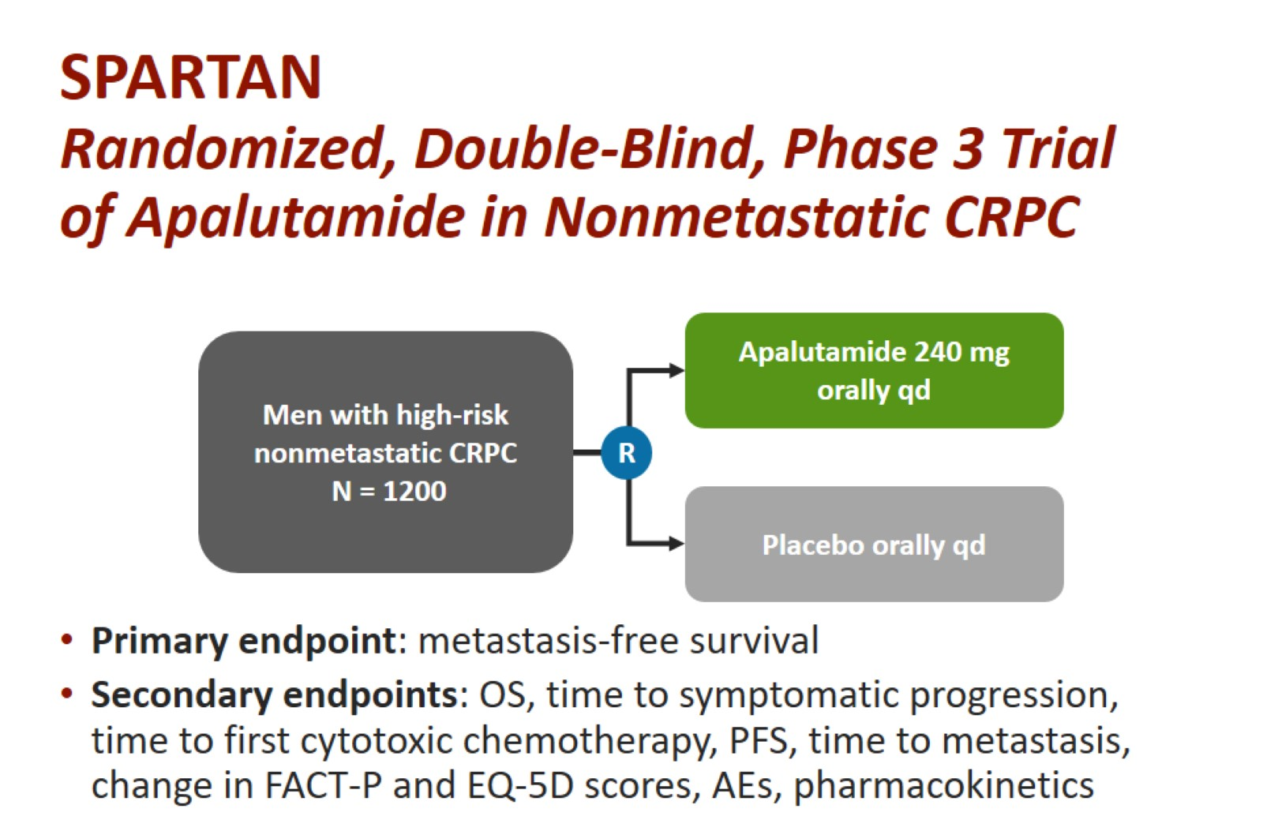
SPARTAN
Randomized, Double-Blind, Phase 3 Trial of Apalutamide in Nonmetastatic CRPC
ClinicalTrials.gov. NCT02003924.
Courtesy of Daniel P Petrylak, MD

Slide 24
Primary Endpoint – MFS
SPARTAN¹
PROSPER²
100
HR (95% CI): 0.28 (0.23–0.35)
P < .0001
100
HR (95% CI): 0.29 (0.24–0.35)
P < .0001
80
APA, 40.5 mo
(median)
80
ENZA, 36.6 mo
(median)
Metastases-free Survival
(%)
Metastases-free Survival
(%)
60
60
40
40
PBO, 14.7 mo
(median)
PBO, 16.2 mo
(median)
20
20
0
0
0
4
8
12
16
20
24
28
32
36
40
44
0
3
6
9
12
15
18
21
24
27
30
33
36
39
42
No.
a
t
Months
No.
a
t
Months
Risk
Risk
A
P
A
806
713
652
514
398
282
180
96
36
16
3
0
EN
Z
A + A
D
T
933
865
759
637
582
431
418
328
237
159
87
77
31
4
0
PBO
401
291
220
153
91
58
34
13
5
1
0
0
PBO + A
D
T
468
420
296
212
157
105
98
64
49
31
16
11
5
1
0
72% reduction of distant progression or death
Median MFS: APA 40.5 months vs PBO 16.2
24-month additional MFS benefit
71% reduction of distant progression or death
Median MFS: ENZA 36.6 months vs PBO 14.7
22-month additional MFS benefit
Caveat: Comparing across studies is problematic. This is not a head-to-head comparison.
1. Smith MR, et al. N Engl J Med. 2018; 378:1408-1418; 2. Hussain M, et al. N Engl J Med. 2018; 378:2465-2474.
Courtesy of Daniel P Petrylak, MD

Slide 25
M0 CRPC - ARAMIS: Darolutamide
N=1500
M0 CRPC, prostate-specific antigen doubling time of ≤ 10 months and PSA > 2 ng/ml, ECOG 0-1
No prior treatment with second generation androgen receptor inhibitors, other investigational AR inhibitors, CYP17 enzyme inhibitor, or prior chemotherapy or immunotherapy
DARO
300 mg bid + ADT
Primary Endpoint
Metastasis-free survival (MFS)
Key Secondary Endpoints
Overall survival (OS)
Time to first symptomatic skeletal event
Time to initiation of chemotherapy
Time to pain progression
R
2:1
PBO +
ADT
www.clinicaltrials.gov (NCT02200614)
Fizazi et al, NEJM, 2019
Courtesy of Daniel P Petrylak, MD

Slide 26
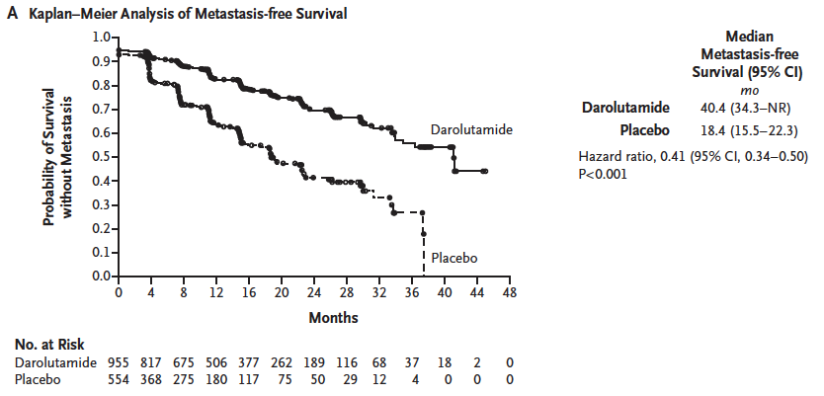
M0 CRPC - ARAMIS: Darolutamide
Fizazi, et al, NEJM, 2019
Courtesy of Daniel P Petrylak, MD

Slide 27
SURVIVAL:
PROSPER, SPARTAN, ARAMIS
 | PROSPER¹ | SPARTAN² | ARAMIS³
Median Follow-up | 47 | 52 | 49
% Died at analysis (control vs experimental) | 31 vs 38% | 34 vs 38% | 19 vs 16%
Median OS (Estimated) | 67 vs 56 months | 74 vs 60 months | Not Estimated
HR OS | 0.73 | 0.78 | 0.69
¹ Sternberg CN et al. N Engl J Med 2020;382(23):2197-206; ² Small EJ et al. ASCO 2020;Abstract 5516; ³ Fizazi et al. ASCO 2020;Abstract 5514.
Courtesy of Daniel P Petrylak, MD

Slide 28
Comparison of Toxicities: PROSPER vs. ARAMIS
Toxicity | Enzalutamide | Placebo | Darolutamide | Placebo
Fatigue/Asthenia | 33% | 14% | 16% | 11%
Fall | 11% | 4% | 4% | 5%
Dizziness | 10% | 4% | 5% | 4%
Mental Impairment | 5% | 2% | 1% | 2%
Hussain M et al. N Engl J Med 2018;378(26):2465-74; Fizazi K et al. N Engl J Med 2019;380(13):1235-46.
Courtesy of Daniel P Petrylak, MD

Slide 29
Conclusions and Clinical Implications
Enzalutamide, apalutamide and darolutamide have similar hazard ratios for metastasis-free survival and overall survival.
Different toxicity patterns particularly with falls, fatigue and mental impairment in favor of darolutamide
Courtesy of Daniel P Petrylak, MD

Slide 30
Which systematic treatment, if any, would you recommend for a 74-year-old man with M0 PC who experiences disease progression with negative imaging while receiving enzalutamide (with ADT)?
None — observation
Abiraterone/prednisone
Docetaxel
Darolutimide
Other
N = 78
Survey of live webinar audience

Slide 31
Case Presentation – Dr Petrylak: 74-year-old man with M0 Prostate Cancer
74 year old male
In 2007, the patient had an elevated PSA. The patient underwent a radical robotic prostatectomy on 6/18/2007. Final pathology demonstrated a Gleason 3+4 = 7 adenocarcinoma involving both lobes of the prostate. Tumor extended into the left posterior pseudo-capsule. Tumor was present at the left apical and left posterior soft tissue margins. Intra-prostatic peri-neural invasion was present. The base and seminal vesicle margins were negative for tumor. Stage pT2cN0M0.

Slide 32
Case Presentation – Dr Petrylak: 74-year-old man with M0 Prostate Cancer (cont)
PSA started to rise in 1/2013. He could not undergo external beam radiation therapy due to the fact that he had severe incontinence from surgery.
The patient's PSA subsequently went to 12 in September 2014 and he started androgen blockade with degarelix.
The patient remained on intermittent androgen blockade until January of 2018, when his PSA did not decline after the initiation of androgen blockade. At that time his PSA was 18. Repeat imaging negative. PSA DT=5 months. Testosterone=20

Slide 33
Case Presentation – Dr Petrylak: 74-year-old man with M0 Prostate Cancer (cont)
The patient was started on enzalutamide when his PSA reached 26.
His PSA doubling time was 8 months at the start of enzalutamide. His PSA reached a nadir of 4 in October 2018 then began to rise again in January 2019 to 11. Repeat imaging negative, patient requested stopping enzalutamide.
He was then started on apalutamide and discontinued this in December 2019. PSA = 71.
Repeat imaging in February 2020 demonstrated new progression in bone metastases, and the patient was started on docetaxel in March 2020.

Slide 34
Agenda
Module 1: M0 Castration-Resistant Prostate Cancer (PC) — Dr Petrylak
Endocrine treatment for patients with cardiovascular disease
SPARTAN, ARAMIS and PROSPER trials and implications
Module 2: Metastatic Hormone-Sensitive PC — Dr Sweeney
Secondary hormonal therapy versus chemotherapy
LATITUDE, ARCHES, TITAN and ENZAMET trials and implications
Module 3: Castration-Resistant Metastatic PC — Dr Dreicer
Cabazitaxel versus secondary endocrine treatment
Radium-223
PARP inhibitors
Module 4: ASCO Journal Club
ARV-110 PROTAC degrader (Abstract 3500)
¹⁷⁷Lu-PSMA-617 (Abstract 5500)
PSMA imaging (Abstract 5501)

Slide 35
Module 2: Metastatic Hormone-Sensitive PC — Dr Sweeney
Secondary hormonal therapy versus chemotherapy
LATITUDE, ARCHES, TITAN and ENZAMET trials and implications

Slide 36
Regulatory and reimbursement issues aside, what systemic therapy, if any, would you typically add to androgen deprivation for a 65-year-old patient who underwent radical prostatectomy for Gleason 8 prostate cancer but presents 3 years later with 3 asymptomatic bone metastases that are not amenable to ablative therapy?
Abiraterone
Apalutamide
Enzalutamide
Docetaxel
None initially, but add secondary hormonal therapy if suboptimal response to androgen deprivation
Darolutamide
None initially, but add chemotherapy if suboptimal response to androgen deprivation
Survey of 50 US-based medical oncologists, June 2020

Slide 37
What systemic therapy, if any, would you typically add to androgen deprivation for a 65-year-old patient presenting de novo with Gleason 8 prostate cancer and widespread, moderately symptomatic bone metastases?
Docetaxel
Abiraterone
Enzalutamide
Apalutamide
Darolutamide
None
None initially, but add secondary hormonal therapy if suboptimal response to androgen deprivation
None initially, but add chemotherapy if
suboptimal response to androgen deprivation
Other
Survey of 50 US-based medical oncologists, June 2020

Slide 38
What systemic therapy, if any, would you typically add to androgen deprivation for a 65-year-old patient presenting de novo with Gleason 8 prostate cancer and asymptomatic liver metastases?
Docetaxel
Abiraterone
Enzalutamide
Apalutamide
None initially, but add chemotherapy if suboptimal response to androgen deprivation
Darolutamide
None
None initially, but add secondary hormonal therapy if suboptimal response to androgen deprivation
Survey of 50 US-based medical oncologists, June 2020

Slide 39
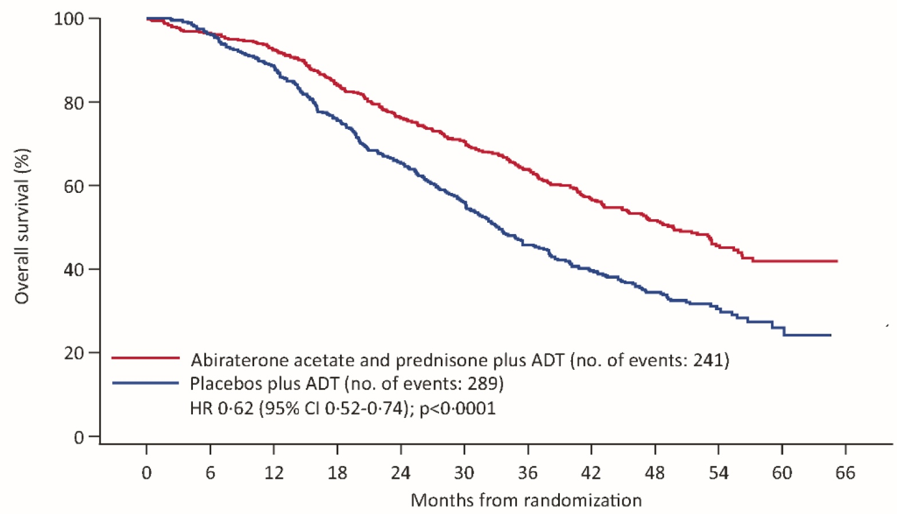
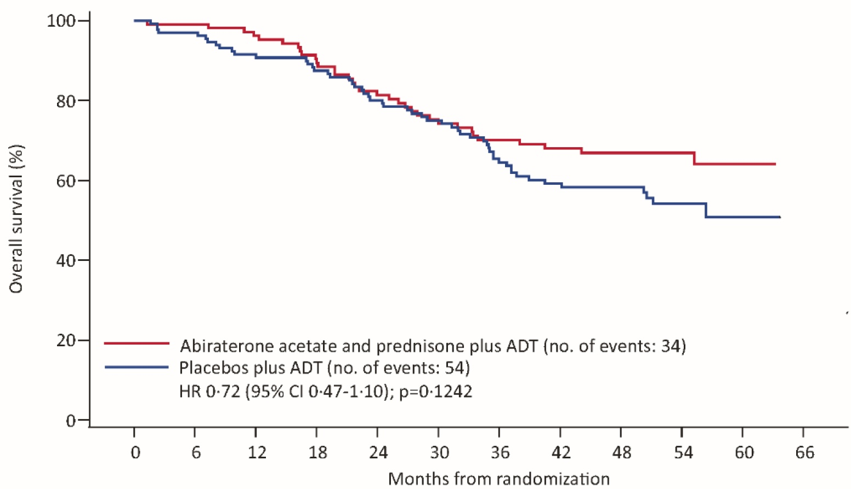
LATITUDE Final Overall Survival Analysis By Volume of Disease (CHAARTED definition*)
High-Volume Disease
Low-Volume Disease
 | ADT + AA + P (n = 487) | ADT + Placebo (n = 468) | HR | P-value
mOS | 49.7 mo | 33.3 mo | 0.62 | <0.0001
 | ADT + AA + P (n = 110) | ADT + Placebo (n = 133) | HR | P-value
mOS | Not reached | Not reached | 0.72 | 0.1242
*CHAARTED definition of low vs high volume: Presence of visceral mets and/or ≥4 bone mets, with one outside the vertebral column or pelvis
Fizazi K et al. Lancet Oncol 2019;20:686-700. Chi et al 2019 GU Cancers Symposium; Abstract 141.

Slide 40
Summary Results for ADT + Enzalutamide (ARCHES) and Apalutamide (TITAN) in Metastatic HSPC
 | ARCHES (N = 1150) |  | TITAN (N = 1052)
Characteristics | 2/3rd High Volume 17% prior docetaxel 25% prior RP/XRT |  | 2/3rd High Volume 10% prior docetaxel 17% prior RP/XRT
 | ADT + Enzalutamide (n = 574) | ADT (n = 576) | ADT + Apalutamide (n = 955) | ADT (n = 554)
Radiographic PFS | NR | 19.0 mo | NR | 22.1 mo
 | HR (overall): 0.39 HR (prior docetaxel): 0.52 HR (high volume): 0.43 HR (low volume): 0.25 |  | HR (overall): 0.48 HR (prior docetaxel): 0.47 HR (high volume): 0.53 HR (low volume): 0.36
Overall Survival | NR | NR | NR | NR
 | HR: 0.81 (Immature) |  | HR (overall): 0.67 HR (prior docetaxel): 1.27 HR (high volume): 0.68 HR (low volume): 0.67
NR, not reached
Armstrong AJ et al. J Clin Oncol 2019;[Epub ahead of print]. Chi KN et al. N Engl J Med 2019;381(1):13-24.

Slide 41
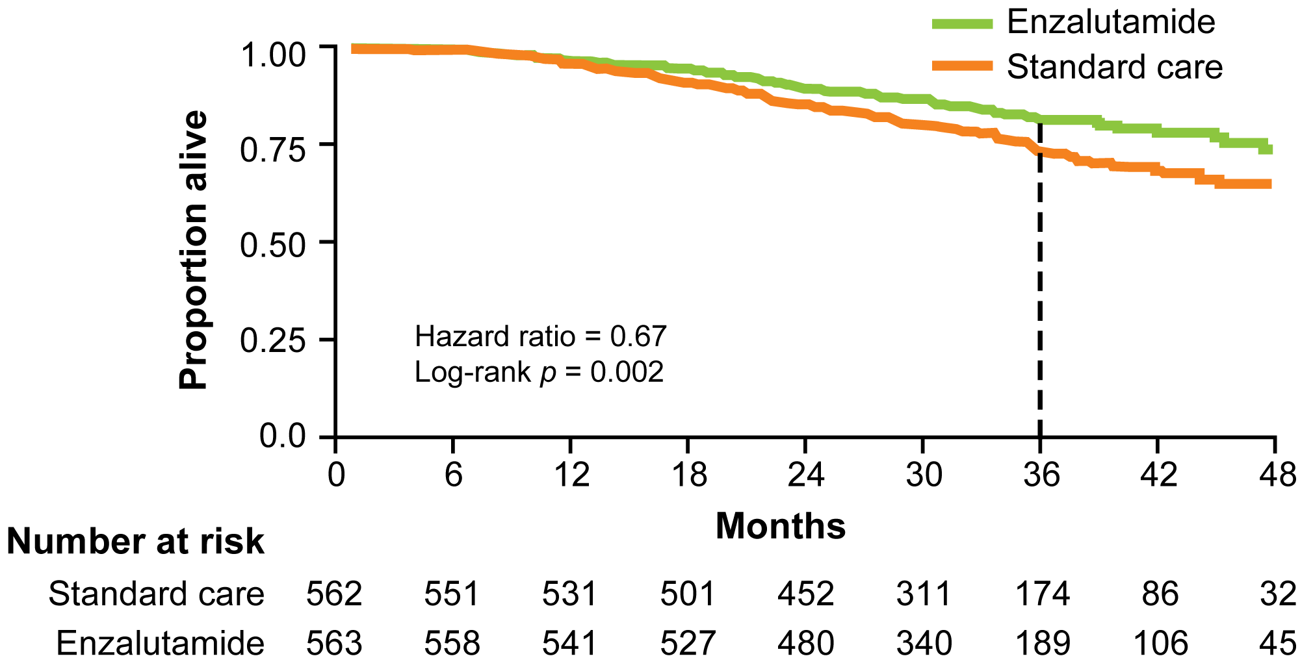
ENZAMET: ADT + Enzalutamide or Standard Nonsteroidal Antiandrogen Primary Endpoint: Overall Survival
A Mixed Bag
High and Low Volume
De novo vs Metach
Concurrent Docetaxel
Many Permutations
Median OS: Not estimable in either group
Est 3-yrs OS: 80% vs 72%
Davis ID et al. N Engl J Med 2019;381(2):121-31.

Slide 42
The many versions of mHSPC
- polymetastatic de novo presentation
Clinical Setting | CT A/P; Tc Bone Scan (possible pelvic LN) | PSMA PET Status (beyond pelvic LN)
High-risk localized | None (but micromets possible) | None or minimal or extensive
Low volume / Low Risk (“oligometastatic”: surgery/ SBRT) | 3 or fewer bone mets (+/- LN) | Few or many more lesions
Low volume / Low Risk* (surgery / SBRT not viable) | 3 or fewer bone mets but extensive nodal involvement | Few or many more lesions
High volume / High Risk* | 4 or more bone mets &/or visceral mets | Many lesions
* CHAARTED and LATITUDE definitions
Courtesy of Christopher Sweeney, MBBS

Slide 43
The many versions of mHSPC
- polymetastatic metachronous presentation
Clinical Setting | CT A/P; Tc Bone Scan (possible pelvic LN) | PSMA PET Status (beyond pelvic LN)
Rising PSA post RP or XRT | None | None or minimal or extensive
Low volume* (“oligometastatic”: surgery/ SBRT) | 3 or fewer bone mets and/or isolated nodal | Few or many more lesions
Low volume* (surgery/ SBRT not viable) | 3 or fewer bone mets but extensive nodal involvement | Few or many more lesions
High volume * | 4 or more bone lesions, visceral mets | Many lesions
* CHAARTED definition volume only; LATITUDE/STAMPEDE high vs low risk only de novo
Courtesy of Christopher Sweeney, MBBS

Slide 44
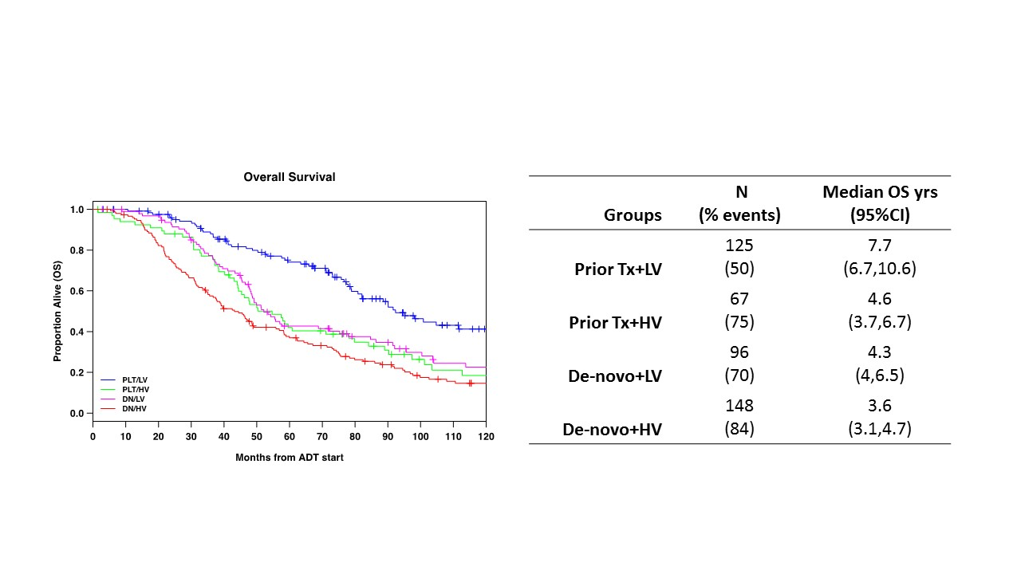
Different Prognoses by:
Type of presentation / Extent of metastases
CHAARTED & GETUG-15 (TS alone) | Median OS (years)
Metach and low volume | ~8
Metach and high volume | 4.5
De Novo and LV | 4.5
De Novo and HV | 3
High volume: visceral mets and/or 4 or more bone mets
With at least one beyond vertebra and pelvis
Francini et al Prostate 2018; Gravis et al Eur Urol 2018
(Prior Tx: metachronous metastases)
56% of mHSPC low volume in hospital registry are metachronous; found by surveillance with rising PSA
Courtesy of Christopher Sweeney, MBBS

Slide 45
Which systemic treatment would you likely recommend for a 55-year-old man with no comorbidities and high-volume de novo metastatic PC?
ADT + docetaxel
ADT + abiraterone
ADT + enzalutamide
ADT alone
ADT + darolutamide
ADT + apalutamide
N = 88
Survey of live webinar audience

Slide 46
Which systemic treatment, if any, would you most likely recommend for an 82-year-old man with a history of congestive heart failure and coronary artery disease who presents with
2 asymptomatic biopsy-proven rib metastases 10 years after undergoing prostatectomy?
ADT alone
ADT + enzalutamide
None — observation
ADT + darolutamide
ADT + docetaxel
ADT + abiraterone
ADT + apalutamide
Other
N = 75
Survey of live webinar audience

Slide 47
Spectrum of patients with mHSPC and the disease
    One extreme: 55 yo with no co-morbidities and high volume de novo metastatic disease
versus
    Other extreme: 82 yo with CHF and CAD and 2 bone metastases 10 years after prostatectomy
Courtesy of Christopher Sweeney, MBBS

Slide 48
Guidance for polymetastatic HSPC
Based on data as of July 2020: docetaxel versus ‘amide versus abiraterone depends on
Fitness for chemotherapy
Fitness for apa/enzalutamide (no seizure, no frailty)
Fitness for abiraterone (blood sugar, hypertension, liver function)
Evidence of consistent overall survival benefit for a given setting with use of a given agent
with no decrement in QOL on therapy
If chemofit and high volume (and not in COVID pandemic):
Docetaxel either at time of TS start or at CRPC after abiraterone or ‘amide
Consider giving docetaxel first (when most fit; less ‘amide or abiraterone “costs”/”exposure”)
If chemofit and low volume not amenable to surgery/SBRT
At time of TS start: Clear evidence for ‘amide, abiraterone; less consistent for docetaxel but do not forget about docetaxel for mCRPC
Courtesy of Christopher Sweeney, MBBS

Slide 49
Score-card of direct consistent data to help choose the right mHSPC Rx¹
Patient co-morbidity | Burden and Presentation of Mets | Agent to add to testosterone suppression
Chemofit³ | High volume² | Docetaxel / Abiraterone / Apalutamide/ Enzalutamide
Not Chemofit | High volume² | Abiraterone / Apalutamide / Enzalutamide
Chemofit and Not Chemofit | Low volume² / De-Novo Metastatic | Abiraterone / Apalutamide / Enzalutamide or Radiate primary⁴ (Docetaxel mixed results if chemofit)
Chemofit and Not chemofit | Low volume² / Prior local therapy⁶ | Apalutamide⁷ / Enzalutamide⁷ (no data from abiraterone studies no evidence of benefit with docetaxel)
¹ Choice based on patient-physician discussion and availability/affordability; ²CHAARTED definition; ³Able to tolerate 75mg/m² of docetaxel every 3 weeks; ⁴Unknown if docetaxel or new hormonal therapies add to radiation or radiation adds to docetaxel or new hormonal therapies; ⁶Prior prostatectomy or radiation with curative intent; ⁷Very immature
Courtesy of Christopher Sweeney, MBBS

Slide 50
Conclusions polymetastatic HSPC
When deciding on which systemic therapy for which patient with mHSPC
  Are they chemo-fit or not chemo-fit?
  Do they have a low or high burden of mHSPC?
  Look at all the data to define treatment burden vs treatment benefit for a given subgroup
  Engage the patient in treatment choice
    Some chemofit pts with high vol mHSPC might want to get chemo out of the way
    Avoid chemo in COVID pandemic
    Avoid personal biases (eg: “chemophobia - hormonophilia”)
Courtesy of Christopher Sweeney, MBBS

Slide 51
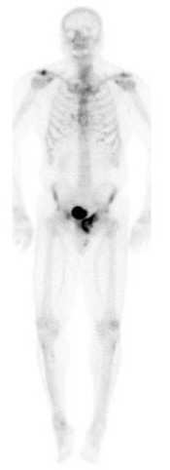
Case Presentation – Dr Sweeney: 66-year-old man with de novo low volume metastatic HSPC
66 yo in 2010 with left hip pain & sciatica and MRI pelvis bone met -> PSA 1244 + Prostate mass.
  Tc bone scan uptake in left pubic bone only
  CT C/A/P craggy prostate; pubic bone lesion only
  Prostate biopsy: high volume Gleason 8
Treatment
  Dec 2010 ADT commenced
  Apr 2011 radiation to bone met and prostate
  ADT completed Jan 2013.
Surveillance off ADT:
  June 2014: PSA 0.05 with testo 340.
  Mar 2018: 0.05 ng/mL; testo 190 ng/dL
  76 yo May 2020: PSA < 0.02; testo 60 with elevated LH and FSH; working full time.

Slide 52
Agenda
Module 1: M0 Castration-Resistant Prostate Cancer (PC) — Dr Petrylak
Endocrine treatment for patients with cardiovascular disease
SPARTAN, ARAMIS and PROSPER trials and implications
Module 2: Metastatic Hormone-Sensitive PC — Dr Sweeney
Secondary hormonal therapy versus chemotherapy
LATITUDE, ARCHES, TITAN and ENZAMET trials and implications
Module 3: Castration-Resistant Metastatic PC — Dr Dreicer
Cabazitaxel versus secondary endocrine treatment
Radium-223
PARP inhibitors
Module 4: ASCO Journal Club
ARV-110 PROTAC degrader (Abstract 3500)
¹⁷⁷Lu-PSMA-617 (Abstract 5500)
PSMA imaging (Abstract 5501)

Slide 53
Module 3: Castration-Resistant Metastatic PC — Dr Dreicer
Cabazitaxel versus secondary endocrine treatment
Radium-223
PARP inhibitors

Slide 54
A 65-year-old man receiving androgen deprivation therapy (ADT) for M0 disease after radical prostatectomy is found to have asymptomatic bone metastases. What systemic treatment would you most likely recommend?
Enzalutamide
Abiraterone
Sipuleucel-T
Docetaxel
Survey of 50 US-based medical oncologists, June 2020

Slide 55
A 65-year-old man receiving ADT for M0 disease after radical prostatectomy is found to have widespread, moderately symptomatic bone metastases. What systemic treatment would you most likely recommend?
Enzalutamide
Abiraterone
Docetaxel
Sipuleucel-T
Survey of 50 US-based medical oncologists, June 2020

Slide 56
A 65-year-old man receiving ADT for M0 disease after radical prostatectomy is found to have asymptomatic liver metastases. What systemic treatment would you most likely recommend?
Enzalutamide
Docetaxel
Abiraterone
Sipuleucel-T
Survey of 50 US-based medical oncologists, June 2020

Slide 57
A 65-year-old man presents with minimally symptomatic metastatic prostate cancer (BRCA wild type) to the nodes and bone and receives docetaxel and androgen deprivation with response followed by progression. The patient is started on enzalutamide but experiences further disease progression after 18 months. What would you recommend?
Cabazitaxel
Abiraterone
Test for AR-V7 and then decide
Other hormonal therapy
Survey of 50 US-based medical oncologists, June 2020

Slide 58
Clinical States In Prostate Cancer (Circa 2020)
Metastatic
Disease
(De novo)
Organ
Confined
Rising PSA
Hormone
Naive
Hormone
Sensitive
Metastatic
Metastatic
Castrate
Resistant
(mCRPC)
mCRPC
Post ASI*
and Docetaxel
Locally
Advanced
Disease
Rising PSA
Castrate
Oligometastatic
* ASI: androgen signaling inhibitor
Modified from Scher H, et al. Urology 2000; Courtesy of Robert Dreicer, MD, MS

Slide 59
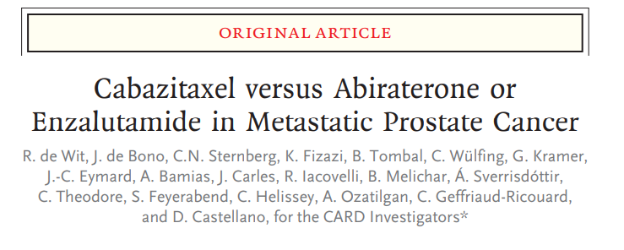
CARD Trial
mCRPC patients previously treated with docetaxel and had progression within 12 months of receiving either abiraterone or enzalutamide
Randomized 1:1 to receive either cabazitaxel (25 mg/m² plus growth factor) OR alternative agent either abiraterone or enzalutamide
Primary end point imaging-based progression free survival
de Wit, et al. N Engl J Med 2019 381:2506-2518; Courtesy of Robert Dreicer, MD, MS

Slide 60
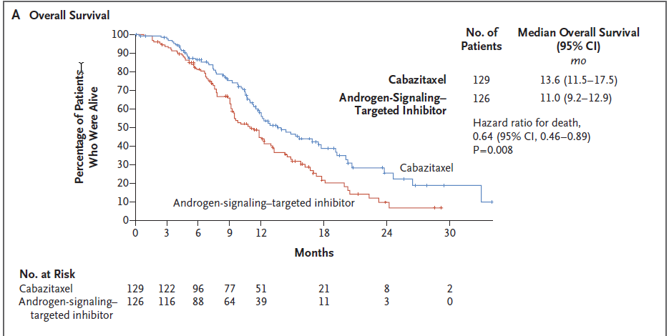
CARD Trial
de Wit, et al. N Engl J Med 2019 381:2506-2518; Courtesy of Robert Dreicer, MD, MS

Slide 61
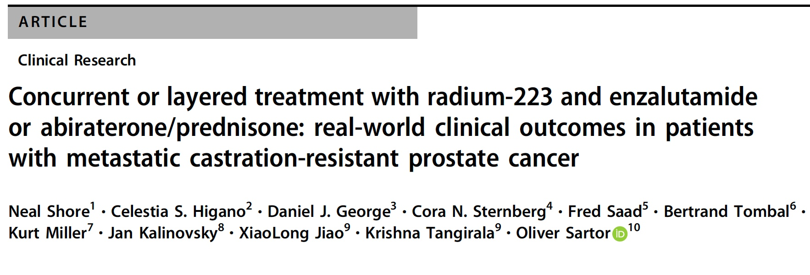
Prostate Cancer and Prostatic Disease 2020 May 13; [Epub ahead of print]
Retrospective study (N = 625) of patients with mCRPC treated with radium-223
Treatment with radium-223 plus abiraterone/prednisone or enzalutamide was defined as concurrent if both drugs started within 30 days of one another, or layered when the second drug started ≥30 days after the first

Slide 62
A retrospective analysis of treatment patterns in metastatic castration-resistant prostate cancer patients treated with radium-223
Sartor AO et al.
Genitourinary Cancers Symposium 2019; Abstract 180.

Slide 63
Era of Genomic Targeted Therapy in Prostate Cancer Has Arrived
mCRPC is molecularly heterogeneous; up to 30% of mCRPC harbor deleterious alterations in DNA damage repair genes, including those with direct or indirect roles in homologous recombination repair (HRR)
These gene alterations can confer sensitivity to poly(adenosine diphosphate–ribose) polymerase (PARP) inhibition and platinum agents
  BRCA1, BRCA2 and ATM are the most well characterized
Courtesy of Robert Dreicer, MD, MS

Slide 64
FDA Approved PARP Inhibitors For Prostate Cancer
“On May 19, 2020, the Food and Drug Administration approved olaparib for adult patients with deleterious or suspected deleterious germline or somatic homologous recombination repair (HRR) gene-mutated metastatic castration-resistant prostate cancer (mCRPC), who have progressed following prior treatment with enzalutamide or abiraterone.”
“On May 15, 2020, the Food and Drug Administration granted accelerated approval to rucaparib for patients with deleterious BRCA mutation (germline and/or somatic)-associated metastatic castration-resistant prostate cancer (mCRPC) who have been treated with androgen receptor-directed therapy and a taxane-based chemotherapy.”
Courtesy of Robert Dreicer, MD, MS

Slide 65
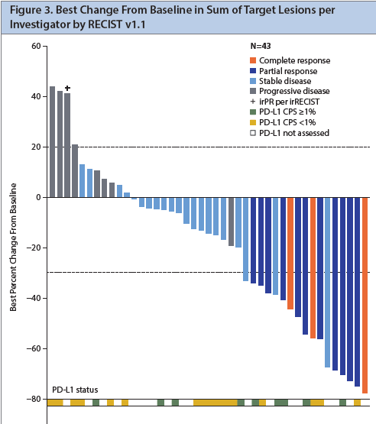
Cabozantinib in combination with atezolizumab in patients with metastatic castration-resistant prostate cancer: results of cohort 6 of the COSMIC-021 study
Atezolizumab/cabozantinib
ORR was 32% per RECIST v1.1 with a median DOR
of 8.3 months
Median duration of exposure in all patients was 6.9 months
Most common grade 3 toxicities
  Fatigue, diarrhea, nausea, PPE
Agarwal N, et al. JCO 38, no. 6 suppl (February 20, 2020) 139-139; Courtesy of Robert Dreicer, MD, MS

Slide 66
Case Presentation – Dr Dreicer: 72-year-old man with mCRPC
72 year old man 5 years out from RRP Gleason 4 +3 , iPSA 8.5
12 months post op, detectable rising PSA (0.45), salvage EBRT administered
PSA progression, pelvic bone mets
ADT/abiraterone, progression at 18 months
Some limited bone pain, no weight loss, ECOG 1
NGS: no actionable DDR germline/somatic mutations

Slide 67
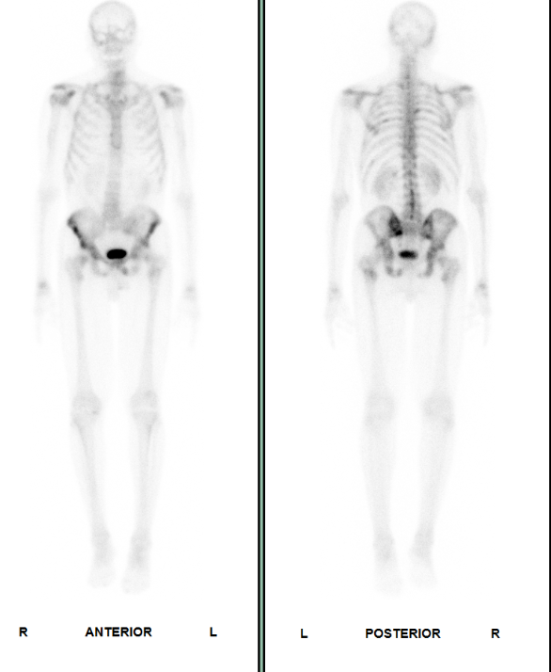
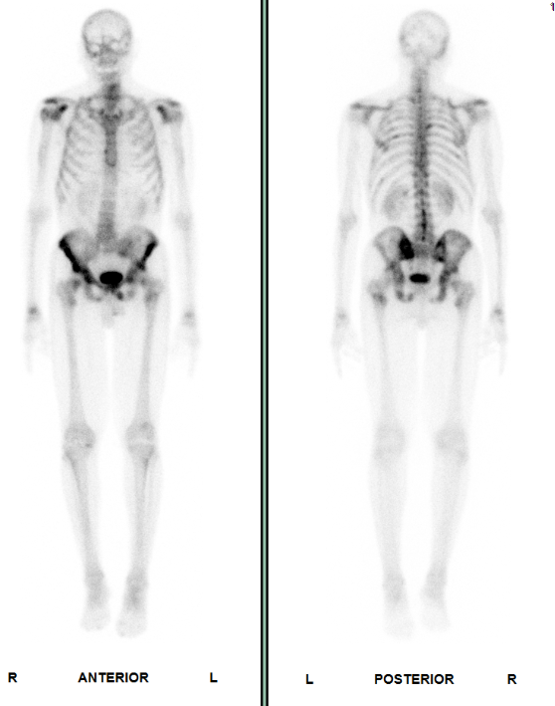
Case Presentation – Dr Dreicer: 72-year-old man with mCRPC
baseline
progression

Slide 68
Agenda
Module 1: M0 Castration-Resistant Prostate Cancer (PC) — Dr Petrylak
Endocrine treatment for patients with cardiovascular disease
SPARTAN, ARAMIS and PROSPER trials and implications
Module 2: Metastatic Hormone-Sensitive PC — Dr Sweeney
Secondary hormonal therapy versus chemotherapy
LATITUDE, ARCHES, TITAN and ENZAMET trials and implications
Module 3: Castration-Resistant Metastatic PC — Dr Dreicer
Cabazitaxel versus secondary endocrine treatment
Radium-223
PARP inhibitors
Module 4: ASCO Journal Club
ARV-110 PROTAC degrader (Abstract 3500)
¹⁷⁷Lu-PSMA-617 (Abstract 5500)
PSMA imaging (Abstract 5501)

Slide 69
Module 4: ASCO Journal Club
ARV-110 PROTAC degrader (Abstract 3500)
¹⁷⁷Lu-PSMA-617 (Abstract 5500)
PSMA imaging (Abstract 5501)

Slide 70
First-in-human phase I study of ARV-110, an androgen receptor (AR) PROTAC degrader in patients (pts) with metastatic castrate-resistant prostate cancer (mCRPC) following enzalutamide (ENZ) and/or abiraterone (ABI)
Petrylak DP et al.
ASCO 2020; Abstract 3500.
Developmental Therapeutics—Molecularly Targeted Agents and Tumor Biology

Slide 71
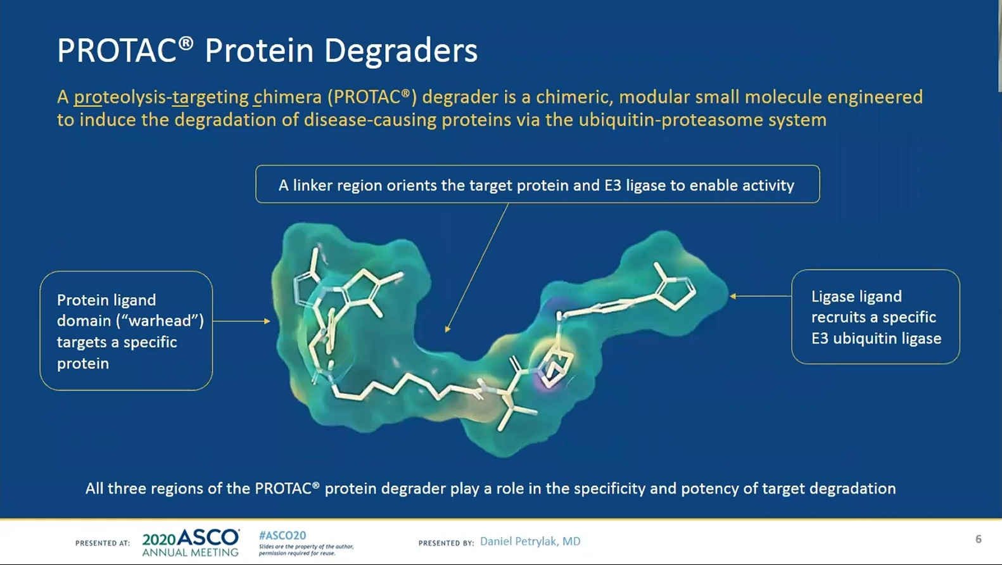
Petrylak DP et al. ASCO 2020; Abstract 3500.

Slide 72
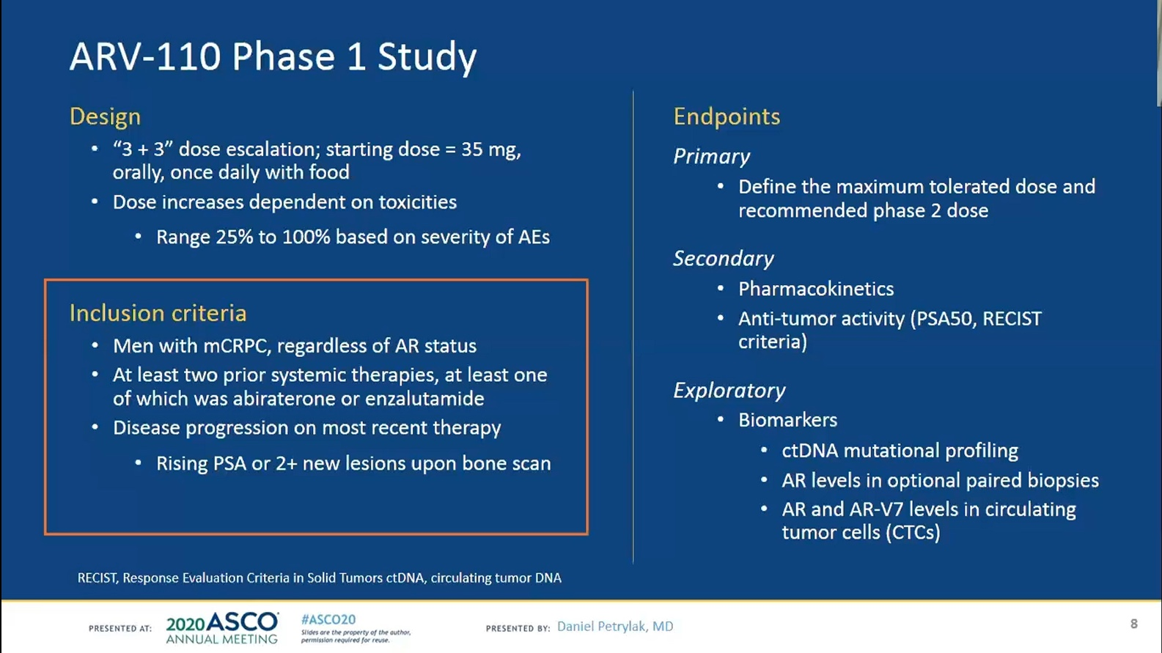
Petrylak DP et al. ASCO 2020; Abstract 3500.

Slide 73
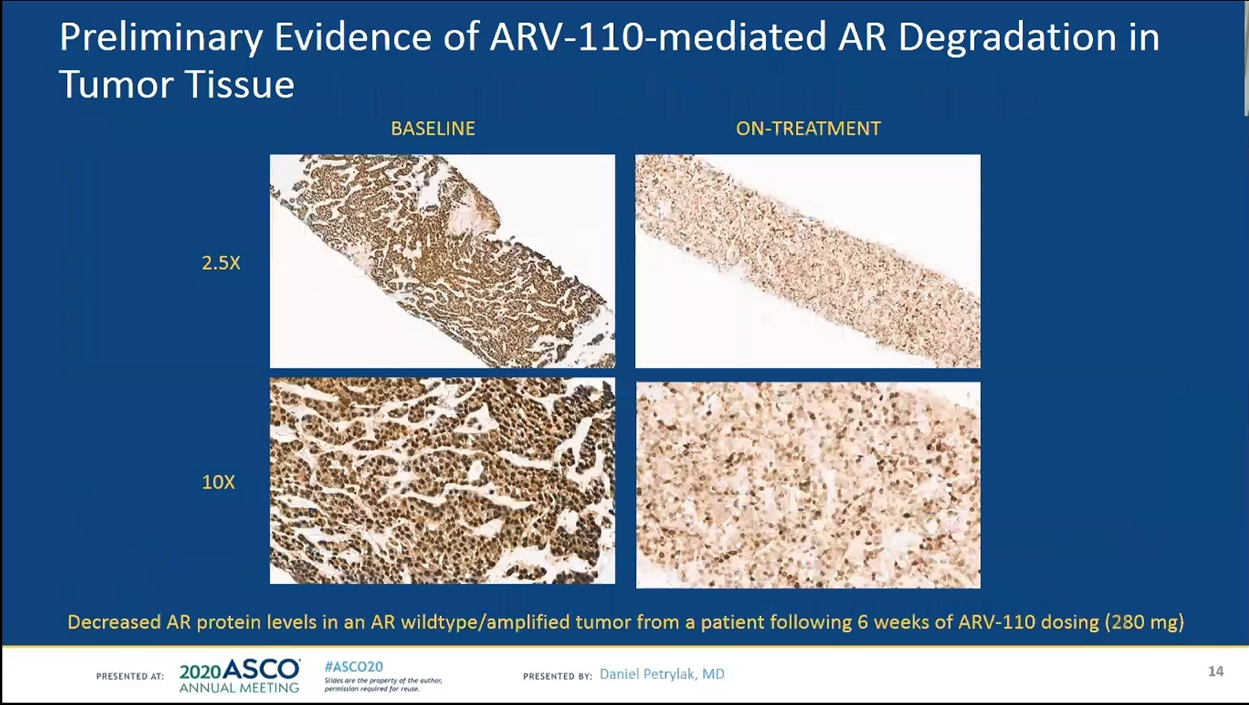
Petrylak DP et al. ASCO 2020; Abstract 3500.

Slide 74
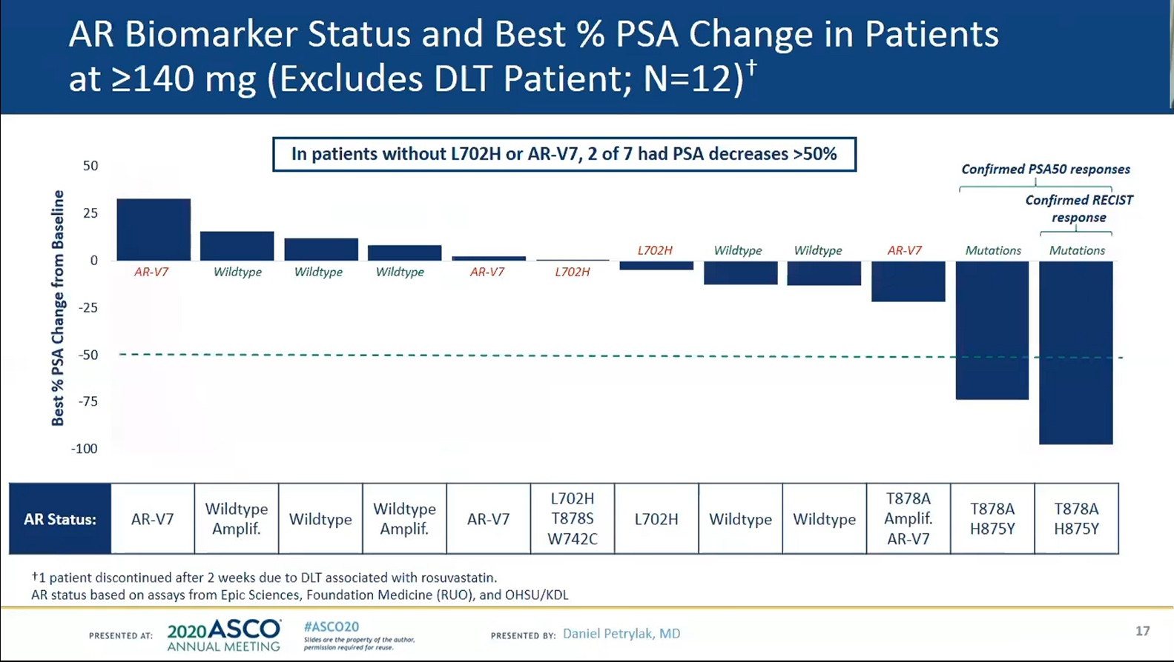
Petrylak DP et al. ASCO 2020; Abstract 3500.

Slide 75
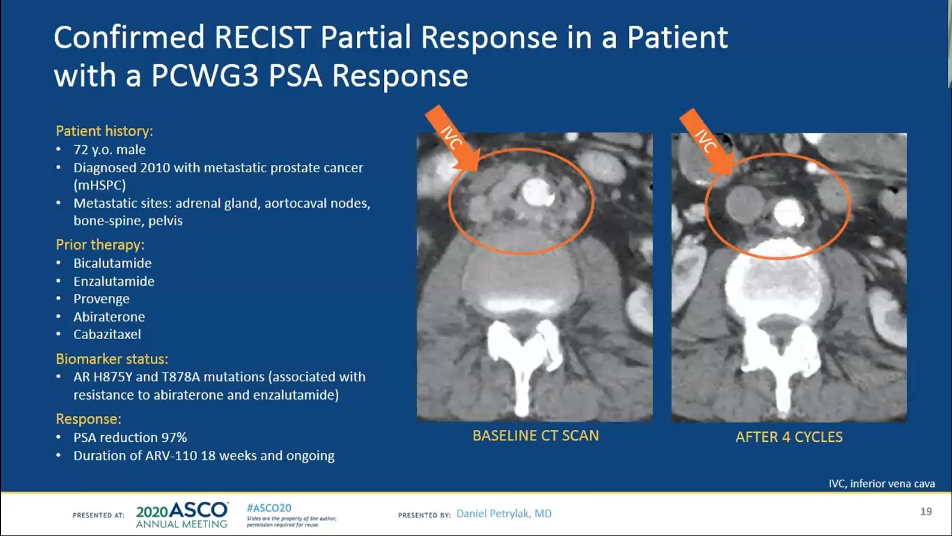
Sipuleucel-T
Petrylak DP et al. ASCO 2020; Abstract 3500.

Slide 76
TheraP: A randomised phase II trial of ¹⁷⁷Lu-PSMA-617 (LuPSMA) theranostic versus cabazitaxel in metastatic castration resistant prostate cancer (mCRPC) progressing after docetaxel: Initial results (ANZUP protocol 1603)
Hofman MS et al.
ASCO 2020; Abstract 5500.
Genitourinary Cancer (Prostate, Testicular, and Penile) Track

Slide 77
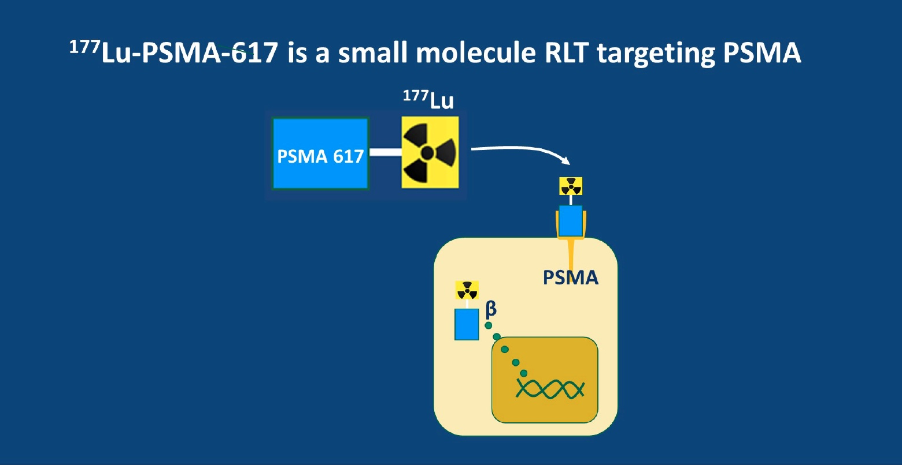
Wise DR. ASCO 2020 Highlights of the Day: Genitourinary Cancer (Prostate)

Slide 78
Impact of PSMA-targeted imaging with 18F-DCFPyL-PET/CT on clinical management of patients (pts) with biochemically recurrent (BCR) prostate cancer (PCa): Results from a phase III, prospective, multicenter study (CONDOR)
Morris MJ et al.
ASCO 2020; Abstract 5501.
Genitourinary Cancer (Prostate, Testicular, and Penile) Track

Slide 79
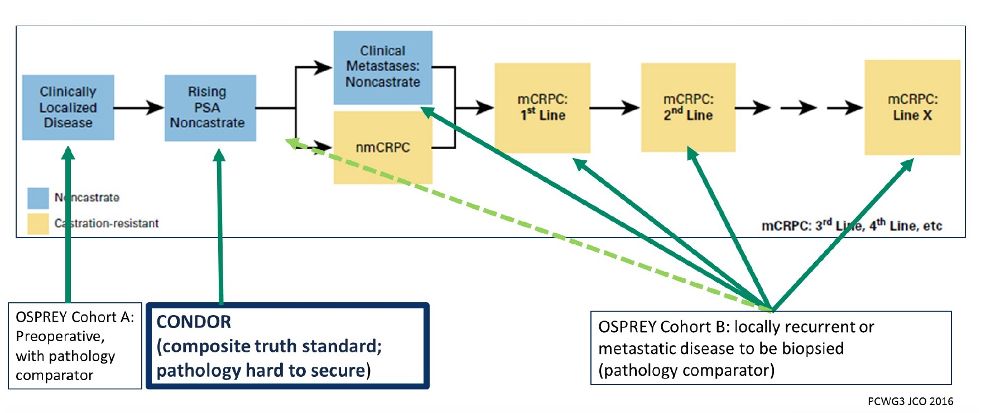
¹⁸F-DCFPyL Clinical Development Program
Morris MJ et al. ASCO 2020; Abstract 5501.

Slide 80
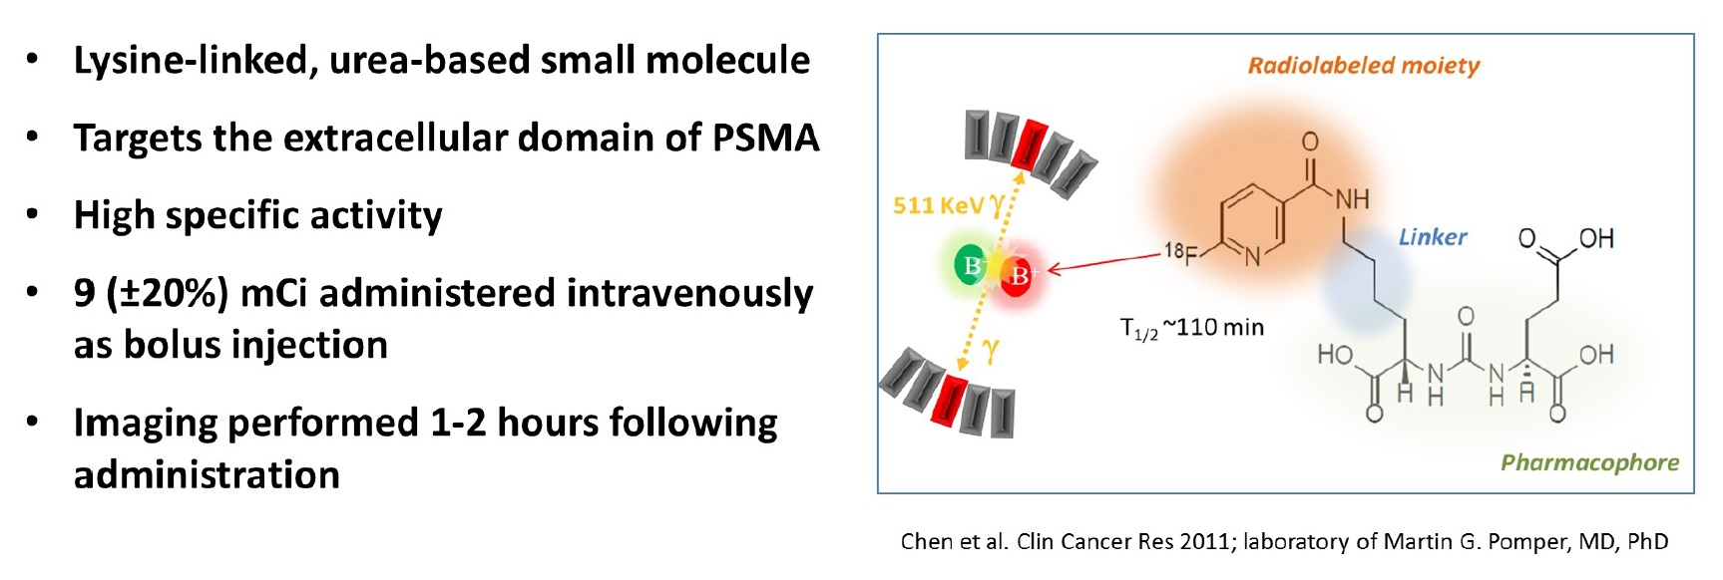
¹⁸F-DCFPyL
Morris MJ et al. ASCO 2020; Abstract 5501.

